Slide 1


Self saturation of Alfvén eigenmodes
with a reactor-like low ρ*
…toward refinement of the reduced TGLF-EP+Alpha model
E.M. Bass and C. Holland
UC San Diego
Presented at
IAEA Technical Meeting on Energetic Particles in Magnetically Confined Systems
Lausanne, Switzerland
September 28 – October 2, 2026
SMARTS
Supported by US DOE SMARTS and FREDA SciDACs
Computations performed at NERSC

Slide 2
Outline
Background: The state of TGLF-EP+Alpha modeling
Nonlinear physics of stiff Alfvén eigenmodes in GYRO
Effect of decreasing ρ* (increasing mode density) on a test compact reactor scenario in nonlinear CGYRO

Slide 3
TGLF-EP+Alpha: simple physics-based model for predicting energetic ion transport by Alfvén eigenmodes (AEs).
Alpha: 1D radial energetic particle (EP) steady-state (time-invariant) density transport model includes:
Transport
AEs using critical gradient
Various models for (generally small) microturbulent EP transport
Sources/Sinks
Fusion or beam source
A sink representing slowing down collisions
Major approximation: “Infinitely” stiff AE transport.
TGLF-EP: Parallelized and automated wrapper for TGLF (local,
linear, thermal distribution) giving AE critical gradient
Inputs
  Complete equilibrium geometry
  Thermal-species profiles
  Source rate(s) or classical EP profile(s)
Outputs (steady-state)
  EP density profile(s).
  Radial density flux(es) versus radius.
  Revised power depositions.

Slide 4
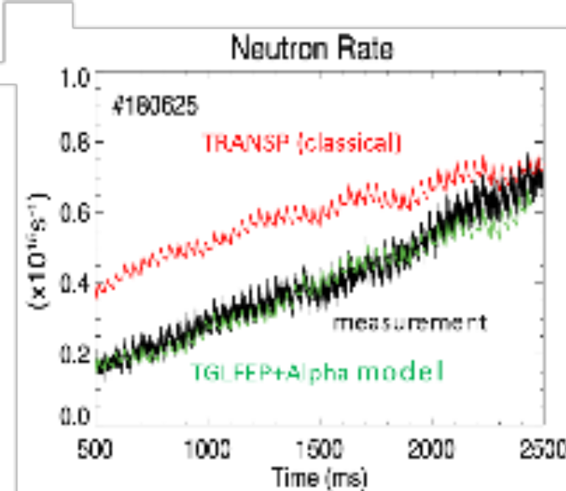
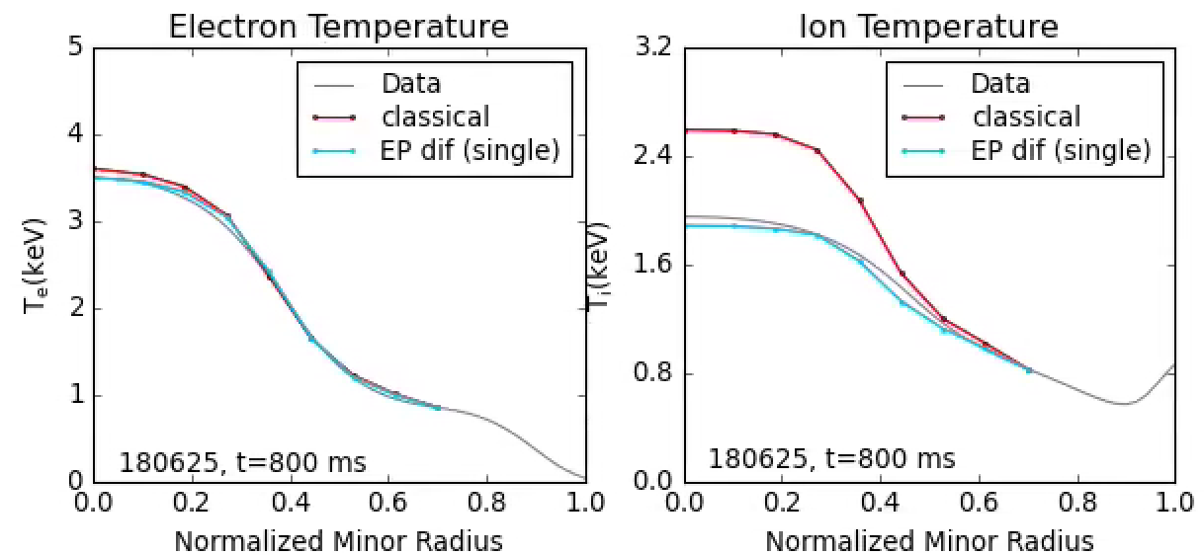
The TGLF-EP+Alpha stiff EP transport model by AEs is now well integrated into modeling.
TGLF-EP+Alpha works well in many DIII-D discharges.
Collins et al. IAEA 2021
Integrating EP power redistribution into TGLF power predictions has become increasingly automated.

Slide 5
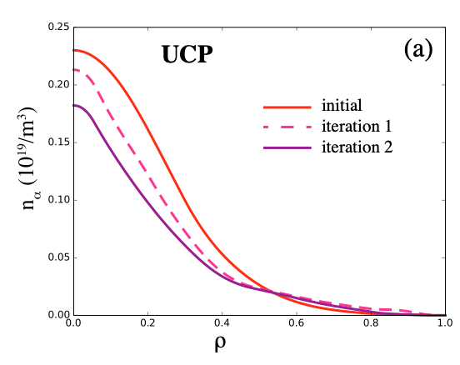
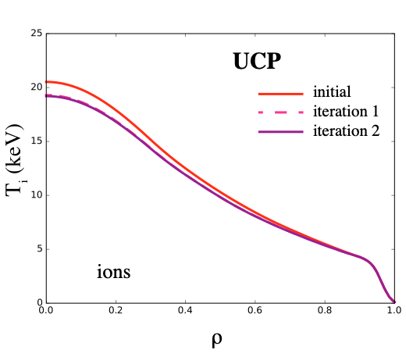
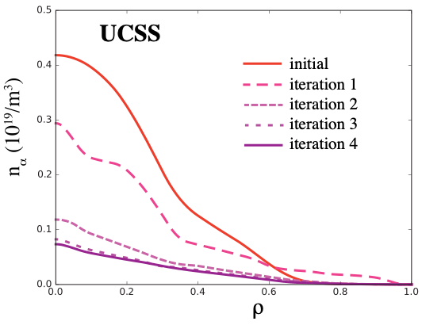
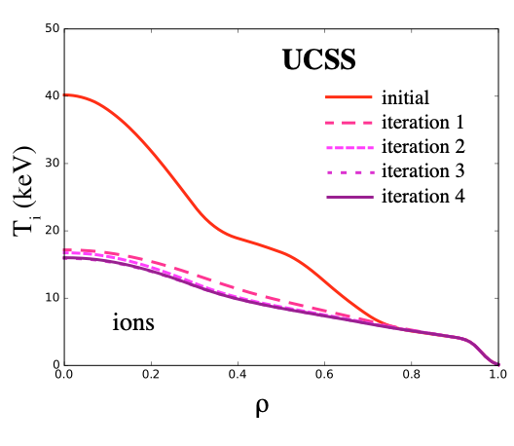
TGLF-EP+Alpha has been applied to reactor scenarios
Holland compact reactor use case scenarios
Pulsed (UCP)
10% power loss
Steady state (UCSS)
65% power loss
T_{i} collapse results from loss of geometrical stabilization from alphas.
C. Holland et al., JPP 89, 905890418 (2023)

Slide 6
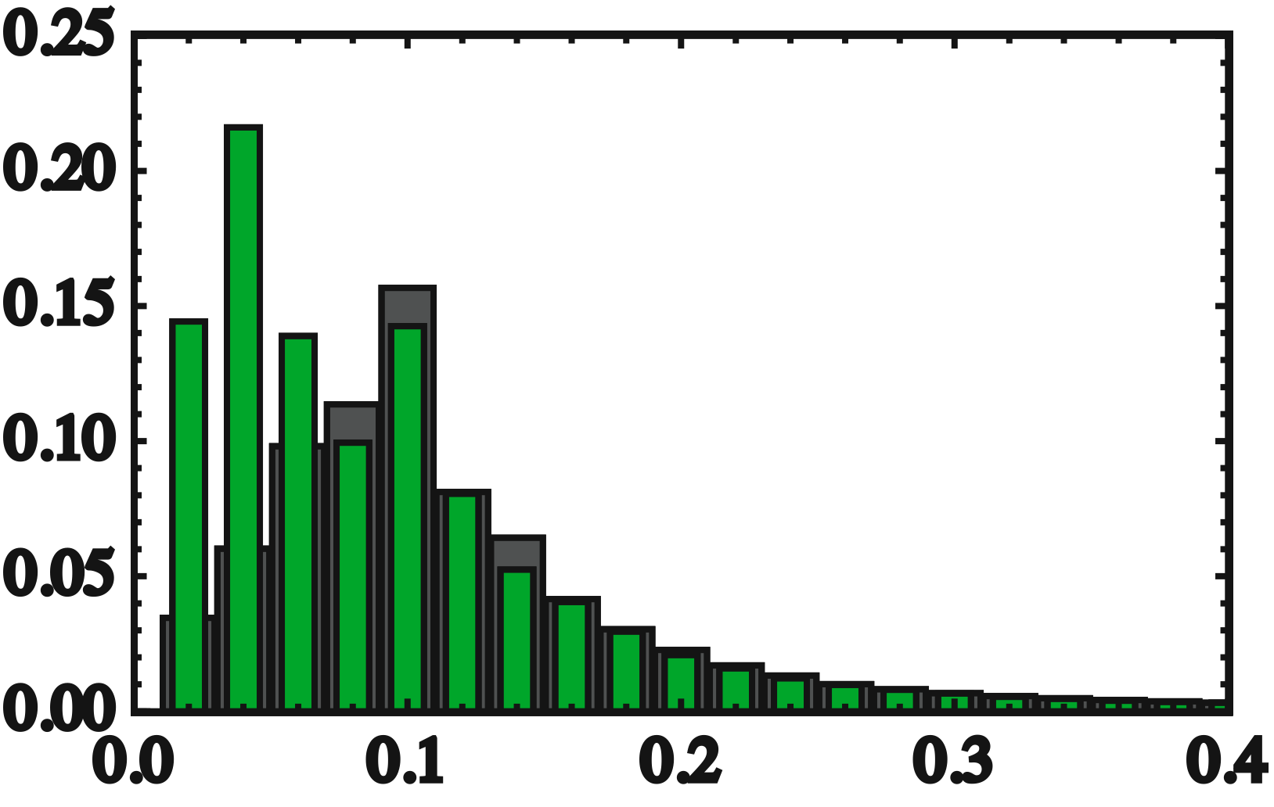
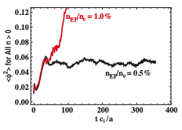
The stiff transport assumption in TGLF-EP+Alpha is based on nonlinear GYRO simulations at modern experimental ρ*.
AE range
n_{EP}/n_{e}=0.5%
D_{EP}/χ_{gB} per mode
n_{EP}/n_{e}=0.8%
k_{θ}ρ_{s} 0.8
k_{θ}ρ_{s}
Multiscale simulations included both AEs and microturbulence.
Simulation runaway signifies profile flattening is needed to saturate.
AEs are just for 4 out of 40 modes in these multi-scale simulations.
Implication: Profiles must flatten down to the runaway point and AEs will grow as large as needed for given source.
E.M. Bass and R.E. Waltz, PoP 17, 012319 (2010)
E.M Bass and R.E. Waltz, PoP 24, 122303 (2017)

Slide 7
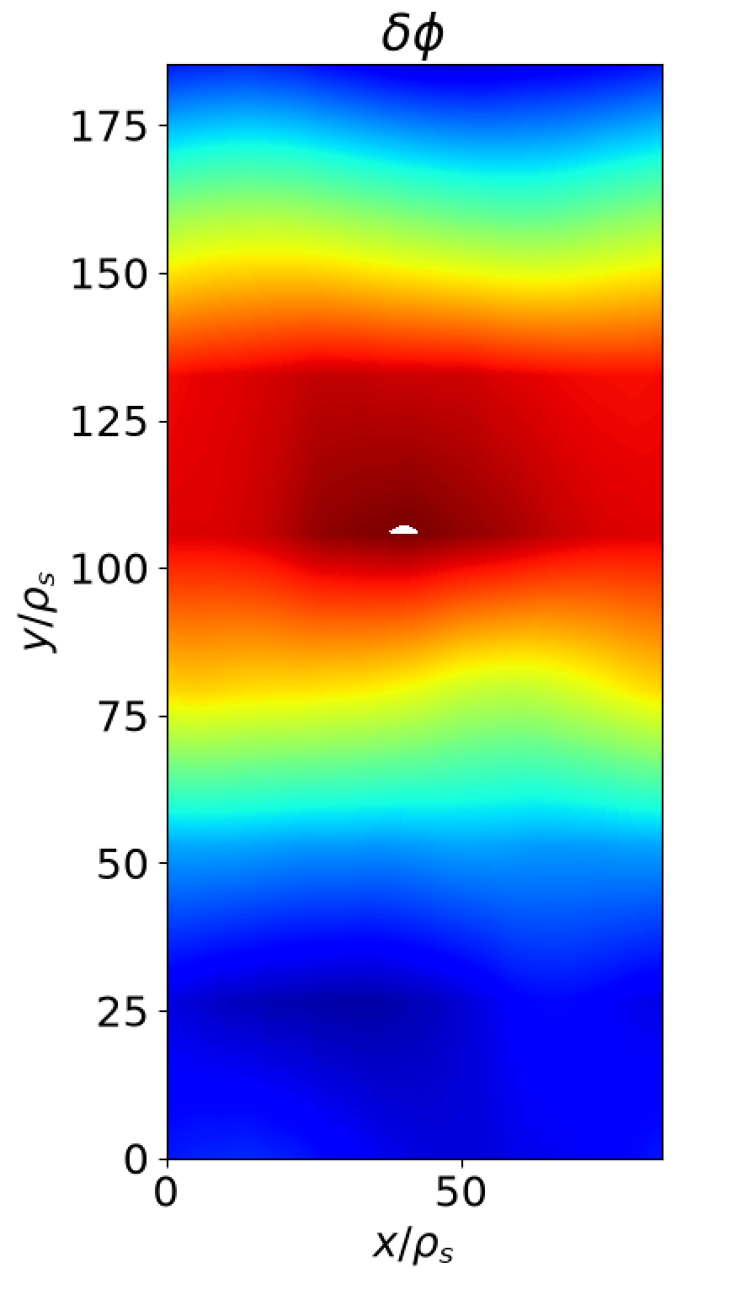
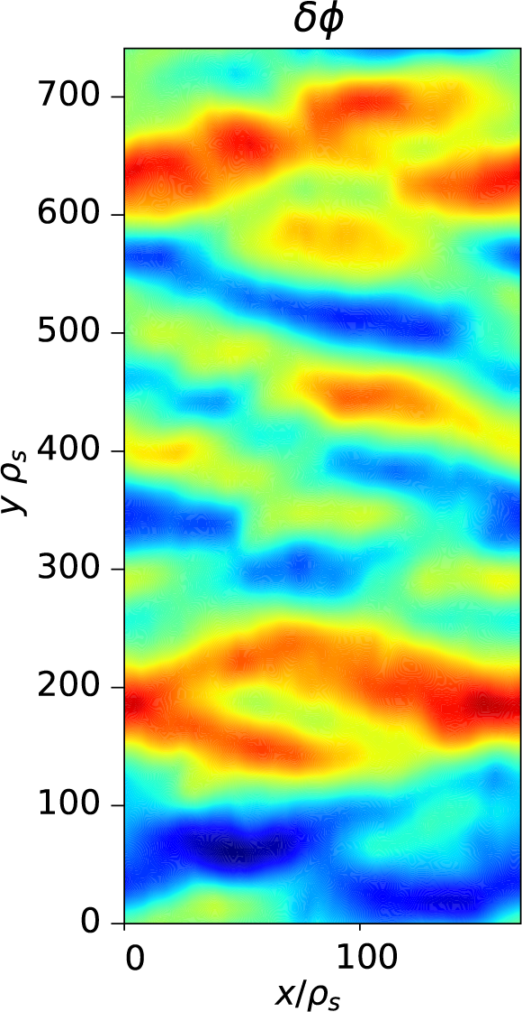


Big Question: How good is the stiff AE transport approximation at high spectral density expected in reactors?
In a reactor, the AE spectrum gets more dense:
CGYRO nonlinear AE flux tube
decreasing
ρ*
$$n_{\max{AE}}≈6$$
in DIII-D
$$n_{\max{AE}}≈30$$
in a reactor
Two things might happen:
Mode overlap gets easier → transport gets even stiffer.
Increased mode-mode coupling → transport gets less stiff

Slide 8
Could the massive predicted performance loss in steady state be ameliorated by a dense AE spectrum?
consider flux tube @ ρ=0.6
AEs are driven at ρ=0.6 well above the stiff-transport threshold identified by TGLF-EP → good case study.
Could the stiff transport assumption – informed by experiments and simulations performed at experimental mode densities – relax in a reactor due to higher AE mode density?
YES!
C. Holland et al., JPP 89, 905890418 (2023)
E.M. Bass and C. Holland, IAEA 2023, in prep. for JCP

Slide 9
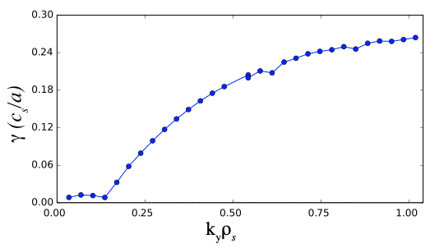
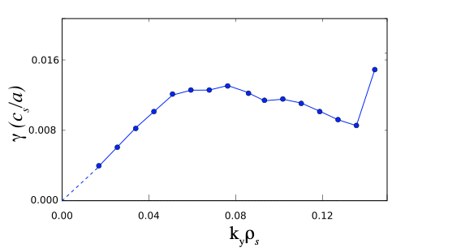
The AE spectrum is denser in a reactor. Does this change the nonlinear dynamics (spoiler: yes)?
Consider the Holland use-case steady-state compact reactor scenario (UCSS) at r=0.6.
UCSS
ρ = 0.6
ITG/TEM
AE
C. Holland et al., JCP, 2023; 89(4)
Δn=8
AE
DIII-D: 3-6 AEs
Compact
reactor
: >30 AEs
Δn=2
Consider only AE range of k_{θ}, no microturbulence.
Use nonlinear CGYRO to explore how mode density affects saturation dynamics.

Slide 10
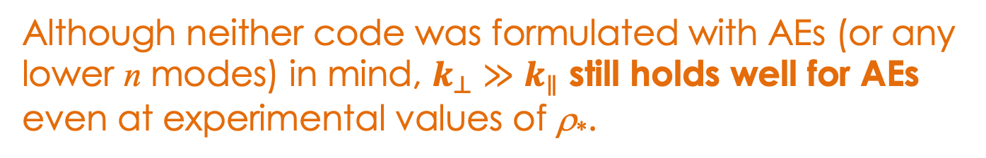
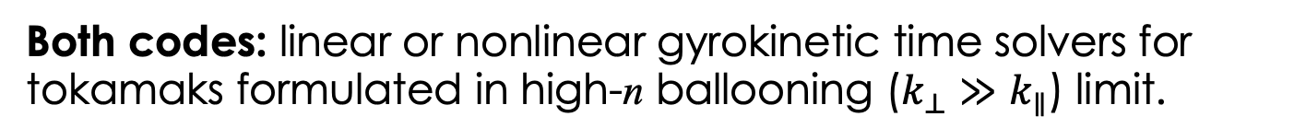
CGYRO (current) and GYRO (old) gyrokinetic codes differ in grid handling, timestepping, and default settings.
Both codes: linear or nonlinear gyrokinetic time solvers for tokamaks formulated in high-n ballooning ($k_{⊥}≫k_{∥}$) limit.
GYRO
CGYRO
Hybrid (IMEX), fixed time step
Explicit spatial radial grid
Global or local (flux tube)
CPU only
Implicit, adaptive time step
Spectral radial grid
Local (flux tube) only, with optional profile shearing
CPU or GPU
Although neither code was formulated with AEs (or any lower n modes) in mind, $k_{⊥}≫k_{∥}$ still holds well for AEs even at experimental values of ρ*.

Slide 11
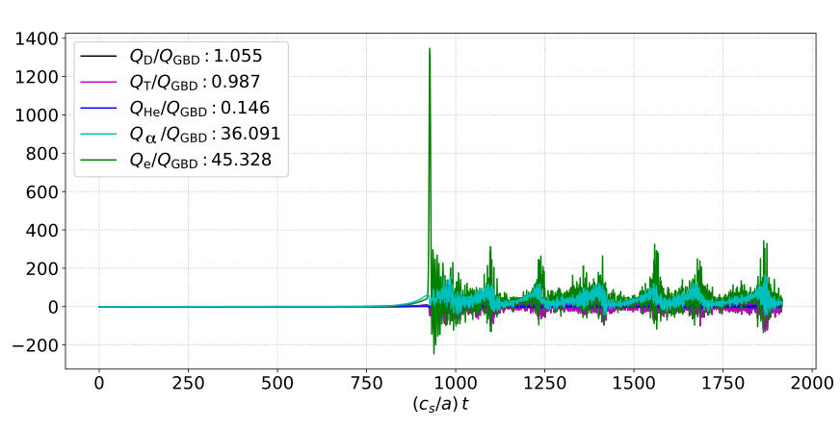
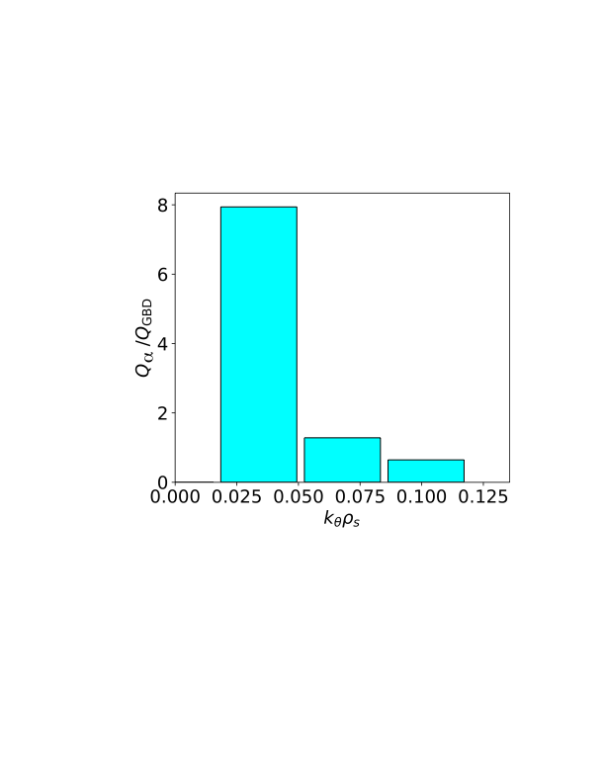
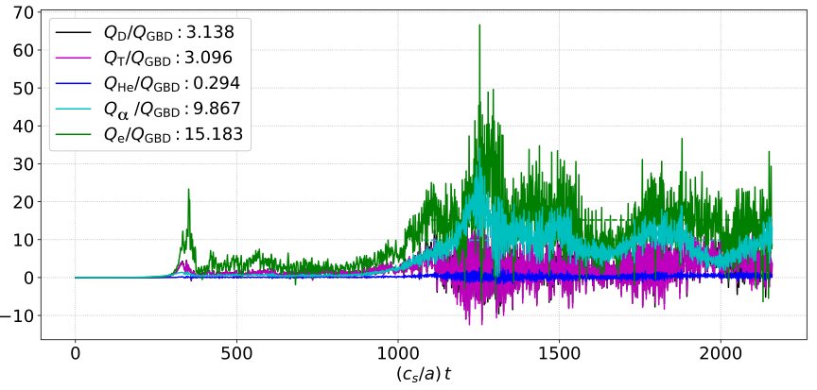
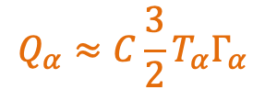
In AE-only CGYRO simulations, increasing mode density makes EP flux decrease…
2 modes
Huge AE amp. & α transport
$$Q_{α}≈C\frac{3}{2}T_{α}Γ_{α}$$
with C=2
(quasi-convective)
Would have caused “field blowup” in GYRO.
4 modes
~1/4 α transport

Slide 12
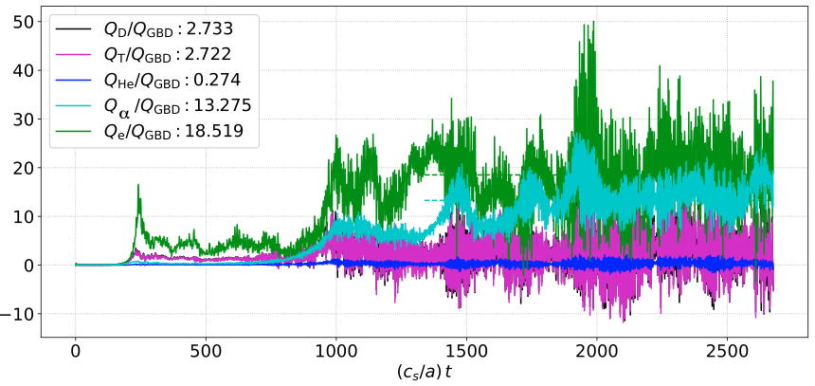
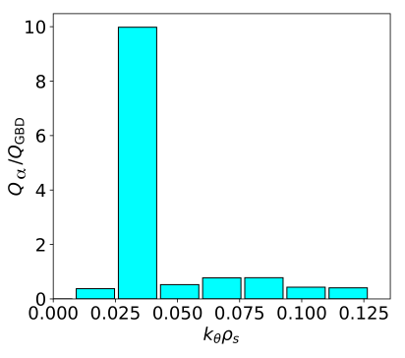
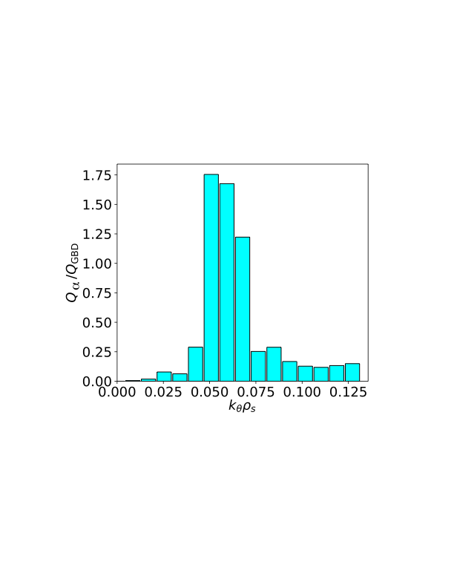
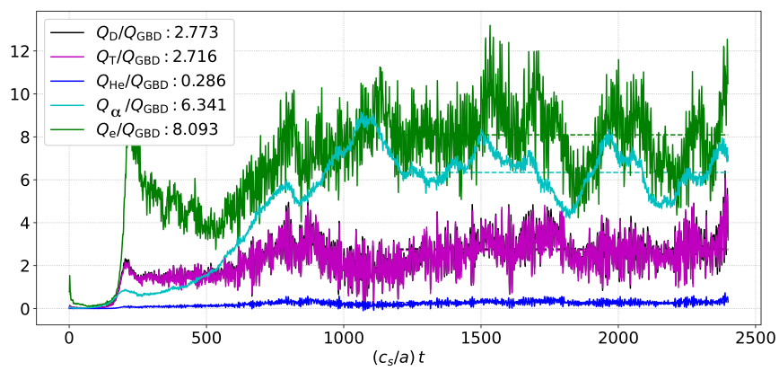
…but EP flux goes up and down again as toroidal resolution increases.
8 modes
Tracer microturbulent
transport
16 modes
(half torus)

Slide 13
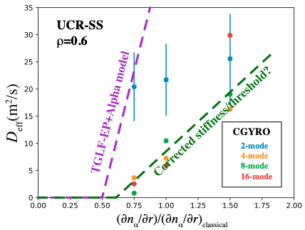
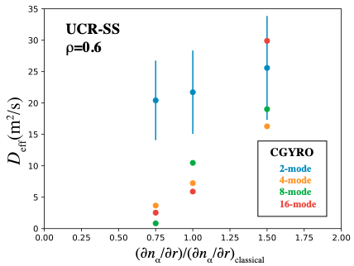
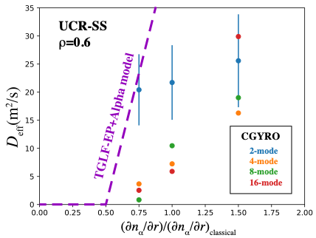
Higher AE mode density in a reactor leads to far less stiff EP transport and maybe a higher onset gradient.
UCSS
The TGLF-EP+Alpha model assumes much higher transport stiffness than seen in CGYRO with 4+ modes.
(Only finite for numerical reasons)
Predicted diffusivity
Possible route forward: Train a neural net on CGYRO to match the right stiffness (and threshold?) with actual ρ*.

Slide 14
Main points
Stiff (critical gradient) models of fast-ion driven Alfvén eigenmode (AE) transport work well in many DIII-D discharges
The denser AE spectrum of reactor-like ρ* allows for nonlinear saturation that is far less stiff → AEs less likely to degrade performance than previously predicted
Even the onset gradient of AE transport (i.e., the critical gradient) could be slightly pushed up by reactor-like AE spectrum density.
Reduced models of transport by energetic particle (EP)-driven AEs – such as TGLF-EP+Alpha – need updates to account for this saturation mechanism to accurately treat reactors.

Slide 15
Future work
Carefully check radial resolution convergence, especially in half-torus (16 mode) simulation.
Test resolution convergence in radial (possible) and toroidal (less likely) dimensions.
Explore dense-spectrum AE saturation over much more of reactor parameter space.
Develop a simple rule or train a neural net for when and how dense AE-spectrum saturation occurs → incorporate into TGLF-EP+Alpha.

Slide 16
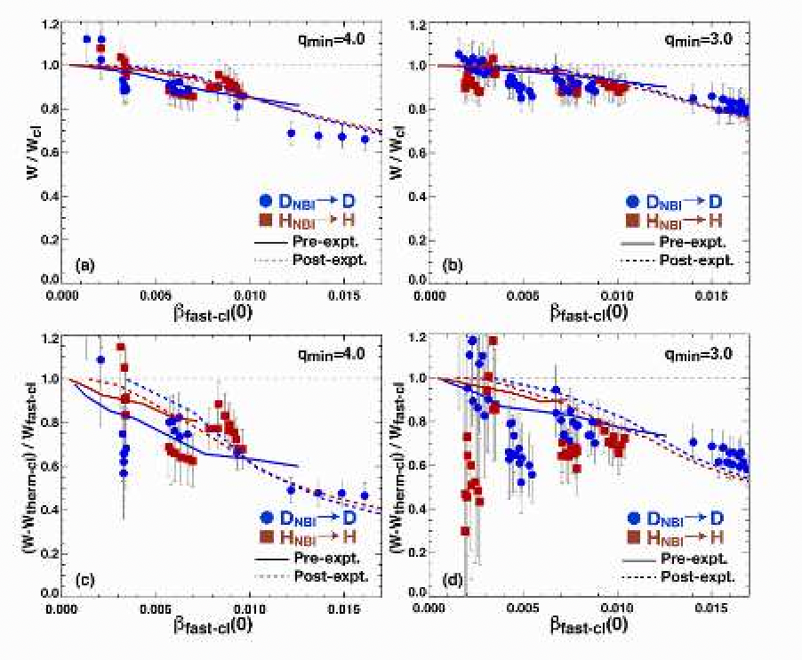
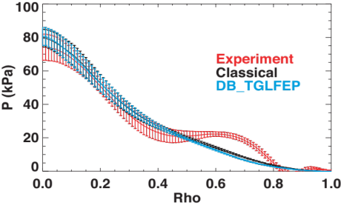
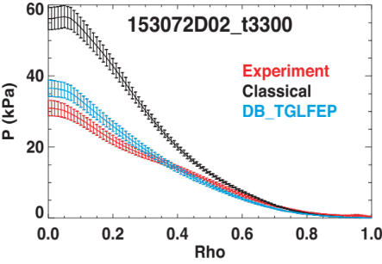
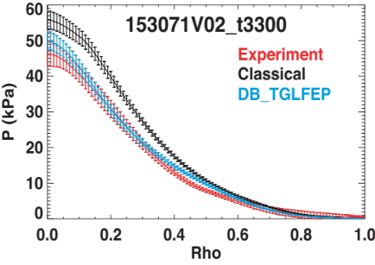
Background: TGLF-EP+Alpha models DIII-D neutral beam ion-driven AEs well.
Stored energy
EP pressure
Super-H case
q_{min}=2 case
All are DIII-D shots.
q_{min}=1 case
Bass et al. APS-DPP 2019
Van Zeeland et al., NF 2024
Collins et al. IAEA 2021

Slide 17
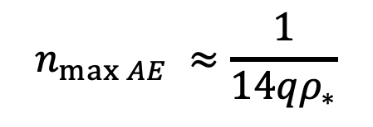
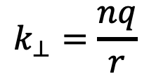
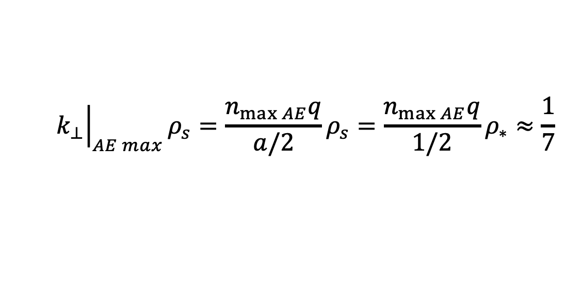
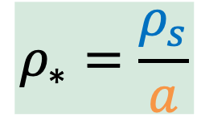
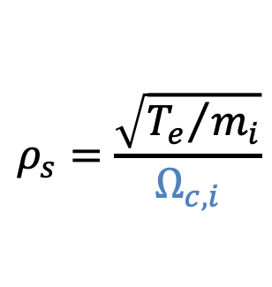
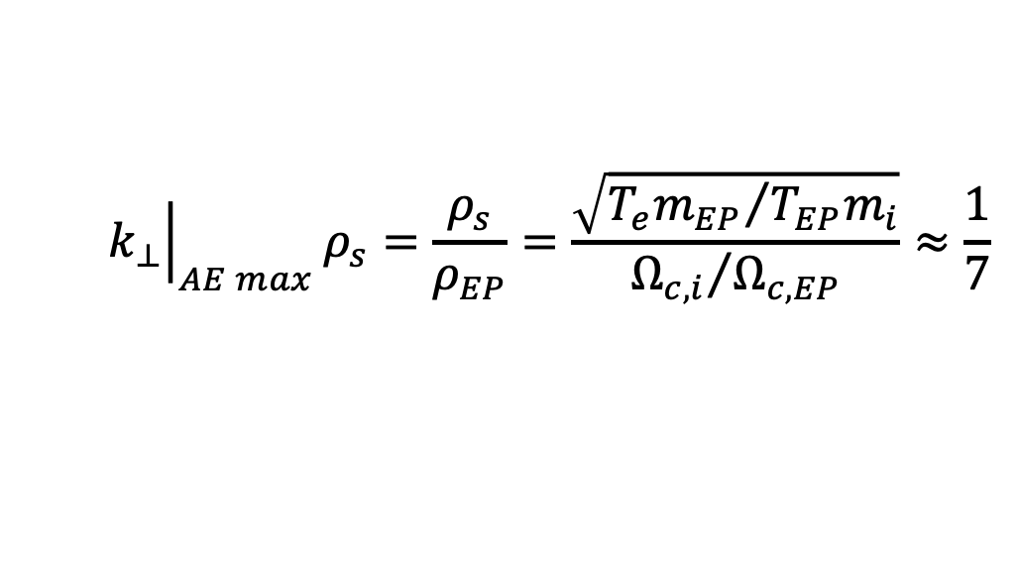

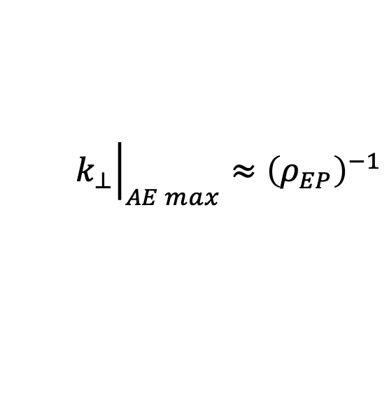

Projected reactors have ρ* 3+ times smaller due to larger size and higher B_{t} , giving a much denser AE spectrum
higher field
$$ρ_{s}=\frac{\sqrt{{T_{e}}/{m_{i}}}}{Ω_{c,i}}$$
$$k_{⊥}=\frac{nq}{r}$$
$$ρ_{∗}=\frac{ρ_{s}}{a}$$
Perpendicular wave number
with
larger size
$${\left.k_{⊥}\right|}_{AE max}≈{\left(ρ_{EP}\right)}^{−1}$$
$${\left.k_{⊥}\right|}_{AE max}ρ_{s}=\frac{ρ_{s}}{ρ_{EP}}=\frac{\sqrt{{T_{e}m_{EP}}/{T_{EP}m_{i}}}}{{Ω_{c,i}}/{Ω_{c,EP}}}≈\frac{1}{7}$$
for alpha particles in a reactor.
At mid-core, r=a/2:
$${\left.k_{⊥}\right|}_{AE max}ρ_{s}=\frac{n_{\max{AE}}q}{a/2}ρ_{s}=\frac{n_{\max{AE}}q}{1/2}ρ_{∗}≈\frac{1}{7}$$
$$n_{\max{AE}} ≈\frac{1}{14qρ_{∗}}$$
$$n_{\max{AE}}≈6$$
in DIII-D
$$n_{\max{AE}}≈30$$
in a reactor

Slide 18
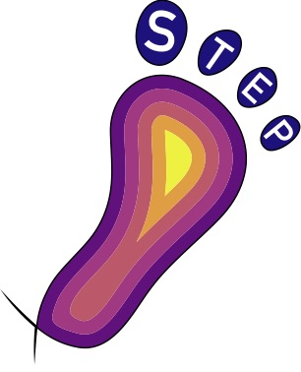
TGLF-EP+Alpha enters STEP workflow as a TGYRO sub-step
(consider simpler case of beam-free fusion)
Equilibrium, heating, current
NEO
Bootstrap current
EPED
Pedestal
height + width
CHEF
Heating, current drive and diffusion
ONETWO
Classical EP profile
Solution
CHEASE
Fixed-boundary Grad-Shafranov solver
TGYRO
Iterative thermal-species transport solver
Focus of this poster
NEO
Neoclassical transport
TGLF
Turbulent transport
Newly-integrated TGLF-EP+Alpha EP transport iterates with TGYRO
https://omfit.io/modules/mod_STEP.html

Slide 19
The TGLF-EP+Alpha model can enter into any workflow through statefile translators.
New input.gacode w/ updated:
EP density
Ion and electron power profiles
Critical-gradient file
+ input.gacode
input.gacode
yourstate.file
Alpha
(transport solver)
TGLF-EP
(critical-gradient
finder)
Any thermal transport solver
Profiles and shaping via input.gacode
This has already been done for the Integrated Plasma Solver (IPS) – FASTran workflow.

