Slide 1

Suppression of Coherent Energetic Particle Phase Space Structures due to 3D fields
Alexandra Lachmann¹, Dingyun Liu¹, Alexey Knyazev¹, Elizabeth Paul¹
¹Columbia University

Slide 2
Can 3D magnetic fields suppress Alfvén Eigenmode (AE) chirping?
3D geometry in stellarators creates additional resonances
Static 3D fields
Larger harmonic family
Static phase space islands
Resonance overlap may suppress Berk-Breizman chirping

Slide 3
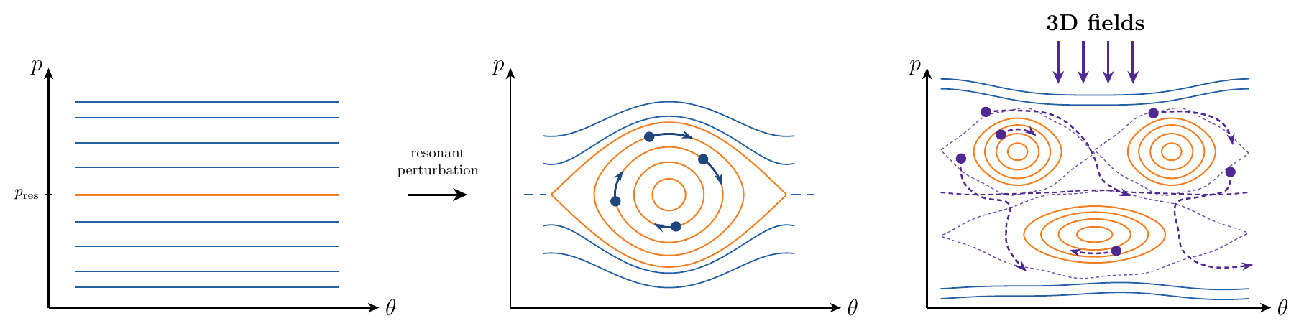
Can 3D magnetic fields suppress Alfvén Eigenmode (AE) chirping?
3D geometry in stellarators creates additional resonances
Resonance overlap may suppress Berk-Breizman chirping

Slide 4
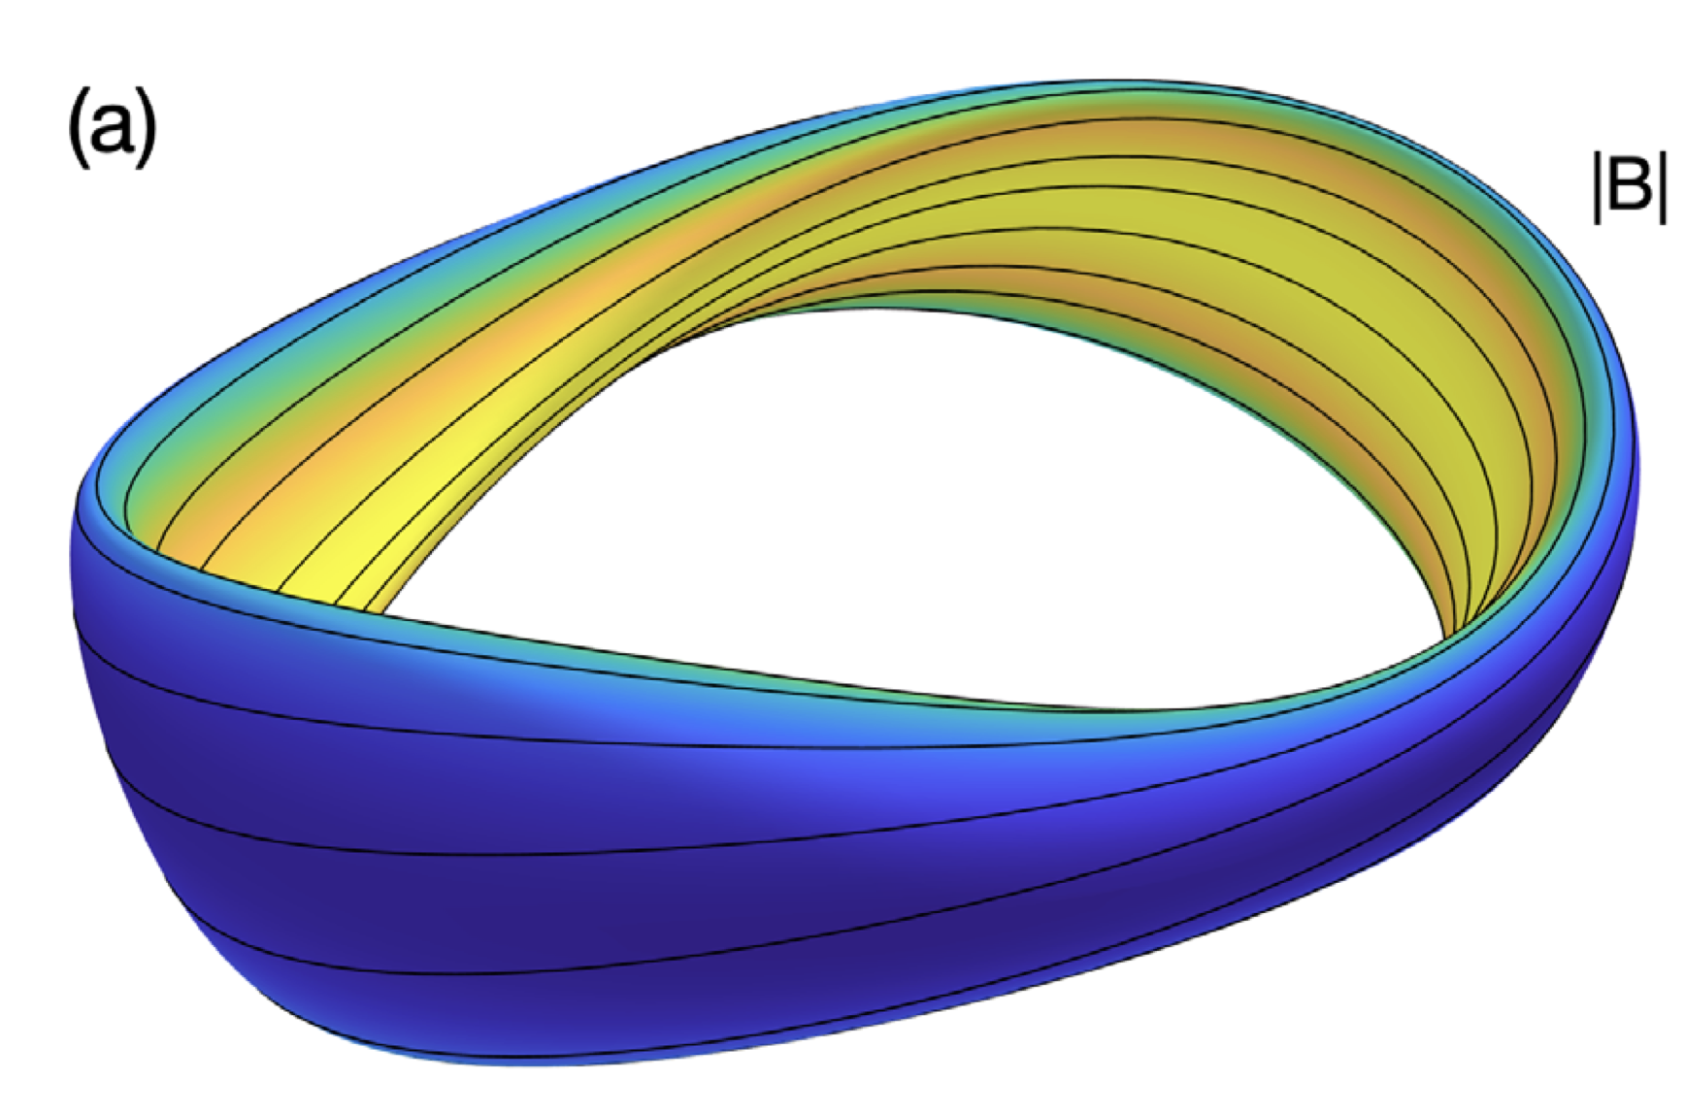
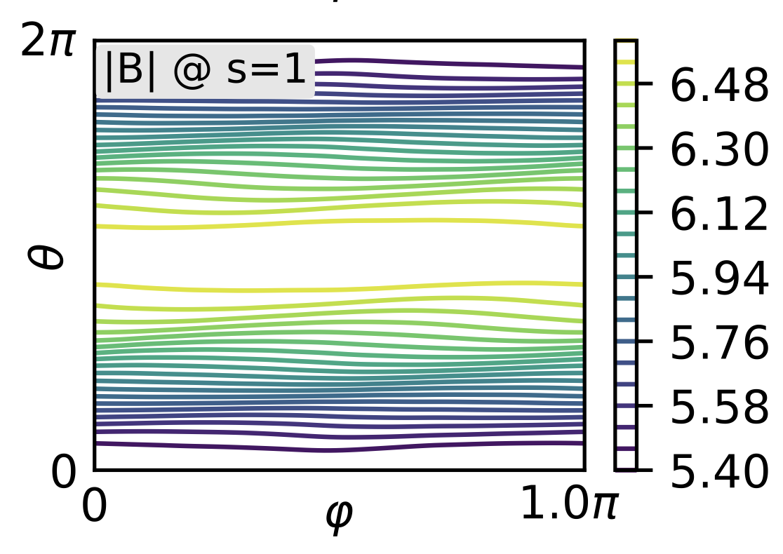
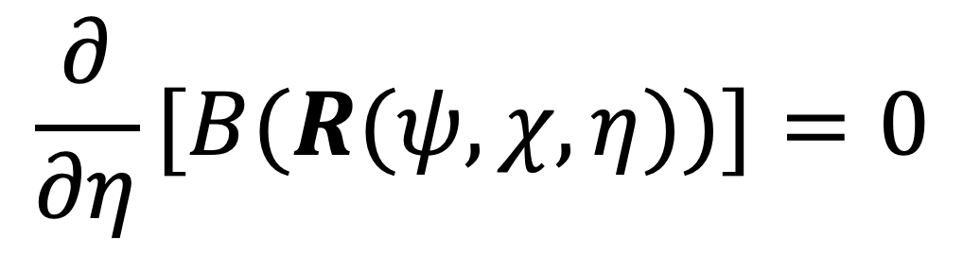
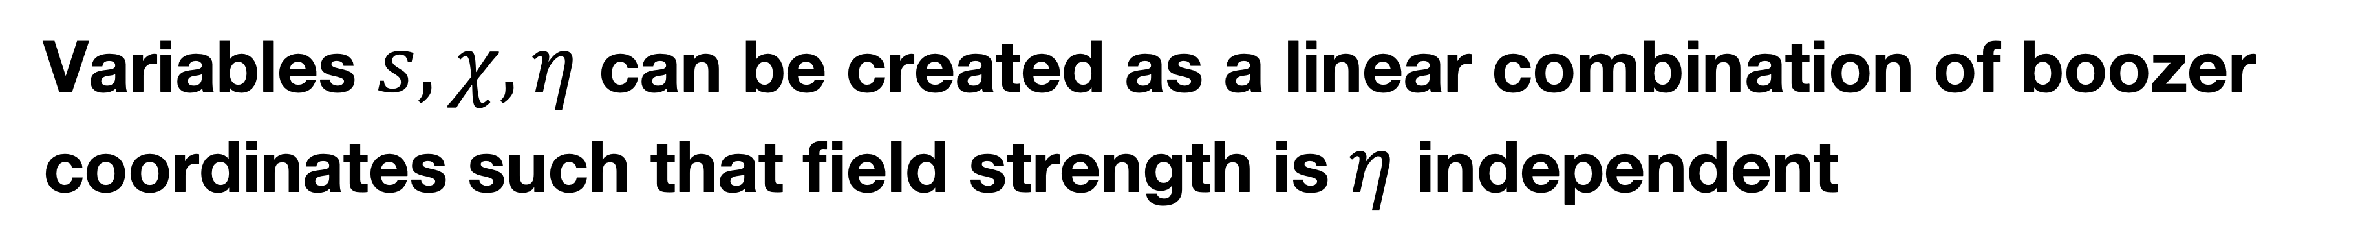
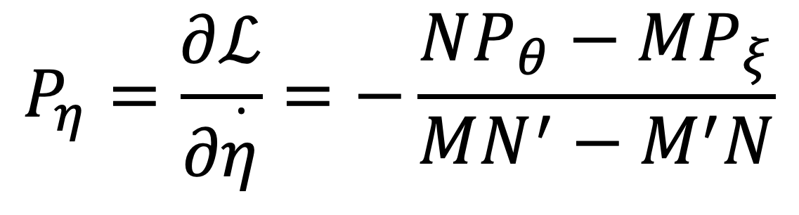
What is quasi-symmetry?
Variables $s,χ,η$ can be created as a linear combination of boozer coordinates such that field strength is $η$ independent
$$\frac{∂}{∂η}[B(R(ψ,χ,η))]=0$$
$$P_{η}=\frac{∂ℒ}{∂\overset{·}{η}}=−\frac{NP_{θ}−MP_{ξ}}{MN^{′}−M^{′}N}$$
Landreman, et al.,
Phys. Plasmas 29, 082501 (2022)
Imbert-Gérard, et al.,
SIAM, 10.1137 (2024)

Slide 5
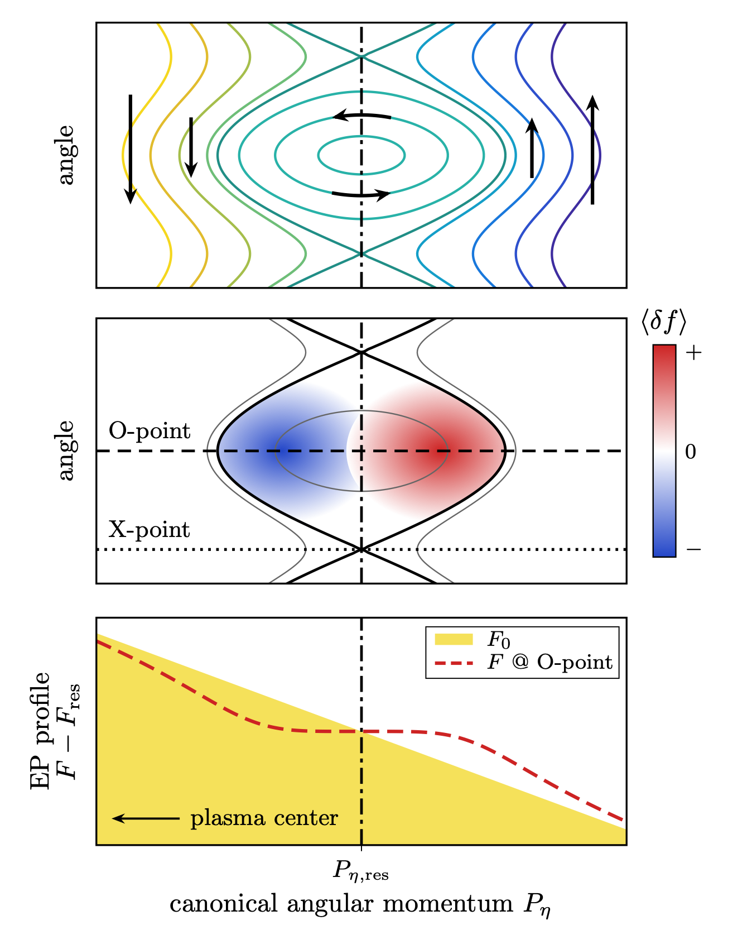
Near marginal stability, hole–clump pairs detach from the resonance and chirp
hole-clump pair formation schematic
Resonances with AEs may create a hole-clump pair in phase space, eliciting one of two responses:
Relax distribution and damp wave
Shift frequency, causing for neighboring particles to become resonant
Bierwage, White, and Duarte.
Plas. and Fus. Res.,
16:1403087–1403087, 2021.
Notes:
Define hole and clump more clearly here.
- explain the bottom plot

Slide 6
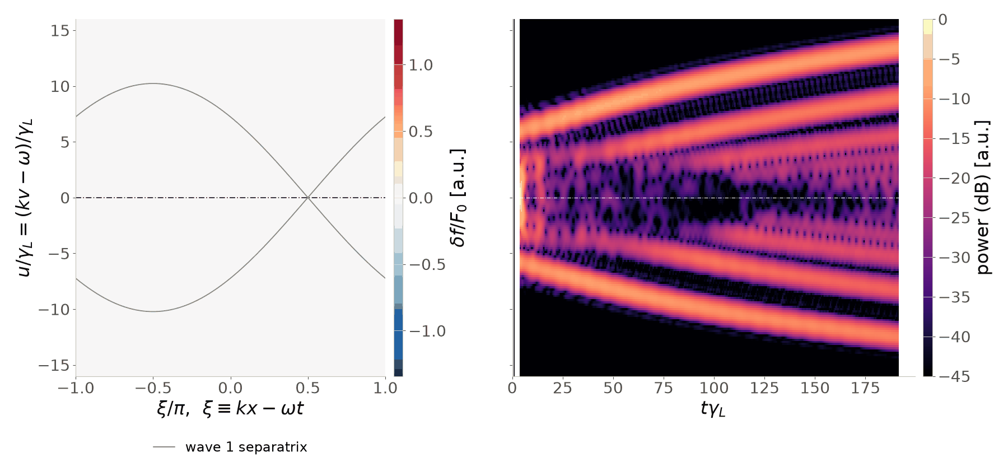
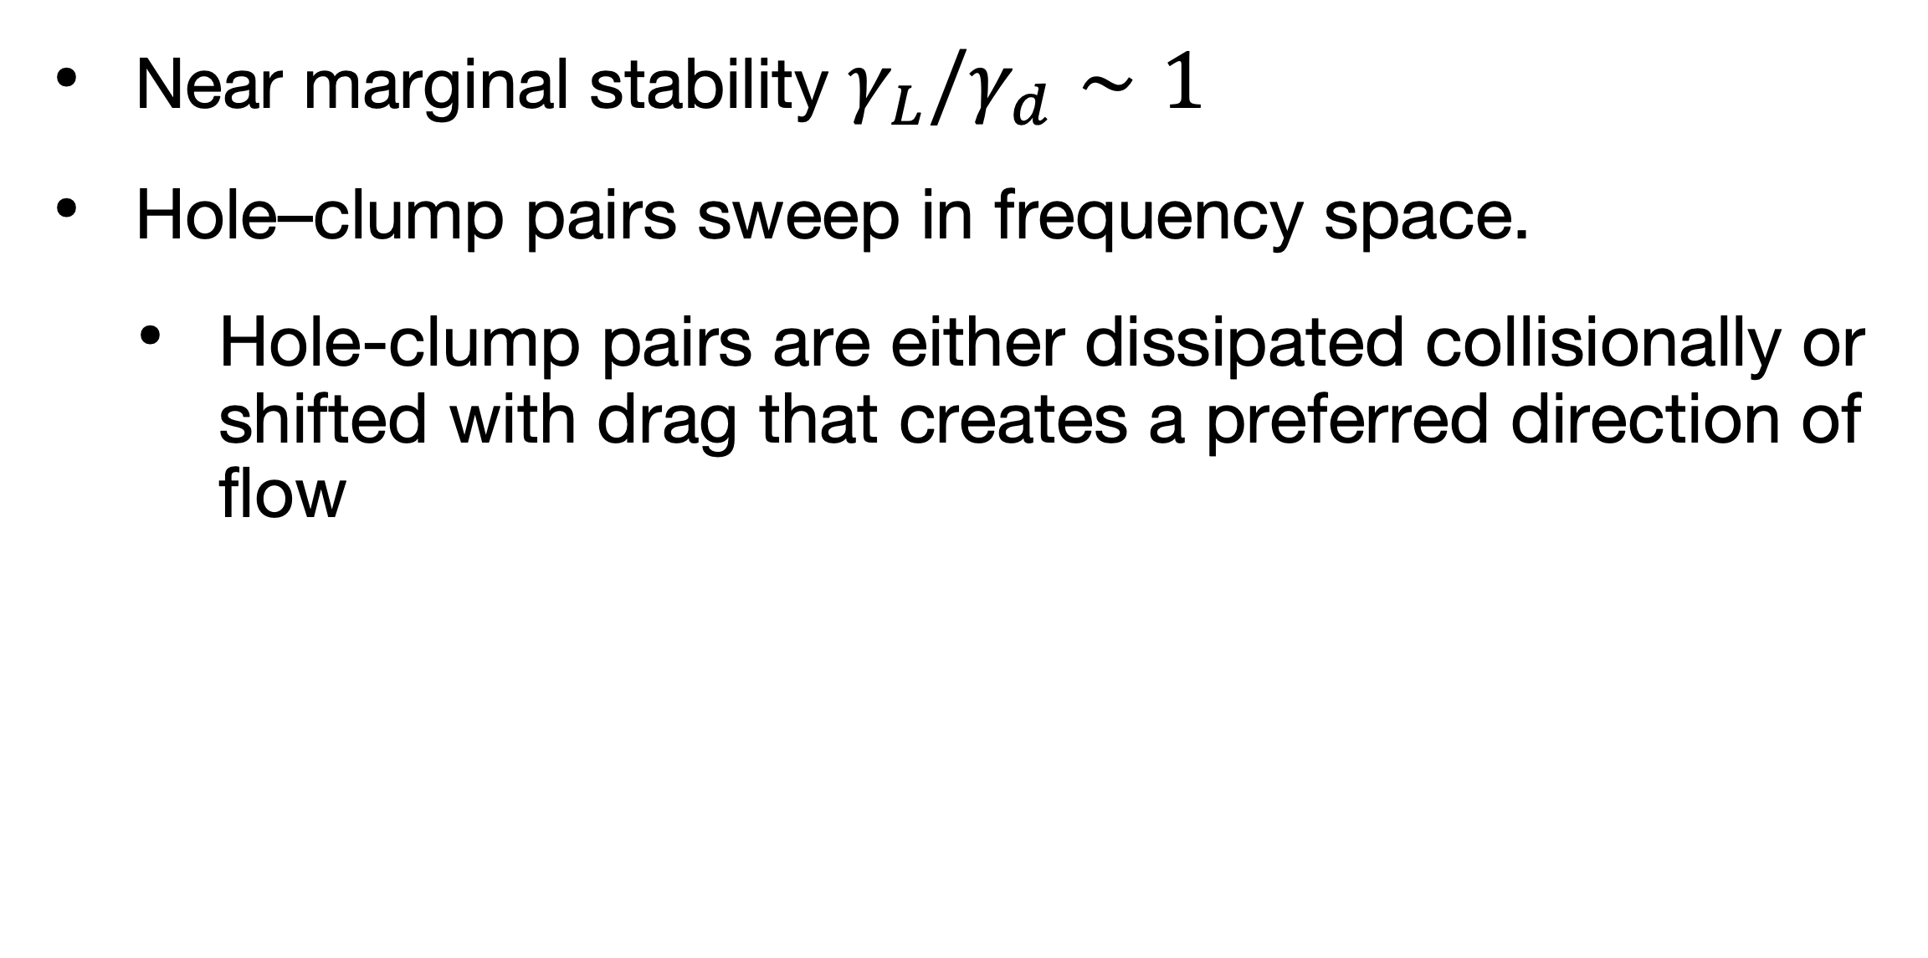
Near marginal stability, hole–clump pairs detach from the resonance and chirp
Perturbative: MHD sets the eigenmode spatial structure, energetic particles evolve amplitude and phase
Bump on tail result: hole & clump centers migrate in velocity space
Near marginal stability $γ_{L}/γ_{d}∼1$
Hole–clump pairs sweep in frequency space.
  Hole-clump pairs are either dissipated collisionally or shifted with drag that creates a preferred direction of flow
Notes:
Drag creates a

Slide 7
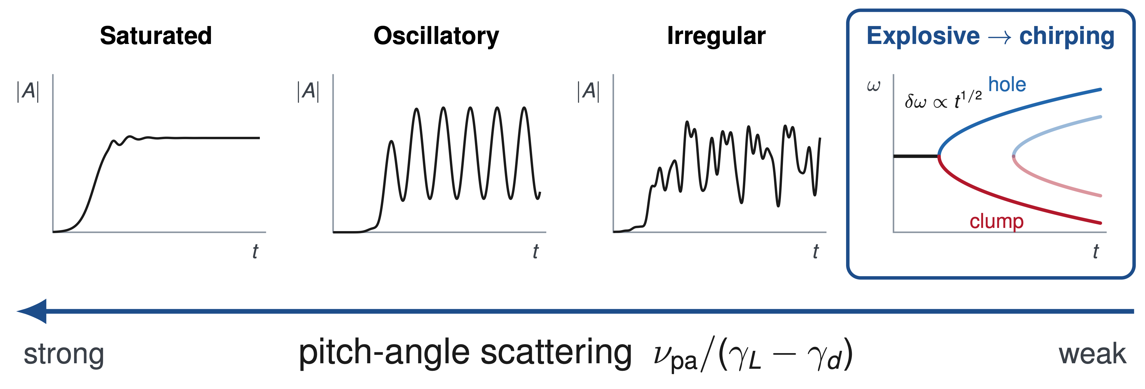
Stochastic scattering promotes steady-state mode saturation
Berk, Breizman & Pekker,
Phys. Rev. Lett. 76, 1256 (1996)

Slide 8
Diffusive processes can be mapped to scattering events, providing a possible mechanism for phase-space dissipation
  Microturbulence is one of such stochastic processes which prevents chirping onset.
  Duarte et al., 2017 explained experimental steady state AE results with additional stochastic diffusion due to microturbulence
    A chirping criterion, the ‘chirping integral,’ was developed with that uses a diffusion coefficient derived from microturbulence simulations to correctly predict experimental steady state regimes in DIII-D.
Additional stochastic scattering can move a marginally unstable mode from chirping to steady behavior.
Duarte et al., PoP,
24(12):122508, Dec. 2017.

Slide 9
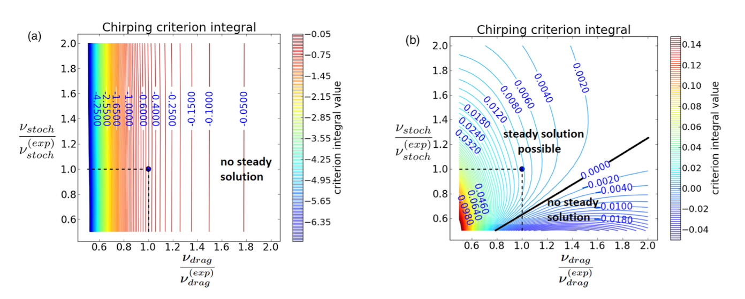
Duarte et al. demonstrated including microturbulent scattering made the chirping criterion consistent with the experimental steady-frequency regime.
    Without Microturbulence
    With Microturbulence
V. N. Duarte, et al., PoP,
24(12):122508, Dec. 2017.

Slide 10
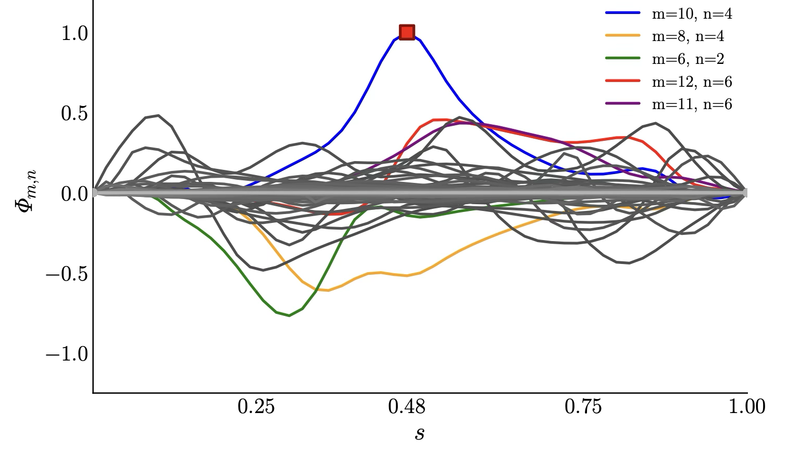
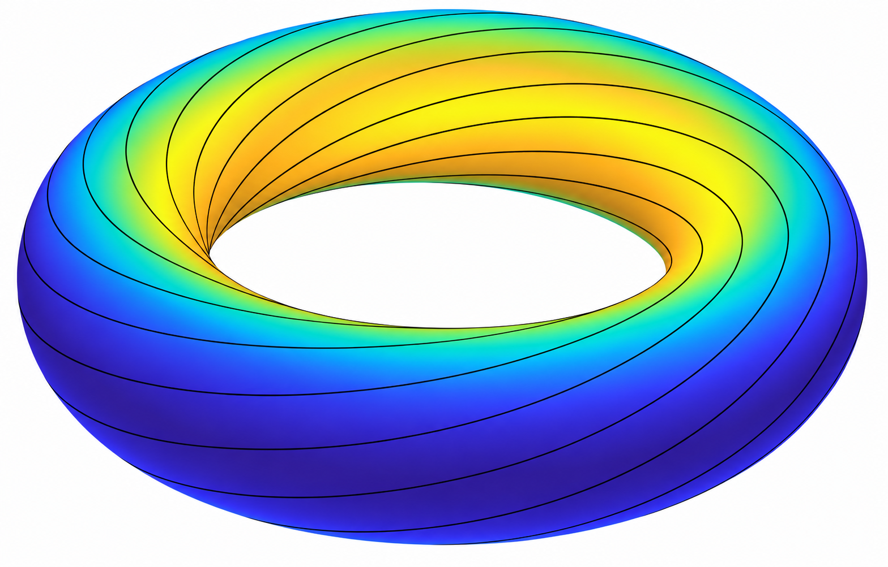
Magnetic geometry couples AE harmonics helically
Global AE in Landreman-Buller QA
Tokamak:
Stellarator:
 | Mode Family
Tokamak | n fixed, any m
Stellarator | n±k Nfp, any m
eg. 2 field periods
For some integer k
Landreman, et al.,
Phys. Plasmas 29, 082501 (2022)
A.R. Knyazev, et al.,
J. Plasma Phys. 92, E104 (2026)
Notes:
Make sure to say helical coupling

Slide 11
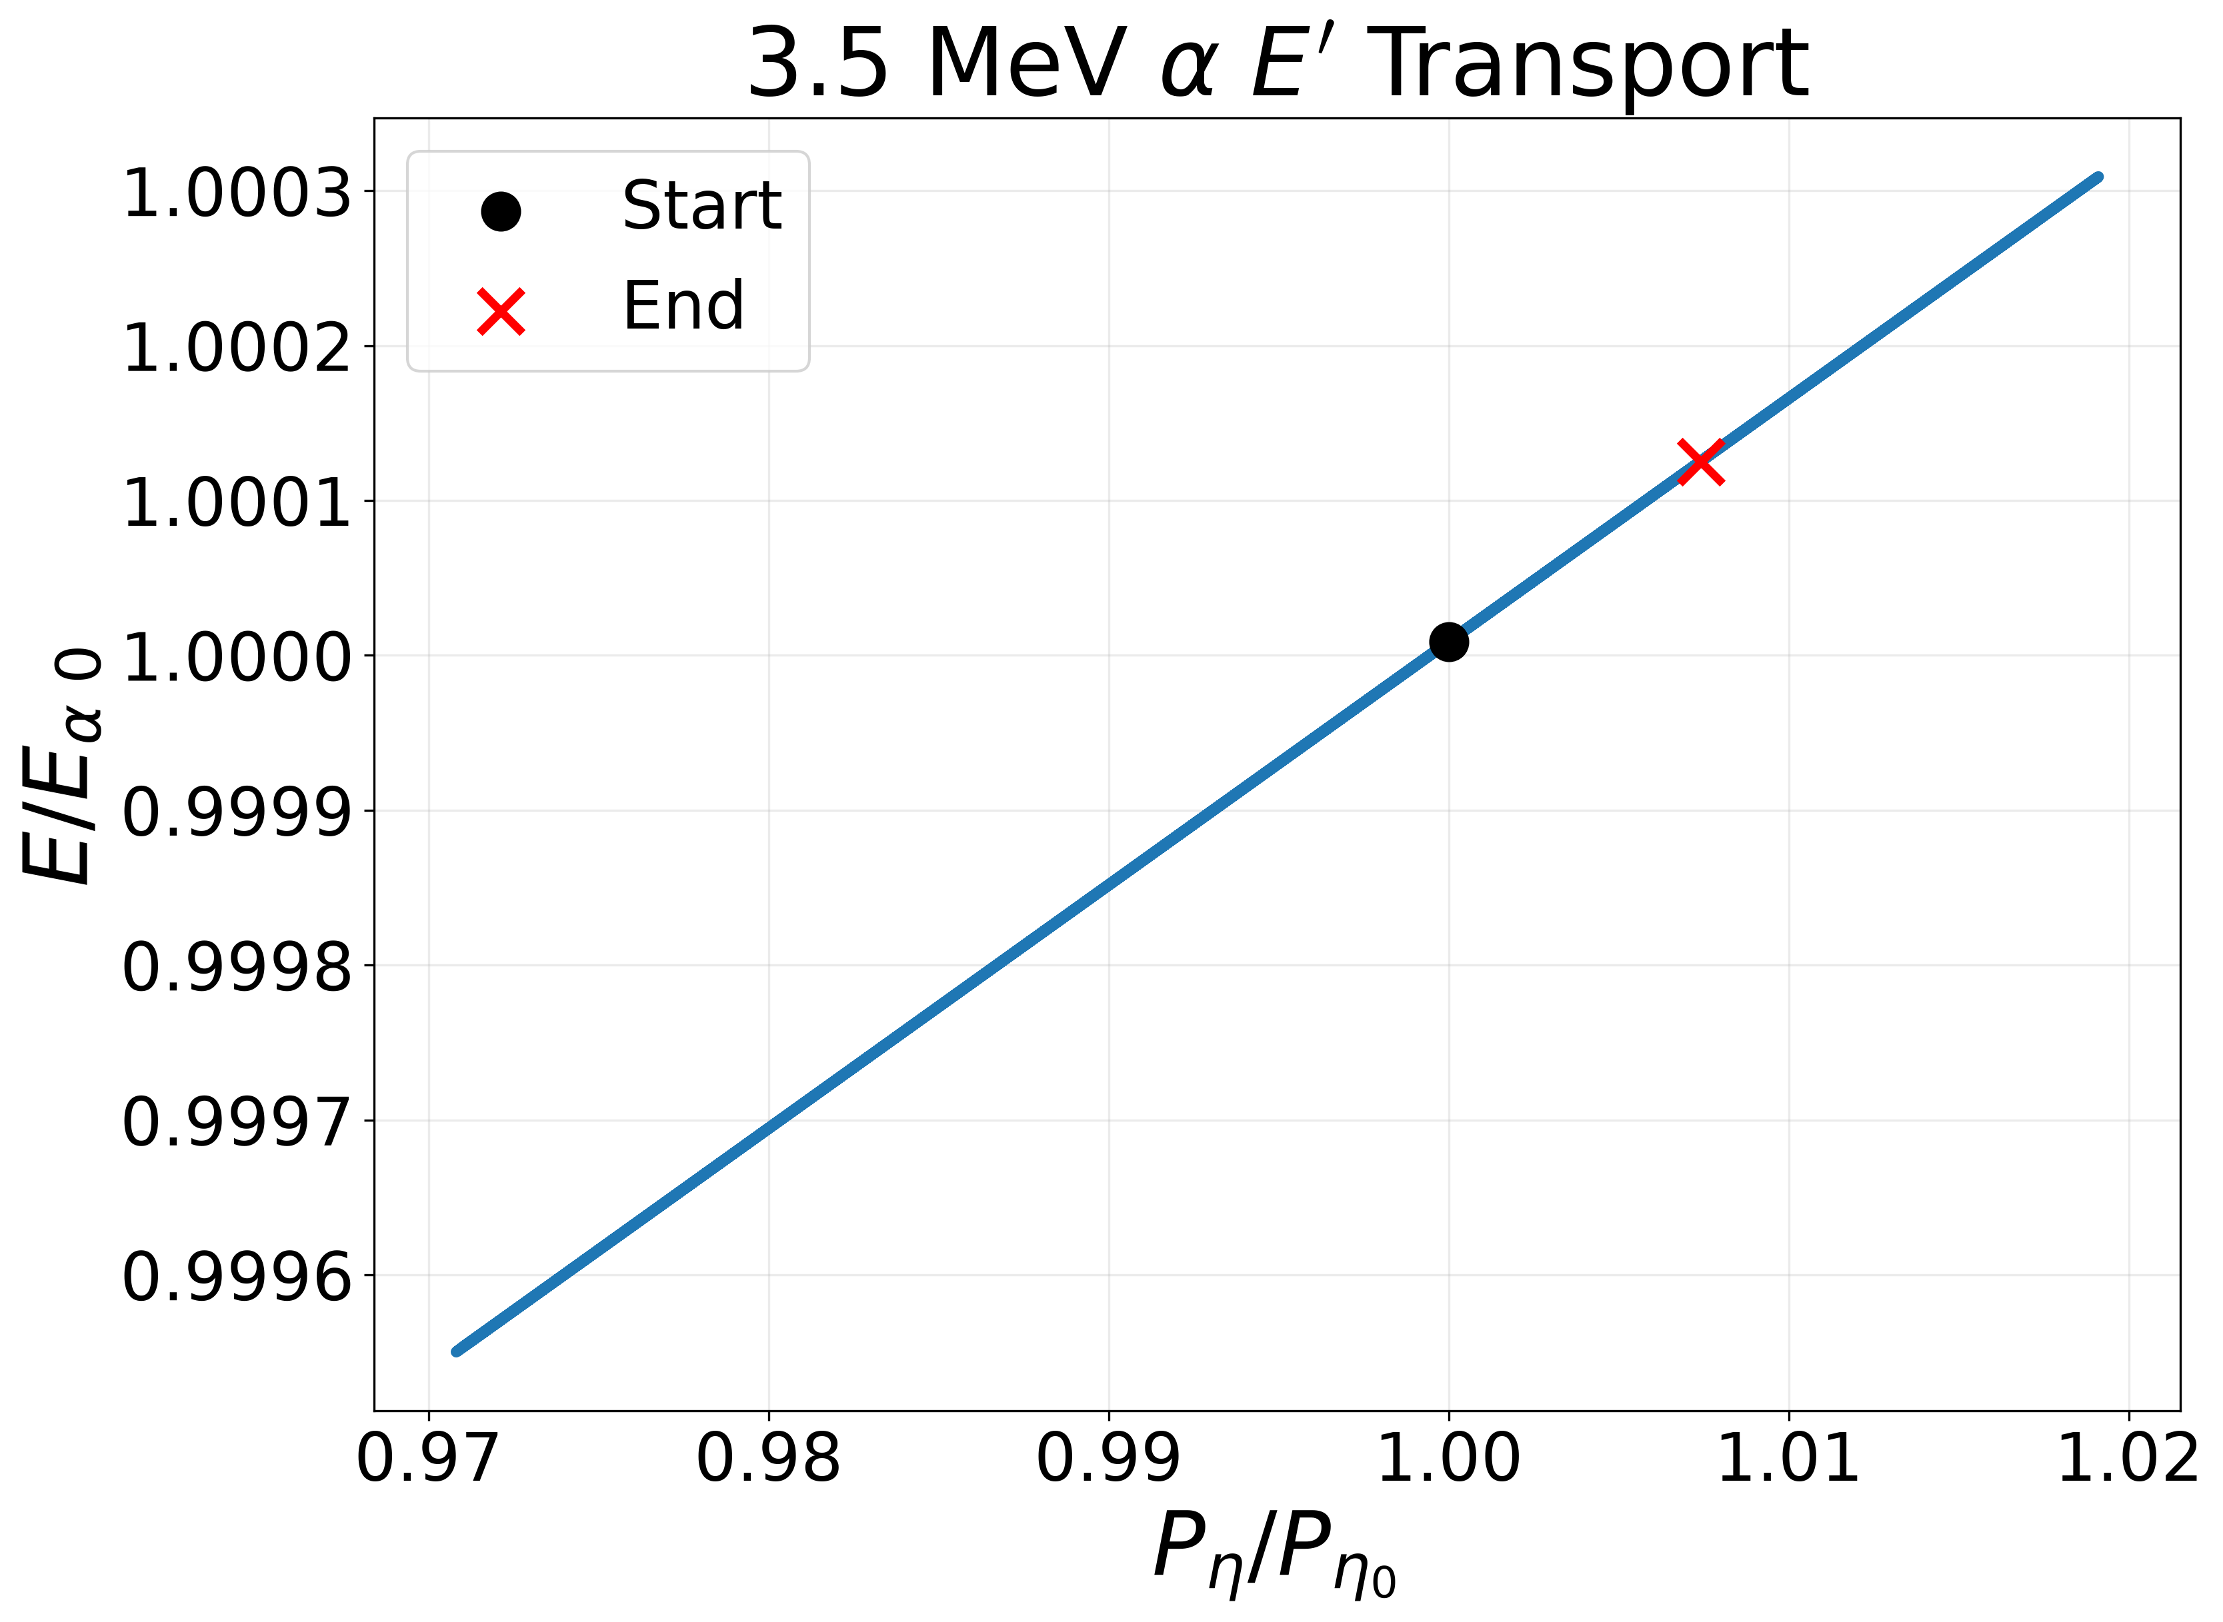
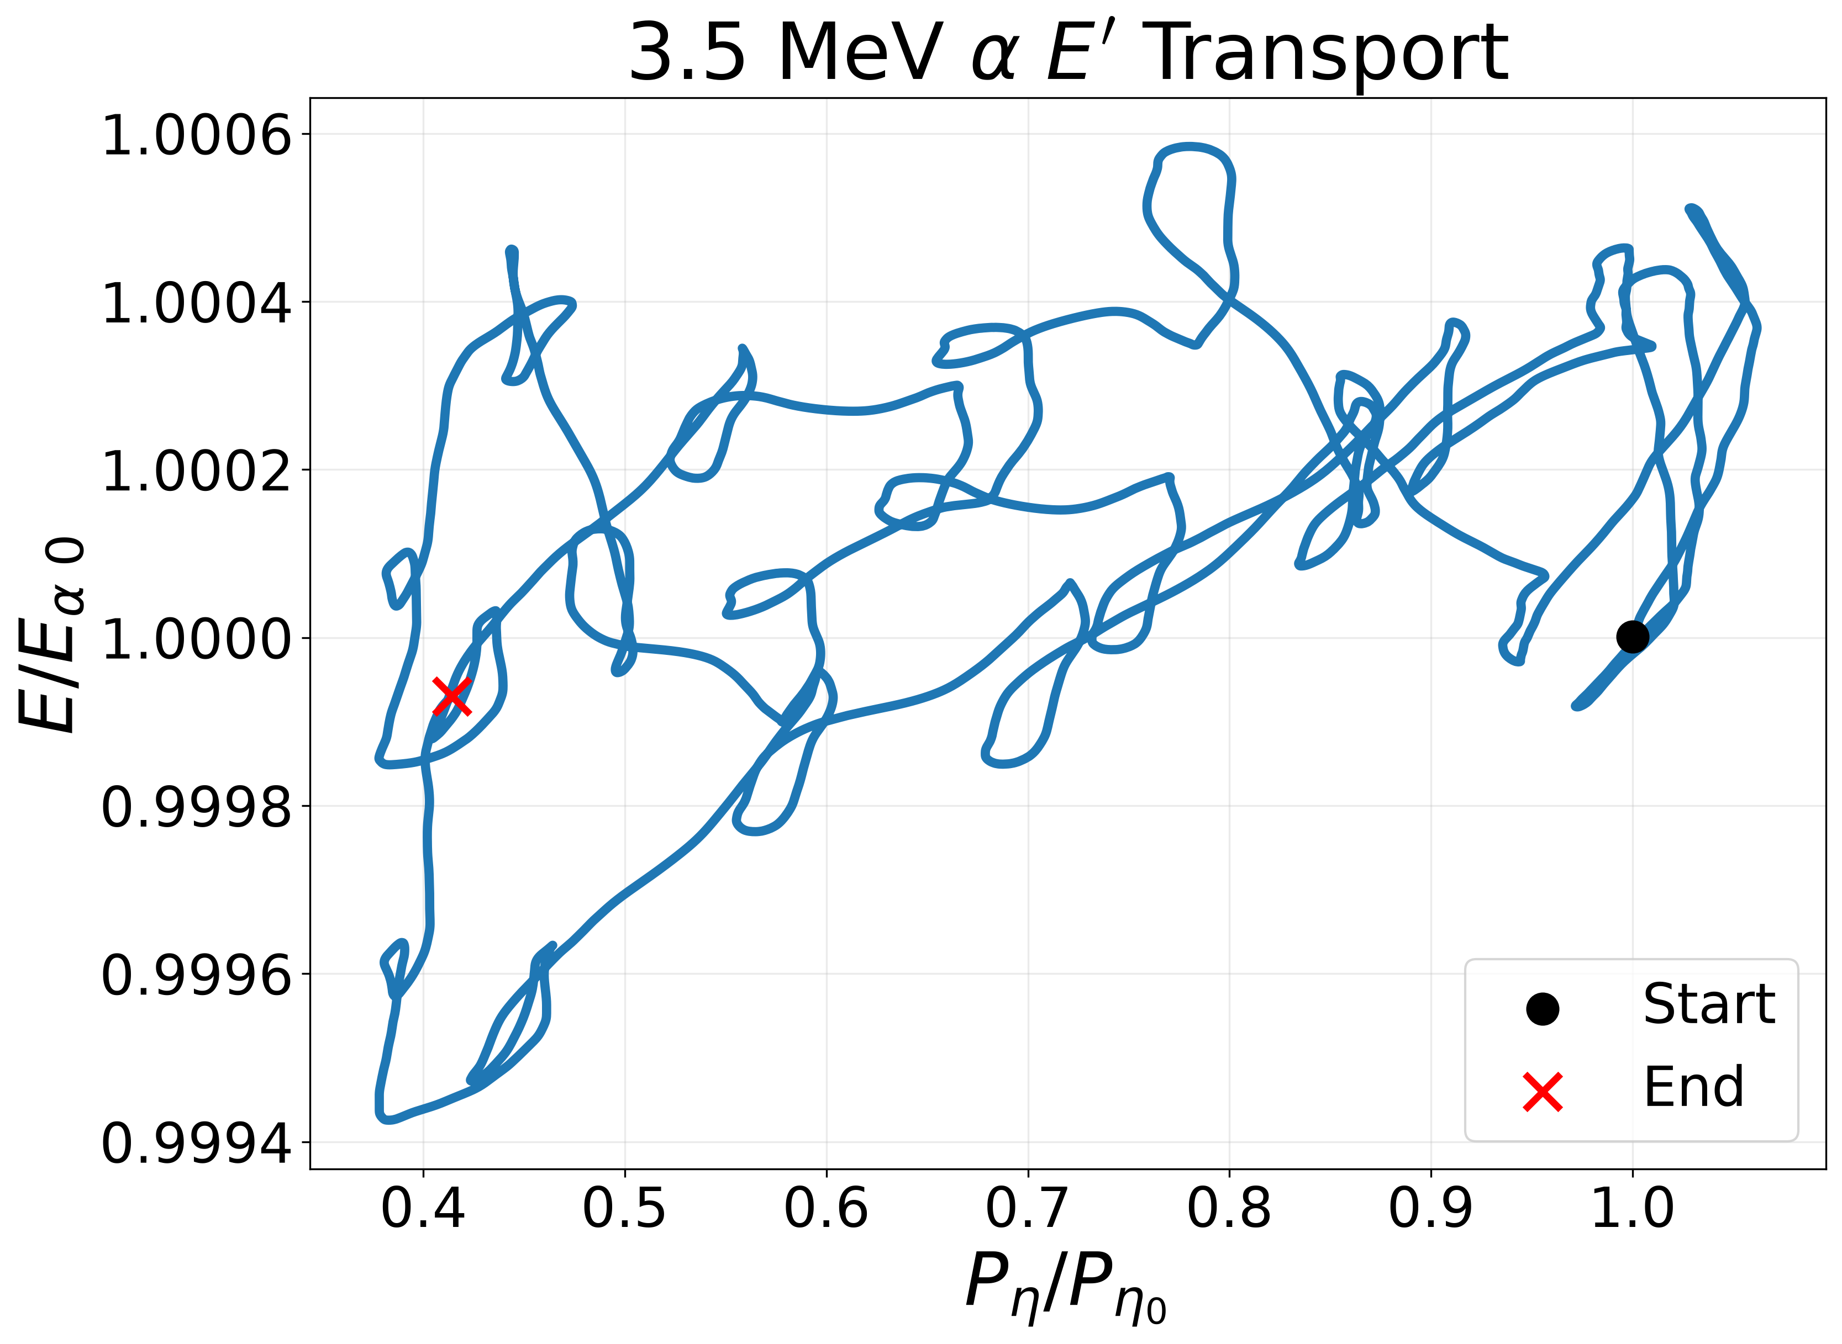
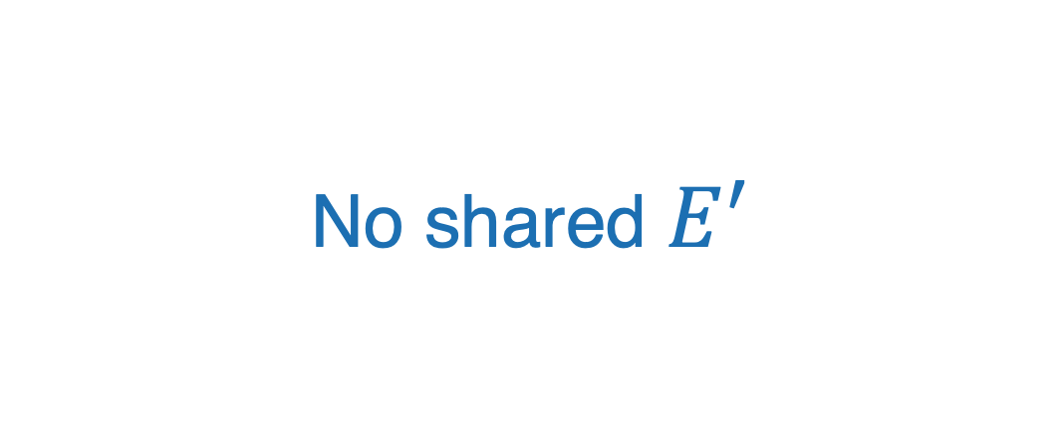
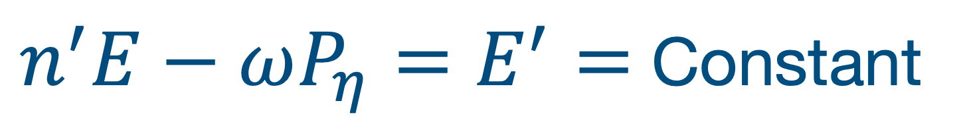
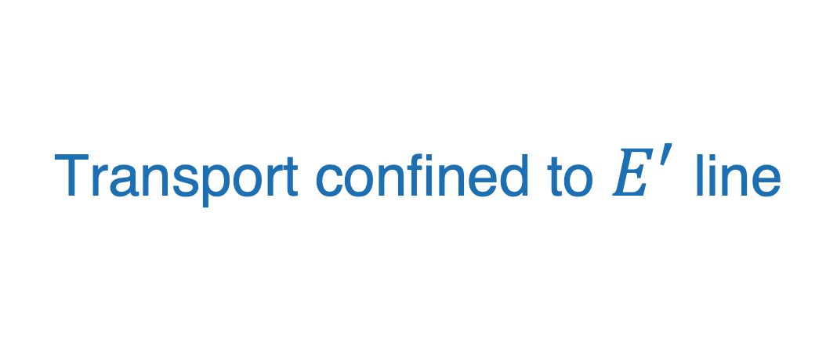
3D fields carry large impacts for AE resonance
Tokamak: fixed n and ω
Quasisymmetric stellarator
No shared $E^{′}$
Transport confined to $E^{′}$ line
Transport throughout phase space
$n^{′}E−ωP_{η}=E^{′}=$ Constant
Notes:
Single trajectory

Slide 12
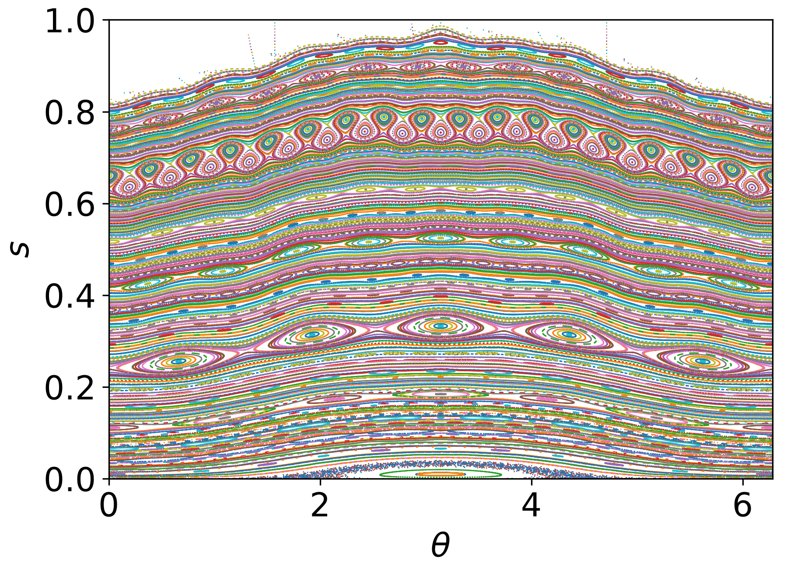
3D error fields in stellarators create resonant islands
Landreman-Buller 2.5% $β$ quasi-axisymmetric equilibrium in the absence of an AE
Landreman et al.
Phys. Plasmas 29, 082501 (2022)
Notes:
Make sure to verbally emphasize not perfect QS, passing particles

Slide 13
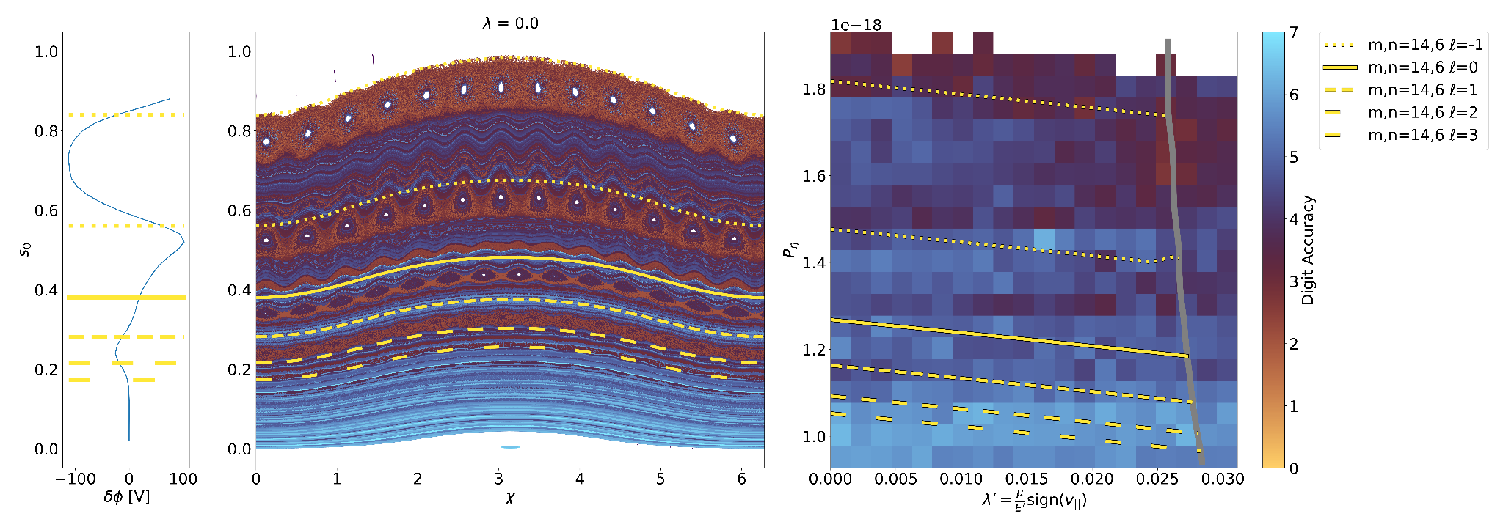
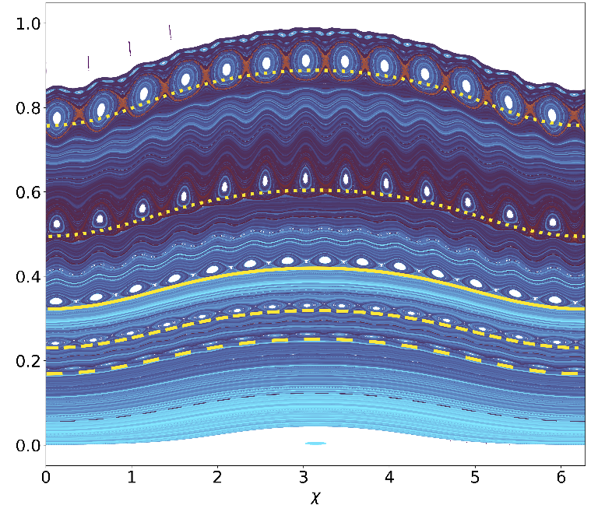
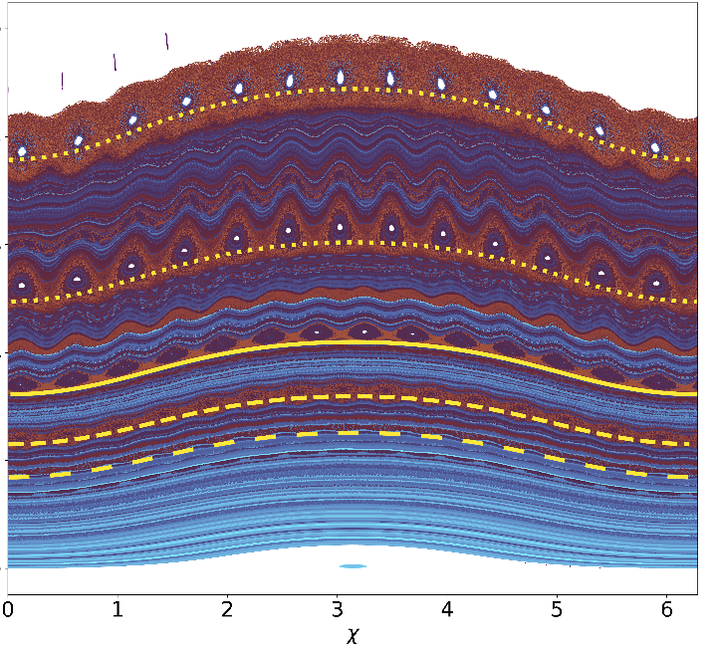
Inclusion of symmetry-breaking QS increases chaos
Same single AE harmonic
Perfectly Quasi-Symmetric field
With symmetry breaking modes
Less
Stochastic
More
Stochastic

Slide 14
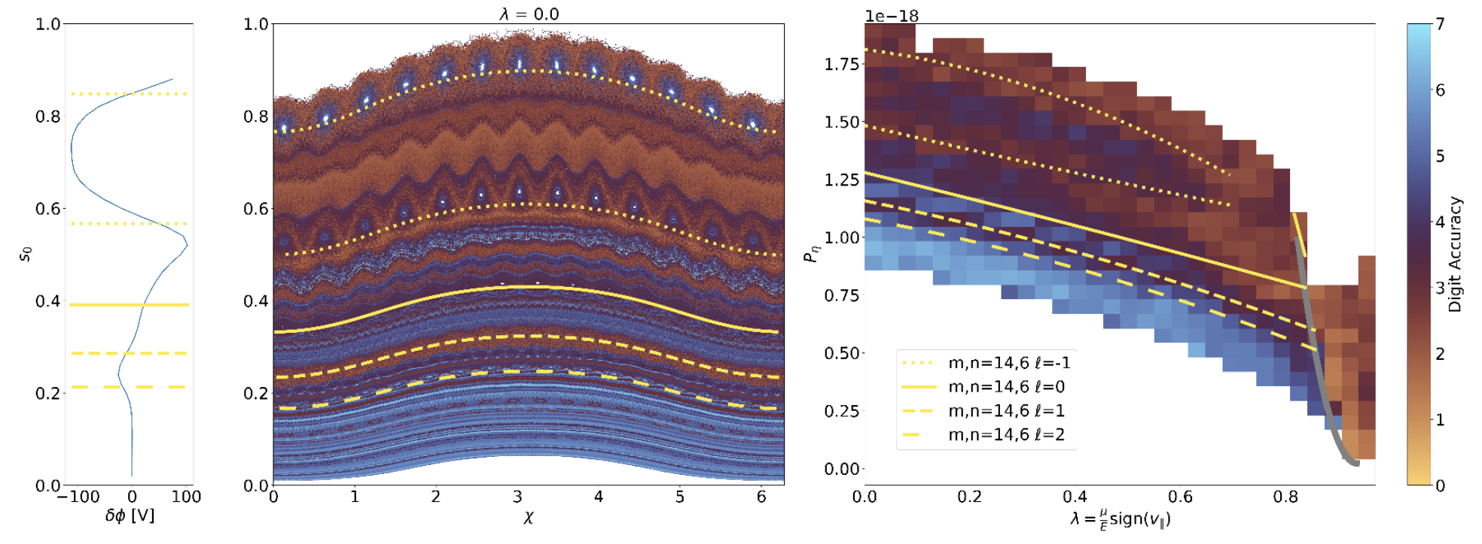

We can use this stochasticity metric to map phase space
Symmetry-breaking mode with m, n = 14, 6 harmonic
Less
Stochastic
More
Stochastic
Notes:
Emphasize that this is COM space, poincare plot maps onto slice

Slide 15
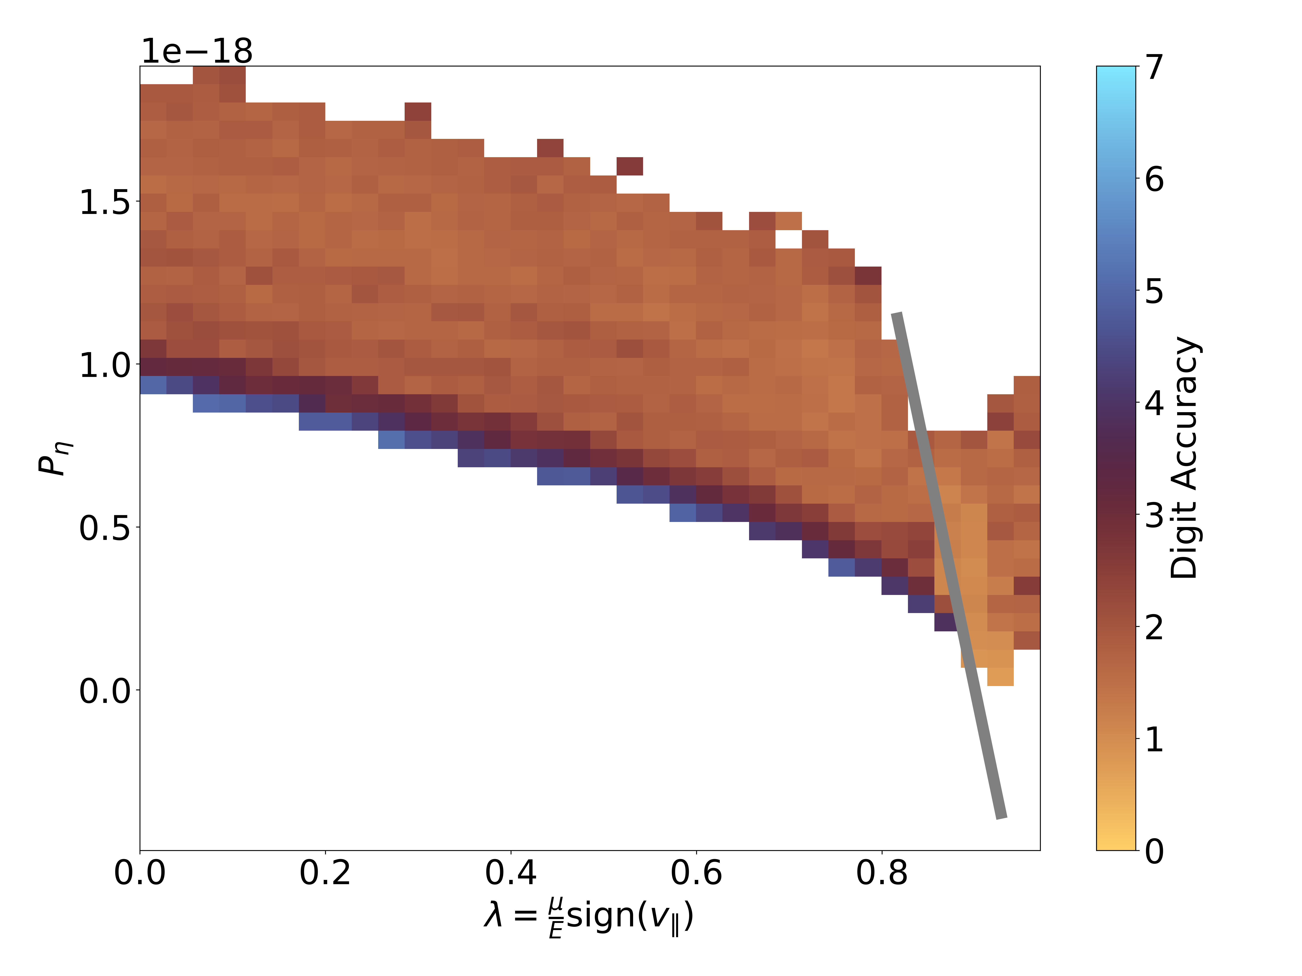
Adding a multi-harmonic AE dramatically widens stochastic regions of phase space
m, n = 14, 6 harmonic
35 harmonic AE
Less
Stochastic
More
Stochastic

Slide 16
3D fields make resonances
Begin with a reduced model to test how an additional resonances affect chirping

Slide 17
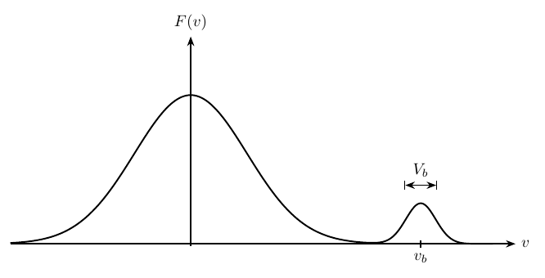
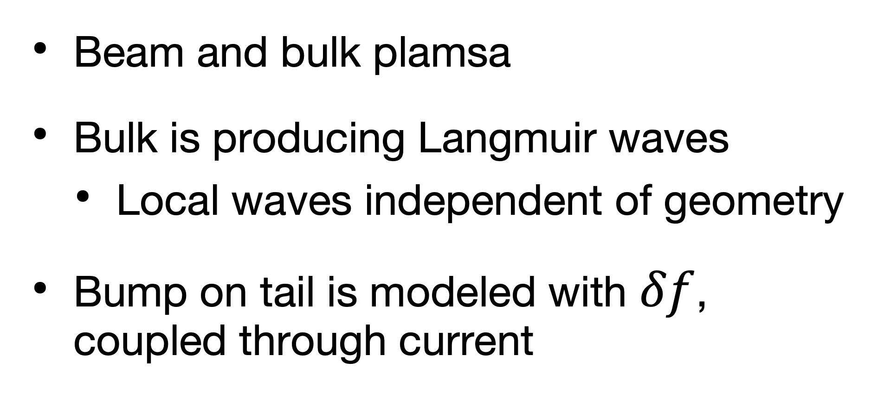
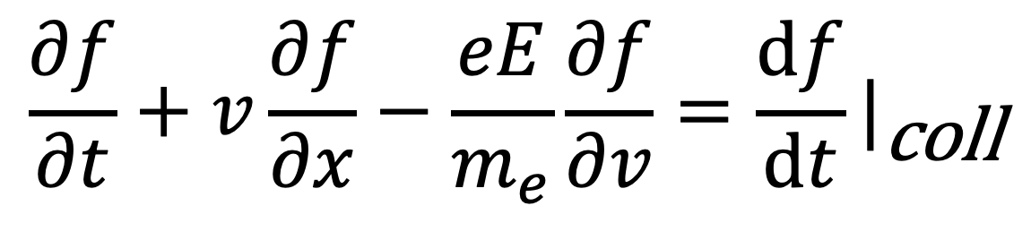
The Bump on tail (BOT) instability highlights the effect of stochastic scattering on chirping
1D proxy problem
$$\frac{∂f}{∂t}+v\frac{∂f}{∂x}−\frac{eE}{m_{e}}\frac{∂f}{∂v}={\frac{df}{dt}|}_{\text{coll}}$$
Beam and bulk plamsa
Bulk is producing Langmuir waves
  Local waves independent of geometry
Bump on tail is modeled with $δf$, coupled through current
M. K. Lilley, et al.
Phys. Plasmas 17, 092305 (2010)

Slide 18

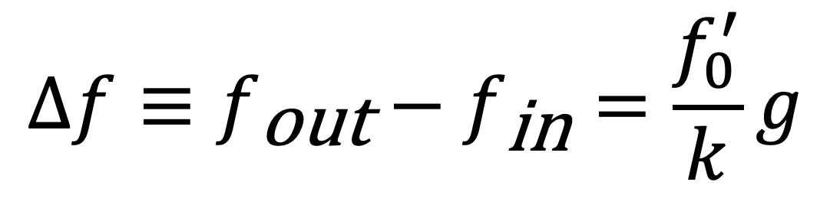
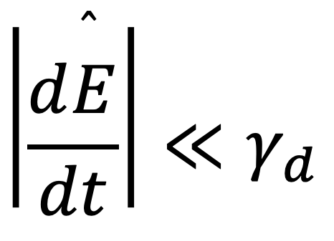
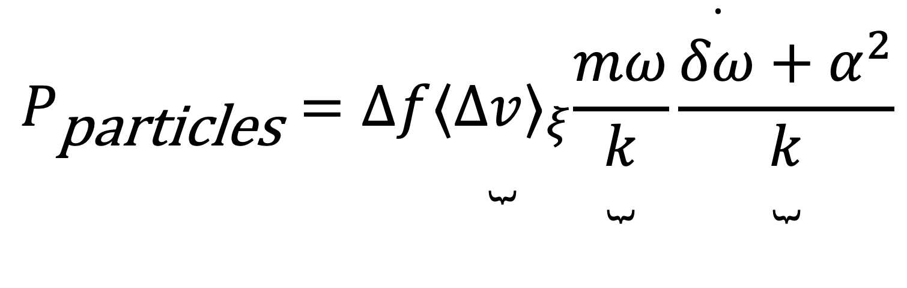
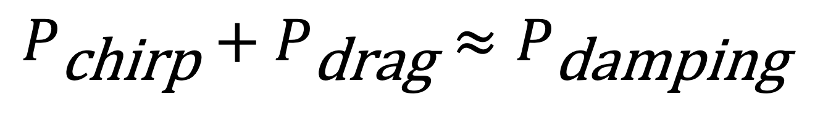
Berk-Breizman time evolution of chirping
Energy balance between hole and wave
$$\left|\frac{d\overset{̂}{E}}{dt}\right|≪γ_{d}$$
Power Balance:
$$\frac{dW}{dt}=P_{\text{chirp}}+P_{\text{drag}}−P_{\text{damping}}$$
$$P_{\text{chirp}}+P_{\text{drag}}≈P_{\text{damping}}$$
$$Δf≡f_{\text{out}}−f_{\text{in}}=\frac{f_{0}^{′}}{k}g$$
$$P_{\text{particles}}=Δf\underset{ }{\underset{⏟}{⟨Δv⟩_{ξ}}}\underset{ }{\underset{⏟}{\frac{mω}{k}}}\underset{ }{\underset{⏟}{\frac{\overset{·}{δω}+α^{2}}{k}}}$$
Trapping Width
Resonant mom.
Accelleration
M. K. Lilley, et al.
Phys. Plasmas 17, 092305 (2010)

Slide 19
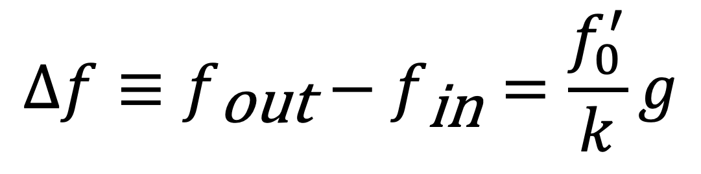
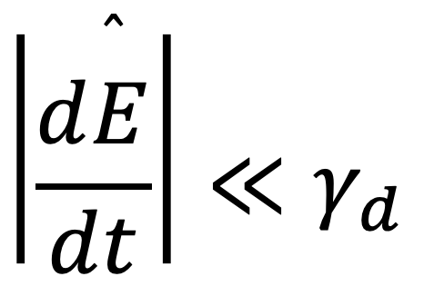
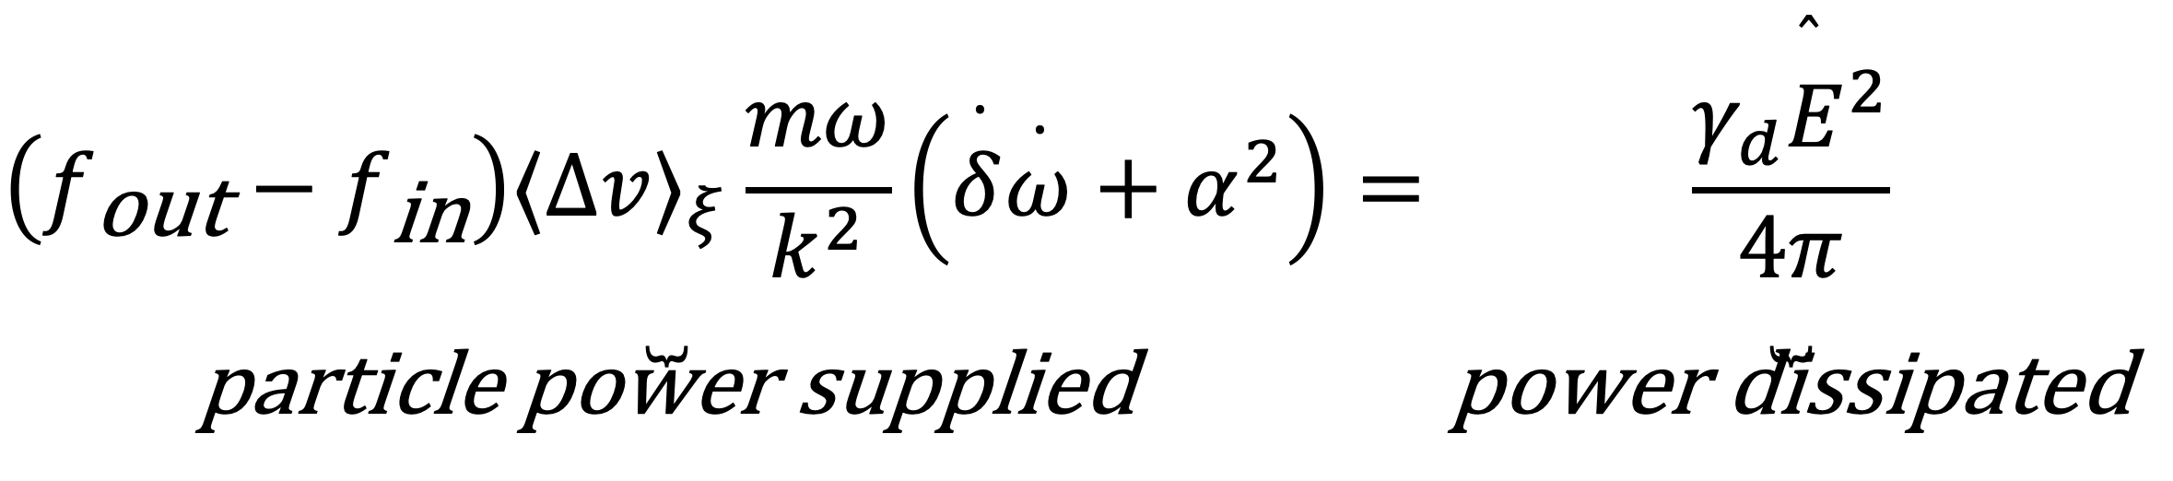
Berk-Breizman time evolution of chirping
Energy balance between hole and wave
$$\left|\frac{d\overset{̂}{E}}{dt}\right|≪γ_{d}$$
Power Balance:
$$\frac{dW}{dt}=P_{\text{chirp}}+P_{\text{drag}}−P_{\text{damping}}$$
$$P_{\text{chirp}}+P_{\text{drag}}≈P_{\text{damping}}$$
$$Δf≡f_{\text{out}}−f_{\text{in}}=\frac{f_{0}^{′}}{k}g$$
$$\underset{\text{particle} \text{power} \text{supplied}}{\underset{⏟}{\left(f_{\text{out}}−f_{\text{in}}\right)⟨Δv⟩_{ξ}\frac{mω}{k^{2}}\left(\overset{·}{δ}\overset{·}{ω}+α^{2}\right)}}=\underset{\text{power} \text{dissipated}}{\underset{⏟}{\frac{γ_{d}{\overset{̂}{E}}^{2}}{4π}}}$$
M. K. Lilley, et al.
Phys. Plasmas 17, 092305 (2010)

Slide 20

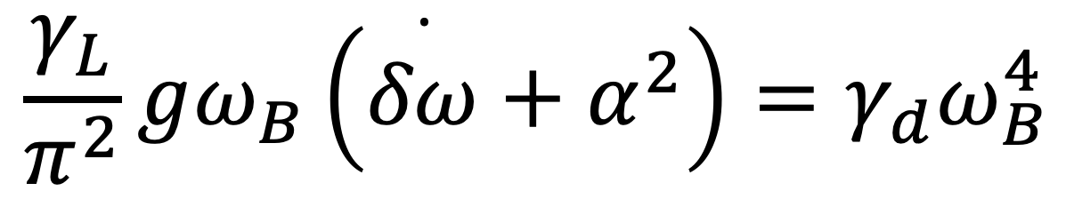
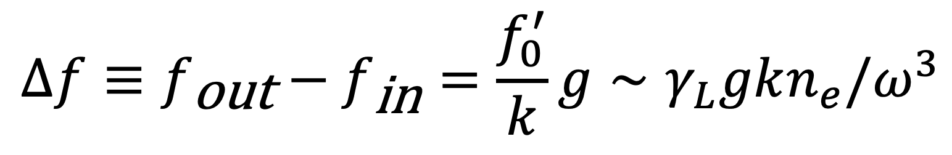
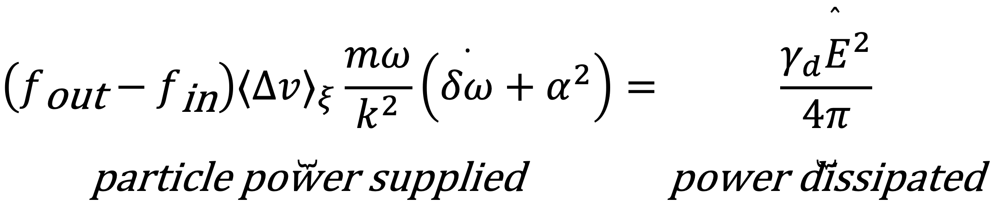
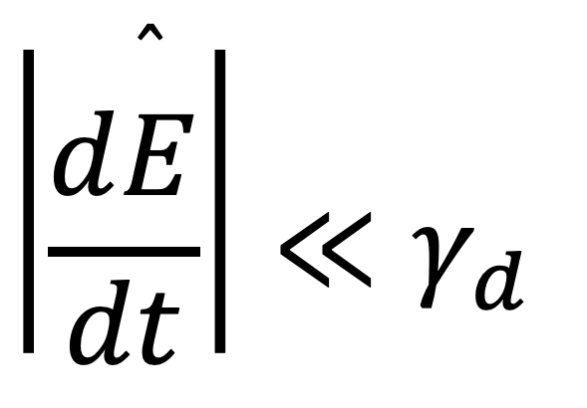
Berk-Breizman time evolution of chirping
Energy balance between hole and wave
$$\left|\frac{d\overset{̂}{E}}{dt}\right|≪γ_{d}$$
Power Balance:
$$\frac{dW}{dt}=P_{\text{chirp}}+P_{\text{drag}}−P_{\text{damping}}$$
$$Δf≡f_{\text{out}}−f_{\text{in}}=\frac{f_{0}^{′}}{k}g∼γ_{L}gkn_{e}/ω^{3}$$
$$P_{\text{chirp}}+P_{\text{drag}}≈P_{\text{damping}}$$
$$\underset{\text{particle} \text{power} \text{supplied}}{\underset{⏟}{\left(f_{\text{out}}−f_{\text{in}}\right)⟨Δv⟩_{ξ}\frac{mω}{k^{2}}\left(\overset{·}{δω}+α^{2}\right)}}=\underset{\text{power} \text{dissipated}}{\underset{⏟}{\frac{γ_{d}{\overset{̂}{E}}^{2}}{4π}}}$$
$$\frac{γ_{L}}{π^{2}}gω_{B}\left(\overset{·}{δω}+α^{2}\right)=γ_{d}ω_{B}^{4}$$
$$δω∝γ_{L}\sqrt{γ_{d}\left(t−t_{0}\right)}$$
M. K. Lilley, et al.
Phys. Plasmas 17, 092305 (2010)

Slide 21
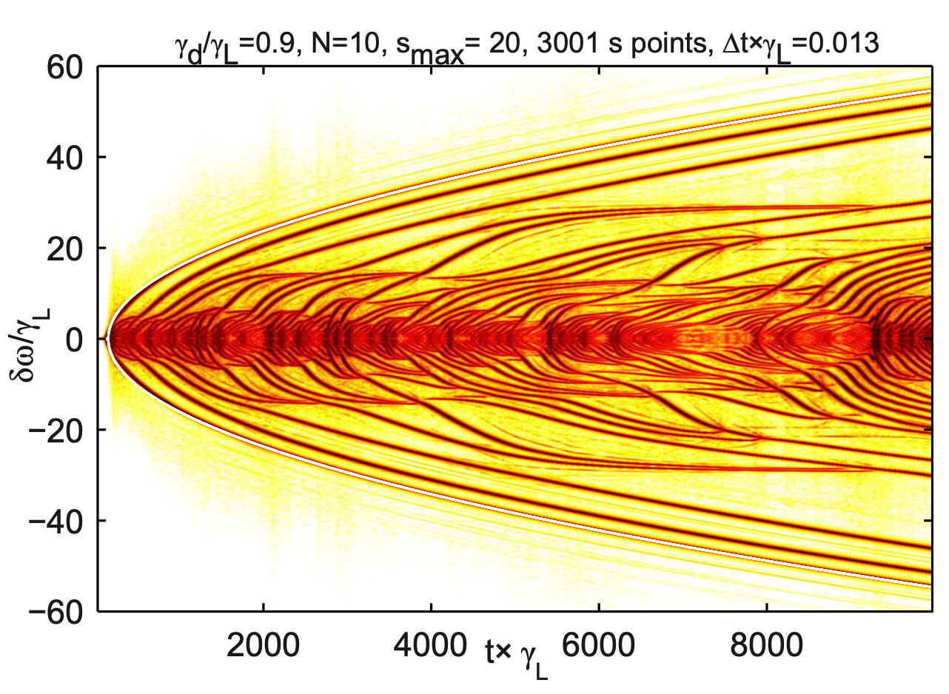
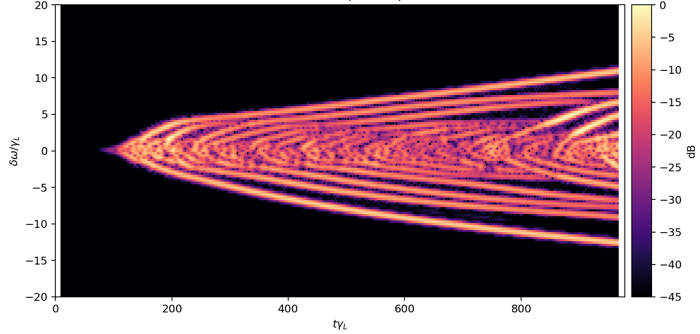
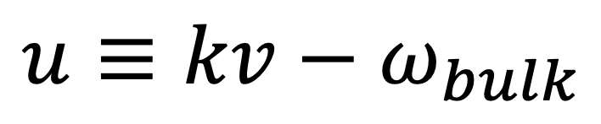
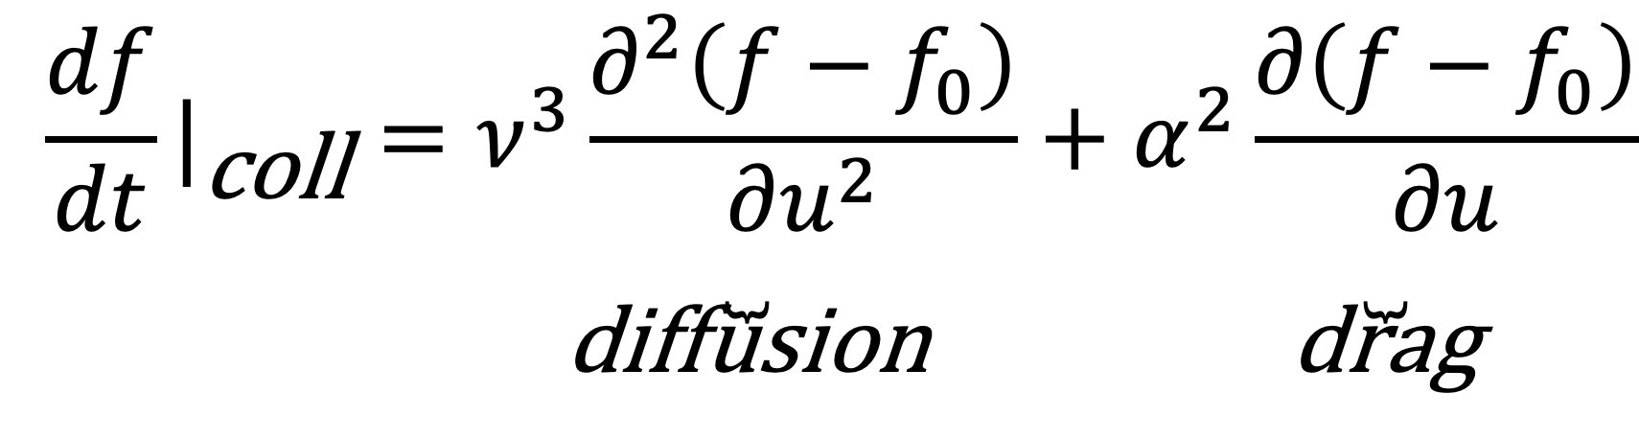
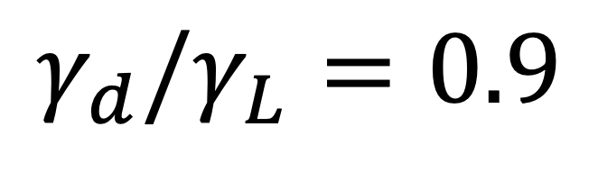

Benchmark: collision less case produces chirping
Lilley et al., 2010
This work:
$$γ_{d}/γ_{L}=0.9$$
$$γ_{d}/γ_{L}=0.9$$
0
0
$$u≡kv−ω_{bulk}$$
$${\frac{df}{dt}|}_{\text{coll}}=\underset{\text{diffusion}}{\underset{⏟}{ν^{3}\frac{∂^{2}\left(f−f_{0}\right)}{∂u^{2}}}}+\underset{\text{drag}}{\underset{⏟}{α^{2}\frac{∂\left(f−f_{0}\right)}{∂u}}}$$
M. K. Lilley, et al.
Phys. Plasmas 17, 092305 (2010)
Notes:
characterizing the velocity space diffusion, dynamical friction respectively

Slide 22
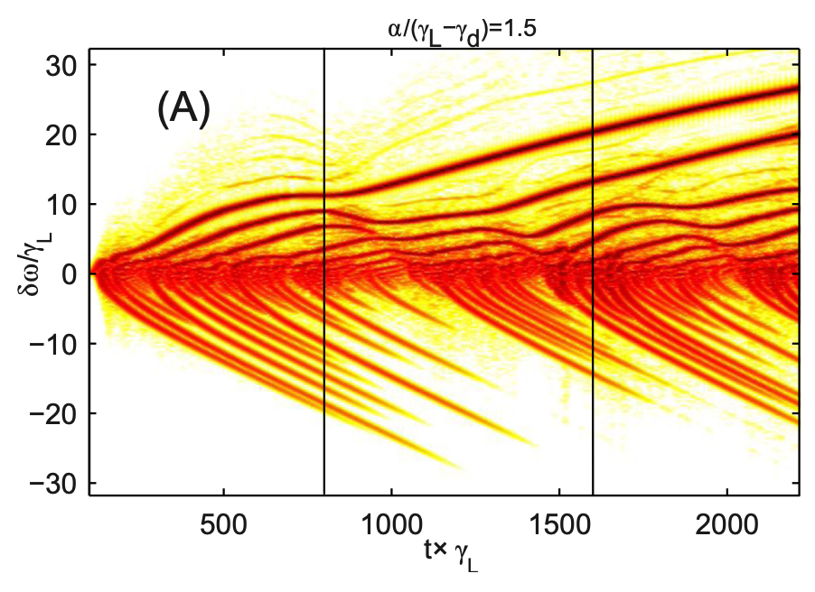
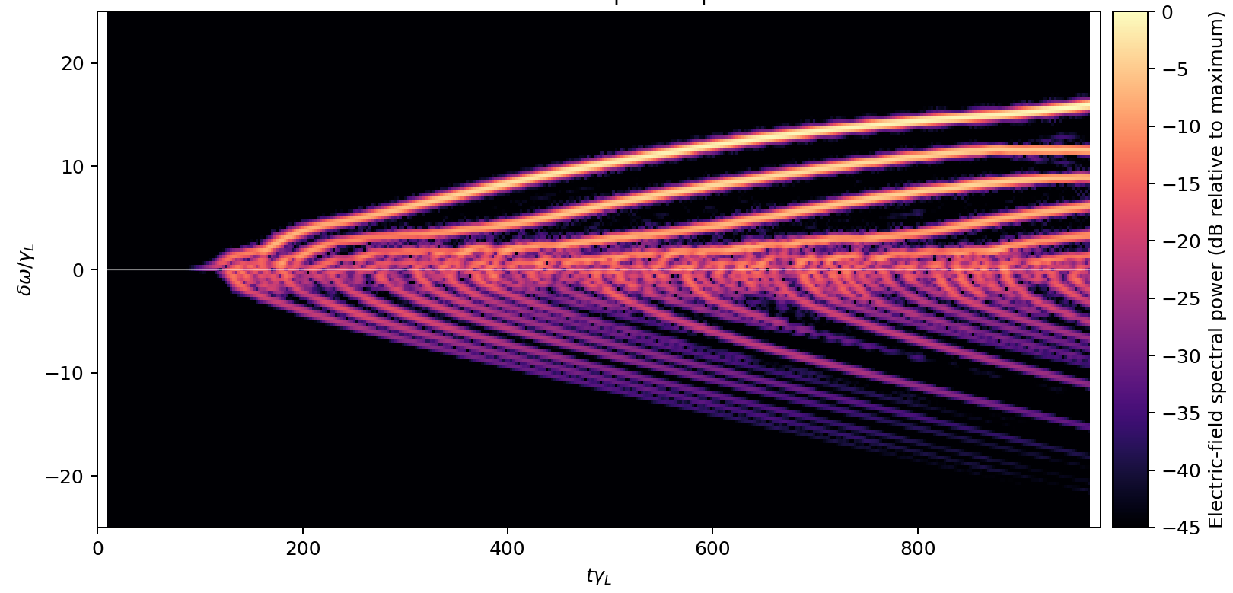


Benchmark: inclusion of drag produces asymmetric chirping
Lilley et al., 2010
This work:
$$α/\left(γ_{L}−γ_{d}\right)=1.5$$
0
$${\frac{df}{dt}|}_{\text{coll}}=\underset{\text{diffusion}}{\underset{⏟}{ν^{3}\frac{∂^{2}\left(f−f_{0}\right)}{∂u^{2}}}}+\underset{\text{drag}}{\underset{⏟}{α^{2}\frac{∂\left(f−f_{0}\right)}{∂u}}}$$
M. K. Lilley, et al.
Phys. Plasmas 17, 092305 (2010)

Slide 23
Single collision-less seed resonance acts as the reference solution

Slide 24
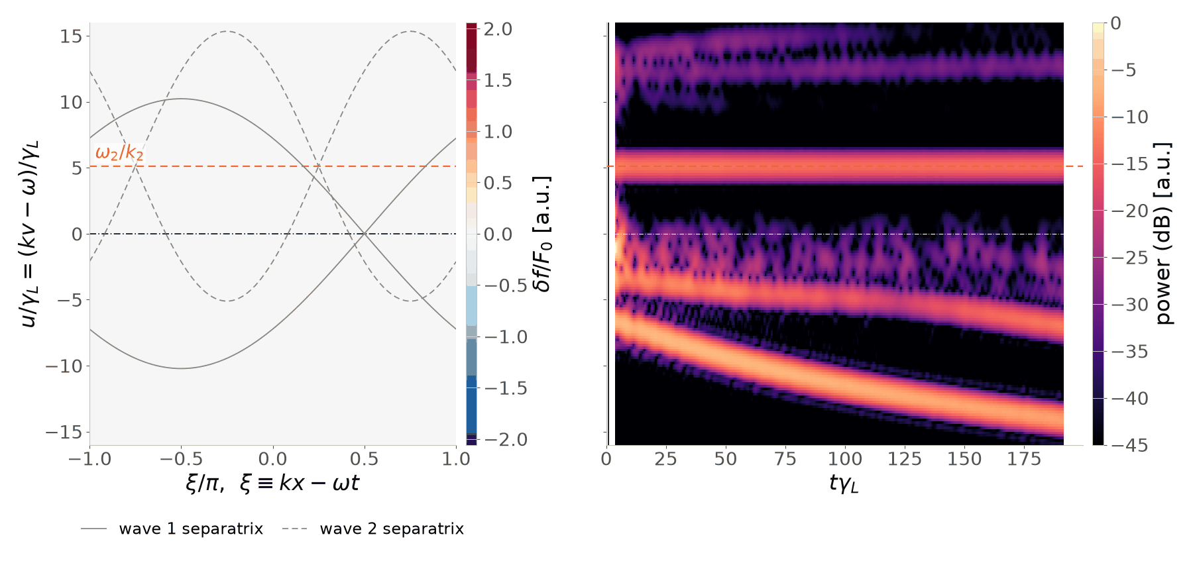
Adding an overlapping electrostatic resonance reduces chirps
Effects of an externally applied wave that does not evolve
Static nature is analogous to effects by 3D field error
Notes:
Dashed lines around island width for that island - what is static island doing?
- time dependent

Slide 25
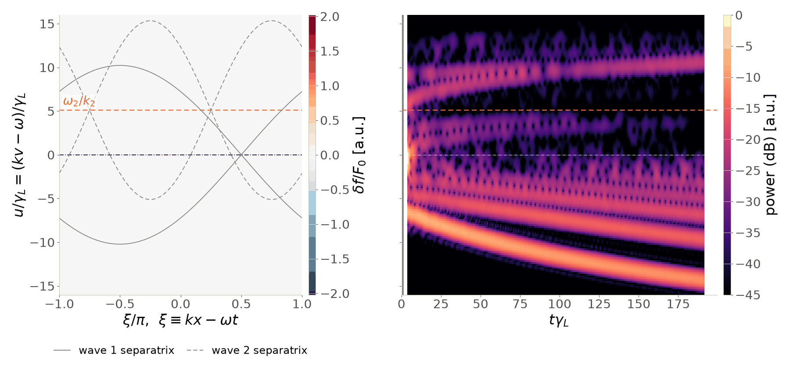
Evolving the overlapping resonance completely eliminates the secondary resonance and weakens chirping
Self-consistent, coupled evolution of both modes
Analogous to effects of multi-harmonic 3D mode structures
Notes:
Plot island widths

Slide 26
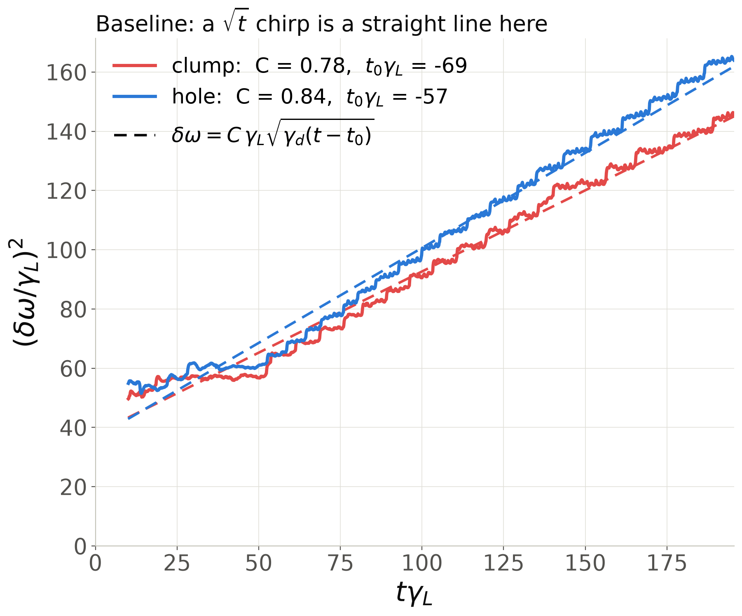
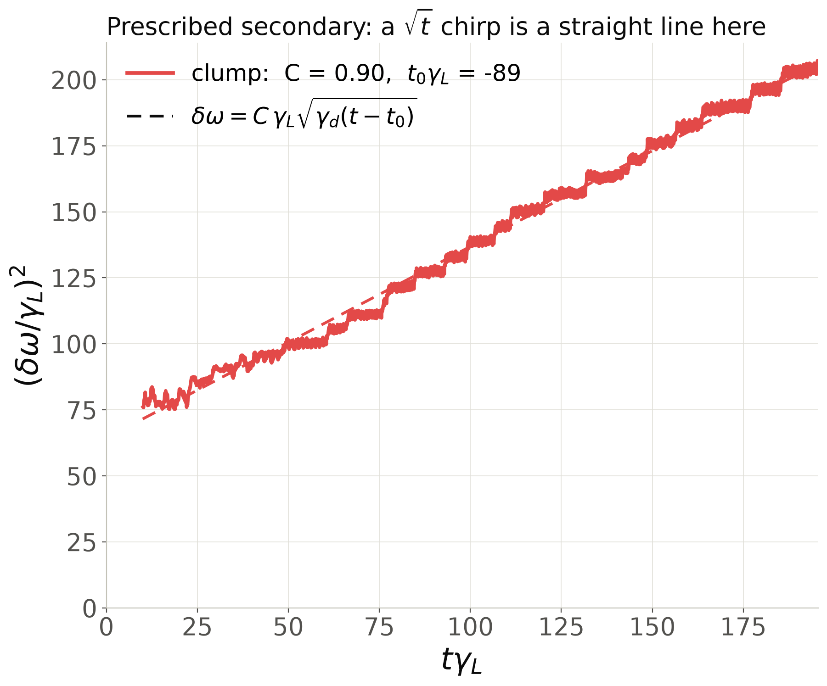
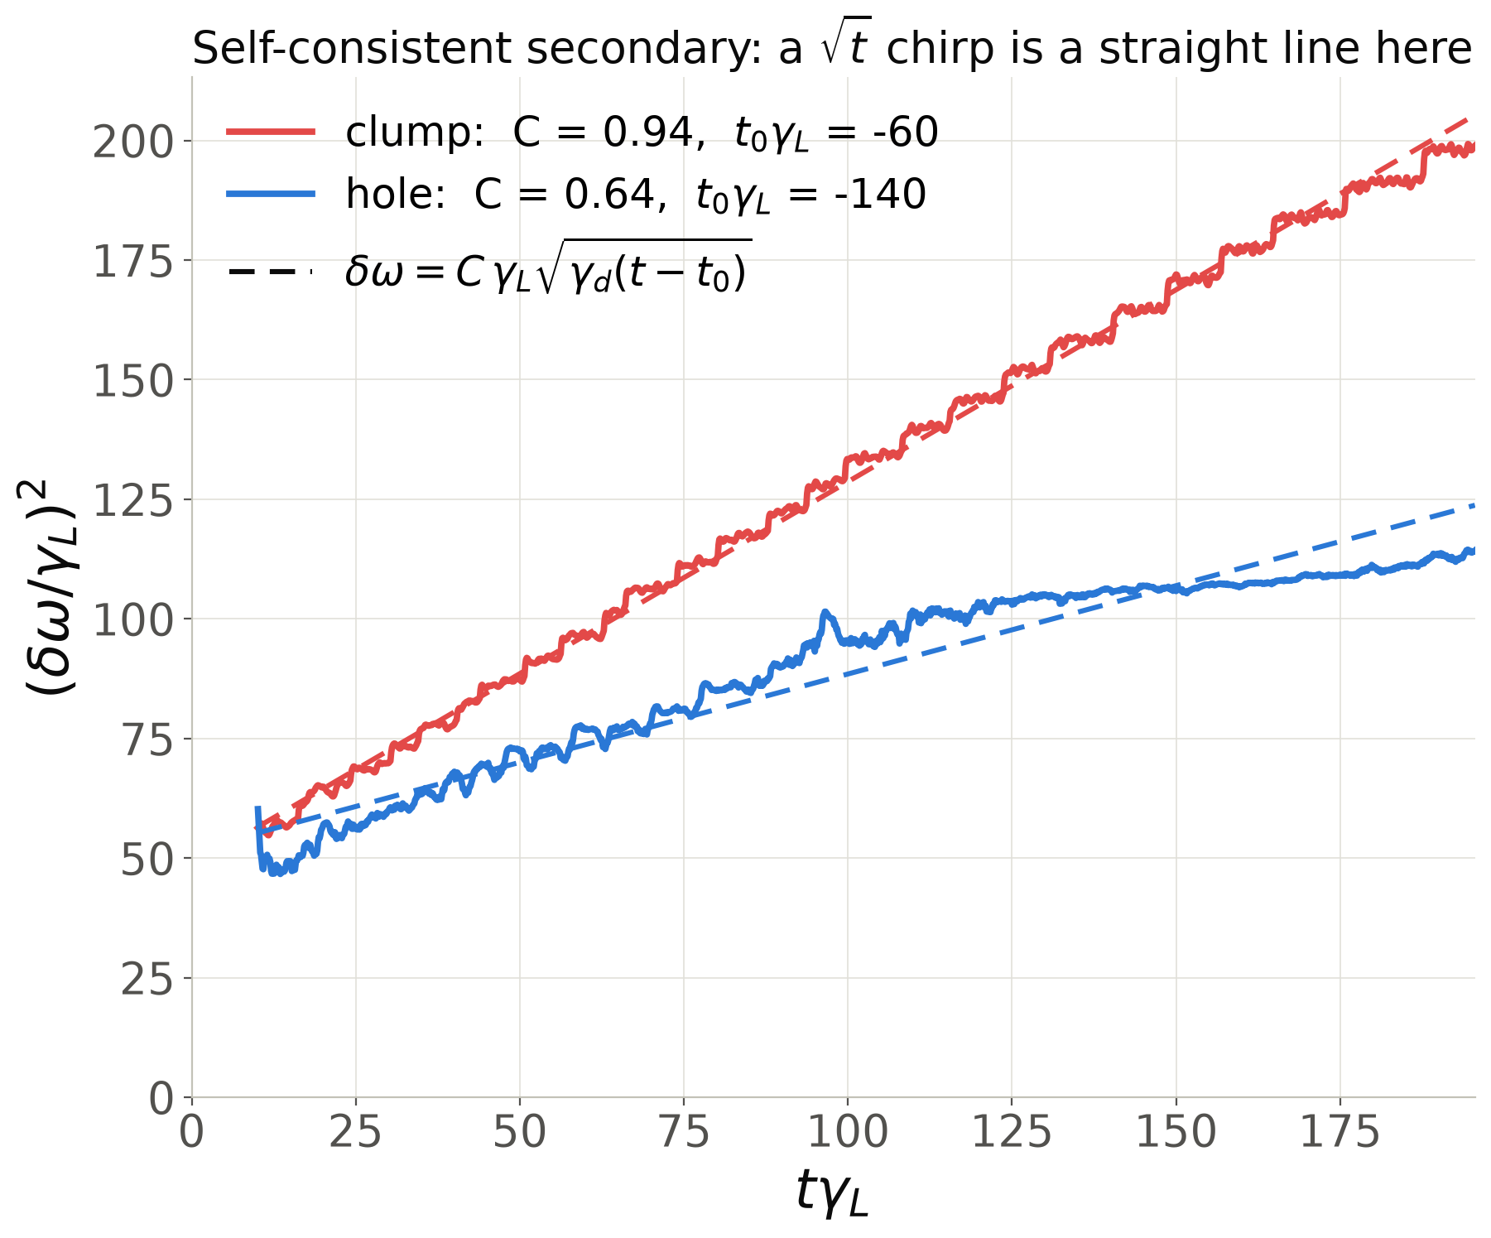
Movement of hole-clump pairs scales with $\sqrt{t}$
Reference case
Static second overlap
Self consistent overlap
Resonance overlap changes the hole–clump asymmetry.

Slide 27
Future steps
Extending AE chirping simulations for stellarator geometry.

Slide 28

Future steps
Extending AE chirping simulations for stellarator geometry.
Possible proposal for DIII-D experiment: using magnetic perturbation coils as a proxy for QS error.
    Applying static 3D magnetic perturbations (δB/B ~ 0.01) to EP driven chirping AE resulted in a steady state frequency by inducing EP losses, therefore removing the drive.
Bortolon et al.
PRL 110, 265008 (2013)

Slide 29
Future steps
Extending AE chirping simulations for stellarator geometry.
Possible proposal for DIII-D experiment: using magnetic perturbation coils as a proxy for QS error.
Could we do more precise phase space engineering that prevents strong EP losses by targeting 3D perturbations near AE resonances?

Slide 30

Suppression of Coherent Energetic Particle Phase Space Structures due to 3D fields
Alexandra Lachmann¹, Dingyun Liu¹, Alexey Knyazev¹, Elizabeth Paul¹
¹Columbia University

