Slide 1
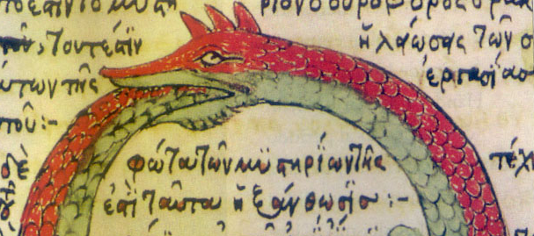
FLR effects in stellarators: the hidden ripples in hidden symmetry.
M. Fitzgerald

Slide 2
Scope
This talk is concerned with the orbital motion of test particles in known fields which are assumed constant in time
We will be discussing the long-term behaviour of test particle motion in those fields, based on qualitative features of the equilibrium fields
Acknowledgment:
I pay tribute to Matt Landreman and Elizabeth Paul for making their data so openly accessible!

Slide 3
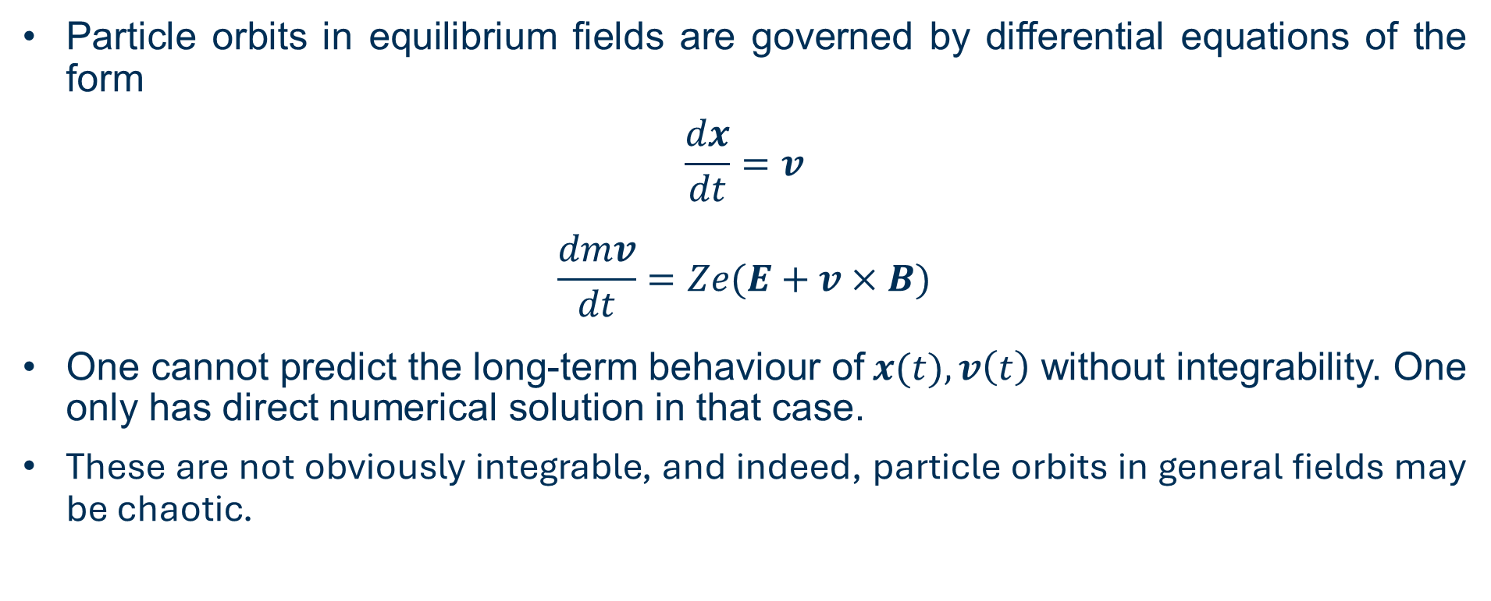
The importance of integrability
“Analyzing a general potential system with two or more degrees of freedom is beyond the capability of modern science”. – V. Arnold
Particle orbits in equilibrium fields are governed by differential equations of the form
$$\frac{dx}{dt}=v$$
$$\frac{dmv}{dt}=Ze(E+v×B)$$
One cannot predict the long-term behaviour of$x(t),v\left(t\right)$ without integrability. One only has direct numerical solution in that case.
These are not obviously integrable, and indeed, particle orbits in general fields may be chaotic.

Slide 4
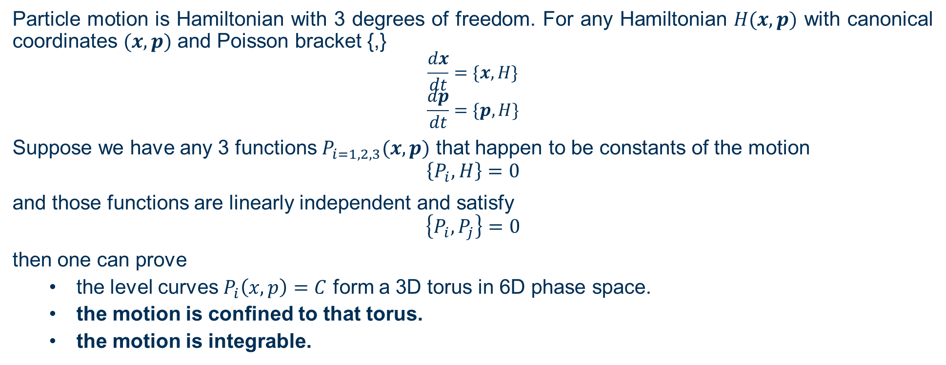
Invariants give integrability and confinement
Particle motion is Hamiltonian with 3 degrees of freedom. For any Hamiltonian $H(x,p)$ with canonical coordinates $(x,p)$ and Poisson bracket {,}
$$\frac{dx}{dt}=\{x,H\}$$
$$\frac{dp}{dt}=\{p,H\}$$
Suppose we have any 3 functions $P_{i=1,2,3}(x,p)$ that happen to be constants of the motion
$$\left\{P_{i},H\right\}=0$$
and those functions are linearly independent and satisfy
$$\left\{P_{i},P_{j}\right\}=0$$
then one can prove
  the level curves $P_{i}\left(x,p\right)=C$ form a 3D torus in 6D phase space.
  the motion is confined to that torus.
  the motion is integrable.
Invariants for particle motion are obtained by identifying symmetries

Slide 5
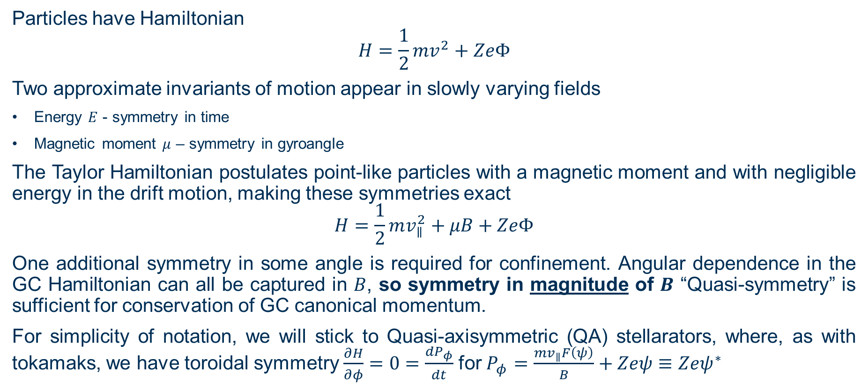
Guiding centre approximation
Particles have Hamiltonian
$$H=\frac{1}{2}mv^{2}+ZeΦ$$
Two approximate invariants of motion appear in slowly varying fields
Energy $E$ - symmetry in time
Magnetic moment $μ$ – symmetry in gyroangle
The Taylor Hamiltonian postulates point-like particles with a magnetic moment and with negligible energy in the drift motion, making these symmetries exact
$$H=\frac{1}{2}mv_{∥}^{2}+μB+ZeΦ$$
One additional symmetry in some angle is required for confinement. Angular dependence in the GC Hamiltonian can all be captured in $B$, so symmetry in magnitude of $B$ “Quasi-symmetry” is sufficient for conservation of GC canonical momentum.
For simplicity of notation, we will stick to Quasi-axisymmetric (QA) stellarators, where, as with tokamaks, we have toroidal symmetry $\frac{∂H}{∂φ}=0=\frac{{dP}_{φ}}{dt}$for $P_{φ}=\frac{mv_{∥}F\left(ψ\right)}{B}+Zeψ≡Zeψ^{∗}$

Slide 6
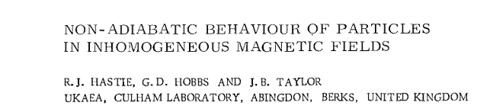
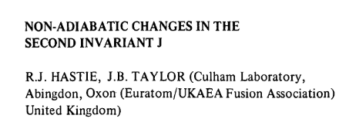
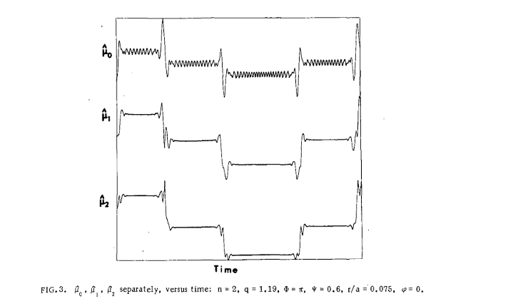
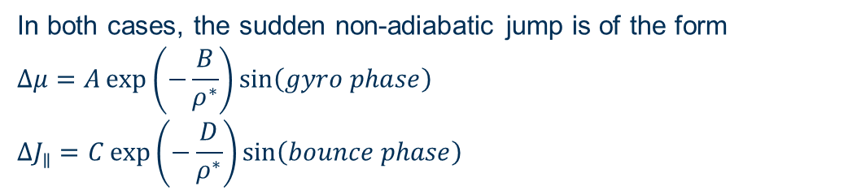
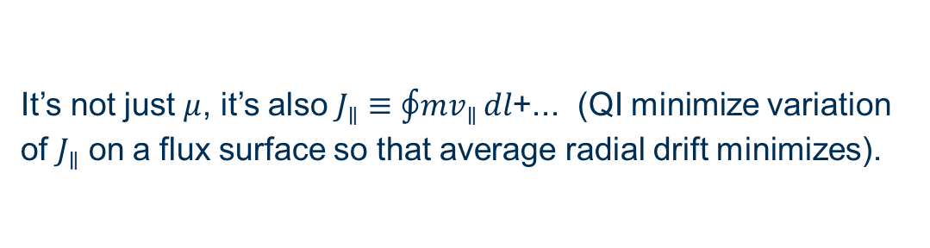
Particles are not guiding centres
‘constant to all orders – but not a constant’ – J.B. Taylor
It’s not just $μ$, it’s also $J_{∥}≡\oint{mv_{∥}}dl$+... (QI minimize variation of $J_{∥}$ on a flux surface so that average radial drift minimizes).
Hastie R J, Hobbs G D and Taylor J B in Third International Conference on Plasma Physics and Controlled Nuclear Fusion Research.1968
Hastie R J 1982 Nucl. Fusion 22 269–71
Adiabatic oscillations are from truncation of infinite series - “lack of algebra”
Non-adiabatic jumps are inescapable changes in the adiabatic invariant at all orders
In both cases, the sudden non-adiabatic jump is of the form
$$Δμ=A\exp\left(−\frac{B}{ρ^{∗}}\right)\sin\left(gyro phase\right)$$
$$ΔJ_{∥}=C\exp\left(−\frac{D}{ρ^{∗}}\right)\sin\left(bounce phase\right)$$
Exponential sensitivity to Larmor radius

Slide 7

Derivation capturing the difference between GC and FO
“matters of elegance ought to be left to the tailor and to the cobbler” — L. Boltzmann (via A. Einstein)
We deviate slightly from the elegant procedure of Littlejohn to see the ugly parts more clearly.
Full orbit equilibrium motion:
$$\begin{aligned}&L\left(x,v,\dot{x},\dot{v}\right)=\left[ZeA_{0}\left(x\right)+mv\right]⋅\dot{x}−\left[\frac{1}{2}mv^{2}+ZeΦ_{0}\left(x\right)\right]\end{aligned}$$
Coordinate shift $x=X+ρ$ to lowest order GC position (but not dropping any terms)
$$L\left(X,v_{∥},v_{⊥},ξ,\dot{X},\dot{ξ}\right)=\left[ZeA_{0}\left(X\right)+mv_{∥}\hat{b}\right]⋅\dot{X}+\frac{m}{Ze}μ\dot{ξ}−\left[\frac{1}{2}mv_{∥}^{2}+μB+ZeΦ_{0}\left(X\right)\right]+ΔL$$
(Littlejohn Lagrangian)
(Taylor Hamiltonian)
There are corrections to both the “symplectic” and Hamiltonian parts

Slide 8

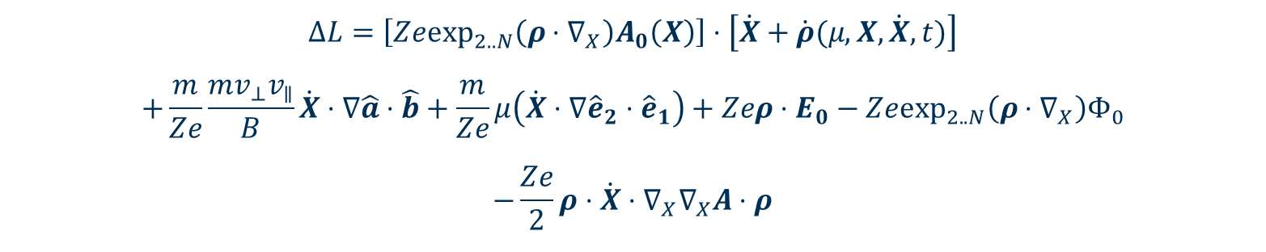
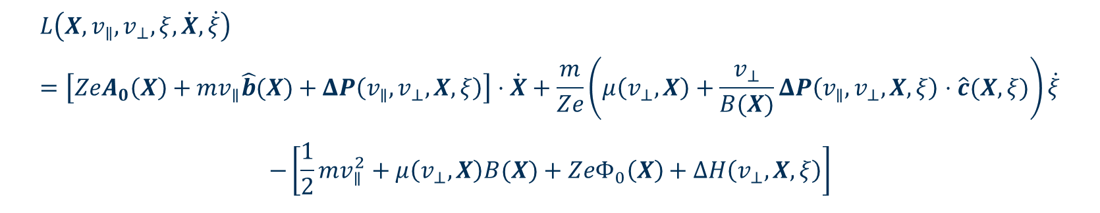
The higher order contribution to the action
All the higher order and FLR physics is contained in:
$$\left({\hat{e}}_{1},{\hat{e}}_{2},\hat{b}\right)$$
$$\hat{a}(X,ξ)=\cos{ξ}{\hat{e}}_{1}\left(X\right)−\sin{ξ}{\hat{e}}_{2}\left(X\right)$$
$$ΔL=\left[Ze\exp_{2..N}\left(ρ⋅∇_{X}\right)A_{0}\left(X\right)\right]⋅\left[\dot{X}+\dot{ρ}(μ,X,\dot{X},t)\right]$$
$$+\frac{m}{Ze}\frac{mv_{⊥}v_{∥}}{B}\dot{X}⋅∇\hat{a}⋅\hat{b}+\frac{m}{Ze}μ\left(\dot{X}⋅∇{\hat{e}}_{2}⋅{\hat{e}}_{1}\right)+Zeρ⋅E_{0}−Ze\exp_{2..N}\left(ρ⋅∇_{X}\right)Φ_{0}$$
$$−\frac{Ze}{2}ρ⋅\dot{X}⋅∇_{X}∇_{X}A⋅ρ$$
$$\frac{∂\hat{a}}{∂ξ}\left(X,ξ\right)=\hat{c}\left(X,ξ\right)$$
This can be split into symplectic (the perturbation in the momentum definition) and Hamiltonian pieces:
$$L\left(X,v_{∥},v_{⊥},ξ,\dot{X},\dot{ξ}\right)=\left[ZeA_{0}\left(X\right)+mv_{∥}\hat{b}(X)+ΔP\left(v_{∥},v_{⊥},X,ξ\right)\right]⋅\dot{X}+\frac{m}{Ze}\left(μ\left(v_{⊥},X\right)+\frac{v_{⊥}}{B(X)}ΔP\left(v_{∥},v_{⊥},X,ξ\right)⋅\hat{c}(X,ξ)\right)\dot{ξ}$$
$$−\left[\frac{1}{2}mv_{∥}^{2}+μ\left(v_{⊥},X\right)B(X)+ZeΦ_{0}\left(X\right)+ΔH\left(v_{⊥},X,ξ\right)\right]$$

Slide 9
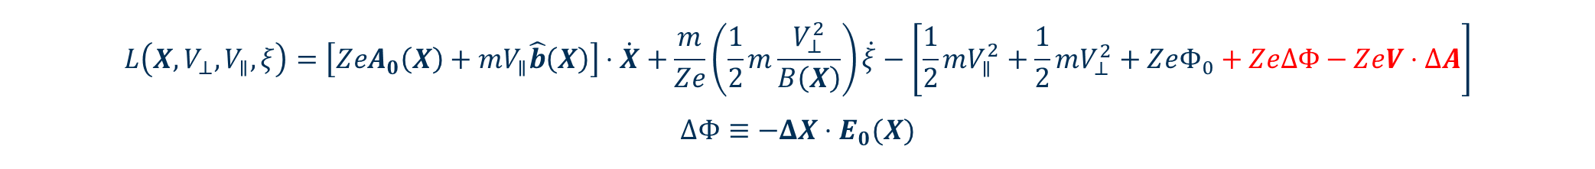

Full orbit effects can be made to look like a fictional magnetic perturbation to the GC motion
Rewrite the symplectic piece as an imaginary vector potential
$$ΔA=\frac{1}{2}{\left(ρ⋅∇_{X}\right)}^{2}A_{0}\left(X\right)+\frac{m^{2}}{Z^{2}e^{2}}\frac{v_{⊥}v_{∥}}{B}∇\hat{a}⋅\hat{b}+\frac{m}{Z^{2}e^{2}}μ∇{\hat{e}}_{2}⋅{\hat{e}}_{1}−\frac{1}{2}ρ^{i}∇∇_{i}A⋅ρ+O({ρ^{∗}}^{3}A_{0})$$
Then, exactly as with a real perturbation $δA$ (ripple etc) a small shift in coordinates gets rid of the symplectic piece. The trick is to make the shift
$$v_{∥}=V_{∥}−\hat{b}⋅\frac{ZeΔA}{m} , v_{⊥}=V_{⊥}−\hat{c}⋅\frac{ZeΔA}{m}$$
$$ΔX=−\frac{ΔA×\hat{b}}{B}$$
Then one discovers a perturbing Hamiltonian for FLR effects
$$L\left(X,V_{⊥},V_{∥},ξ\right)=\left[ZeA_{0}\left(X\right)+mV_{∥}\hat{b}\left(X\right)\right]⋅\dot{X}+\frac{m}{Ze}\left(\frac{1}{2}m\frac{V_{⊥}^{2}}{B\left(X\right)}\right)\dot{ξ}−\left[\frac{1}{2}mV_{∥}^{2}+\frac{1}{2}mV_{⊥}^{2}+ZeΦ_{0}+ZeΔΦ−ZeV⋅ΔA\right]$$
$$ΔΦ≡−ΔX⋅E_{0}(X)$$
This captures the perturbation to the lowest order guiding centre motion as a fictional ripple

Slide 10
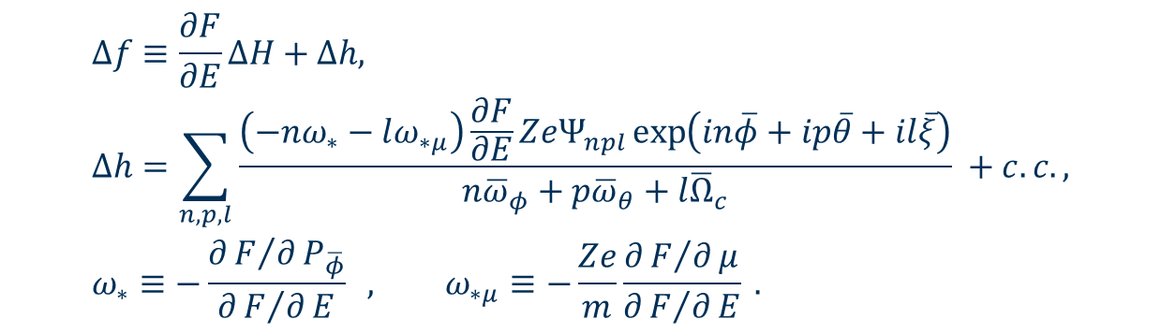
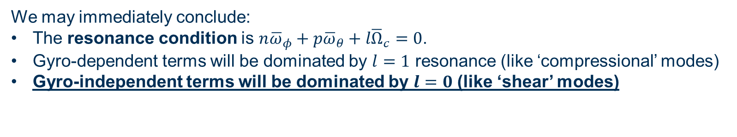
Analysing transport using the usual tools for perturbing fields
For example, linear Vlasov theory gives immediately
$$\begin{aligned}&Δf≡\frac{∂F}{∂E}ΔH+Δh, \\ &Δh=\sum_{n,p,l}{\frac{\left(−nω_{∗}−lω_{∗μ}\right)\frac{∂F}{∂E}ZeΨ_{npl}\exp\left(in\overline{φ}+ip\overline{θ}+il\overline{ξ}\right)}{n{\overline{ω}}_{φ}+p{\overline{ω}}_{θ}+l{\overline{Ω}}_{c}}} +c.c., \\ &ω_{∗}≡−\frac{∂F/∂P_{\overline{φ}}}{∂F/∂E} , ω_{∗μ}≡−\frac{Ze}{m}\frac{∂F/∂μ}{∂F/∂E} .\#\end{aligned}$$
$$Ψ_{npl}≡\frac{1}{2π}\int_{0}^{2π}{\frac{1}{2π}\int_{0}^{2π}{\frac{1}{2π}\int_{0}^{2π}{\left[ΔΦ−V_{∥}ΔA_{∥}−V_{⊥}{\hat{c}}_{0}⋅ΔA_{⊥}\right]\exp\left(−n\overline{φ}−ip\overline{θ}−il\overline{ξ}\right)}}d\overline{ξ}d\overline{θ}}d\overline{φ}$$
We may immediately conclude:
The resonance condition is $n{\overline{ω}}_{φ}+p{\overline{ω}}_{θ}+l{\overline{Ω}}_{c}=0$.
Gyro-dependent terms will be dominated by $l=1$ resonance (like ‘compressional’ modes)
Gyro-independent terms will be dominated by $l=0$ (like ‘shear’ modes)

Slide 11
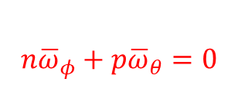
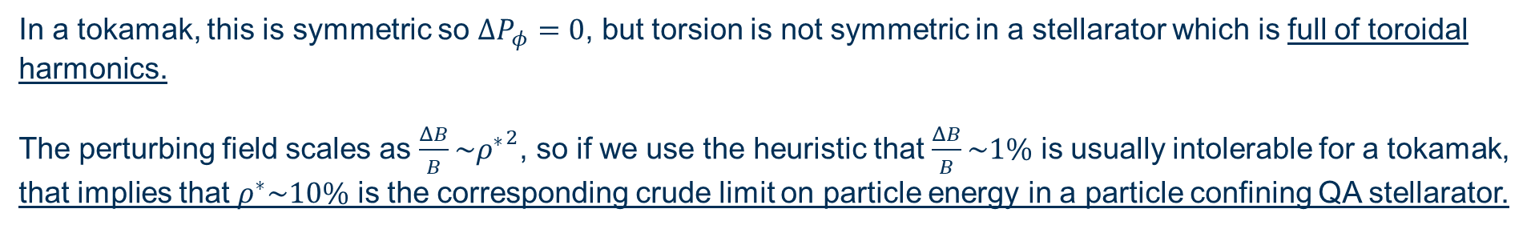
The torsional part of the perturbation
$$n{\overline{ω}}_{φ}+p{\overline{ω}}_{θ}=0$$
$$ΔA=\frac{1}{2}{\left(ρ⋅∇_{X}\right)}^{2}A_{0}\left(X\right)+\frac{m^{2}}{Z^{2}e^{2}}\frac{v_{⊥}v_{∥}}{B}∇\hat{a}⋅\hat{b}+\frac{m}{Z^{2}e^{2}}μ∇{\hat{e}}_{2}⋅{\hat{e}}_{1}−\frac{Ze}{2}ρ^{i}∇∇_{i}A⋅ρ+O({ρ^{∗}}^{3}A_{0})$$
Drift orbits will experience a perturbation which is due to the torsion of the magnetic field
$$ΔH_{l=0}=ZeV_{∥}\frac{m}{Z^{2}e^{2}}μ\hat{b}⋅∇{\hat{e}}_{2}⋅{\hat{e}}_{1}$$
$\frac{dP_{φ}}{dt}=$ $\frac{∂ΔH_{l=0}}{∂φ}$
In a tokamak, this is symmetric so $ΔP_{φ}=0$, but torsion is not symmetric in a stellarator which is full of toroidal harmonics.
The perturbing field scales as $\frac{ΔB}{B}\sim {ρ^{∗}}^{2}$, so if we use the heuristic that $\frac{ΔB}{B}\sim 1\%$ is usually intolerable for a tokamak, that implies that $ρ^{∗}\sim 10\%$ is the corresponding crude limit on particle energy in a particle confining QA stellarator.

Slide 12
orbit calculations using HALO

Slide 13
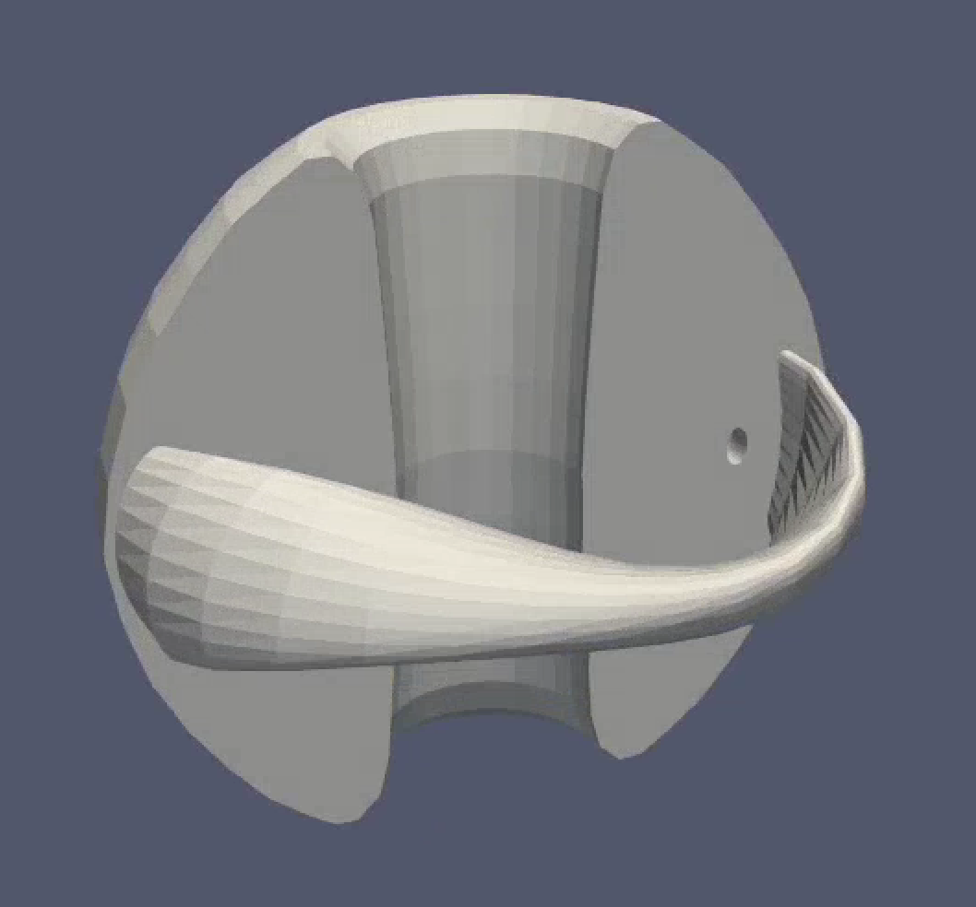
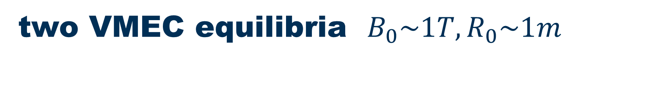
two VMEC equilibria $B_{0}\sim 1T, R_{0}\sim 1m$
Full Fourier VMEC representation of fields and their derivatives (slow!). NOT 3D splines to maintain maximum correspondence to VMEC solution.
(1) MAST
(2) ‘Precise QA’ from (Landreman and Paul 2022)
MAST: n=0
QA: n= [-24, -22, …, 22, 24]
(overplotted for comparison)
Full-orbit and GC trackers both integrating in cylindrical coordinates

Slide 14
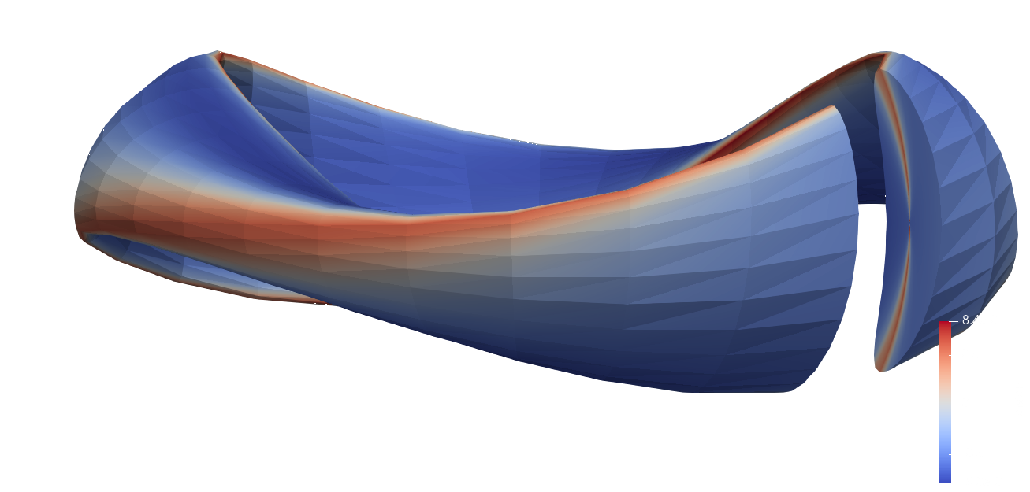


Visualising the torsion $\hat{b}⋅∇{\hat{e}}_{2}⋅{\hat{e}}_{1}$
$$ΔH_{l=0}=ZeV_{∥}\frac{m}{Z^{2}e^{2}}μ\hat{b}⋅∇{\hat{e}}_{2}⋅{\hat{e}}_{1}$$
Torsion is order unity in this example

Slide 15
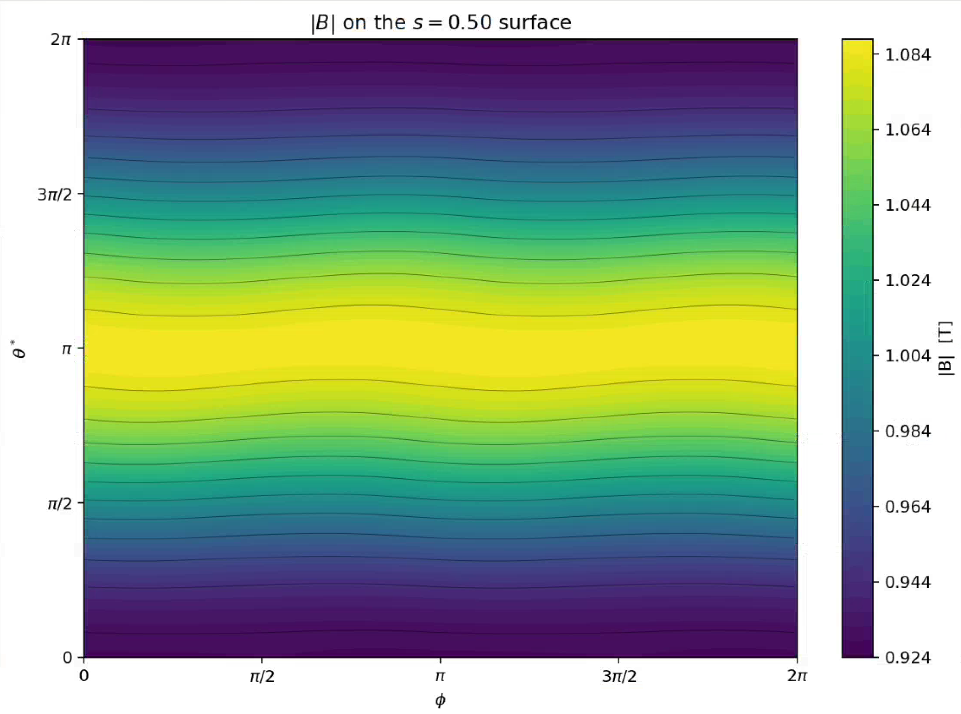
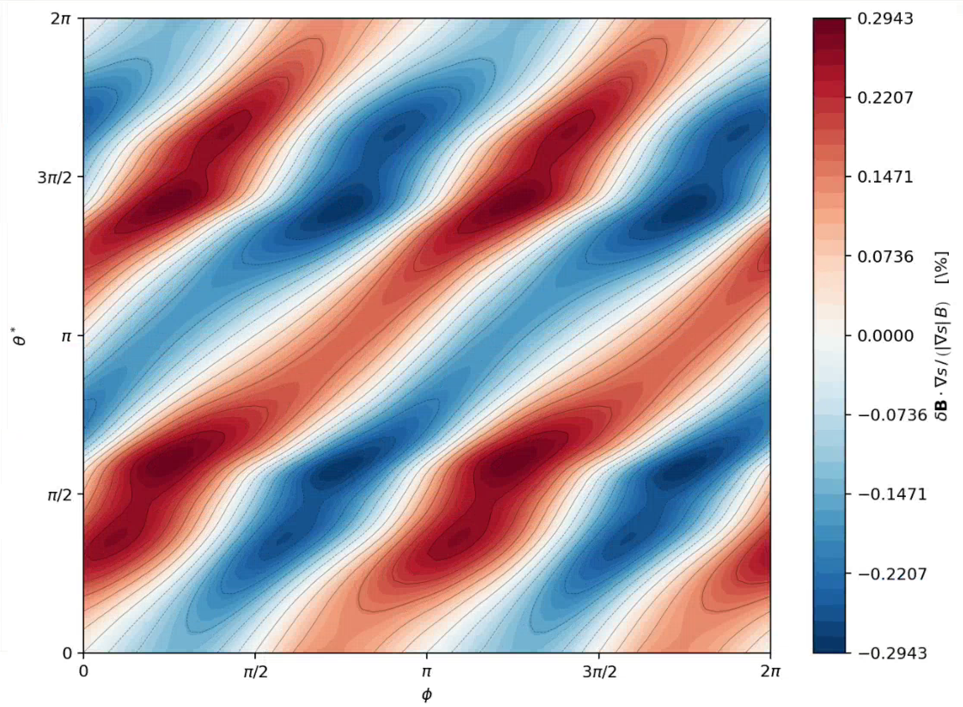

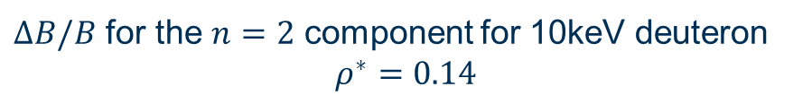
Visualising $ΔB$
Equilibrium field in PEST coordinates
$ΔB/B$ for the $n=2$ component for 10keV deuteron
$$ρ^{∗}=0.14$$
the hidden ripples in hidden symmetry

Slide 16
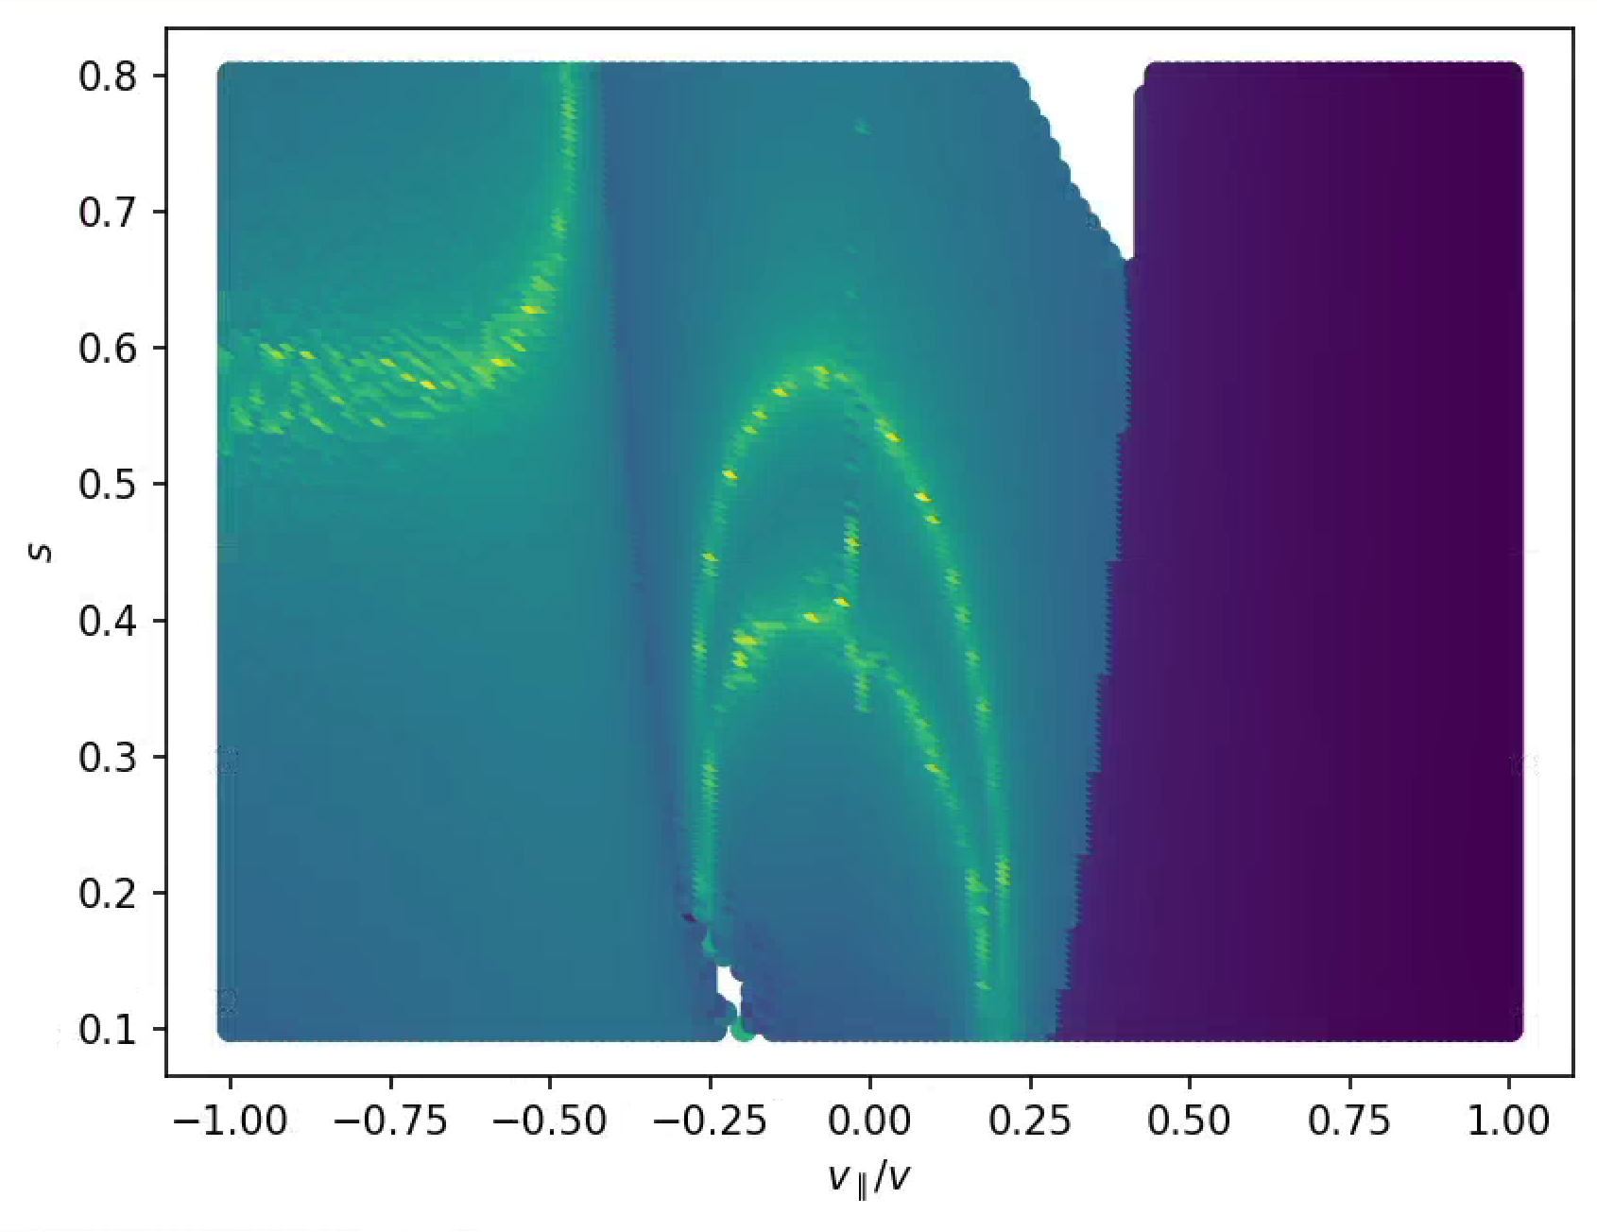

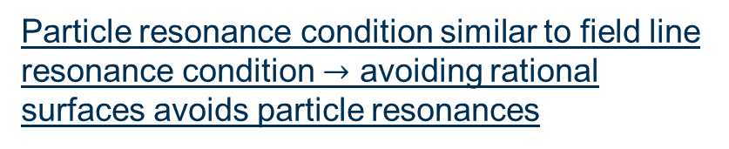
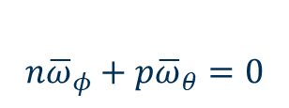
0.1keV resonance condition (QA)
$$n{\overline{ω}}_{φ}+p{\overline{ω}}_{θ}=0$$
$$ρ^{∗}=0.014$$
Low order resonances are avoided because particle resonances closely resemble field line resonances.
First resonances available are n=4 and n=5
Particle resonance condition similar to field line resonance condition $→$ avoiding rational surfaces avoids particle resonances

Slide 17
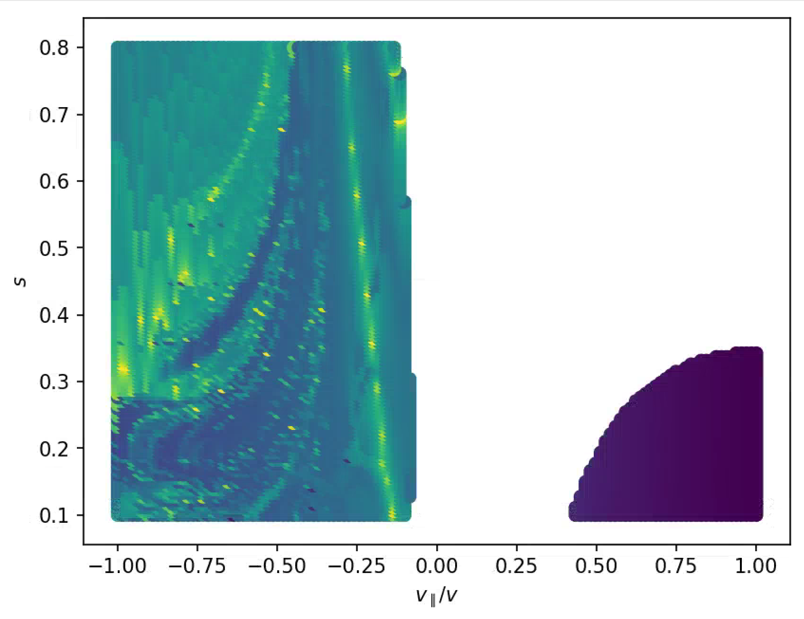

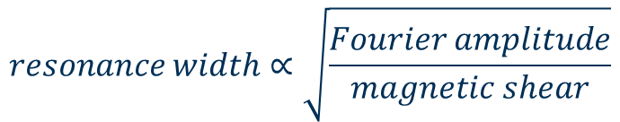
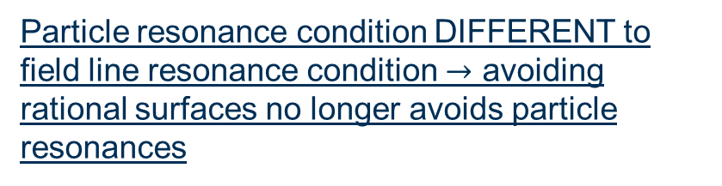
10 keV resonance condition GC tracker
$$ρ^{∗}=0.14$$
Low order resonances are now available! n=1 and n=2 resonances appear in the passing particles
Particle resonance condition DIFFERENT to field line resonance condition $→$ avoiding rational surfaces no longer avoids particle resonances
Low magnetic shear means broad resonance
$$resonance width∝\sqrt{\frac{Fourier amplitude}{magnetic shear}}$$

Slide 18
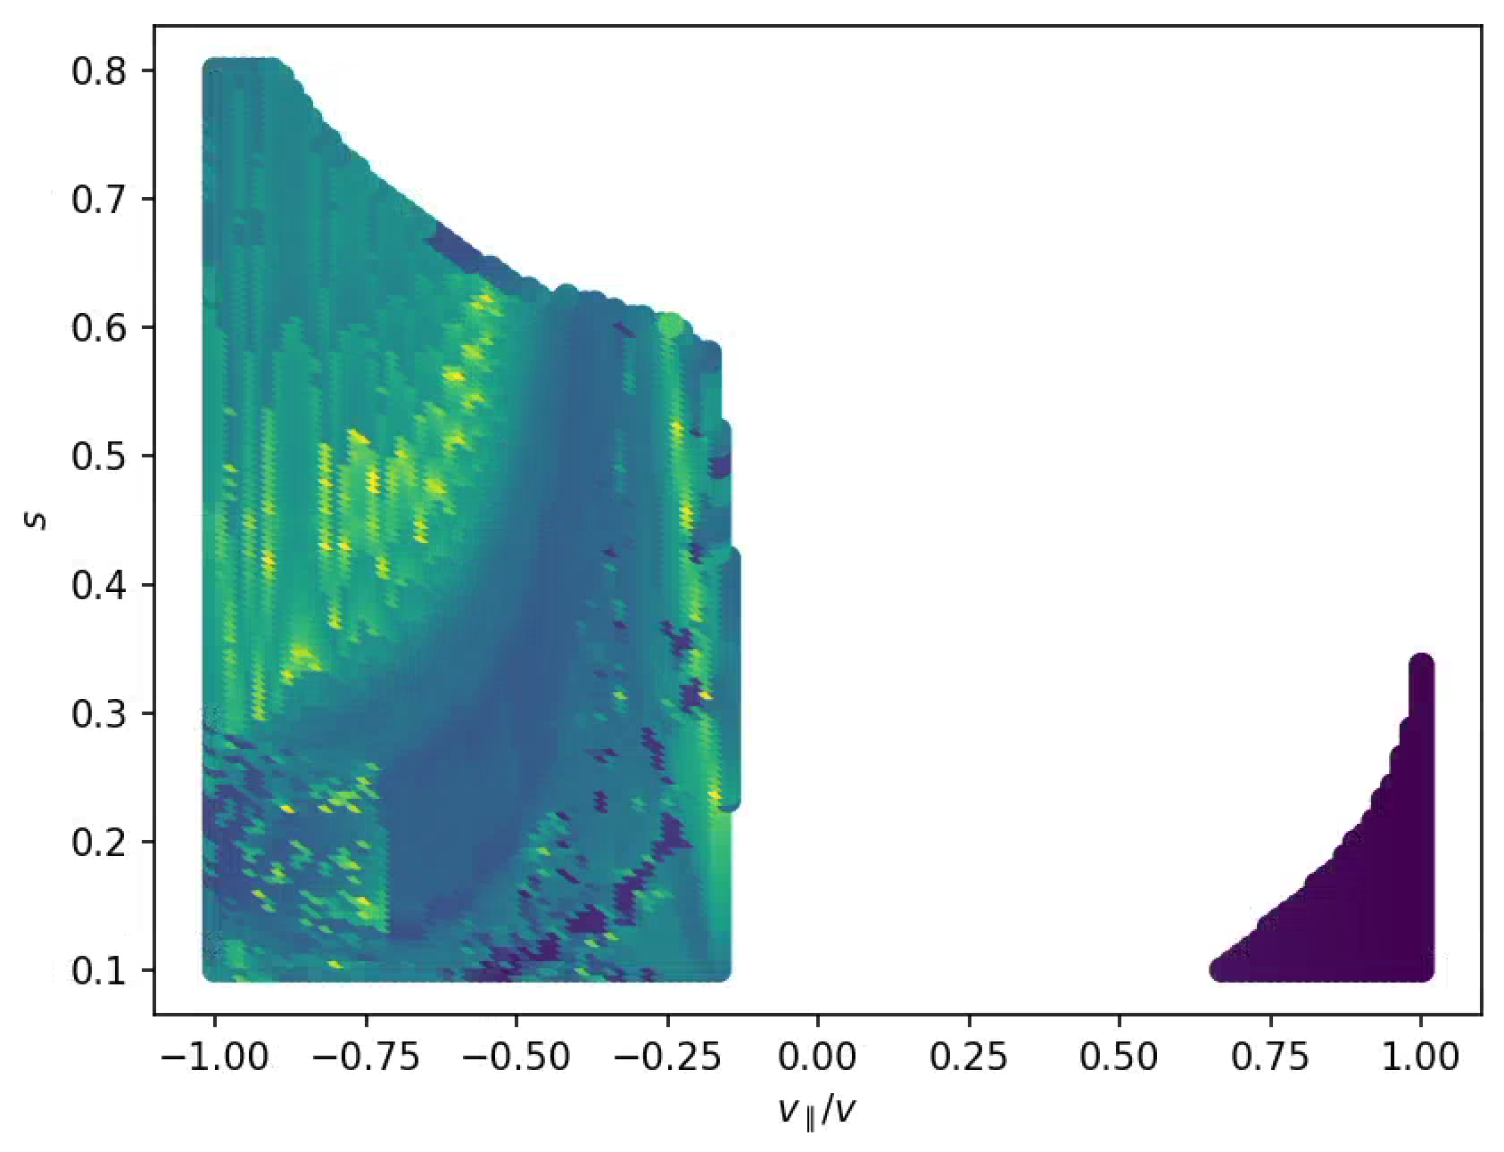
10 keV resonance condition Full-Orbit tracker
$$ρ^{∗}=0.14$$
Full-orbit effects push the low order n=2 into more passing pitches.
The very low shear in this QA case makes the resonances very difficult to pin down since the resonance width goes as the inverse of shear.
In low magnetic shear, even full-orbit effects shift the resonance

Slide 19
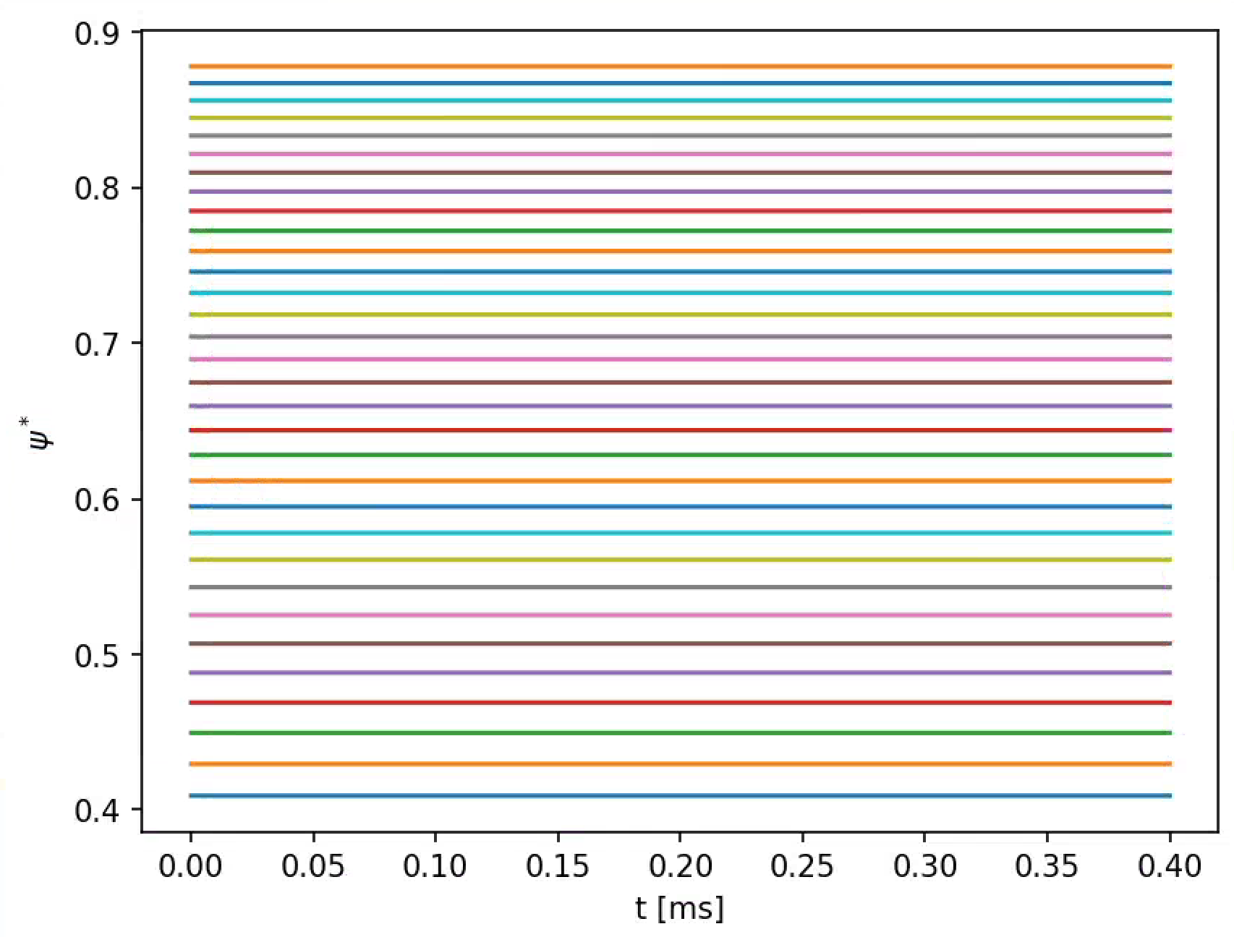
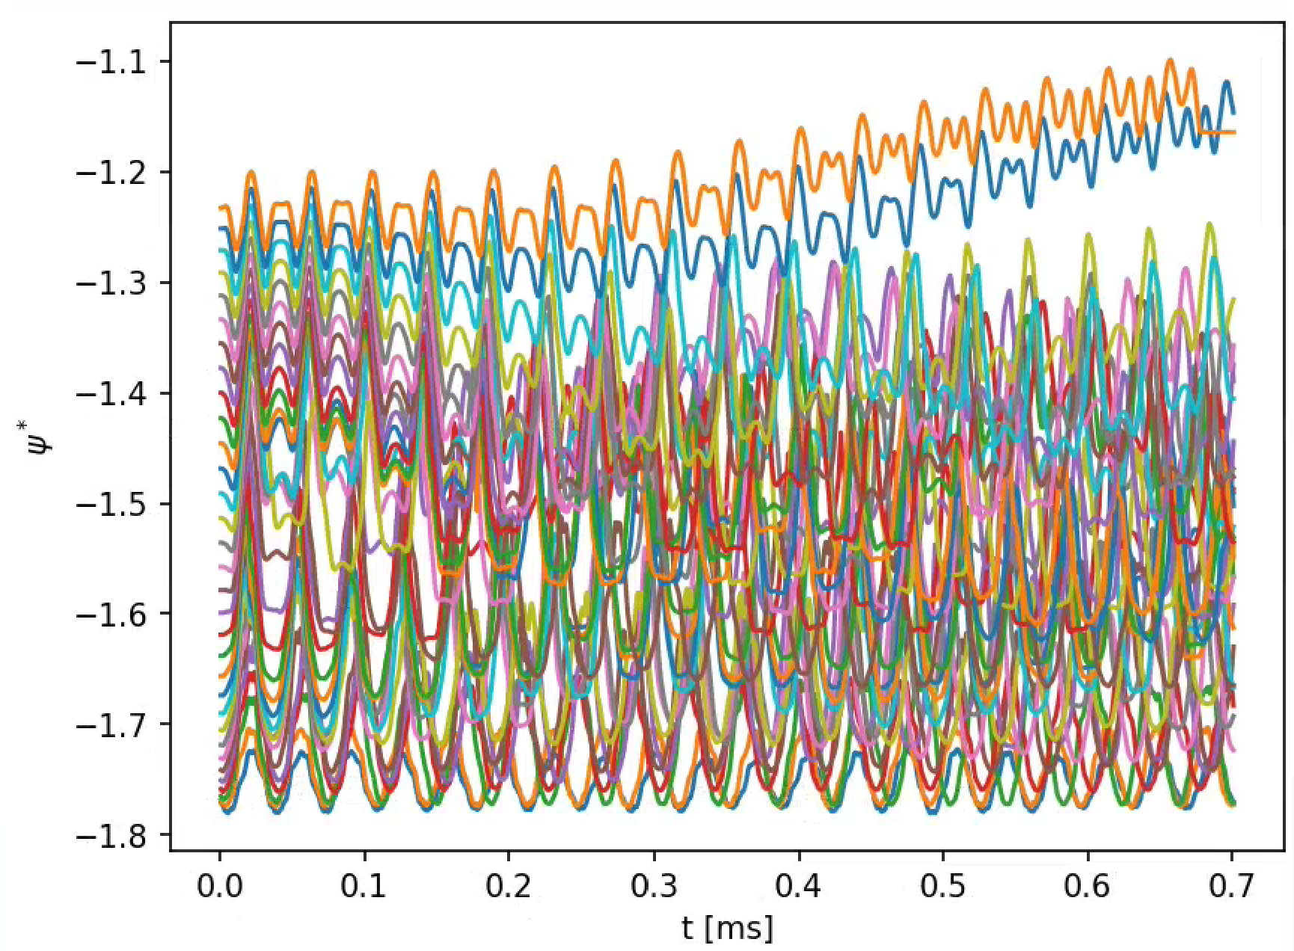
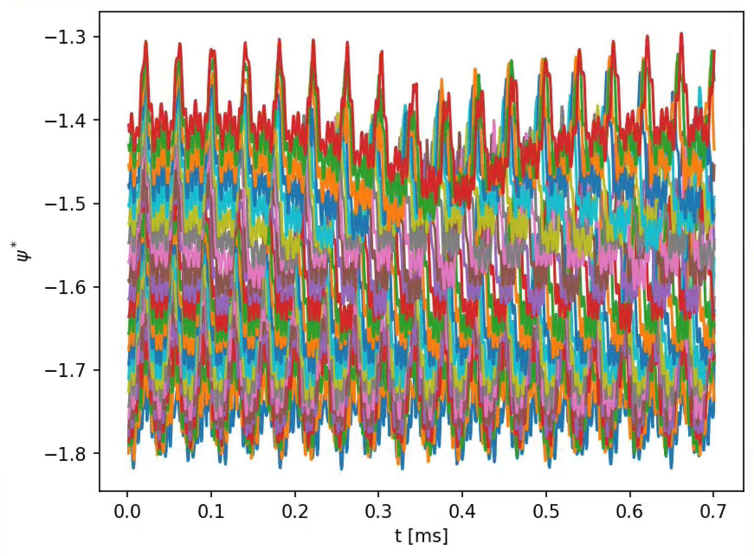
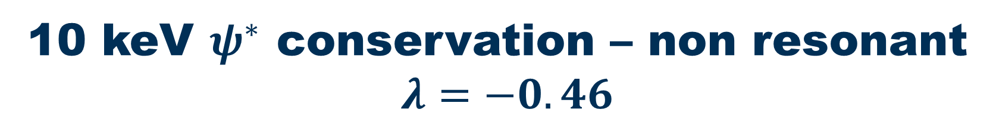
10 keV $ψ^{∗}$ conservation – non resonant
$$λ=−0.46$$
MAST Full-orbit
QA GC
QA Full-orbit
The difference in integrability is apparent to the naked eye. Perhaps these QA orbits remain confined?

Slide 20
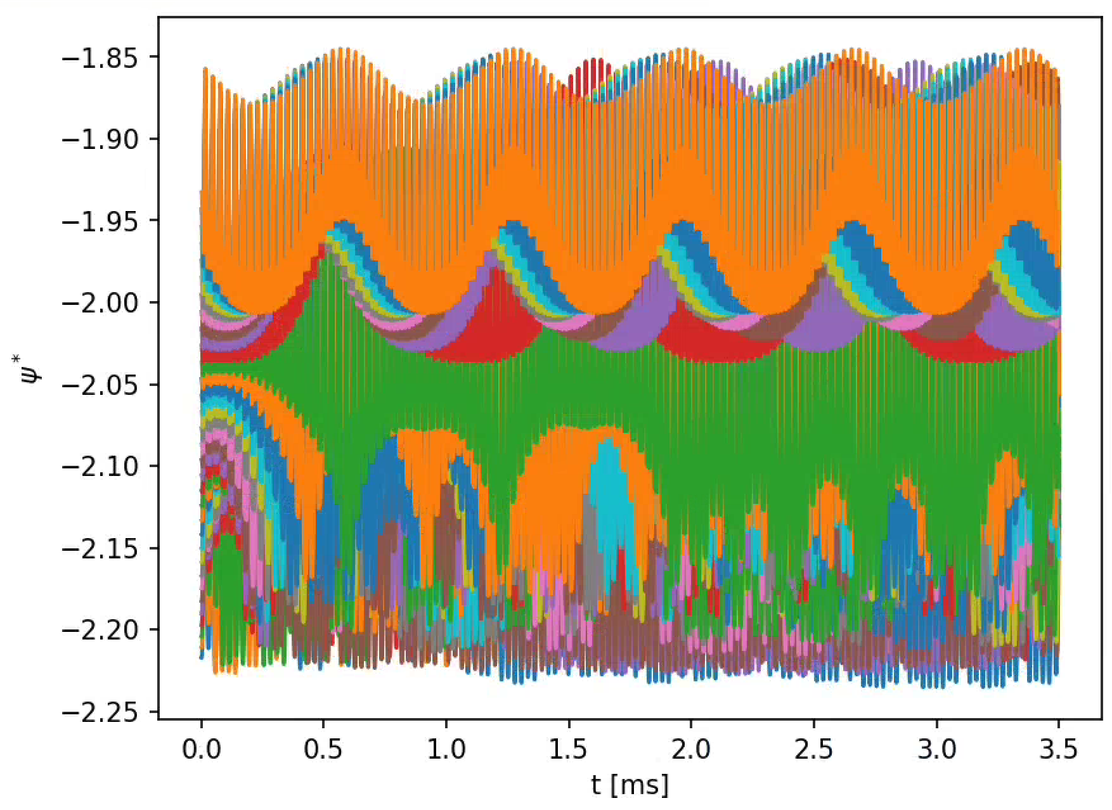
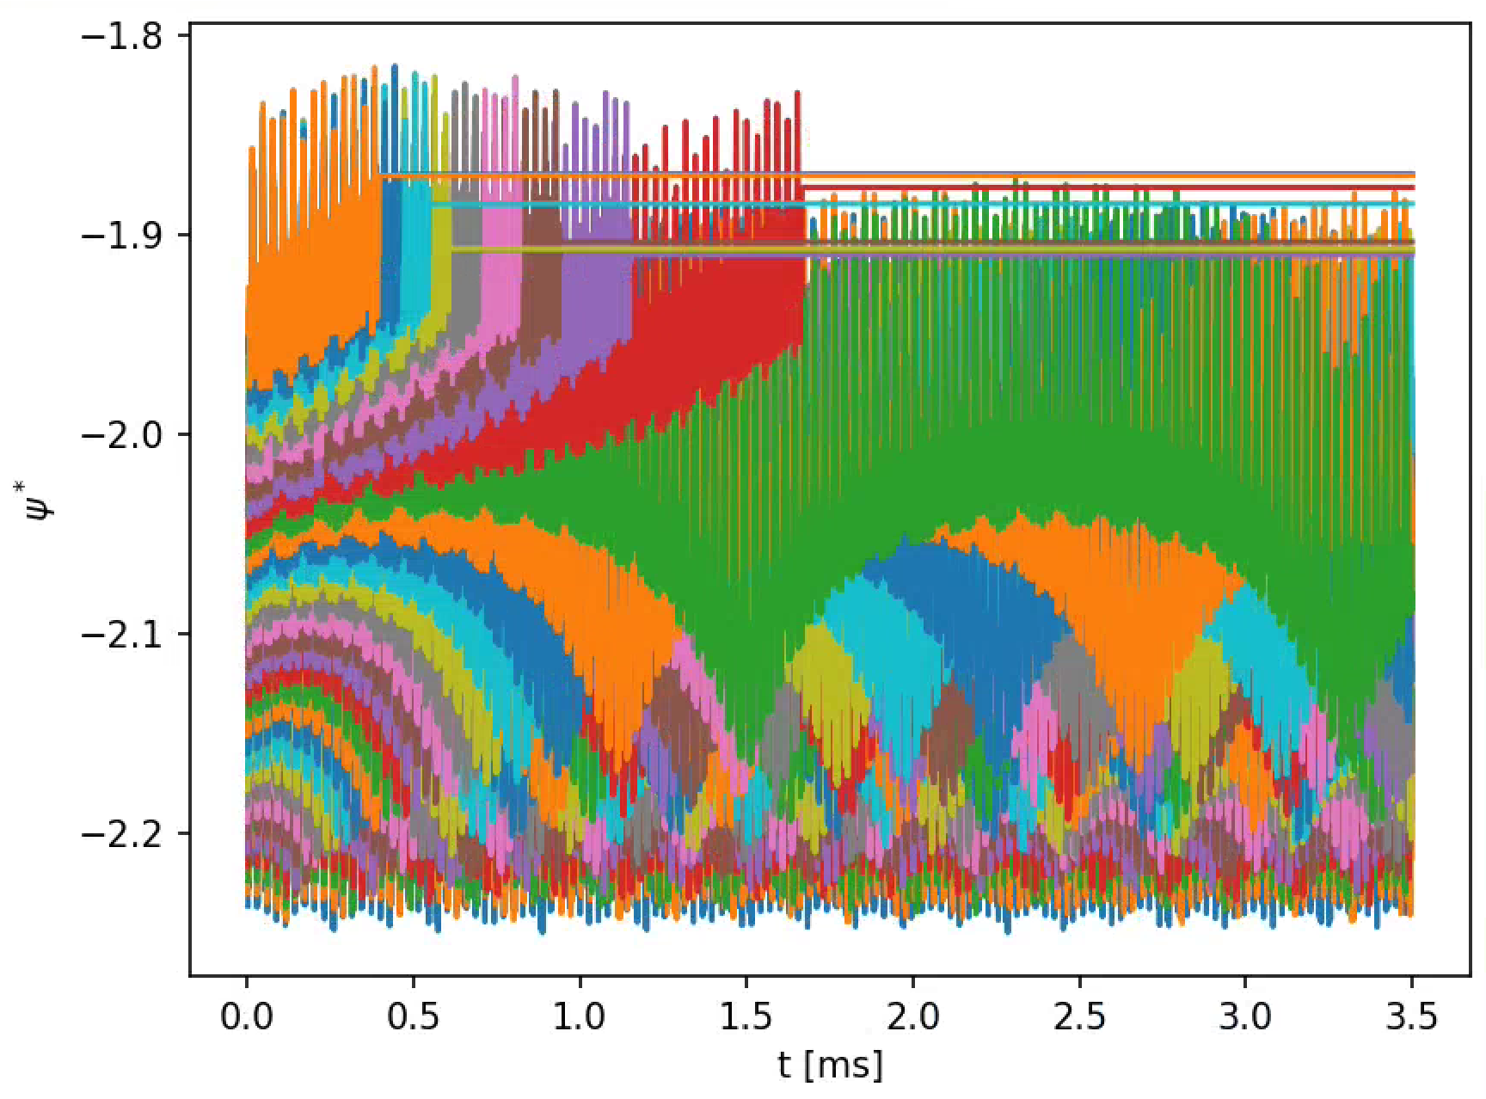
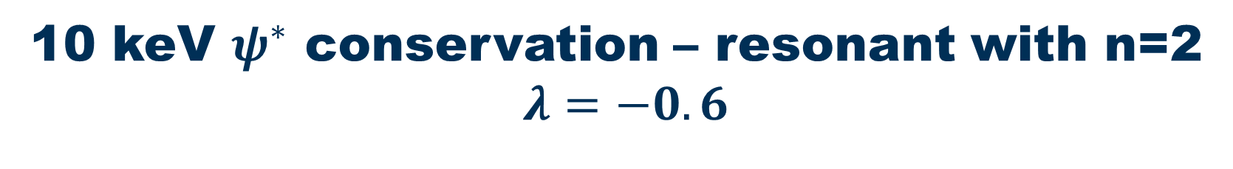
10 keV $ψ^{∗}$ conservation – resonant with n=2
$$λ=−0.6$$
GC
Full-orbit
Resonant particles experience secular drift when full-orbit tracking is enabled. The full-orbit effects accumulate and eventually deconfine the particles.

Slide 21
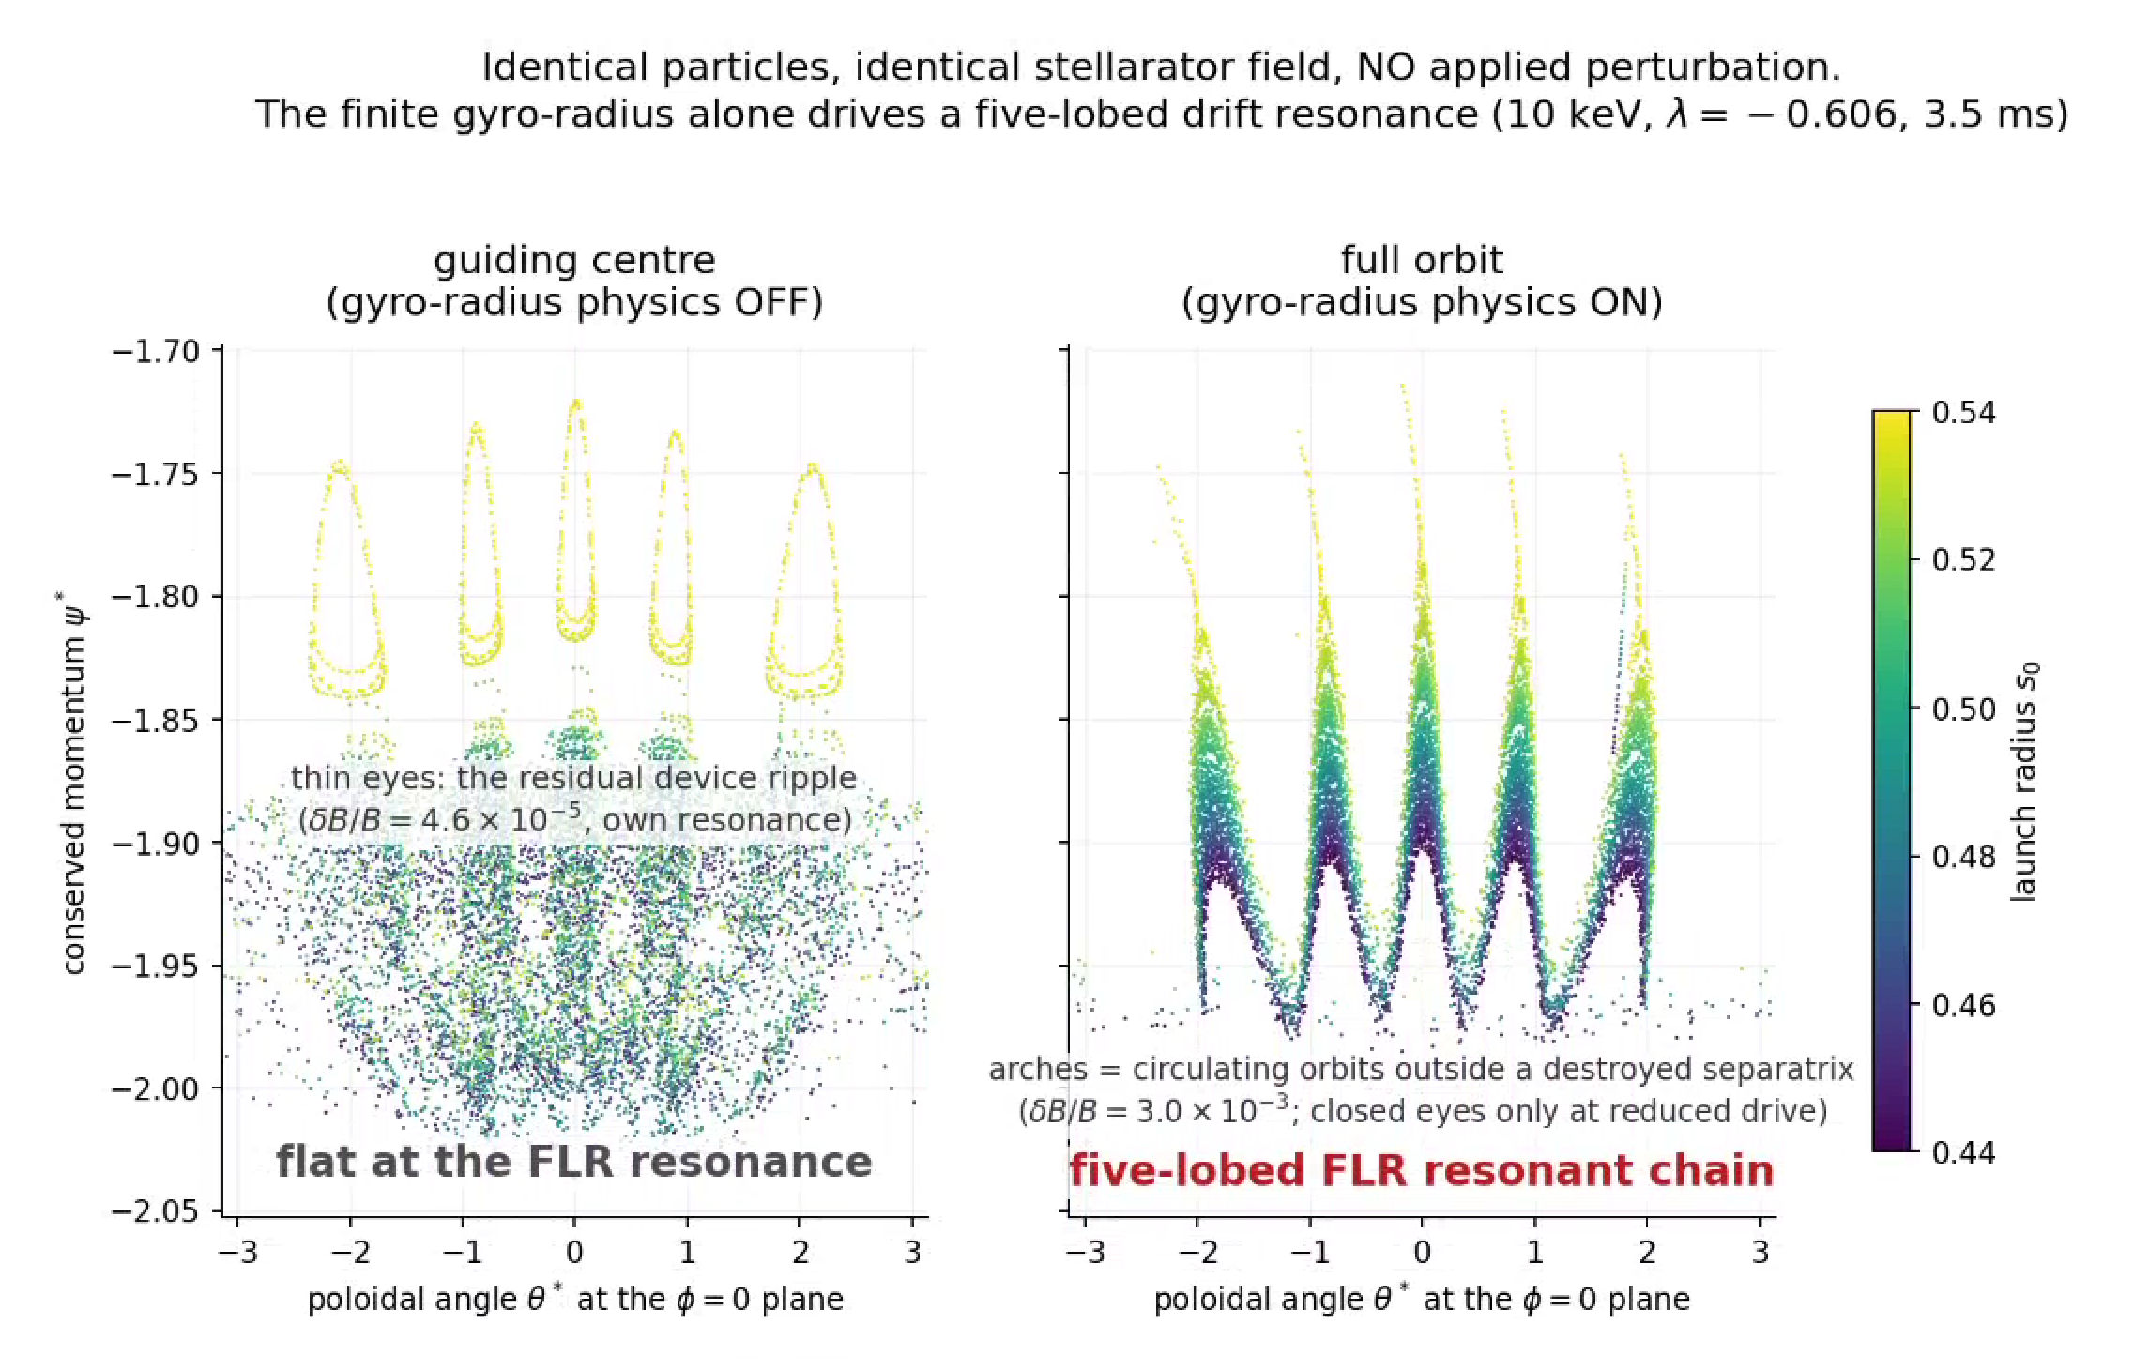
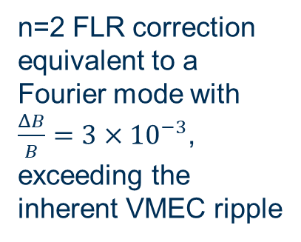
Ripple islands and FLR islands (Full orbit)
n=2 FLR correction equivalent to a Fourier mode with $\frac{ΔB}{B}=3×{10}^{−3}$, exceeding the inherent VMEC ripple

Slide 22
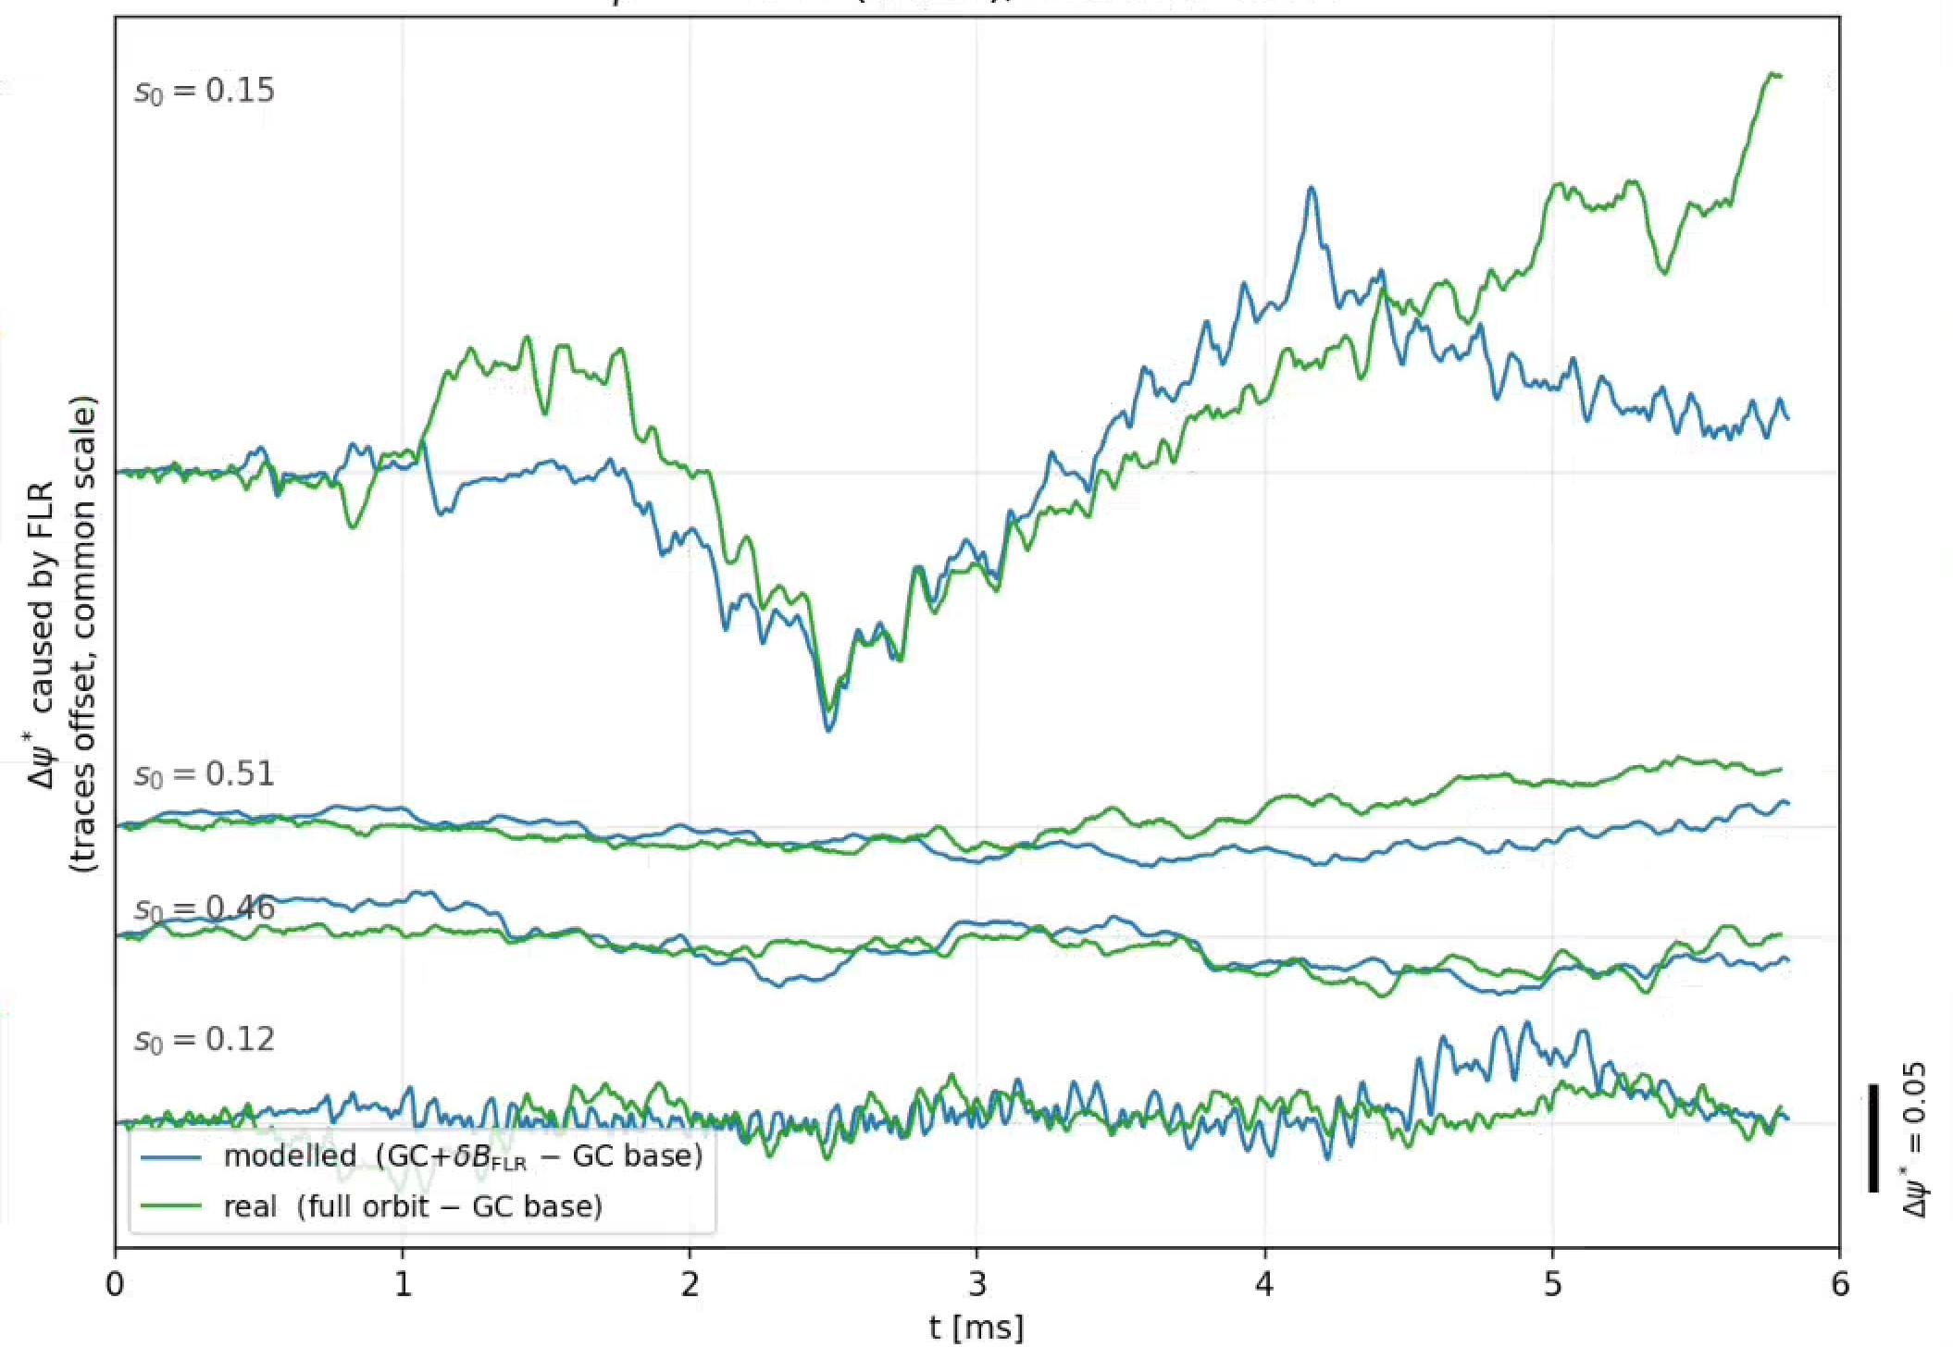
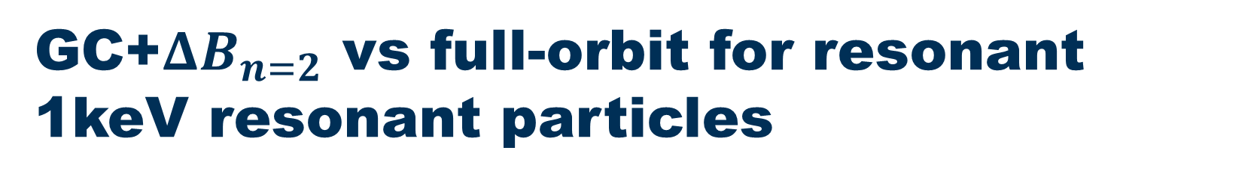
GC+$ΔB_{n=2}$ vs full-orbit for resonant 1keV resonant particles

Slide 23
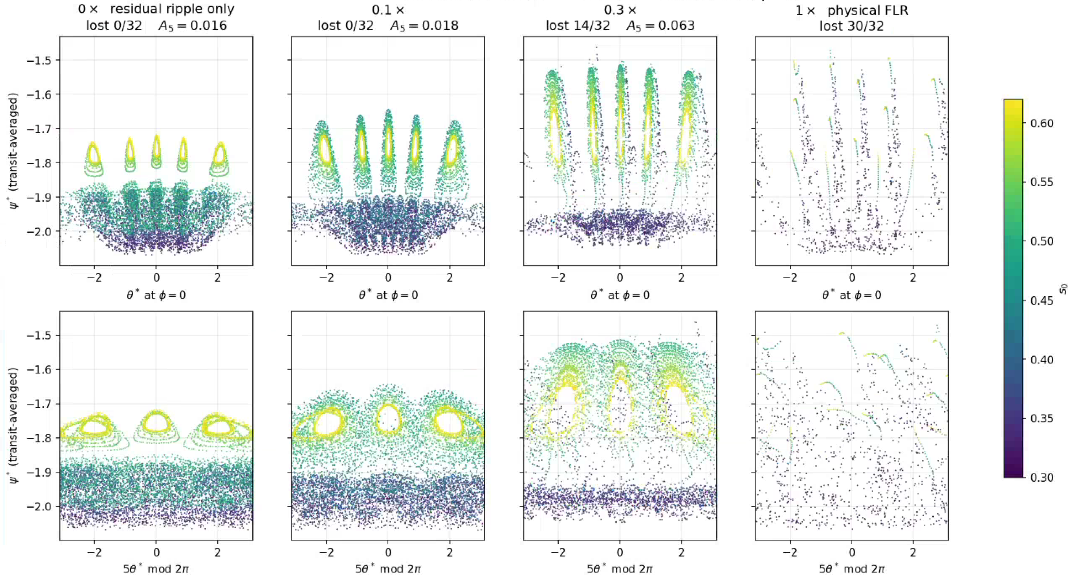

FLR ripple vs ordinary ripple ($Δ$B model)

Slide 24
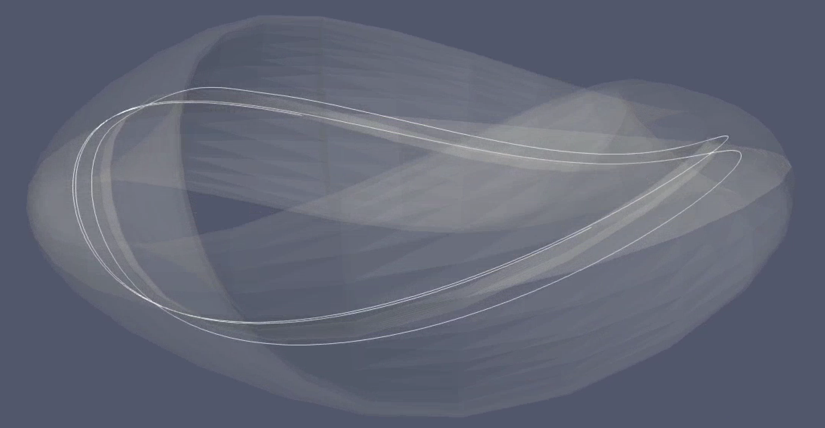
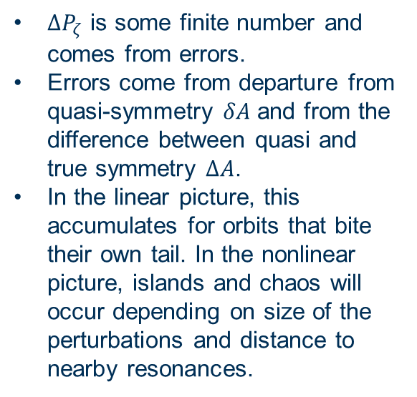
Simple picture of resonant drift orbit physics
n=2 p=1 resonance
$ΔP_{ζ}$ is some finite number and comes from errors.
Errors come from departure from quasi-symmetry $δA$ and from the difference between quasi and true symmetry $ΔA$.
In the linear picture, this accumulates for orbits that bite their own tail. In the nonlinear picture, islands and chaos will occur depending on size of the perturbations and distance to nearby resonances.

Slide 25
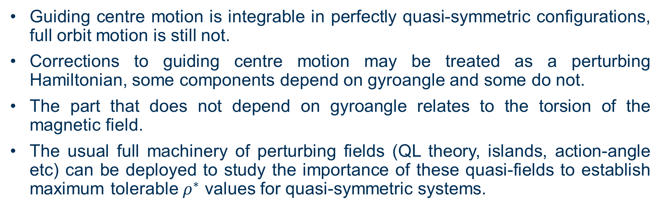
Conclusion
Guiding centre motion is integrable in perfectly quasi-symmetric configurations, full orbit motion is still not.
Corrections to guiding centre motion may be treated as a perturbing Hamiltonian, some components depend on gyroangle and some do not.
The part that does not depend on gyroangle relates to the torsion of the magnetic field.
The usual full machinery of perturbing fields (QL theory, islands, action-angle etc) can be deployed to study the importance of these quasi-fields to establish maximum tolerable $ρ^{∗}$ values for quasi-symmetric systems.

