Slide 1


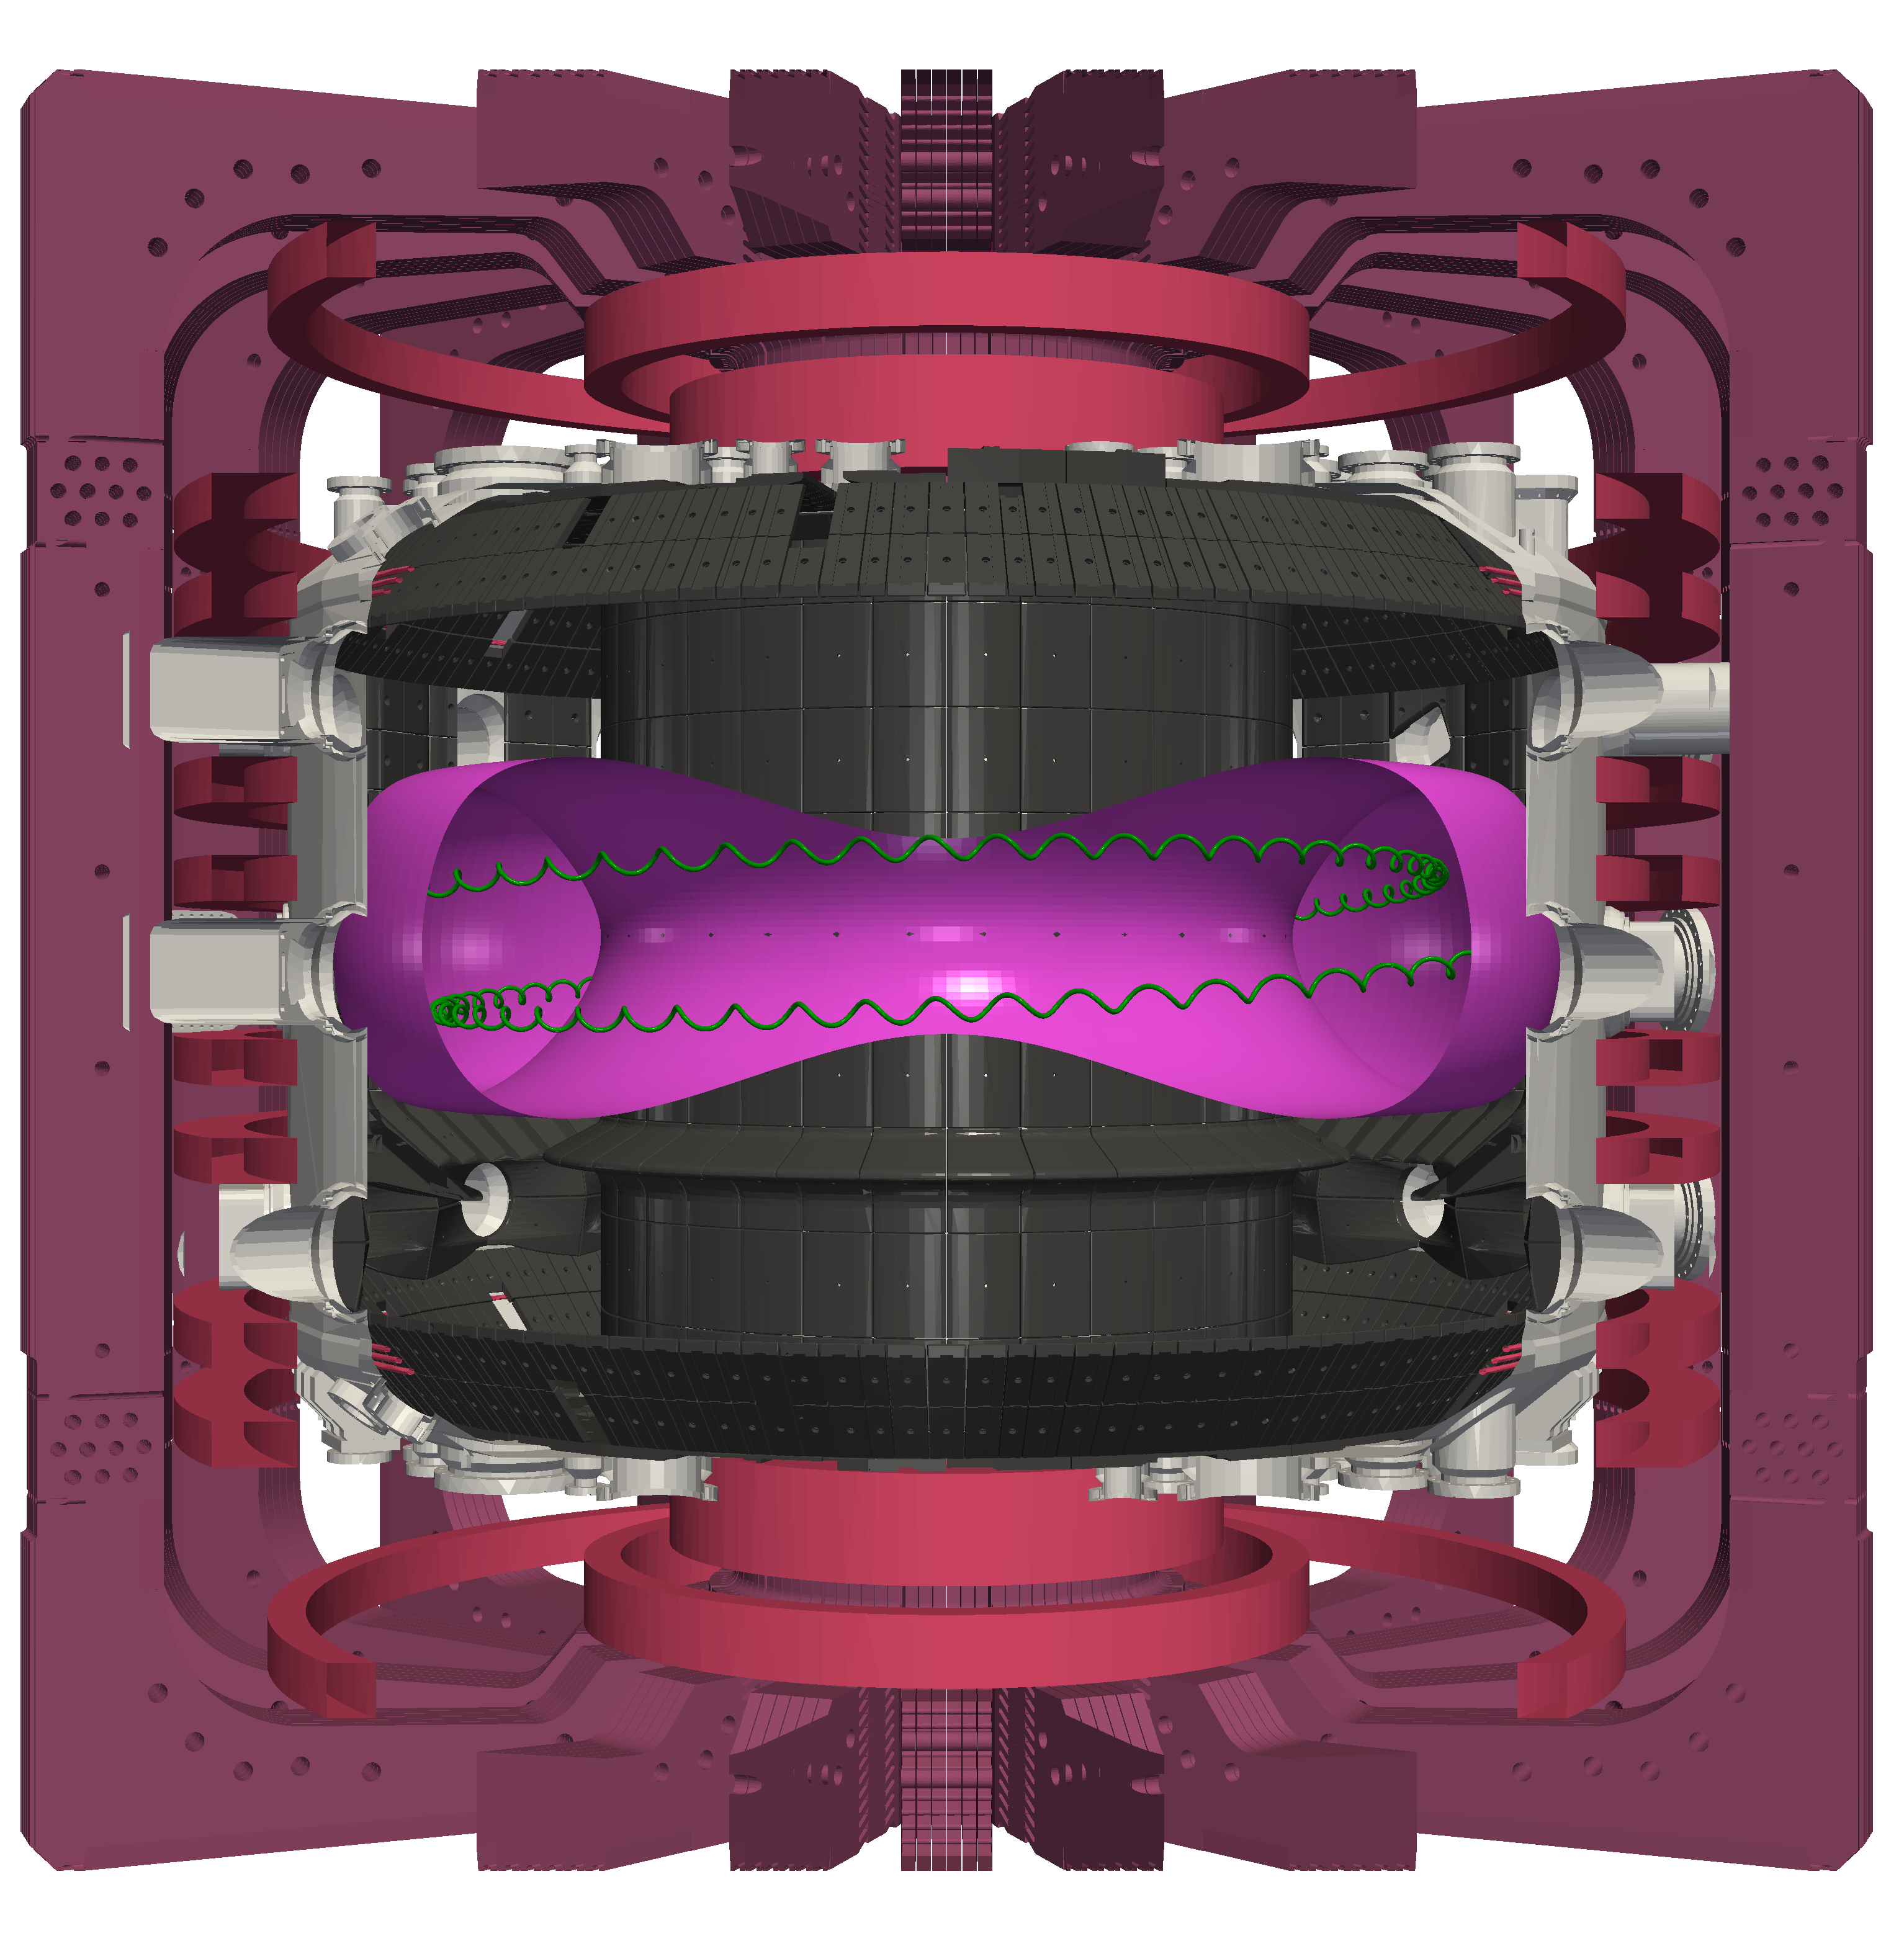

Overview of energetic particle physics studies on TCV
Anton Jansen van Vuuren, M. Podestà, A. N. Karpushov, M. Rud, Q. Kernel, A. Fasoli, D. Mykytchuk J. Poley-Sanjuán, B. P. Duval, J. Decker, B. Rofman, M. Dreval, S. Sharapov, and the EUROfusion Tokamak Exploitation* and the TCV** teams
* See author list of N. Vianello et al 2026 Nucl. Fusion 66 116010
** See author list of C. Theiler et al 2026 Nucl. Fusion 66 116007
This work has been carried out within the framework of the EUROfusion Consortium, funded by the European Union via the Euratom Research and Training Programme (Grant Agreement No 101052200 — EUROfusion). Views and opinions expressed are however those of the author(s) only and do not necessarily reflect those of the European Union or the European Commission. Neither the European Union nor the European Commission can be held responsible for them.

Slide 2
Outline
    TCV as a fast-ion testbed
        Heating and fast-ion sources
        Fast-ion diagnostics
    TCV Modelling and analysis workflow
    Recent energetic-particle studies on TCV
      Negative vs positive triangularity confinement
      Alfvén eigenmode control
      Fishbone redistribution of fast-ions
      Runaway-electron and high-frequency waves
    Conclusions and outlook

Slide 3
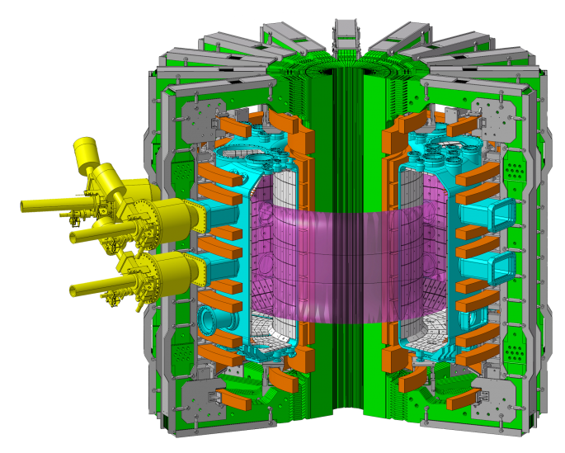
The Tokamak à Configuration Variable (TCV)
Major and minor radii | 0.88 / 0.25 m
First wall material | Carbon (graphite)
Max magnetic field | 1.54 T
Max plasma current | 1.0 MA
Max elongation | 2.8
Triangularity | -0.6 / +0.9
Pulse duration | 2 s (4 s)
ECH power | 2.4 MW – X2 +1.9 MW – X3
NBI power | 2.5 MW
Main species | D, H, He
See C. Theiler et al 2026 Nucl. Fusion 66 116007

Slide 4
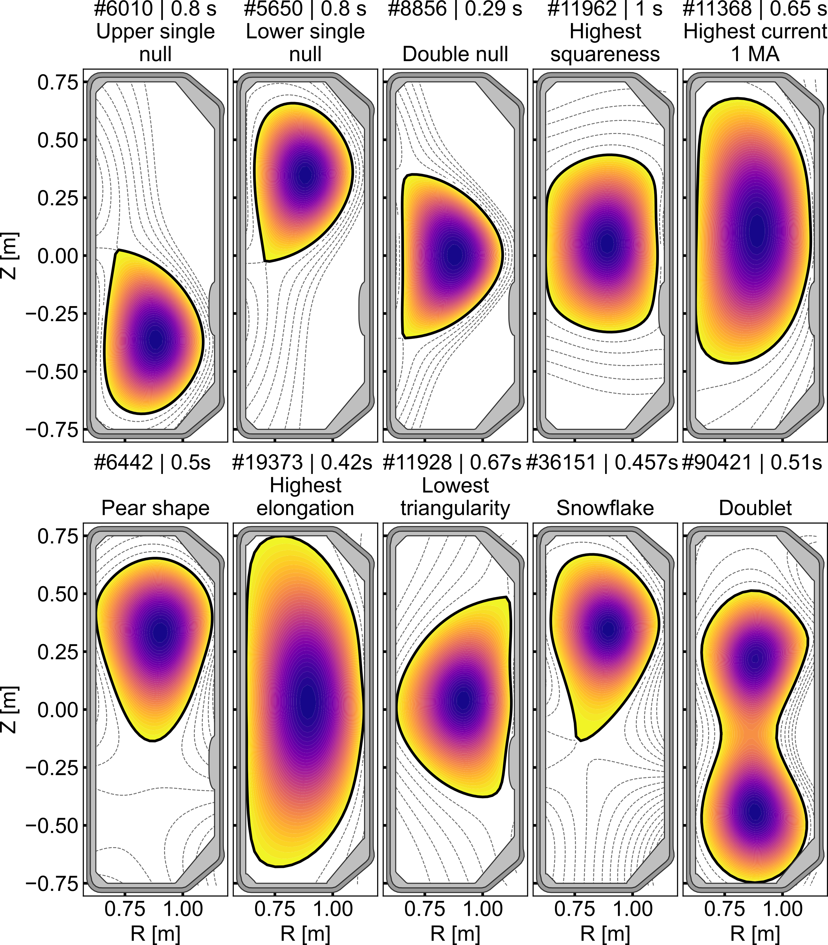
TCV offers exceptional plasma-shaping flexibility
    16 independently controlled poloidal-field coils enable a wide range of plasma shapes and magnetic configurations.
    Enables systematic investigations of plasma-shaping effects on particle confinement.

Slide 5
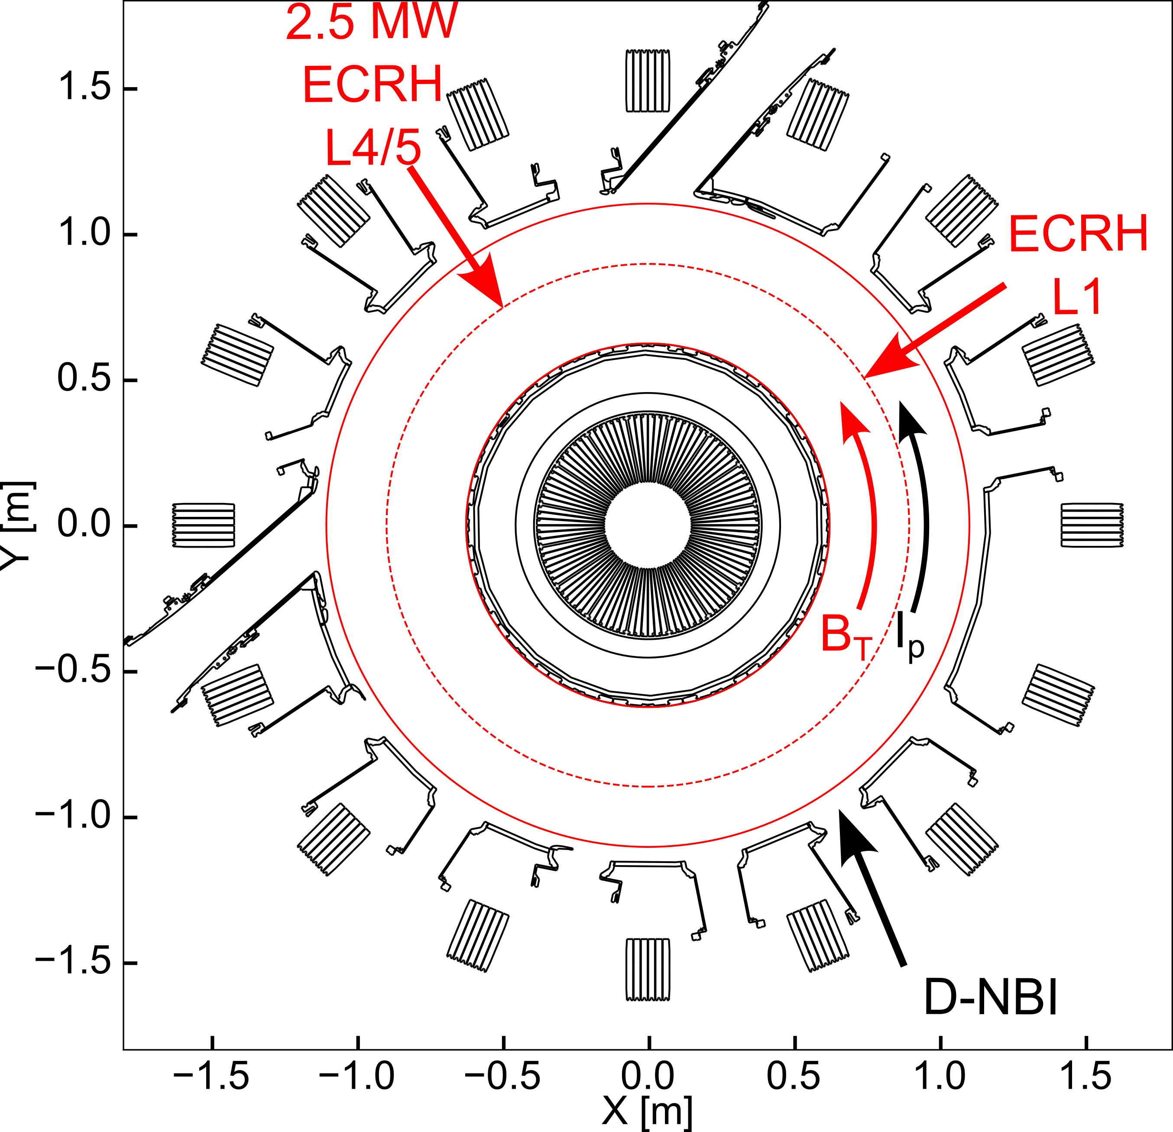
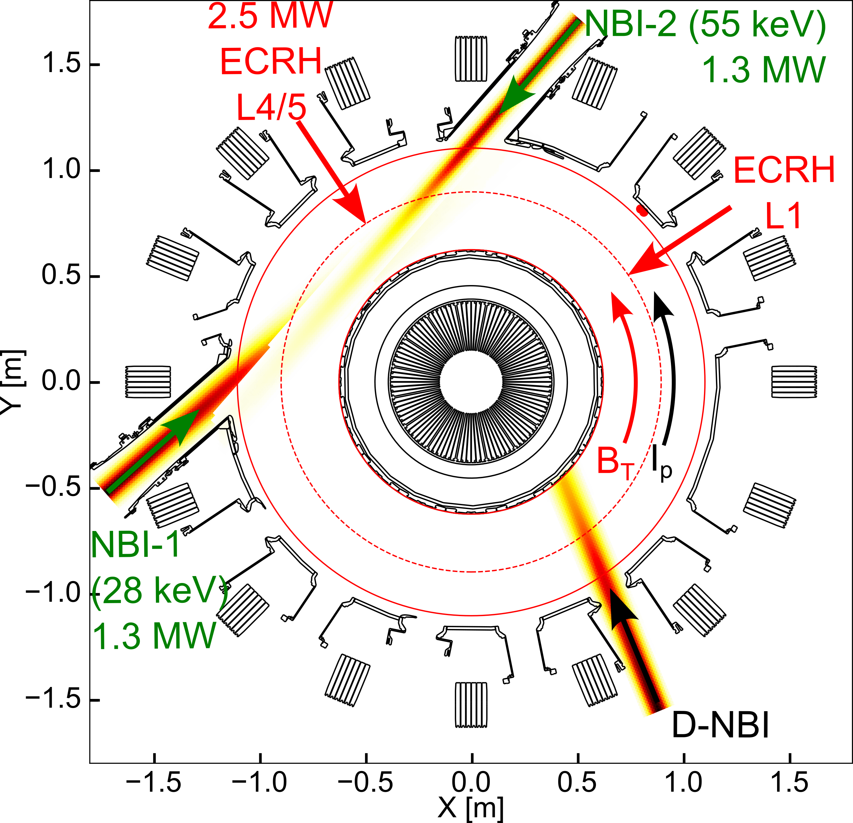
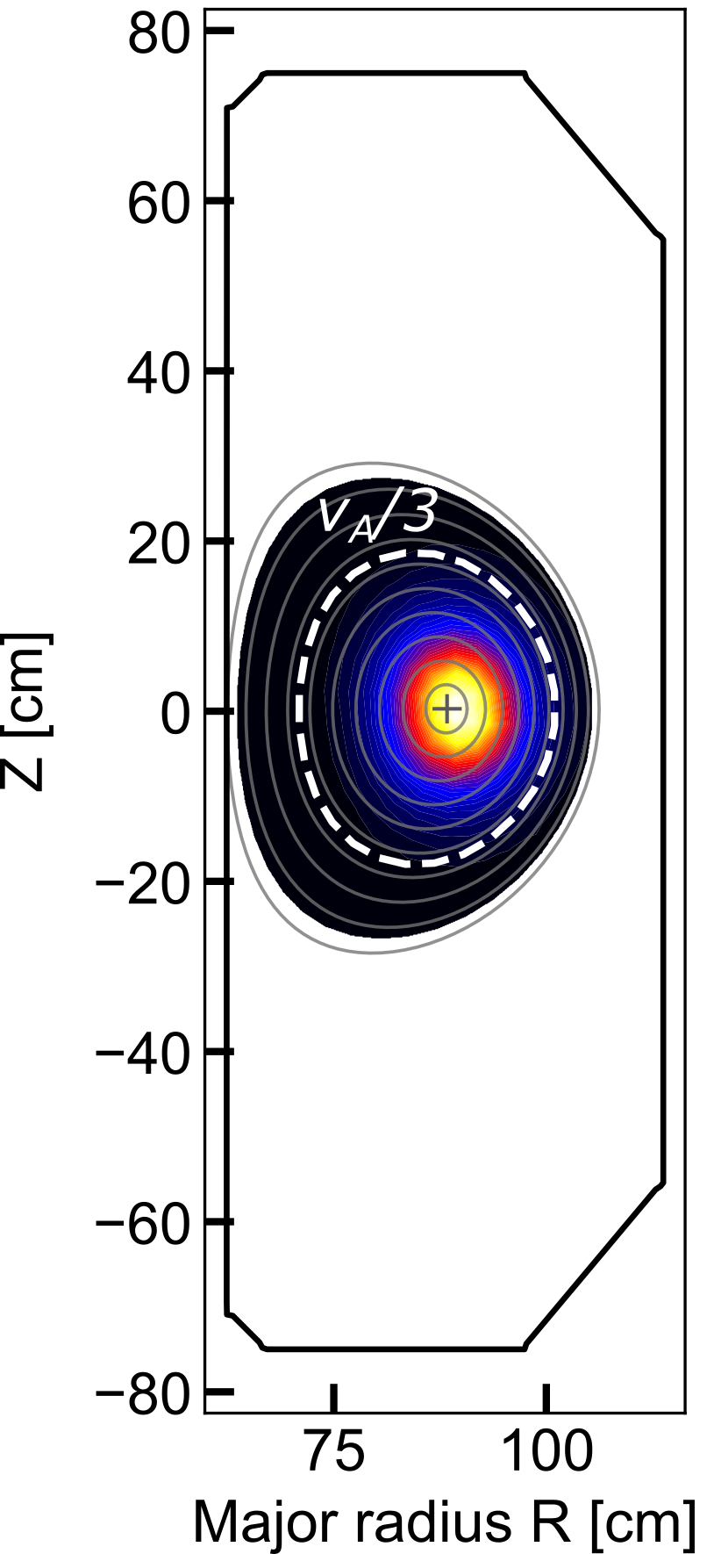
TCV combines flexible ECRH and NBI heating capabilities
TCV Top View
Electron Cyclotron Resonance Heating (ECRH)
X2: Three real-time steerable launchers,
up to 2.5 MW
X3: Two launchers, up to 1.9 MW
TRANSP
Fast-ion Distro.
Neutral Beam Injection (NBI)
Diagnostic beam: 50 keV H, 70 kW
NBI1: 28 keV, up to 1.3 MW [1]
NBI2: 55 keV, up to 1.3 MW
    NBIs generates ions with velocities approaching v_{A}/3, providing drive for Alfvén eigenmodes (AEs).
    Near-Alfvénic velocities (v∼v_{A}) are accessible at reduced magnetic field (Bt ≈ 0.9 T).
[1] A. Karpushov et al., 2023, Fusion Engineering and Design, 187, 113384

Slide 6
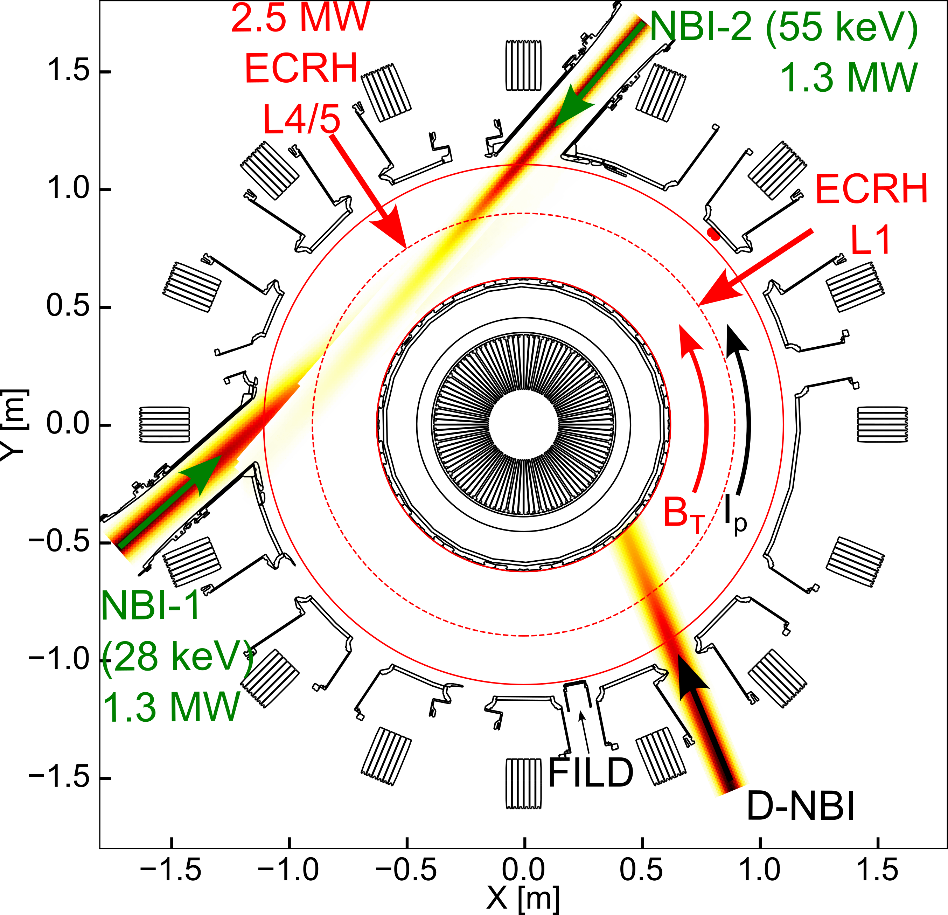
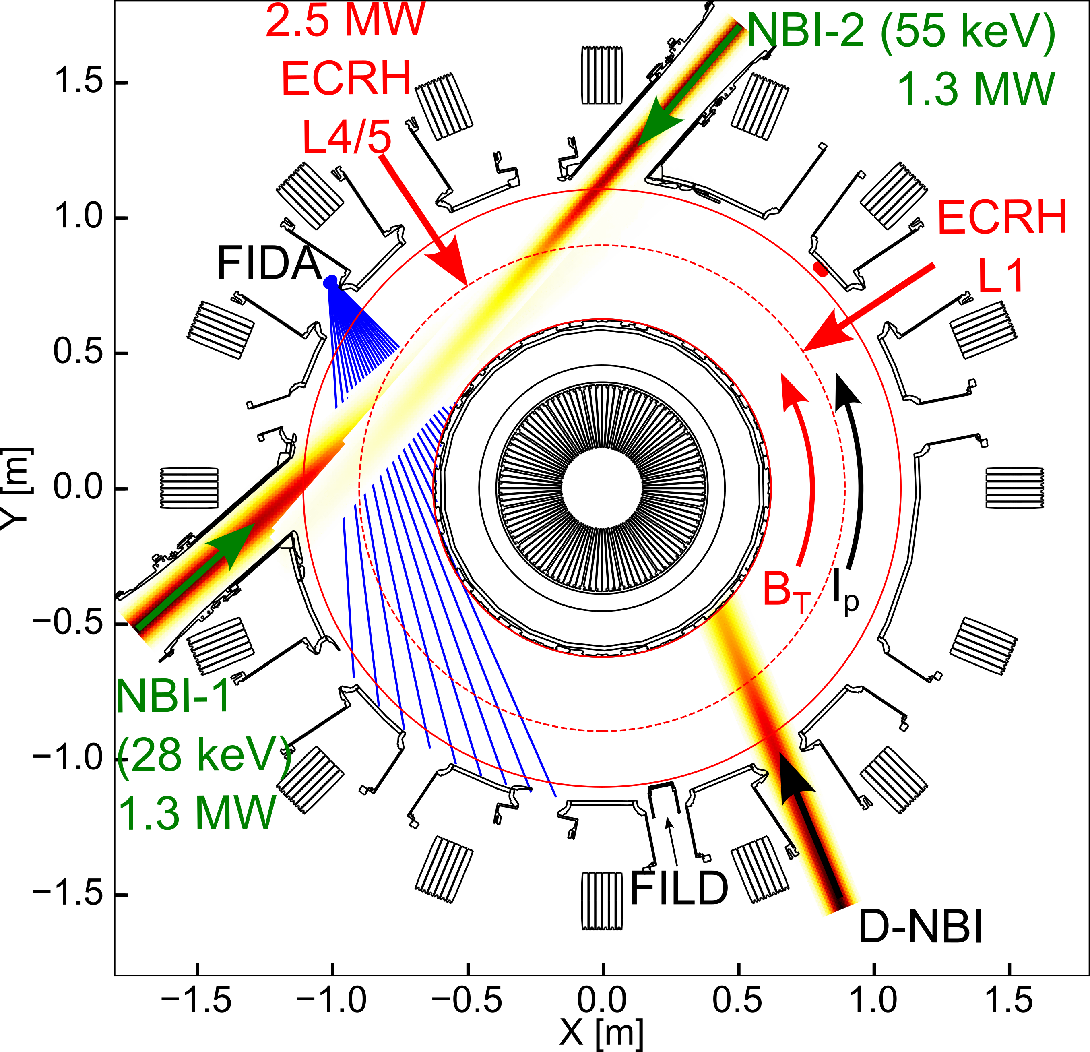
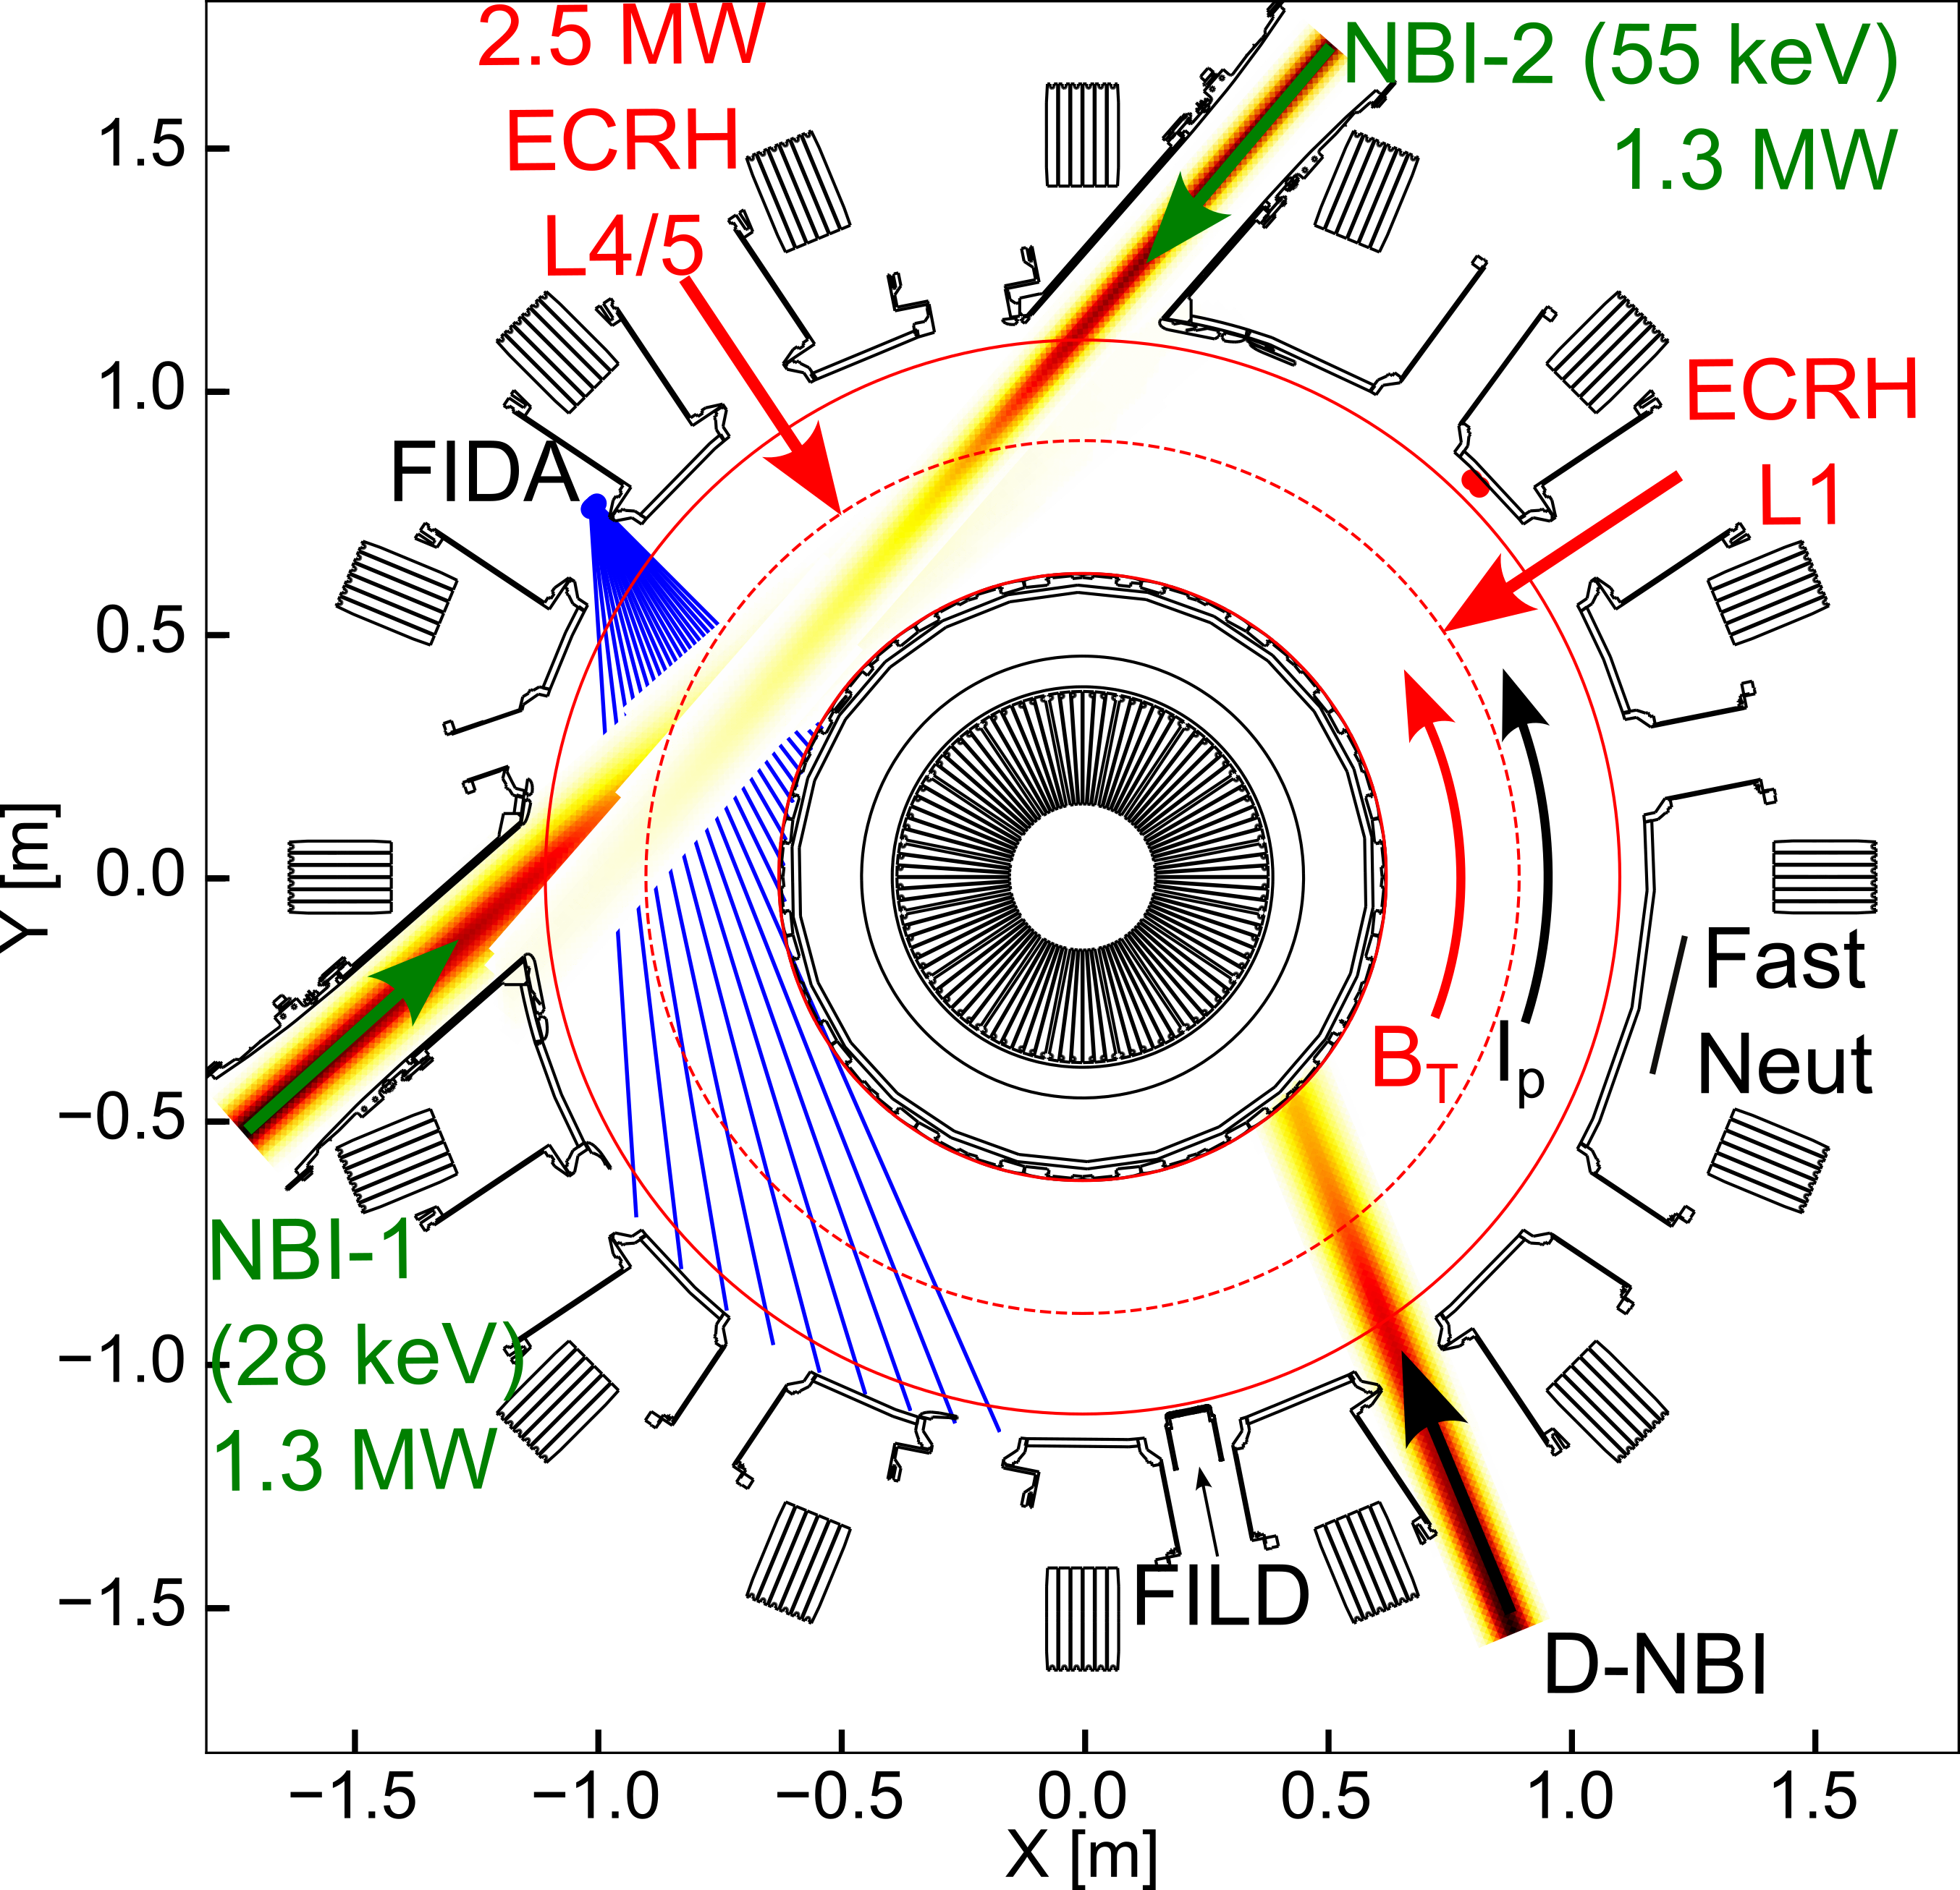

TCV is equipped with a comprehensive suite of fast-ion diagnostics
TCV Top View
Several diagnostics provide measurements of fast-ion confinement and losses :
TRANSP
Fast-ion Distro.
Fast-ion loss detector (FILD)
Fast-ion D-alpha spectroscopy (FIDA)
Neutron detector (1MHz)
Ion cyclotron emission (ICE) probes
Supported by an extensive suite of plasma diagnostics, including charge-exchange spectroscopy (CXRS), Thomson scattering, as well as fluctuation diagnostics

Slide 7
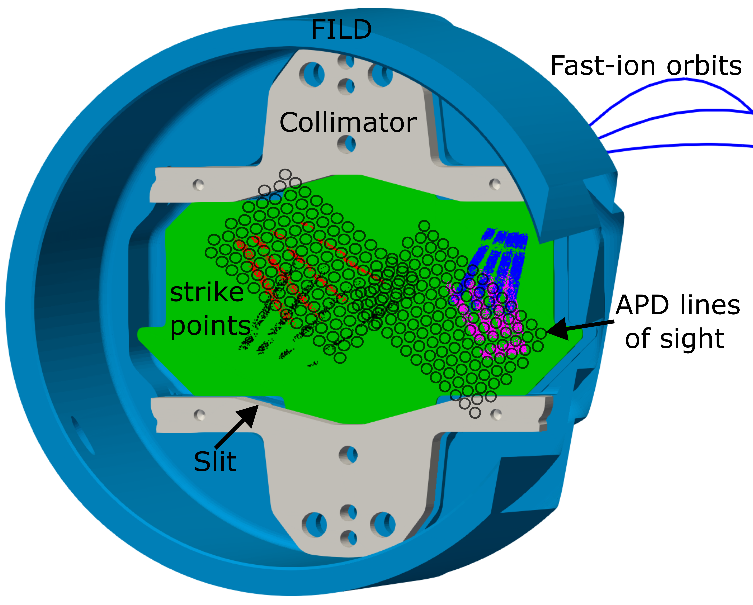
TCV features a unique Fast-Ion Loss Detector (FILD)
    Four slits enable measurements for all I_{p} and B_{t} combinations [1].
    Rotatable head allows precise alignment with the edge magnetic field [2].
    Dual acquisition: 3 kHz camera and 128-channel APD array (up to 4 MHz).
    Reconfigurable APD array enables velocity-space mapping across four configurations.
[1] J. Poley-Sanjuán et al 2025 Nucl. Fusion 65 076006
[2] J. Poley-Sanjuán et al 2025 Rev. Sci. Instrum. 96 083504

Slide 8
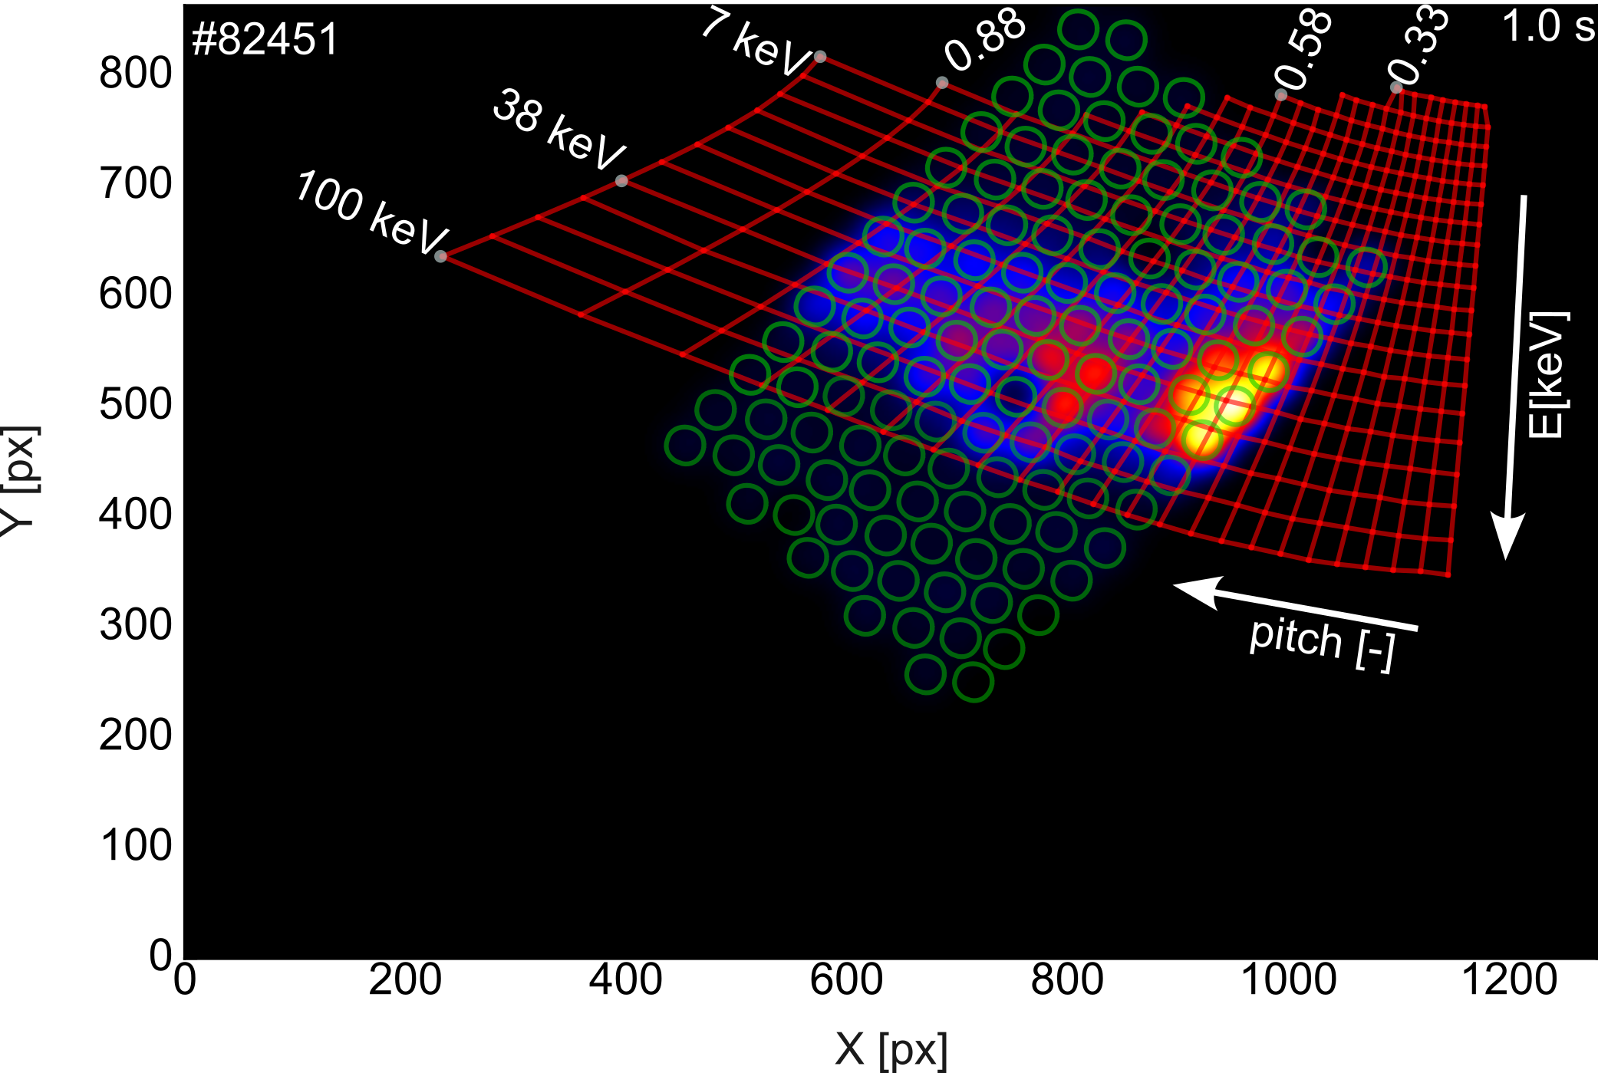
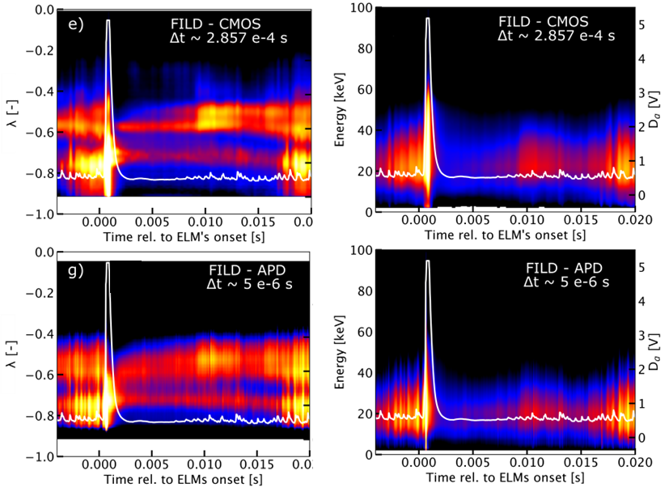
High-resolution measurements of fast-ion losses in velocity space
Conditional ELM averaging (5 cycles)
    Remapping of CMOS and APD signals enables high-resolution velocity-space measurements.
FILDSIM
Strike map
APD views
    Energetic-ion loss dynamics resolved with unprecedented detail [1, 2].
    Tomographic reconstruction of the velocity distribution at the pinhole currently being implemented.
    See presentation by Q. Kernel on Friday morning and poster by M. Larsen Thursday
[1] J. Poley-Sanjuán et al 2025 Nucl. Fusion 65 092006
[2] J. Poley-Sanjuán et al 2026 Nucl. Fusion 66 036009

Slide 9
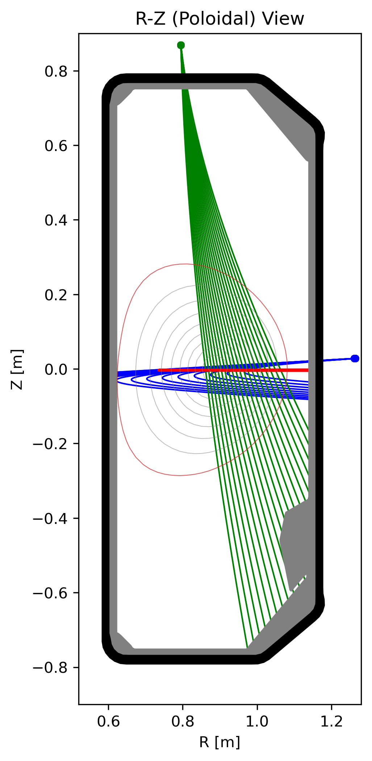
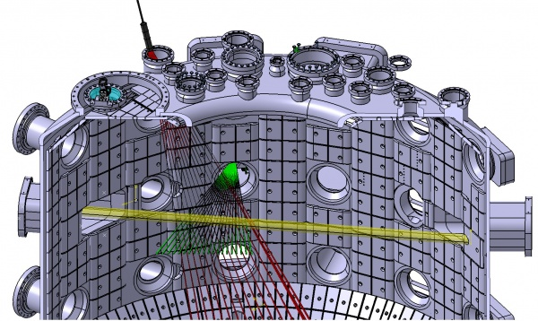
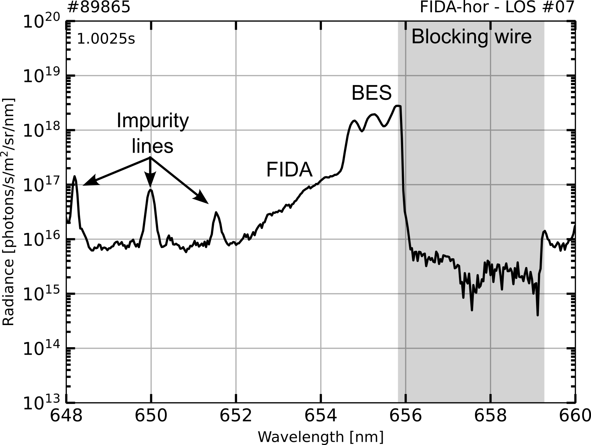
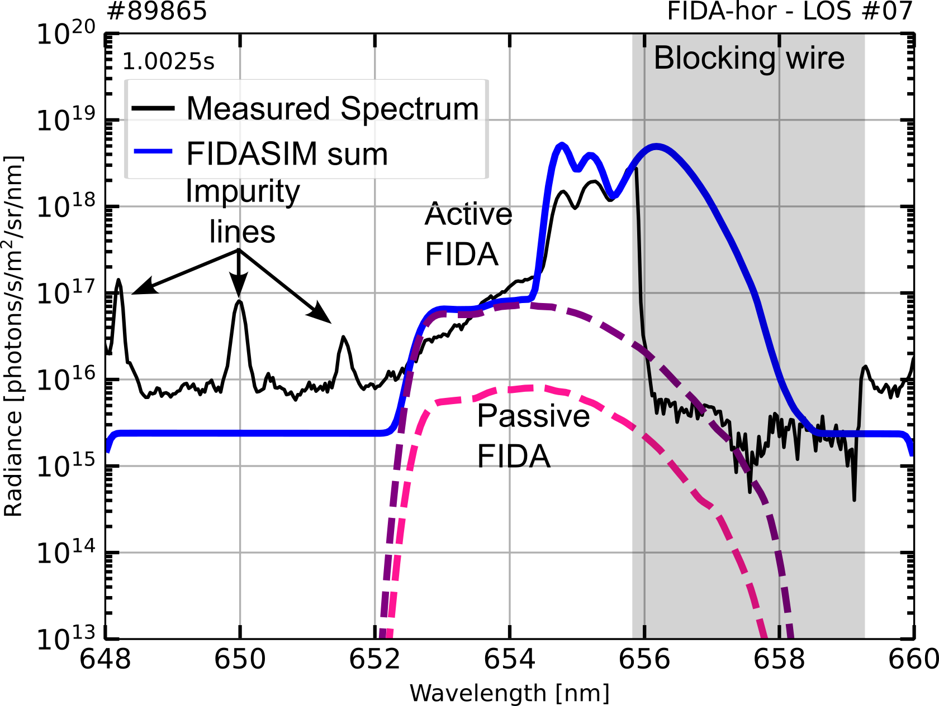
FIDA spectroscopy probes the confined fast-ion distribution
Vertical FIDA
    FIDA spectroscopy probes the confined fast-ion distribution.
Horizontal FIDA
Top and midplane views, with a third bottom view planned.
Doppler shifted emission contains information on confined fast-ion distribution.
Evaluate theoretical the fast-ion distribution against measured spectra via forward modelling.
Bayesian velocity-space tomography enables reconstruction with uncertainty quantification [1]
see M. Rud’s poster on Thursday ☺
[1] M Rud et al 2026 Plasma Phys. Control. Fusion 68 015035

Slide 10
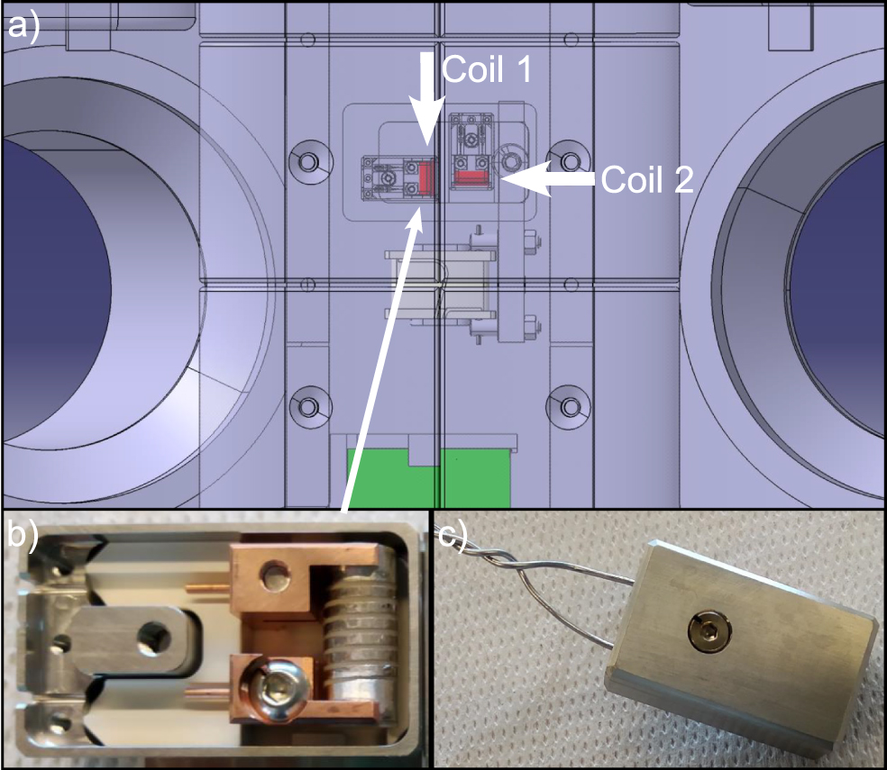
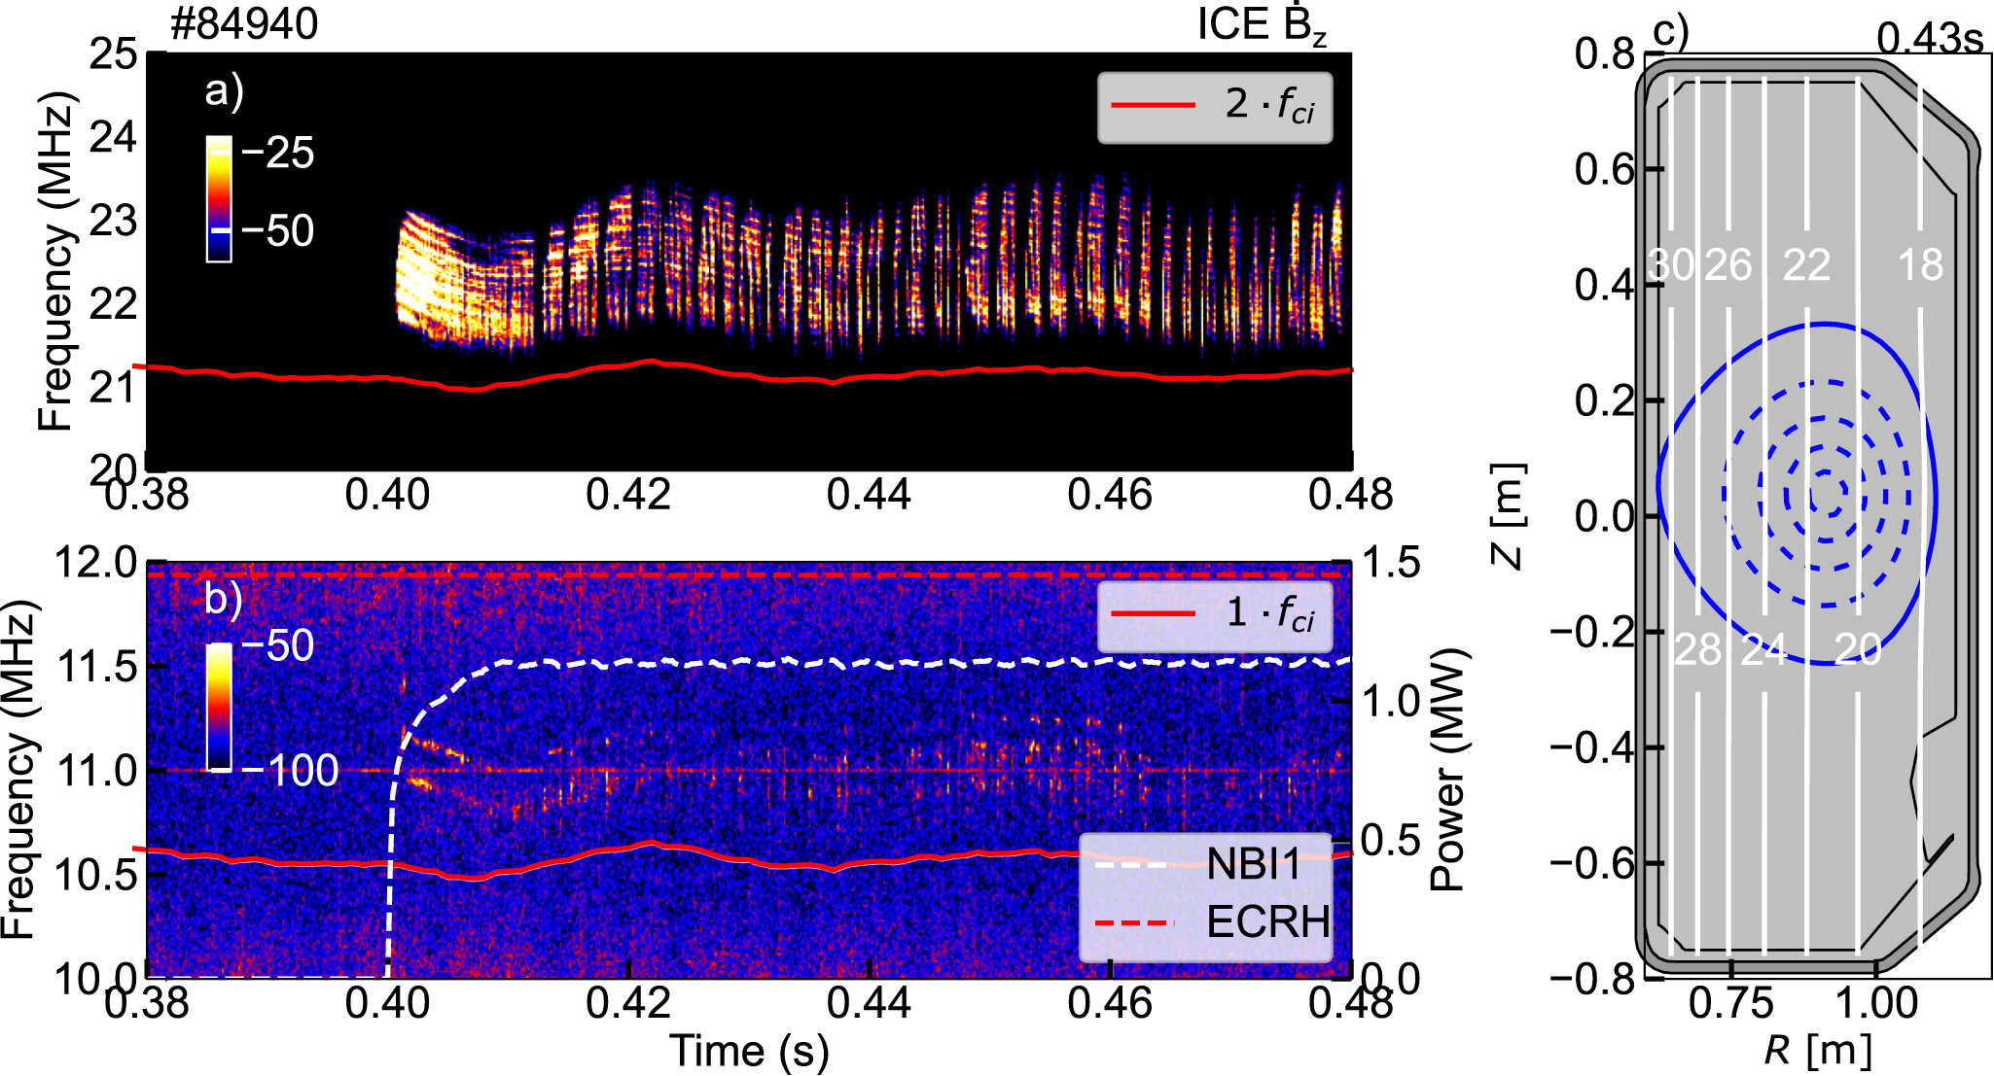
ICE probes routinely measure ion cyclotron emission on TCV
    Two orthogonal magnetic probes installed in 2024, measuring two components of the fluctuating magnetic field [1, 2].
    High-speed acquisition with 1 GS/s sampling rate over full shot duration.
    ICE routinely observed, predominantly at the second ion cyclotron harmonic.
    A new interpretation of TCV ICE suggests an origin in Bernstein-type shear Alfvén waves [3].
[1] A. Jansen van Vuuren et al 2026 Nucl. Fusion 66 086033
[2] R. Ochoukov et al 2026 EPJ Web of Conferences 346 03009
[3] B. N. Breizman et al 2025 Phys. Plasmas 32 100702

Slide 11
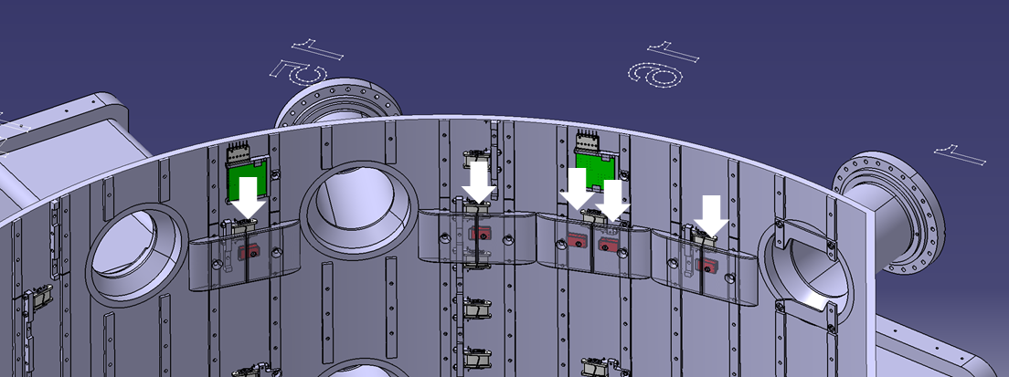
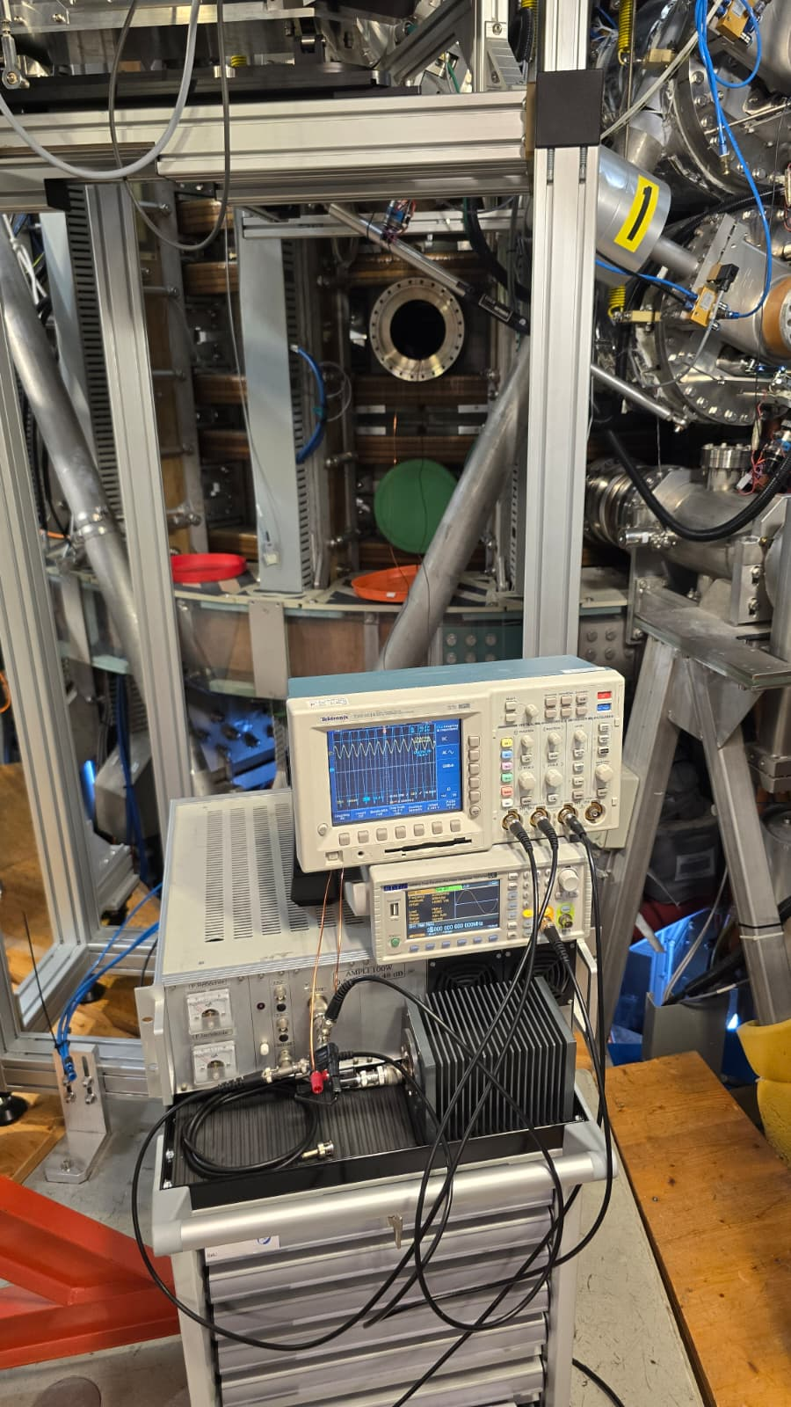
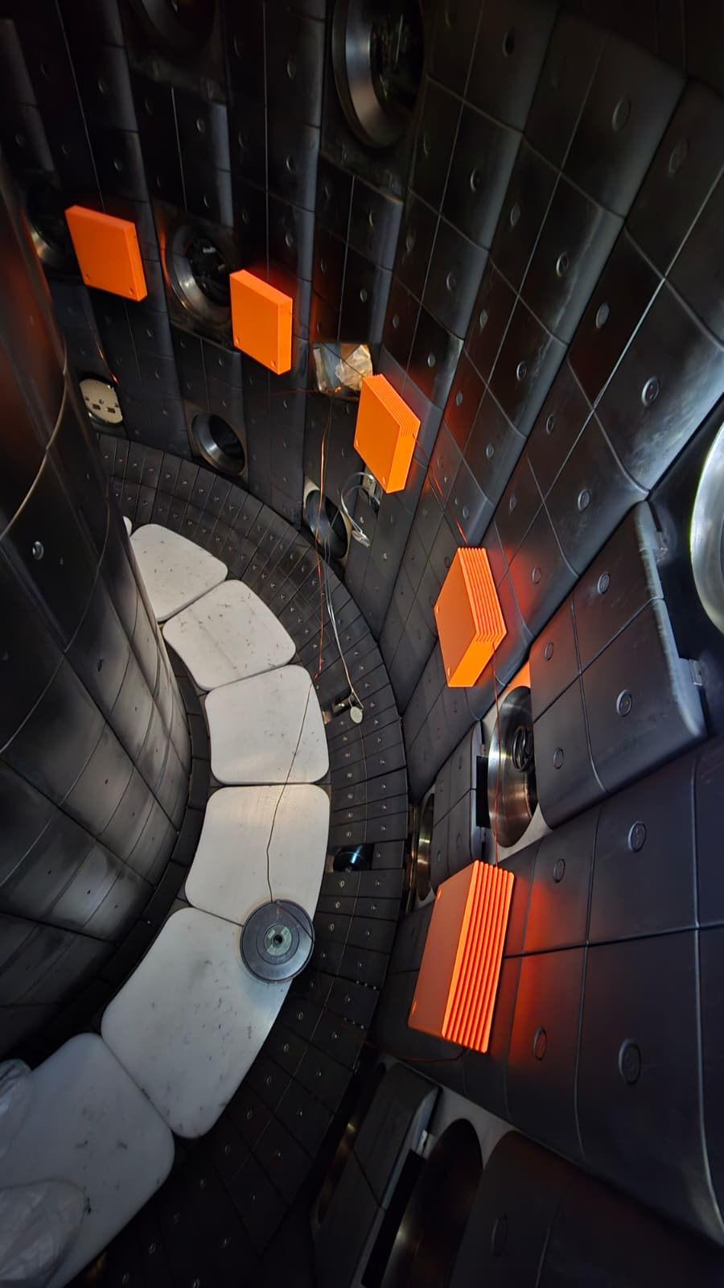
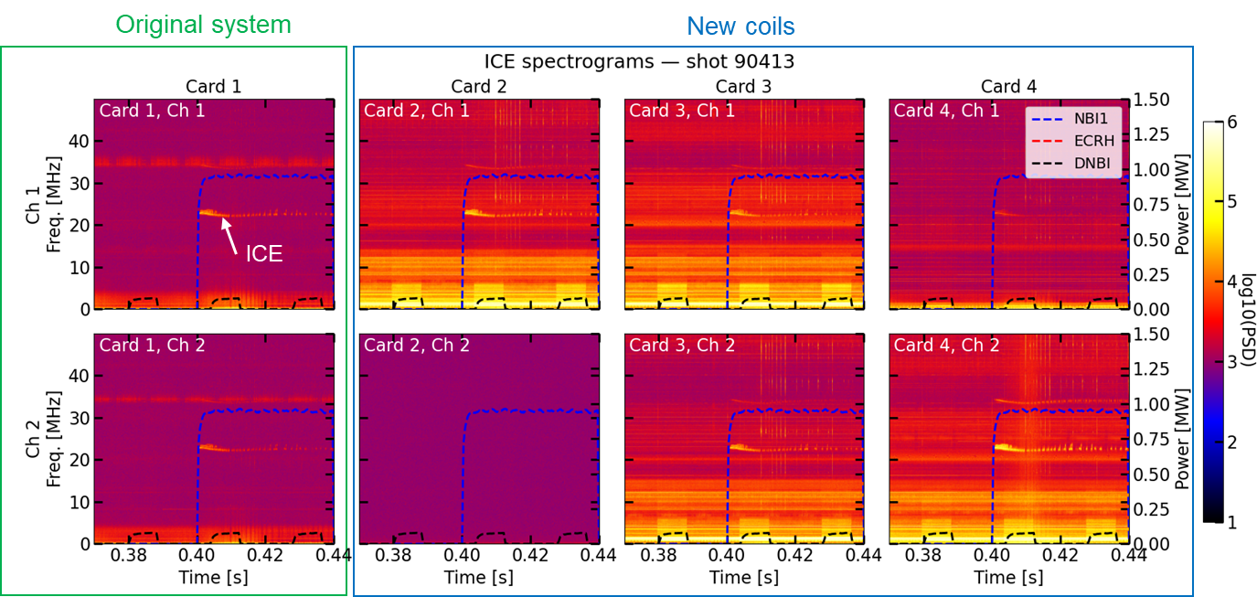
ICE diagnostic upgraded with five additional toroidal probes
Ex-vessel wave source
In-vessel calibration setup
    Five new B_{Z} probes installed in 2026, forming a toroidal array.
Single loop antenna
    9 distinct angular separations (4.4°to 45°) were selected to enable toroidal mode-number determination.
    Simultaneous acquisition at 1 GS/s.
    In-vessel calibration performed in summer 2026 to characterize frequency response and relative channel phases.
    Exploitation to start in current campaign

Slide 12
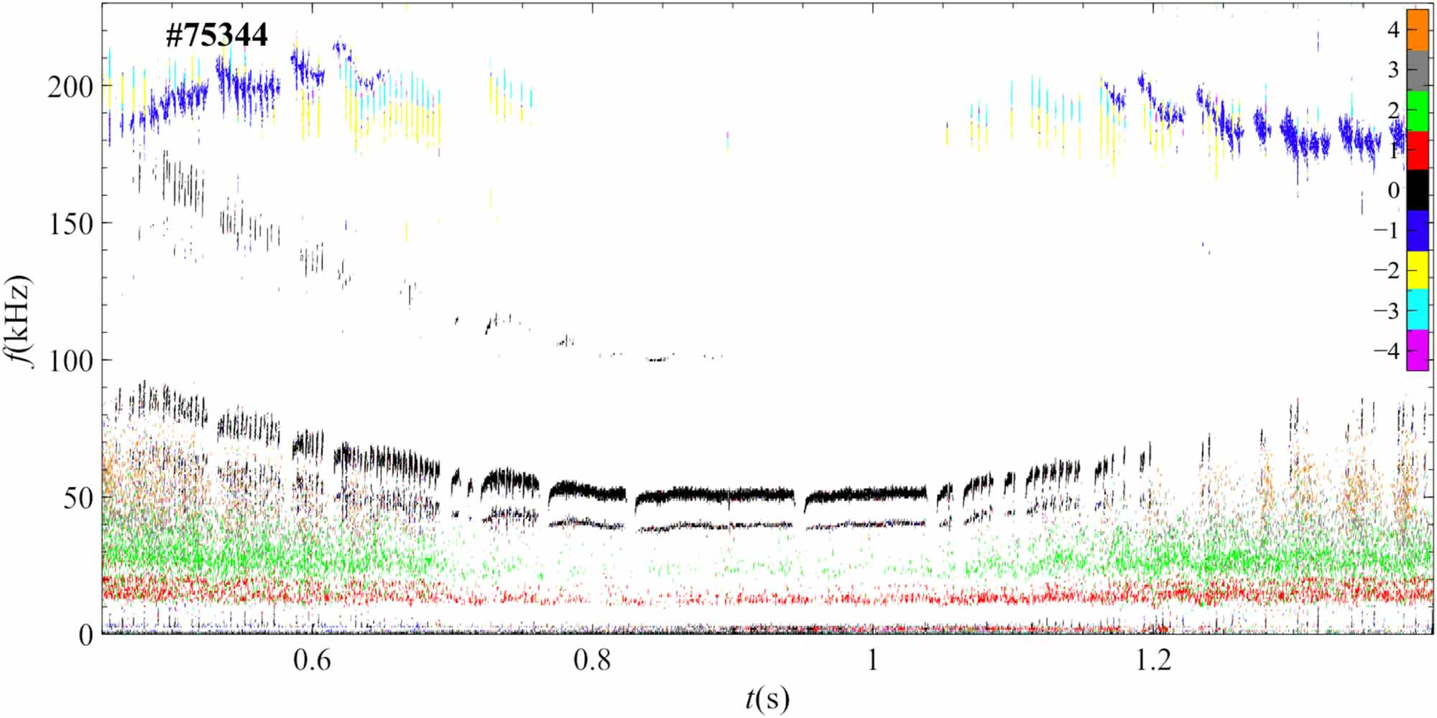
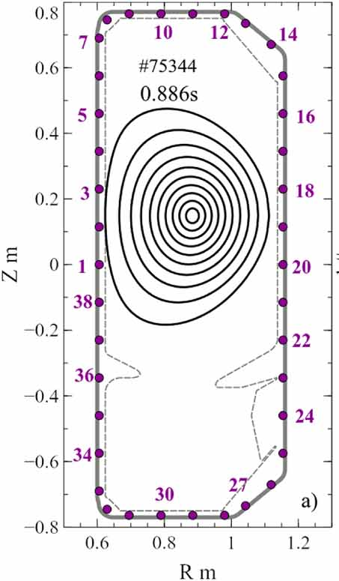
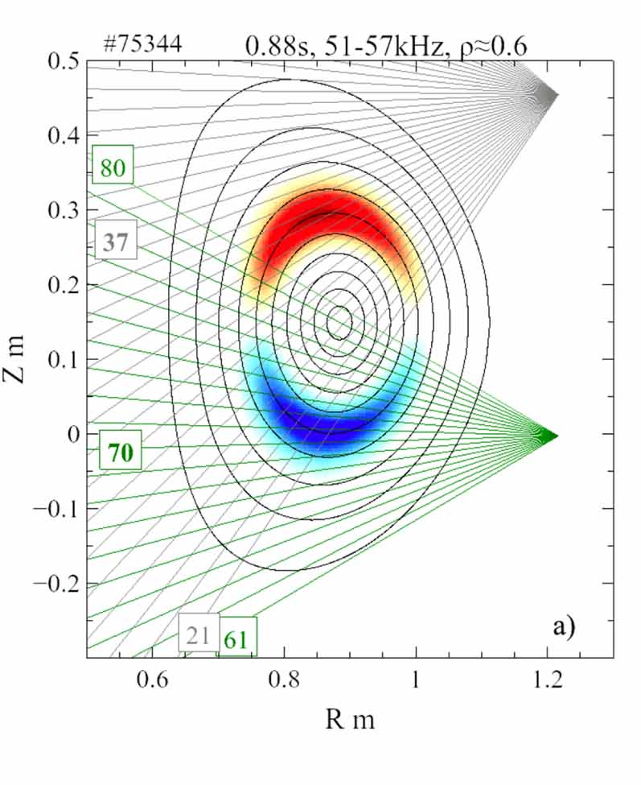
Fluctuation diagnostics for mode characterization
    Magnetic pickup coils and ECE other fluctuation diagnostics provide complementary measurements of MHD activity and mode characteristics.
    Multichannel SXR diagnostics provide spatial information, enabling reconstruction of mode structures and radial dynamics [1].
    Combined measurements and modelling reveal complex EGAM and axisymmetric Alfvén eigenmode structures [2, 3].
    New MSE diagnostic (2026) to provide additional constraints on the q-profile for improving equilibrium reconstruction
[1] M.B. Dreval et al 2025 Nucl. Fusion 65 016037
[2] M.B. Dreval et al 2026 Plasma Phys. Control. Fusion 68 082501
[3] M.B. Dreval et al 2026 Nucl. Fusion 66 086025

Slide 13
Outline
    TCV as a fast-ion testbed
        Heating and fast-ion sources
        Fast-ion diagnostics
    TCV Modelling and analysis workflow
    Recent energetic-particle studies on TCV
      Negative vs positive triangularity confinement
      Alfvén eigenmode control
      Fishbone redistribution of fast-ions
      Runaway-electron and high-frequency waves
    Conclusions and outlook

Slide 14
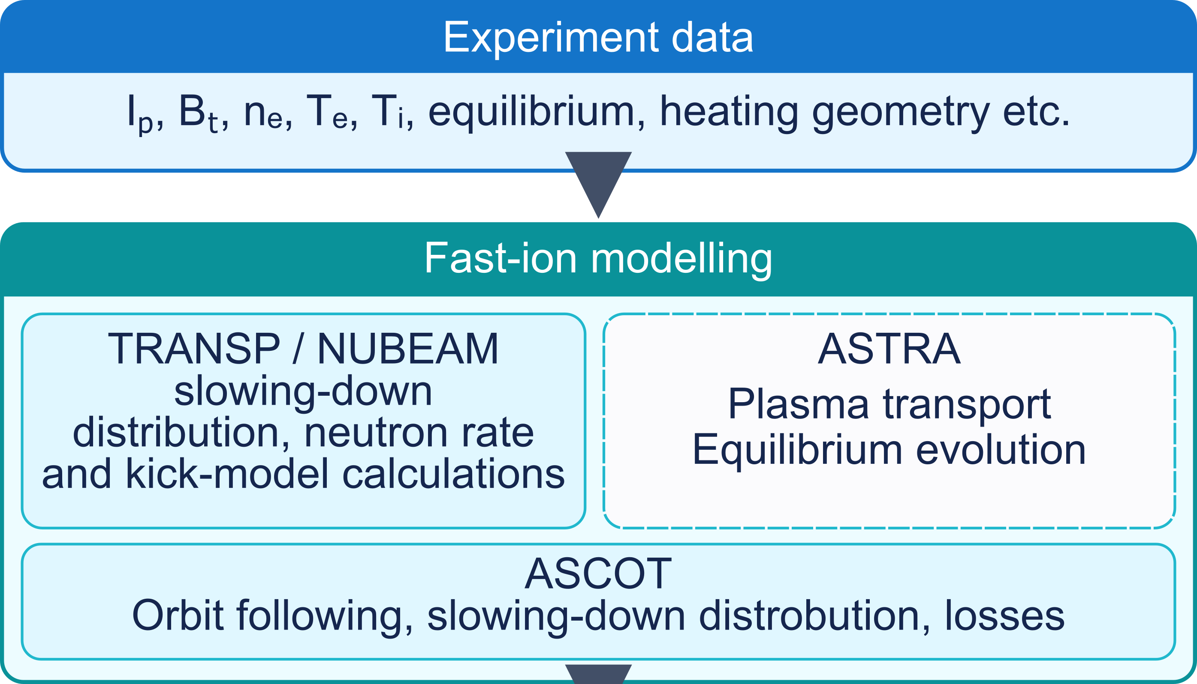
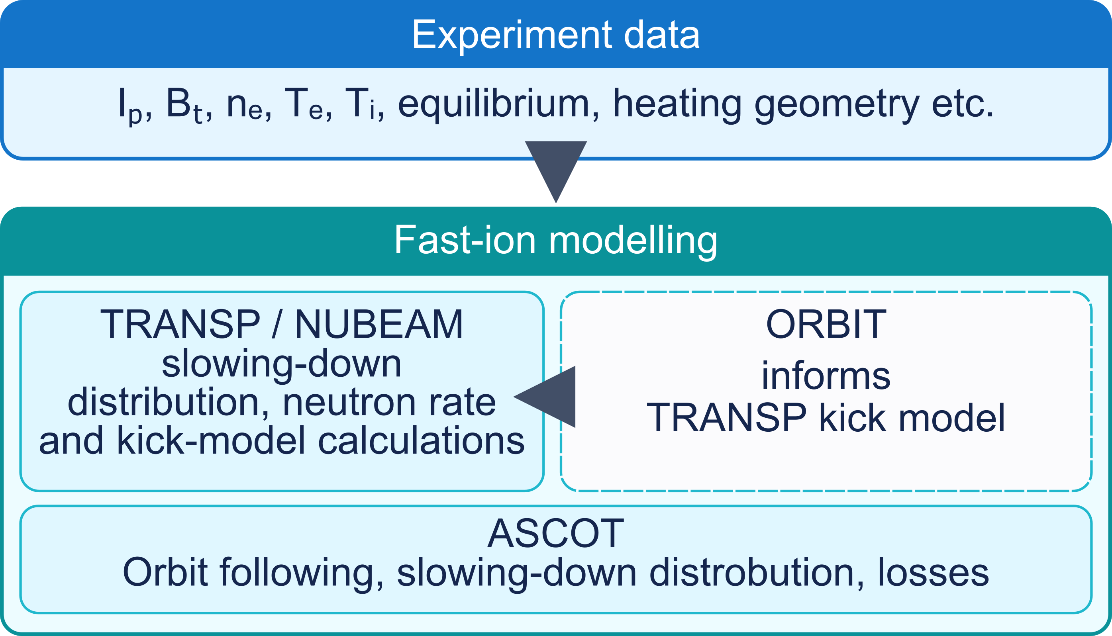
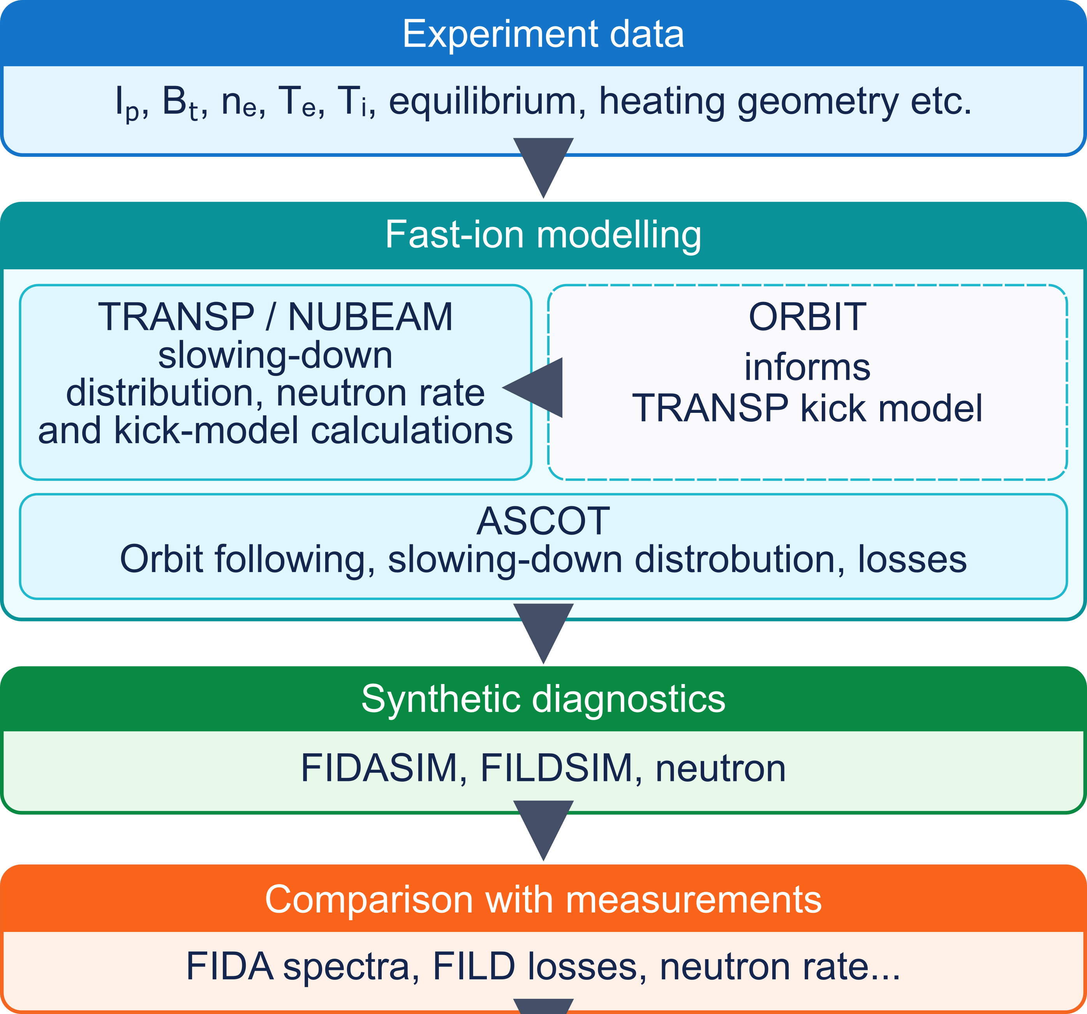
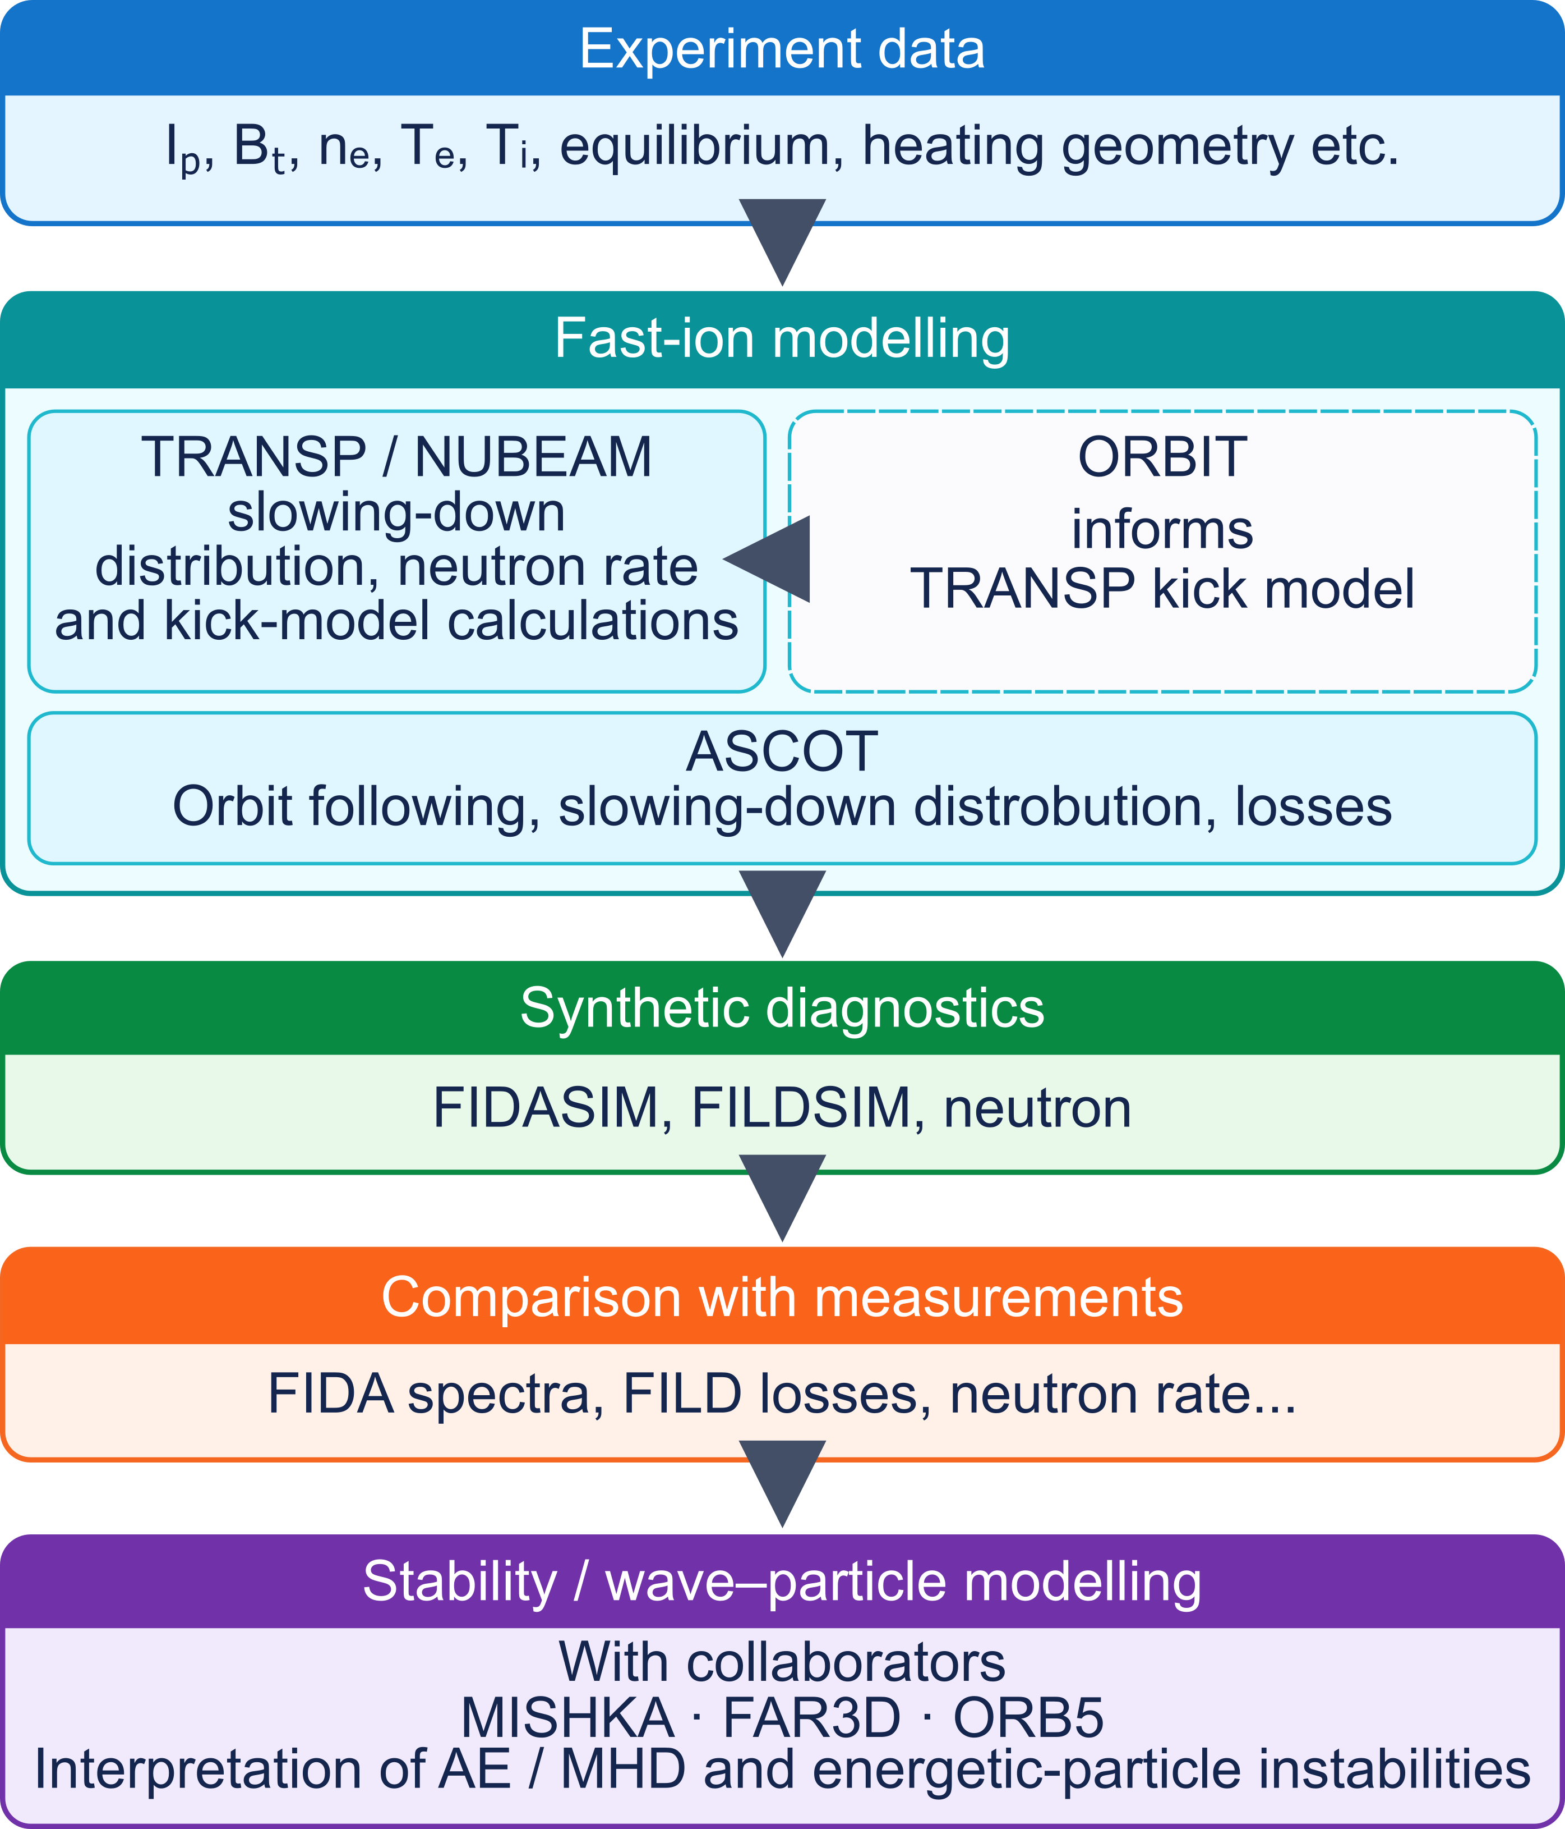
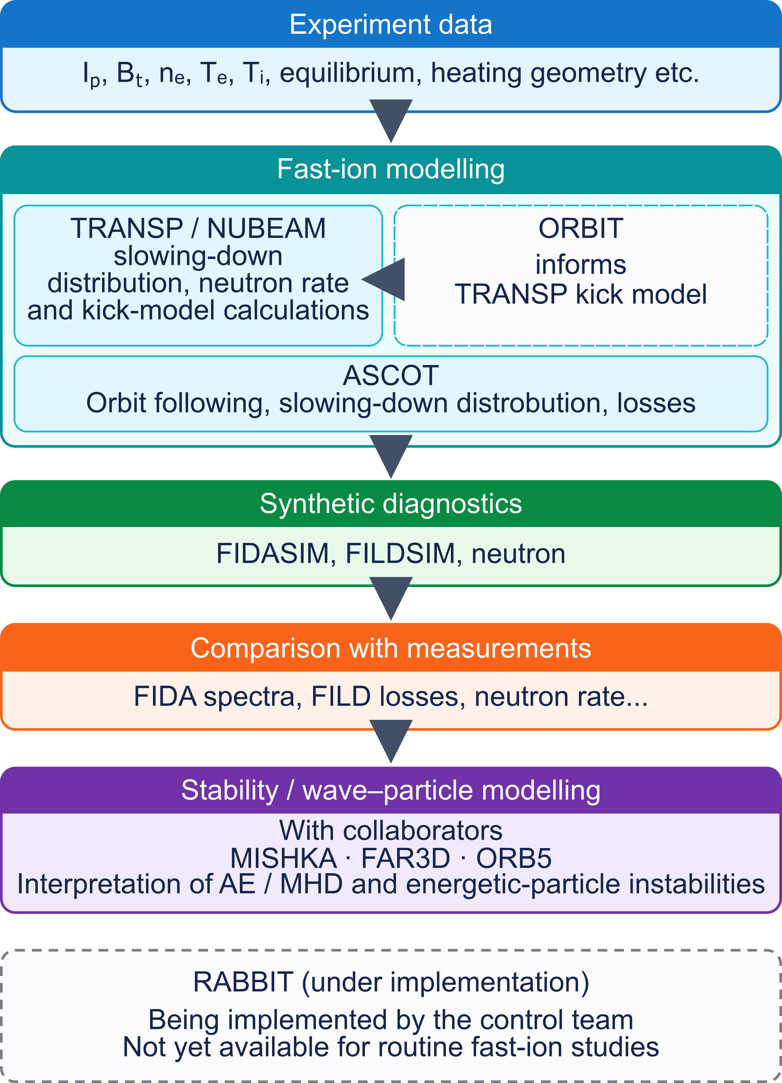
Integrated modelling workflow for fast-ion studies on TCV
    Experimental data combined with ASTRA, TRANSP and ASCOT simulations to assess fast-ion transport.
    Reduced transport modelling ORBIT + TRANSP kick model to investigate instability-induced fast-ion transport. [1]
    See presentation by M. Podesta on Friday morning ☺
    Synthetic diagnostics enable direct comparison with FIDA, neutron and FILD measurements.
    MISHKA/FAR3D/ORB5 support interpretation of energetic-particle-driven instabilities.
    RABBIT is being implemented for real-time/control applications, but is not yet routinely used for fast-ion studies.
[1] M Podestà et al 2017 Plasma Phys. Control. Fusion 59 095008

Slide 15
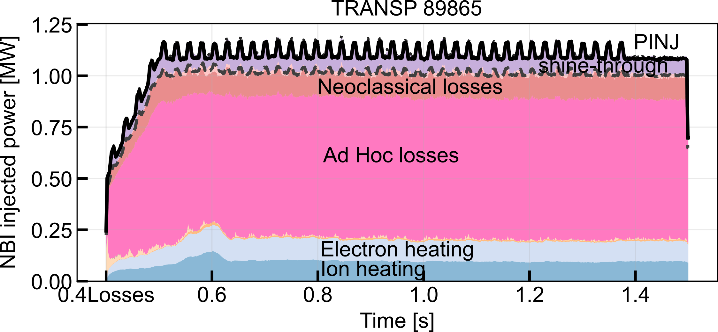
TRANSP modelling integrated into the TCV analysis environment
    TRANSP runs on TCV analysis servers via docker with an easy interface for input preparation, simulation execution and analysis.
#89865
#89865
    Simulations are compared with experimental measurements, including stored energy and neutron rate
    Reproducing experimental measurements requires significant fast-ion losses and/or redistribution.
    Two principal mechanisms are considered:
    - Charge-exchange (CX) losses with background neutrals
    - MHD induced fast-ion transport
    Separating these contributions requires an independent constraint on the background neutral density.
A.Y. Pankin et al 2025 Computer Physics Communications 312 109611

Slide 16
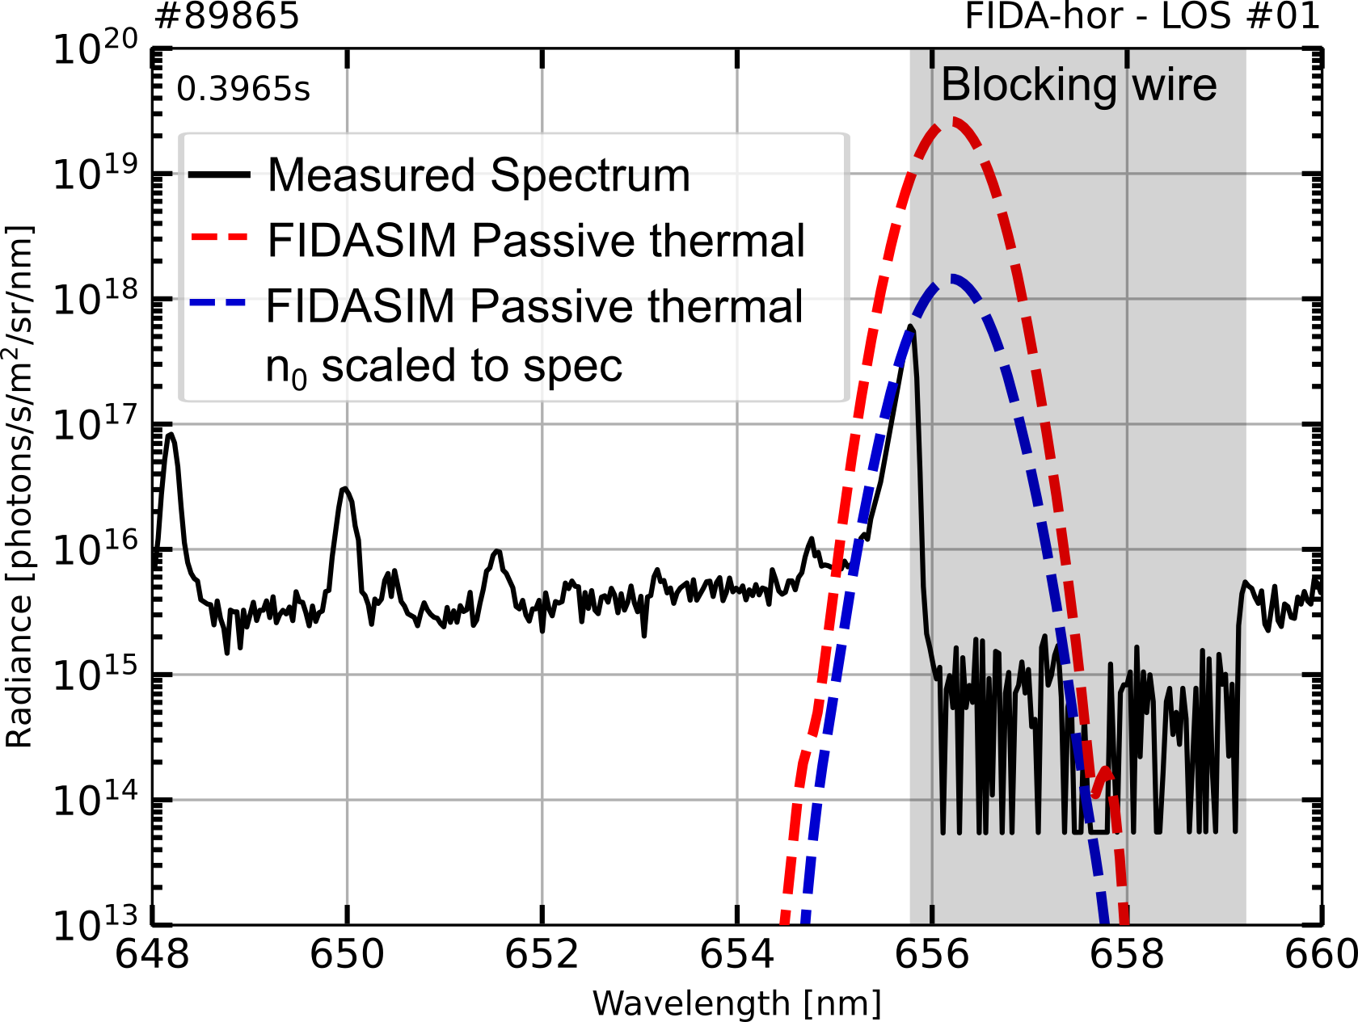
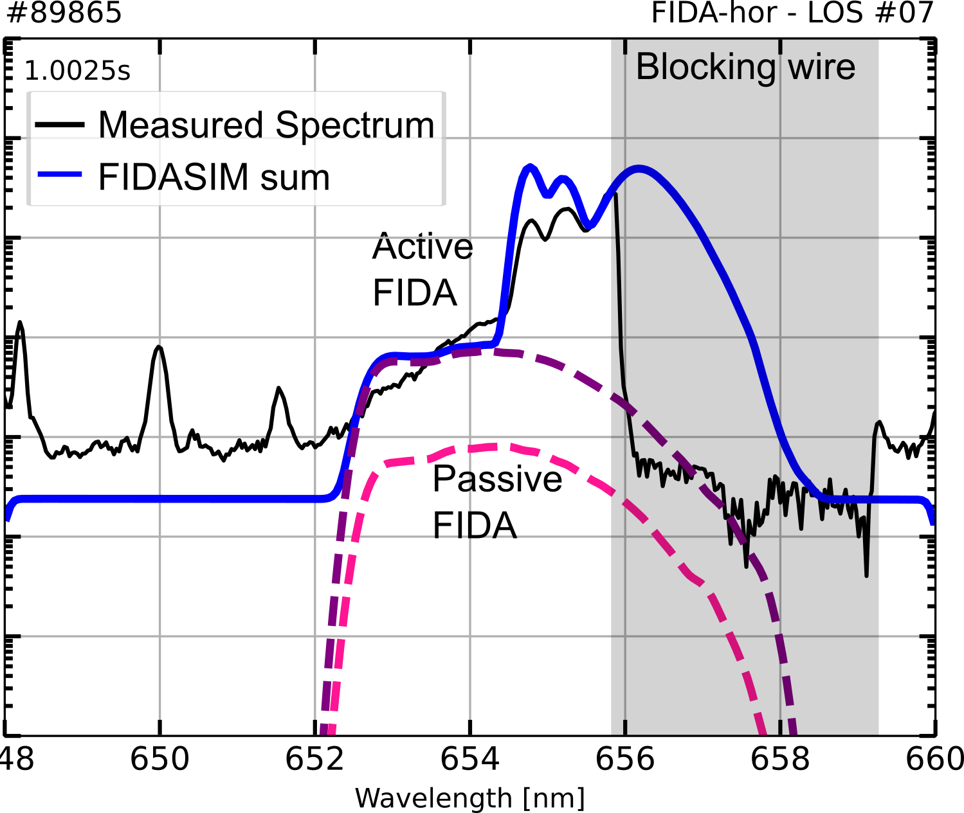
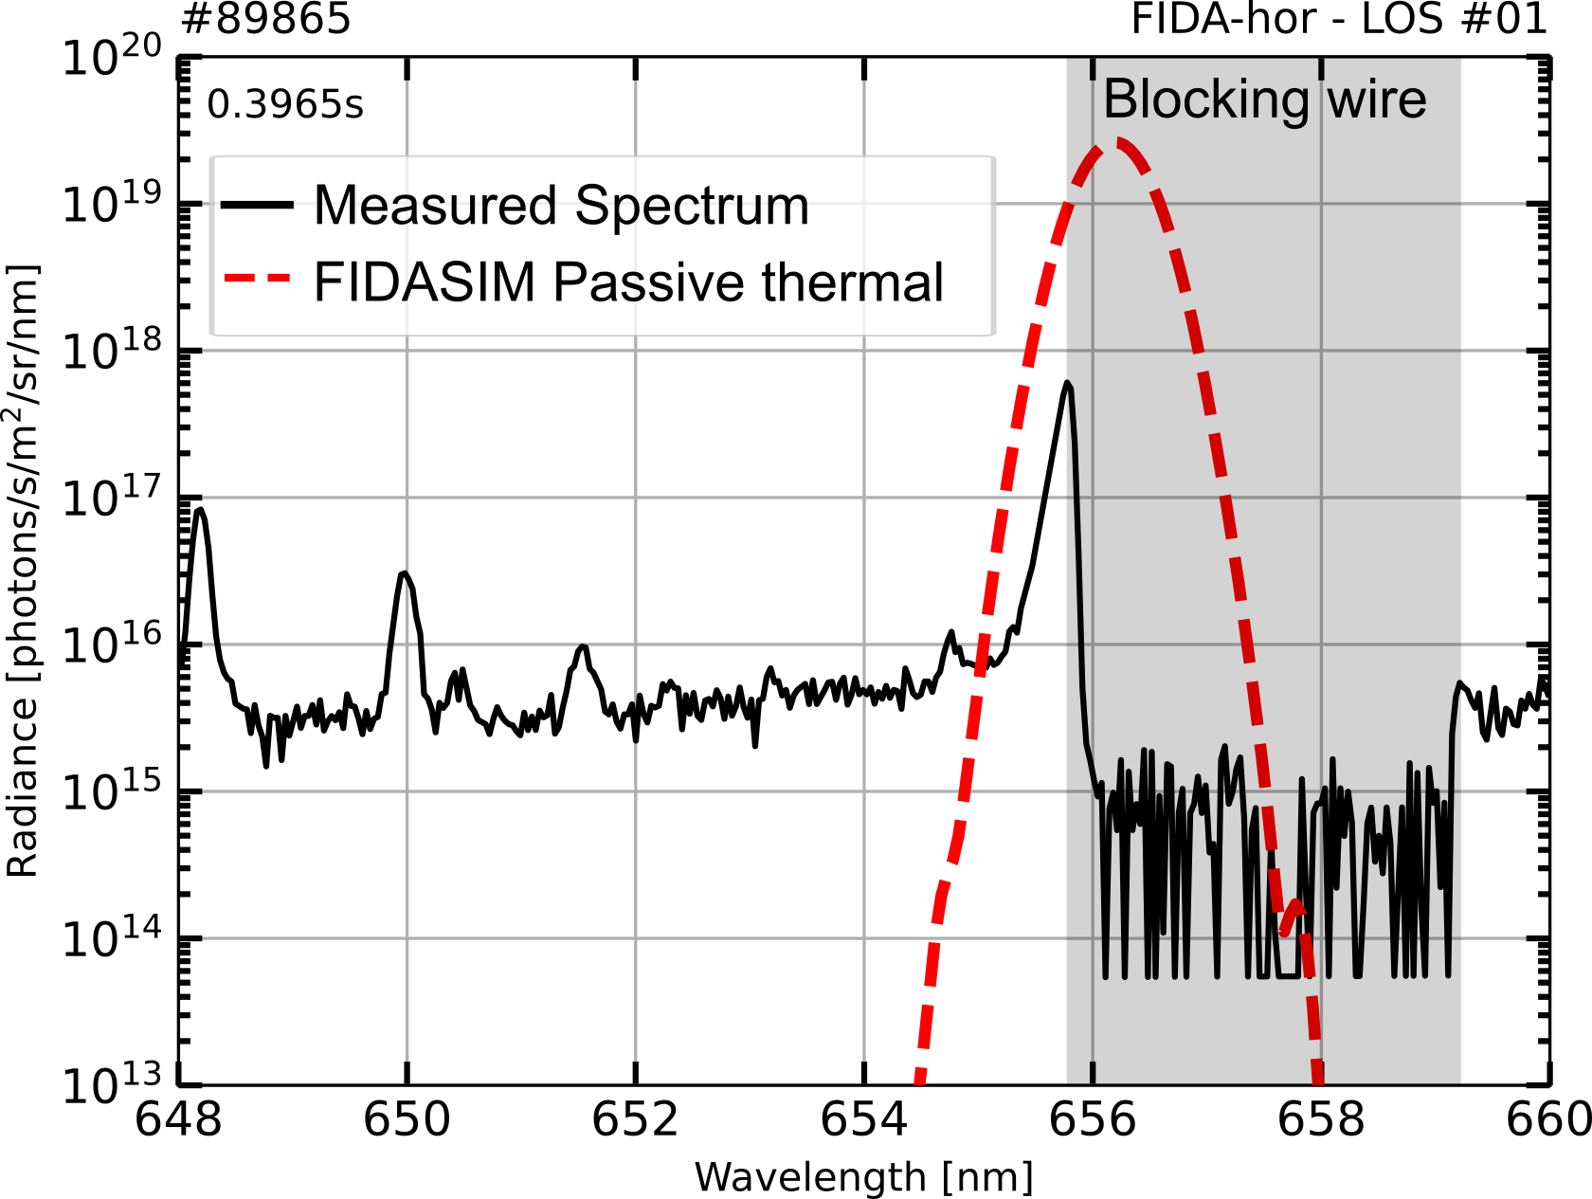
CX losses constrained using spectral measurements
    FIDASIM predicts thermal D_{α} emission using TRANSP neutral-density profiles.
    Background neutral density is adjusted to reproduce measured D_{α} spectra, constraining the CX loss contribution.
D_{anom,FI}2.5 m²/s
Neutron rate
    The remaining discrepancy is modelled using an ad-hoc fast-ion diffusion, D_{anom,FI}, adjusted to reproduce experimental measurements.
+ FIDA emission matched
    Both absolutely calibrated neutron rate and FIDA spectra matched

Slide 17
ASCOT modelling of fast-ion losses and synthetic FILD signals
    ASCOT5 orbit-following simulations model fast-ion confinement and wall losses using realistic TCV equilibria and wall geometry.
    Fast-ion slowing-down distributions can be calculated, including the effects of charge-exchange (CX) losses.
    Synthetic FILD simulations predict fast-ion losses reaching the detector for comparison with measurements.
[1] J. Poley-Sanjuán et al 2025 Nucl. Fusion 65 092006

Slide 18
Outline
    TCV as a fast-ion testbed
        Heating and fast-ion sources
        Fast-ion diagnostics
    TCV Modelling and analysis workflow
    Recent energetic-particle studies on TCV
      Negative vs positive triangularity confinement
      Alfvén eigenmode control
      Fishbones redistribution of fast ions
      Runaway-electron and high-frequency waves
    Conclusions and outlook

Slide 19
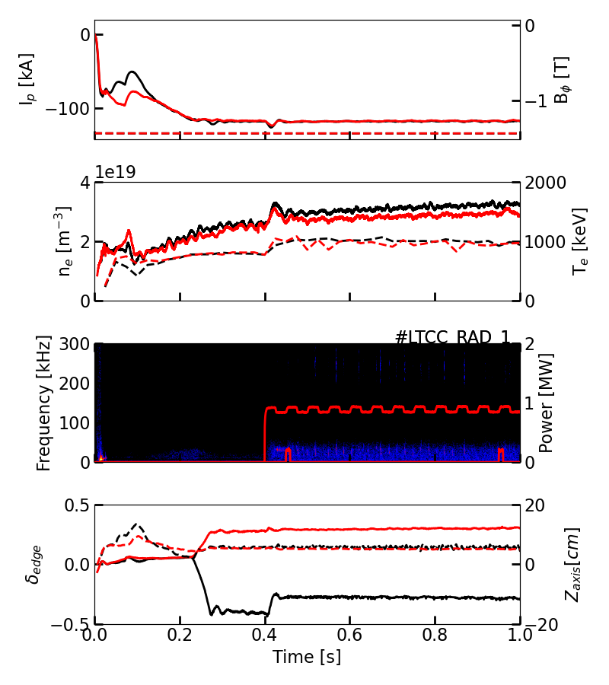
Comparable fast-ion confinement in quiescent NT and PT plasmas
    Matched NT/PT scenarios with identical NBI parameters and minimal MHD activity have been investigated [1, 2].
NT: 80323
δ ~ -0.3
δ ~ +0.3
PT: 80326
    TRANSP (and ASCOT) modelling successfully reproduce experimental measurements using neoclassical fast-ion transport.
NT: 80323
PT: 80326
    Charge-exchange (CX) losses are identified as the dominant fast-ion loss mechanism.
Magnetics
t = 0.54s
    Similar fast-ion confinement in comparable quiescent NT vs PT plasmas
    Differences in neutron rates are primarily attributed to thermal plasma conditions.
[1] A. Jansen van Vuuren et al 2024 APS-Atlanta
[2] J. Poley-Sanjuán et al 2026 Nucl. Fusion 66 046012

Slide 20
Energetic-particle-driven instabilities differ between NT and PT plasmas on TCV
ORB5
Note scale diff
    MHD-active NT and PT scenarios developed to investigate instability-driven fast-ion transport.
    eGAMs are more prominent in NT, but can be suppressed using localised ECH.
TAE
    Higher-amplitude TAEs and larger fast-ion losses observed in PT, unlike DIII-D experiments reporting comparable AE-induced transport [1].
    Modelling predict higher TAE growth rates and amplitudes in PT, respectively [2, 3].
TAE
    Modelling remains sensitive to plasma equilibrium inputs, particularly the poorly constrained experimental q-profiles.
    Further experiments with co-NBI planned to investigate these differences.
[1] M.A. Van Zeeland et al 2019 Nucl. Fusion 59 086028
[2] Y. Ghai et al 2021 Nucl. Fusion 61 126020
[3] P. Oyola et al 2024 APS-Atlanta

Slide 21
Outline
    TCV as a fast-ion testbed
        Heating and fast-ion sources
        Fast-ion diagnostics
    TCV Modelling and analysis workflow
    Recent energetic-particle studies on TCV
      Negative vs positive triangularity confinement
      Alfvén eigenmode control
      Fishbones redistribution of fast ions
      Runaway-electron and high-frequency waves
    Conclusions and outlook

Slide 22
A reproducible co-NBI scenario enables systematic AE control studies
Magnetics
ECRH
    Previous TCV AE studies predominantly relied on counter-NBI scenarios [1].
    A reproducible, steady-state high power co-NBI scenario was established using off-axis ECRH, outside ρ ≳ 0.6.
NBI1
Neutron rate
n_{e}
    Strong TAEs are routinely excited that efficiently expel fast-ion.
Toray
n-number
    CX-constrained TRANSP modelling indicates anomalous fast-ion diffusion of D_{anom,FI} around 2.5 m²/s, with even higher values inferred at increased ECRH power.
FILD
TAEs
FILD retracted
[1] A. Jansen van Vuuren et al 2026 EPS-Edinburgh

Slide 23
TAEs are suppressed by on-axis ECRH deposition on TCV
    As ECRH deposition moves inward towards ρ ≈ 0.6, TAE amplitudes decrease and a lower-frequency mode, possibly a BAE, becomes dominant.
    With further inward deposition, coherent mode activity is suppressed and the neutron rate reaches its maximum.
Magnetics
TAEs
ECRH
NBI1
Neutron rate
BAEs
    Similar deposition-dependent behavior has been reported on ASDEX Upgrade, where off-axis ECRH destabilized TAEs driven by ICRH-accelerated ions [1].
n_{e}
Launcher angle
Toray
FILD
[1] S. E. Sharapov et al 2018 PPCF 60 014026

Slide 24
ECCD-induced shear changes possible explanation to suppression
    Co-/counter-ECCD scans reveal a moderate effect, consistent with the small driven (I_{ECCD}≈ ±5 kA vs I_{P} ≈ 120 kA)
    Co-ECCD reduces TAE activity, while counter-ECCD has little effect.
    Modelling predicts similar fast-ion density and magnetic shear profiles for both configurations.
Counter ECCD
CO-ECCD
    MSE measurements, however, indicate differences in the experimental shear profiles, suggesting sensitivity to small changes not captured by current modelling.
    Comparable observations on KSTAR and AUG highlight the influence of ECCD-induced equilibrium changes and the balance between energetic-particle drive and damping [1, 2]
[1] Kim et al., Nucl. Fusion 2022 62 026029
[2] Calado et al., Nucl. Fusion 2024 64 016039

Slide 25
Outline
    TCV as a fast-ion testbed
        Heating and fast-ion sources
        Fast-ion diagnostics
    TCV Modelling and analysis workflow
    Recent energetic-particle studies on TCV
      Negative vs positive triangularity confinement
      Alfvén eigenmode control
      Fishbone redistribution of fast ions
      Runaway-electron and high-frequency waves
    Conclusions and outlook

Slide 26
Fishbones trigger coherent bursts ​of fast-ion losses
Magnetics
Magnetics
    Scenario with fishbone instabilities well established on TCV.
    Magnetic perturbations and enhanced losses are well correlated​.
Magnetics
FILD + Neutrons
FILD
FILD
    Simultaneous burst of 3rd harmonic ICE observed corelated with
    Strong evidence radial expulsion of fast-ions to edge of plasma
ICE
ICE
See presentation by Q. Kernel on Friday morning ☺
Radial outward transport

Slide 27
Outline
    TCV as a fast-ion testbed
        Heating and fast-ion sources
        Fast-ion diagnostics
    TCV Modelling and analysis workflow
    Recent energetic-particle studies on TCV
      Negative vs positive triangularity confinement
      Alfvén eigenmode control
      Fishbone redistribution of fast ions
      Runaway-electron and high-frequency waves
    Conclusions and outlook

Slide 28
TCV research on runaway electrons
    TCV is very active in runaway electron (RE) research with a multi-tier mitigation approach
    Expel RE seed using ECRH [1]
    ⟹ combined effects of heating and turbulent transport
    Limit RE beam current by increasing RE transport
    using inductively loaded mitigation coil (REMC)
    ⟹ will be installed on TCV in a few months
    See talk by A. Battey Friday morning
    inject low-Z gas to reduce the impact of the final collapse
    ⟹ “benign termination” resulting from fast-growing MHD mode and reduced RE regeneration [2]
    TCV is equipped with dedicated RE diagnostics:
    Bremsstrahlung diagnostics:
    PMTX, HXRS, BGO and recently LaBrDORE [3]
    Fast-ion and electron detector [4]
    Antennas capturing RE-driven kinetic instabilities:
    REWS (EPS-2026), recently upgraded ICE, future LHPI
    See poster by O. Panico ☺
[1] J. Decker et al 2024 Nucl. Fusion 64 106027
[2] U Sheikh et al 2024 Plasma Phys. Control. Fusion 66 035003
[3] Simons et al 2025 Rev. Sci. Instrum. 96, 093501 (2025)
[4] J. Poley-Sanjuán et al 2025 Nucl. Fusion 65 114001

Slide 29
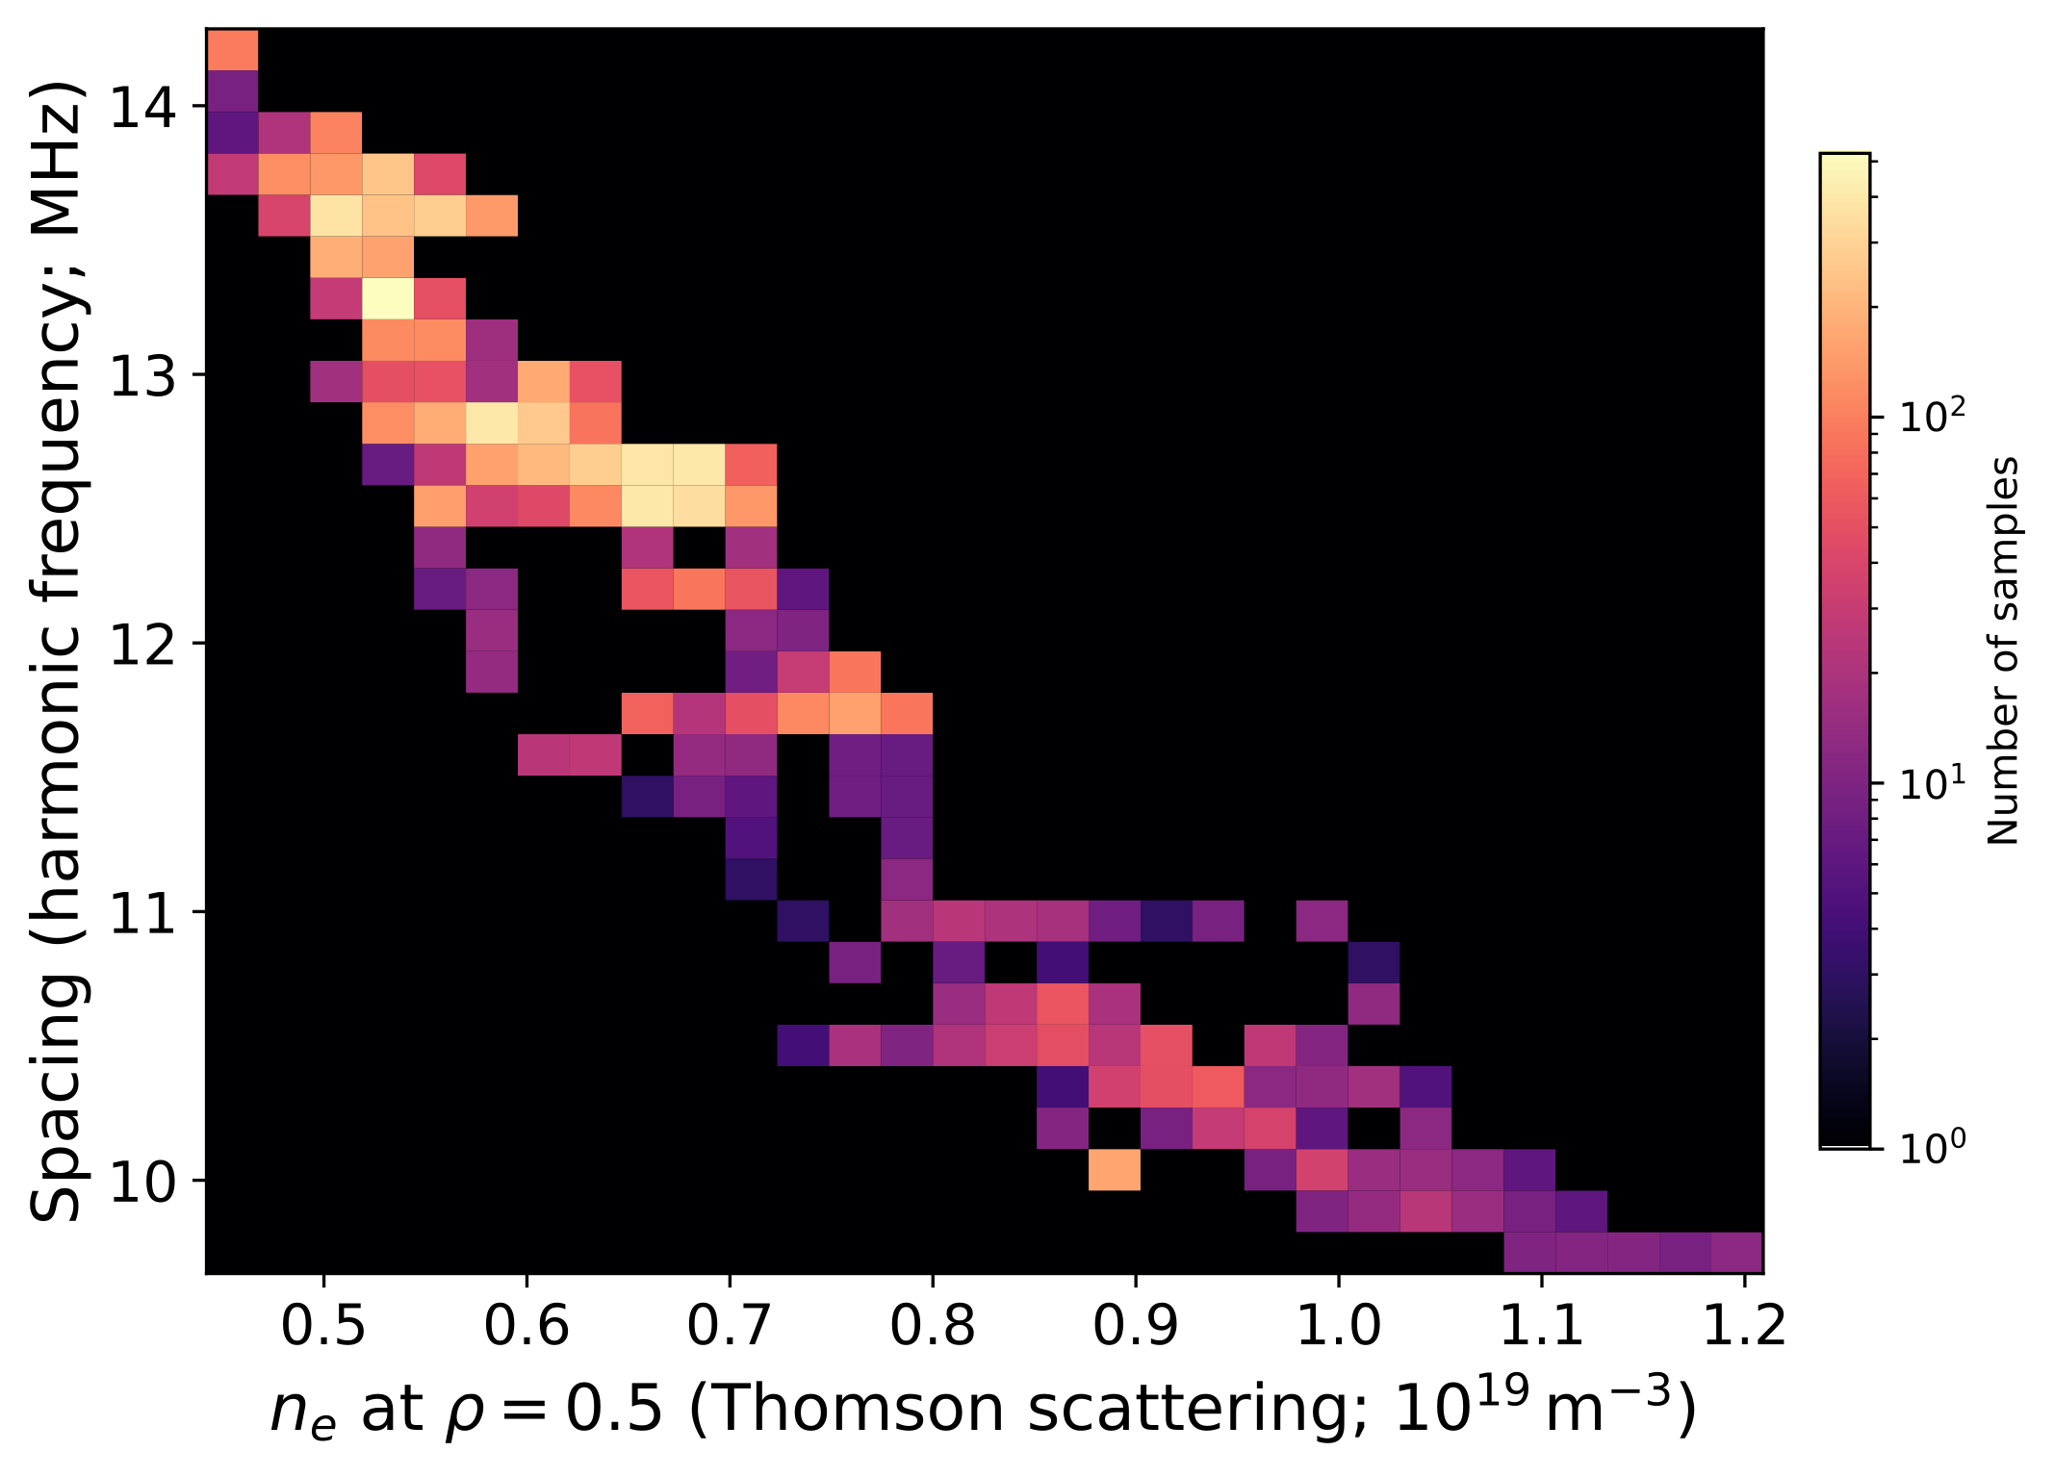
Investigating high-frequency instabilities associated with runaway electrons
    Automated mode-tracking algorithm developed to identify high-frequency (HF) modes measured by ICE probes
    69 RE discharges analyzed, with HF modes identified in 20 discharges. Similar to RE modes seen on DIII-D [1, 2, 3]
    Modes appear during high HXR emission, with some dependence on plasma triangularity and temperature
    Mode-pair frequency spacing exhibits a strong inverse correlation with plasma density.
Out of 69 shots, 20 exhibited modes
    Ongoing investigation to identifying the underlying wave physics (i.e. Whistlers [1,2] vs Ion Bernstein Waves [3])
[1] D.A. Spong et al 2018 Phys. Rev. Lett. 120, 1550021
[2] W.W. Heidbrink et al 2019 Plasma Phys. Control. Fusion 61 014007
[3] A. Lvovskiy et al 2019 Nucl. Fusion 59 124004
[4] W. Bin EPS Edinburg 2026
[5] C. Castaldo et al 2024 Nucl. Fusion 64 086003

Slide 30
Outline
    TCV as a fast-ion testbed
        Heating and fast-ion sources
        Fast-ion diagnostics
    TCV Modelling and analysis workflow
    Recent energetic-particle studies on TCV
      Negative vs positive triangularity confinement
      Alfvén eigenmode control
      Fishbone redistribution of fast ions
      Runaway-electron and high-frequency waves
    Conclusions and outlook

Slide 31
Conclusions
TCV provides a versatile testbed for energetic-particle studies, combining flexible heating, advanced diagnostics and integrated modelling.
Large suite of diagnostics enable detailed phase-space characterization of fast-ion populations.
NT and PT plasmas exhibit comparable neoclassical fast-ion confinement, but differences in AE activity and associated losses.
AE control experiments demonstrate effective TAE suppression using localized ECRH, with additional sensitivity to ECCD-induced equilibrium changes.
Fishbone instabilities produce coherent bursts of fast-ion losses, accompanied by ICE activity.
Other studies:
Structure and dynamics of n=0 modes, including eGAMs
See posters by D. Banerjee, L-G Erickson, S. Cavallero and talk by F. Porcelli.
Interplay between supra Alfvénic fast ions and Alfvén eigenmodes
Interplay between AEs and turbulence during improved-confinement regimes.

Slide 32
Outlook
Long-term goal: High-resolution characterization of fast-ion phase space to understand and ultimately control fast-ion transport and losses.
Leverage diagnostic upgrades:
ICE: Exploit the new toroidal array for mode-structure analysis.
MSE: Better constrain the core q-profile for equilibrium reconstruction and stability modelling.
Developing a new iNPA system for additional measurements of confined fast ions.
Extended stability modelling: Identify instability mechanisms and improve understanding of AE suppression and fast-ion redistribution.
Open to collaborations on both experimental and modelling activities!

Slide 33
THE END
Thank you for your attention!

Slide 34
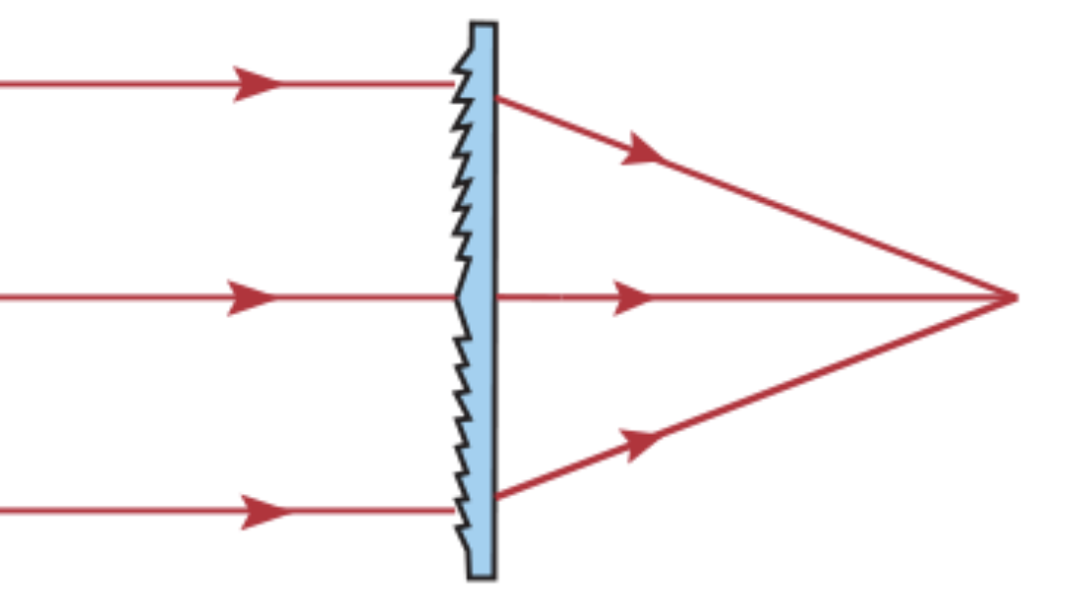
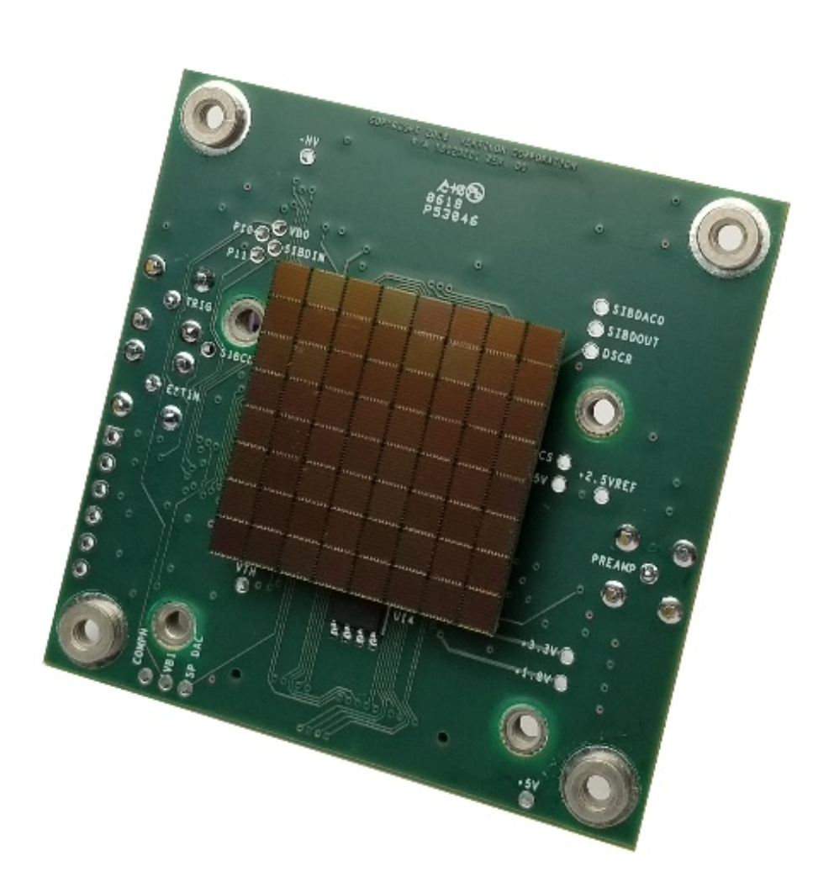
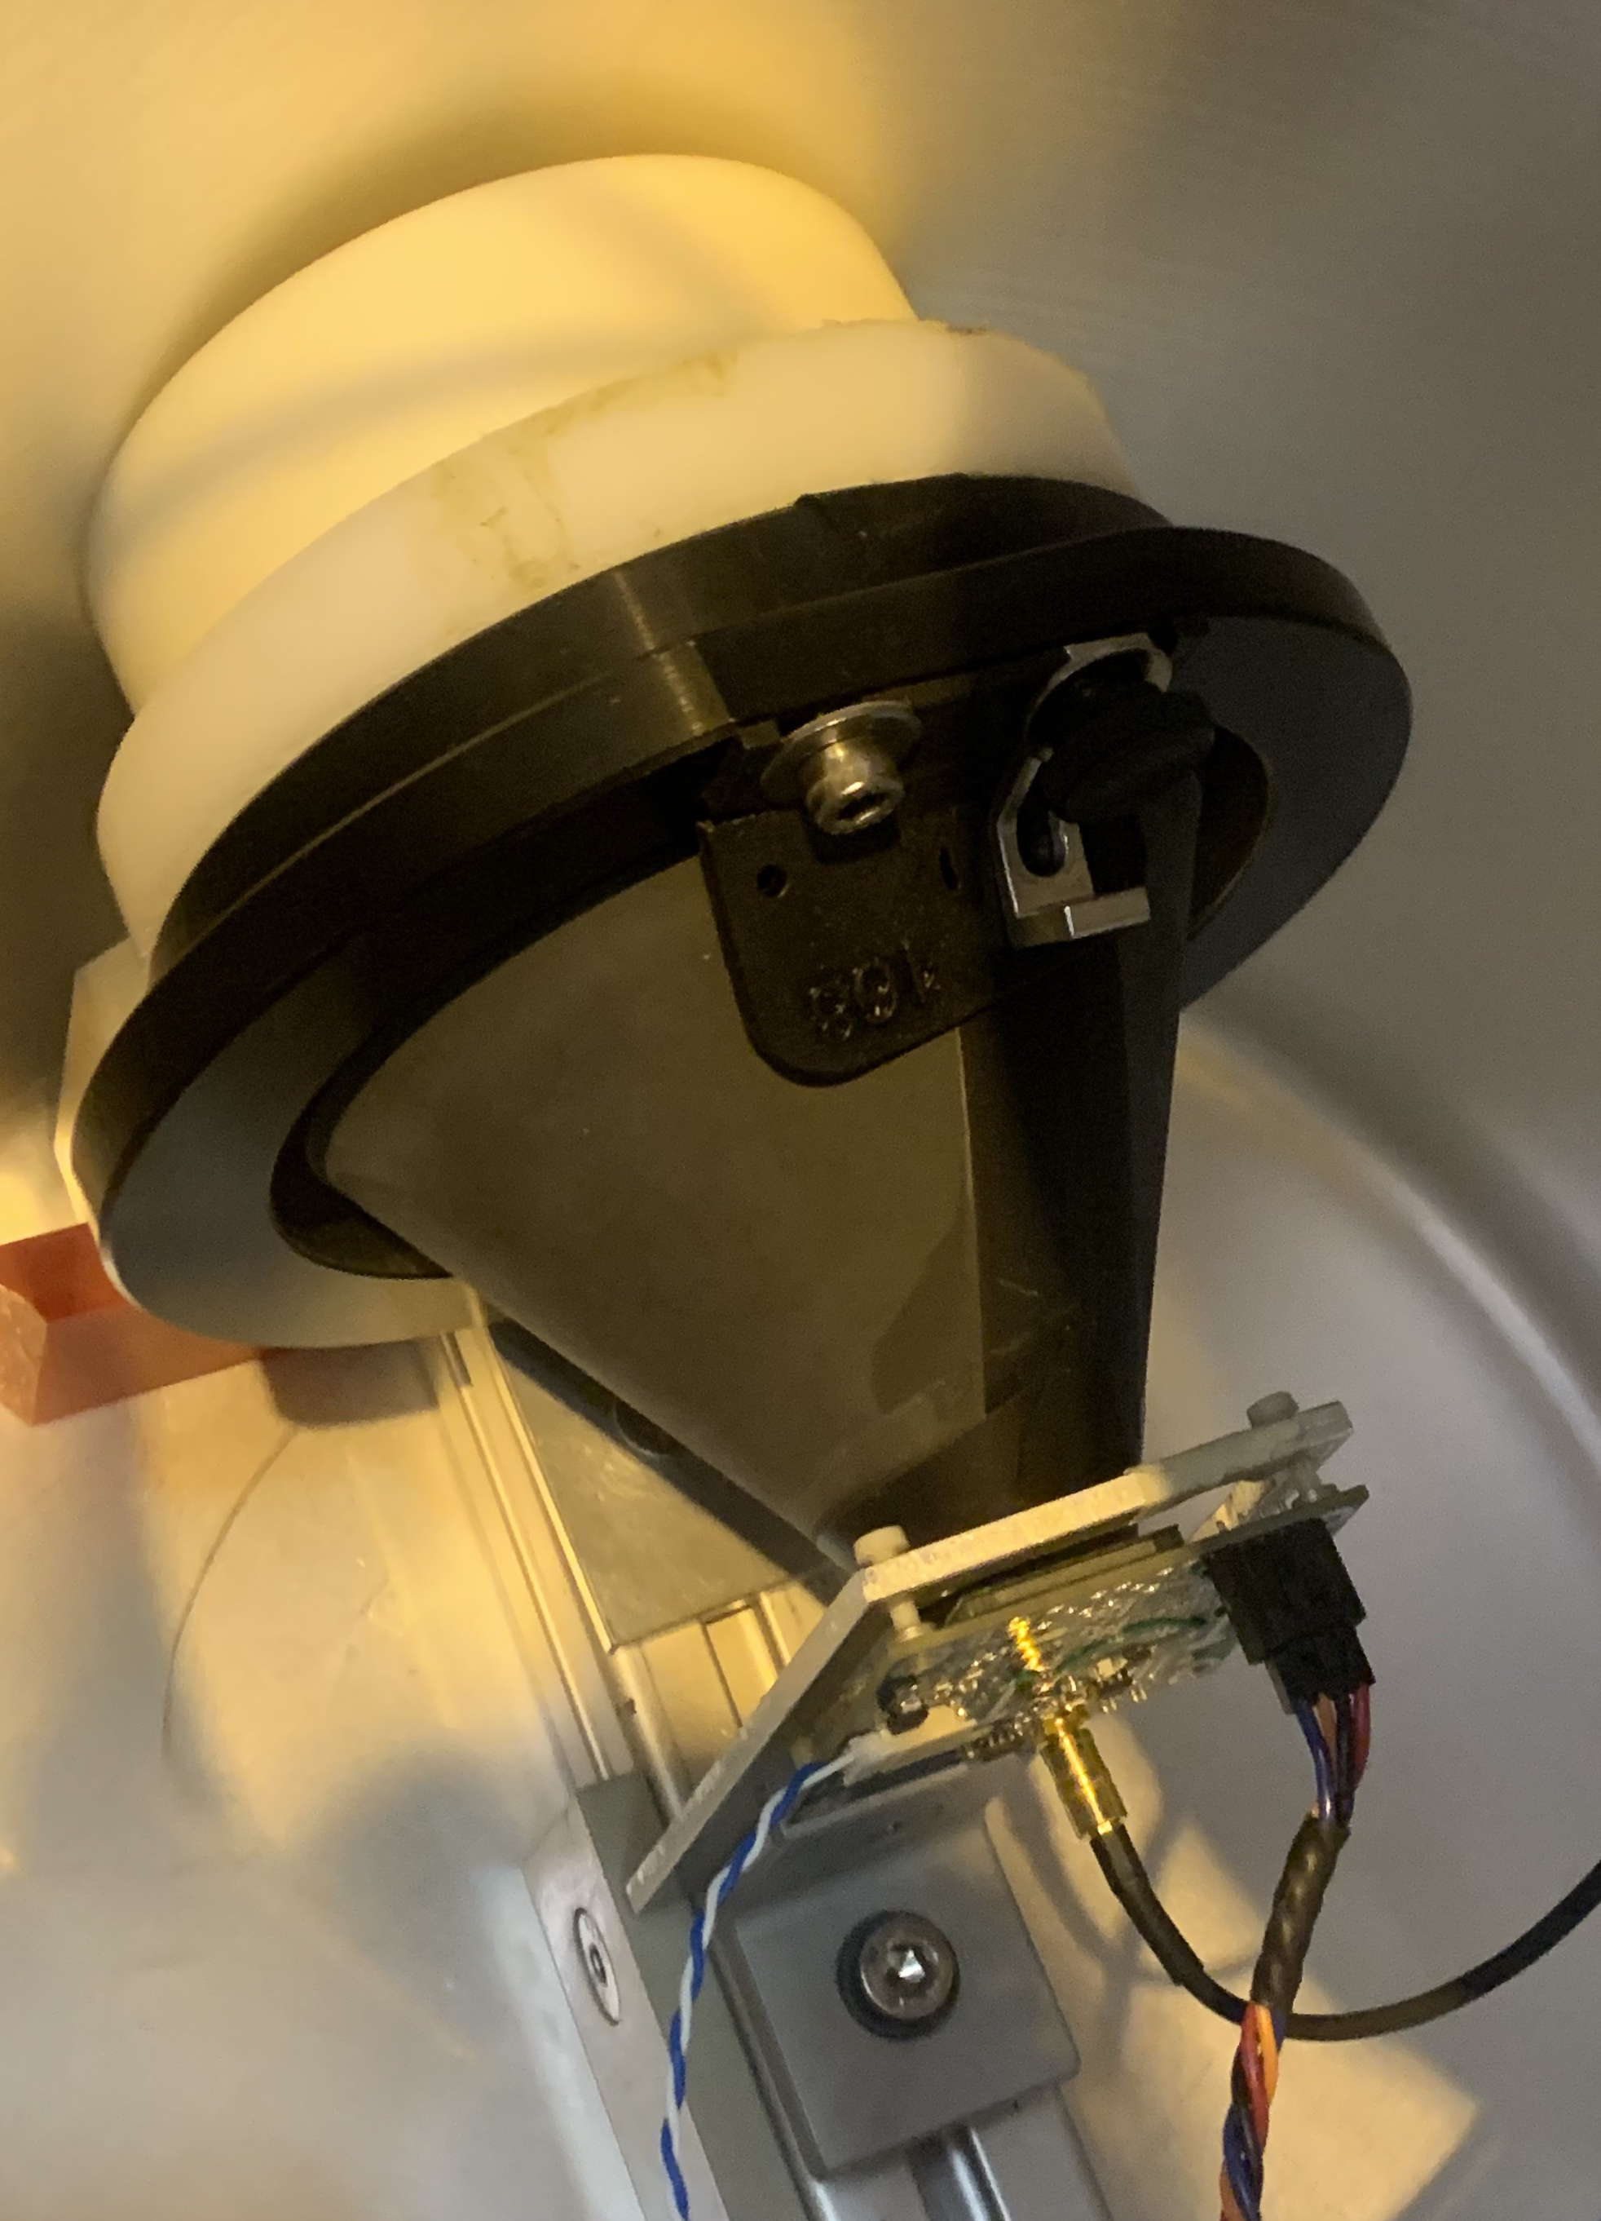
Neutron detector
filter
SiPM:
Ketek PA3325-WB-0808
    TCV is equipped with a fast scintillator (6Li in ZnS(Ag) ) based neutron detector
    The detector operates at 1MHz and can resolve changes in neutron flux rates due to MHD mode activity.
    The fast detector is cross-calibrated against a slow (50ms) calibrated LUPIN neutron detector.
mirrored surface
HDPE (50 mm)
Fresnel Lens
neutrons from TCV
HDPE
SiPM

