Slide 1



19th Technical Meeting on Energetic Particles in Magnetic Confinement Systems
Nonlinear dynamics of resistive hose modes for runaway electron beams in post-disruption tokamak plasmas
by Liu Tong¹
with Wang Zheng-Xiong¹ , Liu Shijie² , Wei Lai¹ , Wang Jialei³
1 Dalian University of Technology, Dalian 116024, PR China
2 Max Planck Institute for Plasma Physics, Garching bei München 85748, Germany
3 National Institute for Fusion Science, Toki 509-5292, Japan
2026.9.28-10.2 Lausanne, Switzerland

Slide 2

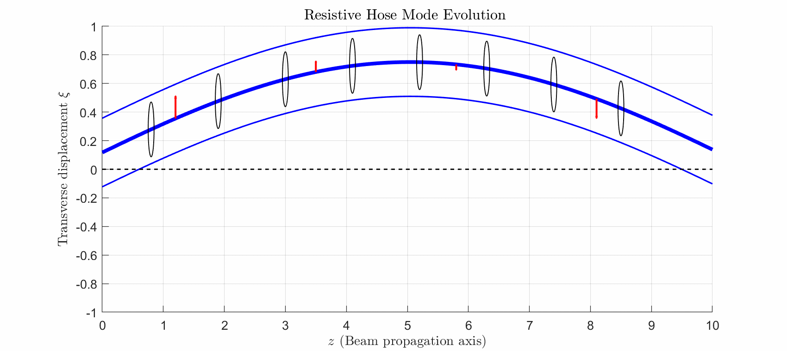
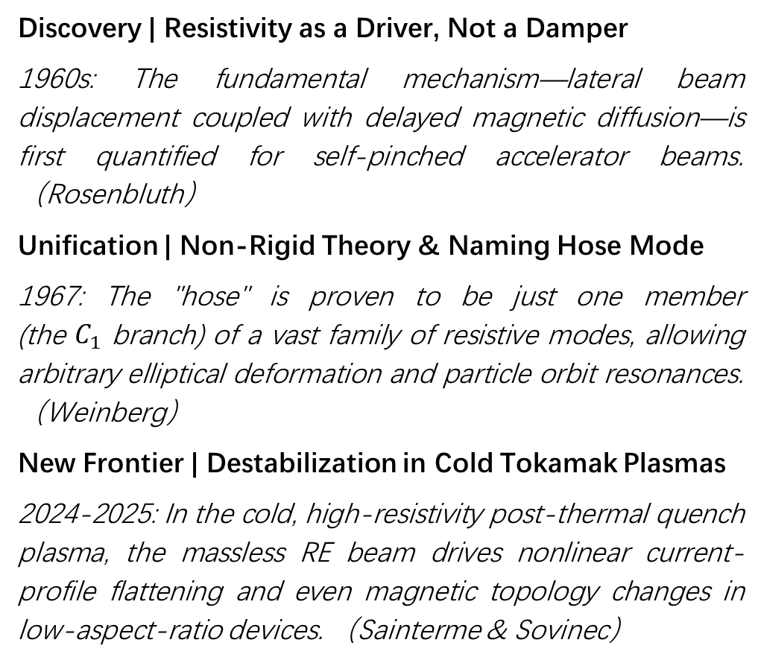
A Beam Instability Originating from Accelerator Physics
Discovery | Resistivity as a Driver, Not a Damper
1960s: The fundamental mechanism—lateral beam displacement coupled with delayed magnetic diffusion—is first quantified for self-pinched accelerator beams. （Rosenbluth）
Unification | Non-Rigid Theory & Naming Hose Mode
1967: The "hose" is proven to be just one member (the $C_{1}$ branch) of a vast family of resistive modes, allowing arbitrary elliptical deformation and particle orbit resonances. （Weinberg）
New Frontier | Destabilization in Cold Tokamak Plasmas
2024-2025: In the cold, high-resistivity post-thermal quench plasma, the massless RE beam drives nonlinear current-profile flattening and even magnetic topology changes in low-aspect-ratio devices. （Sainterme & Sovinec）

Slide 3
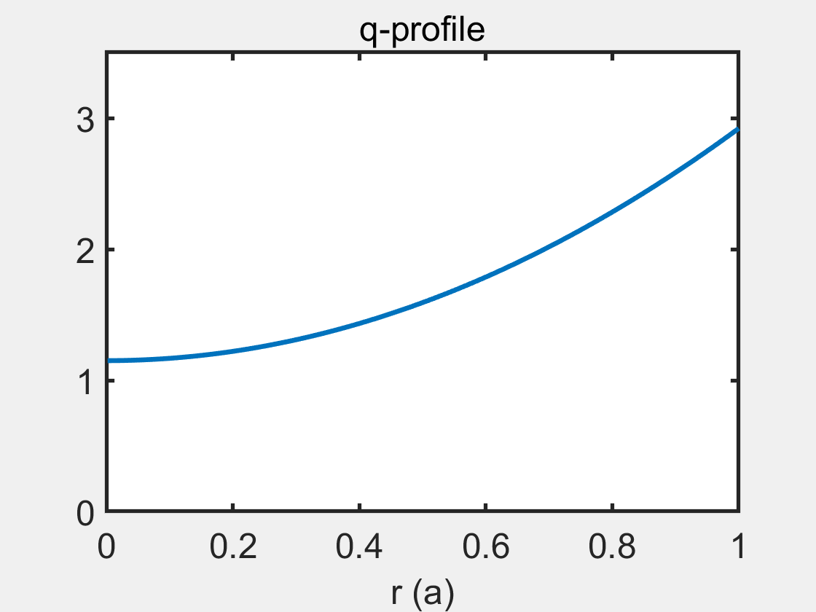
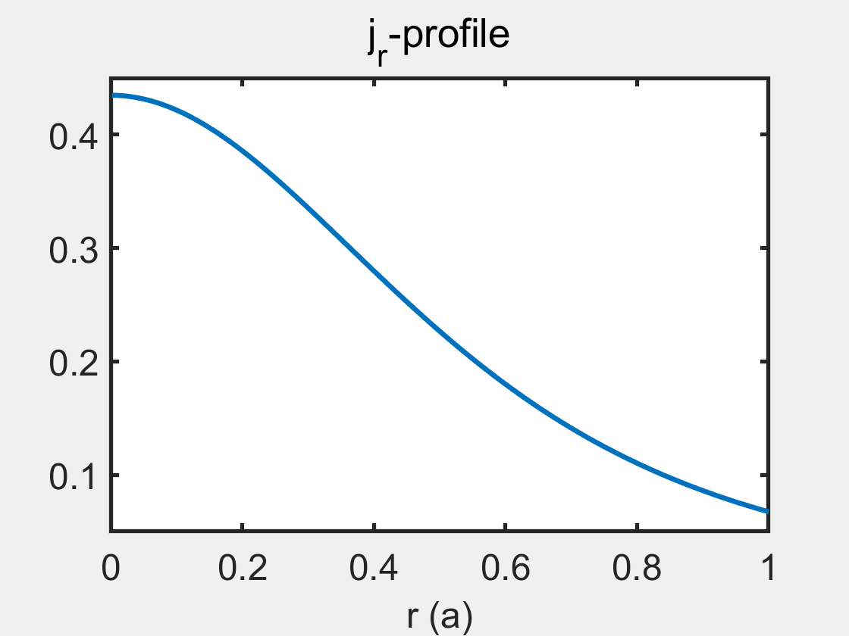
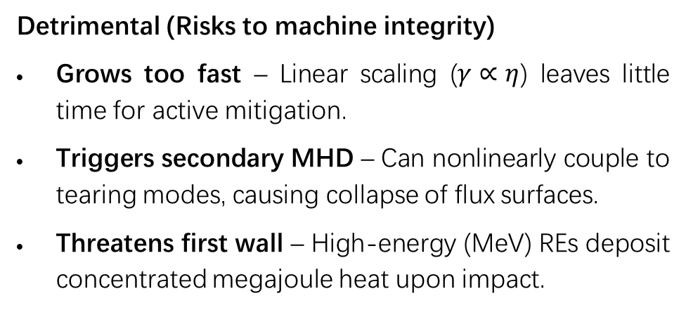
Nonlinear Hose Dynamics Ejecting REs for Better or Worse
Beneficial (Potential for benign mitigation)
Flattens current gradients – Removes the instability’s own free-energy source, self-limiting its growth.
Dilutes heat flux – Redistributes REs radially, spreading localized core energy over a larger volume.
May enable benign termination – Offers a passive path for RE deconfinement.
Detrimental (Risks to machine integrity)
Grows too fast – Linear scaling ($γ∝η$) leaves little time for active mitigation.
Triggers secondary MHD – Can nonlinearly couple to tearing modes, causing collapse of flux surfaces.
Threatens first wall – High-energy (MeV) REs deposit concentrated megajoule heat upon impact.

Slide 4

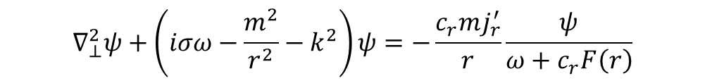
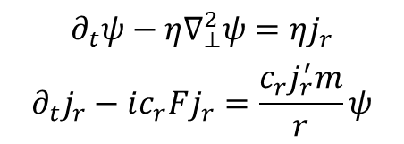
Resonance independent of the q=1 rational surface
Neglect background plasma flow ($v=0$); massless REs slide along perturbed field lines.
$$∂_{t}ψ−η∇_{⊥}^{2}ψ=ηj_{r}$$
$$∂_{t}j_{r}−ic_{r}Fj_{r}=\frac{c_{r}j_{r}^{′}m}{r}ψ$$
The top equation governs magnetic diffusion (Ohm's law + Faraday).
The bottom equation governs RE density convection along bent field lines.
$$∇_{⊥}^{2}ψ+\left(iσω−\frac{m^{2}}{r^{2}}−k^{2}\right)ψ=−\frac{c_{r}mj_{r}^{′}}{r}\frac{ψ}{ω+c_{r}F\left(r\right)}$$
Implicit Dispersion Relation
$$F\left(r\right)≡\frac{mB_{θ}{\left(r\right)}/r+kB_{z}\left(r\right)}{B\left(r\right)}$$
Resonance Condition
$$ω+c_{r}F\left(r\right)=0$$
The left-hand side is the resistive diffusion of the perturbed field. The right-hand side is the drive term, proportional to the RE current gradient .
When the denominator approaches zero, the drive diverges. This is where the electron-wave resonance occurs.

Slide 5
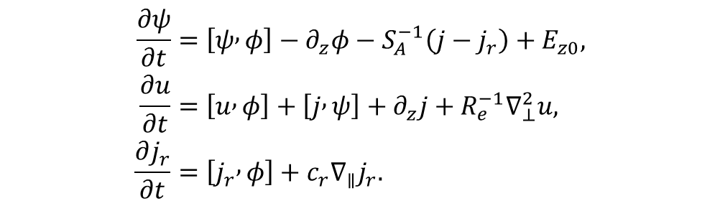
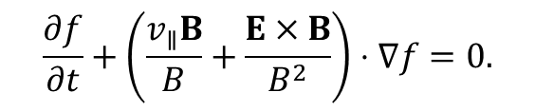


Fluid RE Current: Velocity-Space Integration of Drift-Kinetics
Helander P. et al. POP (2007)
In the zero-gyroradius limit, the runaway electron distribution function f is governed by the drift kinetic equation.
$$\begin{aligned}\frac{∂ψ}{∂t}&=\left[ψ , φ\right]−∂_{z}φ−S_{A}^{−1}\left(j−j_{r}\right)+E_{z0}, \\ \frac{∂u}{∂t}&=\left[u , φ\right]+\left[j , ψ\right]+∂_{z}j+R_{e}^{−1}∇_{⊥}^{2}u, \\ \frac{∂j_{r}}{∂t}&=\left[j_{r} , φ\right]+c_{r}∇_{∥}j_{r}.\end{aligned}$$
$$\frac{∂f}{∂t}+\left(\frac{v_{∥}B}{B}+\frac{E×B}{B^{2}}\right)⋅∇f=0.$$
$$j=−∇_{⊥}^{2}ψ$$
$$u=∇_{⊥}^{2}φ$$
The runaways move practically at the speed of light along the magnetic field.
It is straightforward to integrate over velocity space and obtain an equation for the normalized runaway current density.
Following the thermal quench, the plasma is well approximated by the large‑aspect‑ratio, low‑beta, circular‑cross‑section limit, and the reduced MHD equations are adequate for capturing the relevant physical processes.

Slide 6
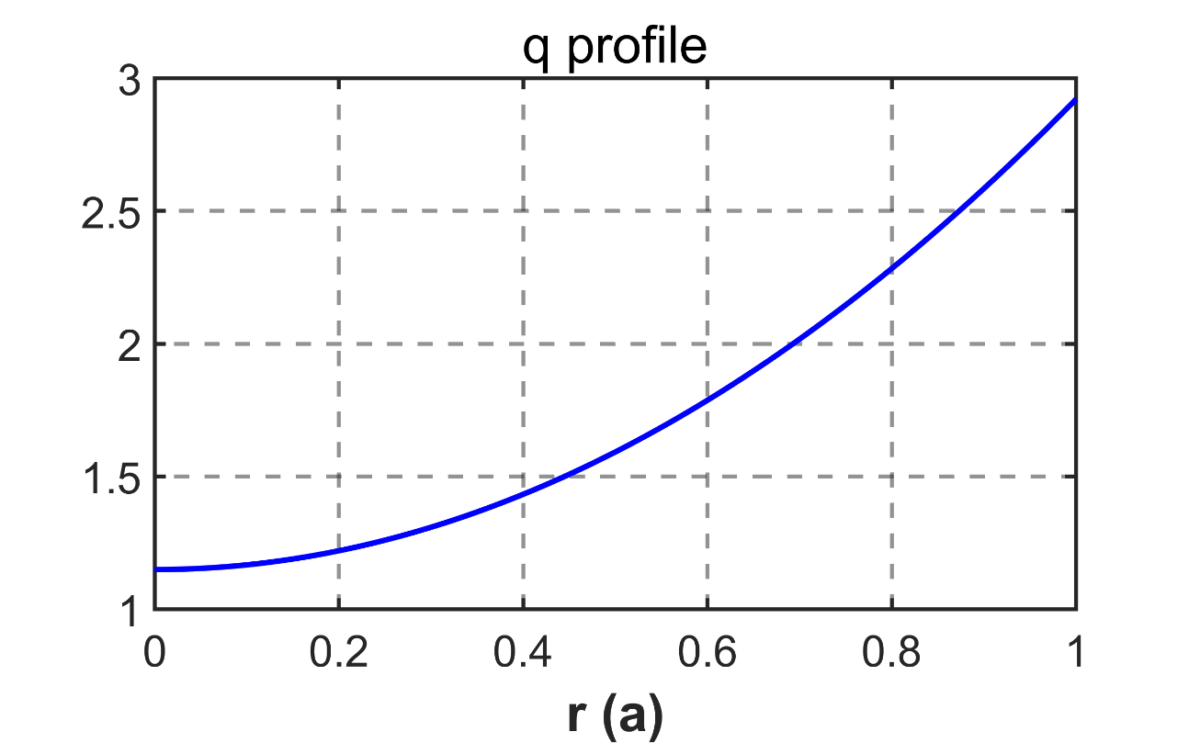
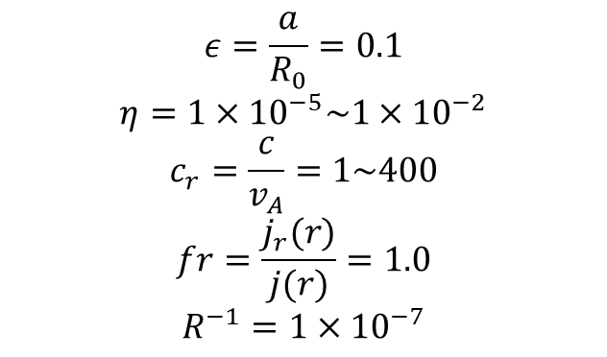
Initial equilibrium with a monotonic q-profile
$$ε=\frac{a}{R_{0}}=0.1$$
$$η=1×{10}^{−5}\sim 1×{10}^{−2}$$
$$c_{r}=\frac{c}{v_{A}}=1\sim 400$$
$$fr=\frac{j_{r}(r)}{j(r)}=1.0$$
$$R^{−1}=1×{10}^{−7}$$
Liu C. et al. POP (2020) Sainterme & Sovinec POP (2024) Liu S.J. et al. JPP (2026)
The monotonic q-profile is selected for the purpose of benchmarking with other codes.
An extensive parameter scan has been performed, covering conventional and advanced tokamak regimes.

Slide 7
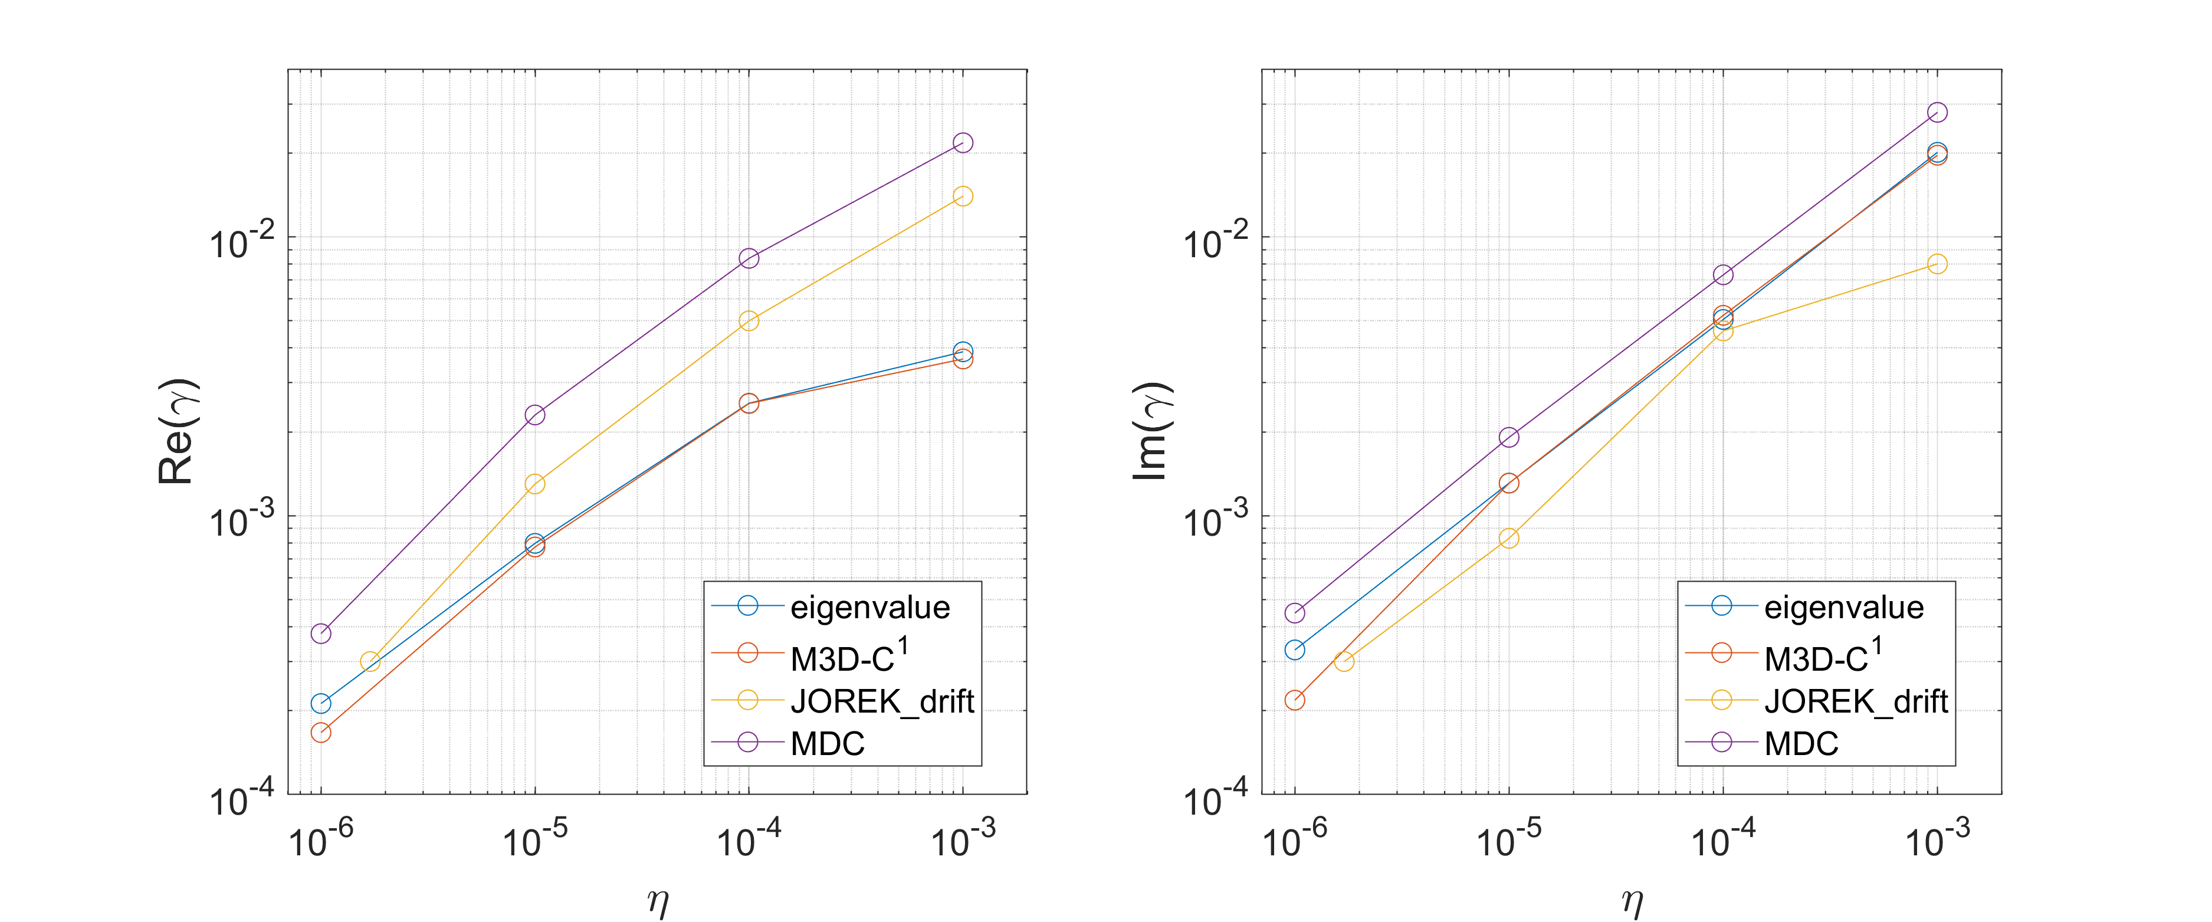
Benchmarked against multiple internationally established codes
The monotonic q-profile is selected for the purpose of benchmarking with other codes.
An extensive parameter scan has been performed, covering conventional and advanced tokamak regimes.

Slide 8
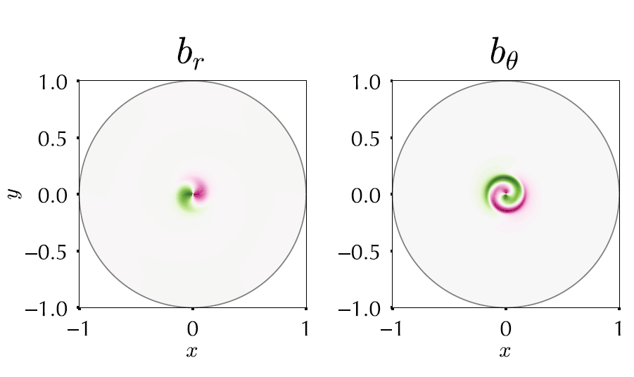
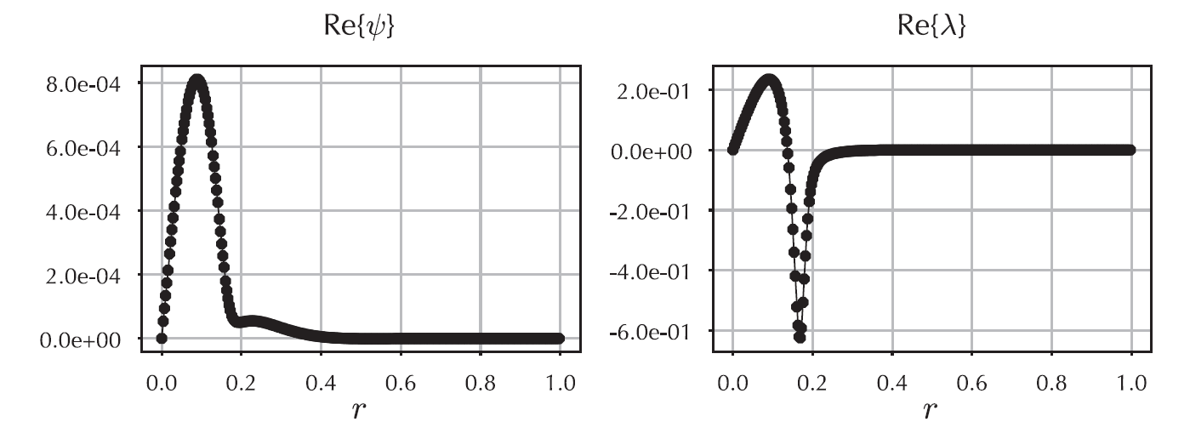
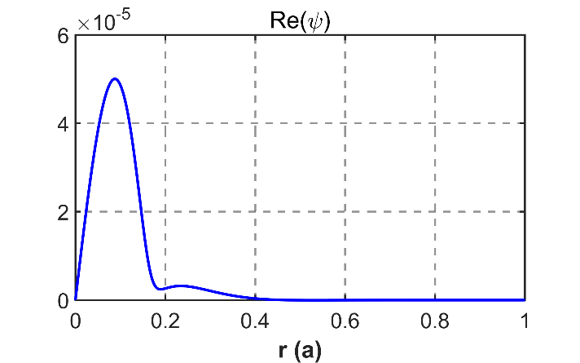
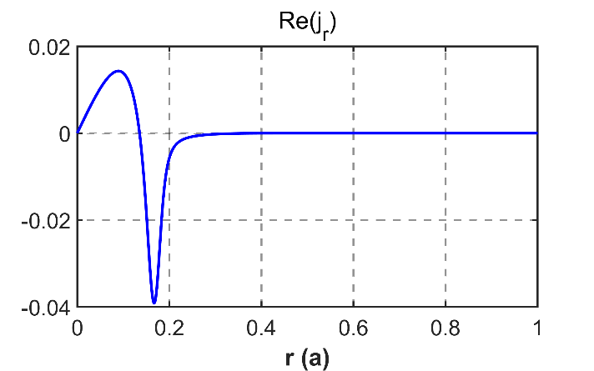
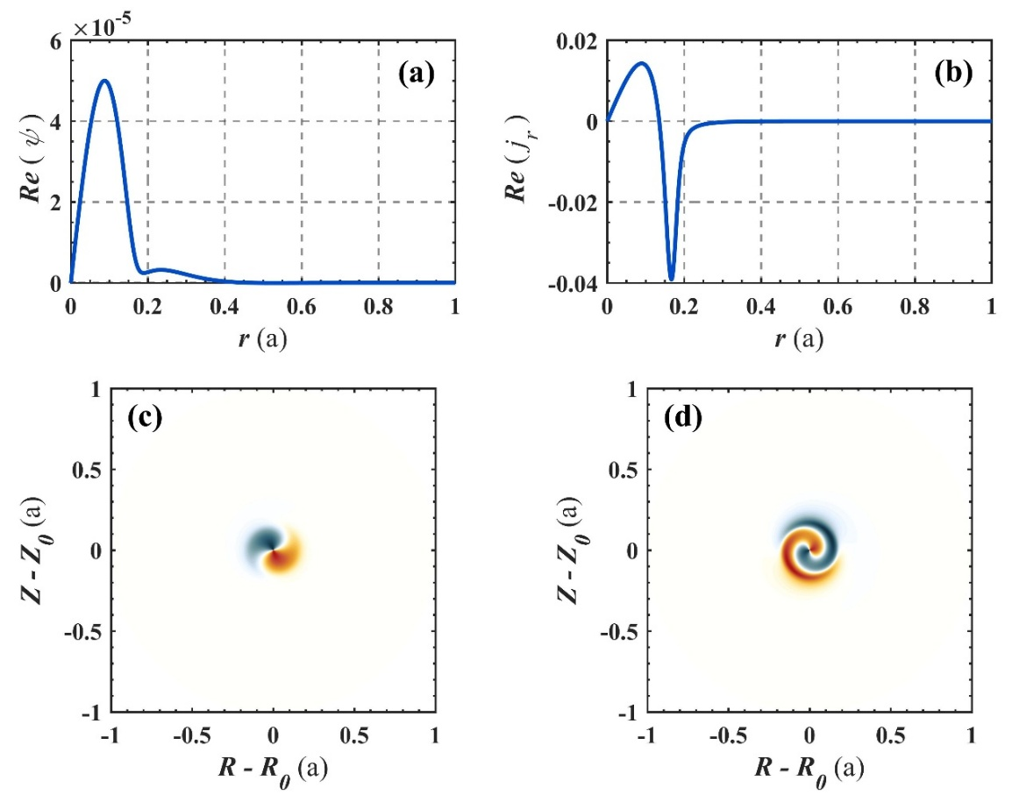
RHM Eigenmode structure matches NIMROD
Sainterme & Sovinec POP (2024)
MHD@Dalian Code

Slide 9
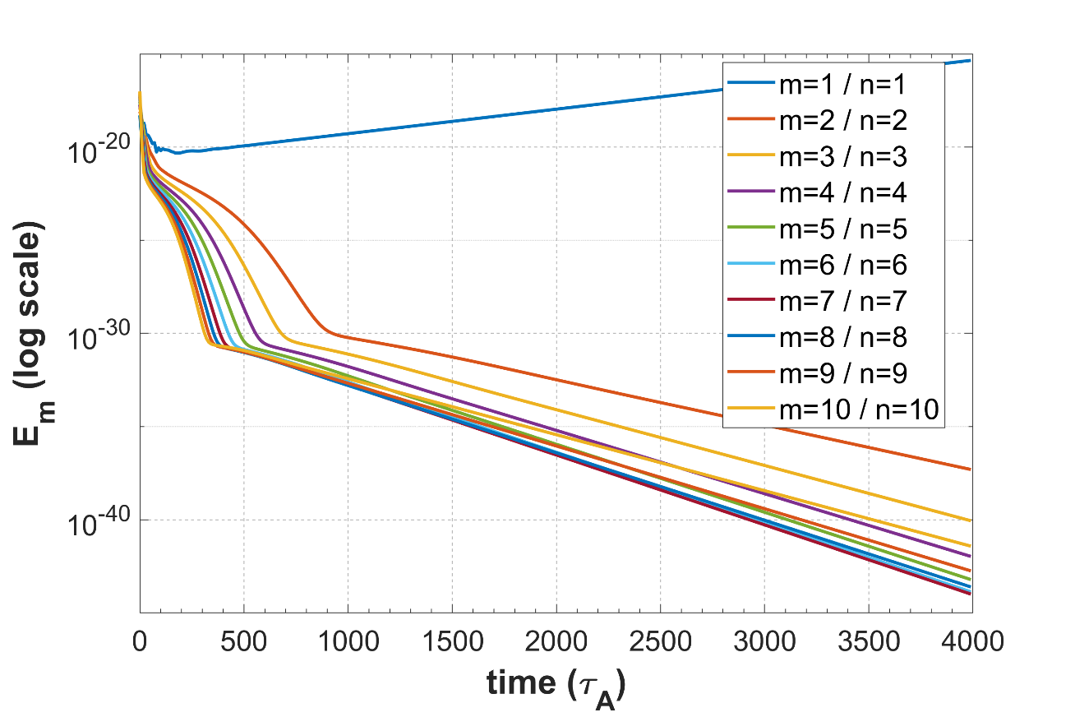
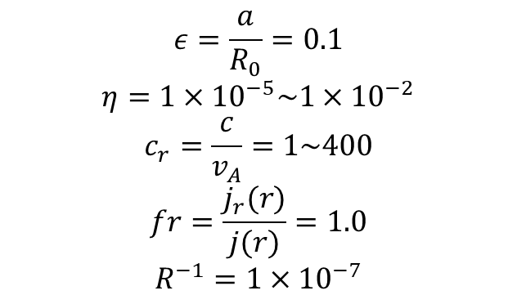
Higher harmonics remain stable except m/n=1/1 mode
$$ε=\frac{a}{R_{0}}=0.1$$
$$η=1×{10}^{−5}\sim 1×{10}^{−2}$$
$$c_{r}=\frac{c}{v_{A}}=1\sim 400$$
$$fr=\frac{j_{r}(r)}{j(r)}=1.0$$
$$R^{−1}=1×{10}^{−7}$$
Within the parameter range studied, only the n=1 mode is unstable.
According to the resonance relation, the higher harmonics have very high frequencies and thus require higher resistivity to be excited.

Slide 10
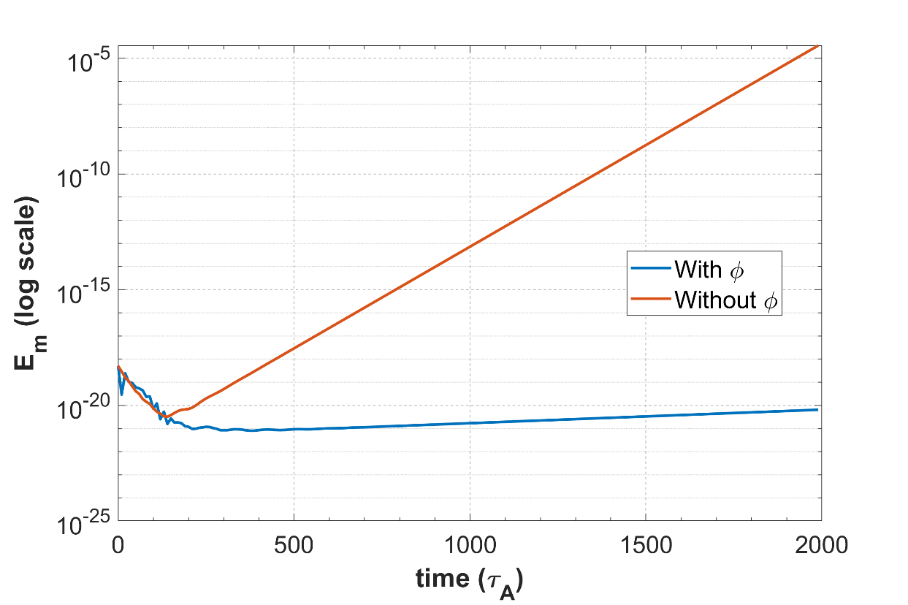
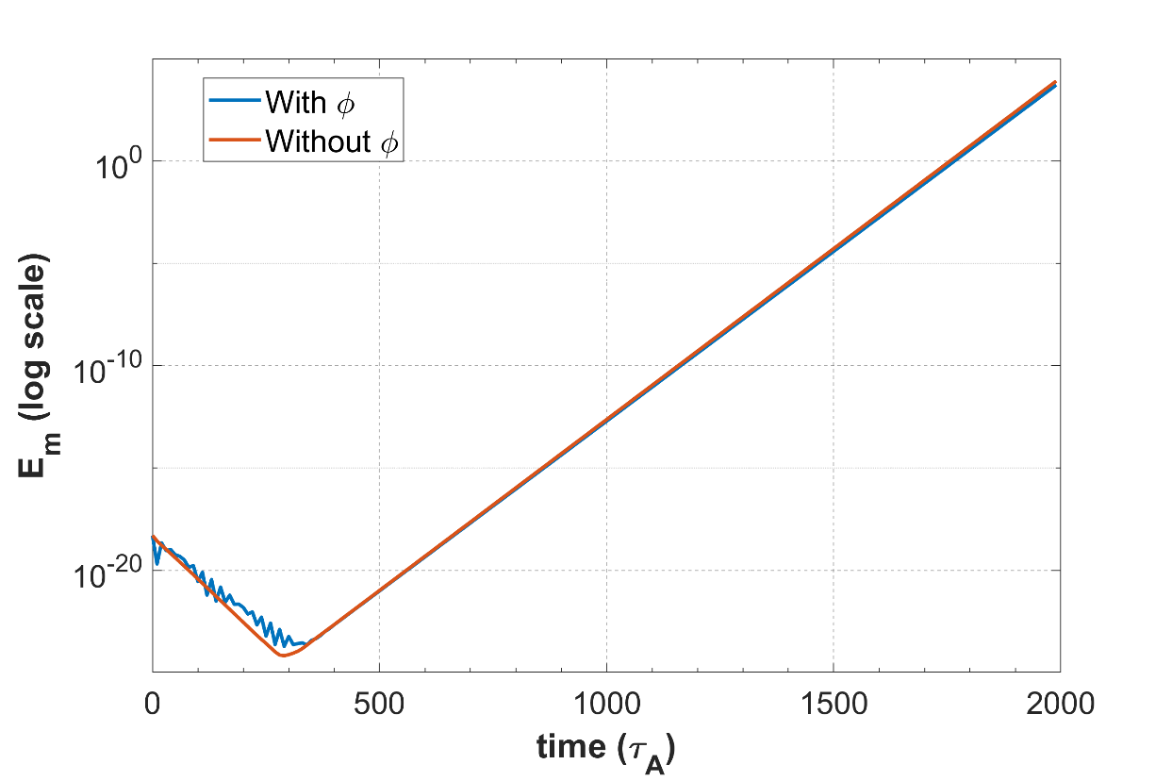


Beam decouples from background flow when $c_{r}≫V_{A}$
$$c_{r}=2$$
$$c_{r}=50$$
When the runaway electron velocity becomes comparable to the Alfvén velocity, the background fluid response significantly reduces the mode growth rate.
When the runaway electron velocity is much greater than the Alfvén velocity, the background fluid and the beam perturbation are almost completely decoupled.

Slide 11
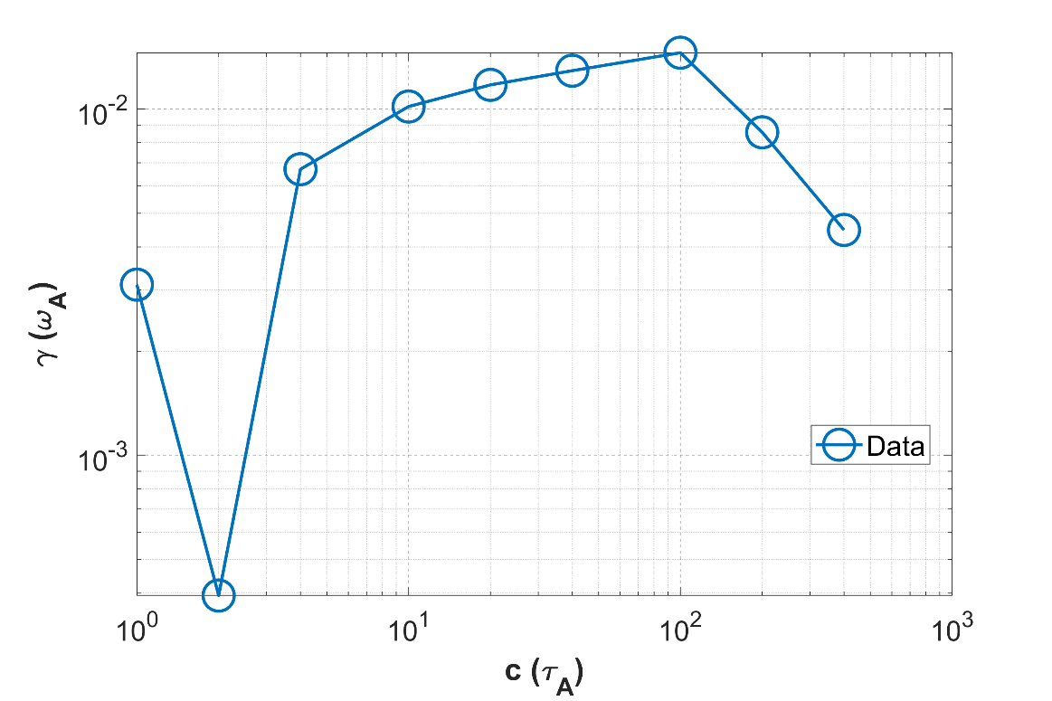
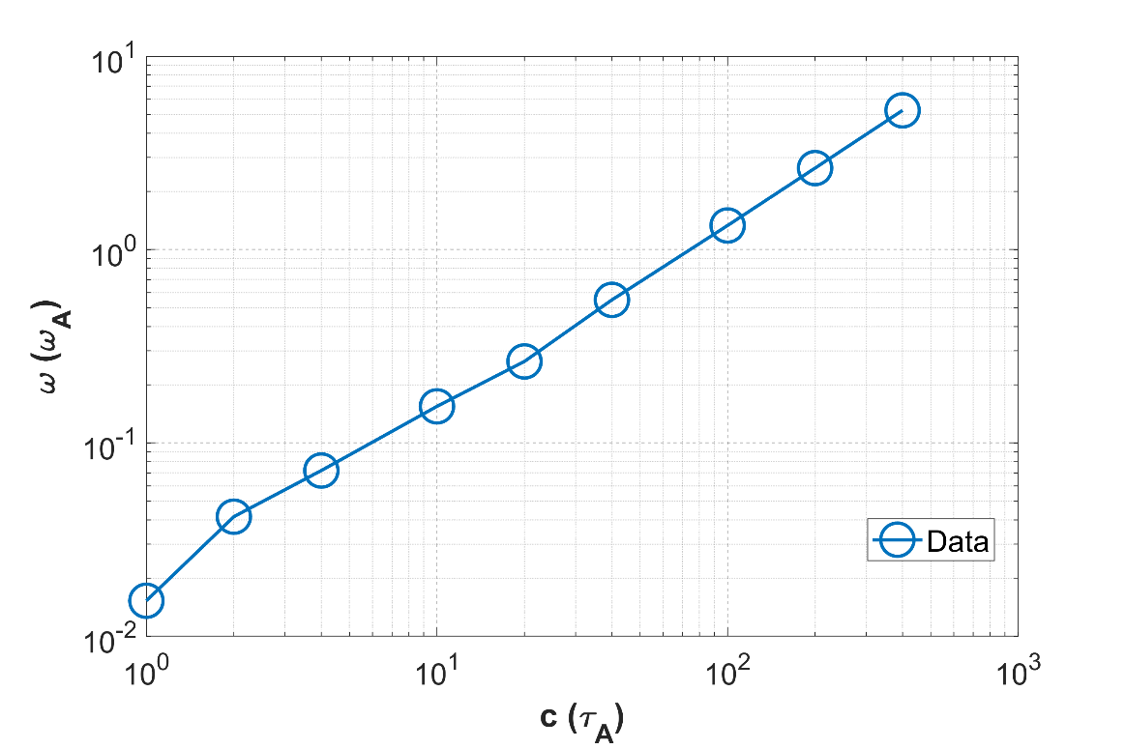



Growth rate exhibits a maximum as a function of $c_{r}$
$$Growth Rate$$
$$Mode Freqency$$
$$η=3×{10}^{−4}$$
The mode growth rate varies non‑monotonically with the normalized runaway electron velocity.
When the runaway electron velocity is much greater than the Alfvén velocity, the mode growth rate first increases and then decreases.
The mode frequency increases monotonically with the runaway electron velocity.

Slide 12
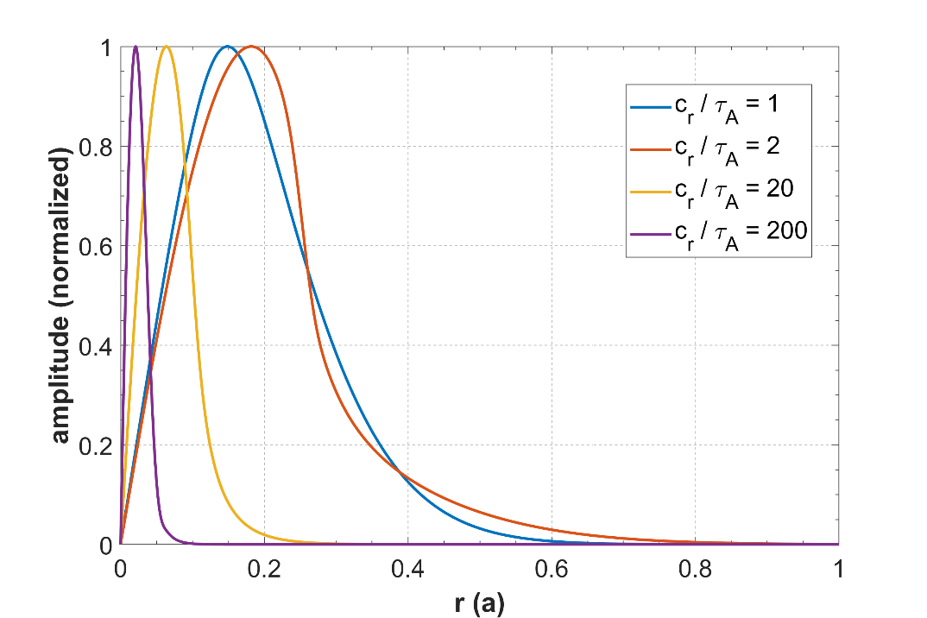


Low growth rate at high $c_{r}$ due to mode width narrowing
$$Growth Rate$$
$$Mode Structure$$
$$ω+c_{r}F\left(r\right)=0$$
$$η=3×{10}^{−4}$$
When the runaway electron velocity becomes comparable to the Alfvén velocity, the growth rate and mode structure are influenced by the background fluid.
When the runaway electron velocity is much greater than the Alfvén velocity, the reduction in the growth rate at high runaway electron velocities is attributed to the narrowing of the mode width.

Slide 13
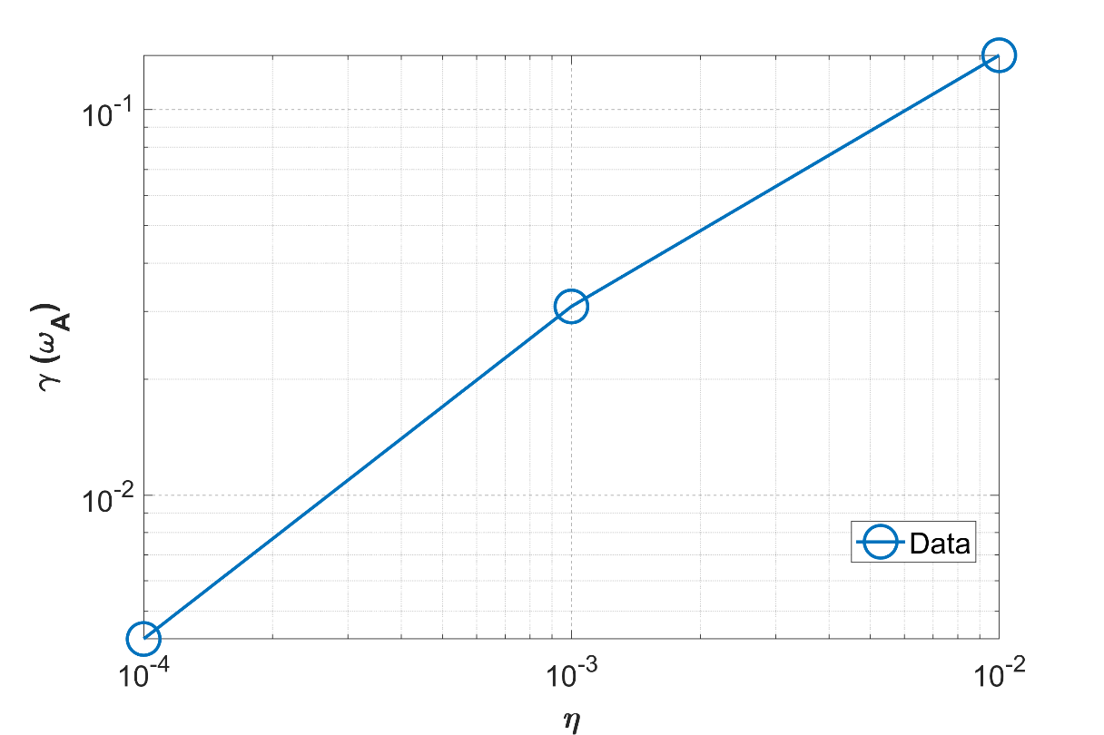
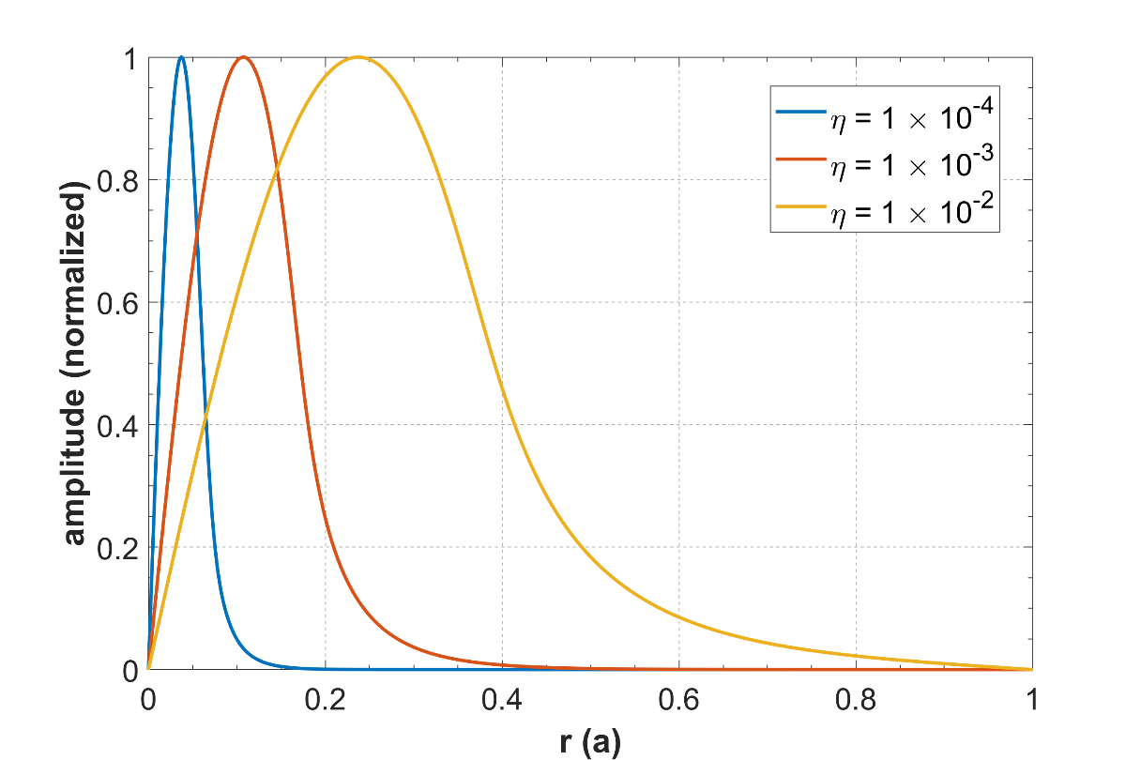

Larger resistivity favors excitation of stronger unstable modes
$$Growth Rate$$
$$Mode Structure$$
$$ω+c_{r}F\left(r\right)=0$$
$$c_{r}=20$$
As the resistivity increases, the growth rate increases, the resonant surface shifts outward, the mode structure broadens, and the mode frequency increases.
The reason is that the increased resistivity leads to a larger phase lag, which in turn excites resonances at higher frequencies.

Slide 14
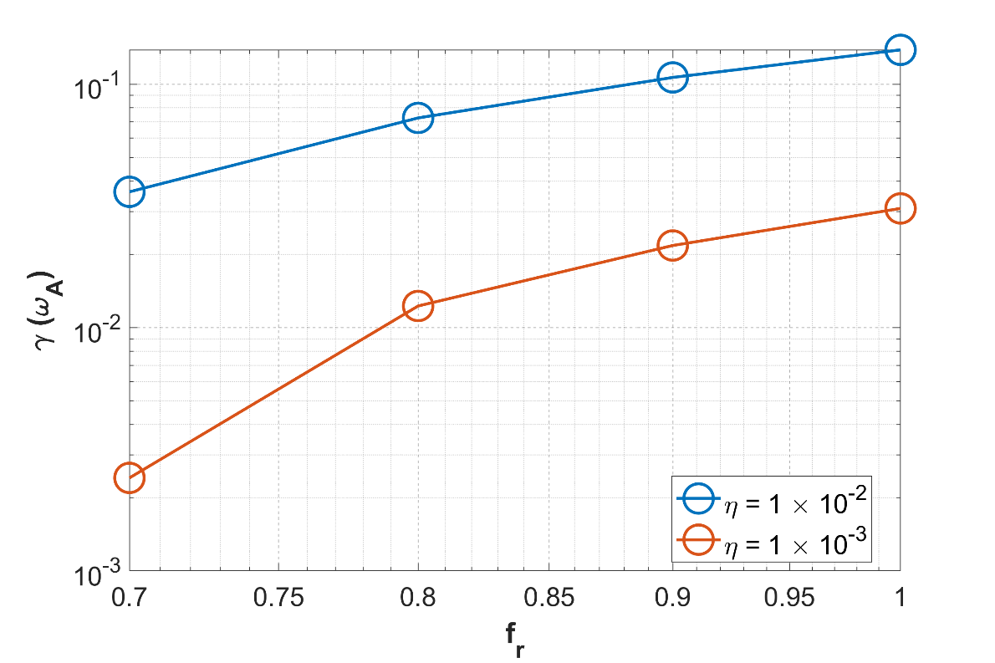
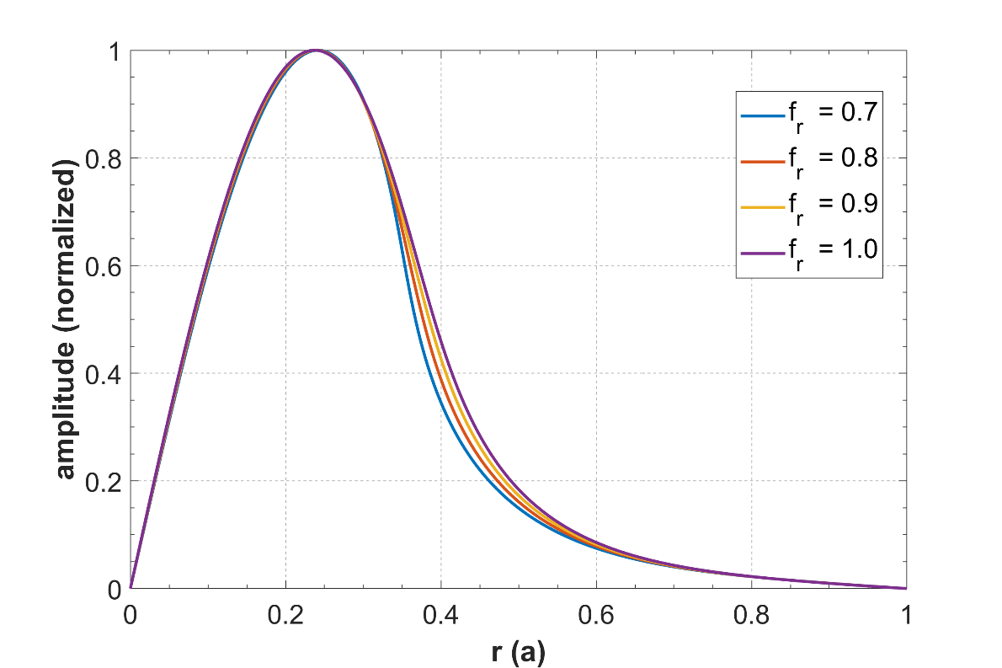


RHM can be excited before the RE current saturates
$$Growth Rate$$
$$Mode Structure$$
$$ω+c_{r}F\left(r\right)=0$$
$$η=1×{10}^{−2}$$
Resistive hose modes have very high growth rates and may be excited before the runaway electrons saturate. Therefore, it is necessary to consider the effect of the runaway electron current fraction.
As the RE current fraction decreases, the mode growth rate drops, while the resonant surface position and the mode frequency remain nearly unchanged.
Resistivity has little effect on the threshold RE current fraction for exciting the RHM.

Slide 15
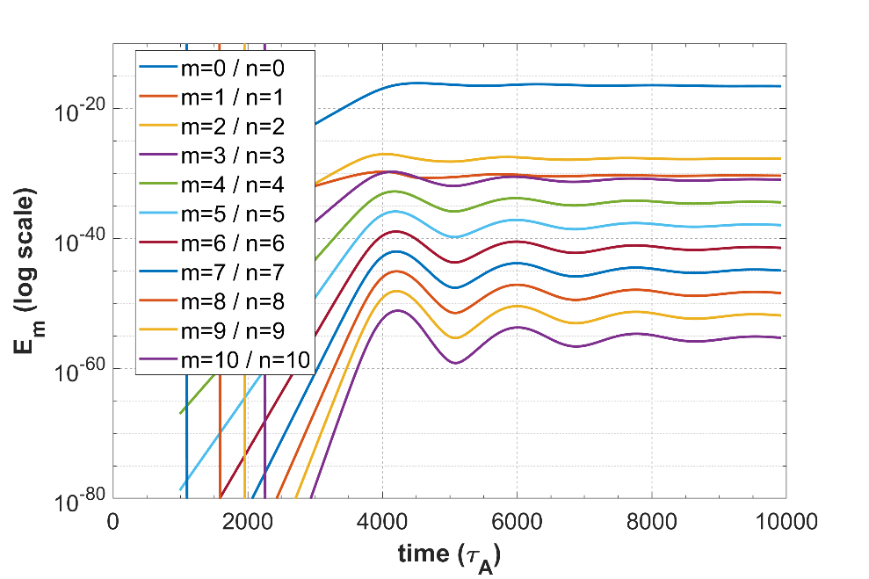
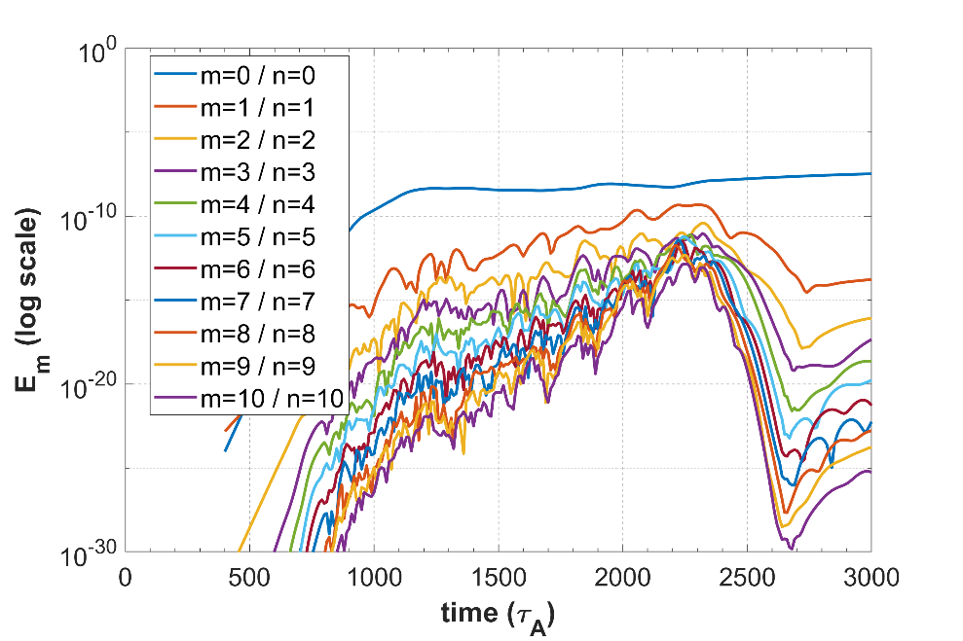
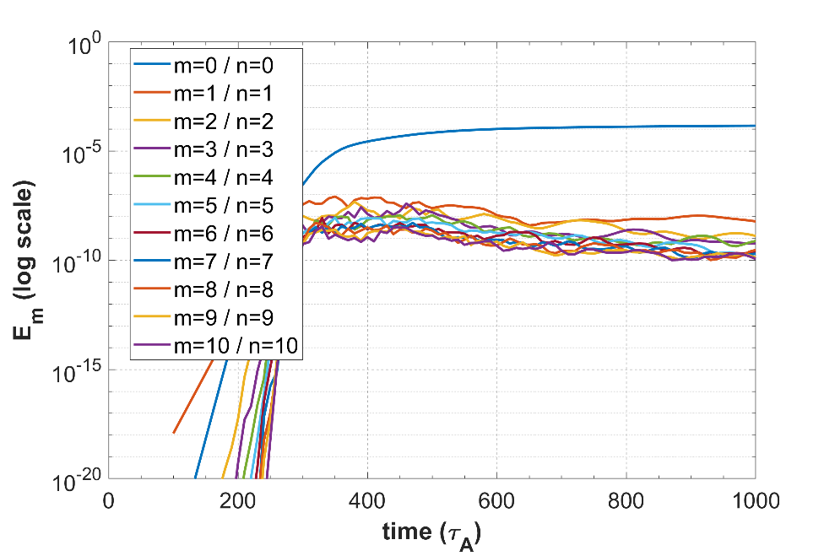






High resistivity increases the mode saturation amplitude
$$c_{r}=20$$
$$c_{r}=20$$
$$c_{r}=20$$
$$η=2×{10}^{−4}$$
$$η=1×{10}^{−3}$$
$$η=5×{10}^{−3}$$
For low resistivity, the mode perturbation evolves gently and the saturation amplitude is very low.
For intermediate resistivity, the mode perturbation evolves violently, the nonlinear interactions are strong, and the saturation amplitude is moderate.
For high resistivity, the mode perturbation evolves very violently, the mode saturates rapidly, and the saturation amplitude is very large.

Slide 16
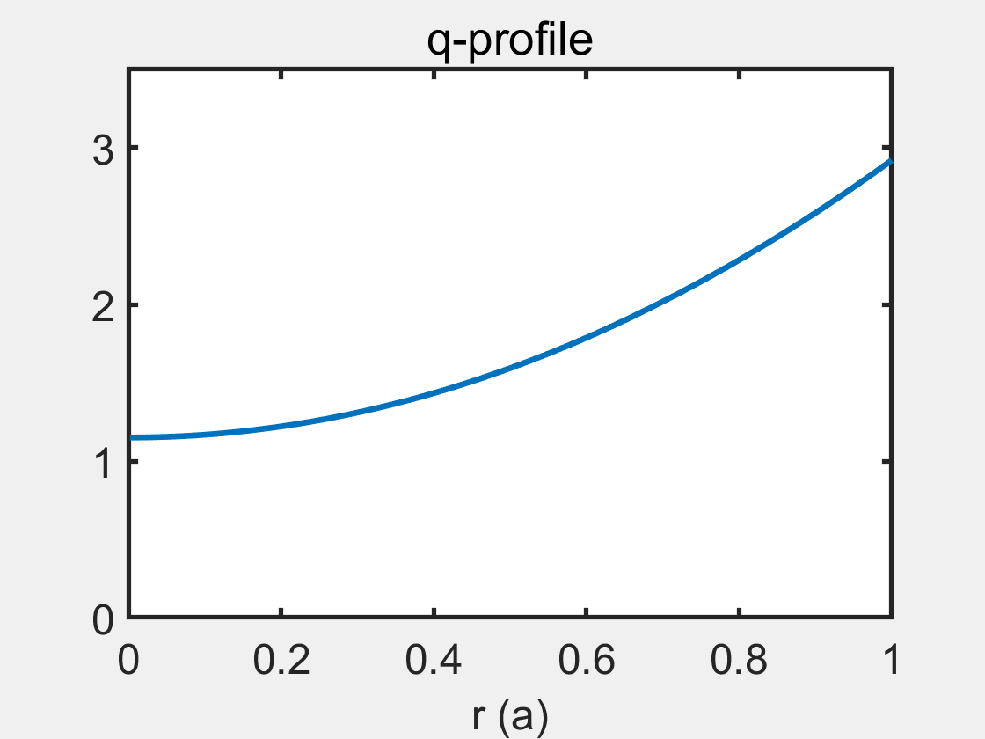
RHM nonlinear evolution lead to rapid q‑profile collapse
$$c_{r}=20$$
$$c_{r}=20$$
$$c_{r}=20$$
$$η=2×{10}^{−4}$$
$$η=1×{10}^{−3}$$
$$η=5×{10}^{−3}$$
For low resistivity, the q‑profile changes very little; for intermediate resistivity, it partially flattens and then saturates; for high resistivity, it collapses rapidly and completely.
For high‑field tokamaks, high‑resistivity conditions are very dangerous.

Slide 17
Nonlinear evolution of RHM can assist in RE dissipation
$$c_{r}=20$$
$$c_{r}=20$$
$$c_{r}=20$$
$$η=2×{10}^{−4}$$
$$η=1×{10}^{−3}$$
$$η=5×{10}^{−3}$$
For low resistivity, the current‑profile changes very little; for intermediate resistivity, it partially flattens and then saturates; for high resistivity, it collapses rapidly and completely.
For high‑field tokamaks, high‑resistivity conditions are very dangerous.

Slide 18


RHM is beneficial within range of existing tokamaks
$$c_{r}=200$$
$$c_{r}=400$$

Slide 19
Summary
RHM as a self‑limiting beam instability – The resistive hose mode (RHM) flattens current gradients ，redistributes runaway electrons radially, and may offer a benign termination path, independent of the q = 1 rational surface.
Resonance and driving condition – The instability is driven by the gradient of the runaway electron current; resonance occurs when the denominator in the dispersion relation approaches zero, and it does not rely on the q = 1 surface.
Non‑monotonic growth with runaway velocity – The growth rate varies non‑monotonically with normalized RE velocity: it increases at intermediate velocities and then decreases at very high velocities, while the mode frequency monotonically rises.
Strong resistivity dependence – Increasing resistivity raises the growth rate, shifts the resonant surface outward, broadens the mode structure, and increases the mode frequency. Larger resistivity also favours stronger unstable modes and raises the saturation amplitude.
Resistivity effects on q‑profile evolution – At low resistivity the q‑profile changes little; at intermediate resistivity it partially flattens and saturates; at high resistivity it collapses rapidly and completely, which is especially dangerous for high‑field tokamaks.
Potential benefit in present‑day devices – Within the parameter range of existing tokamaks, the RHM can assist in runaway electron dissipation and may be beneficial for mitigation, though its nonlinear evolution must be carefully controlled to avoid rapid profile collapse.

Slide 20

Thank you！

Slide 21
Backup

Slide 22
感谢各位老师同学！
敬请指导！

