Slide 1
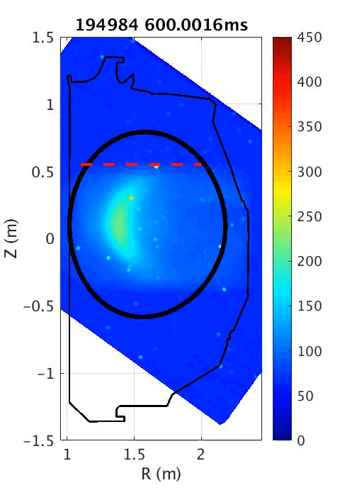
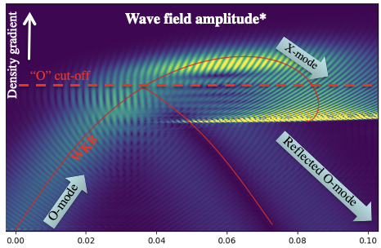
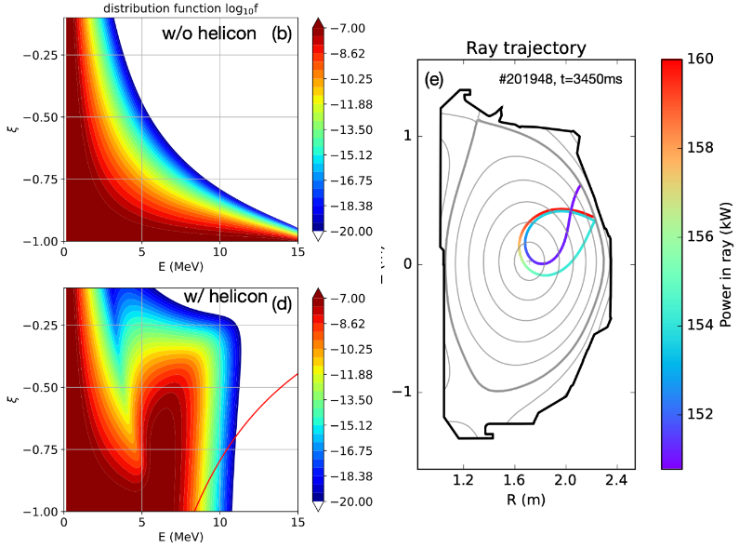
The Effect of Externally Applied and Self-Excited Waves on Relativistic Electrons
By:
Alexander Battey, H. Choudhury, P. Aleynikov, C. Paz-Soldan, X. Tang, Q. Zhang, Y. Zhang, J. Decker, E. Hollmann, J. Lestz, C. Marini, D. Spong, Y. Ghai, W. Heidbrink, U. Sheikh, A. Clément, T. Wijkamp, B. Duval, A. Lvovskiy, S. Tang, C. Lasnier, B. Van Compernolle, M. Pandya
Affiliations:
École Polytechnique Fédérale de Lausanne (EPFL-SPC); Columbia University; Max Planck Institute for Plasma Physics; Los Alamos National Laboratory; University of California, Los Angeles; Oak Ridge National Laboratory; University of California, Irvine; University of California, San Diego; General Atomics; Lawrence Livermore National Laboratory; University of Wisconsin–Madison.
Presented to:
19th Energetic Particle - TM 2026
October 2nd, 2026

Slide 2
Motivations
Runaway electrons (REs) can be created during plasma start-up and tokamak disruptions
  Pose a severe risk to plasma-facing and water-cooled components
Future high-current tokamaks are expected to be capable of producing RE beams with MA’s of current and MeV’s of energy
  Due to much greater avalanche gain than experienced in current devices
  Two additional primary sources also appear in nuclear operation
Runaway electron avoidance is still an active area of research, with no definitive strategy established for high-current devices
The interaction with plasma waves has been shown to significantly alter the distribution function of relativistic electrons in both simulations and experiments
  Can this be leveraged as a mitigation tool?
  Can any of these waves be externally launched?

Slide 3
Outline
Background
  Runaway Electrons
  Wave-particle interactions
Externally Launched: Helicon Waves
  Modeling
  Experimental Results
  Mitigation Applicability
Additional Wave-Particle Experiments
  OXB Mode Conversion
  Low-Density Expulsion
  Toroidal Ripple Experiment
Conclusions and Future Work

Slide 4
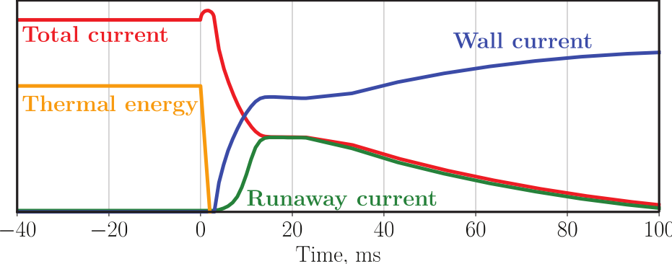
Disruption Dynamics Determine Runaway Electron Sources
Tokamak disruptions have two primary phases:
Thermal Quench: Sudden loss of plasma thermal energy
Induced by impurity influx or large MHD activity
Results in an drastic increase in the plasma resistivity
Current quench: Increase in plasma resistivity results in fast decay of plasma current
Quickly changing plasma current (dI/dt) results in large electric fields
Induced currents can result in potentially dangerous electromagnetic forces on the vessel
Boris N. Breizman et al 2019 Nucl. Fusion 59 083001

Slide 5
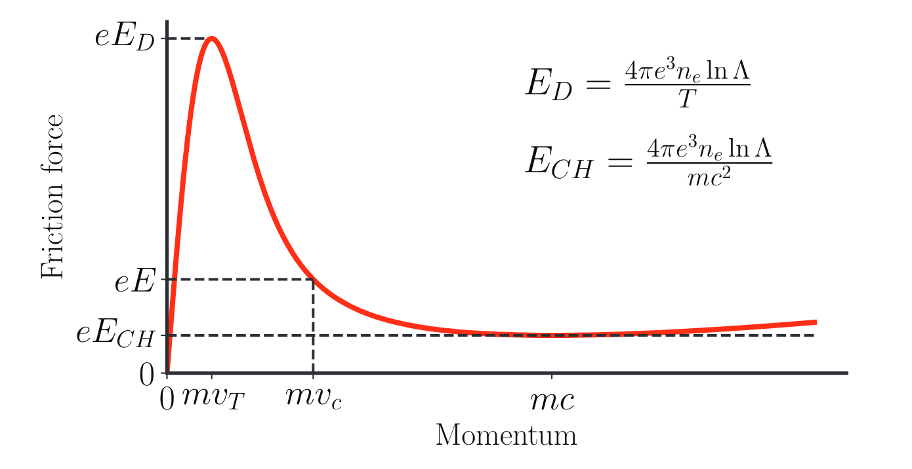
Understanding Four Primary Runaway Mechanisms
Dreicer mechanism: In the presence of a sufficiently large electric field, some electrons will diffuse into the high-energy runaway populations
If $\overset{⃗}{E}>{\overset{⃗}{E}}_{CH}$ then some electrons will be pulled into the relativistic population
If $\overset{⃗}{E}>{\overset{⃗}{E}}_{D}$ then all electrons have the ability to diffuse to high energies
Boris N. Breizman et al 2019 Nucl. Fusion 59 083001

Slide 6
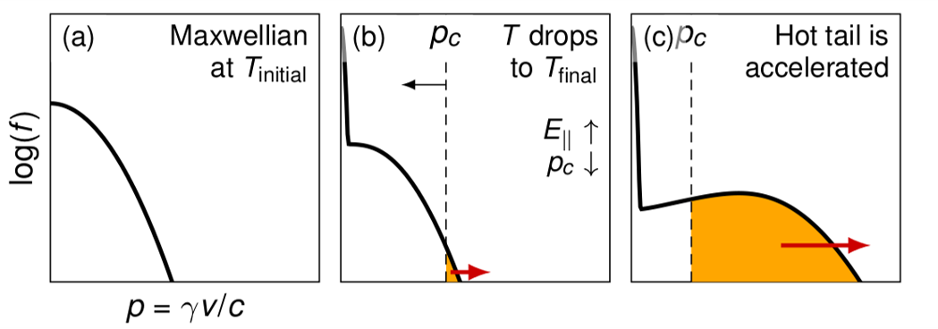
Understanding Four Primary Runaway Mechanisms
Dreicer mechanism
Hot tail: Influx of impurities preferentially cools lower-energy electrons, creating a bump on tail that is likely to runaway
    Hotter particles have fewer collisions and are therefore cooled lower
    Bump is all of a sudden above the new critical velocity/momentum
1.ITER School 2023 - Tünde Fülöp (Modeling of Runaway Electrons)

Slide 7
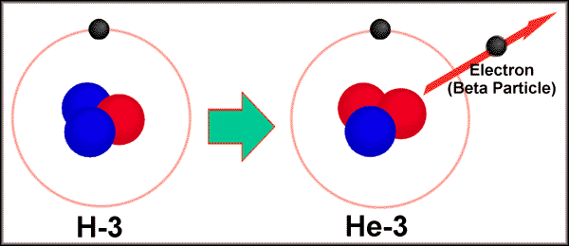
Understanding Four Primary Runaway Mechanisms
Dreicer mechanism
Hot tail
Tritium Decay: When tritium decays, one of its neutrons turns into a proton, and to conserve charge, a fast electron (β-particle) is released
Can become a significant seed when${\overset{⃗}{E}}_{∥}/{\overset{⃗}{E}}_{CH}≳15-20$, allowing part of the 18.6 keV beta spectrum to exceed the critical momentum
A concern for fully nuclear operation (power plant/ITER)

Slide 8
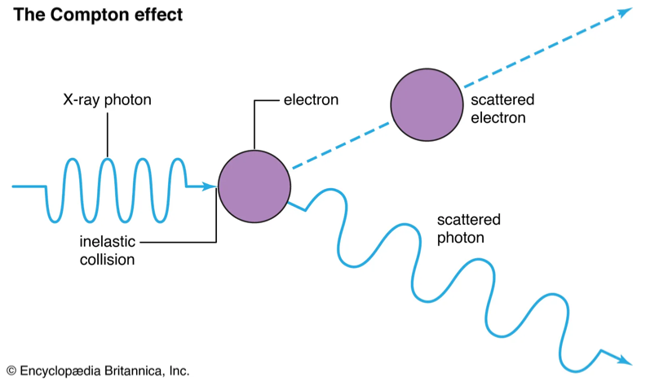
Understanding Four Primary Runaway Mechanisms
Dreicer mechanism
Hot tail
Tritium Decay
Compton Source: As neutrons activate materials in the tokamak, gamma rays will be released, which are capable of scattering bound electrons
  Some of these electrons will be above the critical velocity and runaway

Slide 9
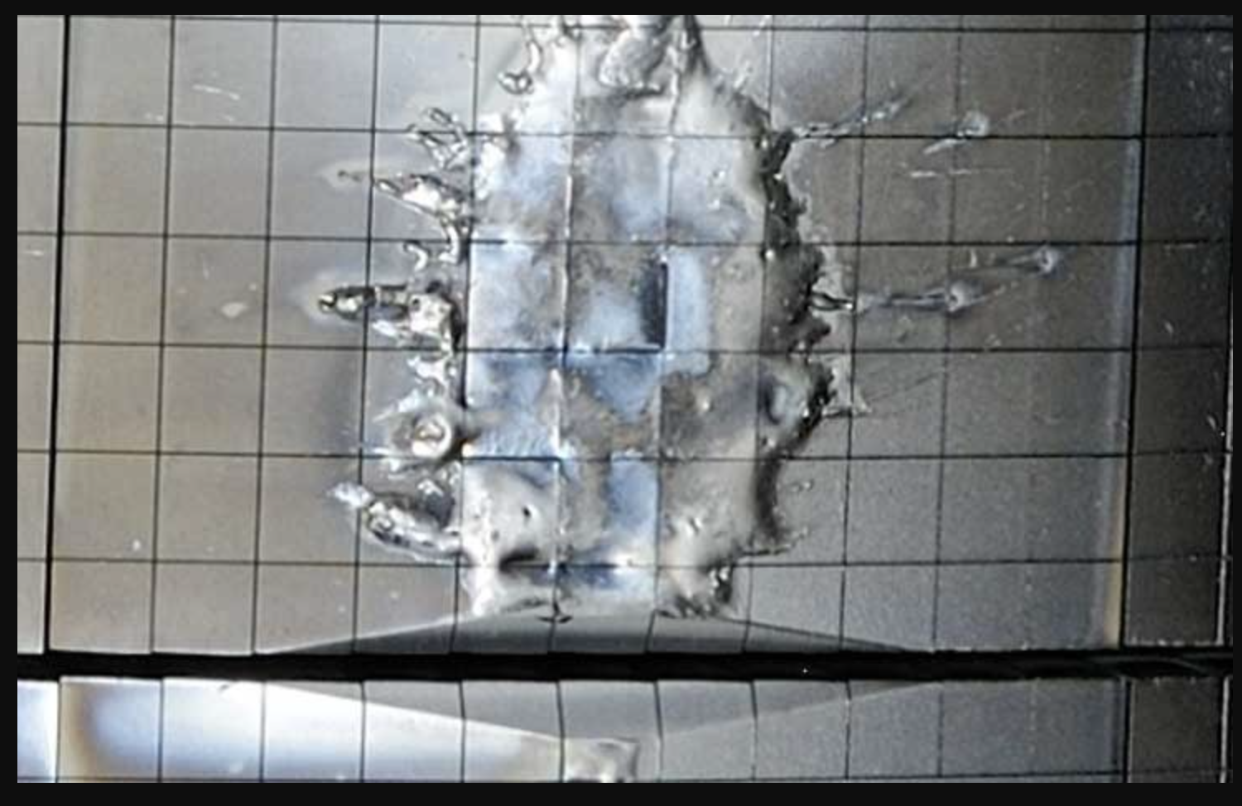
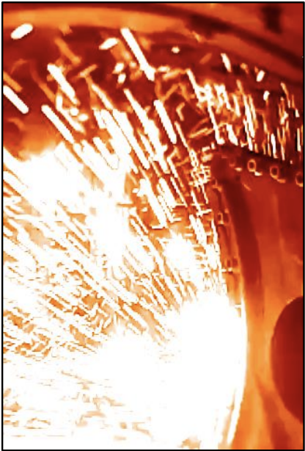
Secondary Runaway Sources and Machine Risks
Secondary Production: Electrons in the relativistic population can knock thermal electrons up to high energies
Known as a runaway avalanche
Results in an exponential growth of runaway current
Extremely dangerous in high-current devices with the avalanche gain$∝e^{I_{p,0}}$
Future machines like ITER and SPARC will be capable of creating runaway beams with MA’s of current and MeV of energy
Note: Direct RE danger due to energy, not current, due to increased ability to penetrate PFC
Ideally want to keep current constant and remove energetic tail
JET
C-Mod

Slide 10
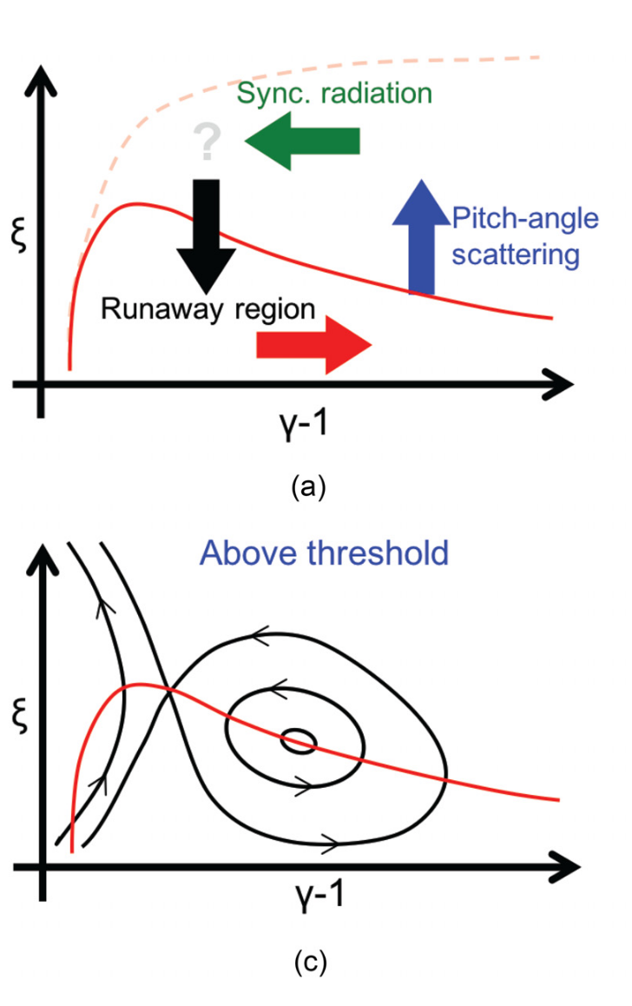
Dynamics of Runaway Electrons Depend on Perpendicular Energy
With a sufficiently large and sustained electric field, runaways execute vortex-like orbits in momentum space
The upper limit of the RE energy is set by synchrotron radiation damping
  Particles with larger perpendicular momentum radiate more intensely
  Increases the critical electric field (E_{crit}) required for runaway production
Idea: Can we decide where the pitch-angle scattering occurs in momentum space?
Phys. Plasmas 26, 082503 (2019)

Slide 11
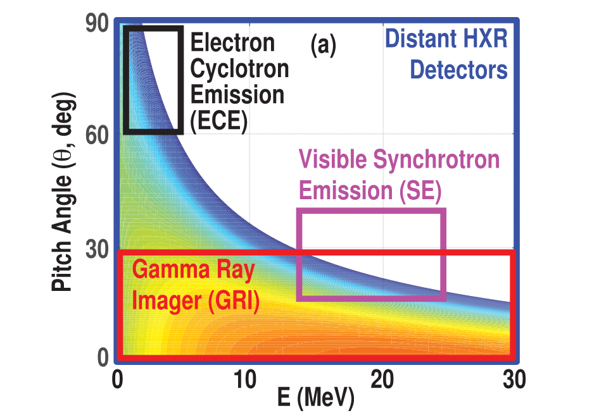
Runaway Radiation Radiation to Probe Different Areas of Momentum Space
Runaway electron radiation from three different mechanisms
Electron cyclotron:
  Primarily sensitive to mildly relativistic REs and pitch-angle distribution
Bremsstrahlung (HXR):
  Created through collisions with plasma ions and plasma-facing components
Synchrotron:
  Strongly increases with both energy and $p_{⊥}$
  Highly directional; probes high-energy, finite-pitch REs
suite of DIII-D RE diagnostics:
Phys. Plasmas 25, 056105 (2018)

Slide 12
Runaway Radiation Radiation to Probe Different Areas of Momentum Space
Runaway electron radiation from three different mechanisms
Electron cyclotron: (Low Energy + Pitch)
  Primarily sensitive to mildly relativistic REs and pitch-angle distribution
Bremsstrahlung (Runaway Population):
  Created through collisions with plasma ions and plasma-facing components
Synchrotron (Increased Pitch):
  Strongly increases with both energy and $p_{⊥}$
  Highly directional; probes high-energy, finite-pitch REs
suite of DIII-D RE diagnostics:
Phys. Plasmas 25, 056105 (2018)

Slide 13
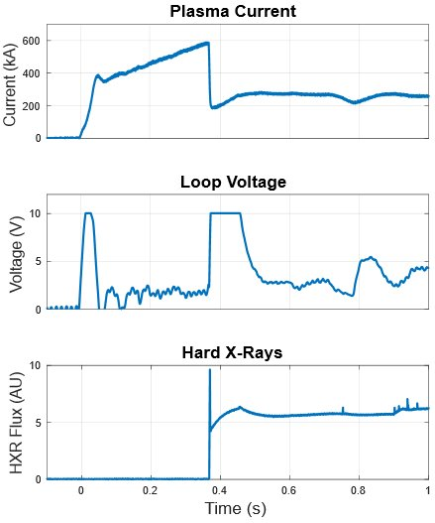
Relativistic Electrons Created in Multiple Regimes in DIII-D Device
First Regime: Created by inducing a current quench through either massive gas or pellet injection
  Plasma current ramped
  Impurities injected (massive gas/pellet)
  Ramp the relativistic current to the desired value
  Experiment conducted
Allows for high-current RE beams to be formed for various studies
  Length of beam ultimately limited by center solenoid
Will be referred to as the ”disruption” regime for this discussion

Slide 14
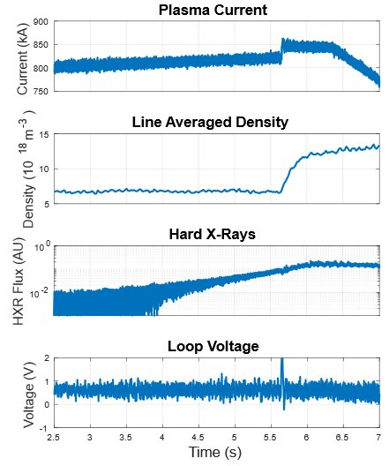
Relativistic Electrons Created in Multiple Regimes in DIII-D Device
Second Regime: Created by lowering density and therefore the Connor-Hastie field
  Density lowered
  Loop voltage from solenoid begins to pull electrons into relativistic population
  Radiation from REs detected by dud detection system
  Secondary gas puffed to raise density and cease RE production
  Experiment Conducted
In this regime, REs carry a small percentage of the total plasma current
Referred to as the “Quiescent Runaway Electron” (QRE) Regime

Slide 15
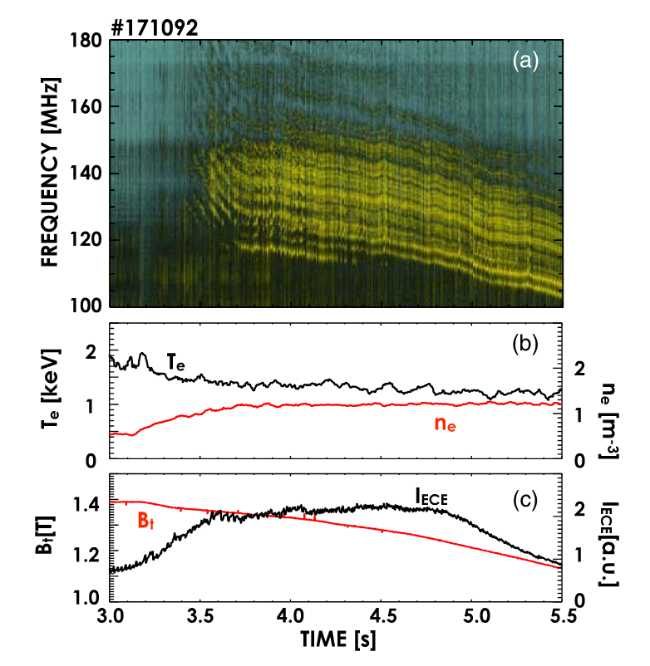
RE-Driven Plasma Waves Observed in Multiple Regimes on the DIII-D Device
A variety of RE-driven plasma waves have been observed on the DIII-D device
  In both the disruption and quiescent runaway electron regime
Whistler and Alfvén waves have been observed in stationary RE beams
  Result in pitch-angle scattering
  Self-excited waves result in a predator-prey relationship
1.PHYSICAL REVIEW LETTERS 120, 155002 (2018)

Slide 16
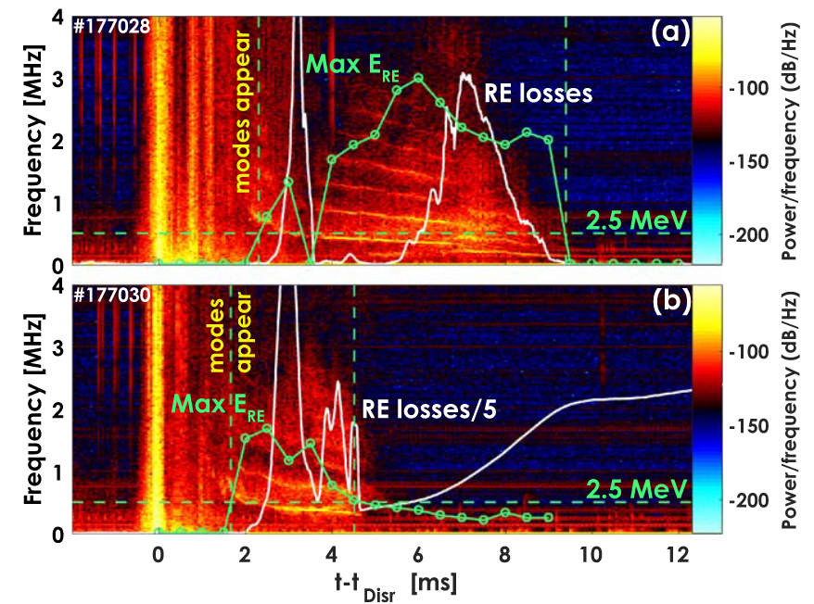
RE-Driven Plasma Waves Observed in Multiple Regimes on the DIII-D Device
Kinetic instabilities have also been observed during the current quench
Observed to depend on sufficiently energetic REs
Result in a deconfinement of runaway electrons
  Prevent the formation of a RE plateau
1.A Lvovskiy et al 2018 Plasma Phys. Control. Fusion 60 124003

Slide 17
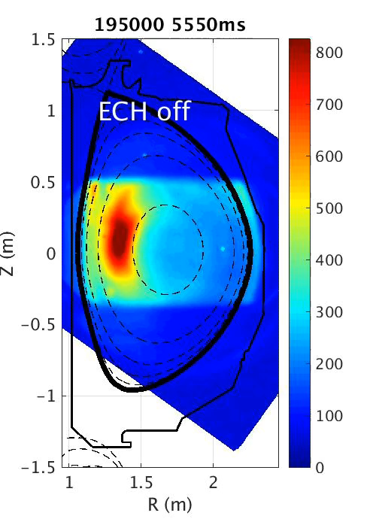
RE-Driven Plasma Waves Observed in Multiple Regimes on the DIII-D Device
Interesting behavior can be observed in measured RE synchrotron emissions
  Emissions flicker in the presence of sufficiently large whistler waves
These oscillations are a consequence of resonant interactions with self-excited whistlers
  REs are accelerated to significant energies
  Free energy in RE population is sufficient to overcome whistler-mode damping mechanisms
  Wave-particle interactions lead to significant pitch-angle scattering of REs
  Increased synchrotron damps REs until they can no longer drive whistlers
  REs are re-accelerated

Slide 18
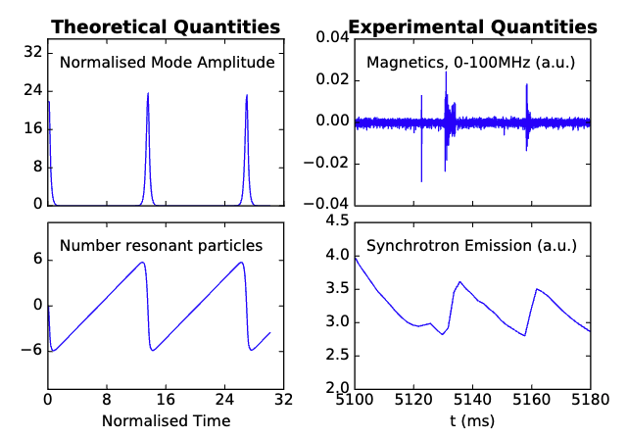
Simple Predator-Prey Model Allows for Useful Parameters to be Extracted
Predator-prey model developed by Heidbrink to describe the interplay between modes and energetic ions (Phys. Fluids B 5, 2176–2186 (1993))
  The model consists of two coupled differential equations
  The initial value of the amplitude, a, is determined from analysis of synchrotron intensity
Synchrotron intensity is used as a proxy for the resonant particles
Whistler-mode amplitude is measured using the fast magnetic (ICE) system on DIII-D
$$\frac{da}{dy}=na$$
$$\frac{dn}{dy}=1−a$$
Phys. Plasmas 32, 092508 (2025)
Notes:
The power of in the whistler modes is then measured using the Ion Cyclotron Emission or ICE system on DIII-D.

Slide 19
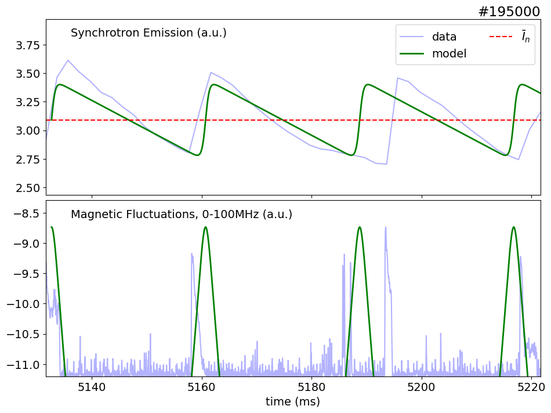
Simple Predator-Prey Model Allows for Useful Parameters to be Extracted
Predator-prey model developed by Heidbrink to describe the interplay between modes and energetic ions (Phys. Fluids B 5, 2176–2186 (1993))
  The model consists of two coupled differential equations
  The initial value of the amplitude, a, is determined from analysis of synchrotron intensity
Synchrotron intensity is used as a proxy for the resonant particles
Whistler-mode amplitude is measured using the fast magnetic (ICE) system on DIII-D
The model accurately reproduces the period of the observed synchrotron oscillations
Phys. Plasmas 32, 092508 (2025)
Notes:
Ultimately this model is able to accurately recreate the experimentally measured values including the period of oscillations in the synchrotron as well as the bursts in the ICE data.

Slide 20
Outline
Background
  Runaway Electrons
  Wave-particle interactions
Externally Launched: Helicon Waves
  Modeling
  Experimental Results
  Mitigation Applicability
Additional Wave-Particle Experiments
  OXB Mode Conversion
  Low-Density Expulsion
  Toroidal Ripple Experiment
Conclusions and Future Work

Slide 21

Outline
Background
  Runaway Electrons
  Wave-particle interactions
Externally Launched: Helicon Waves
  Modeling
  Experimental Results
  Mitigation Applicability
Additional Wave-Particle Experiments
  OXB Mode Conversion
  Low-Density Expulsion
  Toroidal Ripple Experiment
Conclusions and Future Work

Slide 22
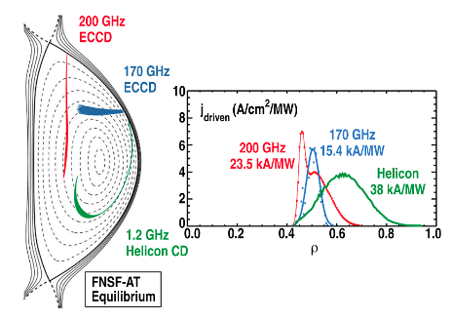
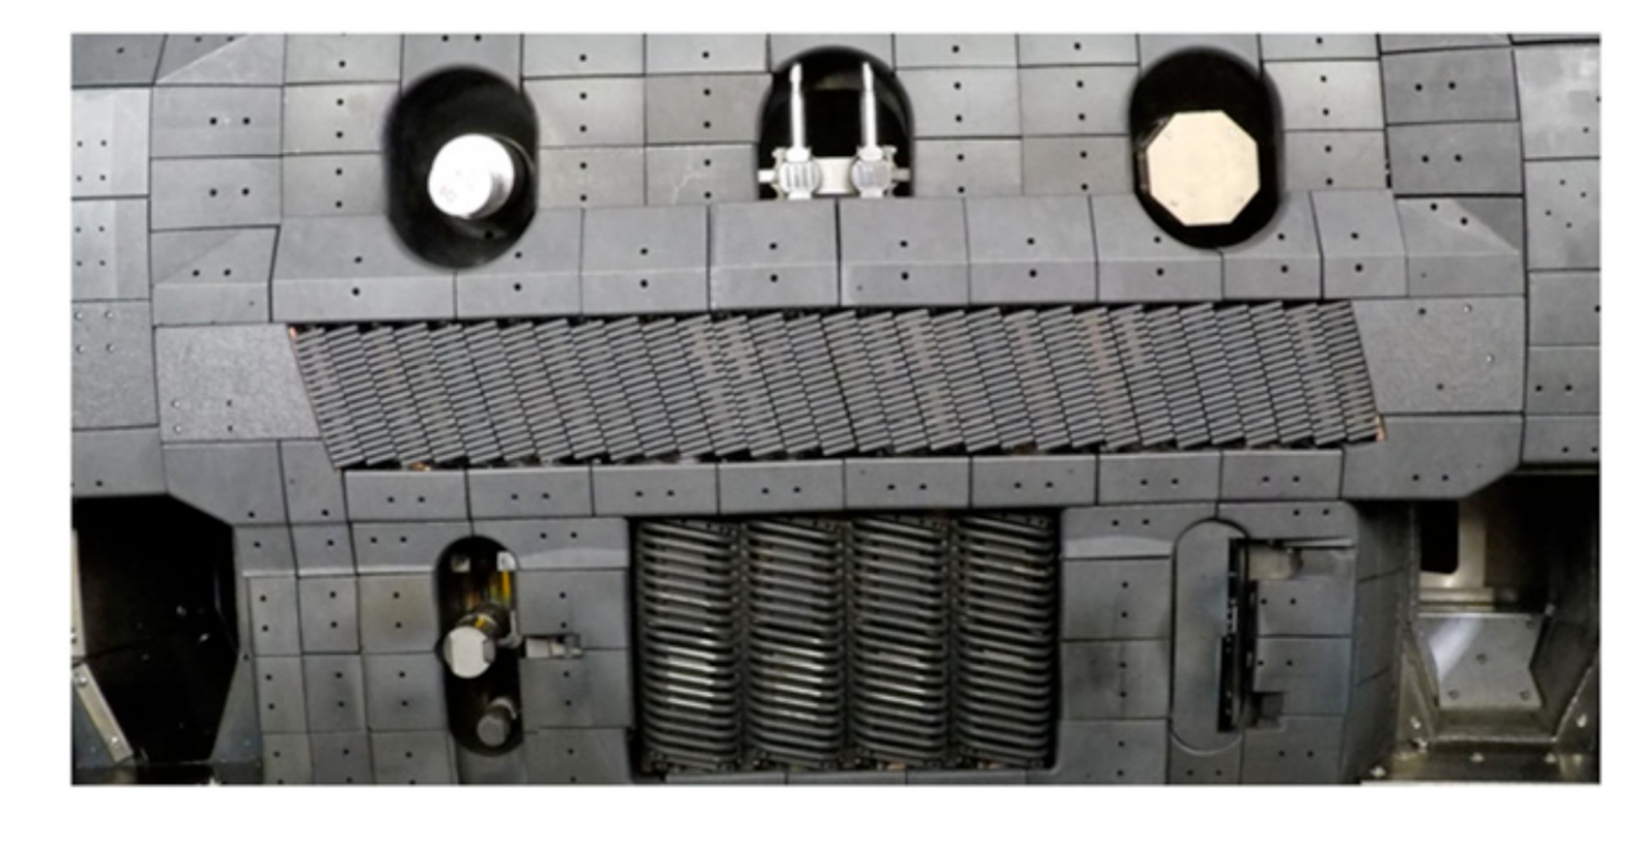
High Power Helicon Antenna Leveraged for RE Studies
Helicon waves (a.k.a. whistler waves) are right-handed electromagnetic waves
  Capable of resonating with relativistic electrons
The DIII-D tokamak recently acquired a 1 MW-class helicon antenna
  Designed for off-axis heating and current drive
  Was leveraged along with the DIII-D established RE scenario
  Parameters:
    $f=476$ MHz
    $$n_{||}≈3$$
    $$k_{||}=30m^{-1}$$
    Toroidal coverage: 40 degrees
Experiments were conducted in 2024
  Using low-density quiescent plasmas
8.Phys. Plasmas 22, 090901 (2015);
R.I. Pinsker et al 2024 Nucl. Fusion 64 126058

Slide 23
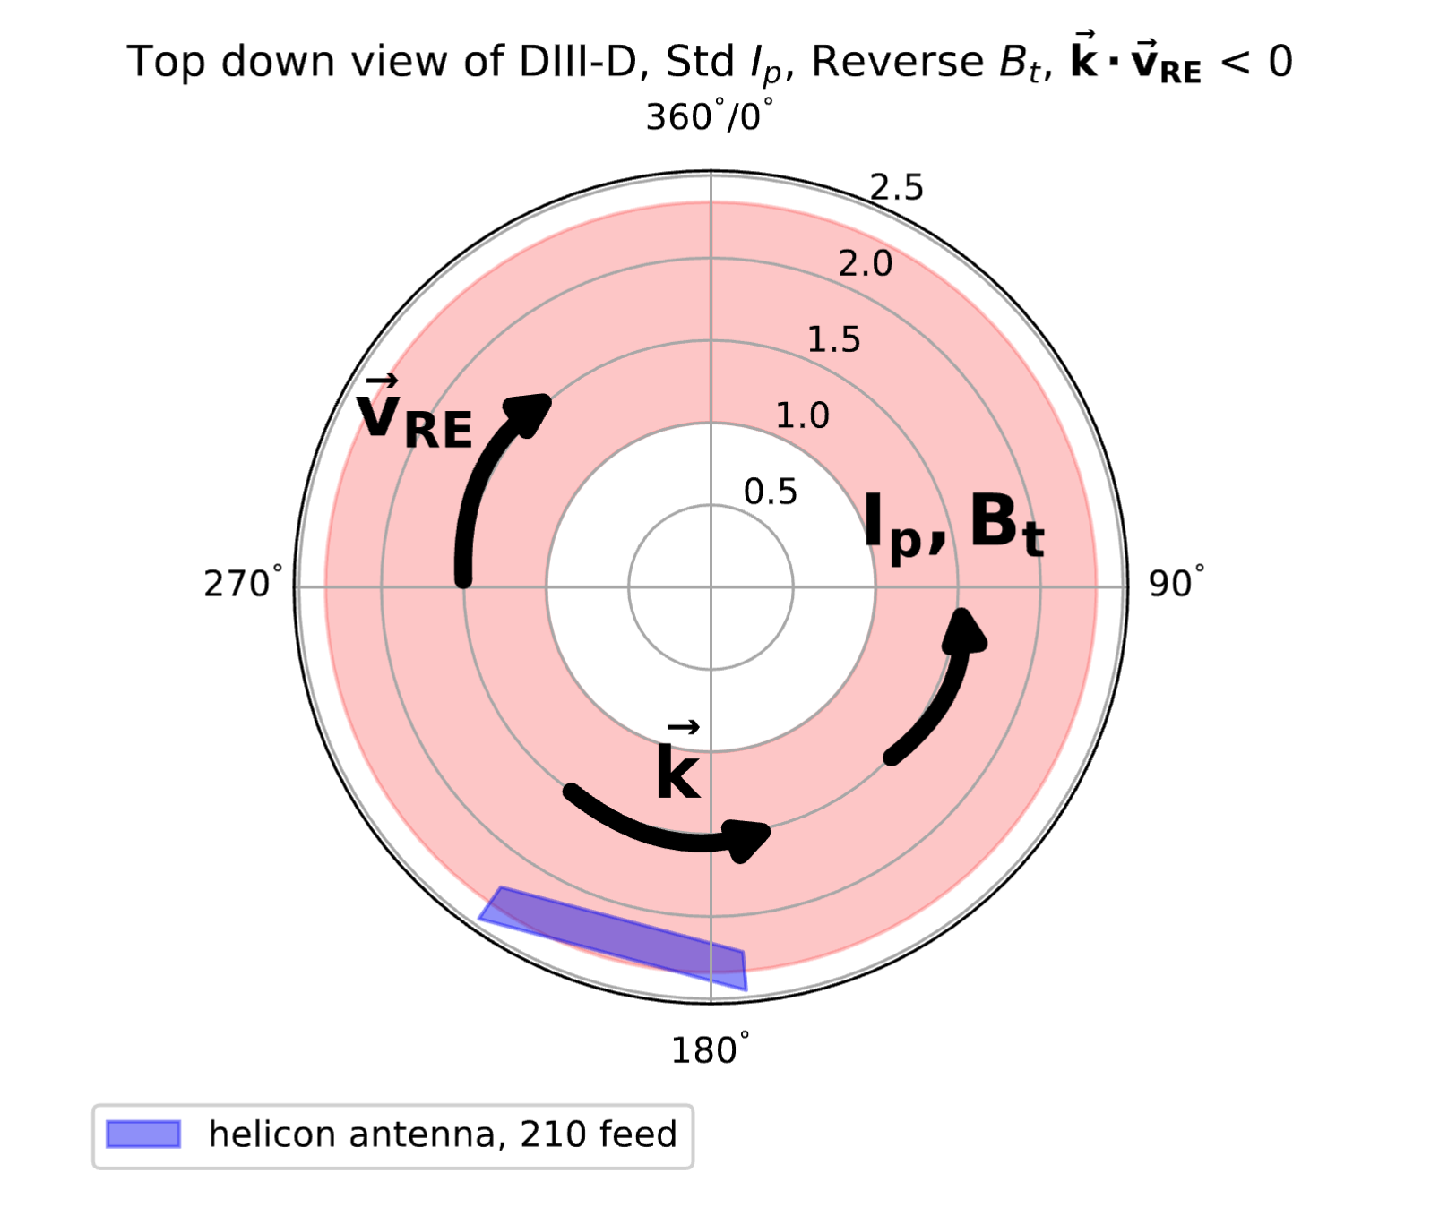
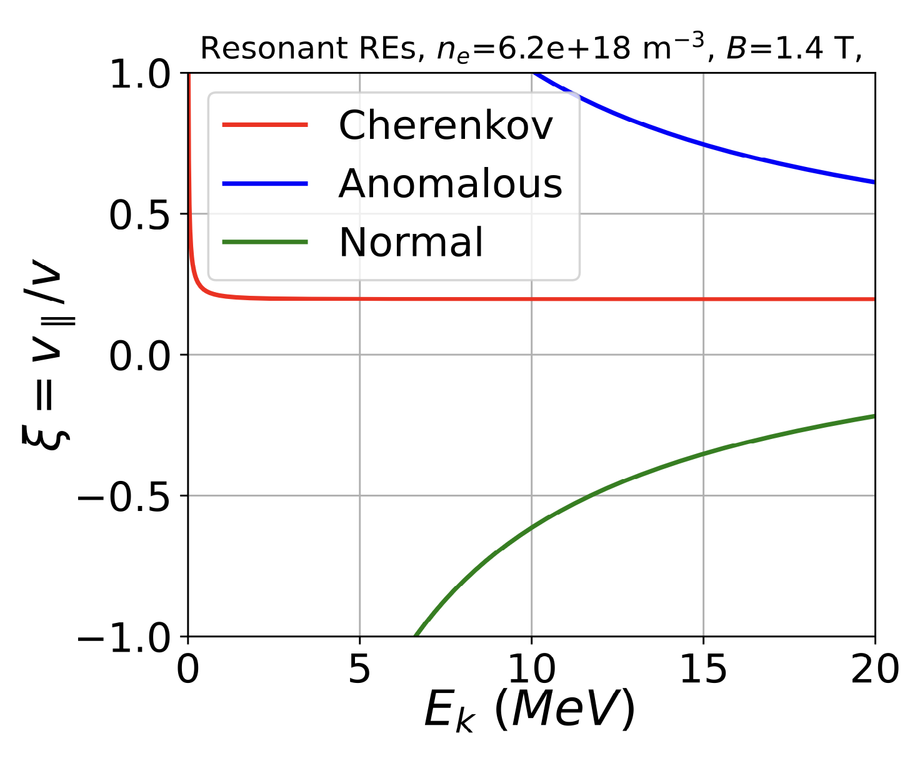
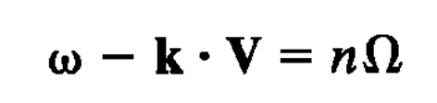
“Normal” Resonance Utilized to Resonate with Relativistic Electrons
wave particle resonance:
Helicon waves launched anticlockwise to favor normal cyclotron resonance
PHYSICAL REVIEW LETTERS 136, 025101 (2026)

Slide 24

Fokker-Planck Solver Predicts Barrier in Momentum-Space
The resonance condition depends on both the momentum and pitch angle of the electron
Low-pitch ($ξ=-1$) REs are expected to resonate around 7-8 MeV
Fokker-Planck simulations predict that this resonance will create a ‘barrier’ in momentum space
  Due to enhanced synchrotron damping and larger pitch
Nomal Resonance
PHYSICAL REVIEW LETTERS 136, 025101 (2026)

Slide 25
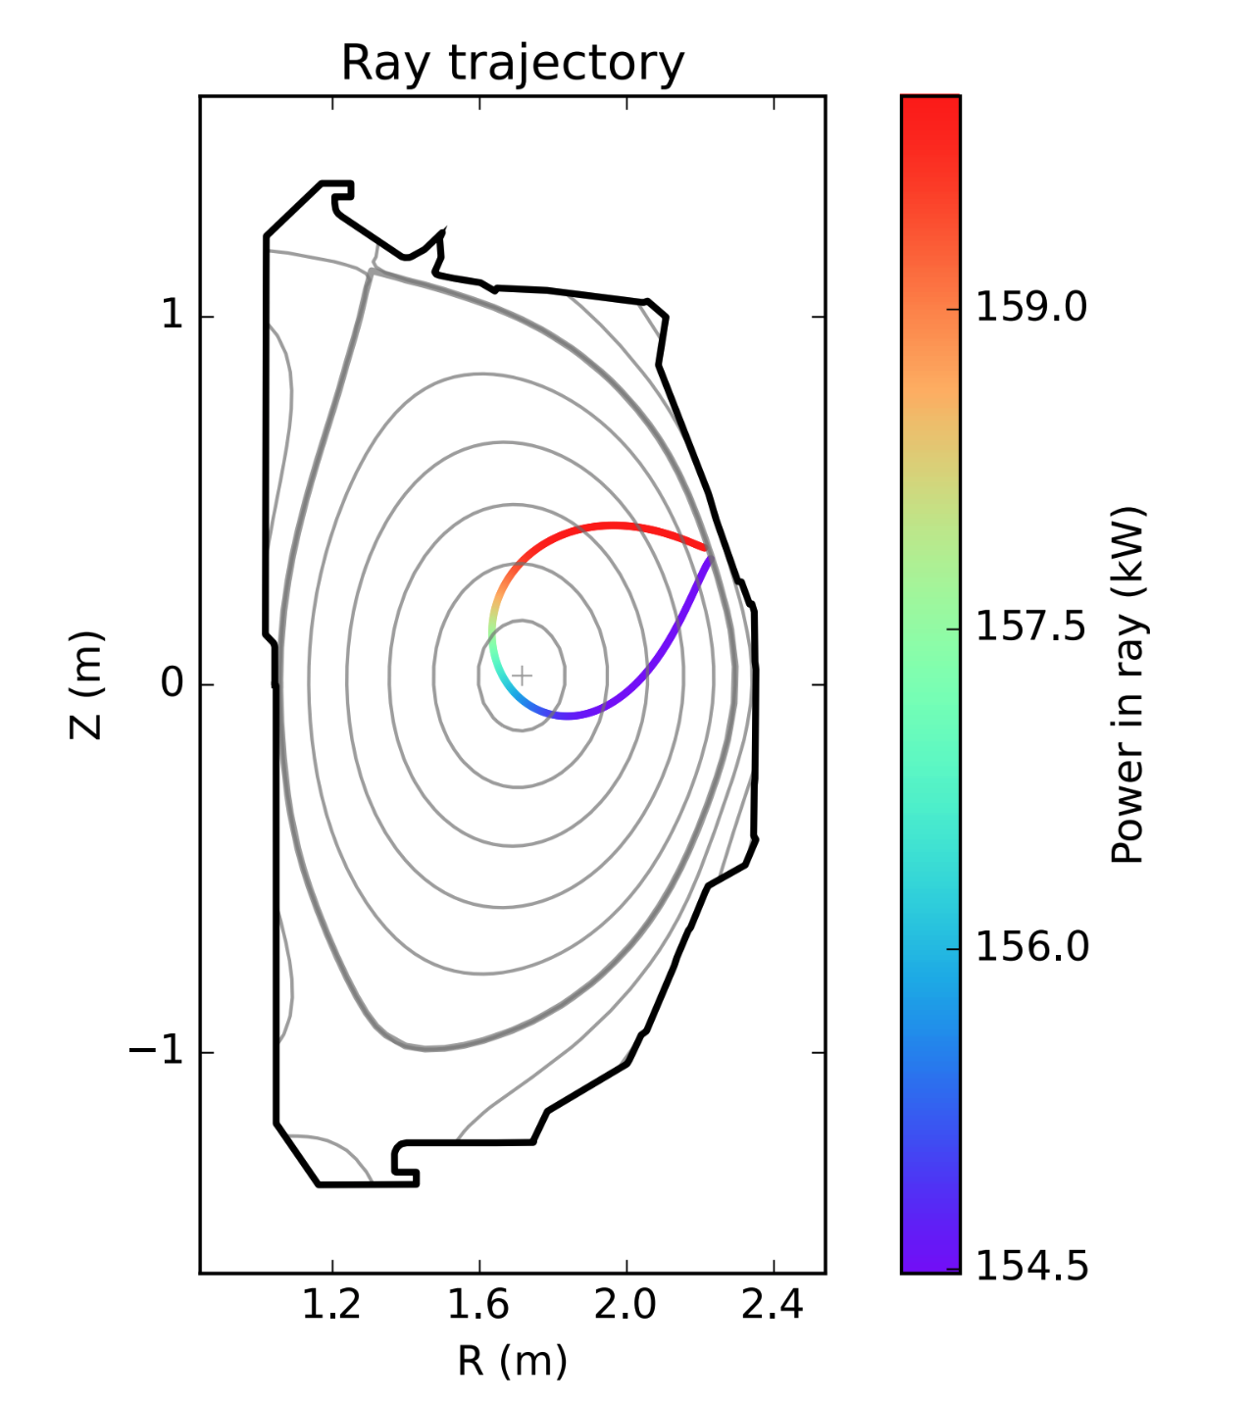
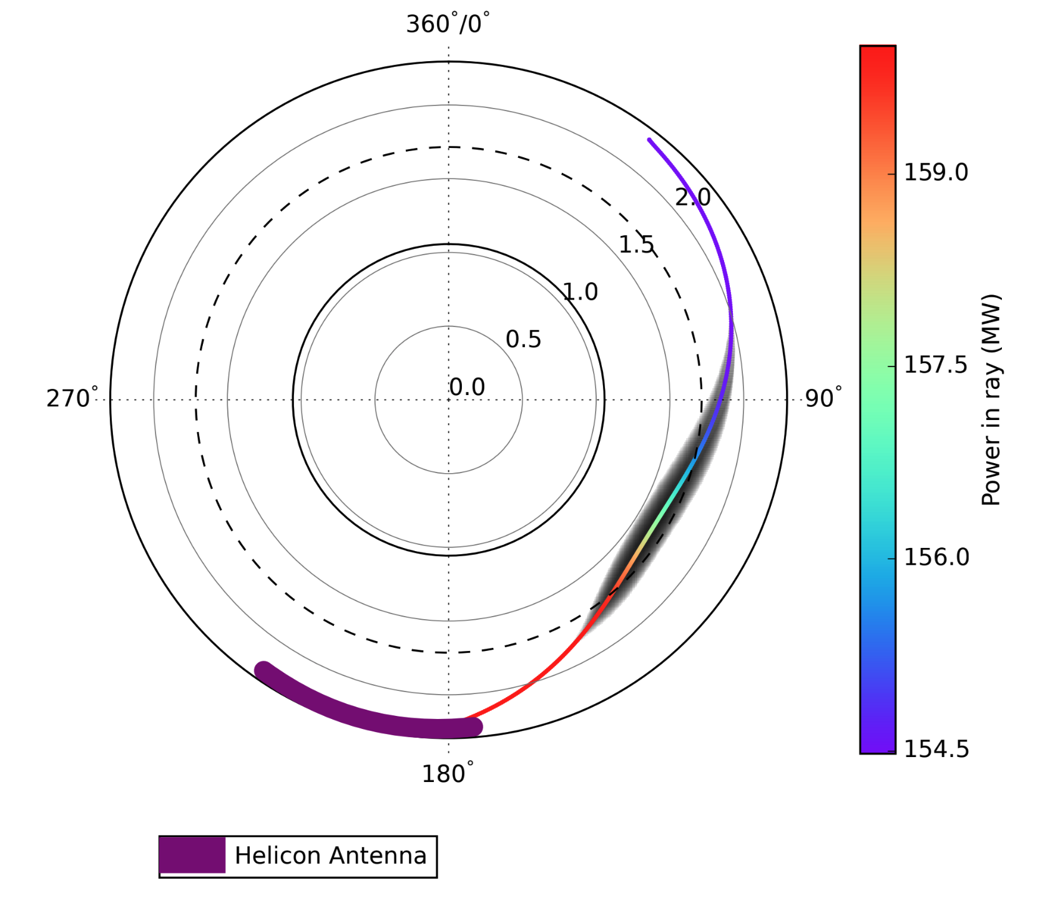
GENRAY Predicts Minimal Absorption in Background Plasma
GENRAY was used to simulate wave propagation in background plasma
  Only simulates companion plasma (no REs)
Low electron beta results in negligible absorption by background plasma
  This is good because it allows the wave to propagate and resonate with REs
Absorption predicted to be 5% for single pass
  Waves expected to make many passes before absorption/resonance
PHYSICAL REVIEW LETTERS 136, 025101 (2026)

Slide 26
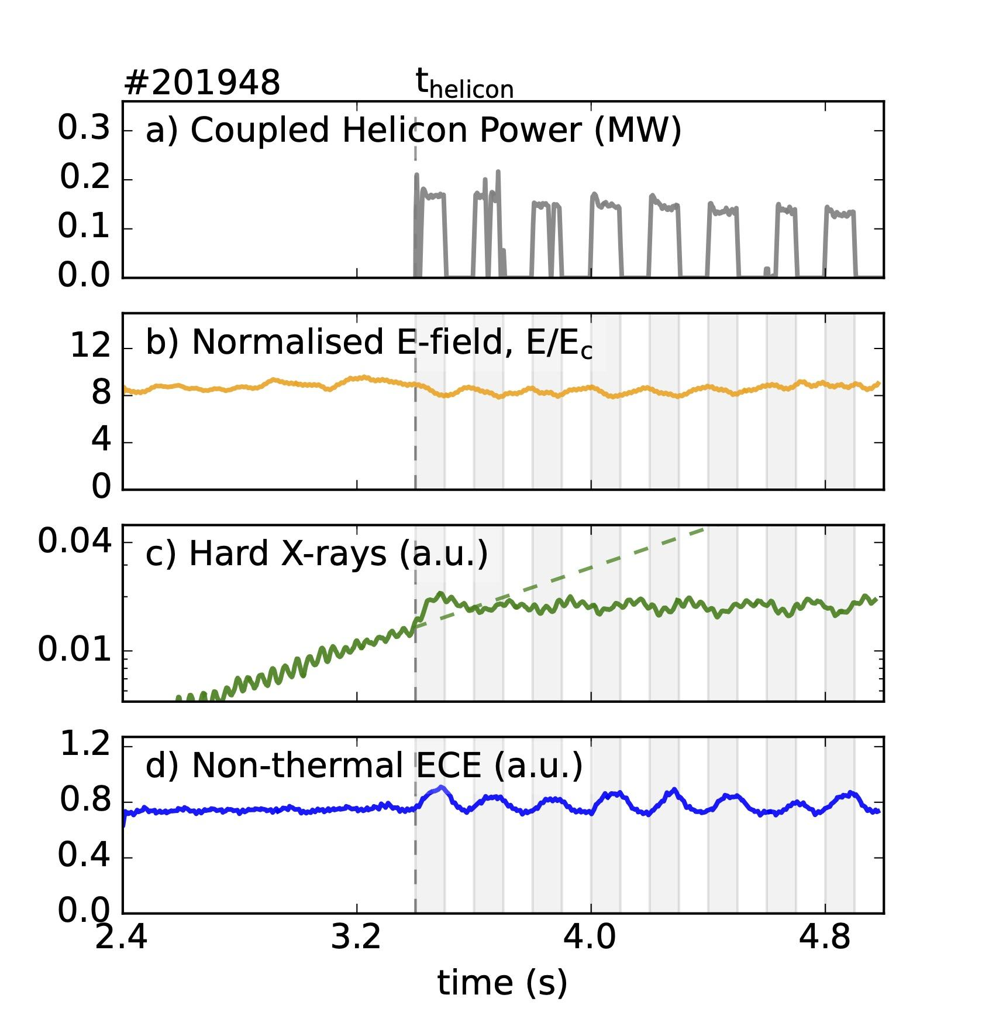
Application of Helicon Power Halts Growths of RE Population
Helicon power applied to quiescent runaway plasmas
  Approximately 200 kW pulses
PHYSICAL REVIEW LETTERS 136, 025101 (2026)

Slide 27
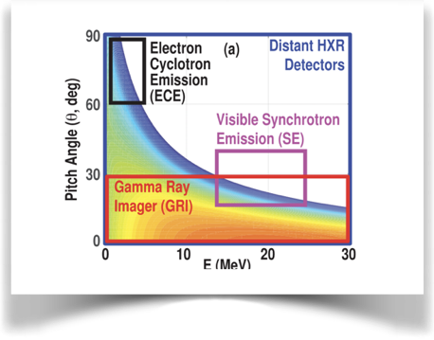
Application of Helicon Power Halts Growths of RE Population
Helicon power applied to quiescent runaway plasmas
  Approximately 200 kW pulses
Runaway growth halts following wave application
  Normalized electric field remains significantly above the critical value
PHYSICAL REVIEW LETTERS 136, 025101 (2026)

Slide 28

Application of Helicon Power Halts Growths of RE Population
Helicon power applied to quiescent runaway plasmas
  Approximately 200 kW pulses
Runaway growth halts following wave application
  Normalized electric field remains significantly above the critical value
Non-thermal ECE indicates an increase in lower-energy/high pitch electrons during application
PHYSICAL REVIEW LETTERS 136, 025101 (2026)

Slide 29
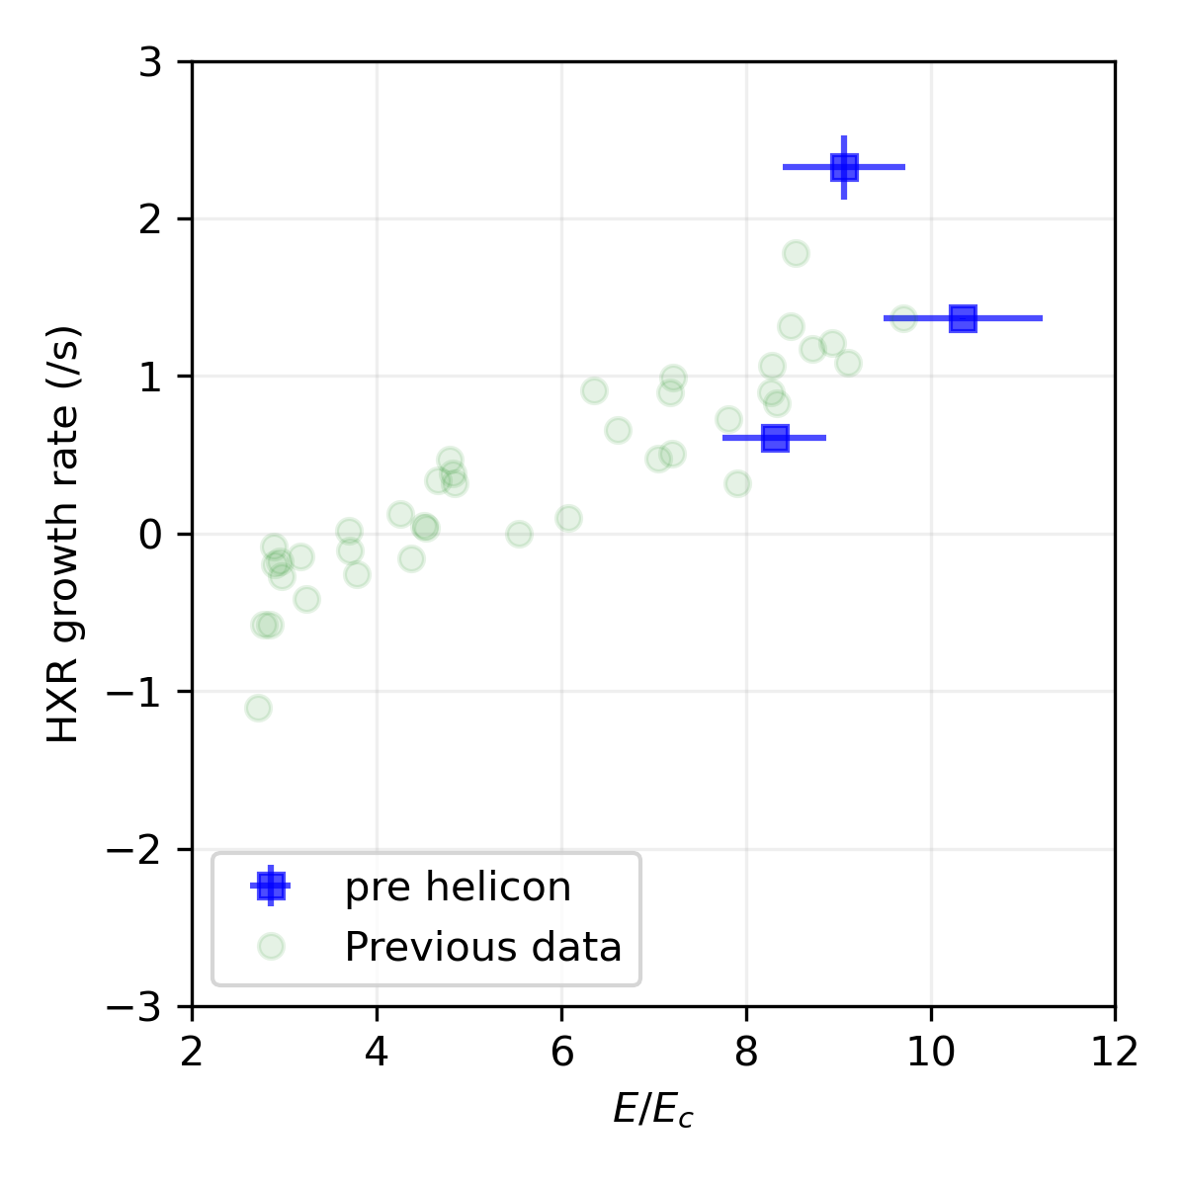
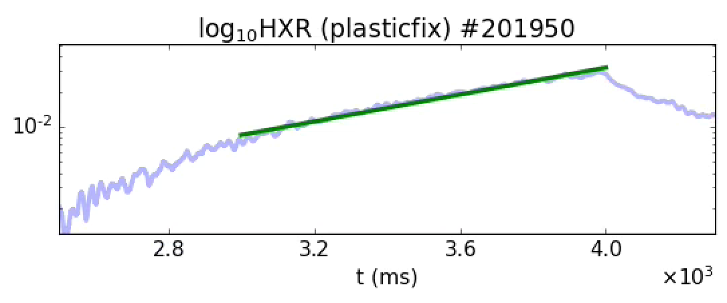
Database Analysis Indicates Similar Early RE Growth
Previous quiescent RE discharges show a clear relationship between the growth rate and normalized electric field
  Growth rate becomes positive for $E/E_{c}⪆5$
Phys. Plasmas 21, 022514 (2014)

Slide 30
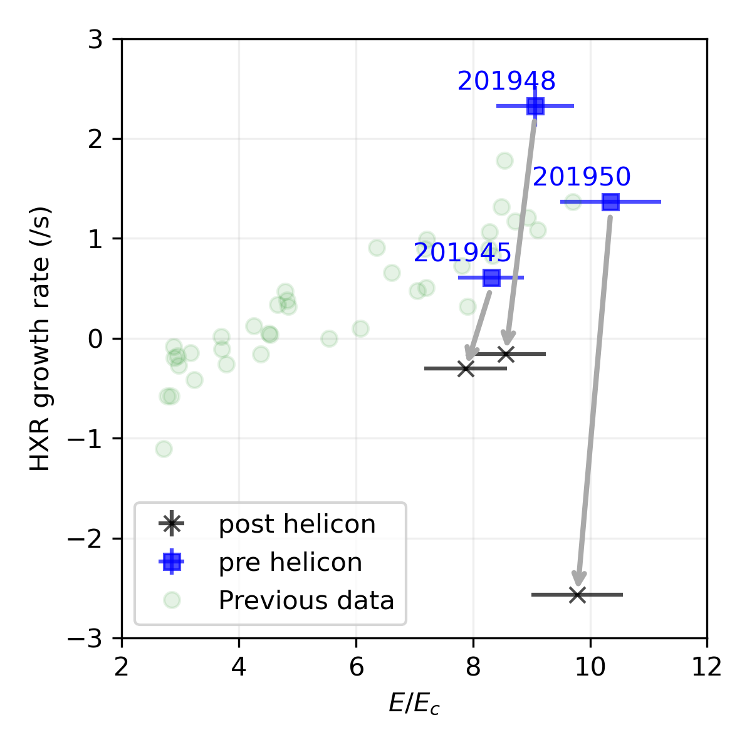
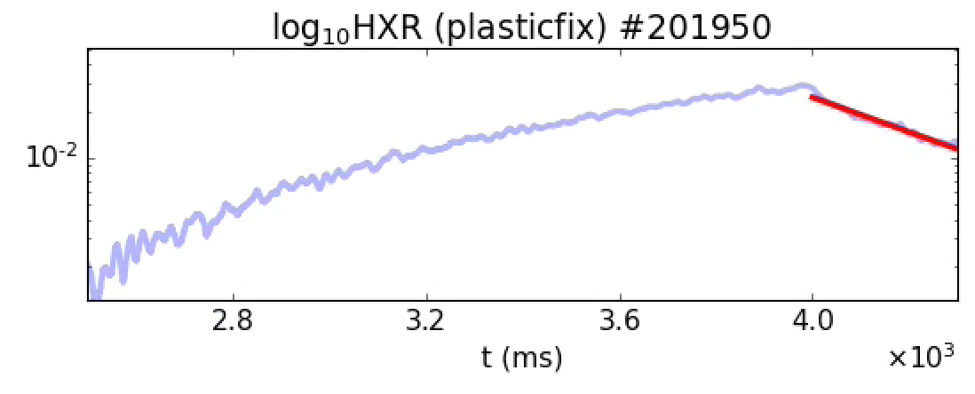
Application Helicon Waves Shown to Completely Supress Growth
Application of helicon results in stabilzation of RE population
  Despite electric field well above critical value
PHYSICAL REVIEW LETTERS 136, 025101 (2026)

Slide 31
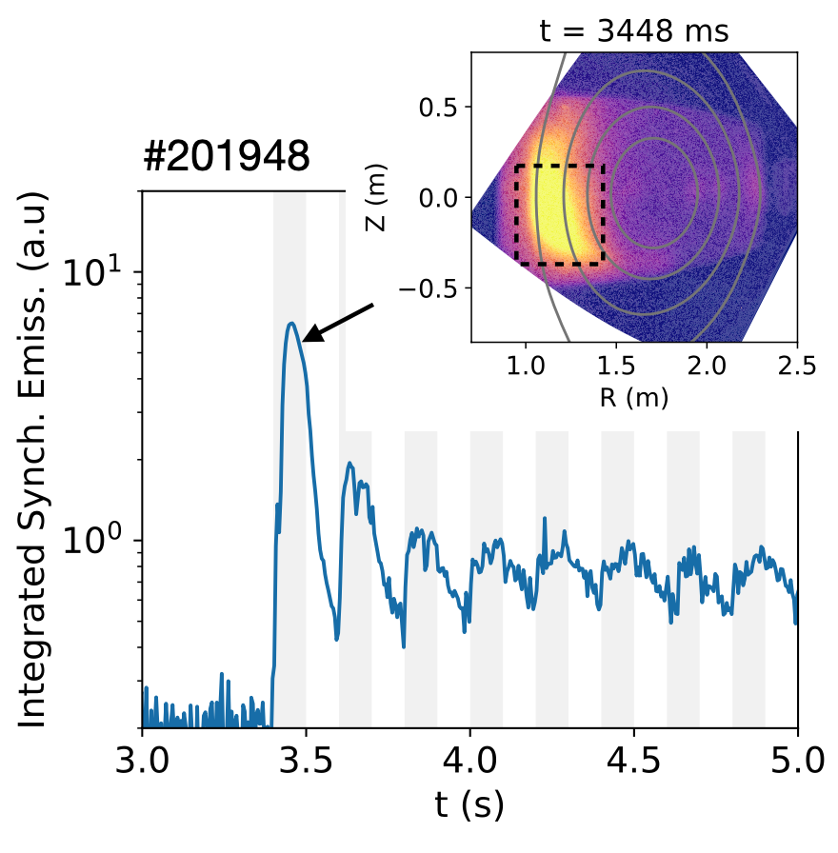
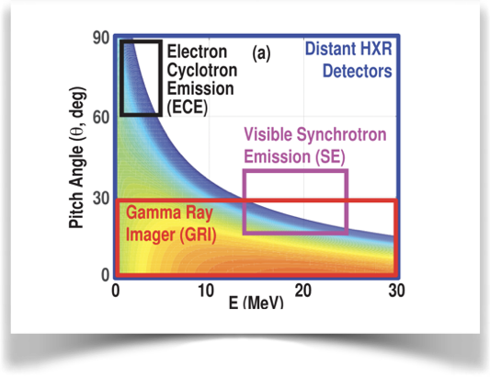
Synchrotron Emssion Hints at Changes in Momentum Space
Application of helicon results in a significant increase in synchrotron emissions
  Strongest during the primary application
This increase is consistent with an increase in pitch angle
PHYSICAL REVIEW LETTERS 136, 025101 (2026)

Slide 32
Synchrotron Emssion Hints at Changes in Momentum Space
Application of helicon results in a significant increase in synchrotron emissions
  Strongest during the primary application
This increase is consistent with an increase in pitch angle
A decrease in emissions hints at a change in the RE population following multiple injections
PHYSICAL REVIEW LETTERS 136, 025101 (2026)

Slide 33
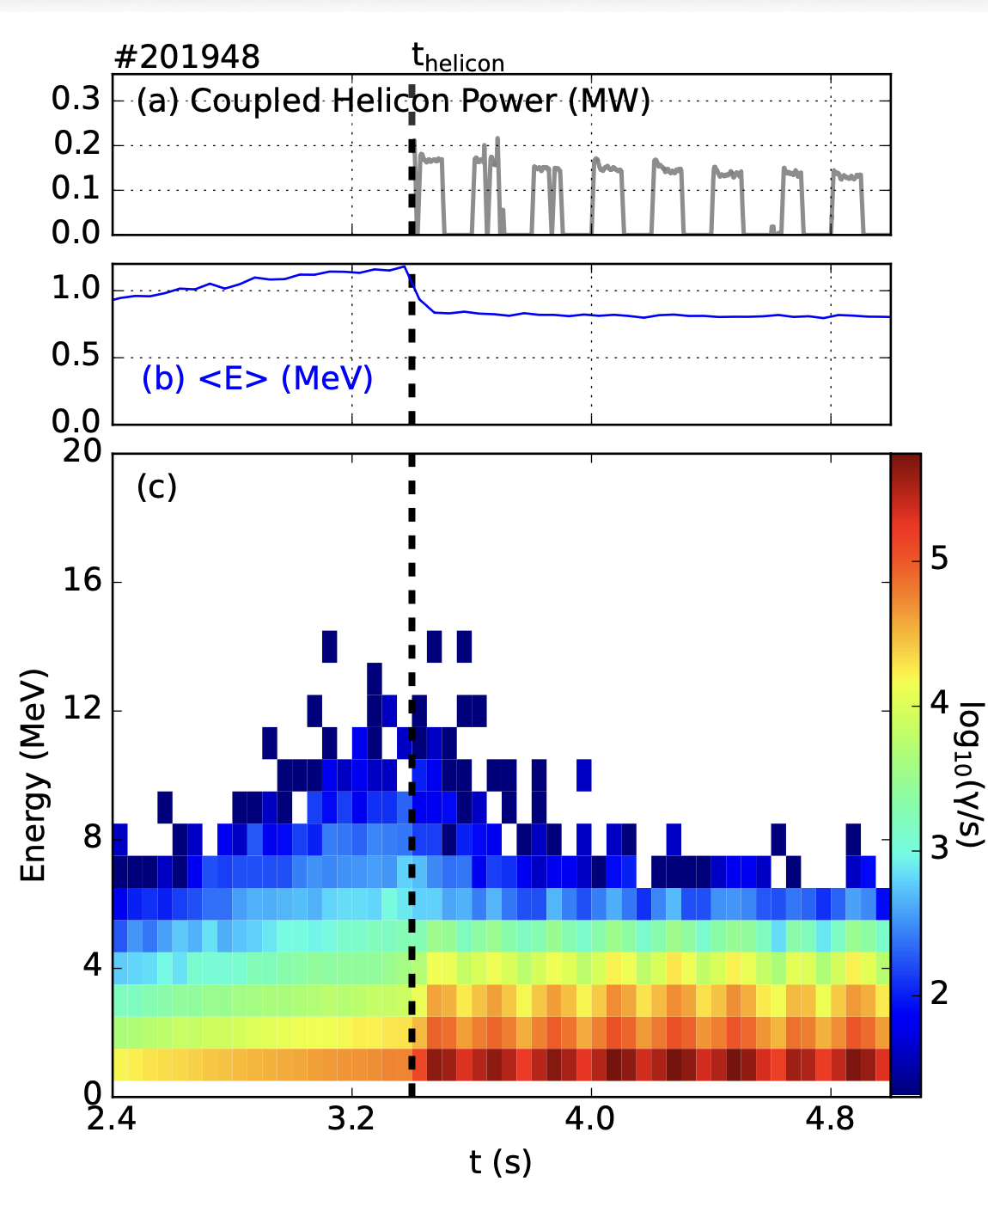
GRI Confirms Predicted Redistribution Around Resonant Energy
Gamma-ray imager (GRI) measures the energy distribution of HXR photons created by RE Bremsstrahlung
  Used to reconstruct the RE energy distribution assuming zero pitch
Helicon application results in a decrease in high-energy and an increase in low-energy REs
  As predicted by Fokker-Planck modeling
First demonstration of RE momentum-space tailoring with an externally launched wave.

Slide 34
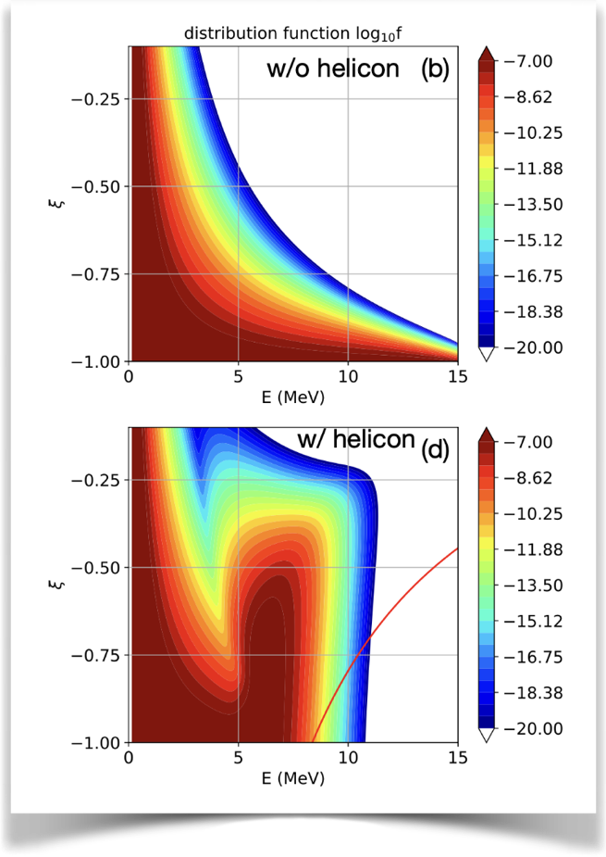
GRI Confirms Predicted Redistribution Around Resonant Energy
Simulation
Gamma-ray imager (GRI) measures the energy distribution of HXR photons created by RE Bremsstrahlung
  Used to reconstruct the RE energy distribution assuming zero pitch
Helicon application results in a decrease in high-energy and an increase in low-energy REs
  As predicted by Fokker-Planck modeling
First demonstration of RE momentum-space tailoring with an externally launched wave.

Slide 35
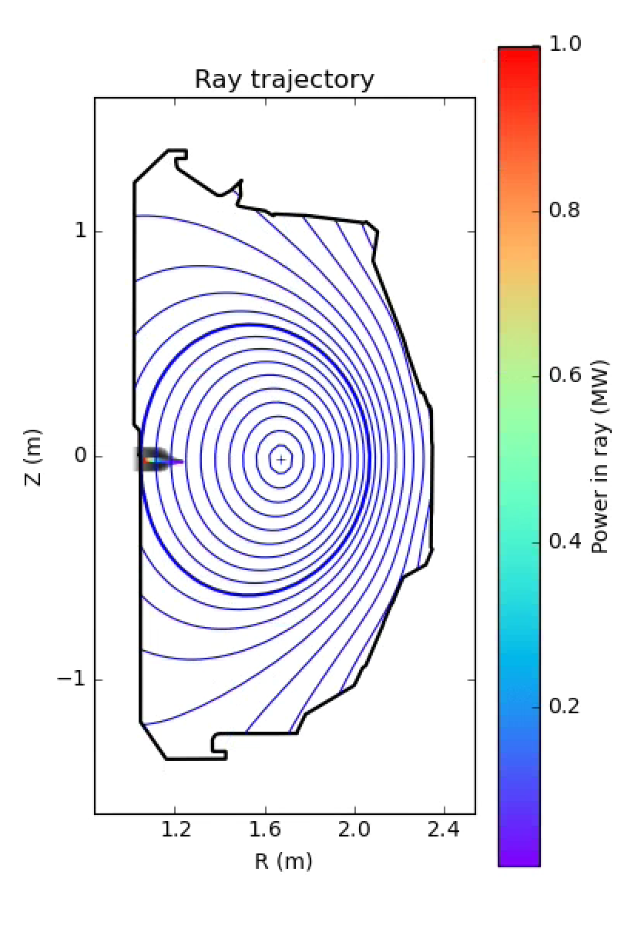
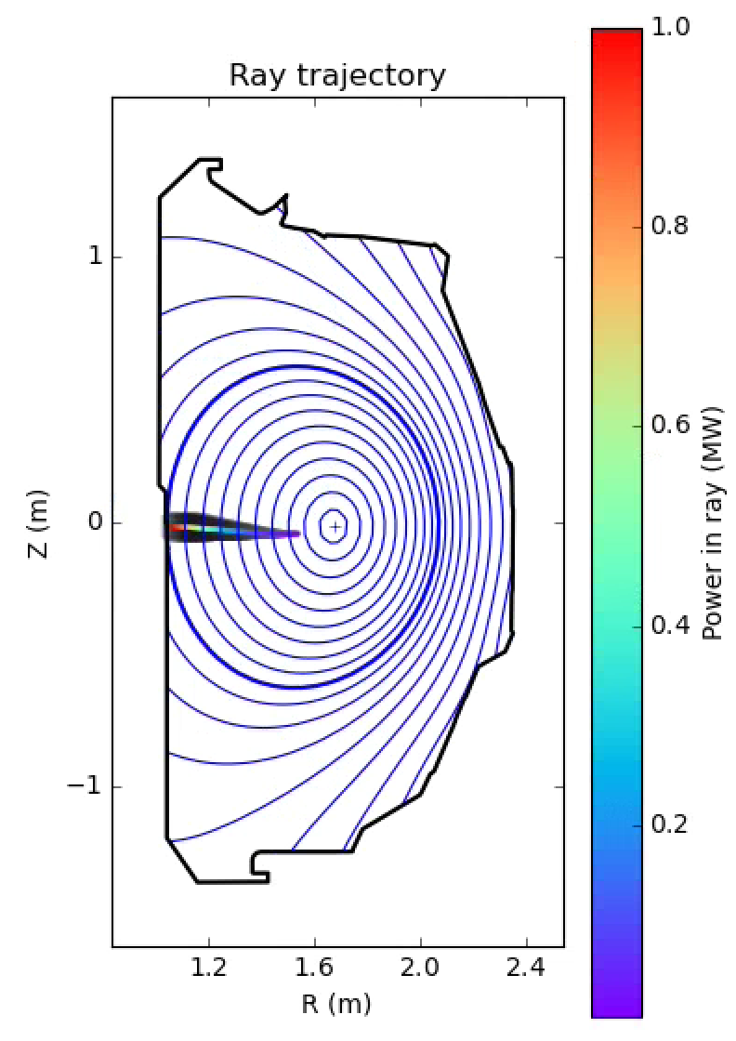
Challenges Remain for Application in Post-Disruption Plasmas
Challenges remain in utilizing externally launched helicon waves for post-disruption REs
The cold and dense post-disruption plasma is strongly refractive and highly collisional
  Waves cannot propagate to the core
Helicon waves are also evanescent in vacuum
  Coupling sensitive to scrape-off layer width
  Could be difficult to couple in dynamic disruption conditions
2 eV
6 eV

Slide 36
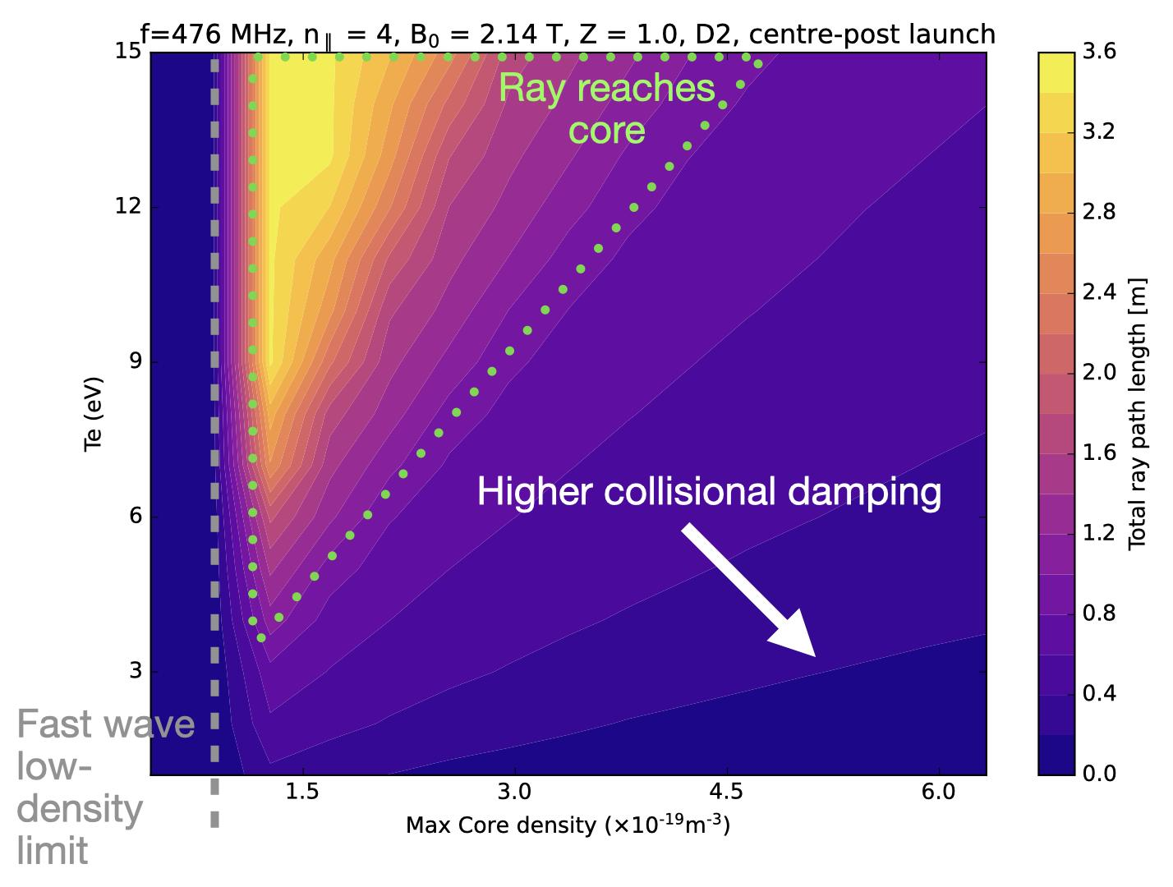
Narrow Operational Window Exists for Current Antenna
Reaching the core is possible for lower-density, hotter plasmas
Mitigation would have to be designed to ensure the beam limits on the antenna
Idea: Dedicated RE Mitigation Antenna
  Design to create a barrier at lower relativistic momentum
  Design to propagate in post-disruption conditions
A higher-frequency antenna could enable this, but further study is needed

Slide 37
Outline
Background
  Runaway Electrons
  Wave-particle interactions
Externally Launched: Helicon Waves
  Modeling
  Experimental Results
  Mitigation Applicability
Additional Wave-Particle Experiments
  OXB Mode Conversion
  Low-Density Expulsion
  Toroidal Ripple Experiment
Conclusions and Future Work

Slide 38

Outline
Background
  Runaway Electrons
  Wave-particle interactions
Externally Launched: Helicon Waves
  Modeling
  Experimental Results
  Mitigation Applicability
Additional Wave-Particle Experiments
  OXB Mode Conversion
  Low-Density Expulsion
  Toroidal Ripple Experiment
Conclusions and Future Work

Slide 39
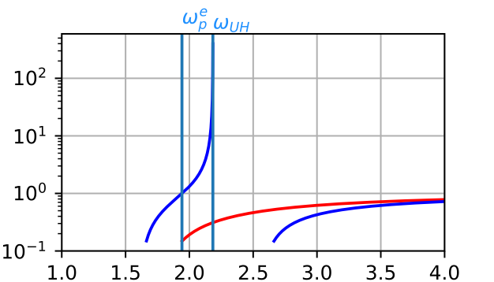
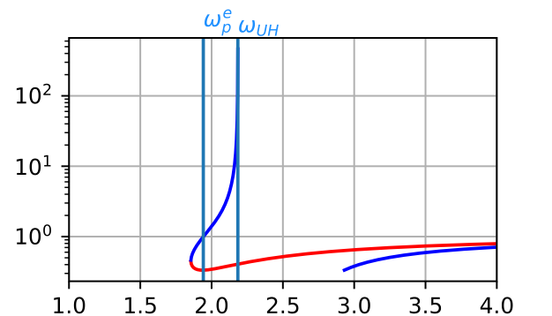
Conversion to Slow-X Wave Required for EC Wave Resonance
Appeal: O and X-mode ECH polarization routinely used on DIII-D for heating and current-drive
Problem: These waves are incapable of interacting directly with runaway electrons
  Their parallel phase velocity is much greater than the speed of light
Solution: Mode conversion to slow-X (Z-mode)
  Launch O-mode wave
Requirement: Optimal parallel index of refraction, $N_{||}$, or angle to magnetic field
$$N^{2}$$
Typical
$$N_{||}=0.5N_{||}^{opt}$$
sX
O
X
$$ω$$
$$N^{2}$$
Optimal
$$N_{||}=N_{||}^{opt}$$
sX
O
X
$$ω$$
Aleynikov et al 2026 Nucl. Fusion 66 106049

Slide 40
Presence of Density Cutoff Enables Conversion to Slow-X Mode
An experiment was conducted to search for the OXB optimal angle
Once mode conversion occurs, the wave will penetrate the cutoff and be efficiently absorbed
Density should increase behind the cutoff surface following absorption
Interaction with REs should lead to an increase in the parallel and perpendicular momentum
Aleynikov et al 2026 Nucl. Fusion 66 106049

Slide 41
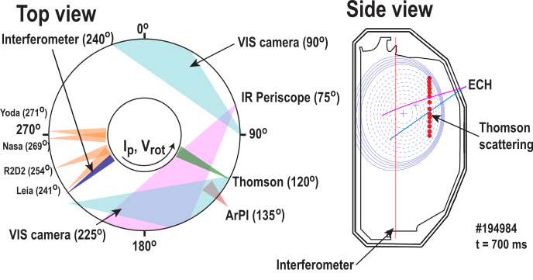
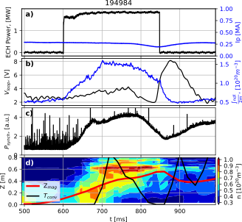
Conversion to Slow-X Mode Observed in DIII-D
Vertical plasma position was scanned to compare OXB and standard O-mode effects
Away from the optimal mode conversion angle, a broad density profile was observed well below the cutoff value
Off-axis peaking in electron density was observed at vertical positions corresponding to nonzero mode conversion efficiency
  Density values above O2 cutoff value observed
Aleynikov et al 2026 Nucl. Fusion 66 106049

Slide 42
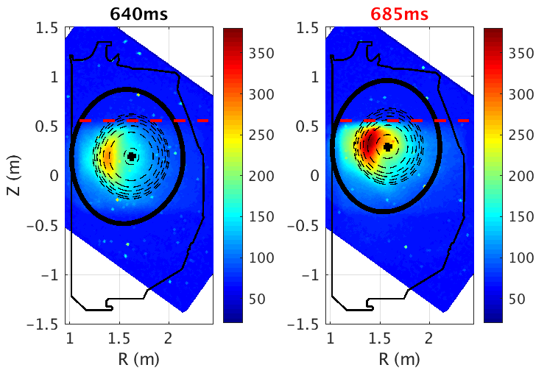
Enhanced Synchrotron Radiation Only Observed for Mode Converted OXB Wave
Synchrotron radiation intensity decays when plasma shifted out of optimal vertical positions
  Calculated conversion efficiency drops to zero
Increase in synchrotron could be caused by:
  Large increase in background plasma density
  Direct wave-particle interactions
Application of ECH results in influx of Ar into the beam which can result in measured synchrotron increase
  As predicted by kinetic modeling
  Modeling matches measure loop voltage
EC Begins at 600ms
Aleynikov et al 2026 Nucl. Fusion 66 106049

Slide 43
Outline
Background
  Runaway Electrons
  Wave-particle interactions
Externally Launched: Helicon Waves
  Modeling
  Experimental Results
  Mitigation Applicability
Additional Wave-Particle Experiments
  OXB Mode Conversion
  Low-Density Expulsion
  Toroidal Ripple Experiment
Conclusions and Future Work

Slide 44
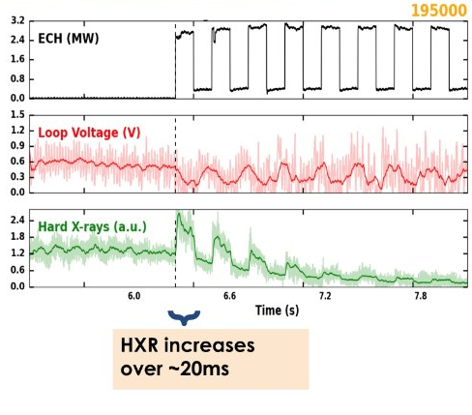
X-Mode EC Observed to Expel RE in Low-Density Plasmas
Low frequency whistler/Alfven modes disappear when expulsion is observed
  Reappear when the EC is switched off
  Consistent with the hypothesis that the RE population is being modified/removed
X-mode EC should be incapable of direct interaction with the highly relativistic electrons
  Due to their phase velocity always being much greater than the speed of light

Slide 45
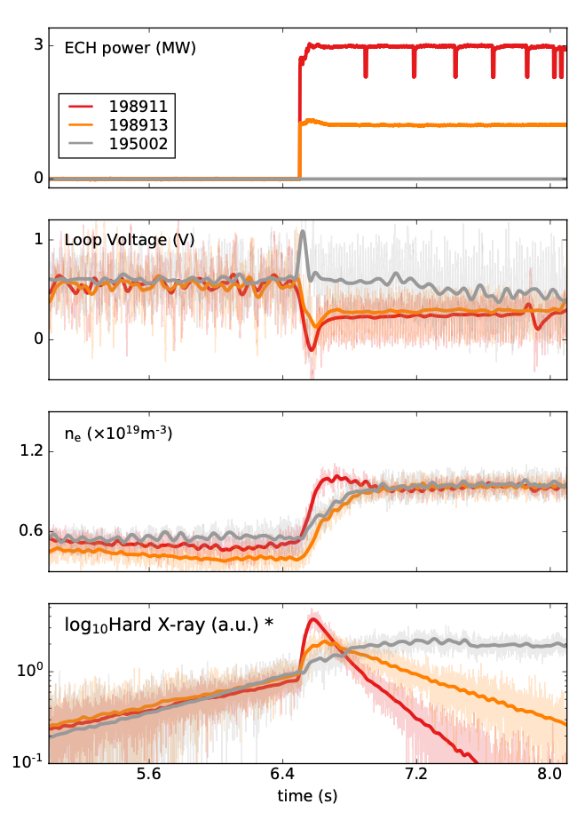
Expulsion Rate Observed to Depend on EC Power
Decay of HXR is faster with increased EC power
  Agrees with a similar power scan completed on TCV
Similar to loop voltages measured for both 1MW and 3MW cases
  Hinting that a change in the RE source is not responsible for differences in expulsion rate
Density is comparable between different power cases
  Indicating that the primary difference between cases is RE transport

Slide 46
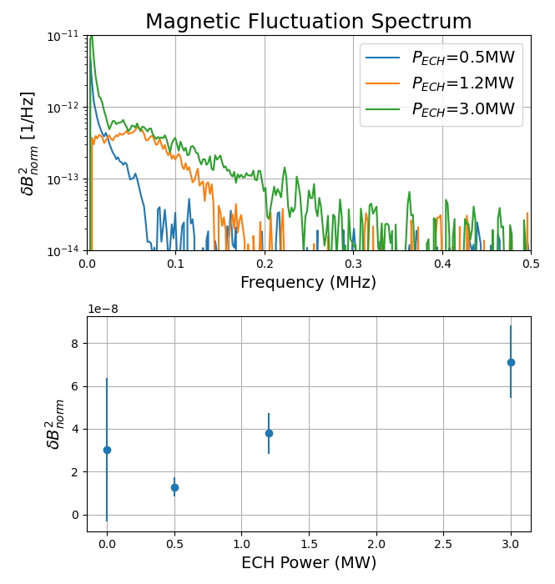
Magnetic Fluctuations Observed to Intensify with EC Power
Density fluctuations correspond to fluctuations in the magnetic field
  Measured using the Radial Interferometer-Polarimeter (RIP)
The intensity of broadband magnetic fluctuations increases with P_{ECH}
  Low density without EC leads to a high signal-to-noise ratio for the 0MW case
The frequency range of fluctuations and total power increase with P_{ECH}
  Power at a given frequency remains relatively constant
P_{ECH}

Slide 47
Outline
Background
  Runaway Electrons
  Wave-particle interactions
Externally Launched: Helicon Waves
  Modeling
  Experimental Results
  Mitigation Applicability
Additional Wave-Particle Experiments
  OXB Mode Conversion
  Low-Density Expulsion
  Toroidal Ripple Experiment
Conclusions and Future Work

Slide 48
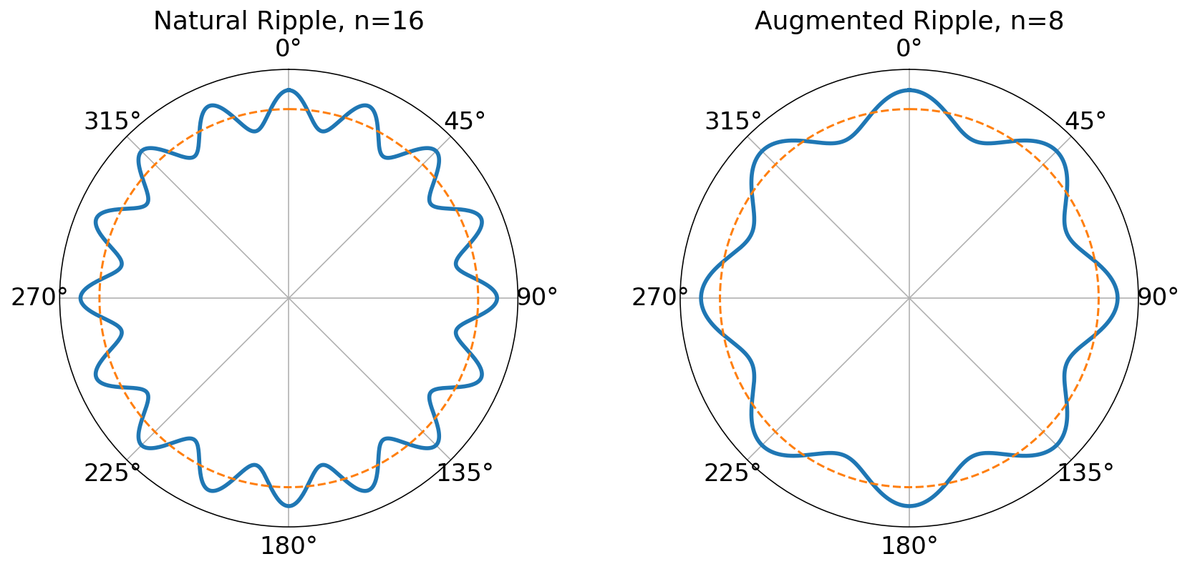
Discrete TF Coils Induce 3D Field Near Edge
REs traveling near the plasma edge experience an oscillating toroidal field
  16 toroidal field coils $→n_{tor}=16$
Particles traveling with the correct momentum experience a resonance with their gyromotion
$$p_{||}=\frac{eB_{T}R}{n_{tor}m_{e}c}$$
For a typical TCV discharge near the plasma edge:
  $$p_{||}≈42m_{e}c$$
  $$E=21MeV$$

Slide 49
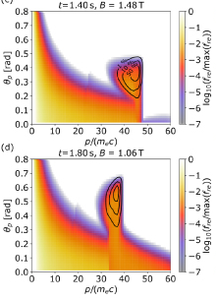
Resonance with Ripple Create Momentum-Space Vortex
A recent study hypothesizes the mechanism behind the observed maximum energy and pitch angle of TCV REs [4]
  MANTIS system
Hypothesizes this resonance between RE gyromotion and the TFR
Modeling in DREAM code illustrated the ability of this resonance to pitch-angle scatter REs and therefore set their maximum momentum.
  Resonance is modeled by creating a diffusion operator to simulate resonance
T.A. Wijkamp etal 2024 Nucl.Fusion 64 016021

Slide 50
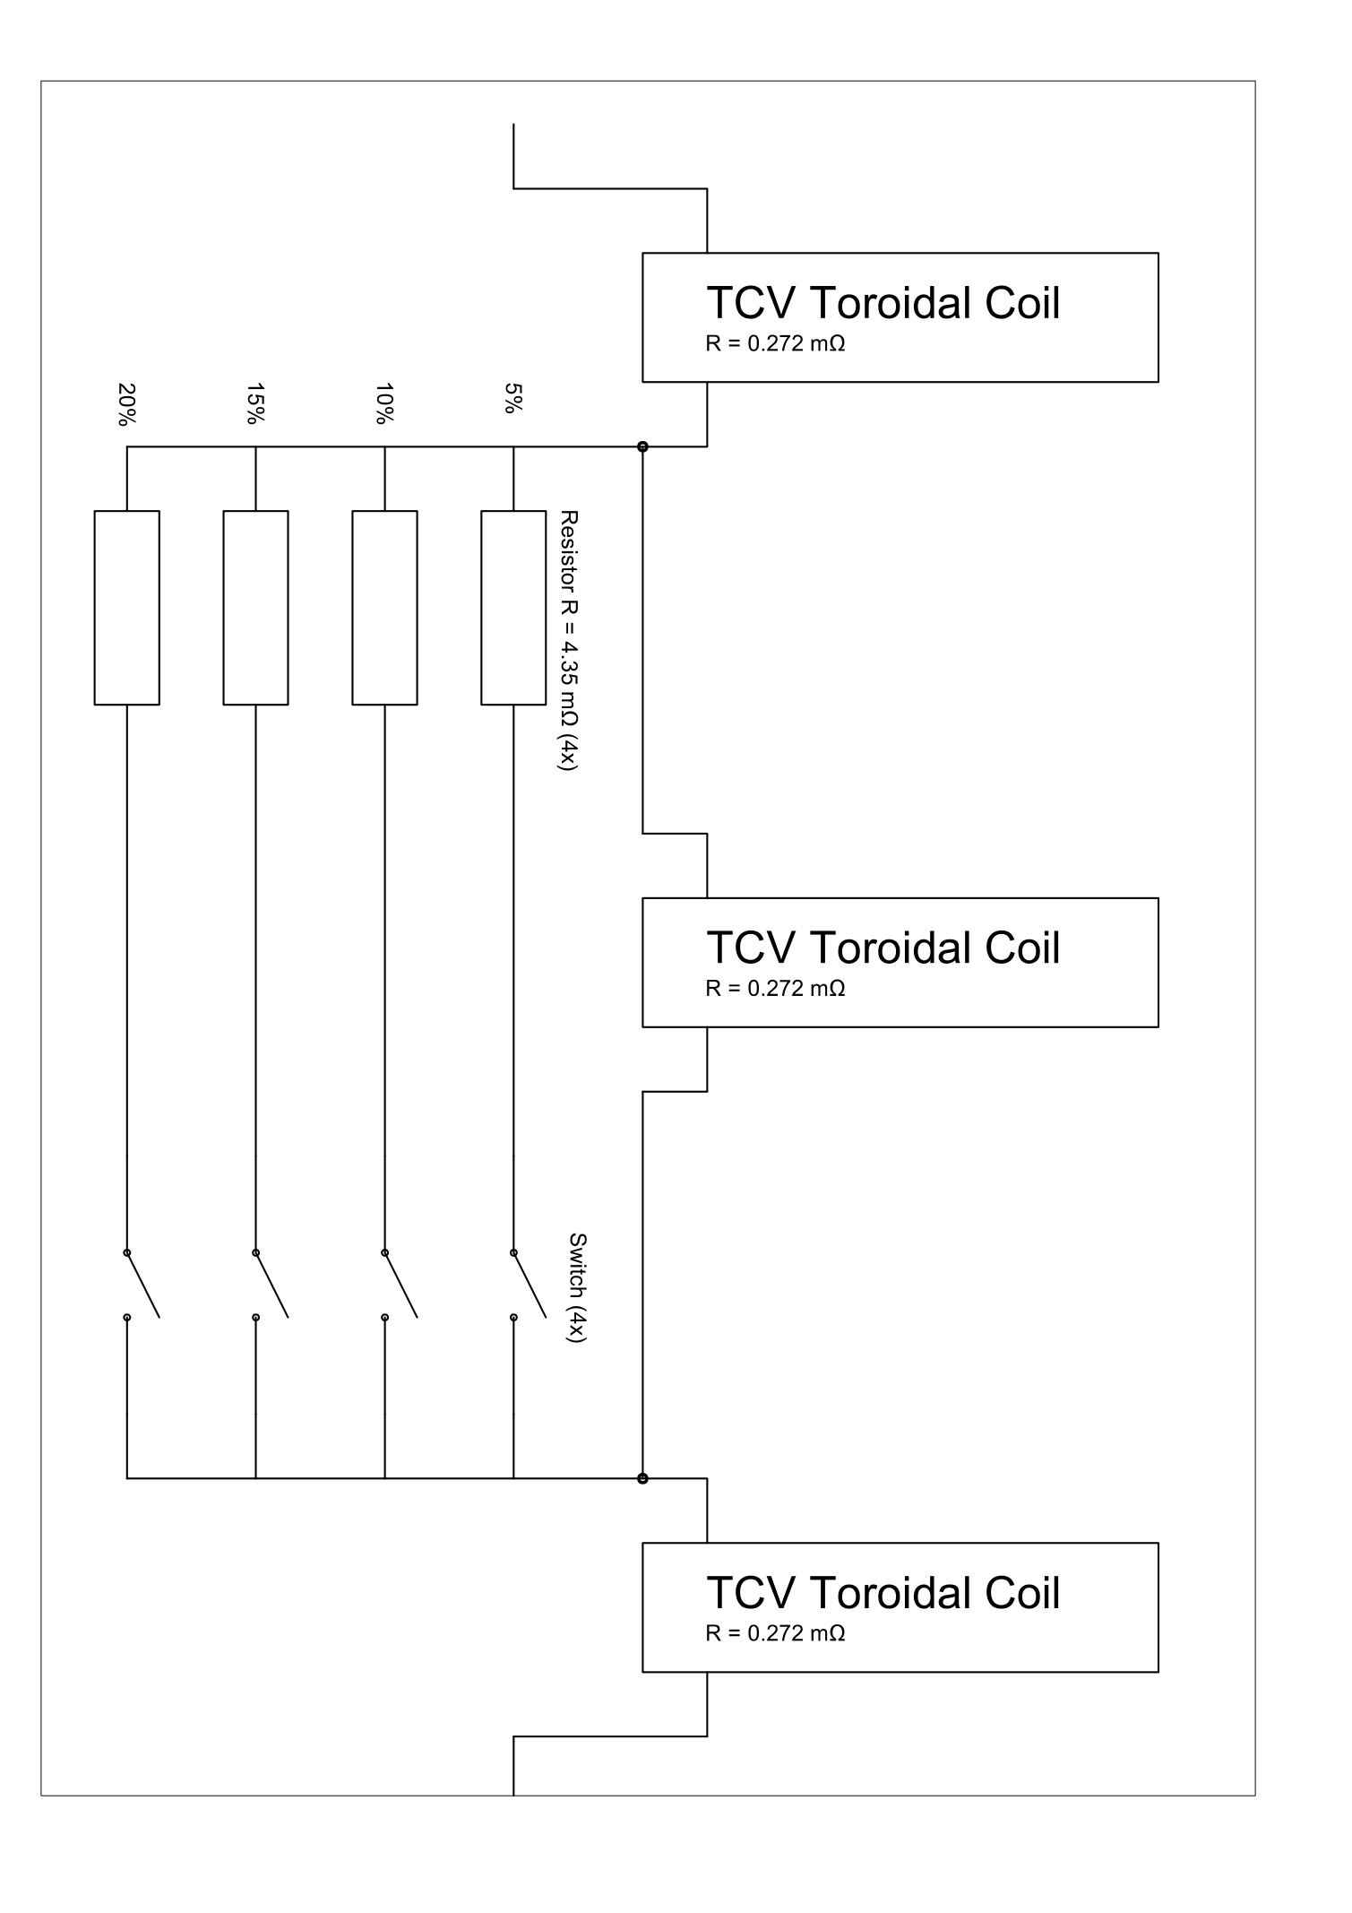
Novel Toroidal Ripple Augmentation System Designed for TCV
Current will be reduced in every other toroidal field coil to allow variable ripple amplitude
  Creating a new $n_{tor}=8$ ripple
Current will be reduced by adding multiple identical resistors, $R_{add}$, in parallel
$$I_{coil}=I_{0}\frac{R_{add}}{R_{add}+NR_{coil}}$$
Switches will be used to add/remove parallel resistance to vary the bypassed current from 6-20%

Slide 51

Applied Ripple Larger Inside the Plasma Volume
Problem: Lower toroidal mode number requires larger momentum for resonance
    $$p_{||}=\frac{eB_{T}R}{n_{tor}m_{e}c}→p_{||,new}=1.8p_{||,old}$$
Resonant energy nearly doubles to 38.6 MeV
  Particles may be blocked by standard resonance before reaching this energy
  Lower-energy resonances would require higher effective harmonics!
Third harmonic required to obtain resonant momentum below the existing level
  Effective amplitude, $δ_{eff,3}=\frac{1}{2}{\left(δ_{1}\right)}^{3}=9.3×{10}^{−7}$ [5]
  Much lower than expected threshold, $δ_{eff}={10}^{−3}$

Slide 52
Outline
Background
  Runaway Electrons
  Wave-particle interactions
Externally Launched: Helicon Waves
  Modeling
  Experimental Results
  Mitigation Applicability
Additional Wave-Particle Experiments
  OXB Mode Conversion
  Low-Density Expulsion
  Toroidal Ripple Experiment
Conclusions and Future Work

Slide 53
Conclusions
Additional tools are needed to mitigate the risk posed by runaway electrons to future high-current tokamaks
Wave-particle interactions are a promising tool for runaway mitigation
  Due to their ability to modify the momentum-space dynamics
Externally launched helicon waves were observed to alter the runaway electron distribution function significantly
  In agreement with established Fokker-Planck modeling
Successful conversion from externally launched O-mode to internal sX-mode observed in post-disruption runaway beam
Significant X-mode power observed to result in runaway electron expulsion in low-density, start-up-relevant plasmas
Resonance with toroidal field ripples will be explored using a hardware upgrade on TCV

Slide 54
Extra Slides

Slide 55

GENRAY Raytracing has Confirmed Low Absorption of Waves on Background Plasma
GENRAY used to simulate wave propagation in background plasma
Does not include REs in simulation
Single pass absorption around 5%
Suggests significant fraction of power left to interact with REs

Slide 56

Cold plasma dispersion for DIII-D plasma parameters
Two solutions to cold plasma dispersion for 476 MHz wave:
slow wave (lower hybrid wave)
fast wave (a.k.a whistler wave, helicon wave, etc)

Slide 57

Parallel refractive index change dominated by major radius location of wave
k = k0 * (R0 / R)
n = k c / omega
we choose wave parameters from the plasma core
Note n_perp is not negligible

Slide 58

Slow wave has a much lower cutoff density than fast wave (a.k.a helicon wave)
Both waves evanescent in vacuum but slow wave can propagate at much lower densities

Slide 59


Special Condition Appears for Waves Near Electron Cyclotron Frequency
Consider either the normal or anomalous cyclotron resonance ($l=±1$)
$$ω−k_{∥}v_{∥}∓\frac{Ω_{ce}}{γ}=0$$
Dealing with relativistic electrons ($v_{||}→c$)
$$1−\frac{c}{v_{ph,∥}}=±\frac{1}{γ}\frac{Ω_{ce}}{ω}$$
Assume mode frequencies very near the electron cyclotron frequency
$$v_{ph,∥}=\frac{c}{1∓\frac{1}{γ}}$$
For significantly relativistic particles (e⁻ rest mass: 0.5MeV)
$v_{ph,∥}$ = c
P. Aleynikov

Slide 60

Wave-Particle Interaction Can Be Divided into Parallel and Perpendicular
The processes that are available for collisionless wave-particle interactions in a magnetized plasma can be divided as either parallel and perpendicular
General wave-particle resonance condition:
$$ω−k_{||}v_{||}−k_{⊥}v_{d}−\frac{lΩ_{ce}}{γ}=0$$
  $l$ is an integer: -1 (anomalous), 0 (Landau/Cherenkov), or +1 (Normal)
$l=0$ case: Particles moving at speeds away from the phase velocity experience a AC field which averages to zero
  Particles moving very near the phase velocity experience a DC field and therefore acceleration/deceleration (Landau damping/drive)
$l=±1$ case: Gyro motion see elliptically polarized light adjusted by the gyrofrequency
  Plus or minus depends on relative direction of the wave and the particle and handedness of the wave
  Handedness become less important in plasmas with minority species
[1]

