Slide 1



Radial electric field induced by NBI fast ions
K. Bogar¹, F. Jaulmes¹, W.W. Heidbrink², X.D. Du³, J. Rueda-Rueda², D. Liu³, M.A. van Zeeland³, Q. Pratt⁴
Klara.bogar@ipp.cas.cz
List of affiliations:
¹ Institute of Plasma Physics of the CAS, Prague, Czech Republic
² Department of Physics and Astronomy, University of California-Irvine, Irvine, USA
³ General Atomics, San Diego, USA
⁴ Princeton Plasma Physics Laboratory: Princeton, New Jersey, USA

Slide 2
outline
Motivation
How fast ions induce radial electric field
DIII-D QH-mode case with counter-NBIs
Co & counter-current NBIs

Slide 3
outline
Motivation
How fast ions induce radial electric field
DIII-D QH-mode case with counter-NBIs
Co & counter-current NBIs

Slide 4

How does NBI induce E_{r}?
Observation: Experimental radial electric field is derived from the radial force balance equation:
Chicken & egg problem of the source:
Common attitude: injected neutrals in one direction transfer their momentum to the plasma → high plasma rotation → v×B induced radial electric field
Tested hypothesis: Fast ions induce radial electric field directly by charge separation?
$$E_{r, exp}=\frac{∇p_{i}}{Z_{i}en_{i}}−v_{θ,j}B_{φ}+v_{φ,j}B_{θ}$$

Slide 5
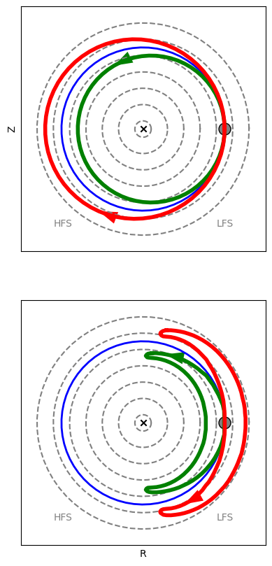
Fast ions Charge separation
passing
NBI fast ions are shifted by drifts from the initial ionization position
Positive charge is separated from the negative charge → induce radial electric field E_{r, FI} (Xingyuan Xu, NF 2021)
Fast ions modelling: FIDASIM (B. Geiger, PPCF 2020) + EBdyna (F. Jaulmes, NF 2021), experimentally constrained 2D map of background neutrals, steady-state phase without any MHD or wave-induced transport
Induced radial electric field modelled for DIII-D QH-mode (QH-mode: E × B shear threshold), (Xi Chen, NF 2007)
trapped
Co-I_{P}, counter-I_{P}, e

Slide 6
outline
Motivation
How fast ions induce radial electric field
DIII-D QH-mode case with counter-NBIs
Co & counter-current NBIs

Slide 7
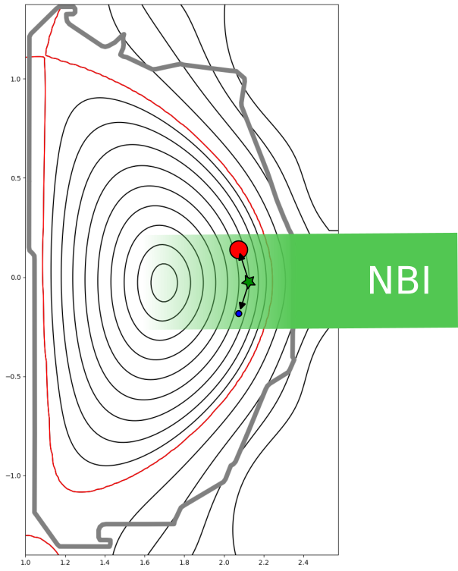
fast ion-electron couple
Injected fast neutrals ionize → formation of fast ion-electron couple
Fast ions: large excursion across magnetic flux surfaces due to drifts
Electrons: remain on ionization flux surface

Slide 8
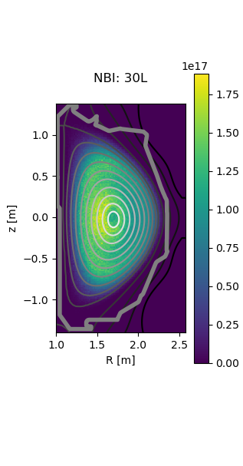
Asymmetric FI distribution
Counter-current NBI
Injected fast neutrals ionize → formation of electron-fast ion couple
Fast ions: large excursion across magnetic flux surfaces due to drifts
Electrons: remain on ionization flux surface
Fast ions distribution is asymmetric in space, energy and pitch
Resulting distribution is given by NBI injection direction and plasma parameters

Slide 9
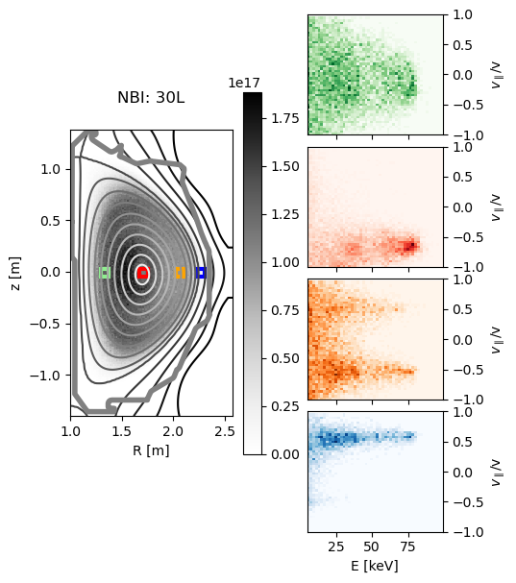
Asymmetric FI distribution
Counter-current NBI
Injected fast neutrals ionize → formation of electron-fast ion couple
Fast ions: large excursion across magnetic flux surfaces due to drifts
Electrons: remain on ionization flux surface
Fast ions distribution is asymmetric in space, energy and pitch
Resulting distribution is given by NBI energy and injection direction and plasma parameters

Slide 10
E_{r} from confined FI
passing
Fast ions drifts are large (due to high energy) → shifted distribution from the ionization profile
Negative charge ~remain on mag. surface of the ionization position
Positive and negative charges are shifted in respect to the magnetic flux surfaces → induce radial electric field
Co-current: positive charge is shifted deeper into plasma → positive radial electric field
Counter-current: positive charge is shifted outward → negative radial electric field
trapped
Co-I_{P}, counter-I_{P}, e

Slide 11
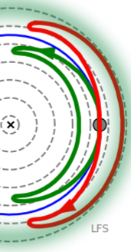
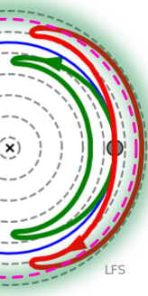
E_{r} from Fast ion losses
Ejected fast ions: positive charge ends up on the wall → each time negative radial electric field in the edge
Charge-exchange losses:
  fast ion capture an electron from the background neutral → fast neutral and cold ion (small drifts)
  positive charge is located in charge-exchange position
  CX collisions occur more likely in outward region (higher background neutral density)
  mostly negative radial electric field in the edge
Counter-current NBIs: significantly higher direct fast ion losses and also higher CX losses → large negative radial electric field in the edge
E_{r ejected FI}
CX
E_{r CX}

Slide 12



E_{r} calculation
Components:
confined fast ions: deep inside plasma, co-current: positive E_{r}, counter-current: negative E_{r}
Ejected fast ions: each time negative E_{r} in the edge, higher for counter-current
Charge-exchange losses: mostly negative E_{r} in the edge, higher for counter-current
Calculation based on Xingyuan Xu, NF 2021: response of the plasma considered, plasma polarization (in constant c)
E_{r, FI} ~ Integral from the plasma core to the edge of the resulting charge inside the magnetic flux surface tube
$${E_{r, FI}=E}_{r, confined}+E_{r, ejected FI}+E_{r, CX}$$
$$E_{r, FI}=c\frac{1}{S}\int{−(Z_{NBI}N_{FI}−n_{e, NBI})}dV$$
$$c=\frac{3.27}{1+κ^{2}}\frac{ω_{pi_bulk}^{2}}{Ω_{i_bulk}^{2}}\frac{q^{2}}{ε^{1/2}}\frac{ε_{0}}{e}$$
Xingyuan Xu, NF 2021

Slide 13
outline
Motivation
How fast ions induce radial electric field
DIII-D QH-mode case with counter-NBIs
Co & counter-current NBIs

Slide 14
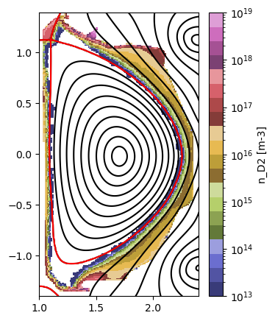
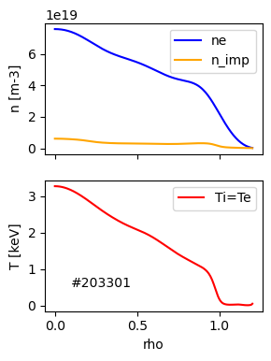
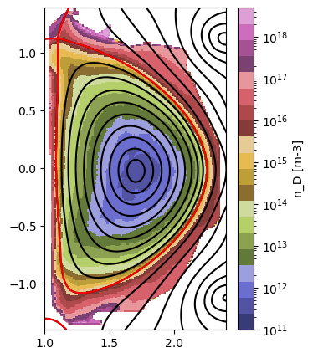
DIII-D, QH-mode
30L
33R
30R
33L
I_{P}, B_{T}
QH-mode: E×B shear threshold to maintain edge harmonic oscillations (Xi Chen, NF 2007)
Counter-current beam injection
Experimentally constrained 2D map of neutrals (more precise CX losses)
21R
21L
15L
15R
 | E [keV] | P [W]
15L | 74.9 | 1.41
15R | 73 | 1.47
30L | 80 | 2.57
30R | 70 | 1.76
33L | 62 | 1.18
33R | 70.3 | 1.64
D. Ernst, APS-DPP 2026
Q. Pratt, Degas

Slide 15
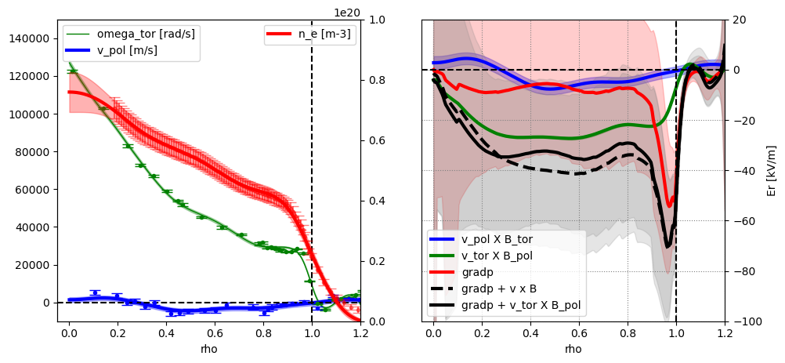

Measured rotations and derived E_{r}
$$E_{r}=\frac{∇p_{i}}{Z_{i}en_{i}}−v_{θ,j}B_{φ}+v_{φ,j}B_{θ}$$
Assumption: all plasma particles have same plasma rotations → gradp_{e}
Neglecting poloidal rotation (low quality)

Slide 16
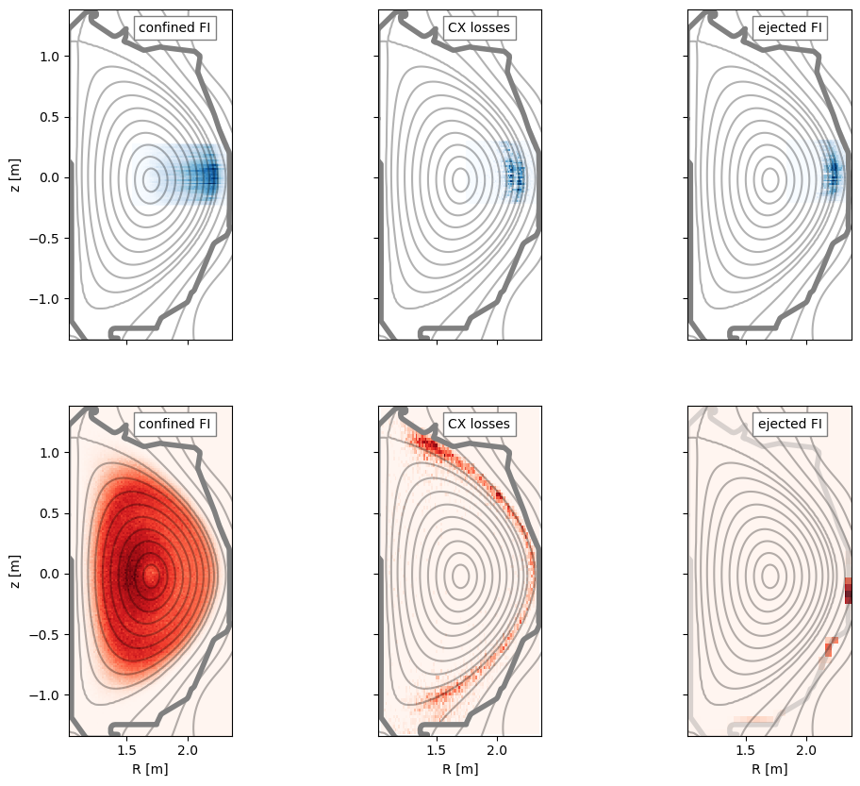
Charge separation
Ionization position ~
Negative charge
30L
33R
30R
33L
I_{P}, B_{T}
21R
21L
15L
15R
final position ~
Positive charge

Slide 17
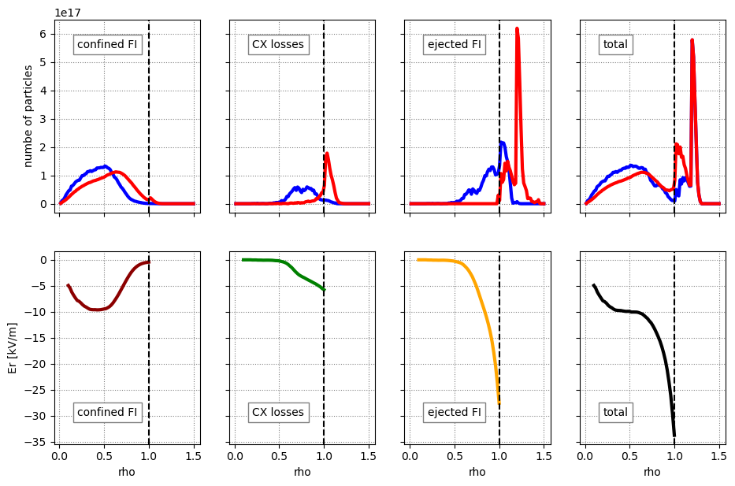

Induced E_{R}
$$E_{r}=c\frac{1}{S}\int{−(Z_{NBI}N_{FI}−n_{e, NBI})}dV$$
30L
Positive charge
Negative charge
E_{r} derived inside closed flux surfaces
33R
30R
33L
I_{P}, B_{T}
21R
21L
15L
15R

Slide 18
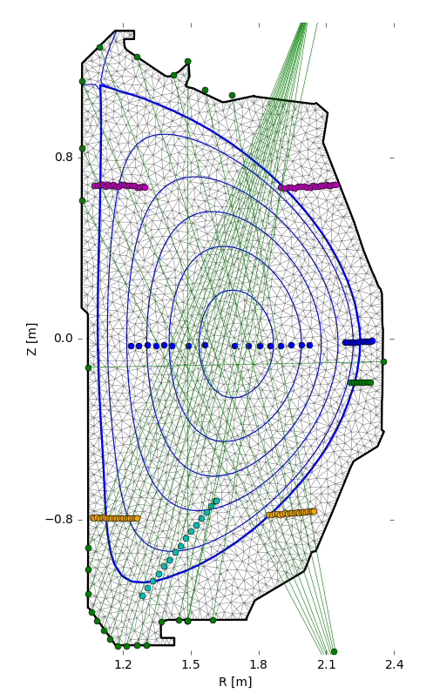
2D map of neutrals
Down filterscopes
LFS Alpaca
DEGAS2 workflow: simultaneous comparison of synthetic diagnostics with measured data from different positions → 2D map of background neutrals of atoms (D) and molecules (D₂)
molecules
atoms
Midplane
filterscopes
X-point D-alpha
LFS Llama
UP filterscopes

Slide 19
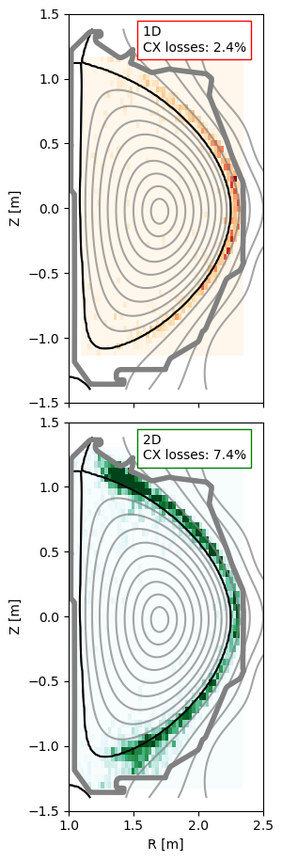
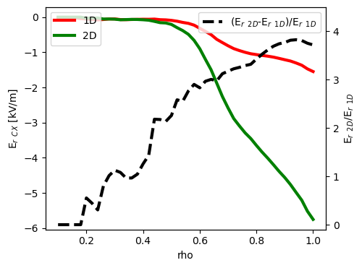
CX losses 1D vs 2D
atoms
1D and 2D background neutral density cause significant difference,
3 × higher CX losses, up to 4 × higher E_{r CX}
1D

Slide 20
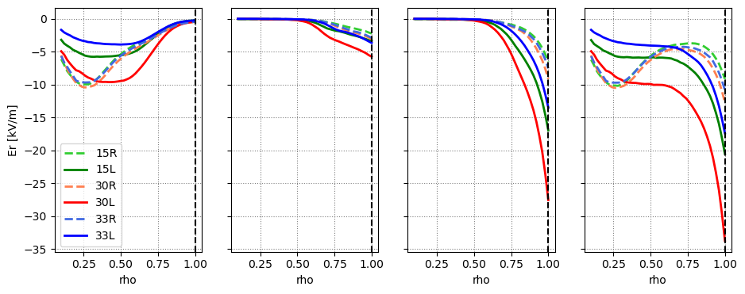
Differences in NBI injection angle
Same pattern for all L NBIs (more tangential) and all R NBIs (more radial)
30L
33R
30R
33L
Confined FI
I_{P}, B_{T}
21R
21L
15L
15R
CX losses
Ejected FI
Total

Slide 21
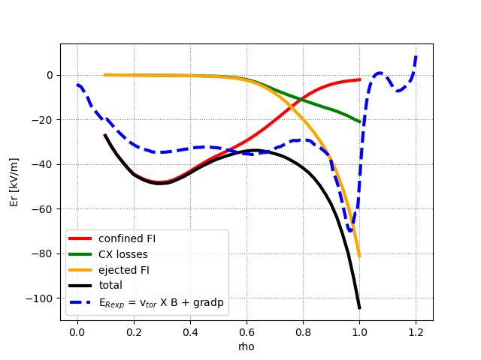
Agreement with measured E_{R}
Core area: dominated by confined fast ions
Edge area: defined by fast ion losses, ejected particles dominates in selected discharge
Good agreement with experimental measurement of E_{r exp} = v_{tor}×B + E_{r}(gradp)
Vicinity of separatrix: shielding from the SOL, not considered in E_{r} from fast ions
Total E_{r}: there are other contributors (thermal ions)

Slide 22
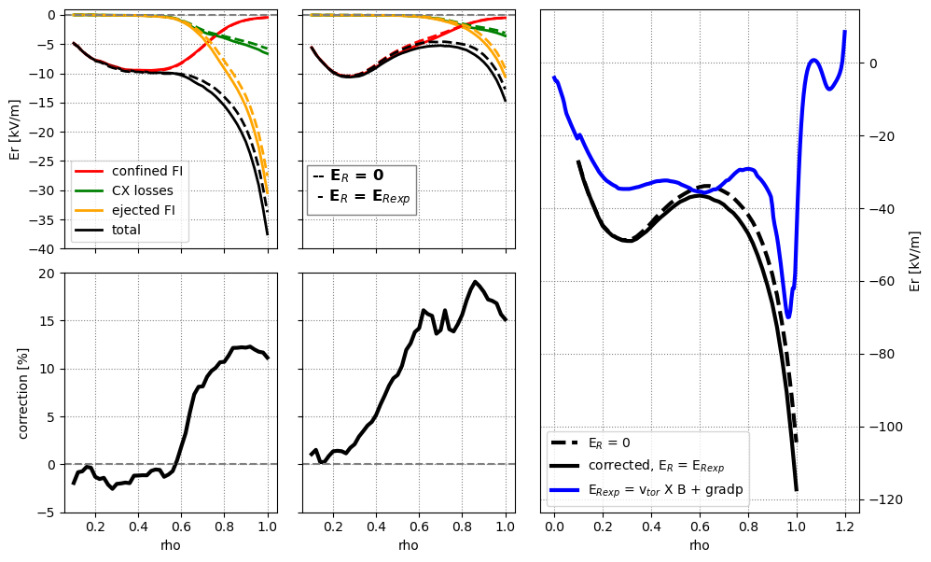
E_{R} correction
30L NBI
(tangential)
30R NBI
(radial)
First round of fast ion simulations had E_{r} = 0 kV/m
Simulations with E_{r} = E_{r exp}
Correction for L and R beams, up to ~ 15 % in the edge area

Slide 23
outline
Motivation
How fast ions induce radial electric field
DIII-D QH-mode case with counter-NBIs
Co & counter-current NBIs

Slide 24
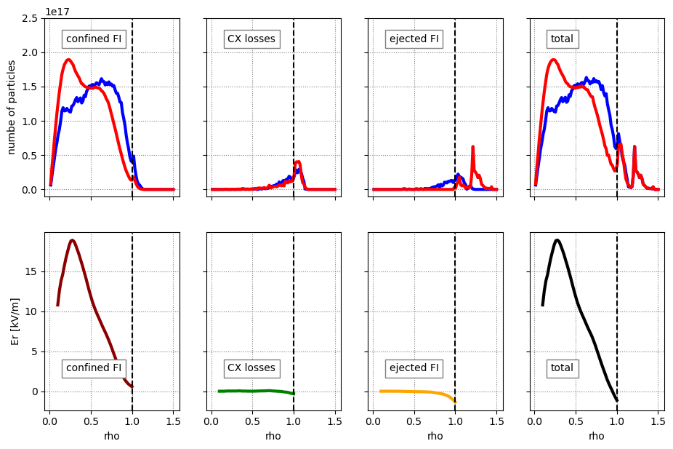
21R, co-current NBI
Positive charge
Negative charge
Co-current beam: positive E_{r} in the core
Contributing mainly confined fast ions
Almost no impact on the plasma edge
30L
33R
30R
33L
I_{P}, B_{T}
21R
21L
15L
15R

Slide 25
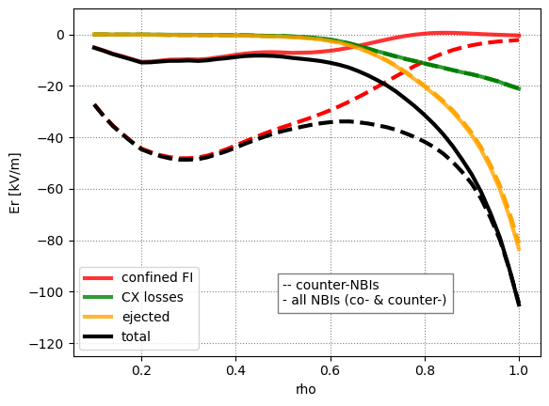
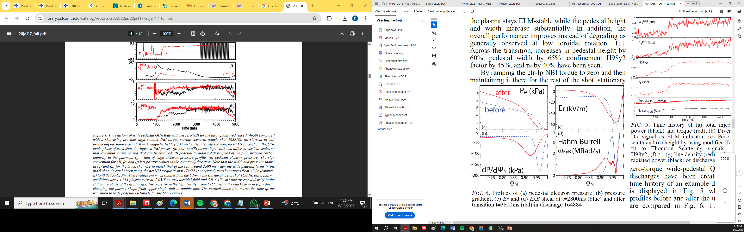
co- & counter- NBI
33R
30L
33L
30R
I_{P}, B_{T}
21R
All beams (15L, 15R, 30L, 30R, 33L, 33R +21R, 21L)
All beams together: steep E_{r} in the edge (from counter-beams) and ~ 0 V/m in the core region
E_{r} steep edge area is wider (wide pedestal QH?)
21L
15L
15R
QH
WPQH
Xi Chen, NF 2017

Slide 26
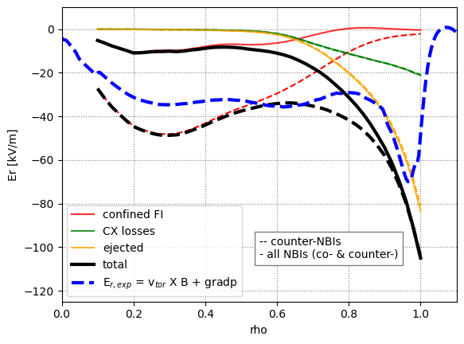
conclusion
Charge separation of NBI fast ions and electrons can induce radial electric field
Co-current NBI: positive E_{r} in the core, lower impact on the edge
Counter-current NBI: negative E_{r} in the core, steep negative E_{r} in the edge
Combination of co- & counter-NBIs: tuning of E_{r} shape
FI induced E_{r} is close to measured E_{r exp} → Fast ions can explain a big part of induced radial electric field
2D map of neutrals cause significant difference
Simplified fast ion models such as Rabbit can be used for a systematic benchmark of presented hypothesis (v → E or E → v ?)

