Slide 1


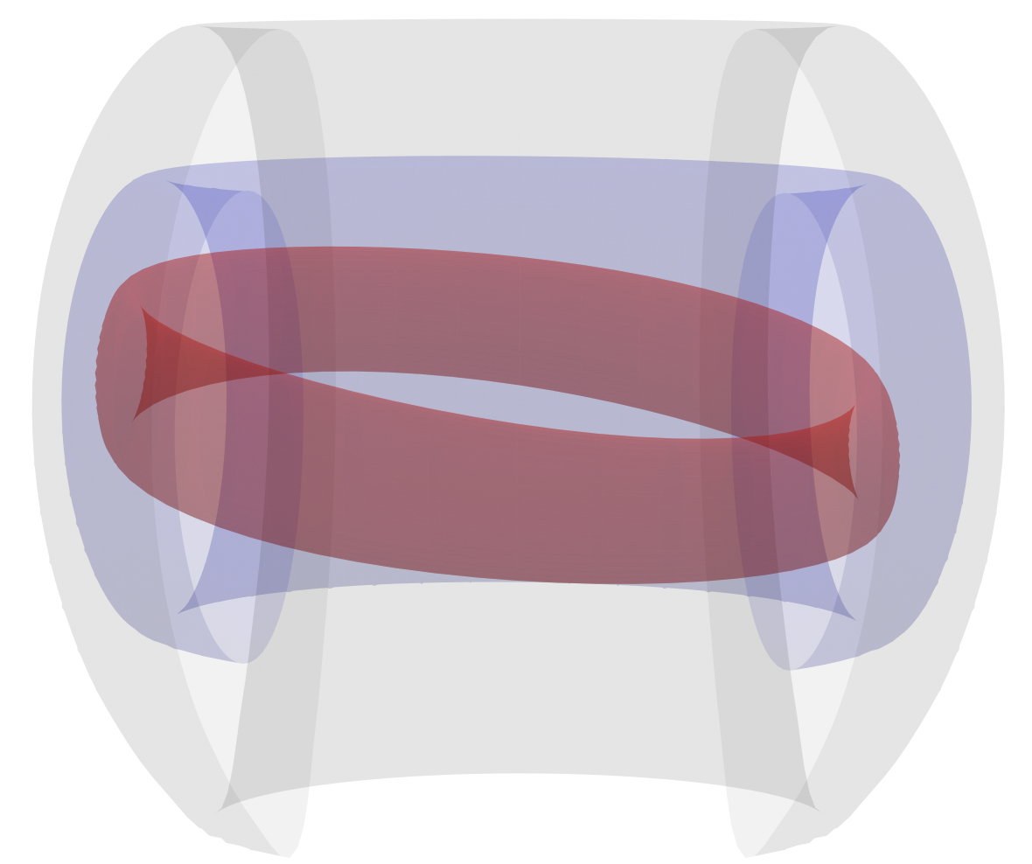
19th Technical Meeting on Energetic Particles
Properties of Pressure-driven & EP-driven MHD Instabilities in Helical Core ITER-Scale Plasmas
Panith Adulsiriswad
September 30, 2026
[1] National Institutes for Quantum Science and Technology, Naka Institute for Fusion Science and Technology
[2] National Institute for Quantum Science and Technology, Rokkasho Institute for Fusion Energy

Slide 2

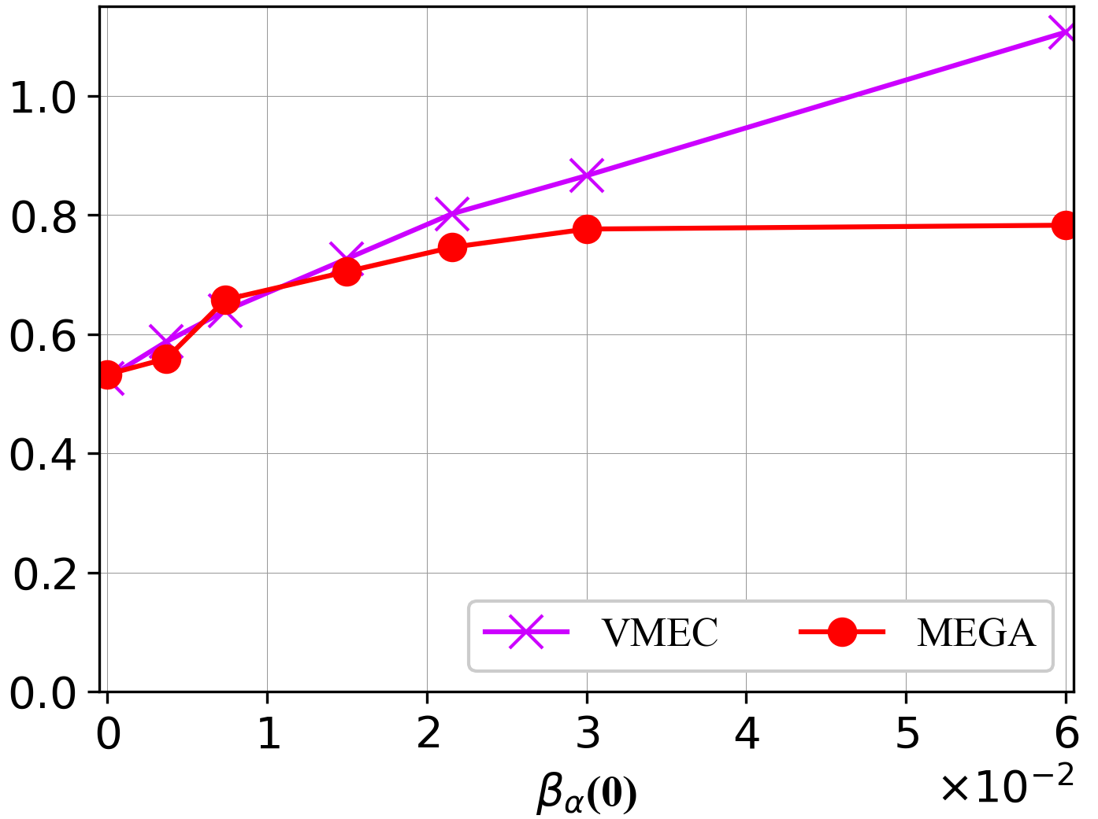
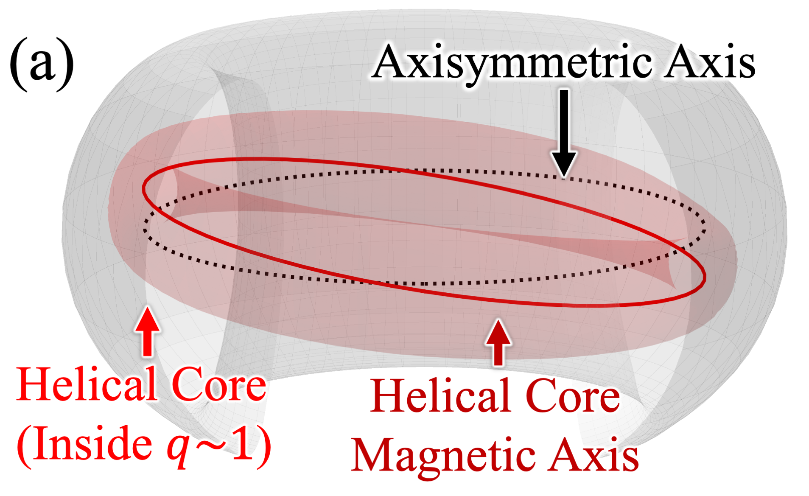
    Background : Helical Core Formation in Tokamak Plasmas
Helical core (HC)¹ is a Long-lived ideal saturation
state of kink/quasi-interchange mode.
Using kinetic alpha + MHD model (MEGA) to study HC formation in ITER-scale plasmas, we found that⁵
[1] Cooper, W. A., et al. Physical review letters 105.3 (2010): 035003
1. Fusion-born alphas enhances HC displacement ($δ_{HC}$)
  Observed in the tokamak hybrid scenario ( $q≳1$ )
  Spontaneous formation is predicted in ITER²⁻³
2. Within $0≤β_{α}≤1.5\%$, alphas remain well-confined*
* Caveat: However, the effects of other instabilities in the HC equilibrium have not be assessed!
[2] Wingen, A., et al. Nuclear Fusion 58.3 (2018): 036004
[3] Cooper, W. A., et al. Plasma Phys. and Cntrl. Fusion 53.2 (2011): 024002
  Responsible for the poloidal flux-pumping⁴
    Sawtooth-free plasmas with expense toroidal symmetry
[4] Piovesan, P, et al. Plasma Phys. Cntl Fusion 59.1 (2016): 014027
HC axis Displacement $δ_{HC}$ (m)
MEGA & VMEC agree within $0≤β_{α}≤1.5\%$
[5] P. Adulsiriswad et al. Nuclear Fusion 66.4 (2026) 046032

Slide 3
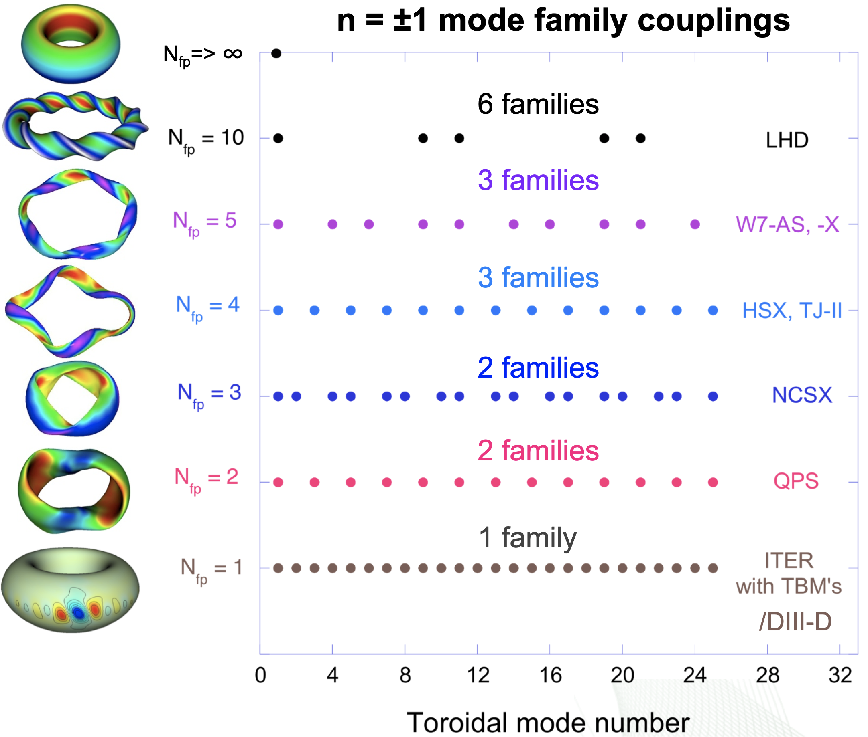
    Research Motivations & Objectives
In LHD, n=1,9,11,19,21 are the same mode
1) Previously, the effects of EP-driven instability were not considered
  Limit to $n≤8$ harmonics and HC formation phase
Source:
D. Spong, ORNL, APS 56th Annual Meeting
2) Toroidally Asymmetry¹ leads to loss of mode degeneracy
  “n” harmonic is coupled with “$n±{iN}_{fp}”$
    More wave–particle resonant channels²
[1] Spong DA, et al. Physics of Plasmas 10.8 (2003): 3217-3224.
[2] Kolesnichenko YI, et al. Physics of Plasmas 9.2 (2002): 517-528
    In HC (N_{fp}=1), all “n” constitute to a same family
DIII-D TBM Exp.
& HC
Question 1:
Motivations
“To verify the feasibility of a HC-based tokamak reactor, its stability need be assessed.”
How HC toroidal asymmetry affects MHD stability?
Question 2:
If there is an instability, how critical is it?

Slide 4
Calculation Basis, Assumption, Setups

Slide 5
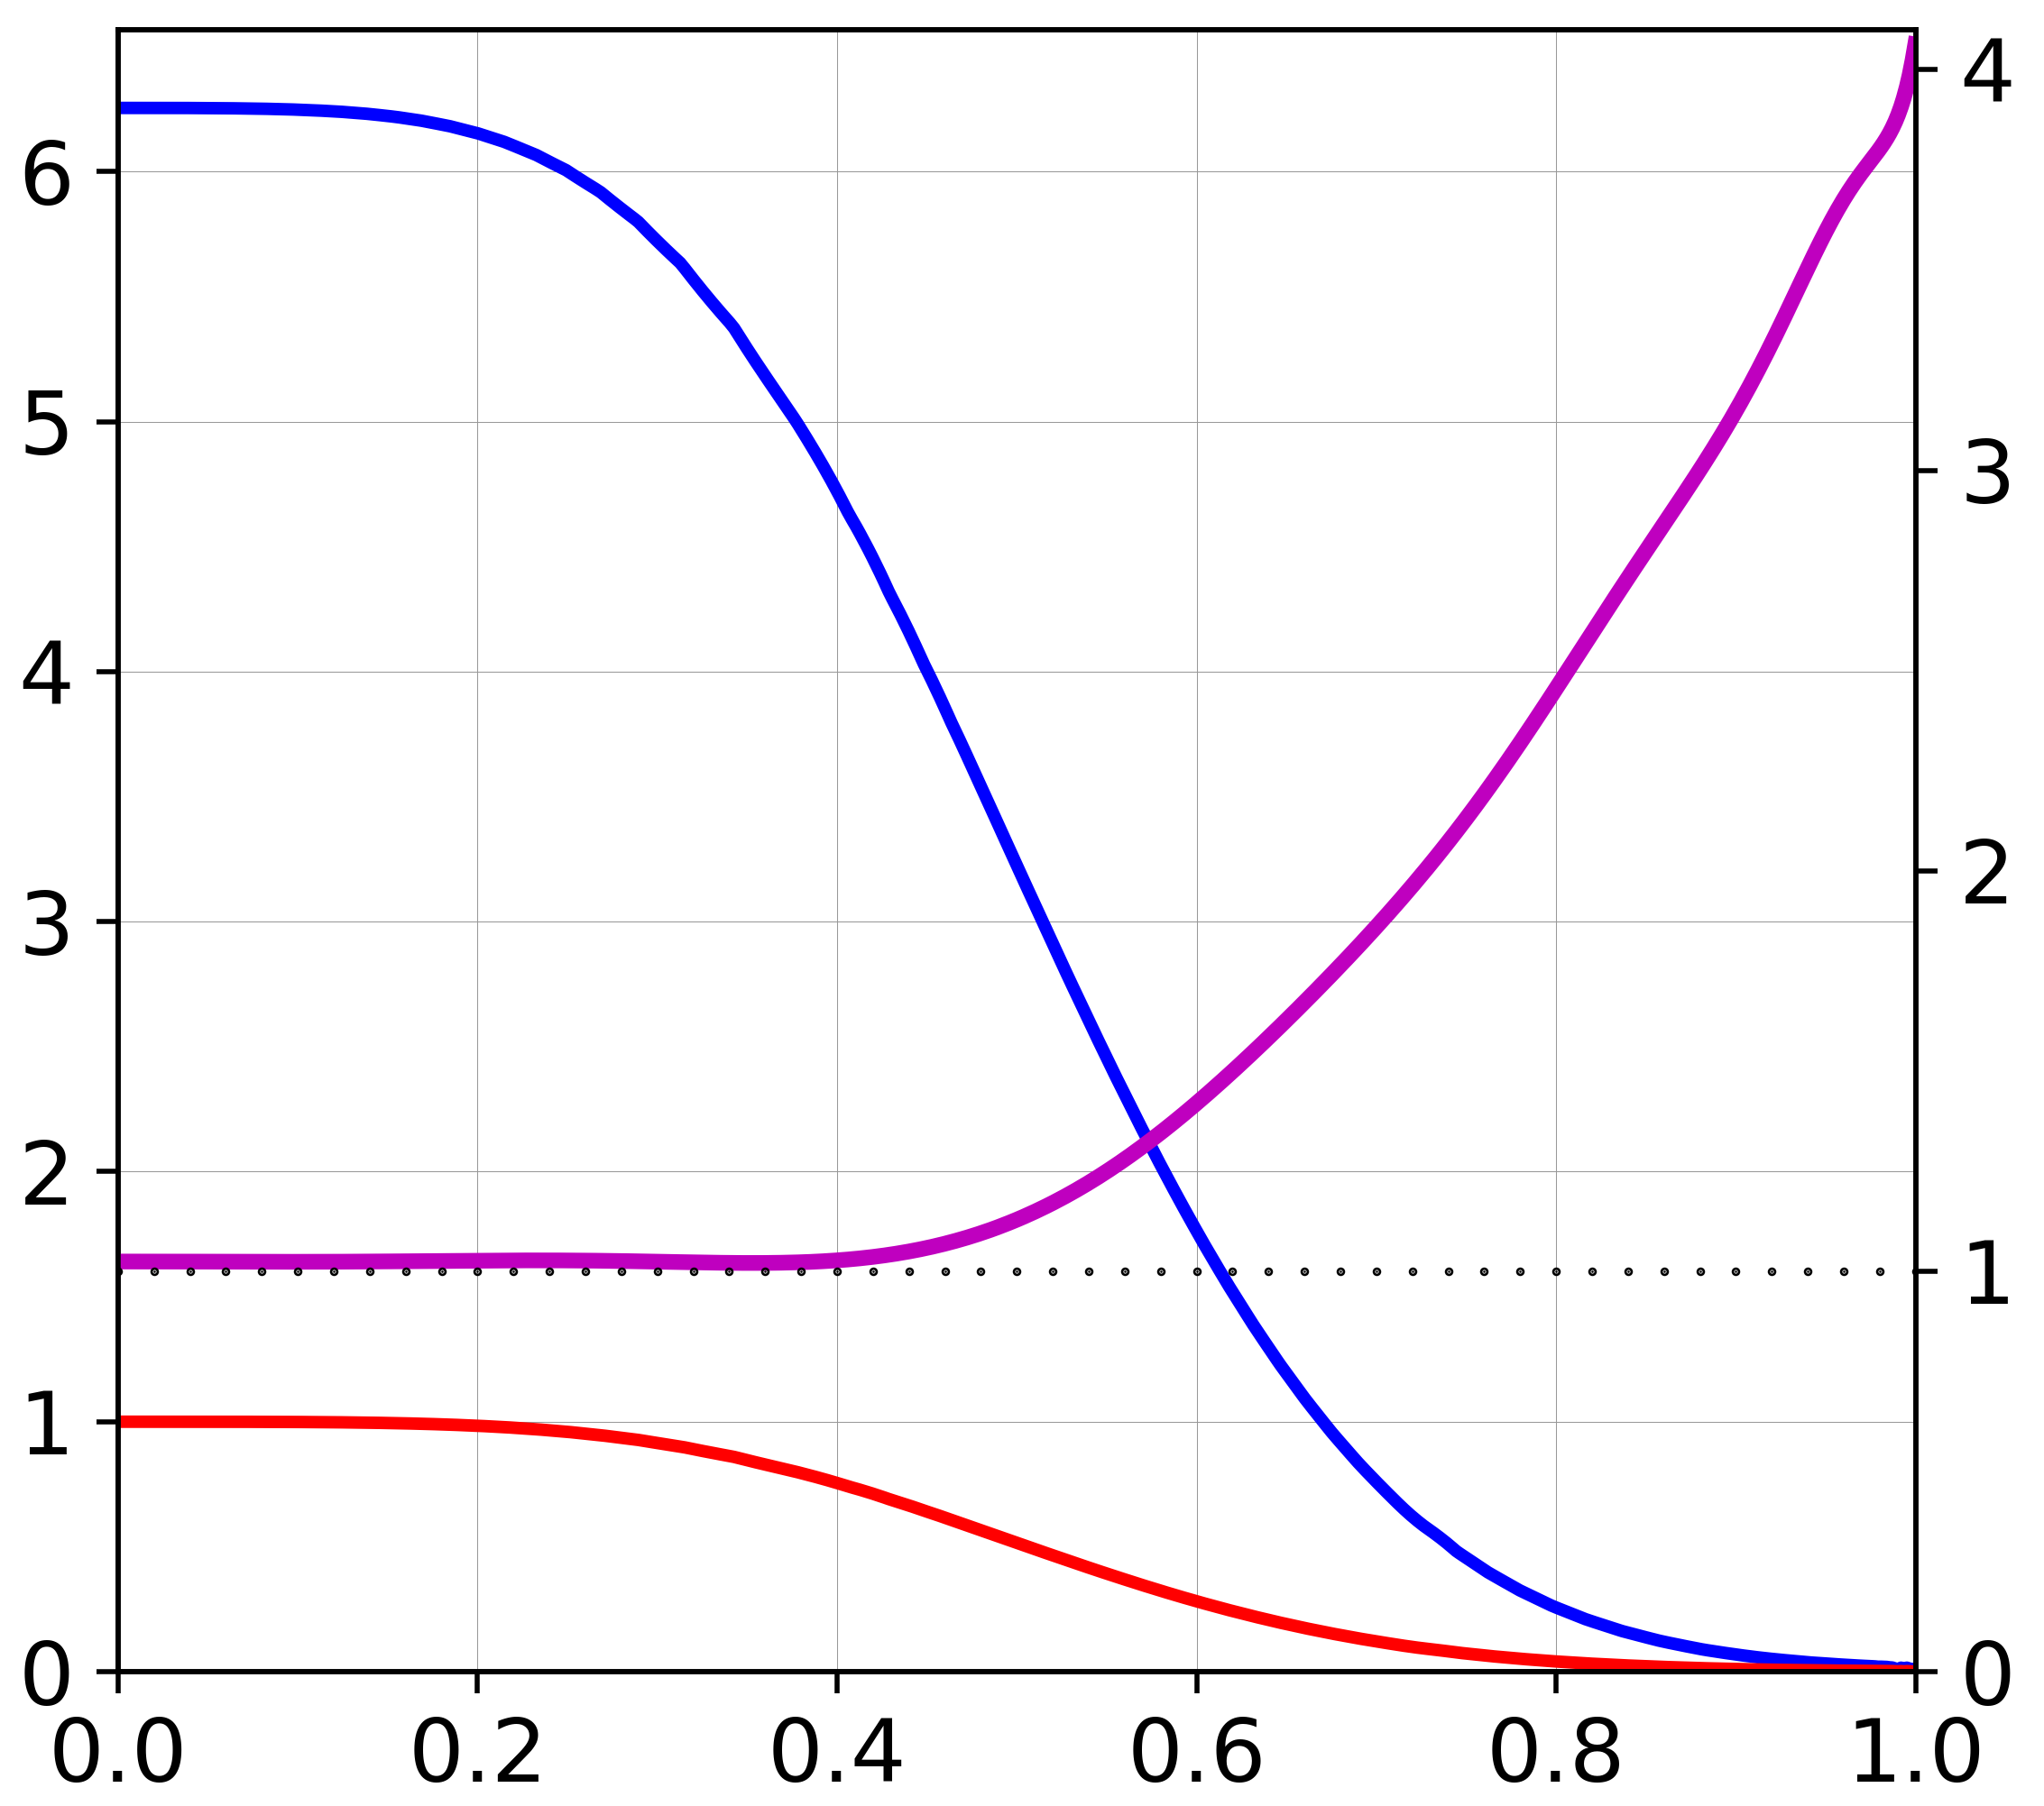
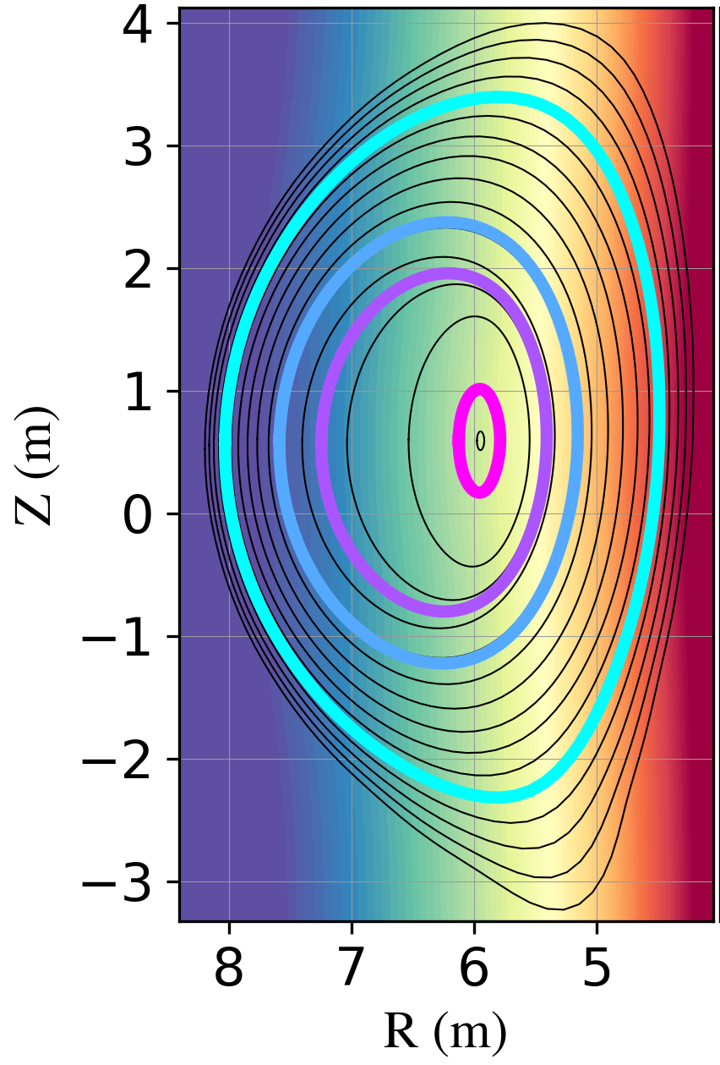
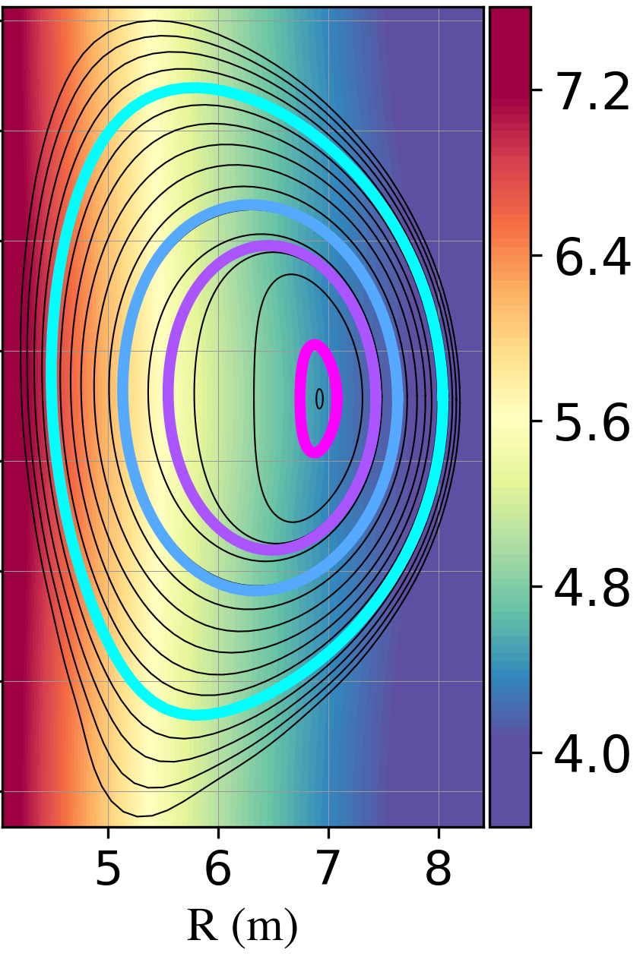
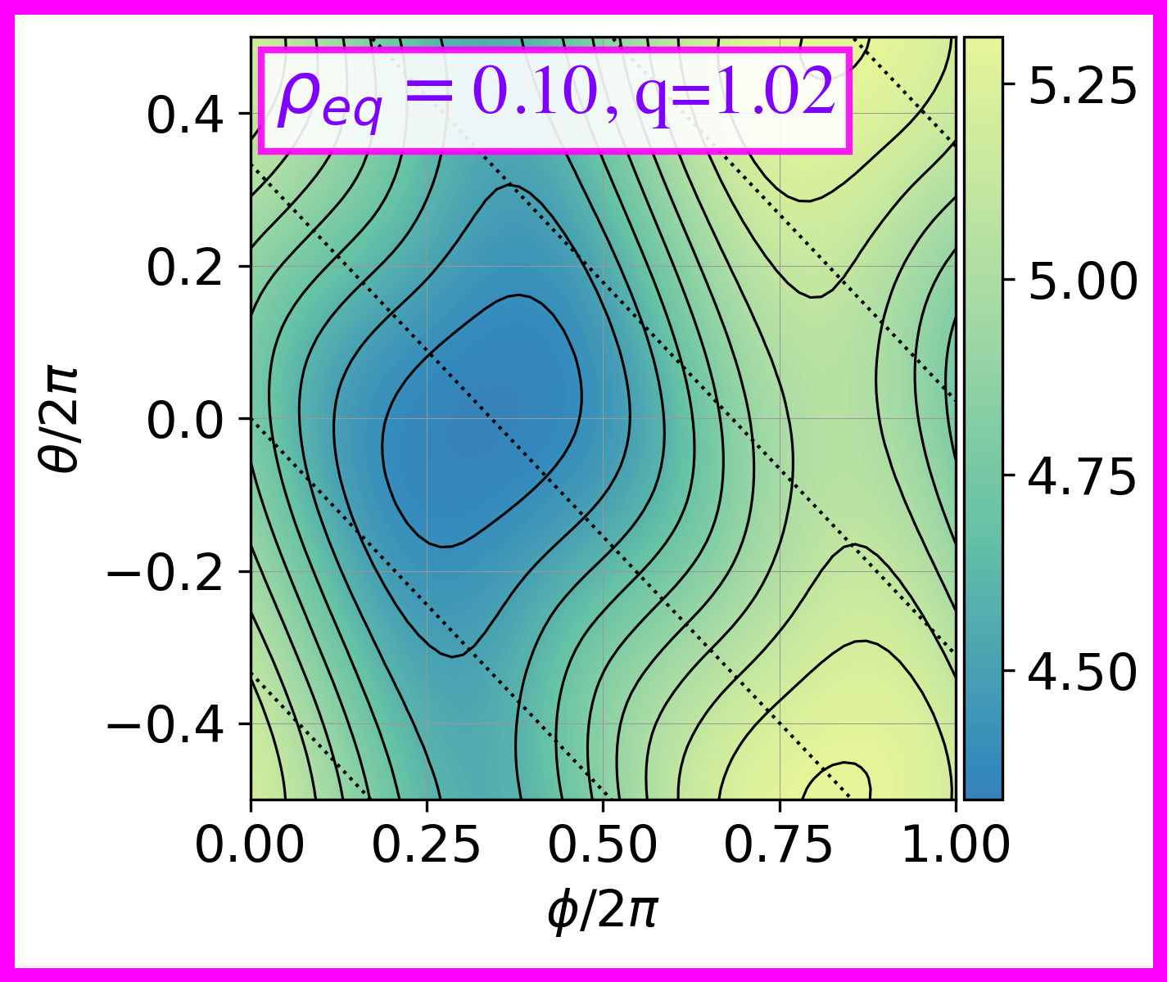
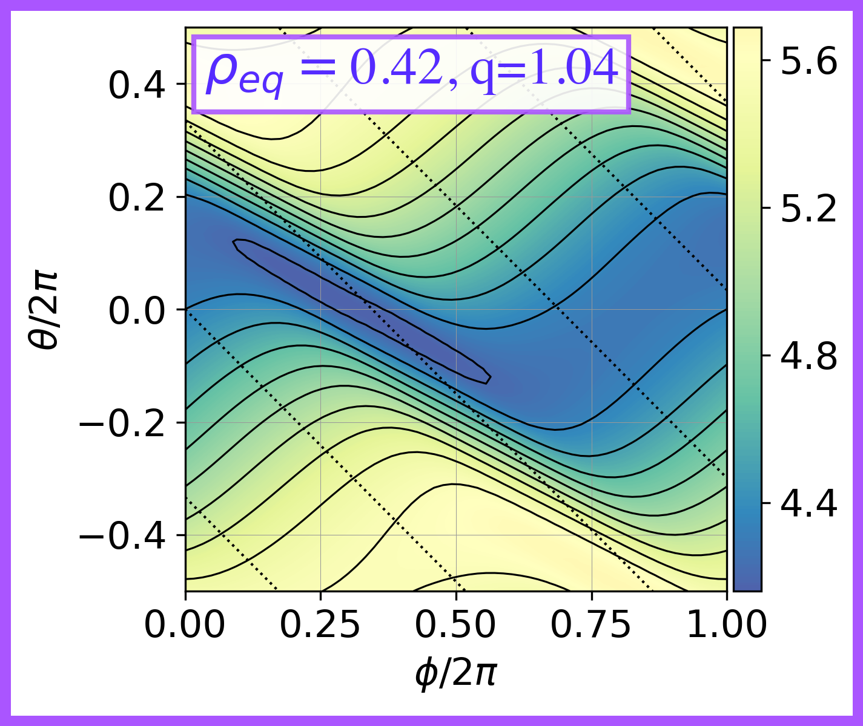
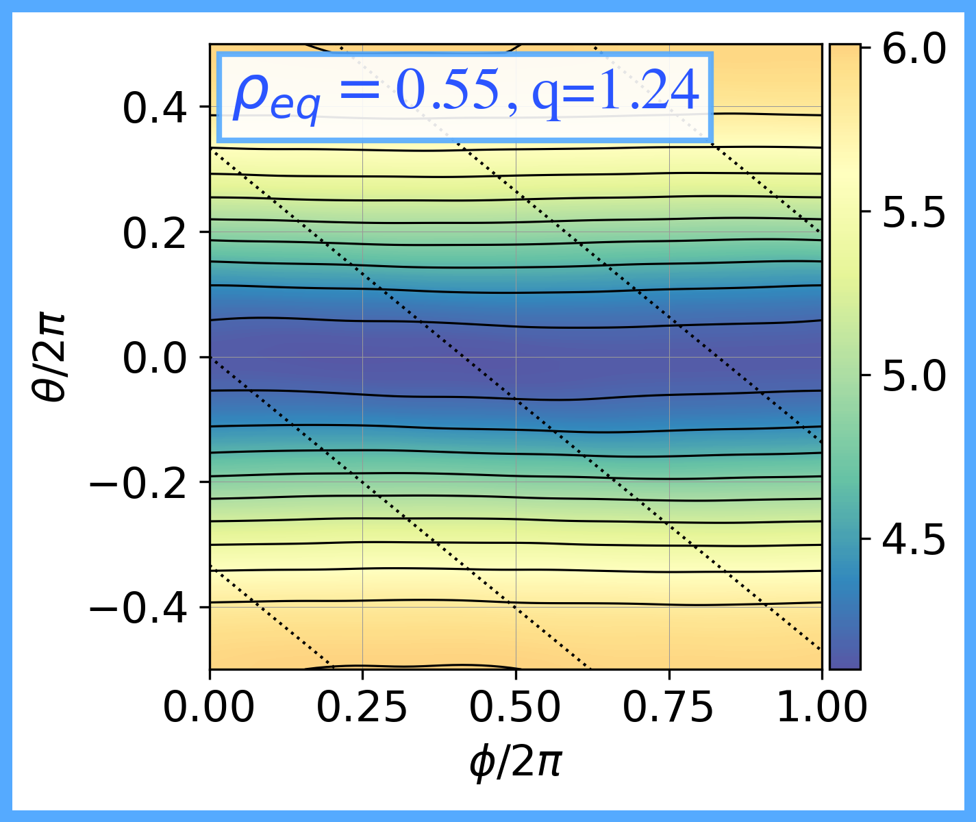
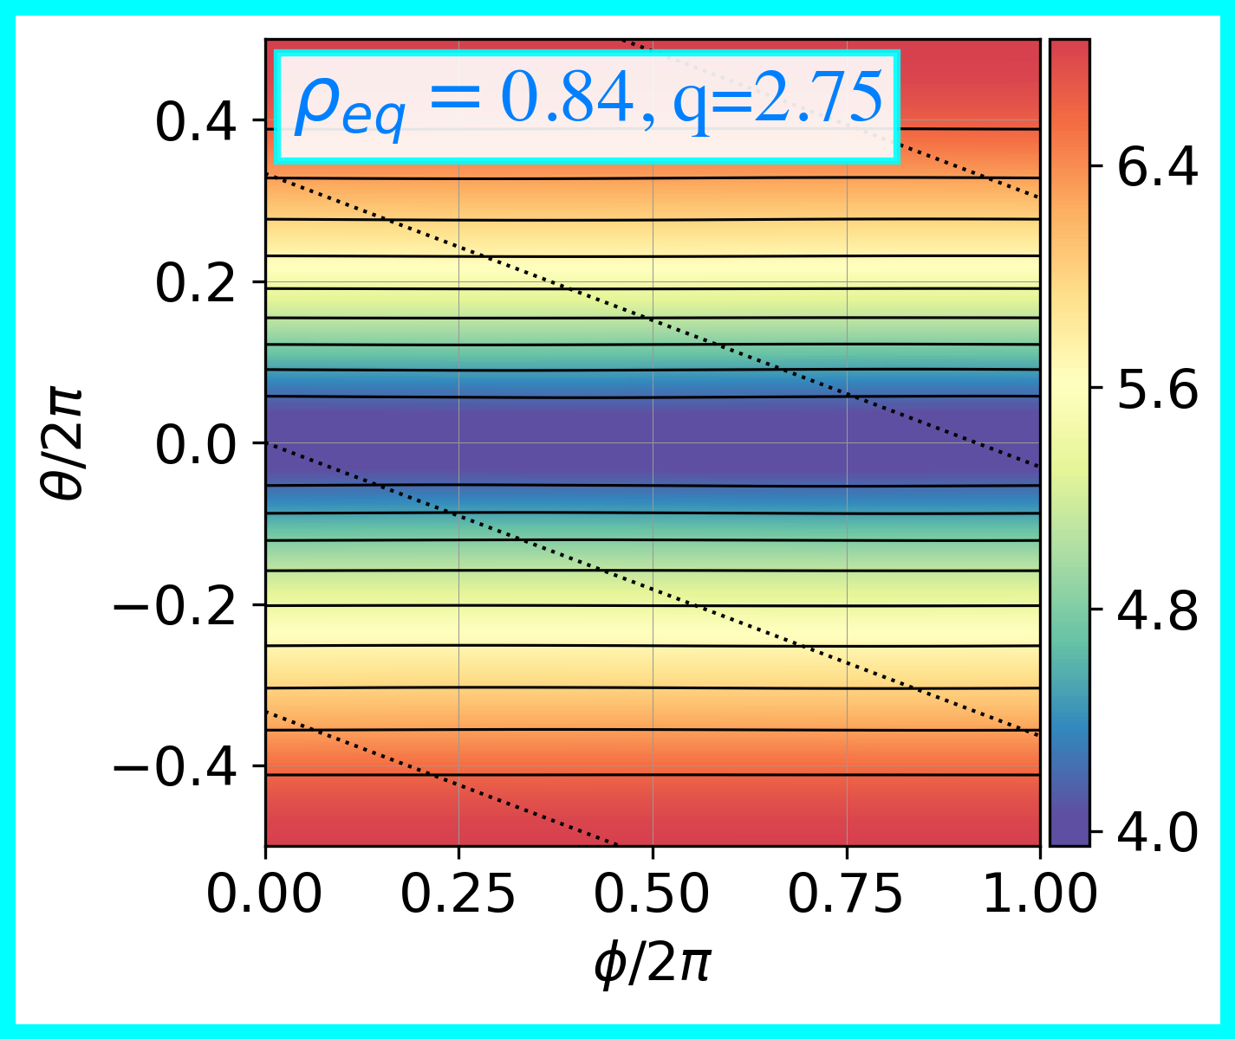

    Calculation Assumptions & HC Equilibrium
ITER-scale hybrid scenario
  $\left\langle β\right\rangle =2.6\%, β_{N}\sim 2.12\%$
  Scan $q_{0}$, $ρ_{qinv}$, and $β$
Magnetic Field Strength in Lab Frame
$$β_{b}$$
Experiences different B
The HC equilibrium state calculated with VMEC¹⁻²
$β_{b}$ $β_{α}$ %
q
[1] Hirschman S.P., et al. Phys. Fluids 26 (1983) 3553
[2] Cooper, W. A., et al. Physical review letters 105.3 (2010): 035003
$$B∝\frac{1}{R}$$
$$B∝\frac{1}{R}$$
$$q$$
Assumptions:
1) Static HC Equilibrium
2) Negligible transport during HC Formation
$$β_{α}$$
$$φ={180}^{∘}$$
$$φ=0^{∘}$$
$$ρ_{φ0}$$
At $φ={180}^{∘}$,
X-axis is inverted.
Slightly
Asymmetric

Slide 6
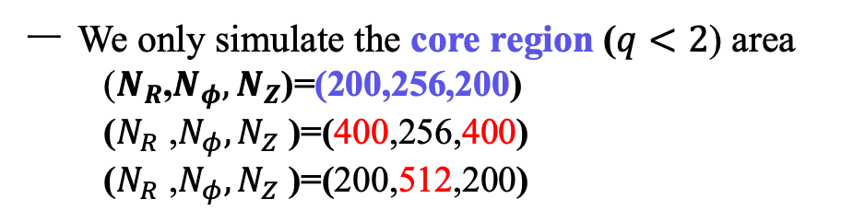
    Simulation Model & Parameters
MEGA¹, a global nonlinear kinetic PIC MHD simulation code, is used in this work.
  Simultaneously solves full MHD equations & drift kinetic equation for energetic particles
Energetic Particles
  Slowing-down Fusion-born Alphas
Cylindrical Grid Resolution
[1] Todo, Y. et al. Phys. of plasma 5.5 (1998): 1321-1327
  Inherently poor core resolution
  *Model is nonlinearly, but our study is
  limited only to the linear growth phase
  We only simulate the core region ($q<2$) area
      ($N_{R}$,$N_{φ},N_{Z}$)=(200,256,200)
      ($N_{R}$ ,$N_{φ},N_{Z}$ )=(400,256,400)
      ($N_{R}$ ,$N_{φ},N_{Z}$ )=(200,512,200)
$$\frac{∂ρ}{∂t}=−∇∙\left(ρ\overset{⃑}{v}\right)+{ν_{n}∇}^{2}(ρ)$$
Convg. Test
$$ρ\frac{∂\vec{v}}{∂t}=−ρ\left(\overset{⃑}{v}∙∇\right)\overset{⃑}{v}+\left(\frac{∇×\overset{⃑}{B}}{μ_{o}}−{\vec{J}}_{α}\right)×\overset{⃑}{B}$$
Dissipation Coefficients
$$−∇P−∇×\left(νρ∇×\vec{v}\right)+\frac{4}{3}∇\left(νρ∇⋅\vec{v}\right)$$
  1) Study of Pressure-driven MHD Instability
Mass Diffusivity
Thermal Diffusivity
$$\frac{∂P}{∂t}=−∇⋅\left(P\vec{v}\right)−(γ−1)[P∇⋅\vec{v}−νρ{\left(∇×\vec{v}\right)}^{2}$$
Normalized
Viscosity
Resistivity
$$−\frac{4}{3}νP{\left(∇⋅\vec{v}\right)}^{2}−η\vec{J}⋅δ\vec{J}]+χ∇^{2}P$$
  $$\hat{ν}={\hat{ν}}_{n}=\hat{χ}={10}^{−6}$$
  $$10^{−7}≤\hat{η}≤10^{−4}$$
$$\frac{∂\vec{B}}{∂t}=−∇×\vec{E}$$
$$μ_{0}\vec{J}=∇×\vec{B}$$
$$\overset{⃑}{E}=−\overset{⃑}{v} × \overset{⃑}{B}+ηδ\vec{J}$$
  2) Study of EP-driven MHD Instability
  $$\hat{ν}=\hat{χ}={5×10}^{−6}$$
Higher dissipation is used to stabilized pressure-driven mode
$${\vec{J}}_{α}=J_{α∥}\hat{b}+\frac{1}{B}\left(P_{α∥}∇×\hat{b}−\frac{P_{α⊥}}{B }∇B×\hat{b}\right)−∇×\left(\frac{P_{α⊥}}{B}\hat{b}\right)$$
  $$\hat{η}=10^{−7}$$

Slide 7
Pressure-Driven Magnetohydrodynamics Instability in HC Plasmas
  $$\hat{ν}={10}^{−6}$$
Simulation Parameters
:
  $$\hat{χ}={10}^{−6}$$
  $$10^{−7}≤\hat{η}≤10^{−4}$$

Slide 8
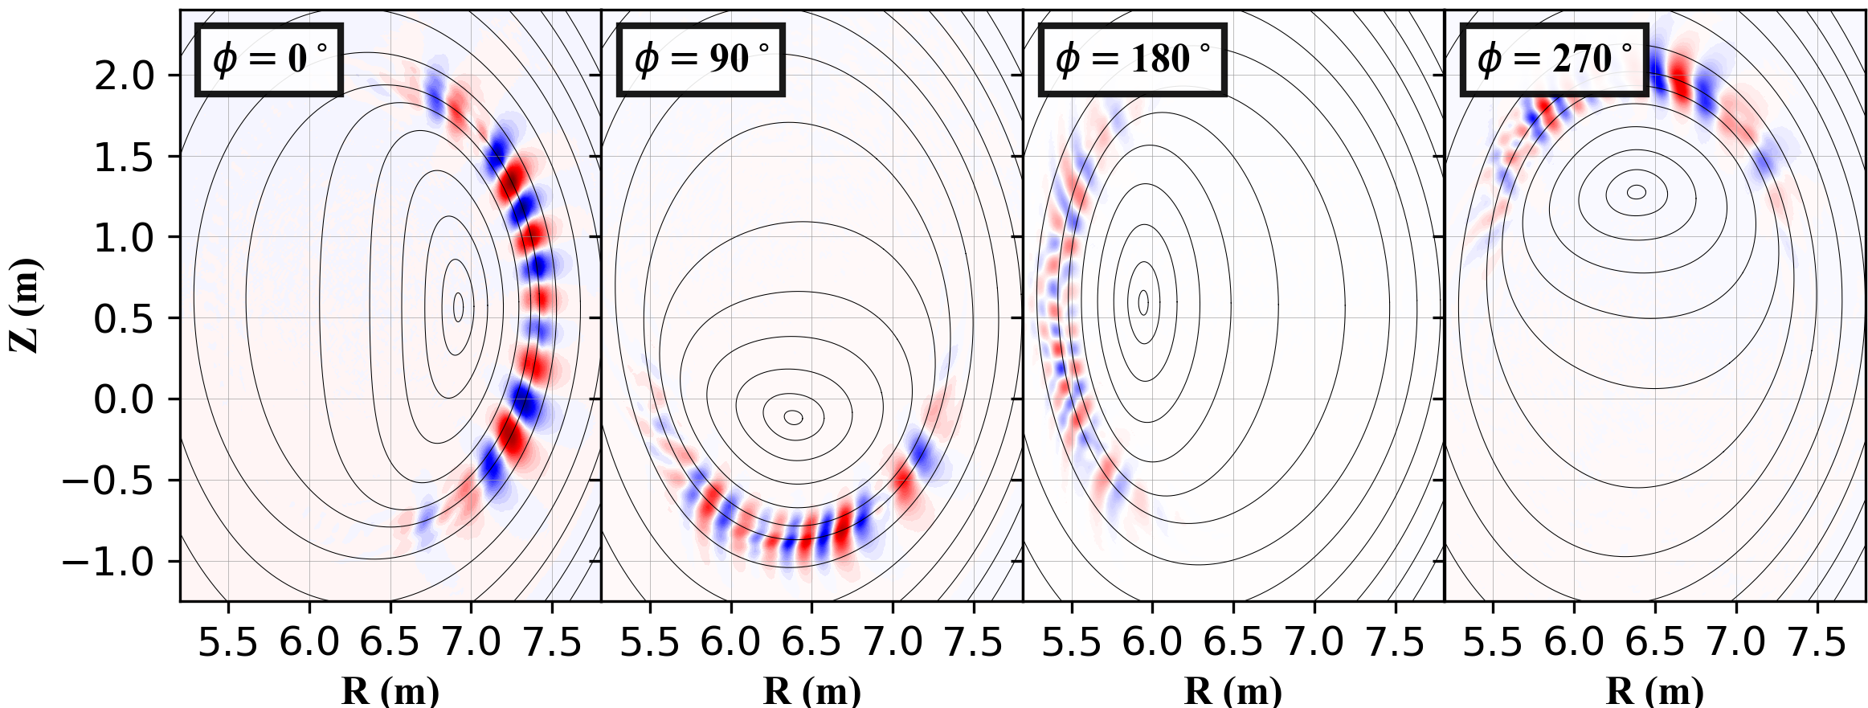
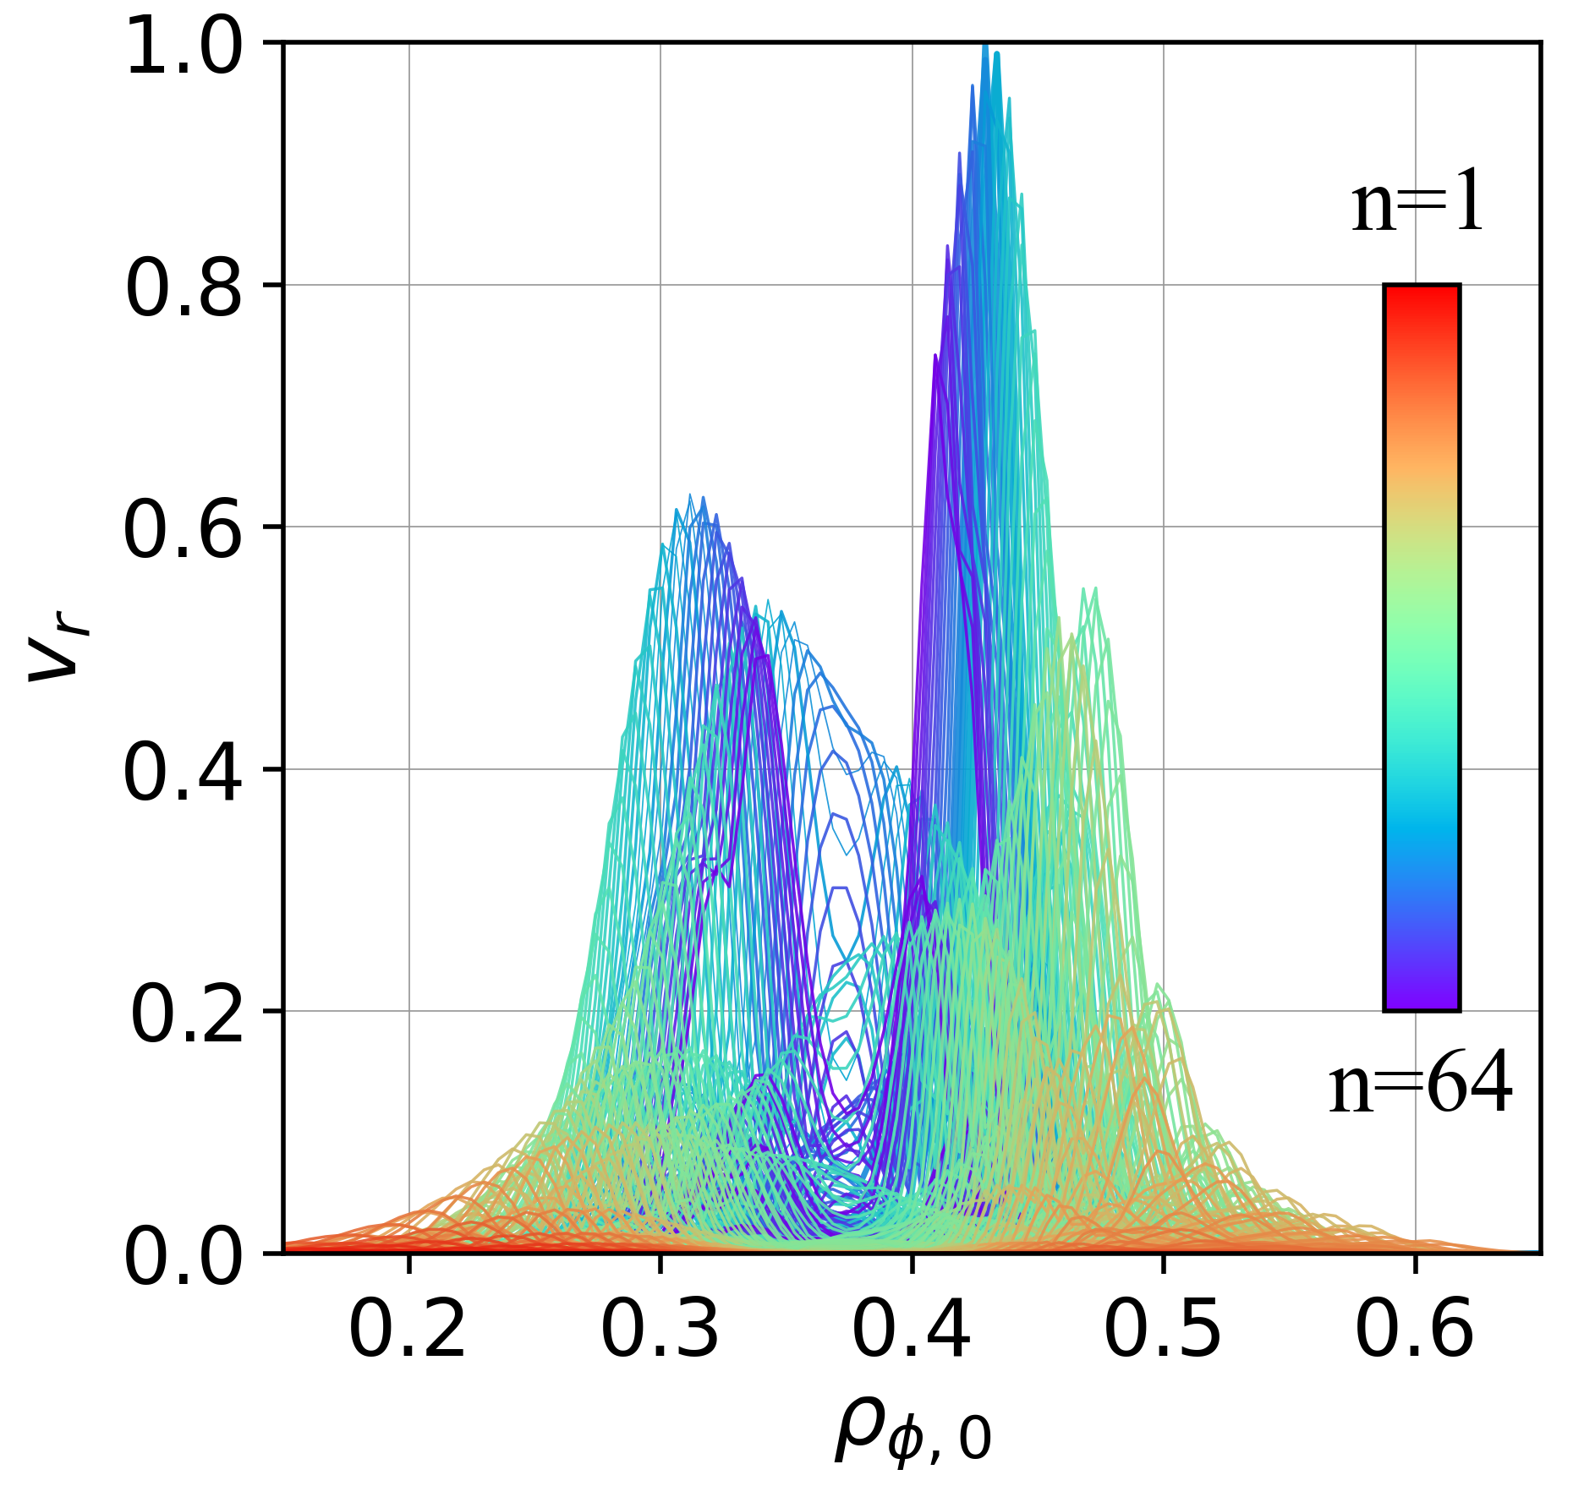
    Eigenfunctions of HC-induced MHD Instability (I)
Cylindrical Coordinate
Interchange parity
Fourier Representation
$$\frac{m}{n}=\frac{n+2}{n}$$
Interchange parity
$$\frac{m}{n}=\frac{n+1}{n}$$
Compressed Flux
Region
Compressed Flux
Region
Compressed Flux
Region
Compressed Flux
Region
Tearing –like parity
Interchange parity
Short-wavelength mode is found to be unstable in HC equilibrium.
  Localized along the HC compressed flux region
Consists of a broad harmonic spectrum
  Difficult to comprehend
Stable in the axisymmetric equilibrium (Same $P(ψ)$ and $q(ψ)$)
(Only the m/n=1/1 and 2/2 modes are unstable)
At first glance, mode seems to have mixed parity
*See Appendix for
discussion via Fourier mode
Tearing-like parity emerges from the incomplete cancellation of
adjacent interchange-parity harmonics
Key Message:
“We found an interchange parity mode localized along the HC compressed flux region”

Slide 9
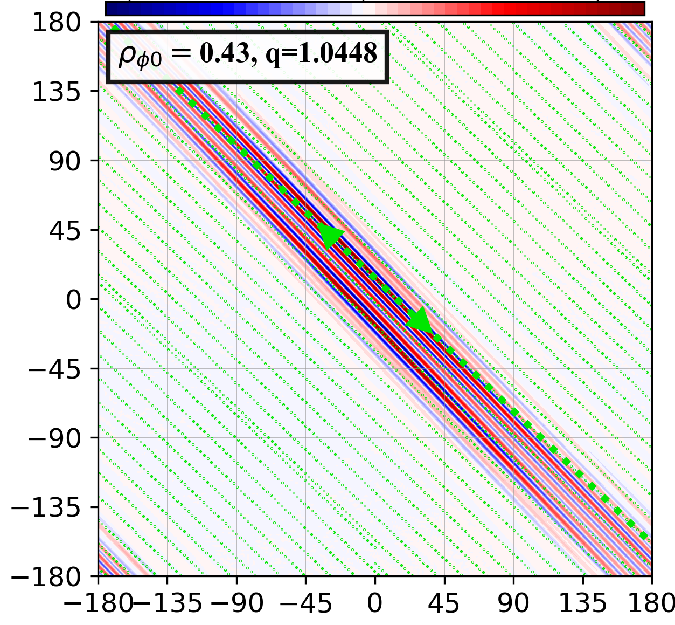
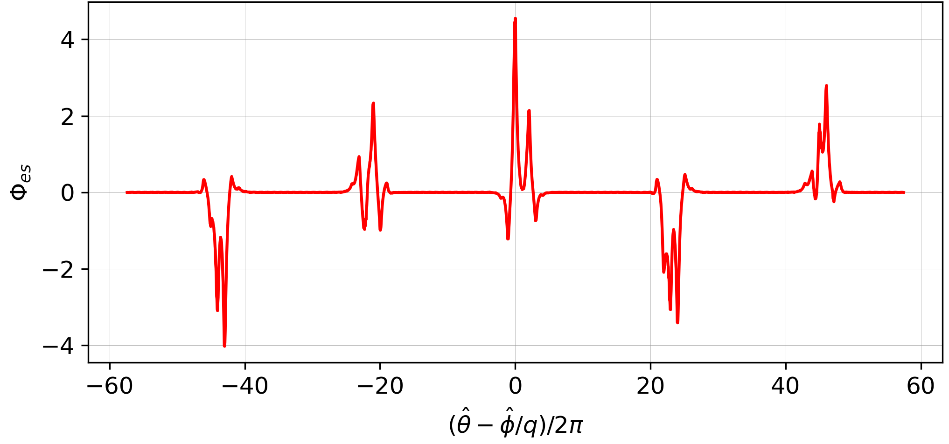
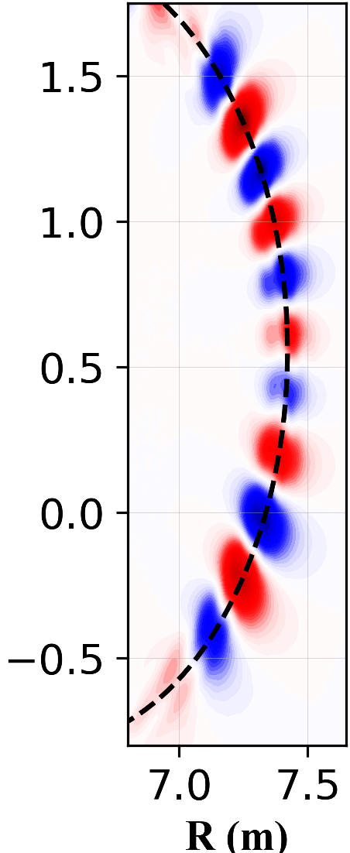


    Eigenfunctions of HC-induced MHD Instability (II)
$Φ_{es}$ Along the Field Line
(1) $\frac{2πq}{\left|q−1\right|}≈22(2π)$
(2) Exchange phase info at $τ_{∥}^{−1}$ rate
(3) Sensitive to initial perturbation
Random Seed Scan
HC Compressed Flux
( Grow independently at t=0 )
Generalized Poloidal Angle $\hat{θ}$
(1) Long connection length $Δθ^{′}≈\frac{2πq}{\left|q−1\right|}≈22(2π)$
|q-1|$≳$0 is intrinsic
(2) Each peak exchanges information via SAW at the rate of
$τ_{∥}^{−1}\sim \frac{v_{A}}{L_{∥}}\sim v_{A}\frac{\left|q−1\right|}{2πR_{ax}}\sim 7.13×{10}^{−3}$ Can be very slow!
Generalized Toroidal Angle $\hat{φ}$
(3) A global coherence may not fully develop if $γ≫τ_{∥}^{−1}$
  $γτ_{∥}^{−1}≈16$.9 for this case (More Ex. in Appendix)!
Key Message:
“HC-induced mode intrinsically has a long $L_{∥}$, delaying the global coherence formation”

Slide 10
    Dependence of HC-induced Instability on Bulk Plasma & Resistivity
Bulk Plasma Pressure $β_{b}$ Scan
Resistivity $η$ Scan
Fixed $\hat{η}={10}^{−7}$ & HC Structure
Ideal
Branch
Resistive Branch¹
Fast Branch¹⁻²
$$γ∝η^{\frac{1}{3}}$$
Weakened field line bending
Bypass field line bending
“This mode is driven by $∇P_{b}$”
Confirms that this mode is driven by $∇P_{b}$
*Completely stabilize with an artificially flat $P_{b}$
Its resistive $η$ dependence resembles that of a ballooning mode
[1] L. Garcia., et al., Phys. Plasmas 6 (1999), 107-115
[2] B.A. Carreras., et al., Phys. Fluids 30 (1987), 1388
Key Message:
“The underlying physics of the HC-induced mode may be associated with the ballooning mode”

Slide 11
Energetic Particle-Driven Magnetohydrodynamics Instabilities in Helical Core ITER Plasmas
“To suppress Pressure-driven Mode”
  $$\hat{ν}={10}^{−6}$$
  $$\hat{ν}=5×{10}^{−6}$$
Simulation Parameters
:
  $$\hat{χ}={10}^{−6}$$
  $$\hat{χ}=5×{10}^{−6}$$
  $$\hat{η}=10^{−7}$$

Slide 12

    Linear Properties of EP-driven Mode $\left(\hat{ν}=\hat{χ}=5×10^{−6}\right)$
(n+2)/n Clusters
Peak harmonic
^{m}/n = $\text{35}\text{/}33$
$φ$=$0^{∘}$
m/n=(n+1)/n
Clusters
m/n=n+1/n BAE-CAP
m/n=n+2/n BAE-CAP
$φ$=18$0^{∘}$
m/n=34/33 & 35/33
$$γτ_{∥}^{−1}≈4.2$$
Even when the pressure-driven mode is stabilized,
alphas can still drive a mode with similar structure
  In the axisymmetric eq., this mode is stable.
Continua were calculated using the modified STELLGAP (Implement up-down asymmetry)
  $1≤n≤40$ Continua
Mode resides at the BAE-CAPs
Key Message:
“Alphas can drive a mode that resides at the BAE-CAP, but its identification remains inconclusive”

Slide 13
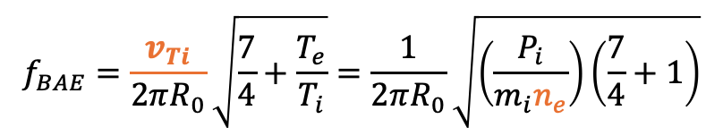
    AE-like Dependence of the Mode Frequency on Electron Density
$$f_{MEGA}$$
$$f_{scale}=\frac{28}{\sqrt{S_{n}}} kHz$$
Performed $n_{e}$ scan, while fixing pressure $P_{i}$
0.5n_{b} $≤ n_{b}≤$ 1.25n_{b}
Fixed $β_{α0}$=1% and $\hat{ν}$=$\hat{χ}$= $5×10^{−6}$
$$f_{BAE}=\frac{v_{Ti}}{2πR_{0}}\sqrt{\frac{7}{4}+\frac{T_{e}}{T_{i}}}=\frac{1}{2πR_{0}}\sqrt{\left(\frac{P_{i}}{m_{i}n_{e}}\right)\left(\frac{7}{4}+1\right)}$$
Vary only $n_{e}$
Mode frequency scales inversely with $\sqrt{n_{e}}$
- BAE-associated mode
- Frequency is governed by MHD plasmas
$S_{n}$=0.5
$S_{n}$=0.75
$S_{n}$=1.25

Slide 14
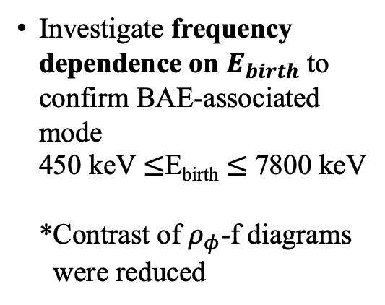
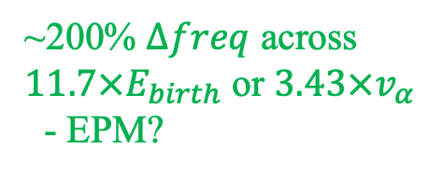
    AE-like Dependence of the Mode Properties on Alpha Birth Energy
450 keV $≤E_{birth}≤$ 7800 keV
Investigate frequency dependence on $E_{birth}$ to confirm BAE-associated mode
450 keV $≤$E_{birth} $≤$ 7800 keV
*Contrast of $ρ_{φ}$-f diagrams
were reduced
Only ~20% $Δfreq$ across $17{×E}_{birth}$ or $4.16×v_{α}$
- BAE-associated mode
~200% $Δfreq$ across
$11.7{×E}_{birth}$ or $3.43×v_{α}$
- EPM?
450 keV
900 keV
1800 keV
3540 keV
5300 keV
7800 keV
Key Message:
“Both sensitivity analysis suggests that this mode is likely to be associated with BAE”

Slide 15
    Why can HC induce a short-wavelength EP-driven mode?
HC Region
Axisymmetric Region
This short-wavelength BAE is not observed in the axisymmetric equi. Why?
Magnetic Midplane
We analyze the unperturbed orbit of the alphas along the magnetic midplane
$n+νN_{fp}$=1
28 kHz
Toroidal Sideband
Poloidal Sideband
$$\left(m+μ\right)=−\left[\frac{f−\left(n+νN_{fp}\right)f_{φ}}{f_{θ}}\right]$$
High - n sidebands are spatially overlap
Exact resonances are marked with
High-n sideband resonances are
spatially overlap at the mode location
High - n sidebands are spatially overlap
High-n harmonics synchronize and
simultaneously grow
$n+νN_{fp}$=40

Slide 16
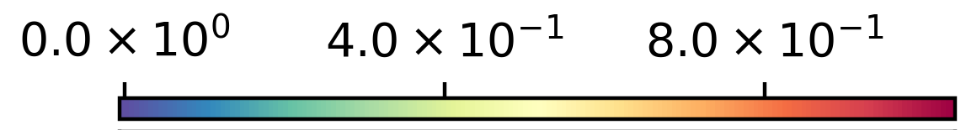
    “Preliminary” Nonlinear Results
Mode Energy Evolution
Mode Structure & Frequency
Long-wavelength Mode
m/n=2/2
Short-wavelength BAE
m/n=1/1
t=0
t=985
During the nonlinear phase,
the long-wavelength mode also becomes unstable.
Within the capability of our model, this mode leads to a minor transport of fusion-born alphas in our ITER-scale plasmas
Caveats: - Mode stability/scale length is sensitive to the dissipation coefficients
Key Message:
“A higher-fidelity physics model is needed to resolve the small-scale physics and dissipations, and to confirm this low-alpha transport”

Slide 17
Conclusion & Outlook

Slide 18

    Conclusion / Outlooks
18
Q1) How HC toroidal asymmetry affects MHD stability?
Q2) How critical is it?
HC can induce a helically localized short-wavelength
Within our model, the alpha transport remains small, BUT mode stability, saturation, and scale length are sensitive to dissipation coefficients
  Higher-fidelity physics model is needed for a quantitative assessment
  Ideal/resistive PRESSURE-driven MHD mode
  Weaken field line bending/change in curvature?
  ii) Low-frequency BAE-associated mode.
  High-n Linear resonance overlap
Slow formation of the global coherence structure
$τ_{∥}\sim \frac{L_{∥}}{v_{A}}\sim \left(\frac{1}{v_{A}}\right)\left(\frac{2πR_{0}}{\left|q−1\right|}\right)$
|q-1|$≳$0 is
intrinsic for HC
Quantitative assessment of HC stability requires a higher fidelity physics
Multi-scale (global)
EM 3-D gyrokinetic simulation
2. Spectral method is ill-suited because a broad harmonic spectrum must be simultaneously considered
Grid-based solver?
3. Straight field line coordinate has a geometrically complex metric coefficients in
HC equilibrium
Limit to a small
HC study?
Outlooks
&
Key Challenges
Generalized angle is strongly distorted
Z (m)
R (m)

Slide 19
    Peculiar Effects of Dissipation & Bulk Pressure on Mode Properties
-$1\%≤{Δβ}_{b}≤2\%$ Scan
Fixed $β_{α0}$=1%
Pressure - driven mode dominates
Mode is stabilized at low-$β_{b}$ for $\hat{ν}=$10⁻⁵
Weaken HC compression & asymmetry?
Gap changes?
Frequency slightly reduces
★ $\hat{χ}$=5$×10^{−6}$
$+ \hat{χ}$=$10^{−5}$
Sound Continua may be affected by $χ$?
or the mode transits to EPM?

Slide 20
    Appendix: Sensitivity of Mode Structure on Initial Condition
Z (m)
Z (m)
The only difference is the random number seed for generating the initial perturbation.
The macroscopic structure and growth rate are similar, but the fine structures are not.

Slide 21
    AE-like Dependence of the Mode Properties on Alpha Pressure & Energy
450 keV $≤E_{birth}≤$ 3540 keV
0.5$\%≤β_{α}≤1.5\%$ Scan
Fixed $β_{b0}$=6.5%
$$\hat{ν}=\hat{χ}=5×10^{−6}$$
Mode frequency is defined by background plasmas
Mode is driven by alphas
Same Mode
Key Message:
“Sensitivity analysis suggests that this mode is likely to be associated with BAE”

Slide 22
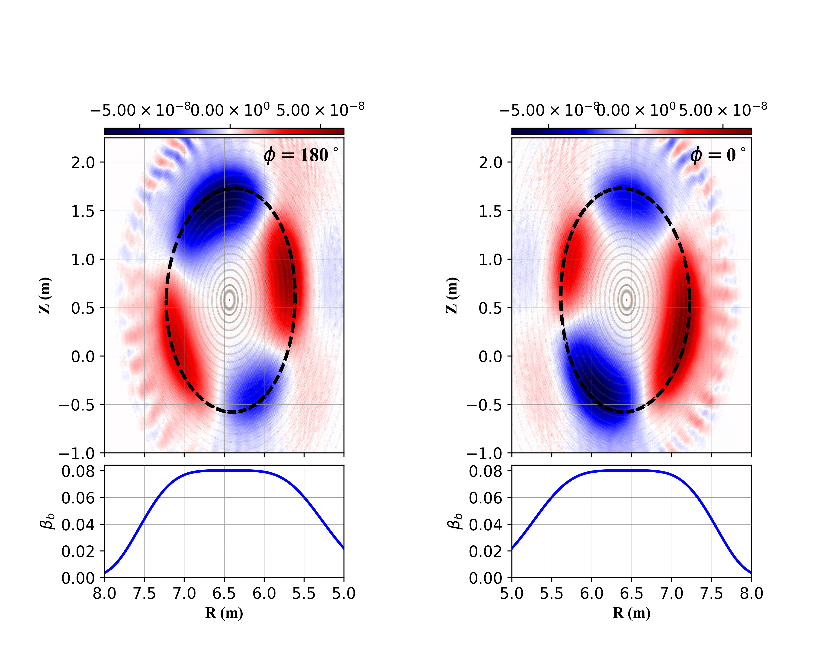
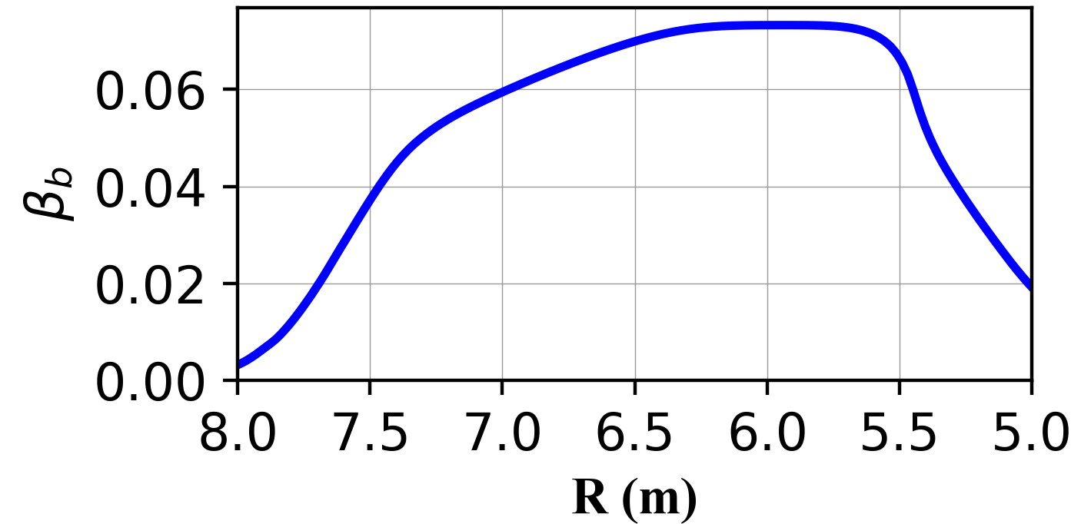
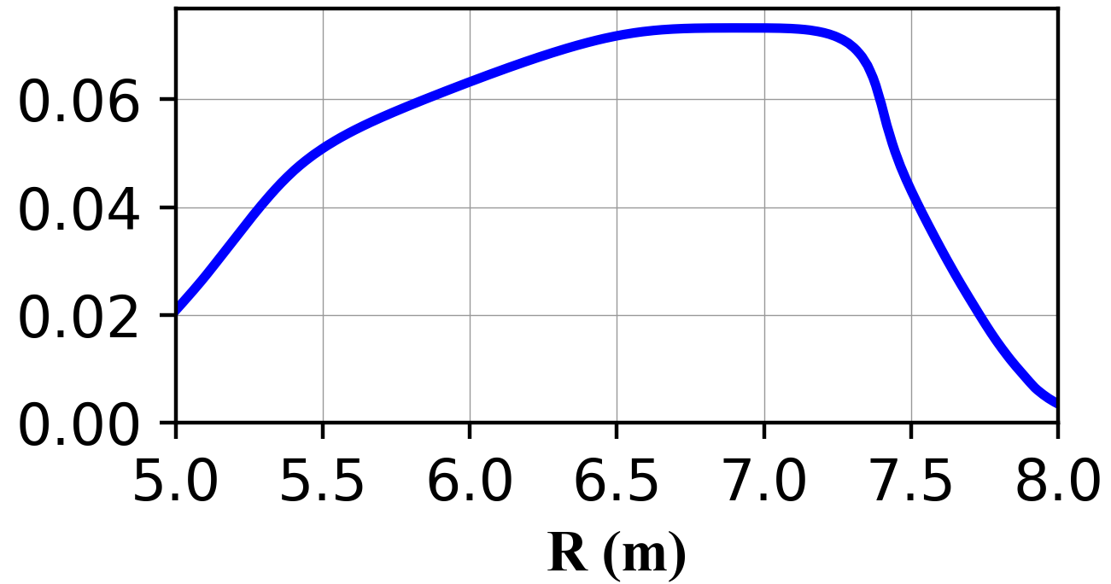
    Visualization of HC Equilibrium in Real Space
Axisymmetric Equilibrium
HC Equilibrium
$$φ={180}^{∘}$$
$$φ=0^{∘}$$
Magnetic Axis
Toward HFS
(Smaller Volume)
Toward LFS
(Larger Volume)
Below
Original axis
Above
Original axis
“Pressure profile is steepened along the compressed flux region”
LFS
HFS
HFS
LFS
LFS
HFS
HFS
LFS
*X-axis is inverted!

Slide 23
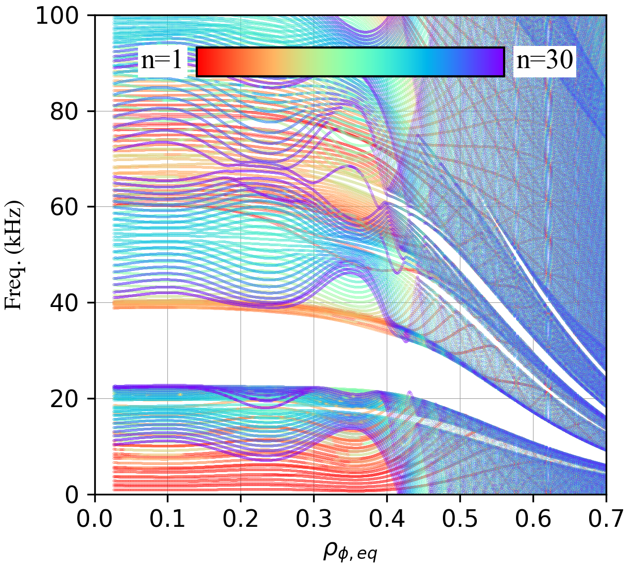
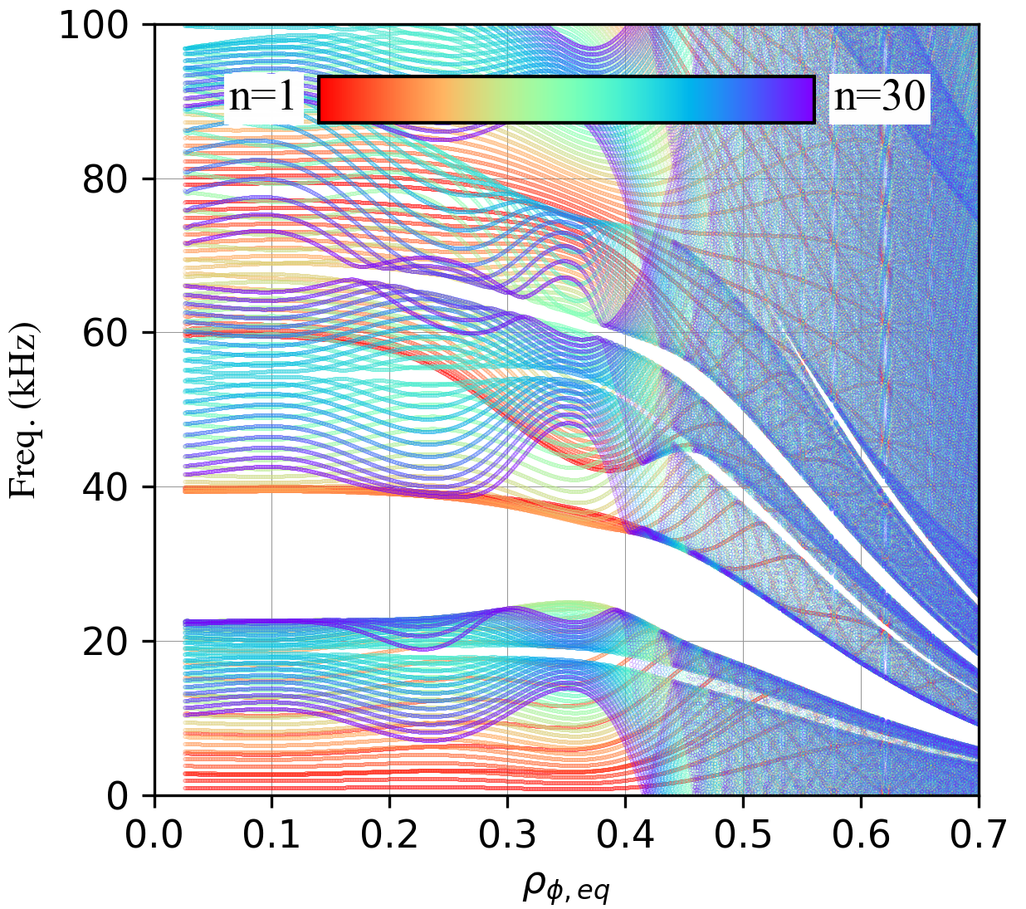
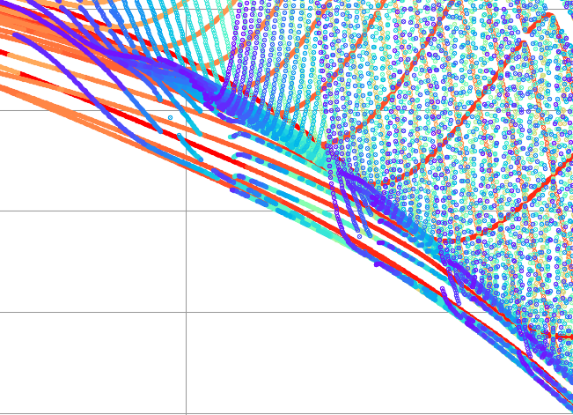
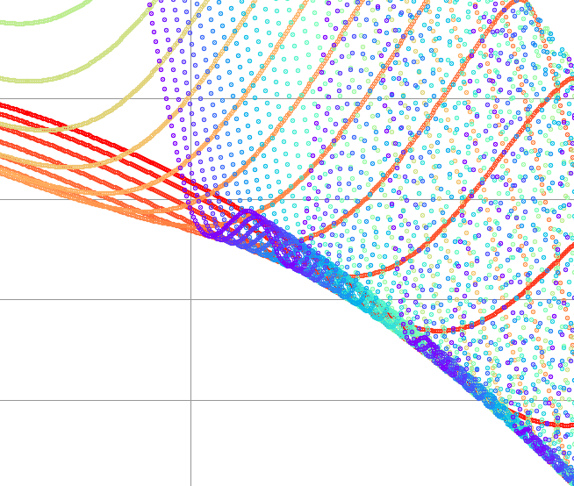
    Appendix: MHD Continua in HC Equilibria
HC Equilibrium
Axisymmetric Equilibrium
At gap point, high-n continua merges
Each ‘n’ has a unique continuum
Continua were calculated using the modified STELLGAP (Implemented Up-down asymmetry)
Each color represents each unique “n”

Slide 24
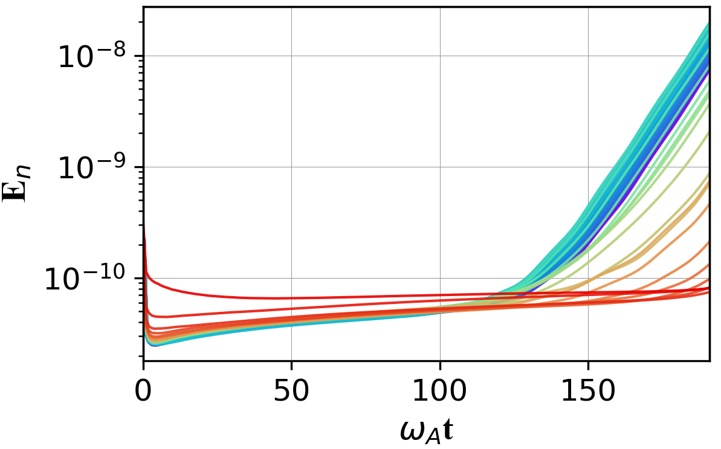
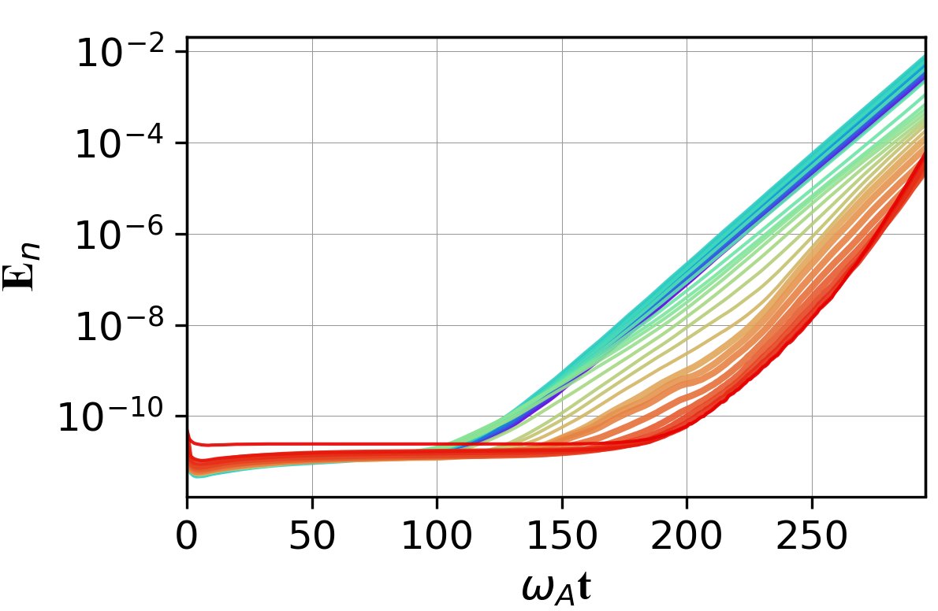
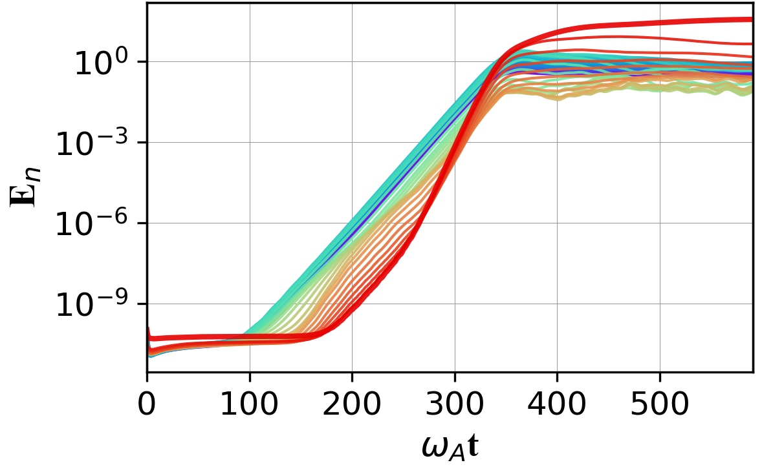
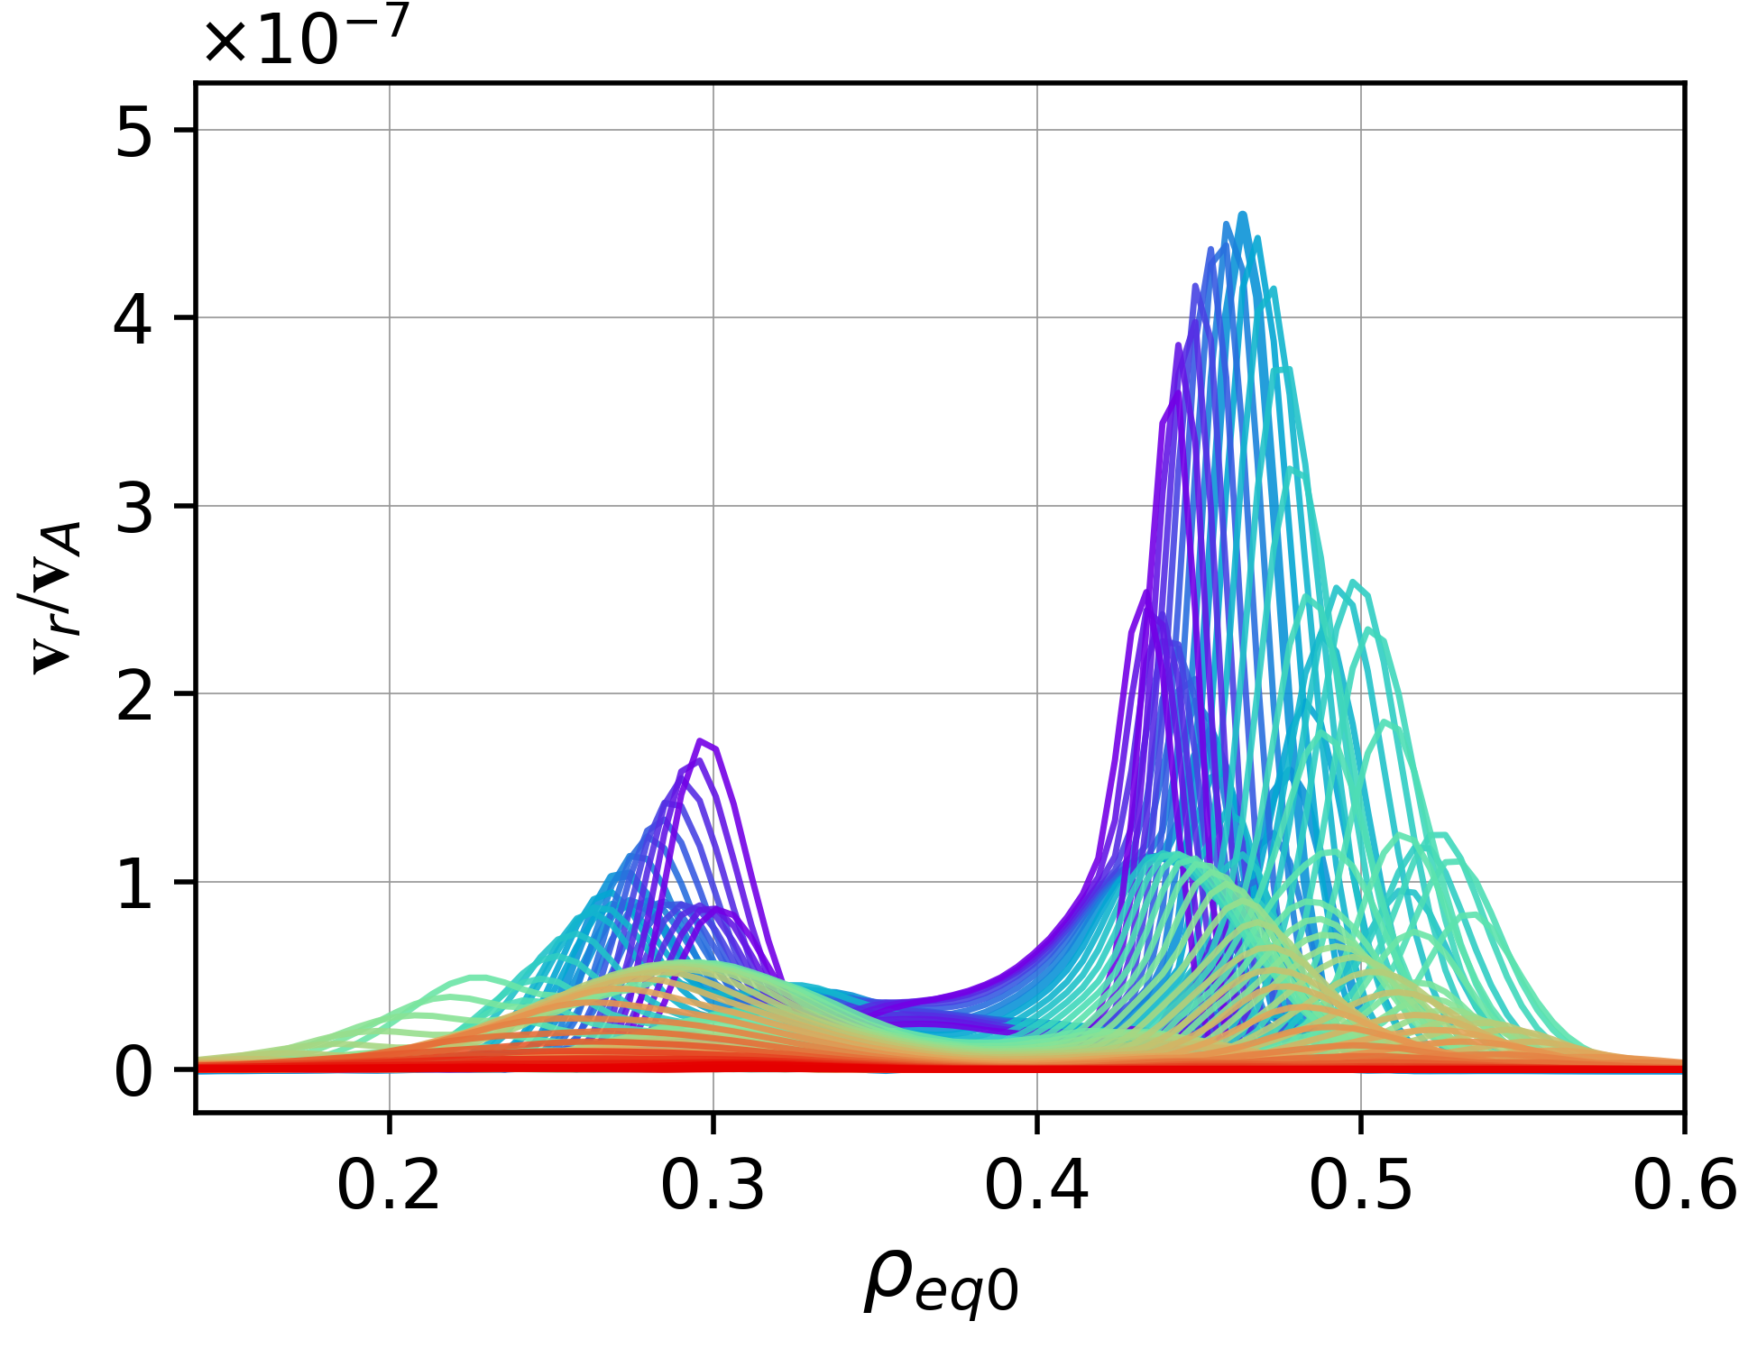
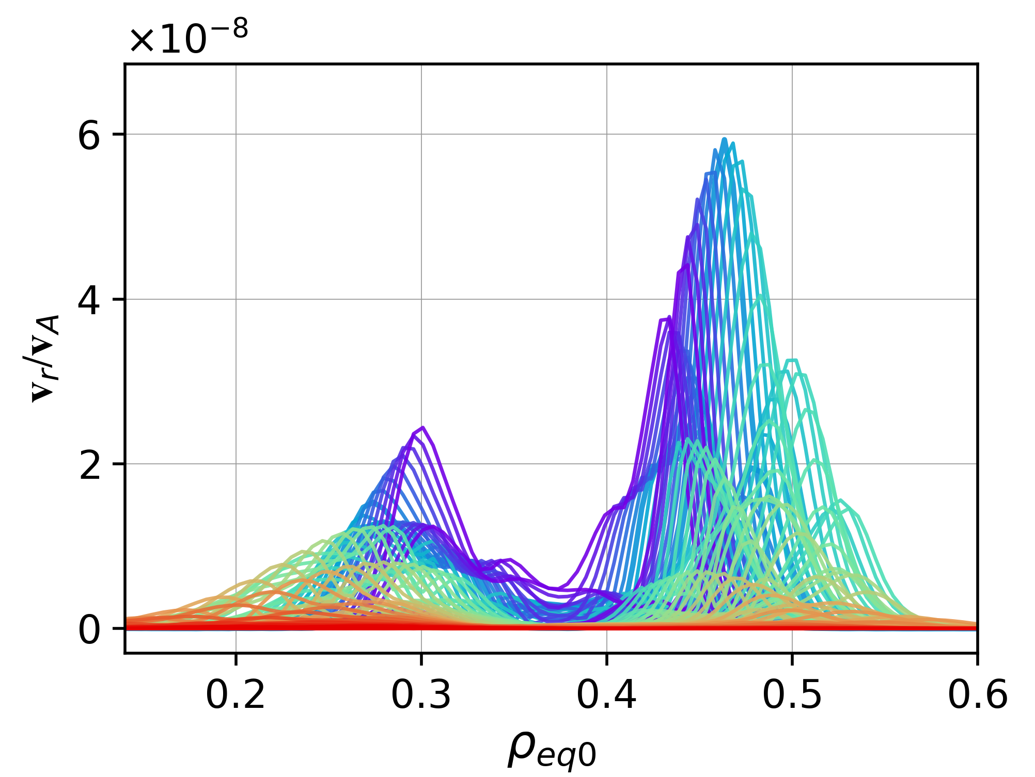
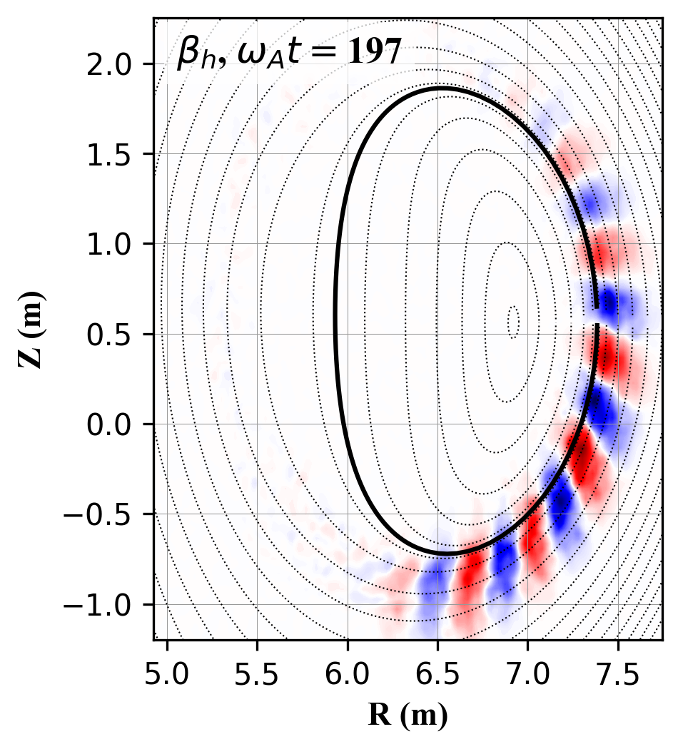
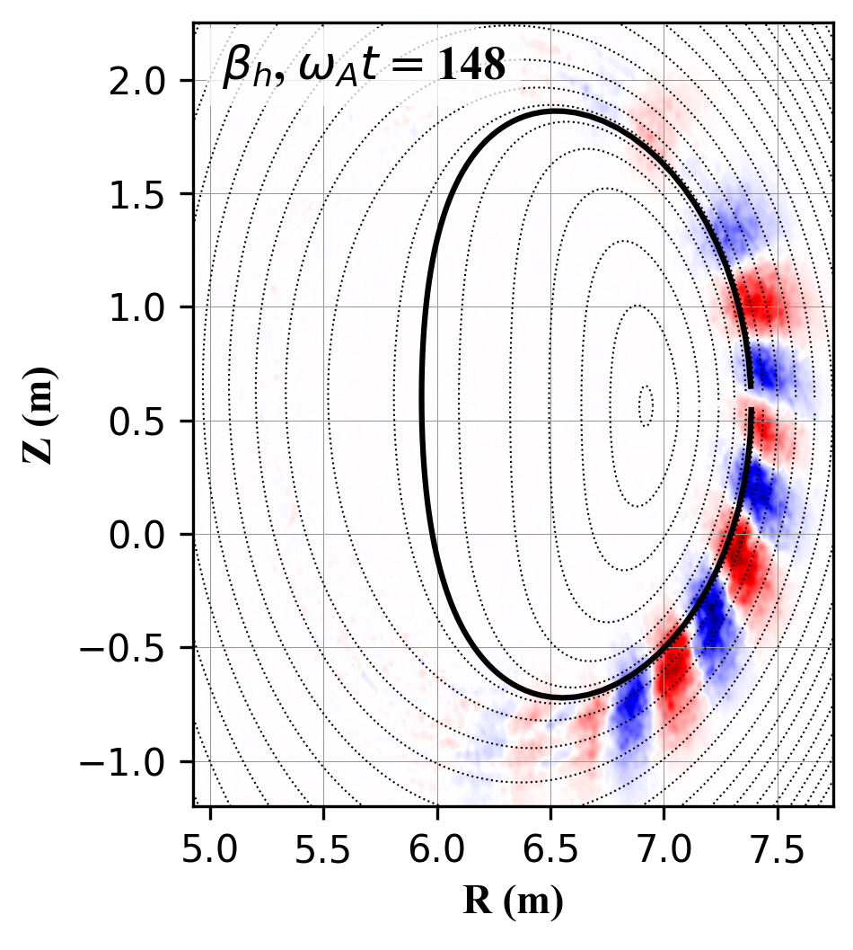
Appendix 1
    Poloidal & Toroidal Convergence Tests
Base Case
($N_{R}$,$N_{φ},N_{Z}$)=(200,256,200)
Poloidal Convg. Test
($N_{R}$,$N_{φ},N_{Z}$)=(400,256,400)
Toroidal Convg. Test
($N_{R}$,$N_{φ},N_{Z}$)=(200,512,200)
$γ$=$5.002×{10}^{−2}ω_{A}$
$γ$=$4.923×{10}^{−2}ω_{A}$
$γ$=$5.548×{10}^{−2}ω_{A}$

Slide 25
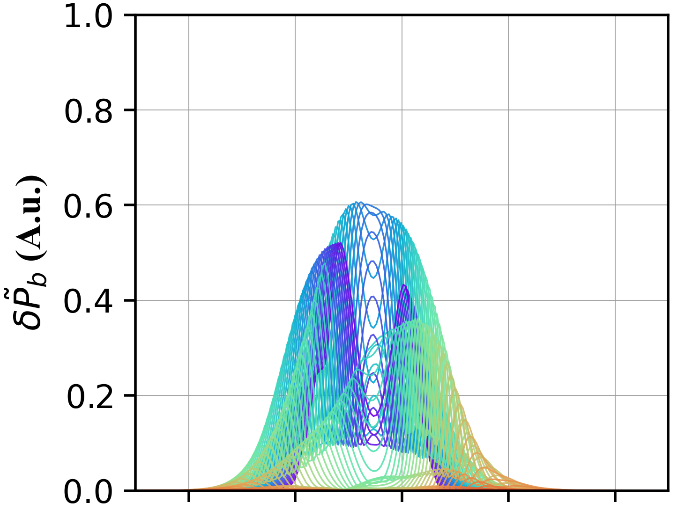
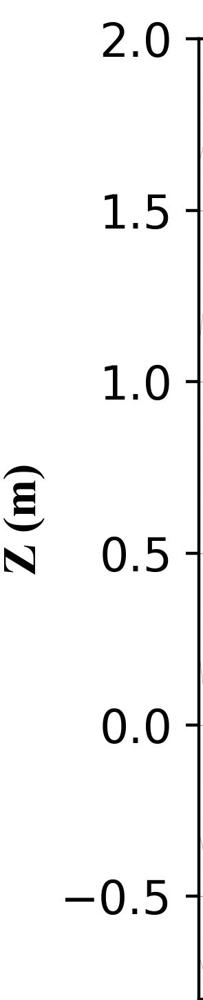
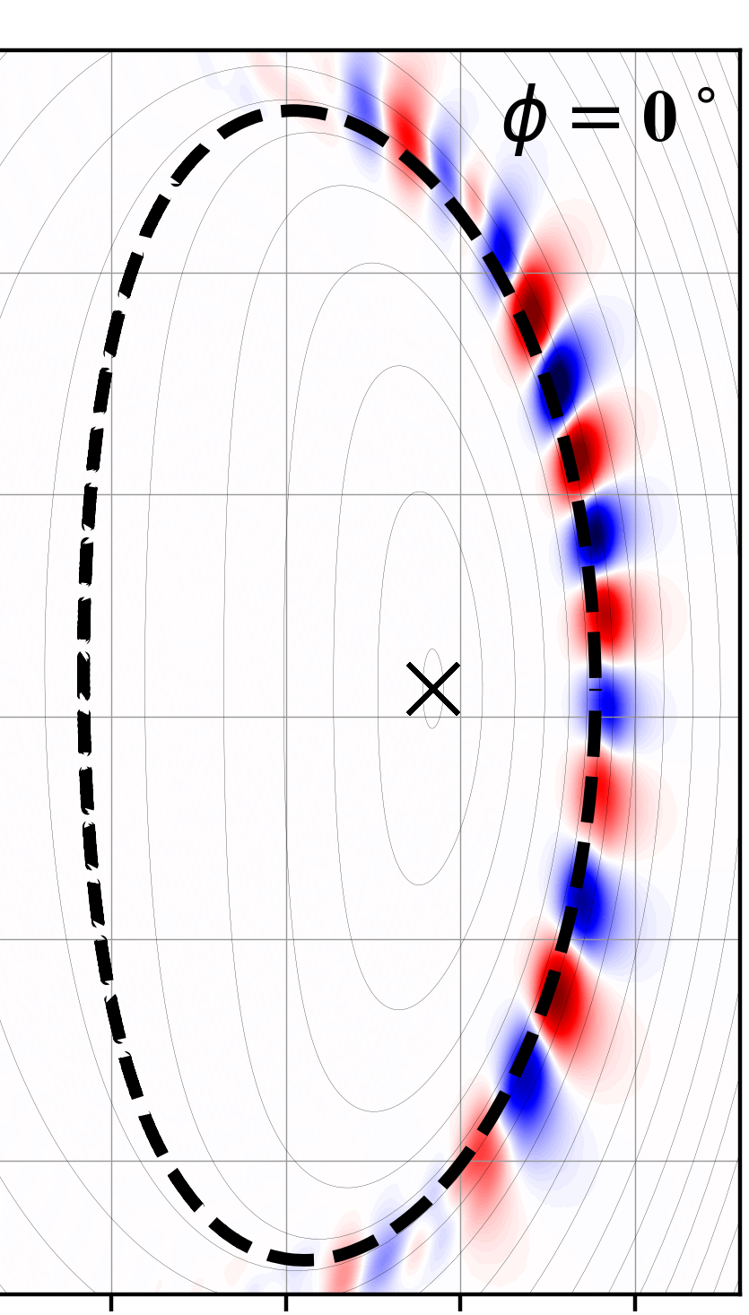
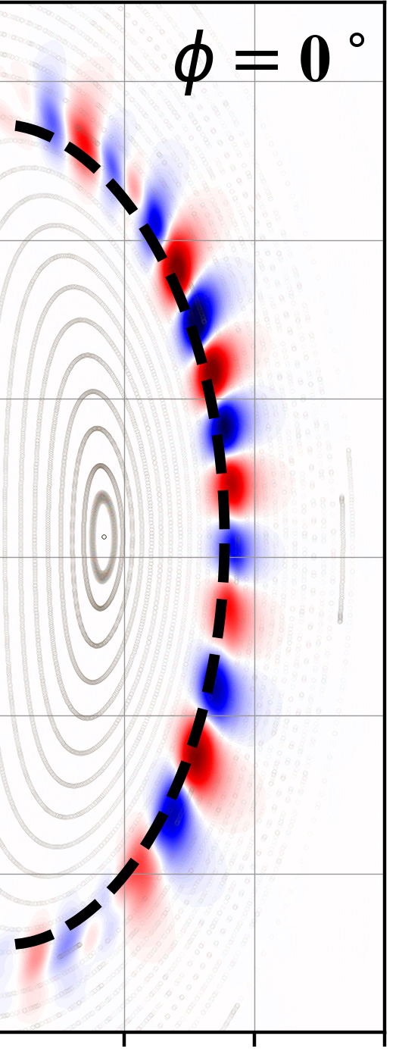
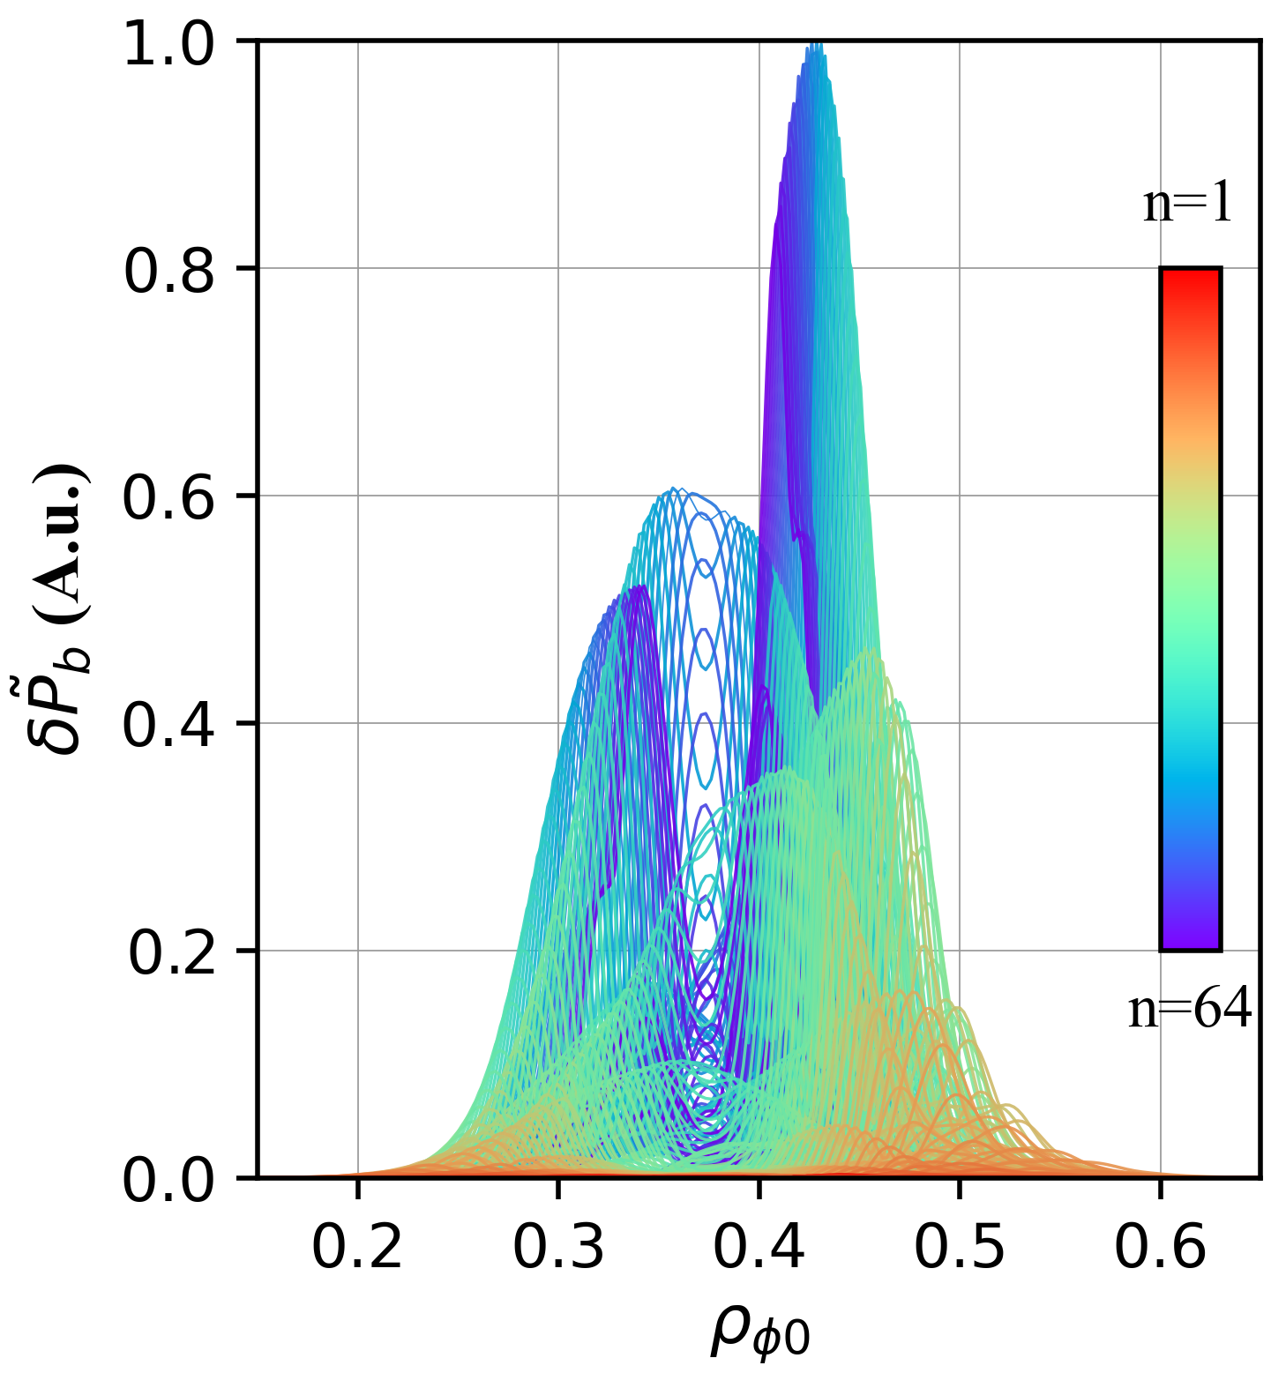
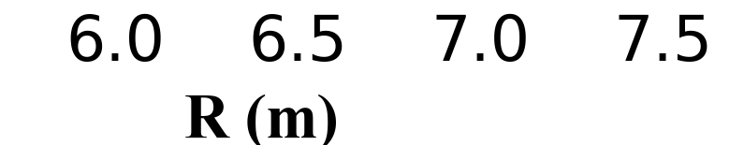
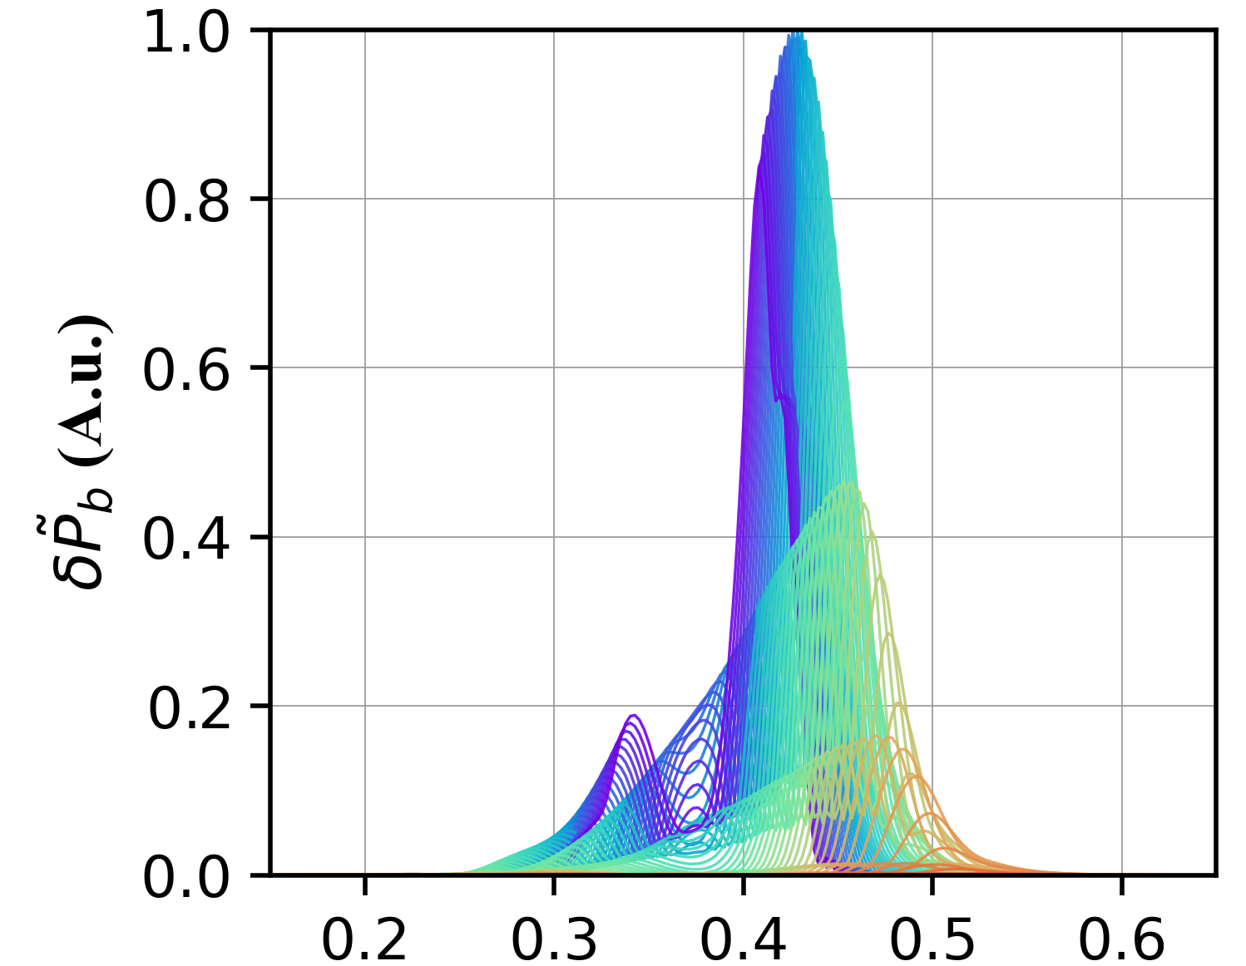
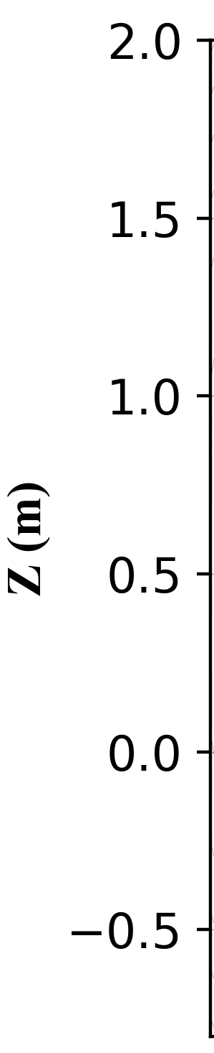
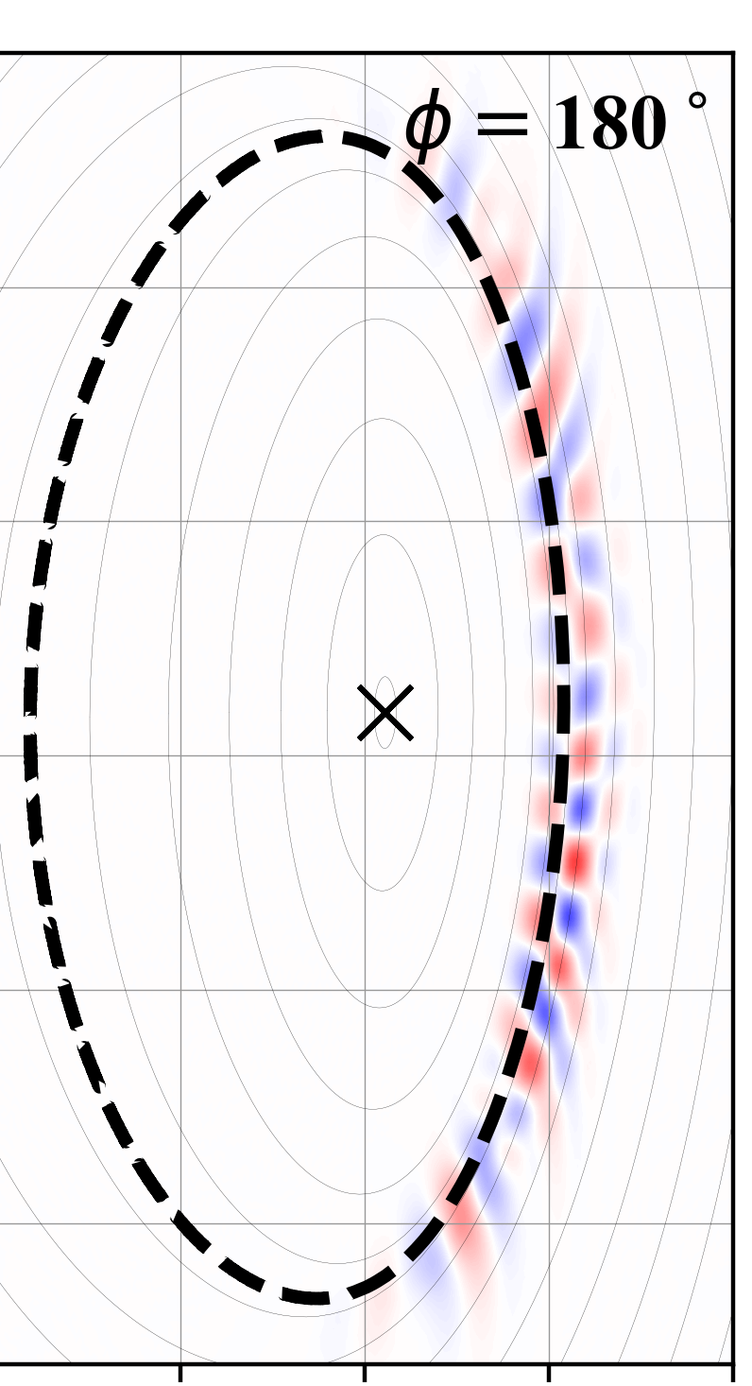
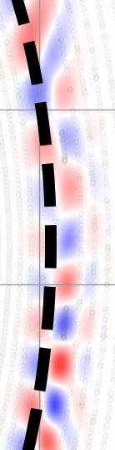
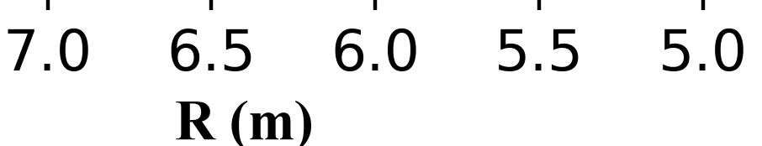
    Appendix: Eigenfunctions of HC-induced MHD Instability (Fourier Space)
m/n=(n +1)/n Cluster
LFS of $φ$=$0^{∘}$
All Harmonics
Two clusters
interfere Constructively
m/n=(n +2)/n Cluster
HFS of $φ$=${180}^{∘}$
Two clusters
interfere Destructively
Magnetic Shear Inversion Radius
$$ρ_{φ0}$$
This mode consists of a broad spectrum of “n” & “m” Fourier harmonics
  Consists of two clusters: m/n= (n+1)/n & (n+2)/n
“These cannot yet explain helically-localized structure”
  Difference in parity is due to “poloidal coupling”

Slide 26
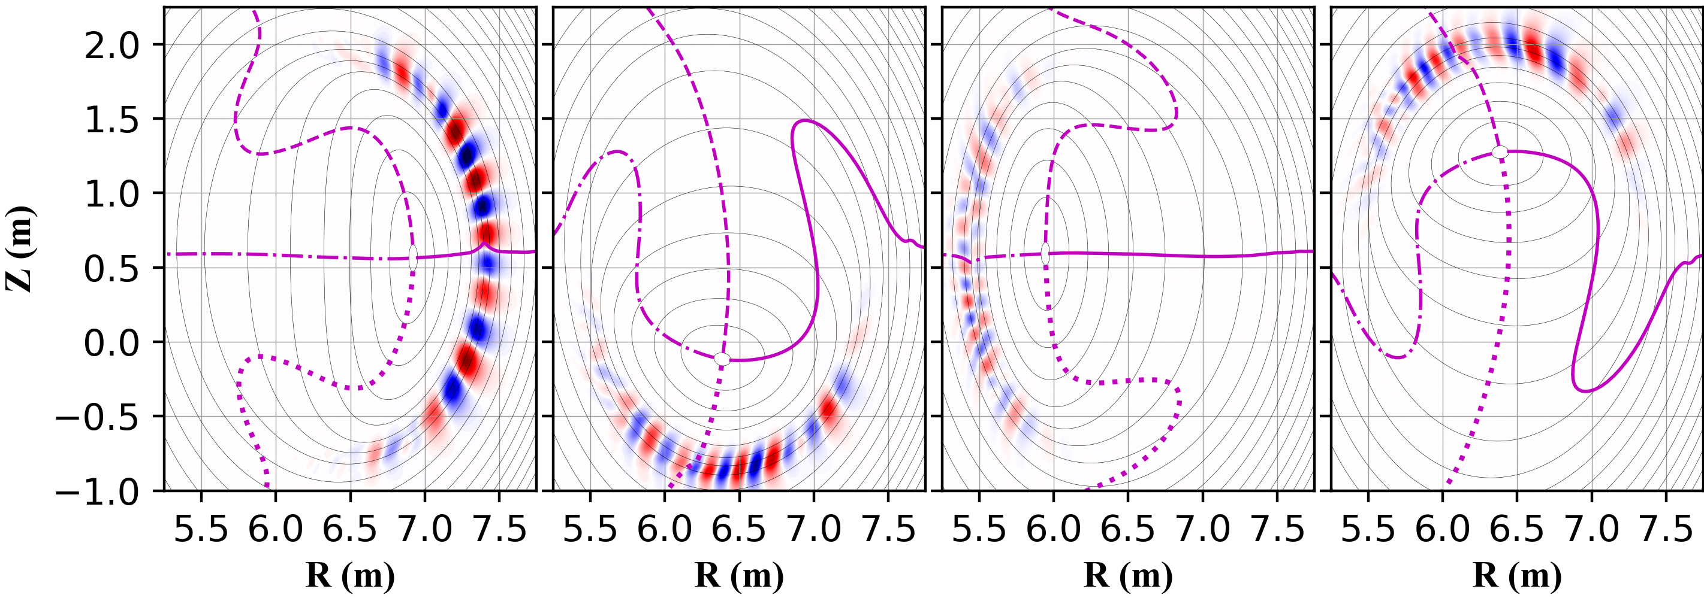
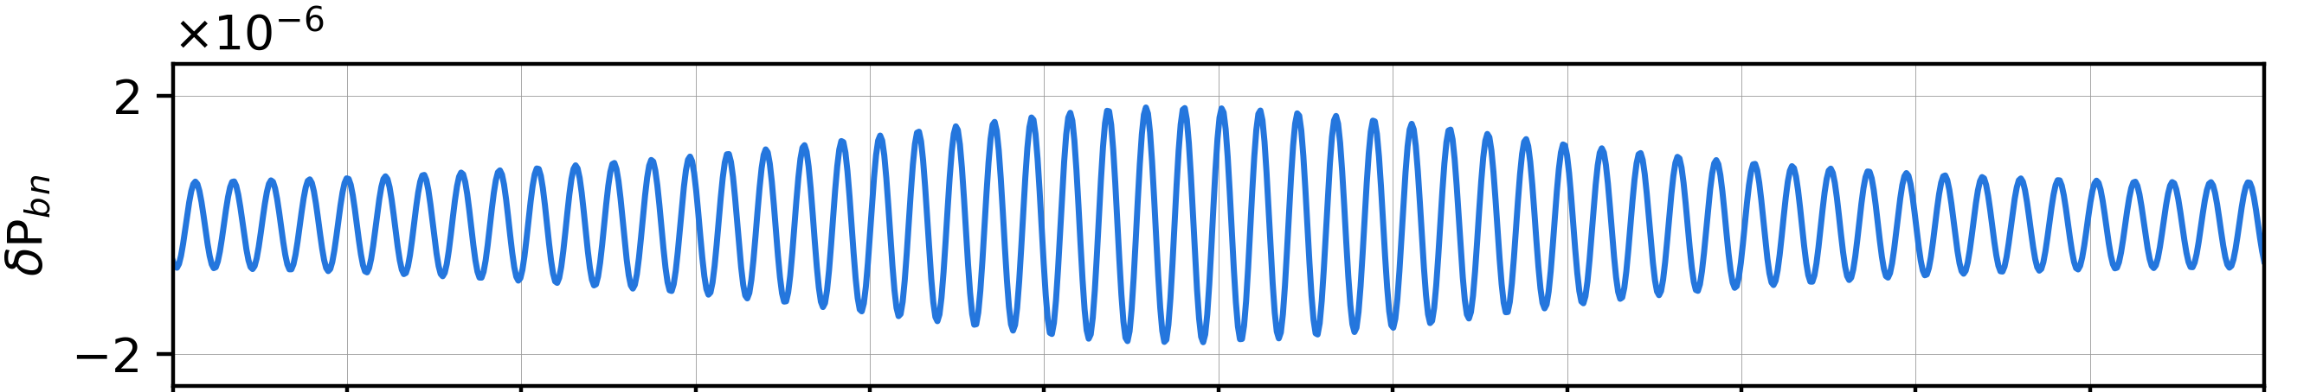
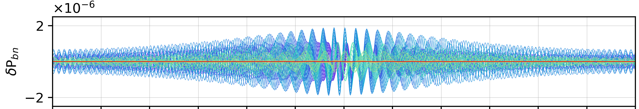
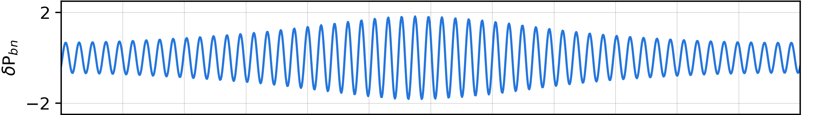





    Phase Analysis of HC-induced Instability
$φ$=9$0^{∘}$
  To understand mode helical localization, we analyze the phase of each toroidal harmonic $δP_{bn}$
$φ$=$0^{∘}$
$φ$=1$80^{∘}$
$φ$=2$70^{∘}$
$$δP_{bn}(θ)=\sum_{m}{δP_{bmnc}\cos\left(mθ−nφ\right)+δP_{bmns}sin⁡(mθ−nφ)}$$
n=52 $δP_{bn}$ Poloidal Structure
1$≤n≤$64 $δP_{bn}$ Poloidal Structure
$φ$=$0^{∘}$
$φ$=$0^{∘}$
$φ$=${90}^{∘}$
$φ$=${90}^{∘}$
“A single n harmonic is insufficient to explain the helically localized structure”
$φ$=${180}^{∘}$
$φ$=${180}^{∘}$
$φ$=${270}^{∘}$
$φ$=${270}^{∘}$

Slide 27
    Phase Analysis of HC-induced Instability
$φ$=9$0^{∘}$
  To understand mode helical localization, we analyze the phase of each toroidal harmonic $δP_{bn}$
$φ$=$0^{∘}$
$φ$=1$80^{∘}$
$φ$=2$70^{∘}$
$$δP_{bn}=\sum_{m}{δP_{bmnc}\cos\left(mθ−nφ\right)+δP_{bmns}sin⁡(mθ−nφ)}$$
n=52 $δP_{bn}$ Poloidal Structure
1$≤n≤$64 $δP_{bn}$ Poloidal Structure
$φ$=$0^{∘}$
$φ$=$0^{∘}$
$φ$=${90}^{∘}$
$φ$=${90}^{∘}$
$φ$=${180}^{∘}$
$φ$=${180}^{∘}$
$φ$=${270}^{∘}$
$φ$=${270}^{∘}$

Slide 28
    Phase Analysis of HC-induced Instability
$φ$=9$0^{∘}$
  To understand mode helical localization, we analyze the phase of each toroidal harmonic $δP_{bn}$
$φ$=$0^{∘}$
$φ$=1$80^{∘}$
$φ$=2$70^{∘}$
$$δP_{bn}=\sum_{m}{δP_{bmnc}\cos\left(mθ−nφ\right)+δP_{bmns}sin⁡(mθ−nφ)}$$
n=52 $δP_{bn}$ Poloidal Structure
1$≤n≤$64 $δP_{bn}$ Poloidal Structure
$φ$=$0^{∘}$
$φ$=$0^{∘}$
$φ$=${90}^{∘}$
$φ$=${90}^{∘}$
$φ$=${180}^{∘}$
$φ$=${180}^{∘}$
$φ$=${270}^{∘}$
$φ$=${270}^{∘}$

Slide 29
    Phase Analysis of HC-induced Instability
$φ$=9$0^{∘}$
  To understand mode helical localization, we analyze the phase of each toroidal harmonic $δP_{bn}$
$φ$=$0^{∘}$
$φ$=1$80^{∘}$
$φ$=2$70^{∘}$
$$δP_{bn}=\sum_{m}{δP_{bmnc}\cos\left(mθ−nφ\right)+δP_{bmns}sin⁡(mθ−nφ)}$$
n=52 $δP_{bn}$ Poloidal Structure
1$≤n≤$64 $δP_{bn}$ Poloidal Structure
$φ$=$0^{∘}$
$φ$=$0^{∘}$
$φ$=${90}^{∘}$
$φ$=${90}^{∘}$
$φ$=${180}^{∘}$
$φ$=${180}^{∘}$
$φ$=${270}^{∘}$
$φ$=${270}^{∘}$

Slide 30
    Phase Analysis of HC-induced Instability
$φ$=9$0^{∘}$
  To understand mode helical localization, we analyze the phase of each toroidal harmonic $δP_{bn}$
$φ$=$0^{∘}$
$φ$=1$80^{∘}$
$φ$=2$70^{∘}$
$$δP_{bn}=\sum_{m}{δP_{bmnc}\cos\left(mθ−nφ\right)+δP_{bmns}sin⁡(mθ−nφ)}$$
n=52 $δP_{bn}$ Poloidal Structure
1$≤n≤$64 $δP_{bn}$ Poloidal Structure
$φ$=$0^{∘}$
$φ$=$0^{∘}$
$φ$=${90}^{∘}$
$φ$=${90}^{∘}$
$φ$=${180}^{∘}$
$φ$=${180}^{∘}$
$φ$=${270}^{∘}$
$φ$=${270}^{∘}$

Slide 31
    Appendix: Phase Analysis of HC-induced Instability
$φ$=9$0^{∘}$
  To understand mode helical localization, we analyze the phase of each toroidal harmonic $δP_{bn}$
$φ$=$0^{∘}$
$φ$=1$80^{∘}$
$φ$=2$70^{∘}$
$$δP_{bn}=\sum_{m}{δP_{bmnc}\cos\left(mθ−nφ\right)+δP_{bmns}sin⁡(mθ−nφ)}$$
n=52 $δP_{bn}$ Poloidal Structure
1$≤n≤$64 $δP_{bn}$ Poloidal Structure
$φ$=$0^{∘}$
$φ$=$0^{∘}$
Constructively Interfere
$φ$=${90}^{∘}$
$φ$=${90}^{∘}$
Perturbations are cancelled out
$φ$=${180}^{∘}$
$φ$=${180}^{∘}$
$φ$=${270}^{∘}$
$φ$=${270}^{∘}$
“This pressure-driven mode may be a cluster of weakly unstable ‘n’ ballooning modes coupled by HC”

Slide 32






    Appendix: Time Evolution of the Eigenfunction (Reference Case)
t=4.96$×{10}^{−2}$ ms $\sim$ 47/$ω_{A}$
t=$6.61×{10}^{−2}$ ms $\sim$ 62/$ω_{A}$
t=$9.09×{10}^{−2}$ ms $\sim$ 87/$ω_{A}$
Shear Alfven wave takes roughly $140$/$ω_{A}$ time to propagate/communicate between each peak.
  Eigenmode structure can partially develop.

Slide 33










    Appendix: Effects of Viscosity on Mode Eigenfunction
$$\hat{ν}=1×10^{−6}$$
$$\hat{ν}=5×10^{−6}$$
$$\hat{ν}=1×10^{−5}$$
$$ω_{A}t=79$$
$$ω_{A}t=126$$
$$ω_{A}t=142$$
$$γ≫\frac{v_{A}}{L}$$
$$γ>\frac{v_{A}}{L}$$
$$γ≳\frac{v_{A}}{L}$$
$$1.2×{10}^{−1}$$
$$7.1×{10}^{−3}$$
$$8.3×{10}^{−2}$$
$$5.5×{10}^{−2}$$
Mode structure becomes smoother
  *Caveat: Broadening caused by viscosity may intertwine with decorrelation!

Slide 34
    Appendix: Sensitivity of Mode Structure on Initial Condition
Z (m)
Z (m)
The only difference is the random number seed for generating the initial perturbation.
The macroscopic structure and growth rate are similar, but the fine structures are not.

Slide 35





    Appendix: Linear Properties of EP-driven Mode $\left(\hat{ν}=\hat{χ}=5×10^{−6}\right)$
Axisymmetric Equi. Counterpart
1$≤$ n $≤$ 40 Continua
m/n=2/2
f~3.14 kHz
$φ$=$0^{∘}$
m/n=1/1
f~1.05 kHz
$φ$=18$0^{∘}$
m/n=(n+2)/n Continua
m/n=3/3
f~5.7 kHz
$$γτ_{∥}^{−1}≈4.2$$
Peak harmonic
^{m}/n=$\text{3}\text{5}\text{/}33$
High-n modes are stable
Alphas drive HC localized mode, residing at the BAE-CAPs
Only long-wavelength low-frequency EPMs are unstable
Continua were calculated using the modified STELLGAP (Implemented Up-down asymmetry)
[1] ZZ Ren et al 2017 Phys.
Plasmas 24, 052501
[2] S Liu et al 2024 Phys. Scr. 99 075604

Slide 36







    Appendix: Pressure-Driven Mode Stability in Axisymmetric Equilibria
(a) $q_{0}$=1.02/$ρ_{qinv}=0.4$
(b) $q_{0}$=1.10/$ρ_{qinv}=0.4$
(a1)
$$ρ_{qinv}$$
(a2)
m/n=2/2
(b1)
$$ρ_{qinv}$$
(b2)
m/n=1/1
m/n=1/1
(a3)
(a4)
(b3)
(b4)
n=2
n=1
n=1

