Slide 1


Effect of Pressure Gradients of Multiple Fast-Ion Species on Fast-Ion-Driven Instabilities in the Large Helical Device
R. Seki ¹, Y. Todo¹, S. Kamio³, K. Ogawa^{1,2},
M. Isobe^{1,2}, and M. Osakabe ^{1,2}
National Institute for Fusion Science, National Institutes of Natural Sciences
SOKENDAI , Department of Fusion science, The Graduate university
For Advanced Studies
TAE Technologies.
Notes:
Thank you, Chairman.
Today, I will talk about the effect of pressure gradients of multiple fast-ion species on fast-ion-driven instabilities in the Large Helical Device.

Slide 2
Background
〇In fusion devices, there are multiple fast-ion species such as fusion-product α-particles and fast deuterons produced by neutral beam injection (NBI). These fast ions may induce instabilities such as Alfvén Eigenmodes (AEs) which enhance fast-ion transport and losses.
〇In the plasma with multiple fast-ion species, a complex synergistic effect of multiple fast-ion species may arise on the instabilities and fast-ion transport, because the interaction with the instabilities may differ for different species.
〇Computer simulations are useful tools for investigating the synergistic effect. A hybrid simulation code for nonlinear MHD and energetic particle dynamics, MEGA, can investigate AE instabilities including the fast ion source, collisions, and losses
Notes:
First, I will briefly introduce the background of this study.
In fusion devices, there are multiple fast-ion species, such as fusion-product α particles and fast deuterons produced by neutral beam injection (NBI). These fast ions may induce instabilities such as Alfvén eigenmodes (AEs), which can enhance fast-ion transport and losses.
In a plasma with multiple fast-ion species, complex synergistic effects between the different fast-ion species may arise in the instabilities and fast-ion transport, because their interactions with the instabilities may differ between species.
In this case,
Computer simulation is a useful tool for investigating the synergistic effect. A hybrid simulation code for nonlinear MHD and energetic particle dynamics, MEGA, can investigate AE instabilities including the fast ion source, collisions, and losses.

Slide 3
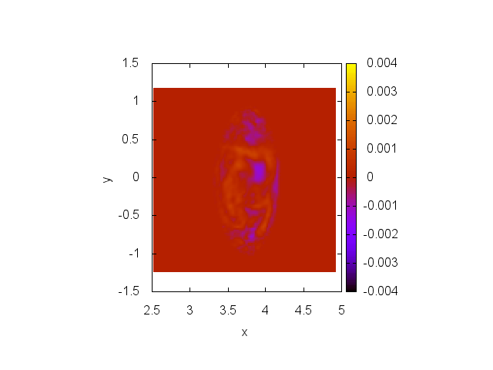
MEGA code
MEGA code
- a hybrid simulation code for nonlinear magnetohydrodynamics (MHD) and energetic-particle dynamics in the real coordinates with use of equilibrium magnetic field calculated by HINT.
〇time evolution of fast ion
・source of fast ion
・change of position and velocity
・fast-ion loss
PIC
Fast ion pressure
〇time evolution of MHD
・change of magnetic field and electric field
・evolution of AE
MHD
Magnetic field・electric field with instabilities
● Nonlinear calculation of fast ion induced instabilities.
● Fast-ion transport /losses due to the instabilities.
Notes:
Next, I will briefly explain the MEGA code.
MEGA is a hybrid simulation code for nonlinear magnetohydrodynamics (MHD) and energetic-particle dynamics in the real coordinates.
This simple figure show one time step of MEGA code,
In the MEGA code, the fast ion pressure is evaluated by using the PIC method,
First, fast ions are introduced according to their birth profiles.
And then, the guiding centers of the fast ions are followed while taking Coulomb collisions into account.
When the fast ion reach the loss boundary, fast ion is regarded as the lost fast ion.
Using the fast ion pressure, time evaluation of MHD perturbation is calculated.
In the next orbit-following step, the magnetic field with instabilities are used.
By iterating this loop, MEGA code can calculate
Nonlinear calculation of fast ion induced instabilities and fast ion transport and/losses due to the instabilities.

Slide 4
Outline
Background
MEGA simulation for LHD experiments with multiple fast-ion species
  Time evolution of kinetic energy and fast-ion profiles
  Transferred energy from AEs to fast ions
Effect of pressure gradients of multiple fast-ion species on AEs in LHD
  Time evolution of kinetic energy when fast-ion pressures are varied.
  Pressure of multiple fast ions and second peak due to multiple fast-ion species
Summary
Notes:
Now, let me briefly explain the outline of my talk.
First, I will discuss the MEGA simulations for LHD experiments with multiple fast-ion species.
In this part, I will show the time evolution of the kinetic energy and fast-ion pressure profiles, and discuss the energy transferred from AEs to fast ions.
Next, I will discuss the effect of pressure gradients of multiple fast-ion species on AEs in LHD.
I will show the time evolution of the kinetic energy when the fast-ion pressures are varied.
And then, I will discuss the relationship between the fast-ion pressures and the second AE peak caused by multiple fast-ion species.
Finally, I will summarize the my talk.

Slide 5
Outline
Background
MEGA simulation for LHD experiments with multiple fast-ion species
  Time evolution of kinetic energy and fast-ion profiles
  Transferred energy from AEs to fast ions
Effect of pressure gradients of multiple fast-ion species on AEs in LHD
  Time evolution of kinetic energy when fast-ion pressures are varied.
  Pressure of multiple fast ions and second peak due to multiple fast-ion species
Summary
Notes:
Now, I will talk about the MEGA simulations for LHD experiments with multiple fast-ion species.

Slide 6
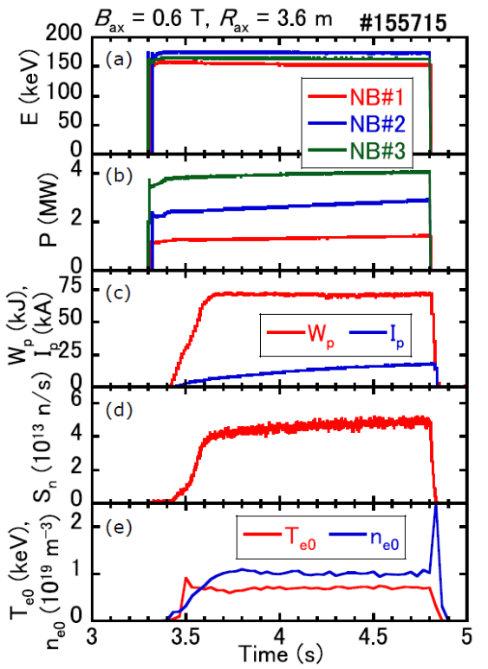
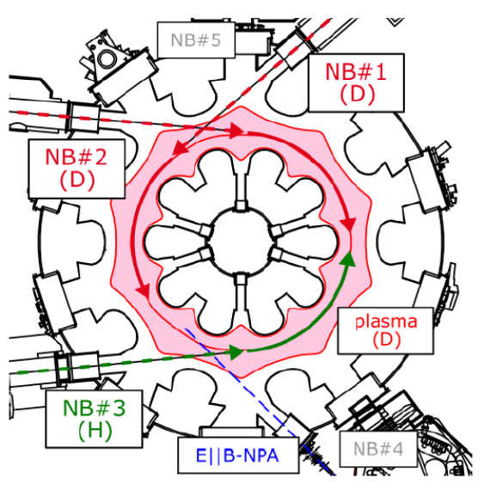
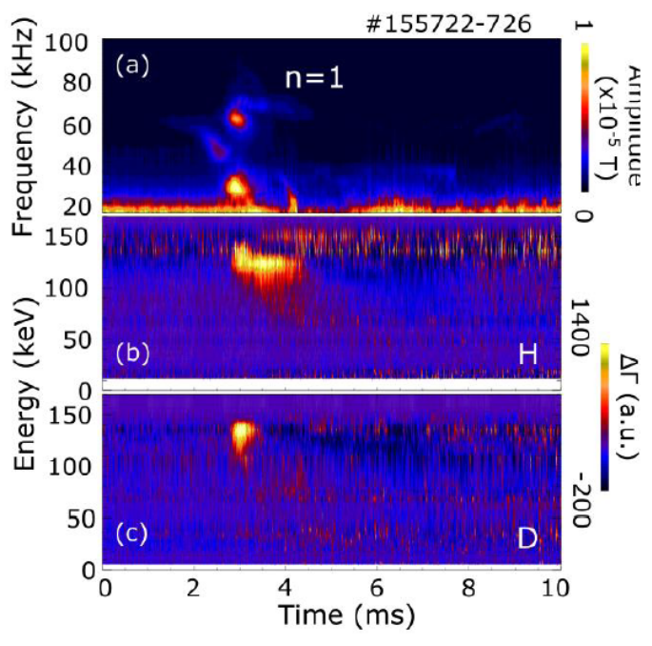
LHD experiment with multi fast-ion species
〇The experiments with the combined injection of hydrogen and deuterium beams were conducted in the Large Helical Device (LHD). The AE bursts caused by fast protons and fast deuterons were observed in the experiments [1].
Magnetic fluctuation and measurements of (b) Fast proton and (c) Fast deuteron.
[1] S. Kamio, et al, Plasma and Fusion Research, 16, 2402044 (2021)
Notes:
First, I will introduce the LHD experiment with multiple fast-ion species.
To clarify the relationship between instabilities and fast ion transport in the multiple fast ion species plasma,
the experiments with the combined injection of hydrogen and deuterium beams were conducted in the Large Helical Device (LHD).
The AE bursts caused by the fast protons and fast deuterons were observed in the experiments [1].
The center figure shows the shot summary, including the NBI injection energy and power, plasma stored energy, neutron emission rate, electron temperature, and electron density.
The right figure shows the AE frequencies observed in the magnetic fluctuation measurements, as well as the fast-proton and fast-deuteron fluxes measured by the E//B-NPA.
In the right figure, we can see that the AEs during this burst have three frequencies.
We can also see increases in the fast-proton flux measured by the E//B-NPA during the burst.
At the same time, increase of fast-deuteron flux was observed.

Slide 7
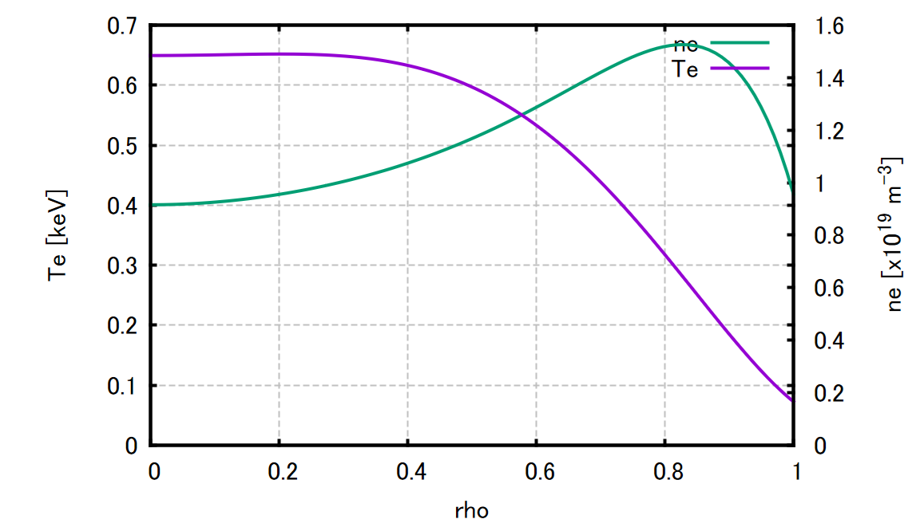
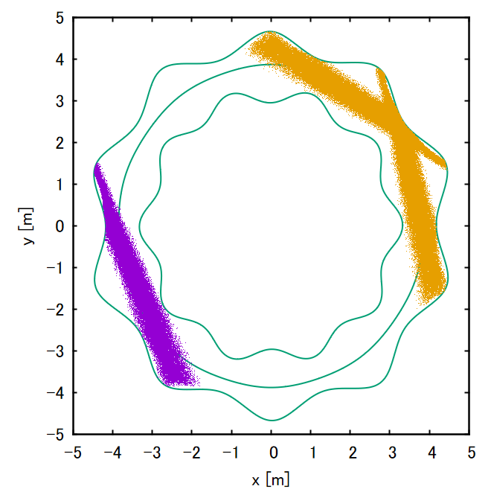
Simulation conditions
(a)
○Magnetic configuration
(calculated by HINT code)
Bax= 0.6 T, <beta> = 1.55%
○Tangential-NBIs
Total port-through power
4.15 MW(H)
2.93 MW(D)
Total absorption power
2.39 MW(H)
2.08 MW(D)
Beam injection energy (H/D)
～ 180 keV
○ Ti = Te, ni=ne profile
measured in the LHD experiment.
〇Realistic fast-ion birth profile
(calculated by HFREYA)
←NB2(D)
(b)
←NB3(H)
←NB1(D)
Notes:
Next, I will explain the simulation conditions for MEGA.
The magnetic field strength is 0.6 T.
Three tangential NBIs are used.
One is a co-injected NBI for protons, and the other two are co- and counter-injected NBIs for deuterons.
The total power of the proton NBI is about 4 MW, while the total power of the two deuteron NBIs is 3 MW.
The absorbed power is shown here.
The beam injection energy is approximately 180 keV.
The bulk plasma profiles measured in the LHD experiment are used.
The profiles are shown in the right figure.
Using these profiles, realistic fast-ion birth profiles are calculated with the HFREYA code.
The calculated birth profiles, shown in the lower-right figure, are used as the fast-ion sources in the MEGA simulations.

Slide 8
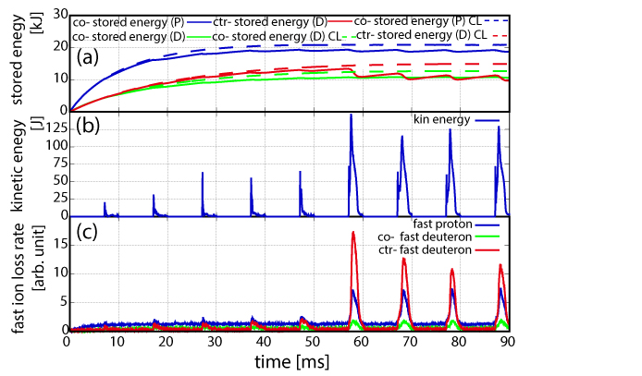
Time evolution of stored fast-ion energy and MHD kinetic energy of the instabilities.
(a) Fast ion stored energy
(b) MHD kin. Energy
(c) fast ion loss rate
〇AE bursts after 57 ms, when the fast-ion stored energy is close to the steady state, are different from those before 57 ms.
〇The fast-ion loss rate in AE bursts after 57 ms becomes large in all fast-ion species. The largest component of the fast-ion loss rate is the ctr-injected fast deuteron.
Notes:
Now, let me show you the results of the MEGA simulations for LHD experiments with multiple fast-ion species.
This figure shows the time evolution of the stored fast-ion energy, the MHD kinetic energy of the instabilities, and the fast-ion loss rate.
In the upper panel, the blue line shows the stored energy of the co-injected protons, the green line shows that of the co-injected deuterons, and the red line shows that of the counter-injected deuterons.
The dashed lines show the classical calculation without instabilities.
In the bottom panel, the blue, green, and red lines show the loss rates of fast protons, co-injected deuterons, and counter-injected deuterons, respectively.
Here, I would like you to focus on the AE burst after 57 ms.
At this time, the stored fast-ion energy is close to the steady state.
As you can see, the AE burst after 57 ms is different from those before 57 ms.
In particular, the MHD kinetic energy is larger after 57 ms.
In addition, the fast-ion loss rate becomes large for all fast-ion species after 57 ms.
The largest component of the fast-ion loss rate is the ctr-injected fast deuteron.

Slide 9
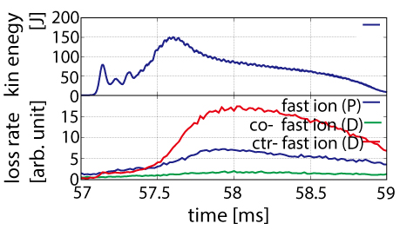
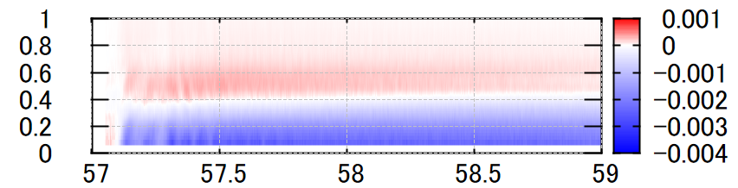
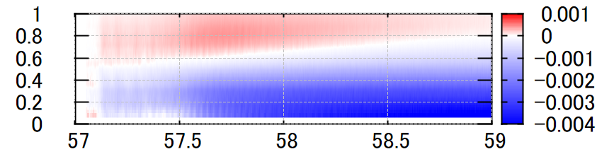
Time evolution of MHD kinetic energy and fast-ion profiles near 57 ms.
〇In the AE burst after
57 ms, there are two peaks of kinetic energy.
〇The fast-ion loss rate increase near second peak.
〇At the first peak,
fast P pressure decreases near rho < 0.3 and then, P pressure changes slightly.
〇fast D pressure largely change near second peak.
first peak
2nd peak
Fast P pres.
Difference of fast ion pressure from 57 ms [arb. unit]
Fast D pres.
time [ms]
Notes:
Next, for the AE burst near 57 ms, I will show the time evolution of the MHD kinetic energy and the changes in the fast-ion pressure profiles.
The top panel shows the kinetic energy of the instability, and the second panel shows the fast-ion loss rate.
The bottom two panels show the changes in the fast-ion pressure profiles from 57 ms.
The upper panel of bottom two panels shows the change in the fast-P pressure, while the lower panel shows the change in the fast-D pressure.
From the upper panel, we can see that there are two peaks in the kinetic energy after 57 ms: the first peak and the second peak.
Around the second peak, the fast-ion loss rate increases.
From the bottom two panels, we can see that at the first peak, the fast-P pressure decreases for ρ < 0.3 and then changes only slightly.
In contrast, the fast-D pressure changes significantly around the second peak.

Slide 10
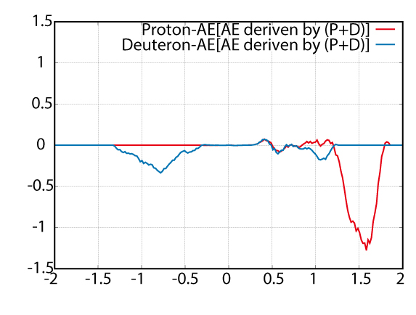
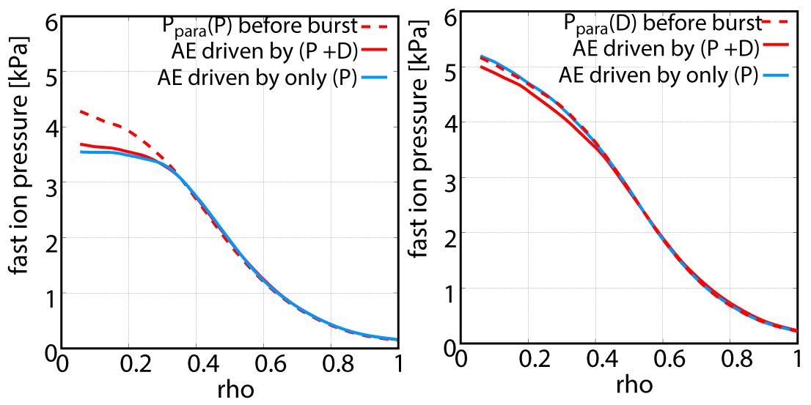

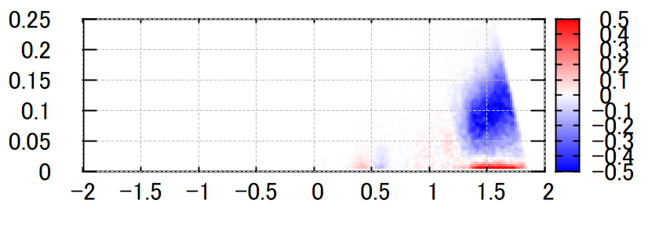
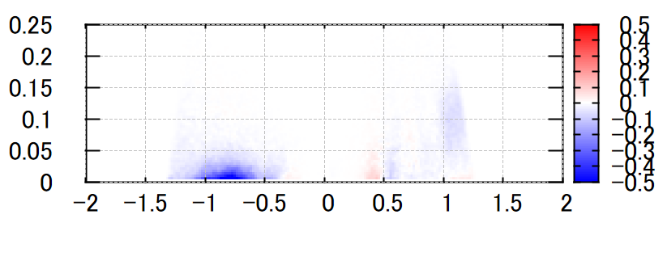
Transferred energy and fast ion pressure near first peak
Fast P pres.
Fast D pres.
Energy transferred from AE
[arb. unit]
vpara/va
〇In the first peak, AEs are mainly caused by fast proton with vpara/va~1.5.
〇In fast D, AEs interact with fast D with vpara<0.
〇The fast D pressure changes less than the fast P pressure.
energy transferred
from AE to proton
Magnetic moment
energy transferred
from AE to deuteron
vpara/va
Notes:
Next, I will discuss the energy transferred from the AEs to the fast ions near the first peak.
The upper figure shows the energy transferred from the AEs to each fast-ion species as a function of parallel velocity.
The horizontal axis shows the parallel velocity normalized by the Alfvén velocity.
The lower two figures show the transferred energy in velocity space.
The upper panel shows the transferred energy to protons, while the lower panel shows the transferred energy to deuterons.
The transferred energy from the AEs to the fast ions is averaged over a time window of approximately 0.05 ms.
Negative values of the transferred energy indicate that the fast ions contribute to the excitation of the AEs.
From the upper figure, we can see that the transferred energy of fast protons, shown by the red line, is negative near v∥/vA ~ 1.5.
This indicates that the AEs at the first peak are mainly driven by fast protons with v∥/vA ~ 1.5.
On the other hand, the AEs interact with fast deuterons mainly at v∥/vA < 0.
The two figures on the right show the changes in the fast-ion pressure around the first peak.
The dashed red lines show the fast-ion pressure before the burst, and the red lines show the fast-ion pressure at the first peak.
At the first peak, the fast-D pressure changes less than the fast-P pressure.

Slide 11
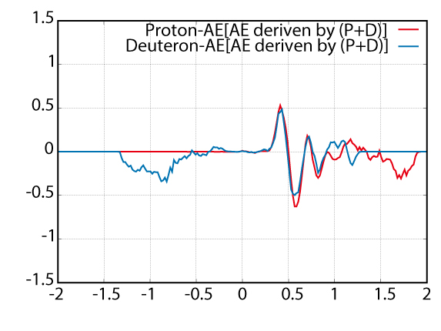
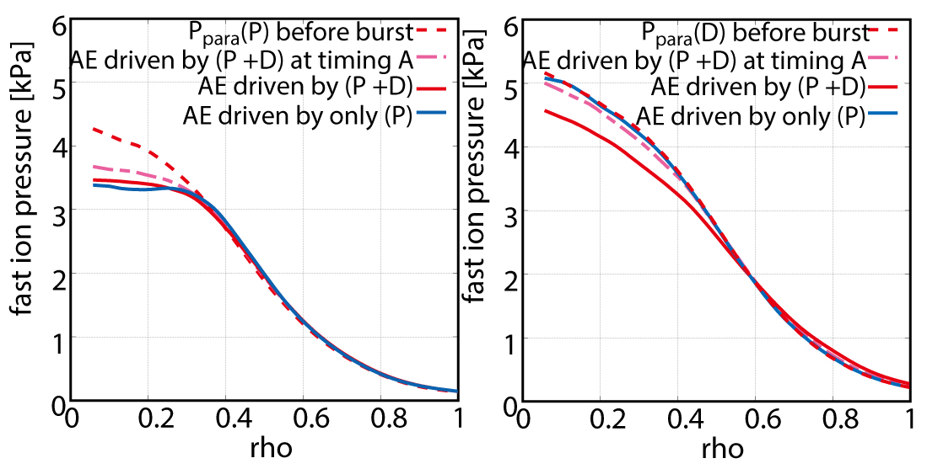
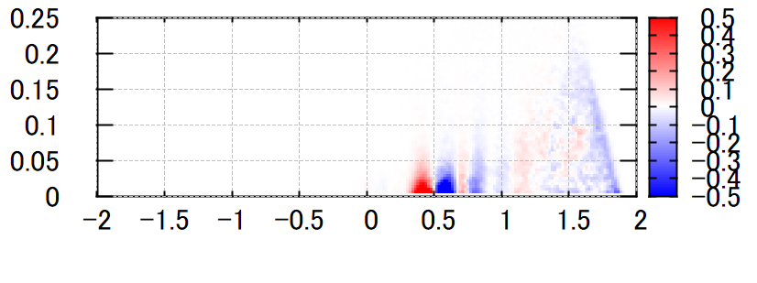
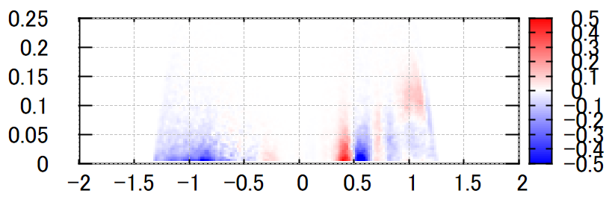
Transferred energy and fast ion pressure near 2nd peak
2nd peak
2nd peak
Energy transferred from AE
[arb. unit]
Fast P pres.
Fast D pres.
vpara/va
〇In the second peak,
・fast D pressure changed significantly.
・ AEs mainly interact with fast protons and deuterons with vpara/va~0.5.
mu
energy transferred
from AE to proton
mu
energy transferred
from AE to deuteron
vpara/va
Notes:
Next, I will discuss the energy transfer near the second peak.
As shown in the right figure, the fast-D pressure changes significantly during the second peak.
The AEs mainly interact with fast protons and deuterons at v∥/vA ~ 0.5.

Slide 12
Outline
Background
MEGA simulation for LHD experiments with multiple fast-ion species
  Time evolution of kinetic energy and fast-ion profiles
  Transferred energy from AEs to fast ions
Effect of pressure gradients of multiple fast-ion species on AEs in LHD
  Time evolution of kinetic energy when fast-ion pressures are varied.
  Pressure of multiple fast ions and second peak due to multiple fast-ion species
Summary
Notes:
next, I will investigate the effect of pressure gradients of multiple fast-ion species on AEs in LHD.

Slide 13
Effect of pressure gradients of multiple fast-ion species on AEs in LHD
〇In MEGA simulations of LHD experiments with fast protons and fast deuterons, AEs were successfully reproduced.
〇On the other hand, the synergistic effects of multiple fast-ion species on AEs and fast-ion transport remain unclear when the fast-ion pressure gradients are varied, particularly when the fast D pressure becomes sufficiently large to excite AEs.
Purpose
・The dependence of AEs driven by multiple fast-ion and their transport on the fast-ion pressure gradients will be clarified.
Notes:
In the MEGA simulations of the LHD experiments with fast protons and fast deuterons, AEs with frequencies observed in the experiments were successfully reproduced.
However, the synergistic effects of multiple fast-ion species on AEs and fast-ion transport remain unclear when the fast-ion pressure gradients are varied, particularly when the fast-D pressure becomes sufficiently large to excite AEs.
Therefore,
The purpose of this study is to clarify the dependence of AEs driven by multiple fast-ion species, and their transport, on the fast-ion pressure gradients.

Slide 14
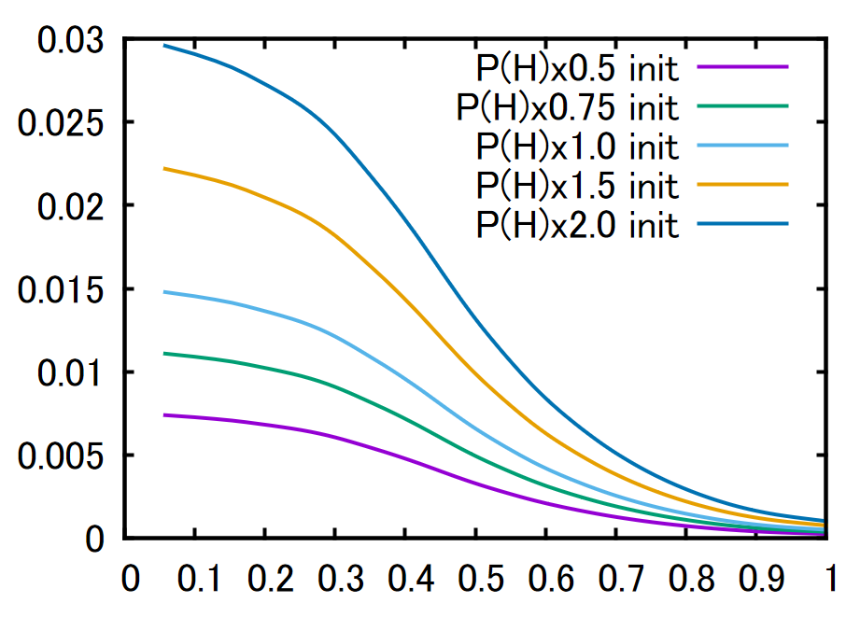
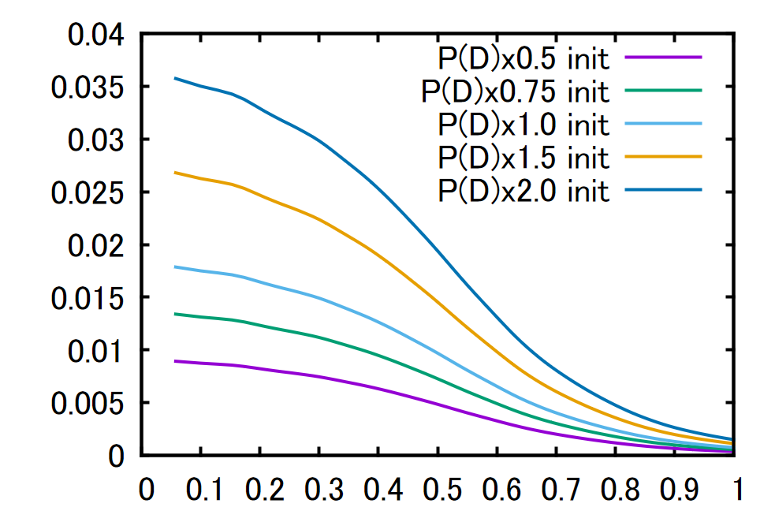
Simulation conditions(Effect of pressure gradients)
○Magnetic configuration
(calculated by HINT code)
Bax= 0.6 T, <beta> = 1.55%
○Fast-ion pressure was changed from the pressure at 57 ms.
P(H) => x0.5, x0.75, x1.0, x1.5, x2.0 (5 case)
P(D) => x0.5, x0.75, x1.0, x1.5, x2.0 (5 case)
P_{para}
P_{para}
Fast P pres.
Fast D pres.
rho
rho
Notes:
First, I will explain the simulation conditions used to investigate the effect of the fast-ion pressure gradient.
In these simulations, we vary the fast-ion pressures while keeping the same equilibrium as that used in the experimental analysis.
The fast-ion pressures are independently varied for protons and deuterons from 0.5 to 2.0, with five cases for each species.

Slide 15
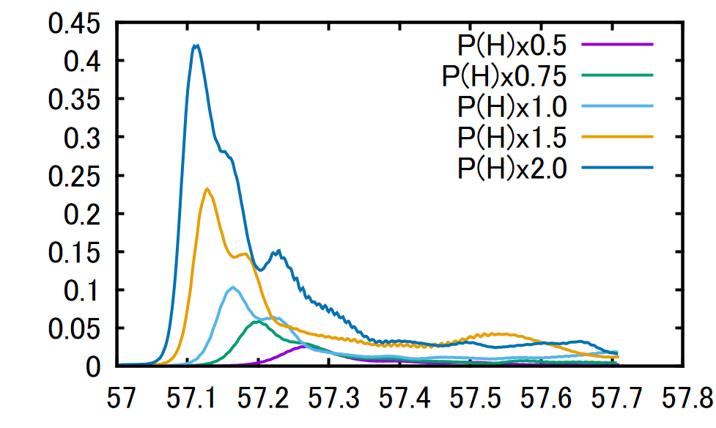
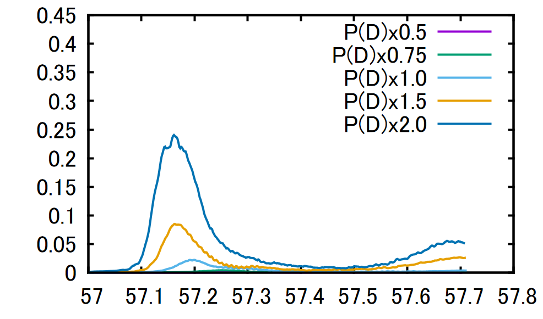
Effect of pressure gradient on AEs in LHD
(AE driven by only P or D)
〇AE driven by fast P only
〇AE driven by fast D only
Kinetic energy
Kinetic energy
time [ms]
time [ms]
〇There is no second peak with an increased fast-ion pressure
When AE is driven by fast P or D only
〇The amplitude of AE in the case of fast D only is lower than
that in the case of fast P only.
Notes:
First, I will discuss the effect of the pressure gradient for cases where AEs are driven by fast protons only or fast deuterons only.
The two figures show the time evolution of the kinetic energy of the instabilities as the fast-ion pressures are varied.
In these figures, the purple, green, light-blue, yellow, and blue lines correspond to fast-ion pressure multipliers of 0.5, 0.75, 1.0, 1.5, and 2.0, respectively.
From these figures, we can see that there is no second peak when AEs are driven by fast protons only or fast deuterons only.
Also, the AE amplitude in the fast-D-only case is lower than that in the fast-P-only case.
The maximum amplitude in the P(D) × 1.5 case is close to that in the P(H) × 1.0 case.

Slide 16
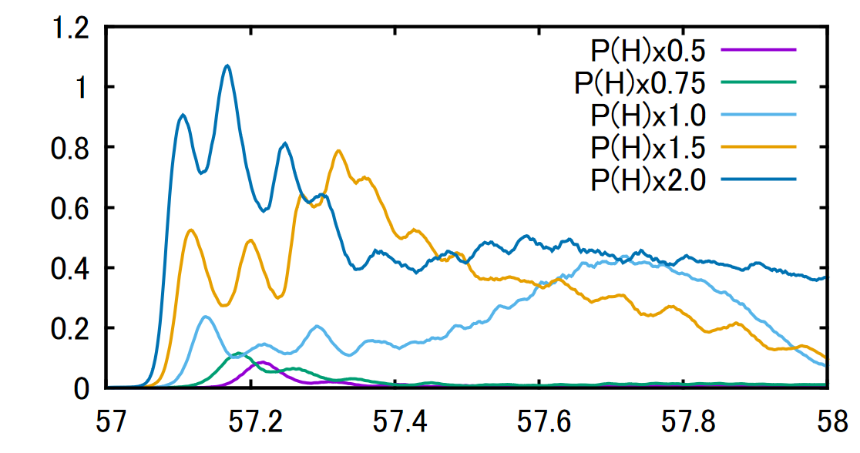
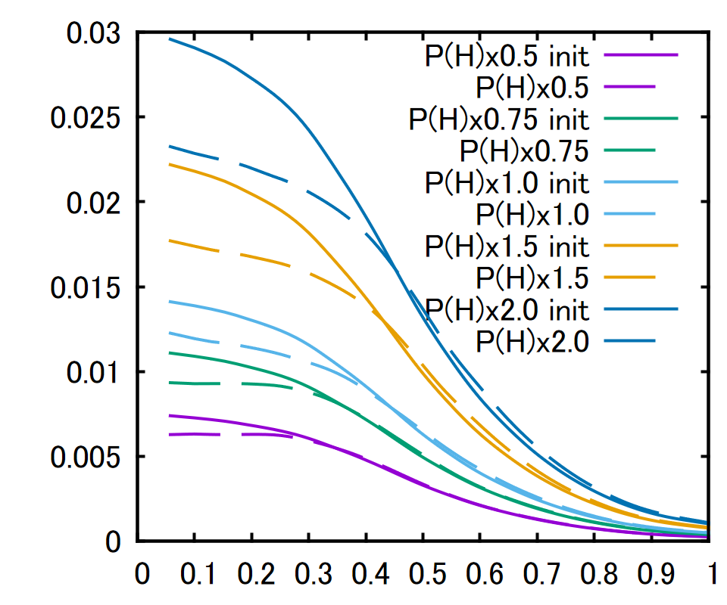
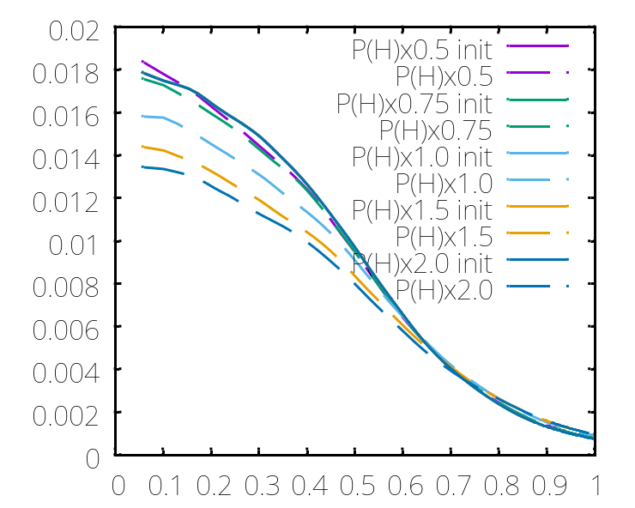
Dependence of AEs on fast P pressure (case of P(D)x1.0)
(when AEs are driven by (P+D)).
2nd peak
2nd peak
1st
P_{para}
Kinetic energy
2nd peak
Fast P pres.
time [ms]
As P(H) increases:
〇The first and second peaks become larger.
〇The time interval between
the first peak and the second peak becomes shorter.
P_{para}
Fast D pres.
〇When the second peak is present,
the fast D pressure decreases significantly, and the decrease becomes larger as P(H) increases.
rho
Notes:
Next, I will discuss the dependence of AEs on the fast-P pressure when AEs are driven by both fast protons and fast deuterons.
The left figure shows the time evolution of the kinetic energy of the instabilities as the fast-proton pressure is varied.
As in the previous figure, the purple, green, light-blue, yellow, and blue lines correspond to fast-proton pressure multipliers of 0.5, 0.75, 1.0, 1.5, and 2.0, respectively.
As shown in the figure, a first peak appears in all cases, as indicated by the black arrows.
On the other hand, when the fast-proton pressure is increased above 1.0, a second peak appears, as shown by the light-blue, yellow, and blue lines.
Therefore, as the fast-proton pressure increases, both the first and second peaks become larger.
At the same time, the time interval between the first and second peaks becomes shorter.
The right figure shows the fast-ion pressure at 57.8 ms.
The colors correspond to the same conditions as in the kinetic-energy plot.
The solid lines show the initial fast-ion pressure for reference.
From this figure, we can see that when the second peak is present, the fast-D pressure decreases significantly.
Furthermore, the decrease becomes larger as the fast-proton pressure increases.
Next I will talk about Dependence of AEs on fast P pressure when AEs are driven by fast P and Deuteron.
The left figure show the time evolution of kinetic energy of instabilitites when fast proton pressure are varied.
In these figure, the purple line show the results of fast proton pressure x 0.5
Green x 0.75, light bule x 1.0, yellow 1.5 and blue x2.0, respectievely.
From this figure,
In the all cases, there is fist peaks indicated by the black arrows.
On the other hand, when the fast proton pressure is increased above 1.0, light blue, yellow blue lines, a second peak appears.
So, As fast proton pressure increases:The first and second peaks become larger.
And the time interval between the first peak and the second peak becomes shorter.
Right figure show the fast ion pressure at 57.8.
The colors correspond to the same conditions as in the kinetic energy.
In these figure, the solid line show the initial fast ion pressure for reference
From right figure,
When the second peak is present, light blue, yellow , blue lines cases
the fast D pressure decreases significantly, and the decrease becomes larger as fast proton pressure increases.

Slide 17
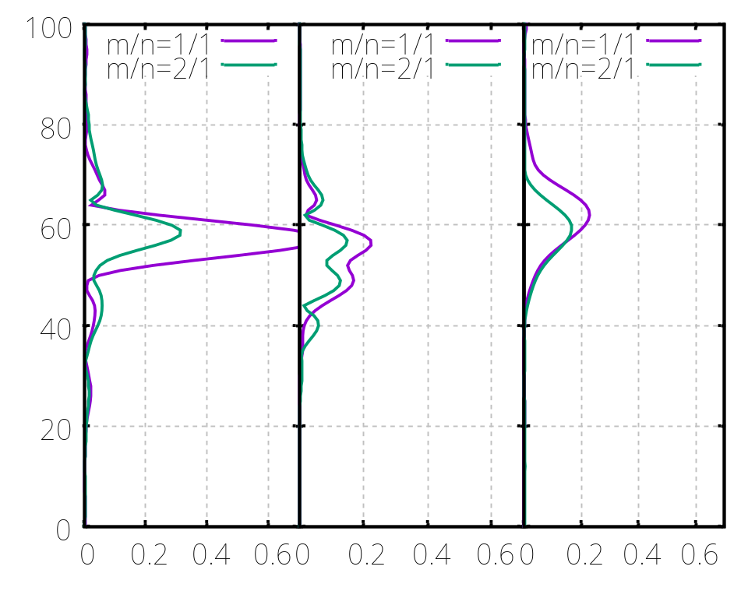
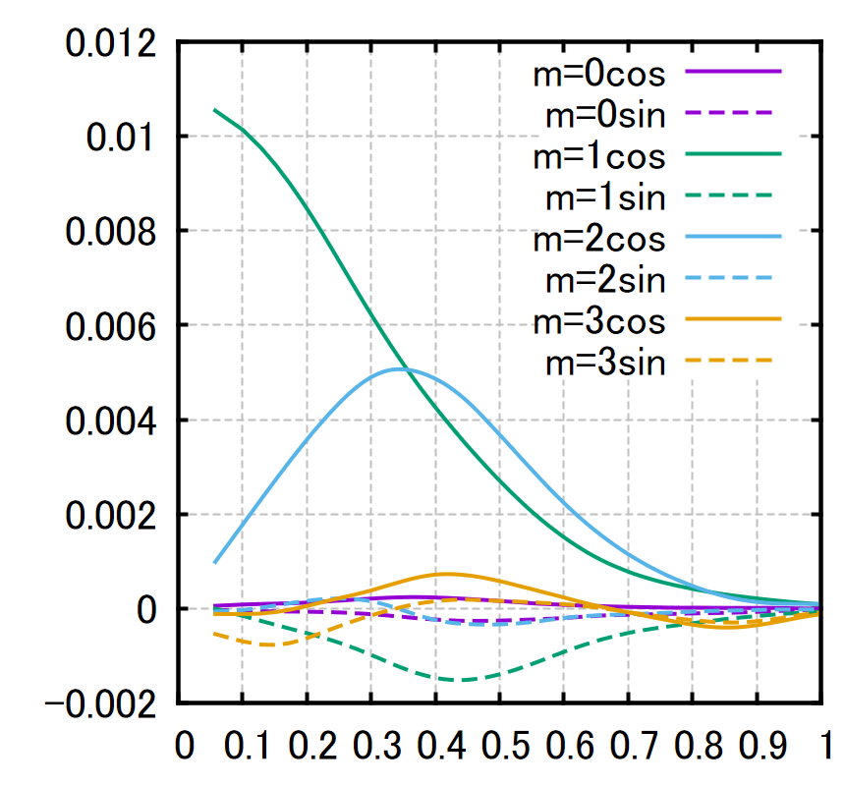
Frequency of AEs when AEs are driven by (P+D).
Mode profile
(AEs driven by (P+D).
60 [kHz]
Frequency [kHz]
amplitude [arb. unit]
50 [kHz]
25 [kHz]
AE driven
by (P+D)
AE driven
by only P
AE driven
by only D
amplitude [arb. unit]
rho
〇AE modes have the primary frequencies of 60, 50 and, 25 [kHz].
〇For fast P only, the primary frequencies are 50, 55 [kHz].
〇For fast D only, the primary frequency is 60 [kHz].
〇The primary modes are m/n=2/1 and 1/1.
Notes:
Next, we investigate the frequency spectra for the case of P(H) × 1.5 and P(D) × 1.5.
The right figure shows the frequency spectra of the radial MHD velocity harmonics.
The left panel shows the result when the AEs are driven by both fast protons and fast deuterons for P(H) × 1.5 and P(D) × 1.5.
The center panel shows the result for AEs driven by fast protons only, and the right panel shows the result for AEs driven by fast deuterons only.
When the AEs are driven by both fast protons and fast deuterons, the primary AE frequencies are approximately 60, 50, and 25 kHz.
These frequencies are in good agreement with those observed in the LHD experiments.
On the other hand, for fast protons only, the primary frequencies are approximately 50 and 55 kHz, while for fast deuterons only, the primary frequency is approximately 60 kHz.
The primary modes of the AE are m/n = 2/1 and 1/1.

Slide 18
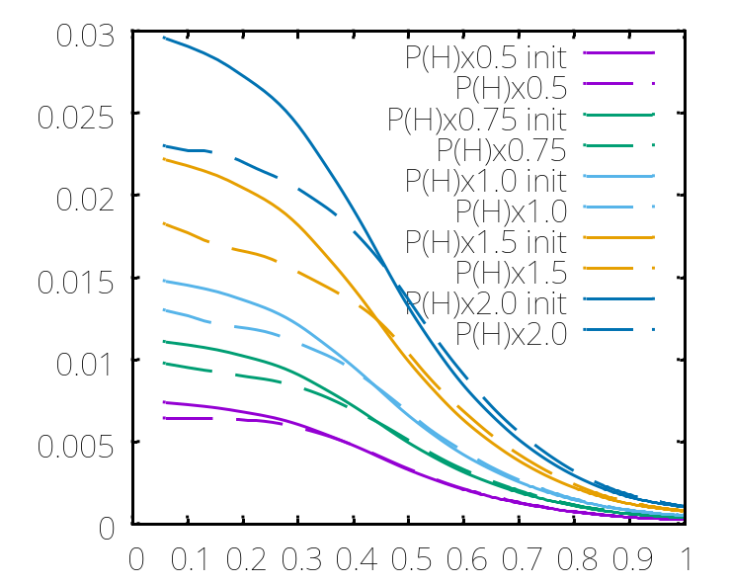
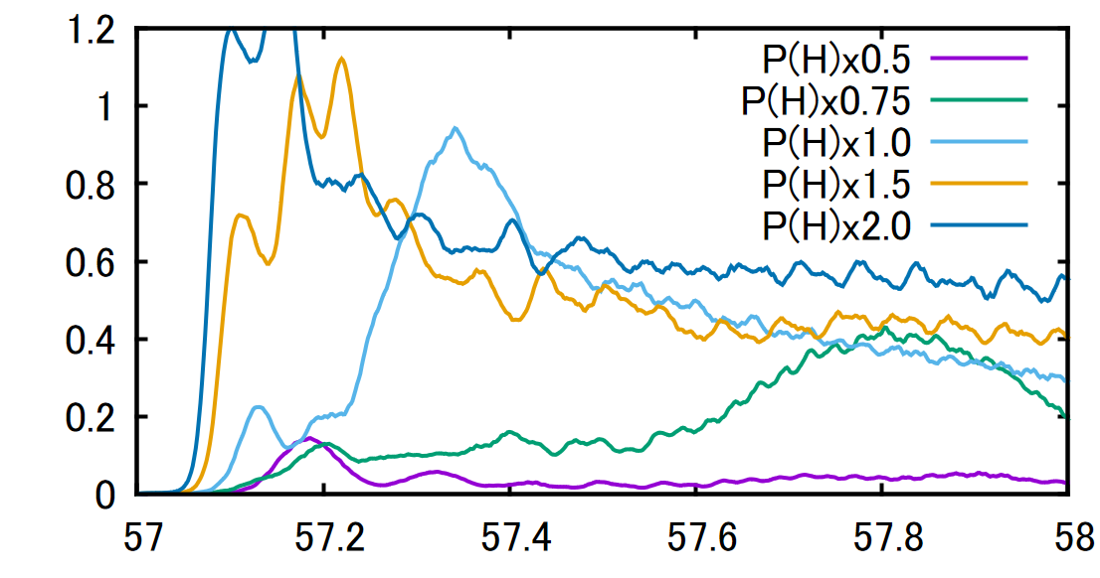
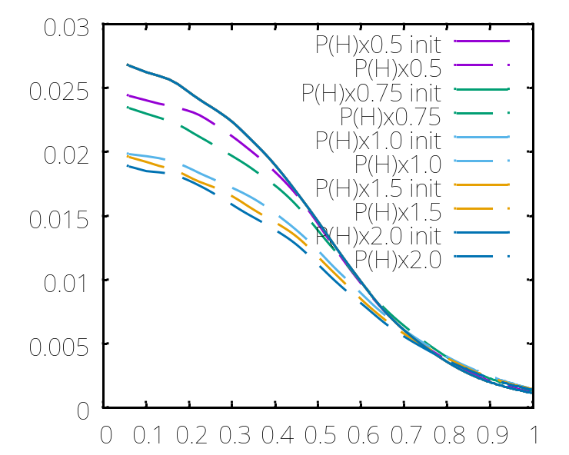
Dependence of AEs on fast P pressure(case of P(D)x1.5)
when AEs are driven by (P+D).
2nd peak
2nd peak
2nd peak
P_{para}
1st
Kinetic energy
2nd peak
Fast P pres.
time [ms]
〇Second peak appears even at P(H) × 0.75.
〇Second peak appears close to the first peak at P(H)x2.0.
〇The fast D pressure with a large second peak changes significantly.
The fast D pressure after the burst is similar for P(H) × 1.0–2.0.
P_{para}
Fast D pres.
rho
Notes:
Next, I will discuss cases where the fast-D pressure becomes sufficiently large to excite AEs.
Here, the fast-deuteron pressure is fixed at 1.5.
The left figure shows the time evolution of the kinetic energy, and the right figure shows the changes in the fast-ion pressure.
From the left figure, a clear second peak is observed in all cases except for the P(H) × 0.5 case, shown by the purple line.
The second peak appears even at P(H) × 0.75.
For P(H) × 2.0, the second peak appears very close to the first peak.
In particular, a large second peak is observed when the fast-proton pressure is P(H) × 1.0 or higher.
From the lower-right figure,
the fast-D pressure changes significantly in the cases with a large second peak.
light blue, yellow and blue lines are almost
we can see that the fast-D pressure after the burst is similar for P(H) × 1.0–2.0.

Slide 19
Pressure of multiple fast ions and second peak
Amplitude of the second peak
(Amplitude is normalized by that in case of P(H)x1.0 and P(D)x1.0)
 | P(H)x0.5 | x0.75 | x1.0 | x1.5 | x2.0
P(D)x0.5 | no 2nd peak | no 2nd peak | no 2nd peak | no 2nd peak | 1.1
x0.75 | no 2nd peak | no 2nd peak | no 2nd peak | 0.56 | 1.33
x1.0 | no 2nd peak | no 2nd peak | 1.0 | 1.78 | 2.44
x1.5 | no 2nd peak | 0.89 | 2.0 | 2.44 | 3.1
X2.0 | 1.56 |  | 2.89 |  | 3.33
〇When P(H) and P(D) are both low, the second peak does not appear.
〇The amplitude of the second AE peak depends on P(H) and P(D).
〇The first peak is also present when a second AE peak due to multiple fast-ion species appears.
Notes:
Next, I will summarize the relationship between the pressure of multiple fast ions and the second peak.
This table shows the amplitude of the second peak. The amplitude is normalized by that in the case of P(H) × 1.0 and P(D) × 1.0.
The columns show the fast-proton pressure, while the rows show the fast-deuteron pressure.
From this table, we can see that when both the fast-proton and fast-deuteron pressures are low, the second peak does not appear.
The amplitude of the second AE peak depends on both the fast-proton and fast-deuteron pressures.
And, The first peak is also present when a second AE peak due to multiple fast-ion species appears.

Slide 20
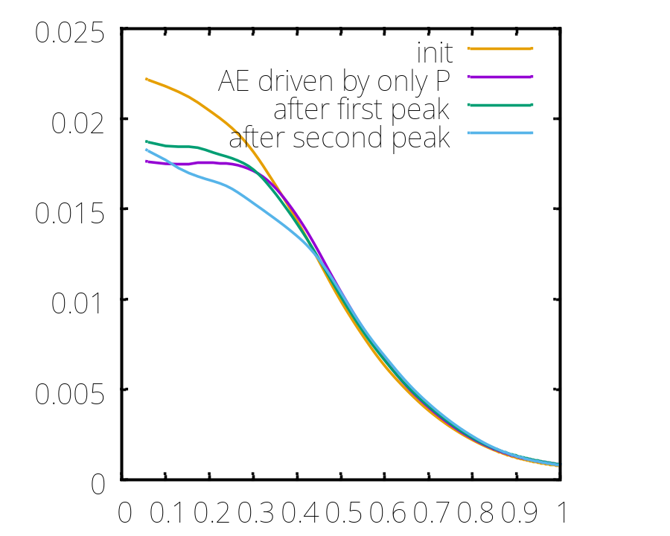
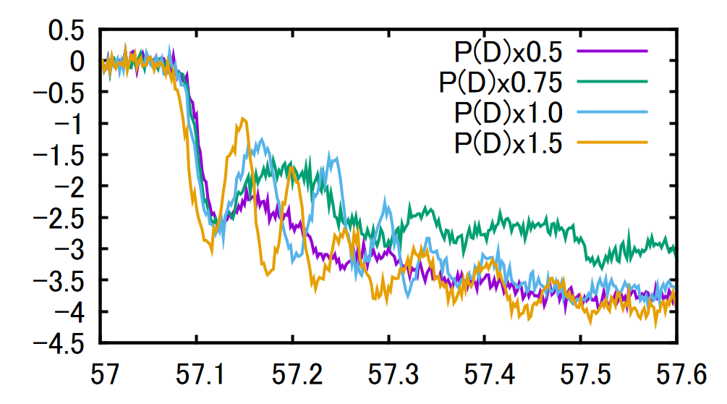
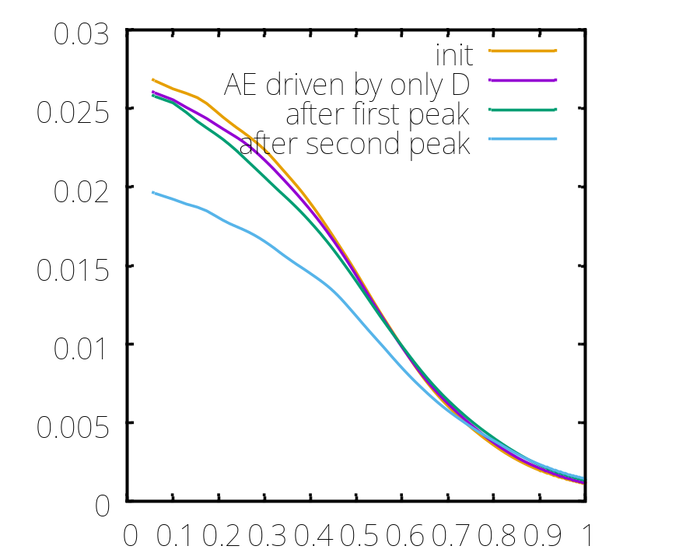
Discussion of the second peak.
Time evolution of fast P pressure
near plasma center （rho＝０．１）
(P(H)x1.5)
P_{para}
(P_{para}-P_{para_init})x1e3
Fast P pres.
(P(H)x1.5, P(D)x1.5)
time [ms]
〇As P(D) increases, the recovery of fast P pressure near the plasma center becomes more significant.
〇After the first peak, the fast P pressure decreases in rho <0.3.
〇After the second peak, the gradients of fast P and D pressure change near rho~0.35.
P_{para}
Fast D pres.
(P(H)x1.5, P(D)x1.5)
rho
Notes:
Finally, I would like to discuss the second peak.
First, the left figure shows the time evolution of the fast-P pressure near the plasma center.
In this figure, the fast-D pressure is varied.
As the fast-D pressure increases, the recovery of the fast-P pressure near the plasma center becomes more significant.
Next, the right figures show the fast-ion pressures after the first peak and after the second peak.
The upper figure shows the fast-P pressure, and the lower figure shows the fast-D pressure.
In these figures, the green lines represent the fast-ion pressure after the first peak, while the light-blue lines represent the fast-ion pressure after the second peak.
For reference, the initial pressure is shown by the yellow lines, and the pressures for AEs driven by fast P only or fast D only are shown by the purple lines.
From these figures, we can see that the fast-P pressure decreases in the region of ρ < 0.3 after the first peak.
After the second peak, the gradients of both the fast-P and fast-D pressures change near ρ ~ 0.35.
As a result, the fast-ion pressure decreases significantly, and the shape of the fast-ion pressure profile changes.

Slide 21
Summary
MEGA simulations of AEs driven by multiple fast-ion species were performed in the LHD configuration. The dependence of AEs driven by multiple fast-ion and their transport on the fast-ion pressure was investigated
〇As the fast-proton and fast-deuteron pressures increase, two AE peaks appear.
〇The AE modes have the three frequencies (~25, ~50, and ~60) observed in the experiment, even when the fast-ion pressure is increased.
〇The amplitude of the second peak depends on both the fast-proton and fast-deuteron pressures. As both pressures increase, the time interval from the first peak becomes shorter.
〇When the second peak is present, the fast-deuteron pressure decreases significantly. In addition, the gradient of fast P pressure changes in rho ~ 0.35.
Notes:
We will summarize my talk
MEGA simulations of AEs driven by multiple fast-ion species were performed in the LHD configuration. The dependence of AEs driven by multiple fast-ion and their transport on the fast-ion pressure was investigated.
The main results are as follows,
As the fast-proton and fast-deuteron pressures increase, two AE peaks appear.
The AE modes have the three frequencies (~25, ~50, and ~60) observed in the experiment, even when the fast-ion pressure is increased.
The amplitude of the second peak depends on both the fast-proton and fast-deuteron pressures. As both pressures increase, the time interval from the first peak becomes shorter.
Finally, when the second peak is present, the fast-deuteron pressure decreases significantly. In addition, the gradient of fast P pressure changes in rho ~ 0.35.
Tha is all for my talk
Thak you for your attention.

Slide 24
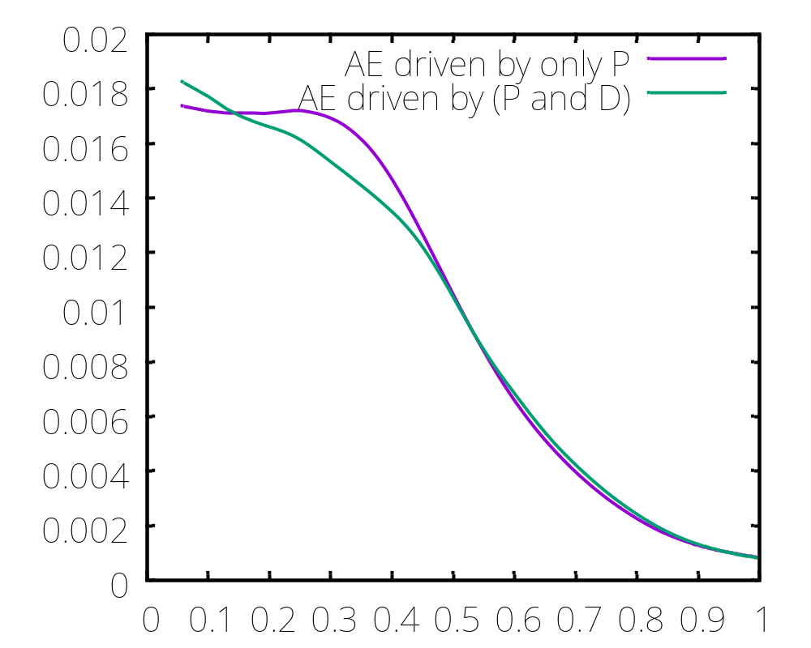
Comparison of fast P pressure with case of AE driven by only P
P_{para}
Fast P pres.
(P(H)x1.5, P(D)x1.5)
rho

Slide 25
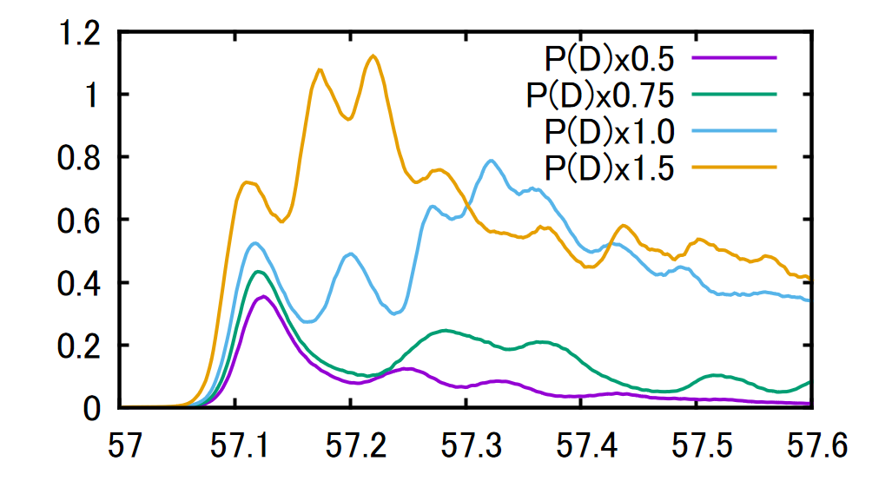
Discussion of the second peak.
Time evolution of fast P pressure
near plasma center （rho＝０．１）
(P(H)x1.5)
Kinetic energy
(P_{para}-P_{para_init})x1e3
time [ms]
time [ms]
〇As P(D) increases, the recovery of fast P pressure near the plasma center becomes more significant.
⇒AEs driven by fast D (or fast P and fast D) cause the recovery of fast P pressure near the plasma center.
⇒ The recovery leads to the re-excitation of AEs and the redistribution of fast D and fast P pressures.
〇The superimposition of these AEs (fast P driven AEs and fast D (or P and D) driven AEs) may produce the second peak.
〇One possible reason for the second peak is that the resonance regions are close to each other, with frequencies ~ 50 kHz for fast P only and ～60 kHz for fast D only.

Slide 26
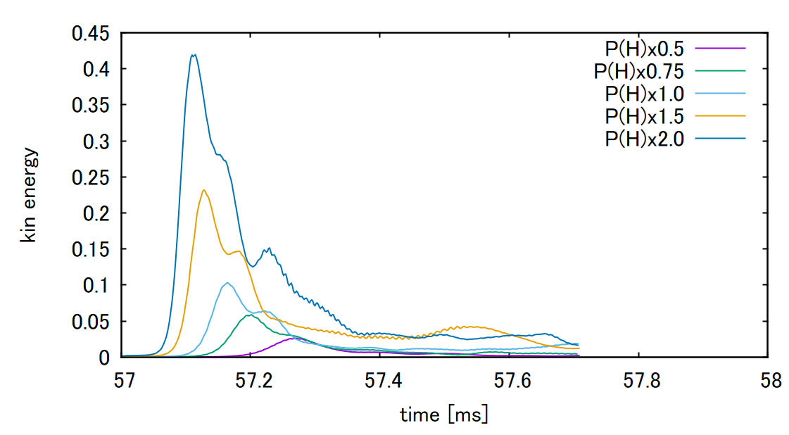
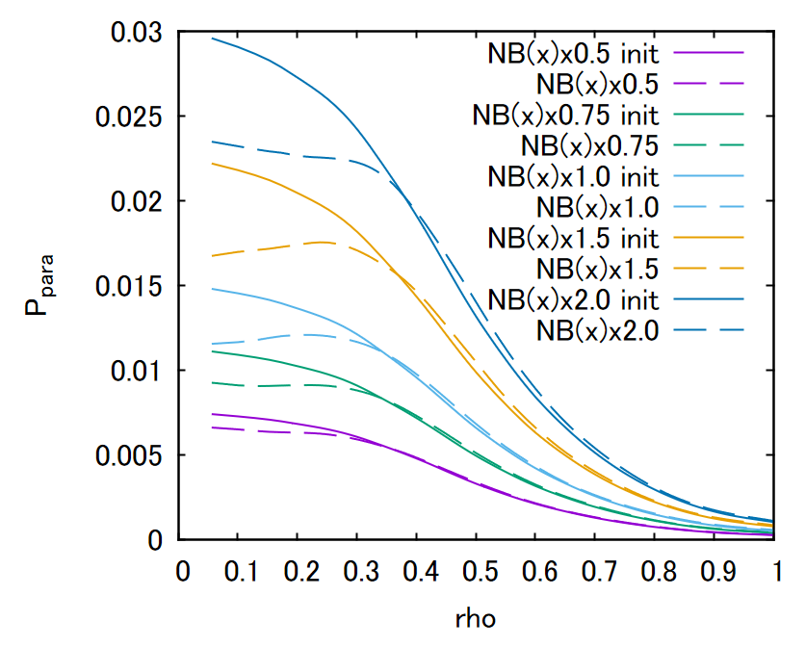
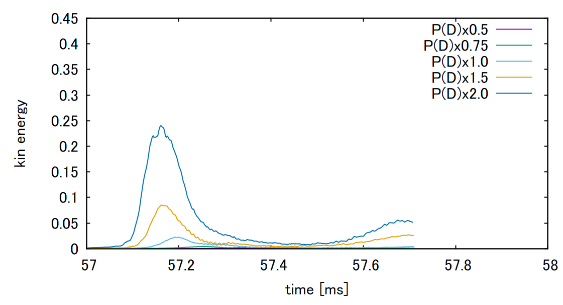
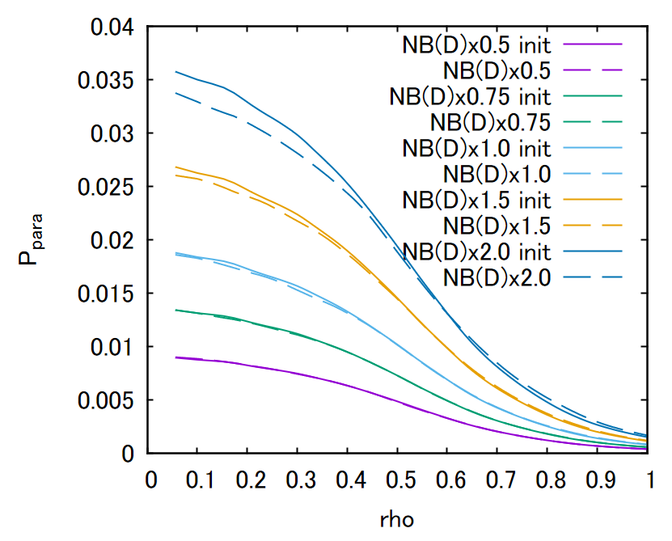
Effect of pressure gradient on AEs in LHD
(AE driven by only P or D)
〇AE driven by fast P only
Fast P pres.
〇AE driven by fast D only
Fast D pres.

Slide 27
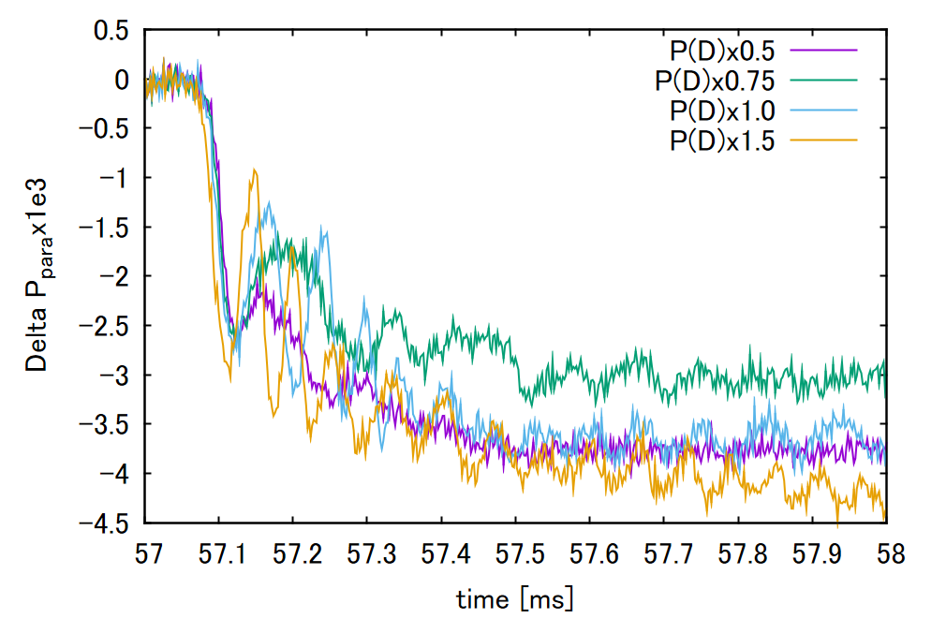
Fast P pres (0.1).
(P(H)x1.5)

Slide 28
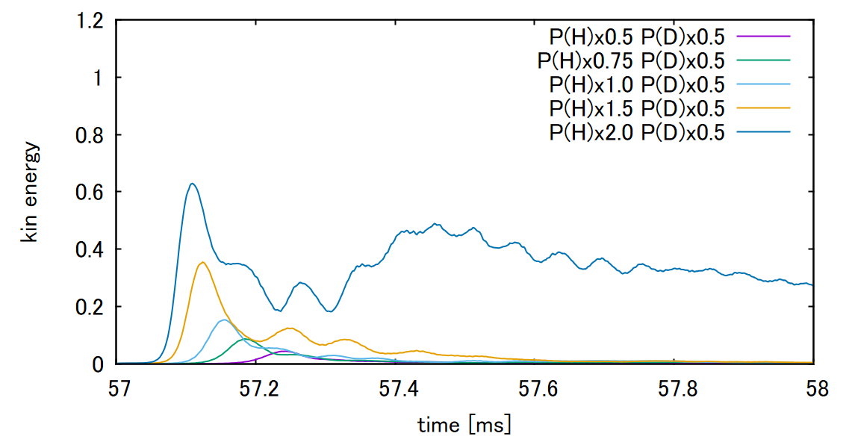
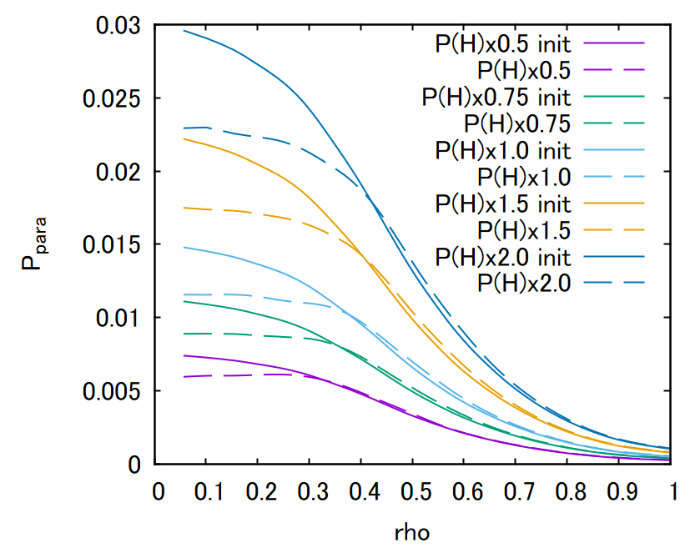
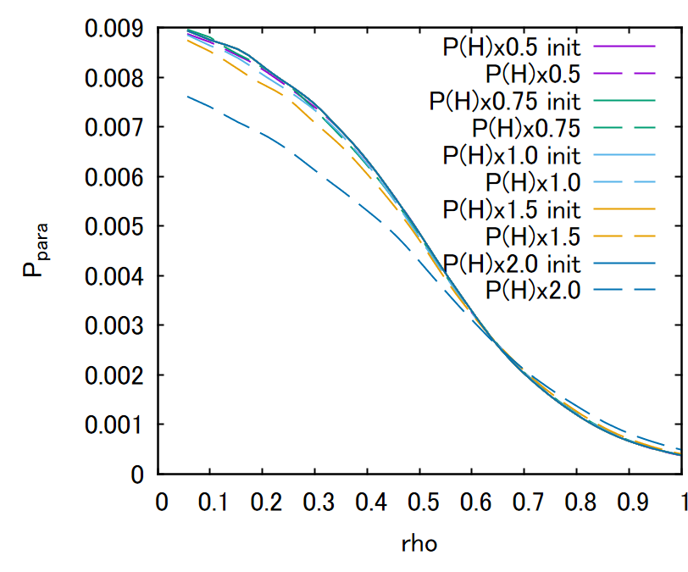
NB Pに対する依存性: P (D)x0.5の場合

Slide 29
追加計算, x1.5, x1.5
x1.0, x1.5
x1.5, x1.0
Mode構造, 上記および, only H or D
周波数 上記および, only H or D

Slide 31
Purpose
Simulations of the LHD experiments with the fast protons (fast P)and fast deuterons (fast D) were performed using MEGA code.
・The instabilities induced by each fast ion species will be identified.
・The synergistic effect of multiple fast ion species on the instability and the fast ion transport will be investigated.
Notes:
To investigate the relationship between instabilities and multi fast ions,
Simulations of the LHD experiments with the fast protons and fast deuterons were performed using MEGA code.
My purpose
・The instabilities induced by each fast ion species will be identified.
・The synergetic effect of multiple fast ion species on the instability and the fast ion transport will be investigated.

Slide 32
Simulation condition
(a)
○Magnetic configuration
(calculated by HINT code)
Bax= 0.6 T, <beta> = 1.55%
○Tangential-NBIs
Port through power 4.15 MW(H)
2.93 MW(D)
absorption power 2.39 MW(H)
2.08 MW(D)
beam injection energy (H/D)
～ 180 keV
○ Ti = Te, ni=ne profile
measured in the LHD experiment.
〇Realistic fast-ion birth profile
(calculated by HFREYA)
←NB2(D)
(b)
←NB3(H)
←NB1(D)
Notes:
Next shows the simulation condition of MEGA.
The field strength is 0.6 T. The tree tangential NBI is used. One is the co injected NBI with proton and others are co and ctri injected NBIs with deuteron .
Total port through power is about ‘ MW. And beam injection energy is close to 180 keV
The bulk profile measured in the LHD experiment is used. The profile show the right figure. Using the this profile, realistic fast ion birth profile ls calculated by HFERYA codo. The birth profile show in right bottom figure. This birth profile is used as fast ion source of MEGA code.

Slide 33
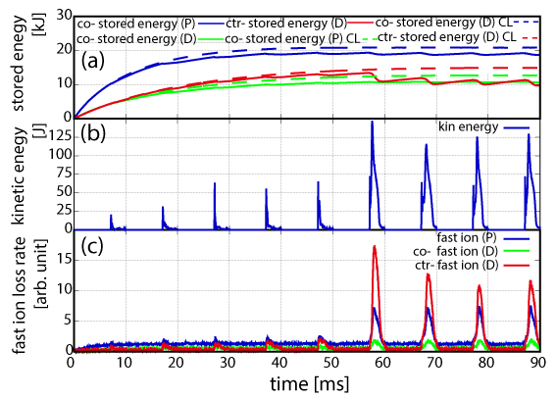
Time evolution of stored fast ion energy and MHD kinetic energy of the instabilities.
(a) Fast ion stored energy
(b) MHD kin. Energy
(c) fast ion loss rate
〇AE burst after 57 ms, when the fast ions stored energy is close to the steady state, is different from those before 57 ms.
〇The lost fast ion rate in AE bursts after 57 ms becomes large in all fast ion species. The largest component of the fast ion loss rate is the ctr-injected fast deuteron.
Notes:
This figure show the Time evolutions of stored fast ion energy and MHD kinetic energy of the instabilities, fast ion loss rate.
In the upper figure,
blue line show the co- stored energy of proton,
green show the co stored energy of deuteron,
Red show shte ctr- stored energy of deuteron.
Dashed lines show the classical calculation without instabilities.
In the lowest figure,
Blue line show the fast proton loss rate, green co-direction deuteron loss rate,
Red is ctr direction deuteron.
please focus on AE burst after 57 ms.
This timing is fast ions stored energy is close to the steady state
From these figure,
AE burst after 57 ms, when the fast ions stored energy is close to the steady state, is different from those before 57 ms.
AE burst after 57 ms
MHD kinetic energy is larger than that before 57 ms.
And then,
The lost fast ion rate in AE bursts after 57 [ms] becomes large in all fast ion species.
The largest component of the fast ion loss rate is the ctr-injected fast deuteron.

Slide 34
Time evolution of MHD kinetic energy and fast ion profile near 57 ms.
〇In the AE burst after
57 ms, there are two peaks of kinetic energy.
〇fast ion loss rate increase from near maximum peak.
〇At first peak,
fast P pressure decrease near rho < 0.4 and then, P pressure changes slightly.
〇fast D pressure largely change near maximum peak.
Fast P pres.
Difference of fast ion pressure from 57 ms [arb. unit]
Fast D pres.
time [ms]

Slide 35
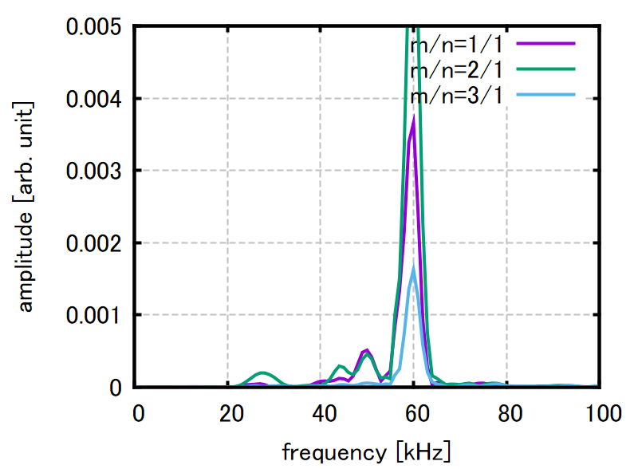
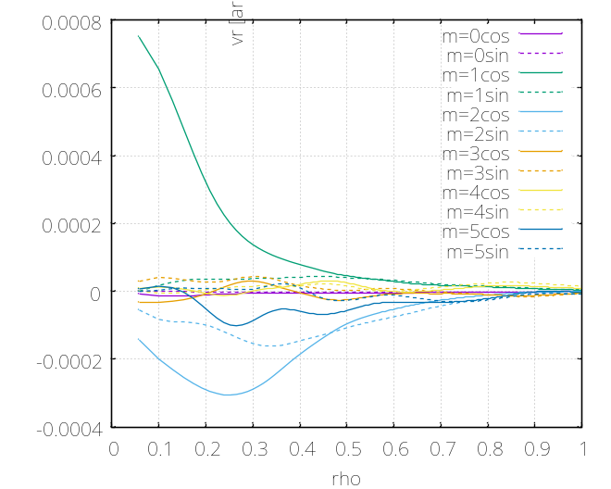
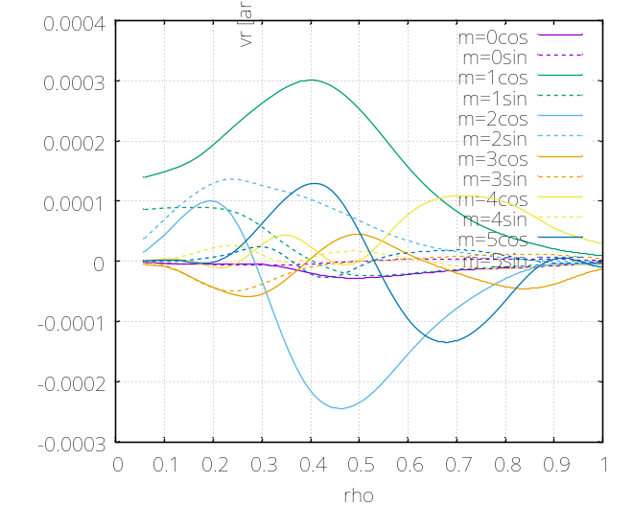
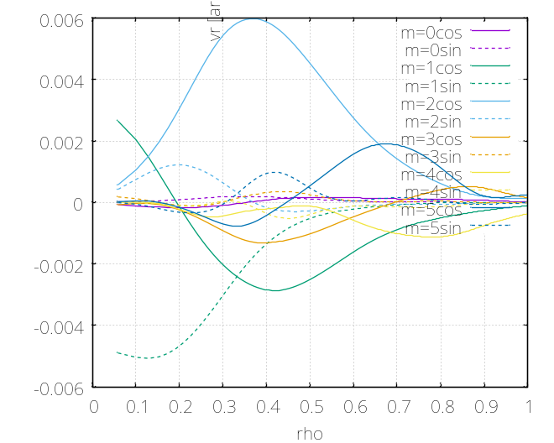
Frequency spectra of
radial MHD velocity harmonics
Freq. spectra
in AE burst
near 57 ms
amplitude [arb. unit]
Mode profile
25 kHz
Mode profile
50 kHz
vr [arb. unit]
Mode profile
60 kHz
rho
rho
rho
〇AE modes have the primary frequencies of 60, 50 and, 25 [kHz]. The frequencies are almost consistent with those in the LHD exp.
Notes:
We investigate the frequency spectra in the AE burse near 57 ms.
Upper figure show the Frequency spectra of radial MHD velocity harmonics
The primary frequencies of AE modes are 60 kHz, ～50 kHz, 25kHz.
The frequencies are almost consistent with the frequencies observed in the LHD experiments.
Lower figure shows the radial profile of modes with 60 kHz, 25 kHz, 50 kHz.
From these figure,
The primary modes of each AE mode are m/n=2/1, 1/1.

Slide 36
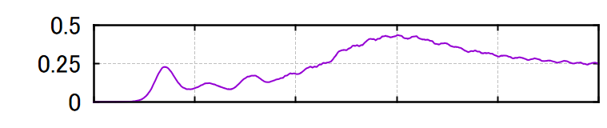
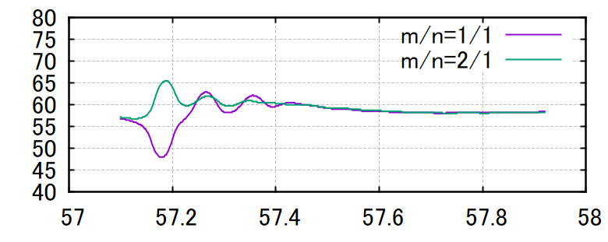


Time evolution of frequency spectra.
〇In the case of AE driven by (P + D),
the additional AEs are destabilized after first peak.
〇In the additional AEs,
frequency of primary AE increases slightly, and AE with around 30 kHz is destabilized.
MHD Kinetic energy
Frequency at peak of freq. spectra.
m/n=1/1
time [ms]
Frequency [kHz]
m/n=2/1
m/n=2/1
time [ms]
Notes:
Nex slide show the timing B
From time evolution of MHD kinetic energy,
In the case of AE driven by (P + D),
additional AEs were destabilized by fast proton and deuteron redistributions.
At the maximum additional AE peak(timing B)
Form figure (b) and(c)
・fast ion loss rates in both protons and deuterons become large in the case of AE driven by (P+D),
・fast deuteron pressure changed significantly.

Slide 37

Synergetic effect of multiple fast ions
To clarify the synergetic effect of multiple fast ions, the results with the assumption that AEs were driven by only protons are shown.
MHD kin.
〇In cases of AE driven by (P+D) and only (P),
there is first AE peak near timing A(57.13 ms).
〇In case of AE driven by only (P), the additional AE peak is destabilized and there is no significant loss of fast ions.
(b) AE driven
by (P + D)
(c) AE driven
by only (P)
Notes:
Next , I will explain the change of fast ion profile and loss.
In this slide, to clarify the synergetic effect of multiple fast ions, the results with the assumption that AEs were driven by only fast protons are shown togather.
In the case of AE driven by only fast deuterons, the kinetic MHD energy is exceedingly small.
Left figure show the MHD kinetic energy and fast ion loss rate in the case of AE driven by fast (P+ D) and only (P)
In the upper left figure, blue line show the case of AE driven by fast (P+ D) and green show the only (P) case
For the reference, red line show the only (D ) case
In the lower tow figure of left, Blue line show the fast proton loss rate, green co-direction deuteron loss rate,
Right two figure show the fast proton and deuteron pressure at timing A.
In these figure,
Dashed line show the pressure before the burst.
Red line show the case of AE driven by fast (P+ D) ,
Blue line show the only fast (P)
From left figure,
In cases of AE driven by (P+D) and only (P), there is first AE peak near timing A(57.13 ms).
In the first AE peak,
It is found from the figure (e), blue line is almost same as the dashed red line.
So ・there is no change of deuteron pressure in the case of AE driven by only (P).
On the other hand,
Form the figure d and e,
Red line is lower than dashed line even in the deuteron pressure.
This results show that fast proton and deuteron pressures in rho < 0.5 decrease in the case of AE driven by (P + D).

Slide 38




Comparison of Frequency spectra of radial MHD velocity harmonics near timing A(first peak).
55 kHz [AE driven by (P+D)]
AE driven by (P+D)
amplitude [arb. unit]
AE driven by only (P)
55 kHz
55 kHz [AE driven by only (P)]
Frequency [kHz]
〇The primary frequencies of AE modes are ~55 kHz.
〇The primary mode are m/n=2/1, 1/1.
Notes:
Next the typical alfven eigenmode burst is investigated
The identification of Alfeven eigenmode is important for validate of the MEGA simulation.
図の説明
The primary mode number at the first peak is m/n=1/1. And then, the instability with m/n=2/1 becomes large.
○ There is the maximum peak of instability at about 37.45 ms. The peak is coincident with the peak of mode amplitude with m/n=2/1.
〇The fast ion loss rate takes the maximum value near the peak of the m/n=2/1 mode amplitude.

Slide 39

Transferred energy and fast ion pressure near first peak
Fast P pres.
Fast D pres.
Energy transferred from AE
[arb. unit]
〇In the first AE peak,
AEs are mainly caused by fast proton with vpara/va~1.5 in both cases. In fast D, AEs interact with fast D with vpara<0.
・fast P and D pressures in rho < 0.5 decrease in the case (P + D).
・there is no change of fast D pressure in the case of only (P).
vpara/va
energy transferred
from AE to proton
[AE driven by (P+D)]
Magnetic moment
energy transferred
from AE to deuteron
[AE driven by (P+D)]
vpara/va

Slide 40


Frequency spectra of radial MHD velocity harmonics
near timing B: maximum peak.
59 kHz [AE driven by (P+D)]
AE driven by (P+D)
amplitude [arb. unit]
Frequency [kHz]
〇Near the second peak,
[timing B: maximum peak]
・The primary frequencies of AE modes are ~ 60 kHz.
・The modes of each AE mode are m/n=1/1 or m/n=2/1, 1/1.
55 kHz [first peak]
Notes:
Next the typical alfven eigenmode burst is investigated
The identification of Alfeven eigenmode is important for validate of the MEGA simulation.
図の説明
The primary mode number at the first peak is m/n=1/1. And then, the instability with m/n=2/1 becomes large.
○ There is the maximum peak of instability at about 37.45 ms. The peak is coincident with the peak of mode amplitude with m/n=2/1.
〇The fast ion loss rate takes the maximum value near the peak of the m/n=2/1 mode amplitude.

Slide 41

Transferred energy and fast ion pressure near timing B
Energy transferred from AE
[arb. unit]
Fast P pres.
Fast D pres.
vpara/va
〇In the second peak,
[timing B: maximum peak]
・fast D pressure changed significantly.
・ AEs mainly interact with fast protons and deuterons with vpara/va~0.5.
mu
energy transferred
from AE to proton
[AE driven by (P+D)]
mu
energy transferred
from AE to deuteron
[AE driven by (P+D)]
vpara/va

Slide 42
Summary
Hybrid simulation of MEGA was applied to the LHD experiments with the fast protons and fast deuterons
〇The AE modes with the three frequencies (~25 kHz, ~50 kHz, and ~60 kHz) observed in the experiment can be reproduced.
〇There are two AE peaks in the case of multiple ion species.
・The primary AE near the first peak was the similar as AE driven by only fast proton. AEs were mainly caused by fast protons with vpara/va~1.5.
・In case of multiple ion species, the additional second peak is destabilized and there is significant loss of fast ions. In the second peak, AEs mainly interact with fast protons and deuterons with vpara/va~0.5.
Notes:
I will summarize my slide
Hybrid simulation of MEGA was applied to the LHD experiments with the fast protons and fast deuterons
〇The AE modes with the three frequencies (~25 kHz, ~50 kHz, and ~60 kHz) observed in the experiment can be reproduced.
〇The synergetic effects of multiple ion species are clearly appeared when the fast ions stored energy is close to the steady state.
〇In the case of multiple ion species, the additional AE mode (60 kHz) was destabilized and the loss of ctr-injected fast deuteron becomes larger.

Slide 43



Effect of charge exchange loss
Kinetic energy [J]
no CX
CX model (10¹⁴)
Change of stored energy [kJ]
CX model (10¹⁵)
CX model (10¹⁴)
〇In the case of neutral density (10^15), the time width of AE burst is close to the experiment results.
〇the modes with three frequencies can reproduced even in the case of 10^15.
CX model (10¹⁴)
CX model (10¹⁵)
Notes:
Next I will investigate Effect of Charge exchange loss on these instabilities,
In this simulation, the synergetic effect of multiple fast ion on instabilities occurs when the stored energy is close to a steady state.
In this case, charge exchange have a large effect on the fast ion velocity distribution.
And, In the LHD experiment, AE burst is shorter than this MEGA simulation
We investigate the CX loss effect.
This is the comparison of no CX, CX model (10^14) and CX model (10^15).
Purple lines shows the no CX,
Green and light blue lines show the (10^14) and (10^15) cases, respectivewly.
Lower figures shows the frequency spectra in the show the (10^14) and (10^15) cases.
In the case of neutron density (10^15), the time width of AE burst is close to the experiment results. But, the modes with three frequencies can reproduced even in the case of 10^15.

Slide 44



Slide 45


Slide 47


Slide 48


Slide 49


Slide 50


Slide 51
fast ion profile and loss.(B:57.61 ms)
MHD kin.
(d)proton pres.
(e) deuteron pres.
(b) AE driven
by (P+D)
(c) AE driven
by only (P)
〇In the case of AE driven by (P + D),
additional AEs were destabilized by fast proton and deuteron redistributions.
〇At the maximum additional AE peak(timing B)
in the case of AE driven by (P+D),
・fast ion loss rates in both protons and deuterons become large.
・fast deuteron pressure changed significantly.
Notes:
Nex slide show the timing B
From time evolution of MHD kinetic energy,
In the case of AE driven by (P + D),
additional AEs were destabilized by fast proton and deuteron redistributions.
At the maximum additional AE peak(timing B)
Form figure (b) and(c)
・fast ion loss rates in both protons and deuterons become large in the case of AE driven by (P+D),
・fast deuteron pressure changed significantly.

Slide 52



Comparison of Frequency spectra of
radial MHD velocity harmonics
45 kHz [AE driven by only (P)]
55 kHz
55 kHz [AE driven by only (D)]
〇The primary frequencies of AE modes are ~45 kHz.
〇The modes of each AE mode are m/n=2/1, 1/1.
Notes:
Next the typical alfven eigenmode burst is investigated
The identification of Alfeven eigenmode is important for validate of the MEGA simulation.
図の説明
The primary mode number at the first peak is m/n=1/1. And then, the instability with m/n=2/1 becomes large.
○ There is the maximum peak of instability at about 37.45 ms. The peak is coincident with the peak of mode amplitude with m/n=2/1.
〇The fast ion loss rate takes the maximum value near the peak of the m/n=2/1 mode amplitude.

Slide 53


Slide 54

57.0924, 0.796701

Slide 55


Slide 56


Slide 57


Slide 58


Slide 59


Slide 60


Slide 61


Slide 62

-3.75739, -0.000661910

Slide 63


