Slide 1
Energetic particle instability characteristics of reactor-scale stellarators
September 30, 2026
19th Technical Meeting on Energetic Particles in Magnetic Confinement Systems
Don Spong
Oak Ridge National Laboratory
Collaborators: L. Garcia, Y. Ghai, J. Varela, A. Bader, A. Chambliss
Notes:
Accessing Title Slide Options
The standard ORNL presentation template includes five branded title slide layouts:
Title | Standard. The preferred layout for lab-wide and general presentations. Features a default aerial photograph of the lab.
Title | Custom Image. Allows replacement of the default background with a custom full-slide image (16:9 or 4:3 landscape format).
Title | Custom Portrait Image. Supports inclusion of a custom 4:3 portrait image positioned next to the introductory text.
Title | Custom Landscape Image. Supports inclusion of a custom 16:9 landscape image positioned next to the introductory text.
Title | Text Only. Offers additional space for longer titles and multiple presenters.
Additional Lab-approved title slides specific to directorates and user facilities are available in PowerPoint under the following folders: Custom Title Slides and User Facility Templates, located in Presentation Templates.
Custom Title Slide Guidelines
Image Rights. Any custom images, graphics, or photography must be owned by ORNL or used with documented permission from the original creator or source.
Appropriate Image Use. Select images that work well with the layout. Ensure the focal point of the image is not obscured by the title text and white overlay box.
Relevance and Impact. Visuals are a key element of effective communication. Whenever possible, use imagery that enhances the message of your presentation and reflects ORNL’s mission and values.
Quality and Clarity. Use high-resolution images for clarity on large screens. Avoid overly complex or dark images that may conflict with the title text.
Text-Only Option. If no appropriate or approved imagery is available, or if imagery is not permitted for the subject matter, the Title | Text Only layout provides a clean, professional alternative.
Learn more about ORNL presentations
https://ornl.sharepoint.com/sites/Branding/SitePages/Presentations.aspx

Slide 2
Stellarators offer unique opportunities for energetic particle physics issues. This talk will:
Introduce stellarators => symmetries, flexible design, optimization to a range of physics goals
Describe the gyrofluid approach to stellarator EP instability modeling
Demonstrate AE suppression at increased densities in stellarators => stabilization above ~2.5 x 10²⁰ m⁻³ and P_{fus} < 1GW
Examine the nonlinear effects of instabilities: enhanced EP transport, zonal flow generation

Slide 3
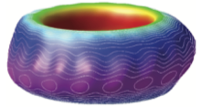

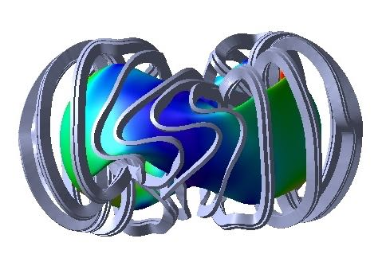
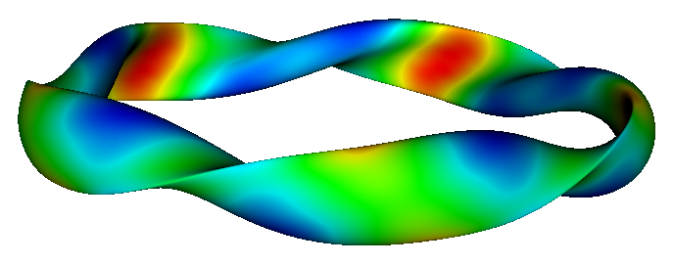
3D systems have both external and hidden symmetries
External symmetries
Hidden symmetries – stellarators
  Transform to Boozer coordinates => GC orbit trajectories depend only on |B|
  |B| ~ f(ѱ,M𝛳-N𝜻) M = 0 (poloidal quasi-symmetry), N = 0 (toroidal quasi-symmetry), N/M = rational number (helical quasi-symmetry)
  Omnigeneity – drift optimization, piecewise omnigeneity => more flexibility than quasi-symmetry
Device | Field period symmetry | Reflection symmetry
Tokamak with ripple | N_{fp} ~ 18 | N_{fp} fold anti-reflection symmetry Flux surface covering field lines + islands
Tokamak with ripple + up-down asymmetry | N_{fp} ~ 18 | None
Tokamak with ripple + ferritic materials | N_{fp} ~ 1 to 3 | None
Stellarator | 1 < N_{fp} < 12 | N_{fp} fold anti-reflection symmetry Flux surface covering field lines + islands
Bumpy torus/square, Drakon | N_{fp} ~ 20 | N_{fp} fold reflection symmetry closed field lines – no islands

Slide 4
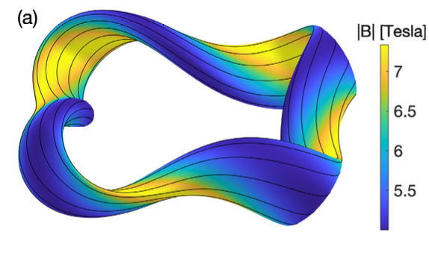
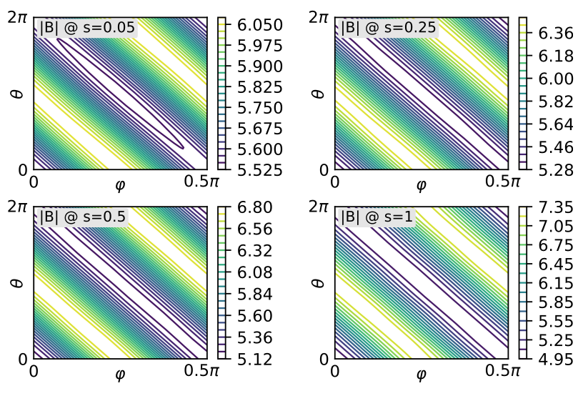
Optimized stellarators strive for “hidden symmetries” to improve confinement => flux surfaces are not symmetric, but B in Boozer coordinates reduces to a 2D function
QH (helical symmetry example from Landreman, et al. (2022)

Slide 5
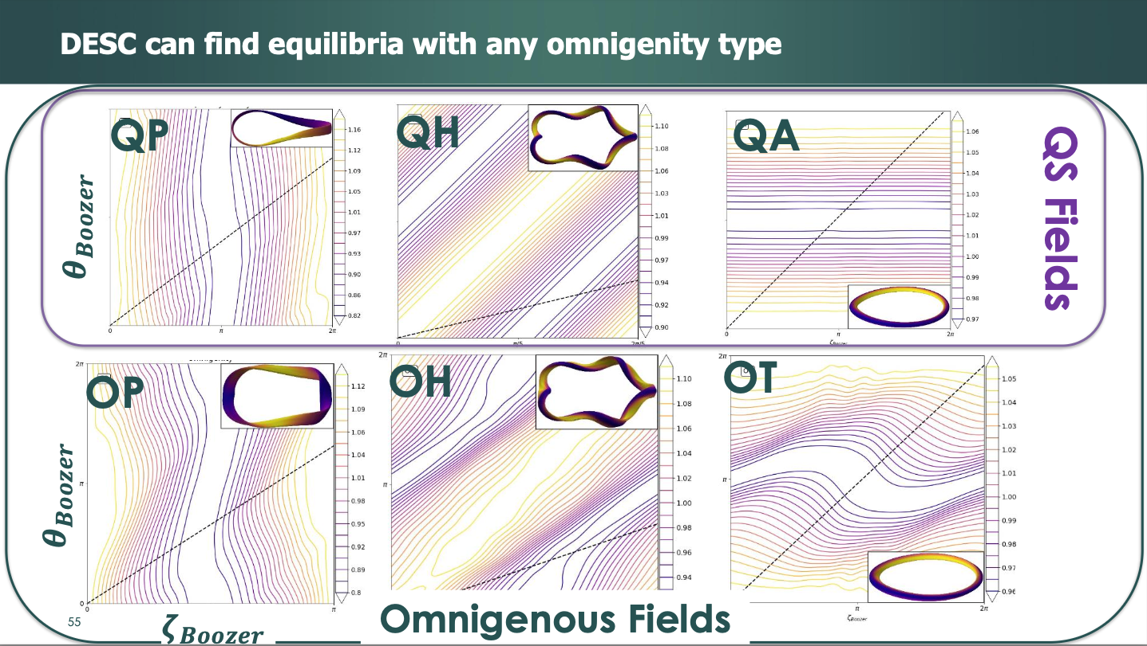
From February, 2024 presentation by Dario Panici, “Stellarator Equilibrium and Optimization with DESC”

Slide 6
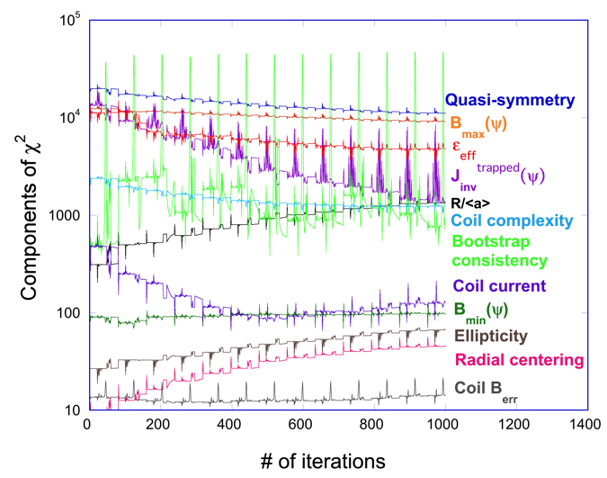
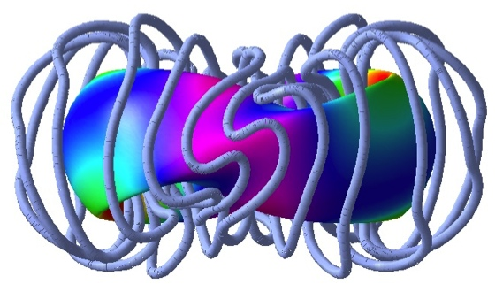
Stellarators can be synthesized to achieve physics goals
Coils outer magnetic surface shape physics properties
3D shapes open up very large design space: ~ 40 independent parameters (A. Boozer, L. P. Ku, 2010) based on SVD analysis
Axisymmetric tokamak shape parameters: 𝜀, 𝜅, 𝛿
Thought experiment: quantize shape parameters into 10 levels
  10³ 2D configurations vs. 10⁴⁰ 3D configurations => “combinatorial explosion”
  Other large numbers: 7x10²² visible stars, 6x10³⁰ prokaryotes (bacteria) on earth’s surface
STELLOPT, SIMSOPT,
DESC, ROSE, …
Adjust plasma
boundary
or coil geometry shape
Solve 3D
equilibrium
Calculate
𝝌² (physics + engr. targets)
Levenberg-Marquardt
or other method used to minimize 𝝌²

Slide 7
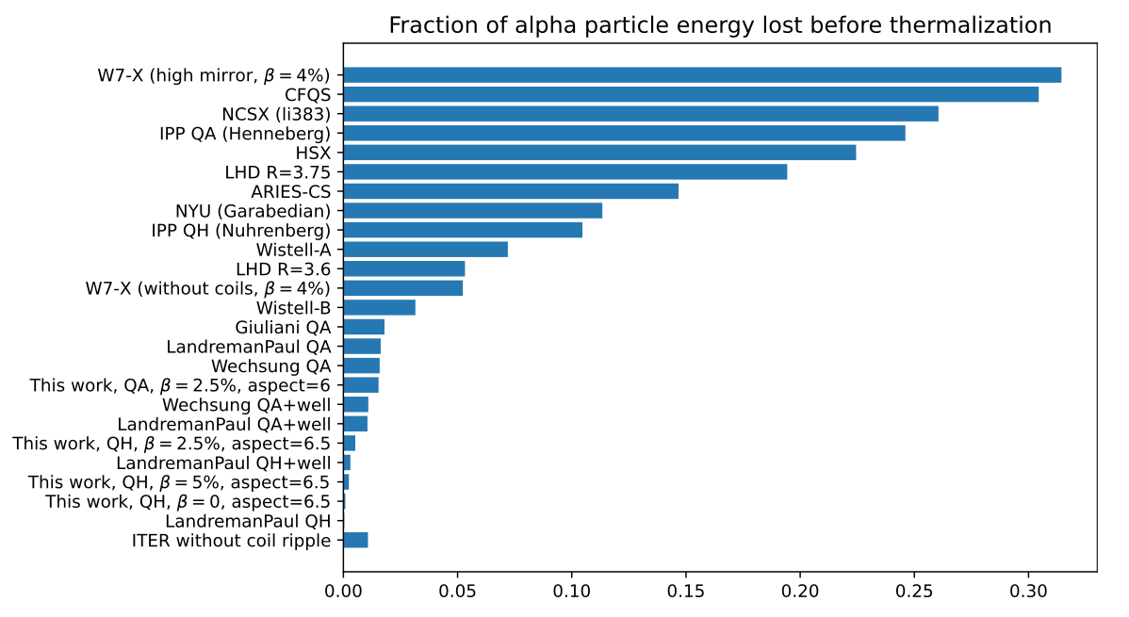
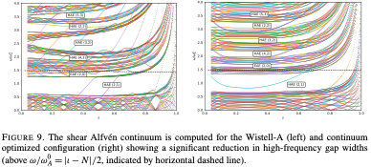
Stellarators have been successfully optimized for EP confinement issues
M. Landreman, et al. (POP, 2022) good alpha particle confinement in optimized stellarators
E. Paul, et al. (JPP, 2025) HAE gap narrowing by shape optimization
FAR3d based optimization of AEs initiated (2026), N. Ambadipudi, D. Spong, J. Larson:

Slide 8
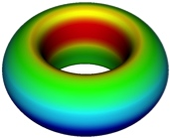
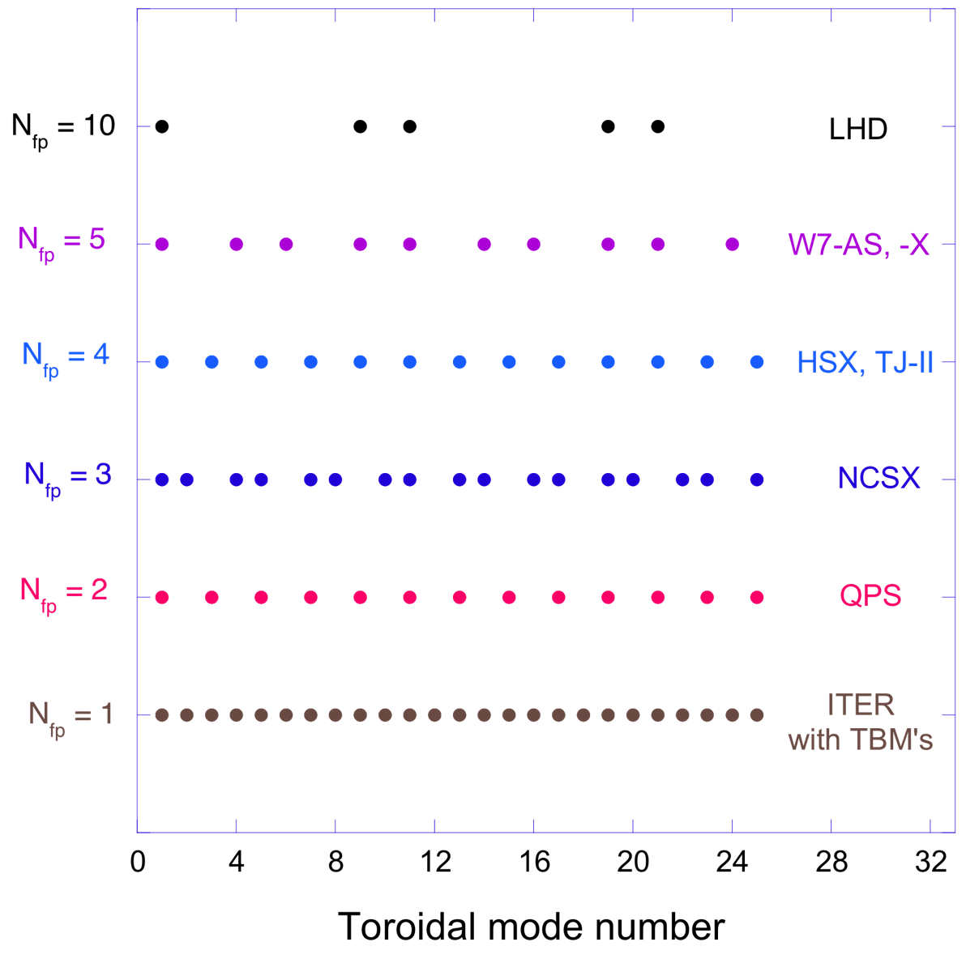
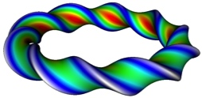
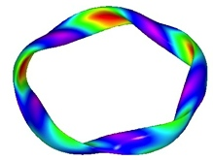
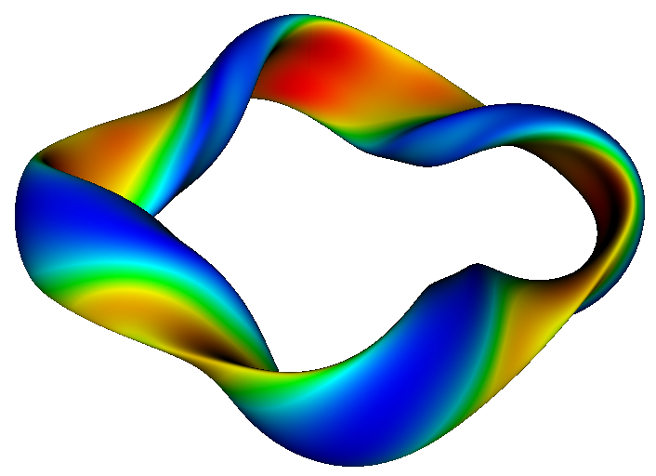
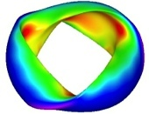
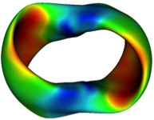
For 3D configurations the toroidal mode number (n) is not a good quantum number
n = ±1 mode families
N_{fp}=> ∞
Field period symmetry: N_{fp} replicated elements
Toroidal coupling => mode families, rather than single toroidal modes:
  n’ ± n = kN_{fp}, k = 0, 1, 2, …
10 families
5 families
4 families
3 families
2 families
1 family
/DIII-D

Slide 9
For 3D configurations the toroidal mode number (n) is not a good quantum number
n = ±1 mode families
N_{fp}=> ∞
Field period symmetry: N_{fp} replicated elements
Toroidal coupling => mode families, rather than single toroidal modes:
  n’ ± n = kN_{fp}, k = 0, 1, 2, …
10 families
5 families
W7-X
4 families
WISTELL-D
3 families
2 families
1 family
/DIII-D

Slide 10
Alfvén instability drive in stellarator reactors can potentially be mitigated by high density operation
Stellarators significantly exceeded the tokamak density limits
  LHD has demonstrated peak densities of ~ 4.5 x 10²⁰ m⁻³
    Super-dense core regime, N. Ohyabu, T. Morisaki, et al., Phys. Rev. Lett. 97 (2006)
  W7-AS demonstrated ~ 3 x 10²⁰ m⁻³
    HDH regime, R. Jaenicke, S. Baeumel, J. Baldzuhn, et al., PPCF 44 (2002).
Alpha slowing-down time inversely proportional to density
  high density shortens slowing-down time, lowers EP instability drive
However, stellarator designs tend toward higher aspect ratio
  At same fusion power output => smaller <a>, stronger 𝛼 gradients
Current optimized stellarators => low shear iota profile
Alpha physics tests: tokamaks => ITER, stellarators => ? Need to model AE stability boundaries vs. density

Slide 11

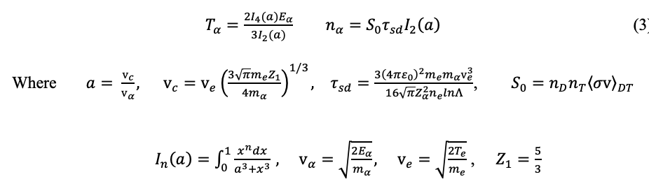
The effect of increasing density: linear stability study of WISTELL-D along constant fusion power contours
(D. Spong, et al. 2026 submitted to JPP)
Contours of constant fusion power => determine plasma density and temperature:
From steady-state slowing-down formulas Estrada-Mila, J. Candy, R. Waltz, Phys. Plasmas 13 (2006) all relevant alpha particle parameters are determined from n_{e}, T_{e}

Slide 12
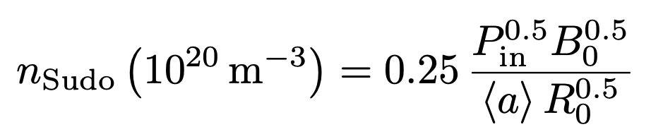
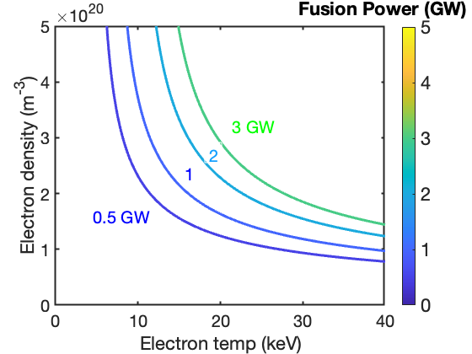
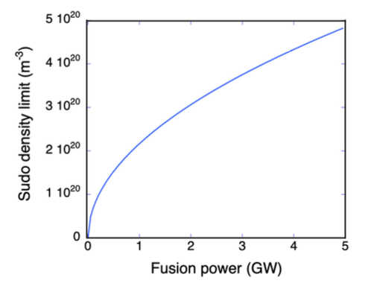
The parameter space for reactor EP instability studies is minimized by following constant fusion power contours
WISTELL-D, P_{in} = P_{fus}/5

Slide 13
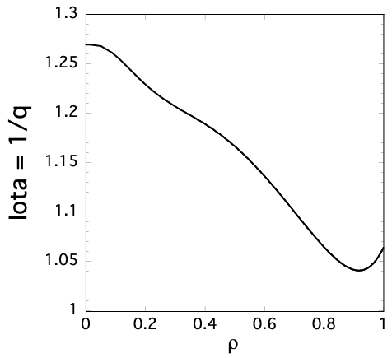
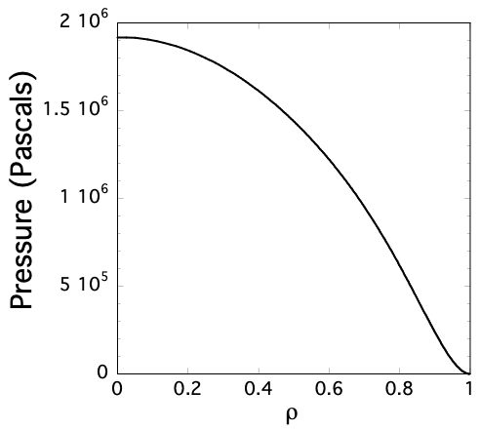
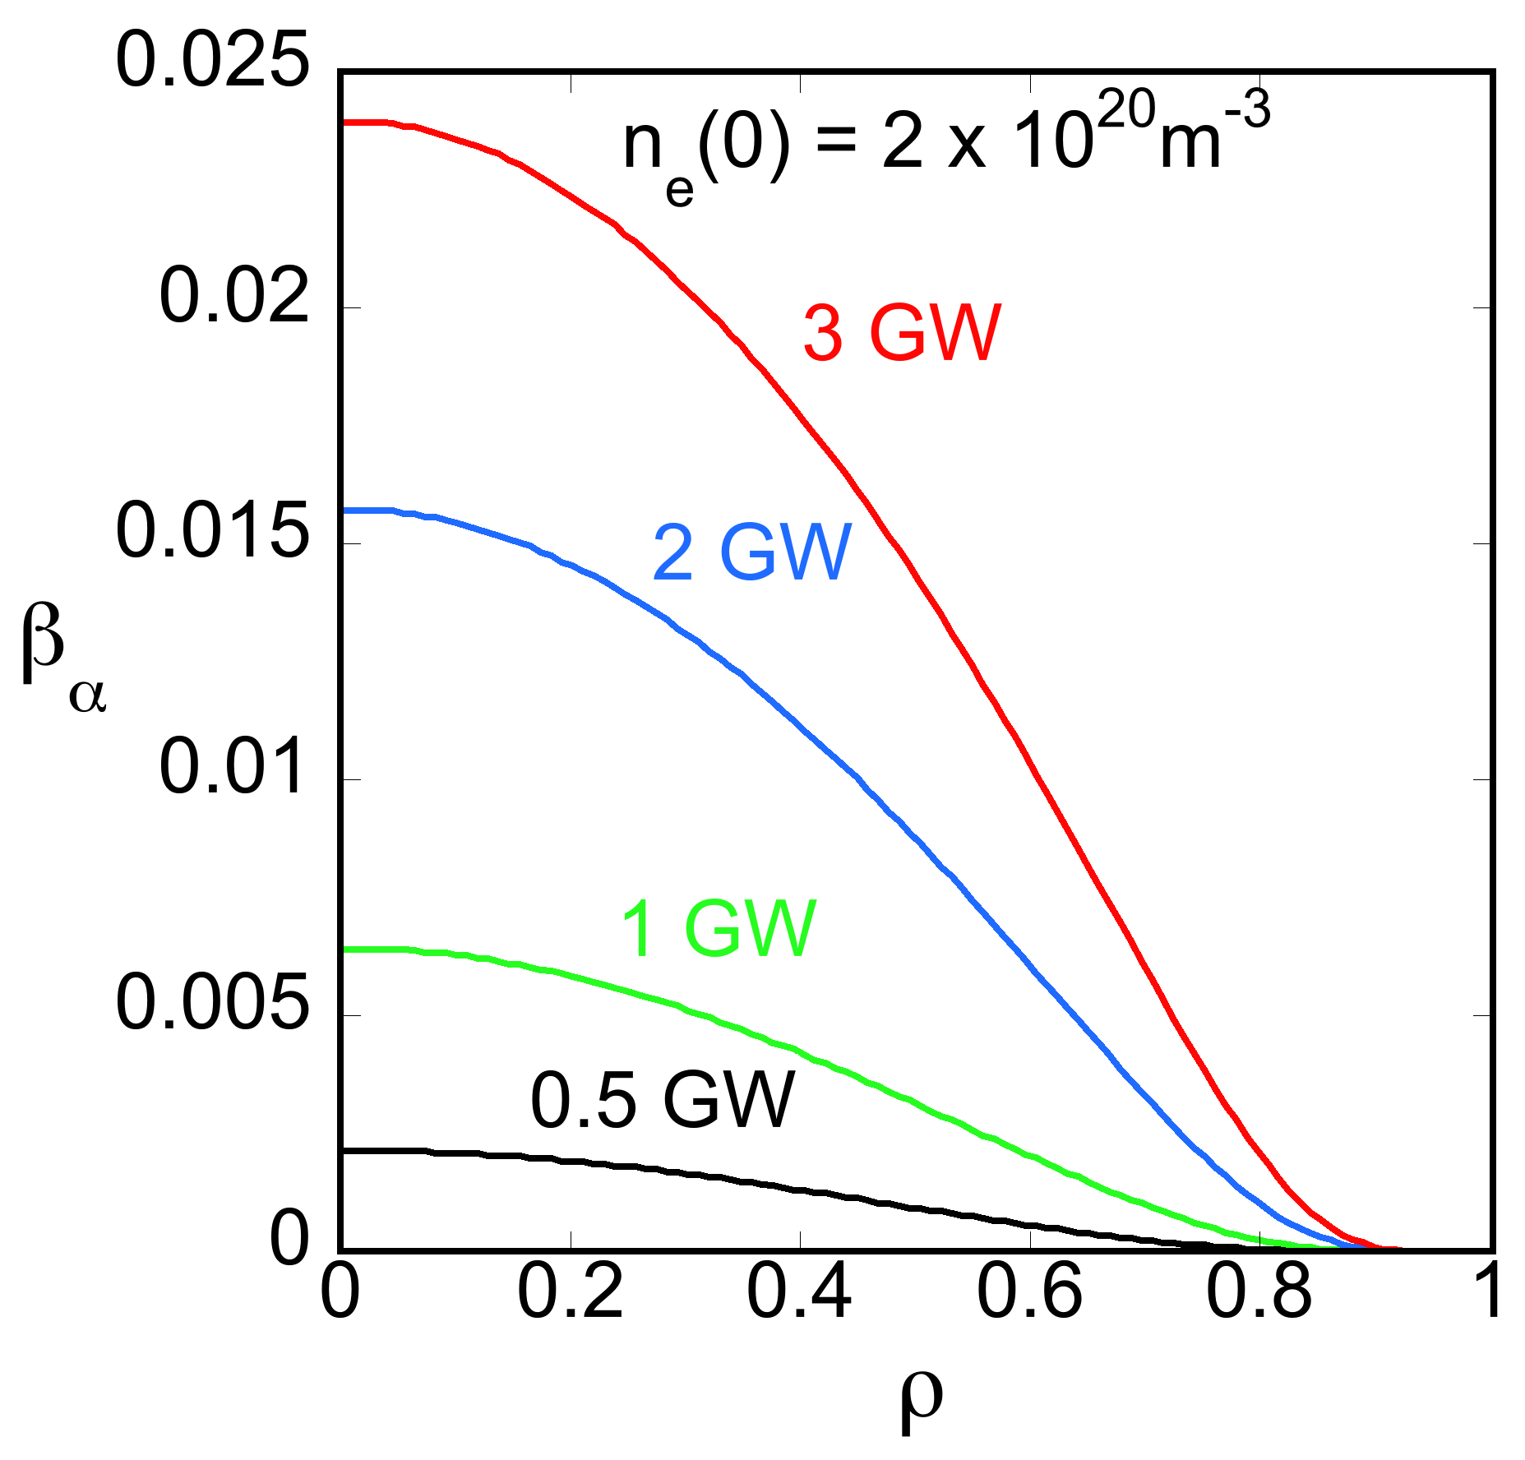
Iota and pressure profiles derived from the equilibrium, n_{e}, T_{e} inferred from pressure: n_{e} = n_{e0} (p/p₀)^{𝜹}, T_{e} = T_{e0} (p/p₀)^{(1-𝜹)}, T_{i}=T_{e}, 𝜹 = 0.3. Alpha parameters from slowing-down formulas
Rotational transform = 1/q
Equilibrium pressure (Pascals)
β_{𝛼} profiles

Slide 14
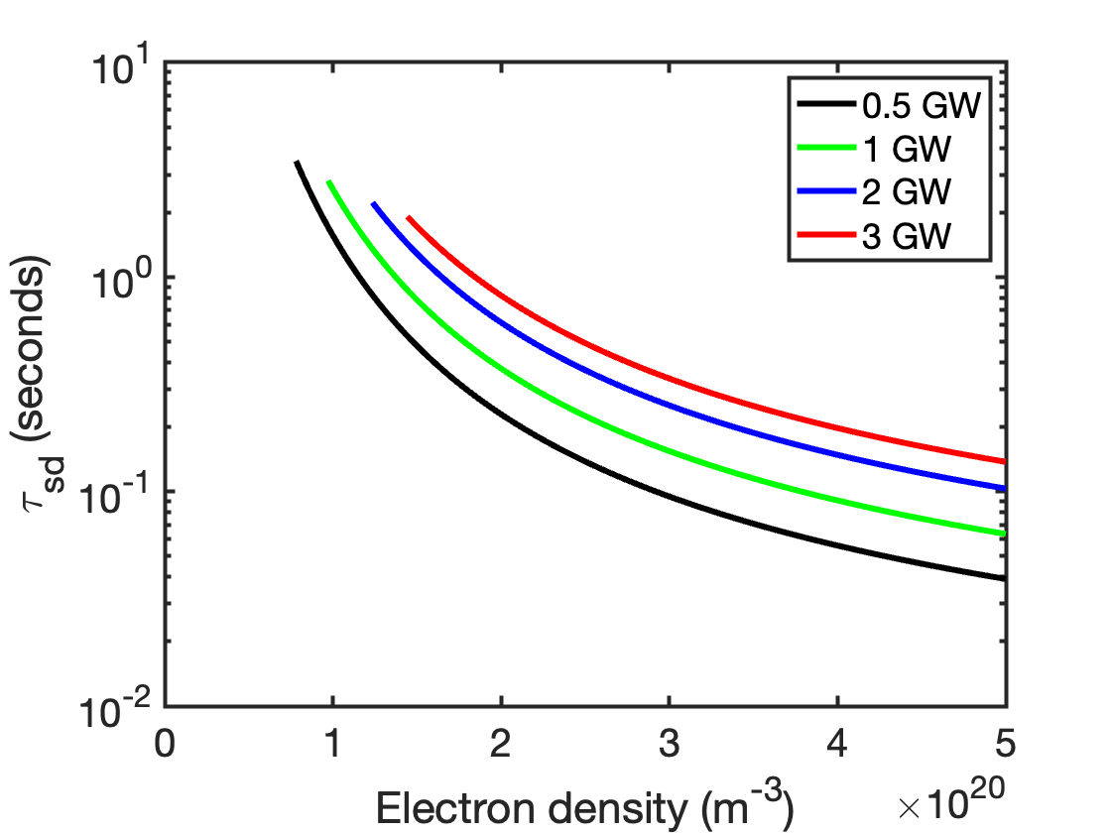
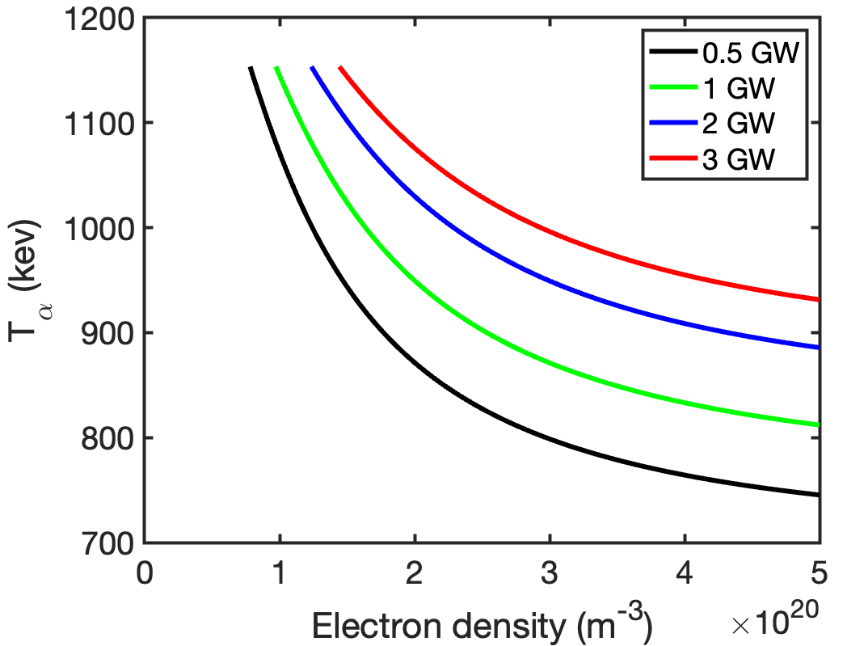
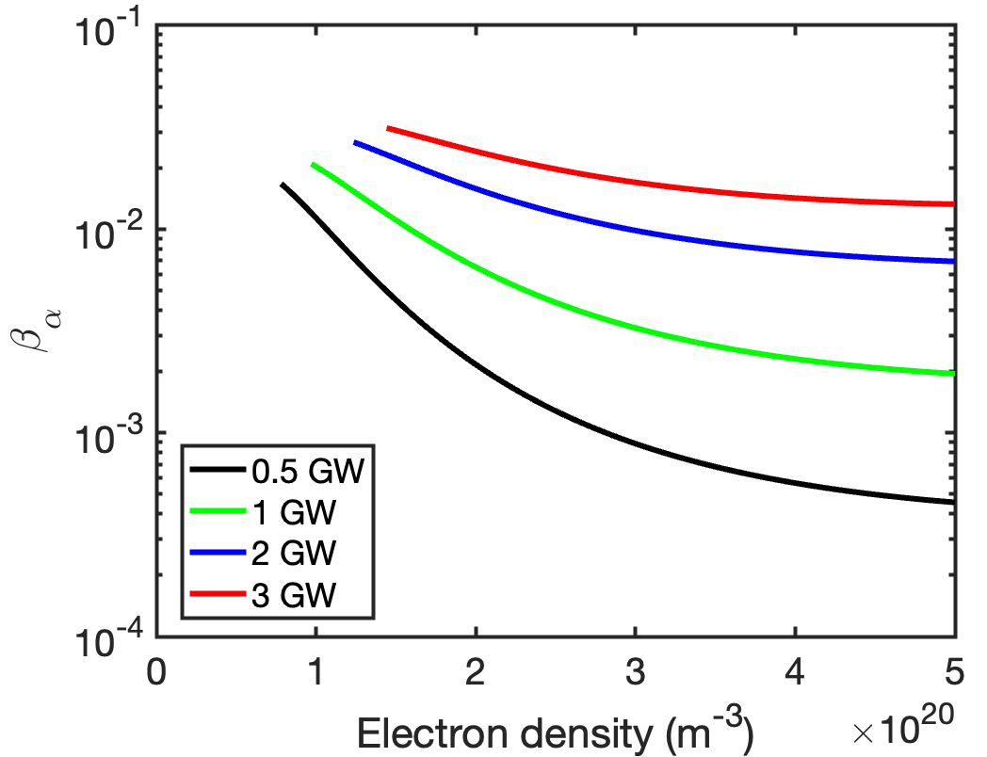
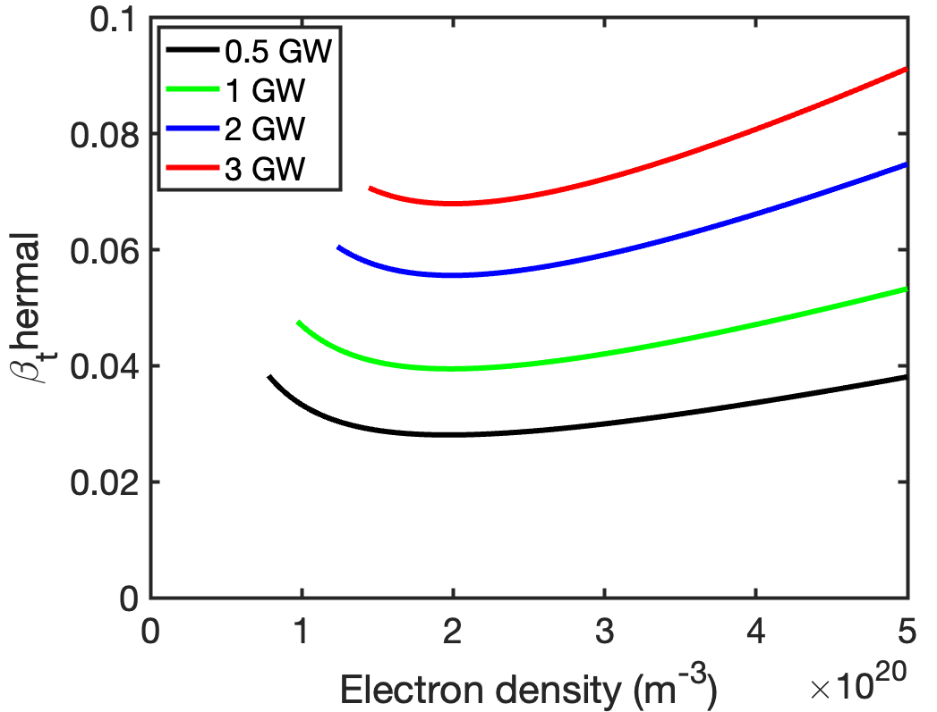
AE drive weakens with increasing density along constant fusion power contours

Slide 15
For the density scan study, we use the reduced dimensionality model FAR3d
Landau closures [as introduced by Hammett, Perkins (1990)] => linear fast ion resonance effects
Used in several other EP stability models (TAEFL, TGLF-EP, MAS)
Includes linear ion and EP FLR effects (Padé form), thermal ion/electron Landau damping, compressibility, 2-fluid option
Applied to tokamaks, stellarators, RFPs
Linear/Nonlinear options; initial value/eigenvalue options
  Nonlinear saturation - convective and JxB nonlinearities drive profile changes, zonal flows/zonal currents
Checked against other codes for tokamaks: S. Taimourzadeh (2019)
Review paper: J. Varela, D. Spong, et al., Frontiers in Physics (2024)

Slide 16
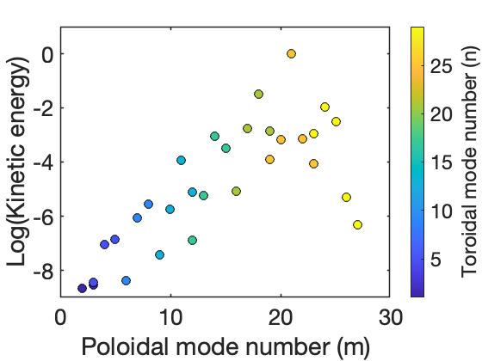
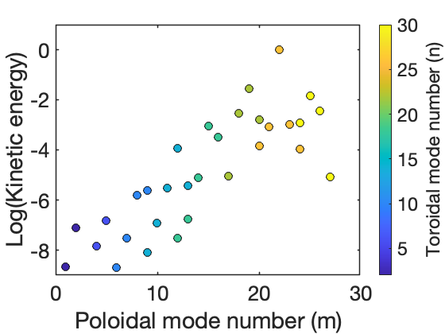
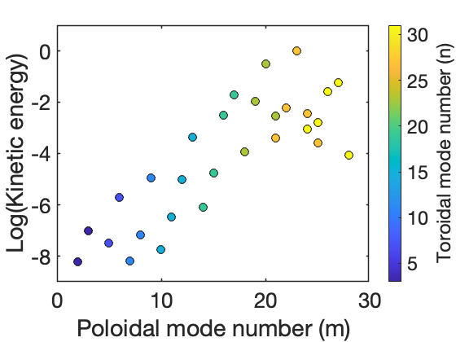
Poloidal/toroidal mode number distribution: chose to provide dropoff in volume averaged kinetic energy
=> Dominance of high mode number range (m ~ 22, n ~ 25) in reactor regime
n = 1 mode family
n = 2 mode family
n = 3 mode family

Slide 17
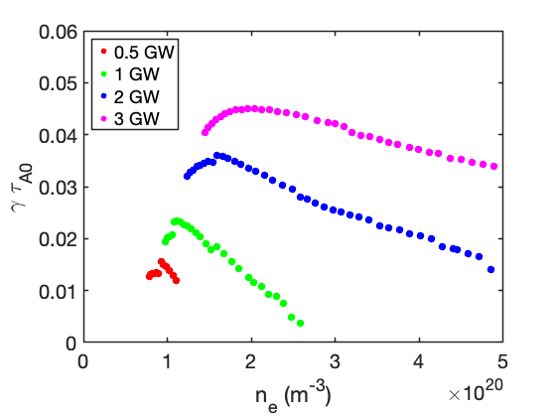
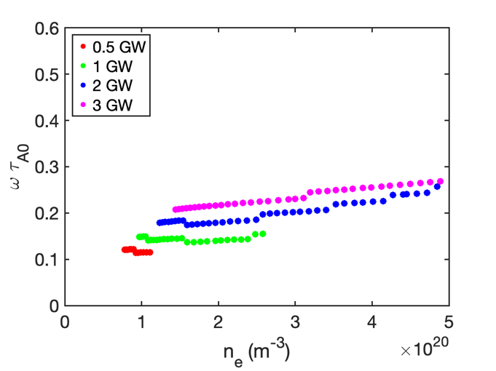
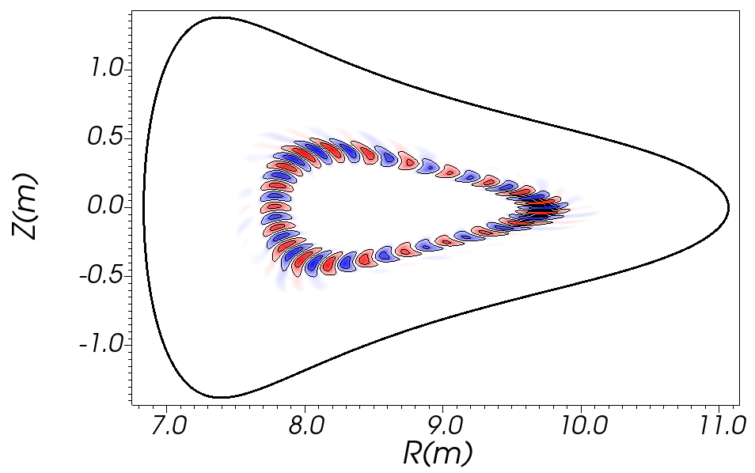
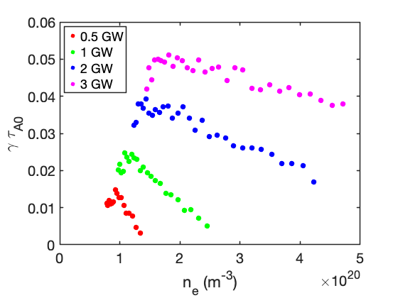
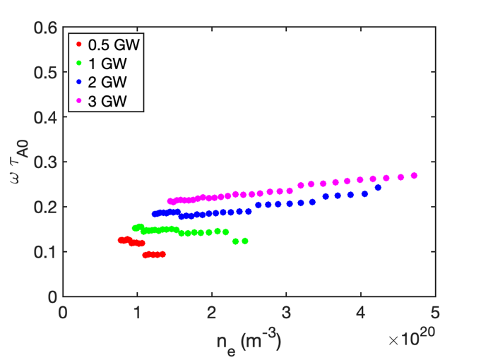
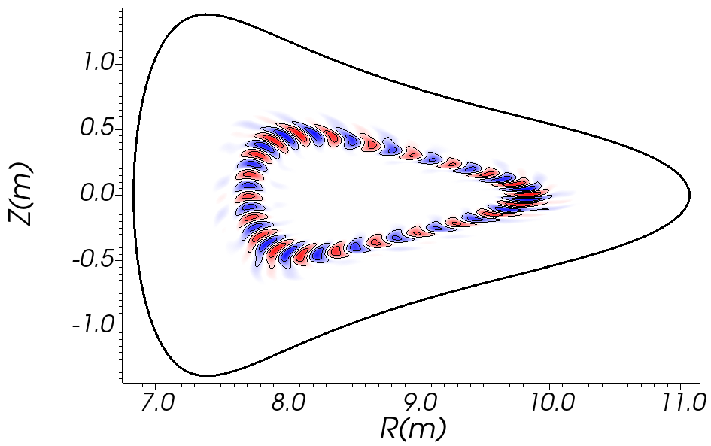
AE stability analysis indicates stabilization above densities of ~ 2.5 x 10²⁰ m⁻³ for reactor power levels up to 1GW
Growth rates
Frequencies
Mode structures
n = 1
family
n = 2
family

Slide 18
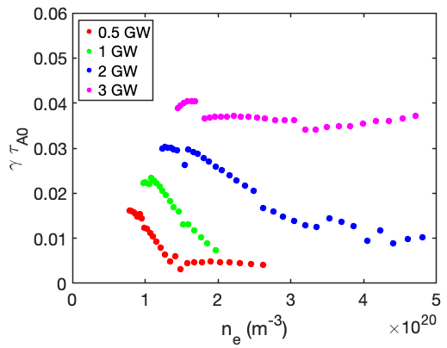
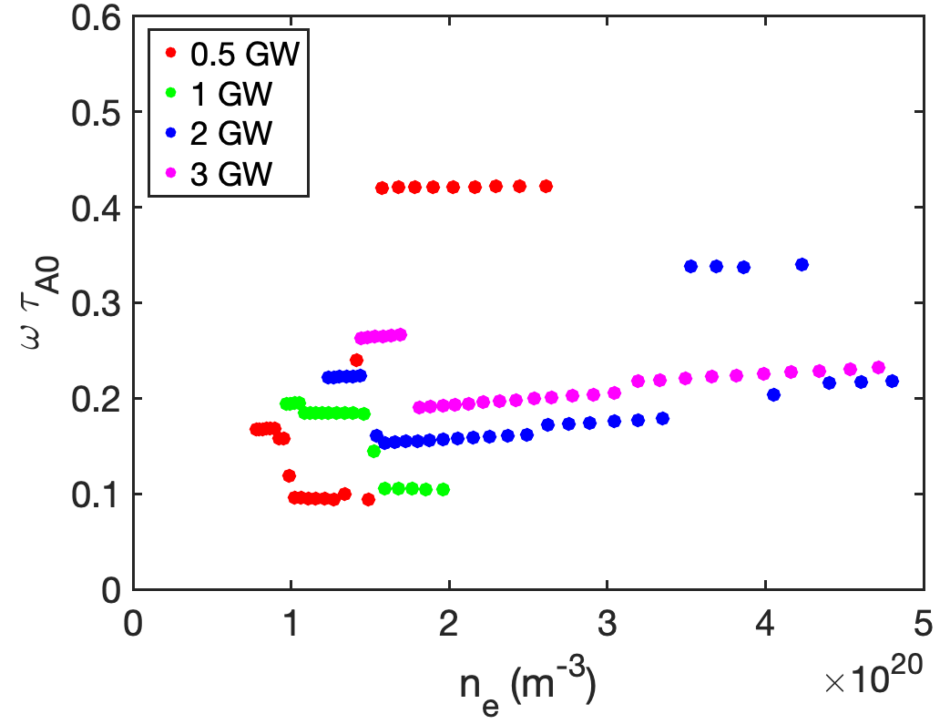
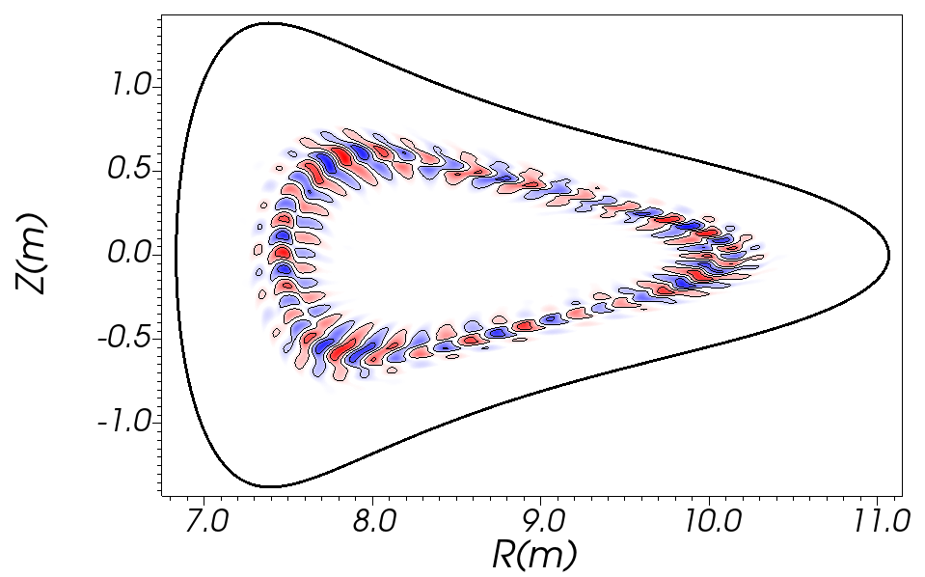
AE stability analysis indicates stabilization above densities of ~ 2.5 x 10²⁰ m⁻³ for reactor power levels up to 1GW
Growth rates
Frequencies
Mode structures
n = 3
family
Key results from linear stability analysis:
For P_{fus} = 0.5 and 1 GW, growth rates are small or 0 above n_{e0} ~ 2.5 x 10²⁰ m⁻³
For P_{fus} = 2 and 3 GW, instability remains up to highest density 5 x 10²⁰ m⁻³
Mode structures localized in 𝜌/<a> ~ 0.4 to 0.7 interval
Frequencies in 𝜔_{real} ~ 0.1 to 0.4 region

Slide 19
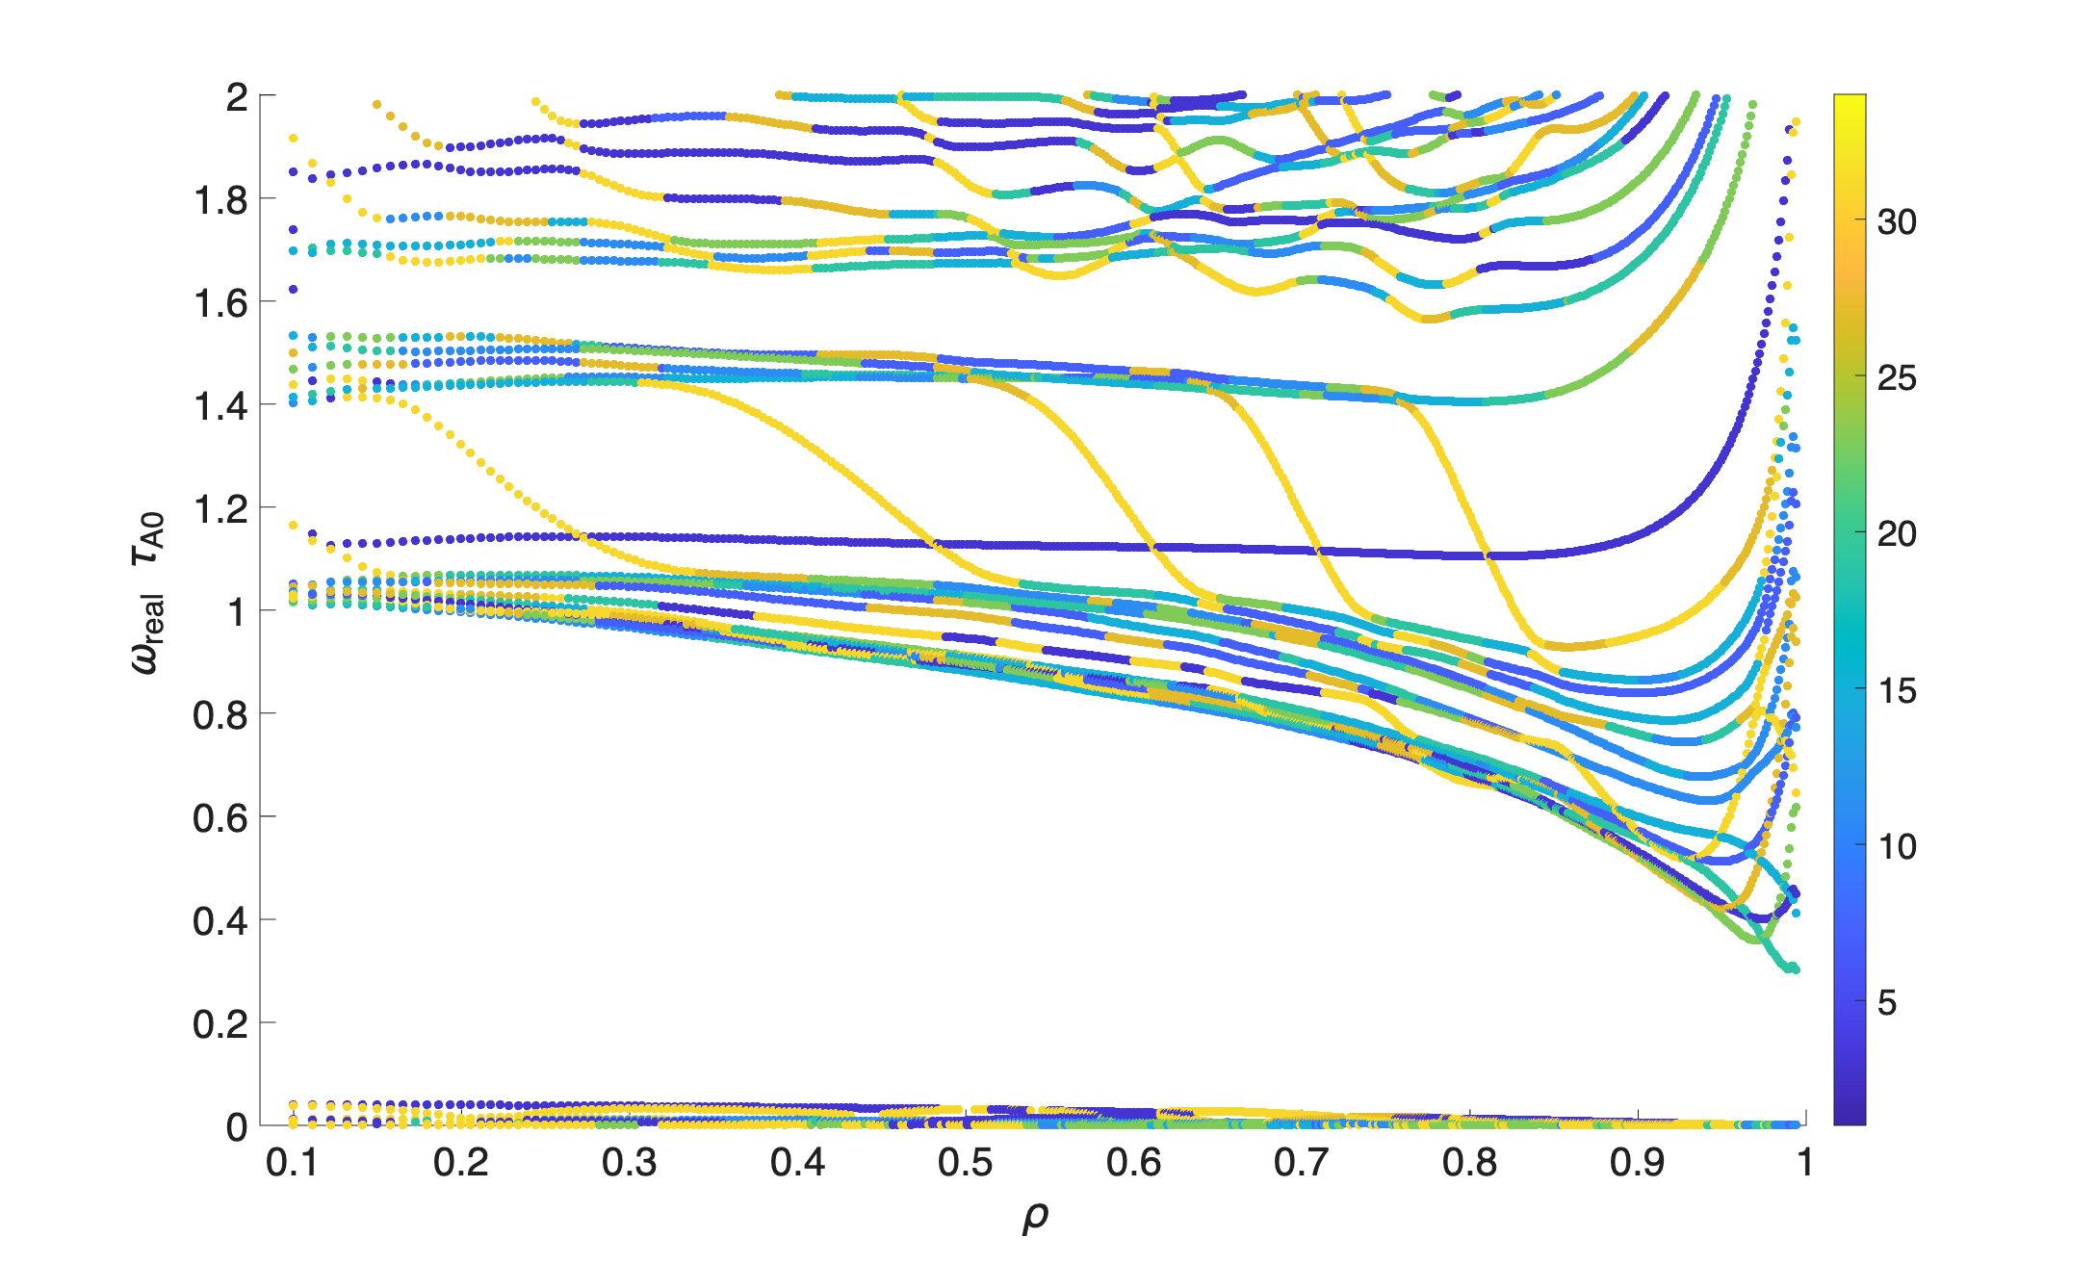
The unstable AE modes reside in the Beta-induced Alfvén gap: suggests optimization methods should focus on this region
Alfvén continuum for the n = 3 mode family at n_{e}(0) = 4.7 x 10²⁰ m⁻³ and T_{e}(0) = 12 keV
Region occupied by unstable modes

Slide 20
Nonlinear simulations
Reactor-scaled W7-X
Wistell-D

Slide 21
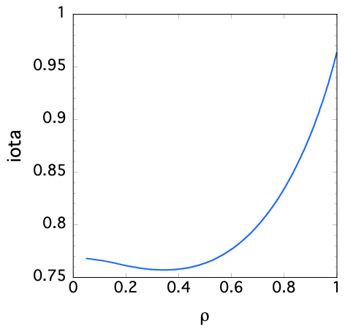
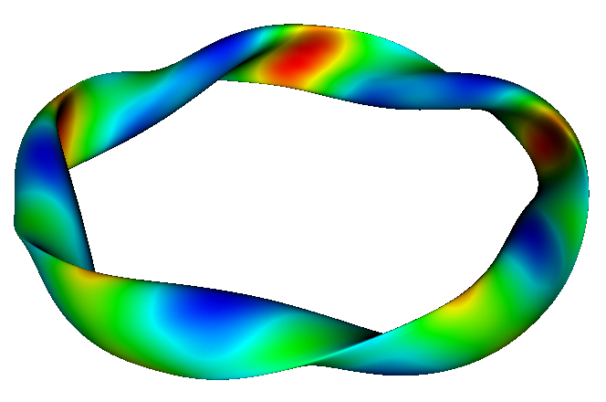
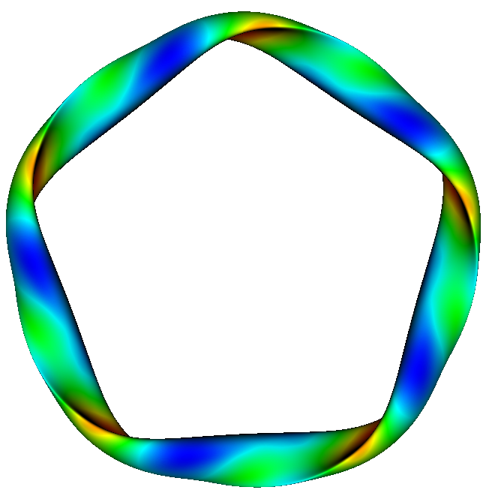
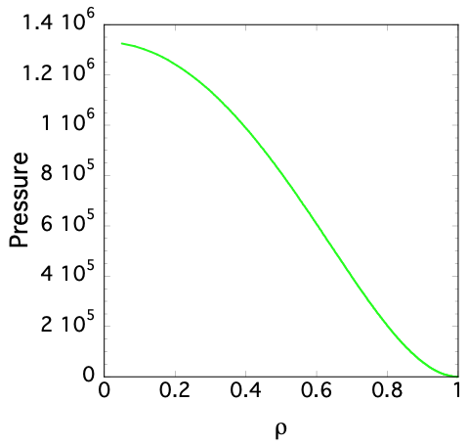
FAR3d nonlinear simulations (enlarged W7-X)
<B> = 5 Tesla, R₀ = 22m, <a> = 2.1m, Volume = 1907 m³, Surface area = 2241 m² Rescaled version of W7-X to reactor parameters

Slide 22
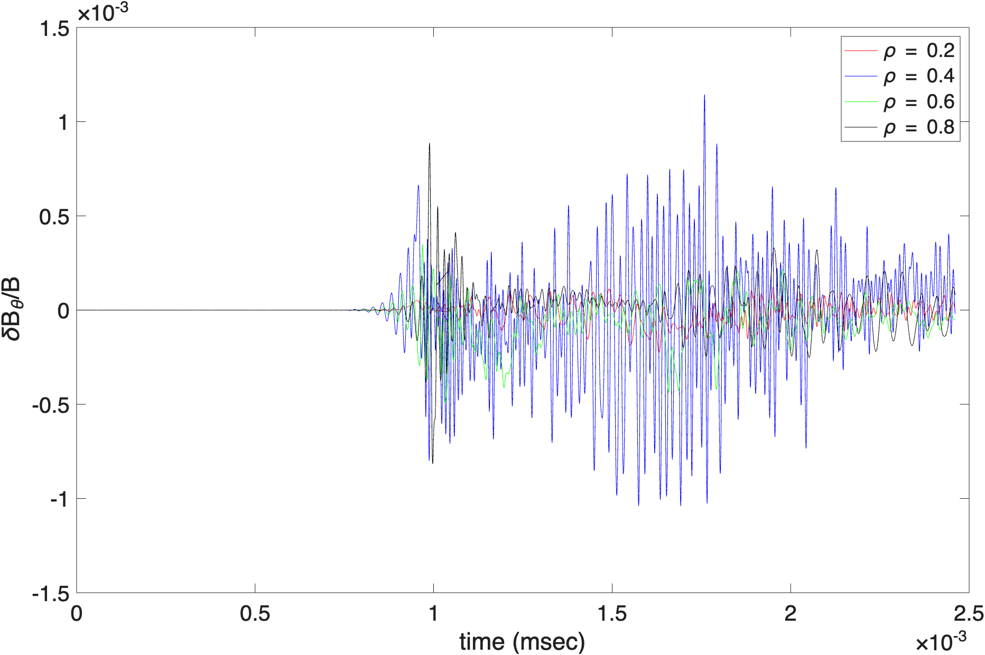
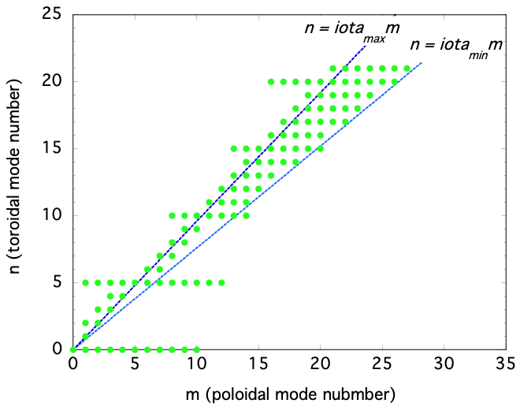
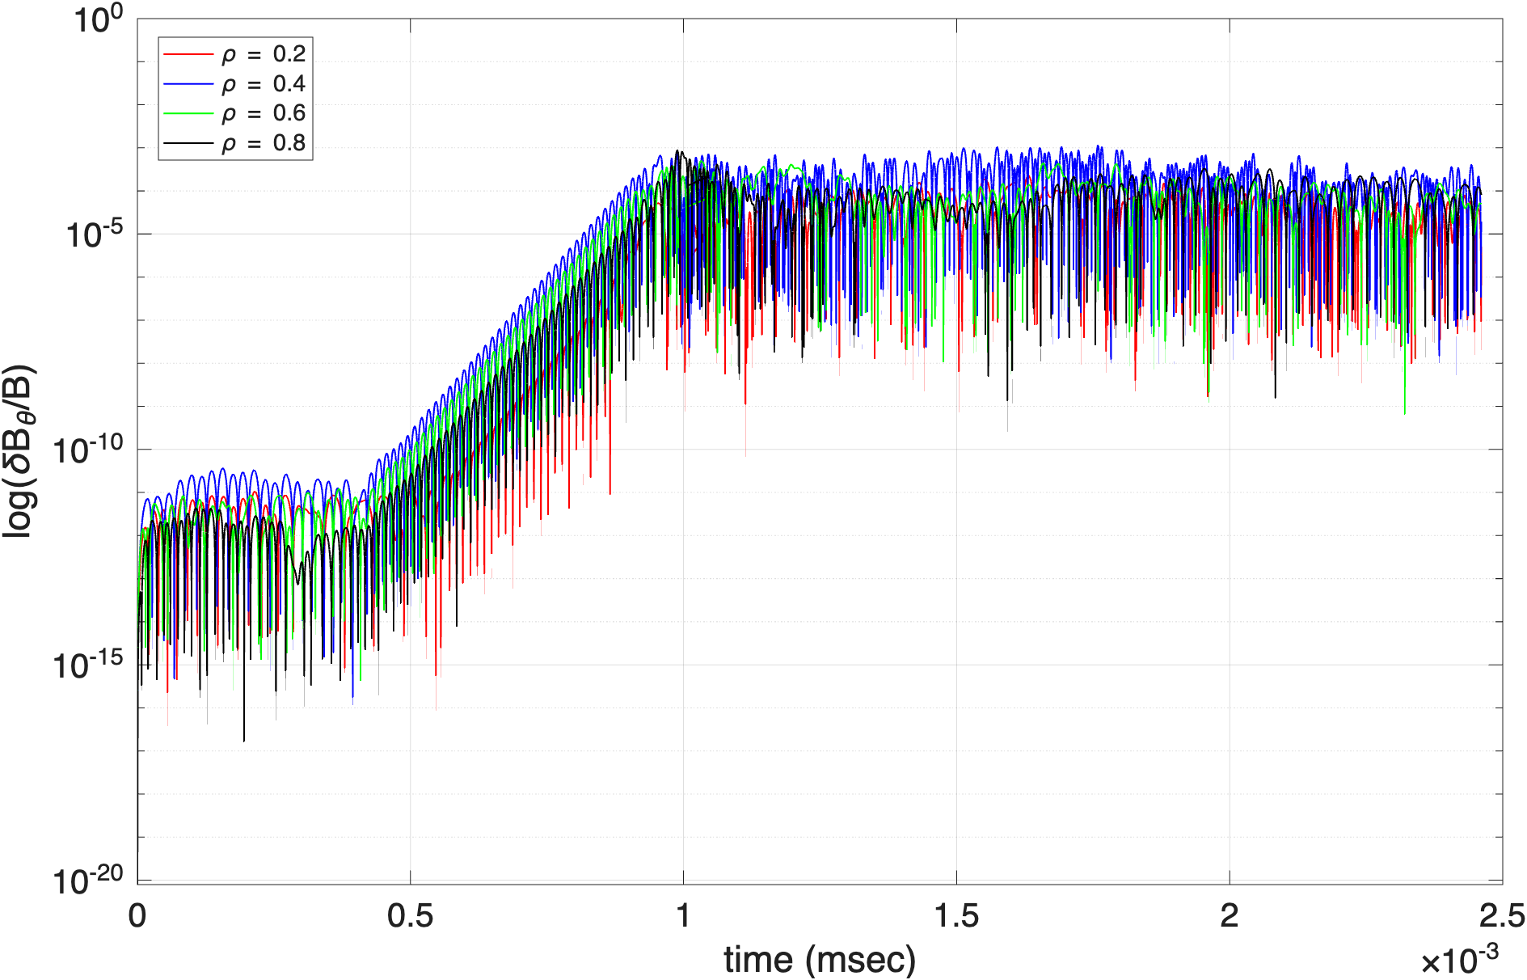
Internal magnetic fluctuations at 4 different radial locations show 𝜹B_{𝛳}/B₀ in the range < 10⁻³, typical of experiments
223 m/n modes are used and 400 radial grid points
Initial
phase
Exponential growth phase
Nonlinearly saturated phase

Slide 23
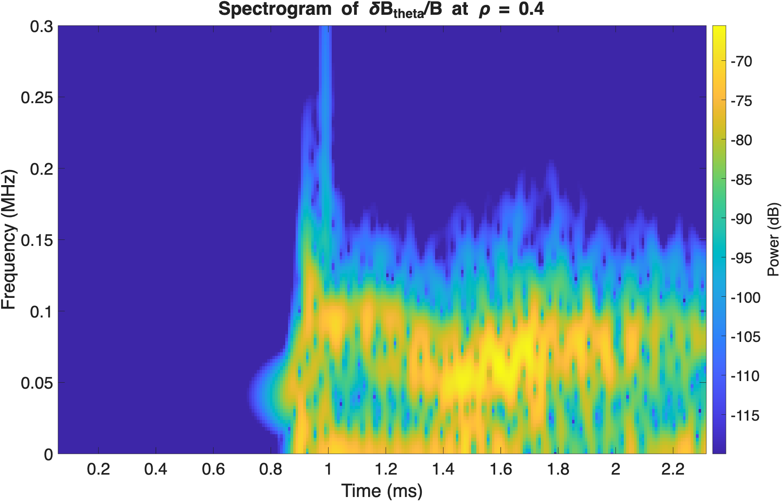
The magnetic fluctuations are FFT’d in a moving time window (spectrogram), indicating dominant frequencies
100kHz
75kHz
50kHz
10kHz

Slide 24
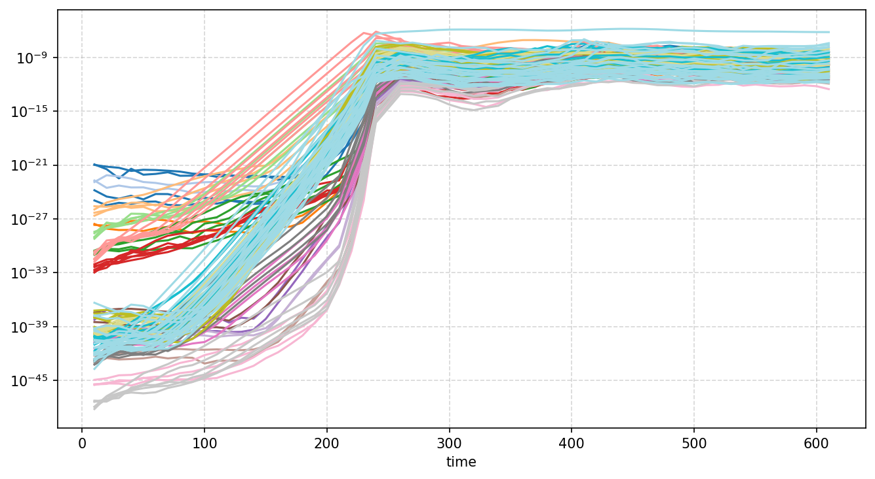

Kinetic energy (perpendicular) evolution (volume-averaged)
Equilibrium (n = 0, 5, 15, 20) mode family

Slide 25






2D potential function slice at ζ = π/10 show a mode (m = 26 – 28) in linear regime that collapses down to m = 2 to 12 nonlinearly
t = 0.44 msec
t = 1.05 msec
t = 0.56 msec
t = 1.33 msec
t = 0.97 msec
t = 1.65 msec

Slide 26

The evolving alpha density profile shows mild flattening in several regions due to AE-driven transport
local
flattening
local
flattening

Slide 27



Fluxes can be derived from profile changes – flux gradient relations show nonlinear, non-diffusive nature of instability driven alpha transport
Flux-gradient relation
Instability-driven flux
Non-diffusive transport can be modeled using integral kernel¹ approach or ML surrogate²
Alpha
20 m²/sec
¹D. del-Castillo-Negrete, 2010 Nonlinear Process Geophys. ²Y. Ghai, arXiv:2606.15512

Slide 28


FAR3d nonlinear simulations (WISTELL-D)
<B> = 8.1 Tesla, R₀ = 10.1m, <a> = 1.25 m, 4 field periods, Volume = 439 m³, Surface area = 832 m² - Reactor version of WISTELL-A

Slide 29


Internal magnetic fluctuations at 4 different radial locations show 𝜹B_{𝛳}/B₀ in the range < 10⁻³, typical of experiments
= Parameters for nonlinear case
𝜹B_{𝛳}/B₀
𝜹B_{𝛳}/B₀
Exponential growth phase
Nonlinearly saturated
phase

Slide 30

Spectrogram of frequencies at 𝝆 = 0.3 in nonlinear regime shows several modes coexisting
110kHz
50kHz
25kHz

Slide 31

Magnetic energy (perpendicular) evolution (volume-averaged) shows n = 0 family driven by n > 0 modes
Equilibrium (n = 0, 4, 16, 20) mode family
0.5 msec
1.1msec

Slide 32






2D potential mode structure evolution indicates shearing and a collapse to lower mode numbers (m ~ 18 drops down to m = 2 – 4)
t = 0.18 msec
t = 0.78 msec
t = 0.37 msec
t = 0.82 msec
t = 0.55 msec
t = 1.0 msec

Slide 33

The evolving alpha density profile shows mild flattening in several regions due to AE-driven transport
local
flattening
local
flattening

Slide 34


Fluxes can be derived from profile changes – flux gradient relations show nonlinear, non-diffusive nature of instability driven alpha transport
Instability-driven flux
Flux-gradient relation
Alpha
10 m²/sec

Slide 35


The zonal flow and zonal flow shearing rate show sustained amplitudes near 𝜌 ~ 0.3 and 0.7 near where the BAE mode induced density flattening was large.
Zonal flow velocity
Zonal flow shearing rate

Slide 36



Nonlinear simulations for the power scan are underway – magnetic energy growth reflects linear growth rates
Equilibrium (n = 0, 4, 16, 20) mode family
3GW
Higher n’s (n = 17, 18,19, 21)
2GW
1GW

Slide 37
Conclusions
Linear density scan (WISTELL-D)
Alfvén-stable regimes identified at n_{e0} ≥ 2.5 x 10²⁰ m⁻³ for P_{fus} ≲ 1 GW; at 2–3 GW instability persists up to 5 x 10²⁰ m⁻³
  Unstable modes in the BAE gap, localized at ρ/<a> ~ 0.4–0.7
  Stability boundaries depend on reactor configuration, magnetic field strength, and reactor size
Nonlinear simulations (reactor-scaled W7-X, WISTELL-D)
Many-mode saturated nonlinear simulations demonstrated, with δB_{θ}/B₀ < 10⁻³
Alpha particle and energy fluxes are non-diffusive and non-local
  A diffusive fit gives only a rough D ~ 10 m²/sec (WISTELL-D) to 20 m²/sec (reactor-scaled W7-X)
  ML surrogates or integral-kernel formulations needed in place of diffusion coefficients
Localized zonal flows are nonlinearly driven; shearing levels show they can supplement turbulence-driven zonal flows
Next steps
Nonlinear simulations of the 1–3 GW power scan are underway
Examine AE suppression by high density in other devices

