Slide 1

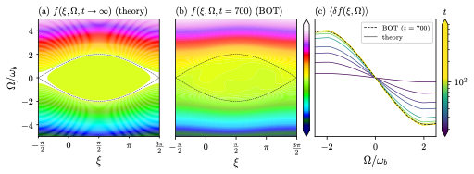
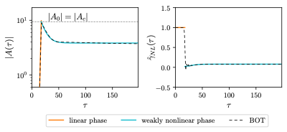
Nonlinear evolution of strongly driven perturbative kinetic instabilities
E. G. Devin & V. N. Duarte | Princeton University and Princeton Plasma Physics Laboratory
The 19th Technical Meeting on Energetic Particles in Magnetic Confinement Systems | 28 September 2026

Slide 2
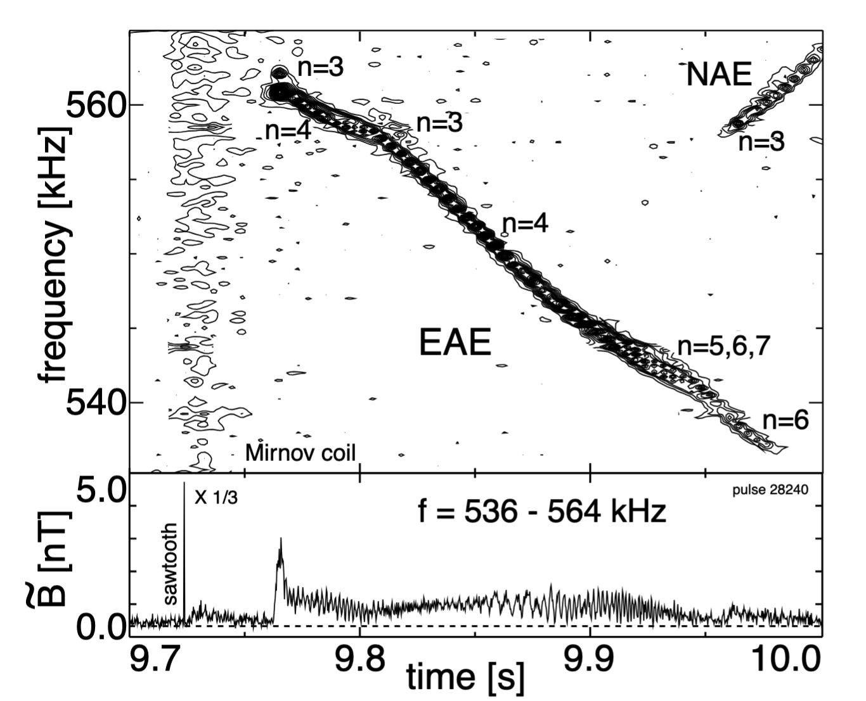
AEs are frequently excited following sawtooth crashes
Crash causes redistribution of fast ions and/or changes to the equilibrium → previously stable modes may be excited with very strong drive
E.g., in this JT-60U case¹:
  Crash time is ~100μs, very quickly changing the equilibrium and redistributing fast particles
  Mode growth time is ~ms
Nonlinear evolution of marginally stable interactions is theoretically established, e.g.^{2,3,4}
Analytical predictions of the saturation level in the strongly driven regime have been established^{5,6}; time evolution has not
EAE in JT-60U triggered by sawtooth crash, figure from¹
¹Kramer et al., NF (2001)
²Berk et al., PRL (1996)
³Wong et al., PoP (1997)
⁴Fasoli, et al., PRL (1998)
⁵Berk et al., Phys. Fluids B (1990)
⁶Petviashivili, Ph.D. Thesis (1998)

Slide 3
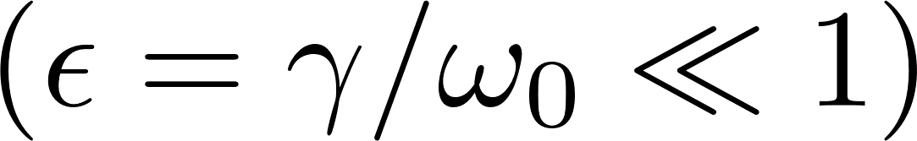
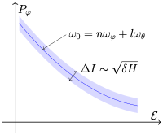

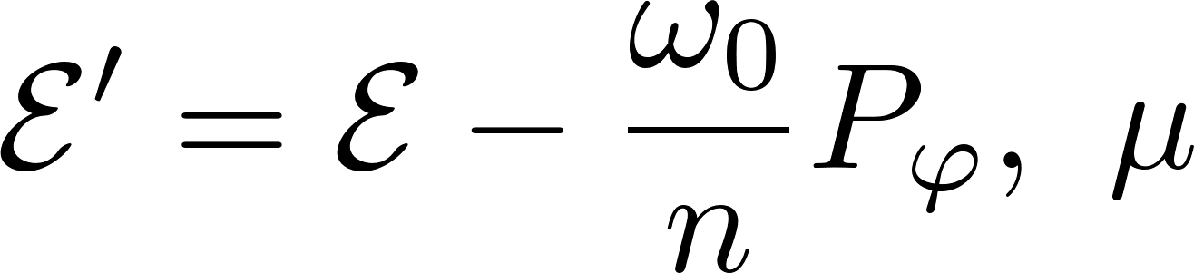
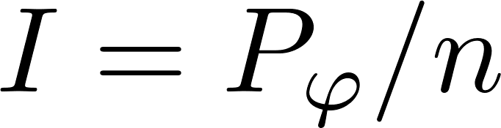
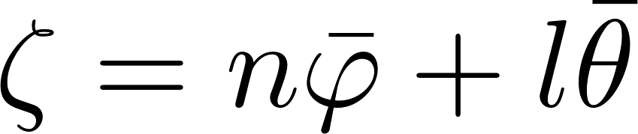
Theoretical framework for perturbatively driven AEs
Assume mode structure is not modified to leading order
Resonant interaction between particles satisfying resonance condition and a low frequency mode in a tokamak is described by two constants of motion¹:
All resonant dynamics occur along the action and angle²:
¹White. “Theory of Toroidally Confined Plasmas” (2014)
²Berk et al., Plasma Phys. Reports (1997)

Slide 4
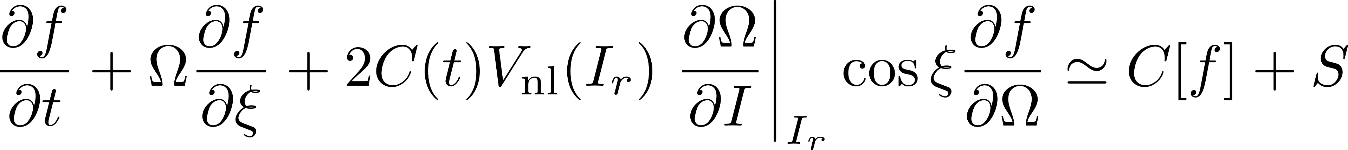
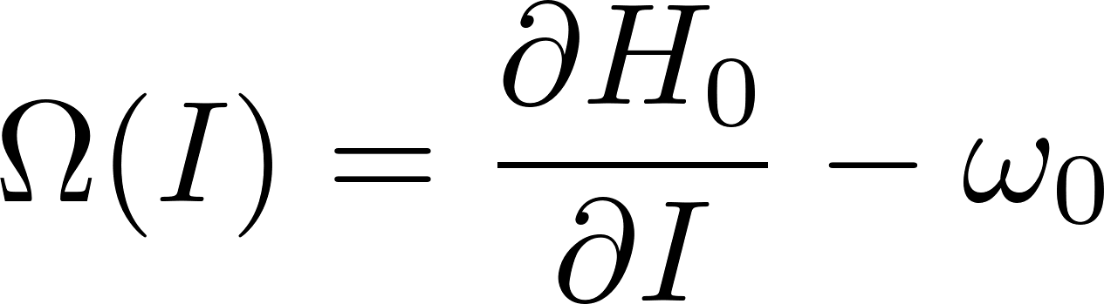
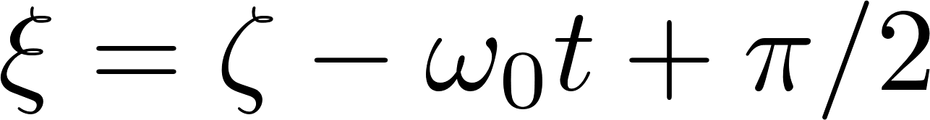
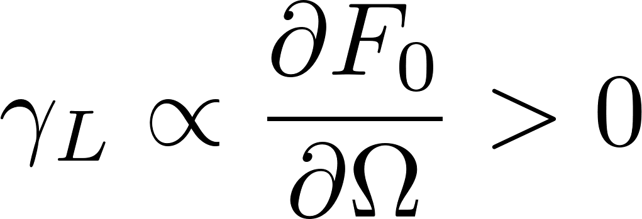
Theoretical framework for perturbatively driven AEs
Under these assumptions:
Fourier coefficient of perturbation H, evaluated at resonance center, dependent on mode structure
collision operator + EP source
f
wave amplitude
EP distribution function
damping rate, constant up to higher order terms
the rest of phase space
resonant contribution, time dependence
unperturbed equilibrium distribution
wave action
linear growth rate:
Berk et al., Plasma Phys. Reports (1997)

Slide 5
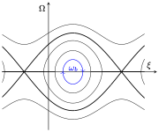
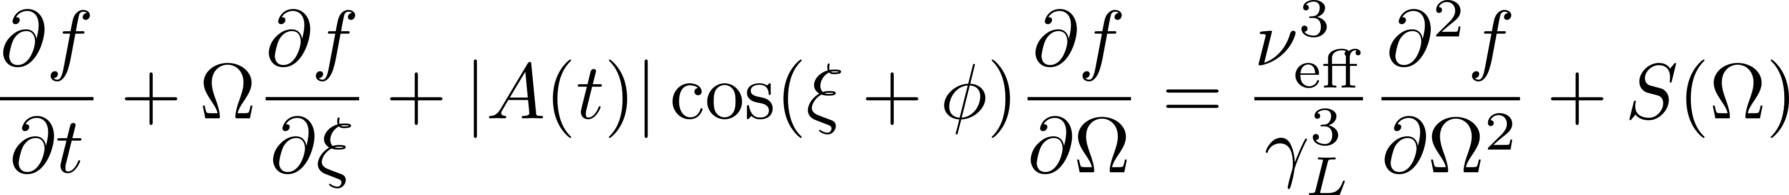
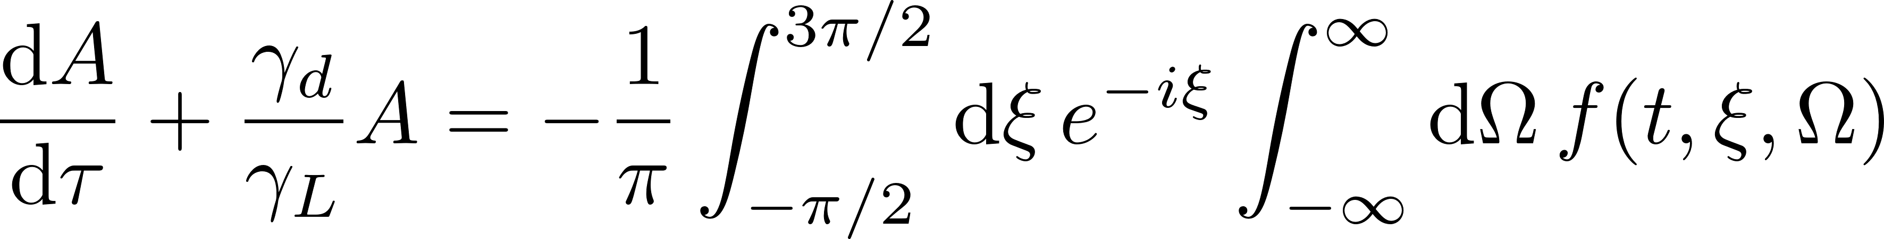
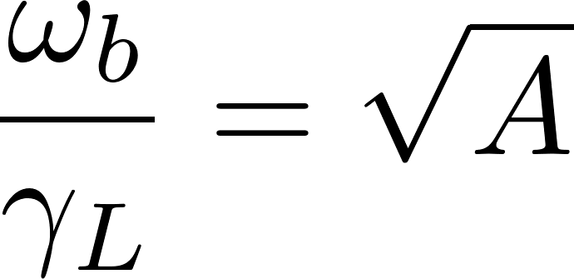
To study the dynamics far from threshold, we first consider an analogous 1D electrostatic system at a single resonance
collisions dominated by pitch angle scattering
contours of constant energy
∝ wave amplitude
f
deeply resonance-trapped particles have bounce frequency:
identical resonant contribution

Slide 6
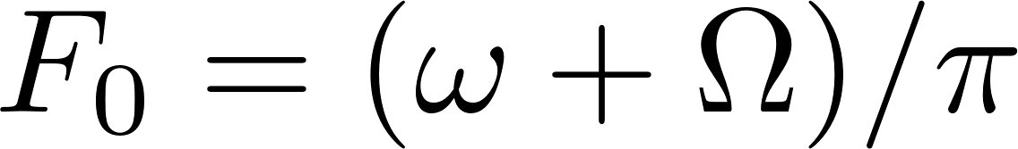
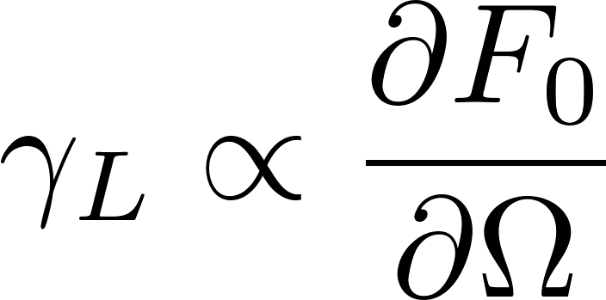
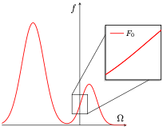
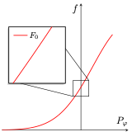
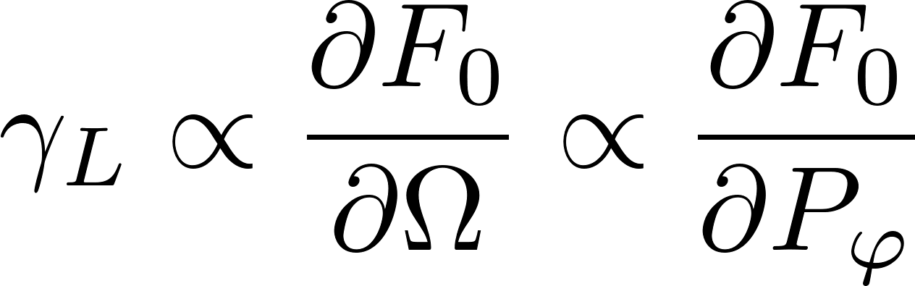
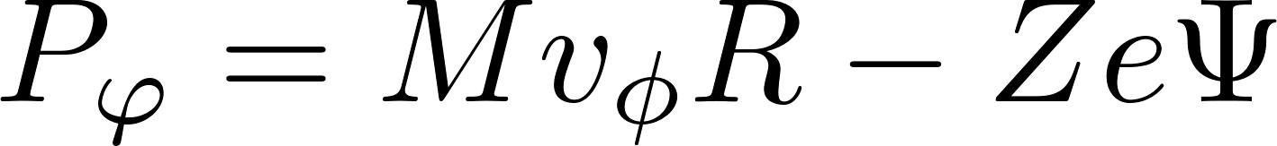
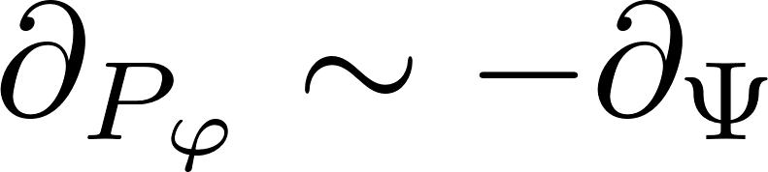
Distribution local to the resonance
Near the resonance, the equilibrium f given with a constant positive slope:
in 1D: bump on tail
in an axisymmetric tokamak:

Slide 7
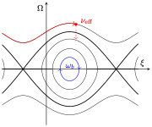
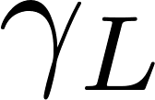

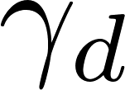

Wave saturation occurs due to balance of sources and sinks
Parameters
 | Linear growth rate | Rate of wave drive from distribution function
 | Bounce frequency | Roughly, rate at which wave flattens distribution
 | Damping rate | Rate at which wave damps on equilibrium
 | Effective collision rate | Wave drive from new particles entering resonance
in the far-from-threshold regime, no single parameter is small for entire evolution

Slide 8
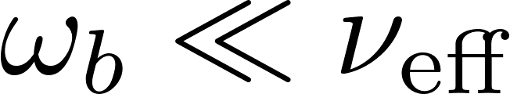
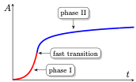
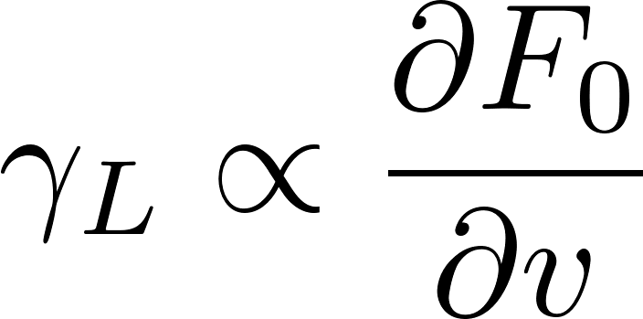

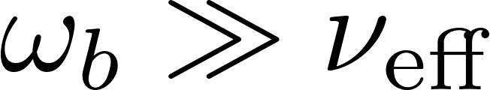
Theoretical approach
Break evolution into linear and nonlinear phases:
linear phase (“Phase I”):
  to 0th order, linear growth driven by gradient
strongly nonlinear transition:
  flattened “island” forms in phase space
weakly nonlinear phase (“Phase II”):
  sources and sinks evolve to equilibrium

Slide 9
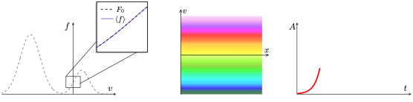


Linear growth phase
Initially, is small, so collisions restore distribution gradient faster than wave flattens it
Wave amplitude grows linearly until is large enough to start flattening the gradient

Slide 10
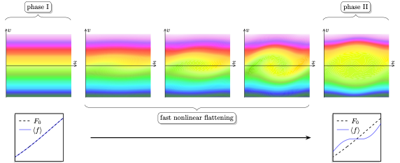
Fast nonlinear flattening of f
We cannot analytically model this phase
BUT this nonlinear flattening occurs much faster than evolution is phases I & II

Slide 11
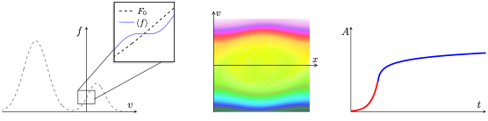
Nonlinear evolution to saturation
Once flattened phase space island has formed, amplitude continues to evolve as collisions kick particles into the resonance
Steady state reached according to balance of this collisional drive and background damping
Contrast with near-marginal case: distribution is strongly modified from its equilibrium

Slide 12
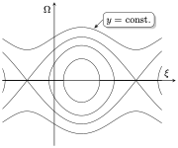
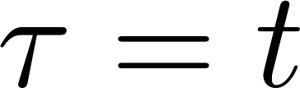
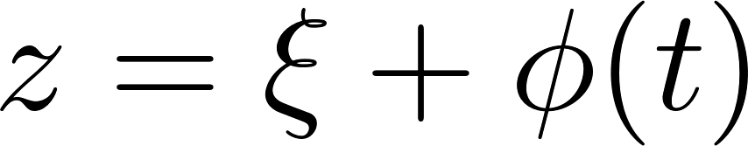
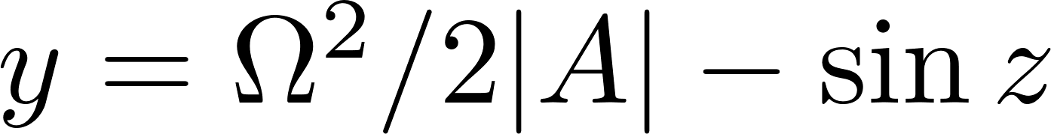
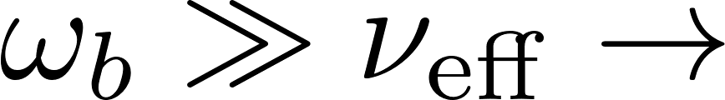
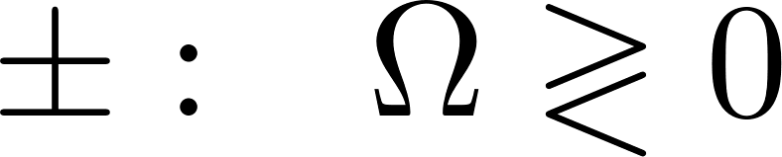
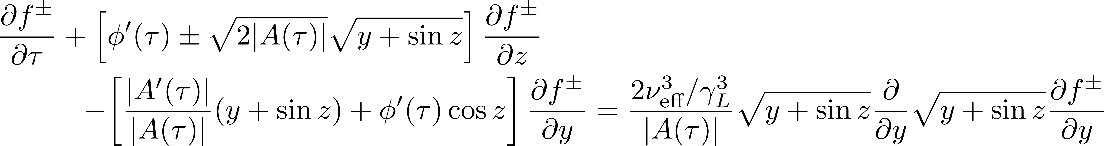
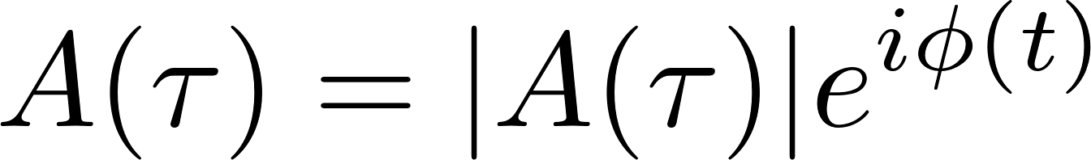
Solving for f in Phase II
even with a small parameter to work with, we need a further approximation to solve for f
particles mostly move along contours of constant energy in phase space
assumption of Markovian dynamics:

Slide 13

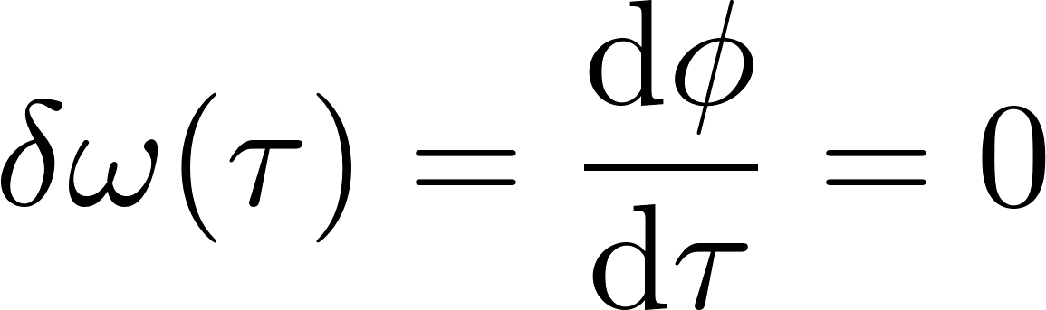
Results for phase in Phase II
Solving for f and evaluating amplitude equation integrals for yields:
As expected, no nonlinear change to the frequency is predicted in this regime.
Collisions erase phase-space structures before they can become chirping waves
This is not to say that chirping should not occur in the far-from-threshold regime, only that it will not occur in the limit considered here,

Slide 14
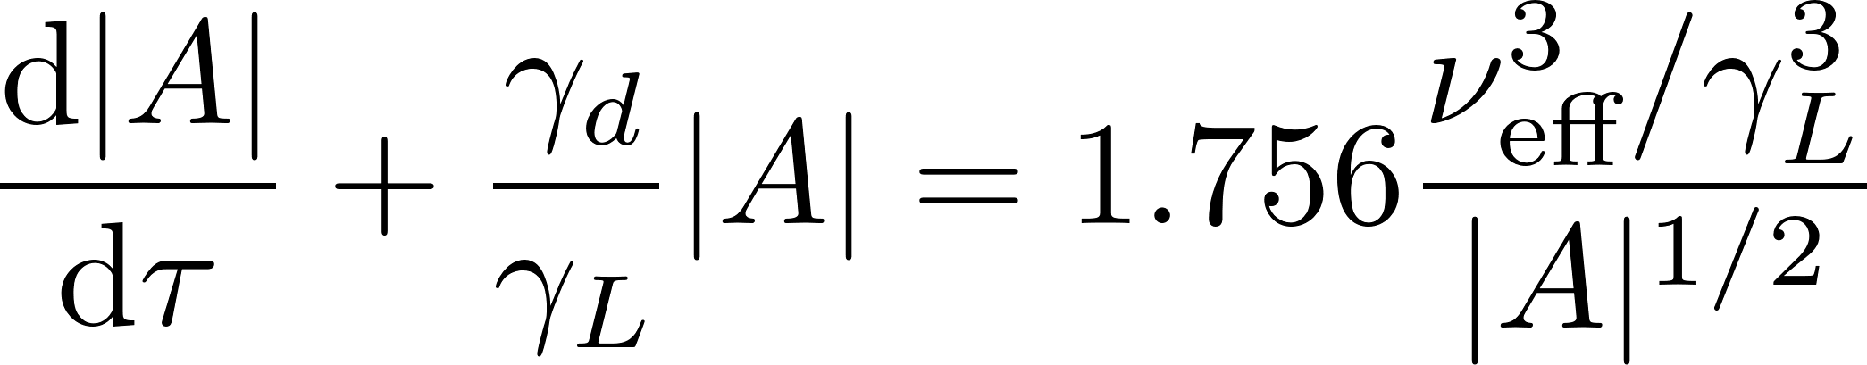
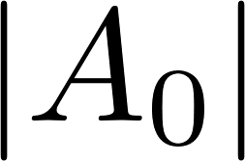

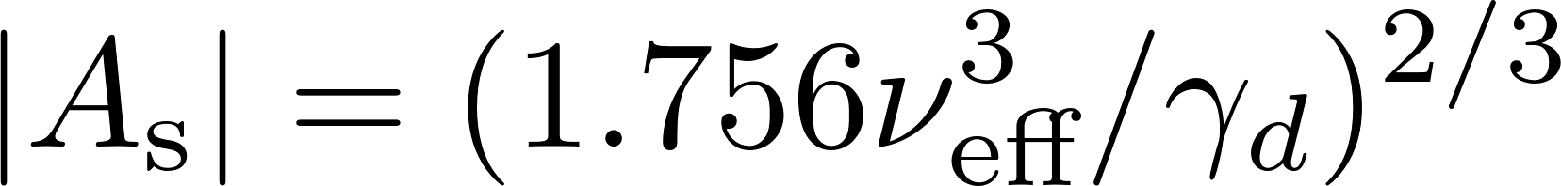
Results for amplitude magnitude in Phase II
Solving for f and evaluating amplitude equation integrals for |A| yields a Bernoulli type ODE:
Solution given by
  : amplitude at which transition occurs
  : time at which transition occurs
  : saturation amplitude¹
Nonlinear growth rate:
¹Petviashivili, Ph.D. Thesis (1998)

Slide 15
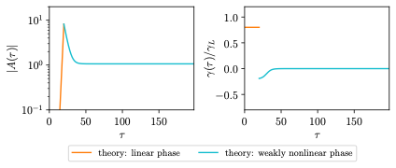
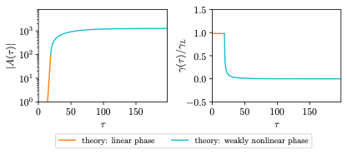
Connecting the linear and nonlinear phases
Two constraints define and :
  the amplitude must be continuous
  net growth rate is continuous or discontinuous, depending on type of solution:
    initial distribution function drive exceeds collisional drive
    collisional drive exceeds initial distribution function drive
A
B

Slide 16
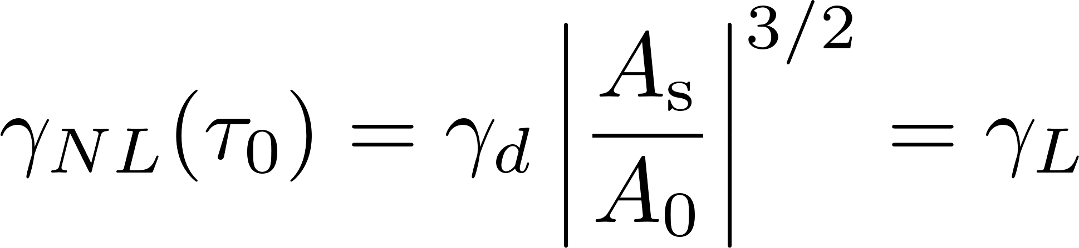
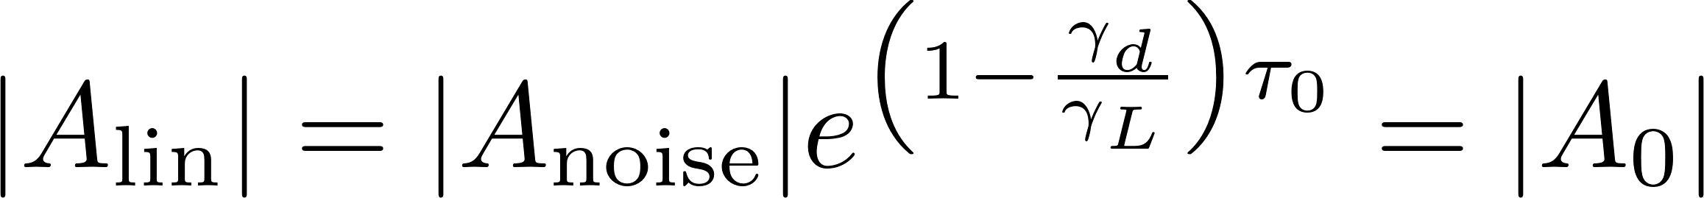
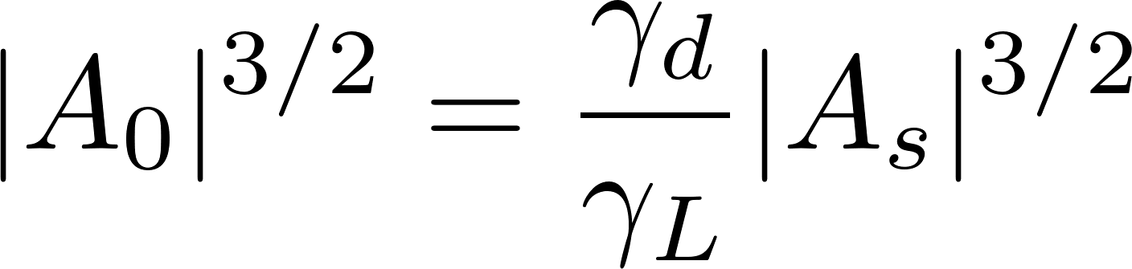

Collisional drive exceeds distribution function drive
Enforce continuity of both amplitude and nonlinear growth rate at the transition point via:
This yields:
and

Slide 17
Distribution function drive exceeds collisional drive
Growth rate has a sharp jump from positive to negative at the transition point, so we cannot enforce continuity of growth rate
Since system includes damping, this means that the amplitude can grow to at most its collisionless saturation level¹ during the linear phase
Therefore, we use:
¹Fried et al., UCLA Tech. Report PPG-93 (1971)

Slide 18


Comparison with Bump-on-Tail (BOT)¹ code
Nonlinear kinetic solver for the system:
Example cases
Case 1 | steady saturation | decaying to saturation
Case 2 | oscillatory saturation | decaying to saturation
Case 3 | steady saturation | growing to saturation
¹Lilley et al., PoP (2010)

Slide 19

Case 1: steady saturation, decaying

Slide 20

Case 2: oscillatory saturation, decaying

Slide 21

Case 3: steady saturation, growing

Slide 22
Distribution function (Case 3)

Slide 23

Summary & impact
Using an assumption of time locality, we formulate an analytic description of time evolution far-from-threshold regime
Solutions which overshoot saturation amplitude are especially important for predictions of EP transport: e.g., losses occurring as a result of the overshoot will be missed if only saturation level is known!
Under review at NF, preprint available: arXiv: 2510.08735

Slide 24

Looking forward
We can now return to the full 3D problem and use these formulate a description for strongly driven AEs driven by EPs
Work is ongoing to compare these results with TAEs excited following in sawtooth crashes in JET, and with more realistic simulations
TAEs excited following sawtooth crashes in JET, figure from¹
¹Ruiz Ruiz et al., PRL (2025)

Slide 25
Backup

Slide 26



Zeroth order field equation: mode structure
Consider an eigenmode, perturbatively interacting with resonant particles
At zeroth order, the field equation determines the spatial structure of the electric field:
E.g., for ideal an MHD equilibrium in a large-aspect circular tokamak, an analytic mode structure for a TAE in the limit of high-n and low shear may be derived^{1,2}
¹Rosenbluth et al., Phys. Fluids B (1992)
²Breizman et al., PPFC (1995)

Slide 27




First order field equation: amplitude equation
At first order, the field equation can be used to derive an equation for the mode amplitude¹:
Wave action:
Background damping rate:
The damping rate is considered here to be approximately constant; the EP population is too small to significantly modify the equilibrium
Energetic particle current:
¹Berk et al., Plasma Phys. Reports (1997)

Slide 28






In a tokamak, unperturbed orbits are integrable
Consider, , where
Due to axisymmetry, there are 3 constants of motion which describe the unperturbed particle orbits¹:
Passing particles, with some small deviation from circular orbits of radius have radial position²
¹White. “Theory of Toroidally Confined Plasmas” (2014)
²Berk et al. Phys. Lett. A (1992)

Slide 29


Collision operator
EP collisions modeled using the Fokker-Planck operator¹:
It can be show that in action-angle space near the resonance that this is dominated by^{2,3}
constant
¹Goldston et al., J. Comput. Phys. (1981)
²Duarte et al., PoP (2017)
³Berk et al., Plasma Phys. Reports (1997)

Slide 30

Markov assumption, time locality
assuming constitutes an assumption of Markovian dynamics
collisions erase the memory of the distribution function, distribution evolves “time locally” through evolution of wave amplitude
Regime where these assumptions are valid:
steady state solutions: oscillations of mode amplitude break this ordering
no frequency chirping: collisions erase phase-space correlations much faster than the mode amplitude is changing
phase space structures forming during chirping, figure from¹
¹Lilley et al., PRL (2014)

Slide 31




Collisional boundary layer
Near , particles move very slowly in phase space (bounce time near the separatrix becomes infinite)
requires solving asymptotically for f in several regions
particles near separatrix
deeply trapped particles
Chandran et al., ApJ. (1999)

Slide 32





Solving for f and A up to first order in
Under time locality assumption:
Writing the complex amplitude:
outer region: contributes at
boundary layer (away from x-points): contributes at
boundary layer (around x-points): contributes at

