Slide 1

Tungsten sputtering due to fast particles in ITER
A. Snicker et al.

Slide 2







A. Snicker, K. Särkimäki, S. Saari, L. Aho-Mantila – VTT Technical Research Centre of Finland Ltd. Espoo, Finland
T. Kurki-Suonio, A. Sand – Aalto University, Espoo, Finland
M. Garcia-Munoz – University of Seville, Seville, Spain
K. Schmid - IPP Garching, Germany
S. Wiesen – DIFFER, The Netherlands
S. Henderson, K. McClements – UKAEA, United Kingdom
H. Kumpulainen - Forschungszentrum Jülich, Germany

Slide 3
Fast ions pose a risk to the plasma and the first wall
Poor fast ion confinement:
  Loss of heating -> degraded performance
  Losses of fast ions

Slide 4
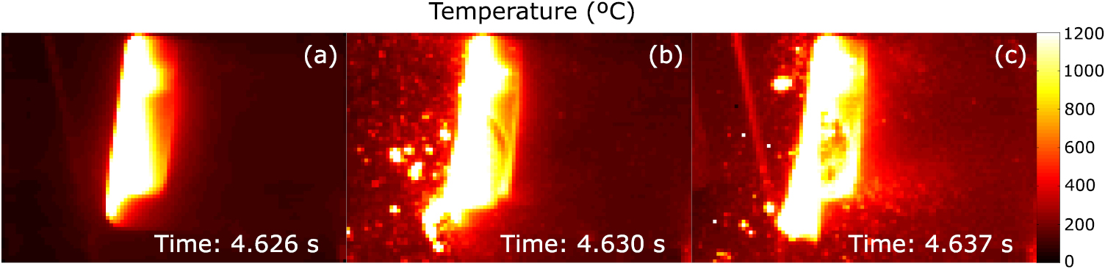
Fast ions can pose risk to the plasma and the first wall
Bad fast ion confinement will result in:
  Loss of heating -> degraded performance
  Losses of fast ions
Fast ion losses can:
  Directly endanger the wall -> damage PFCs
  Indirectly degrade plasma performance by sputtering impurities
J. Galdon-Quiroga et al 2018 Nucl. Fusion 58 036005

Slide 5
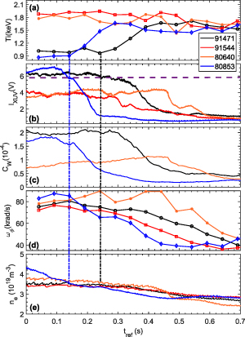
Fast ions can pose risk to the plasma and the first wall
Bad fast ion confinement will result in:
  Loss of heating -> degraded performance
  Losses of fast ions
Fast ion losses can:
  Directly endanger the wall -> damage PFCs
  Indirectly degrade plasma performance by sputtering impurities
J. Galdon-Quiroga et al 2018 Nucl. Fusion 58 036005
H. Sheng et al 2026 Nucl. Fusion 66 036023

Slide 6
Fast ions can pose risk to the plasma and the first wall
Bad fast ion confinement will result in:
  Loss of heating -> degraded performance
  Losses of fast ions
Fast ion losses can:
  Directly endanger the wall -> damage PFCs
  Indirectly degrade plasma performance by sputtering impurities
In this talk: Numerical assessment of W sputtering due to fast particles in ITER
J. Galdon-Quiroga et al 2018 Nucl. Fusion 58 036005
H. Sheng et al 2026 Nucl. Fusion 66 036023

Slide 7
What is needed for the assessment?
Database of fast particle losses

Slide 8
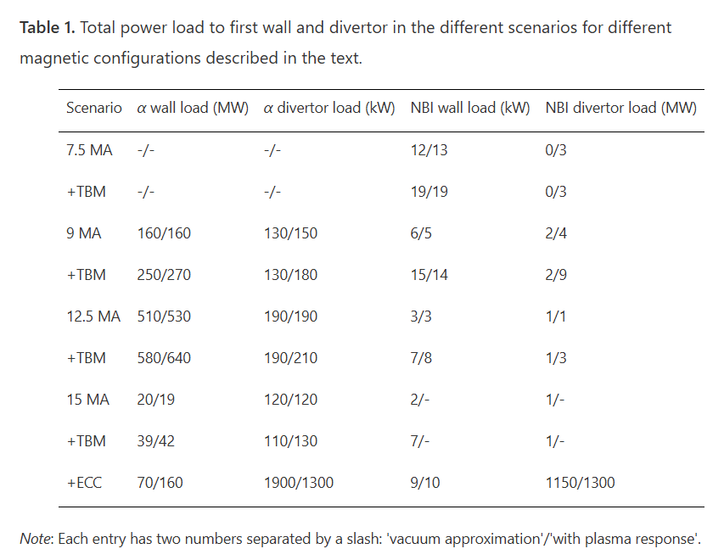
What is needed for the assessment?
Database of fast particle losses
  NBI and alpha particles losses
T Kurki-Suonio et al 2017 Plasma Phys. Control. Fusion 59 014013

Slide 9
What is needed for the assessment?
Database of fast particle losses
  NBI and alpha particles losses
  CX losses of NBI and alpha particles -> this talk!
T Kurki-Suonio et al 2017 Plasma Phys. Control. Fusion 59 014013

Slide 10
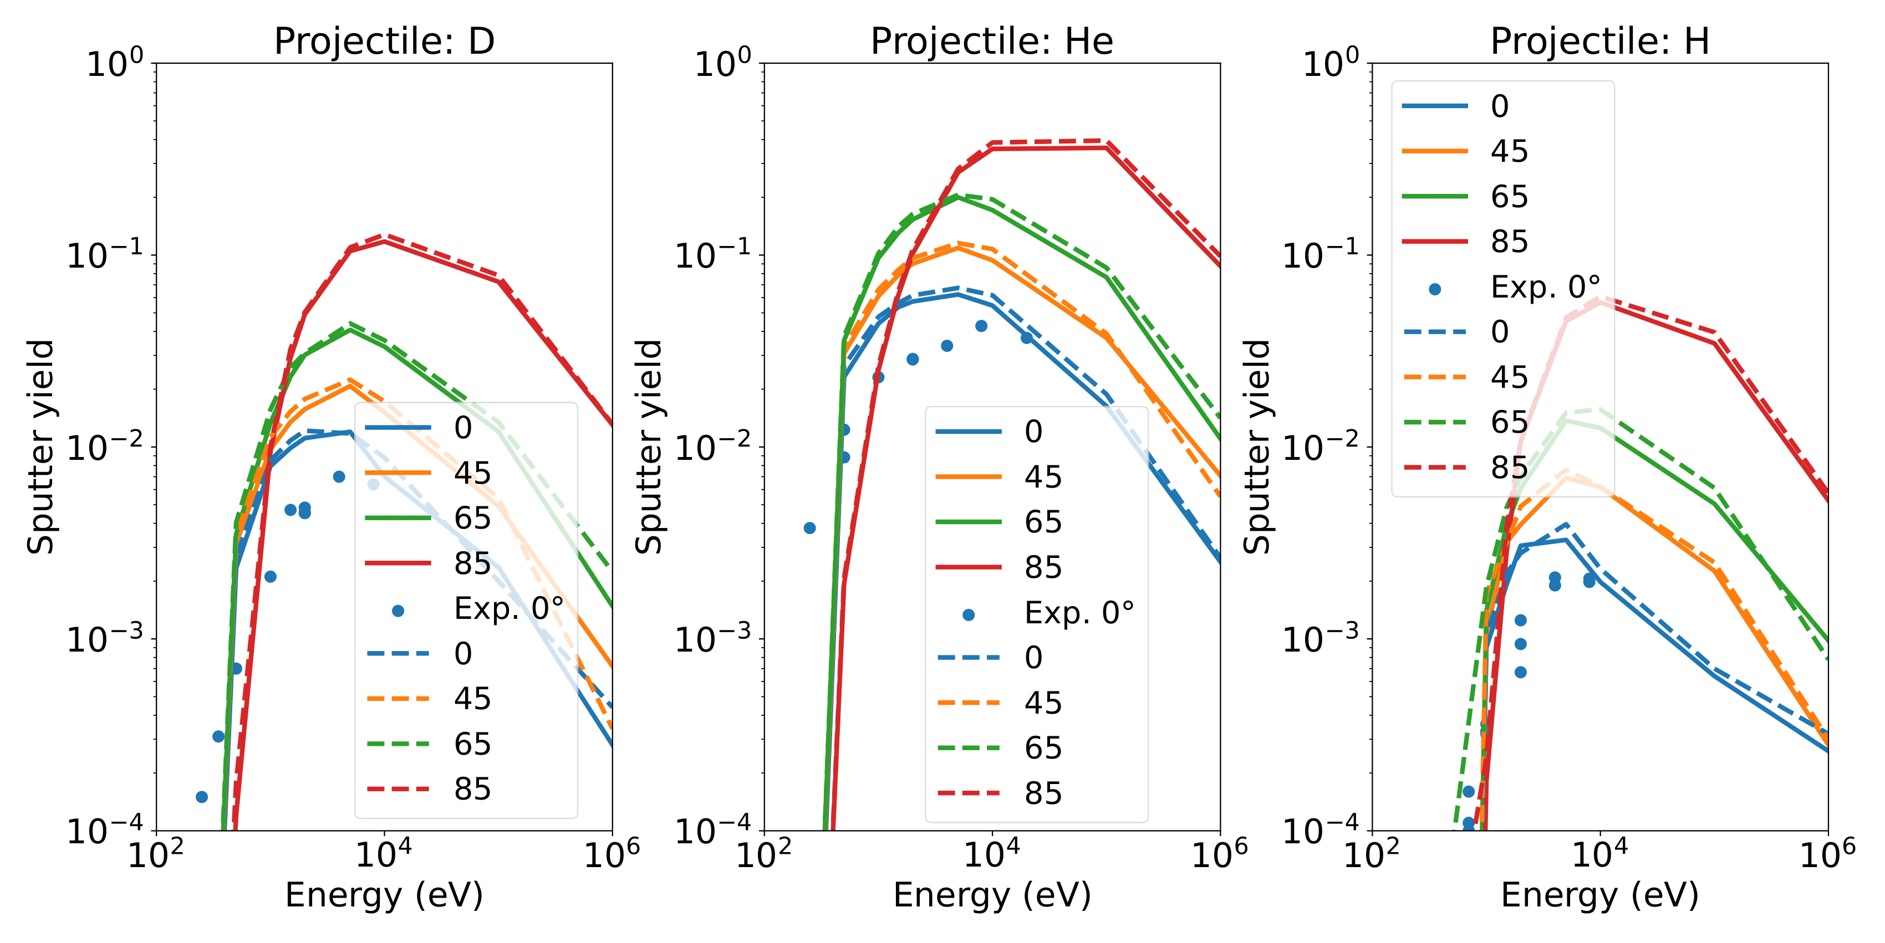
What is needed for the assessment?
Database of fast particle losses
  NBI and alpha particles losses
  CX losses of NBI and alpha particles
Sputtering yields for D and He
  Correct energy range and resolution -> this talk!
Figure by K. Schmid
T Kurki-Suonio et al 2017 Plasma Phys. Control. Fusion 59 014013

Slide 11
What is needed for the assessment?
Database of fast particle losses
Sputtering yields for D and He
Figure by K. Schmid
A workflow to estimate sputtered W
  Here: ASCOT5 + SDTrimSP 7.0 + python script
T Kurki-Suonio et al 2017 Plasma Phys. Control. Fusion 59 014013

Slide 12
Outline
Introduction
Sputtering yield data
CX model in ASCOT5
Analysis on ITER alpha particles
Conclusions and future work

Slide 13
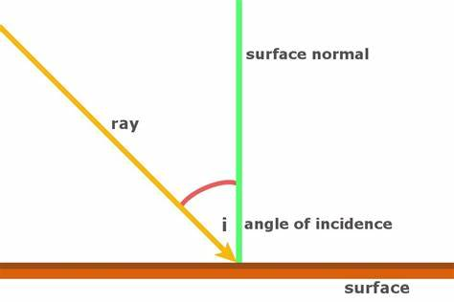
Sputtering data for fast particles
Sputtering yields function of incoming particle energy and incidence angle
  Higher the energy, lower the yield
  More normal (=0 degrees) incidence angle, lower yield
Standard way to obtain sputtering data is by simulations
  Here, SDTrimSP 7.0 will be used
Yield data is needed in 2D grid, with suitable resolution
Towards high E, calculations are expensive
Perform high resolution map for D and He ->
⁴He, D

Slide 14
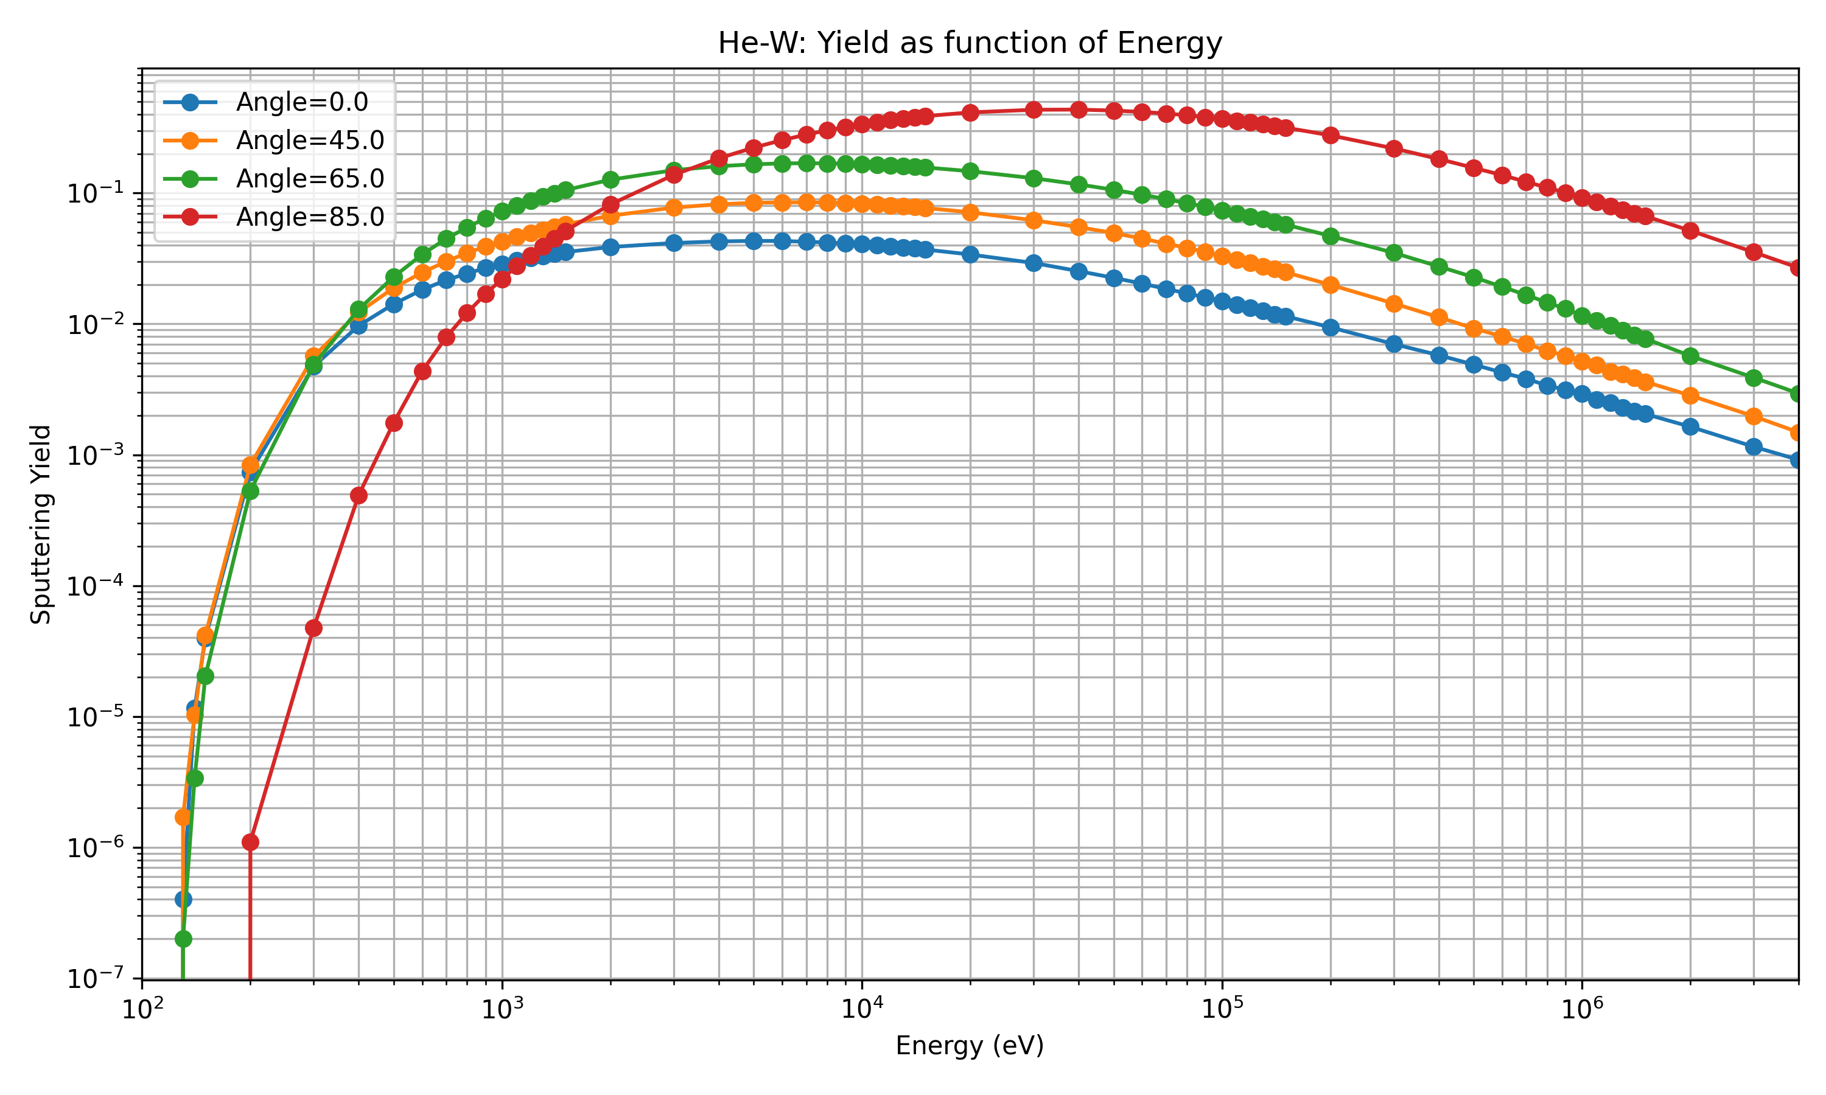
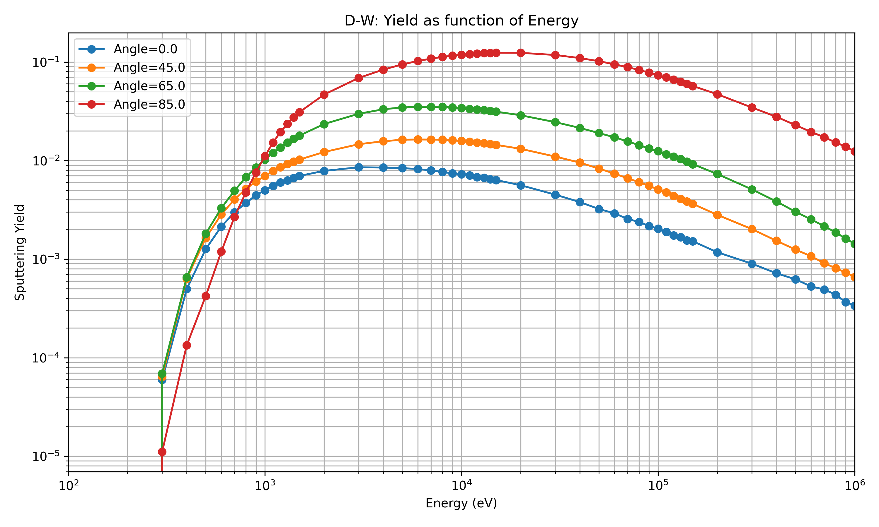
Sputtering yields as a function of energy
Note: He decays slower than D

Slide 15
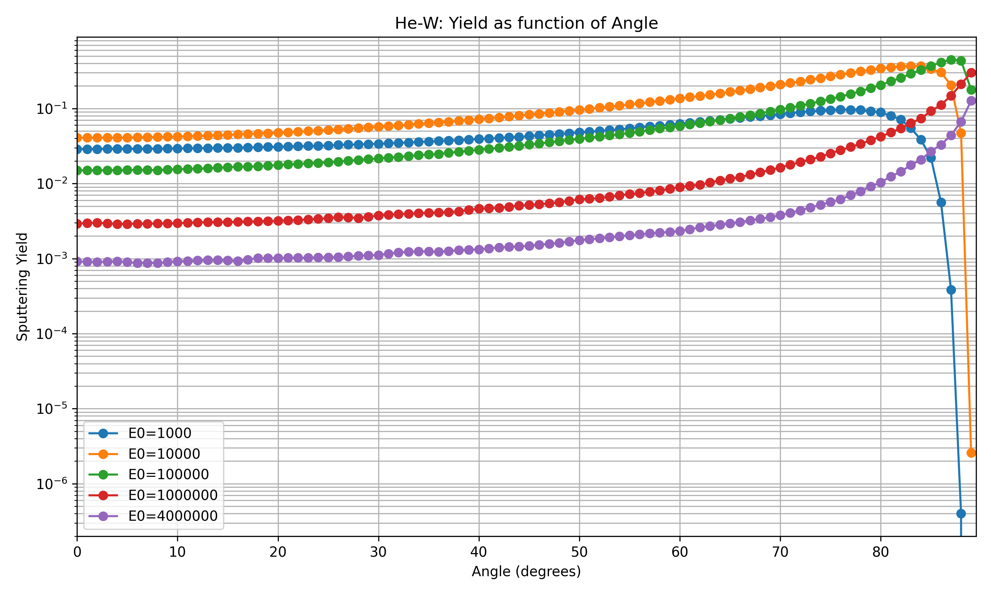
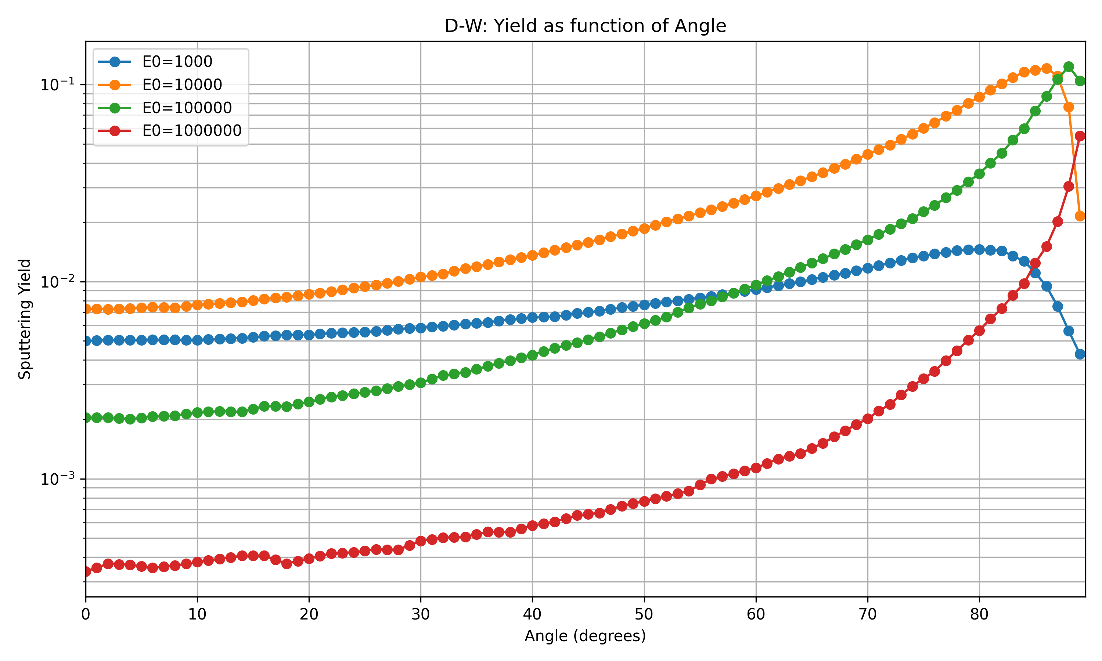
Sputtering yields as a function of incident angle

Slide 16
Impact of refined sputtering yield to W sputtering
With scarce yield and poor interpolation
  ITER W total source: 8.45e+16 W/s
With extensive yield data and refined interpolation
  ITER W total source 7.55e+16 W/s
Difference (Δ=-8.97e15 W/s, -10.6%)
Sputtering yields and interpolation ready for production
  To be shared with the publication following this contribution

Slide 17
Outline
Introduction
Sputtering yield data
CX model in ASCOT5
Analysis on ITER alpha particles
Conclusions and future work

Slide 18
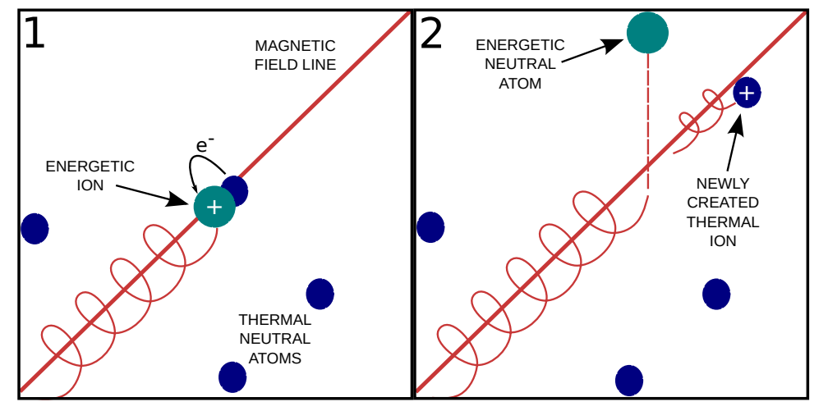
Fast particles can charge exchange with neutrals
Typically implemented for H, D
  Re-ionization using effective cross-section (BMS)
CX cross-section data from ADAS
Suitable for NBI particles in ITER
What about the alphas?
P. Ollus. Modelling charge exchange losses of beam ions in the MAST-U spherical tokamak. Master’s thesis, Aalto University, 2019. Available at: https://urn.fi/URN:NBN:fi:aalto-201912226660.

Slide 19
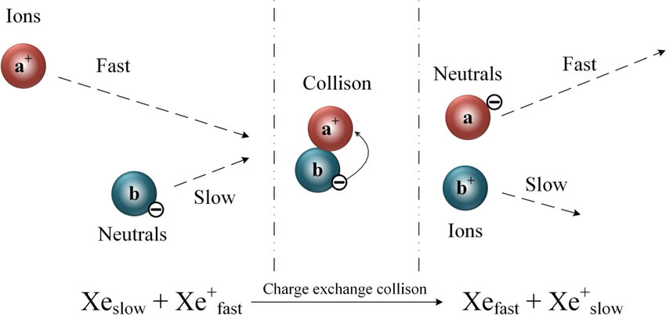
Sputtering due to CX – case alphas
Do not assume Z=1
  Need to track charge state
After 1st CX alpha can:
  Undergo 2nd CX
  Re-ionize
Using BMS not possible
  Consider individual reactions

Slide 20
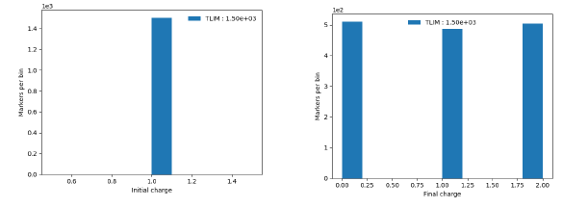
Details of ASCOT5 CX implementation
Open-ADAS only provides data for BMS
Instead of relying on ADAS, IAEA ALADDIN was used.
  Both CX reactions from C.F. Barnett, ORNL-6086, 1990.
  Electron-impact ionization from Janev, H-He Plasma, 1987
  Ion-impact ionization potentially significant but not (yet) included
Testing the implementation by mock-up cross-sections

Slide 21
Outline
Introduction
Sputtering yield data
CX model in ASCOT5
Analysis on ITER alpha particles
Conclusions and future work

Slide 22
Numerical assessment for 15MA H-mode ITER scenario
Standard 3D magnetic field
  TF ripple, FIs, TBMs, ECCs+plasma response
Store locations of wall hits, incidence angle and energy
Interpolate sputtering yields from 2D grids
Integrate total sputtering source rates
Goal: 1st order estimate on fast particle induced sputtering
  Comparison against other sources of W
[Jari Varje et al 2016 Nucl. Fusion 56 046014]

Slide 23
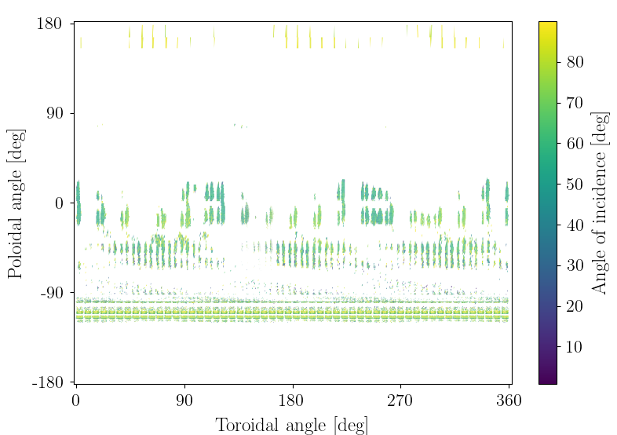
Alphas lost with large incidence angles
Outer midplane
Divertor

Slide 24
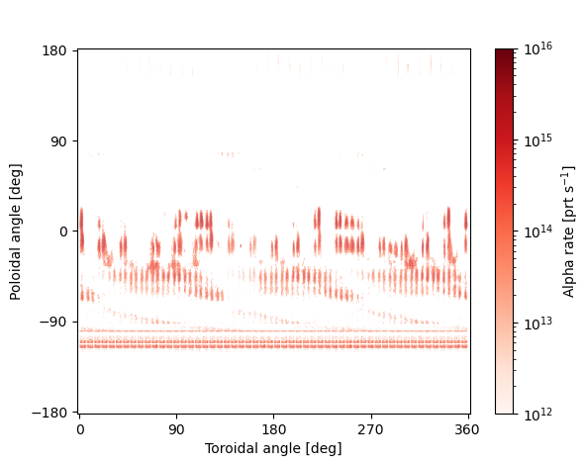
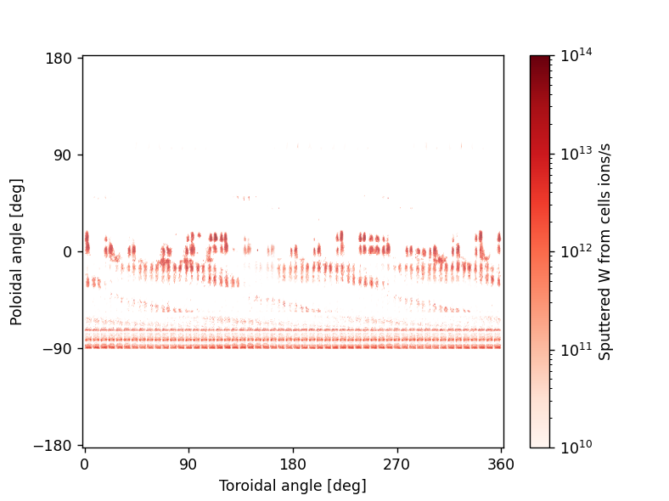
Alpha source (to wall) -> W source (from wall)
x sputtering yield

Slide 25
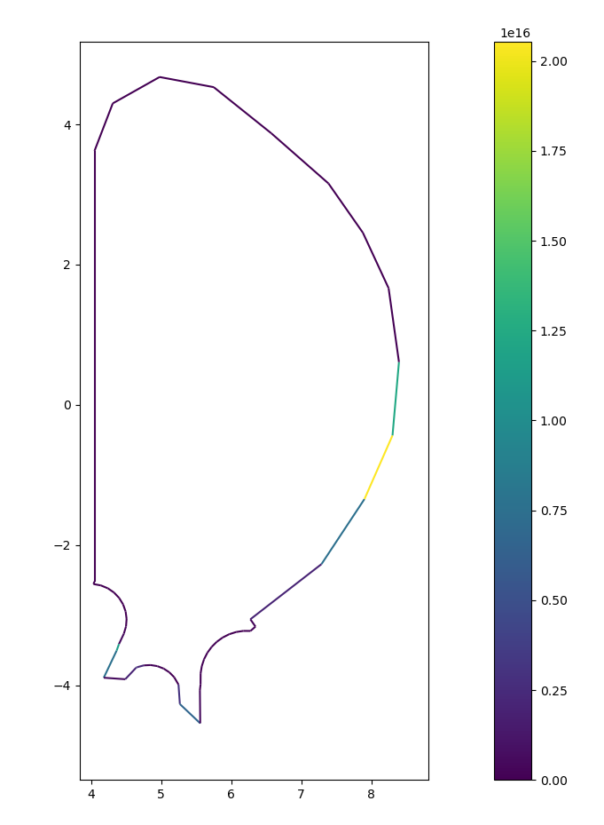
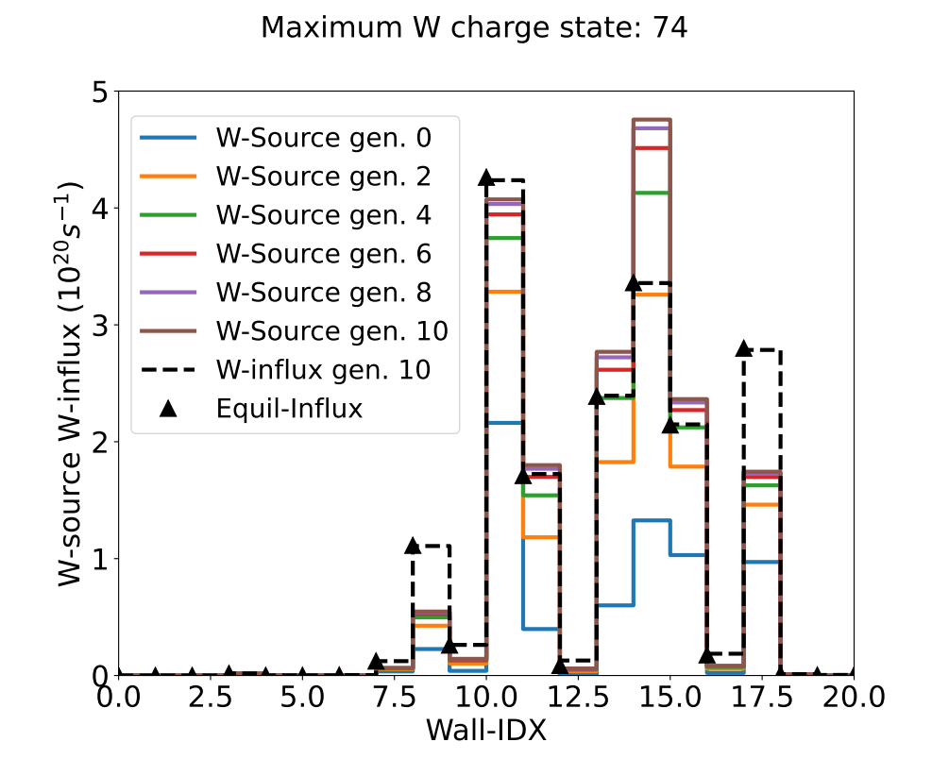
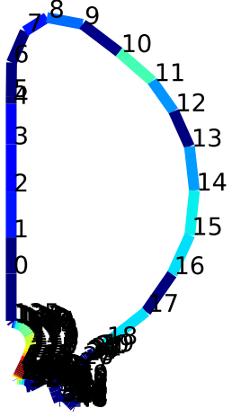
Alpha induced W source vs. WallDyn sources in ITER
Figures: S. Weisen, H. Kumpulainen
“Assume a pure W wall exposed to 100% recycling species: D, D-CX, Ne and partially recycling W”

Slide 26
Alpha induced W source vs. WallDyn sources in ITER
Figures: S. Weisen, H. Kumpulainen
Other sources 5e20 vs. alpha induced 2e16 W/s!

Slide 27
Outline
Introduction
Sputtering yield data
CX model in ASCOT5
Analysis on ITER alpha particles
NBI and CX alphas
Conclusions and future work

Slide 28
Charged NBI sputtering
NBI losses ~ alpha losses
Sputtering yield for D < for He
Figure by K. Schmid
Sputtering due to NBI ~ due to alphas
Charged NBI sputtering can be ignored!
T Kurki-Suonio et al 2017 Plasma Phys. Control. Fusion 59 014013

Slide 29
Contributions from CX losses (preliminary results)
Neutral 1D density from JINTRAC
Nonimal SOL value 1e13 m⁻³
Scale SOL value up to 1e17 m⁻³
CX significant only at 1e17 m⁻³ density
Caveats:
  Neutral density is highly 2D/3D
  Neutral density poorly estimated
Consider results as 1st order estimate
Species | n₀=0 | n₀=1e13 | n₀=1e17
NBI | 1.6 MW | 1.6 MW | 2.3 MW
Alpha | 1.1 MW | 1.1 MW | 1.6 MW

Slide 30
Outline
Introduction
Sputtering yield data
CX model in ASCOT5
Analysis on ITER alpha particles
NBI and CX alphas
Conclusions and future work

Slide 31
Fast particle induced W sputtering in ITER
Charged alpha particle lost induced W source < other W sources
Charged NBI induced W source comparable to alpha source
CX lost source only significant at large neutral density at SOL
Within these assumptions, fast particle induced W source can be ignored in ITER

Slide 32
Was it worth it? Lessons learned and side products
Obtained fast particle relevant sputtering yields for D->W and He->W
  Usable for any device, with potentially different geometry
Generalized CX model usable for alpha induced CX
  Depending on neutral, ion and electron density, alpha CX can be important
From SDTrimSP, we obtain reflection coefficients
  Could be used to finetune fast particle wall power load estimates ->

Slide 33
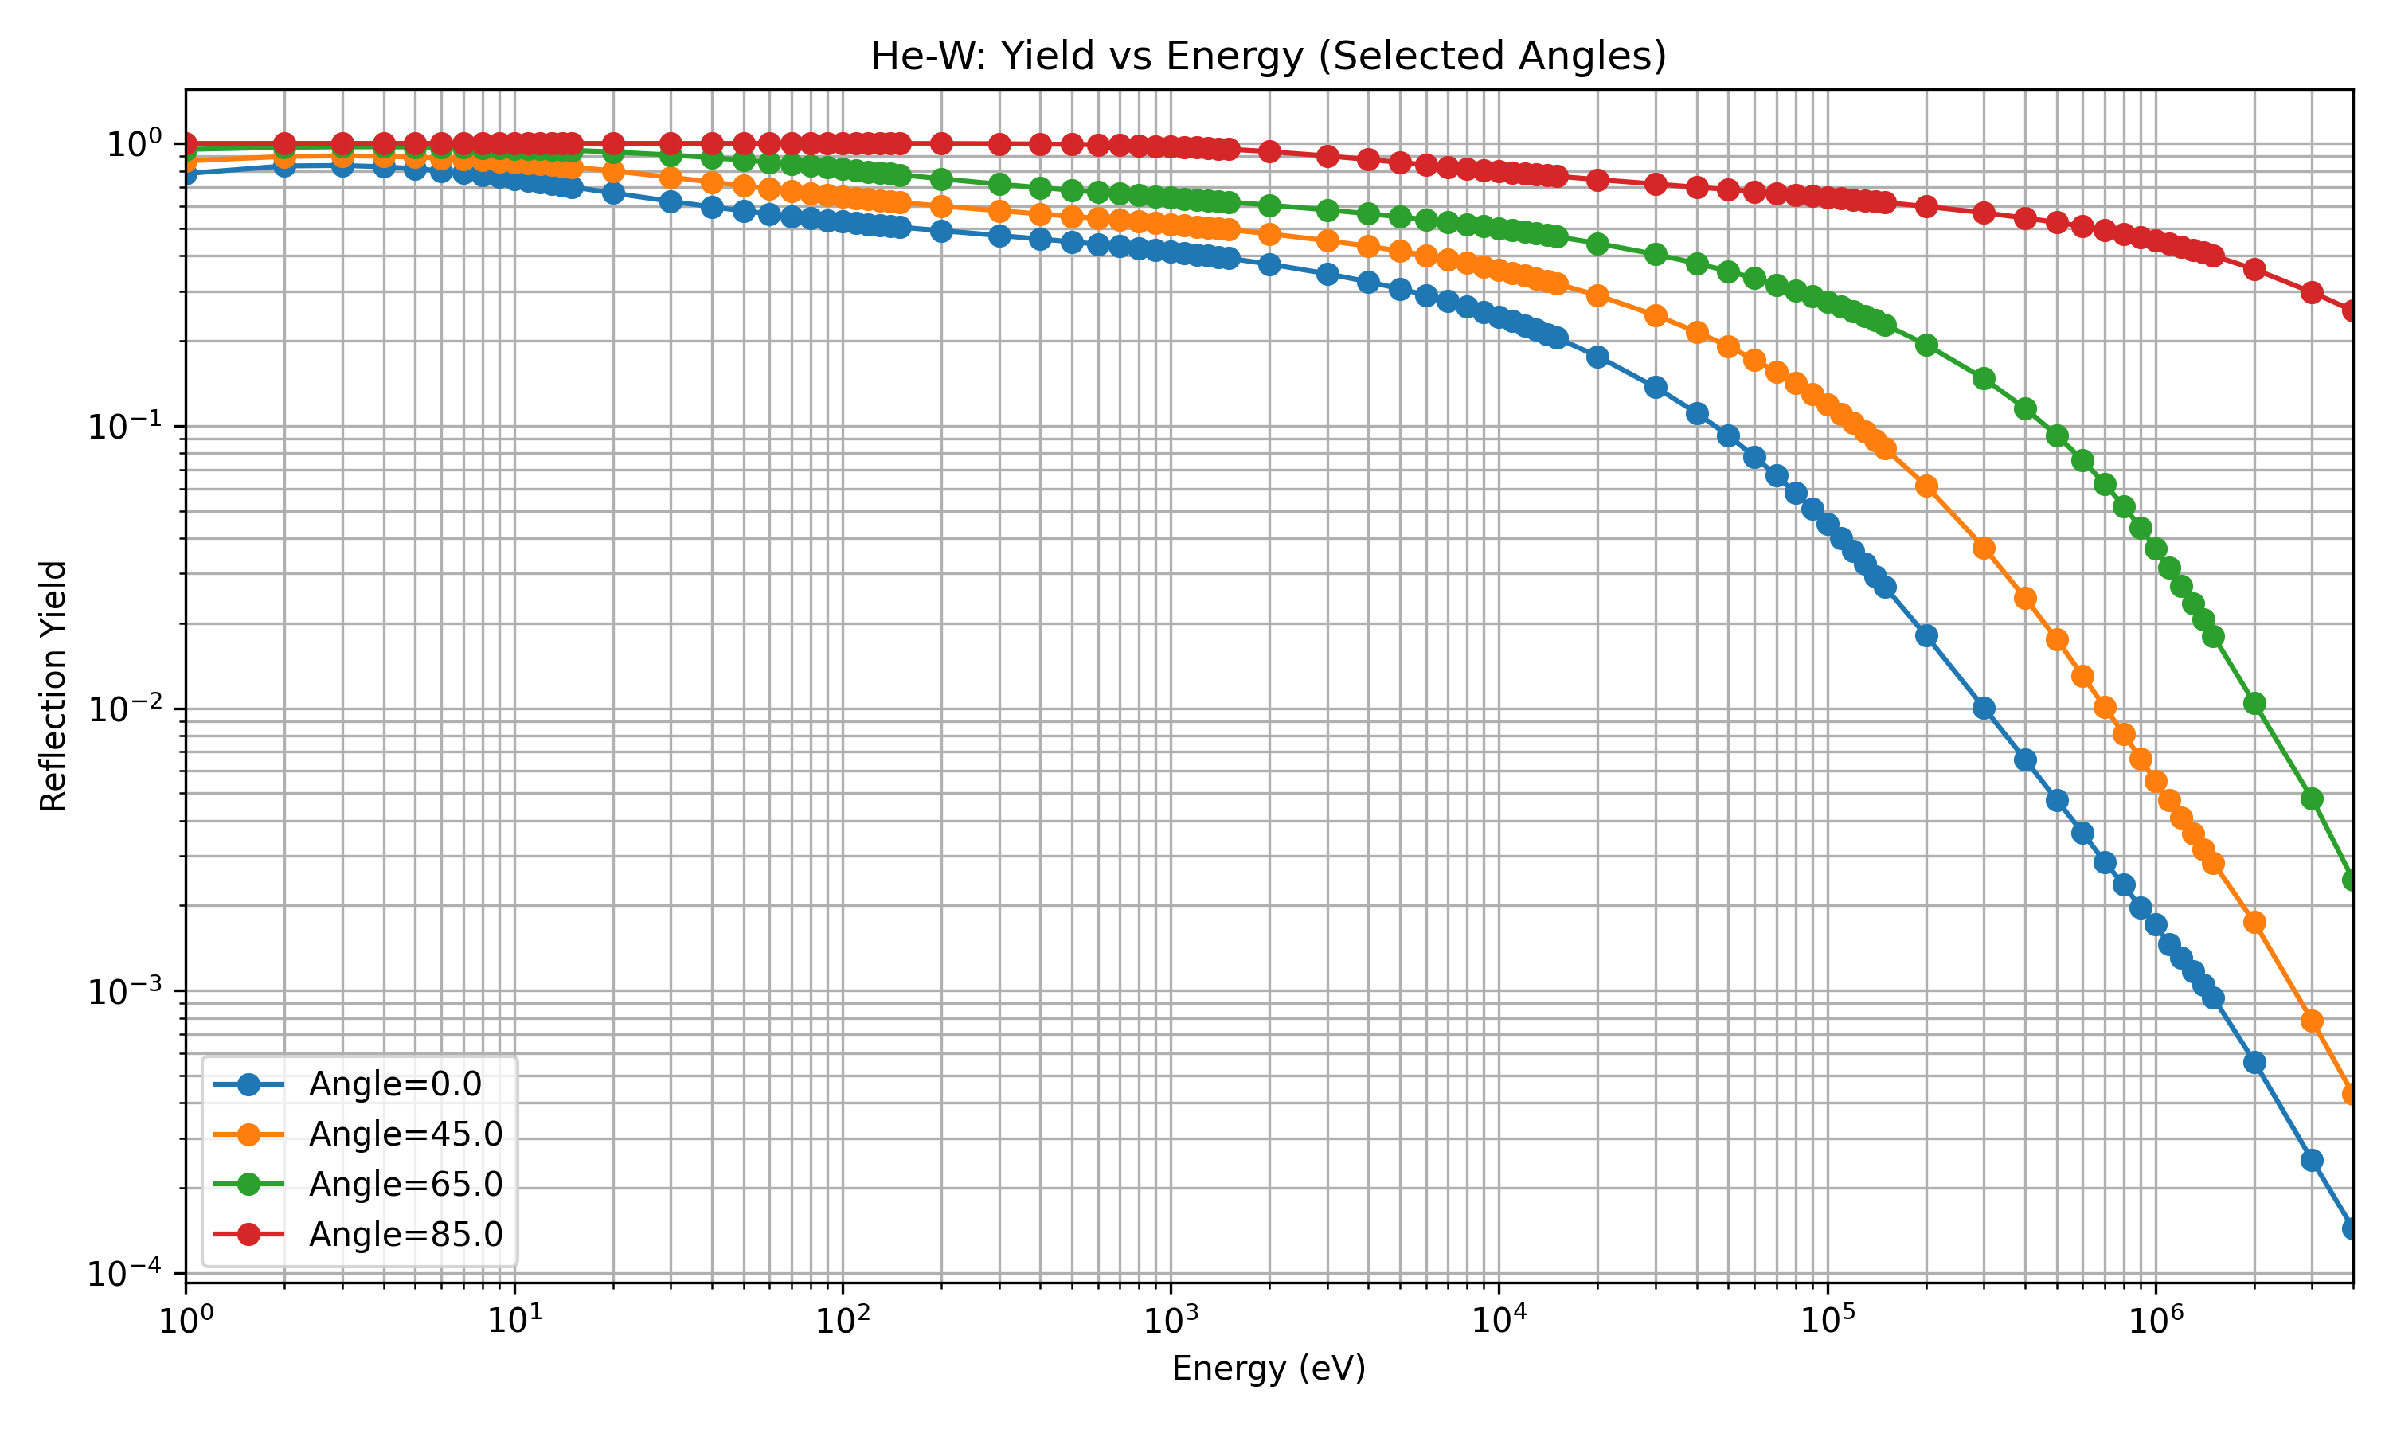
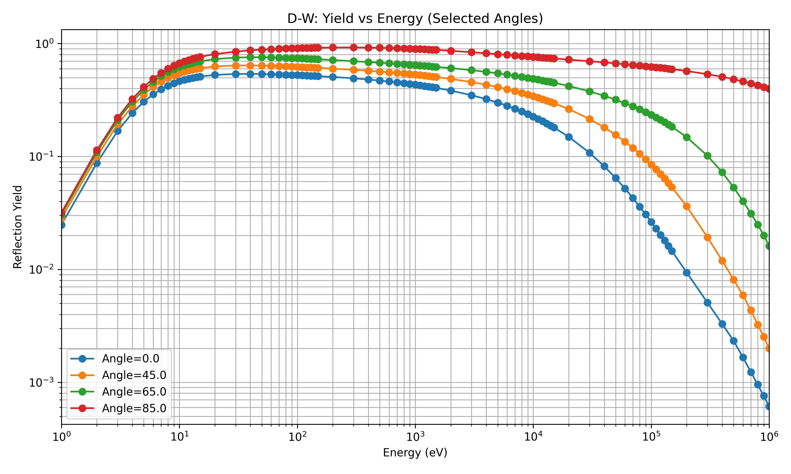
Reflection coefficients for alphas and NBI particles
SDTrimSP gives a reflection co-efficient
The coefficient is well above zero for both He and D

Slide 34
Main caveats and question marks
Are the SDTrimSP 7.0 simulations accurate
  Experimental validation challenging
Are we comparing against reliable “other W sources”?
For CX, neutral density should be 2D/3D
Likely modify results quantitatively but not qualitatively

Slide 35
A. Snicker

