Slide 1
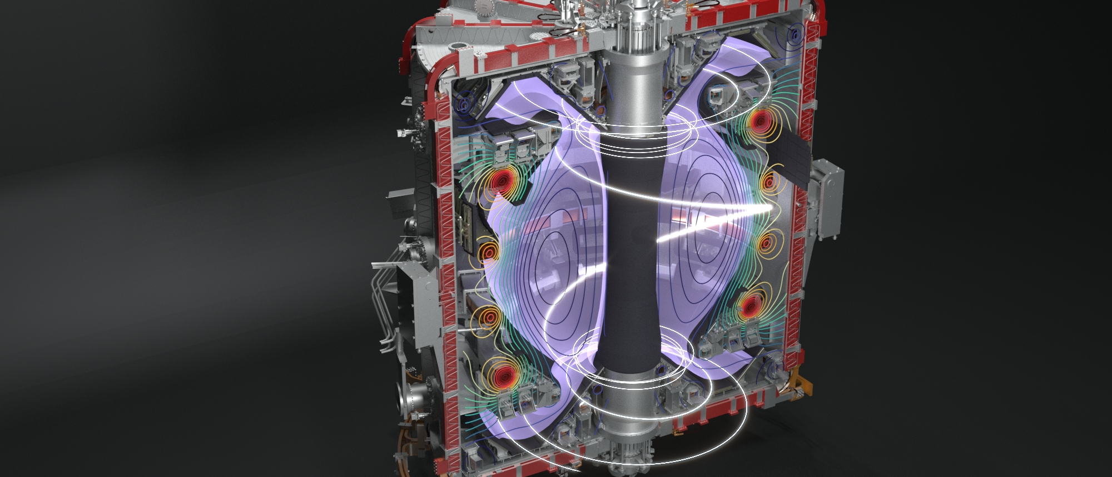
Ken McClements
UKAEA
Observations & modelling of energetic particle-driven ion cyclotron emission in MAST-Upgrade
19th Technical Meeting on Energetic Particles in Magnetic Confinement Systems
September 28 2026, Lausanne, Switzerland
Notes:
So I’m going to report on measurements and modelling of fast particle-driven ion cyclotron emission in MAST upgrade.

Slide 2
M B Dreval¹, C A Michael², R Ochoukov³, J W S Cook⁴, H J C Oliver⁴, D Ryan⁴, R Sarwar⁴, R Scannell⁴, S E Sharapov⁴, A Stephen⁴, R O Dendy⁵, MAST Upgrade Team⁶, WPTE Team⁷
¹Kharkov Institute of Physics and Technology, 61108 Kharkov, Ukraine
² Physics & Astronomy Dept., University of California Los Angeles, USA
³ MPI for Plasma Physics, Boltzmannstrasse 2, 85748 Garching, Germany
⁴ UKAEA, Culham Campus, Abingdon OX14 3DB, UK
⁵ Centre for Fusion, Space and Astrophysics, University of Warwick, Coventry, UK
⁶ See author list of J. R. Harrison et al., 2024 Nucl. Fusion 64 112017
⁷ See author list of N. Vianello et al. 2026 Nucl. Fusion 66 116010
Acknowledgements to co-authors
Notes:
First of all I’d like to acknowledge these co-authors, and I’d like to single out Roman Ochoukov and Dave Ryan for driving the installation of high sampling rate digitisers on MAST-U, Mykola Dreval for mode number analysis and data interpretation, and James Cook for modelling.

Slide 3
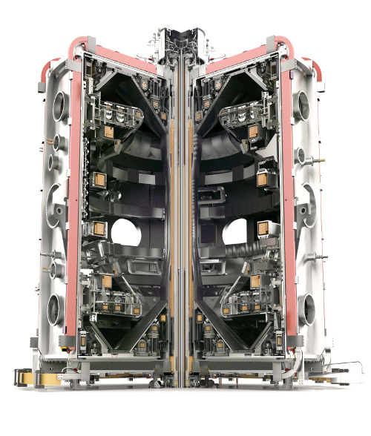
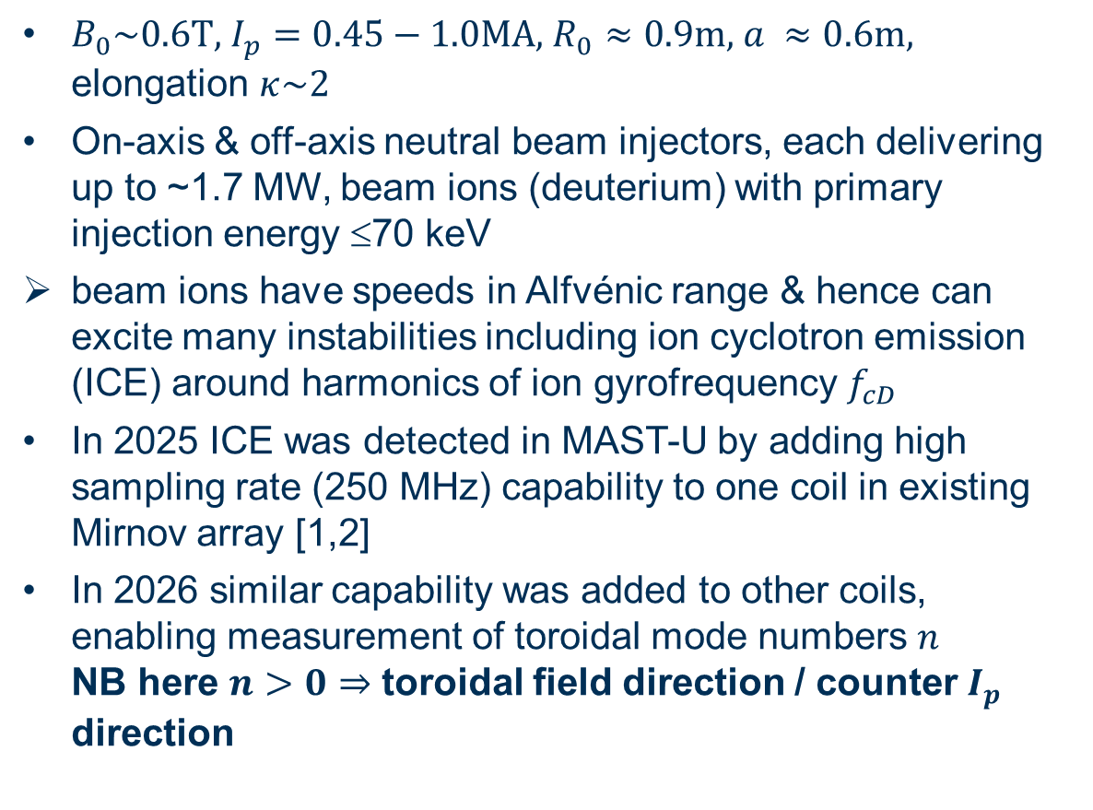
Mega-Amp Spherical Tokamak Upgrade (MAST-U)
$B_{0}\sim 0.6\text{T, }I_{p}=0.45−1.0\text{MA, }R_{0}≈0.9\text{m, }a ≈0.6\text{m},$ elongation $κ\sim 2$
On-axis & off-axis neutral beam injectors, each delivering up to ~1.7 MW, beam ions (deuterium) with primary injection energy ≤70 keV
  beam ions have speeds in Alfvénic range & hence can excite many instabilities including ion cyclotron emission (ICE) around harmonics of ion gyrofrequency $f_{cD}$
In 2025 ICE was detected in MAST-U by adding high sampling rate (250 MHz) capability to one coil in existing Mirnov array [1,2]
In 2026 similar capability was added to other coils, enabling measurement of toroidal mode numbers $n$ NB here $n>0⇒$ toroidal field direction / counter $I_{p}$ direction
[1] M J Hole et al. Rev. Sci. Instrum. 80 (2009) 123507 [2] M B Dreval et al. Plasma Phys. Control. Fusion 68 (2026) 035014
Notes:
For those of you who don’t already know, MAST-U is the UK’s flagship magnetic fusion device, with typical parameters listed here. Most pulses have fast ions provided by one or both of two neutral beams, with tangency radii lying close to the magnetic axis and sixty centimetres above it, the typical field, density and beam injection energies are such that the fast ions are born at super-Alfvenic speeds, hence they can excite a wide range of instabilities, including ion cyclotron emission, meaning waves at frequencies clustered around ion cyclotron harmonics. However we had no means of detecting magnetic fluctuations associated with cyclotron harmonic emission until a high sampling rate capability was added to one of the coils of an existing Mirnov coil array in twenty twenty five. And earlier this year a similar capability was added to other coils, enabling the measurement of ICE toroidal mode numbers. To be clear, in most of the plots I will show, positive n corresponds to propagation in the co-TF direction, which in MAST-U is the counter-current direction.

Slide 4
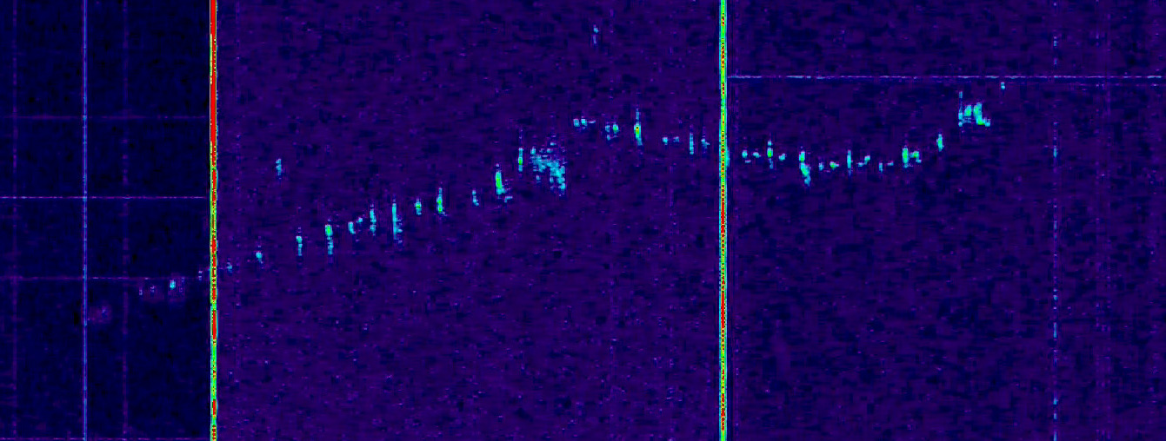
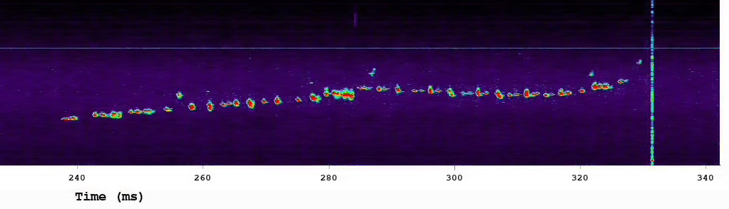

ICE detected using DBS reflectometry as well as coils
Bursting narrow-band ICE detected simultaneously in pulse with pure on-axis NBI using UCLA Doppler backscattering (DBS) [3] reflectometry system (top) & high sampling rate coils (bottom); frequency tracks & is close to ${2f}_{cD}$ at magnetic axis
frequency (MHz)
DBS signal due to velocity fluctuations along microwave ray path
    possible to obtain spatial information on ICE other than that contained in frequency: analysis of DBS data ongoing
DBS also used on MAST-U to detect ICE in Ohmic pulses [4]
    has been attributed to resonant Maxwellian ions in presence of temperature gradient [5]
9
8
DBS reflectometry MAST-U #53363
10
9
8
magnetics MAST-U #53363
240 260 280 300 320 340
t (ms)
[3] T L Rhodes et al. Rev. Sci. Instrum. 93 (2022) 113549 [4] N A Crocker et al. 30th ITPA EP Topical Group Meeting (2023) [5] Ya I Kolesnichenko et al. Phys. Plasmas 31 (2024) 042107
Notes:
In addition to the high sampling rate coils, on MAST-U we also have two Doppler backscattering systems, which have sampling rates extending into the ion cyclotron range. And we have found examples of ICE bursts that can be seen simultaneously in high frequency magnetic and using DBS. In this case the frequency tracks and is close to the second ion cyclotron harmonic at the magnetic axis.

Slide 5
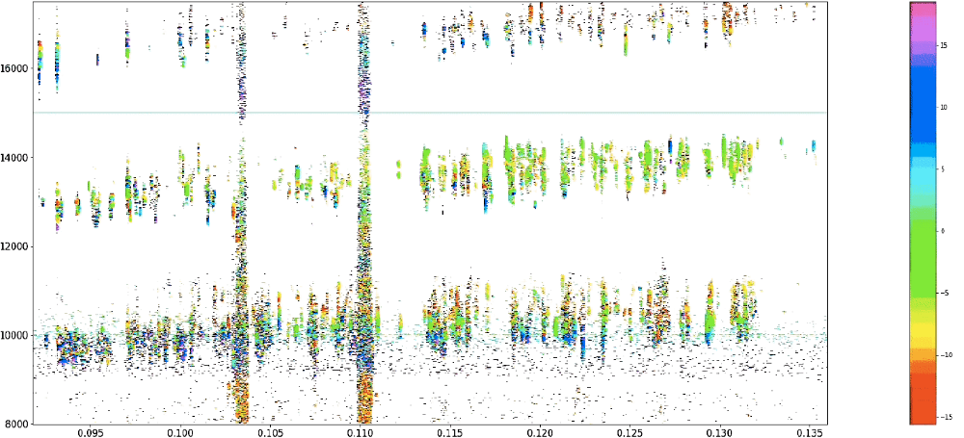
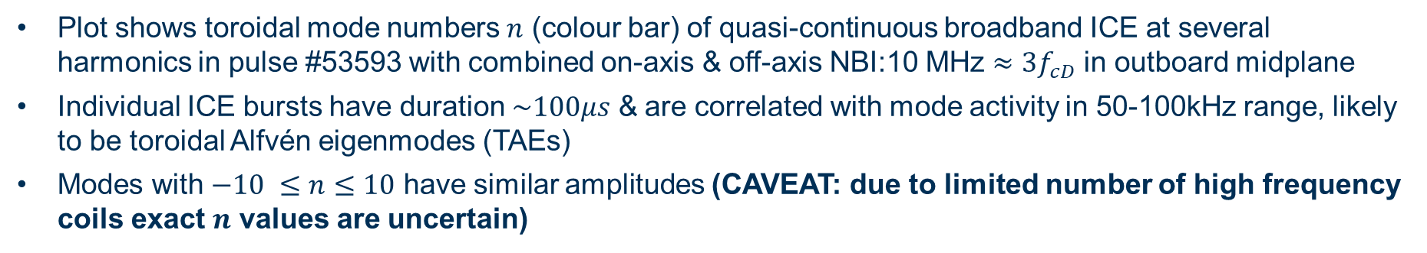



ICE in MAST-U has wide range of mode numbers
Plot shows toroidal mode numbers $n$ (colour bar) of quasi-continuous broadband ICE at several harmonics in pulse #53593 with combined on-axis & off-axis NBI:10 MHz $≈3f_{cD}$ in outboard midplane
Individual ICE bursts have duration $\sim 100μs$ & are correlated with mode activity in 50-100kHz range, likely to be toroidal Alfvén eigenmodes (TAEs)
Modes with $−10 ≤n≤10$ have similar amplitudes (CAVEAT: due to limited number of high frequency coils exact $n$ values are uncertain)
frequency (MHz)
MAST-U #53593
$$ℓ=5$$
15
1000
5
0
-5
-10
-15
16
14
12
10
8
$$ℓ=4$$
$$ℓ=3$$
95 100 105 110 115 120 125 130 135
t (ms)

Slide 6
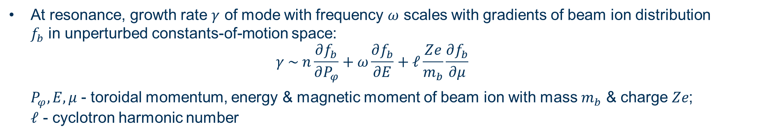
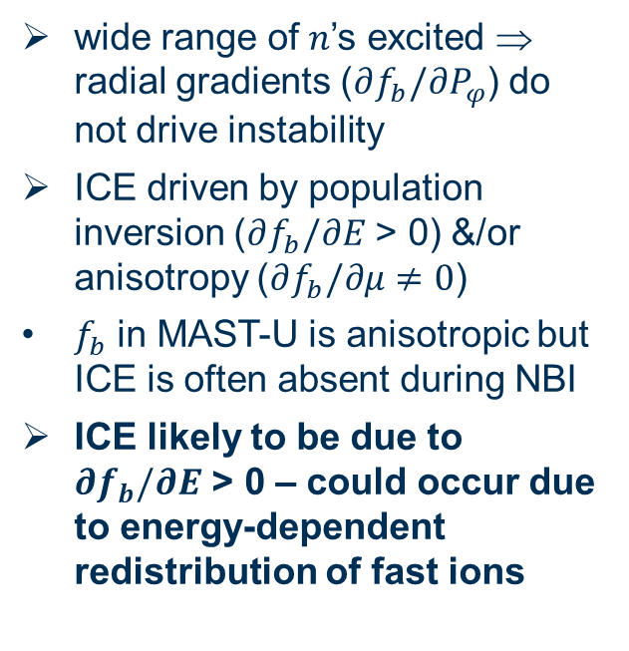
ICE in MAST-U has wide range of mode numbers
At resonance, growth rate $γ$ of mode with frequency $ω$ scales with gradients of beam ion distribution $f_{b}$ in unperturbed constants-of-motion space:
$$γ \sim n\frac{∂f_{b}}{∂P_{φ}}+ω\frac{∂f_{b}}{∂E}+ℓ\frac{Ze}{m_{b}}\frac{∂f_{b}}{∂μ}$$
$P_{φ}, E, μ$ - toroidal momentum, energy & magnetic moment of beam ion with mass $m_{b}$ & charge $Ze$; $ℓ$ - cyclotron harmonic number
frequency (MHz)
wide range of $n$’s excited ⇒ radial gradients ($∂f_{b}/∂P_{φ}$) do not drive instability
ICE driven by population inversion ($∂f_{b}/∂E$ > 0) &/or anisotropy ($∂f_{b}/∂μ≠0$)
$f_{b}$ in MAST-U is anisotropic but ICE is often absent during NBI
ICE likely to be due to $∂f_{b}/∂E$ > 0 – could occur due to energy-dependent redistribution of fast ions
MAST-U #53593
$$ℓ=5$$
15
1000
5
0
-5
-10
-15
16
14
12
10
8
$$ℓ=4$$
$$ℓ=3$$
95 100 105 110 115 120 125 130 135
t (ms)
Notes:
So the question that immediately arises is: how should we interpret the fact that ICE modes with a wide range or toroidal mode numbers, both positive and negative, seem to have similar amplitude?

Slide 7
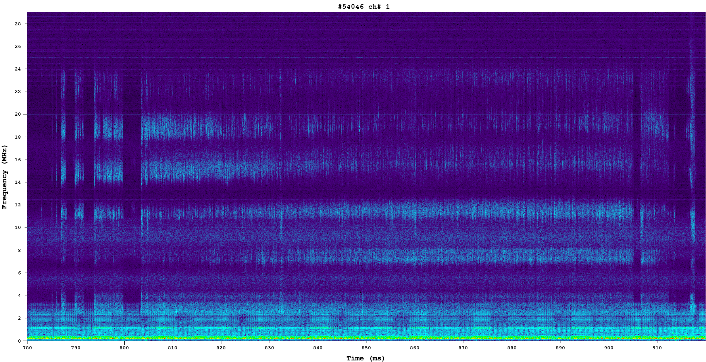
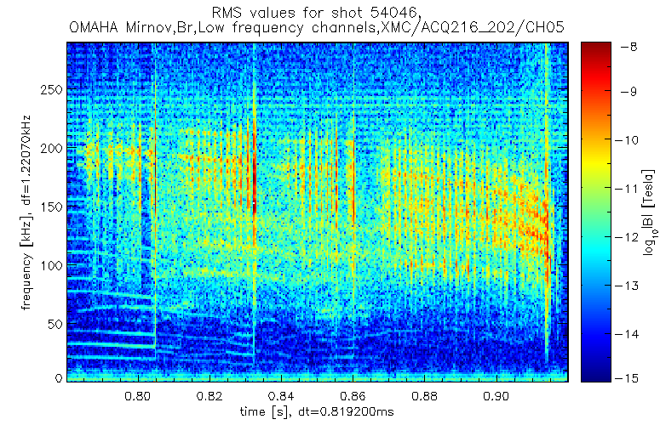

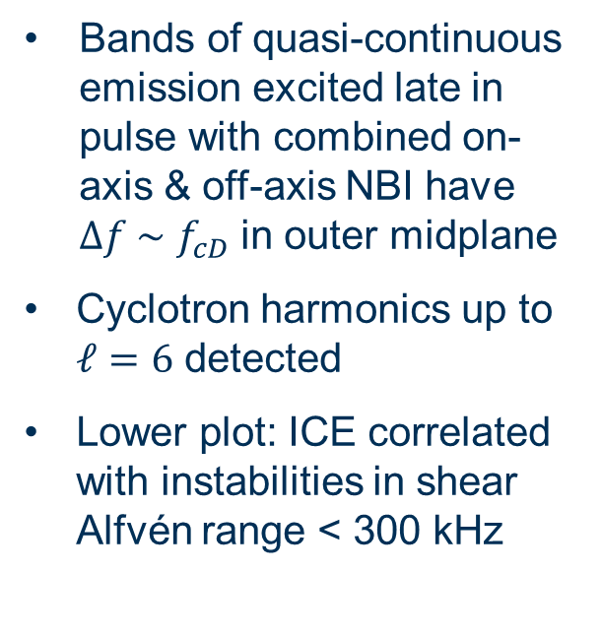





Broadband ICE detected at up to six harmonics
28
24
20
16
12
8
4
0
MAST-U #54046
MAST-U #54046
$$ℓ=6$$
Bands of quasi-continuous emission excited late in pulse with combined on-axis & off-axis NBI have $Δf \sim$ $f_{cD}$in outer midplane
Cyclotron harmonics up to $ℓ=6$ detected
Lower plot: ICE correlated with instabilities in shear Alfvén range < 300 kHz
$$ℓ=5$$
frequency (MHz)
$$ℓ=4$$
$$ℓ=3$$
$$ℓ=2$$
$$ℓ=1$$
ajhgAJv 800 820 840 860 880 900
250
200
150
100
50
0
frequency (kHz)
800 820 840 860 880 900
t (ms)
Fig. 3. Top: multiple harmonic broadband ICE in pulse #54046. Bands of emission have $Δf\sim f_{cD}$: harmonics up to $ℓ=6$ can be seen. Bottom: instabilities at $f<$ 300 kHz in same time window.

Slide 8
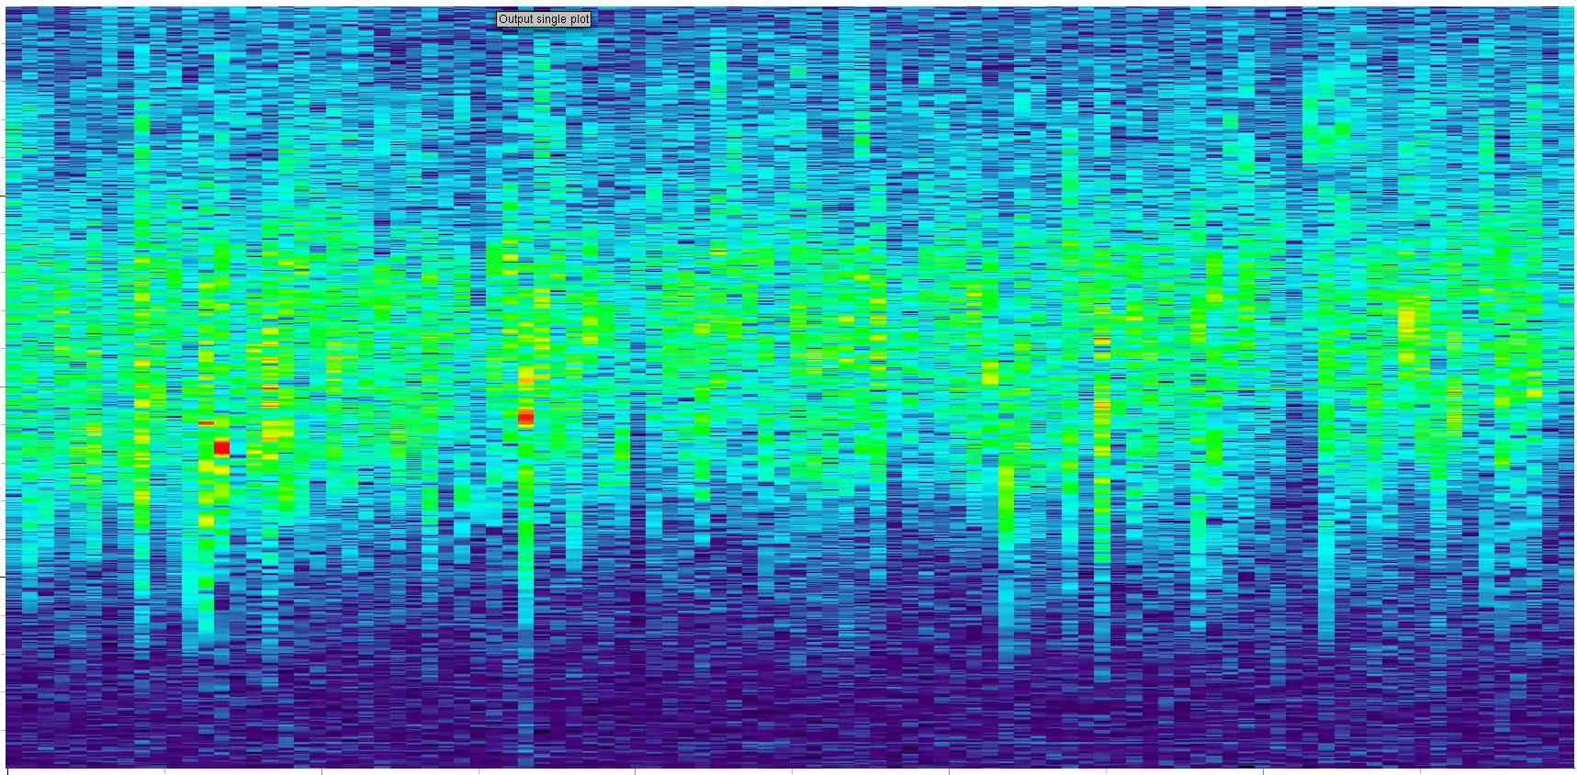
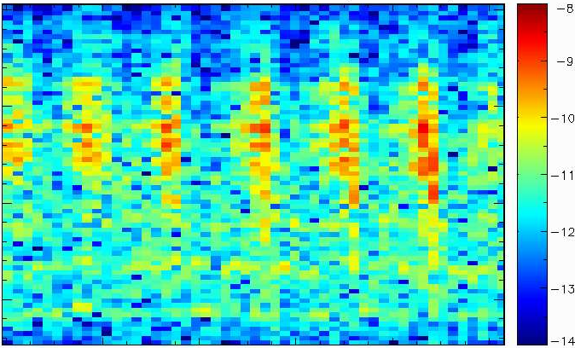

Broadband ICE detected at up to six harmonics
MAST-U #54046
MAST-U #54046
16
15
14
frequency (MHz)
Zoom in frequency & time for this pulse shows that ICE is again intermittent (upper plot)
Some evidence of temporal correlation between maxima in ICE amplitude & individual bursts in shear Alfvén range
$$ℓ=4$$
200
150
100
frequency (kHz)
820 822 824 826 828 830
t (ms)

Slide 9
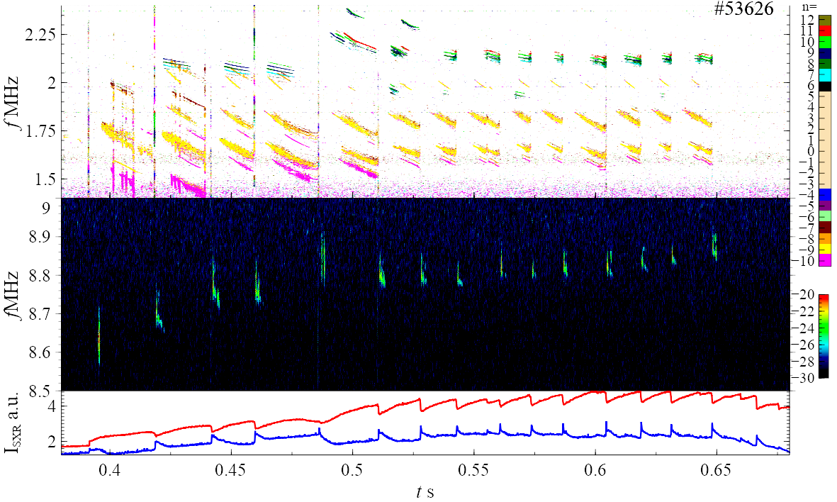

Sawteeth terminated GAEs then triggered ICE
Top plot: global Alfvén eigenmodes (GAEs) [6] in pulse with pure on-axis NBI ; $−10≤n≤12$
Middle plot: ICE; $f$ slightly below $2f_{cD}$ at magnetic axis; $−24≤n≤−20$
Bottom plot – line-integrated soft X-ray emission for chords passing close to axis (red) & outboard edge (blue)
      sawtooth-induced transport of electron thermal energy from core to edge
Duration of ICE bursts ~1ms ~10 × sawtooth collapse time ~ 100μs
    strongly suggests sawtooth-induced redistribution of fast ions driving GAEs, resulting in ICE-emitting fast ion distribution
    cf. studies on DIII-D [7] ⇒ sawteeth expel all fast ions except most energetic trapped ones
GAEs
ICE
Soft X-rays
[6] M B Dreval et al. Nucl. Fusion 65 (2025) 016043 [7] C M Muscatello et al. Plasma Phys. Control. Fusion 54 (2012) 025006

Slide 10
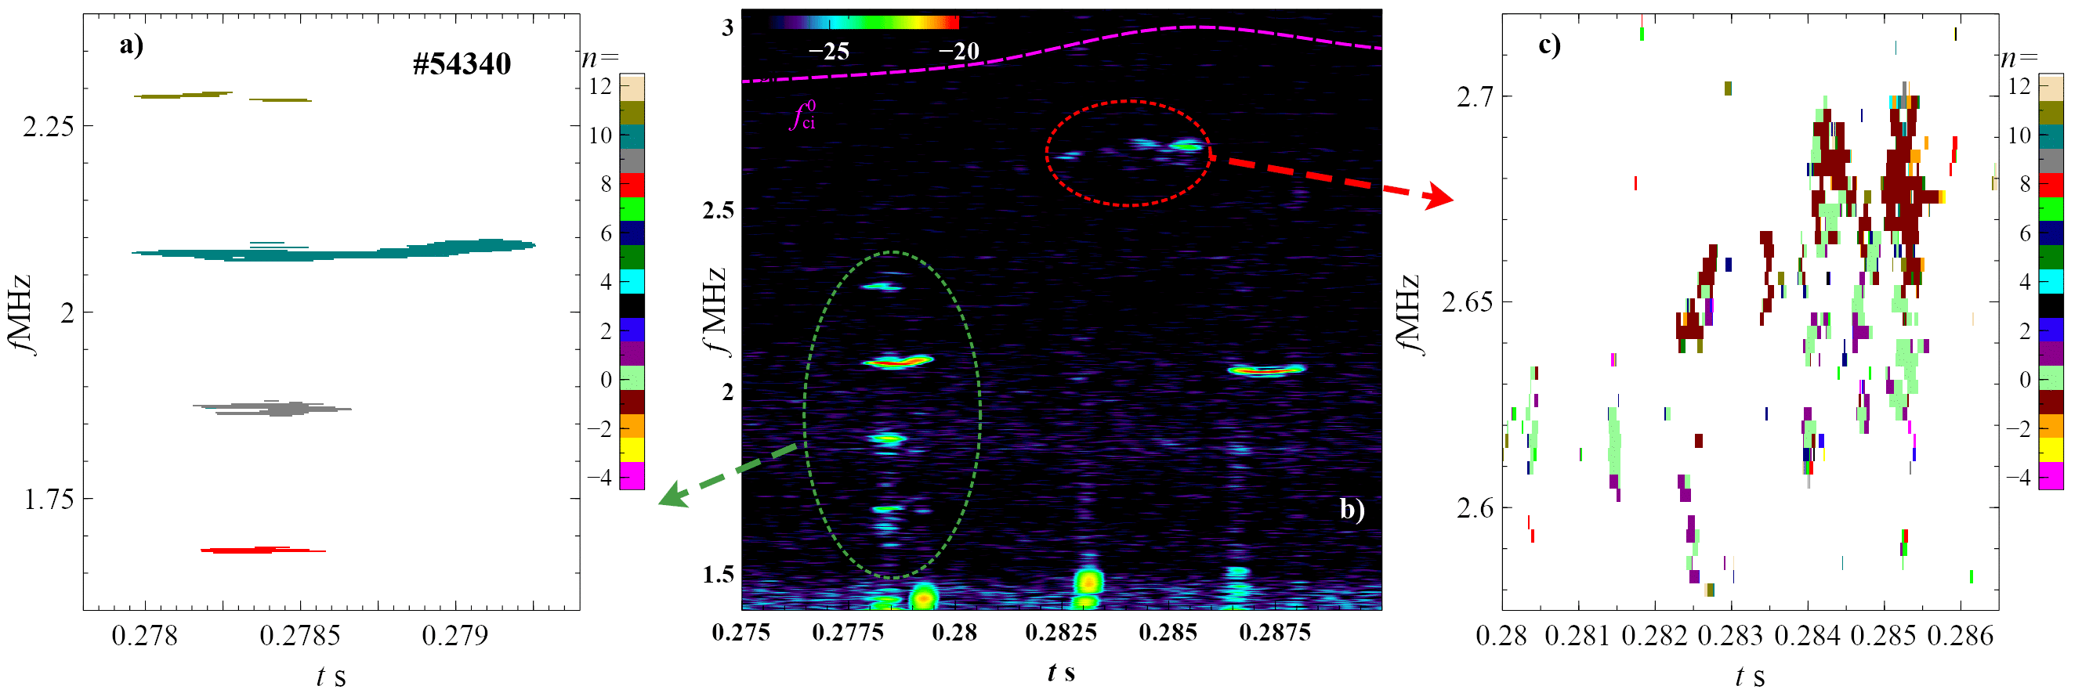
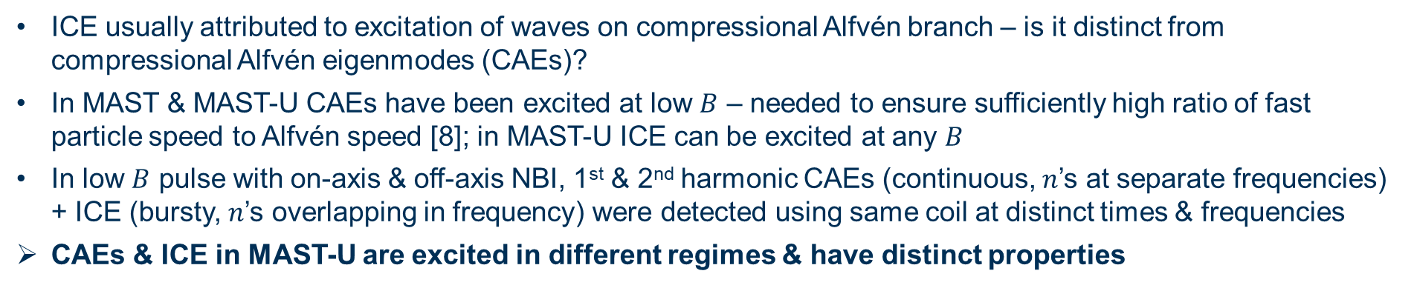
MAST-U ICE is distinct from CAE activity
ICE usually attributed to excitation of waves on compressional Alfvén branch – is it distinct from compressional Alfvén eigenmodes (CAEs)?
In MAST & MAST-U CAEs have been excited at low $B$ – needed to ensure sufficiently high ratio of fast particle speed to Alfvén speed [8]; in MAST-U ICE can be excited at any $B$
In low $B$ pulse with on-axis & off-axis NBI, 1st & 2nd harmonic CAEs (continuous, $n$’s at separate frequencies) + ICE (bursty, $n$’s overlapping in frequency) were detected using same coil at distinct times & frequencies
CAEs & ICE in MAST-U are excited in different regimes & have distinct properties
ICE
CAEs
[8] S E Sharapov et al. Phys. Plasmas 21 (2014) 082501

Slide 11

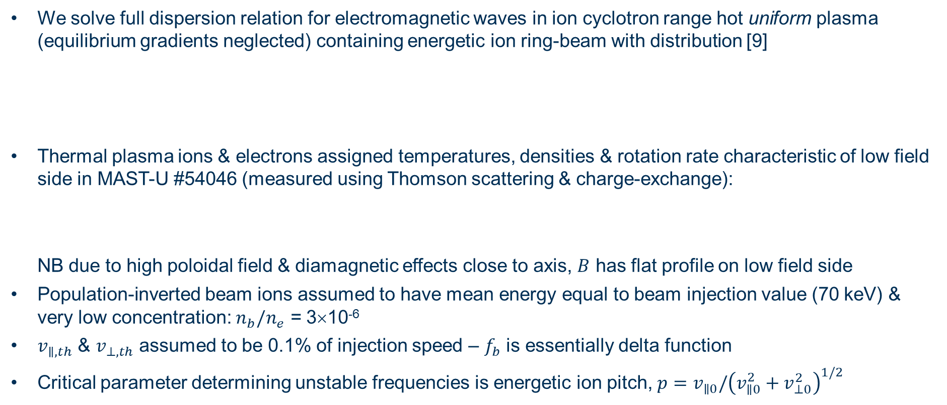
ICE modelled by calculating $ω\text{, }k_{∥}$ for hot plasma
We solve full dispersion relation for electromagnetic waves in ion cyclotron range hot uniform plasma (equilibrium gradients neglected) containing energetic ion ring-beam with distribution [9]
Thermal plasma ions & electrons assigned temperatures, densities & rotation rate characteristic of low field side in MAST-U #54046 (measured using Thomson scattering & charge-exchange):
NB due to high poloidal field & diamagnetic effects close to axis, $B$ has flat profile on low field side
Population-inverted beam ions assumed to have mean energy equal to beam injection value (70 keV) & very low concentration: $n_{b}/n_{e}$ = 3×10⁻⁶
$v_{∥,th}$ & $v_{⊥,th}$ assumed to be 0.1% of injection speed – $f_{b}$ is essentially delta function
Critical parameter determining unstable frequencies is energetic ion pitch, $p=$ $v_{∥0}/{\left(v_{∥0}^{2}+v_{⊥0}^{2}\right)}^{1/2}$
$$f_{b}=f_{0}\text{exp}\left[−\frac{{\left(v_{∥}−v_{∥0}\right)}^{2}}{v_{∥,th}^{2}}\right]\text{exp}\left[−\frac{{\left(v_{⊥}−v_{⊥0}\right)}^{2}}{v_{⊥,th}^{2}}\right]$$
$$B=0.6 \text{T, }T_{i}=1.7 \text{keV, }T_{e}=1.1 \text{keV, }n_{e}=3×{10}^{19}{\text{m}}^{−3}, v_{φ}=60 k\text{m}{\text{ s}}^{−1}$$
[9] J W S Cook Plasma Phys. Control. Fusion 64 (2022) 115002

Slide 12
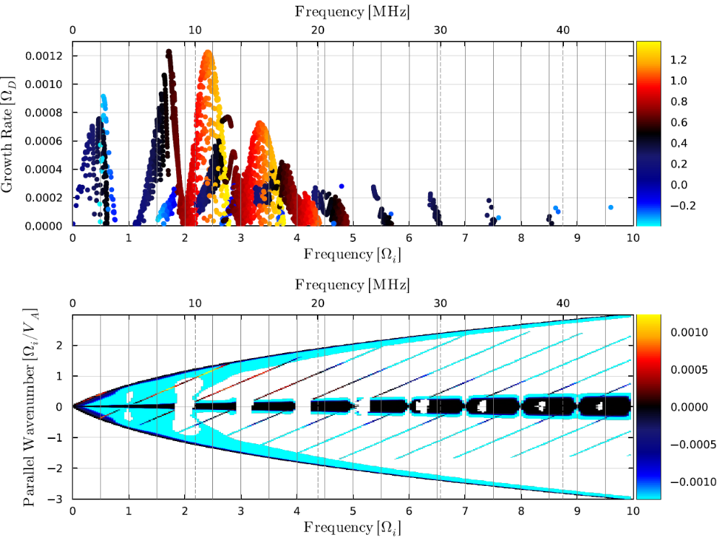
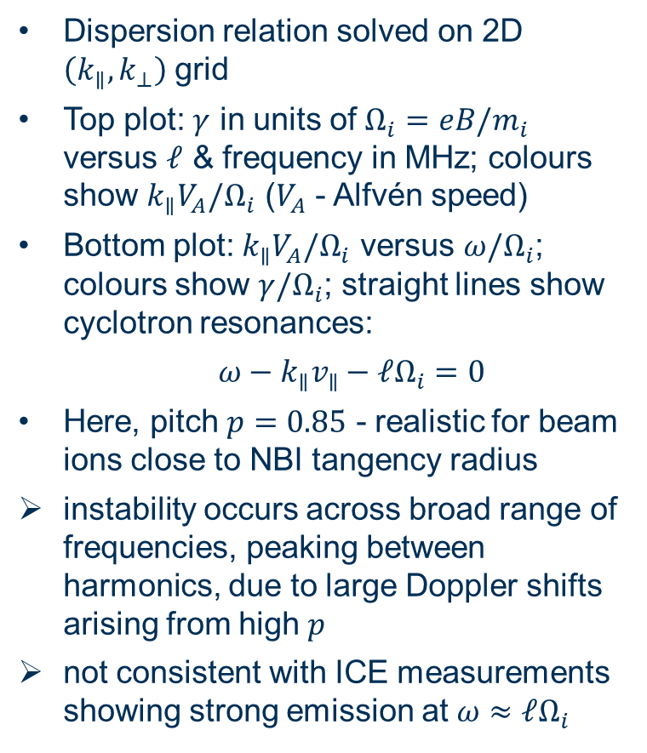


ICE excitation by passing fast ions seems unlikely
Dispersion relation solved on 2D $\left(k_{∥},k_{⊥}\right)$ grid
Top plot: $γ$ in units of $Ω_{i}=eB/m_{i}$ versus $ℓ$ & frequency in MHz; colours show $k_{∥}V_{A}/Ω_{i}$ ($V_{A}$ - Alfvén speed)
Bottom plot: $k_{∥}V_{A}/Ω_{i}$ versus $ω/Ω_{i}$; colours show $γ/Ω_{i}$; straight lines show cyclotron resonances:
  $ω−k_{∥}v_{∥}−ℓΩ_{i}=0$
Here, pitch $p=0.85$ - realistic for beam ions close to NBI tangency radius
instability occurs across broad range of frequencies, peaking between harmonics, due to large Doppler shifts arising from high $p$
not consistent with ICE measurements showing strong emission at $ω≈ℓΩ_{i}$
$$k_{∥}V_{A}/Ω_{i}$$
$$γ/Ω_{i}$$

Slide 13
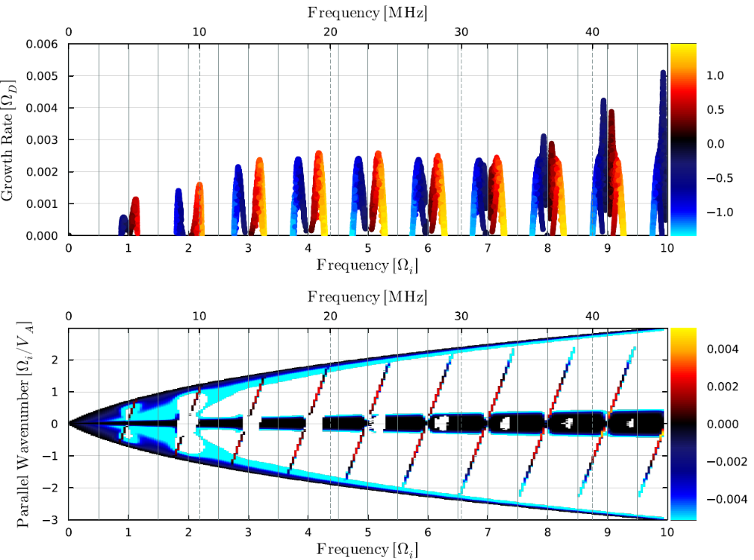
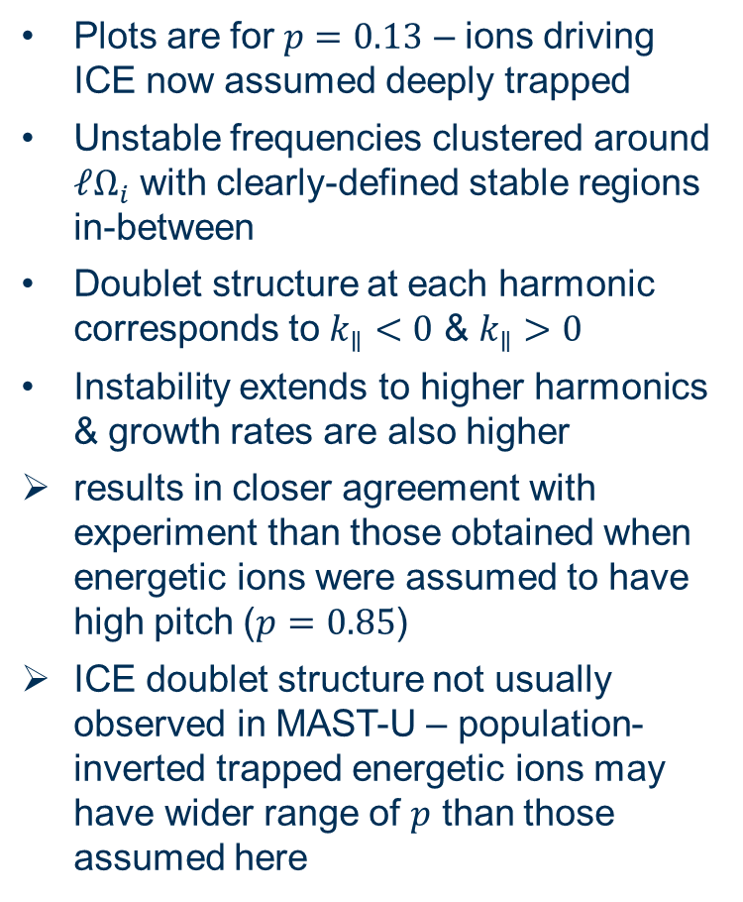
ICE excitation by trapped fast ions seems likely
Plots are for $p=0.13$ – ions driving ICE now assumed deeply trapped
Unstable frequencies clustered around $ℓΩ_{i}$ with clearly-defined stable regions in-between
Doublet structure at each harmonic corresponds to $k_{∥}<0$ & $k_{∥}>0$
Instability extends to higher harmonics & growth rates are also higher
results in closer agreement with experiment than those obtained when energetic ions were assumed to have high pitch ($p=0.85$)
ICE doublet structure not usually observed in MAST-U – population-inverted trapped energetic ions may have wider range of $p$ than those assumed here
$$k_{∥}V_{A}/Ω_{i}$$
$$γ/Ω_{i}$$

Slide 14
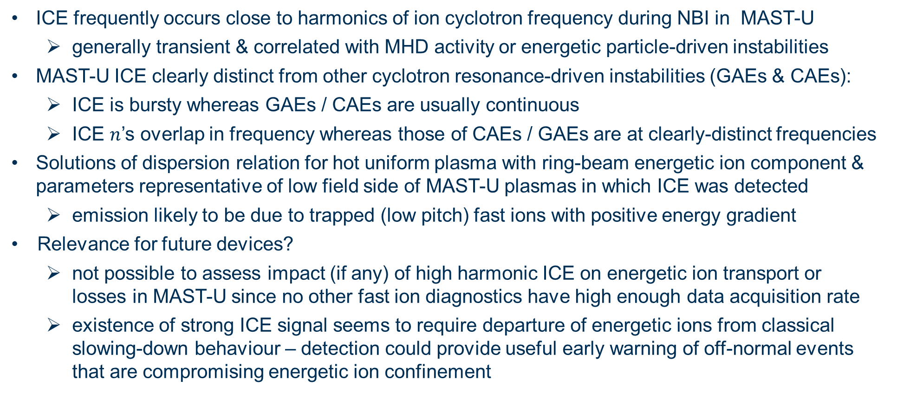
Conclusions
ICE frequently occurs close to harmonics of ion cyclotron frequency during NBI in MAST-U
  generally transient & correlated with MHD activity or energetic particle-driven instabilities
MAST-U ICE clearly distinct from other cyclotron resonance-driven instabilities (GAEs & CAEs):
  ICE is bursty whereas GAEs / CAEs are usually continuous
  ICE $n$’s overlap in frequency whereas those of CAEs / GAEs are at clearly-distinct frequencies
Solutions of dispersion relation for hot uniform plasma with ring-beam energetic ion component & parameters representative of low field side of MAST-U plasmas in which ICE was detected
  emission likely to be due to trapped (low pitch) fast ions with positive energy gradient
Relevance for future devices?
  not possible to assess impact (if any) of high harmonic ICE on energetic ion transport or losses in MAST-U since no other fast ion diagnostics have high enough data acquisition rate
  existence of strong ICE signal seems to require departure of energetic ions from classical slowing-down behaviour – detection could provide useful early warning of off-normal events that are compromising energetic ion confinement

