Slide 1
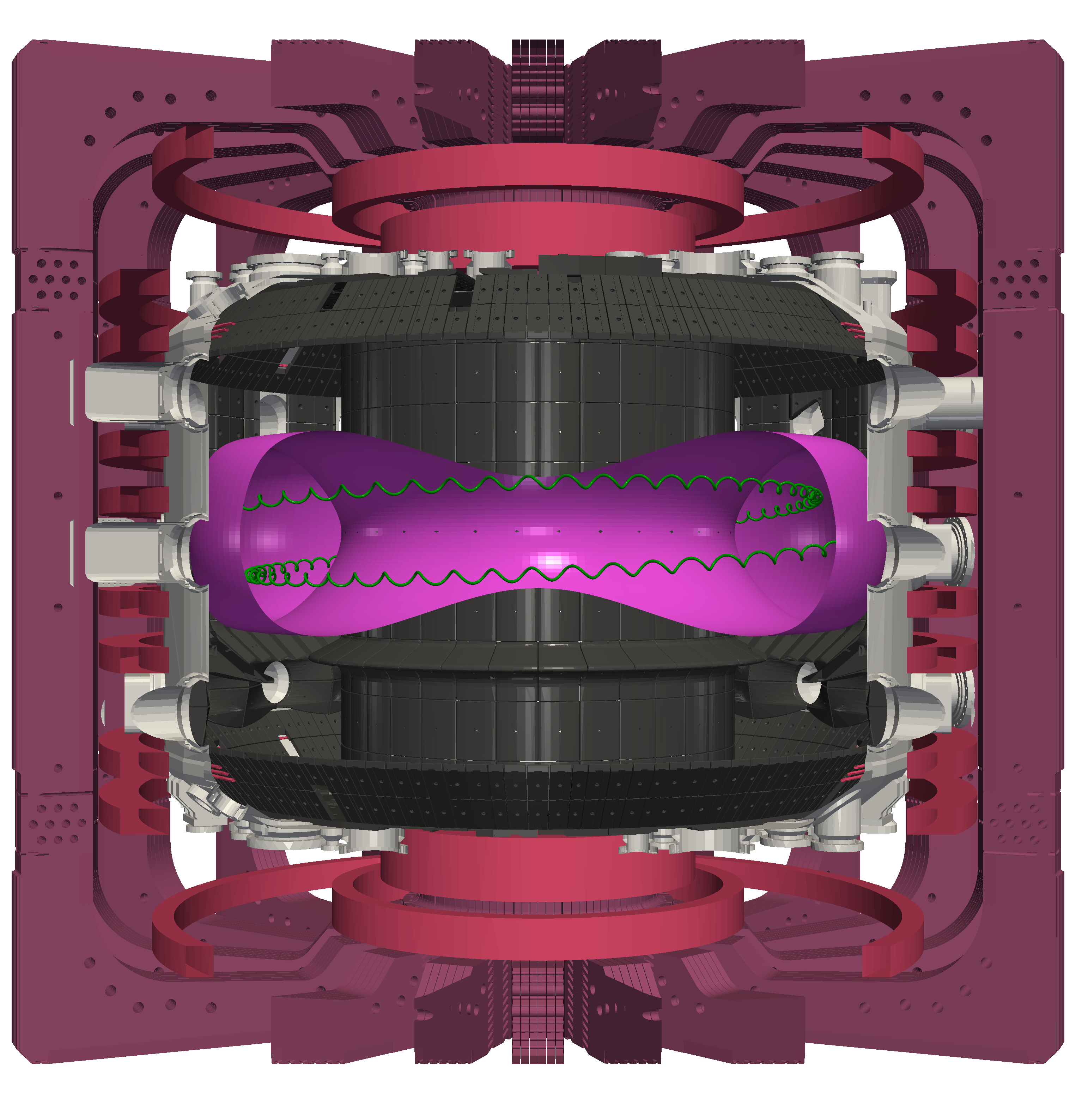
Experimental characterization of fishbone-induced fast-ion transport via correlated FIDA and FILD measurements on the TCV tokamak
19th Technical Meeting on Energetic Particles in Magnetic Confinement Systems
Quentin Kernel, M. Rud, A. Jansen van Vuuren,
J. Poley-Sanjuán, M. Podestà, A. Fasoli, D. Mykytchuk,
A. Karpushov and the TCV team
Invited talk — Physics of energetic particle modes and transport IV
02.10.2026

Slide 2
19th Technical Meeting
on Energetic Particles
in Magnetic Confinement
Systems
Outline
Experimental framework & fishbone characterization
Redistribution of confined fast ions
Fast-ion losses
Towards a consistent picture of fishbone-induced transport

Slide 3
Experimental framework & fishbone characterization
Redistribution of confined fast ions
Fast-ion losses
Towards a consistent picture of fishbone-induced transport
Fishbones as a testbed for fast-ion transport
on TCV

Slide 4
Why these experiments on fishbones?
We want to develop a comprehensive framework to study fast-ion physics on TCV [1, 2]
  Inference of the fast-ion distribution function
  Combining diagnostics of confined and lost fast ions with phase-space reconstruction techniques
  Predictive capabilities
  Validation of fast-ion transport models at multiple levels (primacy hierarchy)
  Control tools
  Identification of sensors and actuators to avoid, dampen or suppress instabilities
[1] M. Podestà et al., (this conference)
[2] W. W. Heidbrink, Phys. Plasmas (2026)

Slide 5
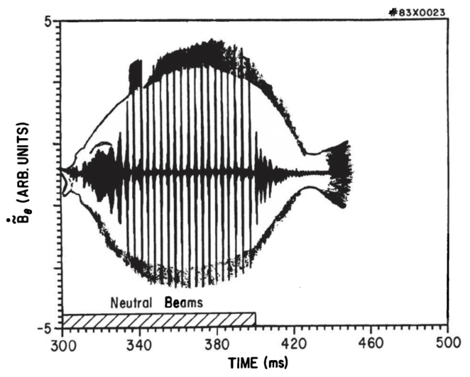
Why these experiments on fishbones?
We want to develop a comprehensive framework to study fast-ion physics on TCV [1, 2]
  Inference of the fast-ion distribution function
  Combining diagnostics of confined and lost fast ions with phase-space reconstruction techniques
  Predictive capabilities
  Validation of fast-ion transport models at multiple levels (primacy hierarchy)
  Control tools
  Identification of sensors and actuators to avoid, dampen or suppress instabilities
Fishbones as a primary target
  Effects are sufficiently significant to
  be “easily” observed
  Well-established theoretical framework, good testbed for model validation
  But still an active field of research,
  some parts still require clarifications
  (nonlinearities, saturation by zonal flows [3])
[1] M. Podestà et al., (this conference)
[2] W. W. Heidbrink, Phys. Plasmas (2026)
[3] G. Brochard et al., Phys. Rev. Lett. (2024)

Slide 6
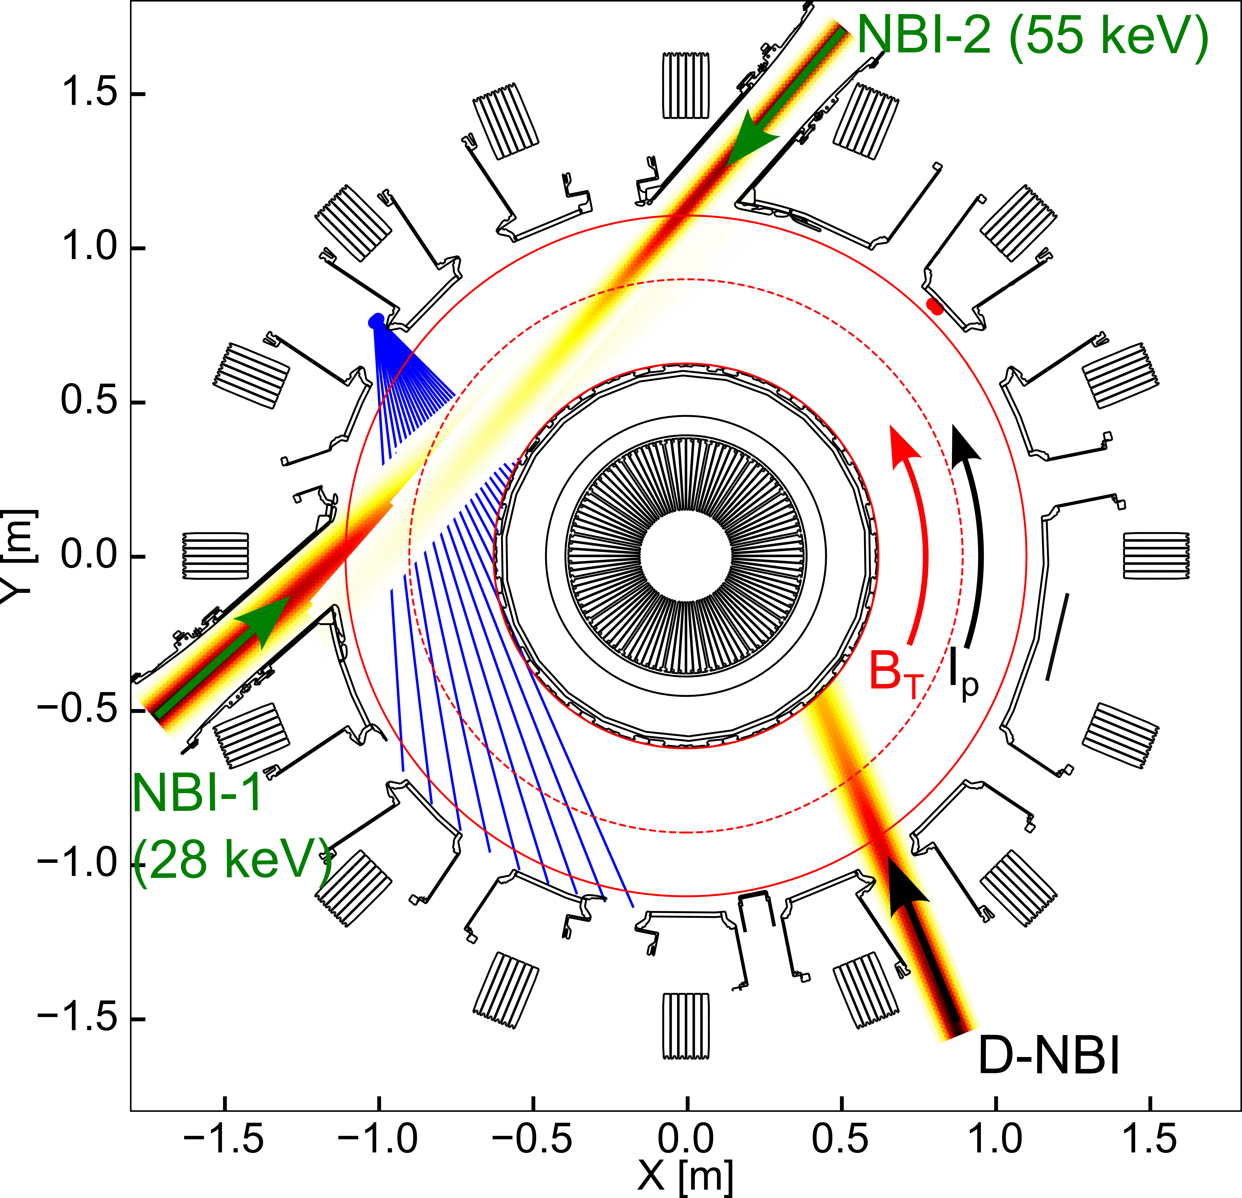
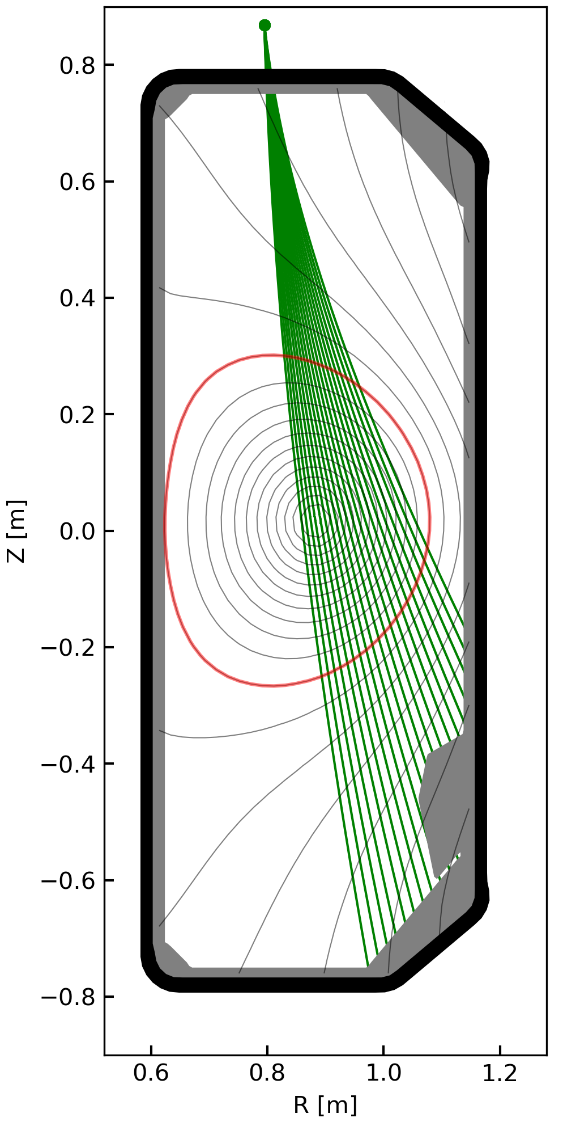
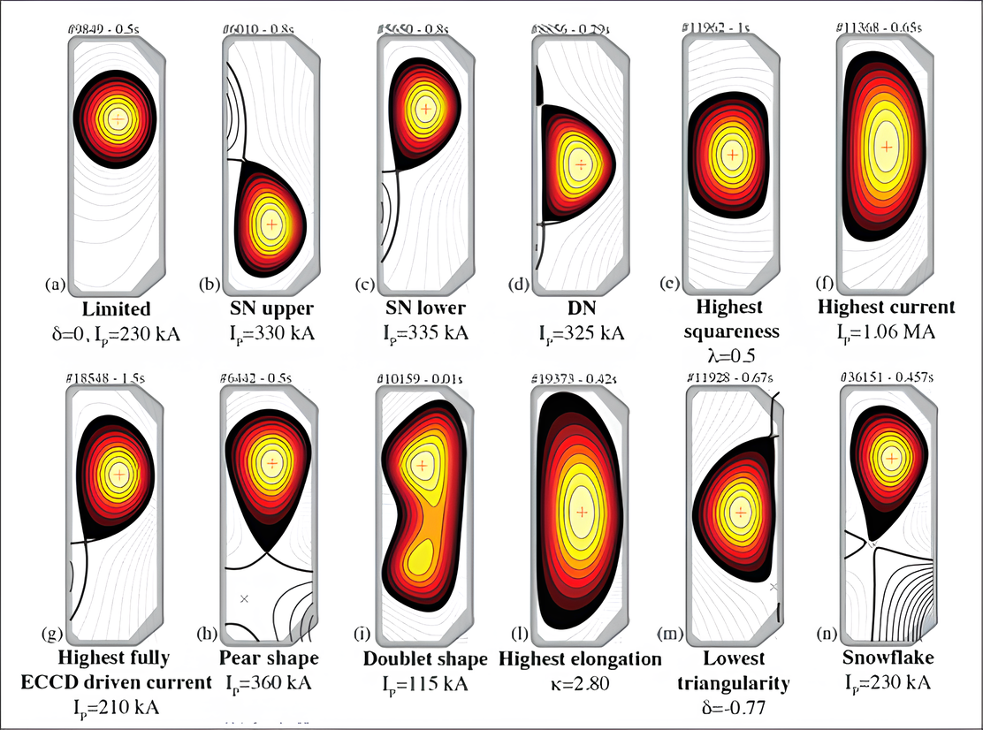
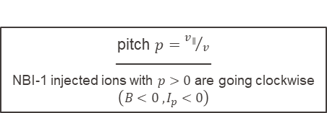
Tokamak à Configuration Variable (TCV), a medium-size machine with strong capabilities
Opportunity to study fast ions across various scenarios [1,2]
  Plasma shaping
  Heating scheme: NBIs, ECRH
  Diagnostics: FIDA, FILD, Neutrons, ICE
FIDA-vert
FIDA-hor
FASTNEUT
FILD
pitch $p={v_{∥}}/v$
——————
NBI-1 injected ions with $p>0$ are going clockwise
$\left(B<0 ,I_{p}<0\right)$
[1] A. Karpushov et al., 46th EPS Conference on Plasma Physics (2023)
[2] A. Jansen van Vuuren et al., (this conference)

Slide 7
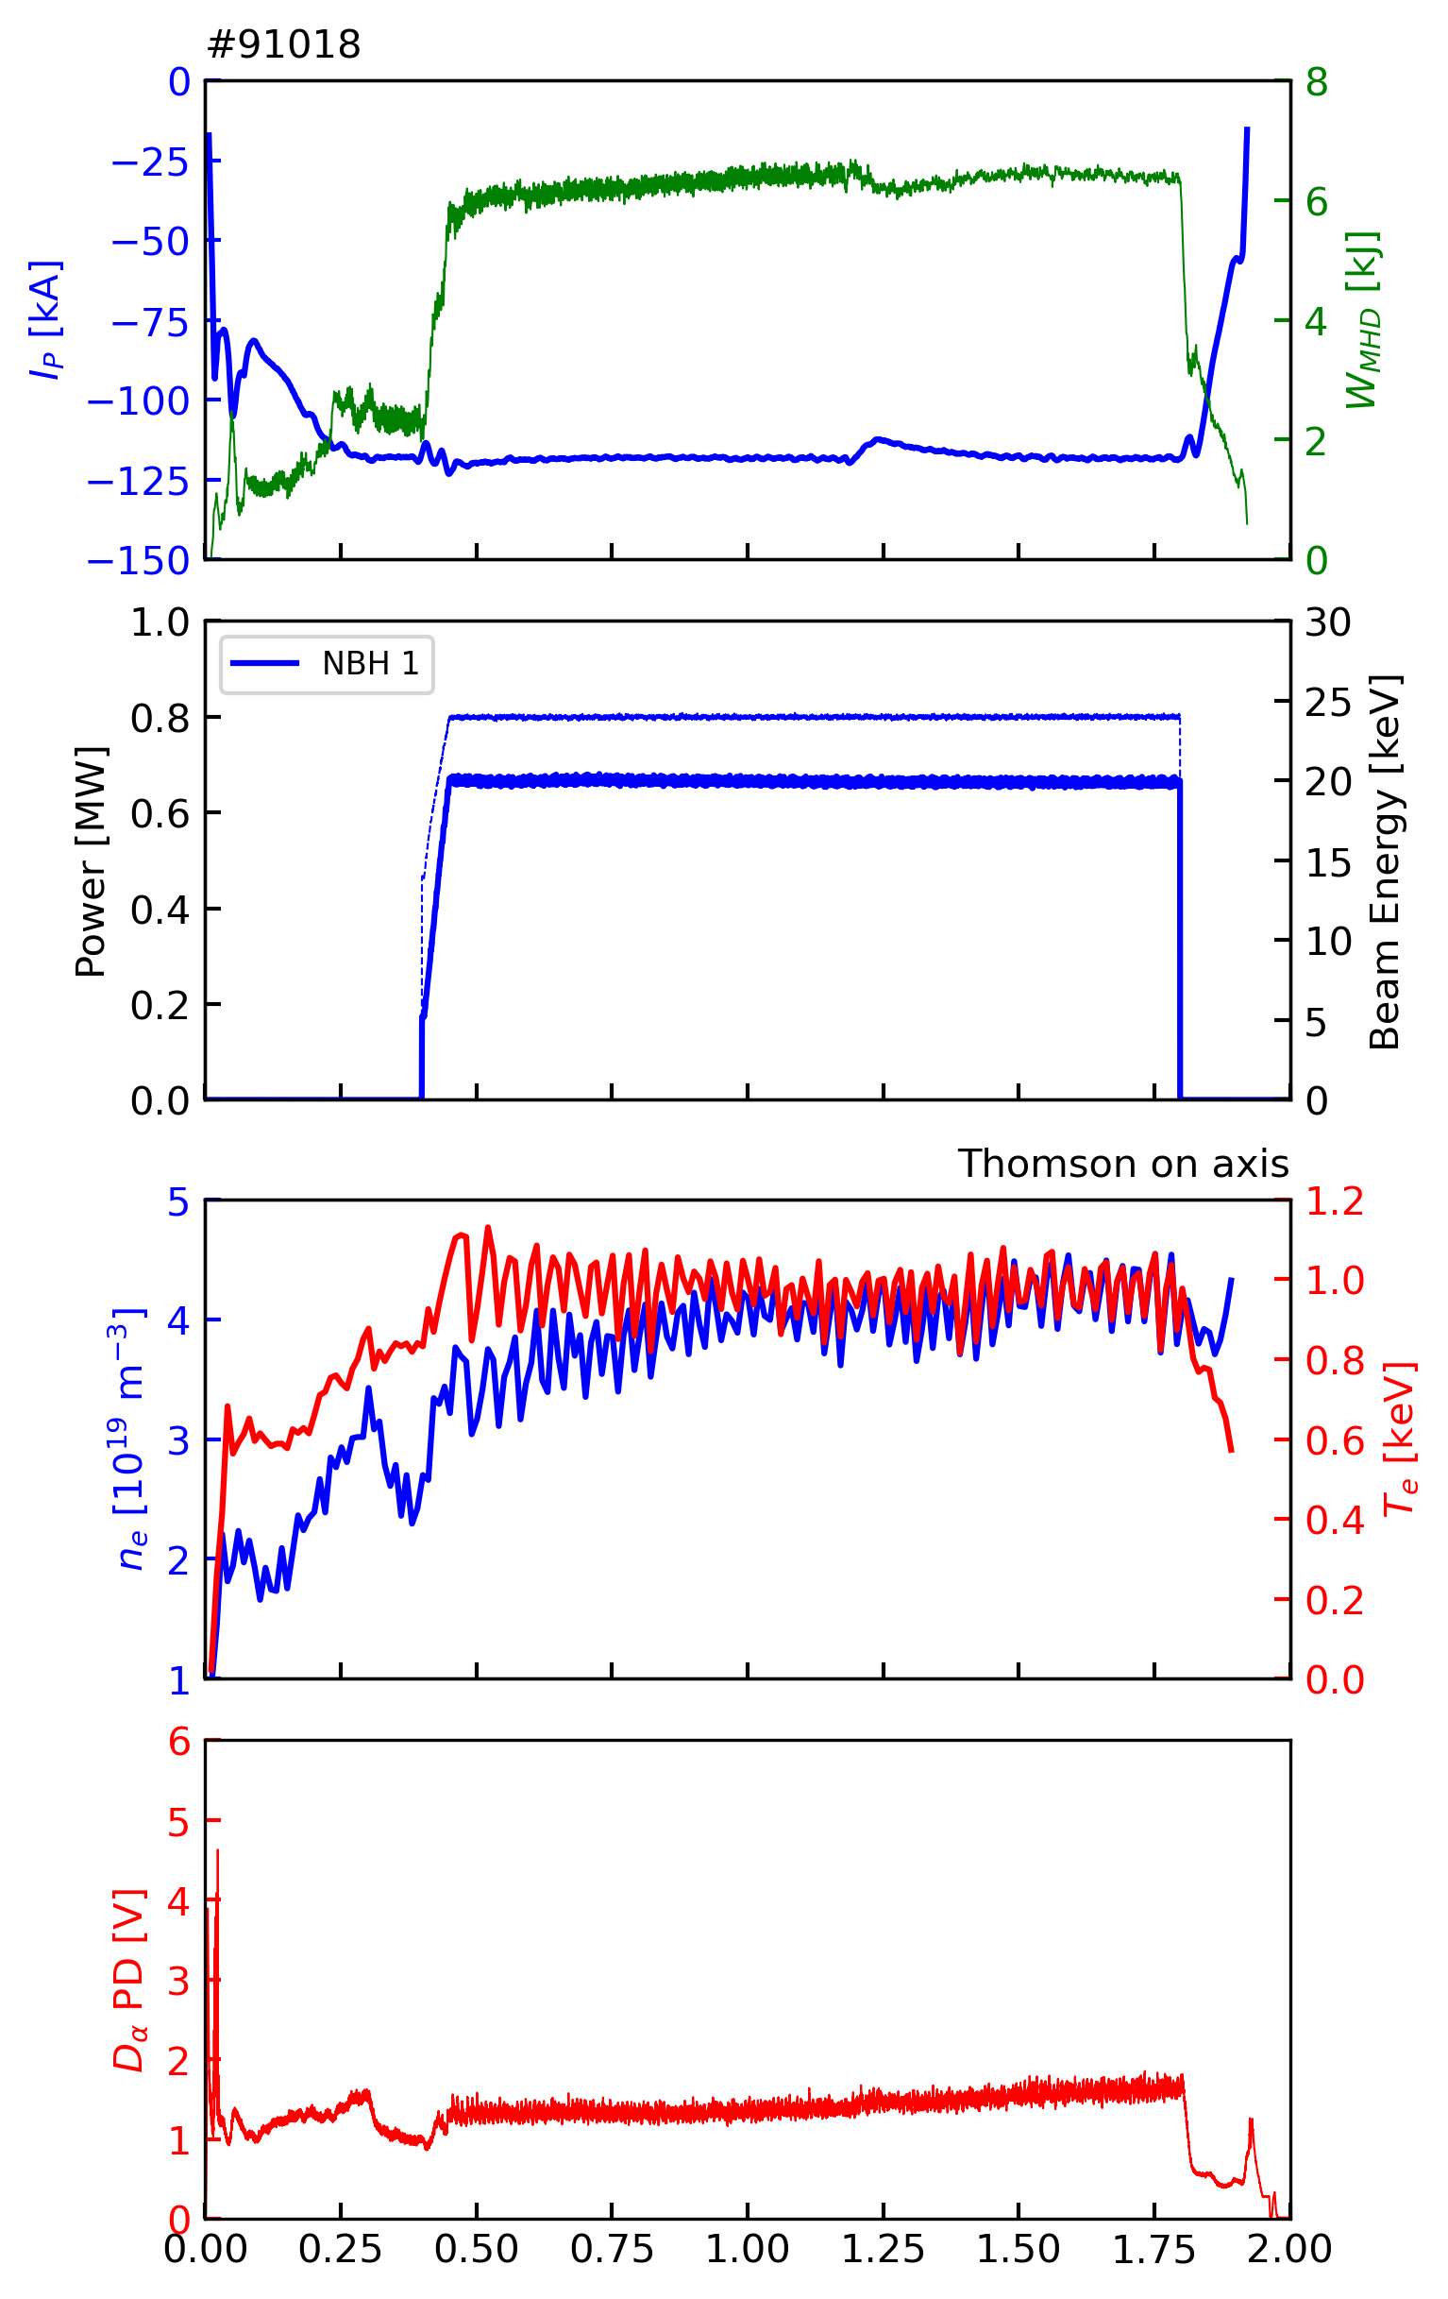
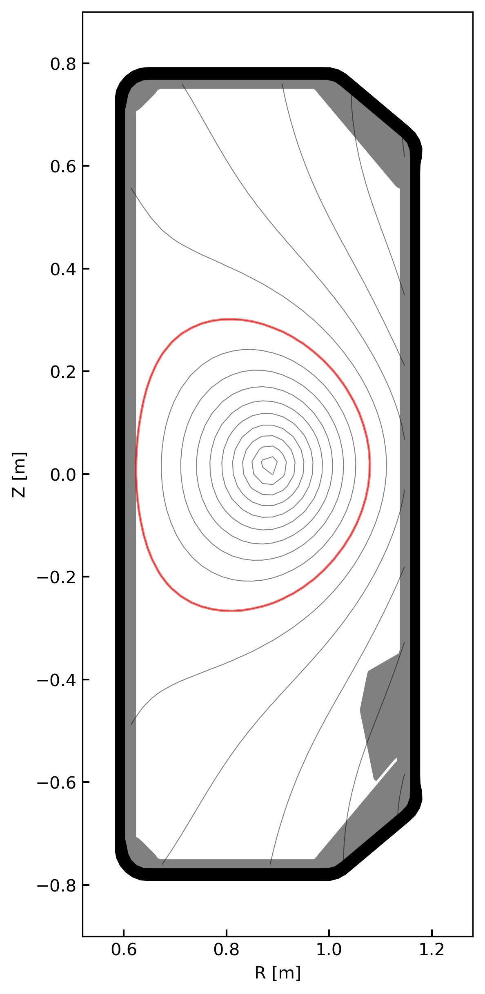
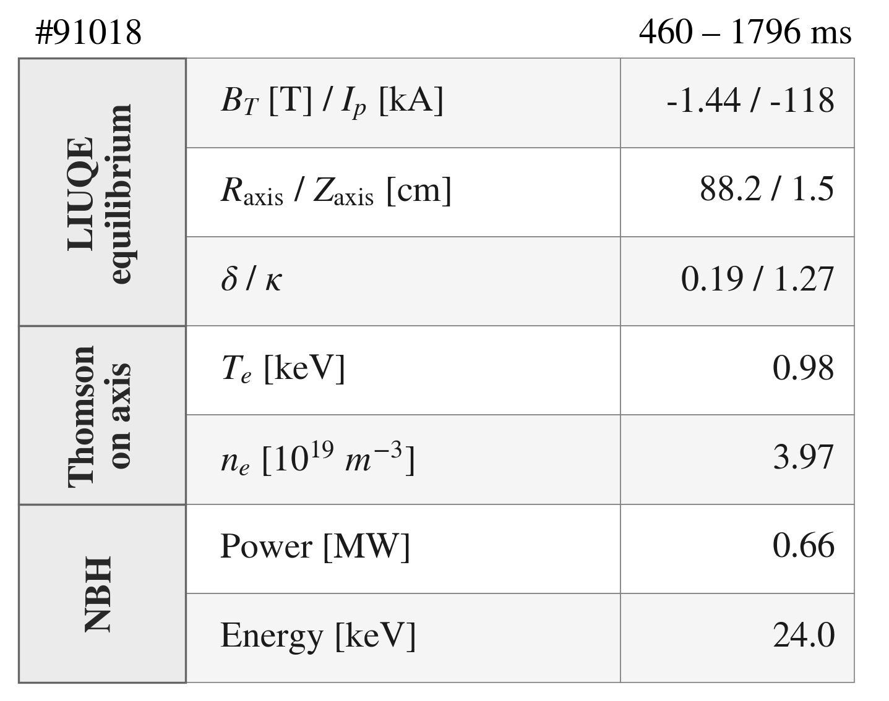
A first simple, reproducible scenario
Limited plasma discharge with positive-δ
  Quasi-steady conditions
  NBI heating generates a fast-ion population

Slide 8
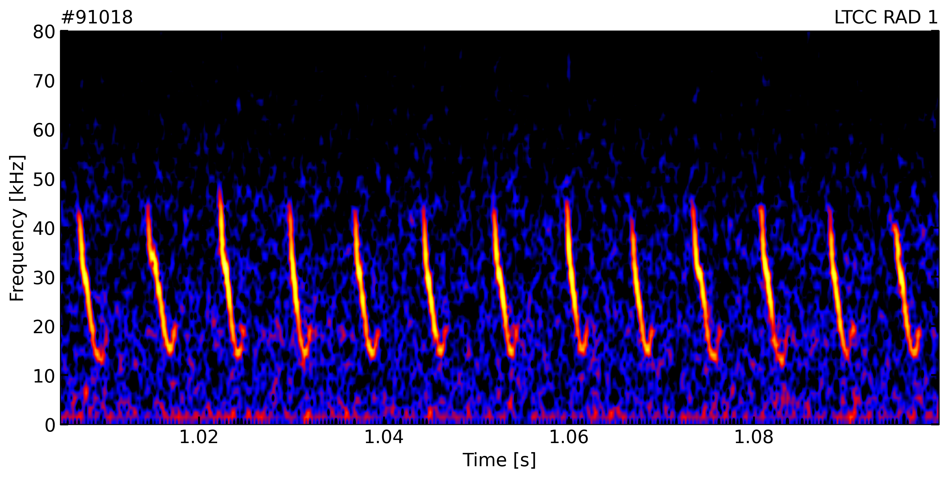
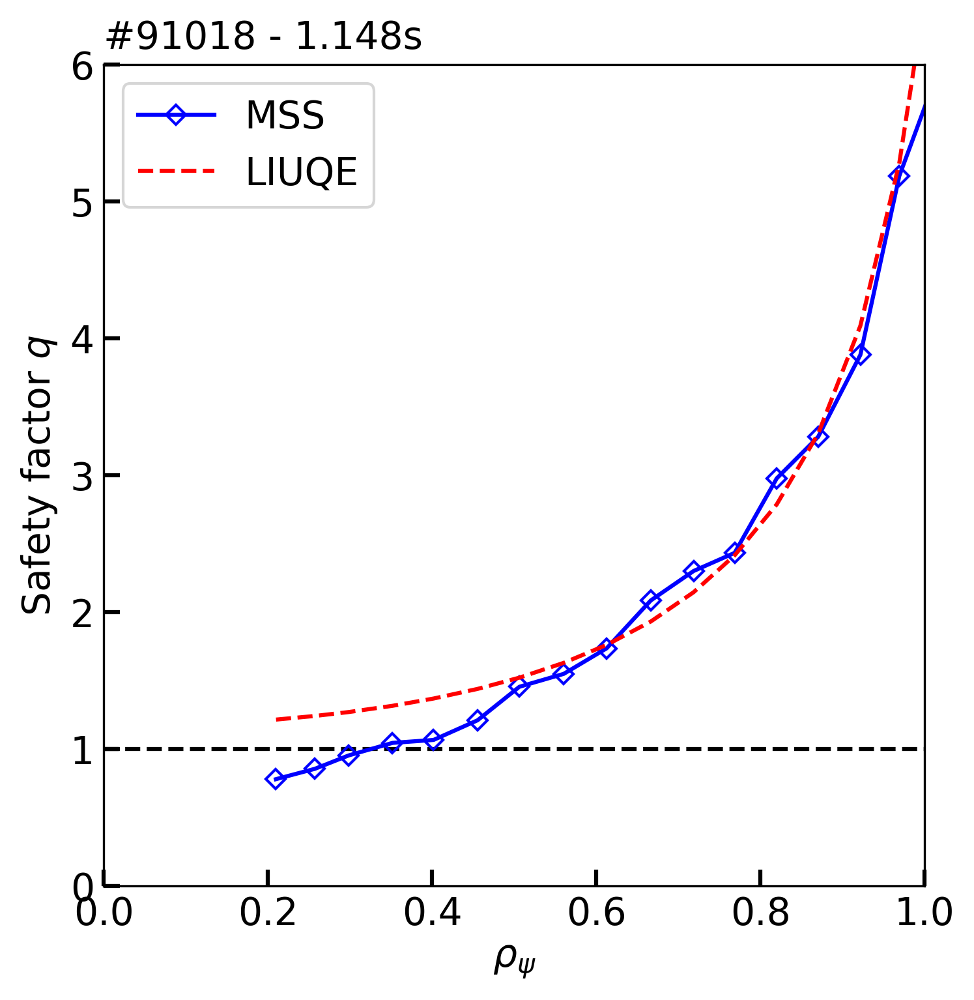
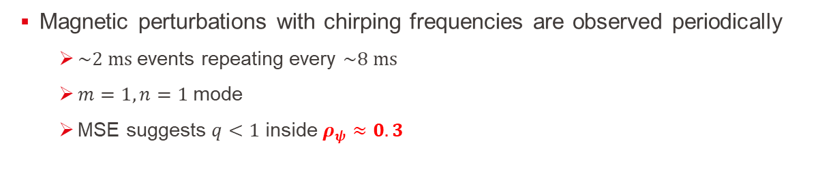
Recurrent MHD bursts are identified as fishbones
Magnetic perturbations with chirping frequencies are observed periodically
  $\sim 2 ms$events repeating every $\sim 8 ms$
  $m=1,n=1$ mode
  MSE suggests $q<1$ inside $ρ_{ψ}≈0.3$

Slide 9
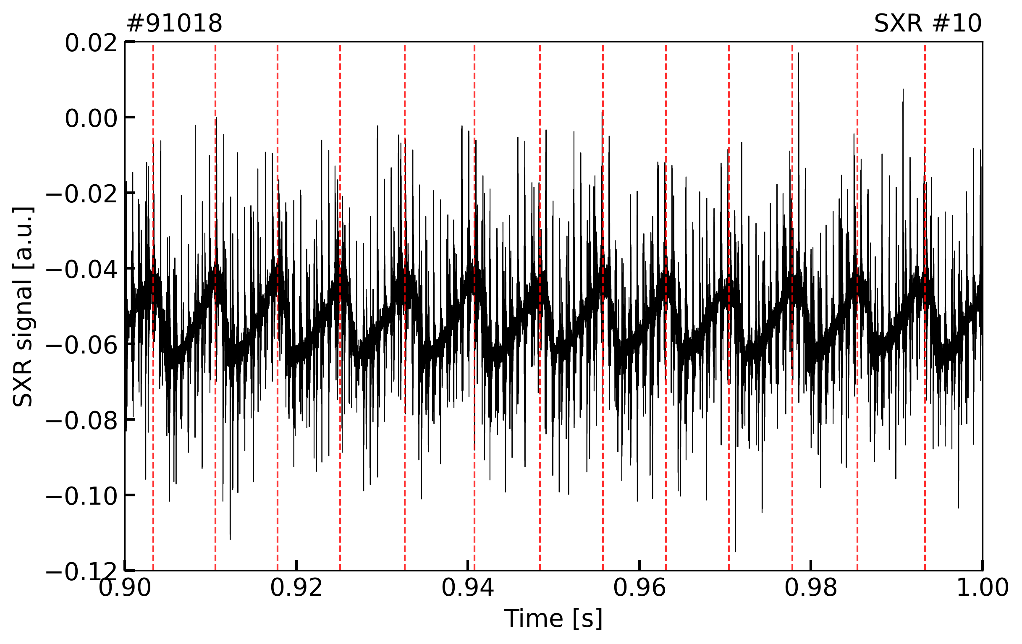
Conditional sampling resolves the fishbone cycle across diagnostics
Reference signal: central vertical Soft X-Ray (SXR) chord
  Sensitive to core plasma perturbations
  Bremsstrahlung-dominated emission → proxy for density and temperature perturbation
  Sharp SXR variations → fishbone onset detection

Slide 10
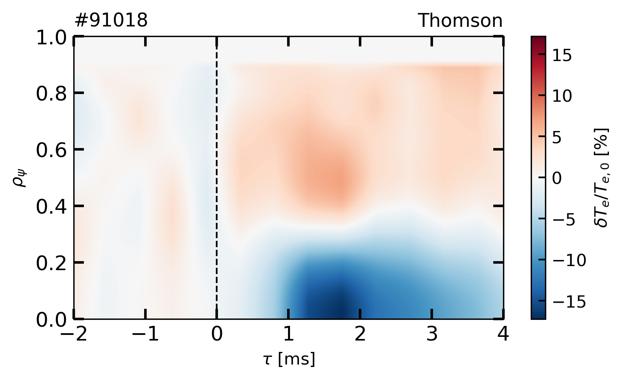
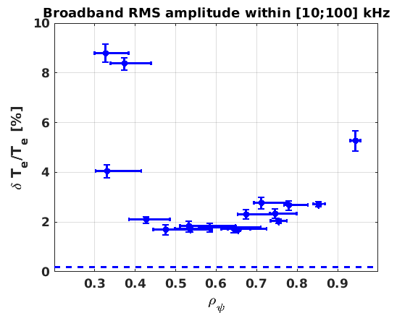
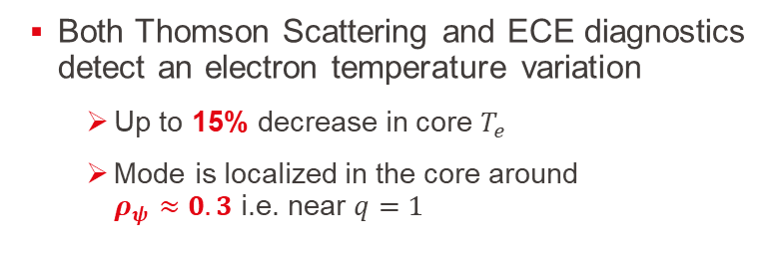
Core plasma is significantly perturbed
Both Thomson Scattering and ECE diagnostics detect an electron temperature variation
  Up to 15% decrease in core $T_{e}$
  Mode is localized in the core around
  $ρ_{ψ}≈0.3$ i.e. near $q=1$

Slide 11
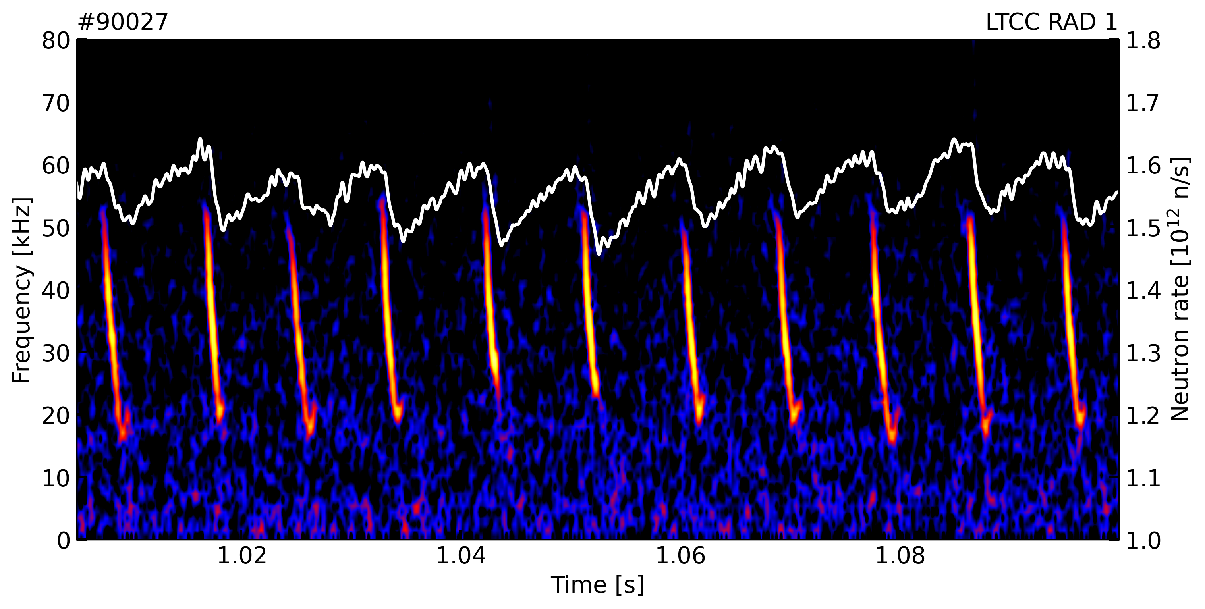
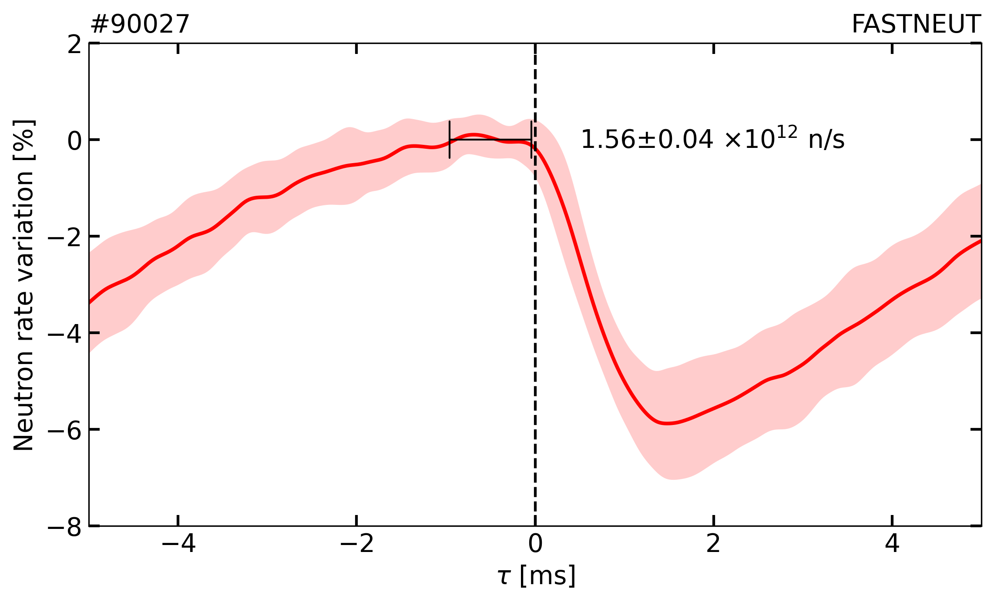
Neutron rate drops are correlated with the fishbone cycle
Neutron emission, produced mainly by reactions involving thermal and fast ions, provides an indirect measure of the fast-ion population
  Is it really fast-ion transport or just change in bulk plasma?
  If fast-ion related, it cannot tell us where in phase space
→ What happens to the fast-ion distribution during a fishbone?

Slide 12
Experimental framework & fishbone characterization
Redistribution of confined fast ions
Fast-ion losses
Towards a consistent picture of fishbone-induced transport
How does the confined fast-ion population respond?

Slide 13
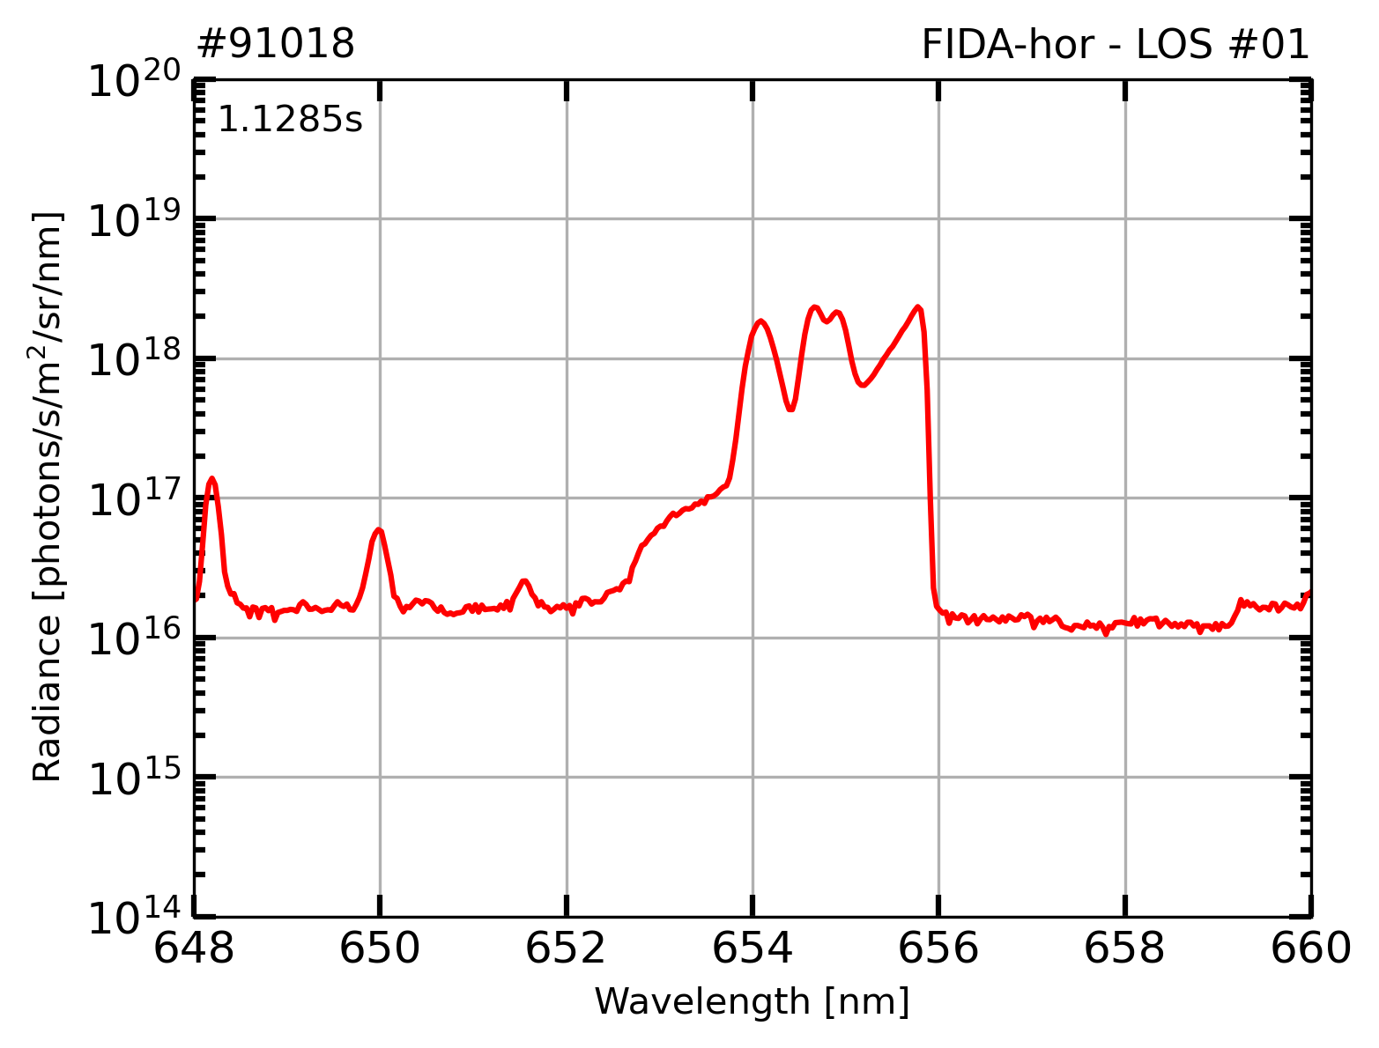
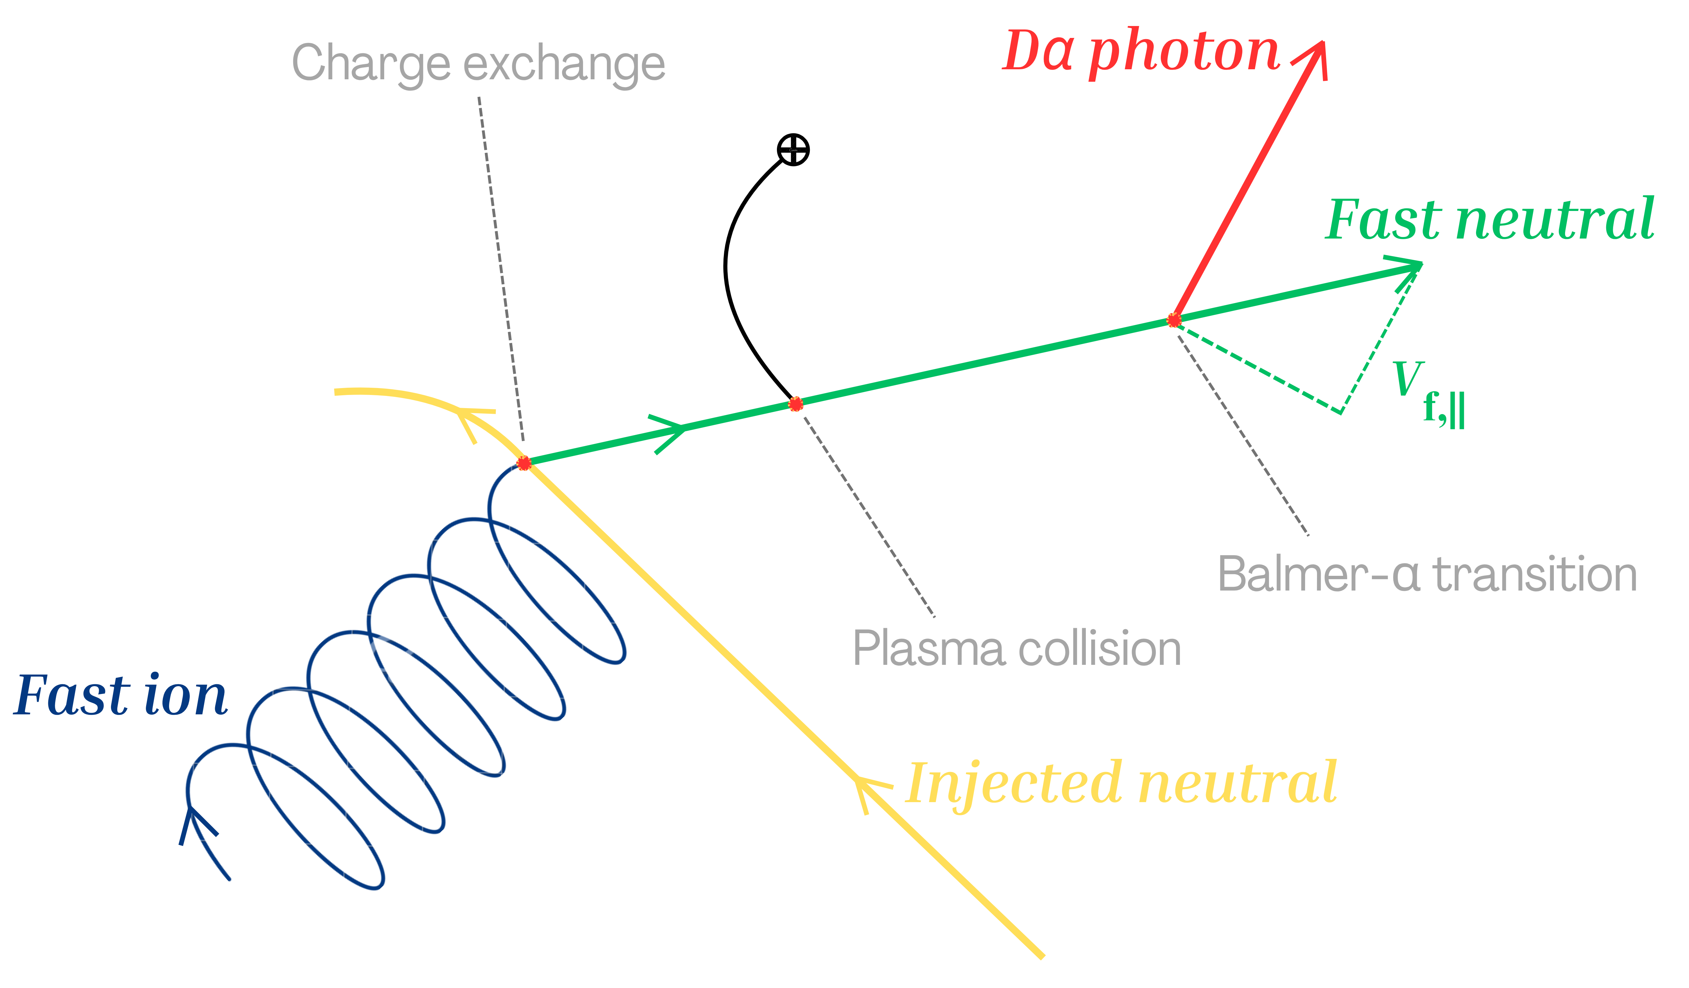
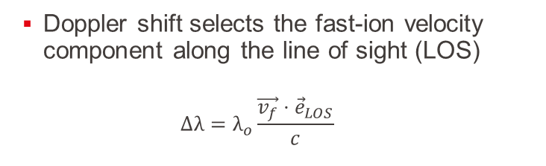

FIDA spectroscopy probes confined fast ions via Doppler-shifted Dα emission
Doppler shift selects the fast-ion velocity component along the line of sight (LOS)
  $$∆λ=λ_{o}\frac{\vec{v_{f}}⋅{\vec{e}}_{LOS}}{c}$$
Beam Emission Spectra
O-V
impurity line
Blocking strip
FIDA
Dα line
$λ_{o}$= 656.1nm
W. W. Heidbrink, Rev. Sci. Instrum. (2010)

Slide 14
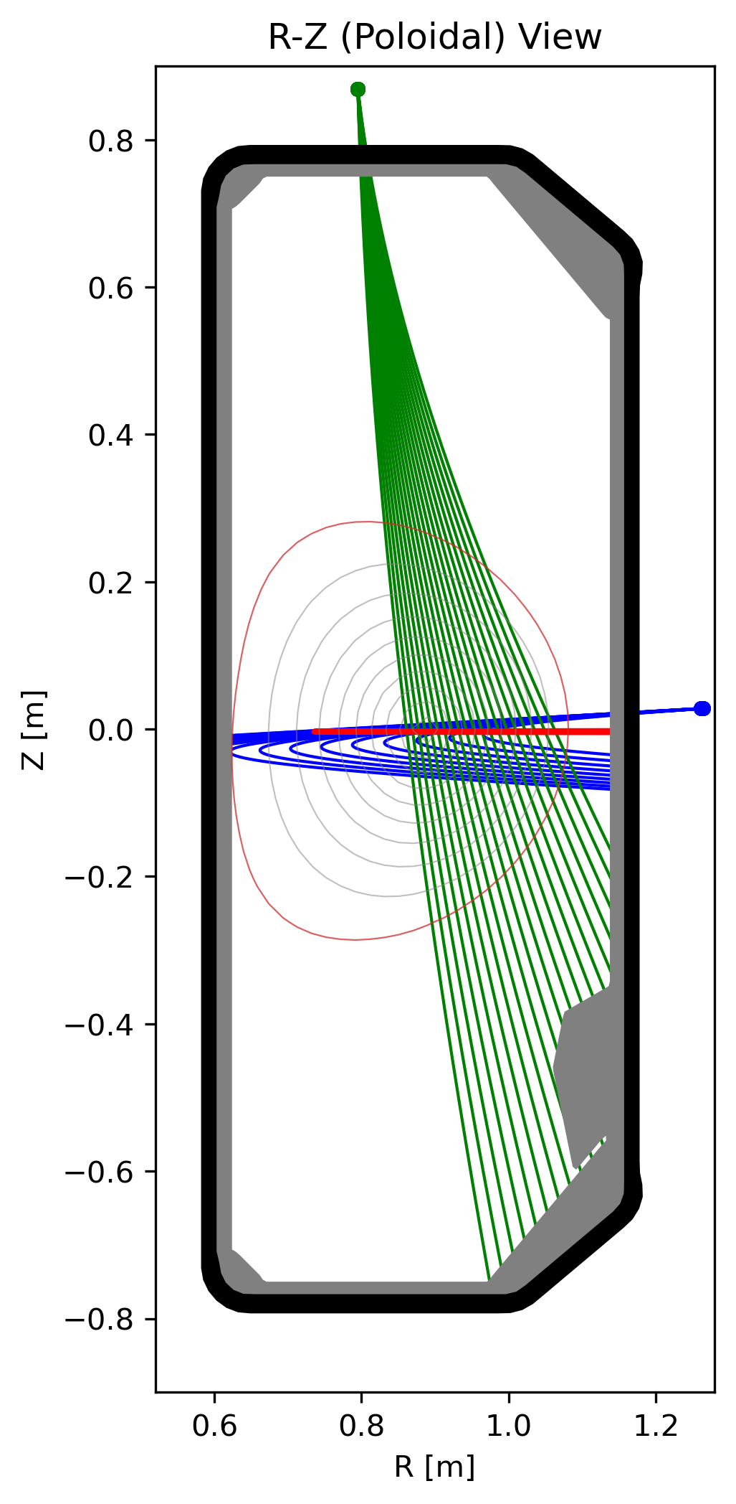
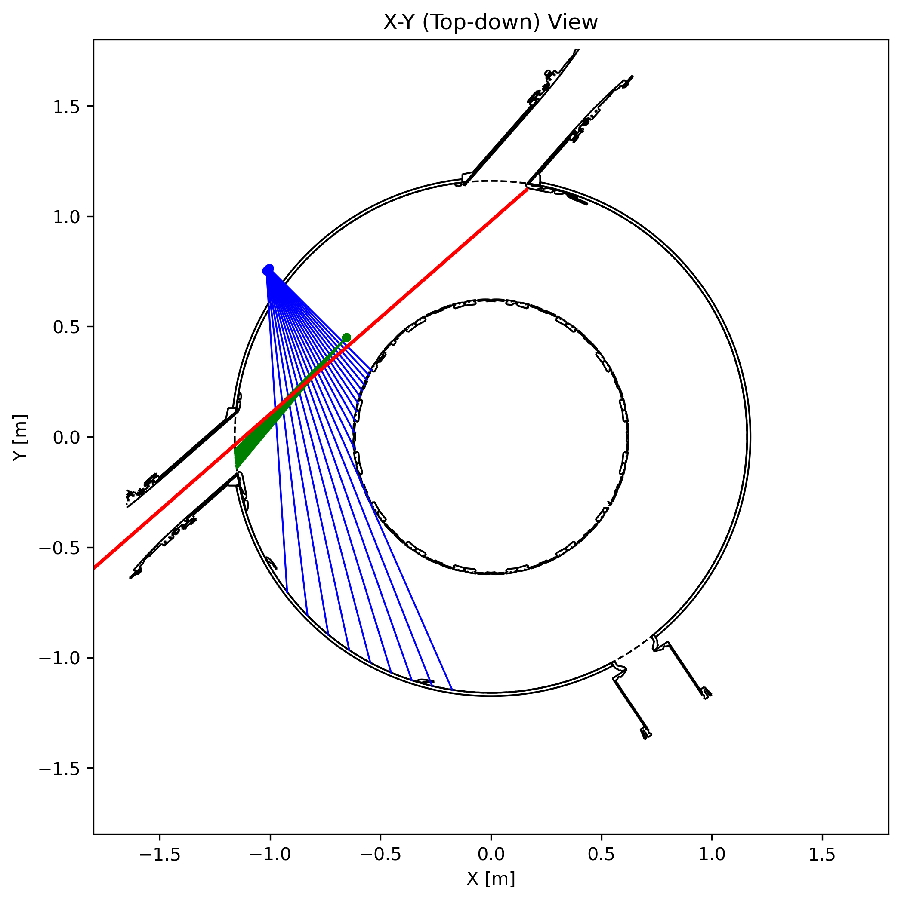
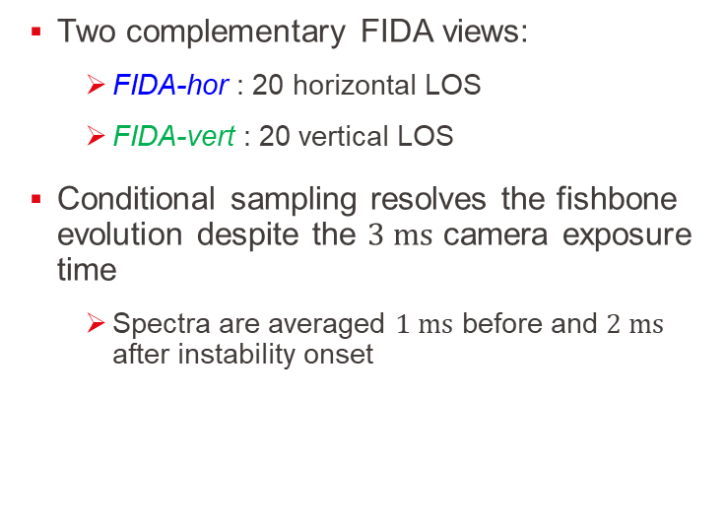
Two FIDA systems measure the confined fast-ion population on TCV
Two complementary FIDA views:
  FIDA-hor : 20 horizontal LOS
  FIDA-vert : 20 vertical LOS
Conditional sampling resolves the fishbone evolution despite the $3 ms$ camera exposure time
  Spectra are averaged $1 ms$ before and $2 ms$ after instability onset
W. W. Heidbrink, Rev. Sci. Instrum. (2010)
B. Geiger et al., Plasma Phys. Control. Fusion (2017)

Slide 15
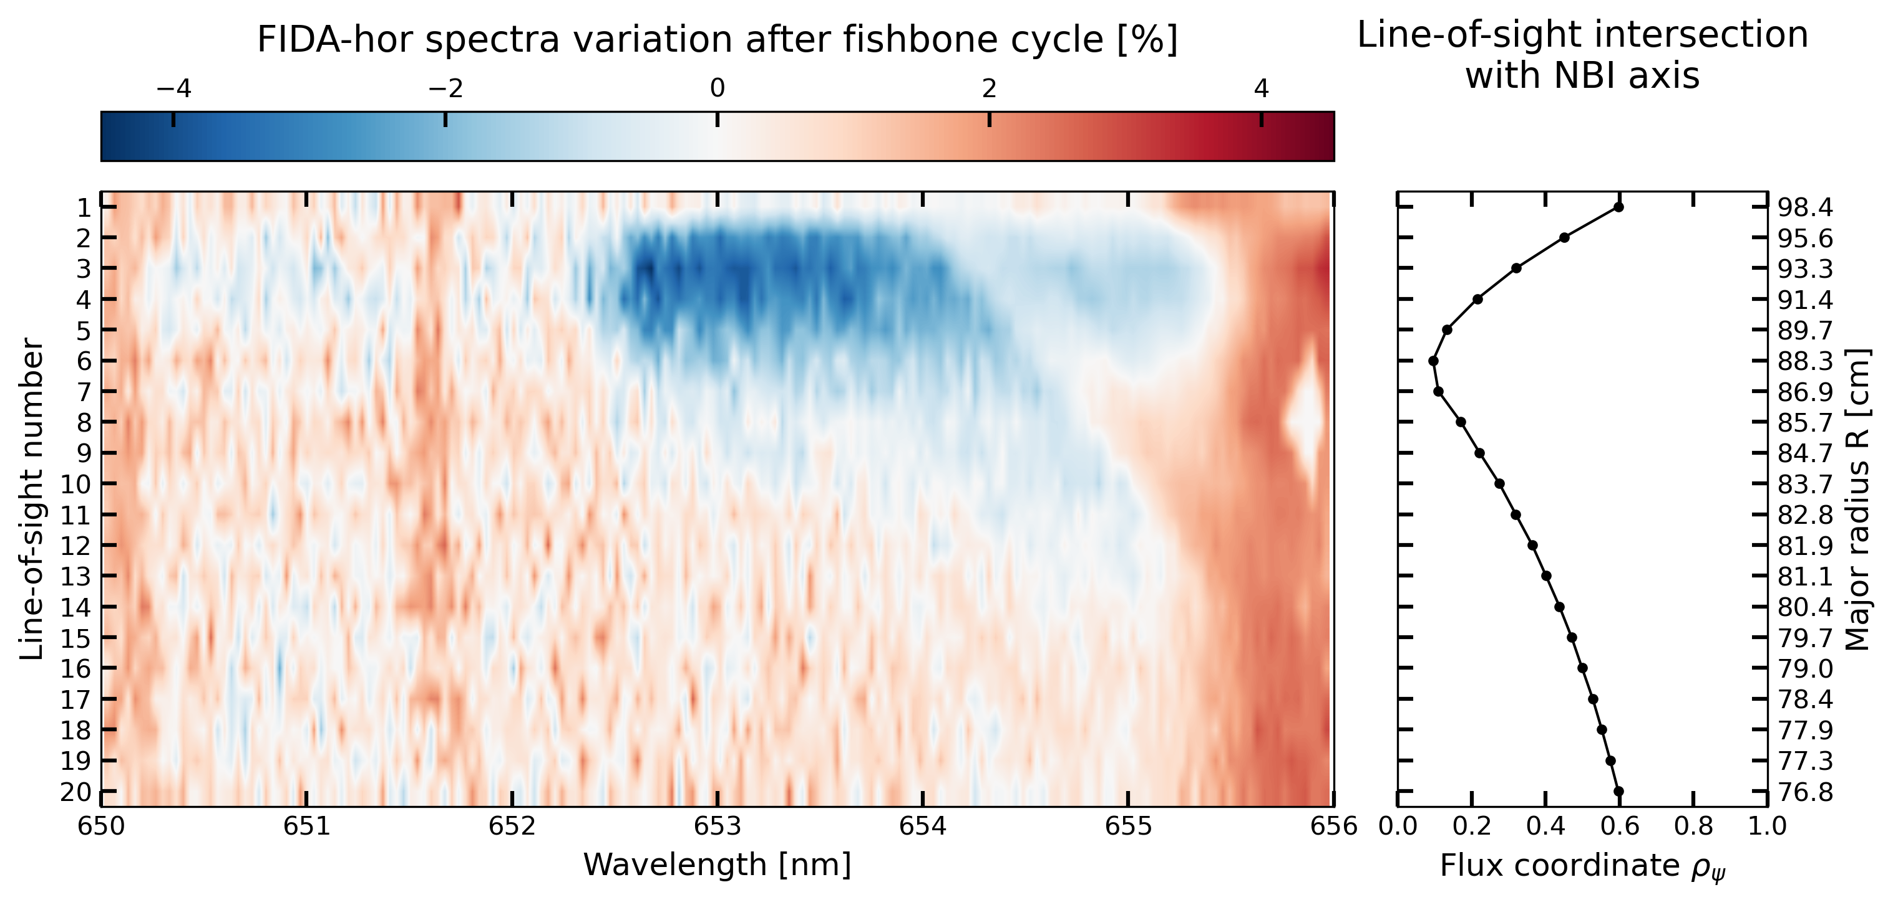
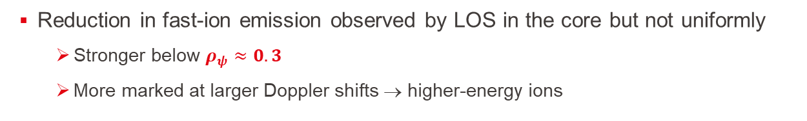
High-energy fast ions are depleted from the core
Reduction in fast-ion emission observed by LOS in the core but not uniformly
  Stronger below $ρ_{ψ}≈0.3$
  More marked at larger Doppler shifts → higher-energy ions
Depletion of fast ions in the core
observed fast-ion energy

Slide 16
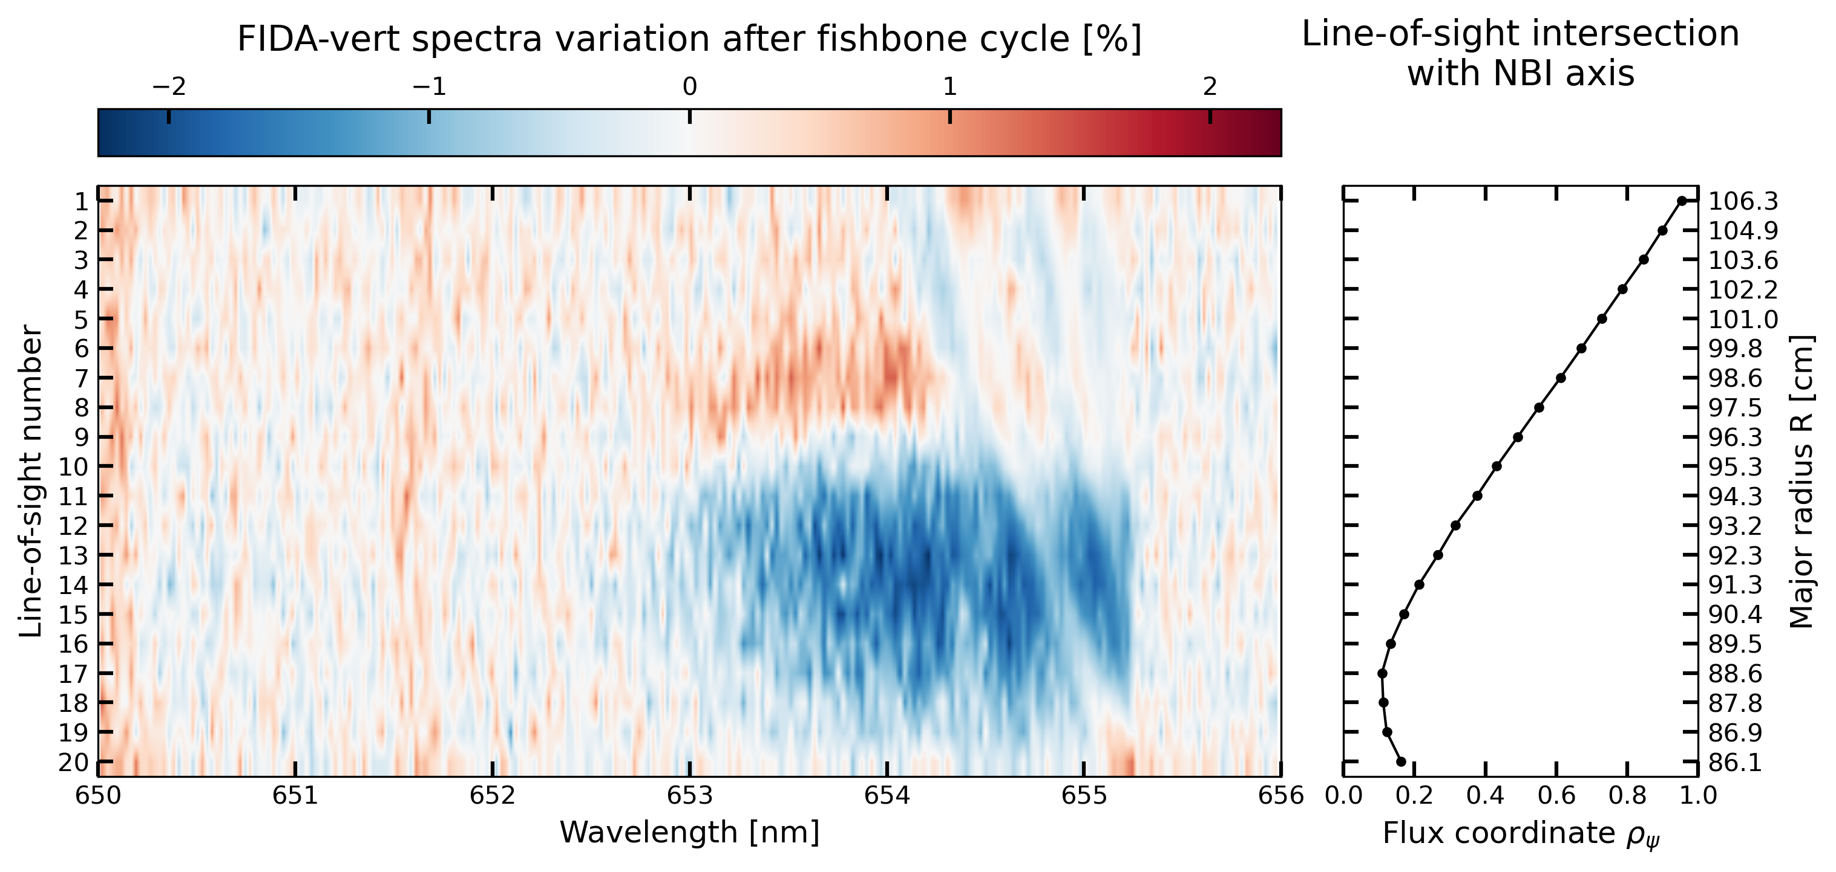
Vertical system suggests a radial outward redistribution
Fast-ion emission rises in LOS probing towards the edge
  Passive FIDA emission may contribute due to higher neutral density at the edge
  Changes in NBI deposition may also affect the measured FIDA emission
Radial outward transport
O.M. Jones et al., Plasma Phys. Control. Fusion (2013)

Slide 17
How to interpret FIDA measurements in velocity space
An ill-posed inverse problem must be solved to reconstruct the fast-ion distribution function from FIDA measurements using weight functions
  Hierarchical Bayesian method infers the most probable $\left(E,p\right)$ distribution given the measurements and provides uncertainty quantification
  Prior knowledge on collision and charge-exchange physics is included
M. Rud et al., Plasma Phys. Control. Fusion (2026)

Slide 18
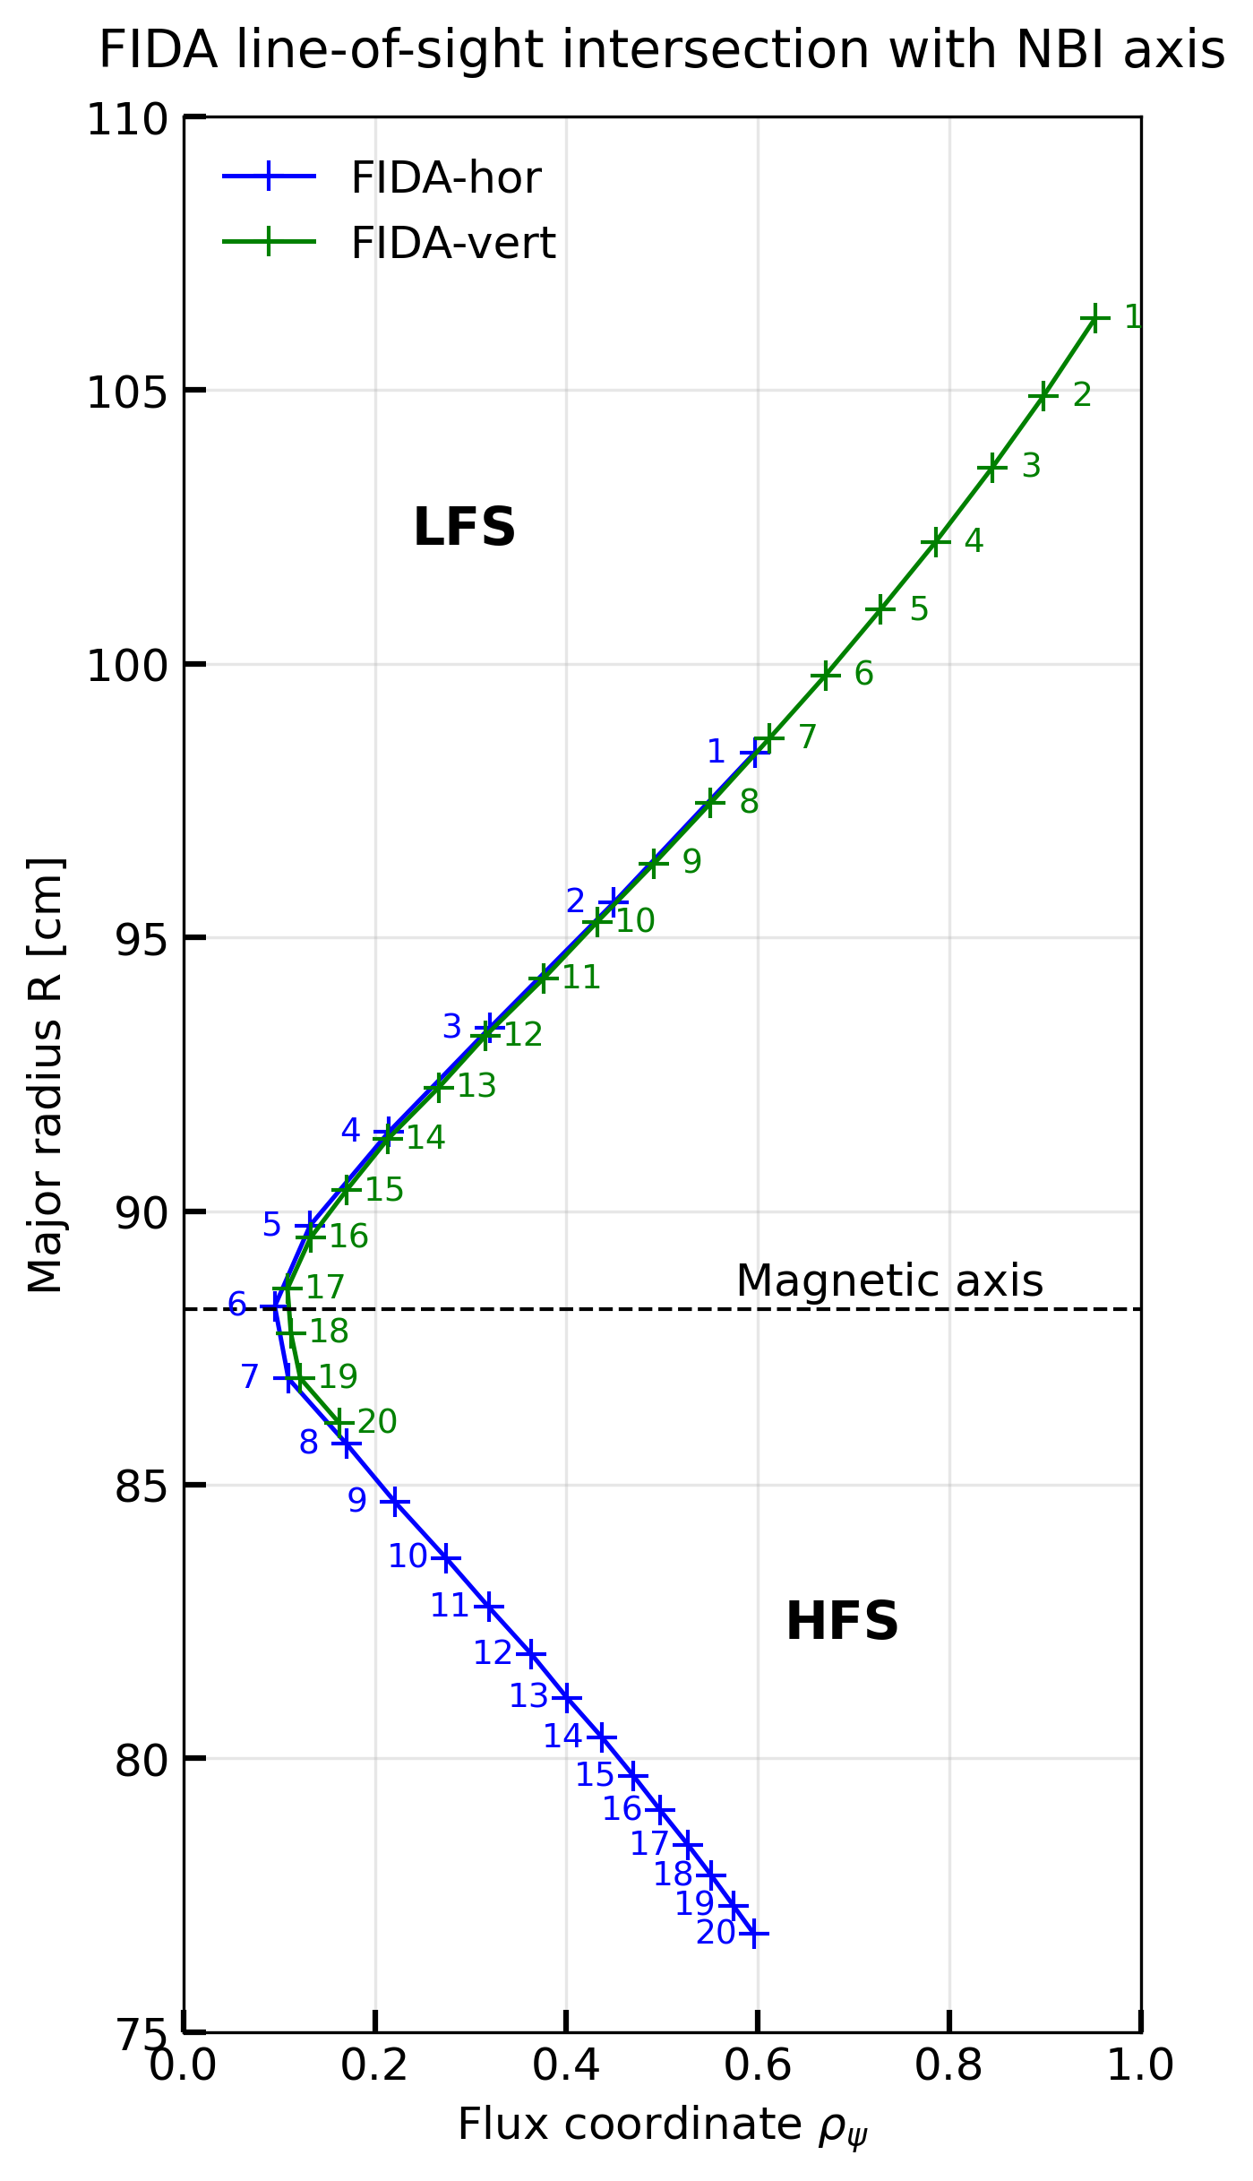


How to interpret FIDA measurements in velocity space
An ill-posed inverse problem must be solved to reconstruct the fast-ion distribution function from FIDA measurements using weight functions
  Hierarchical Bayesian method infers the most probable $\left(E,p\right)$ distribution given the measurements and provides uncertainty quantification
  Prior knowledge on collision and charge-exchange physics is included
Velocity-space tomography is applied to LOS probing volumes in the core and near the edge
edge
($ρ_{ψ}≈0.6$)
core
($ρ_{ψ}≈0.2$)
M. Rud et al., Plasma Phys. Control. Fusion (2026)

Slide 19
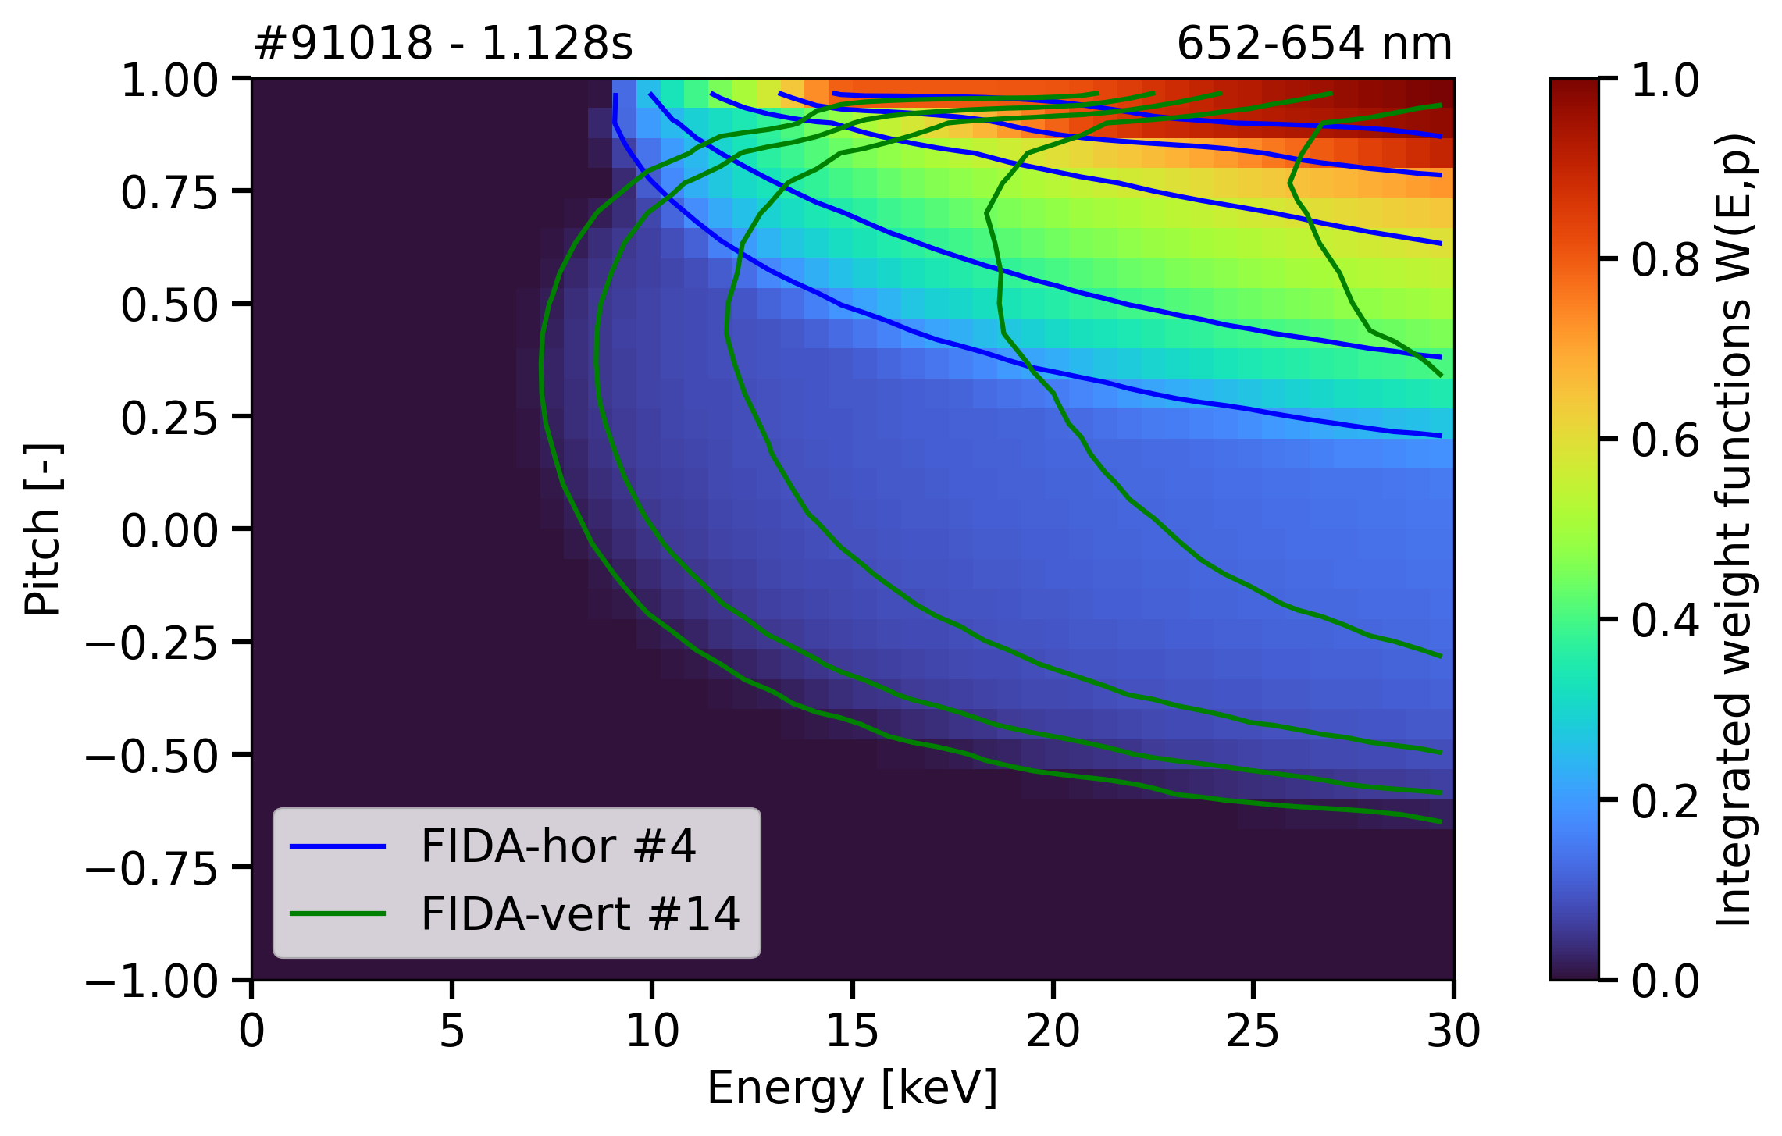
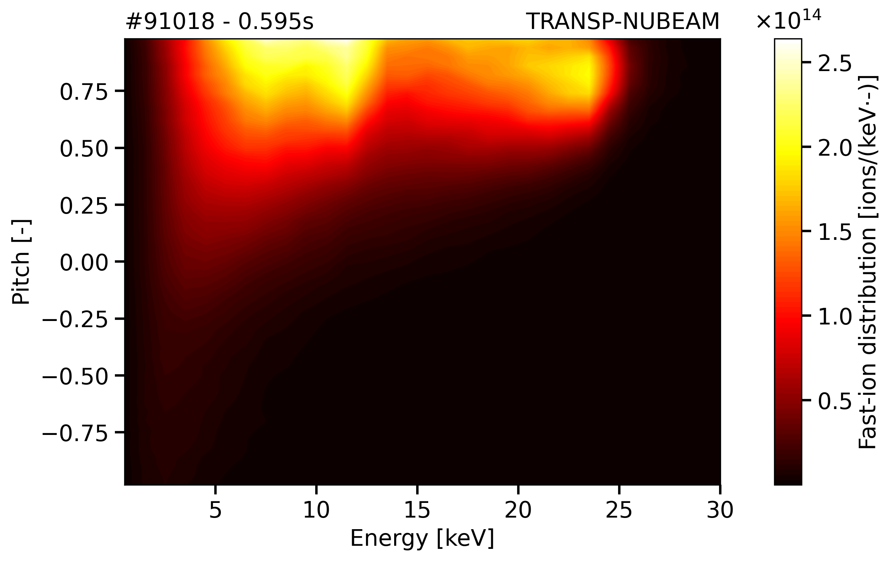
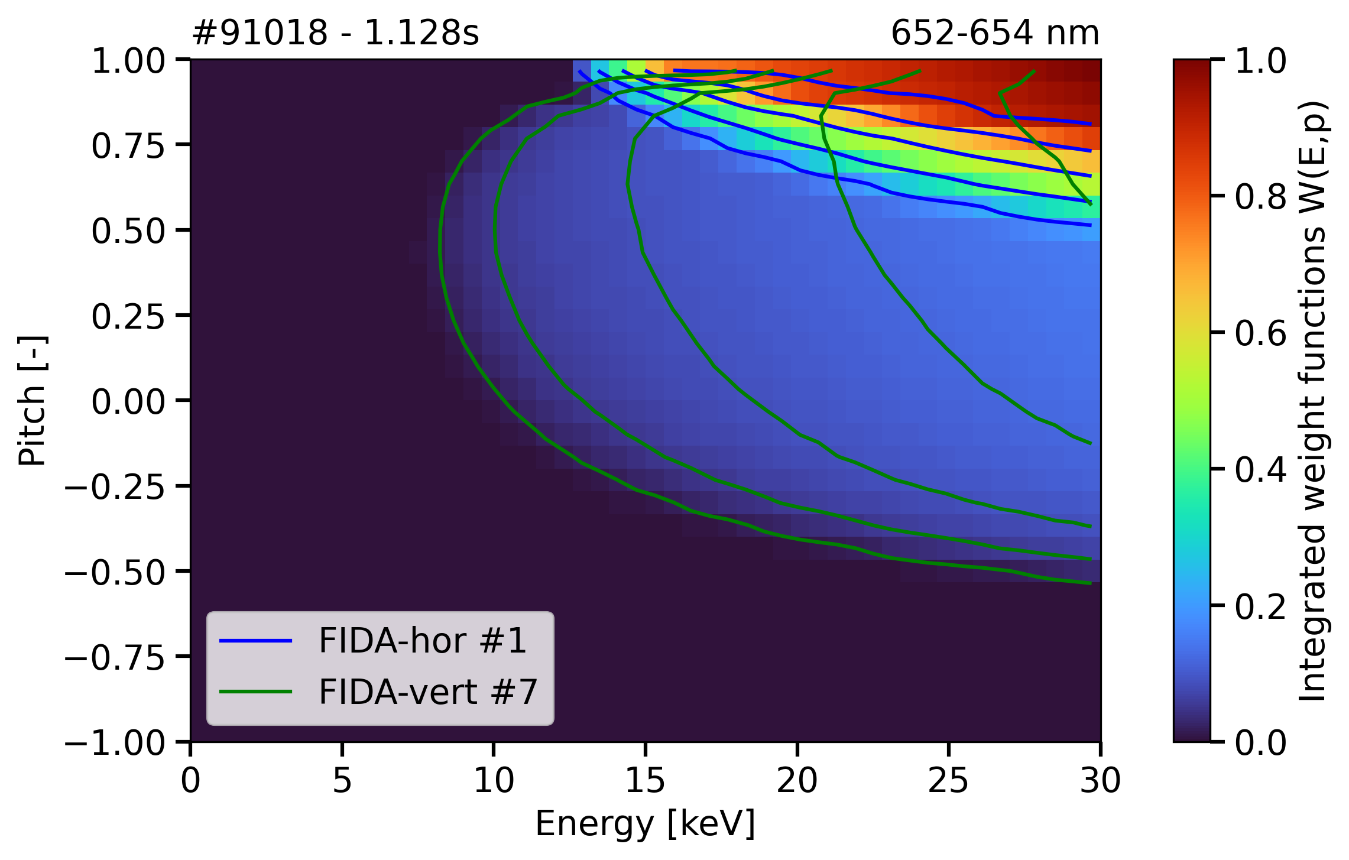
Combined FIDA views cover the NBI-populated velocity space
Viewing geometry and wavelength determine the probed velocity-space region
FIDASIM weight functions show complementary velocity-space coverage of the horizontal and vertical views
CORE
EDGE
B. Geiger et al., Plasma Phys. Control. Fusion (2020)

Slide 20
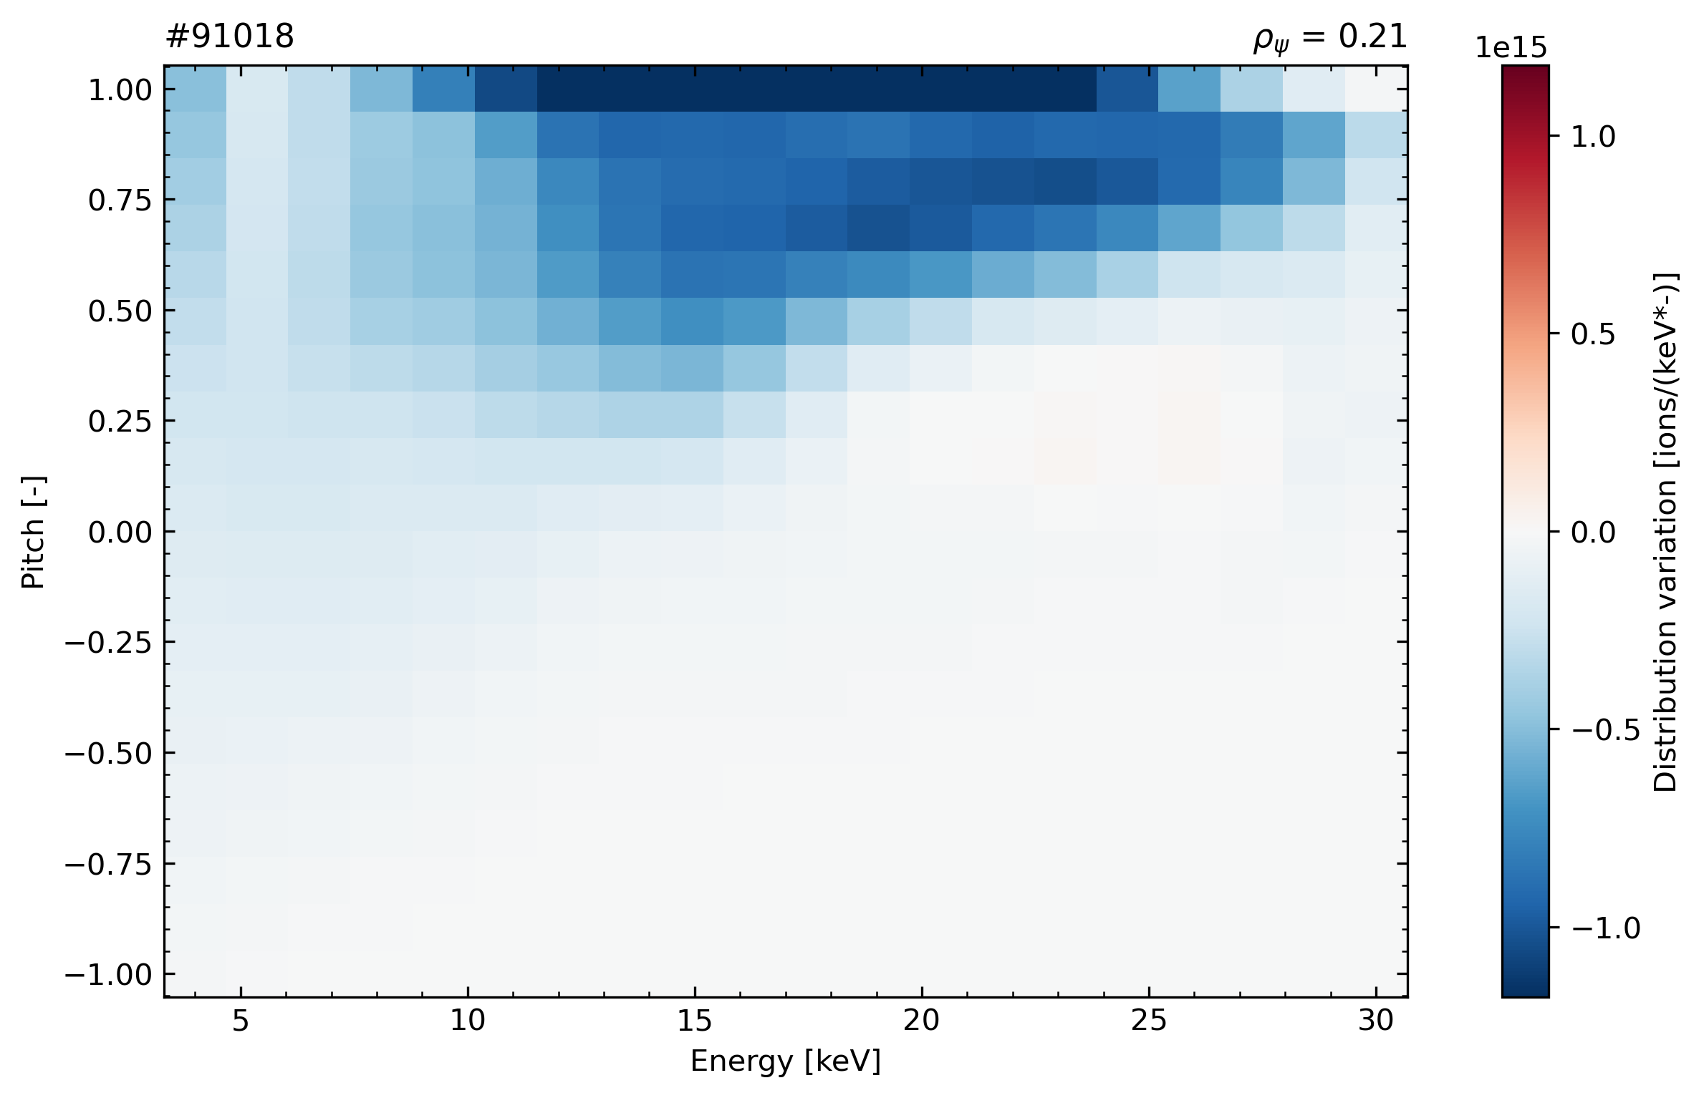
Tomography supports the picture inferred from the spectra
The variations in reconstructed velocity-space distributions suggest a redistribution radially and in velocity space
  High-energy confined ions left the core
CORE

Slide 21
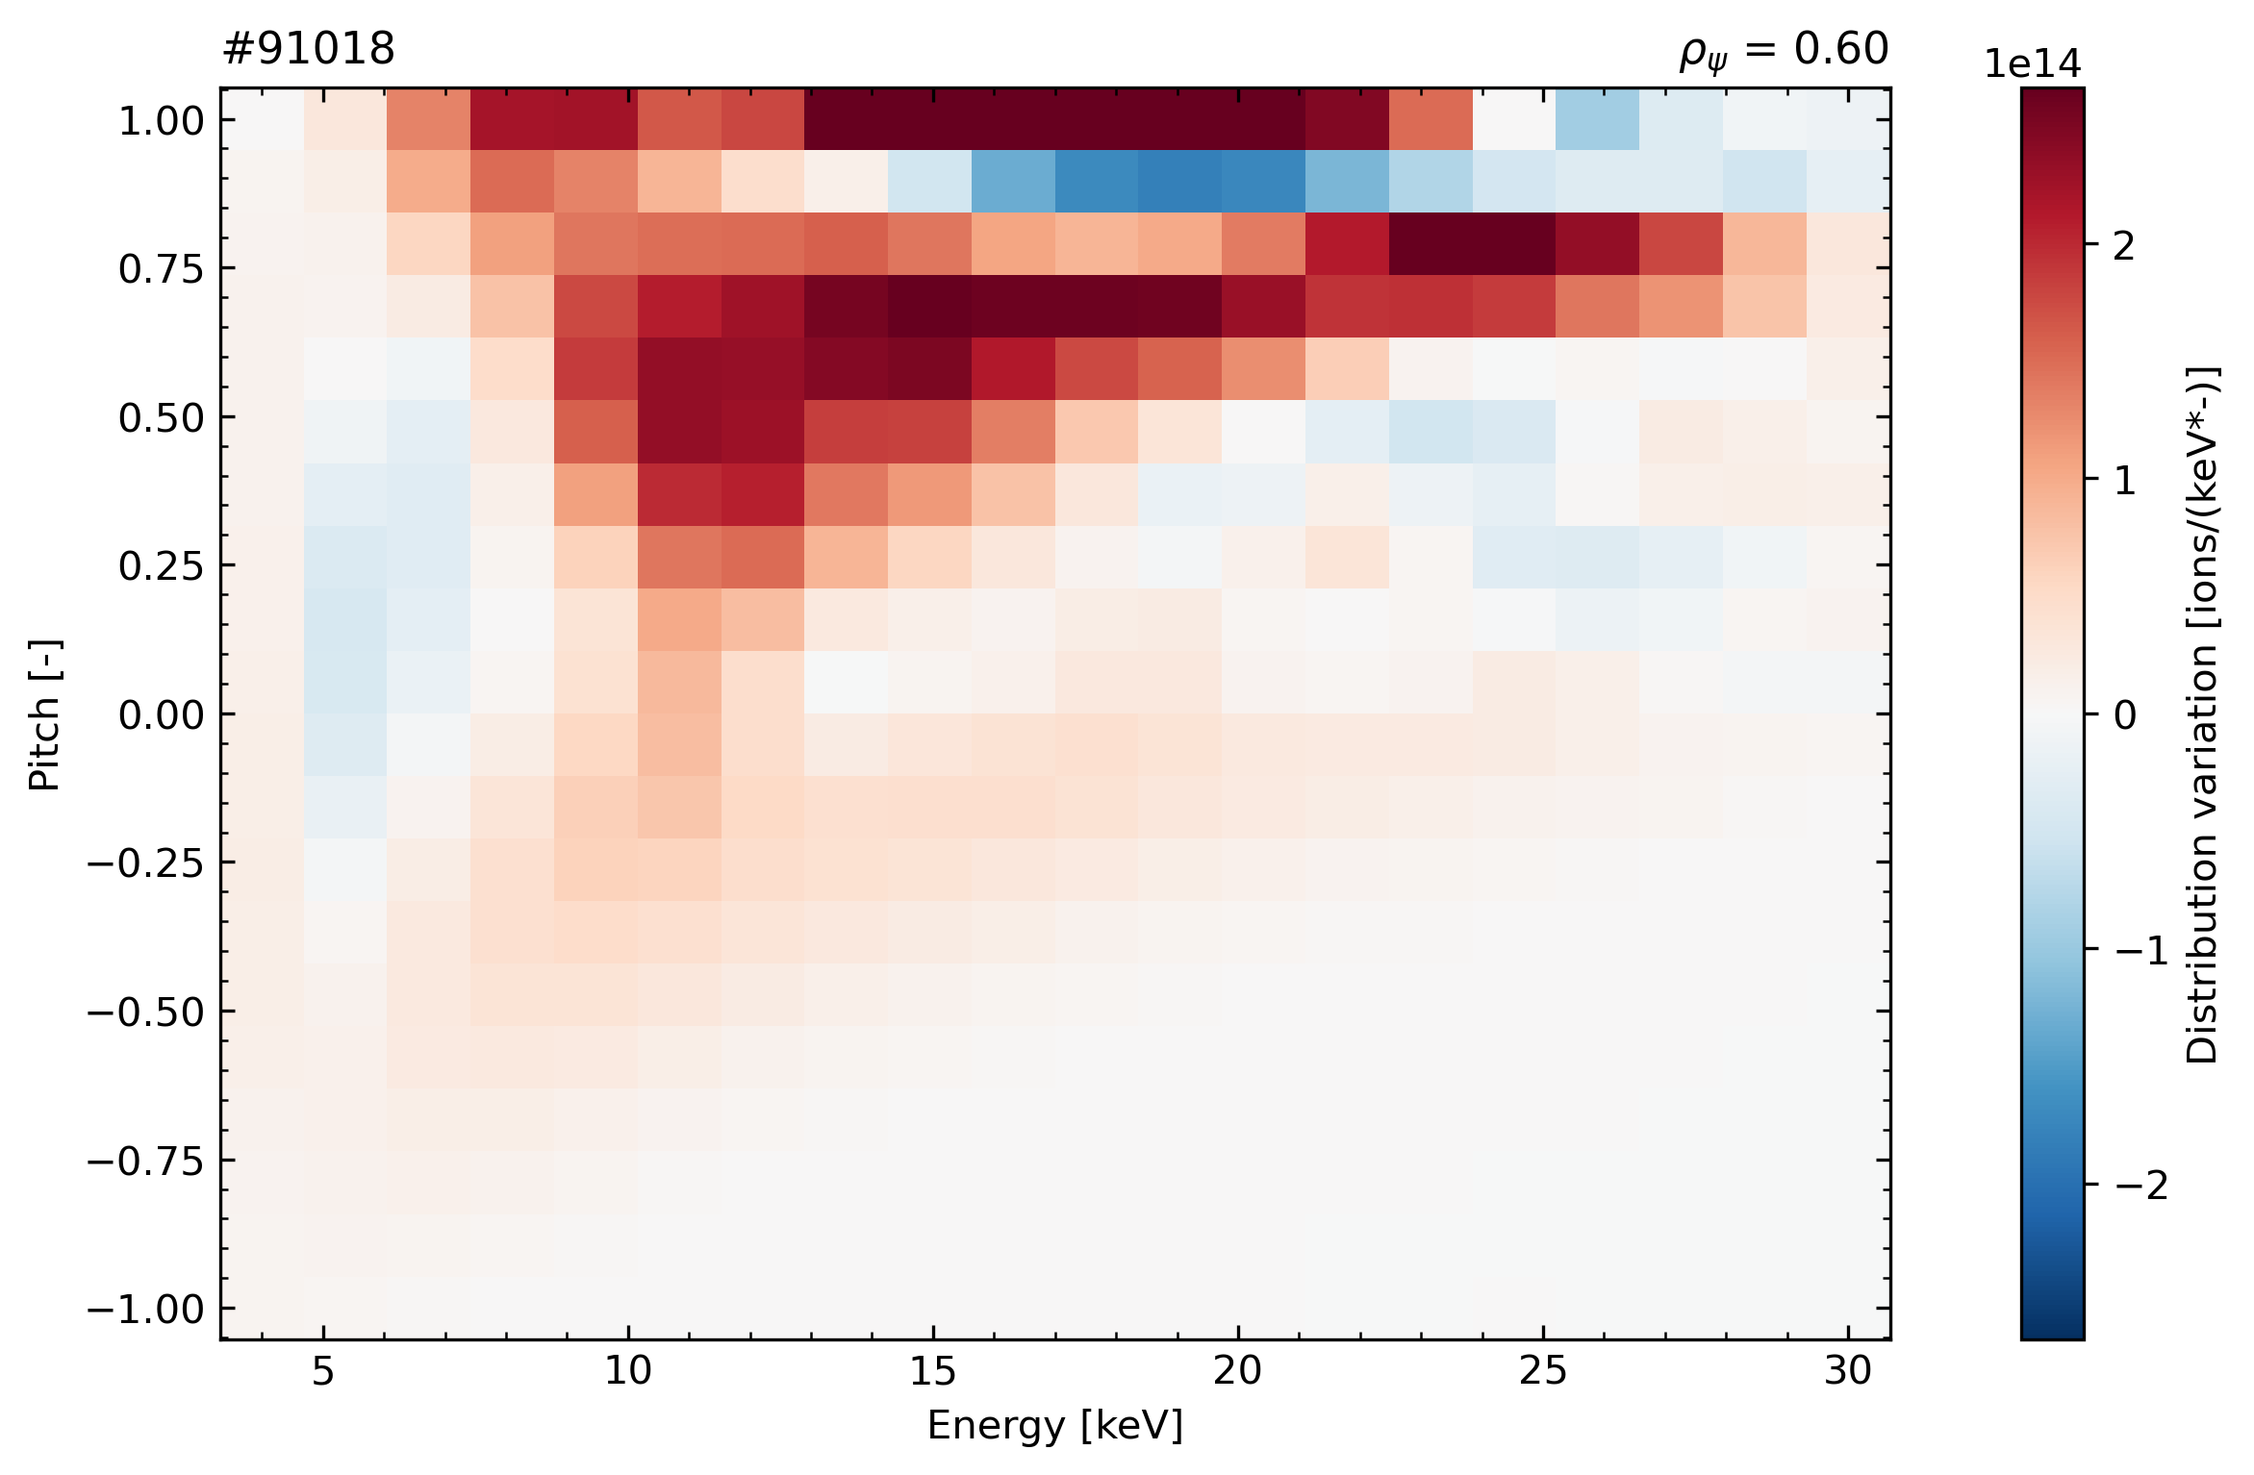
Tomography supports the picture inferred from the spectra
The variations in reconstructed velocity-space distributions suggest a redistribution radially and in velocity space
  High-energy confined ions left the core
  Fast ions appeared near the edge, but shifted toward lower pitch
  → change in orbit topology?
CORE
EDGE

Slide 22
Experimental framework & fishbone characterization
Redistribution of confined fast ions
Fast-ion losses
Towards a consistent picture of fishbone-induced transport
Does redistribution lead to fast-ion losses?

Slide 23
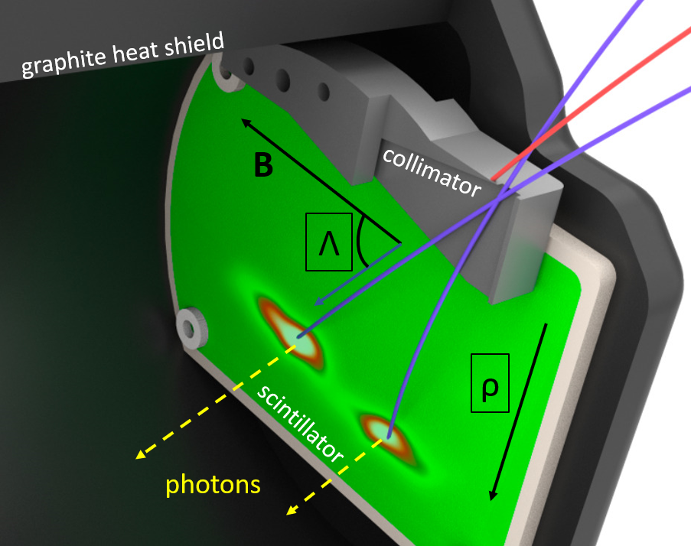
FILD resolves escaping fast ions in velocity space
Lost fast ions strike the scintillator plate at positions determined by their trajectories
  The scintillator image encodes the velocity-space
  distribution of escaping fast ions
Dual-camera system provides complementary
measurements
  CMOS camera at $3.5 kHz$, with high spatial
  resolution for velocity-space characterization
  APD array at $1 MHz$, with high temporal resolution
J. Poley-Sanjuán et al., Nucl. Fusion (2025)
J. Poley-Sanjuán et al., Rev. Sci. Instrum. (2025)

Slide 24
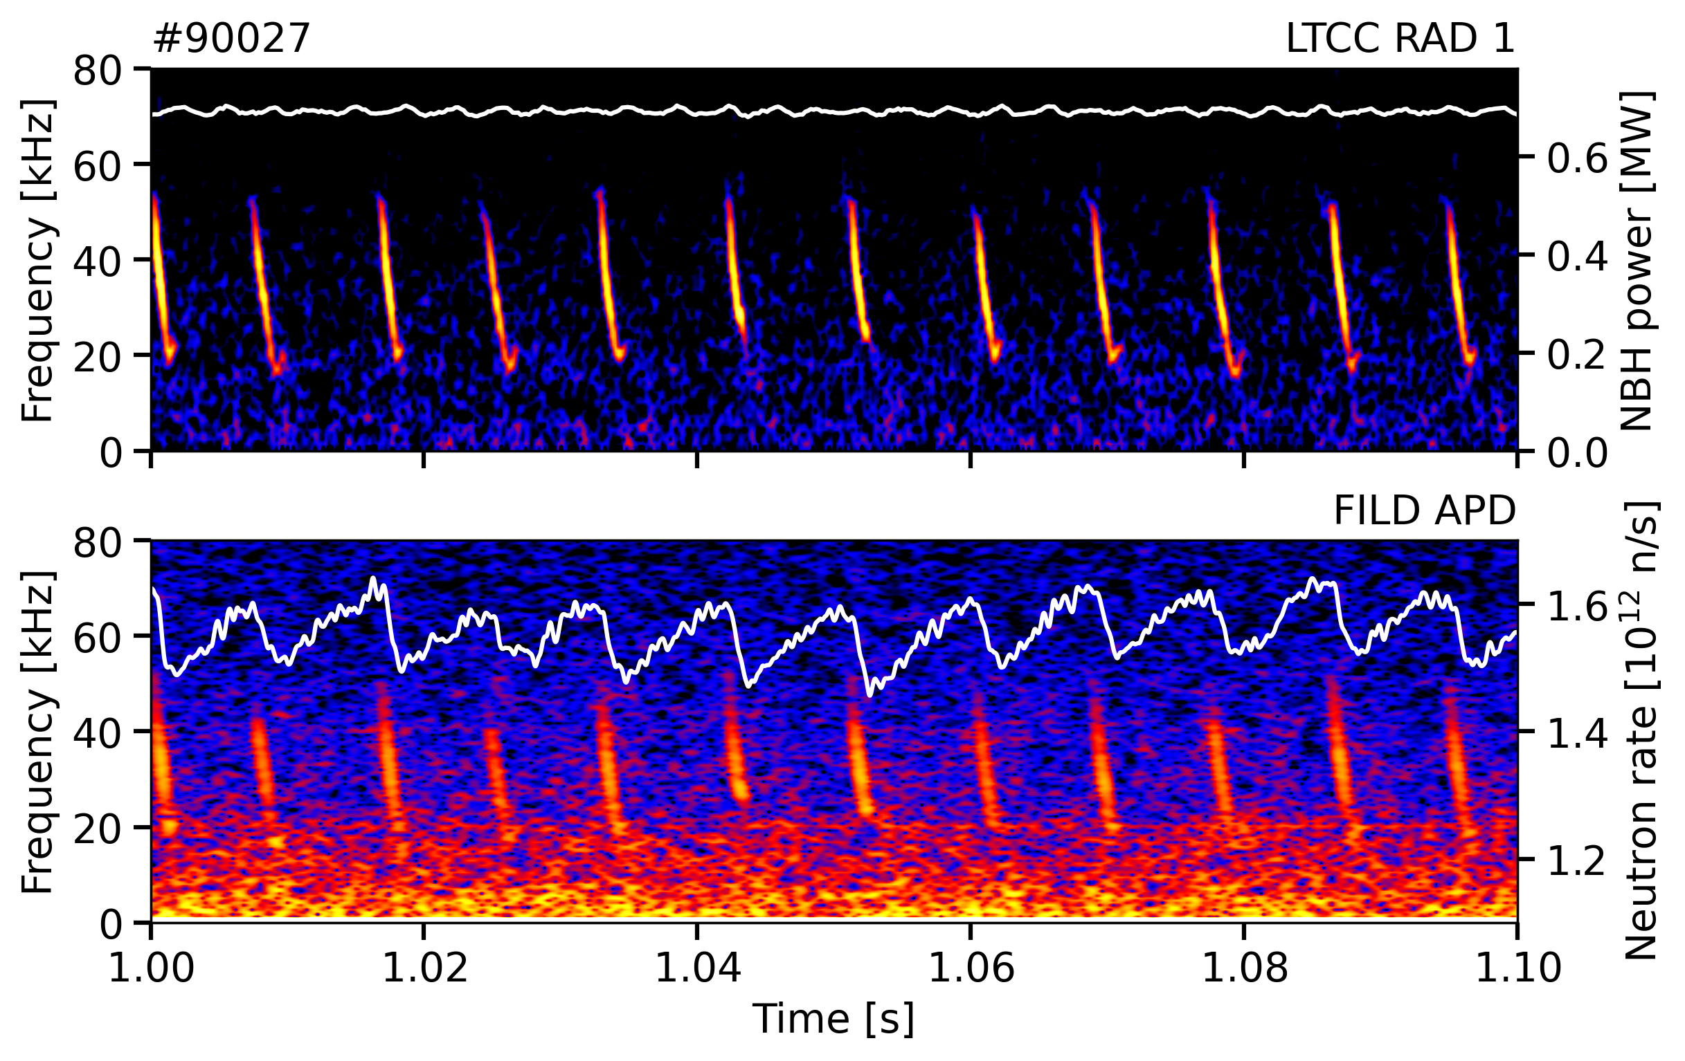
Fishbones trigger coherent bursts of fast-ion losses
Magnetic perturbations and enhanced losses are well correlated

Slide 25
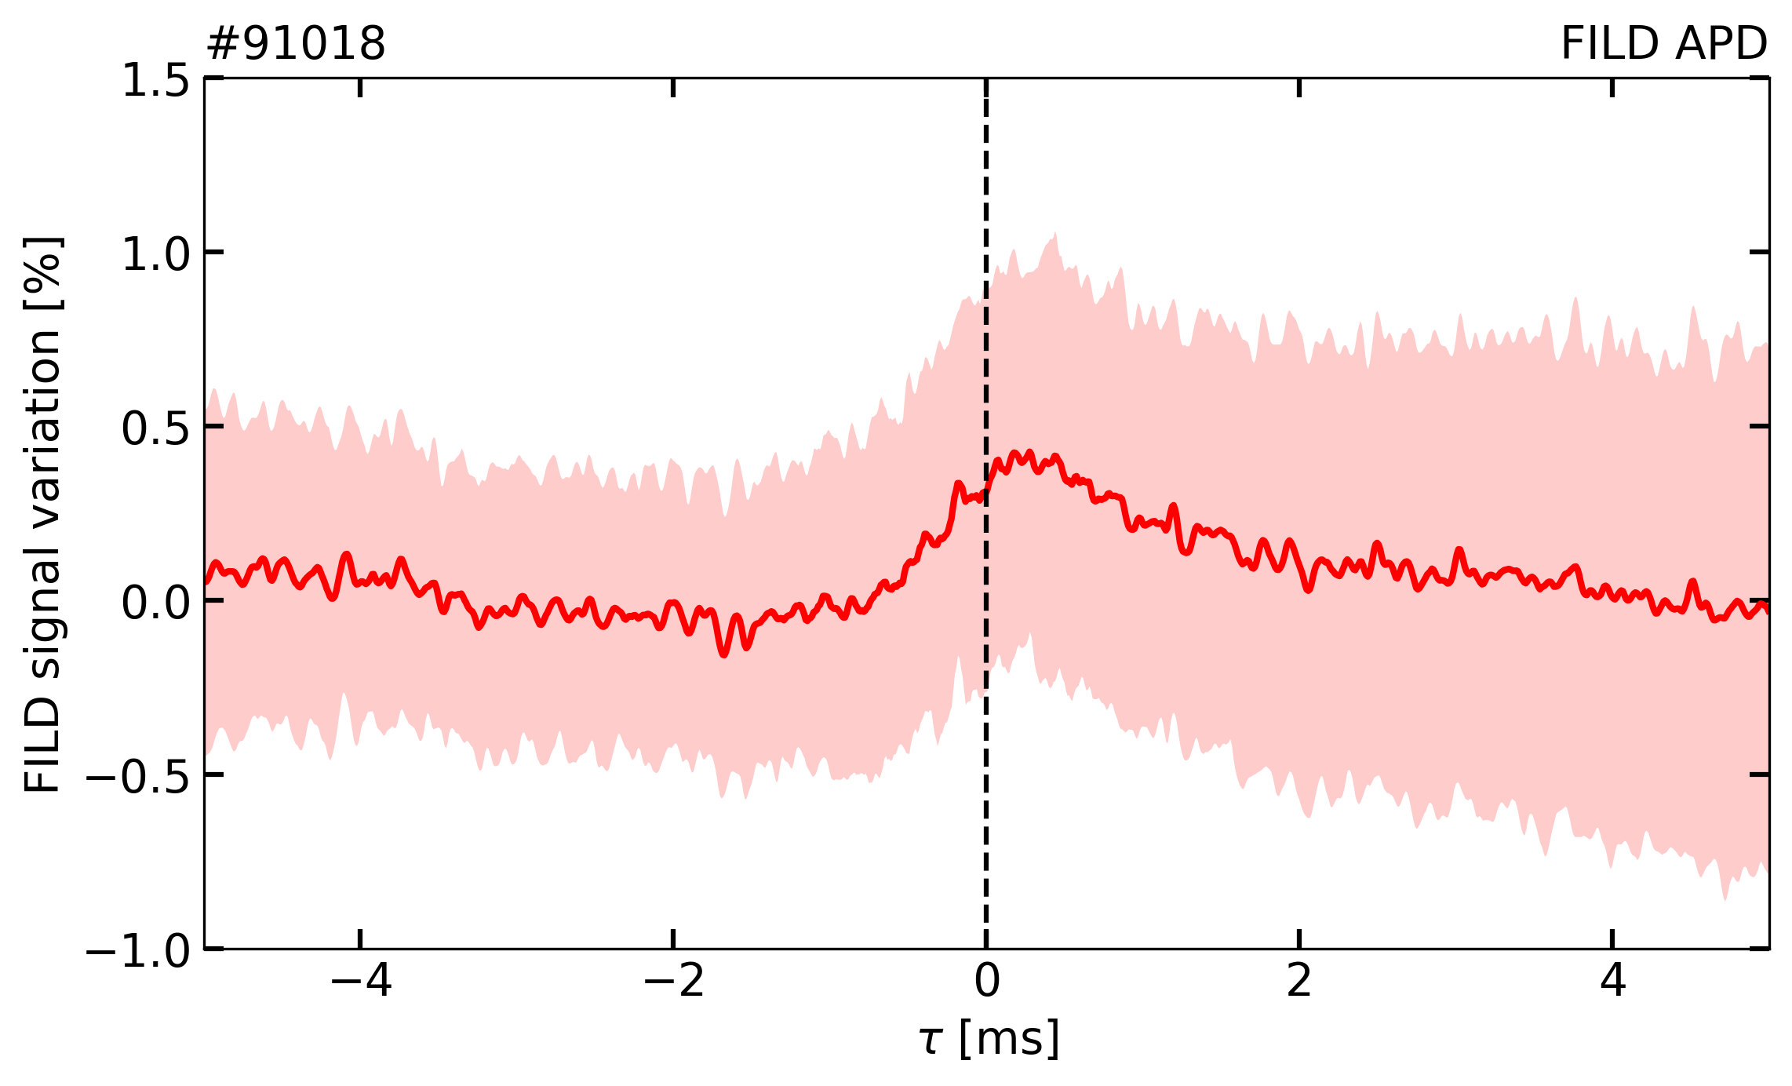
Fishbones trigger coherent bursts of fast-ion losses
Magnetic perturbations and enhanced losses are well correlated
  Additional losses remain small compared to the continuous neoclassical loss level ($<1\%$)

Slide 26
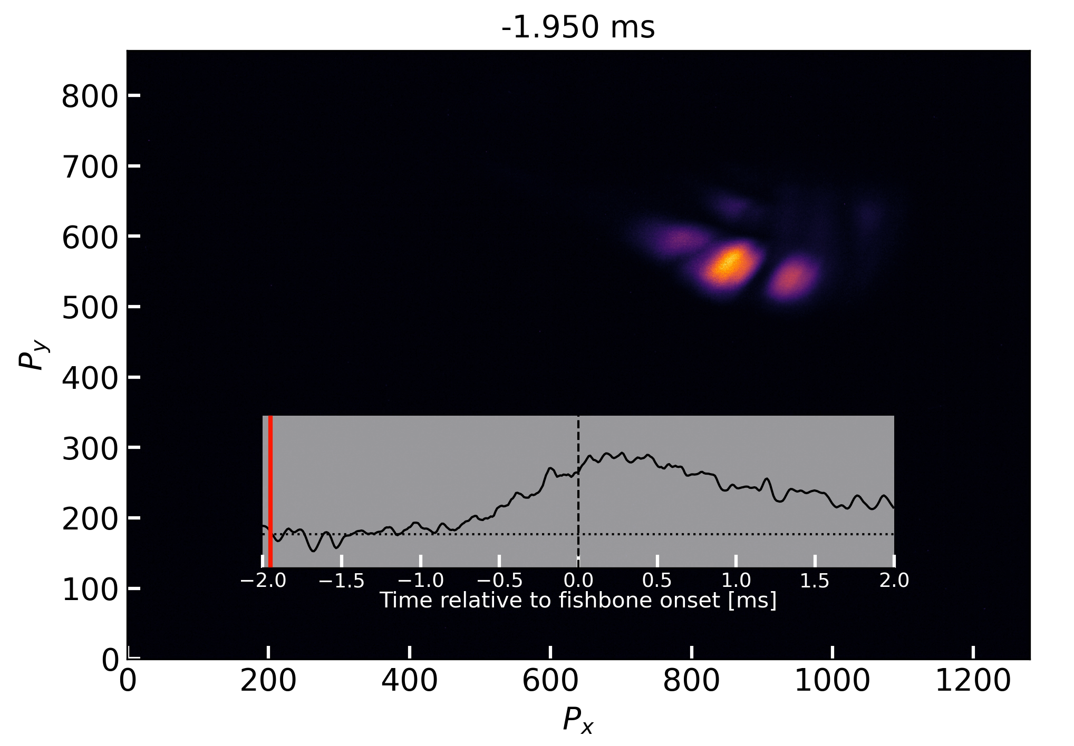


Fishbone-induced losses exhibit complex spatial patterns
CMOS video processing partially removes the intense NBI and DNBI contributions
Conditional averaging isolates the fishbone-induced contribution
Distinct structures emerge around the instability onset and decay with the mode
$$p=\frac{v_{\text{∥}}}{v}$$
$$E$$

Slide 27
Reconstructing the lost-ion velocity distribution
ASCOT simulations map lost ions in energy and pitch onto the scintillator
Bayesian method infers the most probable $\left(E,p\right)$ distribution given the measured scintillator image

Slide 28
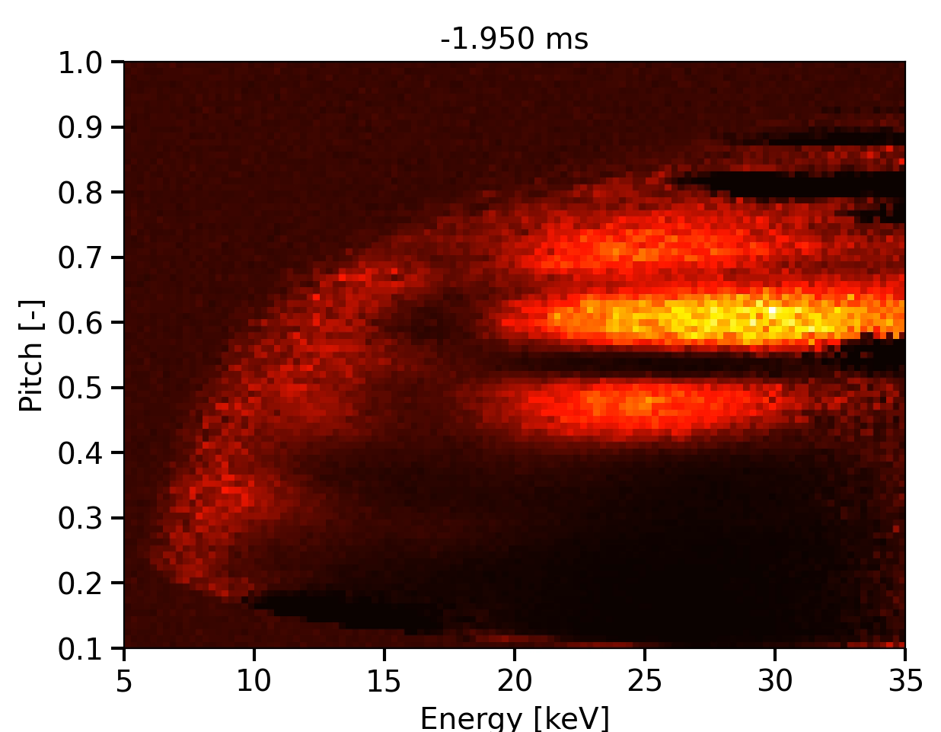
Reconstructing the lost-ion velocity distribution
ASCOT simulations map lost ions in energy and pitch onto the scintillator
Bayesian method infers the most probable $\left(E,p\right)$ distribution given the measured scintillator image
  Observed scintillator structures can now be localized in energy and pitch

Slide 29
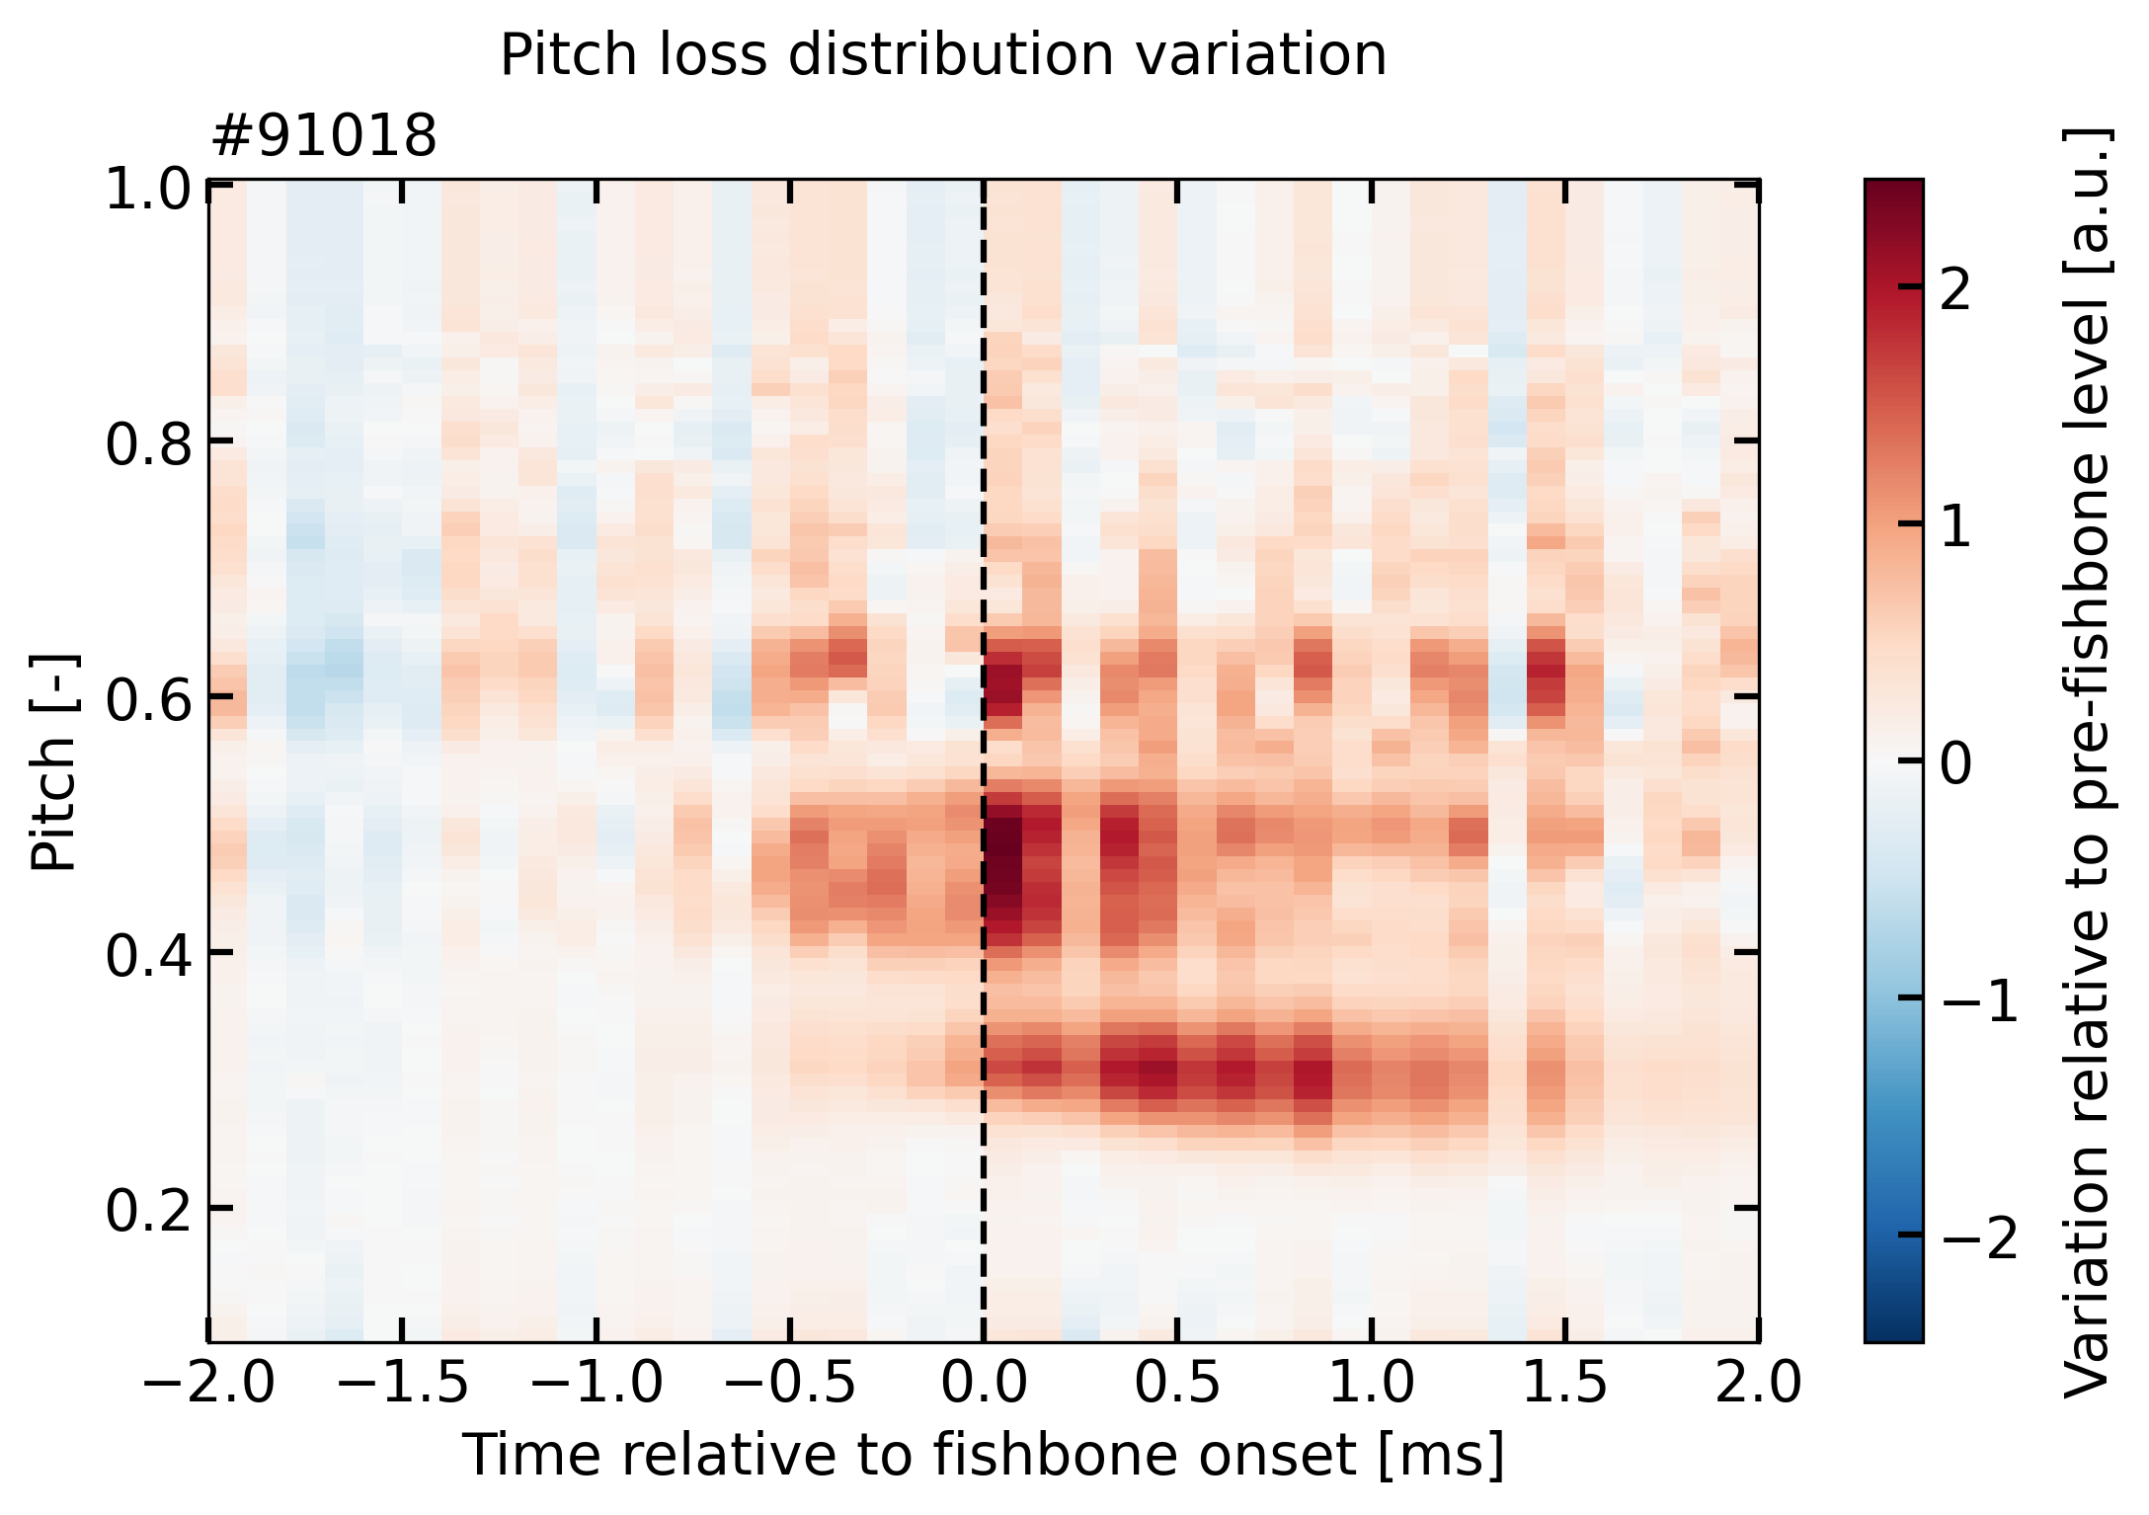
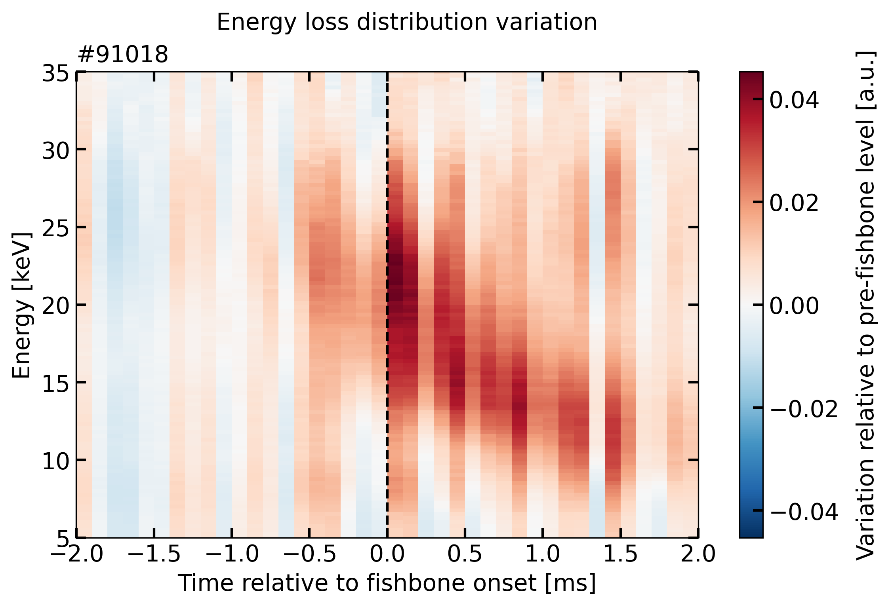
Distinct loss structures evolve during the fishbone cycle
Loss distribution exhibits distinct pitch accumulations and shifts toward lower energies as the mode frequency sweeps down

Slide 30
Experimental framework & fishbone characterization
Redistribution of confined fast ions
Fast-ion losses
Towards a consistent picture of fishbone-induced transport
Can redistribution and losses be explained consistently?

Slide 31
FIDA and FILD reveal a consistent picture of fishbone-induced transport
Combined diagnostics of confined and lost fast ions show complementary signatures of radial outward fast-ion transport during fishbone instabilities
  FIDA observes a redistribution from the core toward the edge
  FILD detects the associated enhanced losses
  Reconstruction techniques provide insights on the underlying velocity-space redistribution

Slide 32
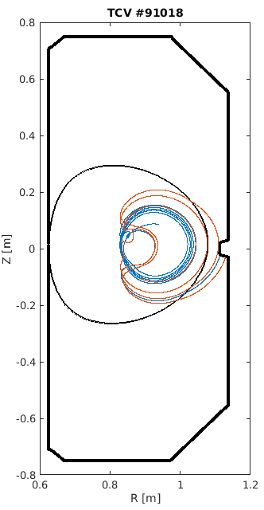
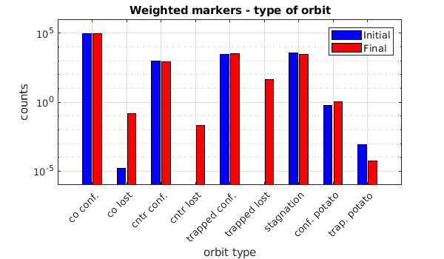
Preliminary modelling results help interpret the observed redistribution
A reduced “kick” model is applied to fast ions and particle trajectories are followed with ORBIT
  Particles are kicked toward the plasma edge onto trapped orbits, consistent with the outward redistribution observed with FIDA
M. Podestà et al., Plasma Phys. Control. Fusion (2014)

Slide 33
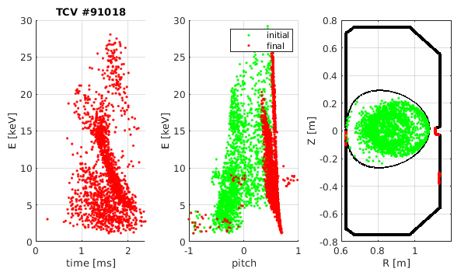
Simulated loss distribution reproduces main features observed with FILD
Mainly counter-passing and trapped particles are kicked onto poorly confined trapped orbits and eventually escape the plasma
Similar pitch accumulations and downward energy sweep as measured by FILD

Slide 34





Closing the loop: from modelled fast ions to synthetic FIDA measurements
Forward modelling provides a direct experiment–model comparison
  TRANSP-NUBEAM + “kick” model simulate
  fast-ion distributions before/after fishbone
  FIDASIM generates synthetic spectra
  for the actual TCV LOS, comparable
  with measured FIDA variations
Forward problem
$$\overline{s}=W\overline{f}$$
Distribution function $\overline{f}$
Weight functions $w$
Measurements $\overline{s}$
$${\overline{f}}_{λ}=\underset{\overline{f}}{argmin}\left({\left\|\overline{s}−W\overline{f}\right\|}_{2}^{2}+λ^{2}{\left\|L\overline{f}\right\|}_{2}^{2}\right)$$
Inverse problem
B. Geiger et al., Plasma Phys. Control. Fusion (2020)

Slide 35
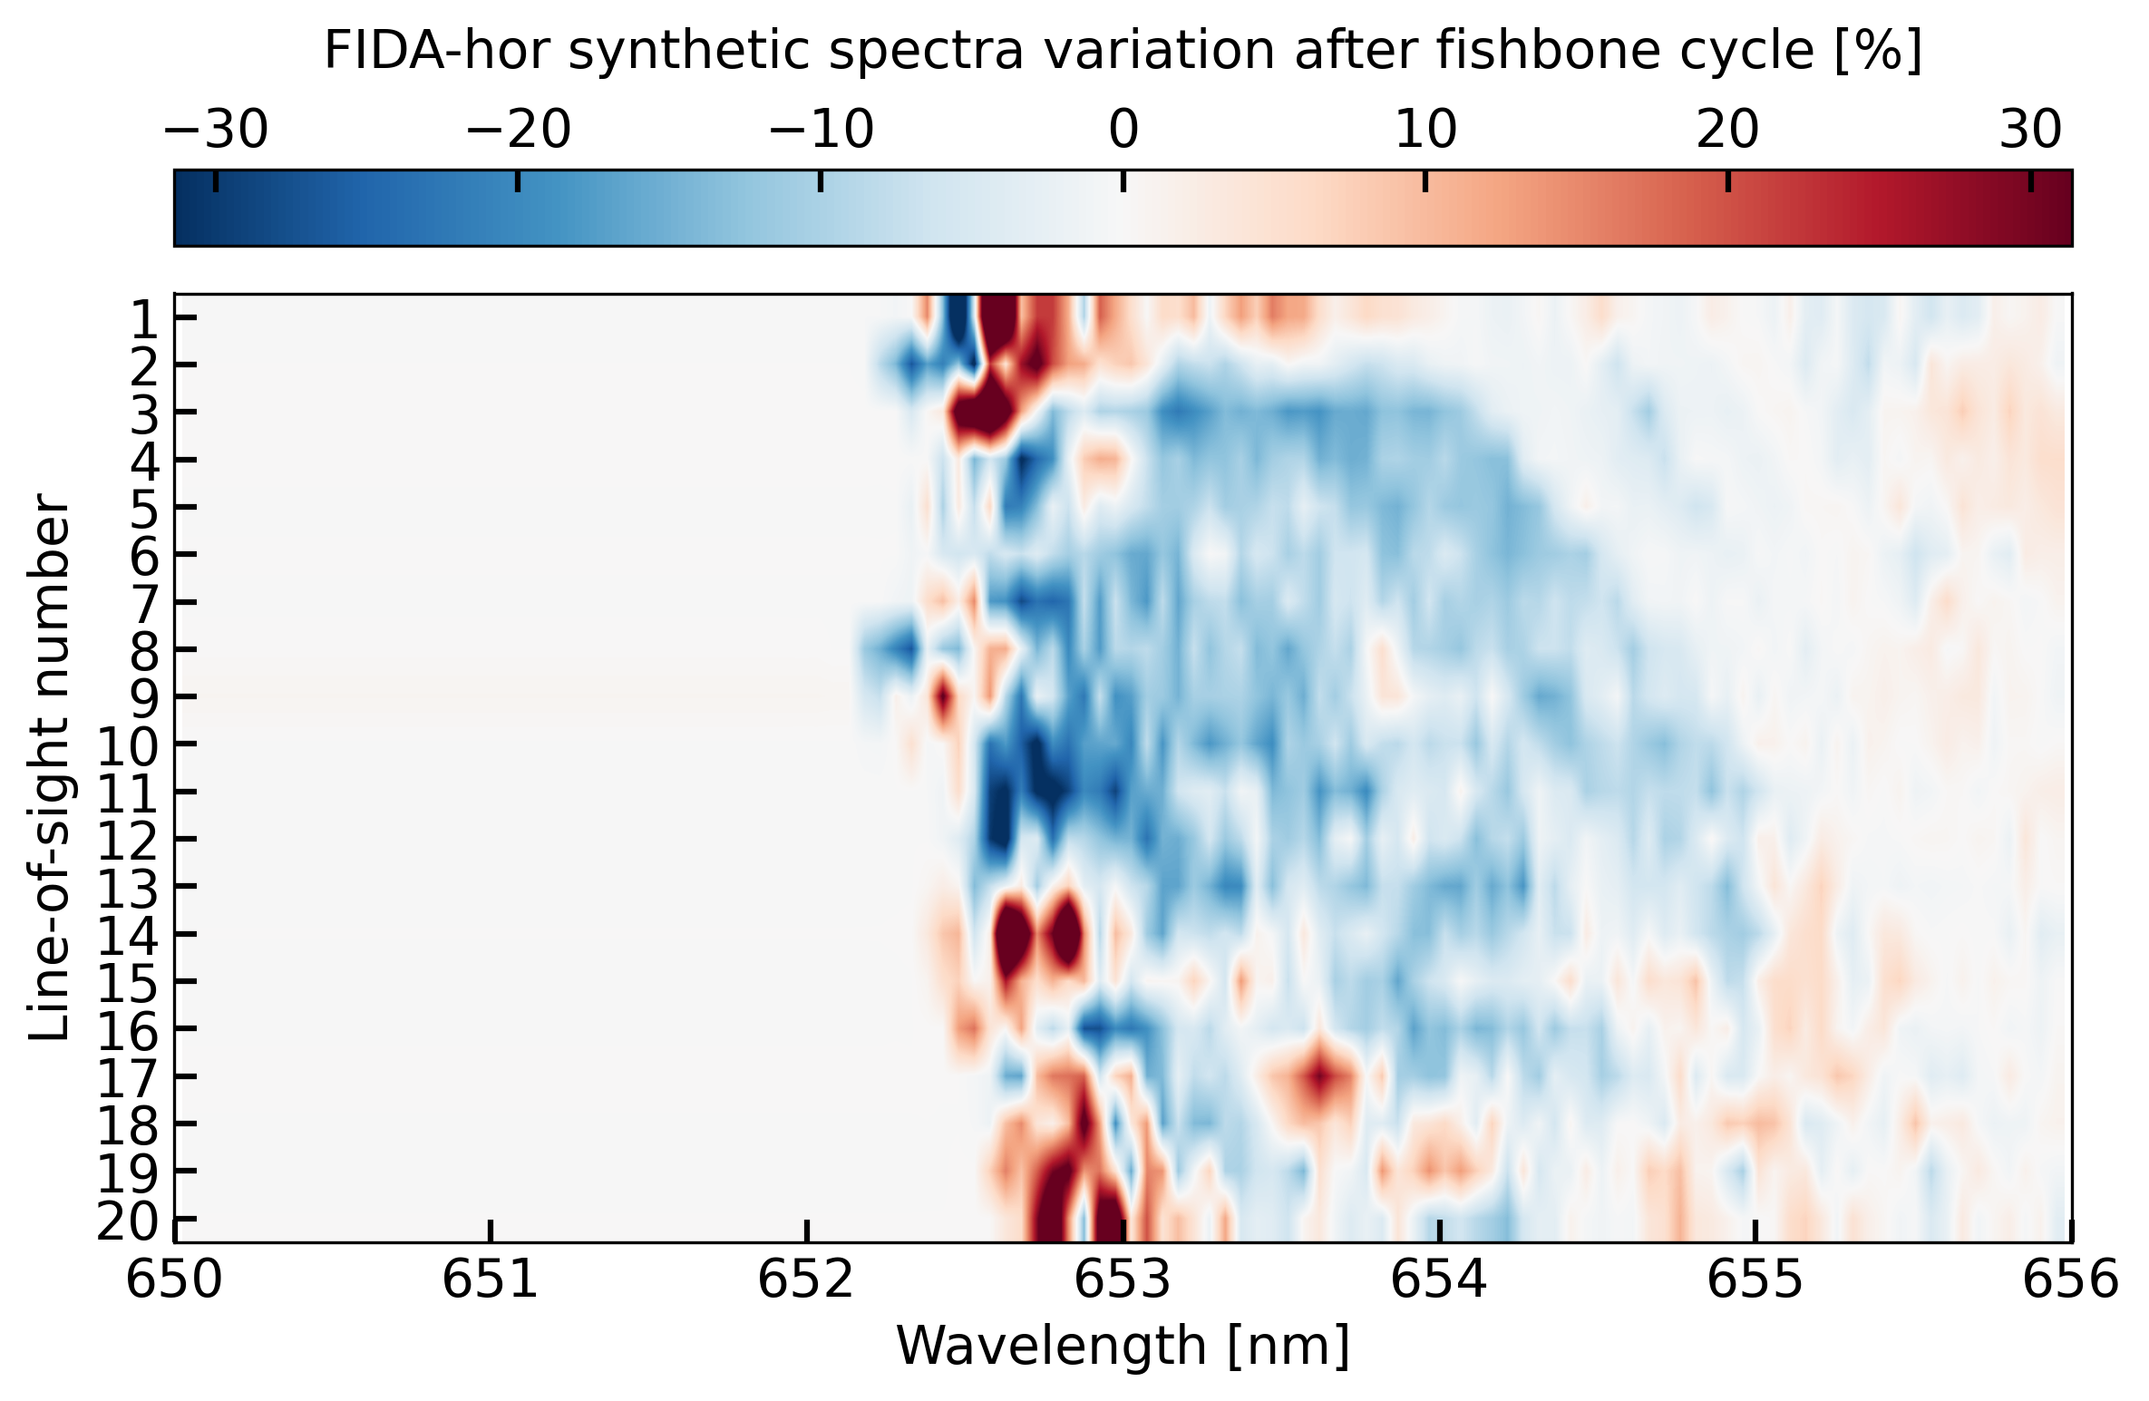
Forward modelling captures the main FIDA variation pattern, but overestimates its amplitude
Experiment
FIDASIM
Depletion at large Doppler shift in core-probing LOS
Synthetic variations are substantially larger
Radial dependence of the response

Slide 36
Correlated FIDA and FILD measurements reveal selective outward fast-ion transport during TCV fishbones
Next steps: quantitative experiment–model validation
Develop fast-ion distribution reconstruction in phase space
  Constant-of-motion inversions using resonant mode-particle interaction priors
Refine forward modelling to interpret observations
  TRANSP-NUBEAM + kick model + FIDASIM to simulate fishbone-induced
  fast-ion transport and diagnostic responses
Explore other discharge scenarios
  How do plasma current, shape, etc. affect fishbone-induced fast-ion transport?
Extend the framework to other energetic-particle-driven instabilities
  Can different fast-ion transport mechanisms be captured,
  in particular those induced by Alfvén eigenmodes?

Slide 37
Appendices

Slide 38
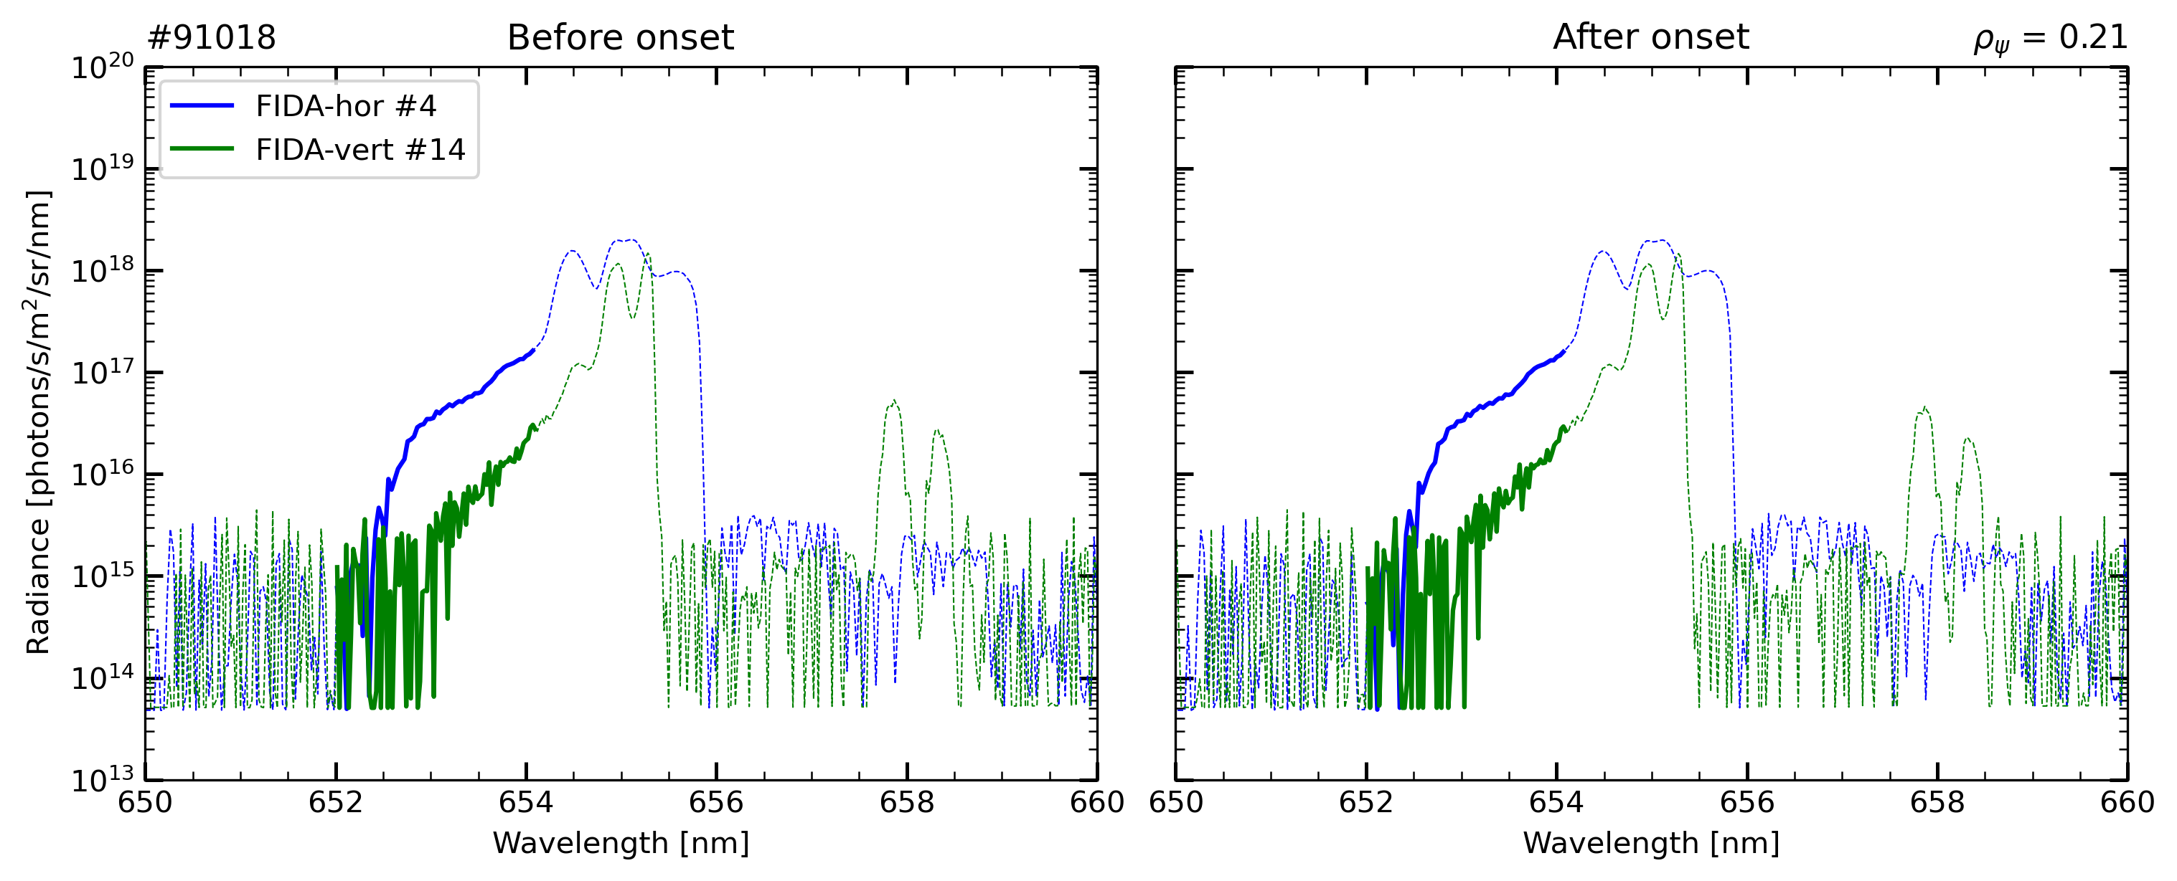
FIDA spectra of LOS crossing in the core and near the edge require processing to apply tomography
Spectra treatment is essential to obtain accurate reconstruction
  Dark frame and smearing corrected
  Beam-off background at $0. 397s$ subtracted
  Absolute calibration
Spectra in the core $\left(R=91.4 cm /ρ_{ψ}=0.21\right)$
Spectra near the edge $\left(R=98.5 cm /ρ_{ψ}=0.60\right)$

Slide 39
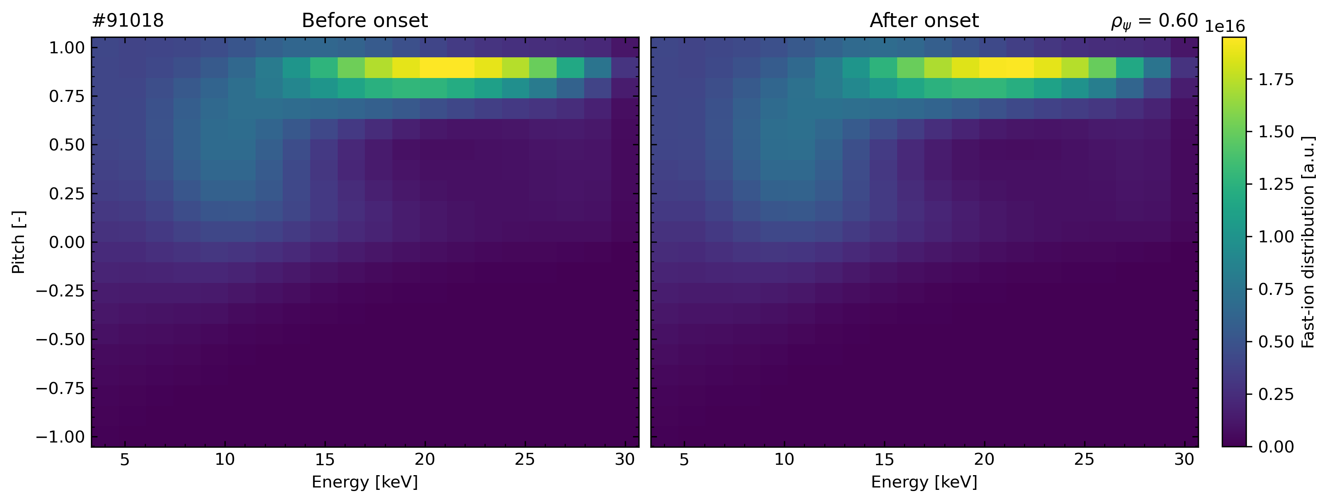
Inverted distribution
Spectra treatment is essential to obtain accurate reconstruction
  nsamples = 10000/nburn=1000
  Mean prior=1.0e0/ variance prior 1.0e-2

Slide 40
Bayesian uncertainty on inverted distribution

Slide 41
Distribution variation
Integrated fast-ion distribution
> location: R = 91.38 cm, rho = 0.214
> before onset = 2.830e+17
> after onset = 2.713e+17
> variation = -1.174e+16
> relative variation = -4.15 %
Integrated fast-ion distribution
> location: R = 98.51 cm, rho = 0.604
> before onset = 1.278e+17
> after onset = 1.298e+17
> variation = +2.022e+15
> relative variation = +1.58 %

Slide 42
FILD weight functions computed with ASCOT
Used to invert strike distribution on the scintillator to particle velocity-space distribution at the probe pinhole

Slide 44
Reconstructing velocity-space loss distribution
Average NBI-1 loss data is inverted using Bayesian inference with uncertainty quantification
  Spurious artefact looking like weight-function edge

Slide 45
Integrating the distribution identifies features of the losses
Three NBI-1 fast-ion energy components can be observed
  Shift in energy, due to incorrect instrument geometry calibration?
Two pitch structures at $0.6$ and $0.7$

Slide 46
Comparing measured and fitted FILD images
  Smoothing due to inversion

Slide 47
Each FIDA line of sight samples a localized but finite plasma region

Slide 48
Mean distribution variation observed by the LOS probing in the core

Slide 49
Mean distribution variation observed by the LOS probing near the edge

Slide 50
Plasma current exacerbates the redistribution
HFS
LFS

Slide 51
Fishbones are suppressed by ECH

