Slide 1
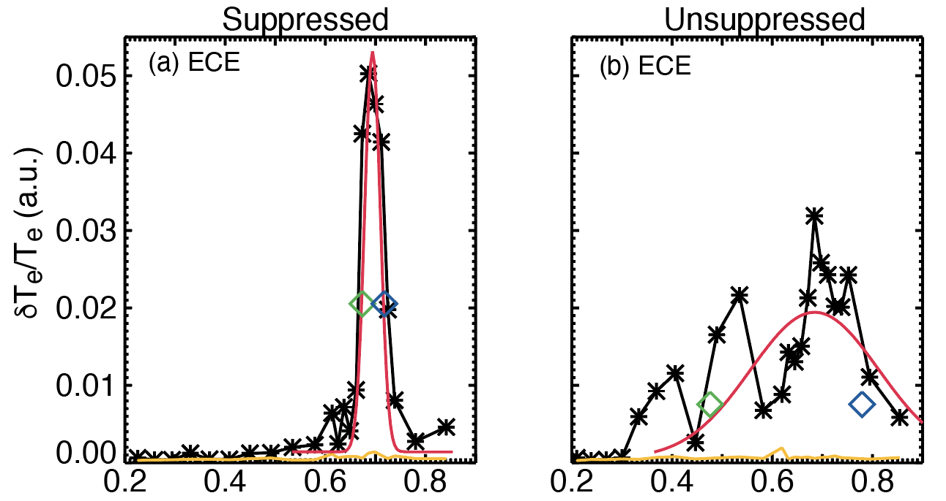

Properties of Alfvén Eigenmodes during Strong Microturbulence Suppression
W. Heidbrink, X.D. Du, M. Austin, I. Bachant,
K. Callahan, F. Eizaguirre R. Hong, L. Liu, G. McKee, M.
Van Zeeland, Z Yan
Methodology
Data
Interpretation
Technical Meeting on Energetic Particles (October 2026)
Normalized Minor Radius

Slide 2
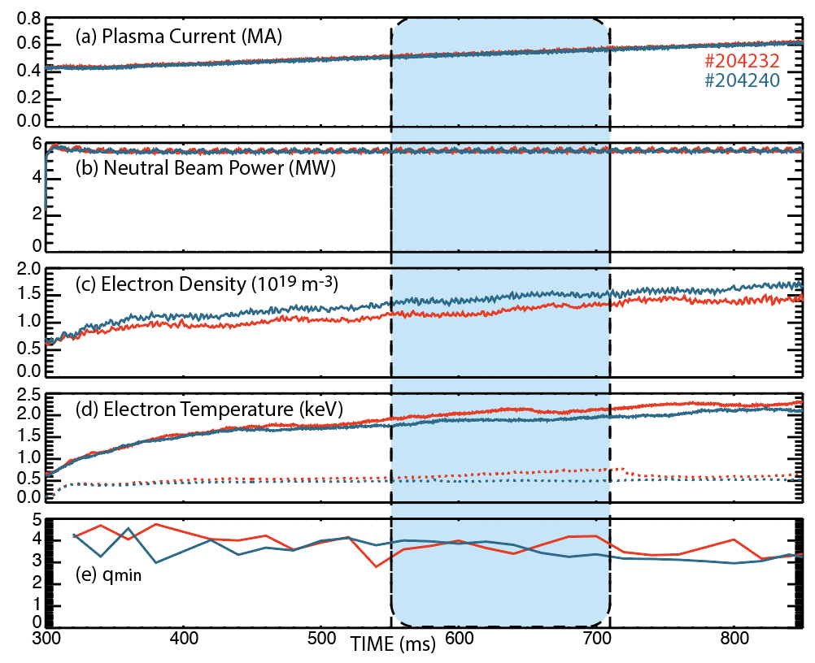
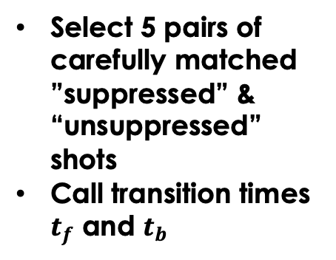


AEs are excited in the current ramp
Onset
Select 5 pairs of carefully matched ”suppressed” & “unsuppressed” shots
Call transition times $t_{f}$ and $t_{b}$
Back Transition
$$t_{f}$$
$$t_{b}$$

Slide 3
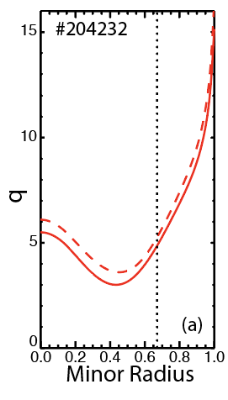
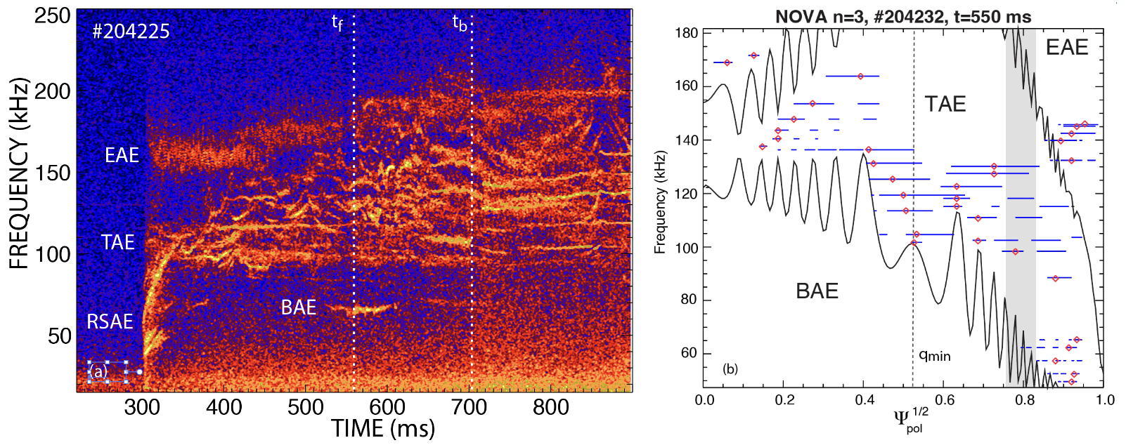
Focus on TAEs excited near $ρ$=0.67
Interferometer
Normalized square root of poloidal flux
Normalized square root of toroidal flux

Slide 4
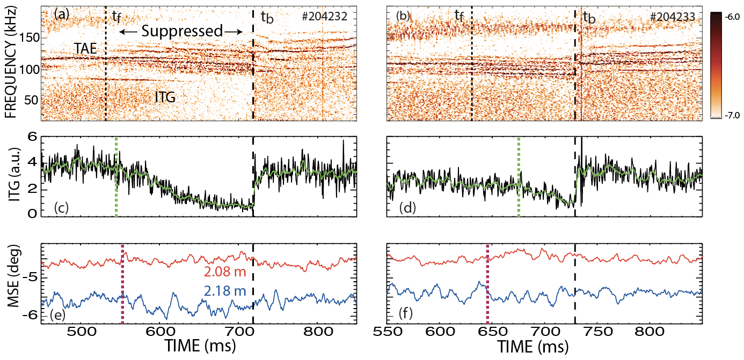

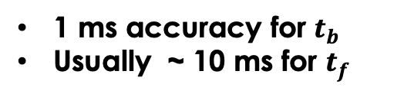
The back transition is much sharper than the forward transition
Use 3 criteria to select $t_{f}$ and $t_{b}$
Change in AEs
Change in ITG amplitude
Change in MSE signals
CO2
BES
1 ms accuracy for $t_{b}$
Usually ~ 10 ms for $t_{f}$

Slide 5
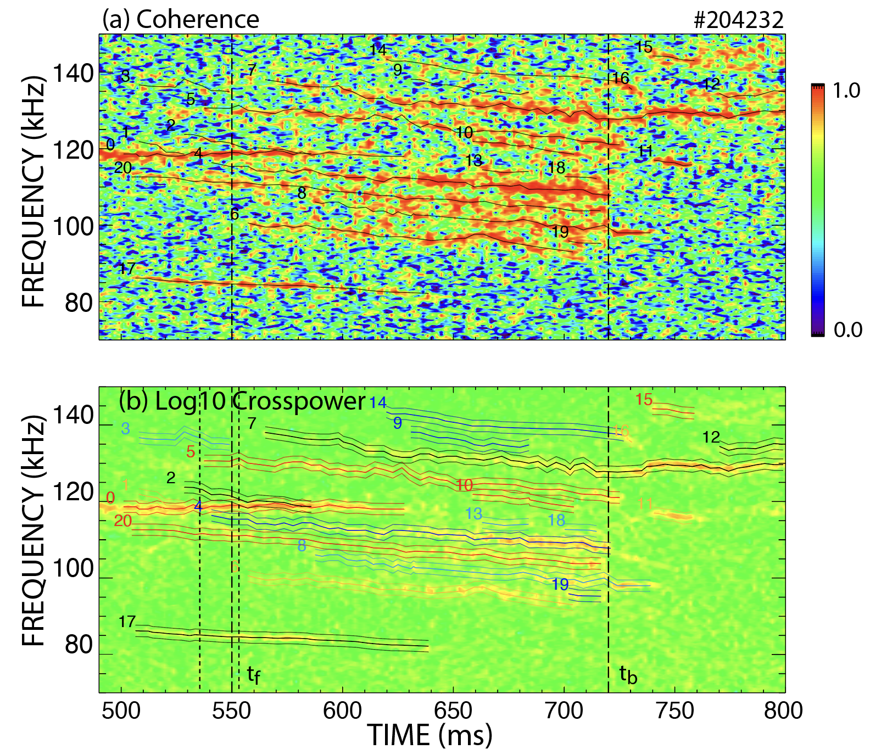
Track modes by hand, then interpolate between points to obtain f(t)
ECE

Slide 6
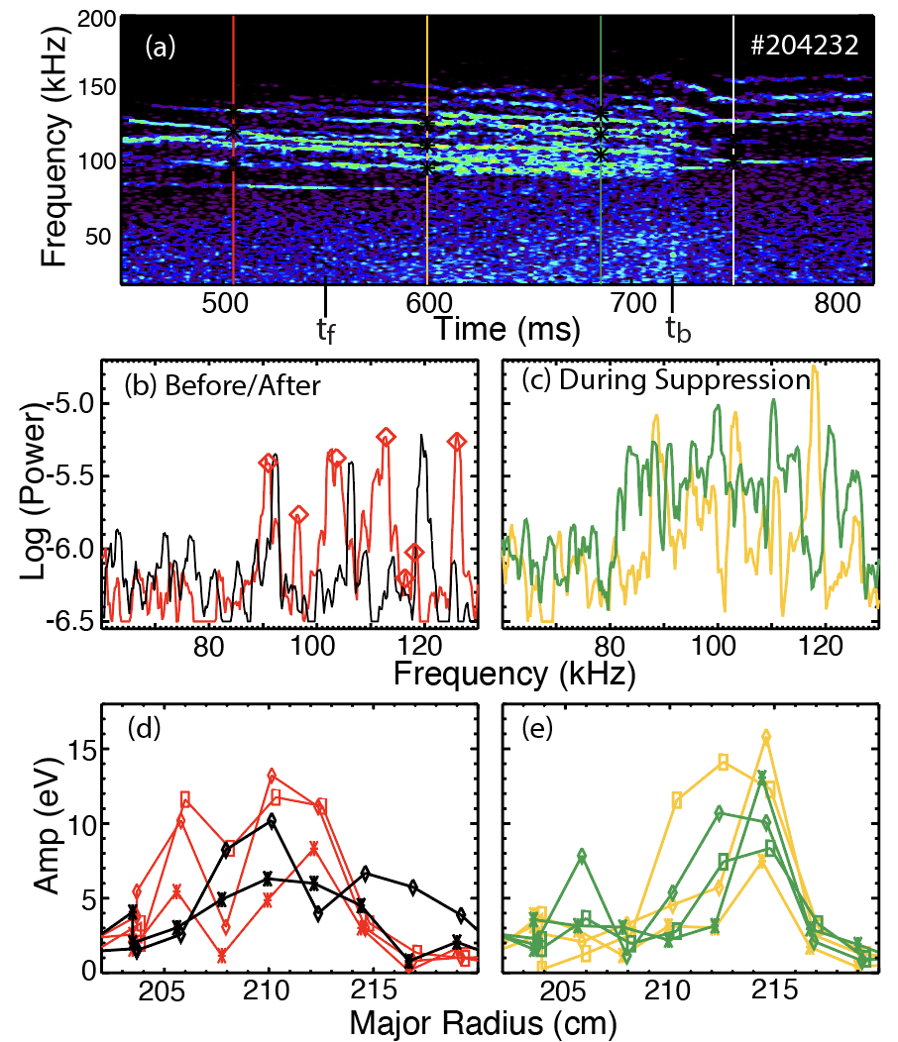
Complementary “peak-finder” approach includes transient modes
ECE
Diamonds are peaks found by peak-finder

Slide 7
Properties of Alfvén Eigenmodes during Strong Microturbulence Suppression
Methodology
Data
Interpretation
Technical Meeting on Energetic Particles (September 2026)
Normalized Minor Radius

Slide 8
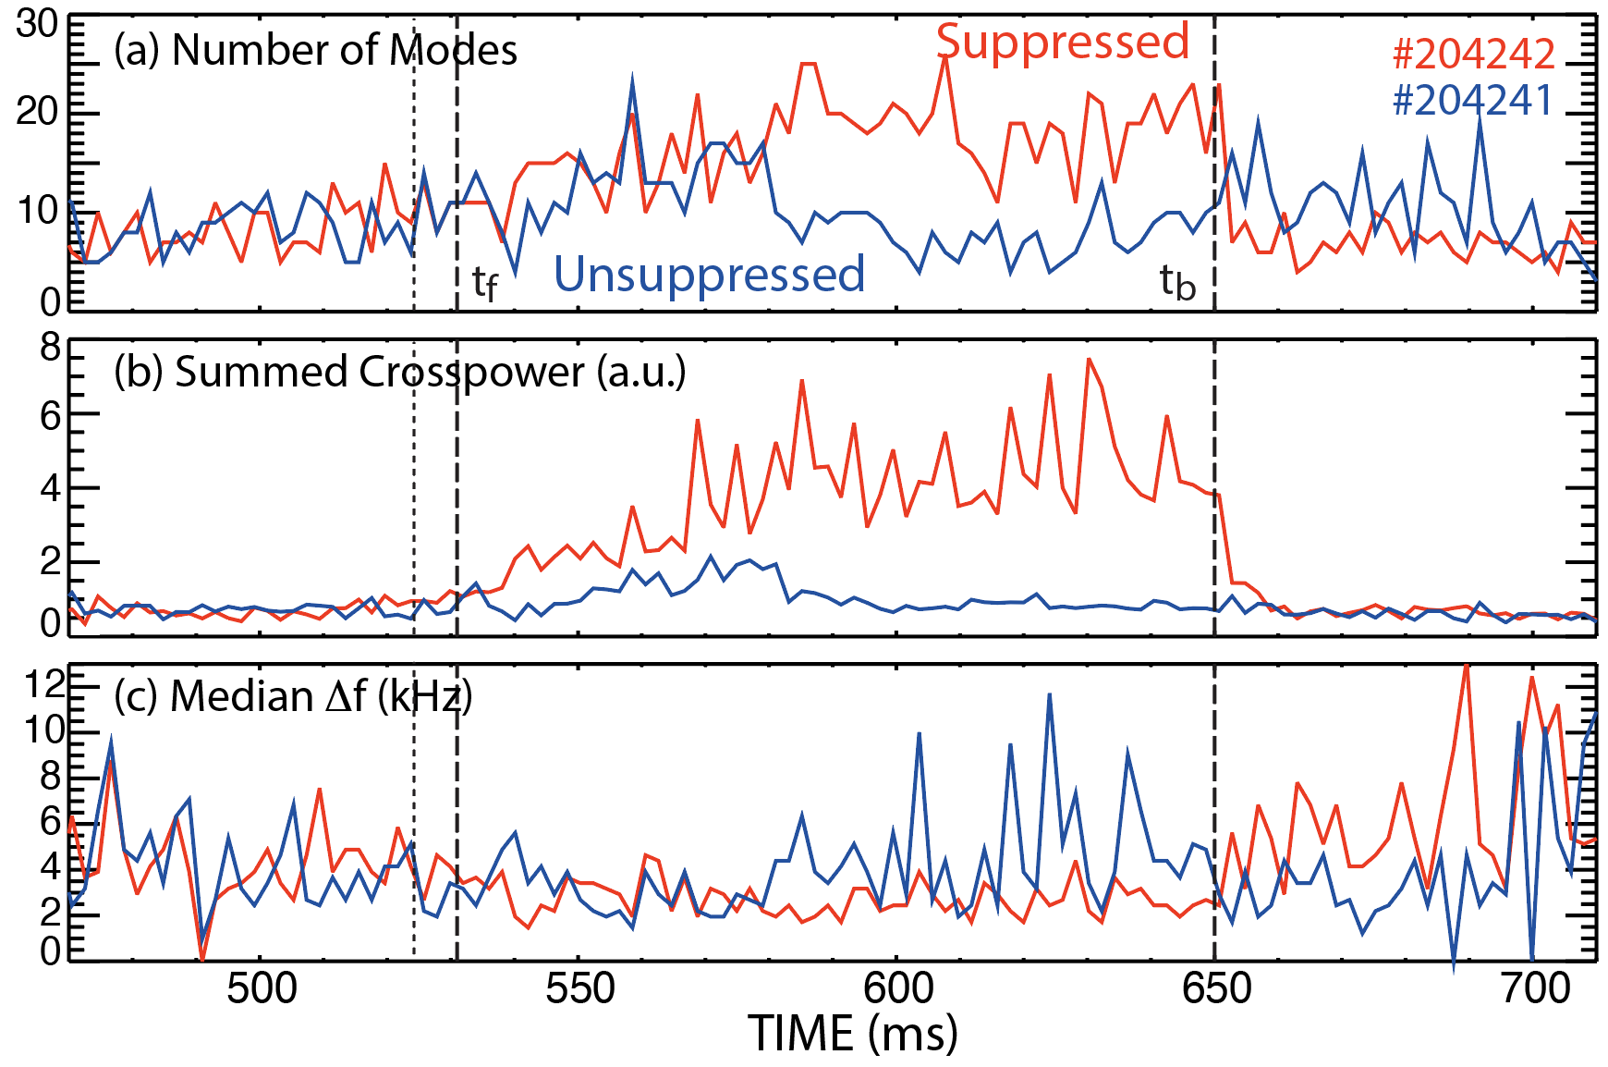
AEs are more numerous and stronger during strong suppression
The number of modes doubles
The summed power increases ~ 6x → modes are stronger too
Note that reference case kind of tracks for first ~ 50 ms before reverting to normal

Slide 9
The eigenfunction narrows during strong suppression
Not all modes look like these but many do
Apply coherence & amplitude thresholds
Fit to three Gaussians: entire data (red curves), mirror-reflected ”left” (green diamond) and “right” (blue diamonds) sides
Normalized Minor Radius

Slide 10
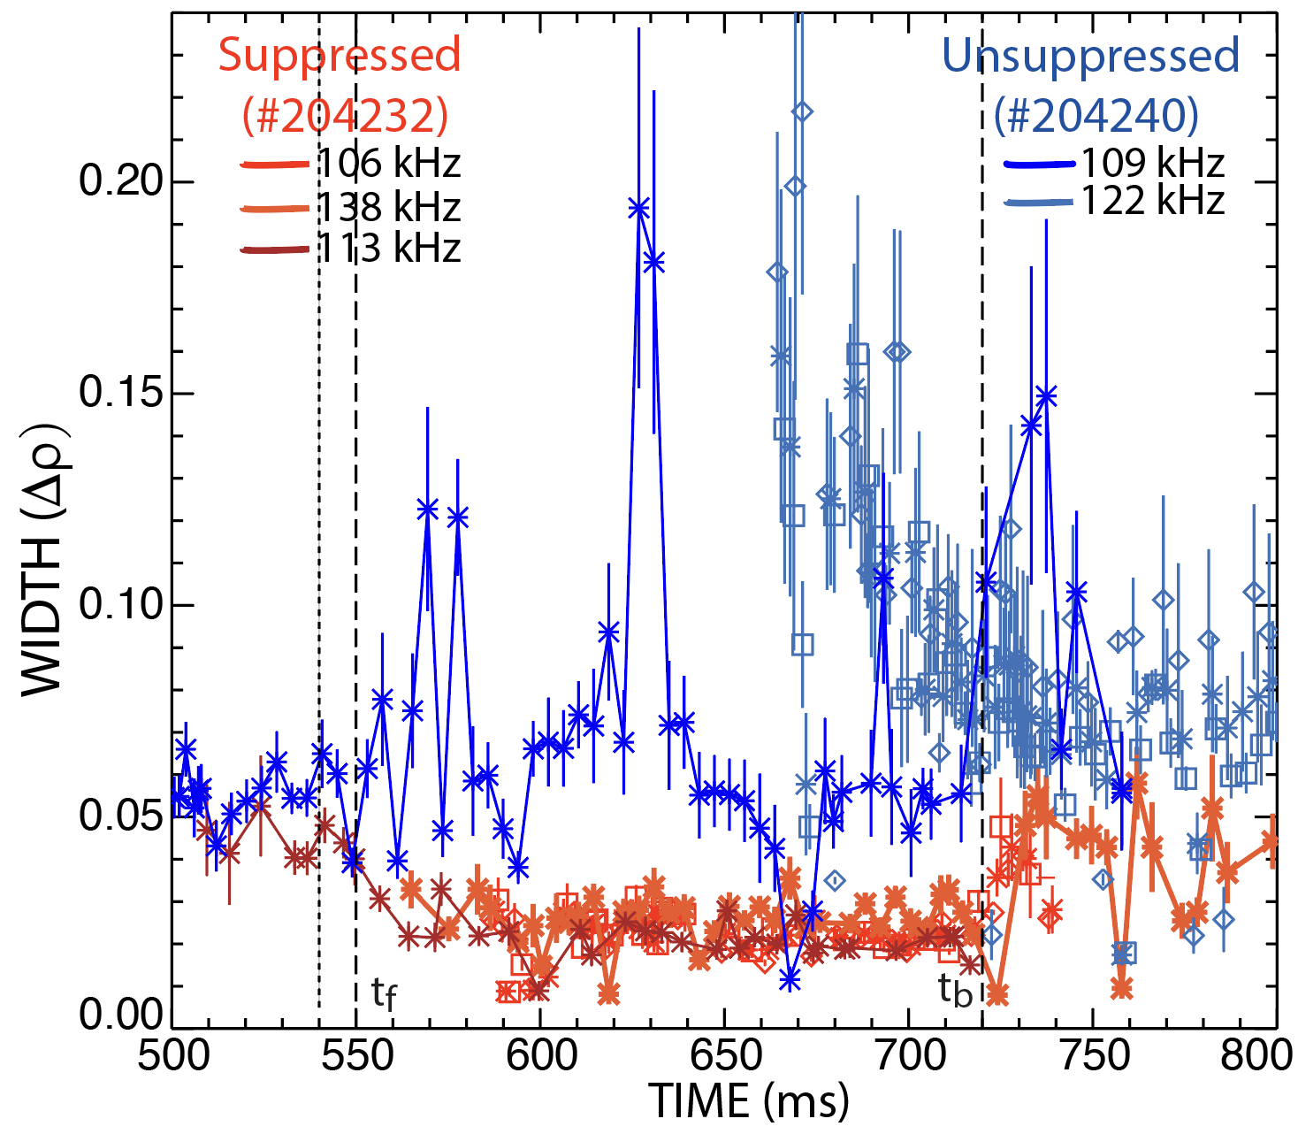
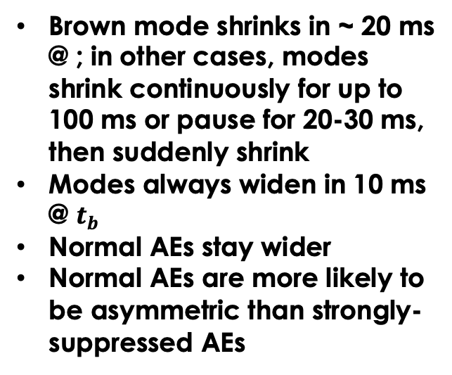
The radial width shrinks during strong suppression
Brown mode shrinks in ~ 20 ms @ ; in other cases, modes shrink continuously for up to 100 ms or pause for 20-30 ms, then suddenly shrink
Modes always widen in 10 ms @ $t_{b}$
Normal AEs stay wider
Normal AEs are more likely to be asymmetric than strongly-suppressed AEs

Slide 11
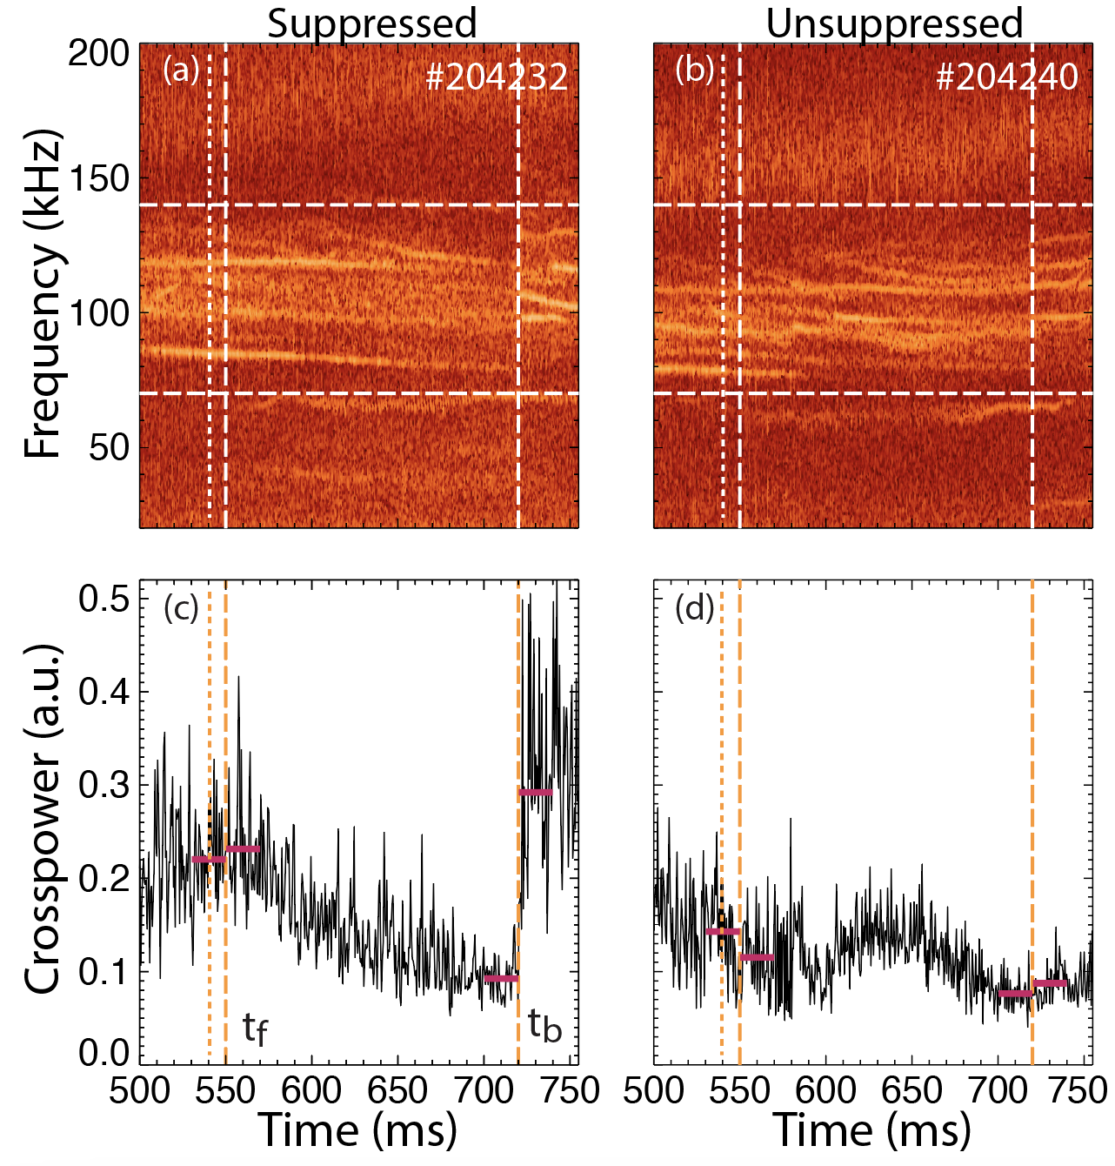
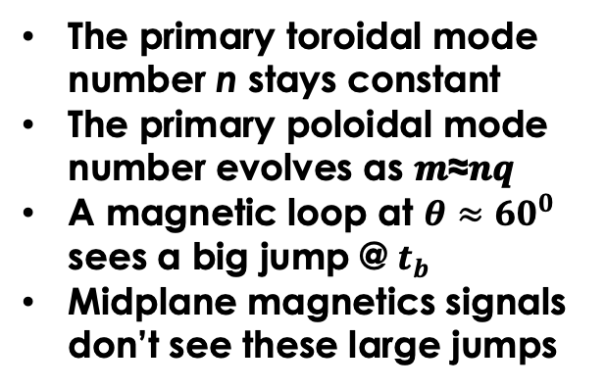
The eigenfunction’s poloidal harmonics change
The primary toroidal mode number n stays constant
The primary poloidal mode number evolves as 𝒎≈𝒏𝒒
A magnetic loop at $θ≈{60}^{0}$ sees a big jump @ $t_{b}$
Midplane magnetics signals don’t see these large jumps
Magnetics

Slide 12
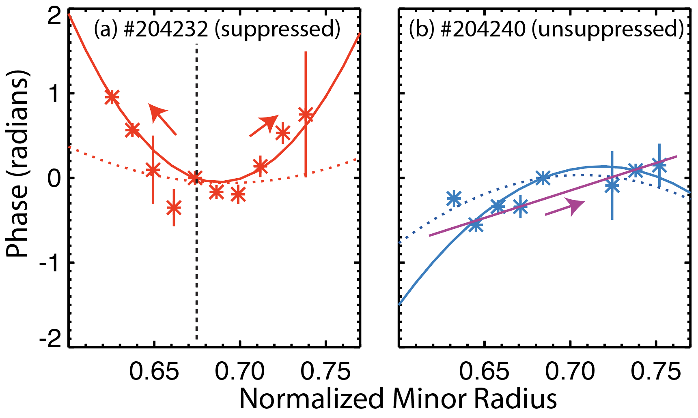
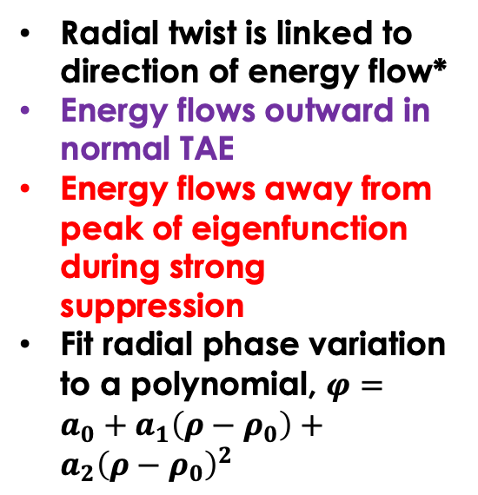
The “radial twist” (phase variation) of eigenfunction is different in suppressed shots
Radial twist is linked to direction of energy flow*
Energy flows outward in normal TAE
Energy flows away from peak of eigenfunction during strong suppression
Fit radial phase variation to a polynomial, $φ=a_{0}+a_{1}\left(ρ−ρ_{0}\right)+$ $a_{2}{\left(ρ−ρ_{0}\right)}^{2}$
*Kolesnichenko, PoP 31 (2024) 112509; Heidbrink, NF 62 (2022) 066020

Slide 13
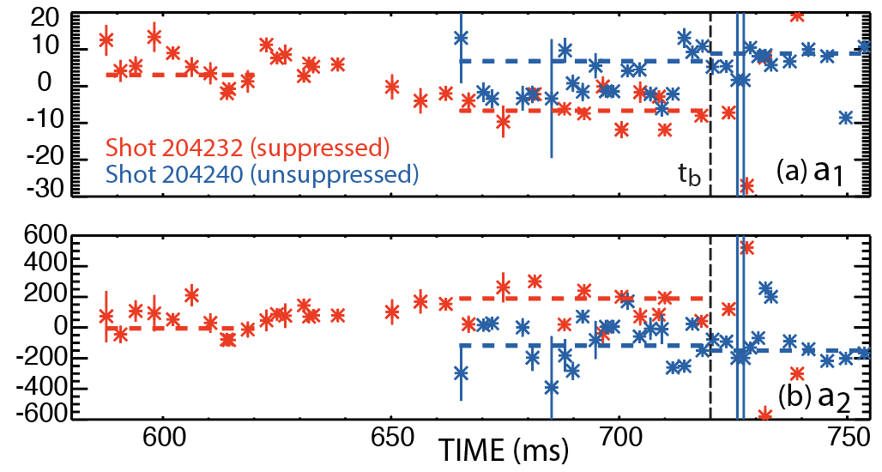
Energy flows away from the peak of the eigenfunction during strong suppression
$φ=a_{0}+a_{1}\left(ρ−ρ_{0}\right)+$ $a_{2}{\left(ρ−ρ_{0}\right)}^{2}$
Outward
Inward
Concave
Convex

Slide 14

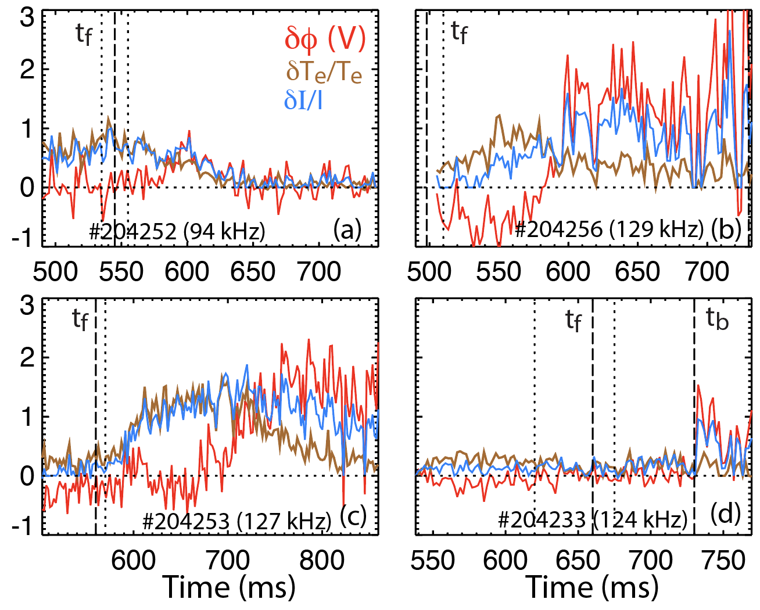
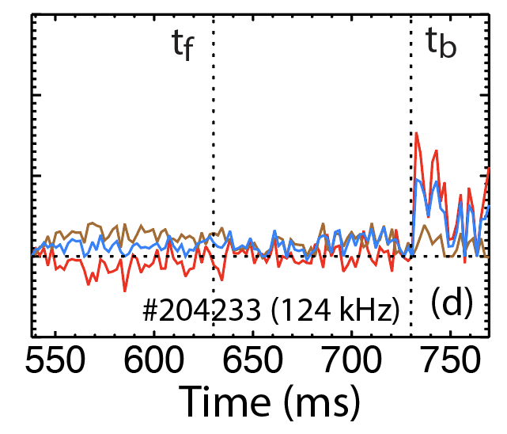




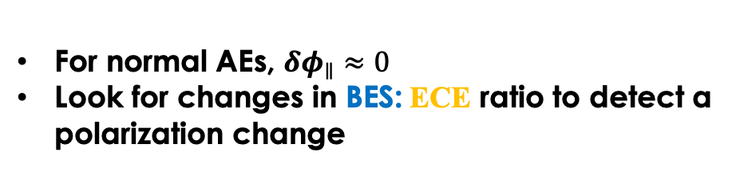
Use $δφ_{∥}$ to detect polarization changes
For normal AEs, $δφ_{∥}≈0$
Look for changes in BES: ECE ratio to detect a polarization change
$$δI_{BES}/I_{BES}$$
$$δT_{e}/T_{e}$$
$δφ_{∥}$
(V)
X.D. Du, PRL 132, 215101 (2024)
Heidbrink, NF 65, 112002 (2025)

Slide 15
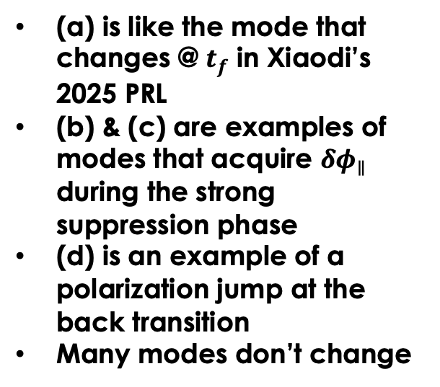
Wide variety: Jumps in $δφ_{∥}$ occur at $t_{f}$, $t_{b}$, and in between
(a) is like the mode that changes @ $t_{f}$ in Xiaodi’s 2025 PRL
(b) & (c) are examples of modes that acquire $δφ_{∥}$ during the strong suppression phase
(d) is an example of a polarization jump at the back transition
Many modes don’t change

Slide 16
Summary of empirical “facts” about the AEs during strong suppression
There are more unstable AEs
AE amplitudes are larger
The radial eigenfunction is generally narrower and more symmetric
The poloidal composition of the eigenfunction is altered
The radial twist of the eigenfunction flips sign, indicating that wave energy flows away from the peak of the eigenfunction in both directions
A subset of modes acquire an electrostatic component of polarization
The nonlinear burst cycle is similar in the suppressed and unsuppressed states
Direct nonlinear coupling between different AEs is weak

Slide 17
Properties of Alfvén Eigenmodes during Strong Microturbulence Suppression
Methodology
Data
Interpretation
Technical Meeting on Energetic Particles (September 2026)
Normalized Minor Radius

Slide 18
Why are there more unstable modes during strong suppression?
Not because they are a family of coupled daughter waves driven by a pump
More modes cross the stability boundary
The fast-ion density is 30% larger → more drive
Reduced scattering of resonant fast ions by microturbulence
Drift waves can damp TAEs* → turbulence suppression reduces damping
Energy flow from zonal modes?
Increasing drive and decreasing turbulence both change on the observed timescale of stronger, more numerous modes
*Chen, Qiu, Zonca, NF (2022)

Slide 19
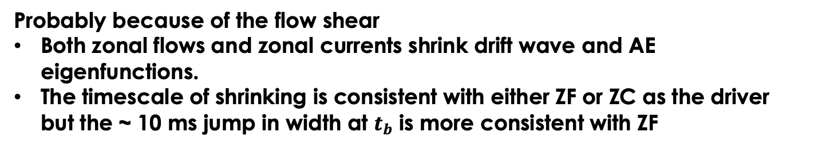
Why is the radial eigenfunction narrower?
Probably because of the flow shear
Both zonal flows and zonal currents shrink drift wave and AE eigenfunctions.
The timescale of shrinking is consistent with either ZF or ZC as the driver but the ~ 10 ms jump in width at $t_{b}$ is more consistent with ZF

Slide 20
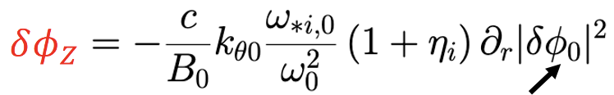
What causes the gradual forward transition?
Two criteria: a polarization change & a feedback loop that amplifies the zonal flow
The polarization change is likely always there—even in the reference shots
Liu Chen’s zonal flow equation implies that, if the modes get stronger and narrower, the zonal flow will grow
The timescale for this mechanism is right
Power/width
But attempts to find a threshold in Power/width have failed

Slide 21
What causes the rapid back transition?
We have no clue!
well, hardly any ...

Slide 22
Summary of empirical “facts” about the AEs during strong suppression
There are more unstable AEs
AE amplitudes are larger
The radial eigenfunction is generally narrower and more symmetric
The poloidal composition of the eigenfunction is altered
The radial twist of the eigenfunction flips sign, indicating that wave energy flows away from the peak of the eigenfunction in both directions
A subset of modes acquire an electrostatic component of polarization
The nonlinear burst cycle is similar in the suppressed and unsupressed states
Direct nonlinear coupling between different AEs is weak
Contact Xiaodi and me if you want to simulate these data
“Properties of Alfvén Eigenmodes during Strong Microturbulence Suppression,” W.W. Heidbrink et al., Nucl. Fusion (2026) submitted

Slide 23
Backup

Slide 24
Why are there more unstable modes during strong suppression?
Not because they are a family of coupled daughter waves driven by a pump
The modes are independent
The frequency interval is nonuniform
The modes exhibit normal variability in radial eigenfunction & twist
More modes cross the stability boundary
The fast-ion density is 30% larger → more drive
Reduced scattering of resonant fast ions by microturbulence
Drift waves can damp TAEs* → turbulence suppression reduces damping
Energy flow from zonal modes?
Increasing drive and decreasing turbulence both change on the observed timescale of stronger, more numerous modes
*Chen, Qiu, Zonca, NF (2022)

Slide 25
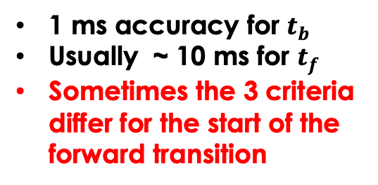
The back transition is much sharper than the forward transition
Use 3 criteria to select $t_{f}$ and $t_{b}$
Change in AEs
Change in ITG amplitude
Change in MSE signals
CO2
1 ms accuracy for $t_{b}$
Usually ~ 10 ms for $t_{f}$
Sometimes the 3 criteria differ for the start of the forward transition

Slide 26
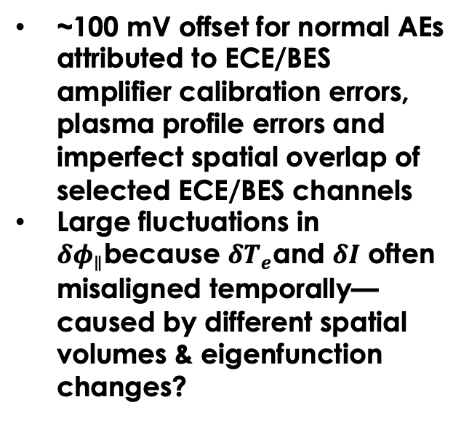
Errors in $δφ_{∥}$are substantial
~100 mV offset for normal AEs attributed to ECE/BES amplifier calibration errors, plasma profile errors and imperfect spatial overlap of selected ECE/BES channels
Large fluctuations in $δφ_{∥}$because $δT_{e}$and $δI$ often misaligned temporally—caused by different spatial volumes & eigenfunction changes?

Slide 27
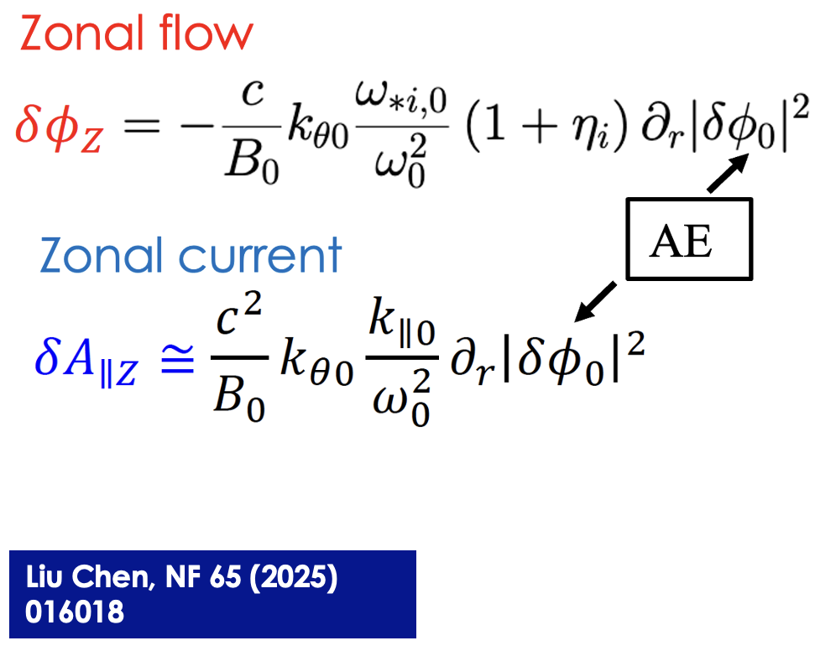
In theory, AEs nonlinearly drive both zonal flows and zonal currents
Predicted in both simulation and analytic theory

Slide 28
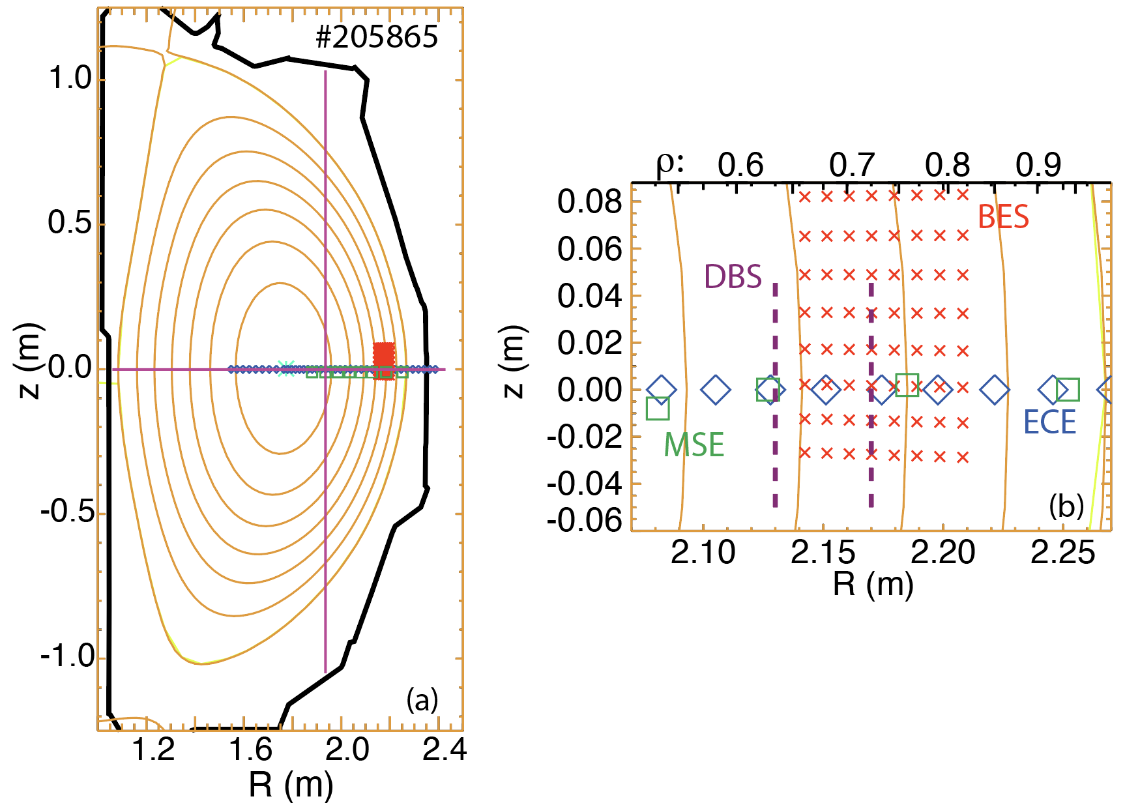
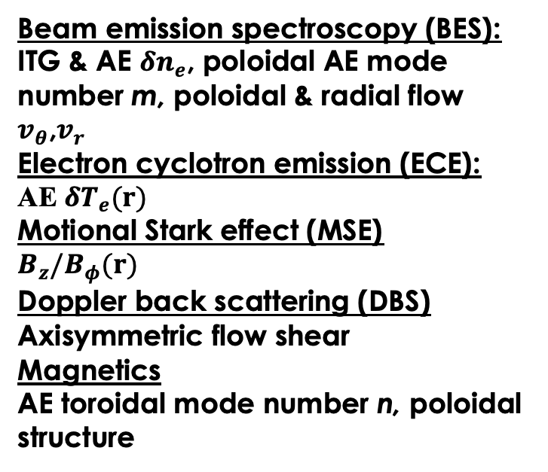
Use BES, ECE, MSE, DBS, and Magnetic Diagnostics
Beam emission spectroscopy (BES): ITG & AE $δn_{e}$, poloidal AE mode number m, poloidal & radial flow $v_{θ}$,$v_{r}$
Electron cyclotron emission (ECE):
AE $δT_{e}(r)$
Motional Stark effect (MSE)
$$B_{z}/B_{φ}(r)$$
Doppler back scattering (DBS)
Axisymmetric flow shear
Magnetics
AE toroidal mode number n, poloidal structure

Slide 29
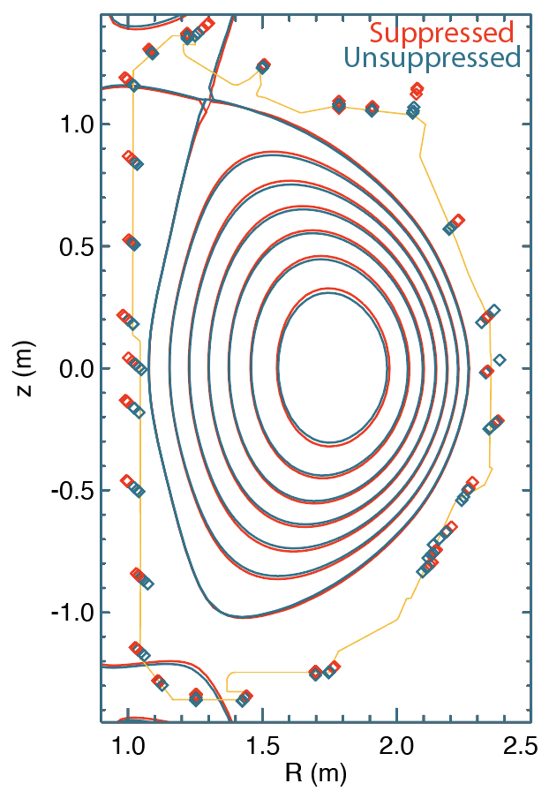
The jump at the back transition is largest near the R+1 port
Analyze jump at back transition for “mpi” poloidal array in 3 matched pairs of shots
Plot jump as distance from vacuum vessel*
Shape contours are from before/after back transition in #204232 (suppressed shot)
Change in plasma shape seems too small to cause these jumps → further evidence of eigenfunction change
*The actual probe positions are a bit farther out

Slide 30
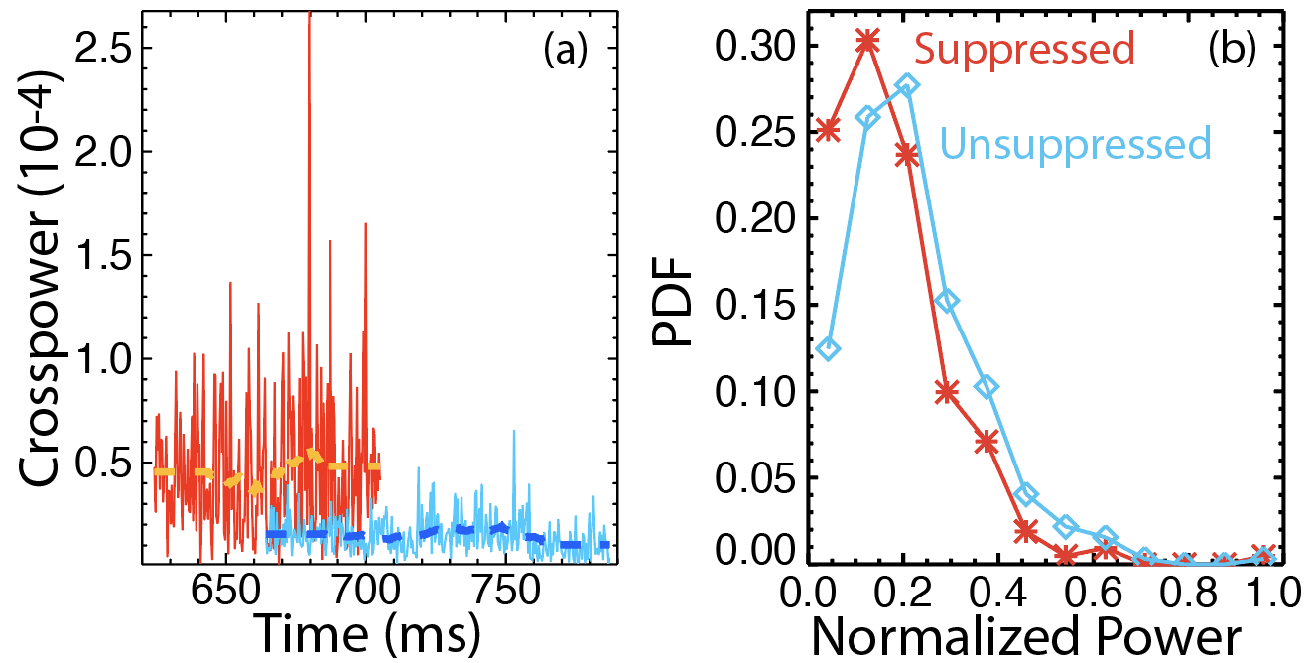
The nonlinear burst pattern is similar to normal TAES during strong suppression
Similar skewness, Kurtosis, and Hurst parameters in suppressed & unsuppressed shots

Slide 31
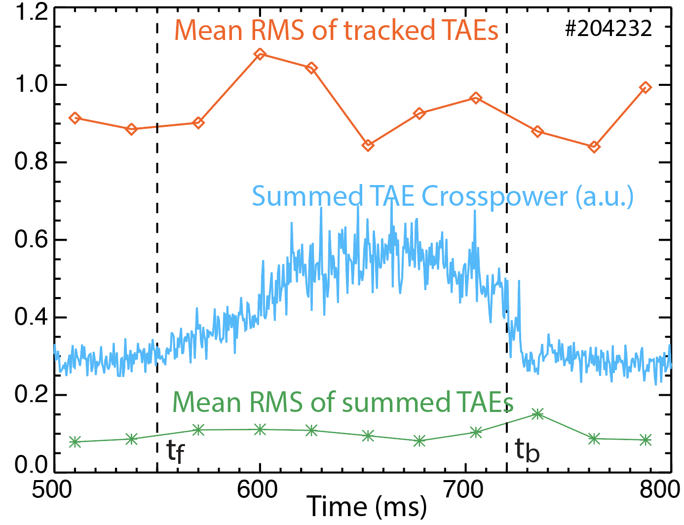
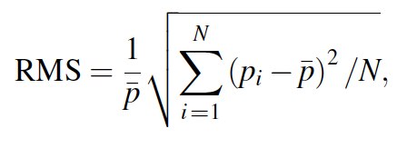
The AEs are independent modes
No statistically significant bicoherence on either BES or ECE signals during suppression
The burst cycles are randomly phased too

Slide 32
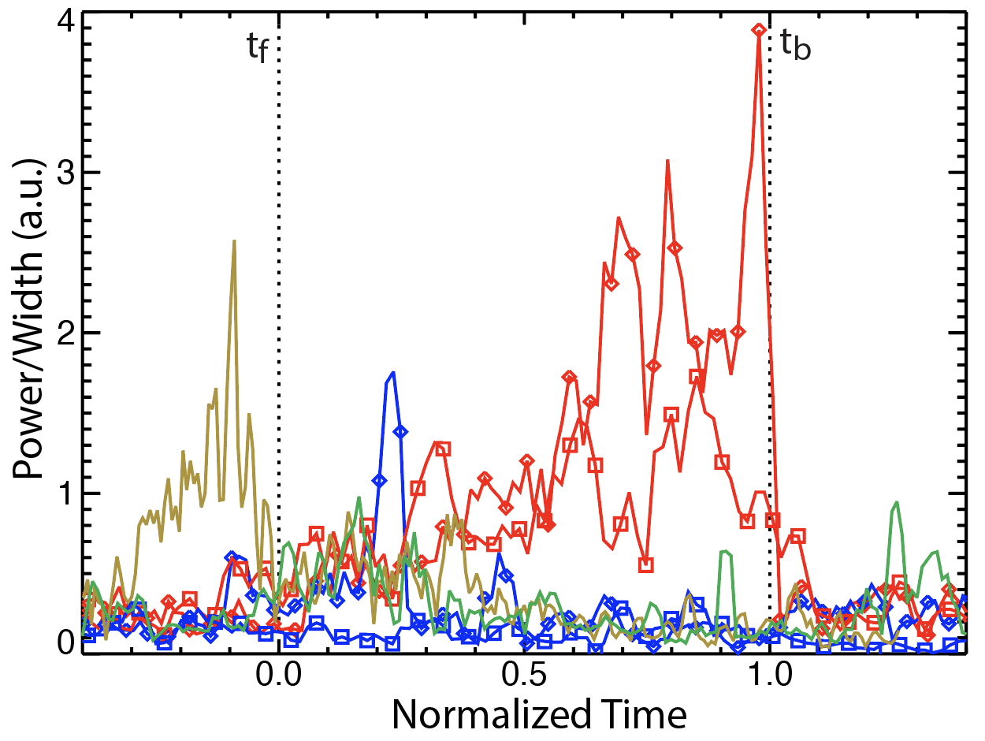
Attempts to find a power/width criterion at t_f have failed

Slide 33
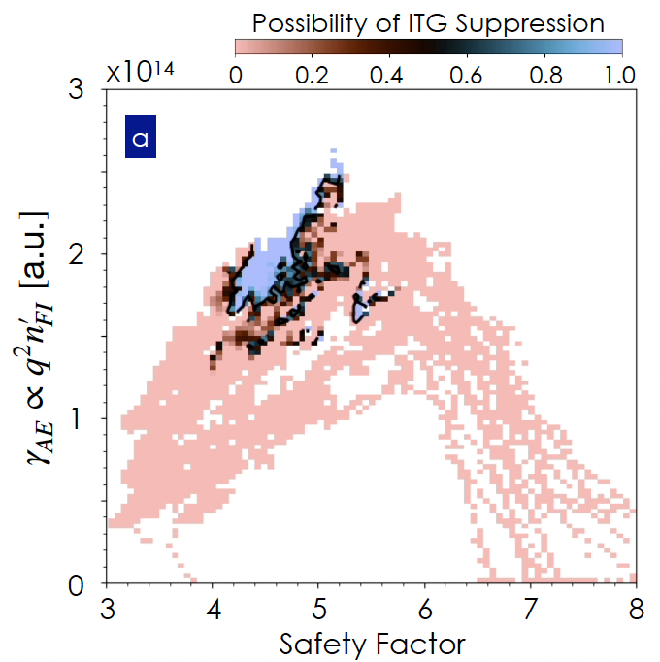
We also don’t know what parameter controls the triggering polarization change
q & n_{FI}
Higher T_{e} favors suppression
Du, PoP (2026)

Slide 34
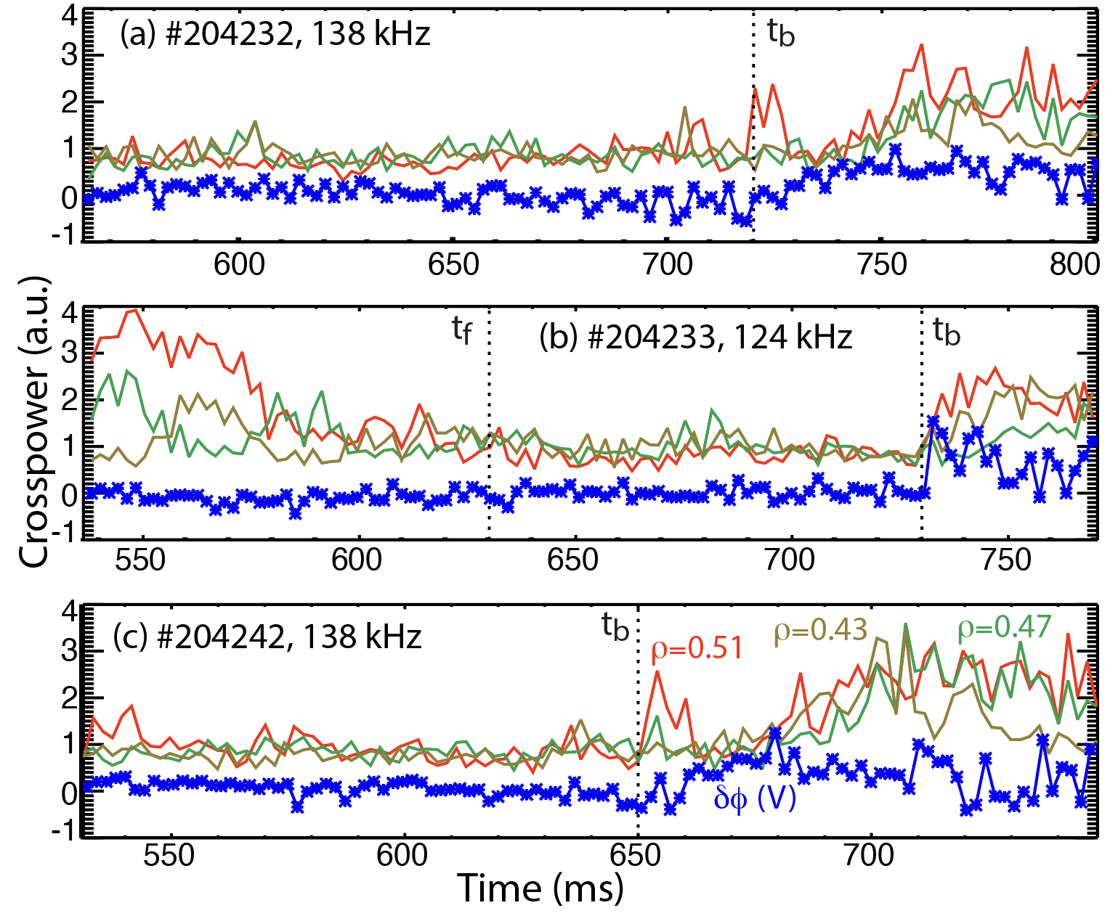
What causes the sudden back transition?
No power/width threshold is evident for t_b either
In some cases, overlapping frequencies between RSAEs and TAEs may broaden the radial eigenfunction, triggering the back transition.
Not always observed, however
A faster back transition is usually observed for H→L than for L→H too

