Slide 1
A workflow for testing energetic particle transport models from experiments
to model validation
M. Podestà¹, Q. Kernel¹, A. Jansen van Vuuren¹, M. Rud Larsen¹, A. N. Karpushov¹, D. Mykytchuk¹, A. Fasoli¹, M. Salewski² and the TCV Team*
¹ Swiss Plasma Center, École Polytechnique Fédérale de Lausanne, Switzerland
² Department of Physics, Technical University of Denmark, 2800 Kgs. Lyngby, Denmark
* See author list in C. Theiler et al., Nucl. Fusion, 66 (2026) 116007
Acknowledgments: L. Persico, J. Tumbokon, B. Duval (SPC/EPFL), S. Sharapov (UKAEA), M. Dreval (IPP, Kharkov, Ukraine), J. Carpenter (Durham U., UK),
02/10/2026

Slide 2
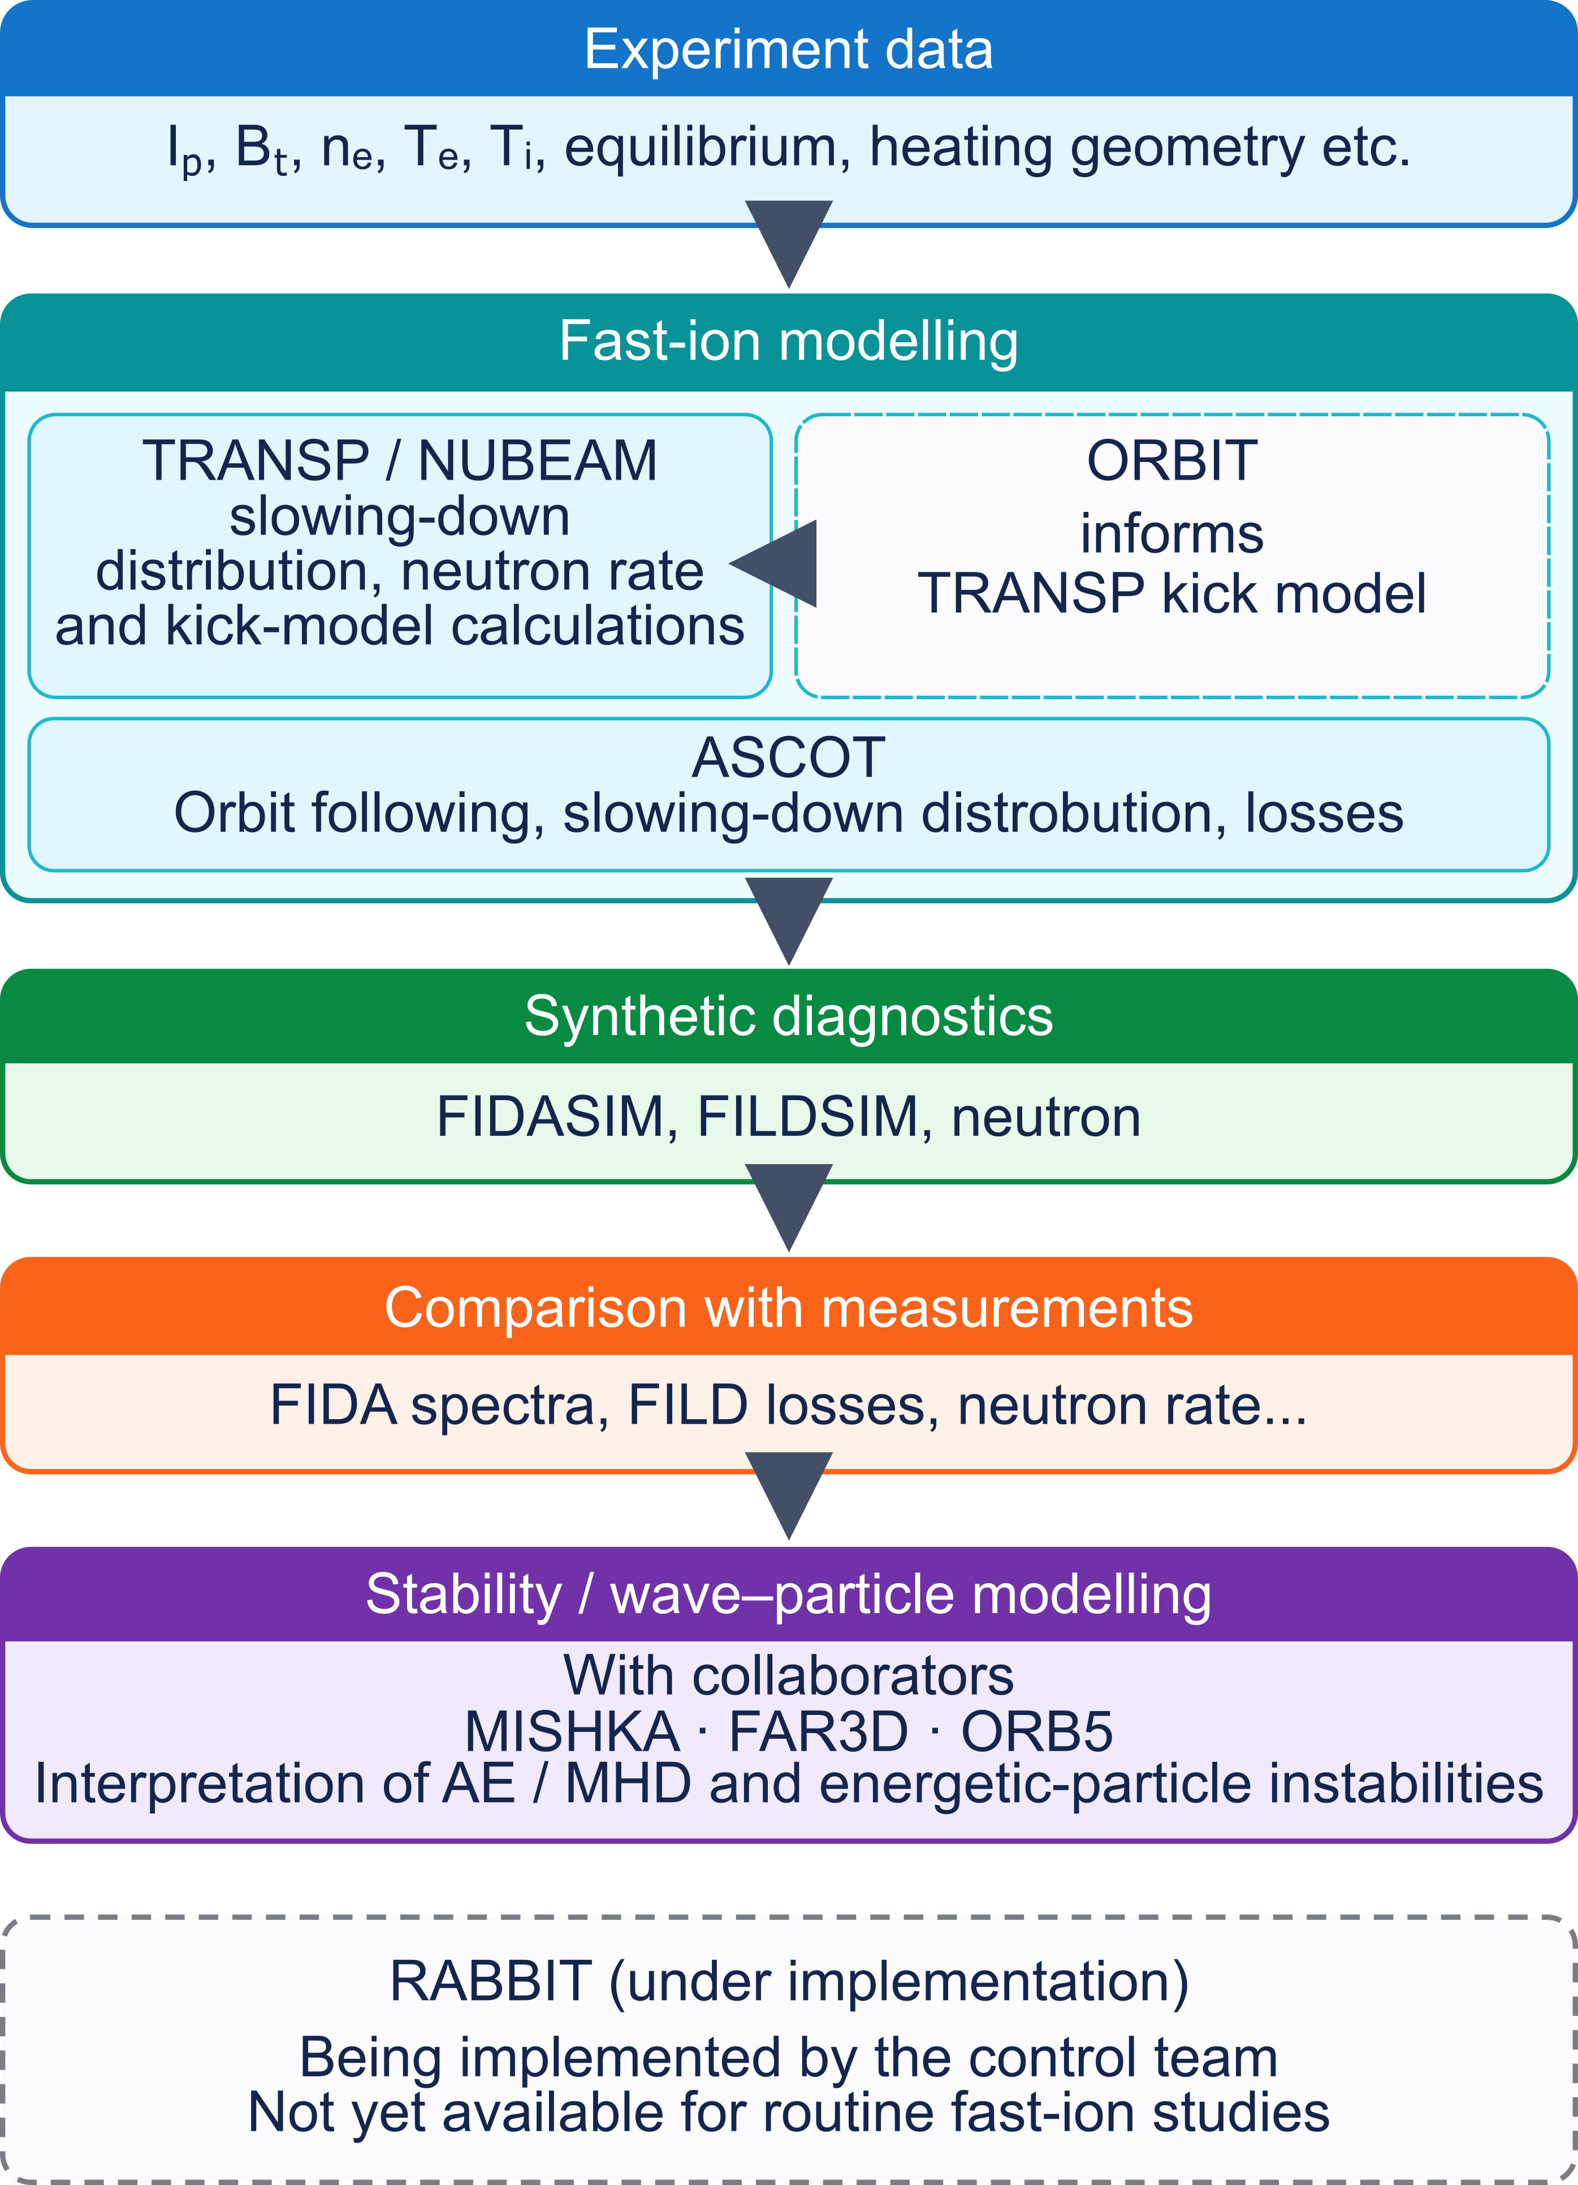
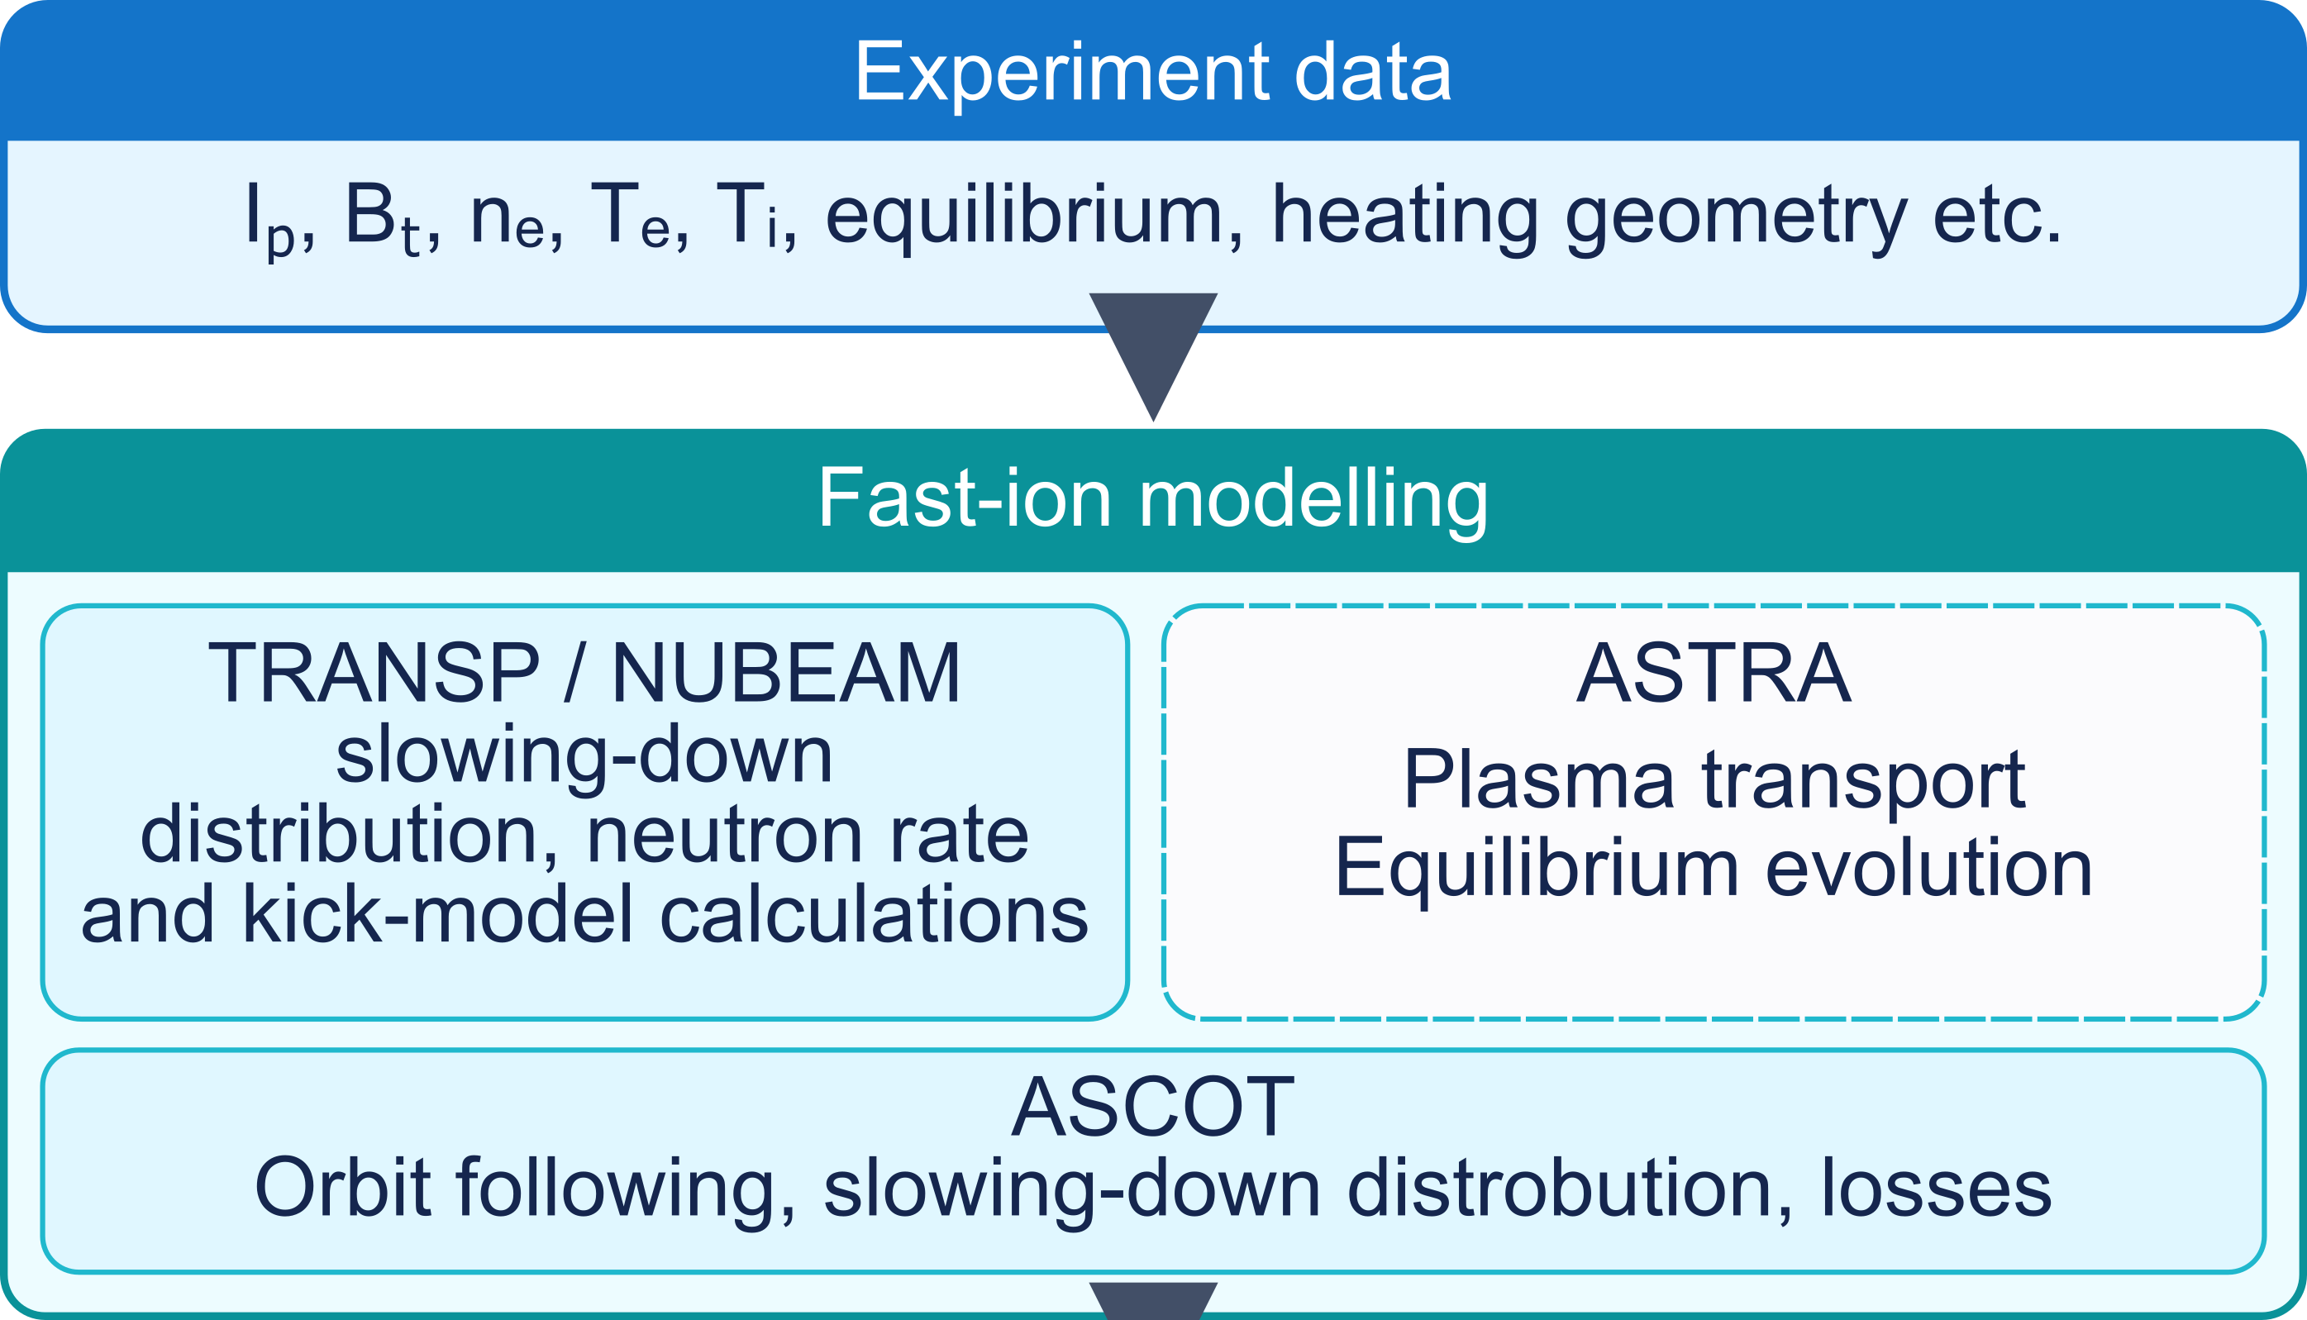
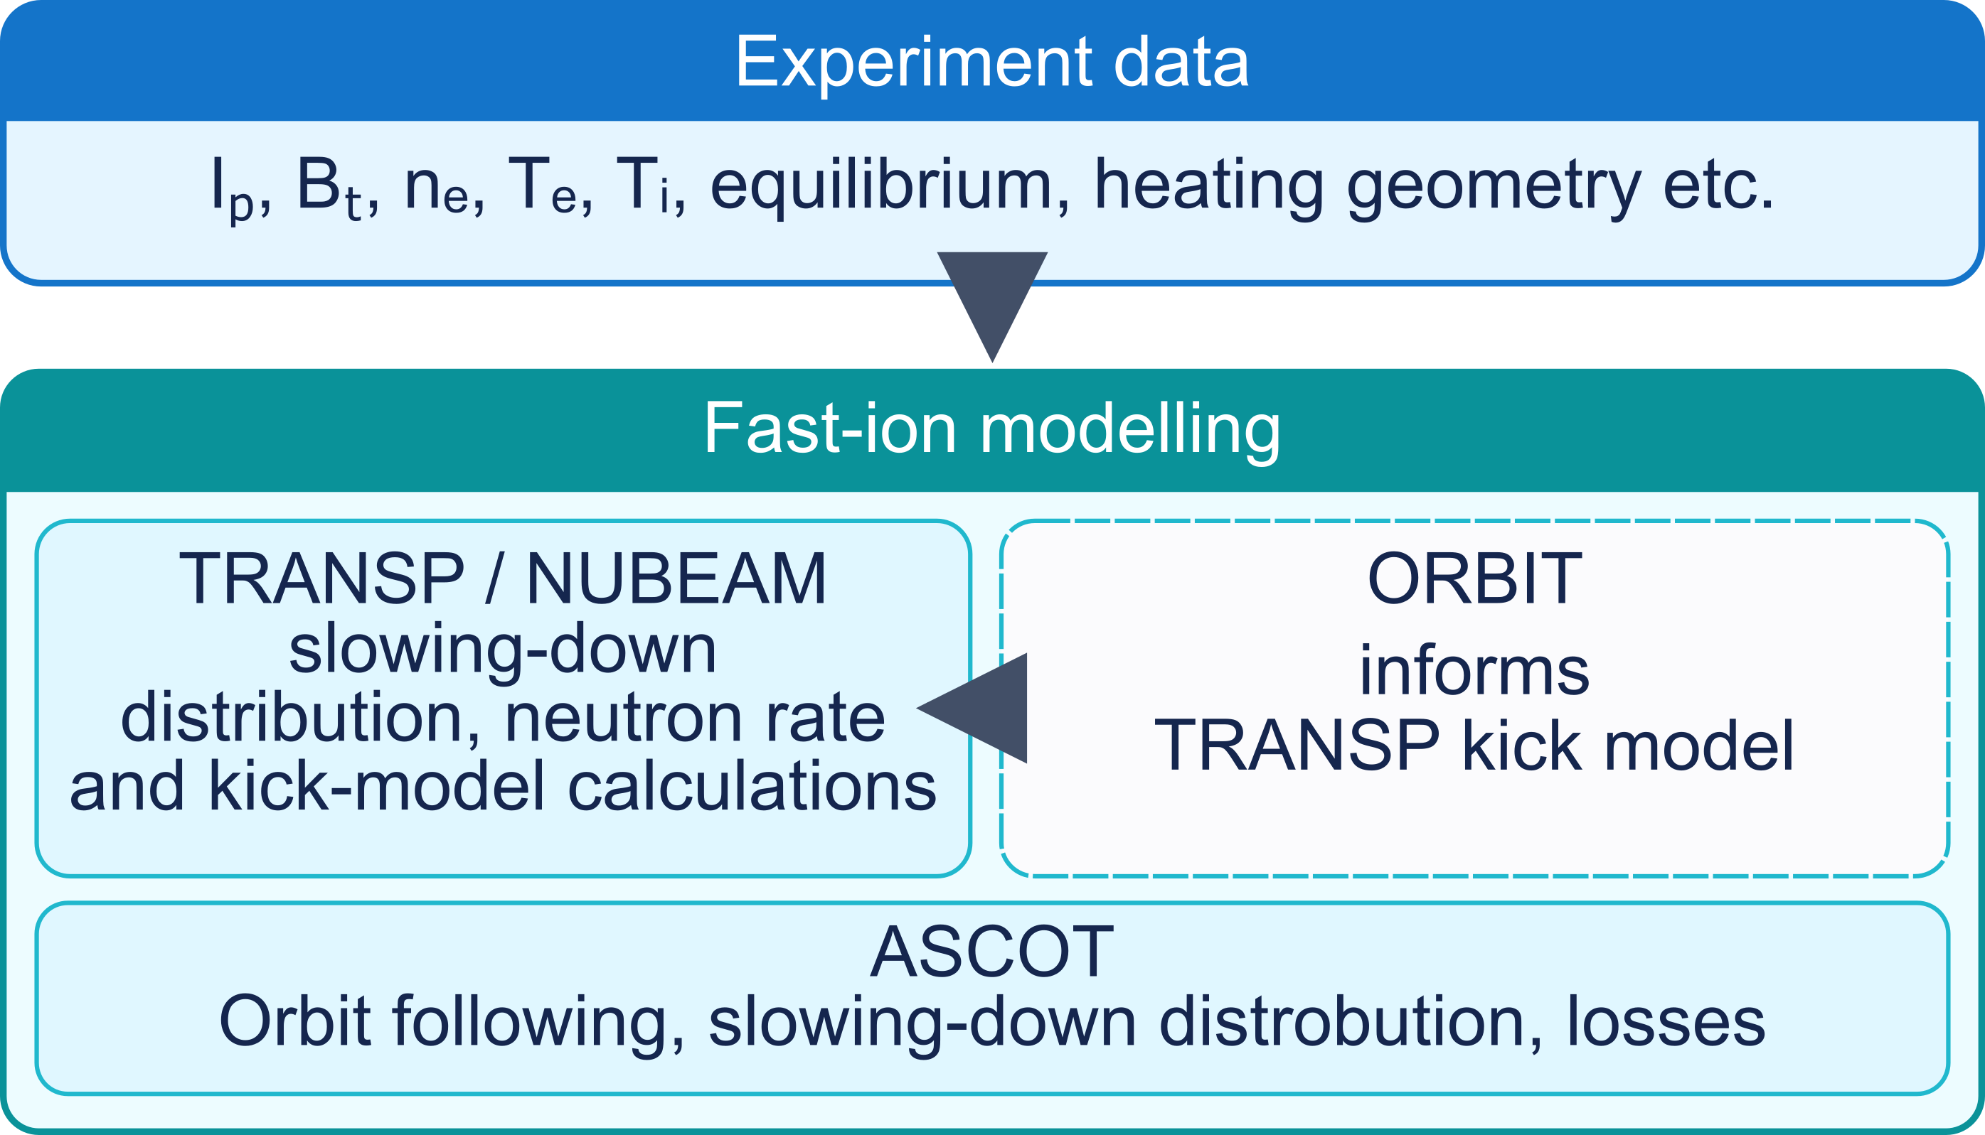
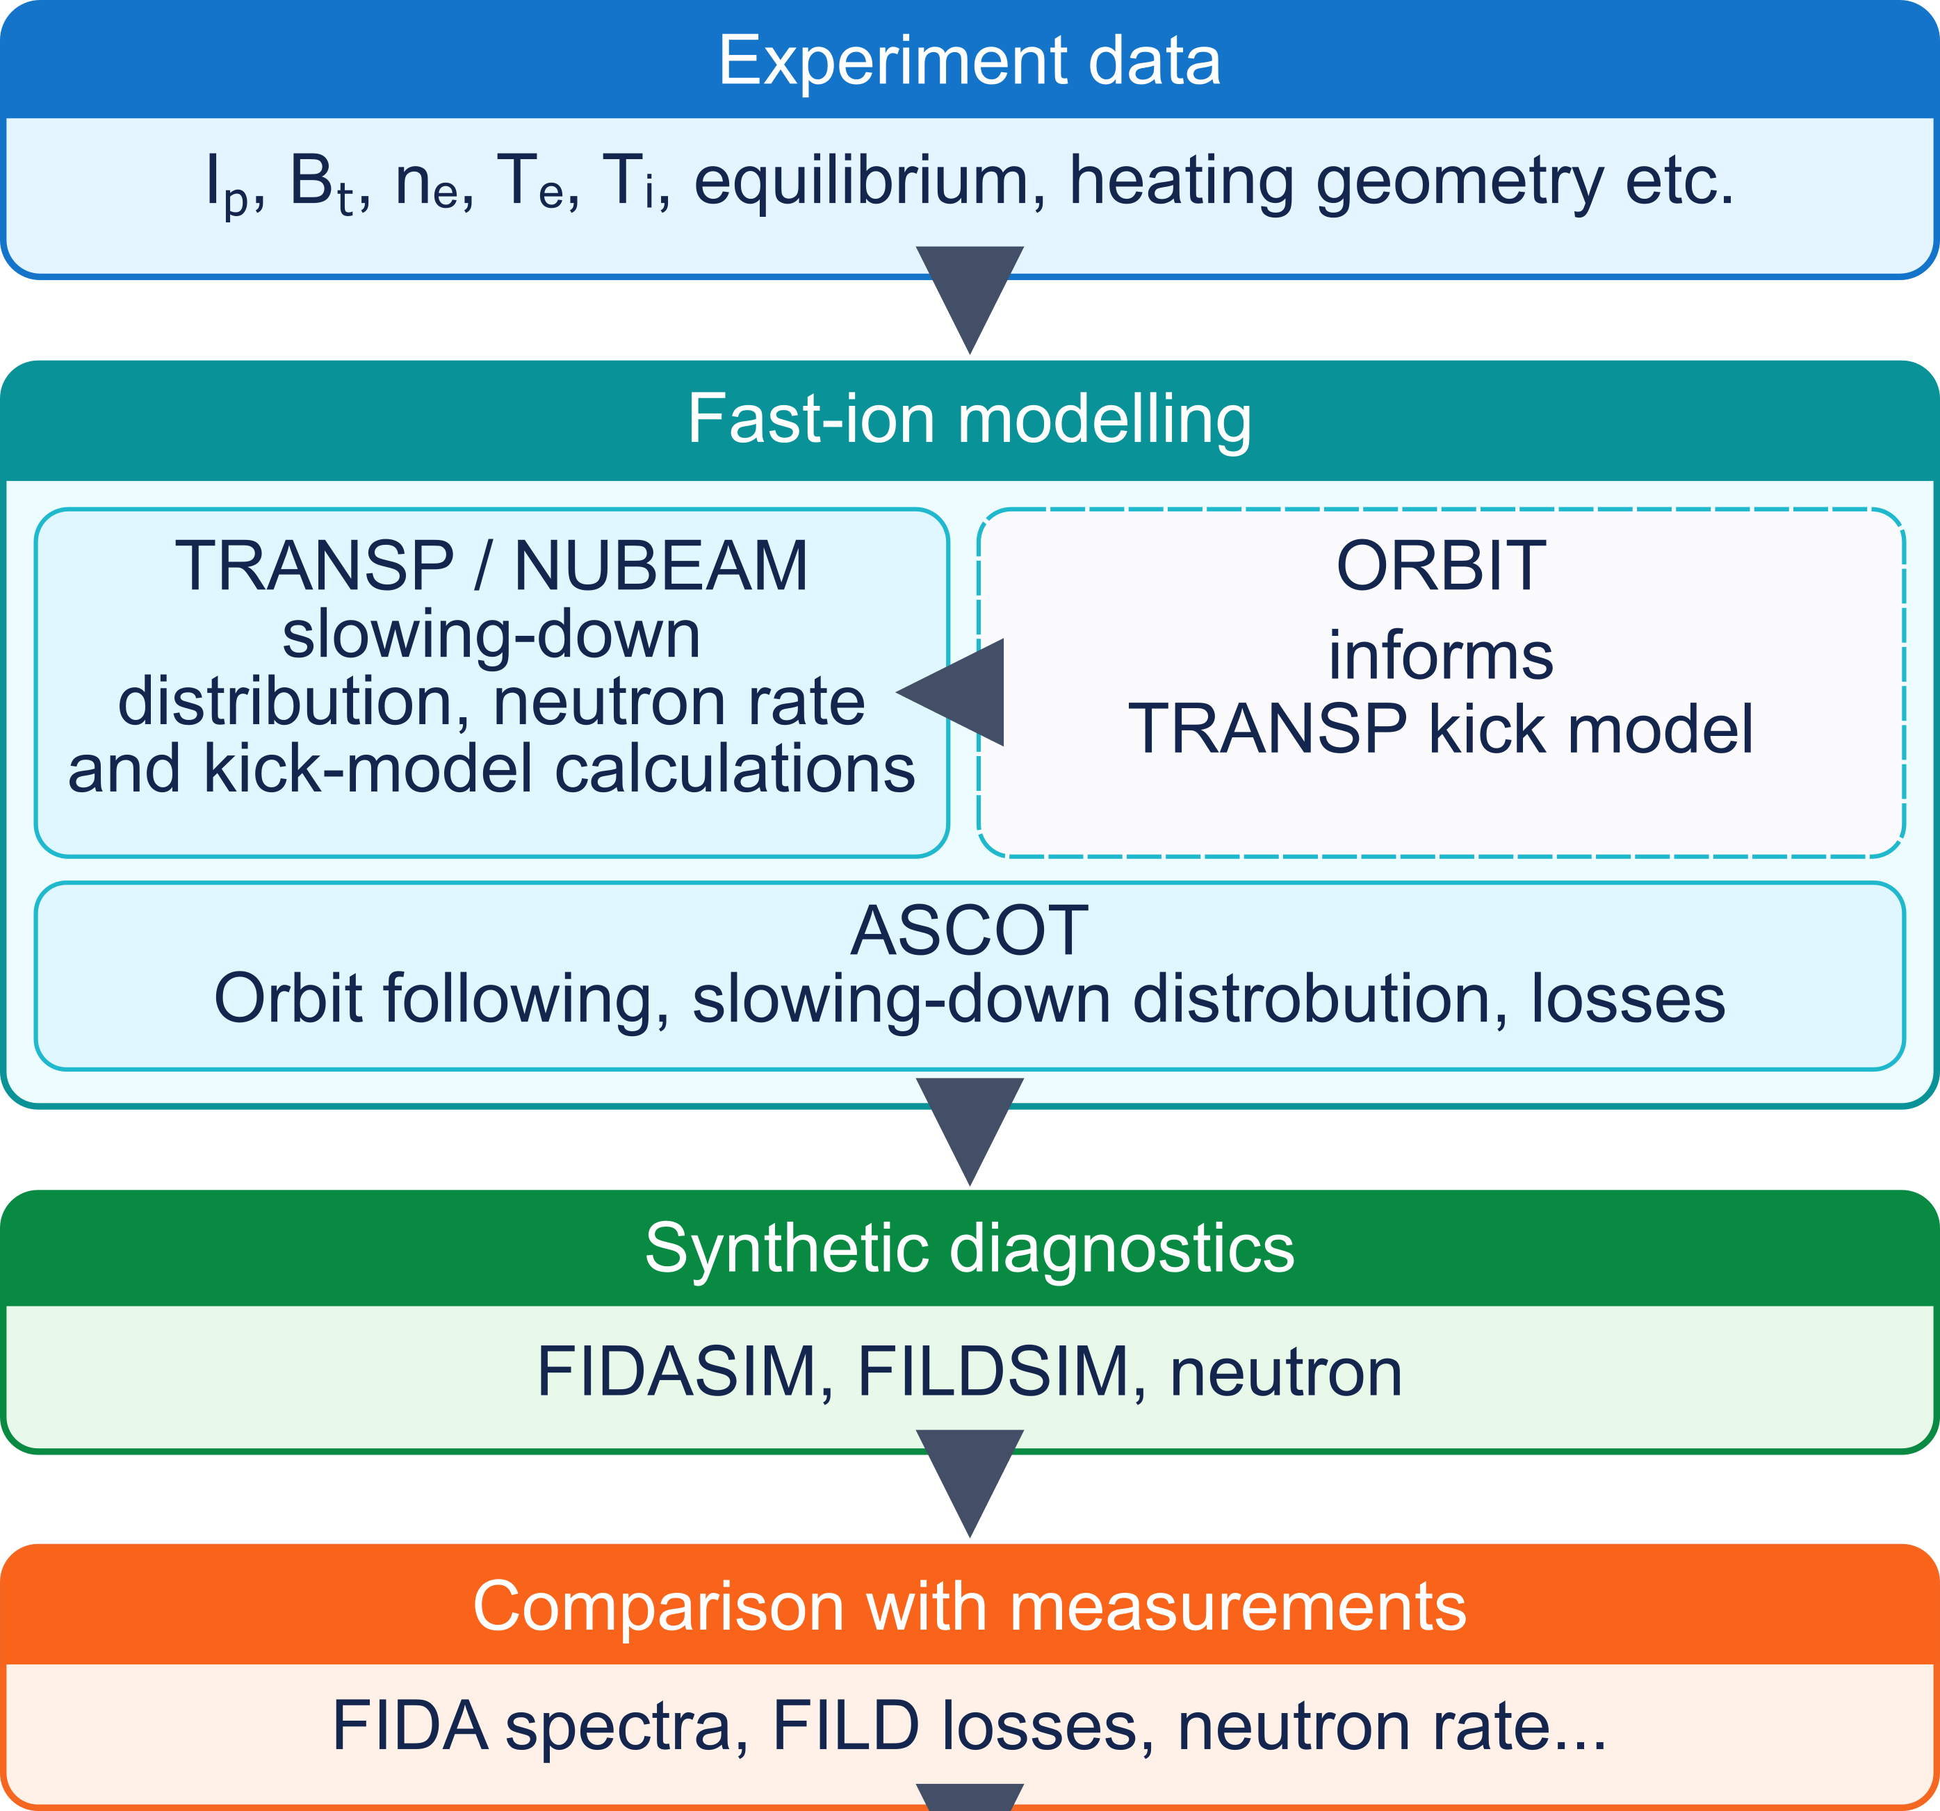
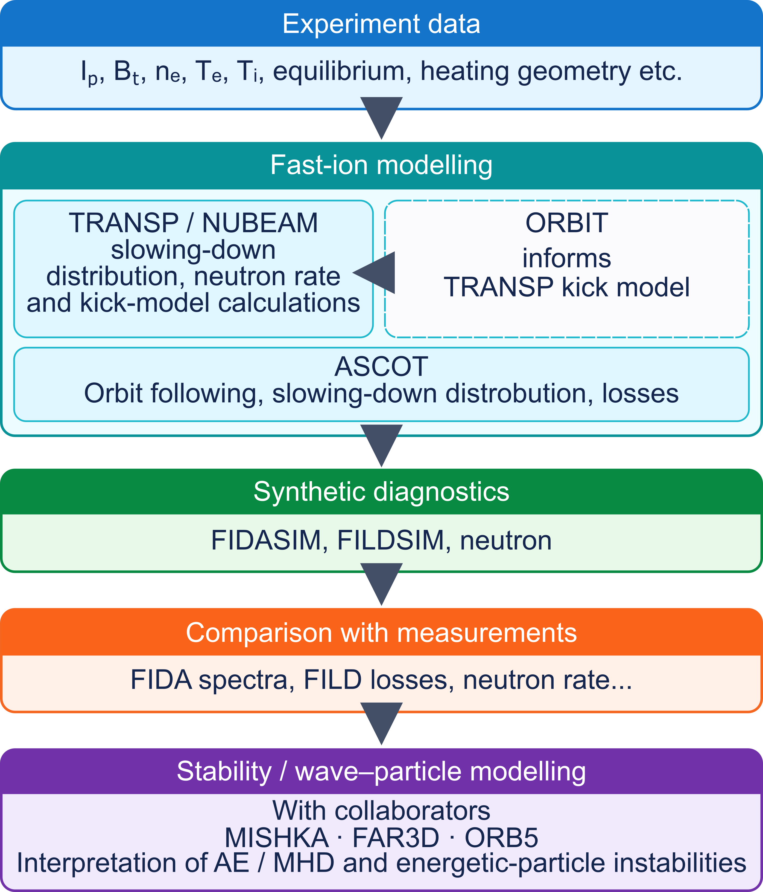
Validation of Energetic Particle (EP) models is a critical step for projections to burning plasmas – and development of EP control tools
Several EP workflows are under development, based on different levels of physics fidelity
On TCV, we’re developing a workflow to close the loop between experiments and simulations
  Make experimental EP data more routinely available
  Make simulations (TRANSP, ASCOT) accessible to more users
  Streamline advanced analysis, e.g. inversion methods of raw EP data for direct comparison with simulations
→ see Invited by A. Jansen van Vuuren, this meeting, Monday morning

Slide 3
Fishbones and sawteeth provide a good initial target to test EP transport models & the entire workflow
Well understood instabilities
  Dominant (n,m)=(1,1) internal kink structure
  Well developed theory, simulation capabilities
Macroscopic effects on fast ion signals, possibly thermal plasma
Good case to test EP transport models before moving to more complicated scenarios (e.g. AEs)
Scans of discharge parameters can be used to test “knobs” for FB/instability control
  Examples: NB power, I_{p} scan, shaping, … not covered in this talk
[also see Invited by Q. Kernel, this meeting, next talk

Slide 4
Outline
TCV tokamak and EP diagnostics
Target scenario for fishbone studies
Simulations of EP response to fishbones
Summary and outlook

Slide 5
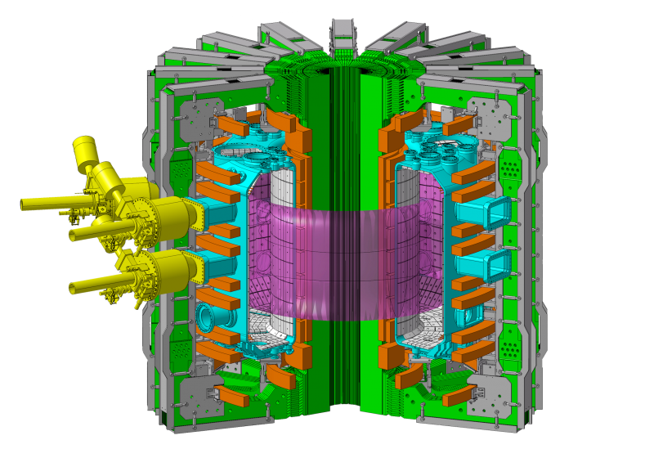
Tokamak à Configuration Variable – TCV a medium size tokamak with flexible shaping, heating capabilities
Major and minor radii | 0.88/0.25 m
First wall material | Carbon (graphite)
Max magnetic field | 1.54 T
Max plasma current | 1.0 MA
Max elongation | 2.8
Triangularity | -0.6 / +0.9
Pulse duration | 2 s (4 s)
ECH power | 2.4 MW (+1.9 MW)
NBI power | 2.5 MW
Main species | D, H, He

Slide 6
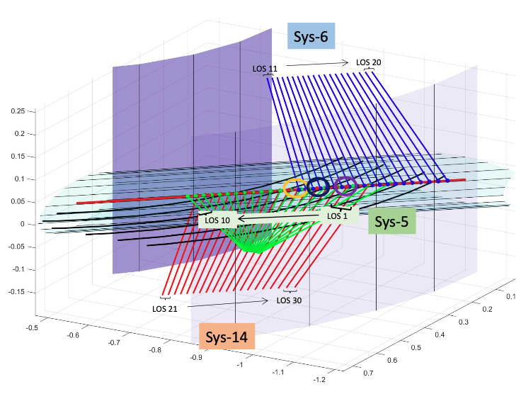
EP diagnostics and analysis tools have been enhanced over last years to diagnose confined/lost NB ions, instabilities
TCV suite of diagnostics includes neutronics, FIDA, FILD, fast fluctuation diagnostics:
  FIDA: 2 systems (horizontal + vertical) routinely available
    20 chords/system looking through NBI-1
    Third system (oblique) foreseen for 2027
  FILD: one midplane system
    Includes full CMOS and fast APDs (MHz range)
  Neutron rate
    Fast scintillator (1Ms/s), cross-calibrated with absolutely calibrated system (50ms integration)
  Fluctuations
    Fast magnetics, SXR.
    ECE & MSE under active development
[from SPC Wiki]

Slide 7
Outline
TCV tokamak and EP diagnostics
Target scenario for fishbone studies
Simulations of EP response to fishbones
Summary and outlook

Slide 8
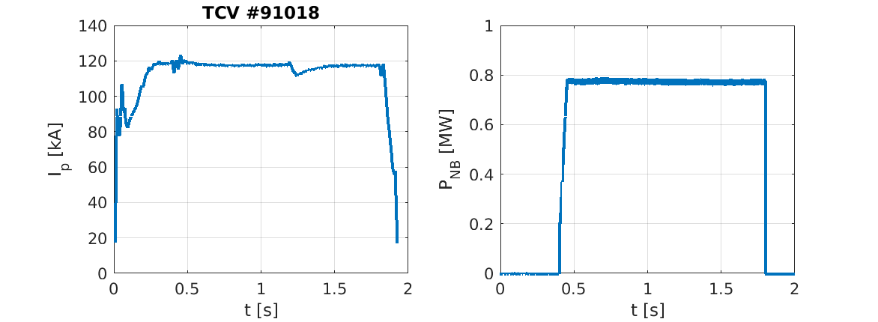
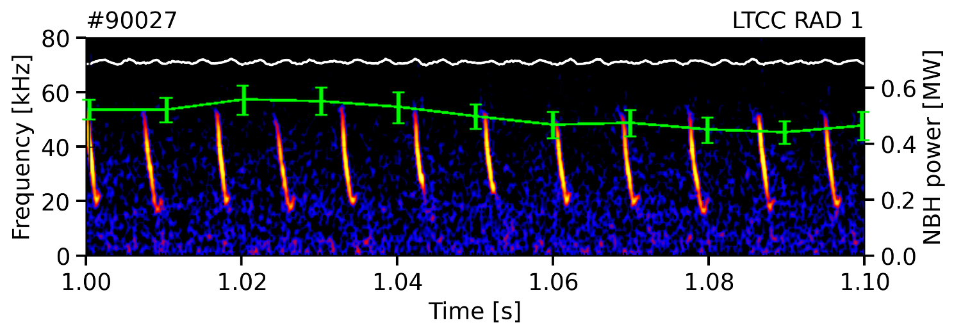
Well reproducible L-mode limited scenario developed on TCV:
I_{p}=120kA, B₀=1.44T, P_{NB}=0.8MW (co-I_{p}), 1.4 seconds of flat-top
During co-I_{p} NBI, fishbones are destabilized every 8-10ms, duration ~2ms
Large frequency sweep
  From f_{*,i}~50kHz down to ~20kHz
  Frequency range suggests diamagnetic type of fishbone
  But: large uncertainty in Doppler shift from toroidal rotation!
Events lead to drop in neutron rate
Spikes observed in FILD raw signal
NB power
Pl. current
[B. Coppi and F. Porcelli, PRL 1986]
magnetics
f_{*,i}
f_{rot,0}

Slide 9
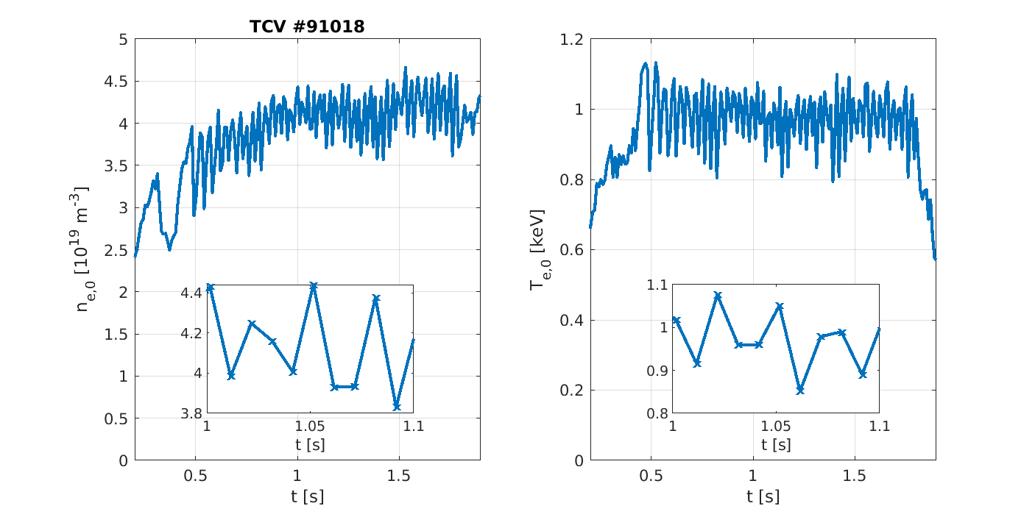
Fishbones also affect thermal plasma due to large NB ion content:
EP transport → thermal plasma response to preserve quasi-neutrality?
Core NB ion density is ~20% of electron density
Core NB driven current is ~20% of ohmic
Similar content of thermal vs fast stored energy
I_{p} | 120 kA
B₀ | 1.4 T
n_{e,0} | 4x10¹⁹ m⁻³
T_{e,0} | 1 keV
P_{NBI} | 0.7-0.8 MW
Fishbones cause 10-15% drops in core n_{e}, T_{e}
  Already visible on raw data from Thomson Scattering
Time resolution of Thomson Scattering system: 10ms
  Not enough to resolve exact dynamic
  A different approach is required…

Slide 10
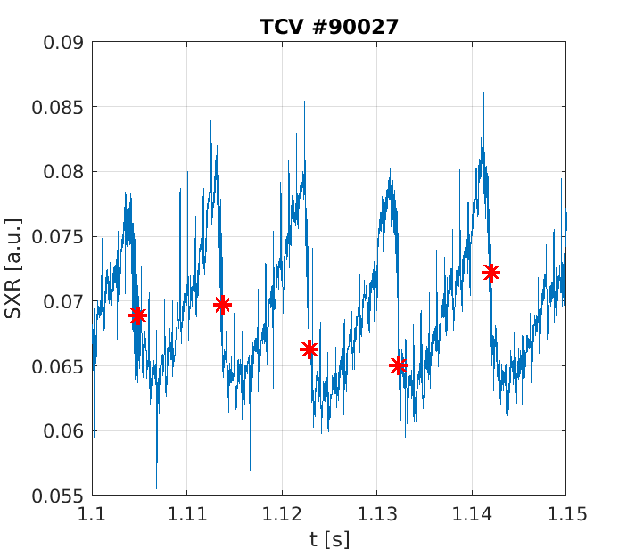
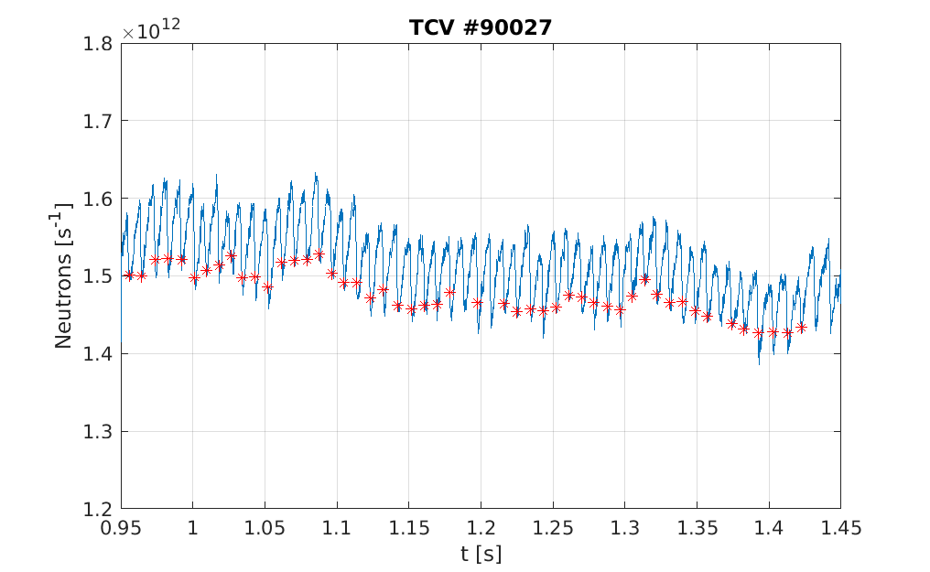
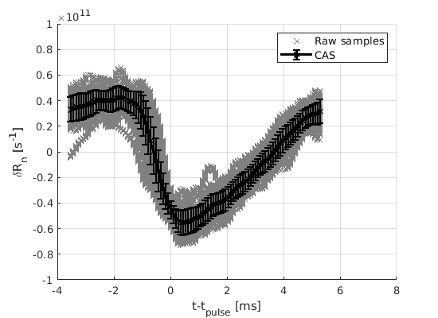
Conditional Average Sampling (CAS) isolates effects of fishbones, provides evolution of plasma parameters on fishbone time-scales
Leverage reasonable stationarity of discharge for ~1-1.4s flat-top
  Several tens of fishbone events collected and re-sampled
A core SXR chord is used as main reference to detect the peak time of fishbones
Signals from Thomson Scattering, neutrons, FIDA, FILD, magnetics, etc. are then CAS averaged
idenitify
select
average

Slide 11
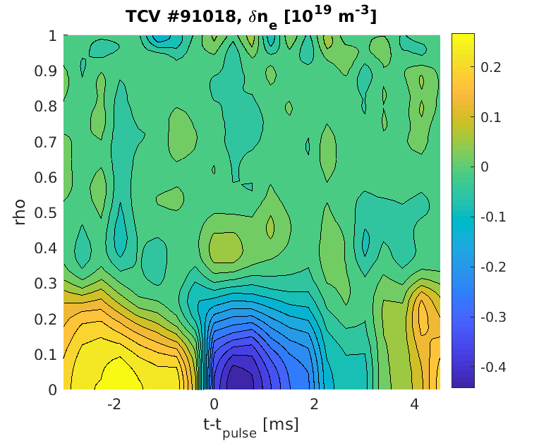
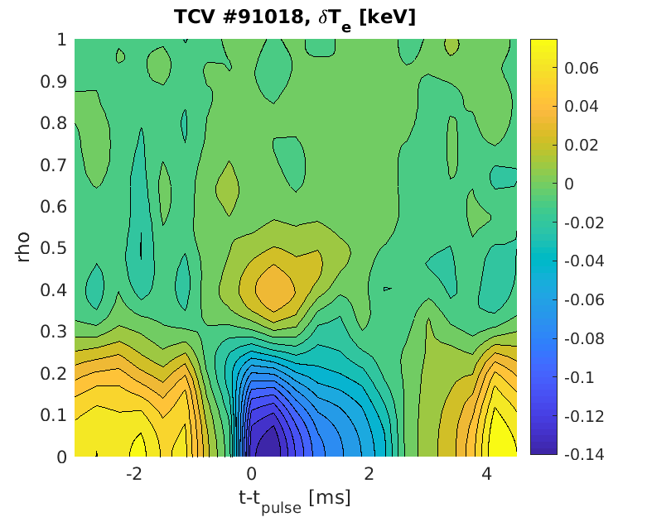
Based on CAS, core n_{e} drops by 15% and T_{e} by 20% – modeling is required to untangle fast ion response from n_{e}, T_{e} changes
Thermal plasma response to fishbones complicates the analysis
  May affect NB deposition, NB driven current, …
Average values:
n_{e,0} | 4x10¹⁹ m⁻³
T_{e,0} | 1 keV
q=1 radius

Slide 12
Outline
TCV tokamak and EP diagnostics
Target scenario for fishbone studies
Simulations of EP response to fishbones
Summary and outlook

Slide 13
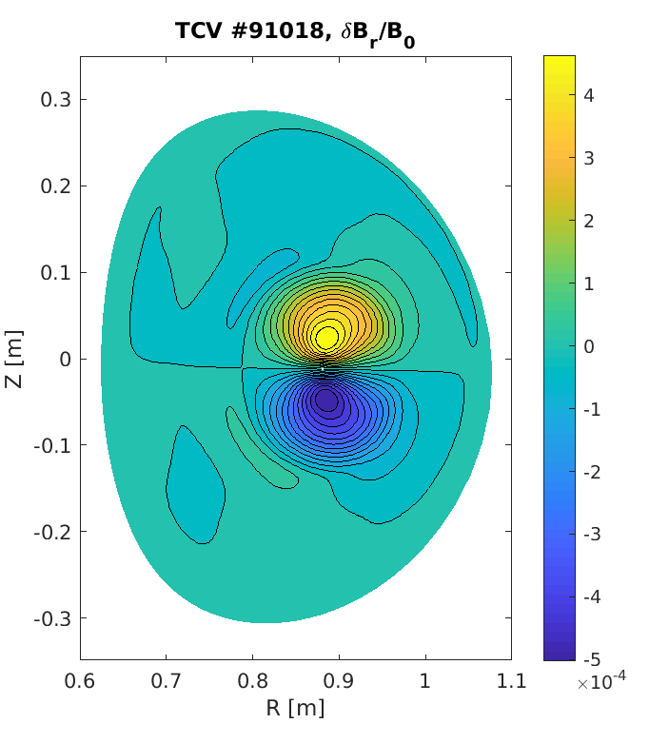
TRANSP runs with profiles from CAS allow to reconstruct fast ion response to fishbones for entire discharge with varying n_{e}, T_{e}
Assume dominant n=1, m=1 component for internal kink
  Analytic mode structure
Use kick model framework to infer EP transport matrix associated with fishbone
Use transport matrix in NUBEAM to evolve fast ions during fishbone
Minimum time step for TRANSP is 0.5ms
  OK to resolve evolution of fast ion distribution, but details are missing
[M. Podestà et al., PPCF 2017]
[M. Podestà et al., PPCF 2022]
Example of n=1, m=1…3 “kink” structure used for TRANSP + kick simulations

Slide 14
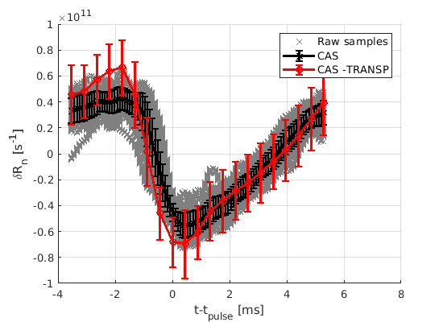
Matching simulated to measured neutron response is used to select mode amplitude in TRANSP + kick runs
Amplitude δB_{r}/B₀ = 0.5-1 x 10⁻³ results in reasonable match
Stored energy drop overestimated by ~50% - but DML measurements have large uncertainties
TRANSP runs with/without kicks shows 20-40% of changes in neutron rate is due to fast variations in n_{e}, T_{e}

Slide 15
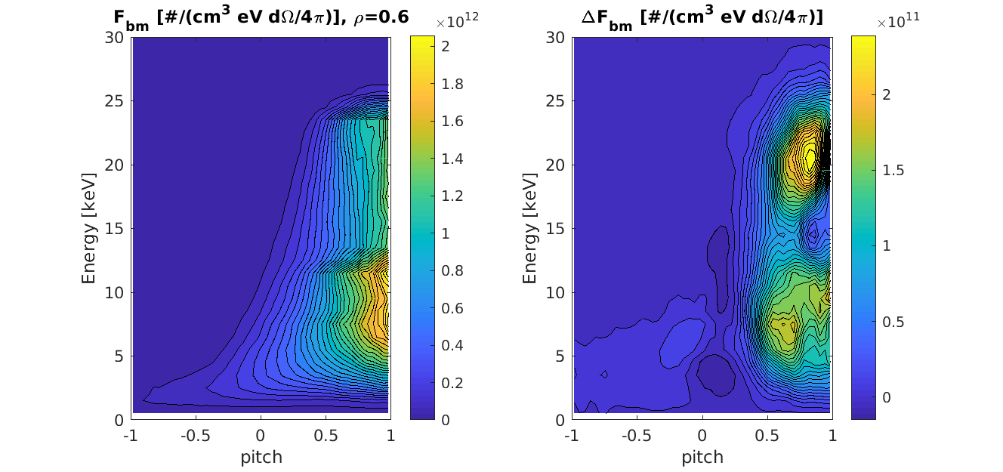
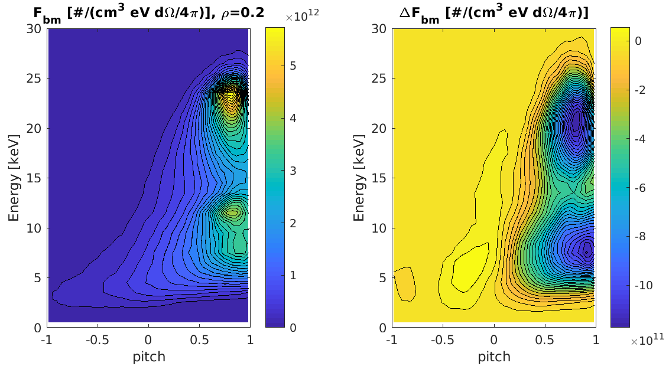
Changes in fast ion distribution pre/post fishbone indicate redistribution. A broad region in (E,pitch,rho) is affected
Changes in (E,pitch) affect mostly co-passing and trapped orbits
Particles redistributed from inside q=1 to outward regions
rho=0.2
rho=0.2
rho=0.6

Slide 16
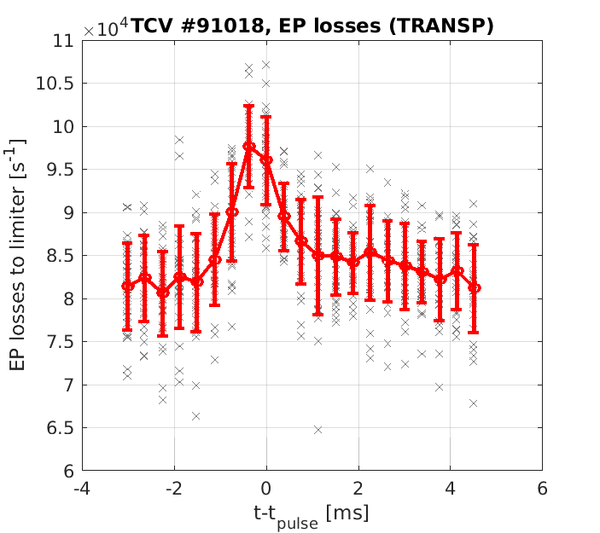
TRANSP also provides additional information on EP losses - with several caveats…
NB ion loss rate from TRANSP + kick increases 15-18% during fishbones
But: TRANSP considers particles “lost” if more than one Larmor radius away from LCFS
Large TCV volume means losses are probably over-estimated
  Many orbits would re-enter the plasma from vacuum regions
  … if not lost due to charge-exchange…

Slide 17
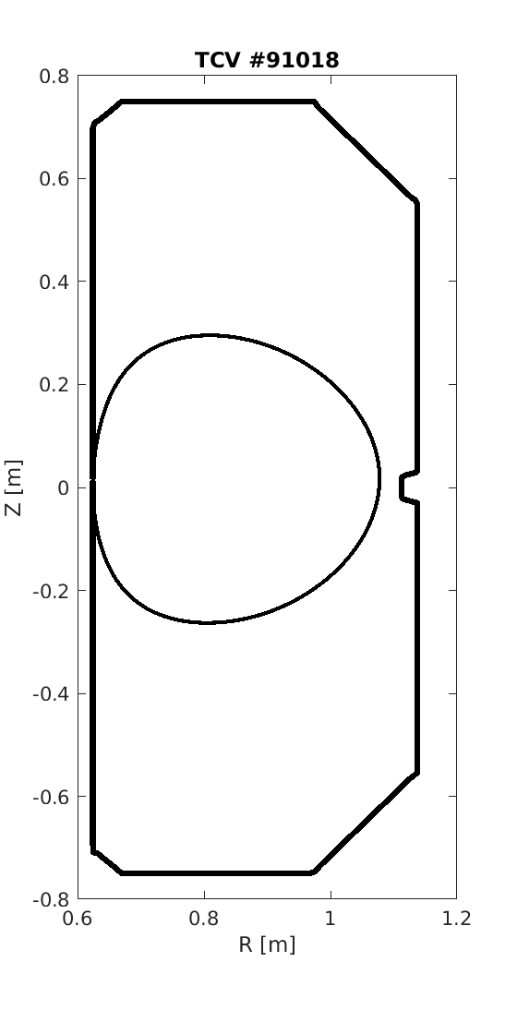
More details can be inferred from Orbit simulations with perturbation that mimics a fishbone cycle
Perturbation based on
  Internal kink for mode structure (same as for TRANSP)
  Amplitude & frequency evolution modeled from experiment
Sample ~200k markers based on unperturbed NUBEAM/TRANSP distribution
Add “bump” at LFS midplane limiter to mimic FILD
Collect lost markers vs time, compare with initial orbits
“FILD”
… but toroidally extended

Slide 18
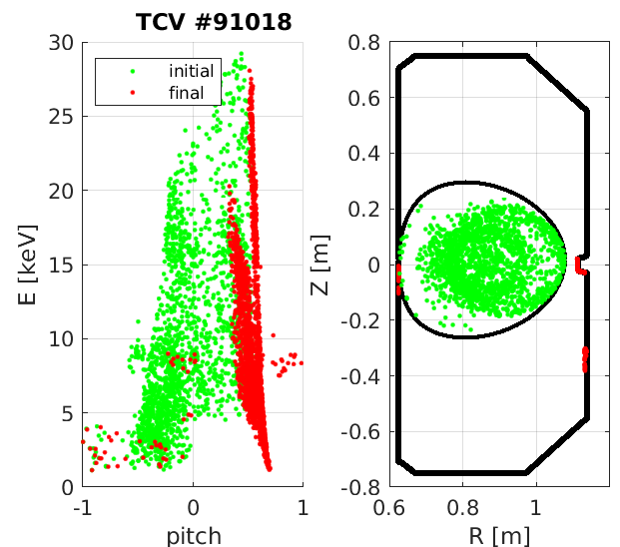
Orbit simulations indicate frequency-dependent losses, plus an accumulation of lost ions in selected (E,pitch) regions
According to Orbit, losses remain <1%
Distinct features appear as frequency sweeps down
Lost particles originate from broad (E,pitch) region
  But they end up at “FILD” with narrow pitch distribution!
Critical to interpret measurements
  Especially when comparing FIDA & FILD (confined vs lost NB ions)
→ see talk by Q. Kernel, this meeting

Slide 19
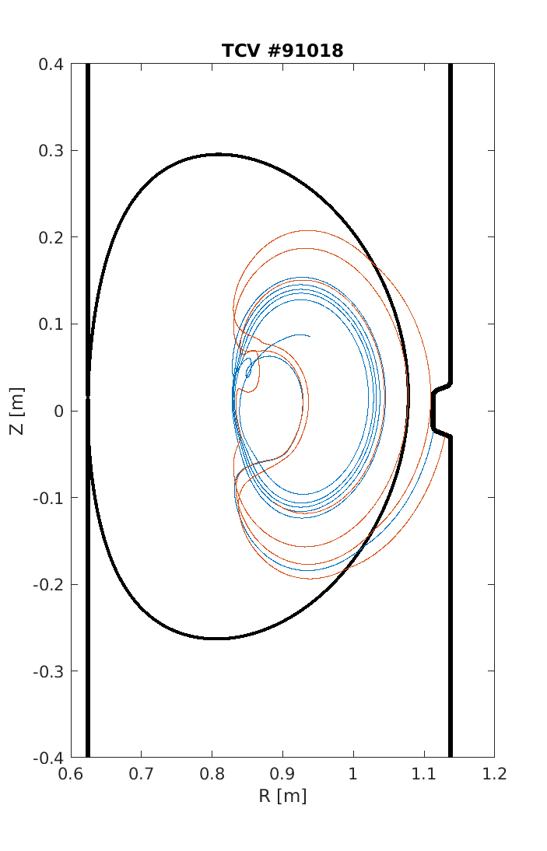
Orbit results enable to discriminate lost NB ions by orbit type, and correlate that to their initial orbit topology
Main effect is a radial redistribution of co-passing particles
  They mostly remain confined
Most lost particles undergo a transition from confined (co-, counter, trapped) orbits to unconfined trapped orbits
  This explains the accumulation in pitch at “FILD” location
  But: information on original orbits is mostly lost from experimental data!

Slide 20
Outline
TCV tokamak and EP diagnostics
Target scenario for fishbone studies
Simulations of EP response to fishbones
Summary and outlook

Slide 21
Summary and outlook
A framework for testing EP transport models is being set up
  Connect TCV data to results from modeling
Targeting fishbones as first step
  Clear effect on fast ion diagnostics
  Results can be interpreted based on solid physics understanding
  … and yet, there’s more physics to be tested, e.g. for non-linear phase
Reference scenario developed, enables scans to explore
  Validity of modeling framework vs experimental trends
  Development of control tools: what can diagnostics tell us? How to react?
More work to do!
  Complete coupling of different analysis and modeling tools
  In parallel, test advanced analysis methods such as inversion of EP diagnostics data to infer confined & lost distributions
    See next talk by Q. Kernel

Slide 22
Backup

Slide 23
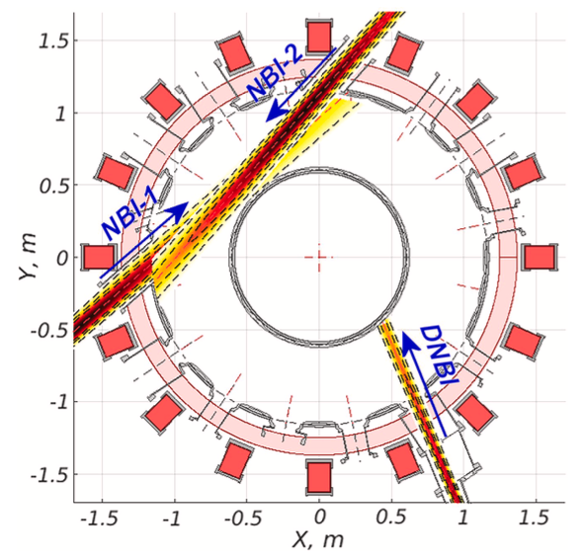
Two NBI systems deliver up to 2.5 MW in co/counter I_{p}
Max injection energy:
  E_{inj}=12-28keV (NBI-1)
  E_{inj}=25-55keV (NBI-2)
Power controllable during pulse
On/off axis achieved through vertical shift of the plasma
This work: single NBI source at ~1MW
[Karpushov, FED 2023]

Slide 24
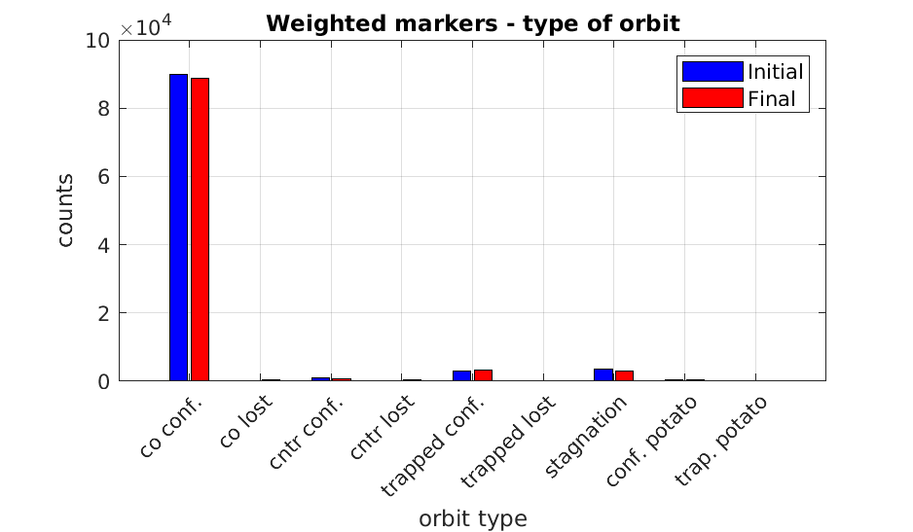
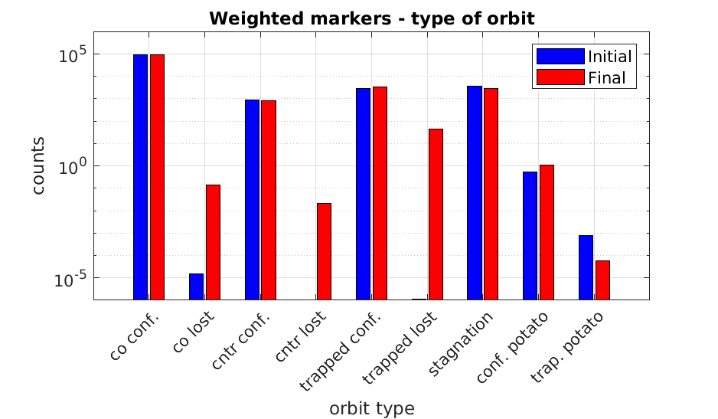
Orbit provides a break-down of lost NB ions by orbit type, and based on the initial orbit topology
Overall, losses remain <1% during each fishbone cycle
Main effect is a radial redistribution of co-passing particles
Let’s zoom in…

Slide 25
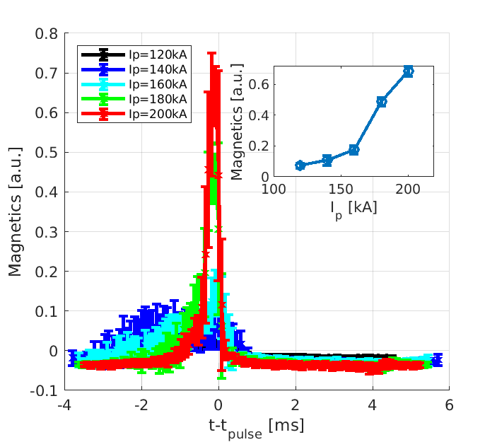
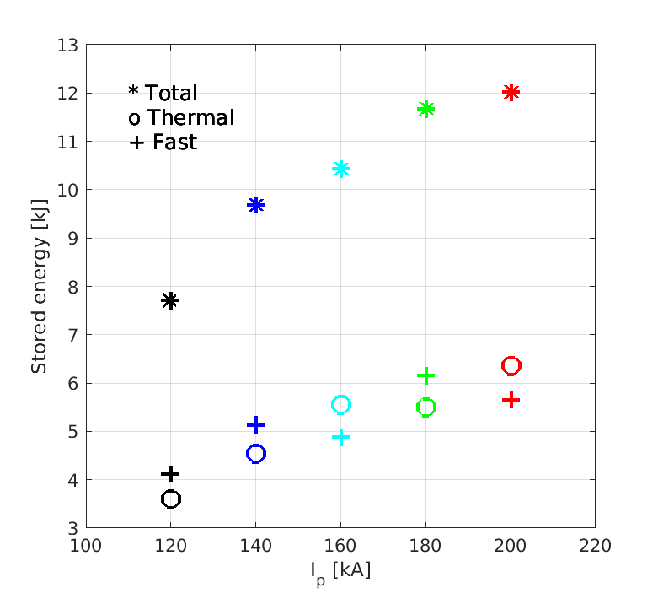
Extensions to I_{p} scan: a database is being collected to characterize the transition from fishbones to sawteeth
As I_{p} is increased, bursts become more virulent
  Shorter duration, higher amplitude
Energy of thermal and fast populations increases at same rate
For I_{p}>160kA, sawteeth replace fishbones

Slide 26
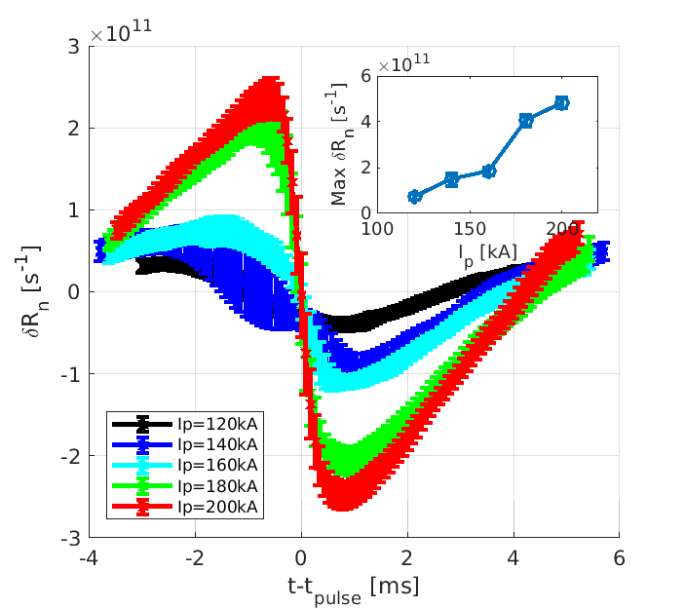
Clear differences predicted by modeling on NB ion losses (much reduced), neutron rate drop (increased) → good case for validation!
I_{p} varied in the 120-200kA range
  Average neutron rate nearly doubles
NB ion losses induced by fishbones/sawteeth much reduced for I_{p}>140kA
But: neutron rate drop increases x5!

Slide 27
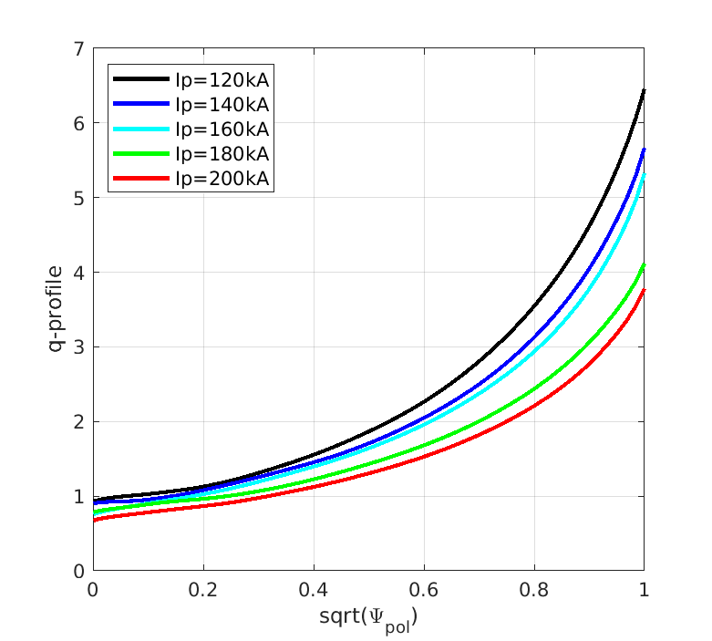
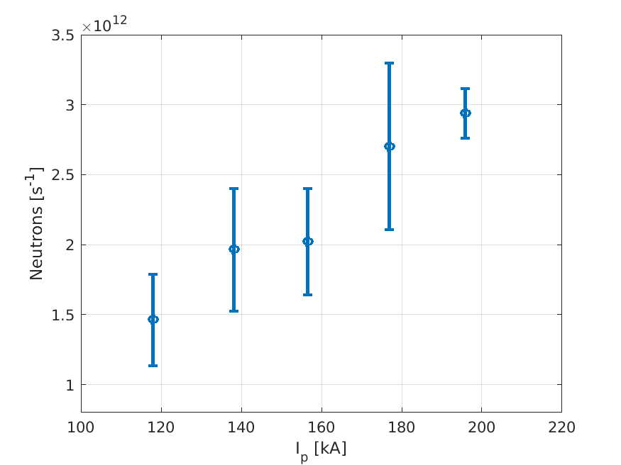
Additional analysis: TRANSP trends

