Slide 1
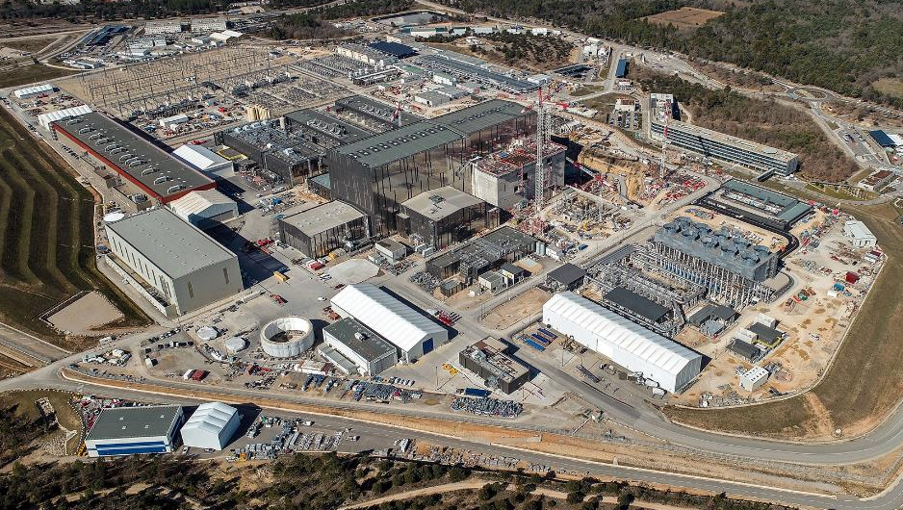

Reference Calibration Discharge
Martin Kocan, Stefan Schmuck
Note: the scope of this presentation is limited to SRO
The views and opinions expressed herein do not necessarily reflect those of the ITER Organization, © 2026, ITER Organization

Slide 2
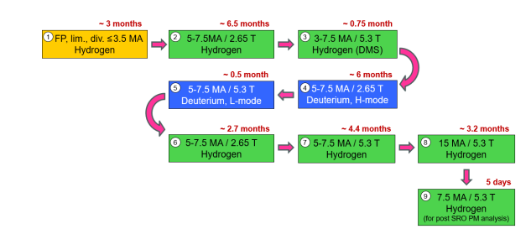
 | Magnetics | Neutron Activation System | Divertor Neutron Flux Monitors | Core Plasma Thomson Scattering | Thomson Scattering - Edge | Toroidal Interf./Polarimeter | Polarimeter Poloidal | Bolometers | H-Alpha (+ visible spectroscopy) | VUV Survey | Divertor Impurity Monitor | Core Imaging X-Ray Spectrometer | Visible Spectroscopy Reference | Radial X-ray Camera Advanced Detectors | Radial X-ray Camera | Neutral Particle Analyser | X-Ray Crystal Spec Survey | Hard X-ray Monitor | Divertor VUV Spectroscopy | VUV Edge Imaging | Electron Cyclotron Emission | Reflectometer LFS | Reflectometer HFS | Density Interferometer Polarimeter | Vis/IR Cameras, (Equatorial Ports) | Thermocouple | Pressure Gauges | Residual Gas Analyzers | IR Thermography (divertor) | Langmuir Probes | Erosion monitor | Dust Monitor | Vis/IR Cameras (Upper Ports) | In-Vessel ECH detectors | Tritium Monitor | FW Samples | Boundary Imaging System
Plasma current, position, shape, loop voltage and βp
Prad total (incl. transient)
∫ne dl / ∫ dl
Fusion power & Total neutron flux
Br/<Bp> RWM + Error Field
Btheta(complex, at wall)/<Bp>
Plasma rotation (vPOL & vTOR)
nT / nD Core (Integral)
C,O influx
Be, Cu, W influx
Be influx distribution
Be, C, O, Cu Ne, Ar, Kr, W rel. conc.
Extrinsic (Ne, Ar, Kr) influx
Line averaged Zeff
ELM radiation bursts
ELM density transient
ELM temperature transient
L-H Dα step
Runaway electrons Emax & current
Gas composition (Fuel, He, impurities) (P div)
Gas pressure, divertor (Pdiv)
Max. surface temperature, divertor
Fine surface metrology - Divertor
Fine net erosion and redeposition - first wall
Position of the ionization front, divertor
Surface luminance and temperature (incl ELMs), FW
Gas composition (Fuel, He, impurities)
Gas pressure
Poloidal current one sector / current distr. Div cassette
Toroidal Magnetic Field BT
Core Te profile
Edge Te profile
Core ne profile
Edge ne profile
Current profile
Zeff profile
Fishbone Btheta(mode) / <Bp>
NTM δT / Te. (complex; 100ms integration time)
TAE Btheta(complex) / <Bp>
TAE δN / n, δT/T
Core Ti profile
Fractional content profile, Z >10
Fractional content profile, Z ≤ 10
nH/nD, nT/nD, edge
First wall neutron fluence
ΓBe, Γc, Γw
Γd, Γt
ne & parallel ion heat flux, divertor target
Te, divertor target
Radiation profile (divertor, main plasma, upper X point)
Surface temperature
nHe, divertor
nH/nD & nT/nD, divertor
ne and Te Divertor
Ti profile, divertor
nH/nD, core
D+T Influx in Chamber
Surface Concentration of mobilizable dust, dust distribution, viewing of dust on and under divertor
Divertor Surface H, D, T Concentration (Inner baffle)
First Wall Surface H, D, T Concentration
In-vessel ECH stray radiation intensity
Limiter plasma initiation
X-point formation @ 3.5MA
Primary Contribution
Backup Contribution
+ In-Vessel Viewing System and Tokamak Monitoring System

Slide 3
Diagnostics Calibration – from manufacturing to operation
ongoing
ongoing
2033 – 2034
2035
Manufacturing
On-site installation
Integrated Commissioning
Plasma Operation

Slide 4
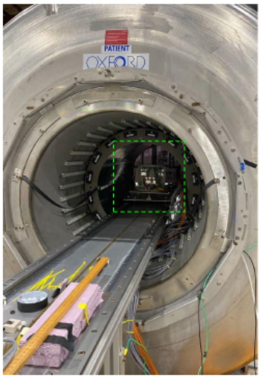
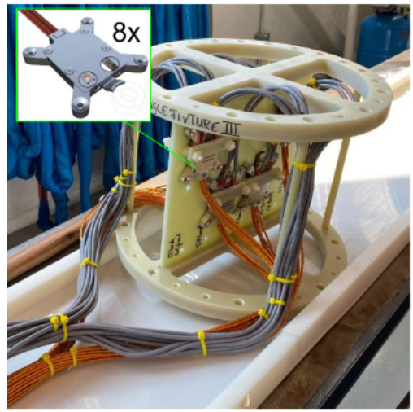
Diagnostics Calibration – from manufacturing to operation
ongoing
ongoing
2033 – 2034
2035
Manufacturing
On-site installation
Integrated Commissioning
Plasma Operation
Calibration of ITER Hall sensors in NMR medical magnet (B ~ V_{Hall})

Slide 5
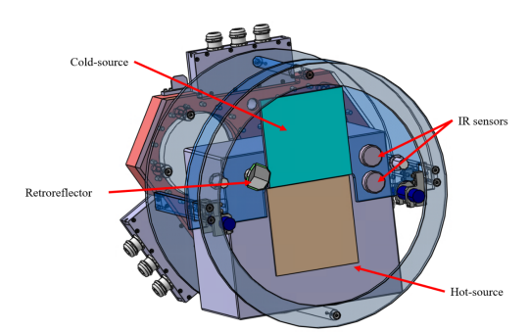
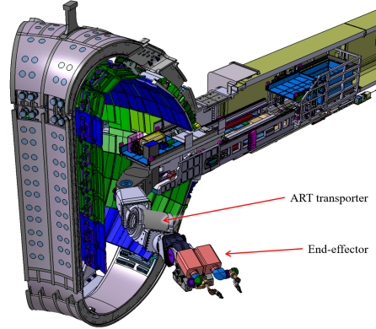
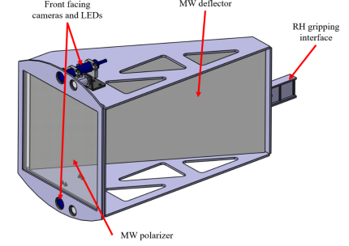
Diagnostics Calibration – from manufacturing to operation
ongoing
ongoing
2033 – 2034
2035
Manufacturing
On-site installation
Integrated Commissioning
Plasma Operation
Includes individual diagnostics commissioning and use of in-vessel sources
Time allocated to use of in-vessel source will be very limited – some may not be deployed prior to SRO
IR and ECE end-effector
Microwave end-effector

Slide 6
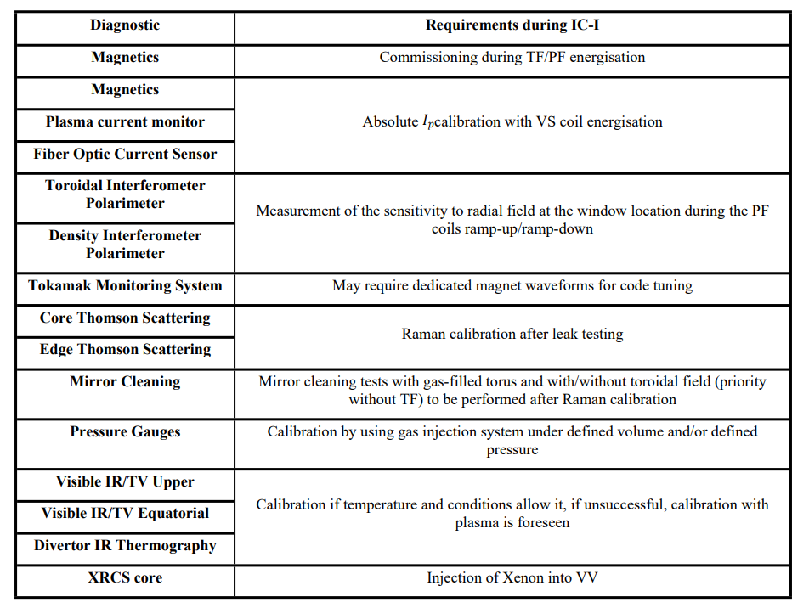
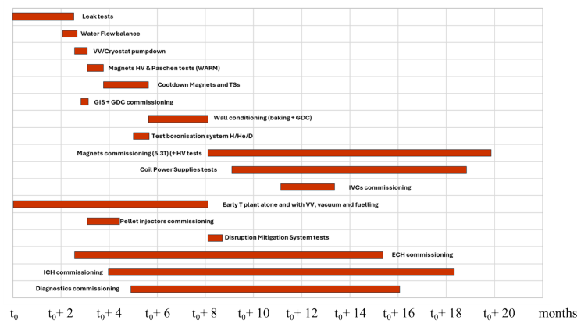
Diagnostics Calibration – from manufacturing to operation
ongoing
ongoing
2033 – 2034
2035
Manufacturing
On-site installation
Integrated Commissioning
Plasma Operation
From ITER_D_EEFPLC - ITER Research Plan (IRP) – Level 2 – First Integrated Commissioning (IC-I)

Slide 7
Diagnostics Calibration – from manufacturing to operation
ongoing
ongoing
2033 – 2034 (18 months)
2035
Manufacturing
On-site installation
Integrated Commissioning
Plasma Operation
35 days dedicated to diagnostics commissioning and calibration during the SRO → 221 good pulses
Diagnostic | Scenario | good pulses
Diamagnetic Loops | Ohmic limiter pulses at ~1-3MA with normal and reversed Ip. | 8 (2-3 w)
Bolometers | Highly (5-10 MW) radiating diverted plasma w/o local radiation. | 4
X-Ray Crystal Spectrometer | T_{e} > 3keV for ρ < 0.5. Density ≈ 2×10¹⁹ m⁻³, Xe injection | 6
Visible Spectro. Reference System | Ne / Ar seeding discharges | 4
Density Interferometer Polarimeter | n_{e} scan at fixed I_{p}. ~10cm vertical plasma position scan. | 4
Toroidal Interferometer Polarimeter | n_{e} scan at fixed I_{p}. ~10cm outer boundary scan. | 4
Edge Thomson Scattering | Fixed I_{p} and n_{e} (few 1e19). Medium T_{e}. Outer boundary scan ±1cm. | 2
LFS/HFS Reflectometry | All combination of I_{p} and B_{t} planned for SRO. Both L- and H-mode. Outboard/inboard boundary scan ~10 cm. | 6
Divertor Langmuir probes | Attached high-recycling L-mode plasmas. I_{p} ~5MA, half B_{t}, P_{ECH}~10MW. Inner (and possibly outer) strike point sweep. | 2
Wide Angle IR views | Dedicated scenarios with wall surface temperature >200 °C | 3
Radial Xray camera | Stable discharge with known T_{e} & impurities. Pellet injection or gas puffing. | 2

Slide 8
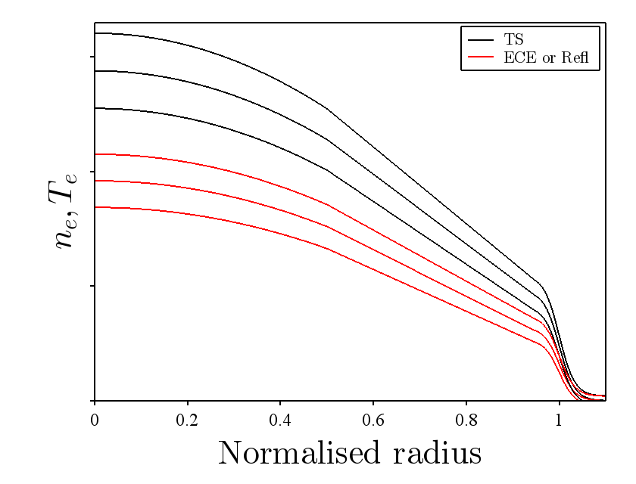
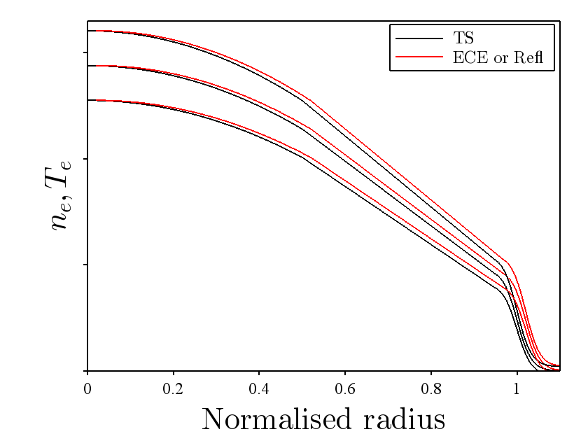
Reference Discharge: Motivation
Diagnostics behaviour may change in time (sensitivity, alignment, non-linear effects).
If not accounted for, this can lead to inconsistencies in n_{e} and T_{e} profile measurements. For instance, n_{e} and T_{e} profiles determined independently for each diagnostic deviate from each other for derived uncertainty bands. Furthermore, profile shifts lead to discrepancies in the localisation of strong gradient regions.
Scaling
Profile
shift
10% relative uncertainty assumed
10% relative uncertainty assumed

Slide 9
Reference Discharge for Core T_{e} and n_{e} Diagnostics Characteristics
Involved diagnostics:
Core n_{e} and T_{e}, line-integrated density: Thomson scattering, reflectometer and ECE diagnostics.
Main purpose:
To track individual diagnostic quantities such as alignment, calibration, non-linear effects.
Such discharge could also test data consistency between diagnostic systems.
Main characteristics of the reference discharge for core Te and ne diagnostics:
Core T_{e} / n_{e} up to a few keV and 10¹⁹ m⁻³ to minimize relativistic effects and avoid unnecessary microwave cut-offs inside plasma
L-mode with minimum ECH (ideally purely ohmic)
Avoid fast particles
Accurate equilibrium reconstruction
Slow dynamic behavior i.e. slow scan of n_{e} , T_{e} and plasma movement

Slide 10
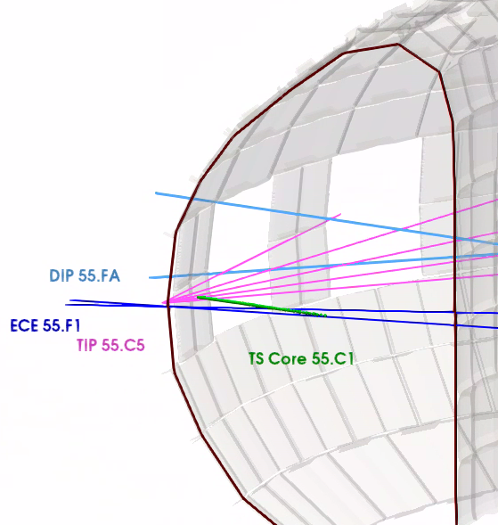
Reference Discharge: Possible Configurations
(1) Shifting plasma slowly vertically over central lines of sight of TS and ECE diagnostics:
Check LOSs alignment/position
Check antenna pattern of ECE diagnostic
(2) Shifting plasma slowly radially over central lines of sight of TS, ECE and reflectometer diagnostics:
Check consistency of individual diagnostic sensitivity
Check joint consistency of all diagnostic sensitivities
Increasing temperature and density
- Check for non-linear effects
1
2
Te, ne
time

Slide 11
Summary
For the SRO, the diagnostics must deliver calibrated measurements early in the research program
This will be achieved by calibrating as many diagnostics as possible before the plasma operation i.e. during the manufacture, installation and integrated commissioning
Some diagnostics will require calibration with plasma – SRO Research Plan dedicates 35 days (or ~221 shots) to these activities
In addition to calibration and commissioning plasma discharges, “reference discharge” is proposed to
  Track performance of individual diagnostics (calibration factors, alignment etc.)
  Compare measurements between several diagnostics
Details of this reference plasma scenario(s) are still to be developed

Slide 12
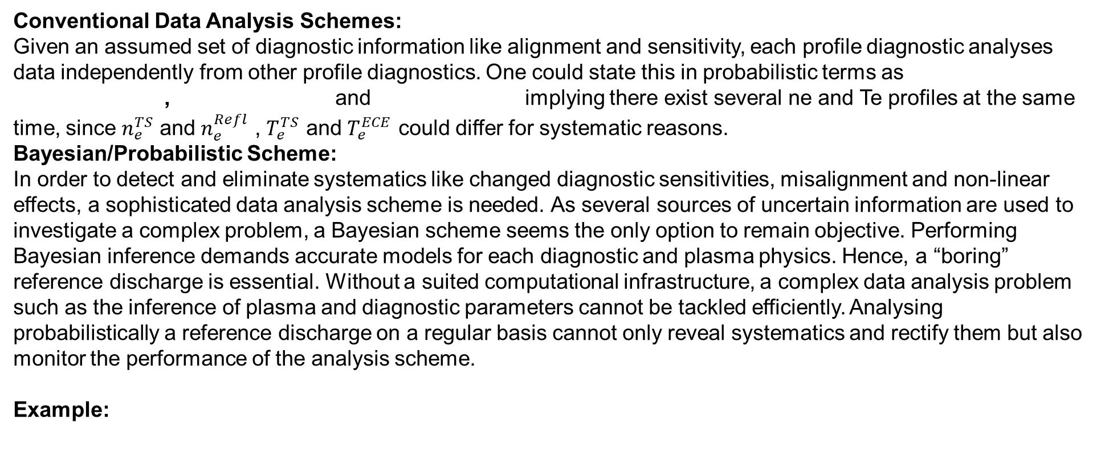



Reference Discharge: Data Analysis Scheme
Conventional Data Analysis Schemes:
Given an assumed set of diagnostic information like alignment and sensitivity, each profile diagnostic analyses data independently from other profile diagnostics. One could state this in probabilistic terms as
, and implying there exist several ne and Te profiles at the same time, since $n_{e}^{TS}$ and $n_{e}^{Refl}$ , $T_{e}^{TS}$ and $T_{e}^{ECE}$ could differ for systematic reasons.
Bayesian/Probabilistic Scheme:
In order to detect and eliminate systematics like changed diagnostic sensitivities, misalignment and non-linear effects, a sophisticated data analysis scheme is needed. As several sources of uncertain information are used to investigate a complex problem, a Bayesian scheme seems the only option to remain objective. Performing Bayesian inference demands accurate models for each diagnostic and plasma physics. Hence, a “boring” reference discharge is essential. Without a suited computational infrastructure, a complex data analysis problem such as the inference of plasma and diagnostic parameters cannot be tackled efficiently. Analysing probabilistically a reference discharge on a regular basis cannot only reveal systematics and rectify them but also monitor the performance of the analysis scheme.
Example:
$$p\left(n_{e}^{TS},T_{e}^{TS} | C_{TS},D_{TS}\right)$$
$$p\left(n_{e}^{Refl} | C_{Refl},D_{Refl}\right)$$
$$p\left(T_{e}^{ECE} | C_{ECE},D_{ECE}\right)$$
Deterministic plasma physics and diagnostic models and measurement uncertainties and, if needed, systematic uncertainties to predict
noisy plasma data
A priori information on calibration as determined by individual/disjoint
calibration procedures
Joint estimation of plasma profiles
and diagnostic calibrations given
plasma data
$p\left(n_{e},T_{e},C_{Refl},C_{TS},C_{ECE} | D_{Refl},D_{TS},D_{ECE}\right) \sim p(D_{Refl},D_{TS},D_{ECE}|n_{e},T_{e},C_{Refl},C_{TS},C_{ECE})$ $p\left(n_{e}\right)p\left(T_{e}\right)p\left(C_{Refl}\right)p\left(C_{TS}\right)p(C_{ECE})$
Only one ne profile and one Te profile
exist in plasma
A priori information
on plasma parameters

