Slide 1
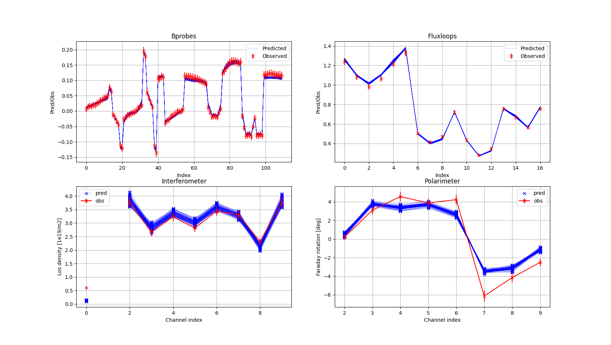
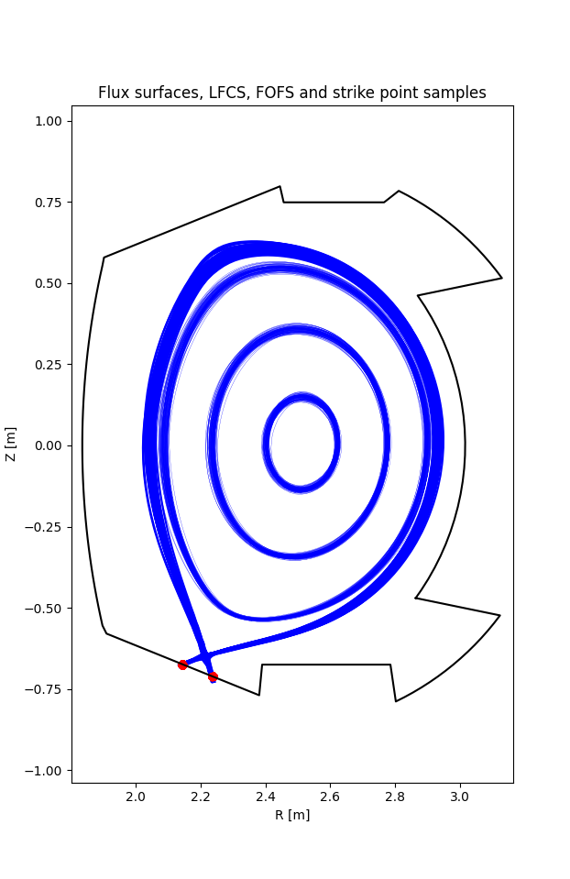

Joint Data Analysis Schemes for Microwave Diagnostics
Shedding light on the distribution of plasma current
Simon McIntosh
Jakob Svensson
Dirk Stieglitz
Rainer Fischer
Jorge Morales
Simon van Mulders
Paulo Abreu
Simon Pinches
Tuesday 13th January 2026
2nd Microwave calibration workshop
Interferometer
Polarimeter

Slide 2
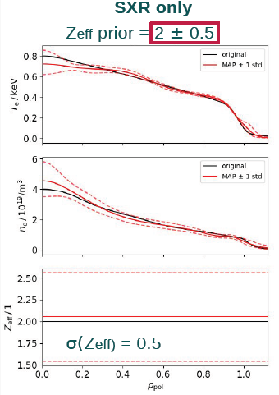
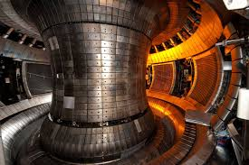
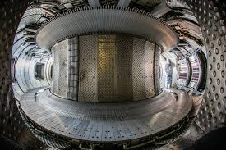

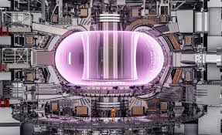
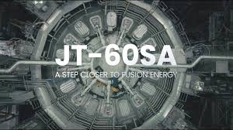
This presentation reports on Integrated / Joint Data Analysis Schemes for ITER’s diagnostic commissioning and calibration.
Minerva at WEST
IDA at JT-60SA
IMAS + multi-machine deployment

Slide 3
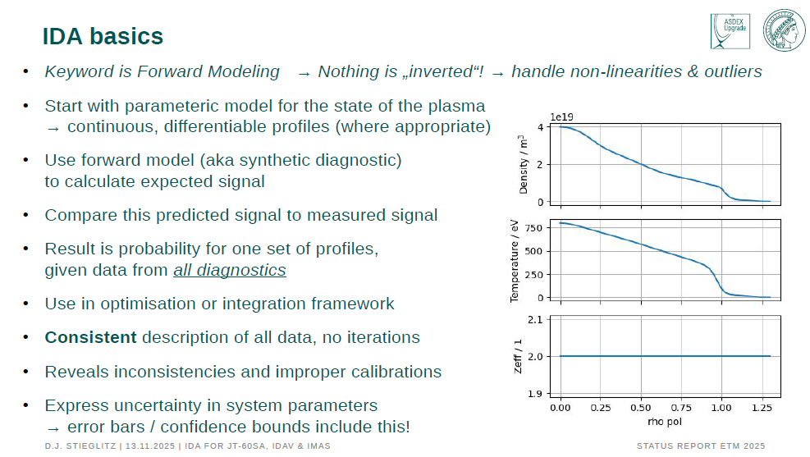

Slide 4
ITER is prototyping a Data Analysis and Interpretation platform using the Minerva framework (for delivery end of January 2026)
Enable routine Bayesian inference of plasma and parameters for a given set of measurements.
Create inference schemes for plasma parameters:
Interferometers (for ITER: TIP, DIP)
Thomson scattering (for ITER: core and edge systems)
Electron cyclotron emission
Develop forward models:
10kHz Magnetics time series using spectral priors
Core and edge Thomson scattering
Electron cyclotron emission
Diamagnetic loop
Combine the diagnostics in with Polarimeters and Magnetics:
Current Tomography and force balance constraints
Use framework to infer: electron density and temperature profiles, plasma current, li, beta, loop voltage, and flux surface topology.
Notes:
Polarimeters measure the electron density via measurement of the Faraday rotation a reliable diagnostic to measure ne due to its immunity to fringe jump errors
enable the routine Bayesian inference of plasma and machine parameters for a given set of measurements.

Slide 5
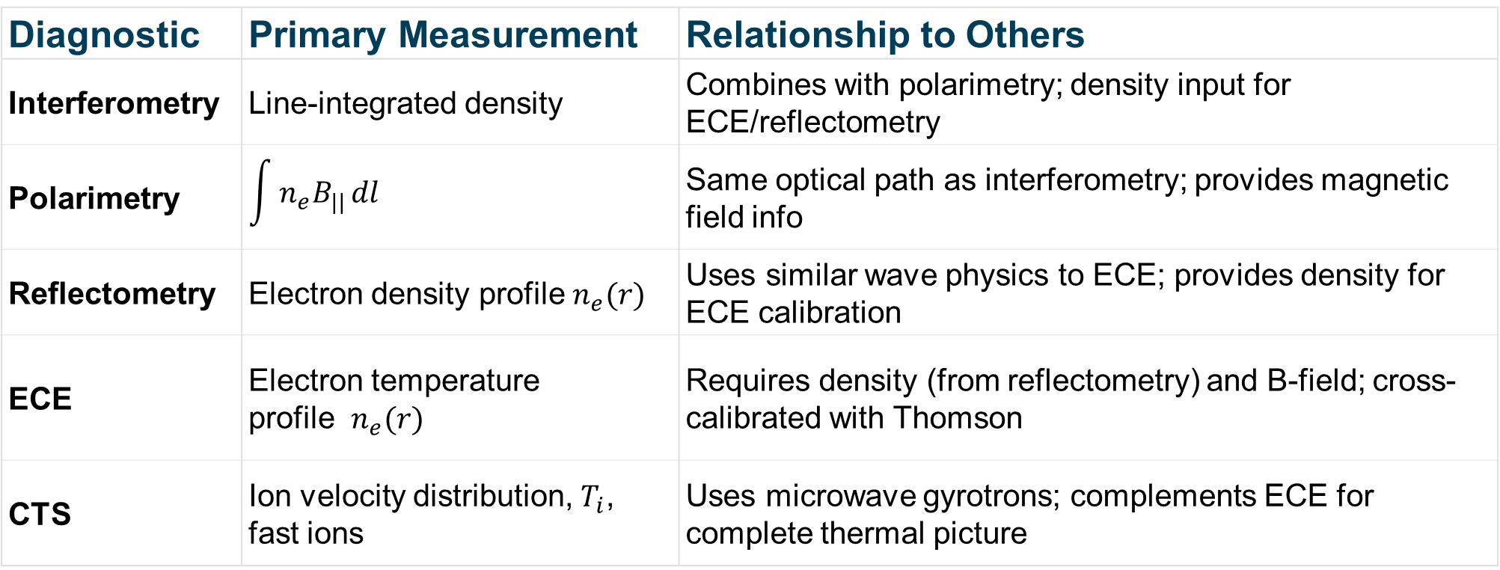
Microwave diagnostics measurements exhibit tight coupling
These systems must not be treated in isolation. Cross-calibration is important (especially for ECE)
Diagnostic | Primary Measurement | Relationship to Others
Interferometry | Line-integrated density | Combines with polarimetry; density input for ECE/reflectometry
Polarimetry | $$\int{n_{e}B_{||}}dl$$ | Same optical path as interferometry; provides magnetic field info
Reflectometry | Electron density profile $n_{e}(r)$ | Uses similar wave physics to ECE; provides density for ECE calibration
ECE | Electron temperature profile $n_{e}(r)$ | Requires density (from reflectometry) and B-field; cross-calibrated with Thomson
CTS | Ion velocity distribution, $T_{i}$​, fast ions | Uses microwave gyrotrons; complements ECE for complete thermal picture
Notes:
Reflectometry ↔ Interferometry: Both measure electron density but at different scales (profile vs. line-integrated). Reflectometry provides local measurements while interferometry provides integrated path measurements.
ECE ↔ Reflectometry: ECE and reflectometry have contributed significantly to understanding plasma dynamics, with ECE providing electron temperature and reflectometry providing density.
ECE ↔ Thomson Scattering: Both measure electron temperature; Thomson scattering is used to cross-calibrate ECE systems.
Polarimetry ↔ Interferometry: Combined systems (like the ITER TIP) carry out two-colour interferometry measurement of line-integrated density while a separate polarimetry measurement captures the plasma-induced Faraday effect.
CTS ↔ ECE: CTS frequency ranges are typically located between ECE harmonics coming from the plasma to avoid interference.
All Systems ↔ Magnetic Field Measurements: Microwave reflectometry will serve as the primary diagnostic tool for measuring plasma density in ITER, with all microwave diagnostics depending on knowledge of the magnetic field configuration.

Slide 6
Minerva inference of WEST data highlights diagnostic inconsistencies between Interferometer and Polarimeter systems
B-probes
Flux loops
Interferometer
Polarimeter
Notes:
Bayesian model analyses all diagnostics in a single model
Current tomography, interferometry, and polarimetry all contribute simultaneously to the posterior inference.
100 posterior samples
We see good agreement from the B probes and fluxloops
Polarimeter and interferometer data are inconsistent
We see large uncertainty in ∫ne​B∥​dl, (polarimeter – Faraday rotation) -> significant mismatch between observations and predictions. The probability of the prediction given the data is low. this uncertainty propagates into the density inference
The equilibrium reconstruction is uncertain

Slide 7
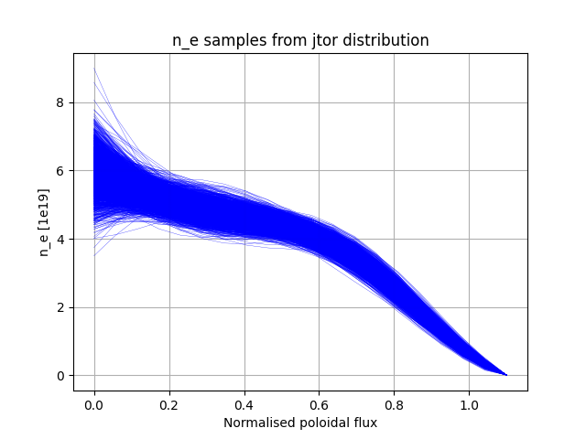
Interferometer and Polarimeter inconsistencies propagate uncertainties to density and magnetic structure of plasma
Notes:
Large uncertainty in flux surface placement – understandable for the core – but why do we see this uncertainty in the edge. Magnetics measurements are good here.
Polarimeter and interferometer data are inconsistent
We see large uncertainty in ∫ne​B∥​dl, (polarimeter – Faraday rotation).
This uncertainty is ours – it does not belong to the physics! This uncertainty indicates that there are issues with the calibration or function of one or more diagnostic systems. This information may be used to commission and (cross) calibrate multiple diagnostic systems in an integrated fashion
Bayesian workflows allow us to quantify uncertainties and to properly articulate the selection of manual weights. Current tomography uncertainty → flux surface uncertainty
Flux surface uncertainty → diagnostic line-of-sight geometry uncertainty
All combine to affect ne​ profile inference

Slide 8
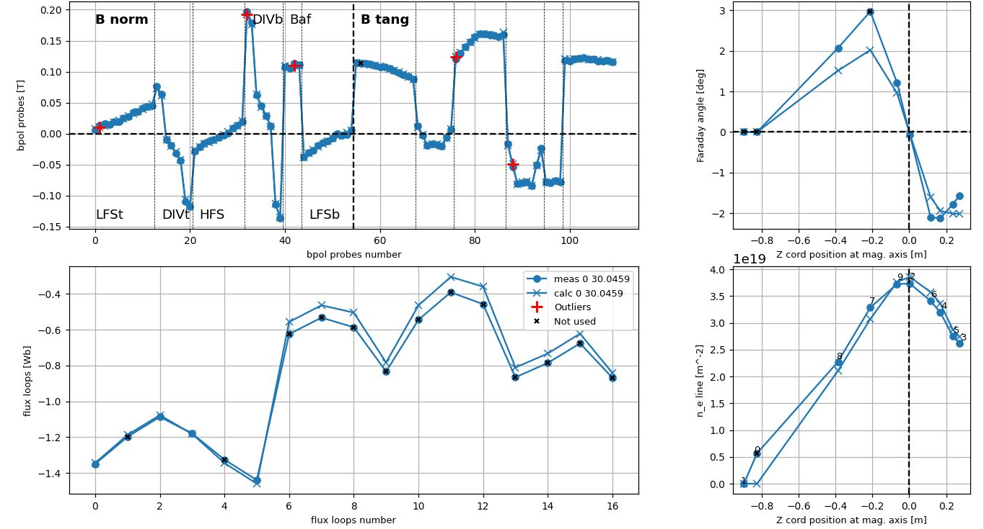
NICE reconstruction of WEST shot 58603/0 includes ad hoc weights
B-probes
Polarimeter
Flux loops
Interferometer
Notes:
Usually we have a good fit for the upper LOS (Z cord > 0, see right-top plot below), but bad fit for lower LOS (in the figure, measurements are points, the reconstruction by NICE are crosses). For instance, the LOS marked with a black cross, is ignored (4th from the left, we think is an outlier). For the lower LOS (Z cord < 0) you can find more than 10%-20% error. For the upper LOS error should be lower. The regularization of NICE makes the reconstruction smoother as well
There could be a systematic error in the lower LOS

Slide 9
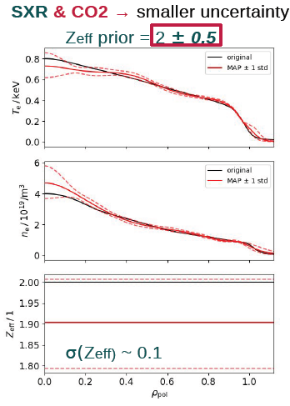
Integrated Data Analysis can combine disparate diagnostic signals
Notes:
Bayesian analysis possible with a limited set of diagnostics. This tool would be very useful for early operation at JT-60SA
Can be used to correct calibration factors and diagnostic faults when applied to multiple shots
Data dropouts handled automatically
By jointly estimating profiles from soft X-ray, interferometry and electron cyclotron emission measurements using Bayesian probability theory, the uncertainty is significantly reduced — specifically, σ(Zeff​) drops from 0.5 to ~0.1 when adding CO2 interferometry data.
SXR and CO2 interferometry are not microwave diagnostics (x-ray and infra-red) but their application is given here to demonstrate the utility of integrated analysis consistent estimation of plasma parameters from heterogeneous data sets SXR measures ne**2​⋅Zeff​⋅f(Te​) this makes it difficult to separate ne​, Te​, and Zeff CO2 interferometry provides an independent constraint on line-integrated electron density (∫ne​dl)

Slide 10

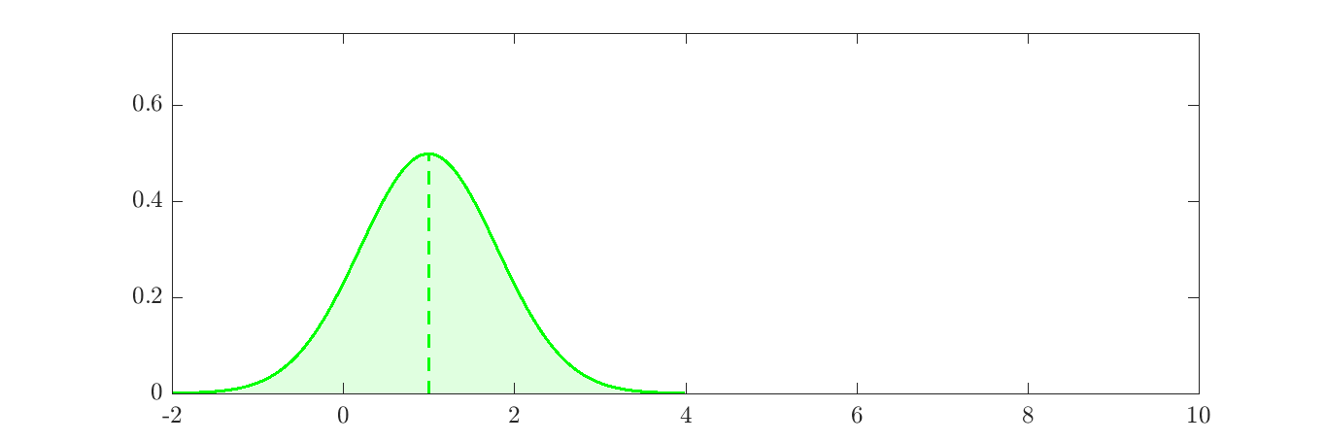
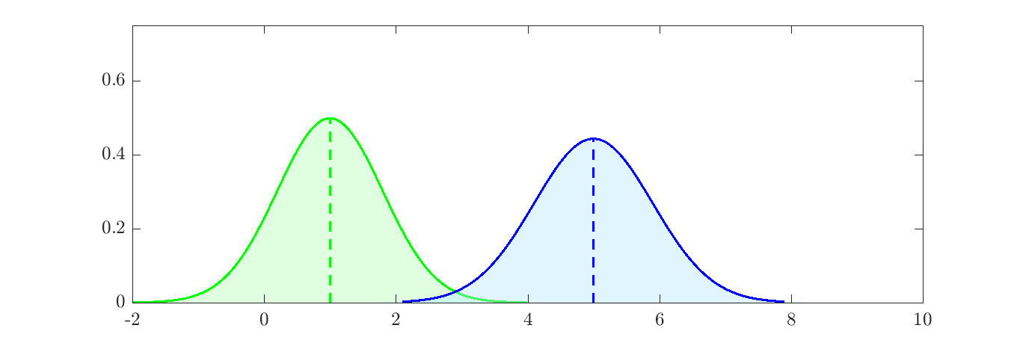
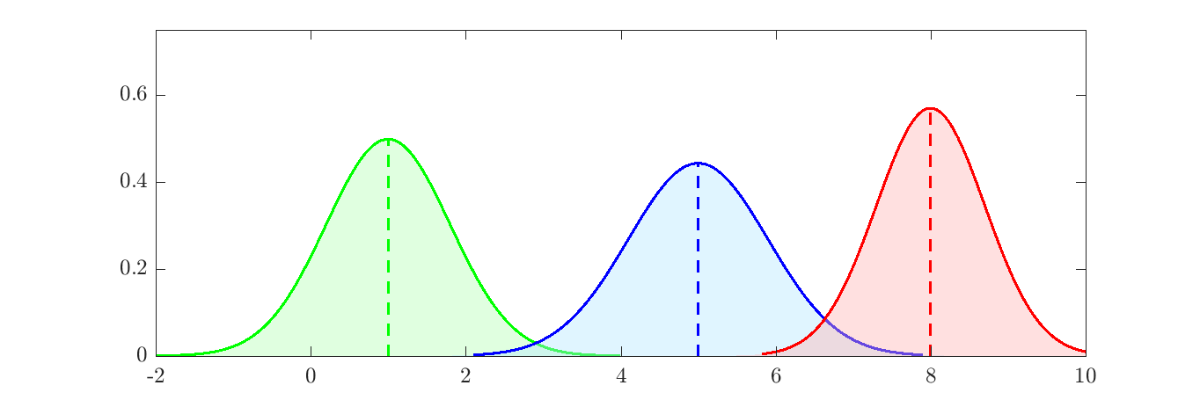
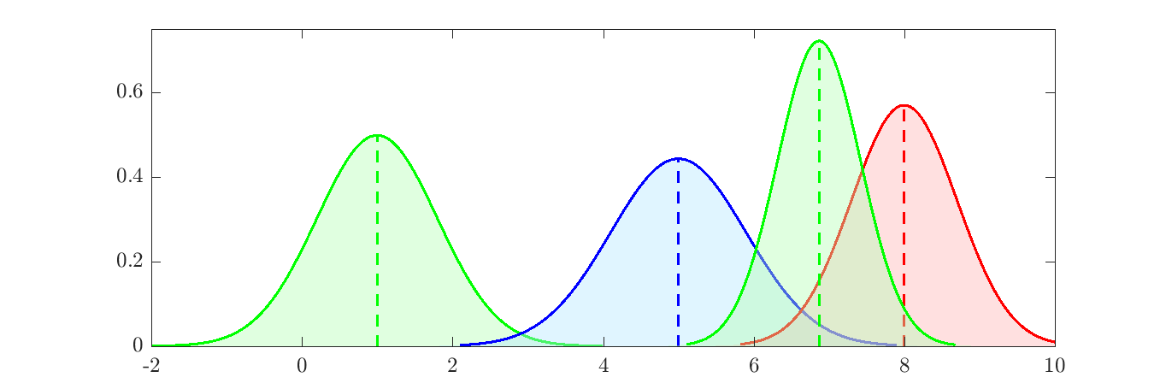
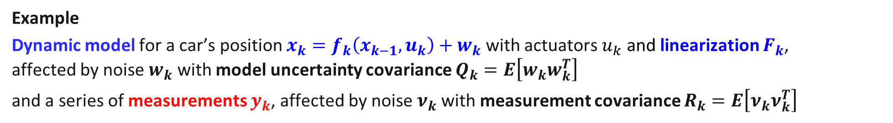



The Extended Kalman Filter: a sequential Bayesian filter
Example
Dynamic model for a car’s position $x_{k}=f_{k}\left(x_{k−1}, u_{k}\right)+w_{k}$ with actuators $u_{k}$ and linearization $F_{k}$, affected by noise $w_{k}$ with model uncertainty covariance $Q_{k}=E\left[w_{k}w_{k}^{T}\right]$
and a series of measurements $y_{k}$, affected by noise $ν_{k}$with measurement covariance $R_{k}=E\left[ν_{k}ν_{k}^{T}\right]$
(2) Measurement step
estimate at k
pdf
Prediction step: apply dynamical model
estimate
at k-1
prior
at k
measurement
at k
car position $x$
$$f_{k}\left(x_{k−1}, u_{k}\right)$$
$$y_{k}$$
Notes:
Use black-box ML models with caution. It is almost always better to look inside the box if you can!

Slide 11
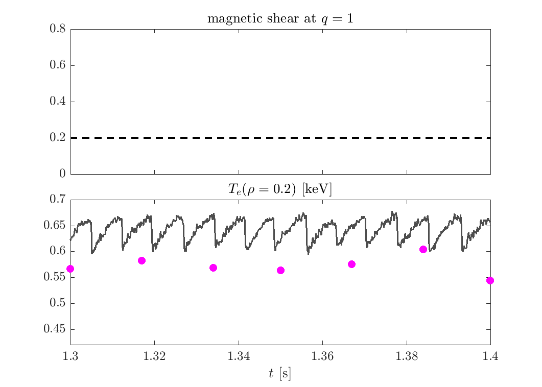
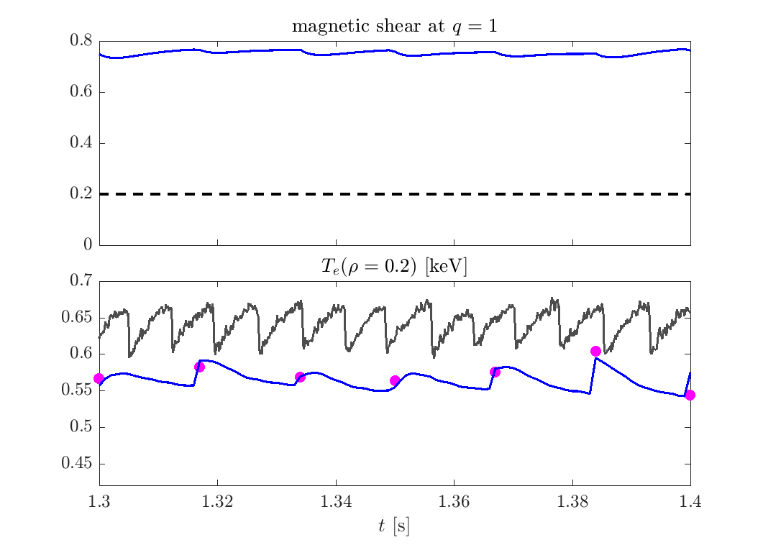
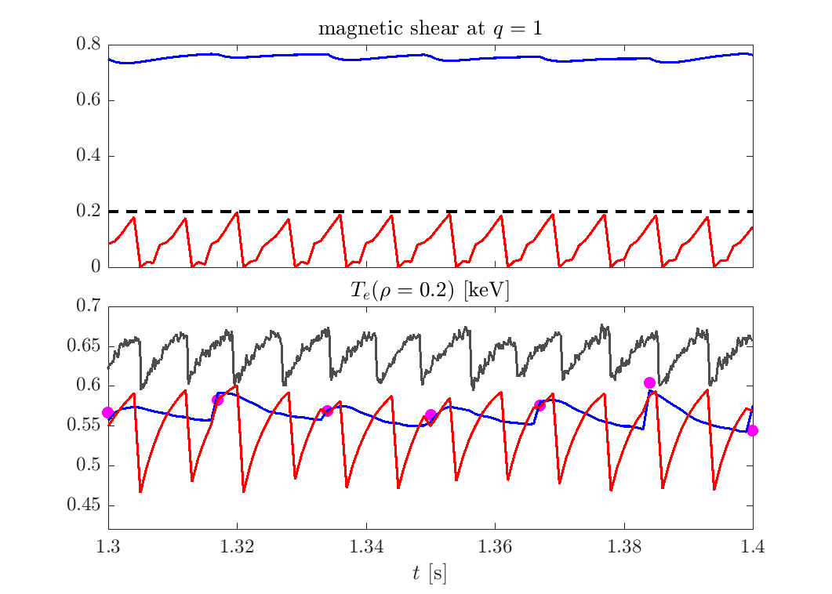

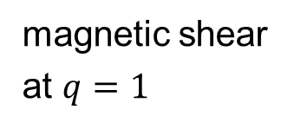

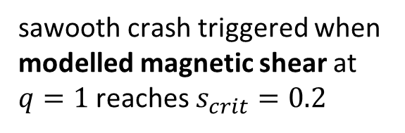
Sawtooth model allows realistic inter-measurement prediction
TCV 64965 (ohmic)
sawooth crash triggered when modelled magnetic shear at $q=1$ reaches $s_{crit}=0.2$
RAPTOR EKF, no sawtooth model
magnetic shear
at $q=1$
RAPTOR EKF, with sawtooth model
critical shear for sawtooth crash in ohmic plasma [1]
TCV
central $T_{e}$ [keV]
soft X ray $T_{e0}$
Thomson scattering
Adaptive EKF scheme: RAPTOR model parameters are continuously adapted based on the past measurements, allowing for realistic predictions for time points between measurement points
[1] O. Sauter et al, Varenna (1999)
from S. Van Mulders et al 2025, Nuclear Fusion NF-108337.R1

Slide 12
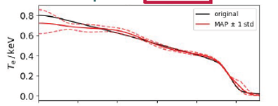
IDA and Minerva are adapted to the IMAS data model.
The robust support for multiple machine interfaces by Bayesian (or any) framework is not feasible.
IDA /
Minerva
Example equilibrium codes with IMAS interface:
CHEESE, CREATE / CREATE-NL, EFIT++, P-EFIT LUQUIE, FreeGSNKE, NICE, OMFIT, ITER PDS…

Slide 13
This presentation demonstrates the value of integrated data analysis for microwave diagnostic commissioning and calibration.
Minerva at WEST
IDA at JT-60SA
IMAS + multi-machine deployment

