Slide 1


Optimization of the Magnetic Difference Calibration Method on HL-3 Tokamak
Southwestern institute of physics
Xin Yu
yuxin@swip.ac.cn

Slide 2
01
Background
CONTENTS
02
Optimization of the MDM
03
Summary

Slide 3
01
Background
CONTENTS
02
Optimization of the MDM
03
Summary

Slide 4
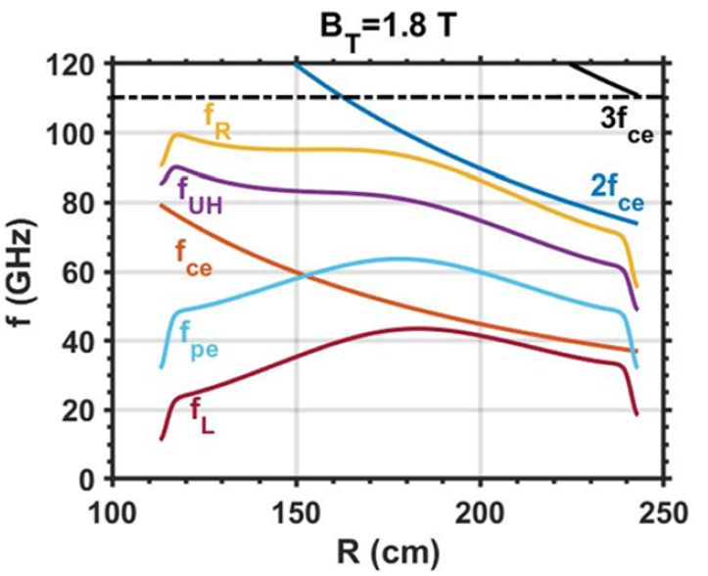
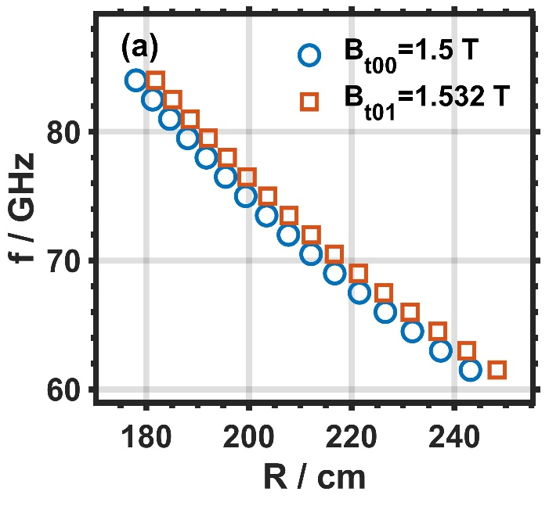
Background
The magnetic field difference calibration method (MDM) is carried out by performing similar shots with slight differences in the B-field.
Its direct error arises from the position deviation between adjacent measurement channels, as the tokamak B-field is nonlinear.
measurement positions under different B-field
Typical ECE characteristic frequency profiles on HL-3
X. Yu, et al, Rev. Sci. Instrum. 95, 113510 (2024)

Slide 5
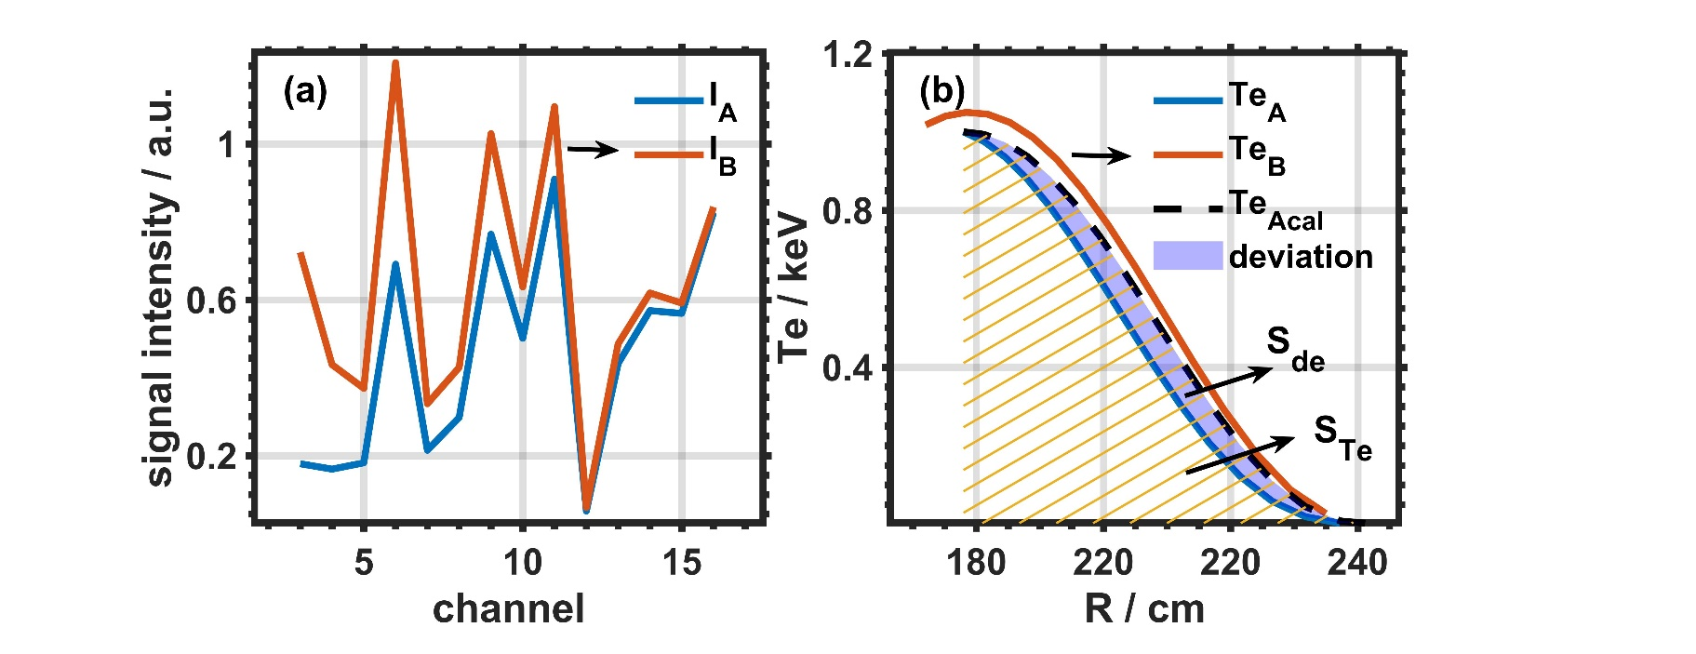
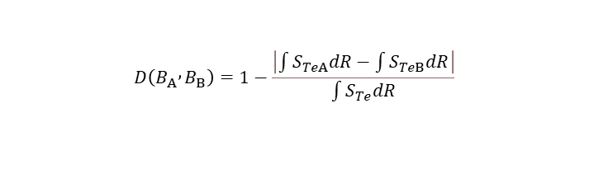
Definition of calibration accuracy
By preset the Te profiles for discharges A and B, the expected relative calibration profile can be obtained using the MDM.
The calibration accuracy is defined by the ratio of the difference in the integrated areas under the profiles.
The stochastic signals corresponding to the preset profiles.
The difference between the preset profile and the calibrated profile.
X. Yu, et al, EPJ Web of Conferences 277, 03009 (2023)
$$D\left(B_{A} , B_{B}\right)=1−\frac{\left|\int{S_{TeA}dR}−\int{S_{TeB}dR}\right|}{\int{S_{Te}dR}}$$
Calibration accuracy：

Slide 6
01
Background
CONTENTS
02
Optimization of the MDM
03
Summary

Slide 7
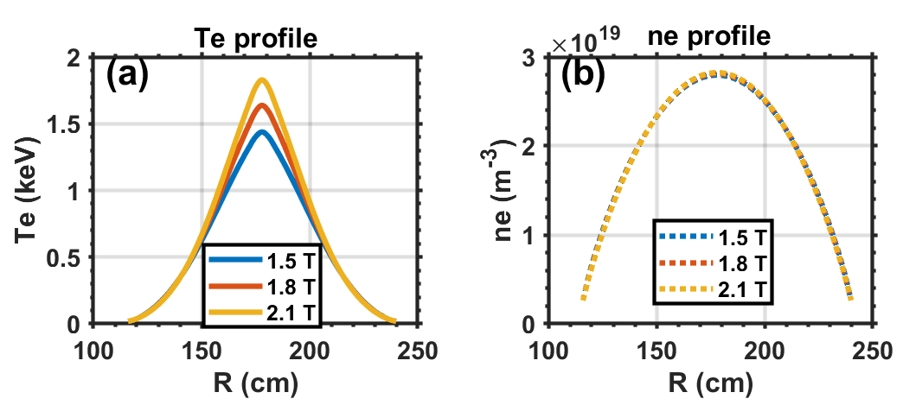
Standard profile input
In the MDM, different B-fields lead to differences in the Te profiles.
To evaluate this part of error, we use the METIS code to define a reference profile.
Te and ne profiles calculated by METIS under different B-field.
METIS is an integrated modeling and simulation code.

Slide 8
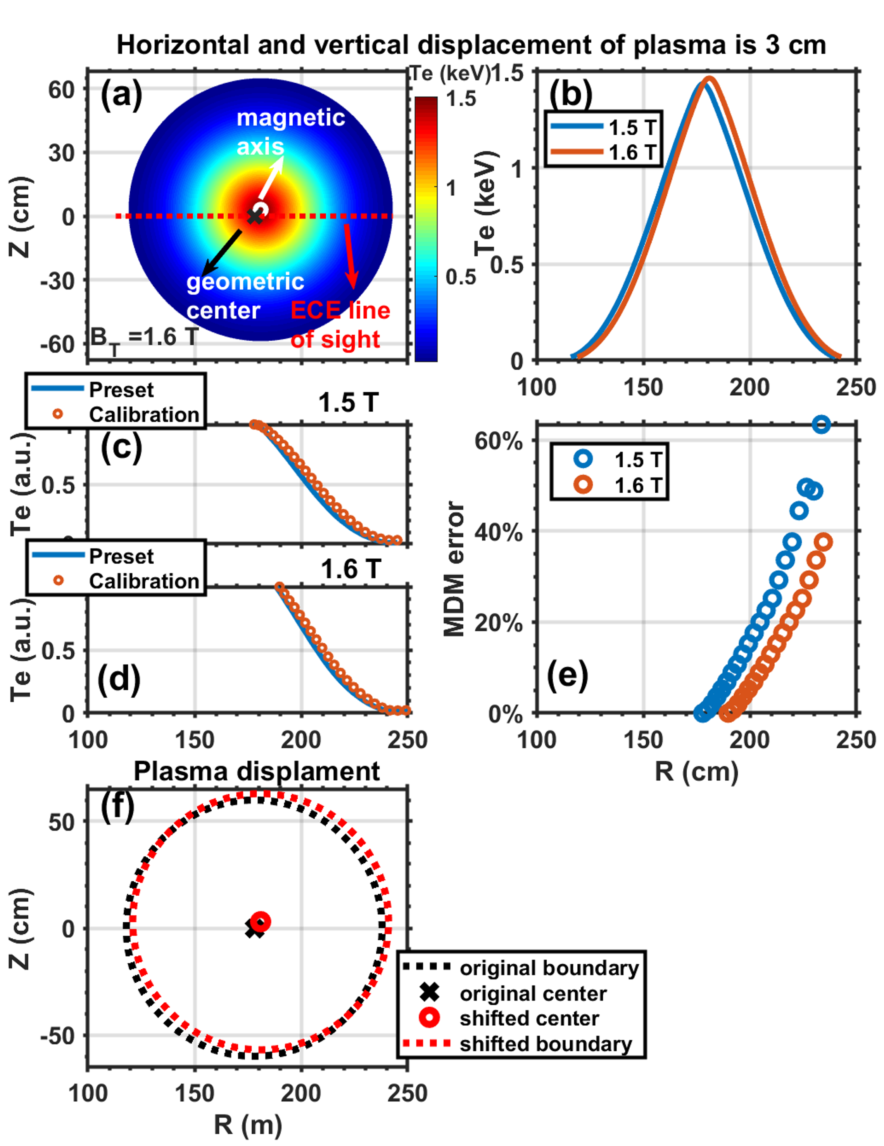
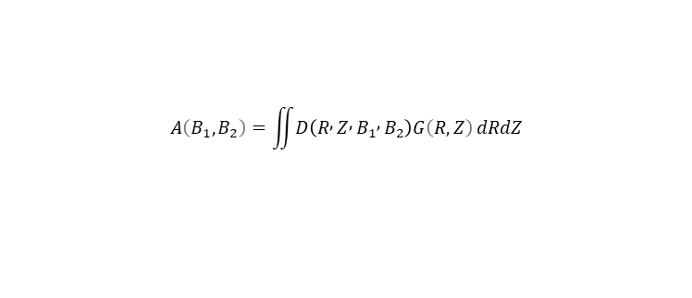
Effect of plasma displacement
Relative displacement of the plasma between two discharges can also introduce significant errors in the MDM.
By constructing an integral of the displacement probability distribution function and the calibration accuracy function, a more accurate assessment of the calibration error can be obtained.
$$G\left(d\right)=\frac{1}{\sqrt{2π}σ}exp\left(\begin{aligned}&−\frac{{\left(d\right)}^{2}}{2σ^{2}}\end{aligned}\right)$$
$$A\left(B_{1},B_{2}\right)=\iint{D\left(R , Z , B_{1} , B_{2}\right)G\left(R,Z\right)}dRdZ$$

Slide 9
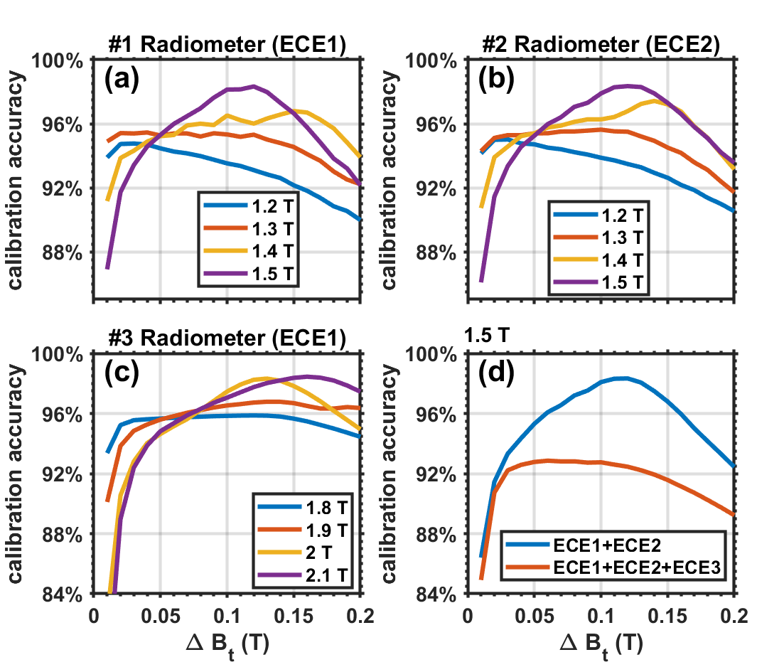
Effect of systems operating at different frequencies
ECE1/ECE2:60-84 GHz, ECE3:84-110 GHz
Accuracy analysis of different ECE systems under different B-field, based on the calibration accuracy function.
The calibration accuracy of ECE systems operating in different frequency ranges differs, because their measurements at different radial locations.
ECE3

Slide 10
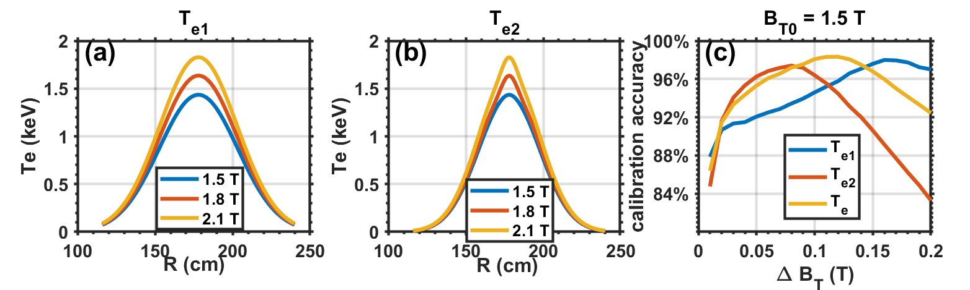
Effect of the profile peaking factor
Different profile peaking factors also affect the calibration accuracy distribution; therefore, pre-calibration simulations and accuracy analysis are essential.
For HL-3, we routinely perform MDM relative calibration at a B-field difference of 0.12 T.
Different peaking factor profiles and corresponding calibration accuracy distributions.

Slide 11
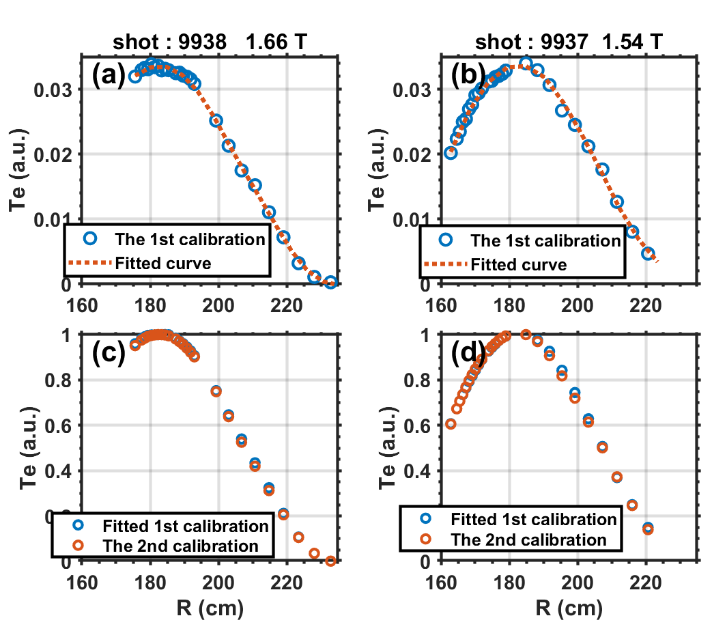
MDM Calibration example
MDM calibration was carried out at magnetic fields of 1.66 T and 1.54 T, and the calibration coefficients were derived based on fitted Te profiles.
Using the profile obtained from the first calibration as the preset Te profile, a second MDM calibration was performed to obtain the error distribution.

Slide 12
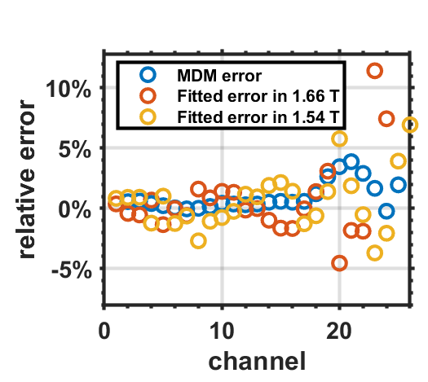
Calibration error
The final MDM calibration error arises from the fitting uncertainty of the first MDM calibration and the error of the second MDM calibration.
The final calibration error is acceptable, with most channels showing errors of approximately 4%.

Slide 13
01
Background
CONTENTS
02
Optimization of the MDM
03
Summary

Slide 14
Summary
The MDM calibration error is from various factors, including deviations in channel measurement positions, plasma displacement, differences in Te under different B-fields, and variations in Te peaking factor, among others.
Based on METIS code and the plasma displacement probability distribution function, the calibration accuracy under different B-field differences was analyzed, providing guidance for ECE calibration on HL-3.
The MDM calibration error is acceptable, and it has become the primary calibration method for the HL-3 ECE system. Absolute blackbody calibration is also under development, and comparison between the two approaches will help further refine the calibration technique.

Slide 15
Thanks for listening
Xin Yu yuxin@swip.ac.cn

