Slide 1



Calibrating the ECE diagnostic for the ITER Tokamak
Johannes van den Berg Stefan Schmuck
Modeling the Overall Sensitivity of the Fourier Transform Spectrometers
Notes:
Project
Diagnostics

Slide 2
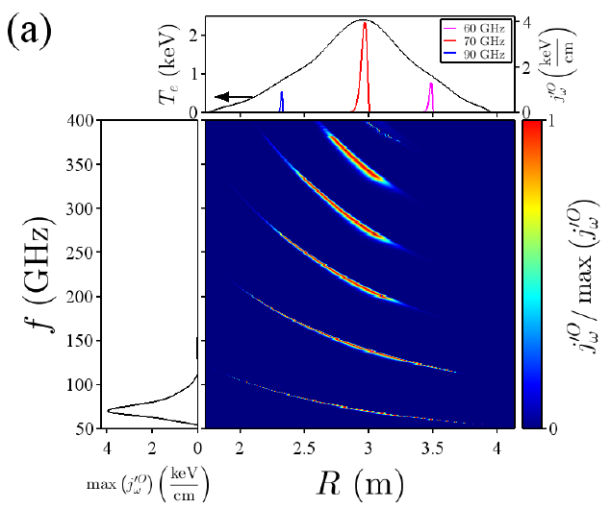
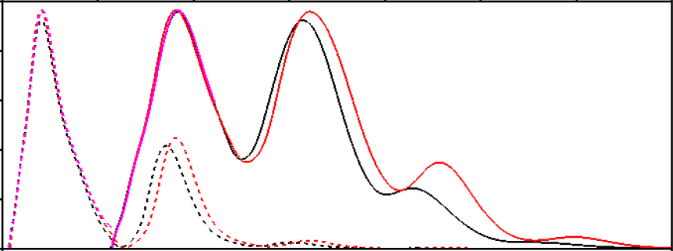

Electron Cyclotron Emission (ECE)
$$I ∝f^{2}T$$
Emission spectrum
O mode
X mode
Frequency
From [1].
Pure O1
Pure X2
ITER ECE: Te from pure O1 and Pure X2
From [1].
Notes:
Rayleigh-Jeans approx.

Slide 3
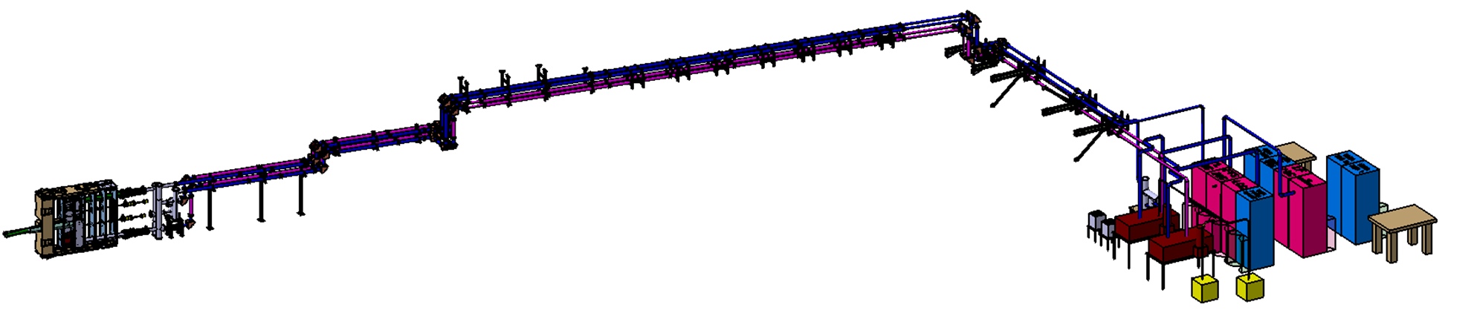
ITER’s ECE diagnostic
B74
4 Oversized Circular Waveguide Transmission Lines
Quasi-Optical Antenna
and Polarizer
From [4].
2 Fourier Transform Spectrometers 2 Heterodyne Radiometers
Antenna
FTS
Transmission Line

Slide 4
Sightlines and Polarizations
Radial sightline
Mainly-X
×4
Oblique sightline
Mainly-O

Slide 5
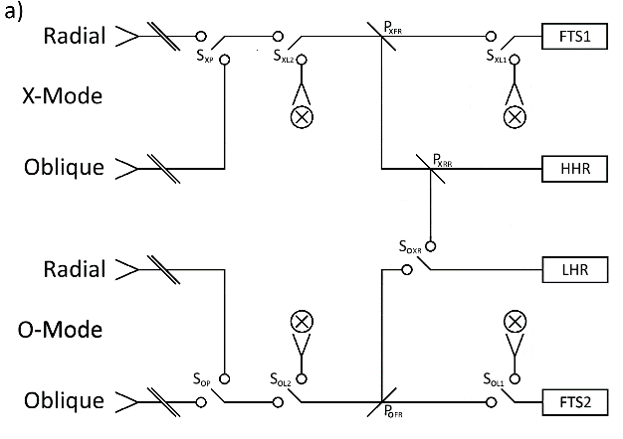
Feeding into diagnostic backends
Spectral Domain
70–1000 GHz
220–340 GHz
X2
122–230 GHz
O1 or half-field X2
70–1000 GHz
2 Fourier Transform Spectrometers 2 Heterodyne Radiometers

Slide 6
Feeding into diagnostic backends
Spectral Domain
70–1000 GHz
220–340 GHz
X2
122–230 GHz
O1 or half-field X2
70–1000 GHz
2 Fourier Transform Spectrometers 2 Heterodyne Radiometers

Slide 7
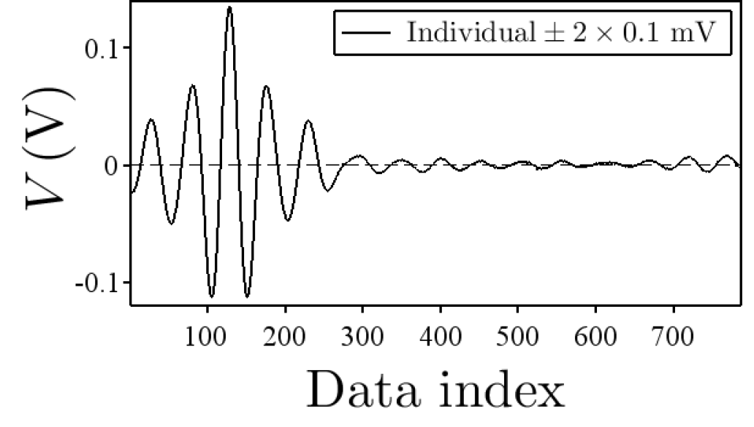
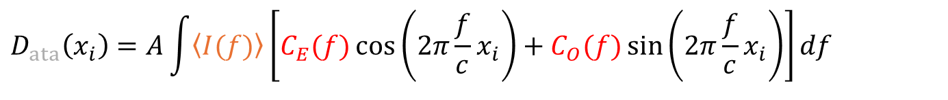
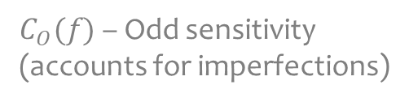

Plasma inference mode
$C_{E}(f)$ – Even sensitivity
$C_{O}(f)$ – Odd sensitivity
(accounts for imperfections)
Measured
Emission spectrum
$$D_{ata}\left(x_{i}\right)=A\int{\left\langle I(f)\right\rangle \left[C_{E}(f)\cos\left(2π\frac{f}{c}x_{i}\right)+C_{O}(f)\sin\left(2π\frac{f}{c}x_{i}\right)\right]df}$$
From [1].
Absolute calibration
required!
Antenna
FTS
Transmission Line

Slide 8
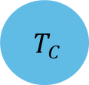
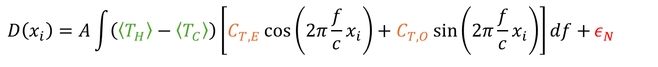
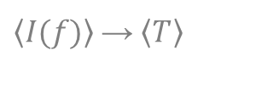
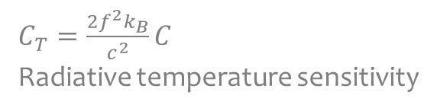
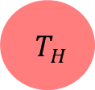
$\left\langle I(f)\right\rangle$ → $\left\langle T\right\rangle$
Calibration mode
$C_{T}=\frac{2f^{2}k_{B}}{c^{2}}C$
Radiative temperature sensitivity
Overall sensitivity
$$D\left(x_{i}\right)=A\int{\left(\left\langle T_{H}\right\rangle −\left\langle T_{C}\right\rangle \right)\left[C_{T,E}\cos\left(2π\frac{f}{c}x_{i}\right)+C_{T,O}\sin\left(2π\frac{f}{c}x_{i}\right)\right]df+}ε_{N}$$
Known
Noise!
$T_{H}$
Antenna
FTS
Transmission Line
$T_{C}$
Hot-Cold Calibration sources inside DSM

Slide 9
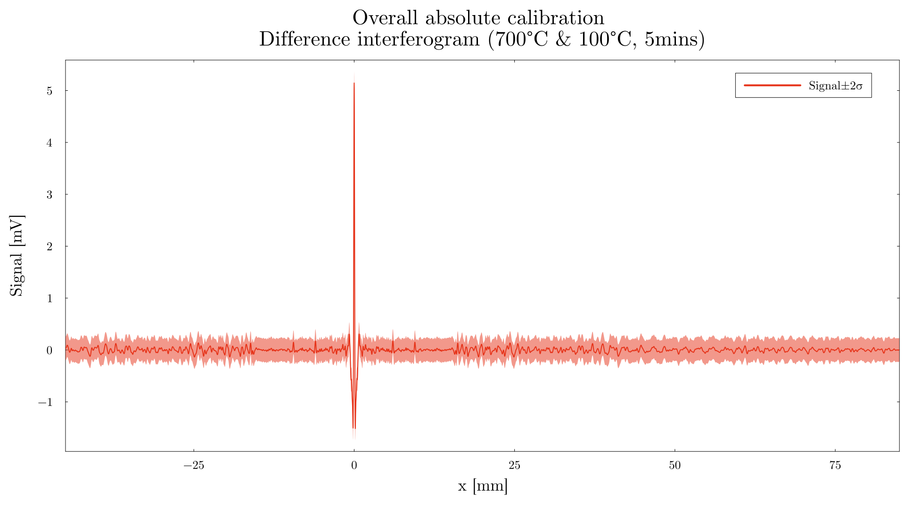

Slide 10
10×–100× noise reduction
8 hours ~ 35 days

Slide 11
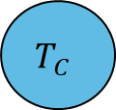
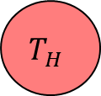
Estimating Overall Sensitivity
$$C_{T,E(O)}=G_{A}×G_{TL}×C_{T,E(O)}^{BE}$$
$$T_{H}$$
Antenna
FTS
Transmission Line
$$T_{C}$$

Slide 12
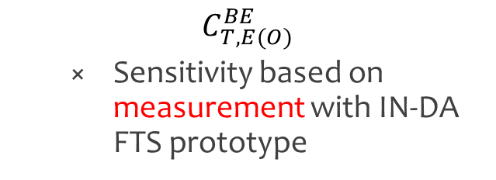
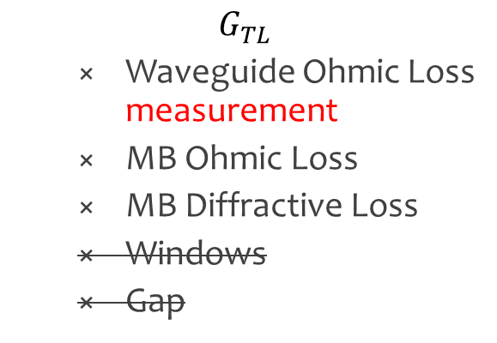
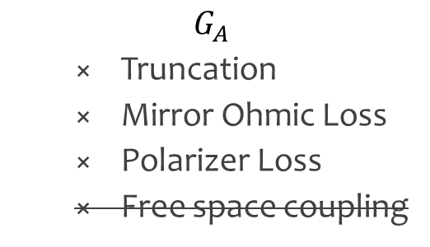
Estimating Overall Sensitivity
$$C_{T,E(O)}=G_{A}×G_{TL}×C_{T,E(O)}^{BE}$$
$$T_{H}$$
Antenna
FTS
Transmission Line
$$T_{C}$$
$$G_{TL}$$
Waveguide Ohmic Loss measurement
MB Ohmic Loss
MB Diffractive Loss
Windows
Gap
$$C_{T,E(O)}^{BE}$$
Sensitivity based on measurement with IN-DA FTS prototype
$$G_{A}$$
Truncation
Mirror Ohmic Loss
Polarizer Loss
Free space coupling
Already included in prototype sensitivity measurement
To be included in more complete analysis

Slide 13
Power divider
$$C_{T,E(O)}=G_{A}×G_{TL}×\text{Power} \text{divider}×C_{T,E(O)}^{BE}$$
$$T_{H}$$
Antenna
FTS
Transmission Line
$$T_{C}$$
HR

Slide 14


$$T_{H}$$
Antenna
FTS
Transmission Line
$$T_{C}$$

Slide 15
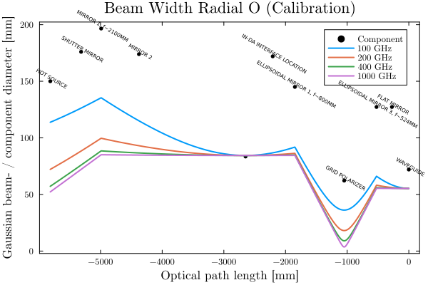
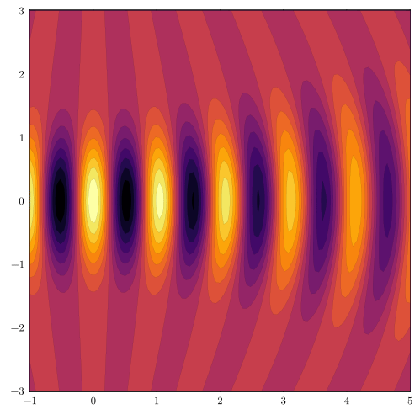
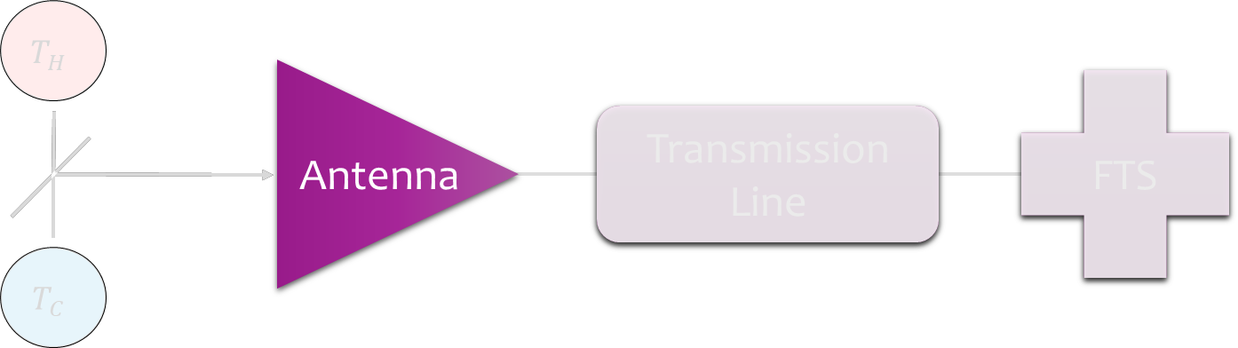


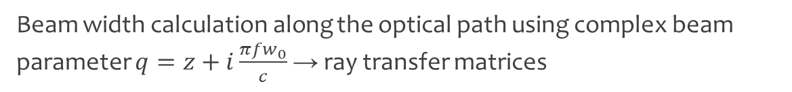
Quasi-optical beam diffractivity
2D slice of a Gaussian beam propagating
Focusing mirror
Focusing mirror
$$T_{H}$$
Foc. Mir.
$$T_{C}$$
Waveguide entrance
Source
Beam width calculation along the optical path using complex beam parameter $q=z+i\frac{π{fw}_{0}}{c}$ → ray transfer matrices
A more thorough analysis would include beam astigmatism and higher order modes

Slide 16
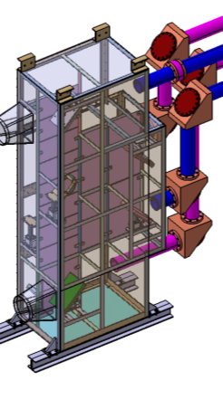
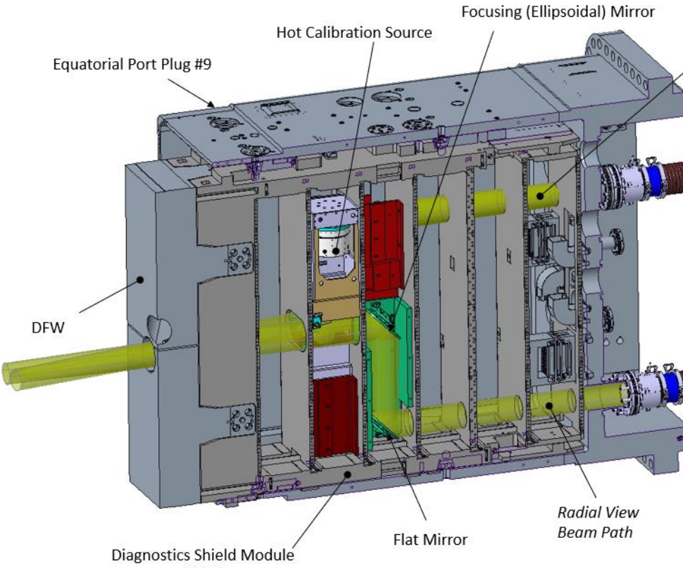
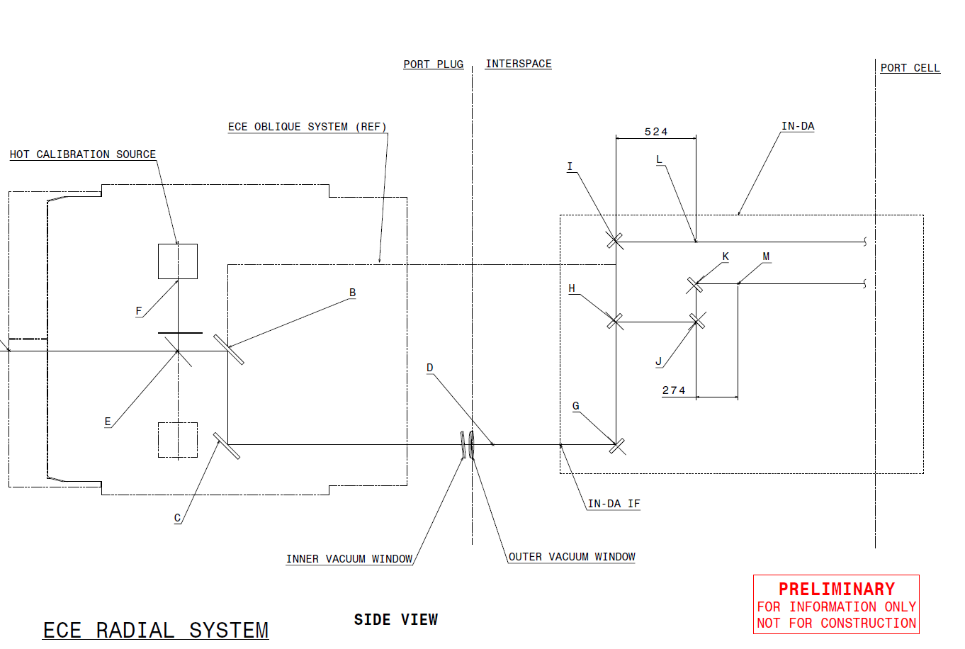
Antenna components
DSM2 Equatorial Port 9
PSU
Input: component positions and dimensions
We assume the (projected) components to be circular
We conservatively take whichever diameter is smaller (significant for polarizer)
Projected
Mirrors & polarizer
Per beam path:
2–3 mirrors in the US-DA front end (depending on operation modus)
2–3 mirrors in the IN-DA PSU (depending on polarisation)

Slide 17
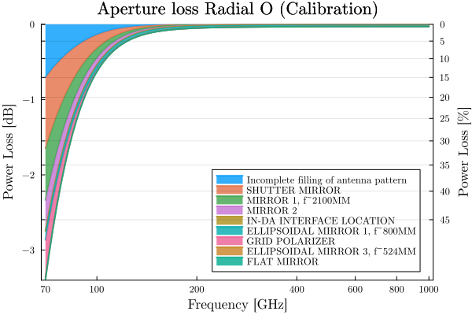
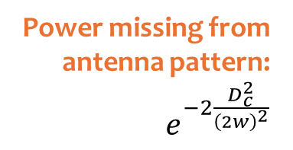
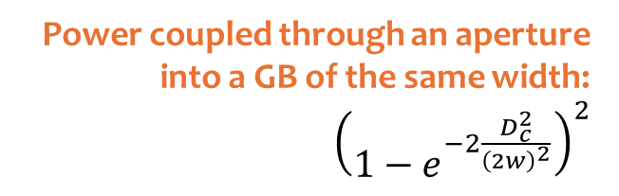


Aperture/truncation loss
Loss due to beam truncation and partial filling of antenna pattern by calibration source
No Aperture D (~25% Loss)
$$D_{c}$$
$$2w$$
Path | Power Loss [%] at
 | 100 GHz | 200 GHz | 500 GHz | 1000 GHz
Radial X-mode | 13.5 | 1.13 | 0.69 | 0.66
Radial O-mode | 13.5 | 1.14 | 0.70 | 0.66
Oblique X-mode | 12.6 | 1.11 | 0.69 | 0.66
Oblique O-mode | 12.6 | 1.12 | 0.70 | 0.66
Power coupled through an aperture into a GB of the same width:
${\left(1−e^{−2\frac{D_{c}^{2}}{{\left(2w\right)}^{2}}}\right)}^{2}$
Power missing from
antenna pattern: $e^{−2\frac{D_{c}^{2}}{{\left(2w\right)}^{2}}}$

Slide 18
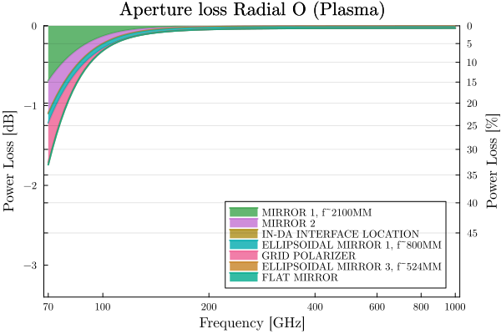
Aside: Apertures are problematic
Misalignment critical for sensitivity / filling the antenna pattern below ~200 GHz
>1% loss, indicating beams are starting to be truncated
Stray radiation due to multi-reflections inside closed spaces like DSM/PSU
Discrepancy between sensitivities for Calibration and Plasma operation due to shutter mirror and discrepancy between filling of antenna patterns (>2% difference below ~120GHz)

Slide 19


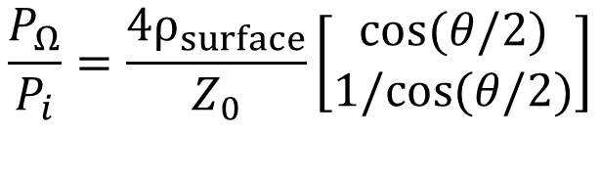
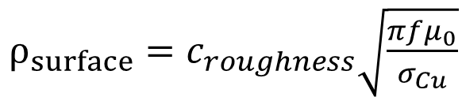
Mirror Ohmic Loss
E- and H-plane losses: O-mode is mostly H-plane reflections, so has fewer Ohmic losses on the mirrors
The bonus resistivity due to surface rougness $c_{roughness}$ is taken as 1.2, a common value in literature. In reality, this factor is likely frequency dependant.
$ρ_{surface}=c_{roughness}\sqrt{\frac{πfμ_{0}}{σ_{Cu}}}$
$$θ$$
$$\frac{P_{Ω}}{P_{i}}=\frac{4ρ_{surface}}{Z_{0}}\left[\begin{matrix}cos⁡(θ/2) \\ 1/cos⁡(θ/2)\end{matrix}\right]$$
H-plane
E-plane

Slide 20
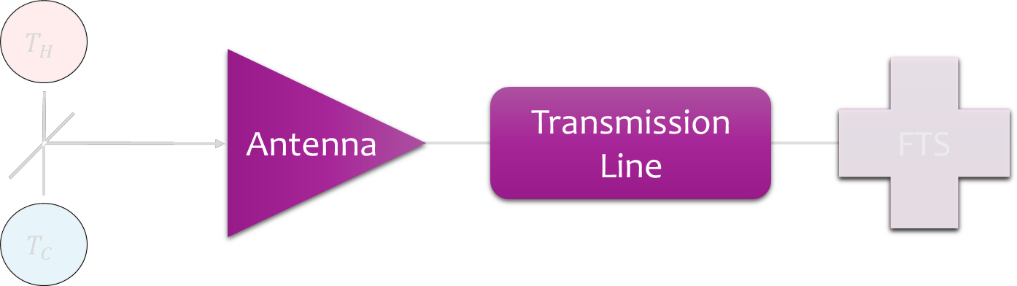
Track polarization through Antenna and Transmission Line
$${\vec{E}}_{refl} =l_{∥}{\vec{E}}_{∥}+l_{⟂}{\vec{E}}_{⟂}−2(l_{⟂}{\vec{E}}_{⟂}⋅\vec{n})\vec{n}$$

Slide 21
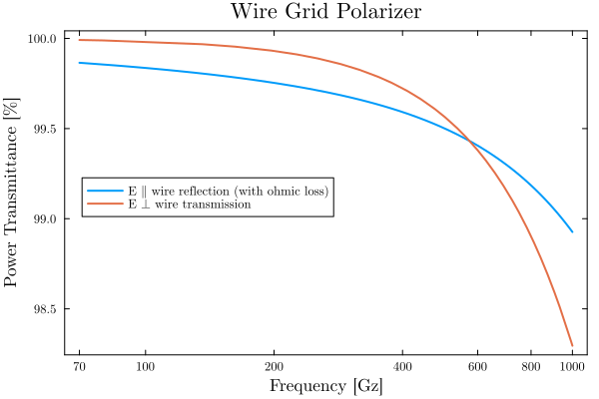
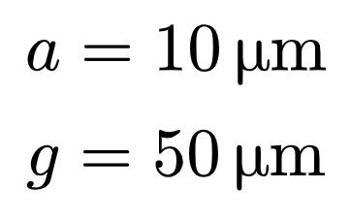
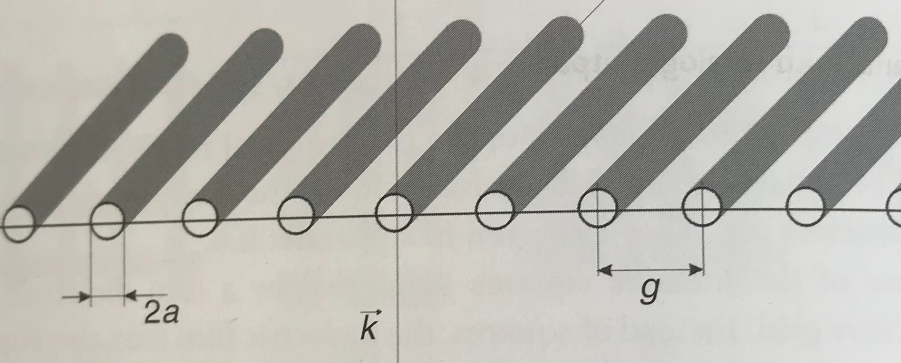
Grid Polarizer Power Transmission

Slide 22
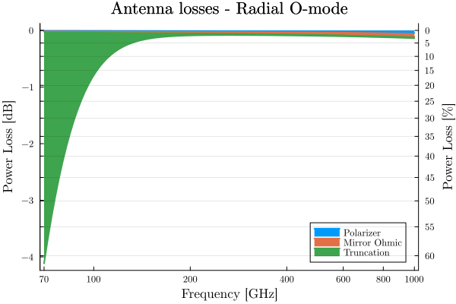
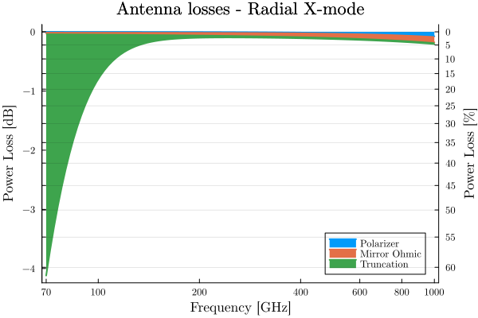
Antenna Overall

Slide 23


$$T_{H}$$
Antenna
FTS
Transmission Line
$$T_{C}$$

Slide 24
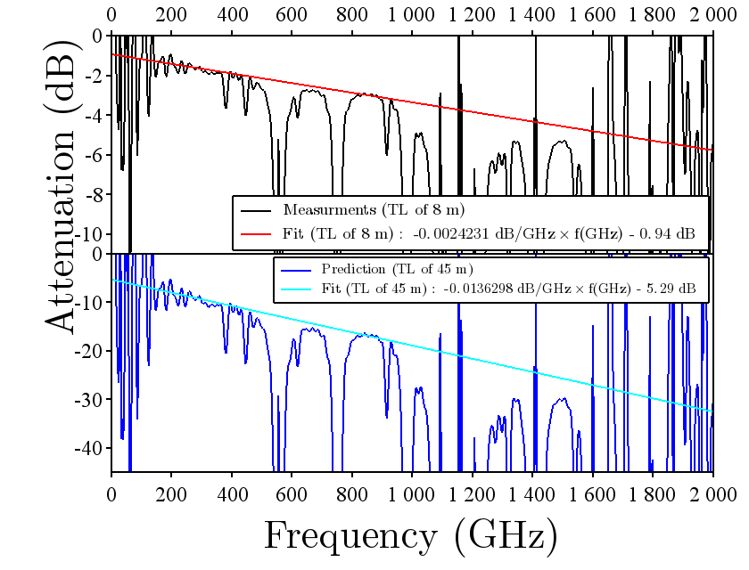
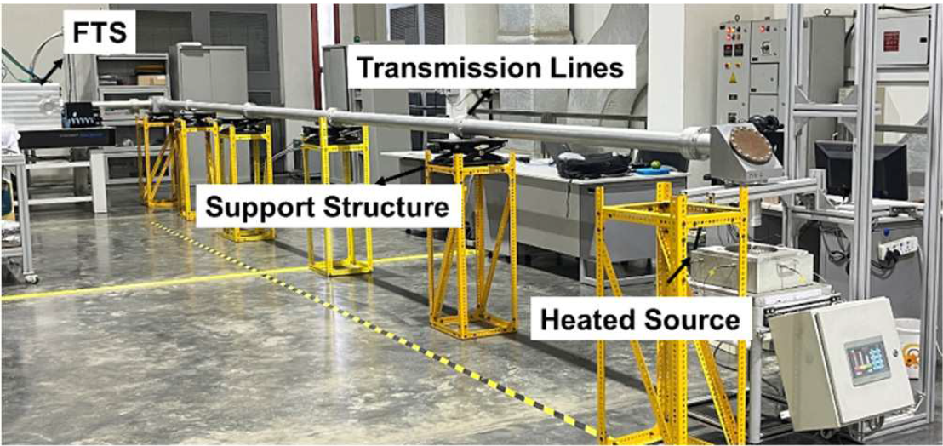
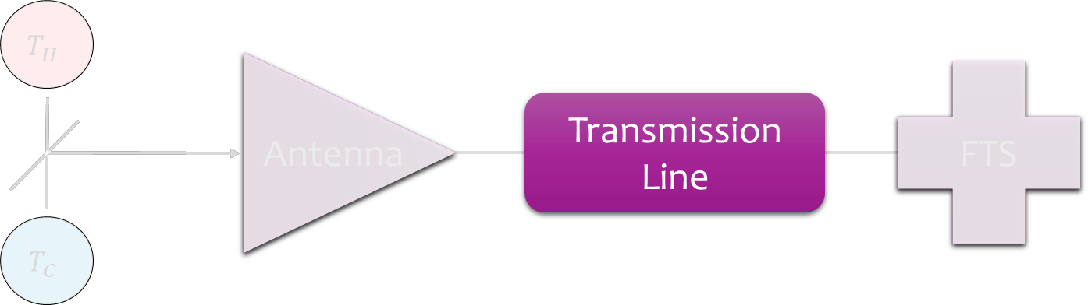
Transmission Line Ohmic Loss measurement
Short
Long
Path | Length [m] | Power Loss [%] at
 |  | 100 GHz | 200 GHz | 500 GHz | 1000 GHz
Radial X-mode | 41.4 | 75.6 | 81.7 | 92.3 | 98.2
Radial O-mode | 44.1 | 77.7 | 83.6 | 93.5 | 98.6
Oblique X-mode | 42.8 | 74.9 | 82.7 | 91.9 | 98.0
Oblique O-mode | 40.6 | 76.7 | 81.1 | 92.9 | 98.4

Slide 25
Transmission Line Ohmic Loss measurement
Short
Long
Surprisingly high! Overmoded circular waveguides are expected to have low losses (<1 dB/km) [Thumm 2002]
Path | Length [m] | Power Loss [%] at
 |  | 100 GHz | 200 GHz | 500 GHz | 1000 GHz
Radial X-mode | 41.4 | 75.6 | 81.7 | 92.3 | 98.2
Radial O-mode | 44.1 | 77.7 | 83.6 | 93.5 | 98.6
Oblique X-mode | 42.8 | 74.9 | 82.7 | 91.9 | 98.0
Oblique O-mode | 40.6 | 76.7 | 81.1 | 92.9 | 98.4

Slide 26
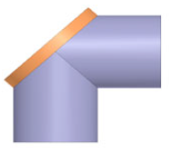
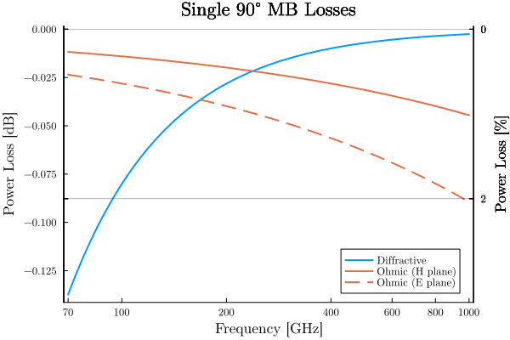
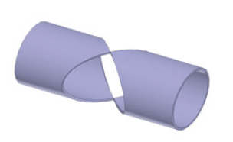

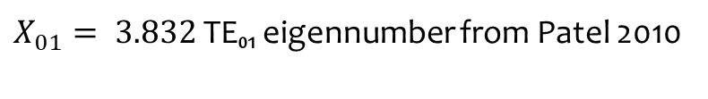
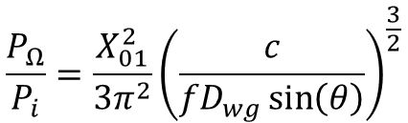
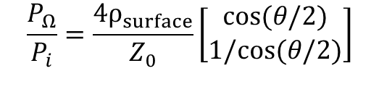
Mitre Bends
Ohmic Losses are same as Mirrors!
$ρ_{surface}=c_{roughness}\sqrt{\frac{πfμ_{0}}{σ_{Cu}}}$
$$\frac{P_{Ω}}{P_{i}}=\frac{4ρ_{surface}}{Z_{0}}\left[\begin{matrix}cos⁡(θ/2) \\ 1/cos⁡(θ/2)\end{matrix}\right]$$
H-plane
E-plane
Diffractive Losses:
$$\frac{P_{Ω}}{P_{i}}=\frac{X_{01}^{2}}{3π^{2}}{\left(\frac{c}{{fD}_{wg}\sin\left(θ\right)}\right)}^{\frac{3}{2}}$$
$X_{01}= 3.832$ TE₀₁ eigennumber from Patel 2010

Slide 27


Losses Overall
Transmission
Line
Transmission
Line
Path | Power Loss [%] at
 | 100 GHz | 200 GHz | 500 GHz | 1000 GHz
Radial X-mode | 80.3 | 82.7 | 92.8 | 98.3
Radial O-mode | 82.2 | 84.6 | 93.9 | 98.7
Oblique X-mode | 81.1 | 83.7 | 93.4 | 98.6
Oblique O-mode | 79.6 | 82.2 | 92.4 | 98.2
High losses from TL realistic?

Slide 28
$$T_{H}$$
Antenna
FTS
Transmission Line
$$T_{C}$$

Slide 29



Backend sensitivity
Uncertainty covariance
Obtained via Bayesian approach
(see talk by S. Schmuck)

Slide 30



Overall sensitivity
$$C_{T,E(O)}=G_{A}×G_{TL}×C_{T,E(O)}^{BE}×\text{Power} \text{divider}$$
Expected difference
interferograms:
Very high uncertainty
at low frequencies
But we have an order of magnitude estimate
High variance past 15mm needs investigation

Slide 31




Measurement Uncertainties of Sensitivity
Noise level of IN-DA FTS for individual interferogram at $σ_{DInd}$ = 9.8 mV
When for each calibration source $N_{Int}$ interferograms are acquired, measurement noise of difference interferogram reads $\sqrt{{2/N}_{Int}}σ_{DInd}$
For FTS shaker frequency $f_{S}$ = 25 Hz and total available integration time $T_{Int}$:
Sensitivities of forward & backward FTS mirror motions different: $N_{Int}$= $f_{S}T_{Int}/2$
Sensitivities of forward & backward FTS mirror motions same: $N_{Int}$= $f_{S}T_{Int}$
When sensitivity estimated conventionally from data vector $\vec{D}$ with $N_{D}$ data points via
then Gaussian noise in data domain translates into Gaussian noise in spectral domain
To reduce noise in spectral domain:
Linear reduction: increase $∆T$ of probed sources
Linear reduction: reduce measurement noise $σ_{DInd}$
Square-root reduction: take more data per interferogram $∆x$ with $N_{D}→$ ${∆x}^{′}=$ $∆x/2$ with ${N_{D}^{′}=2N}_{D}$
Square-root reduction: increase integration time $T_{Int}$
Square-root of 2: symmetric power coupling wrt mirror movement yielding $FB=$1 if not $FB=1/2$
$$C_{T,E}^{}(f)=\frac{2}{A}\frac{∆x}{c}\frac{1}{∆T}\sum_{k=0}^{N_{D}−1}{D_{k}cos\left(2π\frac{f}{c}x_{k}\right)}$$
$$σ_{C_{T,E}^{}}=\frac{2}{A}\frac{L_{Opt,Max}}{c} \frac{1}{∆T} \frac{σ_{DInd}}{\sqrt{N_{D}f_{S}T_{Int}FB}}$$
$$L_{Opt,Max}=N_{D}Δx$$

Slide 32



Integration Time to Reach Relative Uncertainty < 10%
Assumptions to estimate relative uncertainty wrt integration time $T_{Int}$:
No windows, expansion joints, nor aperture D
Antenna pattern filled sufficiently by calibration sources
Emission spectra of calibration sources perfectly known
($T_{HS}=700$ C, $T_{CS}=100$ C)
Relative uncertainty follows $σ_{C_{T,E}^{}}/C_{T,E}^{}(f)$
Problematic domain below 180 GHz: 24 – 48 h integration time needed
Te profile domain affected most:
For full field of B = 5.3 T, LFS determined from O1 less certain
For half field of B = 2.65 T, LFS determined from X2 less certain
Sensitivity differing
for-& backward
motions FB=1
5.3 T: O1
5.3 T: X2
Sensitivity same
for-& backward
motions FB=1/2
Notes:
Important ranges of frequency band

Slide 33

Experimental/Design Suggestions
Measurement of Transmission Line at multiple lengths to pin down contributions of higher order modes, misalignments, etc.
Attenuation much larger than literature needs to be explained.
Investigate impact of antenna component misalignment on sensitivity (below 200 GHz)
Characterize impact of shutter mirror and incomplete antenna pattern on validity of calibration (below 120 GHz) $C_{plasma}$ vs $C_{calibration}$

Slide 34

Modeling Improvements
Add windows, gap losses, and power splitter to sensitivity estimate. (straightforward)
Refine Bayesian method. Uncertainty in O1/X2 domain is very high.
>15mm tails on interferogram seem spurious.
Analyse both antenna and waveguide while taking into account higher order modes. The waveguide is overmoded!

Slide 35
Sources
[1] Schmuck, Stefan. Bayesian Inference for Microwave Diagnostics at Joint European Torus. Diss. KTH Royal Institute of Technology, 2022.
[2] Schmuck, Stefan, et al. "Electron cyclotron emission measurements on JET: Michelson interferometer, new absolute calibration, and determination of electron temperature." Review of Scientific Instruments 83.12 (2012).
[3] Schmuck, Stefan, and Jakob Svensson. "Fourier spectroscopy: a Bayesian way." International Journal of Spectroscopy 2017.1 (2017): 9265084.
[4] Pastor, Orlando. “Introduction to 55.F1” ITER IDM: 7W4TZC.

Slide 36
Path | Length [m] | Attenuation at
 |  | 100 GHz | 500 GHz | 1000 GHz
Radial X-mode |  | 16% | 1.2% | 0.66%
Radial O-mode
Oblique X-mode
Oblique O-mode

Slide 39
$$T_{H}$$
Antenna
FTS
Transmission Line
$$T_{C}$$

