Slide 1
2nd Microwave Calibration Workshop
Introduction
S. Schmuck, A. Sirinelli, Y. Liu

Slide 2
Why Calibrations Matter
Use of diagnostic calibrations and related uncertainties:
  Perform data analyses to infer physics quantities
  Derive confidence intervals on inferred physics quantities
  Enable real-time control and machine protection
  Recognise systematics by comparison of physics quantities inferred independently by different diagnostics
  Enable and ensure high standards mandatory for scientific reasoning, discussions and publications

Slide 3
Relevant Microwave Diagnostic Systems at ITER
Diagnostic | Primarily for | Backup for | Ready for Phase
Low-field side (LFS) Reflectometer | - Edge n_{e} - ELM n_{e} transient - Fluctuations (Delta n_{e} / n_{e}) | - Core n_{e} | Start of Research Operation (SRO)
High-field side (HFS) Reflectometer | - Core n_{e} - ELM n_{e} transient - Fluctuations (Delta n_{e} / n_{e}) |  | SRO
Electron Cyclotron Emission (ECE) | - Core T_{e} profile - Fluctuations (DeltaT_{e} / T_{e}) | - ELM T_{e} transient | SRO
Collective Thomson Scattering (CTS) | - Alpha particle density profile - Alpha particle energy spectrum - p, D, T, He 3 energy spectrum |  | First D-T phase (DT1)

Slide 4
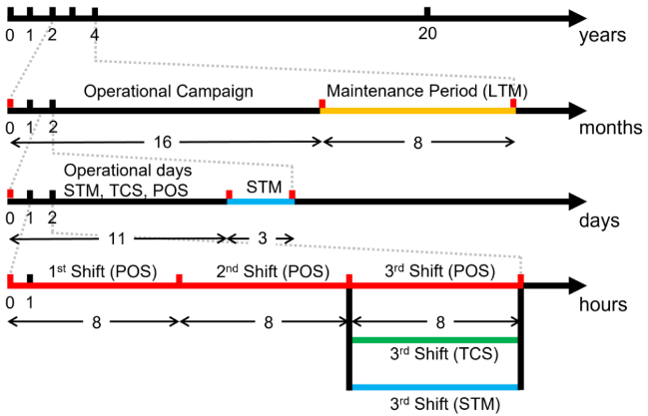
ITER Operation Schedule and Operational States
ITER designed to operate in cycles of 2 years each
Cycle: operational campaign lasting 16 months
+ 8 months of Long-Term Maintenance (LTM)
Operational campaign partitioned into 2 weeks
periods: 11 operational days and
3 days of Short-Term Maintenance (STM)
Operational day divided in 3 shifts of 8 h:
STM night shifts foreseen
Available time for calibration: LTM, STM,
TCS (Testing and Conditioning State) and POS (Plasma Operating State) when
reference pulses could be performed

Slide 5
ITER Constraints
Global Operating State | POS state | TCS state | STM state | Most LTM states
Access to Tokamak Building | Forbidden | Restricted or Forbidden | Restricted | Restricted
Forbidden: because of radioprotection, occupational safety, to avoid impact on operations, due to other elements of risk, such as magnetic field or beam sources
Restricted: access granted pending hazard assessment and to qualified people limited in number to specific required intervention considered brief works
No or limited access: reliable, robust and stand-alone calibration equipment needed
During POS, vacuum vessel at 100°C and equatorial port plug at 70°C:
- Significant thermal expansion of machine components evident and, thus, diagnostic alignment
essential for meaningful calibration: Alignment must be achieved and checked by all means
- Same conditions for POS, TCS (stand-by mode) and STM :
- STM: compact calibration procedure to be finalised in 8h or 3d
- POS: relies on development of well-understood reference pulses and advanced
joint analysis schemes
Discharge duration of more than 1000 s: minimise, track, and/or characterise drift in detection
equipment

Slide 6
Scope of Workshop
Present, assess and discuss existing and envisaged calibration procedures of Collective Thomson Scattering, Reflectometer and Electron Cyclotron Emission diagnostic systems
Identify calibration issues of existing and ITER microwave diagnostic systems
Discuss and plan ways forward and activities

Slide 7
First Microwave Calibration Workshop (Nov 2023): 1. Objective
Present, assess and discuss existing and envisaged calibration procedures of Collective Thomson Scattering, Reflectometer and Electron Cyclotron Emission diagnostic systems to include ultimately identified calibration requirements in ITER system design
Collective Thomson Scattering (1 talk):
  Hardware of ITER system and calibration of AUG system
Electron Cyclotron Emission (5 talks):
  Hardware and calibration approaches at JET, W7-X and ITER
Reflectometer (4 talks):
  High-field side system (1 talk) of ITER
  Low-field side systems (3 talks) of JET, KSTAR, ITER

Slide 8
First Microwave Calibration Workshop (Nov 2023): 2. Objective
Identify calibration issues of existing and ITER microwave diagnostic systems
Collective Thomson Scattering:
  Tracking of changes in calibration TL and source
Electron Cyclotron Emission:
  Calibration sources at T < 0.1 eV: linearity to be ensured for probing T = 40 keV
  ITER: Overall calibration must be carried out for POS alignment
  ITER: Tracking of changes in calibration source
Reflectometer:
  Transmission line dispersion measurement
  Reference position: using a “marker” in transmission lines or a mirror positioned by the ART
  Frequency calibration / sweep linearization
For all diagnostics, no procedure developed currently for calibrating at reference plasma

Slide 9
3. Objective
Discuss and plan ways forward and activities
Going to expert workshops to present details and request further involvement of communities:
  Presentation given at EC22 conference (22nd -26th April 2024, Daejeon, Korea)
Discussions and views to be tracked in shared “living document”
Joint calibrations using reference plasma:
  Development of joint schemes
  Development of accurate diagnostic models needed to perform joint data analysis

Slide 10
Agenda
Today before lunch: ITER site visit
Today:
  Review of previous calibration report done by ITPA working group
  CTS: 2 talks (W7-X, ITER) & ways forward to be discussed
  Refl LFS : 1 talk (ITER)
  Refl/ECE: 1 talk (LHD)
  Refl: ways forward to be discussed
Tomorrow before lunch:
  ECE: 7 talks (SPARC, HL-3, WEST, ITER)
  ECE: ways forward to be discussed
Tomorrow after lunch:
  Development of reference calibration discharge: 1 talk (ITER)
  Joint data analysis scheme: 1 talk (ITER)
  Round table
  Summary and Closure

