Slide 1
Welcome to the 2nd Microwave Diagnostic Calibration Workshop
ITER Organization, January 12, 2026
Victor Udintsev
Program Manager
Diagnostic Program

Slide 2
Welcome!
We are now in the construction process now
A lot of effort put on finalization of diagnostic designs, manufacturing and assembly
IO Diagnostic Team and DA’s goal is to deliver systems as per Baseline schedule to ensure smooth running of the SRO
Microwave diagnostics are essential for the success of ITER!
We thank you for continues support!

Slide 3
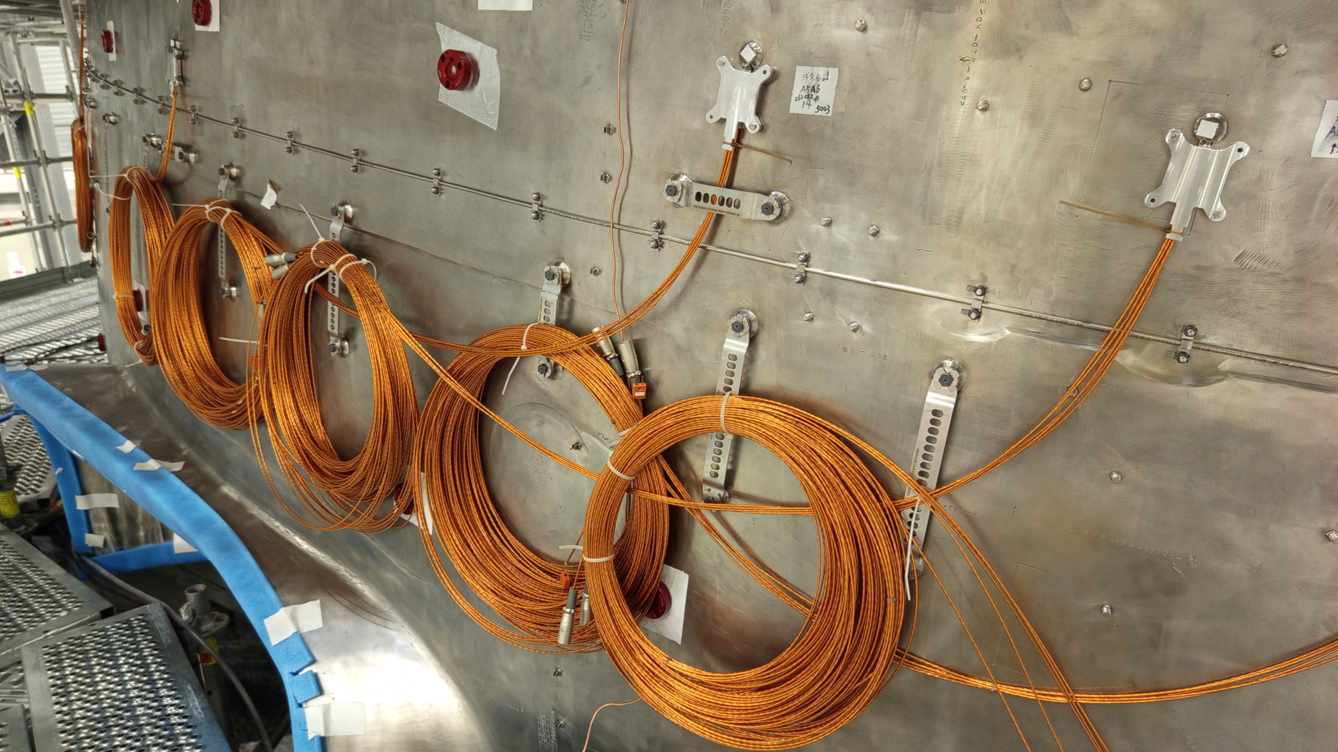

text
Diagnostics
Outer-Vessel Steady-State Sensors
Installation in VV Sectors #5 and #8
July 2025
text
text
3
text

Slide 4
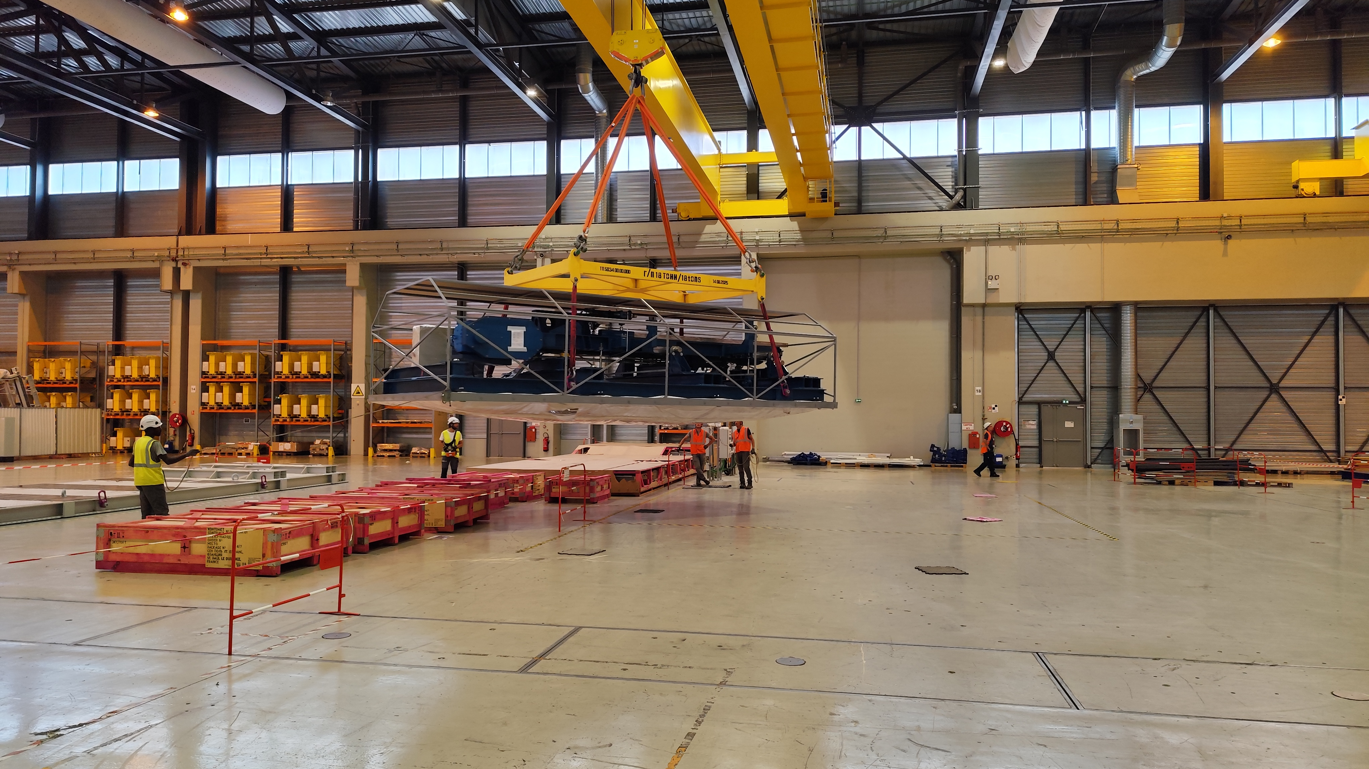
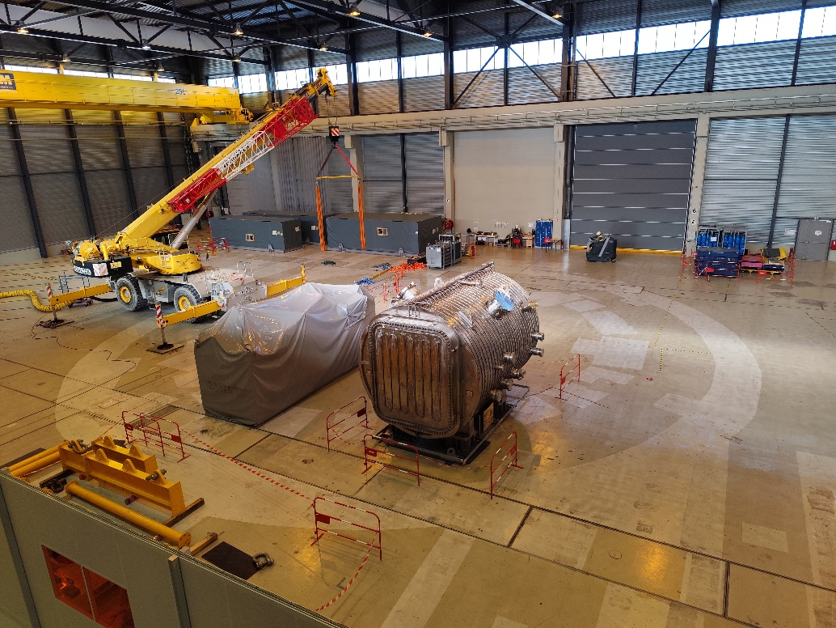

text
Diagnostics
Port Plug Test Facility
Test Stand #4 arrived to IO from RF DA in Q4-2025!
a
text
text
4
text

Slide 5
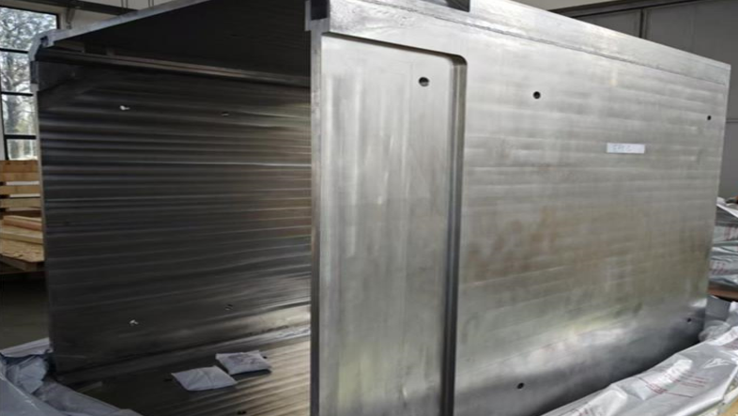
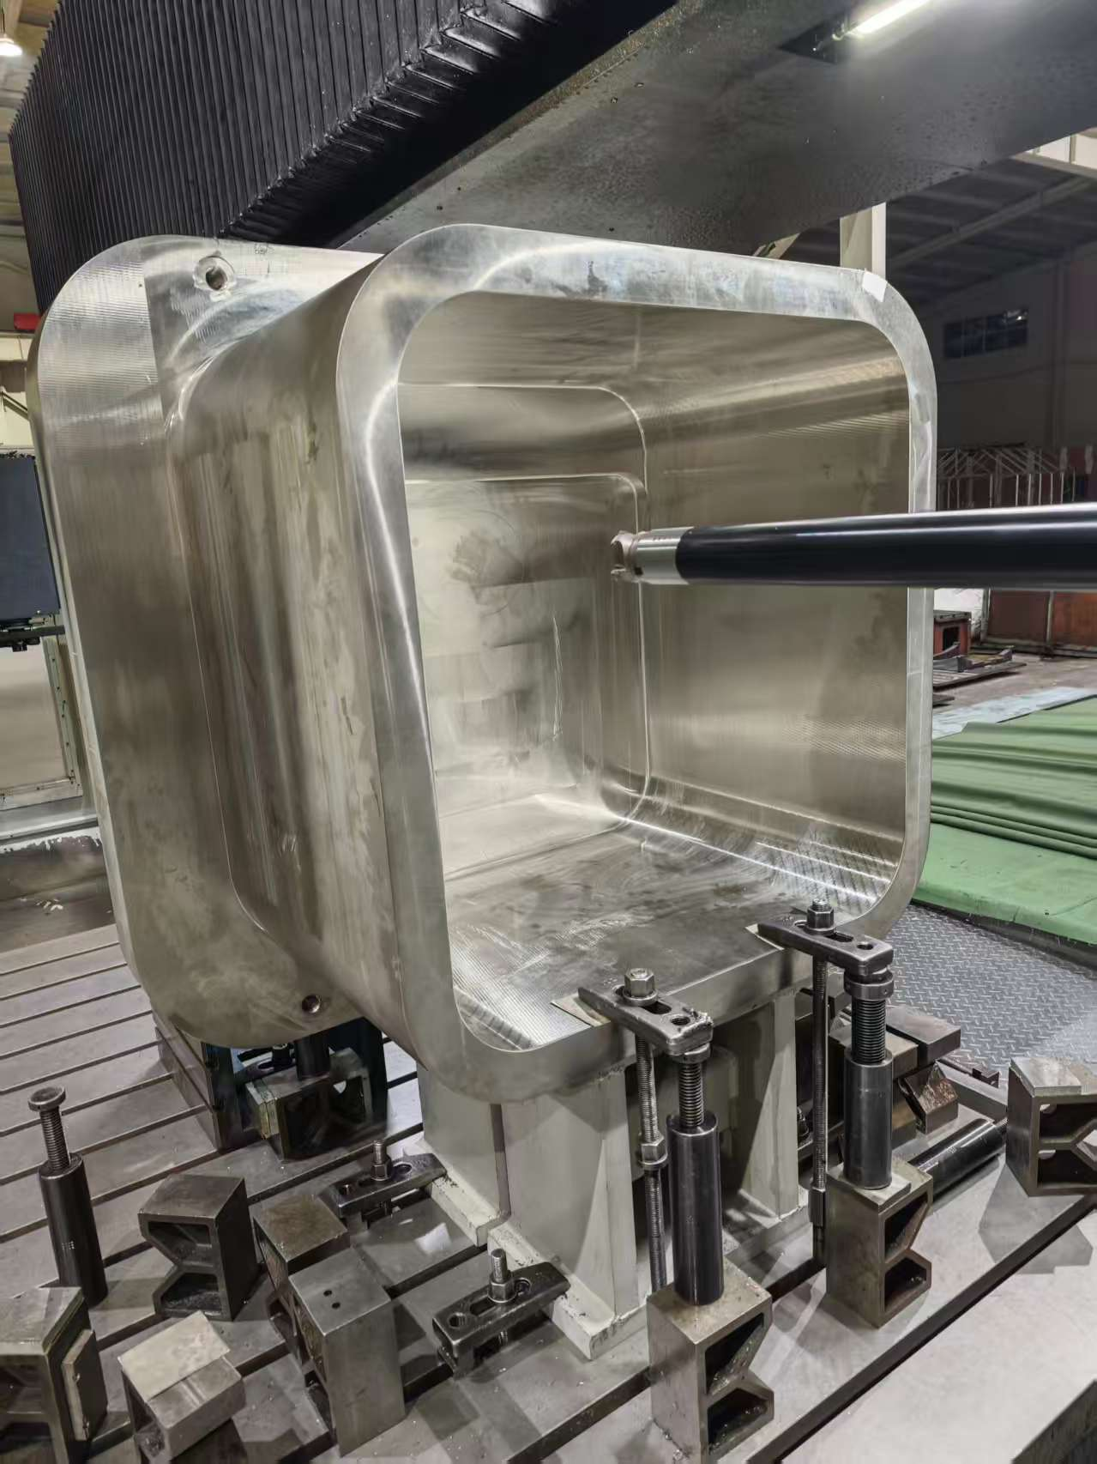
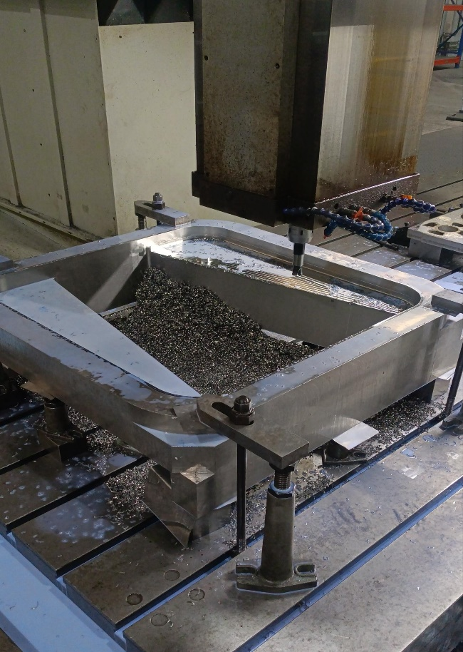
text
Diagnostics
Port Plug Structures manufacturing
Work in progress for Upper Port #4 in ASIPP (China)
a
text
text
5
text

Slide 6
Summary
We appreciate a strong collaboration between IO, DAs and fusion labs across the world
I wish you a successful and fruitful Workshop!
Let’s get started!

