Slide 1
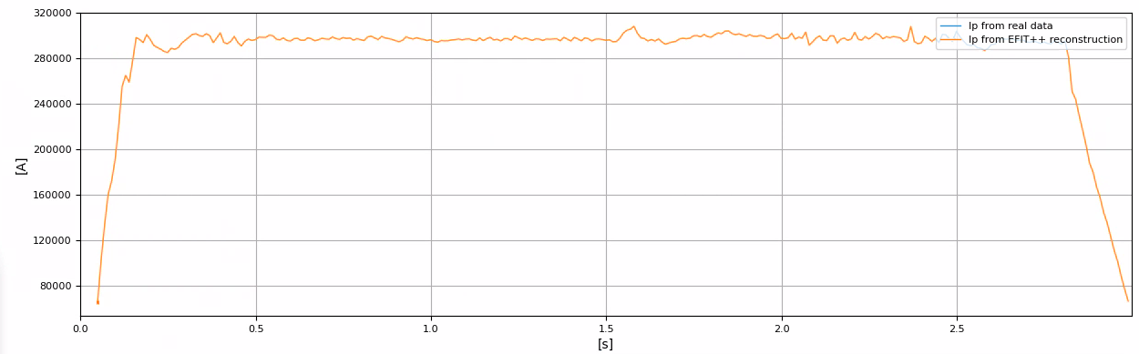
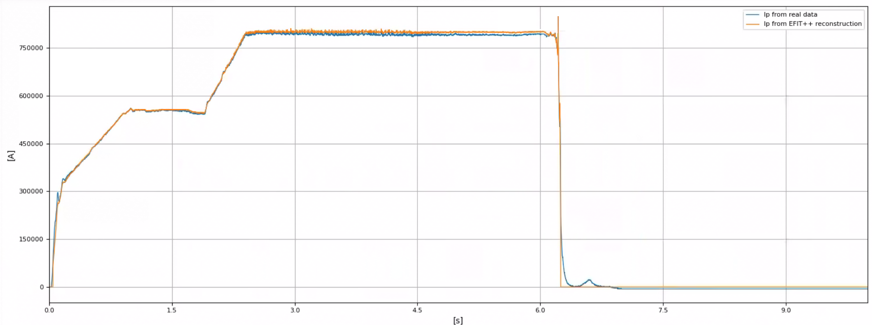
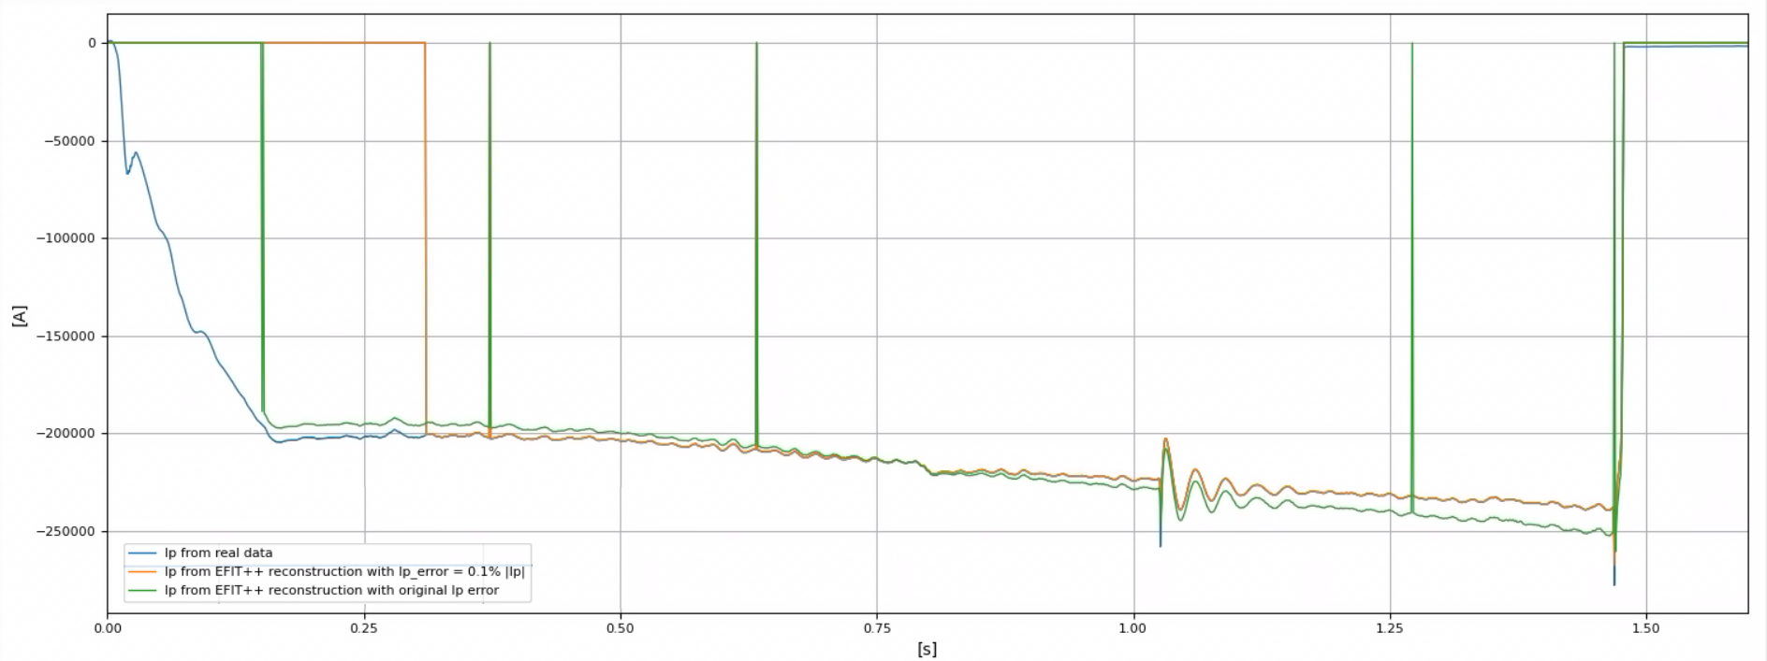
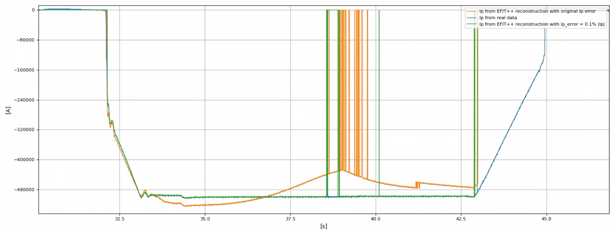
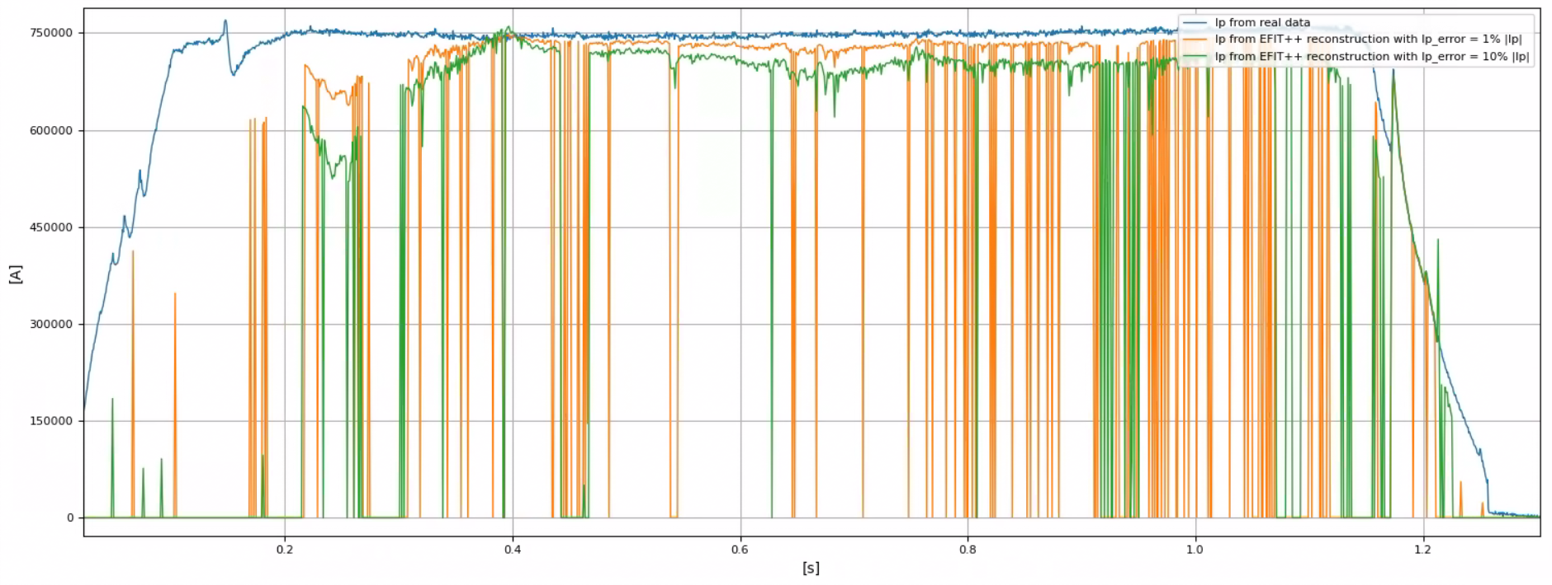
Current status of testing EFIT++ for multiple machines
Success cases:
HL-3 (mapped by SWIP team)
AUG #17151
Cases requiring further testing:
TCV #66441 and #73388
WEST #57410
MASTU #45272
JET #99399 (tested, but poor results)

Slide 2
Input and output from this workshop & further work
Discuss issues with mapped data → EFIT++ can now run directly on new TCV data!
Specify the nodes of the input IDS required by EFIT++
Understand the source of fatal errors and failed convergence for TCV, WEST and MASTU:
  Broken/unreliable structure should be removed
  COCOS version (EFIT++ expects data written in COCOS 11)
  Other factors/parameters
Introduce iron core informations (XML / IDS) → needed for WEST and JET
  Could eventually solve the discrepancy observed for WEST
Run EFIT++ on additional machines (DIII-D, VEST, COMPASS-U)
i.e. using the ideal workflow

