Slide 1
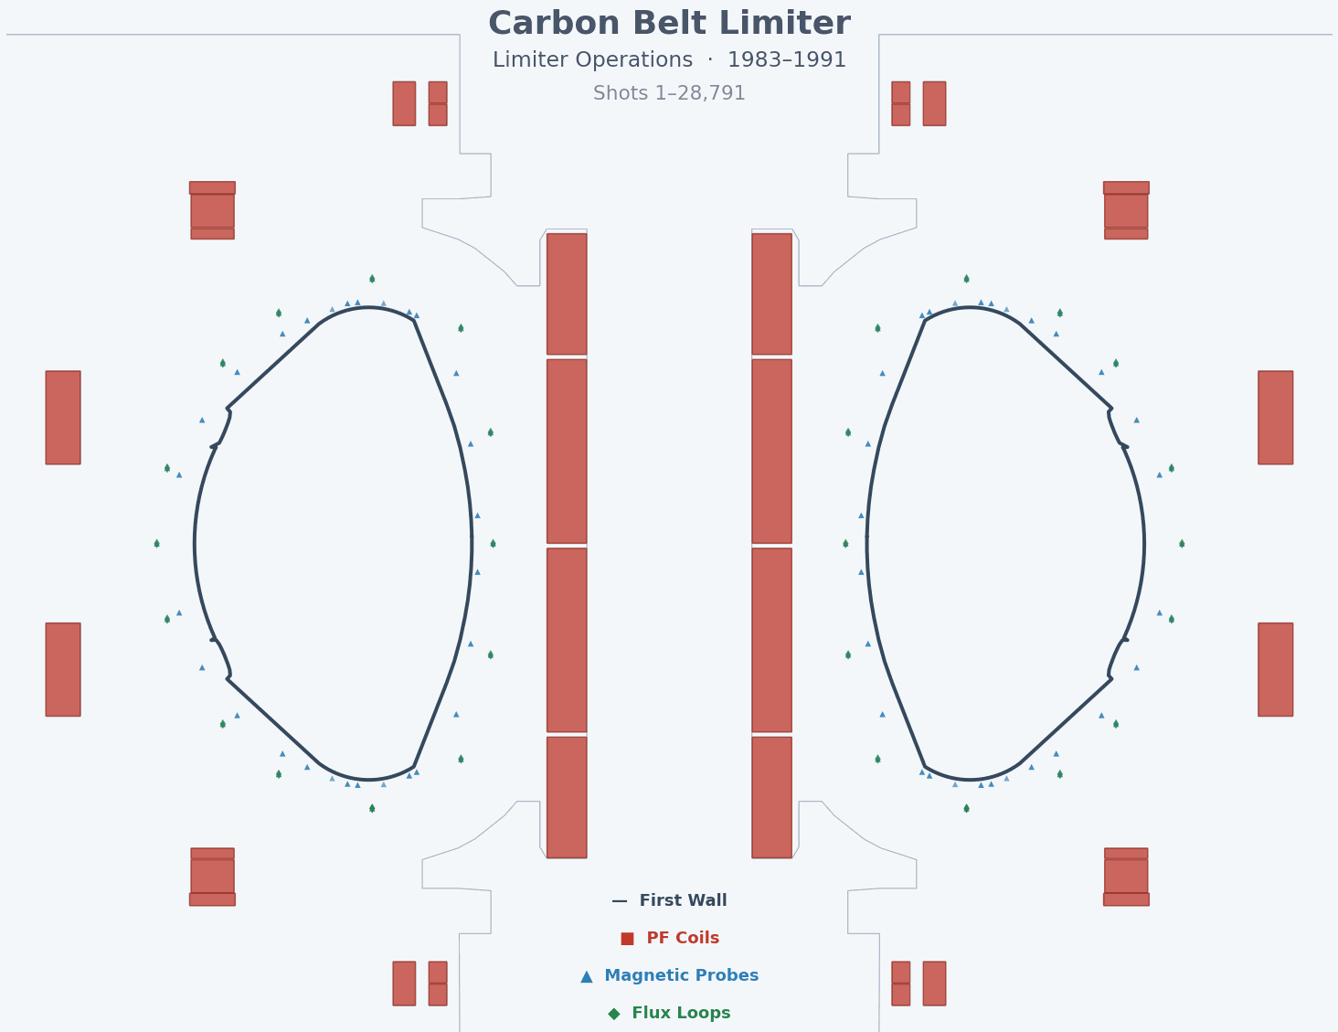

Automating the Discovery and Mapping of Signals with LLM Agents
Simon McIntosh
Simon Pinches
ITER Organization
Tuesday 17th March 2026
Meeting: Workshop for Experimental Data Mapping in IMAS

Slide 2
“Never trust anything that can think for itself if you can't see where it keeps its brain?”
-- Mr Weasley
Notes:
Ginny’s diary, J.K. Rowling’s idea. ‘you would be confiding everything to pages that aren’t inanimate’. Because you can be sure there’s some serious dark magic involved.

Slide 3

Modern frontier LLMs are capable of advanced action-evidence-reasoning loops that eclipse the simple text generators of 2023.
“Write me an ode to bangers and mash in the style of Robert Burns”
ChatGPT 2023
“Discover and validate data access and processing patterns used at TCV”
Claude Opus 4.6 2026
Notes:
GitHub Copilot + Opus 4.6 is VERY good at reading and writing code.

Slide 4
Context window limits prevent single-shot mapping generation.
JET signals
FacilitySignal −[:BELONGS_TO_DIAGNOSTIC]→ Diagnostic 51,472
FacilitySignal −[:DATA_ACCESS]→ DataAccess 46,872
FacilitySignal −[:MEMBER_OF]→ SignalSource 30,284
SignalNode −[:IN_DATA_SOURCE]→ DataSource 6,627
SignalNode −[:INTRODUCED_IN]→ SignalEpoch 6,435
SignalNode −[:MATCHES_SENSOR]→ SignalNode 2,700
IMAS Data Dictionary
IMASNode −[:HAS_PARENT]→ IMASNode 60,334
IMASNode −[:HAS_UNIT]→ Unit 34,680
IMASNode −[:HAS_ERROR]→ IMASNode 31,281
IMASNode −[:HAS_COORDINATE]→ IMASNode 12,805
IMASNode −[:COORDINATE_SAME_AS]→ IMASNode 7,442
IMASNode −[:RENAMED_TO]→ IMASNode 2,696
DDVersion −[:HAS_COCOS]→ COCOS 17

Slide 5
Grounding a model with problem specific context greatly improves its performance.
IMAS-MCP – a collection of search and data retrieval tools for LLMs (April 2025)
  Available at: https://imas-dd.iter.org/mcp
  Facilitates grounded Resource Augmented Generation RAG workflows
  Single DD version
Fusion Metadata Conventions – how we self-describe our data
  Standard Names are a subset of this project.
  Standard Names are clear, concise and unambiguous definitions of a physical or geometric quantity that we attach to our data
Standard Interfaces – how we define machine-code or code-code interfaces
IMAS-Codex – Fusion data Ontology and Mapping (IMAS + TCV + JET)
  Implements a Graph-RAG pattern of hybrid search + graph traversal
  An IMAS-only instance to be published at imas-dd.iter.org at next release

Slide 6
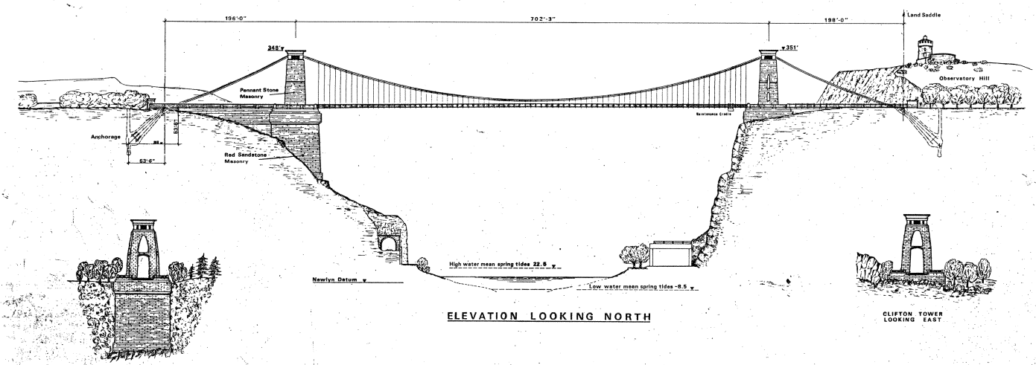
The foundational understanding of both source and target enables the creation of semantic bridges between our data models.
Facility Source
IMAS Target
Embedding models encode meaning within a 256-dimension vector space.
The cosine similarity of a source-target pair provides strong mapping evidence.

Slide 7
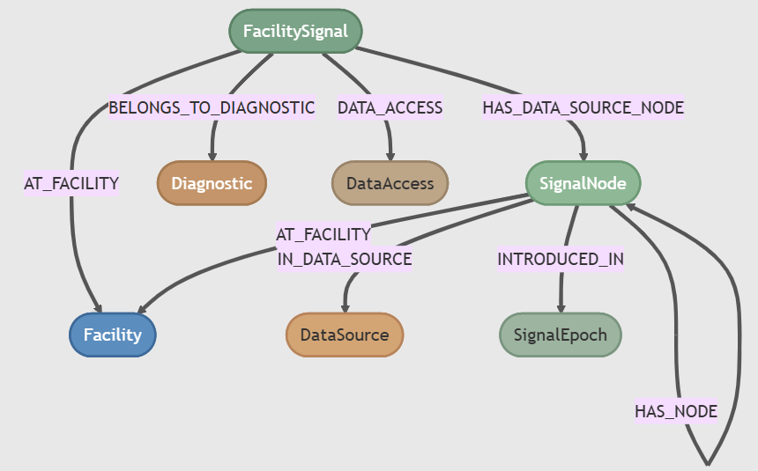
Source facility (meta)data is defined with nodes and relationships.

Slide 8
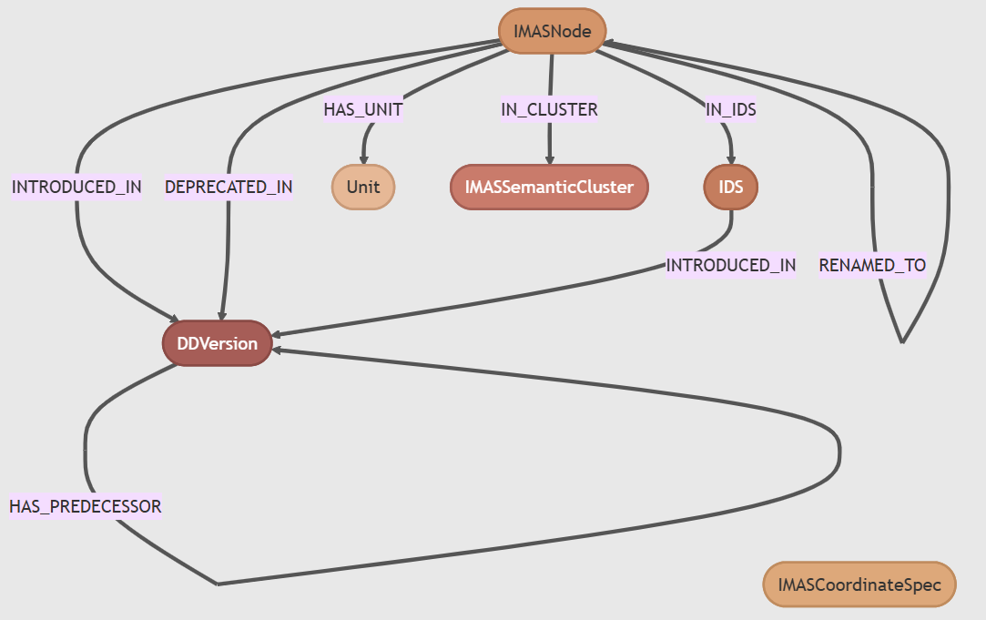
The IMAS target is also graphed with nodes and relationships.
Notes:
Semantic clusters group similar concepts across multiple IDSs in vector space
Graph also links COCOS number to DD version
Graph enables version traversal and multiple epoch – version links

Slide 9
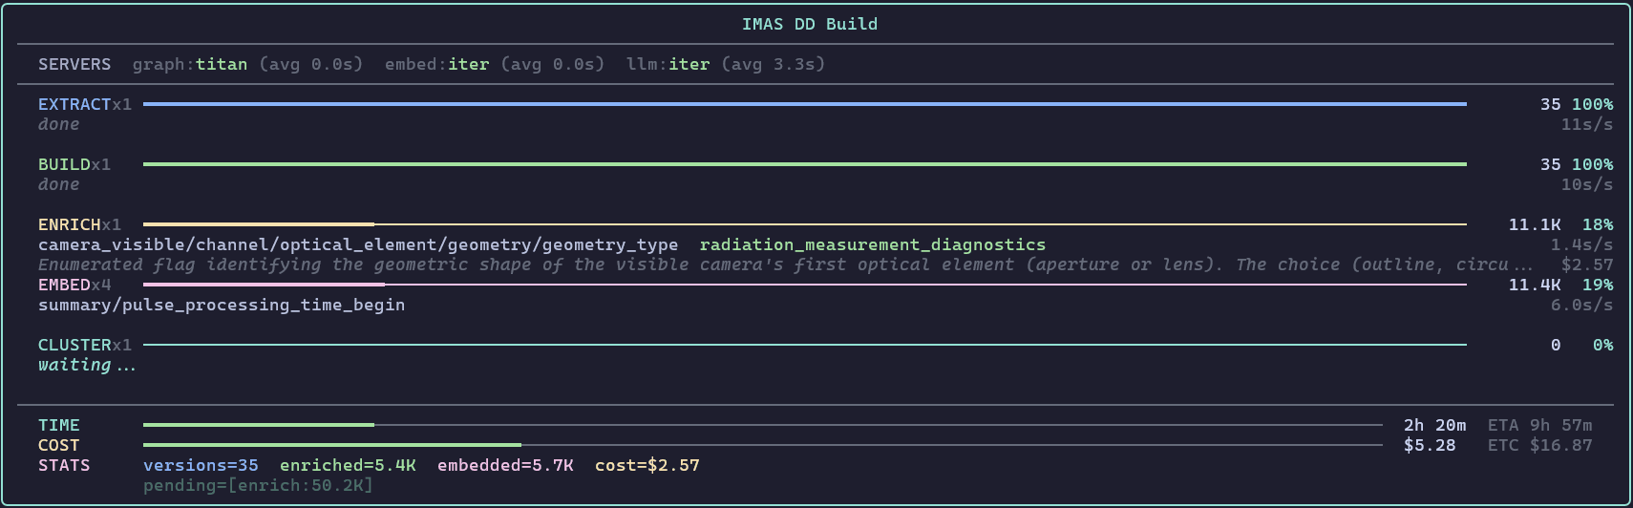
IMAS path documentation requires LLM enrichment (RHS column).
equilibrium/time_slice/boundary_separatrix/strike_point/z
XML: "Height" (6 chars)
LLM: Vertical coordinate (Z) of a strike point where the plasma separatrix intersects a physical wall or divertor plate... essential for heat load analysis, as it determines the location of peak power and particle deposition on plasma-facing components.
equilibrium/time_slice/constraints/ip/measured
XML: "Measured value" (14 chars)
LLM: The 'measured' value of the total plasma current (Ip)... typically sourced from a Rogowski coil. The comparison between this and the 'reconstructed' value is a primary indicator of the equilibrium fit quality. COCOS awareness is required for sign convention.
equilibrium/time_slice/profiles_1d/psi
XML: "Poloidal flux" (13 chars)
LLM (314 chars): Poloidal magnetic flux profile, often the primary radial coordinate in equilibrium analysis. It represents the flux passing through a poloidal surface and is used to define flux surfaces. It is a COCOS-aware quantity where the sign depends on the chosen convention for plasma current and toroidal field directions.
equilibrium/time_slice/profiles_1d/q
XML: "Safety factor" (13 chars)
LLM (299 chars): Safety factor profile (q) representing the ratio of toroidal to poloidal magnetic flux winding. It is a fundamental measure of MHD stability, determining the location of resonant surfaces (e.g., q=1 for sawteeth, q=2 for tearing modes) and the magnetic shear which influences turbulence suppression.

Slide 10
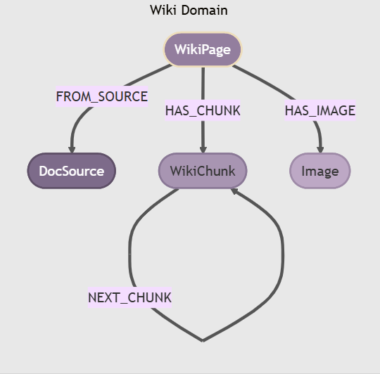
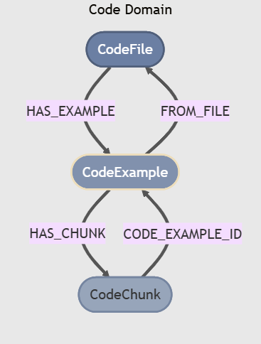
The maps are already present in facility specific data sources
They provide (in)valuable context.
LLM agents bootstrap source discovery – write scripts to populate graph
Notes:
Explain bootstrapping

Slide 11
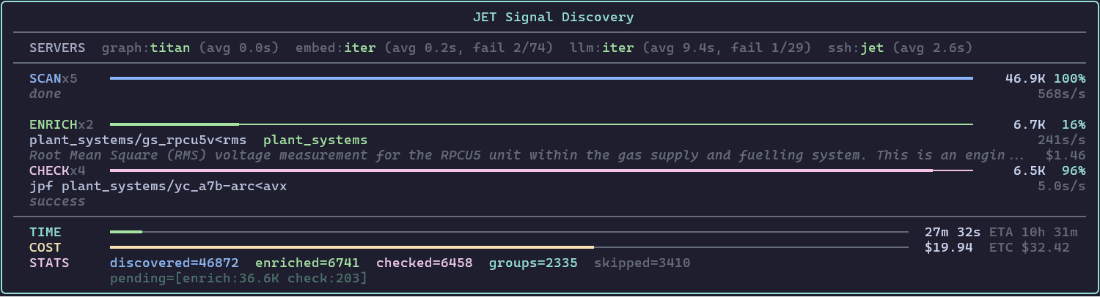
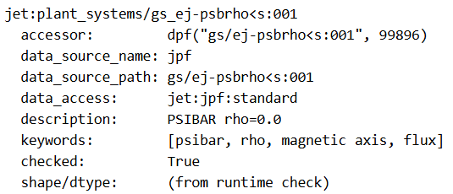
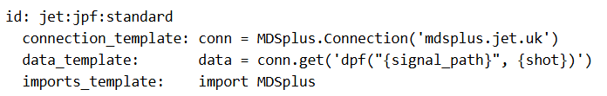
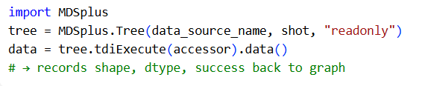
Agents discover signal presence and data access patterns.
Signal node
Data access node
Signal check

Slide 12
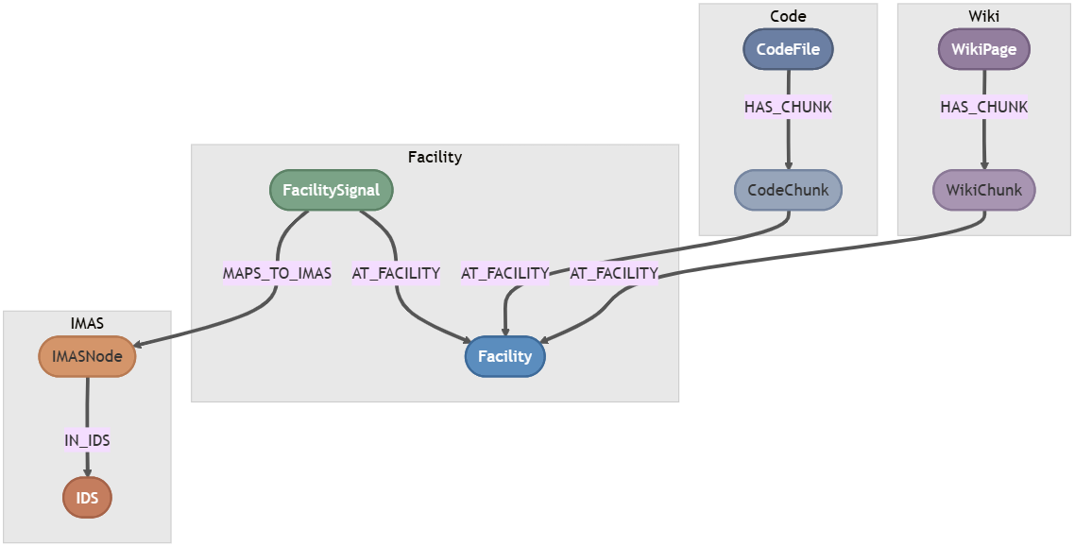
The MAPS-TO relationship links Facility Signals to IMAS Nodes.

Slide 13
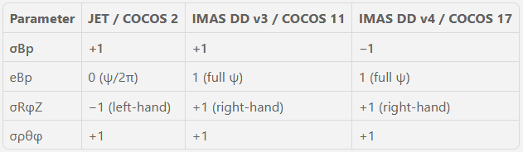
The codex knowledge graph is COCOS aware.
A recent PR completes COCOS psi_like metadata in the Data Dictionary

Slide 14
Mappings are first discovered for common patterns to IMAS nodes
IMAS maps populate high level IMAS nodes and leaf mappings.
An assembly step patterns one-one, one-many, and many-one patterns.
The LLM writes python code to implement mapping specific assembly patterns.
IMASMapping -[:POPULATES]-> IMASNode (STRUCT_ARRAY root)
IMASMapping -[:USES_SIGNAL_SOURCE]-> SignalSource -[:MAPS_TO_IMAS]-> IMASNode (leaf)
dpf("da/c1j-rcNNNt<l") — toroidal pickup coils 6 magnetics/b_field_tor_probe
dpf("da/c2-upNNN") — top coil array 3 magnetics/bpol_probe
dpf("da/c1j-cscmv<ion:NNN") — CSCMV acquisition 6 magnetics/bpol_probe
dpf("da/c1j-rhNNNv") — Hall sensor vertical 6 magnetics/bpol_probe
dpf("da/c1h-hrNNN<dfl") — HR flux loops 3 magnetics/flux_loop
dpf("da/c2e-eflNNN") — internal 45° flux loops 6 magnetics/flux_loop
dpf("da/c2-flNNN<tfe") — poloidal flux loops 3 magnetics/flux_loop

Slide 15
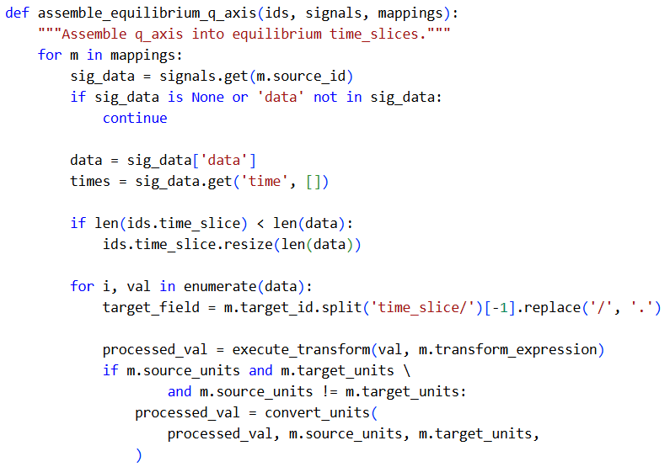
The LLM writes assembly code to build mapped signals into AOS

Slide 16
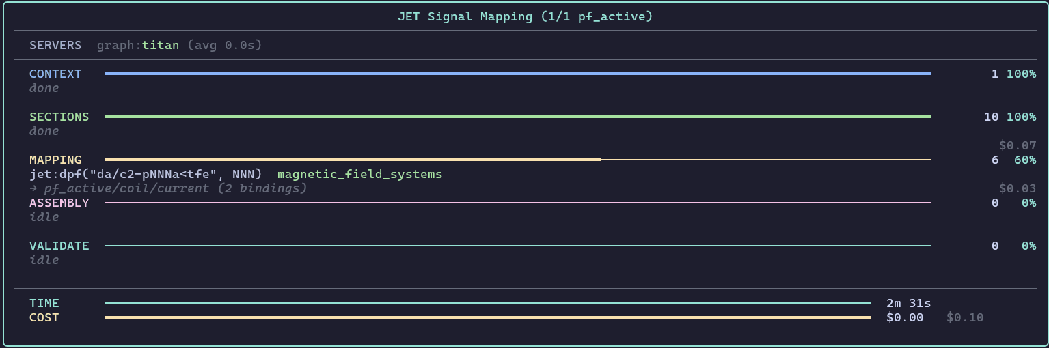
An IMAS mapping pipeline chains 3 LLM calls with context.
Context Capture - Gemini 3 Flash
Map to IMAS – Sonnet 4.6
Singal assembly – Gemini 3 Flash

Slide 17
Leaf maps are LLM generated for each source group.
Dynamic prompts with JINJA templates provide specific context with cached context
dpf("da/c2-ipla:NNN", NNN) equilibrium/time_slice/constraints/ip/measured 0.95 A → A
dpf("gs/ej-psbrho<s:NNN", NNN) equilibrium/time_slice/global_quantities/psi_axis 0.95 Wb → Wb
dpf("gs/ej-qrho<s:NNN", NNN) equilibrium/time_slice/global_quantities/q_axis 0.95 — → 1
ppfdata(NNN, 'KF1', 'PKNNN’) equilibrium/time_slice/boundary/x_point/r 0.95 m → m
dpf("gs/ej-q<s:NNN", NNN) equilibrium/time_slice/constraints/q/measured 0.90 — → 1
dpf("gs/ej-elondn<s:NNN", NNN) equilibrium/time_slice/boundary/elongation_lower 0.90 —
dpf("gs/ej-elonup<s:NNN", NNN) equilibrium/time_slice/boundary/elongation_upper 0.90 —
dpf("gs/ej-tridn<s:NNN", NNN) equilibrium/time_slice/boundary/triangularity_lower 0.90 —
dpf("gs/ej-pp<s:NNN", NNN) equilibrium/time_slice/profiles_1d/dpressure_dpsi 0.85 — → Pa·Wb⁻¹
dpf("gs/ej-zcnter<s:NNN", NNN) equilibrium/time_slice/boundary/geometric_axis/z 0.85 m → m
dpf("gs/ej-triup<s:NNN", NNN) equilibrium/time_slice/boundary/triangularity_upper 0.85 —
dpf("pf/wa-togz<xs:NNN", NNN) equilibrium/time_slice/boundary/gap/z 0.85 m → m
dpf("gs/ej-neerr<s:NNN", NNN) equilibrium/time_slice/constraints/n_e_line/chi_squared 0.82 — → m⁻²

Slide 18
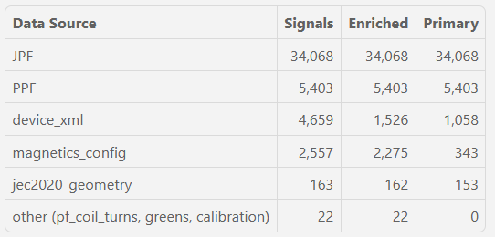
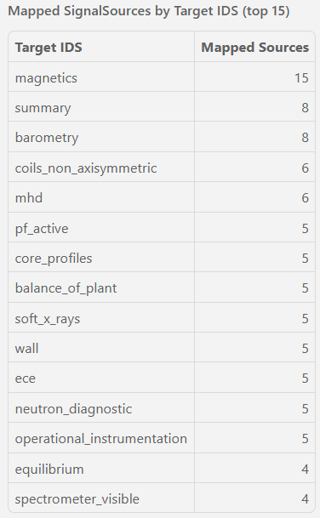
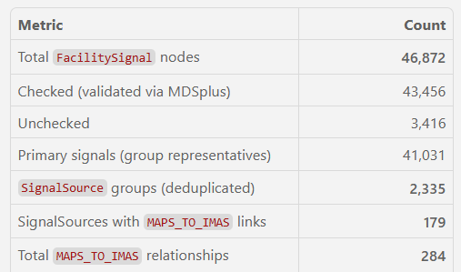
The JET mapping work represents ~ 1 month’s work so far… ~10%
Mapping new Facilities will be quicker with a developed schema
Notes:
These maps are unvalidated. They have not been checked.

Slide 19
In summary we have shown how a combination of discovery LLM agents, static scripts and procedural context enriched LLM calls can
(re)discover data maps targeting the IMAS data model.
Agent as Archaeologist
Data and schema as context
Graph RAG is powerful
Agents are very good at writing code – stop writing code by hand!
Agents should not be used for everything

