Slide 1
IMAS Components Status and Plans
O. Hoenen on behalf of IMAS contributors
ITER Organization

Slide 2

Outline
An overview of available IMAS software, their scope, license and other useful tips:
Physics applications
IMAS Data Dictionary
Supporting tools

Slide 3
Applications
Some physics applications in IMAS (in no particular order)

Slide 4
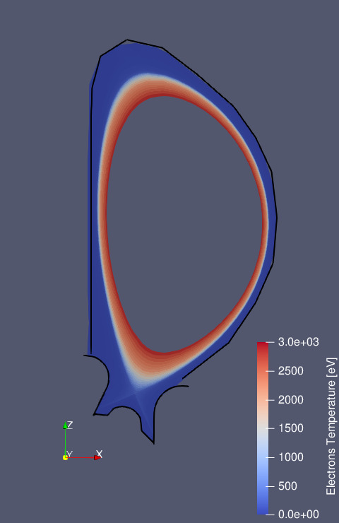
SOLPS-ITER
Scope: plasma edge/SOL modelling
License: EUPL (wide grids version is WIP)
https://github.com/iterorganization/SOLPS-ITER
Composed of several codes
Plasma solver: B2.5 + EIRENE
Case preparation: DivGeo
Grid generation: CARRE
Speaks DD3 and DD4 IMAS: edge_profiles/transport/sources, divertors, radiations, wall
Uses the GGD library to store the mesh in IDS
@ X. Bonnin

Slide 5
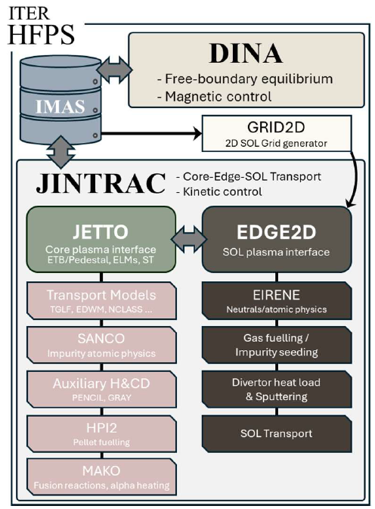

JINTRAC-DINA (HFPS)
Scope: core-edge-SOL transport, sources and stability, plasma wall/target interactions, magnetic/kinetic control
License: open sourcing of JINTRAC + JAMS is WIP
https://github.com/iterorganization/DINA-IMAS (LGPL)
https://git.iter.org/projects/SCEN/repos/jintrac
https://git.iter.org/projects/SCEN/repos/jams
Reads and speaks IMAS (DD 3.42*)
Python workflow, uses MUSCLE3 for coupling JINTRAC models, and iWrap for DINA actors
SDCC: module load JINTRAC JAMS
Install + test ongoing at KSTAR and HL-3
* DINA update from DD 3.39 to 3.42 is WIP
@ F. Casson, H. Kim, F. Koechl, M. Dubrov

Slide 6
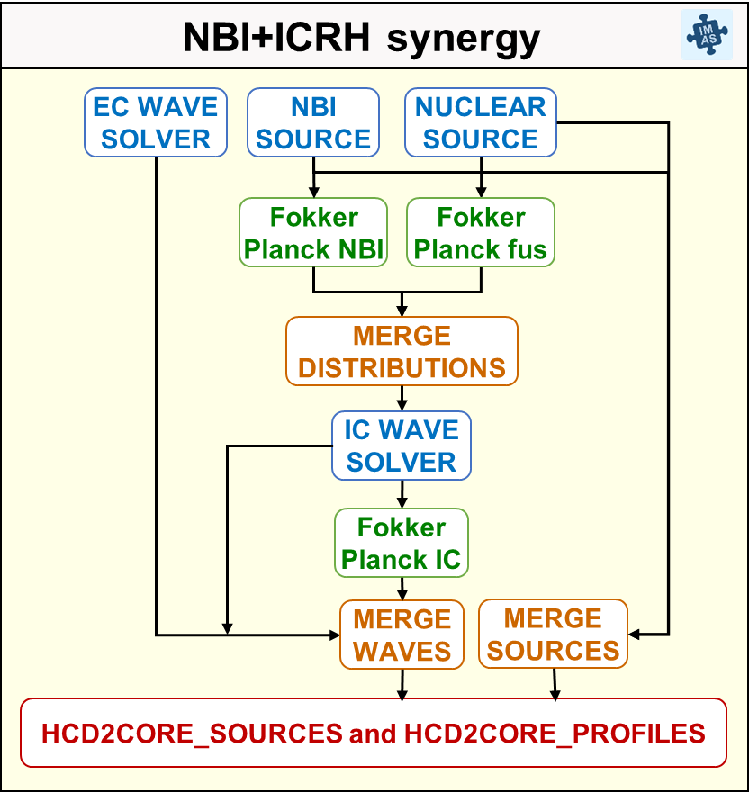
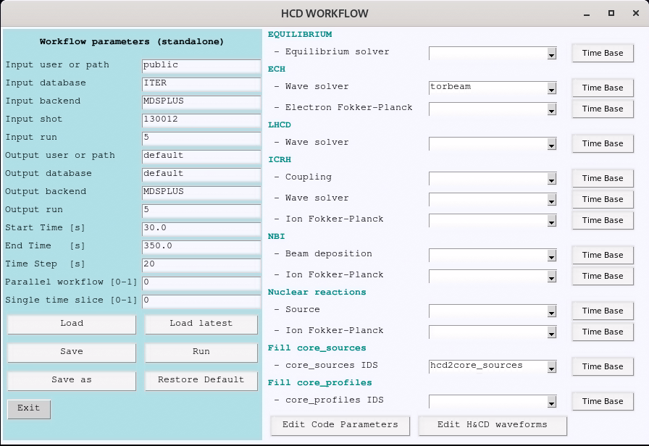
HCD-WF
Scope: models Heating & Current Drive sources
License: LGPL (actors have their own license! *)
https://github.com/iterorganization/HCD-WF
Reads and speaks IMAS (DD 3.42)
Python workflow, uses iWrap Python actors
Coupled to JINTRAC-DINA HFPS
Adaptation to MUSCLE3 and DD 4.1 is WIP
SDCC: module load HCD-WF
Install + in use at WEST, TCV
ECRH: GENRAY, GRAY, GRAYSCALE, TORBEAM, TORAYFOM, RELAX
ICRH: CYRANO, LION, PION, TOMCAT, TORIC, FOPLA, STIXREDIST, ASCOT, SPOT
NBI: BBNBI, NEMO, NBSIM2, RABBIT, ASCOT, SPOT, RISK
Nuclear reactions: AFSI, SPOT, ASCOT
*
@ M. Schneider

Slide 7
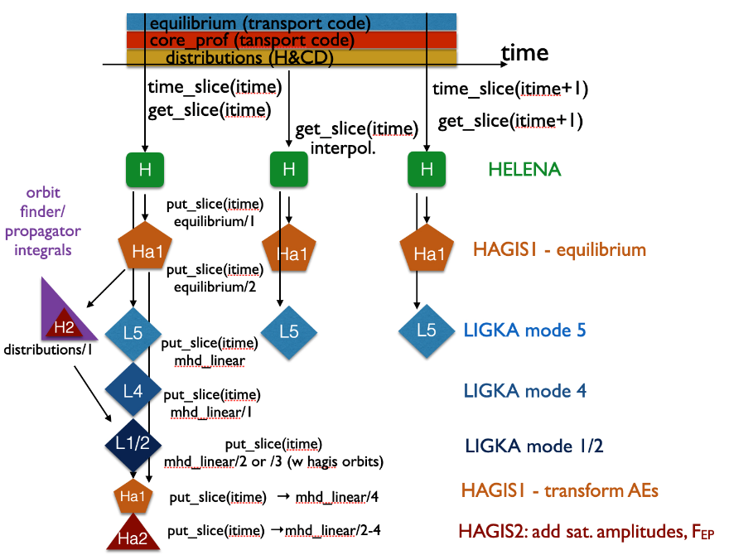
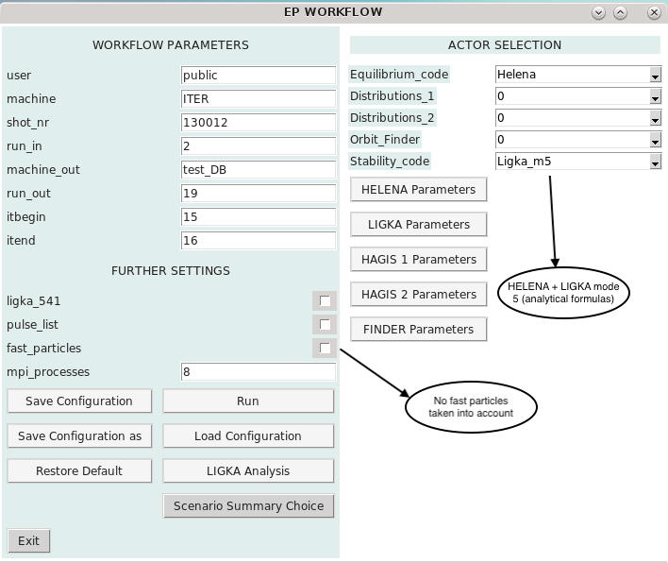
EP-Stability-WF
Scope: models energetic particles stability over time
License: LGPL (actors LIGKA, HELENA, CHEASE, HAGIS have their own license!)
https://github.com/iterorganization/EP-Stability-WF
Reads and speaks IMAS (DD 3.42)
Python workflow, uses iWrap Python actors
EP distributions from EPCoM
SDCC: module load EP-Stability-WF
@ P. Lauber, T. Hayward-Schneider, A. Popa

Slide 8
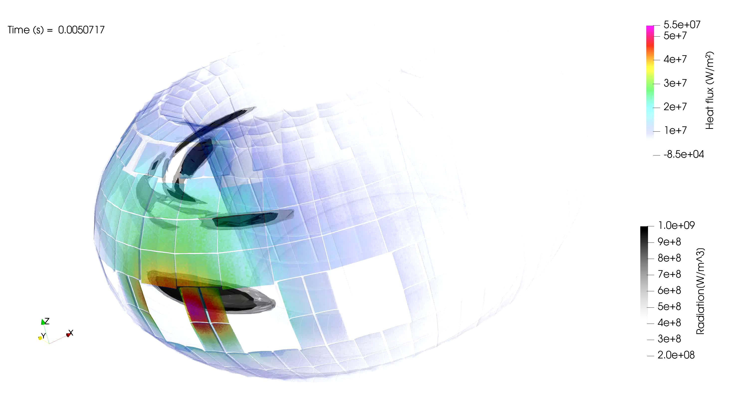
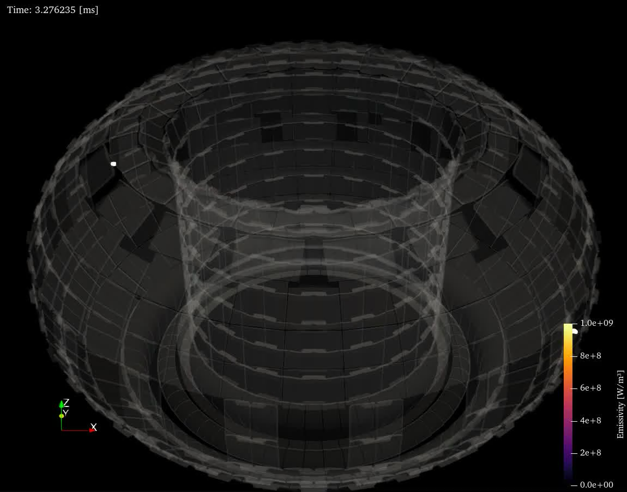

JOREK
Scope: non-linear MHD code to model the physics of disruptions and ELMs in 2D or 3D
License: open sourcing in ongoing!
https://git.iter.org/projects/STAB/repos/jorek
Speaks IMAS (DD 4, plasma_profiles, mhd, radiation IDS)
Coupled with Radiation-Loads-WF (wall IDS)
Coupled with CHERAB-Raysect (bolometer IDS)
With STARWALL and curr2mag (magnetics IDS)
@ J. Artola, K. Munechika, N. Schwartz

Slide 9
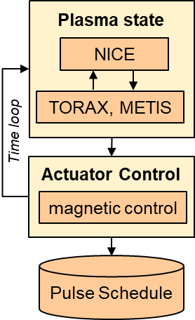
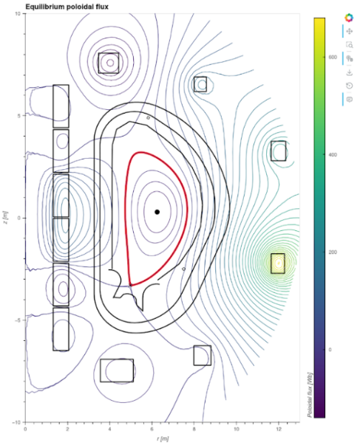
PDS
Scope: Pulse Design Simulator that generates optimal pulse schedule to design scenarios of the ITER Research Plan
License: open sourcing is ongoing!
https://git.iter.org/projects/SCEN/repos/pds
https://gitlab.inria.fr/blfauger/nice (LGPL)
https://github.com/IRFM/METIS (CeCILL-C)
https://github.com/google-deepmind/torax (Apache-2)
Reads and speaks IMAS (DD4)
Coupled with TORBEAM for ECRH modelling
Coupled with PCSSP for NTM control
Uses the Waveform-Editor
@ M. Schneider, JF. Artaud, B. Faugeras, M. Sanders, J. Citrin

Slide 10
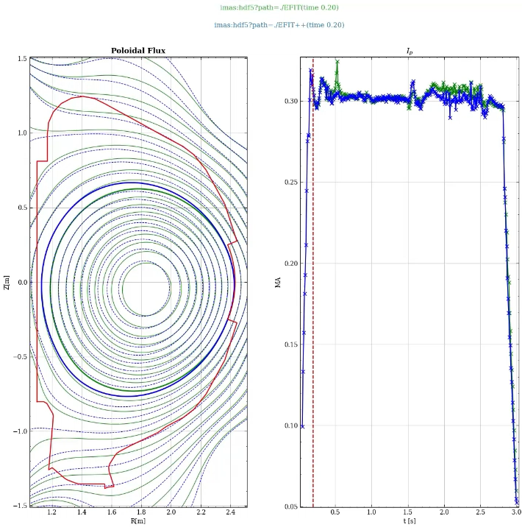
EFIT++
Scope: a free-boundary equilibrium reconstruction
License: open sourcing is ongoing?
https://git.iter.org/projects/EQ/repos/efitpp
Used (not in IMAS) on MAST-U, JET
Reads and speaks IMAS (DD 3.41)
Tested on ITER scenarios with Predict-Magnetics
Demonstrated on HL-3 mapped data
Adding pressure (TS) + pitch angle (MSE) constraints in the IMAS version is tbd.
@ L. Appel, P. Abreu, L. Tauleigne, S.Y. Liu

Slide 11
Data Dictionary
The data model at the core of IMAS and related resources

Slide 12
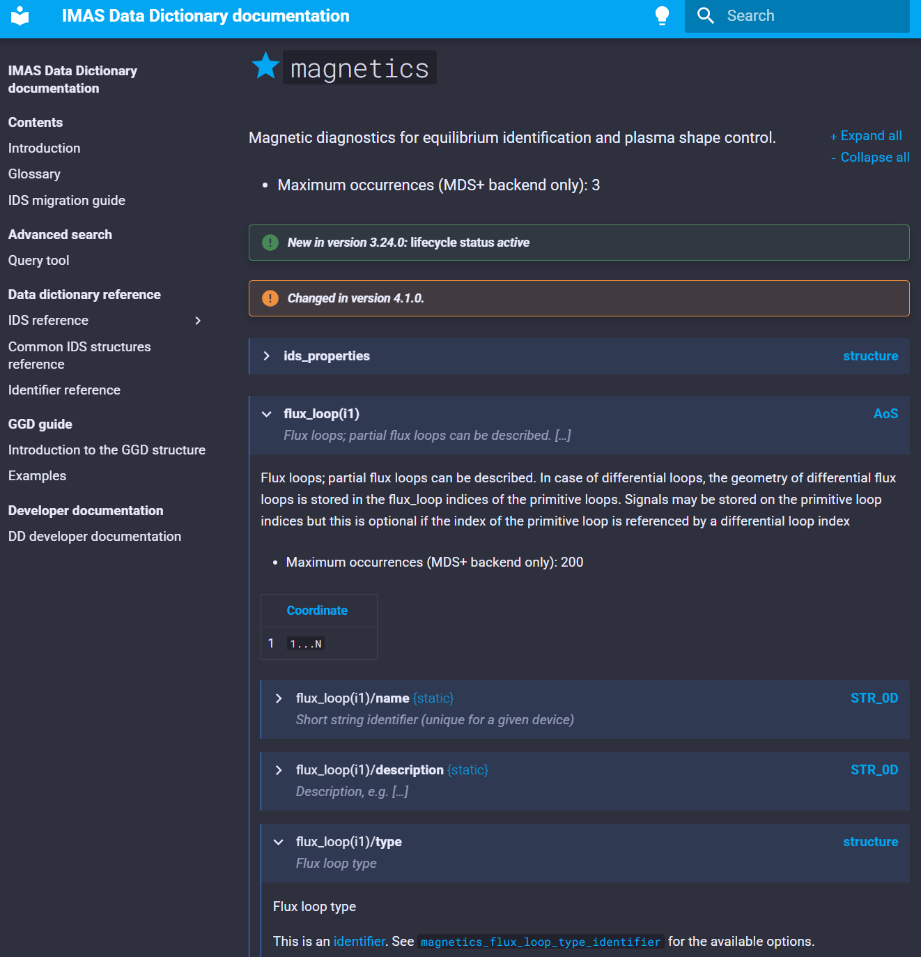
IMAS-Data-Dictionary
Scope: describes standardized physics quantities names, units, coordinates, grouped into IDS hierarchical structures
License: CC-By-ND + LGPL
https://github.com/iterorganization/IMAS-Data-Dictionary
HTML documentation
Features a glossary, a version-migration guide, a GGD guide, search tools
Python packages with XML description
imas-data-dictionary (+ idsinfo CLI tool)
imas-data-dictionaries (all versions)
Open discussions and issues
→ No new features (only fix) in DD3. DD4 removes obsolescent nodes, changes COCOS to 17.

Slide 13
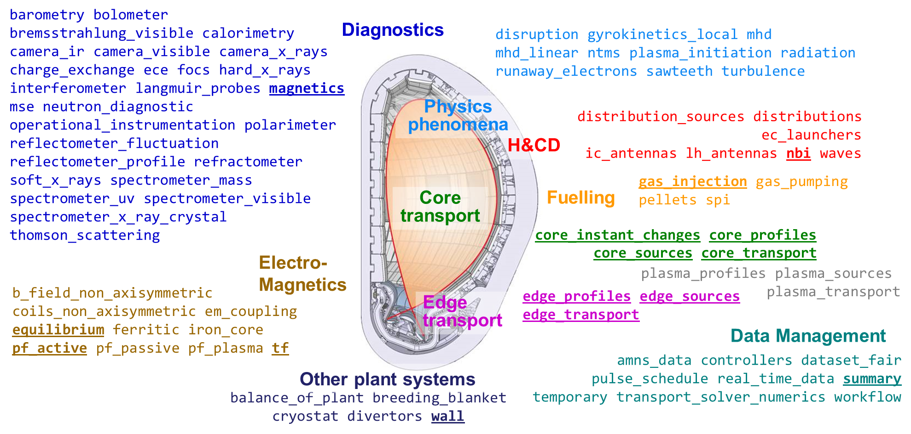
IDS Coverage (4.1)
An active IDS is backward compatible for the duration of a major version
@ F. Imbeaux, S. Pinches, D. Coster

Slide 14

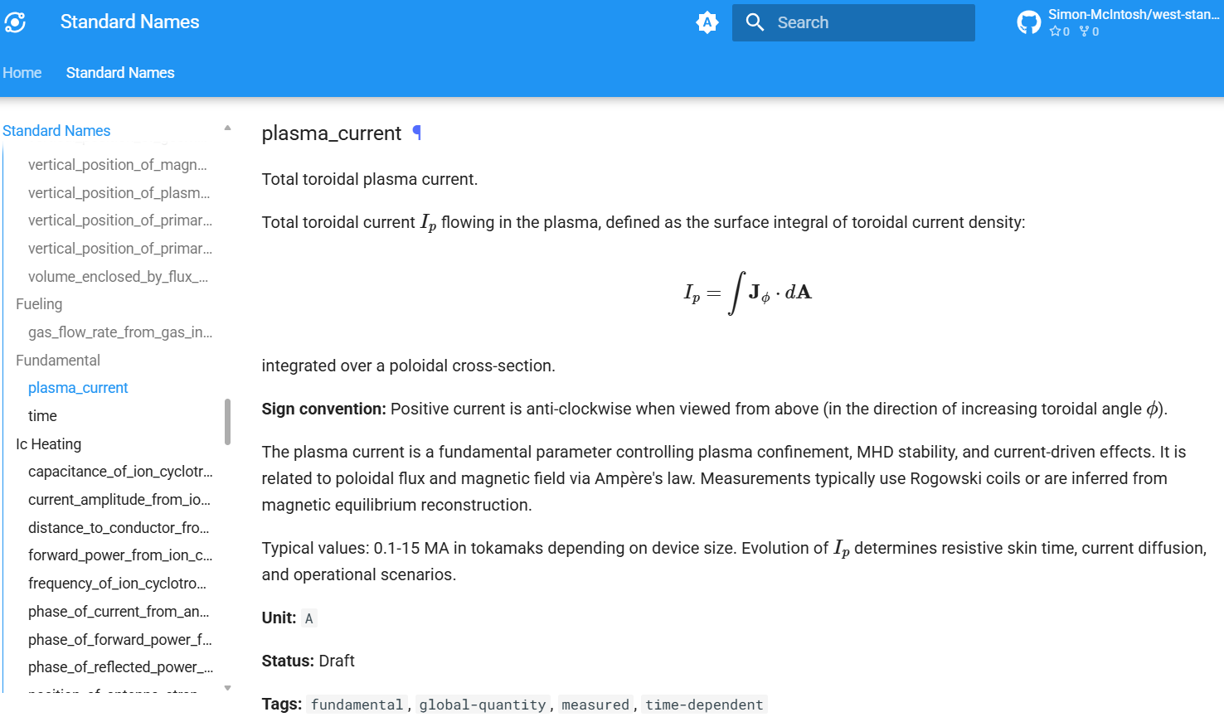
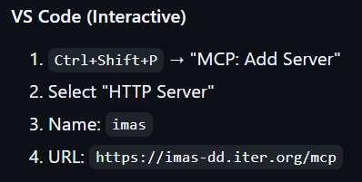

Standard Names and imas-codex
Scope: SN are a set of metadata that describes fusion physics quantities without associating it with a variable name or coordinates (as CF-Conventions). It brings additional semantic to DD and can be used outside of IDS interfaces.
https://github.com/iterorganization/IMAS-Standard-Names
https://github.com/iterorganization/imas-codex
@ S. Mcintosh
SN can be minted with help of LLMs
Current models know little of IMAS
imas-codex is a MCP server that provides IMAS DD context and tools

Slide 15
Supporting tools
Various software that helps application developers and IMAS users

Slide 16
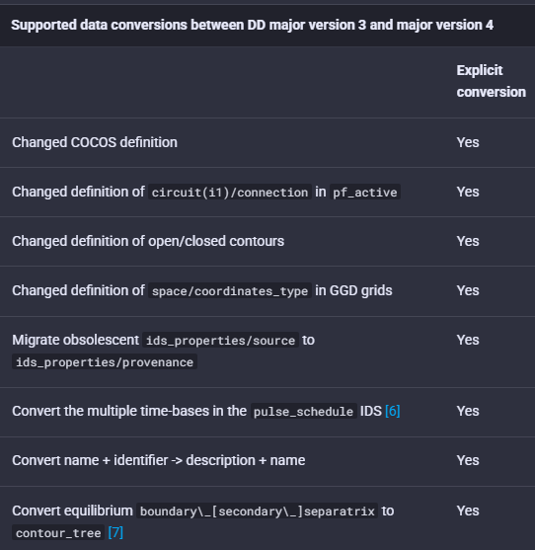
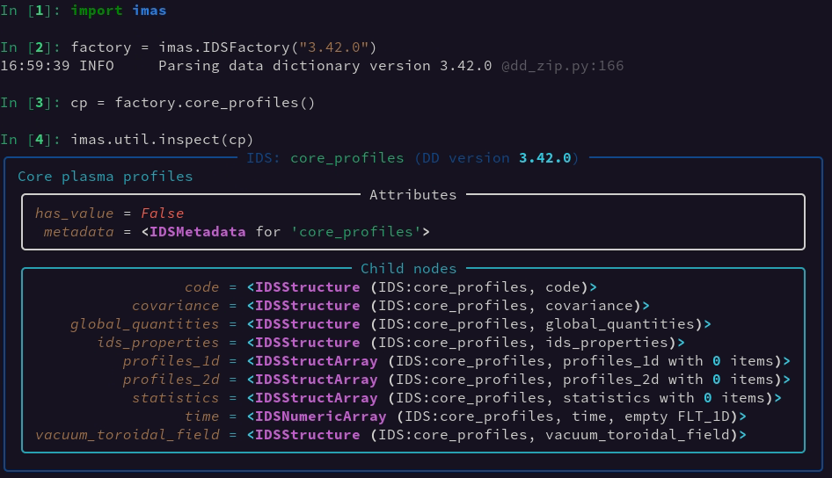
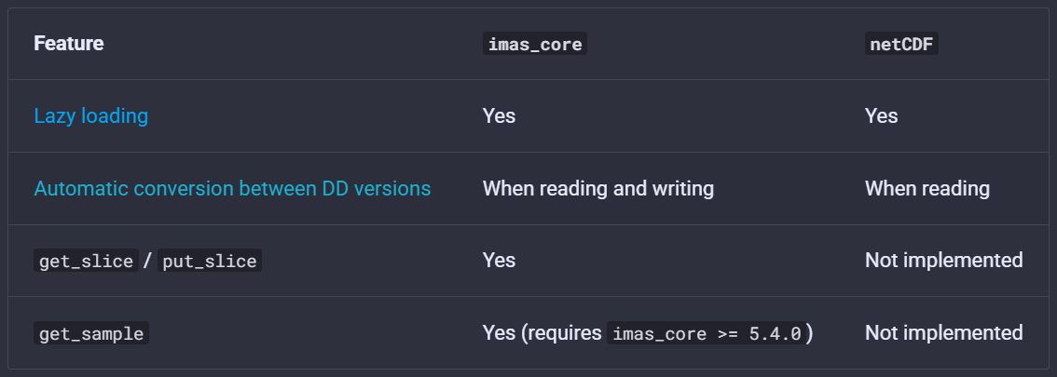
IMAS-Python
Scope: manipulate and R/W access of IDS data in Python
https://github.com/iterorganization/IMAS-Python (LGPL)
https://imas-python.readthedocs.io
https://pypi.org/project/imas-python
Features lazy-loading, full support of IMAS-Core, all DD metadata, DD conversion, netCDF and Xarray support, identifiers API, CLI tools
@ K.v.d. Plassche, D.v. Vugt, M. Sebregts, P. Sawantdesai

Slide 17
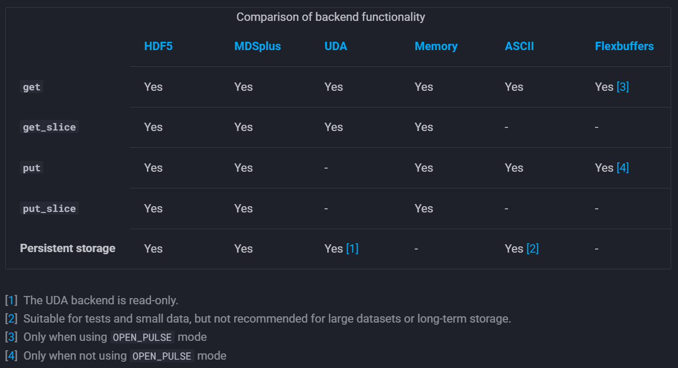
IMAS-Core
Scope: I/O low-level C++ library, abstracts IDS storage from the underlying format, API not expected to be called by end-users
https://github.com/iterorganization/IMAS-Core (LGPL)
https://imas-core.readthedocs.io
https://pypi.org/project/imas-core (Linux*, Windows**, MacOSX-arm**)
Features slicing (linear interpolation) and multiple backends: HDF5, MDSplus, UDA, Memory, ASCII, FlexBuffers
Uses URI API to local data sources imas:[//host/]backend?query
* with all backends except MDSplus
** with all backends except MDSplus and UDA
@ L. Fleury, G. Manduchi, M. Sebregts

Slide 18
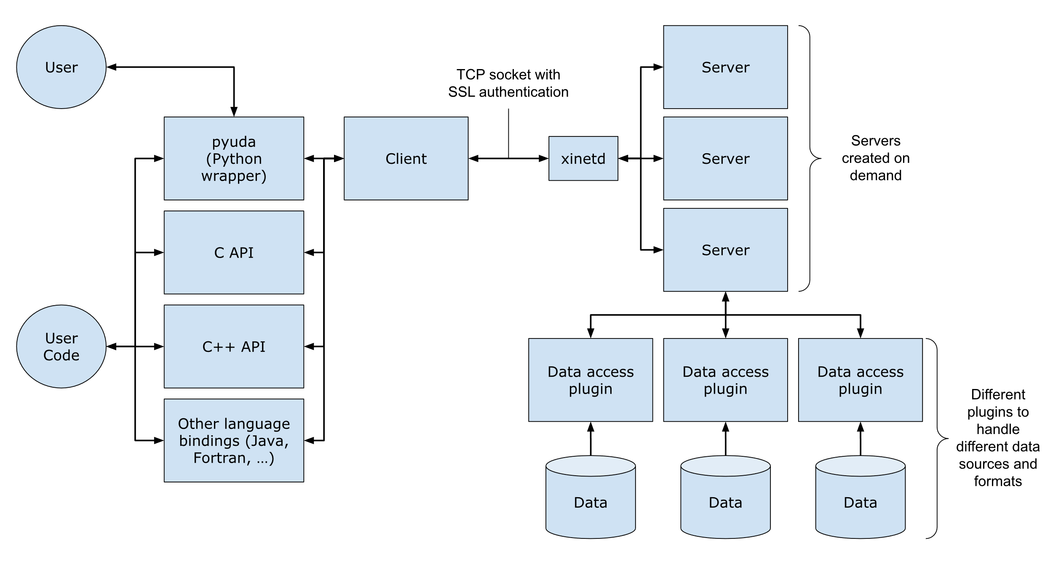
UDA
Scope: a client-server infrastructure to enable the reading and passing of heterogeneous data format back to a client over the network
https://github.com/ukaea/UDA (Apache 2)
https://ukaea.github.io/UDA
Servers can use different plugins
IMAS UDA-Plugins to read IDS
On-the-fly data mappings with the JSON-mapping-plugin
Server for ITER scenarios available at uda.iter.org (how-to reach with PKI certificate)
@ J. Hollocombe, S. Dixon, A. Parker, L. Fleury, D. Maroo

Slide 19

IMAS-Fortran (Cpp/Java/MATLAB)
Scope: manipulate and R/W access of IDS data in Fortran/C++/Java/MATLAB
https://github.com/iterorganization/IMAS-Fortran
https://github.com/iterorganization/IMAS-Cpp
https://github.com/iterorganization/IMAS-Java
https://github.com/iterorganization/IMAS-MATLAB
Code generated from a given DD version
Features full support of IMAS-Core, coordinate checks when writing, improved identifiers API (DD≥4.1)
IMAS-MATLAB soon available as a Toolbox
Release and documentation from GitHub is WIP
@ P. Sawantdesai, D. Maroo

Slide 20
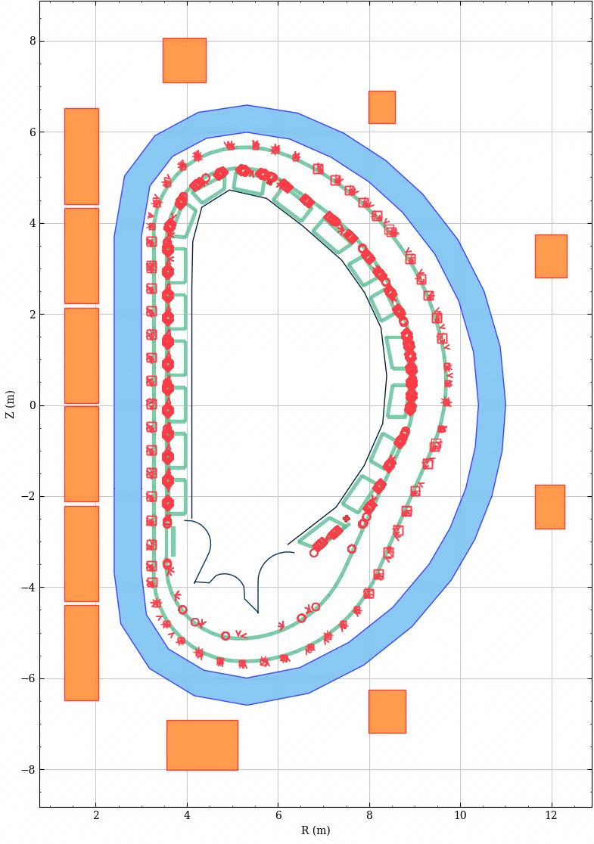
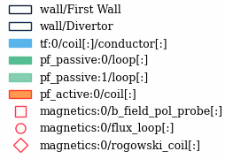
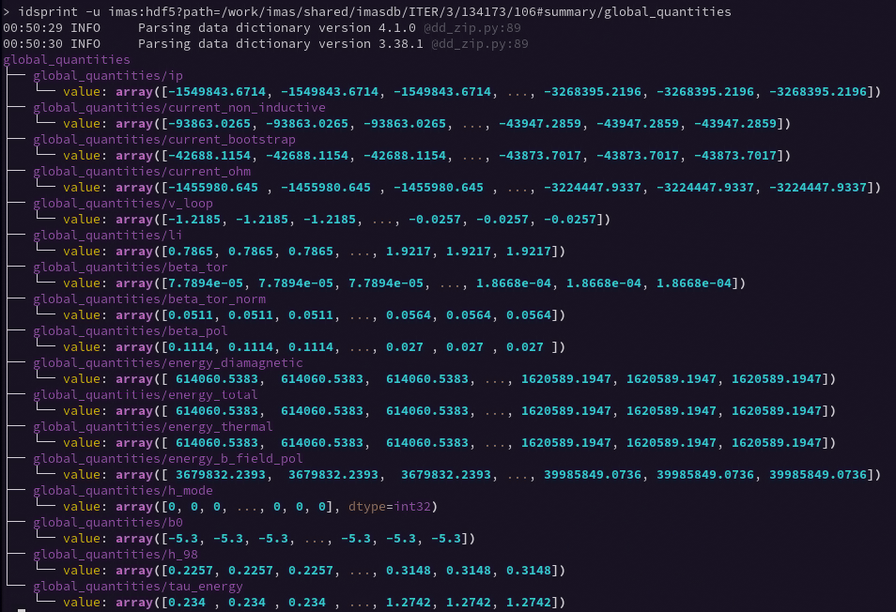
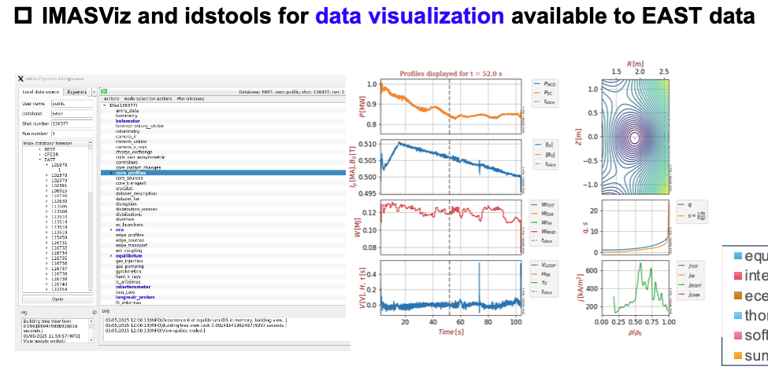
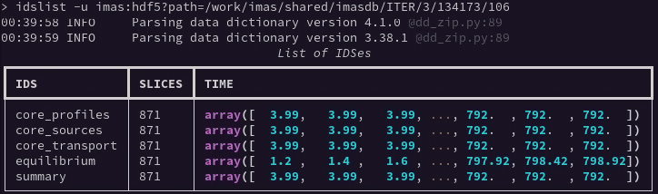
IDStools
Scope: CLI toolbox in Python for quickly plot, explore and manipulate IDS
https://github.com/iterorganization/IDStools (LGPL)
https://imas-idstools.readthedocs.io
https://pypi.org/project/imas-idstools
@ P. Sawantdesai, M. Schneider

Slide 21
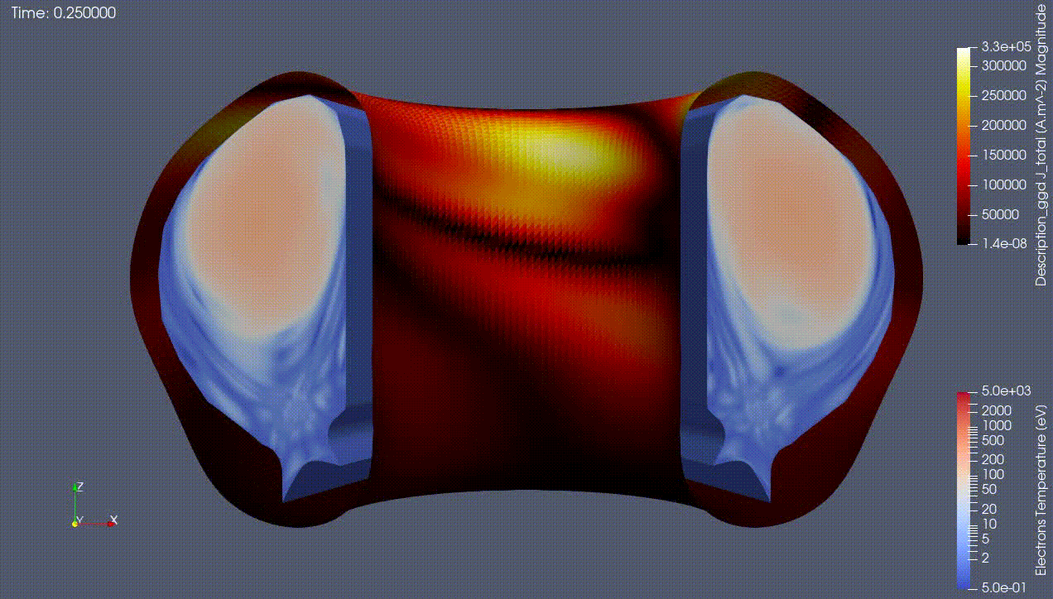
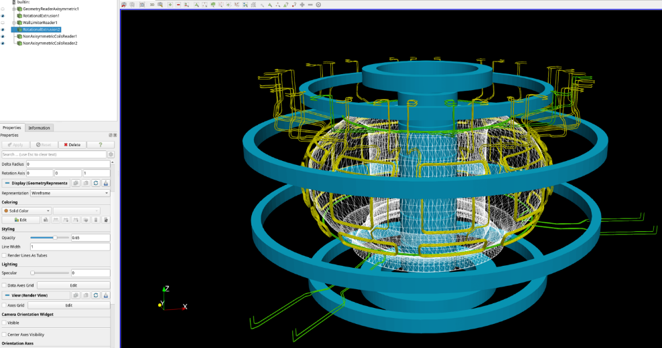
IMAS-ParaView
Scope: a ParaView plugin that convert several IDS data types in VTK, to build complex visualization pipelines in 2D or 3D
https://github.com/iterorganization/IMAS-ParaView
https://imas-paraview.readthedocs.io
https://pypi.org/project/imas-paraview
Features various readers and filter
GGD, JOREK (Bezier FEM)
MD (LoS, beam, position, wall, axisymmetric geometry, non-axisymmetric coils)
1D/2D profiles, time trace
CLI tool to convert GGD ↔ VTK ggd2vtk imas:hdf5?path=./db#mhd output_dir
@ P. Abreu, D.v. Vugt, S. Blockhuizen, M. Sebregts

Slide 22
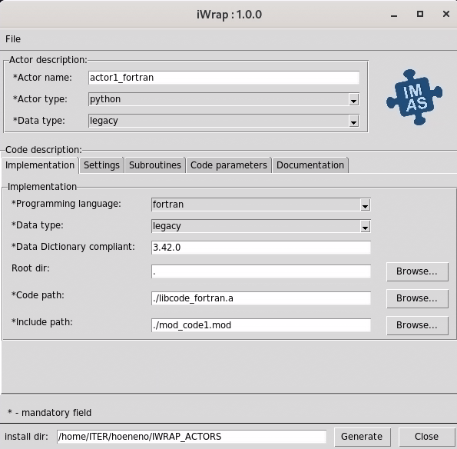
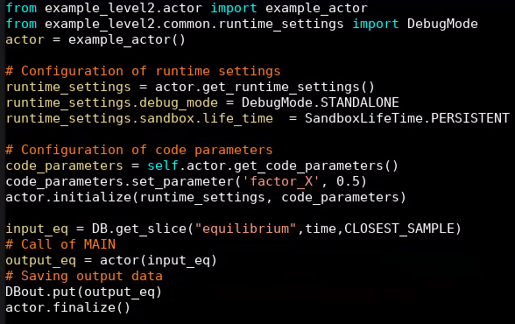

iWrap
Scope: generate standardized IMAS Python actors from Fortran/C++/Java codes, for rapid prototyping of workflows (imperative)
https://github.com/iterorganization/iWrap (LGPL)
Features native code description via a GUI (or Yaml), code specific parameters (XML), call from the library or standalone exec
Can generate simple MUSCLE3 actors in Python, C++ and Fortran
V2 is WIP and will use IMAS-Python API and integrate the MUSCLE3 plugin
@ B. Palak, J. Wasik, P. Sawantdesai

Slide 23
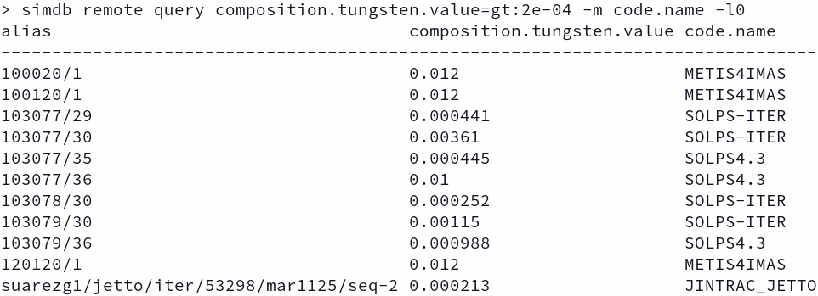
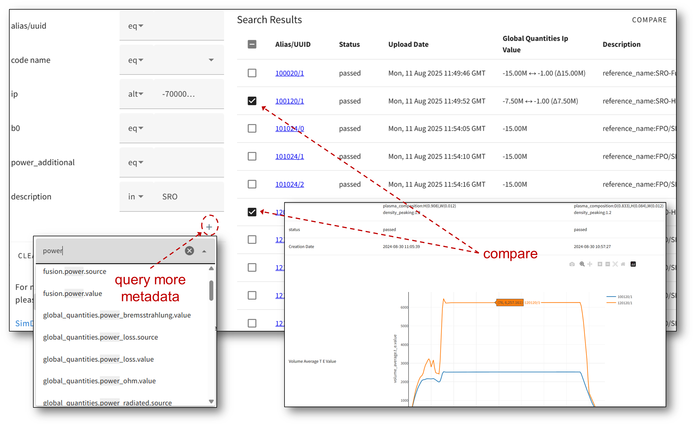
SimDB
Scope: a client-server infrastructure to catalogue and search IMAS simulations
https://github.com/iterorganization/SimDB (LGPL)
https://simdb.readthedocs.io
https://pypi.org/project/imas-simdb
Features a CLI client to ingest/list/query simulations, push/pull from remote
Track simulation inputs + outputs
Queries metadata based on summary IDS (DD4) are automatically collected
Web frontend with SimDB-Dashboard
ITER scenarios at simdb.iter.org
@ J. Hollocombe, D. Maroo, Y. de Jong

Slide 24
Wrap up
Most IMAS tools are now open-source
Available tools covers a wide range of needs
These slides will help finding relevant tools, until IMAS-tutorial improves
Applications are being open-sourced, takes time as BIP are scattered
Training may be available in the documentation of each tool
Find other IMAS software by searching for #fusion #imas

Slide 25

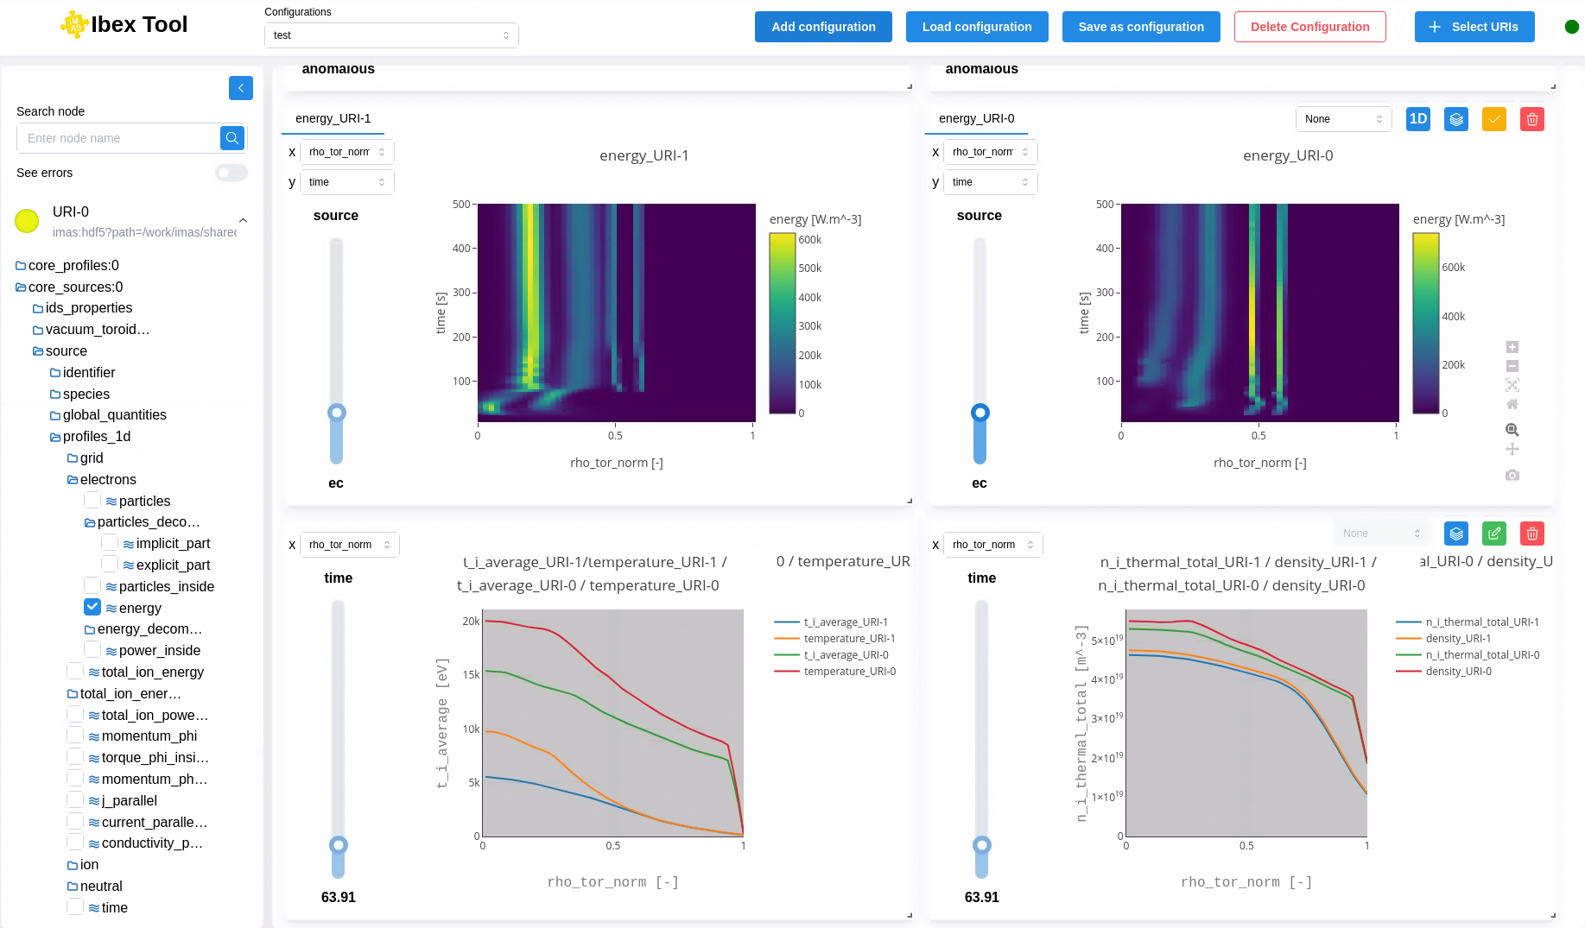

IBEX
A new generic data exploration and visualization tool (replace Viz)
React/JS frontend (towards web app)
Python backend
Compose plot canvas
Render raw, 1D, 2D
Slice in nD array
Explore IDS structure
Geometric features (MD)
Operations on data (normalizing, smoothing, filtering, denoising, offset…)
→ Release end 2025

Slide 26
IMAS-Validator

Slide 27
Waveform-Editor

Slide 28
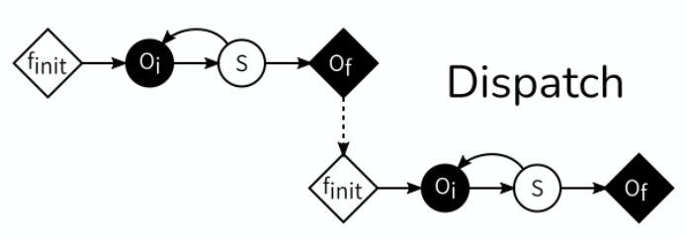
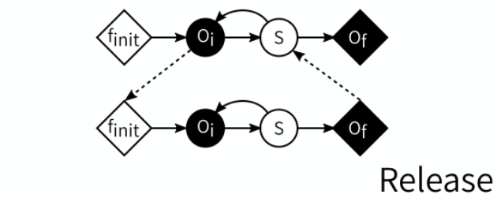


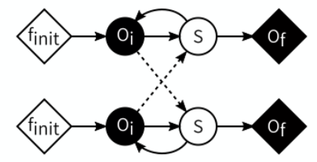
MUSCLE3
Scope: declarative code coupling for multiscale models, using P2P messages
https://github.com/multiscale/muscle3 (Apache 2)
https://muscle3.readthedocs.io
https://github.com/iterorganization/IMAS-MUSCLE3
f_{init} | model initialization step
O_{i} | intermediate state observation
S | state update (timestep)
O_{f} | final state observation (end of time scale)
MMSF theory
A model is described by a Submodel Execution Loop
And a scale separation map (time & space)
It defines a set of 3 possible coupling templates that are sufficient to describe all multiscale models
MUSCLE3 library provide an API
That provide port operators f_{init}, O_{i}, S and O_{f}
To detect the end of a submodel, to deal with its multiplicity…
More info: and
@ L. Veen, D. van Vugt, M. Sebregts

