Slide 1
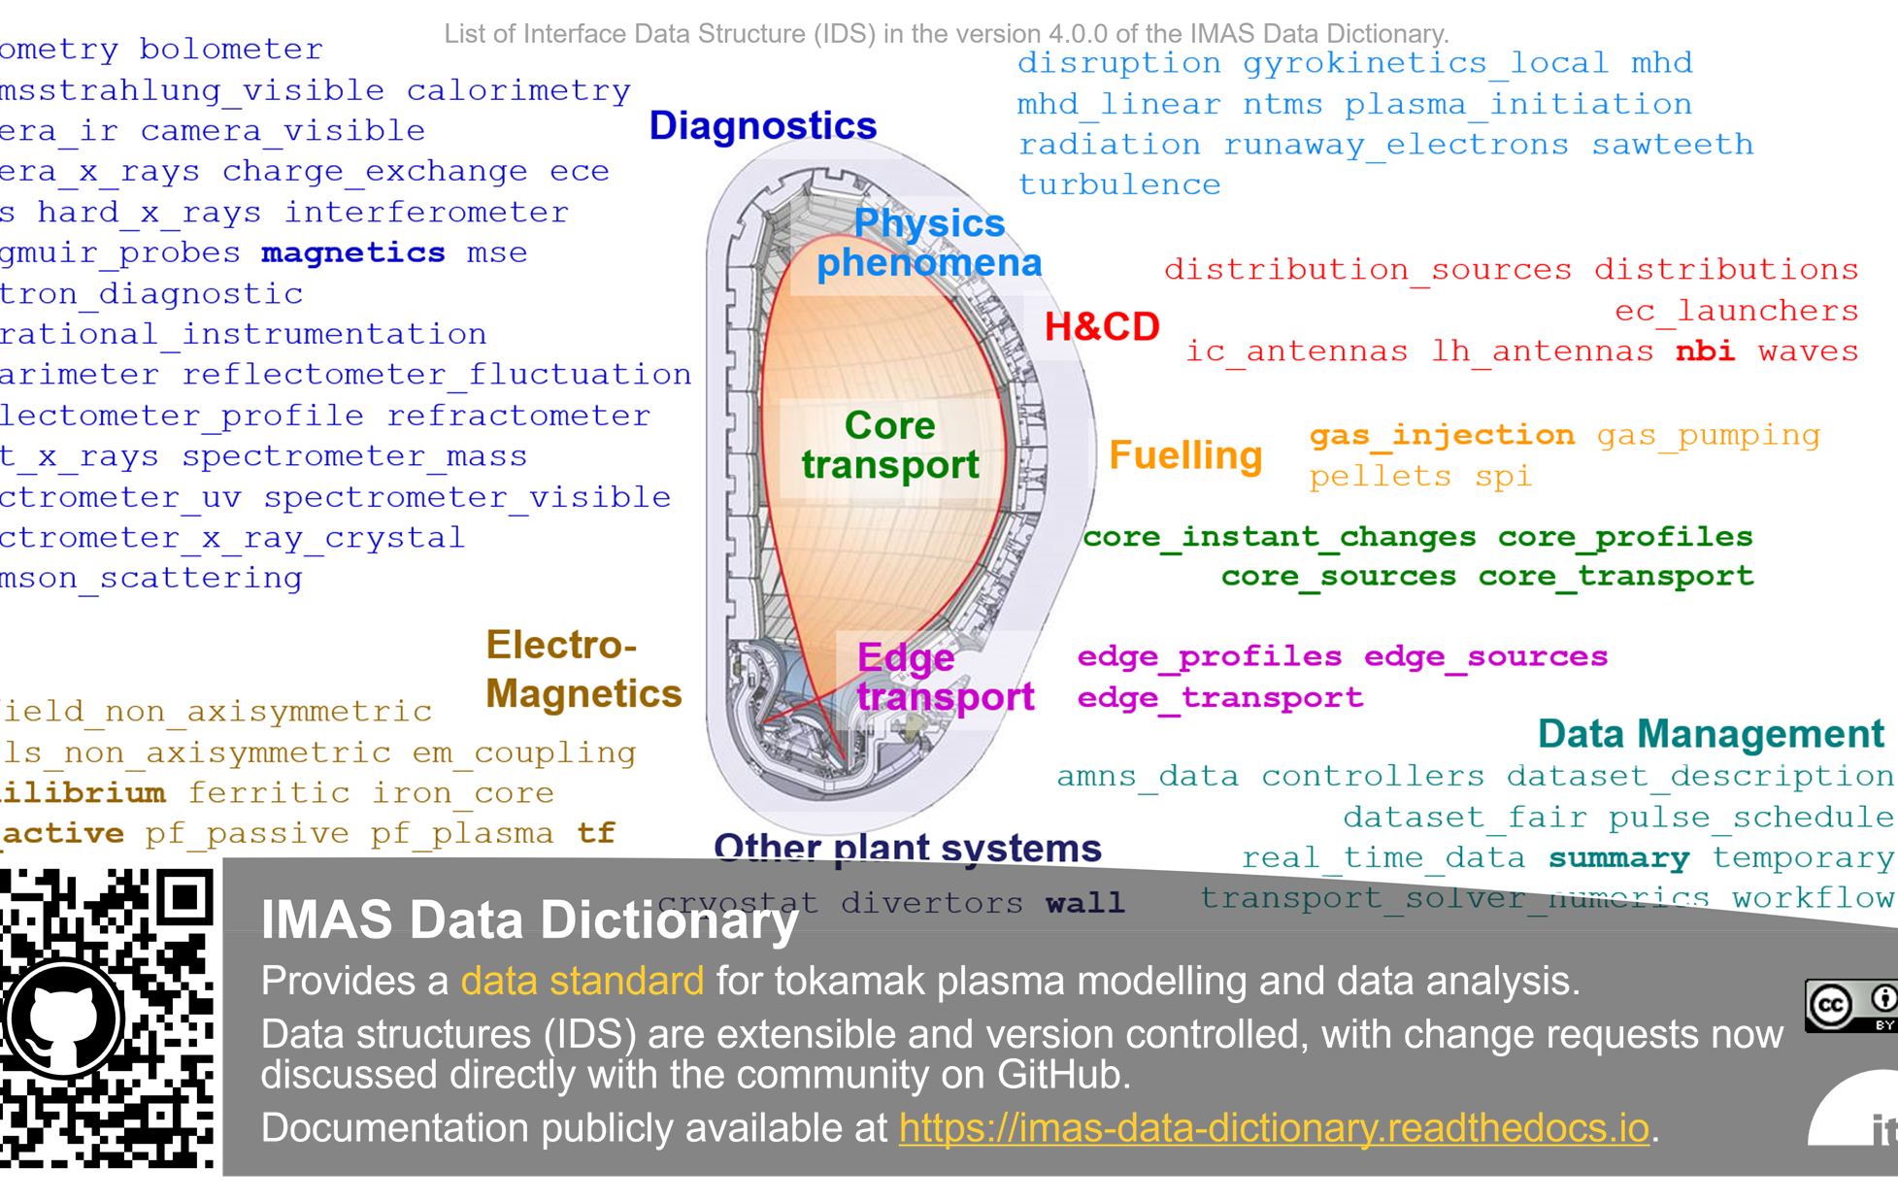
IDS data mapping for TCV
M. Marin
L. Simons
C. Yildiz
O. Sauter
IT team
DMP project
Status and plans

Slide 2
TCV data mapping general information
Device name: TCV
Native data format/data access library: mds trees, retrieved with gdat libraries
Contact persons (name + email) for IMAS / Data mapping: Michele Marin, michele.marin@epfl.ch (tmp)
How the mapping is done (manually, via tools/scripts, hard-coded vs mapping file…): tcv2ids2database, using gdat matlab functions
Pulses (or ranges of) being mapped: On request
Applications that are using the mapped IMAS data: Integrated modelling, soon equilibrium
Data access policy (contact + collaboration + possibility to share test data): Sharing data is possible when for a few discharges. Published discharges preferable
Plans over the coming year: Maintenance, bug corrections, extension of the mapping (on request)
~1000 summary with UDA, more info in https://spcwiki.epfl.ch/wiki/IMAS#TCV_data_from_remote

Slide 3
A large number of IDSs has already been mapped
Partial mapping available for
Bolometer
charge_exchange
core_profiles
core_transport
core_sources
ec_launchers
equilibrium
interferometer
magnetics
nbi
pf_active
pf_passive
pulse_schedule
soft_x_rays
summary
thomson_scattering
tf
wall

Slide 4
Single command extracts data for any discharge
[ids_from_tcv]=tcv2ids2database(59151,0001,'imas_backend','HDF5','ids_names',{'core_profiles','equilibrium','core_sources','nbi','ec_launchers'}, 'time_out', time_out)
tcv2ids
tcv2ids
ids2database
ids2database
Limited customizability
Homogeneous data
TCV keeps control of what is extracted
ASTRA runs
Matlab IDS structure
Hdf5 file
mds native libraries
gdat libraries
Matlab-imas-core
tcv_ids_get_equilibrium.m
...

Slide 5
IMASsification of codes mostly not in house
HFPS
RAPTOR (minimal)
ASTRA (minimal)
SOLPS-ITER
GBS (in progress)
MEQ (in progress)

Slide 6
Plans
Maintenance, bug corrections, extension of the mapping (on request)
Map to DD4
Integration with DEFUSE, python version of the mapping. Capabilities will be maintained
Discussions about data shareability. Need to gathering the contractual constraints possibly imposed by our funding entities (EPFL, SNF, Eurofusion, F4E, ITER, etc)

Slide 7
Fixed a few problems with the TCV data
Properly add interferometer data, add errorbar
Bugfix on the interpolation of 2D psi data
Correction on negative Thomson data
Correction on plasma current error, pf_passive (placeholder)
UDA coupling
EFIT++ coupling
JET data through UDA obtained in the gateway

