Slide 1
Learned from IMAS Data Mapping workshop
EAST Team

Slide 2
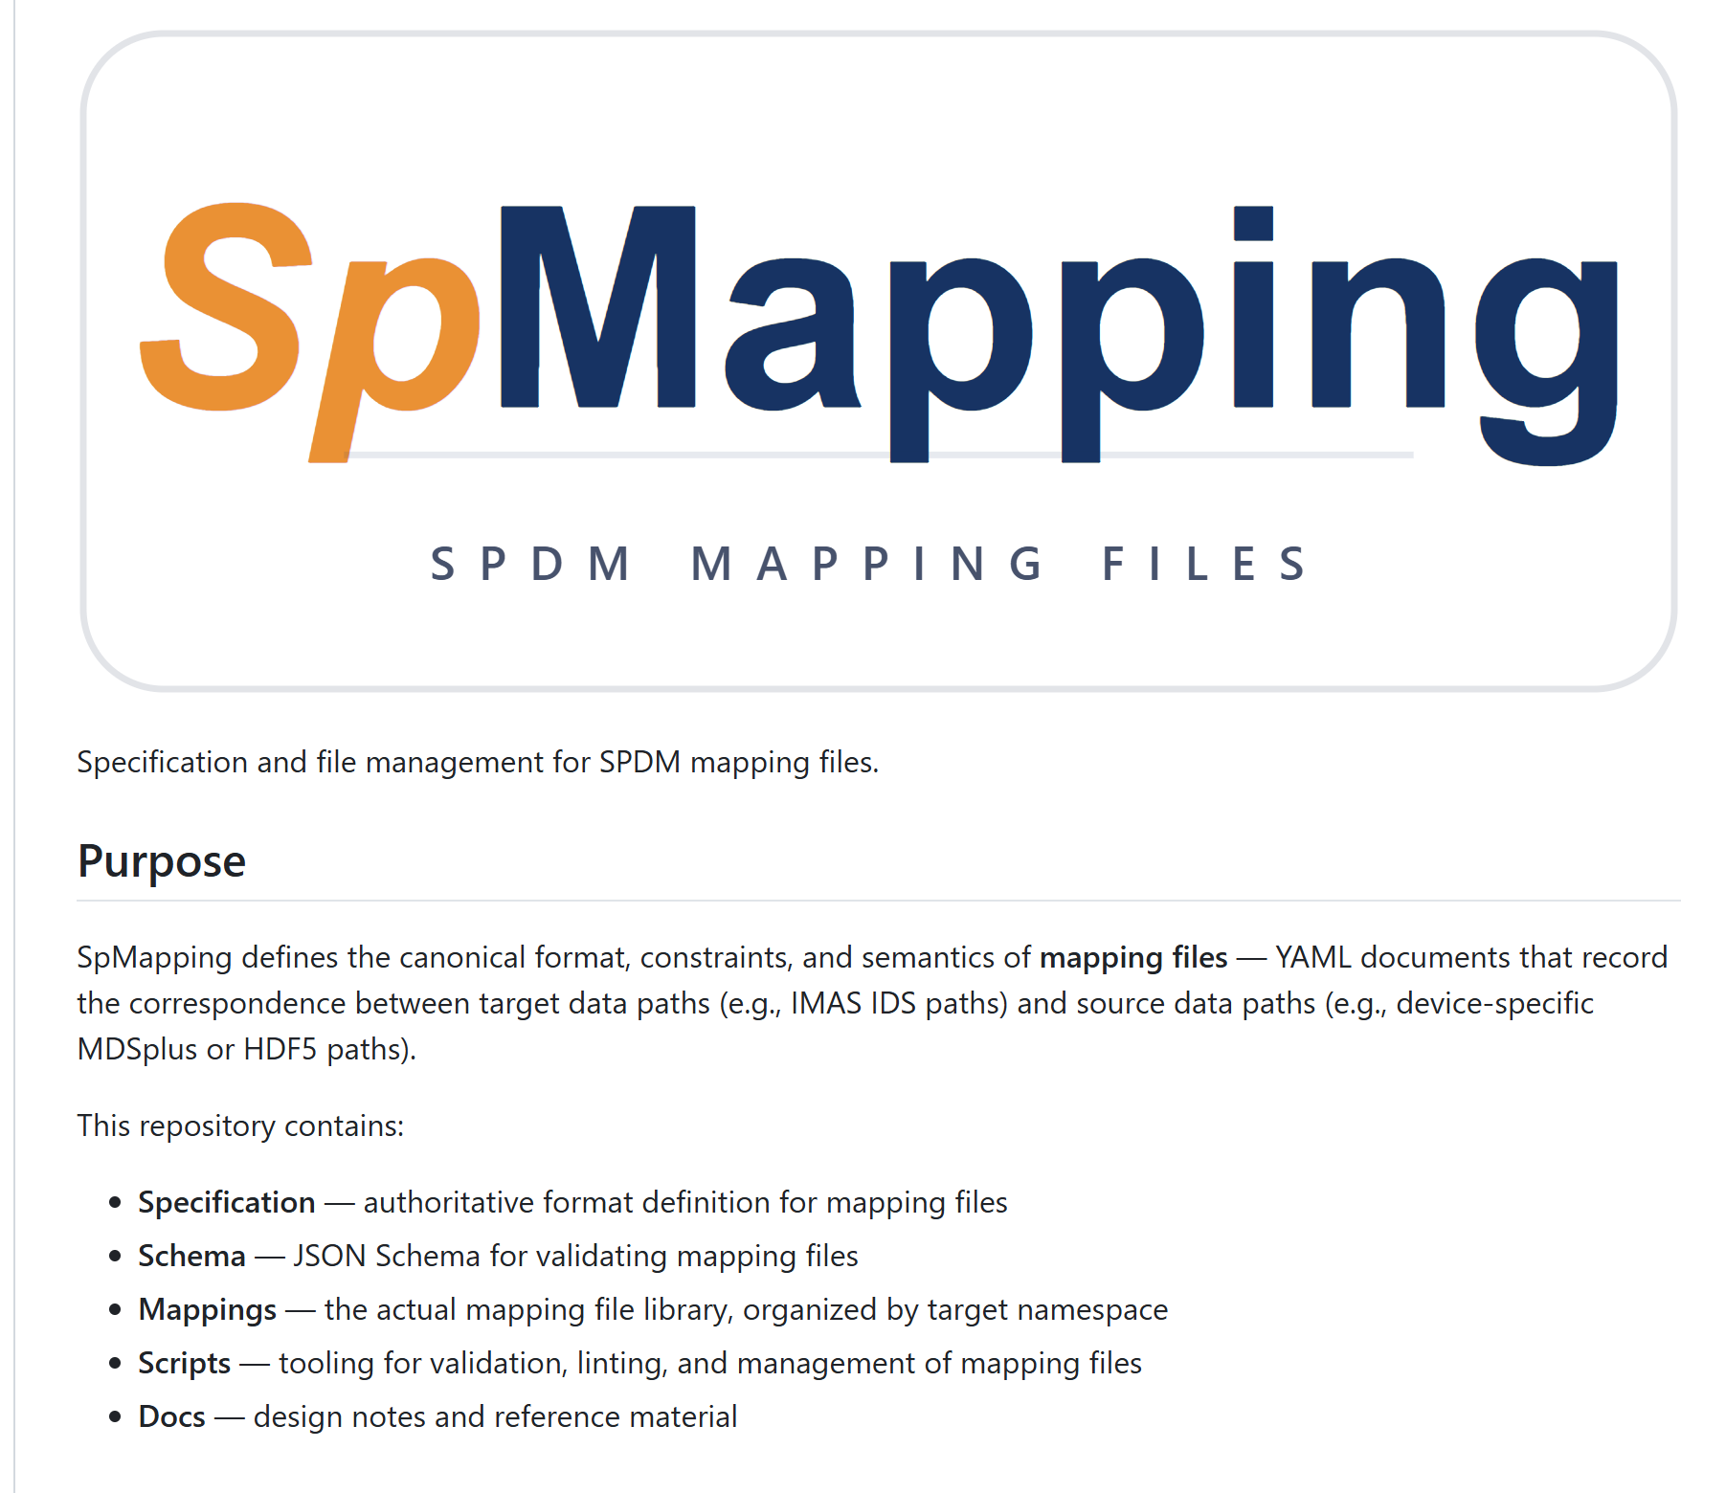
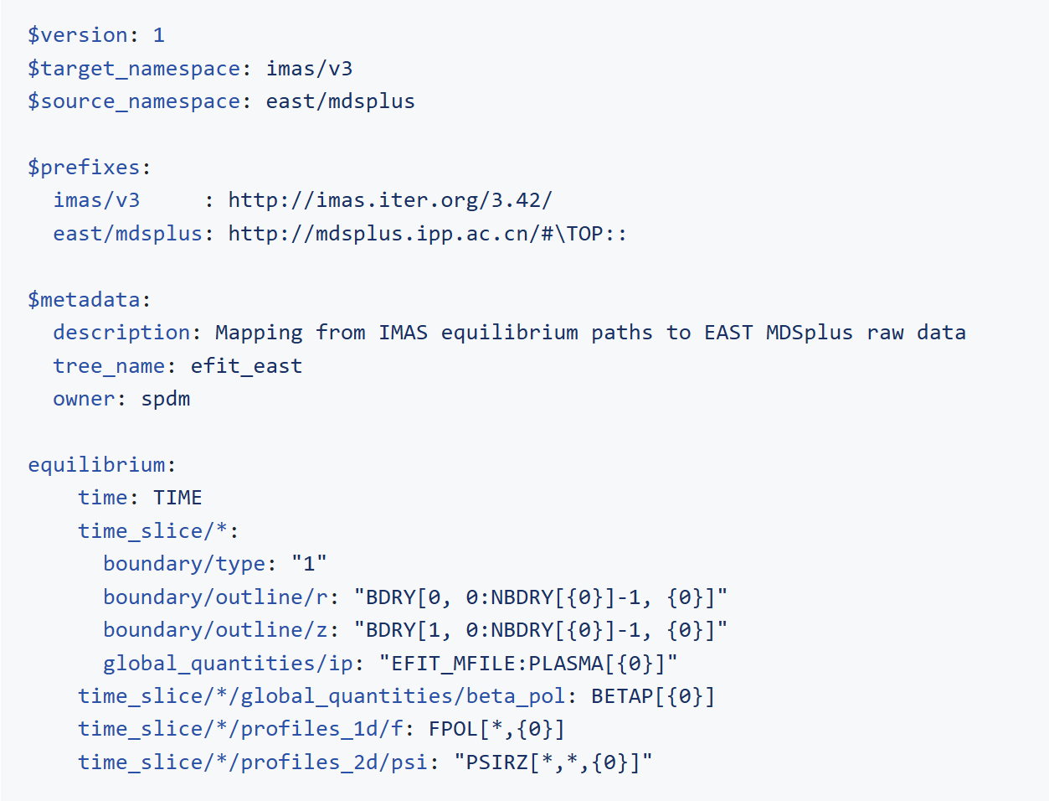
Define/descirbe a mapping file schema https://github.com/fusion-yun/spmapping.git

Slide 3
Feature | SpMapping Specification/Requirement | LinkML-Map Standard
Core Paradigm | Path-to-Path Routing: Focuses on hierarchical tree structures (e.g., IMAS IDS). | Model-to-Model Transformation: Focuses on mapping between LinkML classes and slots.
Directionality | Explicit Bi-directional: Uses $read and $write for symmetric data flow. | Primarily Uni-directional: Derived from source-to-target definitions; bi-directionality often requires inference.
Path Matching | Pattern-based: Uses wildcards (*, **), range slices, and conditional selectors. | Variable-based: Uses variables to bind class instances and attributes.
Structural Logic | AoS/SoA Rotation: Natively handles structure flipping using capture indices (e.g., {0}). | Relational Mapping: Handles collections through complex slot-to-slot or class-to-class mappings.
Transformation | Expression-based: Inline Python/NumPy/SymPy strings for unit and type conversion. | Function-based: Uses predefined library functions or custom user-defined functions.
Conflict Resolution | Weight-based Priority: Literal match count and capture precision determine the winner. | Schema-driven: Conflicts are typically managed by schema validation or rule order.
Aggregation | Gather/Scatter: Natively supported via the $items block for multi-source nodes. | Collection Mapping: Requires multiple rules targeting the same collection slot.

Slide 4
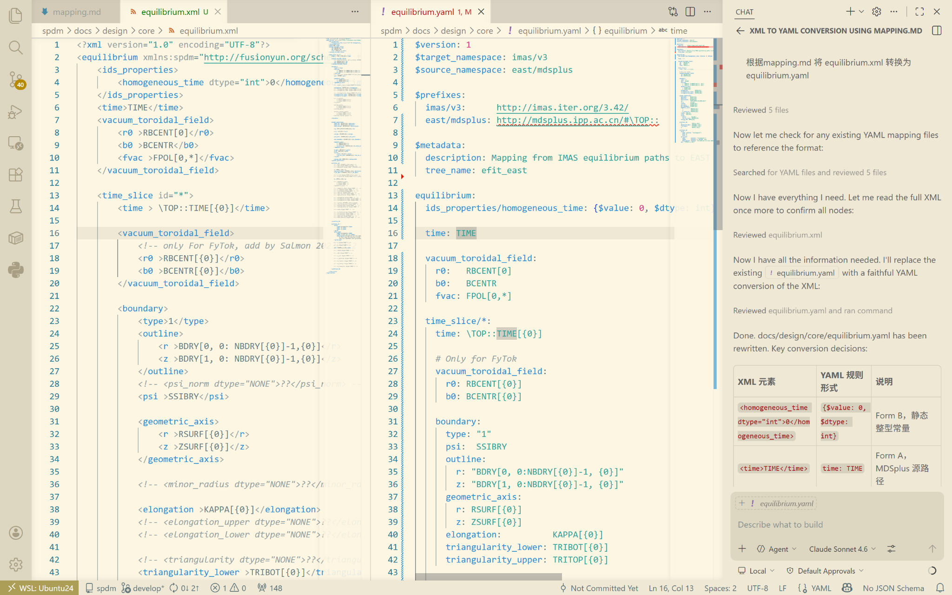
Claude-Sonnet-4.6 Converts Mapping File Based on Document (mapping.md)
old XML file (fytok)
new YAML file

Slide 5
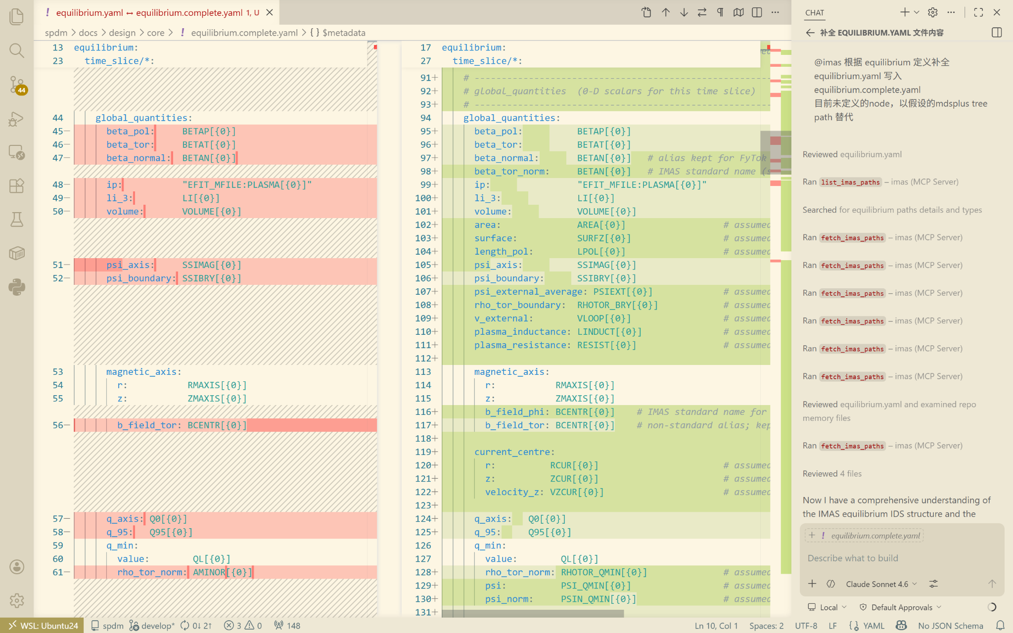
imas-codex mcp completes the full equilibrium IDS
Incomplete
Complete mapping file

Slide 6
Technical Roadmap & Questions
Standardization Strategy: Allow the coexistence of multiple current specifications for the time being, using practical, real-world applications to validate and merge them until they converge into a single, unified standard?
Version Convergence: Ensuring that all practical applications eventually converge toward a single, unified standard version?
Implementation Strategy: Should the focus be on a standard IMAS implementation versus allowing for individual, implementation-specific versions?
Collaborative Infrastructure: Is it necessary to maintain a shared repository for all mapping files to ensure version control and accessibility? (for FAIR )

Slide 7
EAST Data Mapping Collaboration
Data Provision:
Supply EAST datasets in MDSplus raw file format. (Upload to ITER HPC cluster?)
LLM-Assisted Generation:
Leverage LLM to generate mapping files from signal name documentation that are fully compliant with the specification. (imas-codex)

Slide 8
Thanks！

