Slide 1
Device data mapping status card
EAST
EAST team
2026.03.16

Slide 2
General Information
Device Name: EAST
Native Data Formats / Access Libraries:
  MDSPlus
  Custom text files
  HDF5 / NetCDF ( imas-python schema)
Contact Persons (IMAS / Data Mapping):
  Zhi YU: yuzhi@ipp.ac.cn
  Yao HUANG: yaohuang@ipp.ac.cn (specifically for control data)
  Ting LAN: lanting@ipp.ac.cn (specifically for diagnostic data)

Slide 3
Data Mapping Details
IMAS Data Dictionary (DD) Version: imas/v3.42
Mapped Interface Data Structures (IDS):
  core_profiles, core_transport, core_source, equilibrium, magnetics, pf_active, tf, and wall
  langmuir_probes, ece, interferometer, reflectometer_profile, and summary
Mapping Methodology:
  Mapping Files: Used for device description data and MDSPlus access (e.g., equilibrium, wall, and pf_active)
  Hard-coded: Used for input and output files of codes (e.g., EFIT/g-file)
  Scripts: Used for custom data
Pulse Range Coverage:
  Most pulses are stored on the MDSPlus server
  Diagnostic data is converted as required

Slide 4

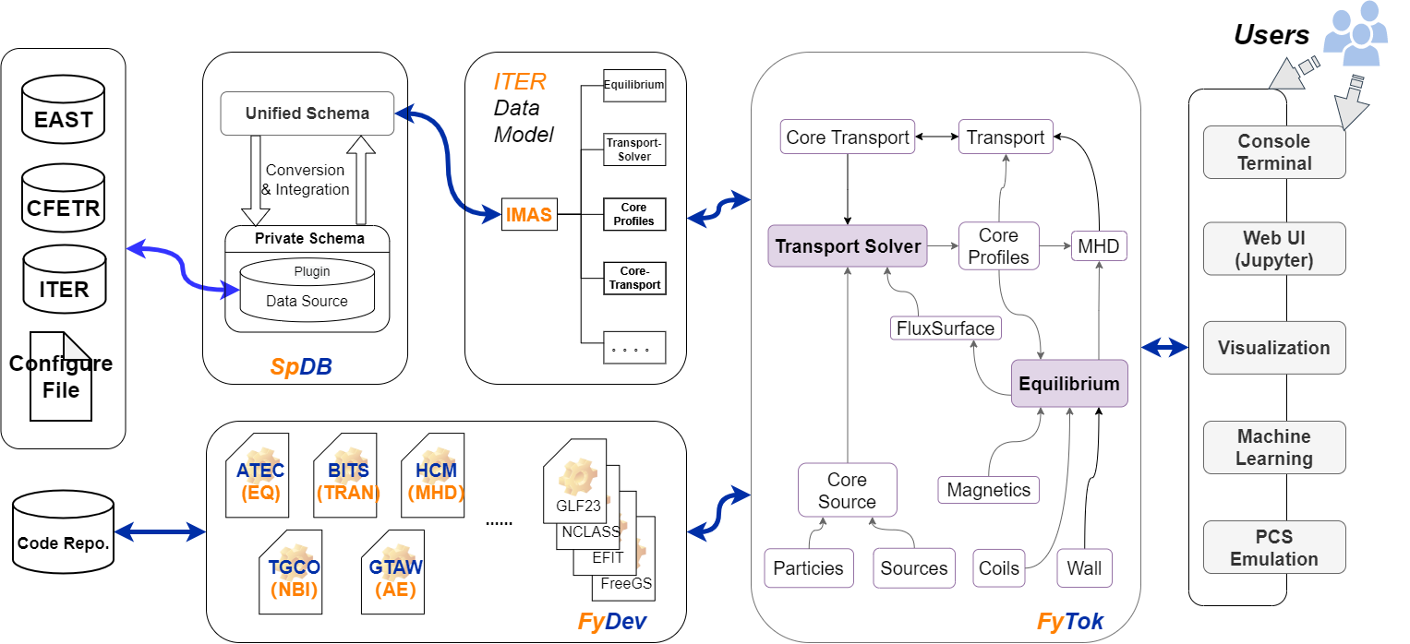
Applications Utilizing Mapped IMAS Data:
FyTok：An integrated modeling framework that facilitates data conversion to interface with and invoke external applications. (https://github.com/fusion-yun/fytok) A new version is planned for release following this workshop.
EAST2IMAS：diagnostic data (https://github.com/jenuis/east2imas)

Slide 5
Data Access Policy:
Collaboration: Current access is based on collaboration, covering contact coordination and the potential sharing of test data.
Open Access: A dedicated platform for open data access is currently under development, and the associated access policies are being researched and formulated.

Slide 6
Upcoming Plans:
Expand and validate the scope and versions of data mapping.
Refine and improve universal data mapping descriptions.
AI-ready data governance to support advanced modeling and analysis.
Develop a data access platform to facilitate open data access.

Slide 7
Thanks！

