Slide 1
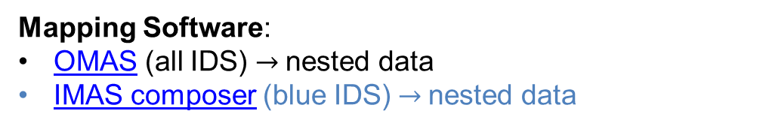
Currently available IMAS mappings at DIII-D
Profile diagnostics:
ECE
Thomson Scattering
Charge exchange
Interferometer
Reflectometer
Equilibrium diagnostics:
Magnetics
Polarimeter
Wall
Processed data
Equilibrium
Core profiles
Summary
Misc. diagnostics:
Bolometer
Langmuir probes
Actuators:
Gas injection
EC launchers
NBI (simplified)
Tf
Pf-active
Coils non-axis symmetric
Mapping Software:
OMAS (all IDS) $→$nested data
IMAS composer (blue IDS) $→$nested data

Slide 2

DIII-D is in the process of overhauling its data infrastructure
Need
FDP/FEDER Solution
Data Distribution
No community-wide broad distribution of fusion data
Use Open Science Data Federation software stack (HEP tested)
Data Curation
No standard tools for curating fusion data
Equip with fusion-specific data curation tools
Standardization
MDSplus commonly used, but no unified schema
Use IMAS schema for curated data
Reproducibility and Provenance
ML models often published with insufficient info to reproduce results
Use HPE's Common Metadata Framework for workflows, with complete provenance tracking of data, models, and metadata
Discoverability
No standard repository of curated data, no ability to search existing models/data
Provide metadata database with web portal and search interfaces

Slide 3
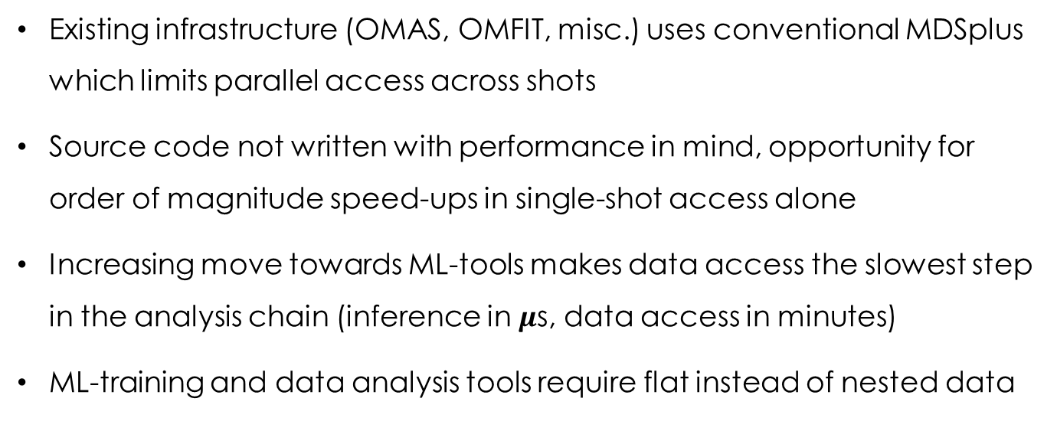
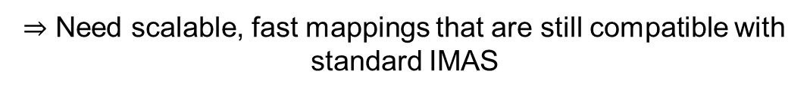
Technical Goal: Highly performant data mapping tools compatible with the standard IMAS tools
Existing infrastructure (OMAS, OMFIT, misc.) uses conventional MDSplus which limits parallel access across shots
Source code not written with performance in mind, opportunity for order of magnitude speed-ups in single-shot access alone
Increasing move towards ML-tools makes data access the slowest step in the analysis chain (inference in $μ$s, data access in minutes)
ML-training and data analysis tools require flat instead of nested data
$⇒$ Need scalable, fast mappings that are still compatible with standard IMAS

