Slide 1

Welcome to the first IMAS Data Mapping Workshop

Slide 2

Objectives of the workshop
code-camp
hackathon
F2F meeting
Build a supportive community of IMAS data enthusiasts
Collaborate on a common open-source IMAS software stack
Share effort, tips and training between data providers
Build links to data consumers and get constructive feedback and tests
Improve the amount, relevance and quality of IMAS data

Slide 3
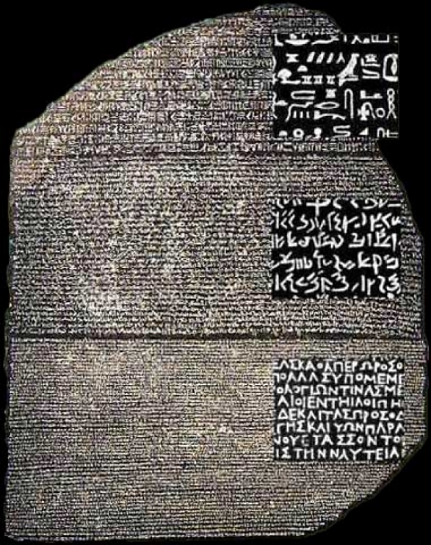
Mappings to IMAS
Discussions
Declarative vs imperative
Data mapping syntax/transformation features
Benefits of using the same language?
MD vs time-dep signals
Making mappings FAIR
LLMs impact
Hands-on
Improved coverage, verification

Slide 4
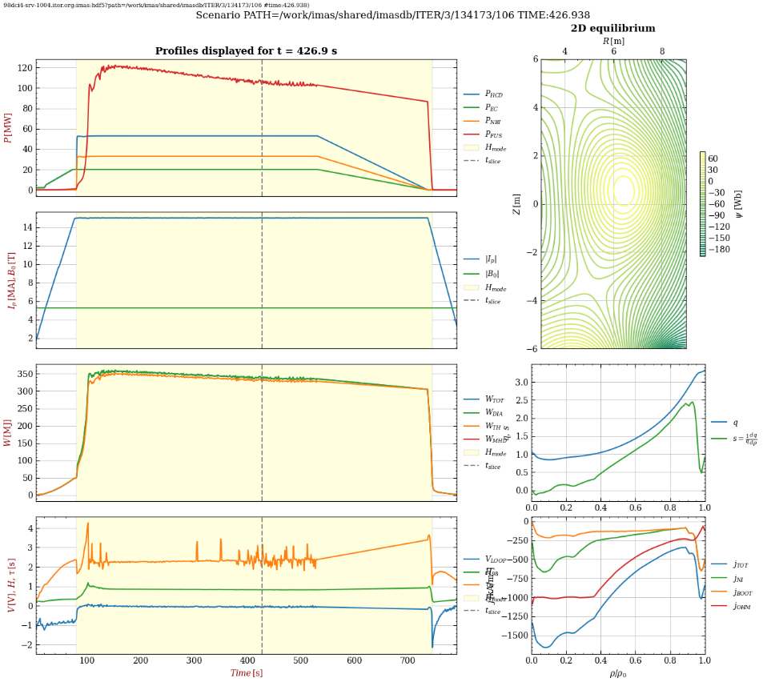
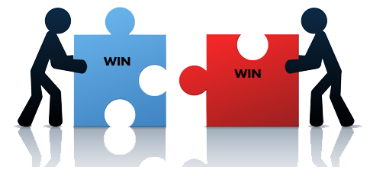
Applications
Existing IMAS apps driving data needs
MD → device agnostic codes
Required input quantities (interfaces)
Output quantities for validation
Cross-device plasma reconstruction
Equilibrium
Plasma profiles…

Slide 5


Tooling
Learn – Use – Share
IMAS Data Dictionary
IDS Data access and visualization tools
Data mapping tools
Tools for supporting V&V
Feedback – Improve – Contribute
Open source, open access
Discuss about tools
Compatibility, overlaps, gaps, ongoing plans…

Slide 6


Verification and validation
Discussions
Linting/verifying mappings
Checking mapped data
Validating applications
How-to and best practices
Manual vs automated checks…
Establish a more efficient collaborative effort
Sharing mappings, test data
Providing efficient feedback
Acknowledgements

Slide 7

Proposed challenges
Verification challenge
Spot and fix issues in mapped data (yours or others)
Spot and fix issues in IMAS DD definitions
Plotting challenge
Plot MD for your device(s) from IDS
Contribute to machine-agnostic plot tools (axi-symmetric)
Equilibrium challenge
Map the required data for equilibrium reconstruction from magnetics
Attempt equilibrium reconstruction from magnetics (e.g. with EFIT++)

Slide 8
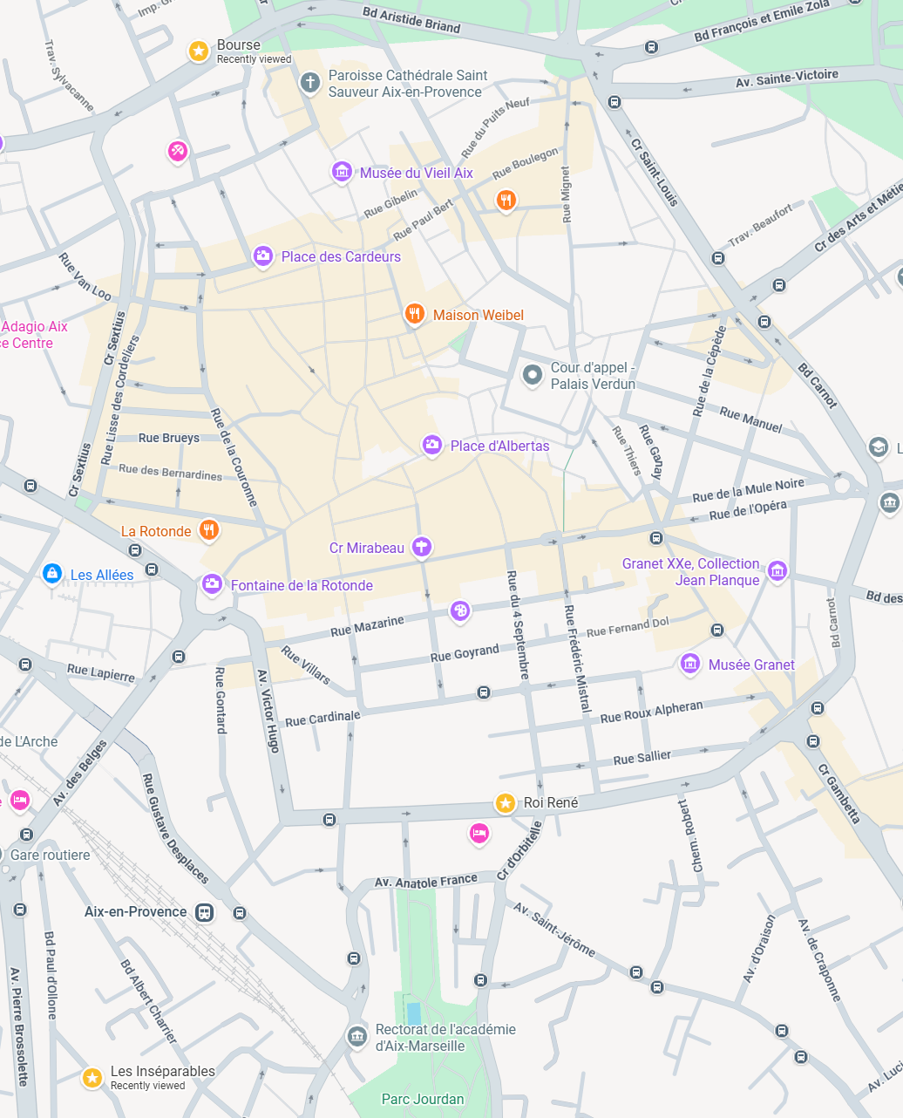
Meeting’s organization
Intro/Outro
Monday (AM): community building (meet each other, device mapping status)
Monday (PM): IMAS reminders + pointers and get started
Fri (AM): reporting on your objectives and on challenges, outcomes of shared discussions (need help from reporters!)
Core meeting (Tue – Wed – Thu)
Common presentation and discussion sessions AM
Mappings, mapping tools, applications, V&V, FAIR & Share
Self-organized working sessions in rooms 3017 + 3048 (10 pax)
Participate in specific discussions (to be announced daily)
Share data & knowledge, ask help from experts (training, issues), …
Work on your objectives and on the challenges
Social and travel
Bus from Aix (7:30 Roy René, 7:40 Bourse), from ITER (17:55, 14:00 on Fri)
ITER site visit (Wed 11:00), Dinner in Aix at Les Inséparables (Thu 19:30)

Slide 9
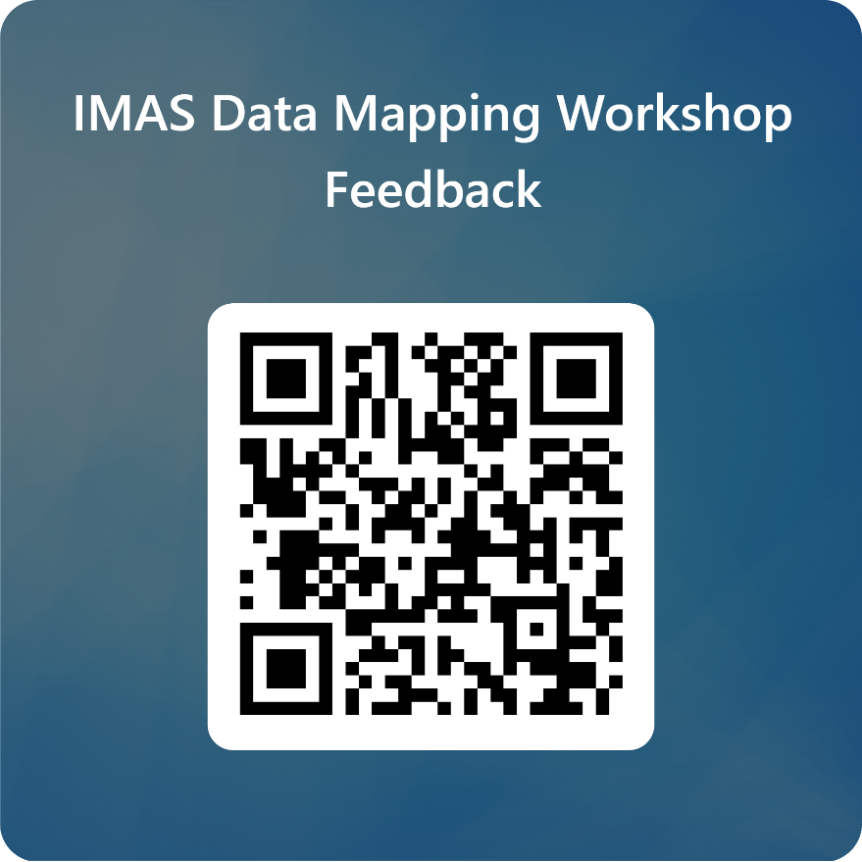
Feedback
Make such event a recurrent one
Improve future editions format
Ideas to keep the momentum
…

