Slide 1


High Field-Rate Losses in Cable-In-Conduit-Conductors Carrying Transport Current
Analytical and Numerical Studies
20th-24th September 2021
Virtual (St. Paul Lez Durance, France)
14th CHATS on Applied Superconductivity (CHATS-AS)
Gianluca De Marzi, ENEA FSN-COND

Slide 2





Acknowledgments
University of Roma Tre
Massimiliano Corradini
ENEA
Luigi Muzzi, Lorenzo Giannini, Antonio della Corte
University of Bologna
Marco Breschi, Lorenzo Cavallucci
Swiss Plasma Center - EPFL
Davide Uglietti
Politecnico di Torino
Roberto Bonifetto, Andrea Zappatore

Slide 3
Outline
Introduction: fast transients in Tokamaks
New model for the calculation of AC losses due to fast varying fields
  Analytical solution of the Osagawara equation
  Coupling, magnetization, and dynamic resistance
Model application: ac losses of a CS module of a Tokamak device (DTT):
  Evaluated AC losses on central turn at peak field
  Developed 2D FE model with variable nτ
Conclusions and future directions

Slide 4

Introduction – Divertor Tokamak Test @ ENEA
18 TF coils:
Nb₃Sn CICC: 42.5 kA – 11.9 T
providing 6.0 T over plasma major radius
6 CS modules (indipendently fed):
Nb₃Sn CICC: 31.3 kA – 13.6 T
providing 16.6 Weber magnetic flux for
plasma initiation at breakdown
6 PF coils:
Nb₃Sn (PF1 & PF6) CICC: 28.3 kA – 9.1 T
NbTi (PF3 & PF4) CICC: 28.6 kA – 5.3 T
NbTi (PF2 & PF5) CICC: 27.1 kA – 4.2 T
Identical in pairs for full top/down symmetry
2.19 m
5.3 m

Slide 5
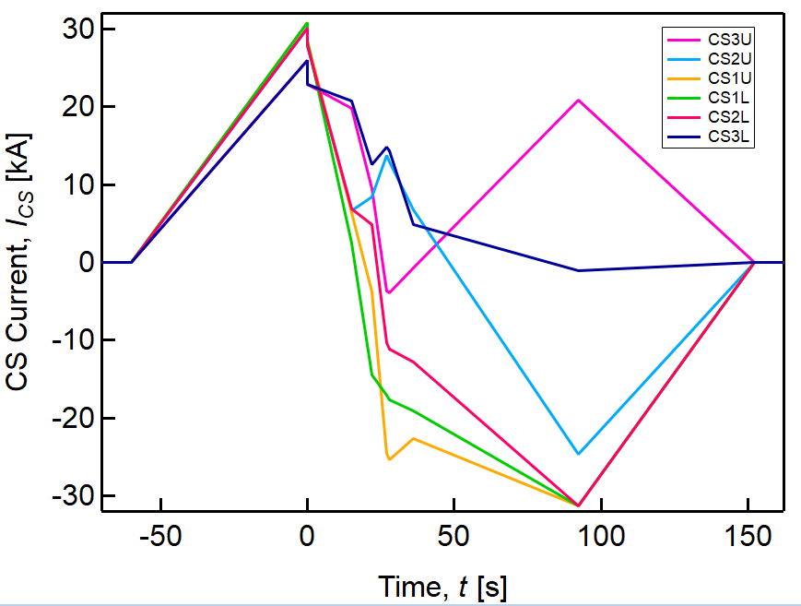
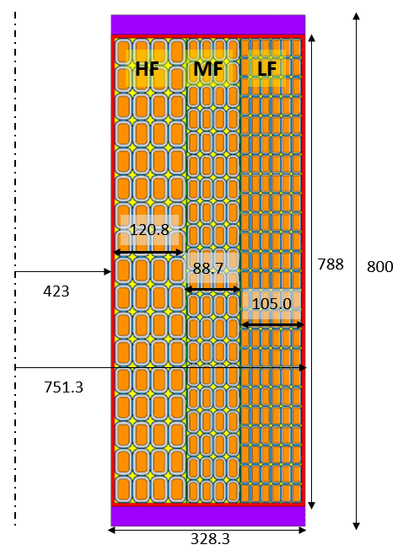
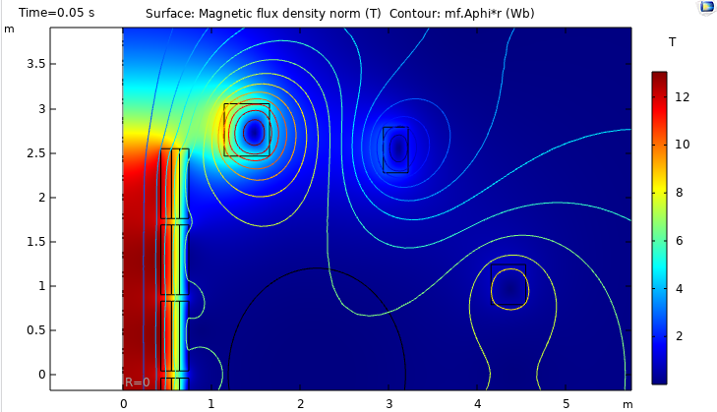
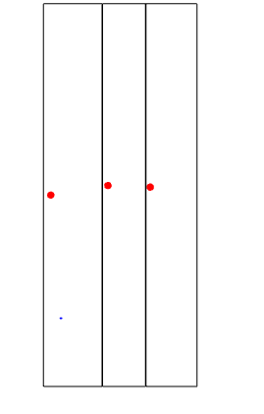
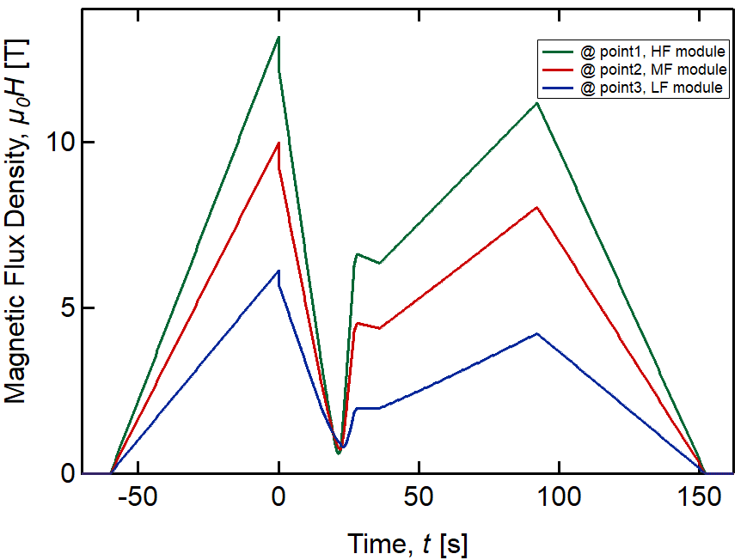
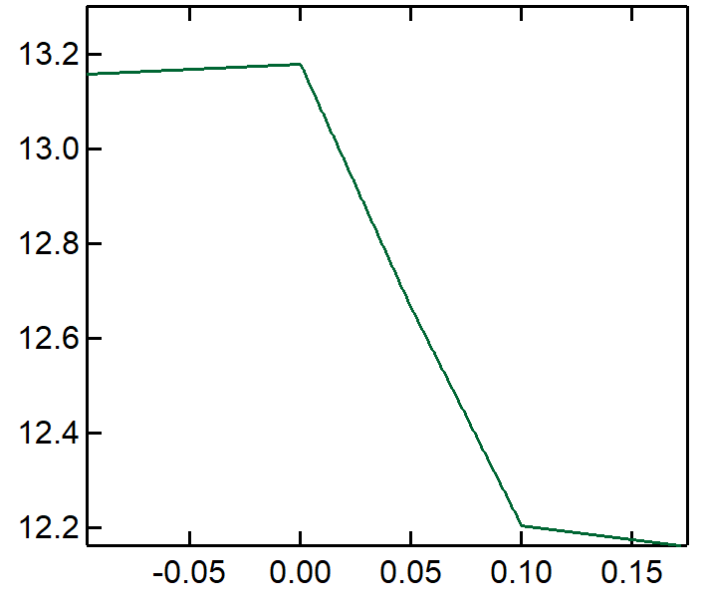

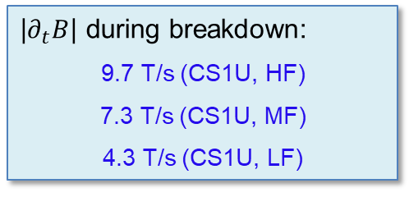
High Field-Rates in CS Modules
Premag (t = 0 s)
CS1U
Single Null
breakdown
~9.7 T/s
|$∂_{t}B$| during breakdown:
9.7 T/s (CS1U, HF)
7.3 T/s (CS1U, MF)
4.3 T/s (CS1U, LF)
Peak field, central turns

Slide 6
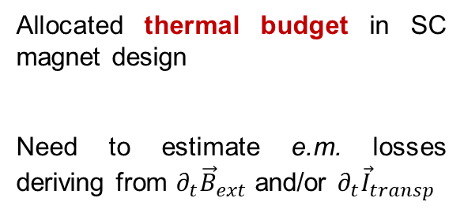
Aim of the Work
Allocated thermal budget in SC magnet design
Need to estimate e.m. losses deriving from $∂_{t}{\vec{B}}_{ext}$ and/or $∂_{t}{\vec{I}}_{transp}$
2.19 m
5.3 m
The present work investigates the ac losses of conductors subjected to time-varying fields and carrying dc currents.

Slide 7
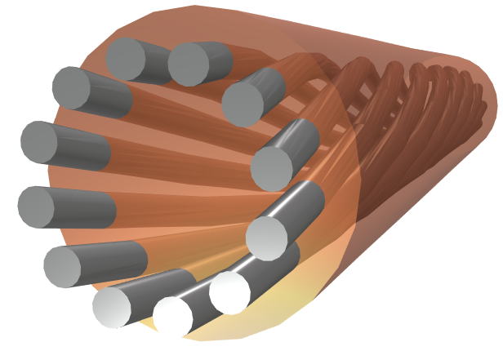










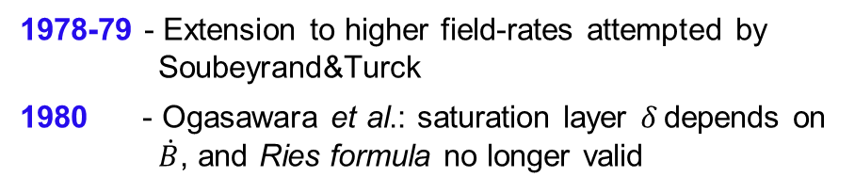

Coupling and Eddy Currents in Composites
1970s - Problem studied by several investigators [Morgan, Ries, Carr, Brandt, Clem, Murphy, Norris, etc.]
Solved for trapezoidal shaped B_{e}(t), for two limiting cases: $\left\{\begin{matrix}B_{e}−B=τ\dot{B} \\ B_{e}−B=B_{p}\end{matrix}\right.$
$$B_{e}−B=τ\dot{B}$$
$$τ=\frac{μ_{0}}{ρ_{et}}{\left(\frac{l_{p}}{2π}\right)}^{2}$$
1978-79 - Extension to higher field-rates attempted by Soubeyrand&Turck
1980 - Ogasawara et al.: saturation layer 𝛿 depends on $\dot{B}$, and Ries formula no longer valid
$$B_{y}$$
$$J_{C}$$
$$B_{e}−B=\frac{\dot{τB}}{1+\frac{τ\dot{B}}{B_{p}}}$$
$$\frac{δ}{R}=\frac{τ\dot{B}}{B_{p}}{\left(1+\frac{τ\dot{B}}{B_{p}}\right)}^{−1}$$
D
$$J_{y}=\frac{E_{y}}{ρ_{t}}=\frac{1}{ρ_{t}}\frac{l_{p}}{2π}\dot{B}$$
$$B_{p}=μ_{0}J_{C}D/2$$
$$J_{p}\left(θ\right)=\frac{1}{ρ_{m}}\frac{l_{p}}{2π}cos\left(θ\right)\dot{B}$$

Slide 8
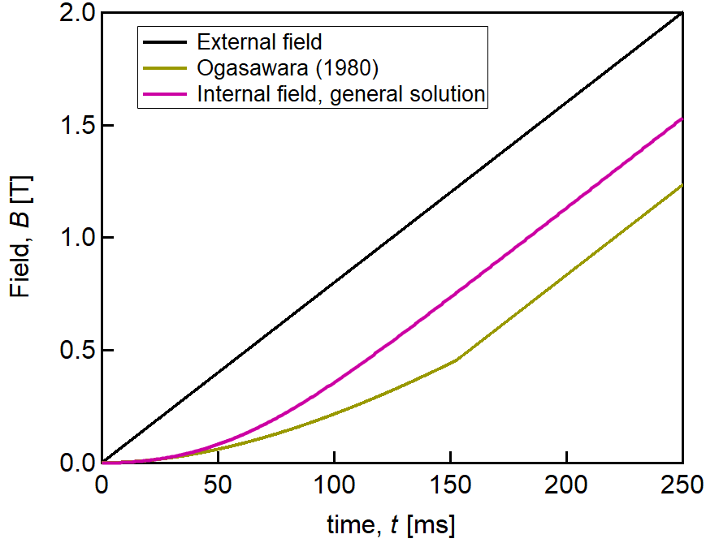
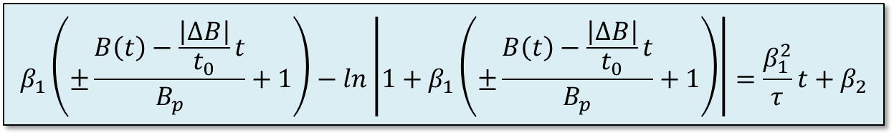


Solution of the Ogasawara Problem
Differential equation slightly modified to include both ramp-up and ramp-down
The solution is an implicit function of B
Good news! The solution is integrable, allowing analytical calculations of AC losses
$$B_{e}−B=\frac{\dot{τB}}{1+\frac{τ\left|\dot{B}\right|}{B_{p}}}$$
$$\begin{matrix}β_{1}=−\left(1+\frac{τ}{t_{0}}\frac{\left|∆B\right|}{B_{p}}\right) \\ β_{2}=β_{1}−ln\left(\frac{τ}{t_{0}}\frac{\left|∆B\right|}{B_{p}}\right)\end{matrix}$$
ΔB = 2 T
t₀ = 0.25 s
τ = 150 ms
I_{c} = 1 kA
d = 20 µm
D = 0.82 mm
$$β_{1}\left(±\frac{B\left(t\right)−\frac{\left|∆B\right|}{t_{0}}t}{B_{p}}+1\right)−ln\left|1+β_{1}\left(±\frac{B\left(t\right)−\frac{\left|∆B\right|}{t_{0}}t}{B_{p}}+1\right)\right|=\frac{β_{1}^{2}}{τ}t+β_{2}$$

Slide 9



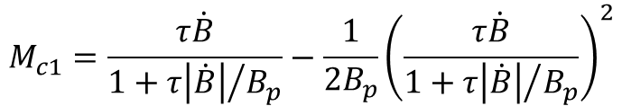
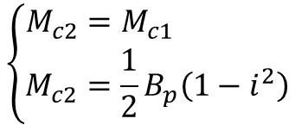


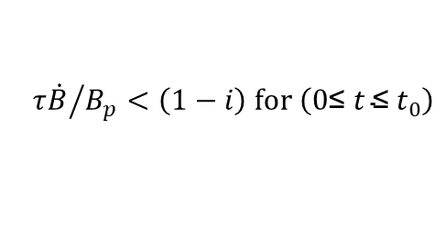

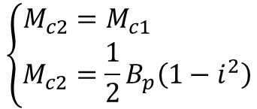


Coupling Magnetization
Magnetization per unit volume, M_{c}, due to the coupling currents
Ogasawara 1980 De Marzi & Corradini 2021
$${τ\dot{B}}/{B_{p}<\frac{\left(1−i\right)}{i} for \left(\text{0}\text{≤} t \text{≤}{ t}_{0}\right)}$$
Case (1)
Case (1)
$${τ\dot{B}}/{B_{p}<\left(1−i\right) for \left(\text{0}\text{≤} t \text{≤}{ t}_{0}\right)}$$
$$M_{c1}=τ\dot{B}−\frac{1}{2B_{p}}{\left(τ\dot{B}\right)}^{2}$$
$$M_{c1}=\frac{τ\dot{B}}{1+{τ\left|\dot{B}\right|}/{B_{p}}}−\frac{1}{2B_{p}}{\left(\frac{τ\dot{B}}{1+{τ\left|\dot{B}\right|}/{B_{p}}}\right)}^{2}$$
$${τ\dot{B}}/{B_{p}\left\{\begin{matrix}<\left(1−i\right) for \left(\text{0}\text{≤} t \text{≤}{ t}_{1}\right) \\ ≥\left(1−i\right) for \left(t_{1}≤t ≤t_{0}\right)\end{matrix}\right.}$$
$${τ\dot{B}}/{B_{p}\left\{\begin{matrix}<{\left(1−i\right)}/i for \left(\text{0}\text{≤} t \text{≤}{ t}_{1}\right) \\ ≥{\left(1−i\right)}/i for \left(t_{1}≤t ≤t_{0}\right)\end{matrix}\right.}$$
Case (2)
Case (2)
$$\left\{\begin{matrix}M_{c2}=M_{c1} \\ M_{c2}=\frac{1}{2}B_{p}\left(1−i^{2}\right)\end{matrix}\right.$$
$$0≤t≤t_{1}$$
$$\left\{\begin{matrix}M_{c2}=M_{c1} \\ M_{c2}=\frac{1}{2}B_{p}\left(1−i^{2}\right)\end{matrix}\right.$$
$$0≤t≤t_{1}$$
$$t_{1}≤t≤t_{0}$$
$$t_{1}≤t≤t_{0}$$

Slide 10
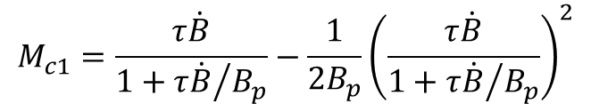
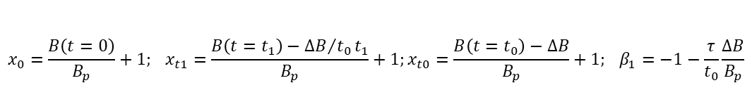
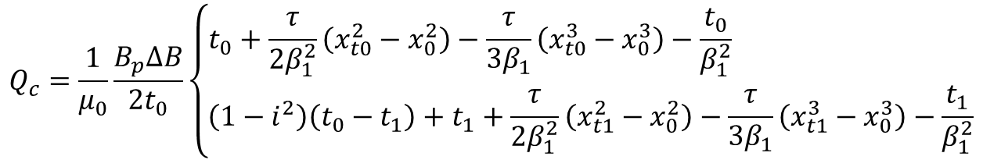

Coupling Losses
Coupling losses per unit volume Q_{c}: analytical solution for ramping-up field
Ogasawara 1980 De Marzi & Corradini 2021
$$Q_{c}=\frac{1}{μ_{0}}\int_{0}^{t_{0}}{M_{c}{\dot{B}}_{e}∙dt}$$
$${τ\dot{B}}/{B_{p}<\frac{\left(1−i\right)}{i} for \left(\text{0}\text{≤} t \text{≤}{ t}_{0}\right)}$$
Case (1)
Case (1)
$${τ\dot{B}}/{B_{p}<\left(1−i\right) for \left(\text{0}\text{≤} t \text{≤}{ t}_{0}\right)}$$
$$M_{c1}=τ\dot{B}−\frac{1}{2B_{p}}{\left(τ\dot{B}\right)}^{2}$$
$$M_{c1}=\frac{τ\dot{B}}{1+{τ\dot{B}}/{B_{p}}}−\frac{1}{2B_{p}}{\left(\frac{τ\dot{B}}{1+{τ\dot{B}}/{B_{p}}}\right)}^{2}$$
$$Q_{c}=\frac{1}{μ_{0}}\frac{B_{p}∆B}{{2t}_{0}}\left\{\begin{matrix}t_{0}+\frac{τ}{2β_{1}^{2}}\left(x_{t0}^{2}−x_{0}^{2}\right)−\frac{τ}{3β_{1}}\left(x_{t0}^{3}−x_{0}^{3}\right)−\frac{t_{0}}{β_{1}^{2}} \\ {\left(1−i^{2}\right)\left(t_{0}−t_{1}\right)+t}_{1}+\frac{τ}{2β_{1}^{2}}\left(x_{t1}^{2}−x_{0}^{2}\right)−\frac{τ}{3β_{1}}\left(x_{t1}^{3}−x_{0}^{3}\right)−\frac{t_{1}}{β_{1}^{2}}\end{matrix}\right.$$
Case (1)
Case (2)
$${τ\dot{B}}/{B_{p}\left\{\begin{matrix}<\left(1−i\right) for \left(\text{0}\text{≤} t \text{≤}{ t}_{1}\right) \\ ≥\left(1−i\right) for \left(t_{1}≤t ≤t_{0}\right)\end{matrix}\right.}$$
$${τ\dot{B}}/{B_{p}\left\{\begin{matrix}<{\left(1−i\right)}/i for \left(\text{0}\text{≤} t \text{≤}{ t}_{1}\right) \\ ≥{\left(1−i\right)}/i for \left(t_{1}≤t ≤t_{0}\right)\end{matrix}\right.}$$
Case (2)
Case (2)
$$\left\{\begin{matrix}M_{c2}=M_{c1} \\ M_{c2}=\frac{1}{2}B_{p}\left(1−i^{2}\right)\end{matrix}\right.$$
$$0≤t≤t_{1}$$
$$\left\{\begin{matrix}M_{c2}=M_{c1} \\ M_{c2}=\frac{1}{2}B_{p}\left(1−i^{2}\right)\end{matrix}\right.$$
$$0≤t≤t_{1}$$
$$t_{1}≤t≤t_{0}$$
$$t_{1}≤t≤t_{0}$$
$$x_{0}=\frac{B\left(t=0\right)}{B_{p}}+1; x_{t1}=\frac{B\left(t=t_{1}\right)−{∆B}/{t_{0}}t_{1}}{B_{p}}+1;x_{t0}=\frac{B\left(t=t_{0}\right)−∆B}{B_{p}}+1; β_{1}=−1−\frac{τ}{t_{0}}\frac{∆B}{B_{p}}$$

Slide 11


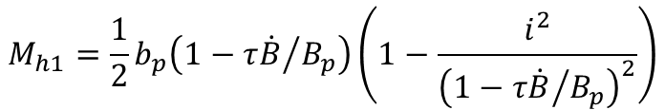


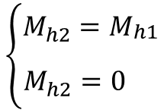

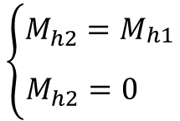


Intrinsic Magnetization of SC Filaments
Intrinsic magnetization per unit volume, M_{h}, due to the shielding currents
Ogasawara 1980 De Marzi & Corradini 2021
$${τ\dot{B}}/{B_{p}<\frac{\left(1−i\right)}{i} for \left(\text{0}\text{≤} t \text{≤}{ t}_{0}\right)}$$
Case (1)
Case (1)
$${τ\dot{B}}/{B_{p}<\left(1−i\right) for \left(\text{0}\text{≤} t \text{≤}{ t}_{0}\right)}$$
$$M_{h1}=\frac{1}{2}b_{p}\left(1−{τ\dot{B}}/{B_{p}}\right)\left(1−\frac{i^{2}}{{\left(1−{τ\dot{B}}/{B_{p}}\right)}^{2}}\right)$$
$$M_{h1}=\frac{1}{2} \frac{b_{p}}{1+{τ\left|\dot{B}\right|}/{B_{p}}}\left(1−{i^{2}\left(1+{τ\left|\dot{B}\right|}/{B_{p}}\right)}^{2}\right)$$
$${τ\dot{B}}/{B_{p}\left\{\begin{matrix}<\left(1−i\right) for \left(\text{0}\text{≤} t \text{≤}{ t}_{1}\right) \\ ≥\left(1−i\right) for \left(t_{1}≤t ≤t_{0}\right)\end{matrix}\right.}$$
$${τ\dot{B}}/{B_{p}\left\{\begin{matrix}<{\left(1−i\right)}/i for \left(\text{0}\text{≤} t \text{≤}{ t}_{1}\right) \\ ≥{\left(1−i\right)}/i for \left(t_{1}≤t ≤t_{0}\right)\end{matrix}\right.}$$
Case (2)
Case (2)
$$\left\{\begin{matrix}M_{h2}=M_{\begin{aligned}h1 \\ \end{aligned}} \\ M_{h2}=0 \end{matrix}\right.$$
$$0≤t≤t_{1}$$
$$\left\{\begin{matrix}M_{h2}=M_{\begin{aligned}h1 \\ \end{aligned}} \\ M_{h2}=0 \end{matrix}\right.$$
$$0≤t≤t_{1}$$
$$t_{1}≤t≤t_{0}$$
$$t_{1}≤t≤t_{0}$$

Slide 12
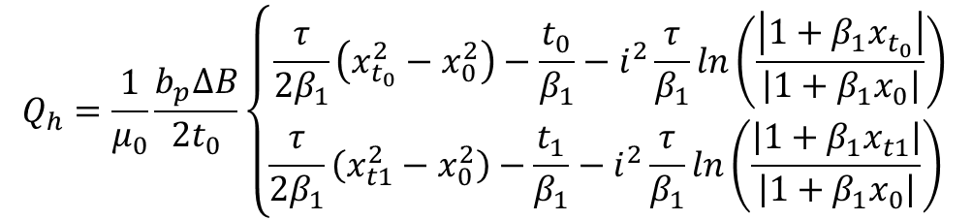

Magnetization Losses
Magnetization losses per unit volume Q_{h}: analytical solution for ramping-up field
Ogasawara 1980 De Marzi & Corradini 2021
$$Q_{h}=\frac{1}{μ_{0}}\int_{0}^{t_{0}}{M_{h}{\dot{B}}_{e}∙dt}$$
$${τ\dot{B}}/{B_{p}<\frac{\left(1−i\right)}{i} for \left(\text{0}\text{≤} t \text{≤}{ t}_{0}\right)}$$
Case (1)
Case (1)
$${τ\dot{B}}/{B_{p}<\left(1−i\right) for \left(\text{0}\text{≤} t \text{≤}{ t}_{0}\right)}$$
$$M_{c1}=τ\dot{B}−\frac{1}{2B_{p}}{\left(τ\dot{B}\right)}^{2}$$
$$M_{c1}=\frac{τ\dot{B}}{1+{τ\dot{B}}/{B_{p}}}−\frac{1}{2B_{p}}{\left(\frac{τ\dot{B}}{1+{τ\dot{B}}/{B_{p}}}\right)}^{2}$$
$$Q_{h}=\frac{1}{μ_{0}}\frac{b_{p}∆B}{{2t}_{0}}\left\{\begin{matrix}\frac{τ}{2β_{1}}\left(x_{t_{0}}^{2}−x_{0}^{2}\right)−\frac{t_{0}}{β_{1}}−i^{2}\frac{τ}{β_{1}}ln\left(\frac{\left|1+β_{1}x_{t_{0}}\right|}{\left|1+β_{1}x_{0}\right|}\right) \\ \frac{τ}{2β_{1}}\left(x_{t1}^{2}−x_{0}^{2}\right)−\frac{t_{1}}{β_{1}}−i^{2}\frac{τ}{β_{1}}ln\left(\frac{\left|1+β_{1}x_{t1}\right|}{\left|1+β_{1}x_{0}\right|}\right) \end{matrix}\right.$$
Case (1)
Case (2)
$${τ\dot{B}}/{B_{p}\left\{\begin{matrix}<\left(1−i\right) for \left(\text{0}\text{≤} t \text{≤}{ t}_{1}\right) \\ ≥\left(1−i\right) for \left(t_{1}≤t ≤t_{0}\right)\end{matrix}\right.}$$
$${τ\dot{B}}/{B_{p}\left\{\begin{matrix}<{\left(1−i\right)}/i for \left(\text{0}\text{≤} t \text{≤}{ t}_{1}\right) \\ ≥{\left(1−i\right)}/i for \left(t_{1}≤t ≤t_{0}\right)\end{matrix}\right.}$$
Case (2)
Case (2)
$$\left\{\begin{matrix}M_{c2}=M_{c1} \\ M_{c2}=\frac{1}{2}B_{p}\left(1−i^{2}\right)\end{matrix}\right.$$
$$0≤t≤t_{1}$$
$$\left\{\begin{matrix}M_{c2}=M_{c1} \\ M_{c2}=\frac{1}{2}B_{p}\left(1−i^{2}\right)\end{matrix}\right.$$
$$0≤t≤t_{1}$$
$$t_{1}≤t≤t_{0}$$
$$t_{1}≤t≤t_{0}$$
$$x_{0}=\frac{B\left(t=0\right)}{B_{p}}+1; x_{t1}=\frac{B\left(t=t_{1}\right)−{∆B}/{t_{0}}t_{1}}{B_{p}}+1;x_{t0}=\frac{B\left(t=t_{0}\right)−∆B}{B_{p}}+1; β_{1}=−1−\frac{τ}{t_{0}}\frac{∆B}{B_{p}}$$

Slide 13


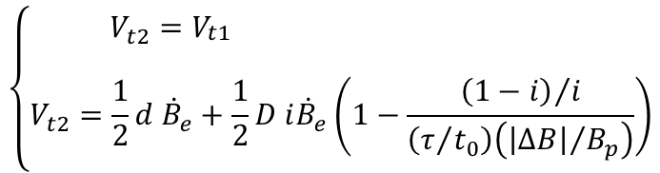



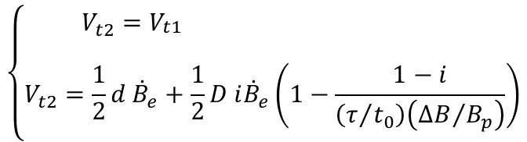

Dynamic Resistance
Resistive voltage per unit length, V_{t}, due to dynamic resistance
Ogasawara 1980 De Marzi & Corradini 2021
$${τ\dot{B}}/{B_{p}<\frac{\left(1−i\right)}{i} for \left(\text{0}\text{≤} t \text{≤}{ t}_{0}\right)}$$
Case (1)
Case (1)
$${τ\dot{B}}/{B_{p}<\left(1−i\right) for \left(\text{0}\text{≤} t \text{≤}{ t}_{0}\right)}$$
$$V_{t1}=\frac{1}{2}d i \dot{B}{\left(1−{τ\dot{B}}/{B_{p}}\right)}^{−1}$$
$$V_{t1}=\frac{1}{2}d i \dot{B}\left(1+{τ\left|\dot{B}\right|}/{B_{p}}\right)$$
$${τ\dot{B}}/{B_{p}\left\{\begin{matrix}<\left(1−i\right) for \left(\text{0}\text{≤} t \text{≤}{ t}_{1}\right) \\ ≥\left(1−i\right) for \left(t_{1}≤t ≤t_{0}\right)\end{matrix}\right.}$$
$${τ\dot{B}}/{B_{p}\left\{\begin{matrix}<{\left(1−i\right)}/i for \left(\text{0}\text{≤} t \text{≤}{ t}_{1}\right) \\ ≥{\left(1−i\right)}/i for \left(t_{1}≤t ≤t_{0}\right)\end{matrix}\right.}$$
Case (2)
Case (2)
$$\left\{\begin{matrix}V_{t2}=V_{\begin{aligned}t1 \\ \end{aligned}} \\ V_{t2}=\frac{1}{2}d {\dot{B}}_{e}+\frac{1}{2}D i{\dot{B}}_{e}\left(1−\frac{1−i}{\left(τ/{t_{0}}\right)\left({∆B}/{B_{p}}\right)}\right)\end{matrix}\right.$$
$$\left\{\begin{matrix}V_{t2}=V_{\begin{aligned}t1 \\ \end{aligned}} \\ V_{t2}=\frac{1}{2}d {\dot{B}}_{e}+\frac{1}{2}D i{\dot{B}}_{e}\left(1−\frac{{\left(1−i\right)}/i}{\left(τ/{t_{0}}\right)\left({\left|∆B\right|}/{B_{p}}\right)}\right)\end{matrix}\right.$$
$$0≤t≤t_{1}$$
$$t_{1}≤t≤t_{0}$$

Slide 14
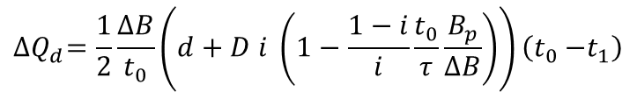
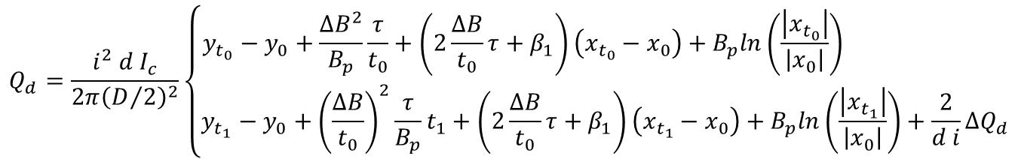

Losses due to Dynamic Resistance
Dynamic resistance losses per unit volume Q_{d}: analytical solution for ramping-up field
Ogasawara 1980 De Marzi & Corradini 2021
$$Q_{d}=\frac{1}{A}\int_{0}^{t_{0}}{V_{t}I_{t}∙dt}$$
$${τ\dot{B}}/{B_{p}<\frac{\left(1−i\right)}{i} for \left(\text{0}\text{≤} t \text{≤}{ t}_{0}\right)}$$
Case (1)
Case (1)
$${τ\dot{B}}/{B_{p}<\left(1−i\right) for \left(\text{0}\text{≤} t \text{≤}{ t}_{0}\right)}$$
$$M_{c1}=τ\dot{B}−\frac{1}{2B_{p}}{\left(τ\dot{B}\right)}^{2}$$
$$M_{c1}=\frac{τ\dot{B}}{1+{τ\dot{B}}/{B_{p}}}−\frac{1}{2B_{p}}{\left(\frac{τ\dot{B}}{1+{τ\dot{B}}/{B_{p}}}\right)}^{2}$$
$$Q_{d}=\frac{i^{2} d I_{c}}{2π{\left(D/2\right)}^{2}}\left\{\begin{matrix}y_{t_{0}}−y_{0}+\frac{{∆B}^{2}}{B_{p}}\frac{τ}{t_{0}}+\left(2\frac{∆B}{t_{0}}τ+β_{1}\right)\left(x_{t_{0}}−x_{0}\right)+B_{p}ln\left(\frac{\left|x_{t_{0}}\right|}{\left|x_{0}\right|}\right) \\ y_{t_{1}}−y_{0}+{\left(\frac{∆B}{t_{0}}\right)}^{2}\frac{τ}{B_{p}}t_{1}+\left(2\frac{∆B}{t_{0}}τ+β_{1}\right)\left(x_{t_{1}}−x_{0}\right)+B_{p}ln\left(\frac{\left|x_{t_{1}}\right|}{\left|x_{0}\right|}\right)+\frac{2}{d i}∆Q_{d}\end{matrix}\right.$$
Case (1)
Case (2)
$${τ\dot{B}}/{B_{p}\left\{\begin{matrix}<\left(1−i\right) for \left(\text{0}\text{≤} t \text{≤}{ t}_{1}\right) \\ ≥\left(1−i\right) for \left(t_{1}≤t ≤t_{0}\right)\end{matrix}\right.}$$
$${τ\dot{B}}/{B_{p}\left\{\begin{matrix}<{\left(1−i\right)}/i for \left(\text{0}\text{≤} t \text{≤}{ t}_{1}\right) \\ ≥{\left(1−i\right)}/i for \left(t_{1}≤t ≤t_{0}\right)\end{matrix}\right.}$$
Case (2)
Case (2)
$$\left\{\begin{matrix}M_{c2}=M_{c1} \\ M_{c2}=\frac{1}{2}B_{p}\left(1−i^{2}\right)\end{matrix}\right.$$
$$0≤t≤t_{1}$$
$$\left\{\begin{matrix}M_{c2}=M_{c1} \\ M_{c2}=\frac{1}{2}B_{p}\left(1−i^{2}\right)\end{matrix}\right.$$
$$0≤t≤t_{1}$$
$${∆Q}_{d}=\frac{1}{2}\frac{∆B}{t_{0}}\left(d+D i \left(1−\frac{1−i}{i}\frac{t_{0}}{τ}\frac{B_{p}}{∆B}\right)\right)\left(t_{0}{−t}_{1}\right)$$
$$t_{1}≤t≤t_{0}$$
$$t_{1}≤t≤t_{0}$$

Slide 15
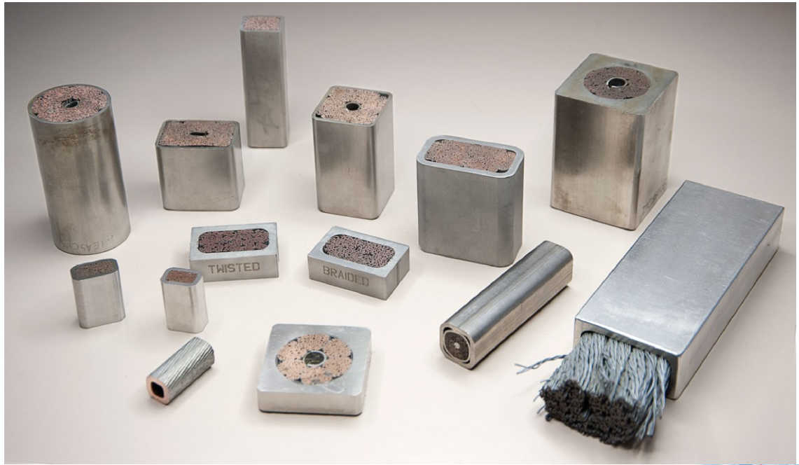
From Wires to Cables
Can this model be applied to CICCs and coils?

Slide 16
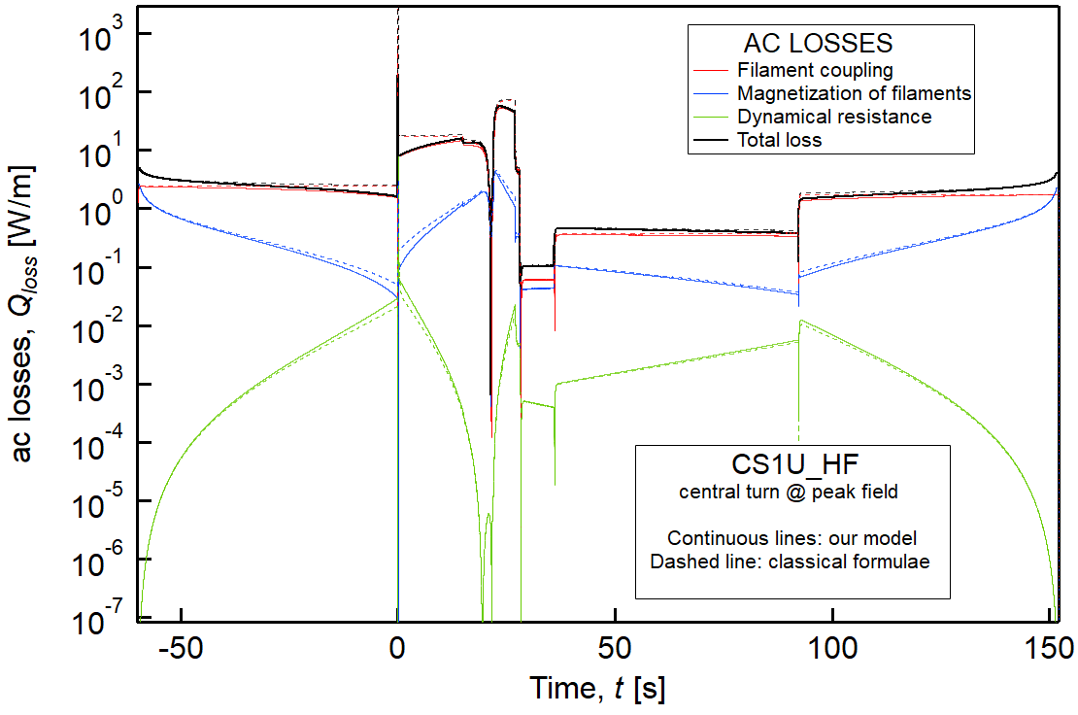
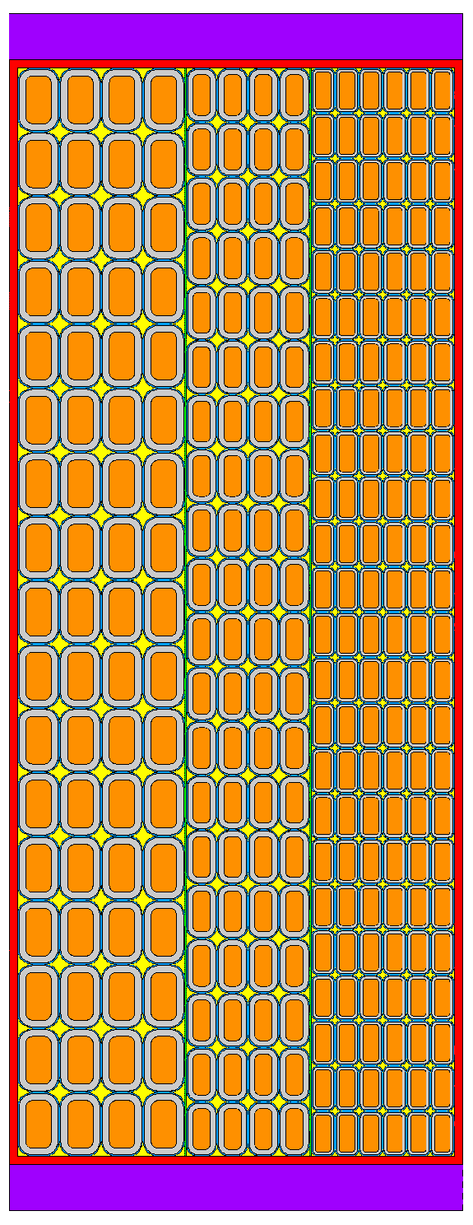
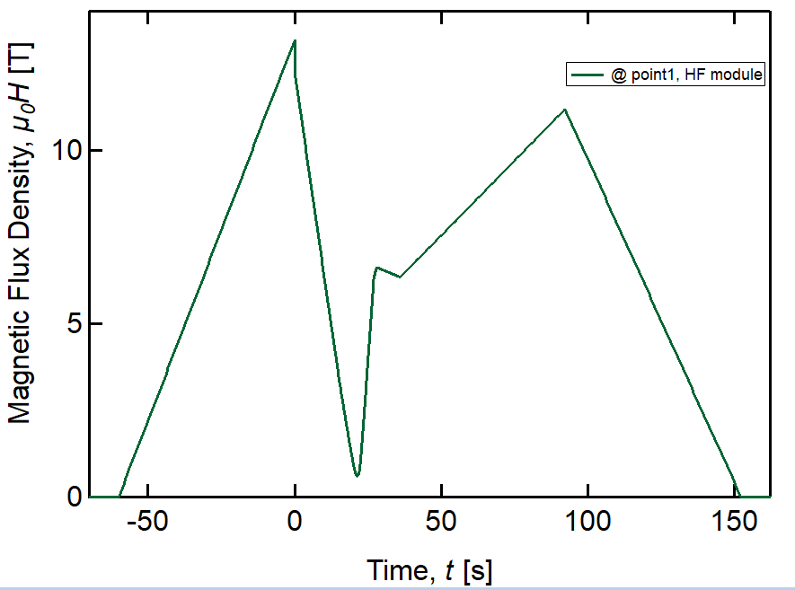
AC Losses in CS1U, HF Module
AC losses evaluated considering the
peak field on central turn
HF
MF
LF
120.8
88.7
τ = 150 ms
B_{p} = µ₀ J_{C}D/2
d = 15 µm
D = 0.82 mm
105.0
328.3

Slide 17
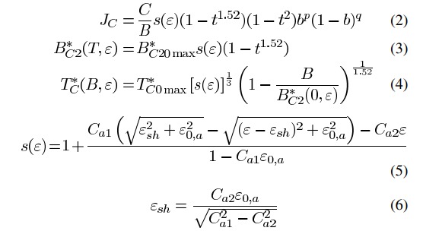
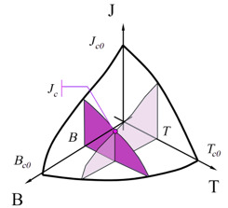

AC Losses in CS1U_HF – J_{C} Parameterization
J_{C} parameterization
ITER-2008 with ε_{eff} = -0.55%
$$J_{C}=\frac{C_{0}}{B}s\left(ε\right)\left(1−t^{1.52}\right)\left(1−t^{2}\right)b^{p}{\left(1−b\right)}^{q}$$
Coefficient | Value
C₀ [A T] | 20918
C_{a1} | 44.48
C_{a2} | 0.0
ε_{0,a} [%] | 0.256
ε_{m} [%] | -0.049
B_{c2,m}(0) [T] | 32.97
T_{c0,m} [K] | 16.06
p | 0.63
q | 2.1
τ = 150 ms
B_{p} = µ₀ J_{C}D/2
d = 15 µm
D = 0.82 mm

Slide 18
Comparative Analysis of AC Losses Results
Estimations using standard formulae lead to largely different values
Coupling&magnetization
AC losses tend to top-off to a maximum value ∝ (1-i²)
Decrease of coupling (≈ -46%) and magnetization (≈ -9%) losses
Dynamic resistance
At high ∂_{t}B, a dynamic resistance appears against the transport current flow, causing a large increase in AC loss ~∝ i²: +400%!
Comparison of the results obtained with different models for ac losses
Losses | Units | New formulation | Standard approach | Percentage change [%]
Coupling | [J/m] | 739.4 | 1357.2 | -45.5
Hysteresis | [J/m] | 78.3 | 85.8 | -8.7
Dynamic | [J/m] | 1.85 | 0.36 | 414
Total loss | [J/m] | 819.6 | 1443.4 | -43.2
Total loss | [W] | 737.7 | 1299.1 | -43.2
τ = 150 ms
B_{p} = µ₀ J_{C}D/2
d = 15 µm
D = 0.82 mm

Slide 19
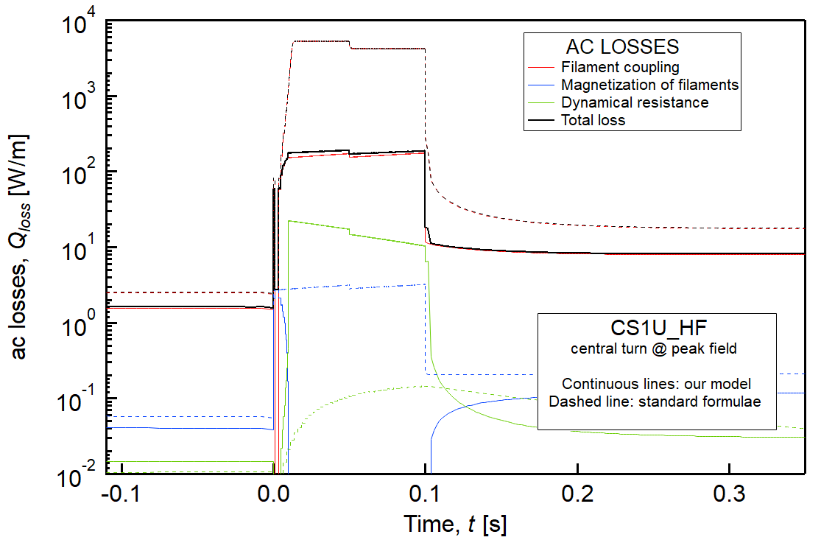



AC Losses in CS1U_HF During Breakdown
During breakdown, where ∂_{t}B peaks at 9.7 T/s, full saturation of strands occurs
The strands behave like a solid conductor and a saturation effect takes place in both the magnetization and the ac losses.
$$\lim_{\dot{B}→∞}{Q_{c}}=\frac{1}{2μ_{0}}B_{p}∆B\left(1−i^{2}\right)$$
$$\lim_{\dot{B}→∞}{Q_{h}}=0$$
$$\lim_{\dot{B}→∞}{Q_{d}}=\frac{1}{μ_{0}}B_{p}∆Bi^{2}$$

Slide 20
AC Losses in CS1U_HF During Breakdown
During breakdown, where ∂_{t}B peaks at 9.7 T/s, full saturation of strands occurs
The strands behave like a solid conductor and a saturation effect takes place in both the magnetization and the ac losses.
Losses | Units | Whole scenario | During breakdown | Contribution [%]
Coupling | [J/m] | 739.4 | 15.5 | 2.1
Hysteresis | [J/m] | 78.3 | 0.016 | 0.02
Dynamic | [J/m] | 1.85 | 1.4 | 75.7
Total loss | [J/m] | 819.6 | 17.0 | 2.1
Total loss | [W] | 737.7 | 15.3 | 2.1
$$\lim_{\dot{B}→∞}{Q_{c}}=\frac{1}{2μ_{0}}B_{p}∆B\left(1−i^{2}\right)$$
$$\lim_{\dot{B}→∞}{Q_{h}}=0$$
$$\lim_{\dot{B}→∞}{Q_{d}}=\frac{1}{μ_{0}}B_{p}∆Bi^{2}$$

Slide 21
Field-Rate Dependent nτ in CICCs
In multistage CICCs there exist multiple induced currents loops with a broad range of time constants, affecting different volume fraction of the cable conductors
Bruzzone et al., IEEE TAS 16, 827 (2006); Bruzzone et al., FED 146, 928 (2019)
Depending on the frequency, a dominant time constant can be picked up
  During plasma initiation, the nτ of the CICC approaches the range of the free standing strands
  Lower field changes (i.e., coil charge) are associated with higher nτ values
A single, but field-rate dependent coupling time constant, nτ(∂_{t}B), has been introduced in AC loss models

Slide 22
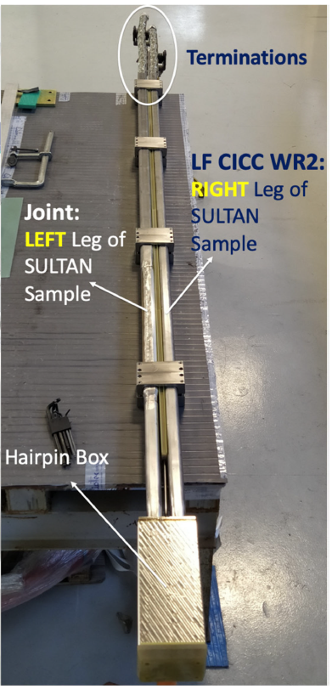
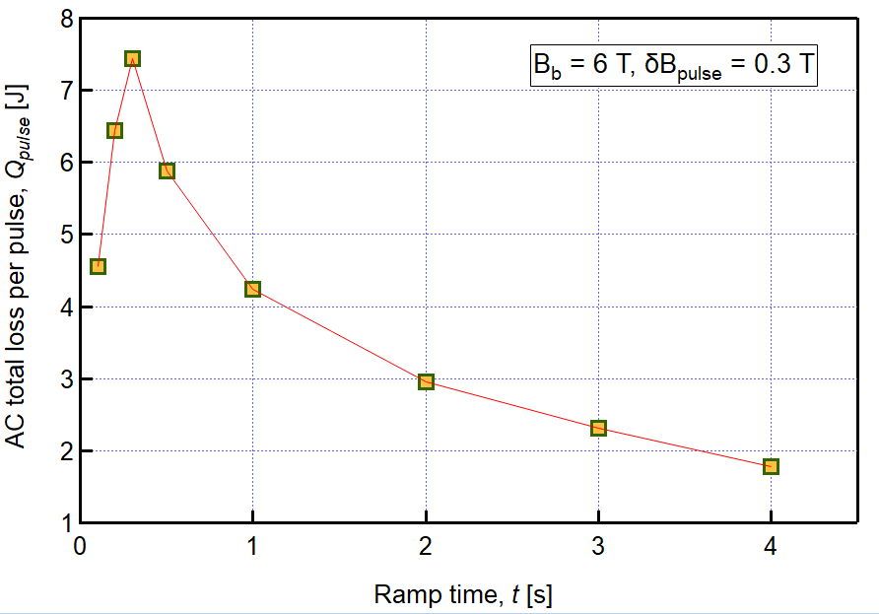
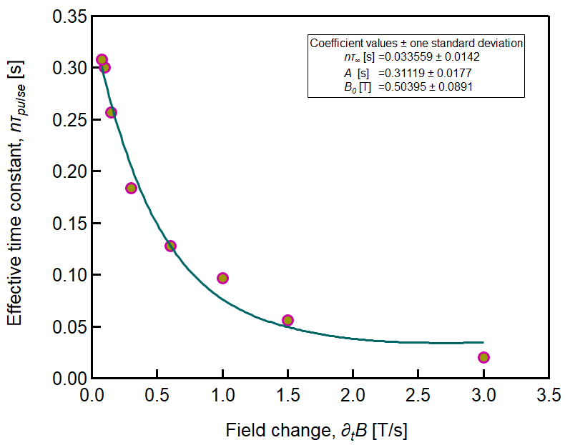
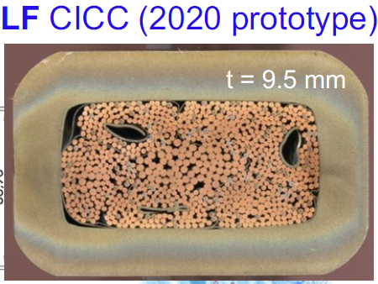
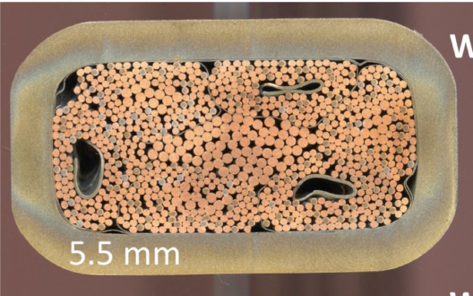

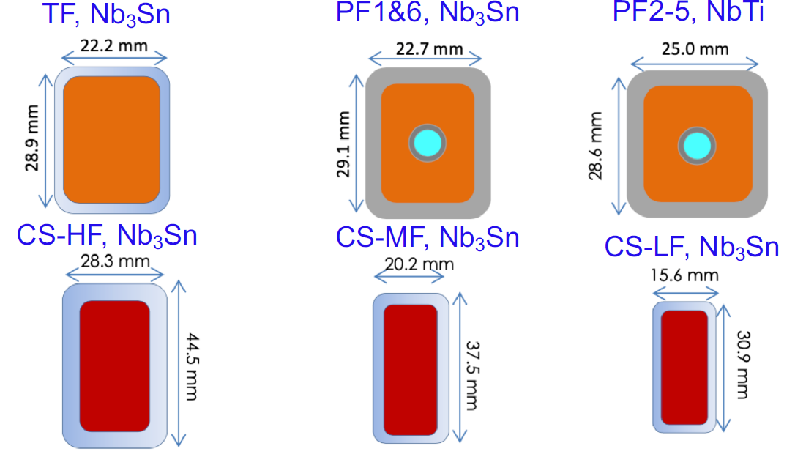

Experimental Assessment of nτ(∂_{t}B)
The behavior of nτ vs. ∂_{t}B is based on the experimental results ​​from recent SULTAN tests on the DEMO Low Field conductor (“WR2”), in which trapezoidal field pulses have been employed
For the procedure to obtain nτ_{pulse}, please refer to P. Bruzzone et al., FED 146, 928 (2019)
DEMO CICC
DTT-CS CICC
$$nτ\left(\dot{B}\right)={nτ}_{∞}+Ae^{−\frac{\dot{B}}{B_{0}}}$$
Courtesy of Luigi Muzzi
M. Kumar, MAG-4.2-T011-D003
DEMO WR2 vs. CS-DTT-HF
Similar layouts (rectangular, long twist pitch, low void fraction, SS wrapping)
Different number of SC strands
L. Muzzi et al., IEE TAS 31, 4201607 (2021)
Sample being inserted for heat treatment

Slide 23
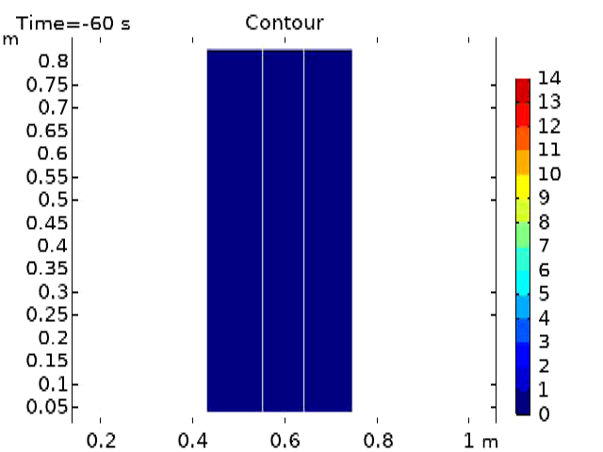


FEM Analysis Using Commercial Software
$$B_{e}−B=\frac{\dot{τB}}{1+\frac{τ\left|\dot{B}\right|}{B_{p}}}$$
Two-step procedure:
Evaluation of the external field map
  2D axisymmetric FE model
  Magnetic Field (mf) interface, AC/DC Module)
  Coil feature: homogeneized multiturn conductors
Evaluation of AC loss contributions
  Coeff Form PDE interface, Math module
  Time-dependent B_{i} map
  Calculation of Q_{c}, Q_{h}, Q_{d} (surface averages)

Slide 24




Recap: AC Losses in CS1U Module, HF Sub-Module
Plasma initiation
(breakdown)
Losses | nτ = 0.15 s |  |  | nτ=f(∂_{t}B)
 | Ries | 1 turn | FEM | FEM
Coupling [J/m] | 1357.2 | 739.4 | 584.5 | 639.9
Hysteresis [J/m] | 88.7 | 78.3 | 76.9 | 73.6
Dynamic [J/m] | 0.72 | 1.85 | 4.52 | 0.41
Total loss [J/m] | 1446.6 | 819.6 | 665.9 | 713.9
Total loss [W] | 1302.1 | 737.7 | 599.4 | 642.6

Slide 25


Future Directions
The qualification phase of the DTT CICC procurements will provide the information for the final choice of the 7 cable layouts
Twist pitch cabling sequence; e.m. cyclic loading; ε_{eff}
Coupling time constant nτ
Pressure drop, MQE tests and T_{cs}
The outcome will constitute a test bed for model validation
Analytical model - Unipolar trapezoidal pulses (ΔB = 0.3 T; t₀ = 0.1 to 4 s)
Numerical model - Sinusoidal pulsing (128 ms, 600 V max)
162/324
324/162
420/180
TF Sample manufacturing scheduled Nov. 2021
180/216
810/0
300/159
180/213
AC loss model as input tool for thermo-hydraulic analyses (PoliTo)
THELMA numerical model based on σ[S/m²] between cable elements - on going activity (UniBo)
Courtesy of M. Breschi and L. Cavallucci

Slide 26
Conclusion
Proposed a novel model for the calculation of AC losses due to fast varying fields
  Analytical solution of the Osagawara equation
  Coupling, magnetization, and dynamic resistance
Model applied to a Central Solenoid module of a Tokamak device (DTT):
  Evaluated AC losses on central turn at peak field
  Developed 2D FE model with variable nτ
Future directions: model validation
  SULTAN tests with trapezoidal ramps
  Benchmark with other approaches (UniBo)
  Other off-normal scenario still to be analyzed, with special reference to quench and disruptions

Slide 27

Gianluca De Marzi
gianluca.demarzi@enea.it

