Slide 1

Chats 2021 - via remote video system
Parametric study and optimization of
the cryo-magnetic system
for EU DEMO at the pre-conceptual design phase
CEA/DRF/IRIG: Christine Hoa, François Bonne, Thomas Latella
CEA/DRF/IRFM: Quentin Le Coz, Louis Zani, Benoît Lacroix
West Pomeranian University of Technology: Monika Lewandowska
EPFL/SPC: Kamil Sedlak
ENEA: Valentina Corato
Notes:
15 mn (12mn +3mn)

Slide 2
Contents
Introduction and context
Parametric study and optimization methodology
Thermal-hydraulic description and assumptions
Comparative results
Conclusions and perspectives

Slide 3
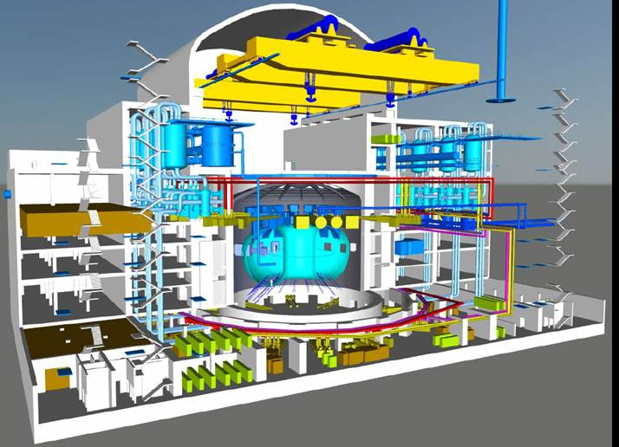
Introduction - Context
Pre-conceptual design of EU DEMO magnets, include eletromagnetic, mechanical, thermal-hydraulic and also cryogenic studies
Toroidal Field superconducting magnets
  3 cable-in-conduit conductor designs (2015)
    ITER-like: double pancake design
    Graded conductors: layer design
  Objective: to find cost effective solutions for the superconducting magnets and their cooling systems

Slide 4
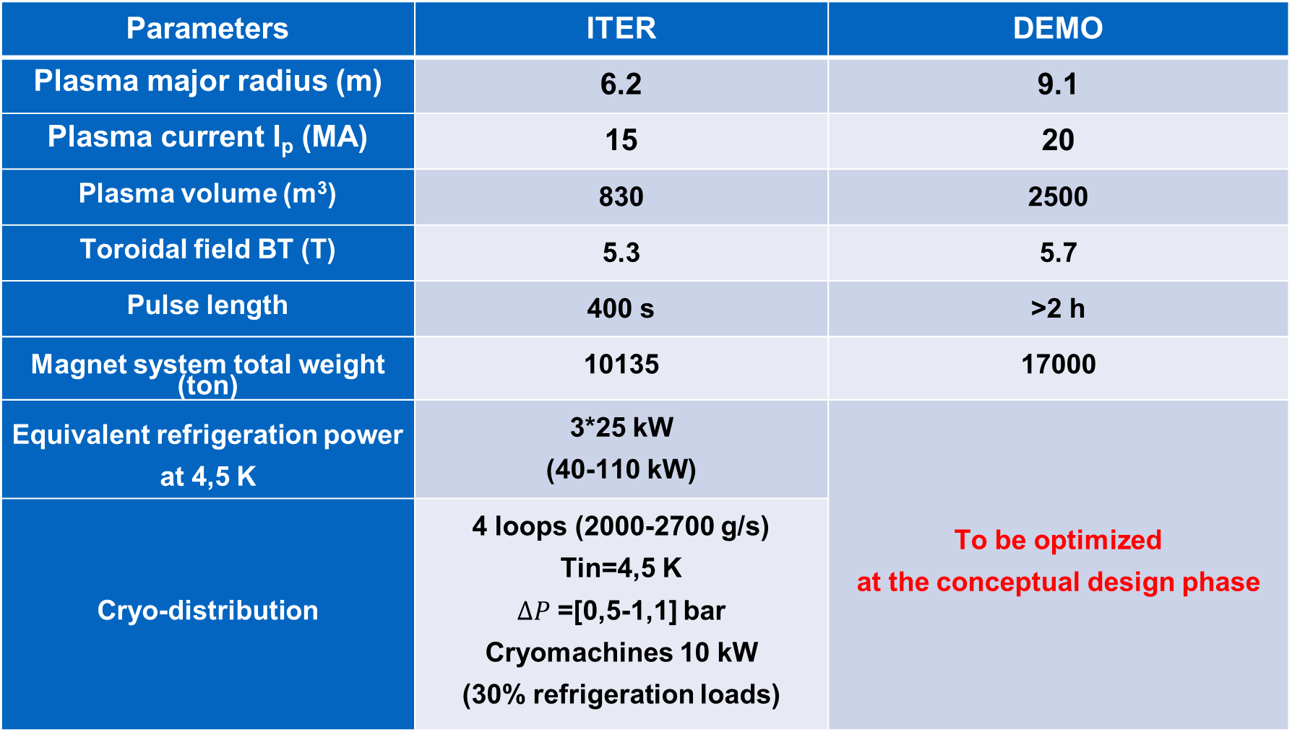
Introduction – Context
Parameters | ITER | DEMO
Plasma major radius (m) | 6.2 | 9.1
Plasma current I_{p} (MA) | 15 | 20
Plasma volume (m³) | 830 | 2500
Toroidal field BT (T) | 5.3 | 5.7
Pulse length | 400 s | >2 h
Magnet system total weight (ton) | 10135 | 17000
Equivalent refrigeration power at 4,5 K | 3*25 kW (40-110 kW) | To be optimized at the conceptual design phase
Cryo-distribution | 4 loops (2000-2700 g/s) Tin=4,5 K $ΔP$ =[0,5-1,1] bar Cryomachines 10 kW (30% refrigeration loads)

Slide 5
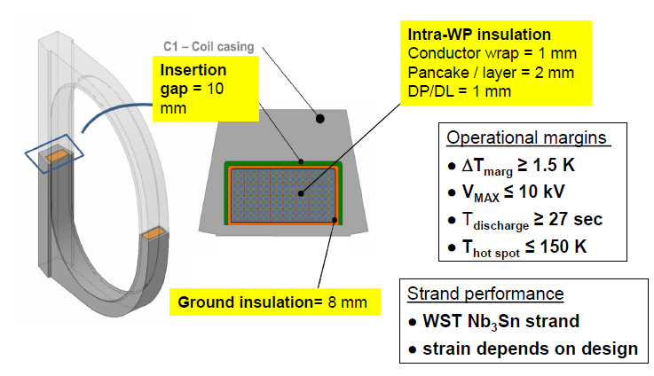

Introduction – Thermal-hydraulics
Supercritical helium at
T_{in}= 4.5 K, P_{in}=6 bar,
$ΔP$= 1 bar
(reference case)
Temperature margin w.r.t to current sharing temperature
(Tcs (x)- Tcicc (x) ) > 1,5 K
Introduction
Plasma
Nuclear heating,
AC losses, radiation,
conduction,
joints….
What is the optimized (magnet+ cryogenic distribution)?
Parametric studies Tin and $ΔP$

Slide 6
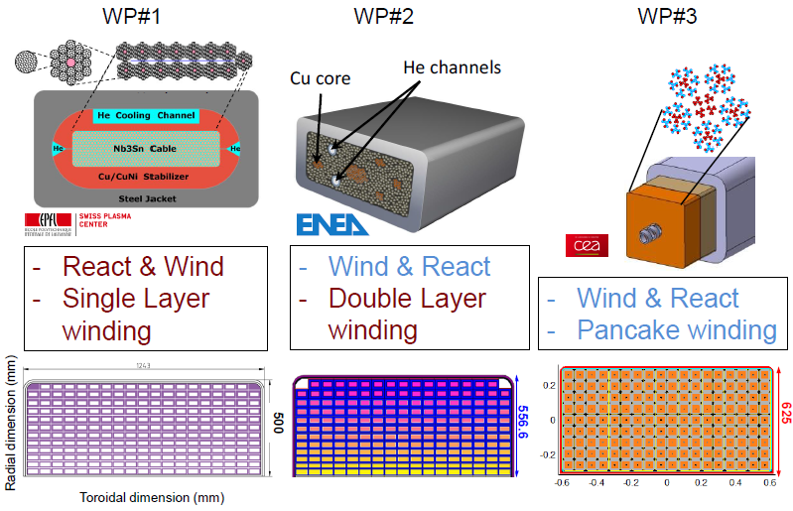
Conductor design options
single layer
Double layers
Double pancake

Slide 7

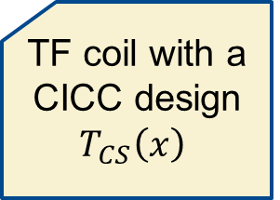


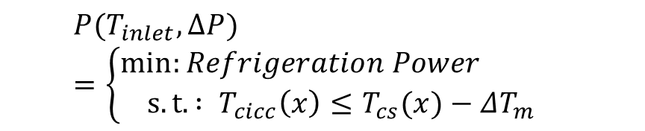
Parametric studies and optimization methodology
TF coil with a CICC design
$$T_{CS}\left(x\right)$$
$${(T_{inlet},∆P) }_{}$$
Cross-checks
SIMCRYOGENICS
1D CICC model
Inter-turn /Inter layer coupling
Parametric studies
TACTICS: THEA/CAST3M model
Inter-turn coupling
Analytical model
1D CICC model
no inter-turn coupling
Parametric studies
Nuclear heating
$Heat load Q(x)$
SIMCRYOGENICS
Optimization algorithm
(Cryodistribution SHe loop+ CICC model
  Variable Parameters
      Tinlet = [4.0- 4.6] K
      ΔP= [0.2-1.2] bar
$$P(T_{inlet},∆P)=\left\{\begin{matrix}min:{Refrigeration Power } \\ s.t. : T_{cicc}\left(x\right)≤T_{cs}(x)−ΔT_{m}\end{matrix}\right.$$
$${(T_{inlet},∆P) }_{optim}$$

Slide 8
Thermal-hydraulics description

Slide 9
Simcryogenics modelling

Slide 10
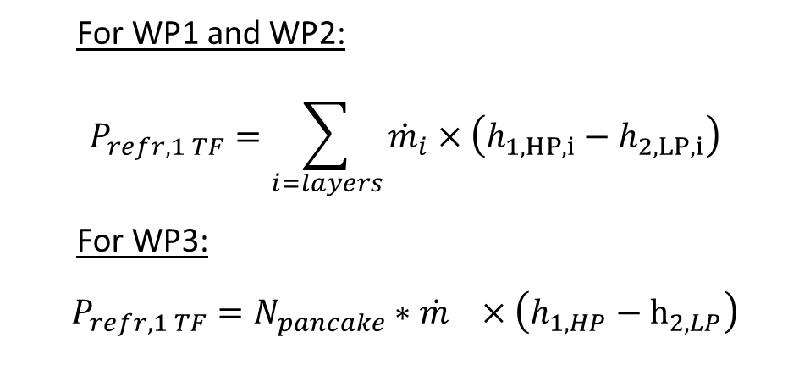
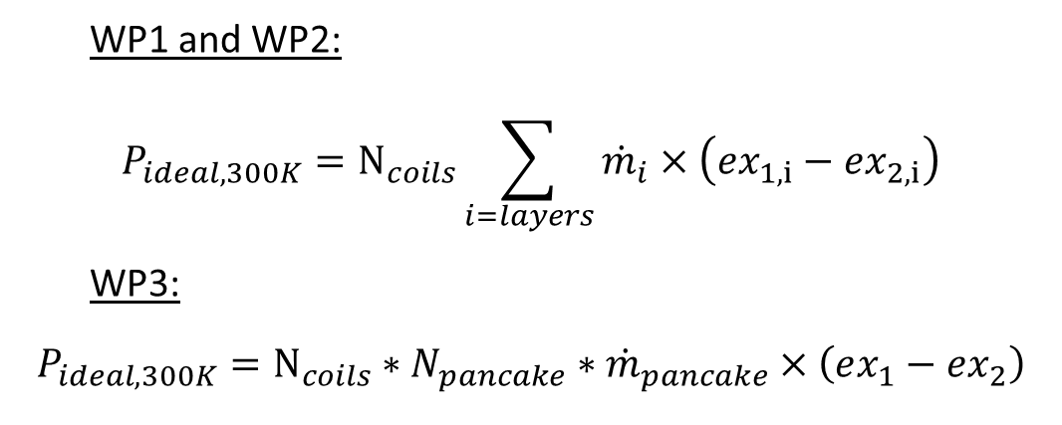
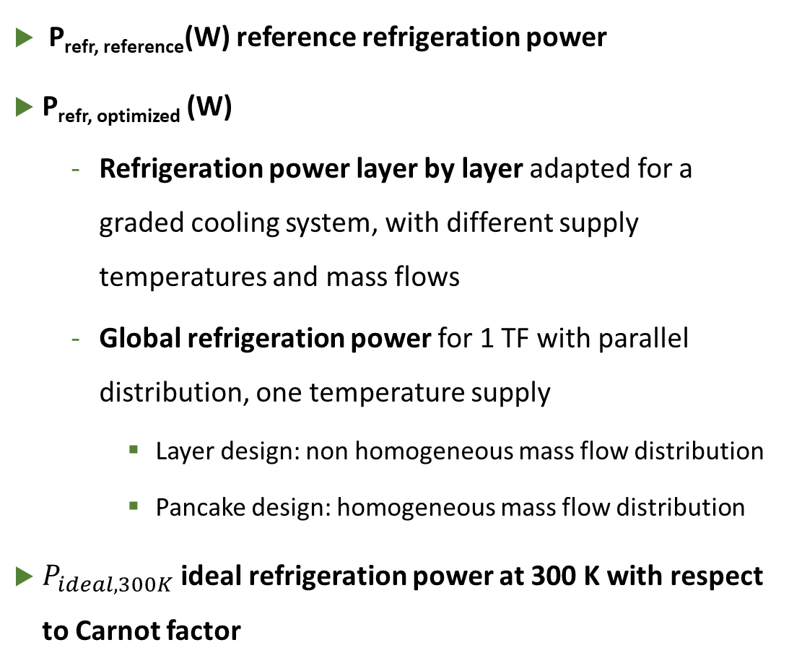
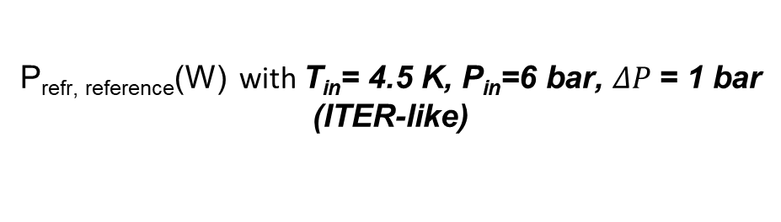
Optimization parameters
P_{refr, reference}(W) reference refrigeration power
P_{refr, optimized} (W)
  Refrigeration power layer by layer adapted for a graded cooling system, with different supply temperatures and mass flows
  Global refrigeration power for 1 TF with parallel distribution, one temperature supply
    Layer design: non homogeneous mass flow distribution
    Pancake design: homogeneous mass flow distribution
$P_{ideal,300K}$ ideal refrigeration power at 300 K with respect to Carnot factor
P_{refr, reference}(W) with T_{in}= 4.5 K, P_{in}=6 bar, $ΔP$= 1 bar
(ITER-like)
For WP1 and WP2:
$$P_{refr,1 TF}=\sum_{i=layers}{{\dot{m}}_{i}×\left(h_{1,HP, i}−h_{2,LP, i}\right)}$$
For WP3:
$$P_{refr,1 TF}=N_{pancake}∗{\dot{m}}_{}×\left(h_{1,HP}−h_{2, LP}\right)$$
WP1 and WP2:
$$P_{ideal,300K}=N_{coils}\sum_{i=layers}{{\dot{m}}_{i}×\left(ex_{1,i}−ex_{2,i}\right)}$$
WP3:
$$P_{ideal,300K}=N_{coils}∗N_{pancake}∗{\dot{m}}_{pancake}×\left(ex_{1}−ex_{2}\right)$$

Slide 11
Comparative results – layer by layer
WP#1 (SPC design) : 12 layers
Each layer is optimized independently
One optimized temperature: 4.5 K
Optimized ∆P : 0,3 bar and 0,25 bar
Power saving with respect to reference case (4.5 K, 1 bar) from 30% to 50%
Layers | L1 | L2 | L3 | L4 | L5 | L6 | L7 | L8 | L9 | L10 | L11 | L12
∆P (bar) | 0,30 | 0,25 | 0,25 | 0,25 | 0,25 | 0,25 | 0,25 | 0,25 | 0,25 | 0,25 | 0,25 | 0,25
T_{inlet} (K) | 4,5 | 4,5 | 4,5 | 4,5 | 4,5 | 4,5 | 4,5 | 4,5 | 4,5 | 4,5 | 4,5 | 4,5
P_{refr, reference} (W) | 59 | 50 | 44 | 37 | 33 | 27 | 23 | 19 | 16 | 13 | 11 | 9
P_{refr, optimized}W) | 42 | 33 | 27 | 23 | 19 | 16 | 13 | 11 | 8 | 7 | 7 | 5
Power saving (%) | -29 | -34 | -39 | -39 | -43 | -43 | -44 | -44 | -46 | -45 | -39 | -49
Heat loads (W) | 38,1 | 30,1 | 24,4 | 20,3 | 16,7 | 13,8 | 11,2 | 9,2 | 7,2 | 6,2 | 5,3 | 3,7

Slide 12
Comparative results – layer by layer
Each double layer is optimized independently
Large range optimized temperatures: 4.2 K to 4.5 K
Large range of optimized ∆P : 0.32 to 1.2 bar
With the reference cooling parameters (4.5 K, 1 bar), DL1 and DL2 are not compliant with the temperature margin of 1.5 K
Double layer design would benefit from a graded cooling scheme
Double layers | DL1 | DL2 | DL3 | DL4 | DL5 | DL6
∆P (bar) | 1,20 | 1,20 | 0,53 | 0,32 | 0,36 | 0,25
T_{inlet} (K) | 4,3 | 4,4 | 4,5 | 4,5 | 4,2 | 4,5
P_{refr, reference}(W) | 80 | 51 | 34 | 22 | 16 | 13
P_{refr, optimized}W) | 89 | 56 | 29 | 17 | 12 | 6
Power saving (%) | +12 | +9 | -14 | -26 | -24 | -57
Heat loads (W) | 70 | 42 | 26 | 15 | 9 | 5

Slide 13
Comparative results- global optimization WP1
∆P (bar) | 0,48
T_{inlet} (K) | 4,6
P_{refr, reference}(W) | 342
P_{refr, optimized}(W) | 229
Power saving (%) | -33
Heat loads (W) | 186
Inter-turn and inter-layer impact the heat load distribution
Layer L11 is the most critical one: the Tmargin=1,5 K is located at the end of the conductor length
Optimization of the cryo-distribution with (4.6 K, 0.48 bar) and a power saving of -33% with respect to reference case

Slide 14
Comparative results- global optimization WP2
Inter-turn and inter-layer impact the heat load distribution
Double layer DL5 is the most critical one: the Tmargin=1,5 K is located at the end of the conductor length
Optimization of the cryo-distribution with (4.0 K, 1 bar) and increase of the refrigeration power +25% with respect to reference case
∆P (bar) | 1.0
T_{inlet} (K) | 4.05
P_{refr, reference}(W) | 217
P_{refr, optimized}W) | 271
Power saving (%) | +25
Heat loads (W) | 167

Slide 15
Comparative results – WP3 Pancake design
Inter-turn impacts the heat load distribution → peak power in the first 50 meters of the conductor length where the temperature margin is located.
Optimization of the cryo-distribution with (4.3 K, 0.2 bar) with a power saving -46% with respect to reference case
∆P (bar) | 0,20
T_{inlet} (K) | 4,3
P_{refr, reference}(W) | 387
P_{refr, optimized}W) | 207
Power saving (%) | -46
Heat loads (W) | 164

Slide 16
Comparative results – Summary
The 3 TF designs have different optimized cooling parameters (T_{inlet} ,∆P)
It would induce different refrigeration requirements: refrigeration power but possibly could lead to different cryo-distribution and cryoplant architectures
The reference cooling parameters (T_{inlet} =4.5 K, ∆P=1 bar) are not the optimized parameters to minimize the refrigeration power.
  Some potential power saving of 30-45% have been estimated for WP1 and WP3.
  WP2 requires +25% refrigeration power in order to become compliant with the temperature margin of 1.5 K.
 | WP1 | WP2 | WP3
∆P (bar) | 0.48 | 1.0 | 0.20
Mass flows (g/s) | ~ 1700 | ~ 800 | ~ 1500
T_{inlet} (K) | 4.6 | 4.05 | 4.3
P_{refr, reference}(W) | 342 | 217 | 387
P_{refr, optimized}W) | 229 | 271 | 207
Total Ideal Power P_{ideal, optimized} (kW) | 402 | 403 | 328
Power saving (%) | -33 | + 25 | -46
Heat loads (W) | 186 | 167 | 164

Slide 17
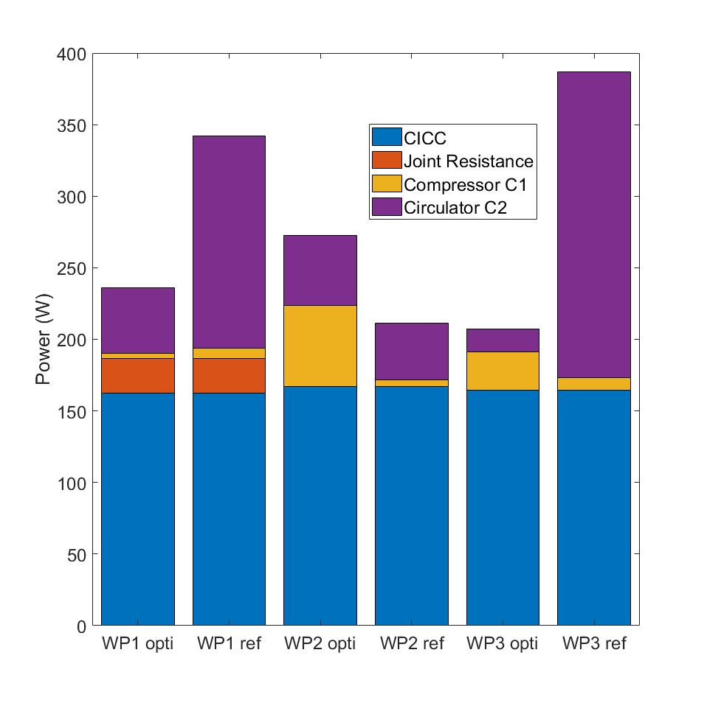

Comparative results – Summary
Reference cooling case
T_{in}= 4.5 K, P_{in}=6 bar,
$ΔP$= 1 bar
(ITER-like)
Details on the different contributions in the refrigeration power distribution
Comparison between the reference and optimized cases
  Optimized WP1 (Tin=4.6 K, ∆P=0.48 bar)
    joint resistance is included in the heat loads
    Significant decrease of the cold circulator power
  Optimized WP2 (Tin=4.05 K, ∆P=1 bar)
    To become compliant with the 1.5 K temperature margin, the cold compressor pumping load is increased to pump down the temperature bath down to 4.05 K
  Optimized WP3 (Tin=4.3 K, ∆P=0.2 bar)
    Significant decrease of the cold circulator power

Slide 18
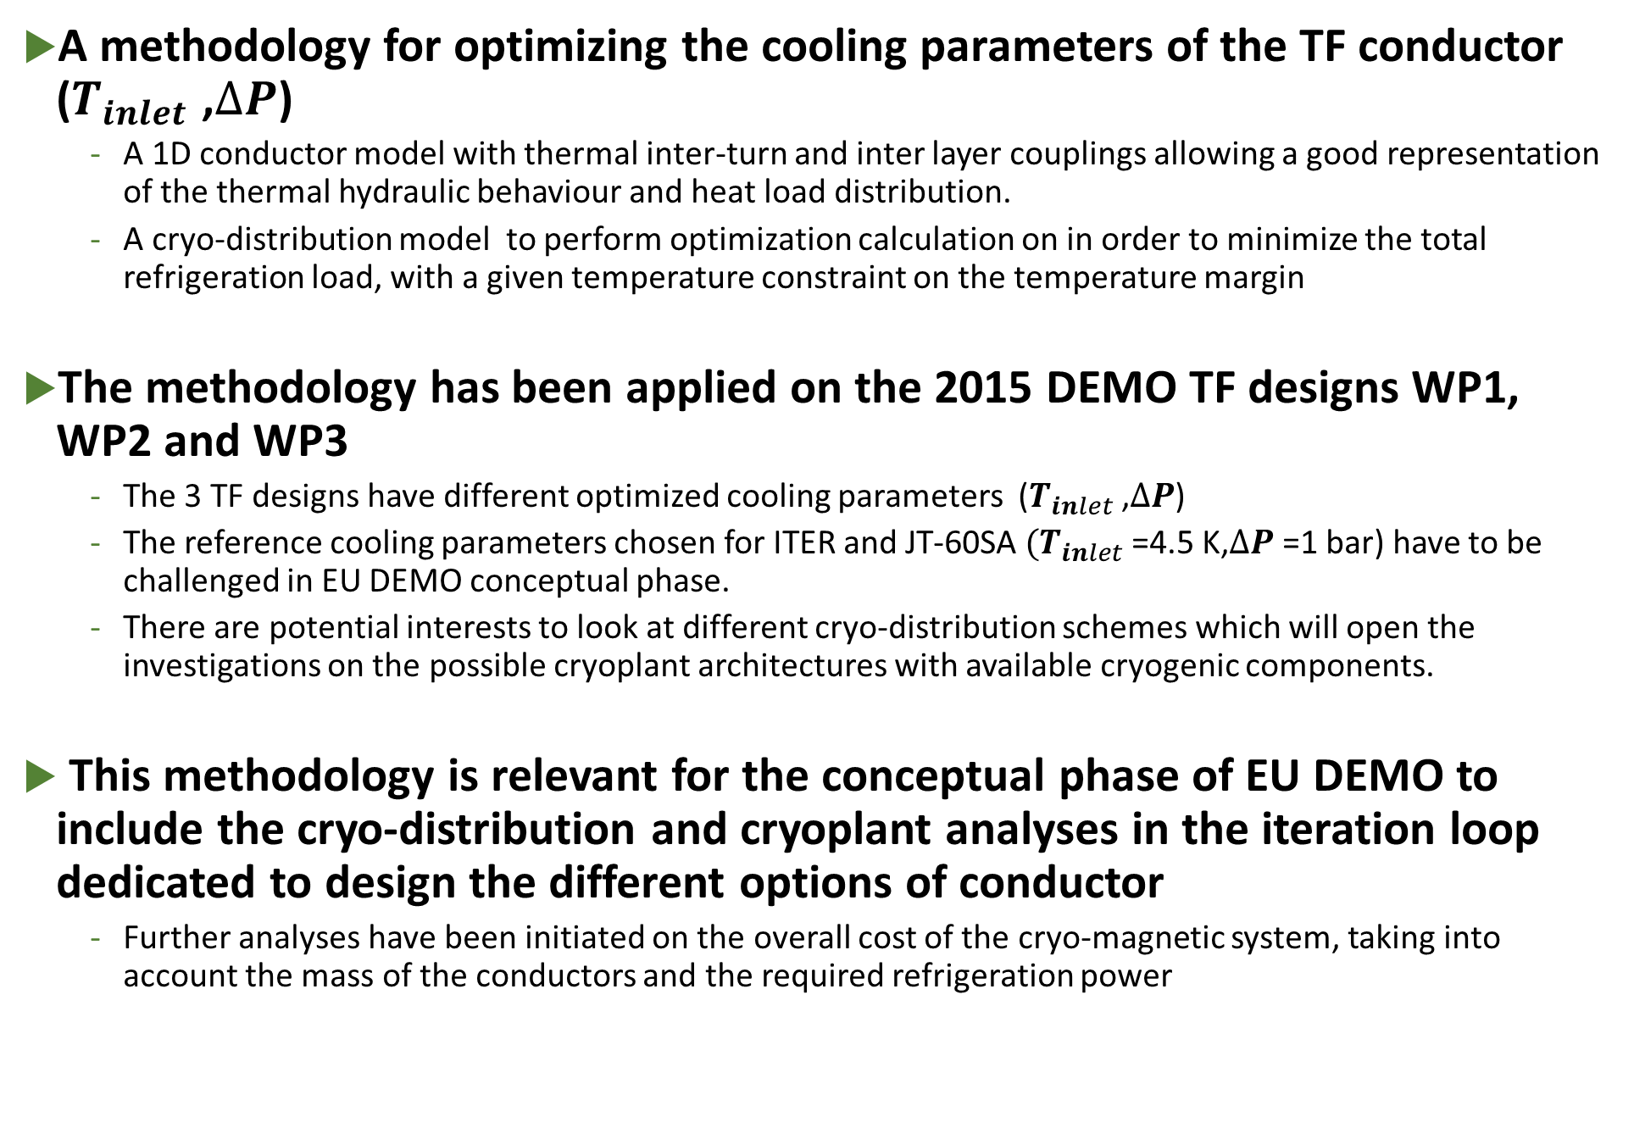
Conclusions and perspectives
A methodology for optimizing the cooling parameters of the TF conductor ($T_{inlet}$ ,$∆P$)
  A 1D conductor model with thermal inter-turn and inter layer couplings allowing a good representation of the thermal hydraulic behaviour and heat load distribution.
  A cryo-distribution model to perform optimization calculation on in order to minimize the total refrigeration load, with a given temperature constraint on the temperature margin
The methodology has been applied on the 2015 DEMO TF designs WP1, WP2 and WP3
  The 3 TF designs have different optimized cooling parameters ($T_{inlet}$ ,$∆P$)
  The reference cooling parameters chosen for ITER and JT-60SA $(T_{inlet}$ =4.5 K,$∆P$ =1 bar) have to be challenged in EU DEMO conceptual phase.
  There are potential interests to look at different cryo-distribution schemes which will open the investigations on the possible cryoplant architectures with available cryogenic components.
This methodology is relevant for the conceptual phase of EU DEMO to include the cryo-distribution and cryoplant analyses in the iteration loop dedicated to design the different options of conductor
  Further analyses have been initiated on the overall cost of the cryo-magnetic system, taking into account the mass of the conductors and the required refrigeration power

Slide 19
Thank you for your attention
Questions?

