Slide 1





JT-60SA Toroidal Field Coil Quench Model and Analysis:
Joule Energy Estimation with SuperMagnet and STREAM
Quentin GORIT
IUSTI/ PT/ IPT
CEA / DRF / IRFM / STEP / GAIM
Q. Gorit, F. TOPIN, S. Nicollet, A. LOUZGUITI, b. lacroix, A. TORRE, R. Vallcorba, L. ZANI
20/09/2021

Slide 2
CONTENT
1) Introduction
2) Normal length estimation from voltage measurement
3) Numerical and analytical quench models
4) JT-60SA TFC02 acceptance quench test in Cold Test Facility analysis
5) JT-60SA TFC quench in Tokamak environment: predictive calculation
6) Conclusion
PhD Q. Gorit: CHATS 2021 Presentation, 20/09/2021
2

Slide 3
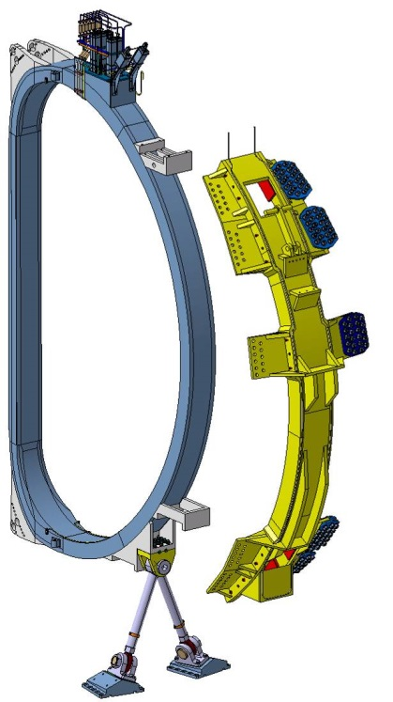
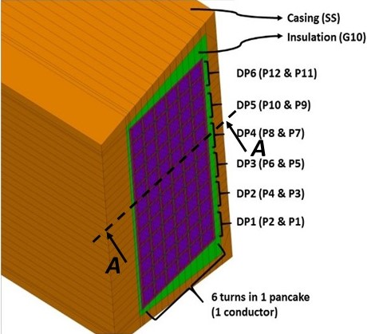
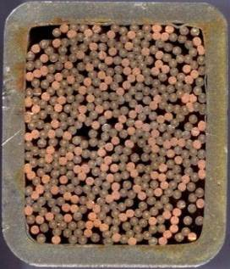
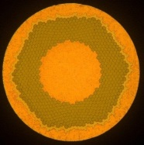
1.1) JT-60SA TF COIL AND QUENCH IN CICC
Copper matrix
22 mm
0,8 mm
26 mm
≈8 m
Central DP
Inner DP
NbTi filaments
Side DP
Strand
CICC
(Cable-In-Conduit-Conductor)
cooled by supercritical helium forced-flow
WP (Winding Pack)
TFC (Toroidal Field Coil)
  Quench: Irreversible transition from superconducting state to normal resistive state.
  If not quickly detected, it may lead to possible permanent damage of the magnet.
Starting from a local perturbation, the normal (quenched) zone propagates and generates a large resistive power by Joule effect.
He inlet
He outlet
113 m
PhD Q. Gorit: CHATS 2021 Presentation, 20/09/2021
3

Slide 4
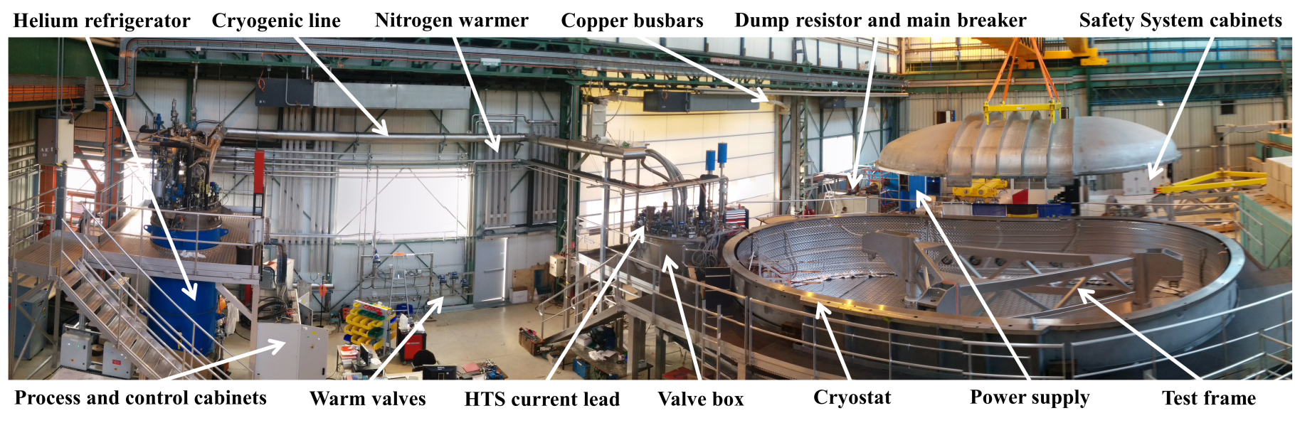
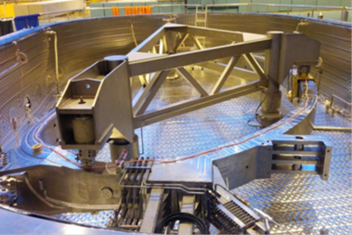
1.2) JT-60SA TFC QUENCH TESTS IN COLD TEST FACILITY (SACLAY, 2016-2018)
      18 TF coils and 2 spare coils were tested for:
      Acceptance tests before delivery
      Quench phenomenon investigations
Inlet quench initiation by increasing the injected helium temperature
Pick-up coil
Joints and helium inlets box
      Helium temperatures at Winding Pack inlet and outlet
JT-60SA TFC in Cold Test Facility
PhD Q. Gorit: CHATS 2021 Presentation, 20/09/2021
4

Slide 5
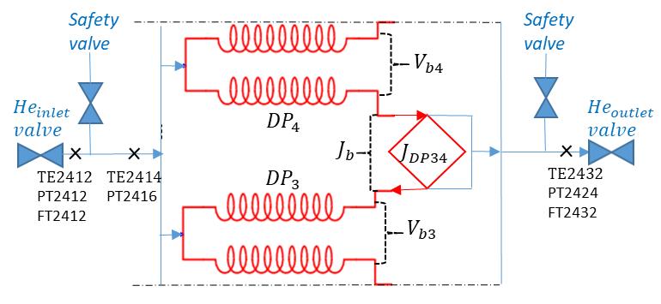
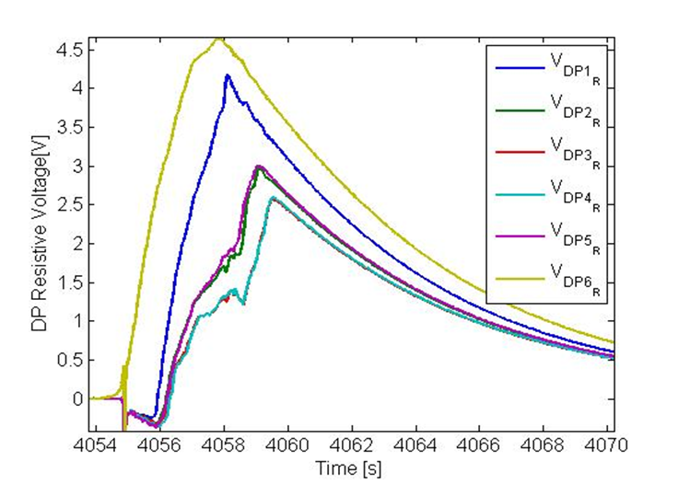
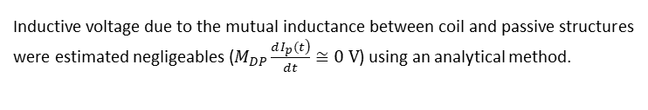




2.1) RESISTIVE VOLTAGE ESTIMATION FROM VOLTAGE MEASUREMENTS
Cold Test Facility instrumentation allows to study the quench propagation and the resulting helium expulsed mass flow from the coil.
Resistive and inductive voltage determination
Pure Current Fast Discharge (PCFD) test (without quench${ R}_{Dp}(t)=$0 Ω) was used in order to estimate inductive voltage induced in TFC02 double-pancakes.
$$γ_{DP}(t)={\left(\frac{V_{b,DP}(t)}{V_{pickup}(t)}\right)}_{PCFD} ={\left(\frac{V_{DP,inductive}(t)}{V_{pickup}(t)}\right)}_{quench}$$
Application to TFC02 acceptance quench test
($I_{0}=25.7 kA, B_{max}=3.05 T, ṁ_{He}=24 g/s, τ_{da}=0.1 s, τ=8 s$)
Cold Test facility instrumentation scheme
The fast current discharge decreases magnetic field which induce inductive voltage inside coil and passive structures.
$$V_{b,DP}\left(t\right)=L_{DP}\frac{ dI\left(t\right)}{dt}+M_{DP}\frac{dI_{p}(t)}{dt}+R_{DP}\left(t\right) I(t)$$
$$V_{DP,inductive}$$
$$V_{DP,resistive}$$
Inductive voltage due to the mutual inductance between coil and passive structures were estimated negligeables ($M_{DP}\frac{\left.dI_{p}(t\right)}{dt}≅0 V$) using an analytical method.
TFC02 acceptance quench test, double-pancake resistive voltages (Exp)
[1] A.Louzguiti et al., ‘Modeling of AC losses and simulation of their impact on JT-60SA TF magnets during commissioning’, ASC Conference, 2020
PhD Q. Gorit: CHATS 2021 Presentation, 20/09/2021

Slide 6
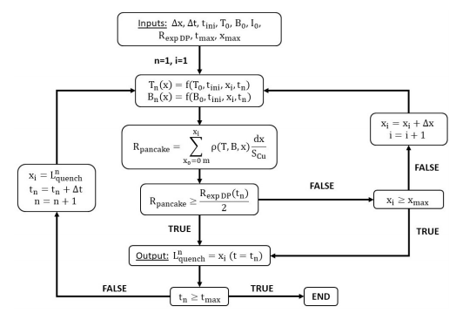




2.2) NORMAL LENGTH ESTIMATION FROM RESISTIVE VOLTAGE
Heuristic quench propagation model for normal length estimation
Experimental pancake resistance assumption:
$$R_{P}(t)=\frac{R_{DP}(t)}{2}=\frac{V_{DP,resistive}(t)}{2 I(t)}$$
Maximal conductor temperature calculation:${ T}_{cond,max}(t)$
$$T_{cond,max}\left(t=0\right)=T_{cs}$$
Initial condition:
0-D energy conservation relations applied to helium, conductor and jacket
Linear temperature profile assumption:
$$T_{cond}\left(t,x=0\right)=T_{cond,max}(t)$$
Boundary condition:
$$\begin{aligned}\frac{dT_{cond}\left(t,x\right)}{dx}=\frac{\left({T_{cs}−T}_{cond,max}\left(t\right)\right) }{L_{q}\left(t\right)}\end{aligned}$$
Predicted and measured resistances comparison
CICC normal length evolution at each time step
Schematic of the heuristic quench propagation model
[2] Y. Huang, ‘Study and modelling of the thermohydraulic phenomena taking place during the quench of a superconducting magnet cooled with supercritical helium’, p. 179, 2019
PhD Q. Gorit: CHATS 2021 Presentation, 20/09/2021

Slide 7
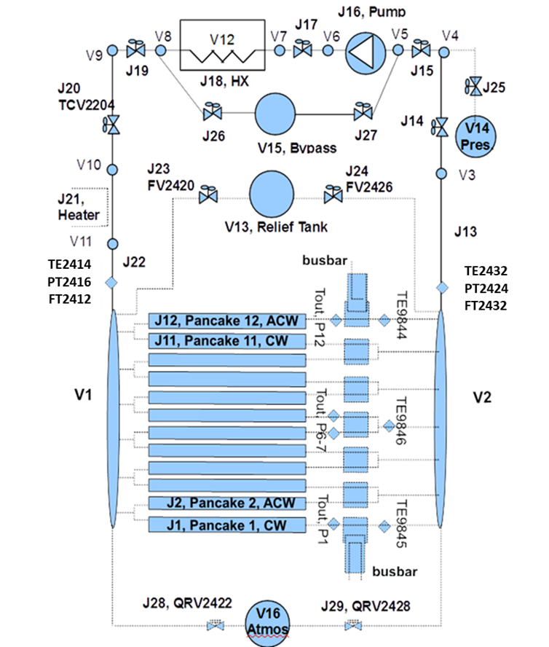






3.1) TF COIL AND CRYODISTRIBUTION sUPERmAGNET model
SuperMagnet code (L. Bottura ,CERN, fortran):
Coupling THEA (1-D CICC electrical and thermohydraulical model) and FLOWER (hydraulical model)
THEA modelisation of 12 CICC with helium, strands and jacket components
Magnetic field profile (TRAPS) and friction factor correlation (OTHELLO facility) for each pancake
FLOWER modelisation of the cryodistribution
(pump, heat exchanger, quench relief tank, valves and heater)
$$q_{PowerLoss,CTF}$$
$$h_{conv}=\frac{f_{EU} λ_{f} R_{e} {P_{r}}^{\frac{1}{3}}}{8 D_{h} }$$
NbTi/Cu strands
SS jacket
$$R_{th}$$
$q_{Joule}$
G10 insulation
$$q_{InterturnCoupling}=\frac{ΔT_{\left\{turn1−turn2\right\}}}{R_{th}}$$
Quench primary detection: voltage threshold $U_{detec}$= 0.1 V
Current discharge ($I(t)=I_{0}e^{−t/τ}$) triggers after quench detection and action time ($τ_{da}$= 0.1 s)
→ Developed numerical SuperMagnet model of JT-60SA TF coil and its cryodistribution
Schematic of TFC and cryodistribution SuperMagnet model
[3] S. Nicollet and al., ‘Parametric Analyses of JT-60SA TF Coils in the Cold Test Facility With SuperMagnet Code’, IEEE Trans. Appl. Supercond., vol. 28, no. 3, p. 4205205, Apr. 2018.
PhD Q. Gorit: CHATS 2021 Presentation, 20/09/2021
7

Slide 8
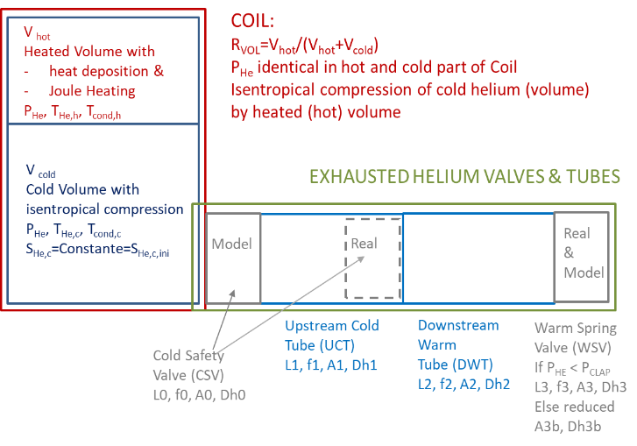
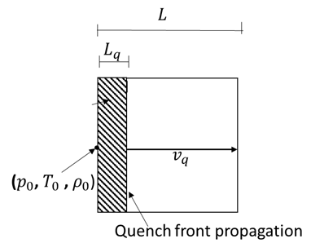





3.2) Analytical stream model
STREAM: Superconductor Thermohydraulical and Resistive Electrical Analytical Model
(S. Nicollet, IRFM, Matlab):
Thermohydraulical governing equations:
0-D adiabatic cold volume submitted to isentropic compression:
$$\frac{dW\left(t\right)}{dt}=−p\left(t\right)\frac{dV_{cold}\left(t\right)}{dt}=p\left(t\right)\frac{dV_{hot}\left(t\right)}{dt}$$
0-D energy conservation relations applied to conductor, helium and jacket:
$$\frac{\left.dT_{cond}(t\right)}{dt} =\frac{\frac{η_{Cu}(t) L_{q}(t)}{A_{Cu}} {\left.I(t\right)}^{2}−h_{conv} P_{w,cond} L \left(\left.T_{cond}(t)− T_{He}(t\right)\right)}{L \left(\left.A_{Cu} ρ_{Cu} C_{Cu}(t)+ A_{NbTi} ρ_{NbTi} C_{NbTi}(t\right)\right)}$$
Second law of thermodynamics, energy and mass conservative relations describe the 1-D expulsed helium flow from the coil when reaching a pressure drop threshold.
STREAM model scheme
A. Shajii analytical quench propagation model: Long coil - High pressure rise Regime
$$\frac{Δp}{p_{0}}=\frac{r ρ_{0}α_{0 }J_{0}^{2} L_{q,ini}}{2{ p}_{0 }v_{q}\left(t_{m}\right)}>1$$
$$v_{q}\left(t\right)=\frac{dL_{q}\left(t\right)}{dt}=0.766{\left(\frac{2 D_{h}}{f}\right)}^{\frac{1}{5}}{\left(\frac{r L_{q,ini} α_{0 }J_{0}^{2}}{c_{0}}\right)}^{\frac{2}{5}}\frac{1}{t^{\frac{1}{5}}}$$
$$L^{2}>\frac{24 D_{h} c_{0}^{2}{ t}_{m}}{f v_{q}(t_{m})}$$
$$α_{0}=\min_{T=[T_{cr}:300]}(\frac{A_{cu}η_{Cu}\left(T\right)}{A_{cond}{ ρ}_{cond}{ C}_{cond}\left(T\right)+A_{jacket}{ ρ}_{jacket}{ C}_{jacket}\left(T\right)})$$
[4] A. Shajii, J. P. Freidberg, and E. A. Chaniotakis, ‘Universal scaling laws for quench and thermal hydraulic quenchback in CICC coils’, IEEE Transactions on Applied Superconductivity, vol. 5, no. 2, pp. 477–482, Jun. 1995
PhD Q. Gorit: CHATS 2021 Presentation, 20/09/2021
8

Slide 9
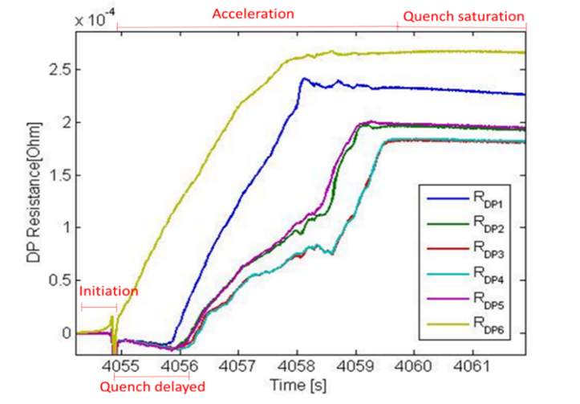
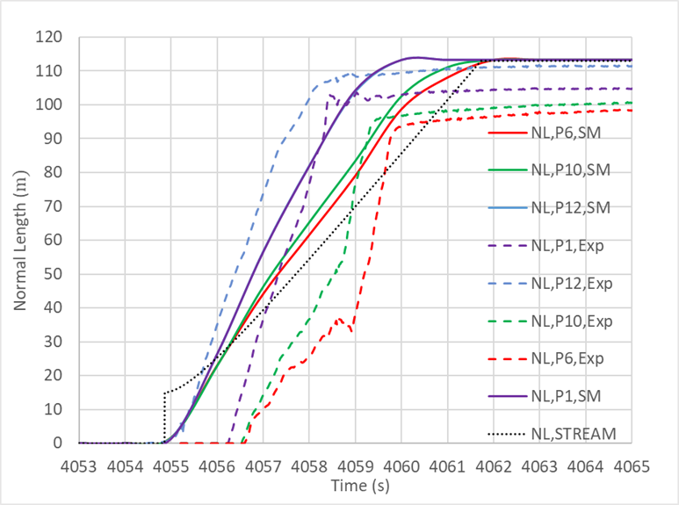
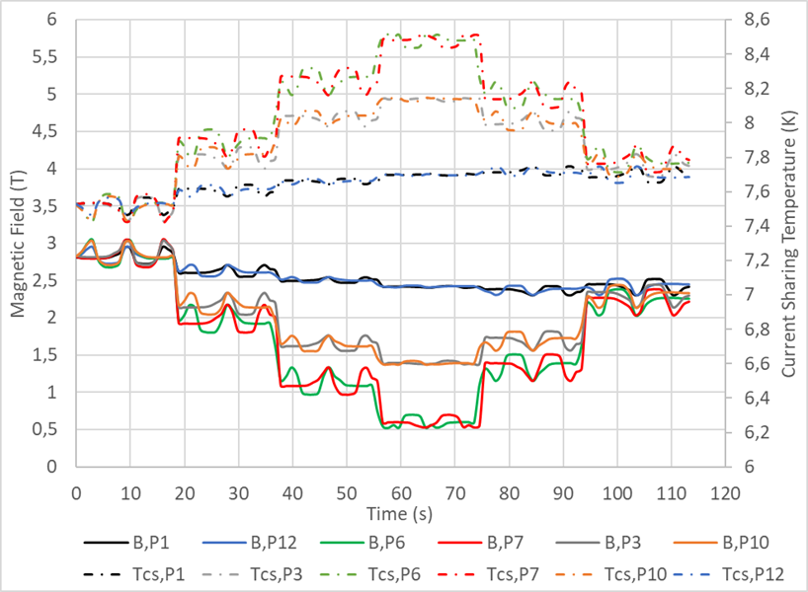


4.1) TFC02 ACCEPTANCE TEST: QUENCH PROPAGATION
$$v_{q,P1,SM}=v_{q,P12,SM}=22.5 m/s$$
$v_{q,P12,Exp=}=25.6$ m/s
39 m
$v_{q,Average,SM=}=17.4$ m/s
19 m
$v_{q,STREAM=}=16.1$ m/s
TFC02 acceptance quench test, double-pancake resistance (Exp)
TFC02 acceptance quench test, normal length propagation (SM , STREAM, Exp)
Quench initiation at inlet of side double-pancake 6 caused by the thermal loss from thick casing to Winding Pack
Central DP
Inner DP
Helium reverse flow effect: warm helium injection (expulsed mass flow from side pancake) → simultaneous quench initiation in inner and central double-pancakes
Side DP
Quench propagation mitigated by V-shape magnetic field distribution:
$v_{q,P6,SM}=16.2 m/s$ ${<v}_{q,P10,SM}=17.4 m/s$ ${<v}_{q,P12,SM}$
19 m
39 m
Re-acceleration phenomenon: Second quench initiation in inner and central double-pancakes ($v_{q}≅$50 m/s) by a quench propagating through electrical inter-pancake joints
TFC02 acceptance quench test, Magnetic field and current sharing temperature profiles
PhD Q. Gorit: CHATS 2021 Presentation, 20/09/2021

Slide 10
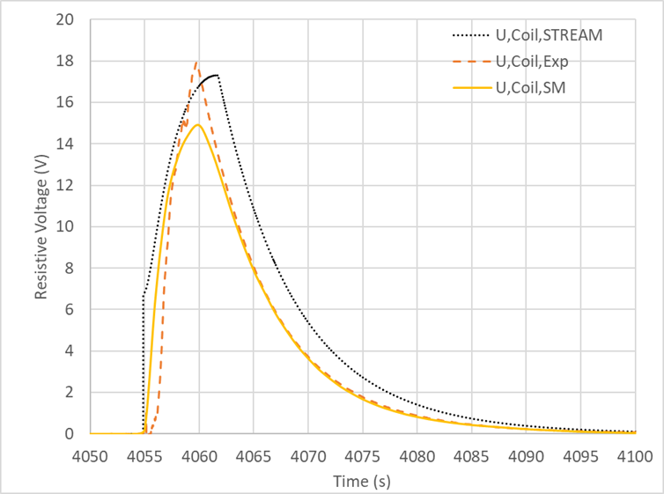
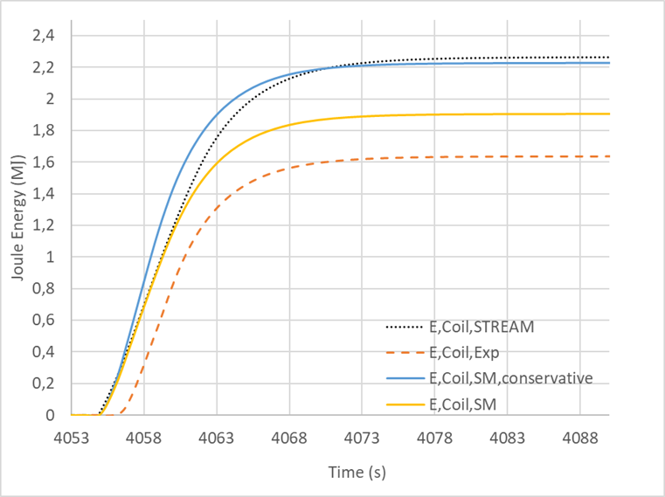

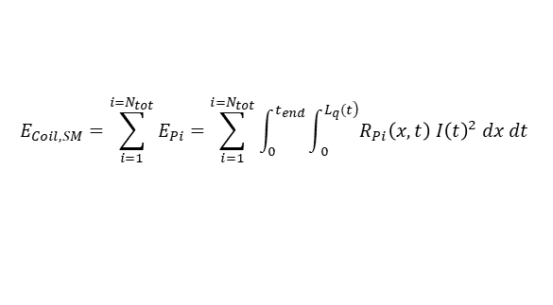
4.2) TFC02 ACCEPTANCE TEST : ELECTRICAL RESULTS
TFC02 acceptance quench test, coil resistive voltage (SM, STREAM, Exp)
TFC02 acceptance quench test, coil Joule energy dissipation (SM, STREAM, Exp)
$$U_{Coil,max,SM}=14.9 V<U_{Coil,max,STREAM}=17. 3 V<U_{coil,max,Exp}=17.8 V$$
$${E_{coil,Exp}=\text{1.64 }\text{MJ} \text{< }E_{coil,SM}=1.90 MJ\text{<} E}_{Coil,STREAM}=2.21 MJ$$
$$E_{Coil,SM}=\sum_{i=1}^{i=N_{tot}}{E_{Pi}}=\sum_{i=1}^{i=N_{tot}}{\int_{0 }^{t_{end}}{\int_{ 0}^{\left.L_{q}(t\right)}{R_{Pi}\left(x,t\right) I{\left(t\right)}^{2} dx dt }}}$$
Good agreement between experimental, analytical and numerical results.
STREAM is conservative, indeed the model extrapolates results from one CICC to the twelve composing the coil.
$$E_{coil,SM,conservative}={N_{tot} E}_{Pi,max}= 2.20 MJ$$
PhD Q. Gorit: CHATS 2021 Presentation, 20/09/2021

Slide 11
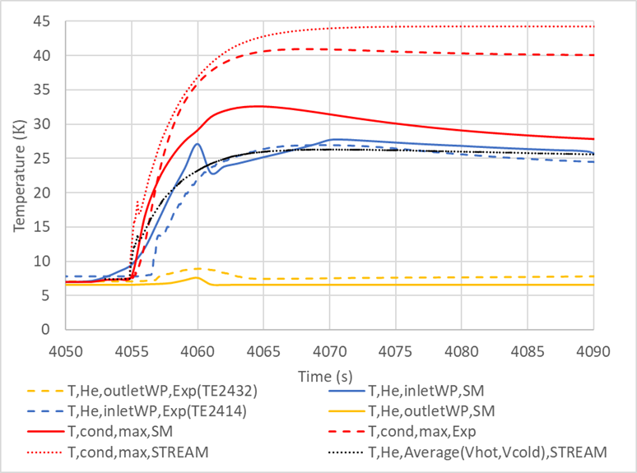
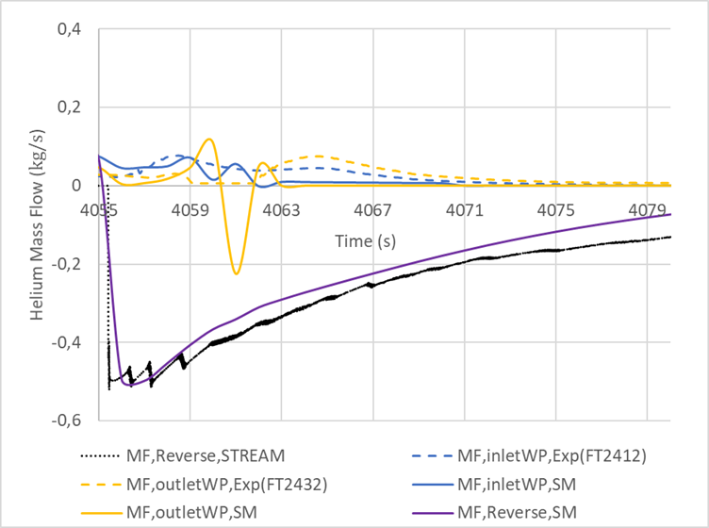



4.3) TFC02 ACCEPTANCE TEST : THERMOHYDRAULICAL RESULTS
$$T_{cond,max,SM}=32.58 K$$
$$T_{He,inletWP,max,SM}=27.12 K$$
$$T_{He,inletWP,max,Exp}=26.77 K$$
$$MF_{Reverse,max,SM}=MF_{Reverse,max,STREAM}=0.5 kg/s$$
TFC02 acceptance quench test, helium and conductor temperatures (SM, STREAM, Exp)
TFC02 acceptance quench test, helium mass flows (SM, STREAM, Exp)
Normal zone induces local helium depletion and high forced convection expulsing helium mass flows in two opposite directions (reverse and accelerate mass flows)
Quench detection time (t=4055 s): Helium inlet and outlet valves are closed (quasy isochoric system)
5 s period (t=4060 s) : Quench safety valves opening (releasing the warmed helium from the coil into the quench tank)
The maximal conductor temperature calculated numerically reach 32.58 K in the side pancake 12 (first pancake reaching the quench saturation phase)
Cold Test facility instrumentation scheme
PhD Q. Gorit: CHATS 2021 Presentation, 20/09/2021

Slide 12
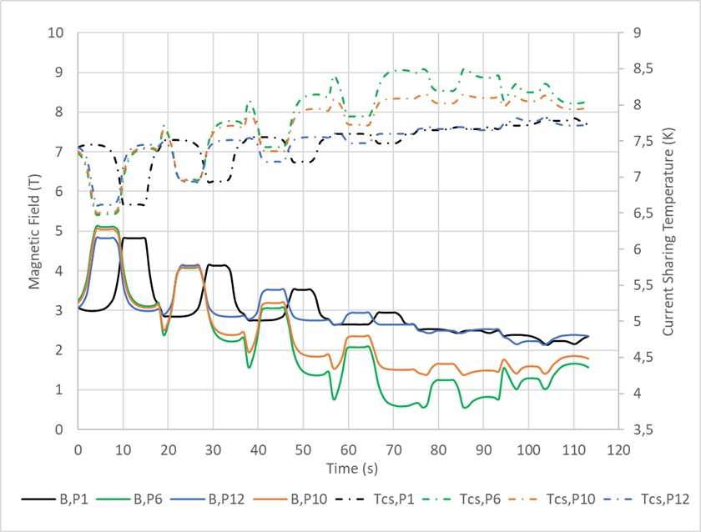

5.1) JT-60SA TFC IN TOKAMAK CONFIGURATION
Study in collaboration with A. Louzguiti in the framework of WPSA
$$T_{cs,min}$$
Name | Tokamak | CTF | Unit
TF Coil
TF stored magnetic energy | 58 | 20.5 | MJ
Maximum magnetic field | 5.65 | 3.05 | T
Minimal Current Sharing Temperature | 6.47 | 7.45 | K
Current discharge time constant | 14 | 8 | s
Helium Coolant
WP Helium inlet temperature | 4.5 | 4.7 | K
WP Helium inlet pressure | 0.53 | 1.038 | MPa
WP Nominal mass flow rate | 48 | 24 | g/s
29 m
48 m
JT-60SA TFC in Tokamak configuration, Magnetic field and current sharing temperature profiles
Hydraulical coil protection:
The quench incident during Tokamak operation is simulated without isolating the coil from cryogenic plant at the quench detection time. For this configuration quench relief valves with pressure threshold of 20 bars are the only hydraulical protection for the coil.
Quench initiation:
The resistive transition is induced by Minimum Quench Energy deposition of 30 W/m during 5 s over each pancake first turn, precisely at absissa 5<x<19 m. The quench begins at the helium inlet of the central pancake 6 where the minimal current sharing temperature belongs.
PhD Q. Gorit: CHATS 2021 Presentation, 20/09/2021
12

Slide 13
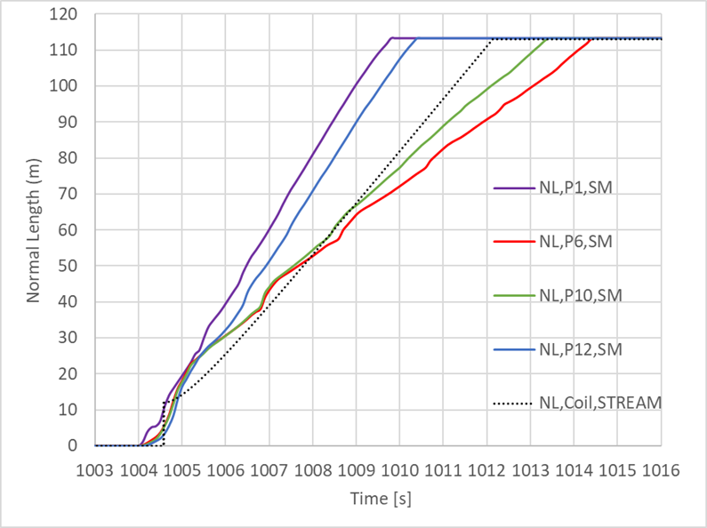
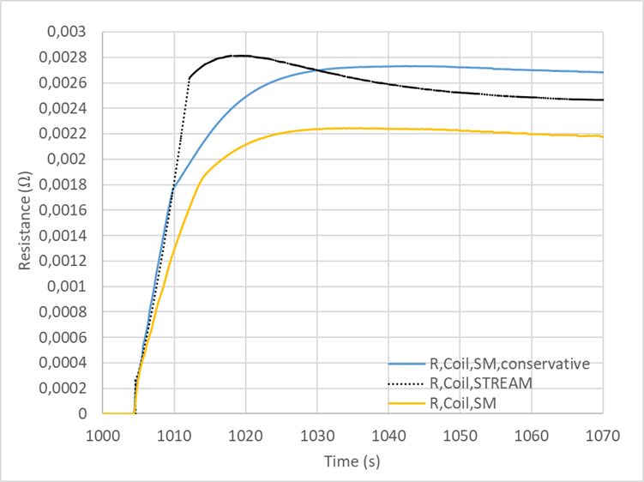


5.2) JT-60SA TFC IN TOKAMAK: QUENCH PROPAGATION VELOCITIES & RESISTANCES
$$v_{q,P1,SM}=19.5 m/s$$
$$R_{Coil,max,STREAM}=2.8 mΩ$$
$$v_{q,P12,SM}=17.7 m/s$$
$$R_{Coil,max,SM}=2.2 mΩ$$
48 m
29 m
JT-60SA TFC in Tokamak configuration, calculated normal zone propagation (SM, STREAM)
JT-60SA TFC in Tokamak configuration, calculated coil resistance (SM, STREAM)
Magnetic field distributions induce significant thermal margin and quench propagation velocity differences between central, inner and side double-pancakes:
$0 m<NL<29 m$ $29 m<NL<48 m$ $48 m<NL<113 m$
$v_{q,P6,SM}=v_{q,P10,SM}{=v}_{q,P12,SM}$= $15.7 m/s$
$v_{q,P6,SM}=v_{q,P10,SM}=12.3 m/s$ ${<v}_{q,P12,SM}$
$v_{q,P6,SM}=9.4 m/s$ ${<v}_{q,P10,SM}=10.9 m/s$ ${<v}_{q,P12,SM}$
The analytical quench propagation velocity ($v_{q,STREAM}=14.7 m/s) \text{allows} \text{to} \text{predict} \text{a} \text{coil} \text{resistance} \text{dynamic} \text{match}\text{ing} \text{the} \text{SuperMagnet} \text{calculation}\text{.}$
PhD Q. Gorit: CHATS 2021 Presentation, 20/09/2021
13

Slide 14
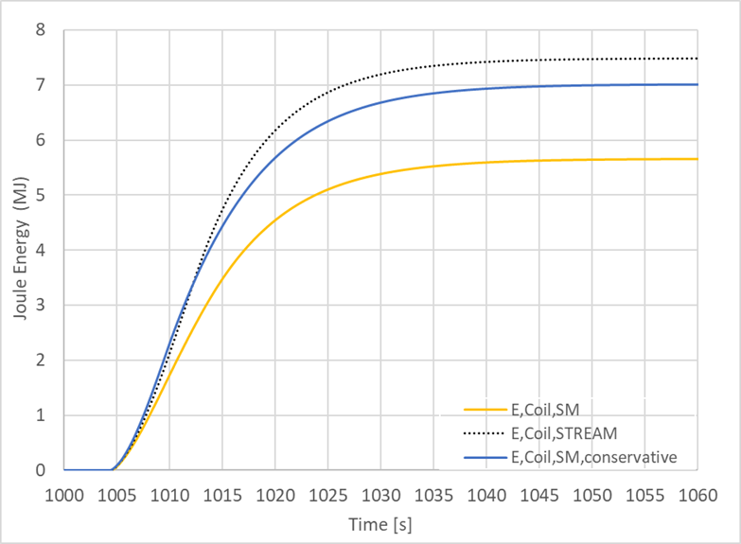
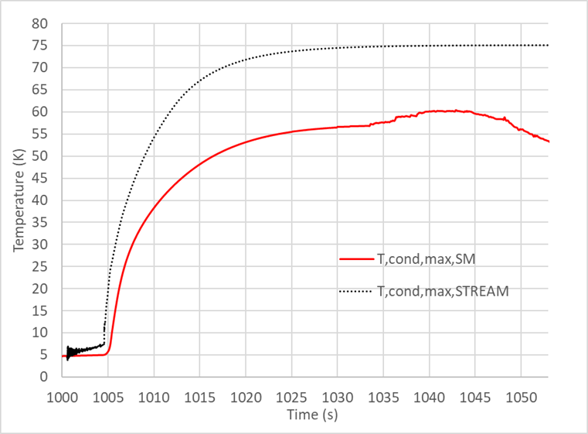
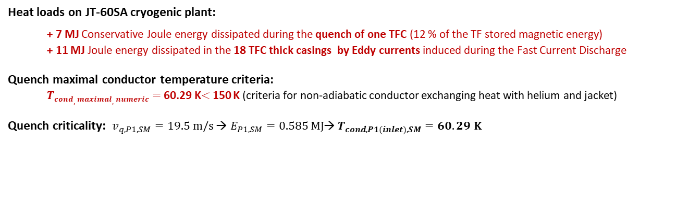
5.3) JT-60SA TFC IN TOKAMAK : CALCULATED JOULE ENERGY & TEMPERATURE
$$E_{Coil,STREAM}=7.48 MJ$$
$T_{cond,max,STREAM}=$75.09 K
$$E_{Coil,conservative,SM}=7.02 MJ$$
$$E_{Coil,SM}=5.65 MJ$$
$T_{cond,max,SM}=60.29$ K
JT-60SA TFC in Tokamak configuration, calculated coil Joule energy dissipation
(SM,STREAM)
JT-60SA TFC in Tokamak configuation, calculated maximal conductor temperature
(SM, STREAM)
Heat loads on JT-60SA cryogenic plant:
+ 7 MJ Conservative Joule energy dissipated during the quench of one TFC (12 % of the TF stored magnetic energy)
+ 11 MJ Joule energy dissipated in the 18 TFC thick casings by Eddy currents induced during the Fast Current Discharge
Quench maximal conductor temperature criteria:
$Tcond,maximal,numeric=$ 60.29 K$<$150 K (criteria for non-adiabatic conductor exchanging heat with helium and jacket)
Quench criticality: $v_{q,P1,SM}=19.5 m/s$ → $E_{P1,SM}=0.585 MJ$→ $T_{cond,P1(inlet),SM}=60.29$ K
[5] M. Wanner, “JT -60SA Plant Integration Document (PID),” V4.2
PhD Q. Gorit: CHATS 2021 Presentation, 20/09/2021
14

Slide 15
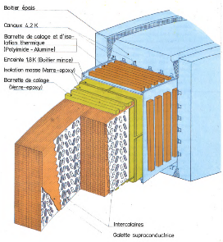
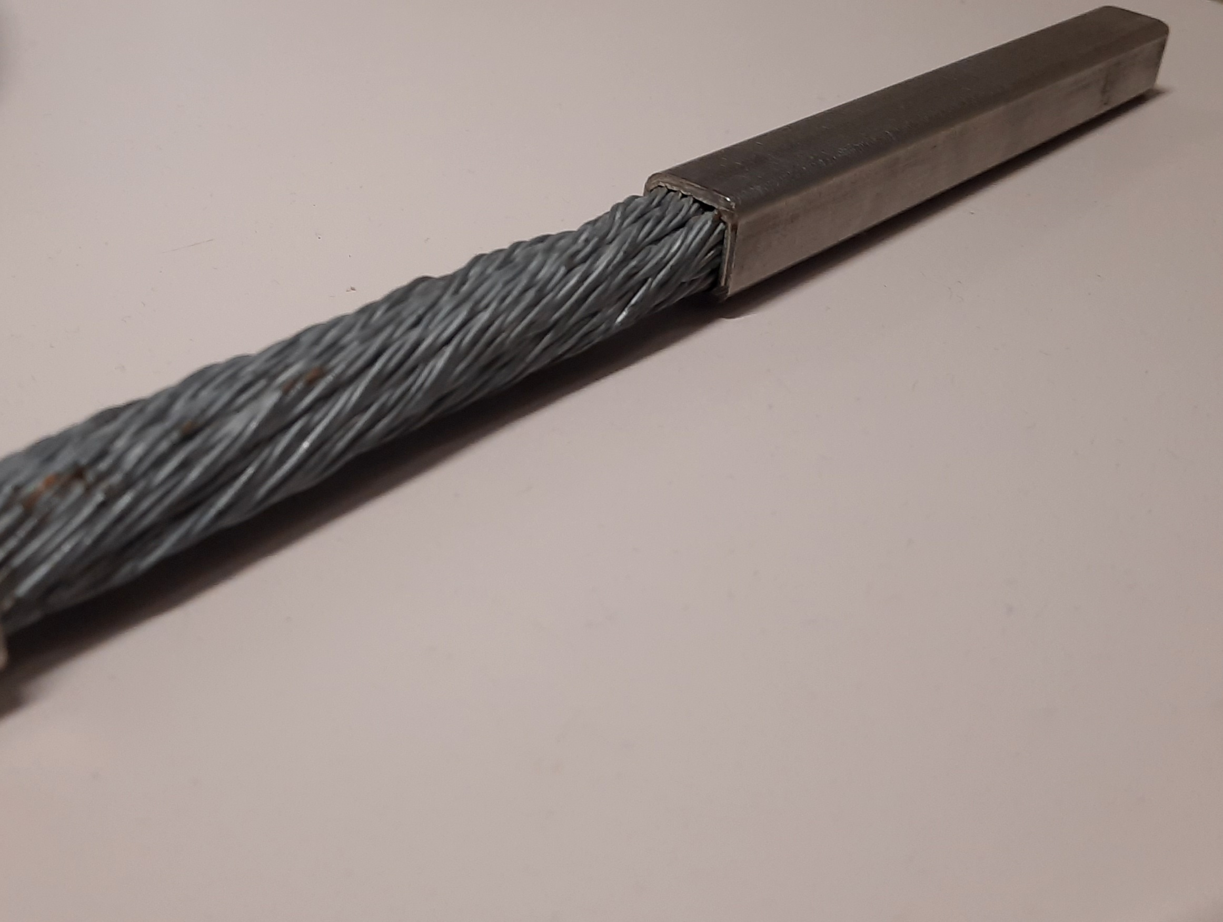
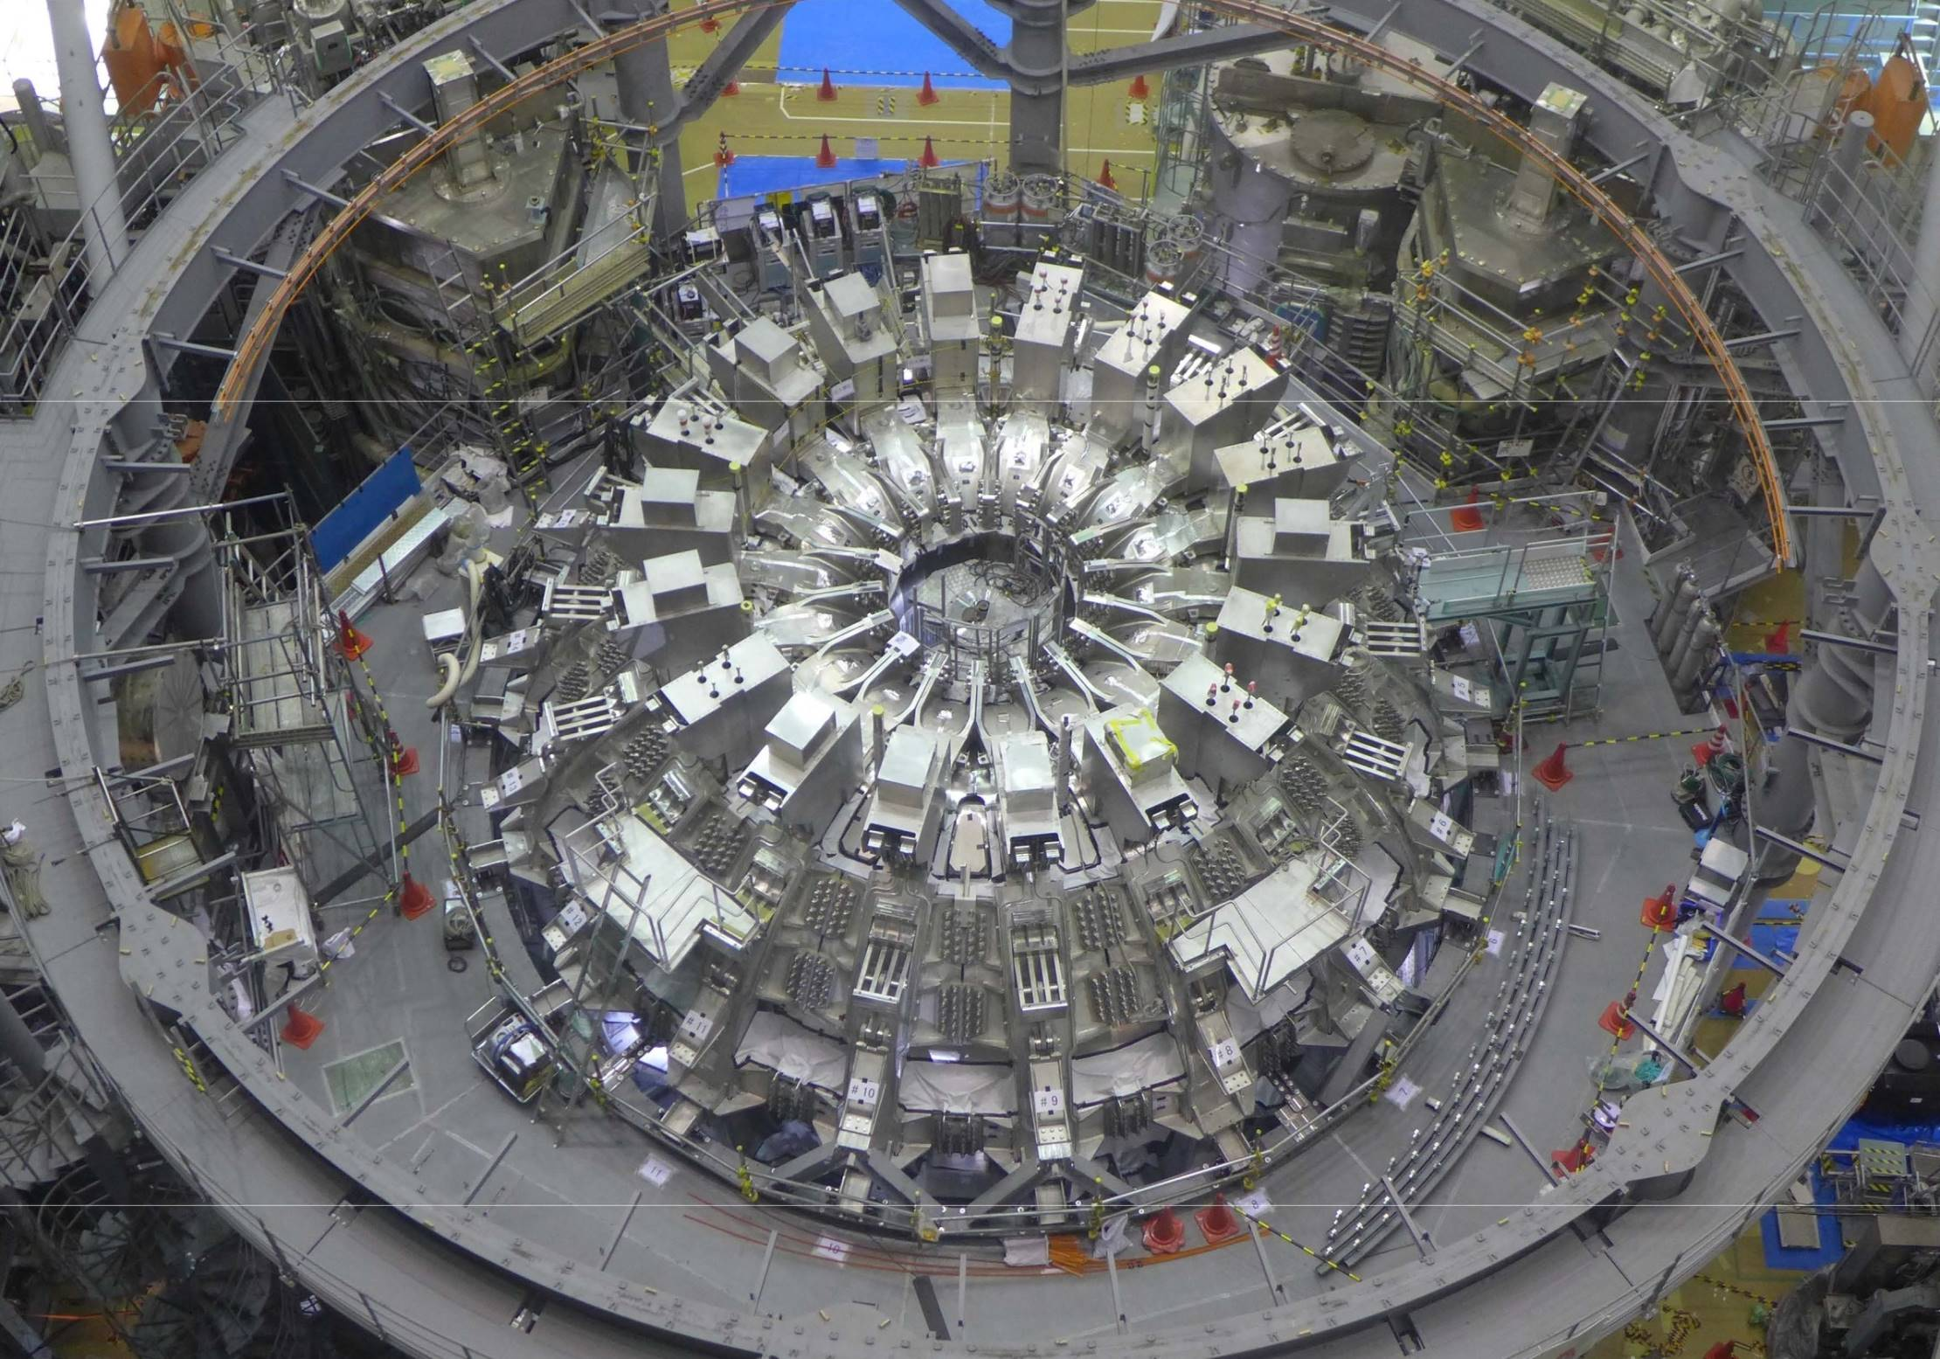
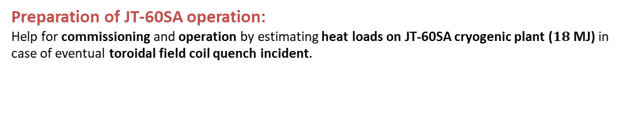
6) CONCLUSION
Quench model development:
STREAM were upgraded from superfluid helium bath to Cable-In-Conduit-Conductor cooling process.
WEST TFC cooled by superfluid helium bath
Cable-In-Conduit-Conductor cooled by supercritical helium forced-flow
Models validation:
Large scale models of the JT-60SA TFC and its cryodistribution simulated the TFC02 quench acceptance test in Cold Test Facility using the numerical code SuperMagnet as well as the analytical STREAM model.
They proved their robuthness and capacity to simulate the quench phenomenon against experimental data.
Quench phenomena analysis:
Further investigations and numerical simulations will be carry out in order to simulate the reverse mass flow effect and re-acceleration phenomenon.
Partial quench of the TFC02 occurred during CTF tests at reduced current and analysis are in progress.
Preparation of JT-60SA operation:
Help for commissioning and operation by estimating heat loads on JT-60SA cryogenic plant ($18$ MJ) in case of eventual toroidal field coil quench incident.
PhD Q. Gorit: CHATS 2021 Presentation, 20/09/2021
15
| PAGE 15
PhD Q. Gorit: IRFM Presentation, 01/07/2021

Slide 16
Thank you for your attention

Slide 17
BIBLIOGRAPHY
[1] A.Louzguiti et al., ‘Modeling of AC losses and simulation of their impact on JT-60SA TF magnets during commissioning’, ASC Conference, 2020.
[2] S. Nicollet et al., ‘Parametric Analyses of JT-60SA TF Coils in the Cold Test Facility With SuperMagnet Code’, IEEE Trans. Appl. Supercond., vol. 28, no. 3, p. 4205205, Apr. 2018.
[3] Y. Huang, ‘Study and modelling of the thermohydraulic phenomena taking place during the quench of a superconducting magnet cooled with supercritical helium’, p. 179.
[4] A. Shajii, J. P. Freidberg, and E. A. Chaniotakis, ‘Universal scaling laws for quench and thermal hydraulic quenchback in CICC coils’, IEEE Transactions on Applied Superconductivity, vol. 5, no. 2, pp. 477–482, Jun. 1995.
[5] M. Wanner, “JT -60SA Plant Integration Document (PID),” V4.2.
[6] A. Shajii, Thesis (Ph. D.)--Massachusetts Institute of Technology, Dept. of Nuclear Engineering, 1994.
[7] ‘Status of the cold test facility for the JT-60SA tokamak toroidal field coils | Elsevier Enhanced Reader’.
[8 ] M. Bagnasco, D. Bessette, L. Bottura, C. Marinucci, and C. Rosso, ‘Progress in the Integrated Simulation of Thermal-Hydraulic Operation of the ITER Magnet System’, 2010.
[9] L. Bottura, C. Rosso, and M. Breschi, ‘A general model for thermal, hydraulic and electric analysis of superconducting cables’, Cryogenics, vol. 40, pp. 617–626, Aug. 2000.
[10] P. Decool et al., ‘JT-60SA TF Coils: Experimental Check of Hydraulic Operating Conditions’, IEEE Transactions on Applied Superconductivity, vol. 26, no. 4, pp. 1–5, Jun. 2016.
[11] P. Hertout, D. Bessette, A. Bleyer, J. L. Duchateau, and S. Nicollet, ‘Heat deposition in the ITER FEAT poloidal field coils during a plasma scenario’, IEEE Transactions on Applied Superconductivity, vol. 12, no. 1, pp. 562–566, Mar. 2002.
[12] L. Bottura, ‘A practical fit for the critical surface of NbTi’, IEEE Trans. Appl. Supercond., vol. 10, no. 1, pp. 1054–1057, Mar. 2000.
[13] L. Zani, P. Barabaschi, E. D. Pietro, and M. Verrecchia, ‘Extended Quality Control Process Applied on TF Strand and TF Conductor Production for JT-60SA Project’, IEEE Transactions on Applied Superconductivity, vol. 25, no. 3, pp. 1–5, Jun. 2015.
[14] S. Nicollet, D. Ciazynski, J. L. Duchateau, B. Lacroix, and B. Renard, ‘Chapter 136 - Evaluation of the ITER Cable In Conduit Conductor heat transfer’, in Proceedings of the Twentieth International Cryogenic Engineering Conference (ICEC20), L. Zhang, L. Lin, and G. Chen, Eds. Oxford: Elsevier Science, 2005, pp. 589–592.
[15] L. Bottura and C. Rosso, ‘Flower, a model for the analysis of hydraulic networks and processes’, Cryogenics, vol. 43, no. 3, pp. 215–223, Mar. 2003.
[16] S. Nicollet et al., ‘A Superconductors Thermohydraulical and Resistive Electrical Analytical Model (STREAM) applied to WEST TF Coil Quench Analysis’, Conference, 2021.
PhD Q. Gorit: CHATS 2021 Presentation, 20/09/2021
17
Notes:
Les bobines toroïdales sont des aimants qui créent le champ magnétique nécessaire au confinement du plasma Bmax ….
Cela implique un courant élevé
Le quench peut donc creér de sérieux dommages donc il est important de le détecter

Slide 18
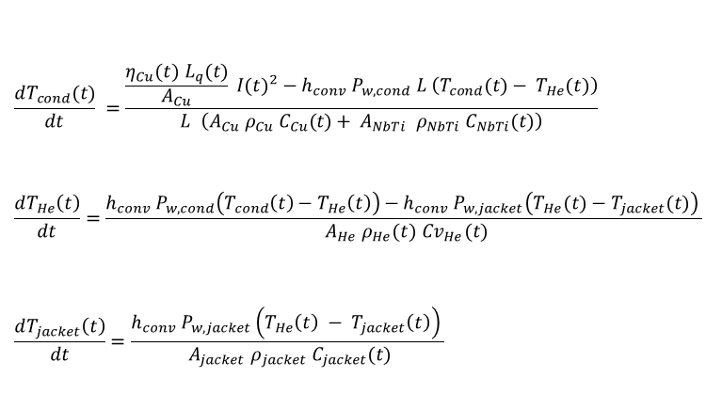
Energy conservation relations applied to helium, conductor and jacket in STREAM and Heuristic quench models
ANNEX 1
$$\begin{aligned}\frac{dT_{cond}(t)}{dt} =\frac{\frac{η_{Cu}(t) L_{q}(t)}{A_{Cu}} {I(t)}^{2}−h_{conv} P_{w,cond} L \left(T_{cond}(t)− T_{He}(t)\right)}{L \left(A_{Cu} ρ_{Cu} C_{Cu}(t)+ A_{NbTi} ρ_{NbTi} C_{NbTi}(t)\right)} \#\end{aligned}$$
$$\begin{aligned}\frac{dT_{He}\left(t\right)}{dt}=\frac{h_{conv} P_{w,cond}\left(T_{cond}\left(t\right)−T_{He}\left(t\right)\right)−h_{conv} P_{w,jacket}\left(T_{He}(t)−T_{jacket}(t)\right) }{ A_{He} ρ_{He}(t) Cv_{He}(t)}\#\end{aligned}$$
$$\begin{aligned}\frac{dT_{jacket}\left(t\right)}{dt}=\frac{h_{conv} P_{w,jacket}\left(T_{He}\left(t\right) − T_{jacket}\left(t\right)\right) }{ A_{jacket} ρ_{jacket} C_{jacket}(t)}\#\end{aligned}$$

Slide 19




STREAM: second law of thermodynamics, energy and mass conservative relations describe the 1-D expulsed helium flow from the coil
ANNEX 2
$$dH+\frac{dc^{2}}{2}=δQ_{e}$$
$$Tds=δQ_{e}+δQ_{f}$$
$$\frac{dρ}{ρ}+\frac{dc}{c}+\frac{dA}{A}=0$$
$$D=ρ c A=Cst$$

Slide 20
JT-60SA TF COILS FULLY ASSEMBLED
SINCE 18/06/2018
ANNEX 3

Slide 21
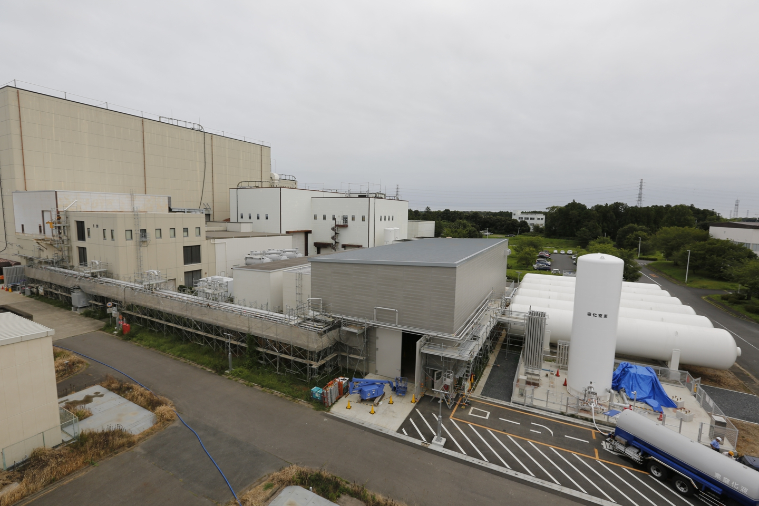
JT-60SA CRYOGENIC SYSTEM (CEA/F4E)
ANNEX 4
Cryogenic Hall
Compressor Building
six He gas storage vessels
LN₂ tank

Slide 22
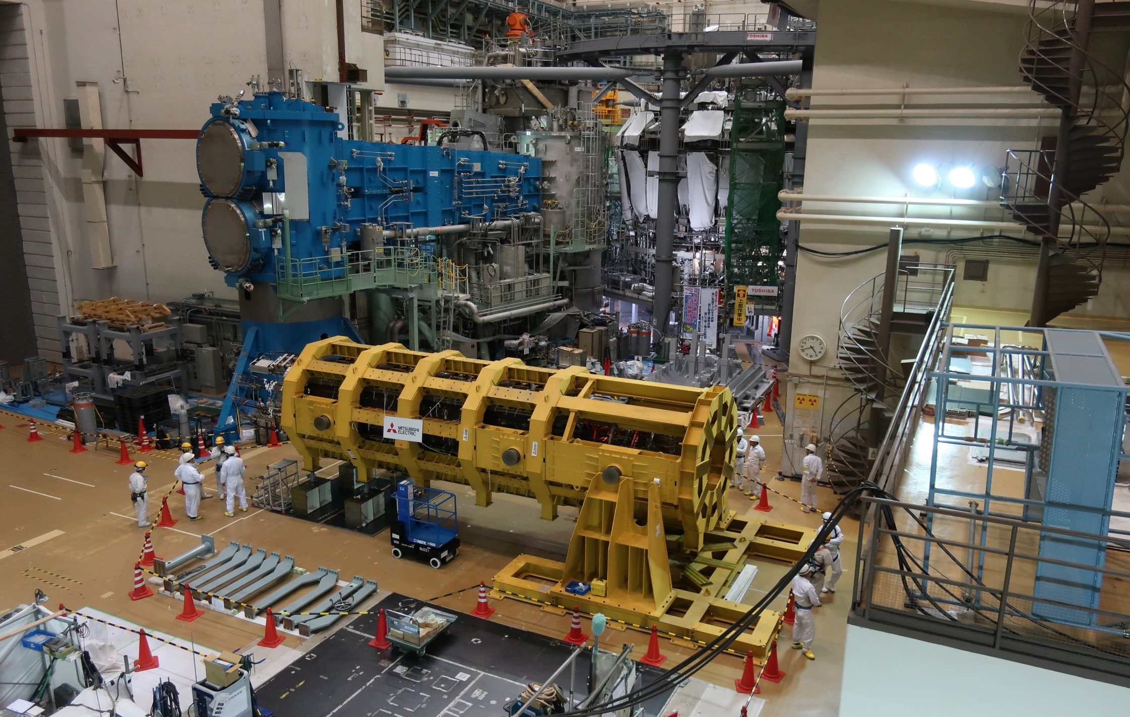
JT-60SA CS DELIVERED TO NAKA 16/03/2019
ANNEX 5

Slide 23
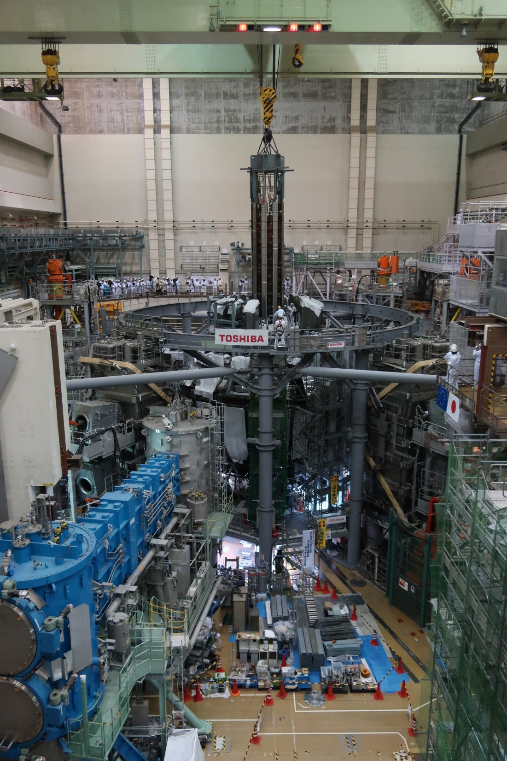
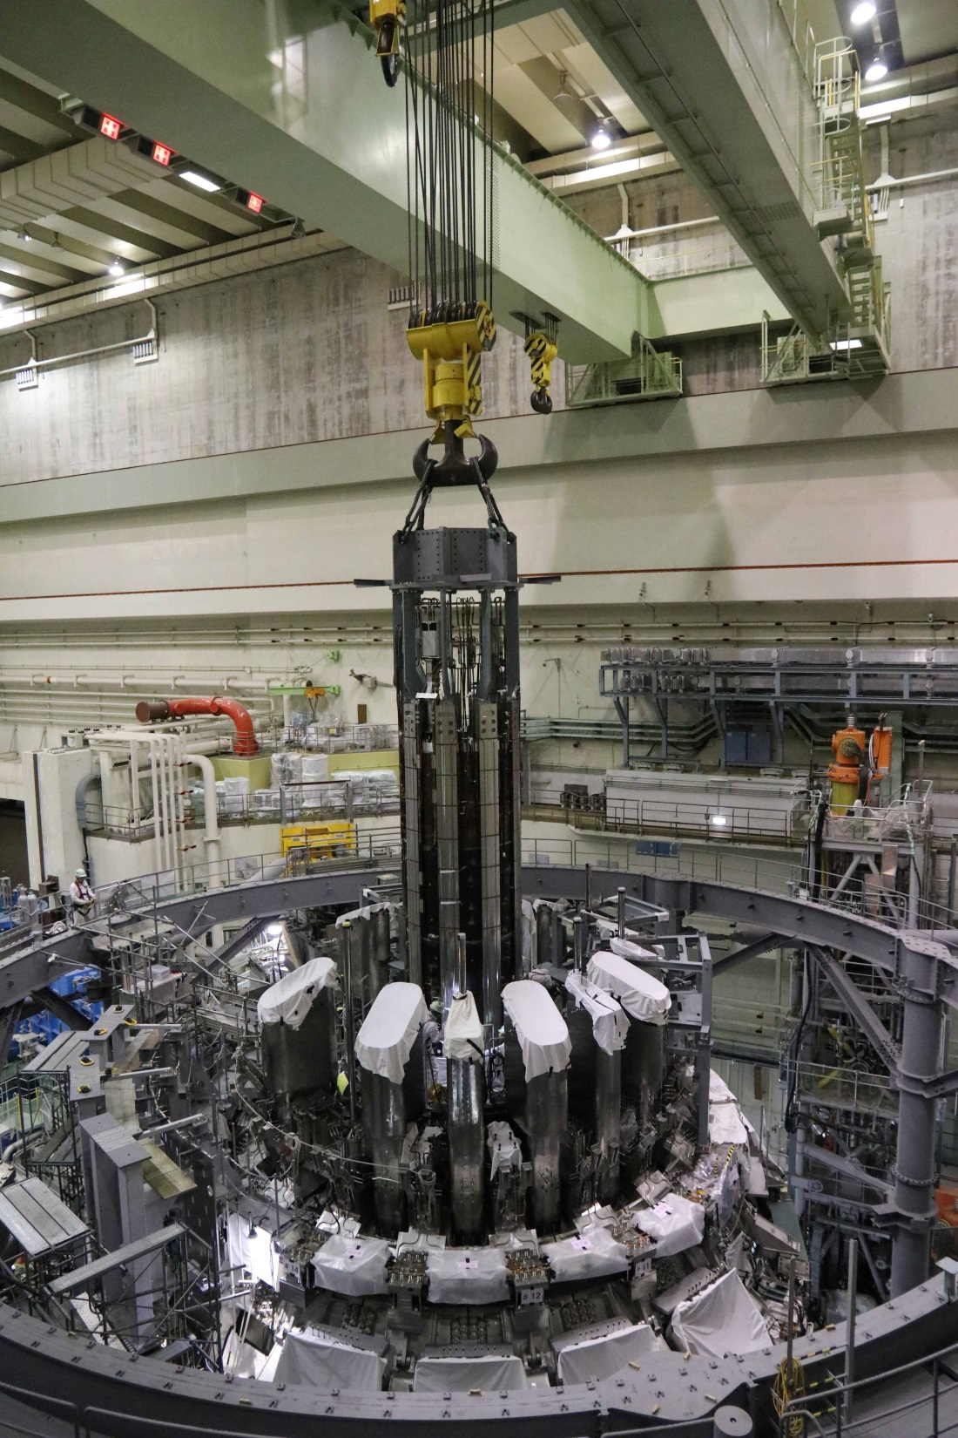
JT-60SA CS INSERTED
ANNEX 6

