Slide 1
Calculation of saturated coupling loss in Rutherford cables
N. Bykovskiy
D. Uglietti
P. Bruzzone
K. Sedlak
CHATS 2021
September 21

Slide 2
Outline
Introduction
Motivation
Saturated coupling loss
Analytical calculation
Network modelling
DEMO CS case study
Outlook on network modelling
Conclusion

Slide 3
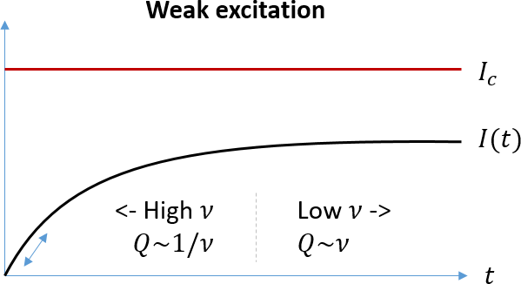
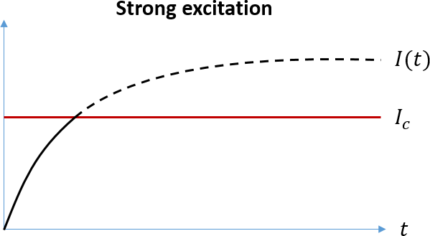
Introduction
Development of network models for Rutherford cables:
70’s, Morgan et al: crossing strand coupling, weak excitation, analytical results
80’s, Sytnikov et al: crossing and adjacent, weak and strong, analytical
90’s, Verweij et al: complete numerical electromagnetic model
00’s – p.t.: CUDI / JackPot / THEA / THELMA multi-physics modelling tools
response to constant $\dot{B}$
LTS have low stability (low MQE), thus must be operated in weak excitation (coupling currents << Ic), therefore leading to small filaments and short twist-pitches.
In contrast, HTS materials have high stability and could be operated in a strong excitation mode (coupling currents ~ Ic). No need for fine twisted filaments, for example Bi2223 tapes with non-twisted filaments, ReBCO monofilamentary tapes.
Large AC losses should then be properly evaluated and accounted in the design. Impact of twisting stacks was found marginal for soldered stacks in fusion conductors, while transposing stacks (twisted or not) have a moderate effect, see https://doi.org/10.1016/j.cryogenics.2020.103118

Slide 4
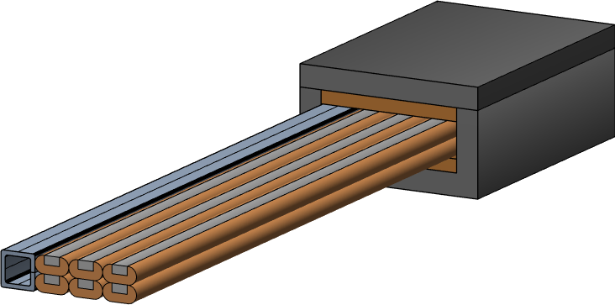
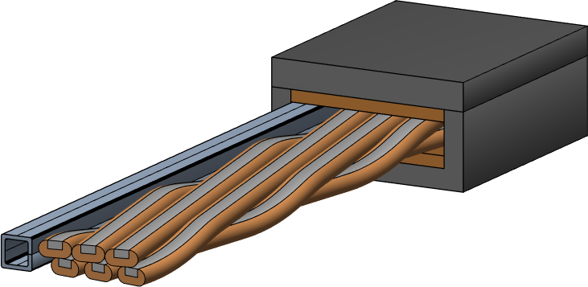
Motivation
ASTRA conductor concept for DEMO CS coils operated up to 18 T at 5 K, ≳0.1 T/s transients:
Aligned Stacks Transposed in Roebel Arrangement
Jacket pre-compression
Separate cooling channel (conduction cooled stacks)
Impregnation of cable space
$$L=∞$$
$$L \sim 1 m$$
Strong excitation mode features interplay between coupling current loops and superconducting loops, i.e. corresponding loss contributions are no longer independent.
Furthermore, effects of saturation and screening are counteracting.
Hence, detailed study on the actual AC loss performance is needed.

Slide 5
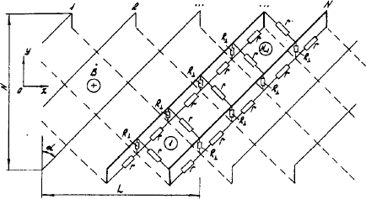
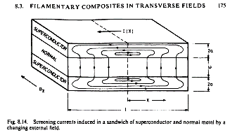
Analytical calculation: weak excitation
$R_{sc}≪R_{c}$: inter-strand loss
https://doi.org/10.1016/0011-2275(89)90207-5
$$R_{sc}$$
$$R_{C}$$
$$R_{C}$$
$$\left[W/m\right]$$
$$w$$
$ε$
$$H={Nw}/2,R_{a}\sim N/L, R_{c}\sim N/{L →}$$
$$P_{c} \sim N^{3}L^{2}, P_{a} \sim NL^{2}$$
$$R_{sc}$$
$R_{sc}$ increases with $L,$ $R_{c}$ decreases with $L$:
Limit of the model applicability in terms of the cable twist-pitch?
$ε=\dot{B}wL_{c}≈I_{c}R\sim {ρI_{c}}/{L_{c}}→L_{c} \sim \sqrt{{ρI_{c}}/{\dot{B}w}}$ (e.g. missing geometry factor)
Geometry: slab (see Wilson’s book, section 8.3.1)
$$L_{c}=\sqrt{\frac{8ρI_{c}}{\dot{B}w}}$$
Geometry: Rutherford cable
$$L_{c}≈\sqrt{\frac{96ρI_{c}}{N\dot{B}w}}$$

Slide 6
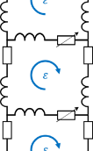
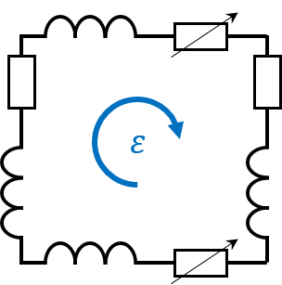
Analytical calculation: strong excitation
$$l$$
$R_{sc}≫R_{c}$: saturated loss
$$ε=\dot{B}xl≈E_{c}l{\left(I/{I_{c}}\right)}^{n}$$
$$I=I_{c}{\left(\dot{B}x∕E_{c}\right)}^{1/n}$$
$${P_{1}}/l=E⋅I=E_{c}I_{c}{\left(I/{I_{c}}\right)}^{n+1}=E_{c}I_{c}{\left({\dot{B}x}/{E_{c}}\right)}^{1+1/n} \left[W/m\right]$$
Critical-state model ($n=∞$):
$P/l=I_{c}w\dot{B}N^{2}/8$ in perp field
$P/l=I_{c}h\dot{B}N/2$ in parr field
or simply
$$R_{sc}$$
$$x$$
$$R_{C}$$
$$R_{C}$$
$ε$
$$P/l=I_{c_total}×width×\dot{B}/4$$
$$R_{sc}$$
Perpendicular field (2 layers):
$${P_{N}}/l=Σ{ P}_{1}(x)/l=E_{c}I_{c}{\left(\frac{\dot{B}w}{E_{c}}\right)}^{1+\frac{1}{n}}F(N)$$
$$\dot{B}$$
$$width$$
$=Nw/2$ (perp)
$=2h$ (parr)
$$w$$
(min $N=4$)
$$I_{c_total}=N×I_{c}$$
Parallel field (N/2 layers):
$${P_{N}}/l=E_{c}I_{c}{\left(\frac{\dot{B}h}{2E_{c}}\right)}^{1+\frac{1}{n}}N$$
Generally, higher loss for finite n-value and same Ic:
$P/l \sim {\dot{B}}^{2}N^{3}$ for $n=1$ in perp field
$$h$$

Slide 7
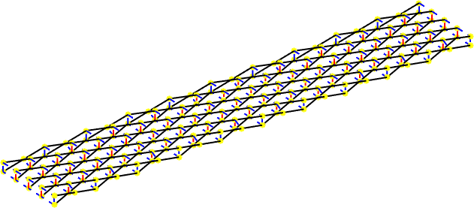
Network modelling: integral formulation
Model parameters
Category | Symbol | Description | Value
Geometry | $$N$$ | Number of strands | 4 – 40
 | $$W$$ | Strand width | 8 mm
 | $$H$$ | Strand height | 4 mm
 | $$L$$ | Cable twist-pitch | 0.1 m – inf
Electrical properties | $$ρ$$ | Trans. specific resistance | 1 – 100 µΩ.m
 | $$I_{c}$$ | Critical current | (strand props)
 | $$n$$ | Index of transition | 1 – 1000
Operating conditions | $$\dot{B}$$ | Ramp rate of external magnetic field | 0.01 – 1 T/s
 | $$φ$$ | Field orientation | 0 – 90 deg
 | $$I_{op}$$ | Operating current | 0 to Ic
$N=10$:
text
$$R_{sc}$$
$$R_{C}$$
$$R_{C}$$
$ε$
$$R_{sc}$$
Find current distribution by solving:
Kirchhoff current law for each node (yellow points)
Kirchhoff voltage law for each elementary circuit
Conservation of total operating current
Specified boundary conditions:
https://doi.org/10.1016/j.cryogenics.2018.10.003
Dirichlet type: fixed input/output currents (i.e. ‘insulated’ strands outside the modeling region)
Neumann type: fixed current derivatives (zero derivatives → equipotential ends, i.e. short-circuited strands)
Periodic type: account for symmetry in current distribution (suitable to model infinitely long transposed strands) →

Slide 8
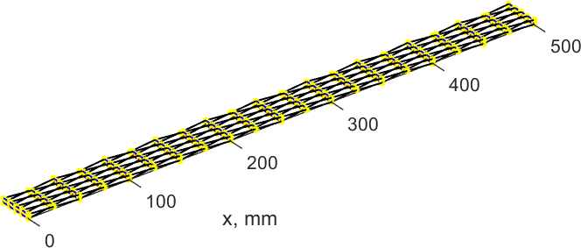
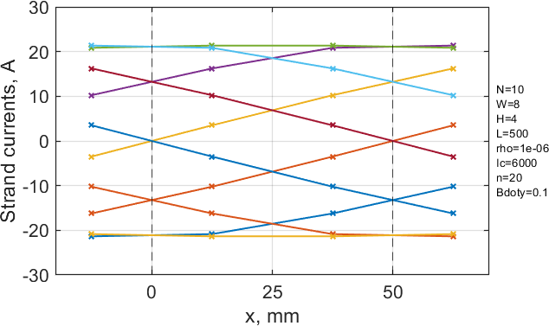
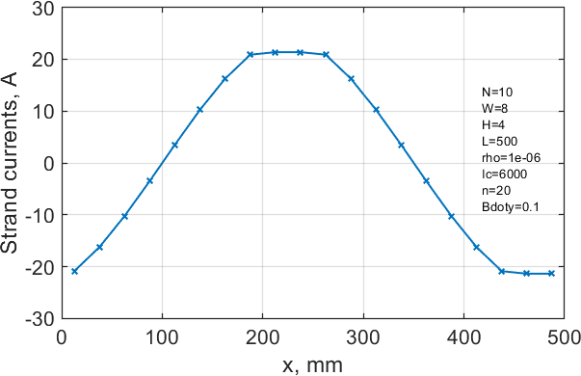
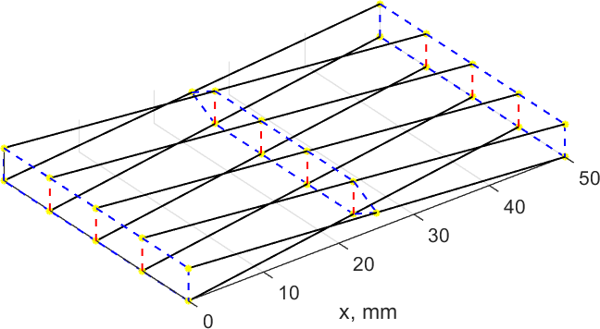
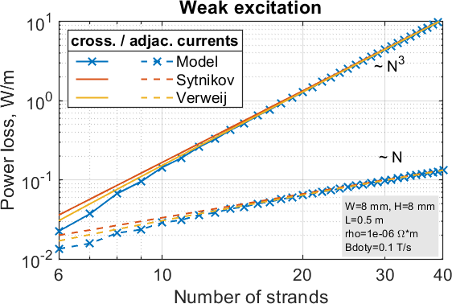
Network modelling: setup and benchmark
$N=10$:
Length = 1 twist-pitch
x
Full distribution can be obtained as well
Length = 1 twist-pitch / N
$P=\sum{I^{2}R/l} \left[W/m\right] Q=\int{Pdt \left[J/m\right]}$
Note: intra-strand loss neglected
output currents deduced from the first band
last band
first band
input currents deduced from the last band
Using periodic BC, $L/N$–long segment is sufficient for fast analysis w/o accuracy loss.
The model is validated wrt analytical solutions.

Slide 9
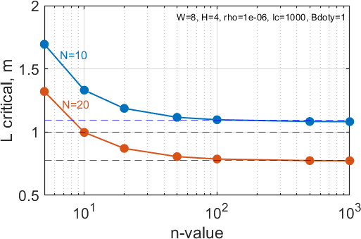
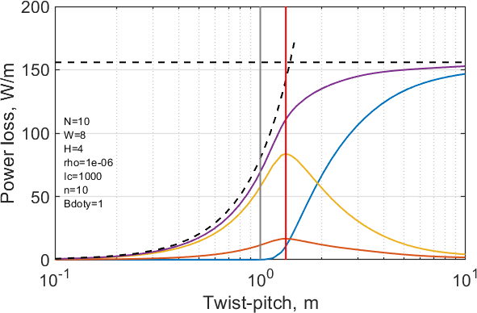
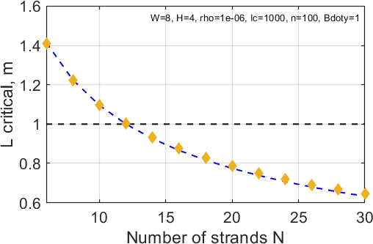
Network modelling: power loss
Study on twist-pitch:
Study on critical twist-pitch:
slab | Rutherford
$$L_{c}=\sqrt{\frac{8ρI_{c}}{\dot{B}w}}$$ | $$L_{c}≈\sqrt{\frac{96ρI_{c}}{N\dot{B}w}}$$
slab estimate
defined from model
Typically, n~10-20 for fusion conductors, thus its impact on $L_{c}$ some 20 – 30%
saturated loss
slab
Total
Rutherford
analytical
Longitudinal
R crossing
R adjacent
$L_{c} \sim N^{−0.5}$ scaling: less strands -> higher $L_{c}$ -> lower P inter-strand, but higher P intra-strand
Rutherford
slab
Power loss at the critical value of twist-pitch ~ 50-70% of the saturated loss
model

Slide 10
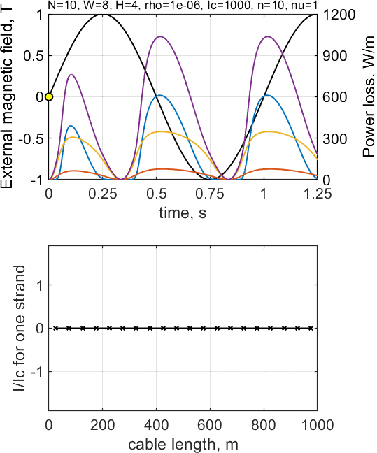
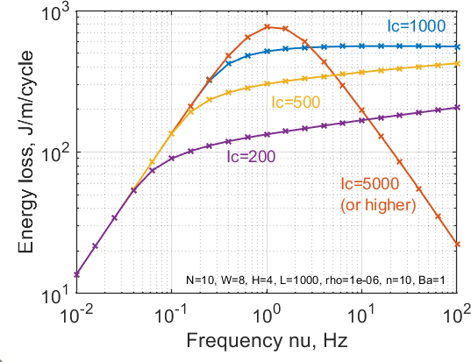
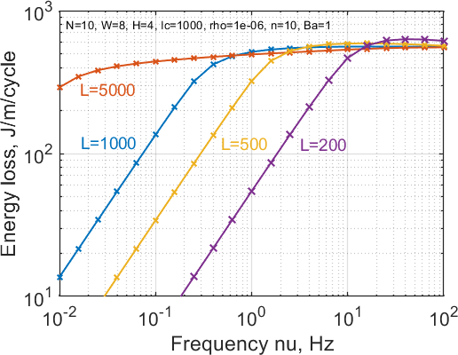
Network modelling: energy loss
$$P_{total}$$
$$P_{long}$$
$$P_{cross}$$
$$P_{adj}$$
$$Q\sim ν^{1/n}$$ (saturation)
$$Q\sim ν$$ (weak excitation)
$$Q\sim ν^{−1}$$ (screening)
$$Q\sim ν$$ (weak excitation)
Mode | $$I≪I_{c}$$ | $$I\sim I_{c}$$
$$ν≪1/τ$$ | Weak excitation: $Q\sim ν$ | Saturation: $$Q\sim ν^{1/n}$$
$$ν≫1/τ$$ | Screening: $Q\sim 1/ν$
Time constant: $τ \sim {μ_{0}L^{2}}/ρ$
Typical AC loss cycles studied at zero transport current.
However, changing of both transport current and produced magnetic field should be analyzed for actual coil operation →
* I/Ic for other strands are similar but phase-shifted

Slide 11
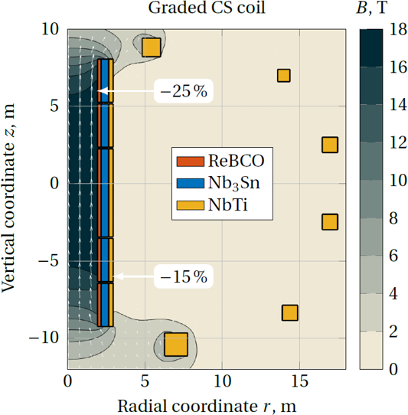
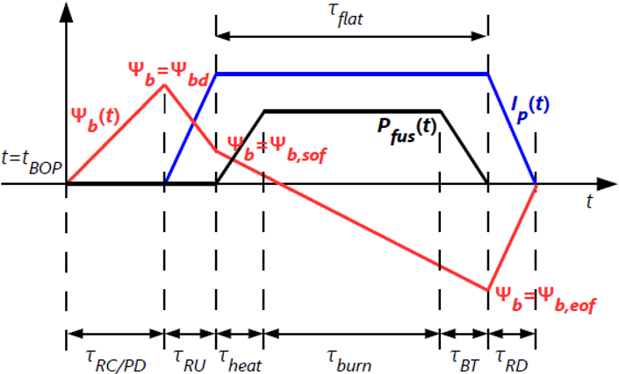
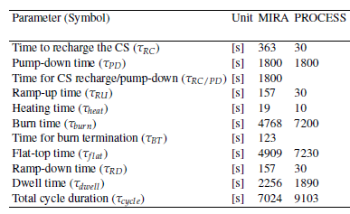
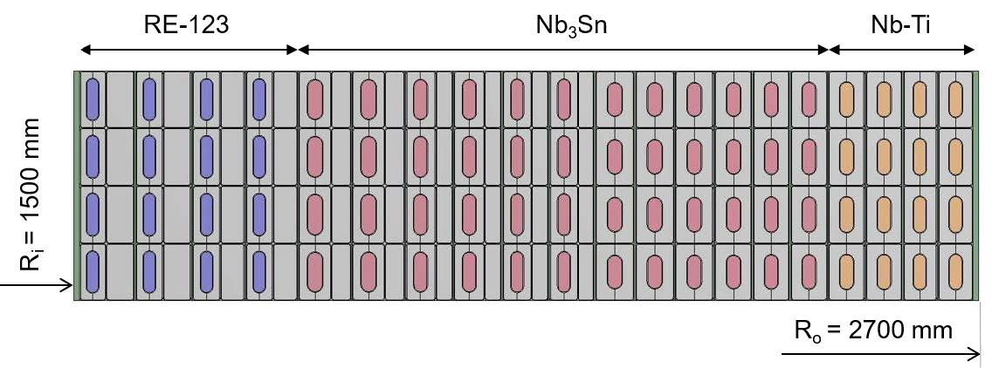
DEMO CS graded coils: quick overview
Target: 60 kA / 18 T / 5 K, pulsed operation
R&D on HTS conductors for DEMO CS started this year: 4 concepts by SPC, ENEA and KIT; performance demonstration before 2024
Operating cycle in pulsed tokamaks: advanced 18 T CS graded coils allow increasing burn time, thus higher plant availability by ~10-20% compared to 12 T baseline option.
Coils operated independently, but detailed scenario not yet specified.
Baseline 12 T DEMO CS:
Assuming 15 T sweep for RU:
Bdot | RU | Flat-top | RD
MIRA | 0.1 T/s | 0.004 T/s | 0.1 T/s
PROCESS | 0.5 T/s | 0.003 T/s | 0.6 T/s
https://idm.euro-fusion.org/?uid=2M4P9J
https://dx.doi.org/10.5445/IR/1000095873

Slide 12
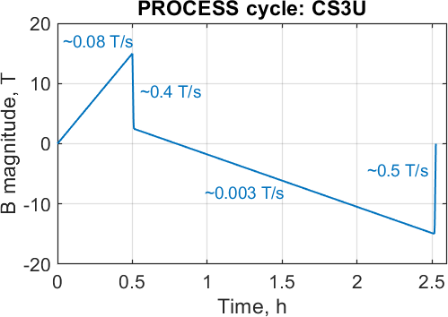
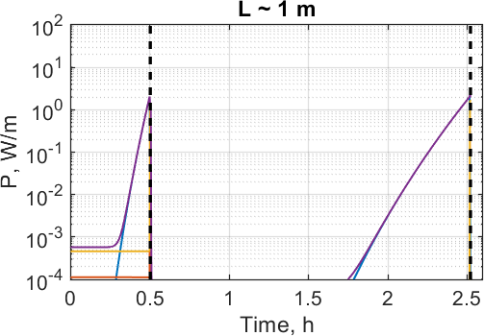
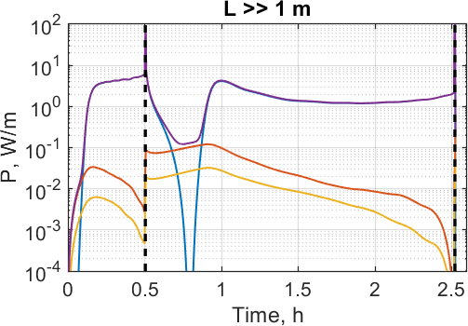
DEMO CS graded coils: power loss estimates
CS module | CS3L | CS2L | CS1 | CS2U | CS3U
Most demanding operating conditions | PREMAG: 14.66 T / 70.1º | EOF: 12.59 T / 70.1º | PREMAG: 18.14 T / 83.7º | EOF: 13.16 T / 70.3º | PREMAG: 15.03 T / 70.2º
# of 3.3 mm tapes (aligned along z-axis) | ~220 | ~200 | ~140 | ~200 | ~220
P max for L ~ 1 m | ≈ 2.2 W/m | ≈ 1.7 W/m | ≈ 1.1 W/m | ≈ 1.9 W/m | ≈ 2.4 W/m
P max for L >> 1 m | ≈ 110 W/m | ≈ 80 W/m | ≈ 60 W/m | ≈ 90 W/m | ≈ 120 W/m
For non-transposed strands, ~100 W/m applied to strands may increase their temperature above 10 K, thus need for higher T_{cs}.
Strands transposition may reduce losses by about 10 times.
2.4 W/m + intra-strand loss = 10–20 W/m?
$$P_{total}$$
$$P_{long}$$
$$P_{cross}$$
$$P_{adj}$$
Operating current $\sim B$ during the cycle
Intra-strand loss should be accounted…
Intra-strand loss is negligible

Slide 13
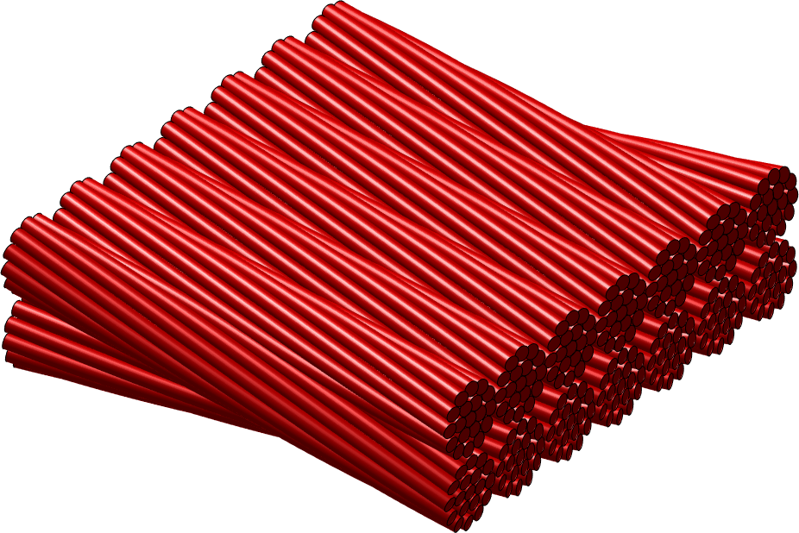
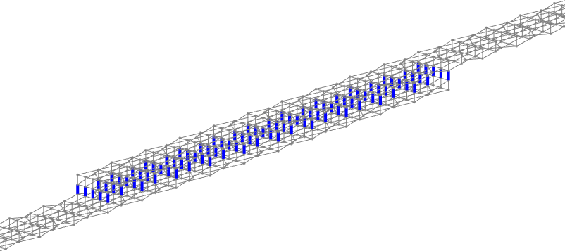
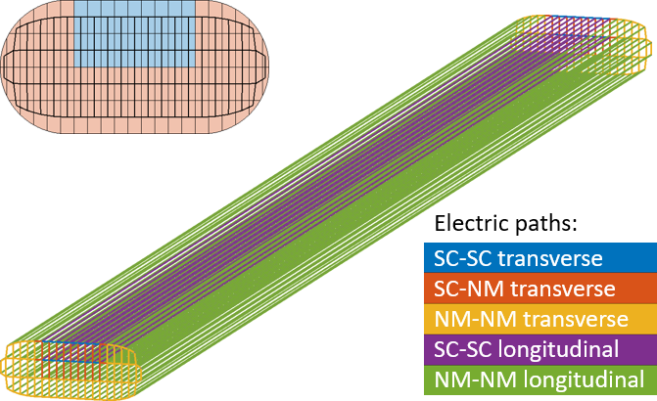
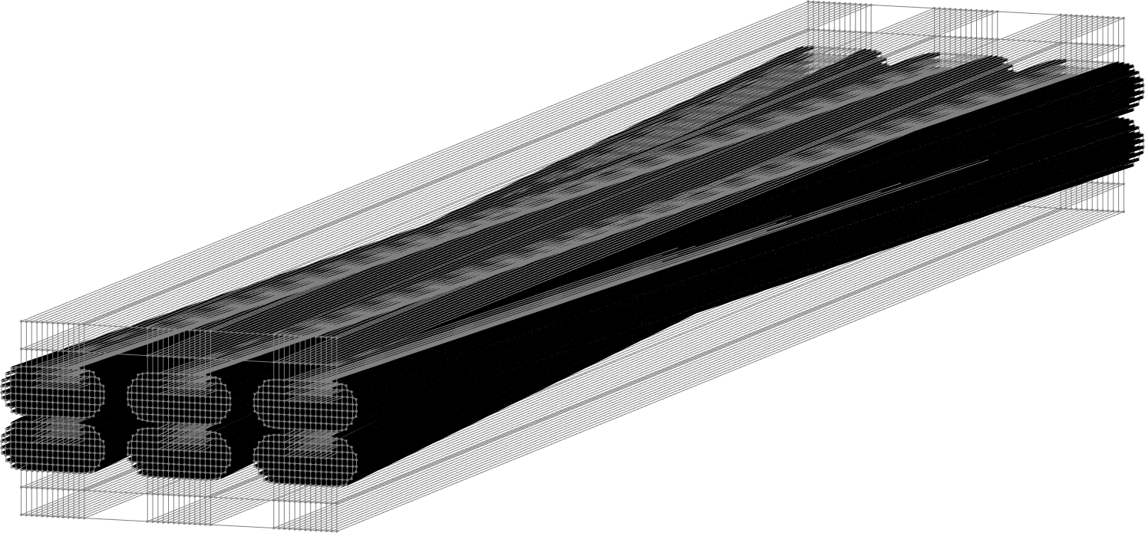
Outlook on network modelling
DEMO R&W sub-cable
DEMO R&W cable
Cable splices
HTS stacked tapes strand
ASTRA conductor

Slide 14
Conclusion
Analytical and numerical models are developed to analyze saturated coupling loss in Rutherford cables.
Relatively low loss is obtained by keeping twist-pitch below its critical value expressed as $L_{c}≈\sqrt{96ρI_{c}∕N\dot{B}w}$.
Transposition of strands is needed to avoid their overheating during fast transients in the DEMO CS coils.
Network modelling approach is being used to simulate electromagnetic behavior of various cable layouts.
THANK YOU FOR YOUR ATTENTION!

