Slide 2
Velocity-space tomography of fast-ion distribution functions in JET using ICRF physics as physics-informed regularisation
Mads Rud Larsen
Postdoc, DTU, Denmark:
Collaborators: Y. Dong, L. G. Eriksson, J. Eriksson, P. C. Hansen, O. Hyvärinen, H. Järleblad, Ye. O. Kazakov, D. Moseev, M. Nocente, B. C. G. Reman, A. Snicker, A. Valentini, M. Salewski and JET Contributors

Slide 3
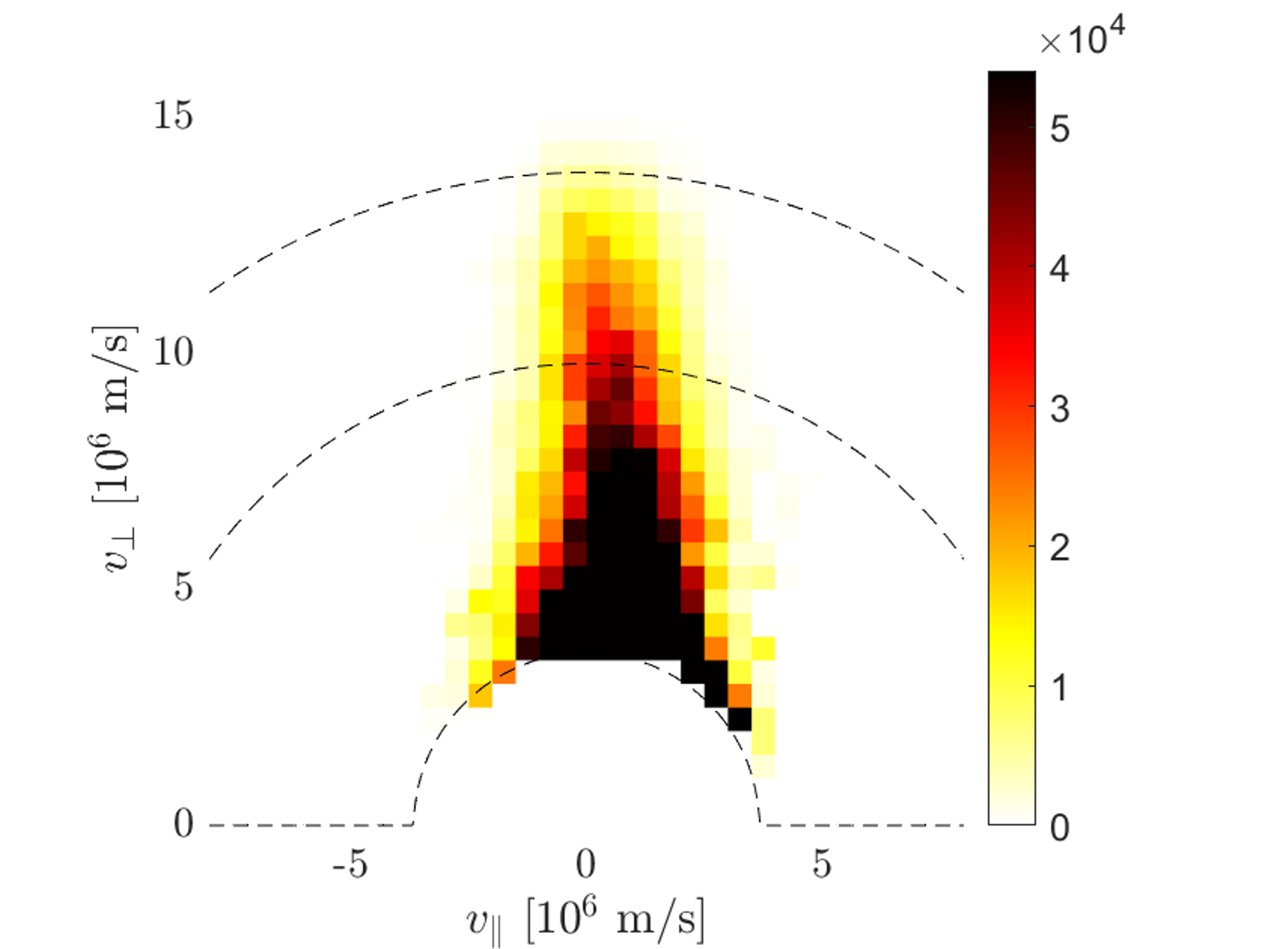
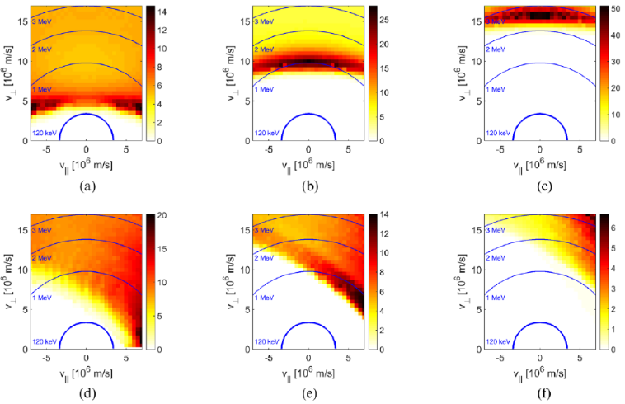
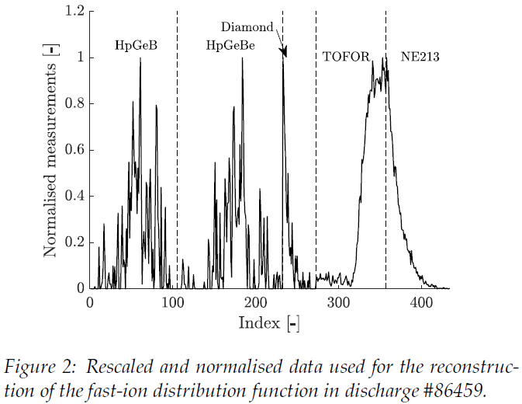





Reconstructing the fast-ion distribution function
Forward problem
$$\overline{s}=W\overline{f}$$
Distribution function, $\overline{f}$
Weight functions, $w$
Measurements, $\overline{s}$
$${\overline{f}}_{λ}=\min_{\overline{f}}\left({\left\|\overline{s}−W\overline{f}\right\|}_{2}^{2}+λ^{2}{\left\|L\overline{f}\right\|}_{2}^{2}\right)$$
Inverse problem

Slide 4
Main takeaways from this work:
Velocity-space tomography in the core of JET using experimental data
Prior information: Collision physics and ICRF physics
ICRF prior improves on previous reconstructions
Based on:
Salewski et al, 2017 Nucl. Fusion
Reman et al “Velocity-space tomography of an MeV fast-ion tail generated by three-ion scheme ICRF heating at JET” submitted
Rud et al, “Fast-ion phase-space tomography with wave-particle interactions in the ion cyclotron frequency range as prior”, revised manuscript submitted

Slide 5
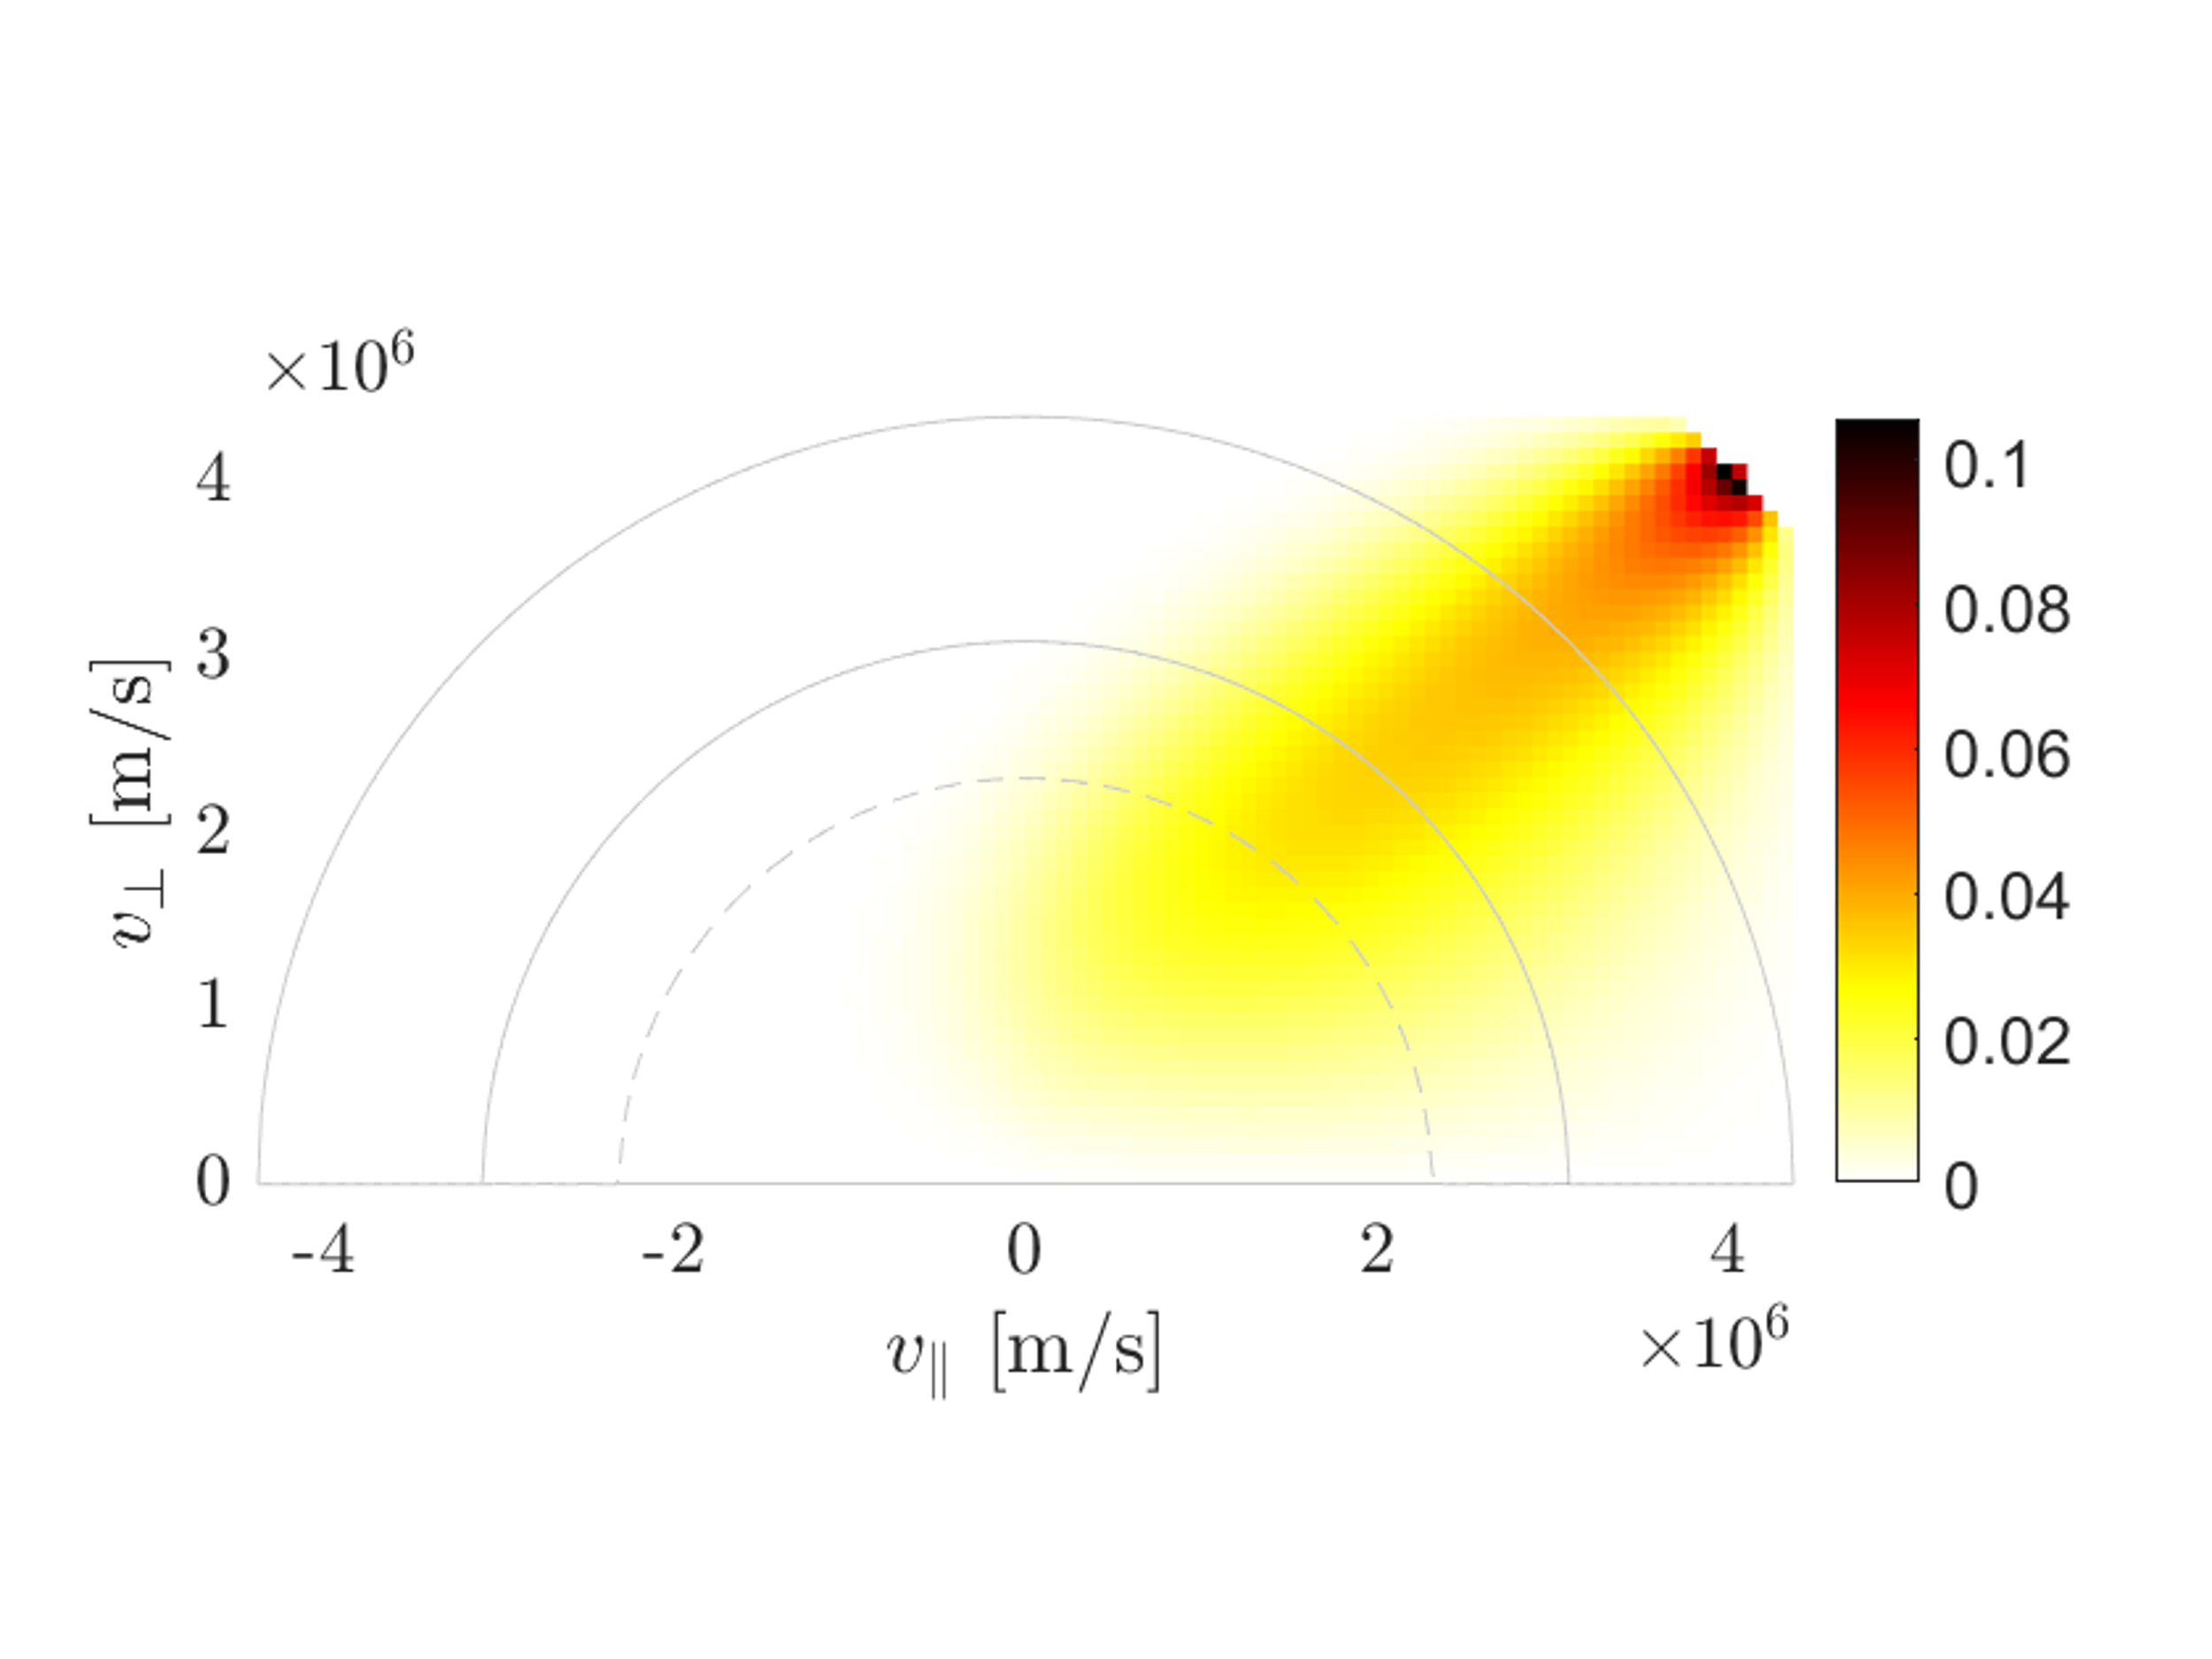
Physics-informed prior information

Slide 6

Evolution of fast-ion distribution function
Collisions and wave-particle interactions
$$\frac{df}{dt}=\left\langle C\left(f\right)\right\rangle +\left\langle Q\left(f\right)\right\rangle$$
$C(f)$ is the collision operator
$Q(f)$ is the wave-particle interaction operator
$\left\langle −\right\rangle$ average over entire orbit

Slide 7
Evolution of fast-ion distribution function
Collisions
Wave-particle interactions

Slide 8
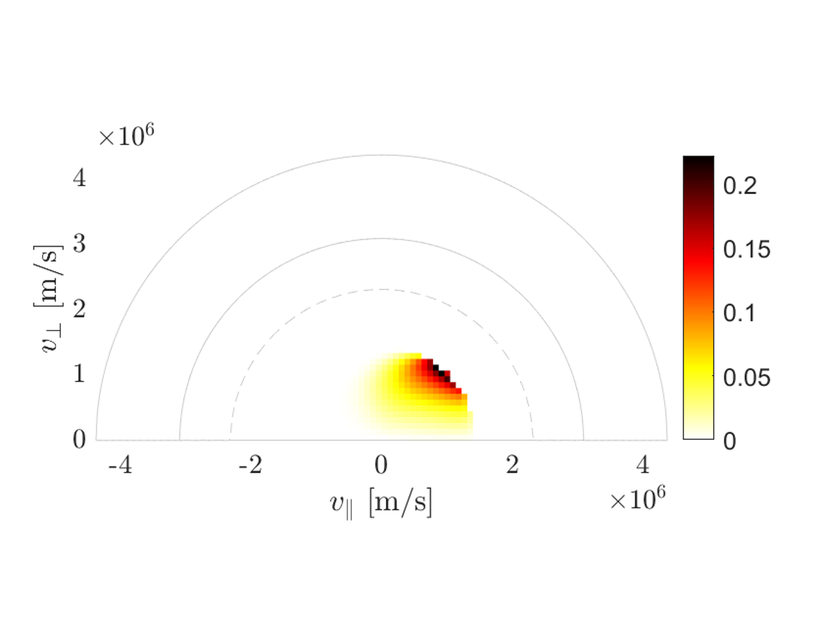
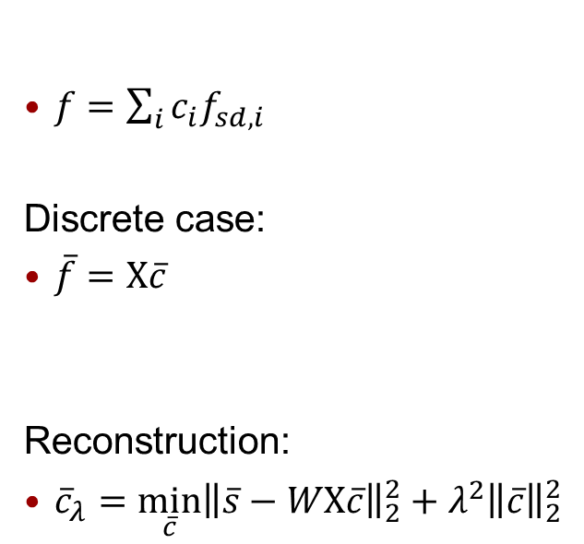
Evolution of fast-ion distribution function
Collisions
Wave-particle interactions
Slowing-down expansion functions:
$f=\sum_{i}{c_{i}f_{sd,i}}$
Discrete case:
$\overline{f}=X\overline{c}$
Reconstruction:
${\overline{c}}_{λ}={\min_{\overline{c}}\left\|\overline{s}−WX\overline{c}\right\|}_{2}^{2}+λ^{2}{\left\|\overline{c}\right\|}_{2}^{2}$
Gaffey, J. Plasma Phys., 1976
Core, Nucl. Fusion, 1993
Madsen et al, Plasma Phys. Control. Fusion, 2020
Schmidt et al, Nucl. Fusion, 2023
Järleblad et al, Nucl. Fusion, 2025,
Reman et al, submitted

Slide 9
Evolution of fast-ion distribution function
Collisions
Wave-particle interactions
Slowing-down expansion functions:
ICRF heating
Fast-ion interactions with Alfvén eigenmodes, NTMs etc.
$f=\sum_{i}{c_{i}f_{sd,i}}$
Discrete case:
$\overline{f}=X\overline{c}$
Reconstruction:
${\overline{c}}_{λ}={\min_{\overline{c}}\left\|\overline{s}−WX\overline{c}\right\|}_{2}^{2}+λ^{2}{\left\|\overline{c}\right\|}_{2}^{2}$
Gaffey, J. Plasma Phys., 1976
Core, Nucl. Fusion, 1993
Madsen et al, Plasma Phys. Control. Fusion, 2020
Schmidt et al, Nucl. Fusion, 2023
Järleblad et al, Nucl. Fusion, 2025,
Reman et al, submitted

Slide 10
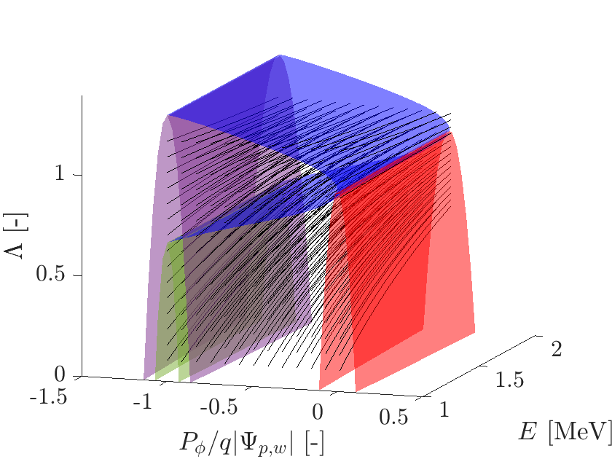
Evolution of fast-ion distribution function
Collisions
Wave-particle interactions
Slowing-down expansion functions:
ICRF heating
Fast-ion interactions with Alfvén eigenmodes, NTMs etc.
$f=\sum_{i}{c_{i}f_{sd,i}}$
Discrete case:
$\overline{f}=X\overline{c}$
Reconstruction:
${\overline{c}}_{λ}={\min_{\overline{c}}\left\|\overline{s}−WX\overline{c}\right\|}_{2}^{2}+λ^{2}{\left\|\overline{c}\right\|}_{2}^{2}$
Gaffey, J. Plasma Phys., 1976
Core, Nucl. Fusion, 1993
Madsen et al, Plasma Phys. Control. Fusion, 2020
Schmidt et al, Nucl. Fusion, 2023
Järleblad et al, Nucl. Fusion, 2025,
Reman et al, submitted

Slide 11





ICRF regularisation
$$ω=nω_{c}+k_{∥}v_{∥}$$
$$ΔP_{φ}=\frac{N}{ω}ΔE$$
$$\overline{ε}=\left(\begin{matrix}ΔΛ \\ ΔP_{φ} \\ ΔE\end{matrix}\right)$$
$$ΔΛ=\frac{\left(Λ_{∞}−Λ\right)}{E}ΔE$$
$$Λ_{∞}=\frac{nω_{c0}}{ω}$$
Rud et al, “Fast-ion phase-space tomography with wave-particle interactions in the ion cyclotron frequency range as prior”, revised manuscript submitted

Slide 12
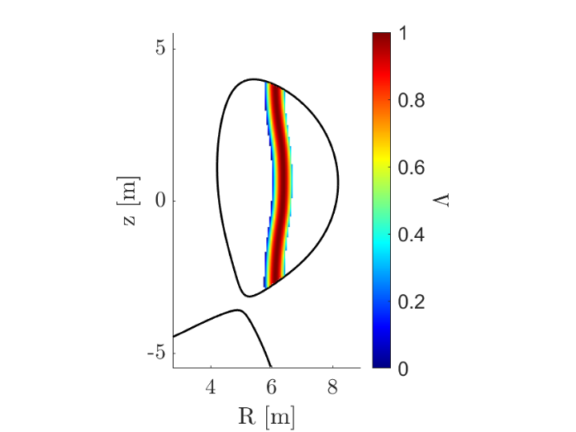
ICRF regularisation
Resonance region
$$ω=nω_{c}+k_{∥}v_{∥}$$
$$ΔP_{φ}=\frac{N}{ω}ΔE$$
$$\overline{ε}=\left(\begin{matrix}ΔΛ \\ ΔP_{φ} \\ ΔE\end{matrix}\right)$$
$$ΔΛ=\frac{\left(Λ_{∞}−Λ\right)}{E}ΔE$$
$$Λ_{∞}=\frac{nω_{c0}}{ω}$$
Rud et al, “Fast-ion phase-space tomography with wave-particle interactions in the ion cyclotron frequency range as prior”, revised manuscript submitted

Slide 13
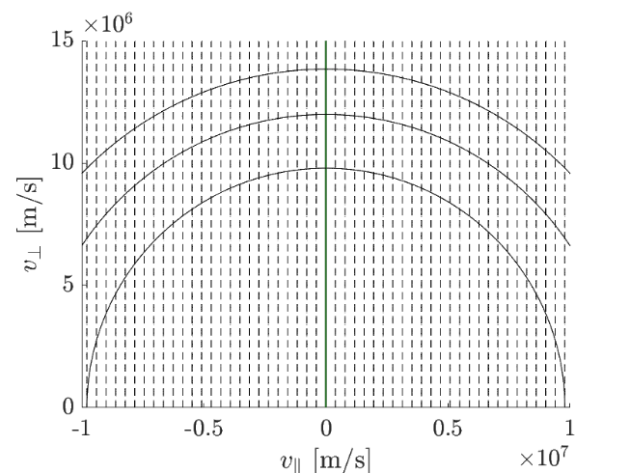
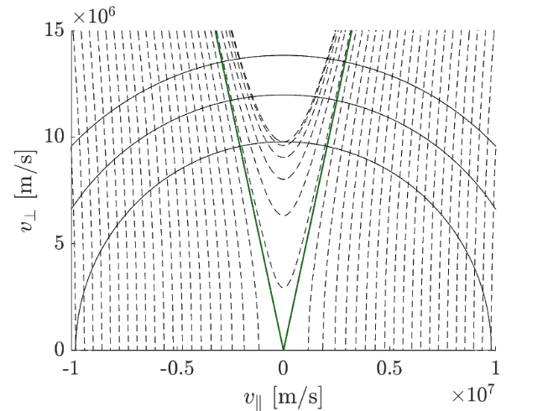
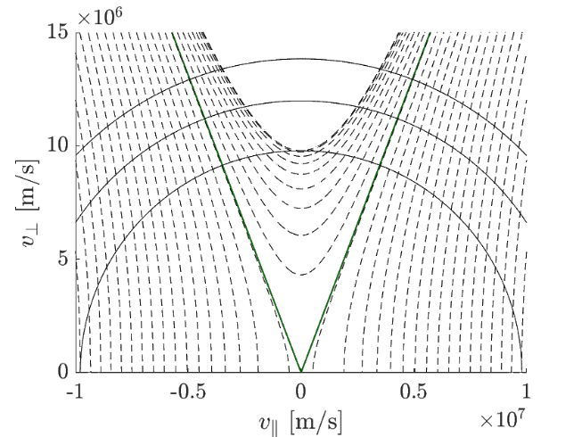
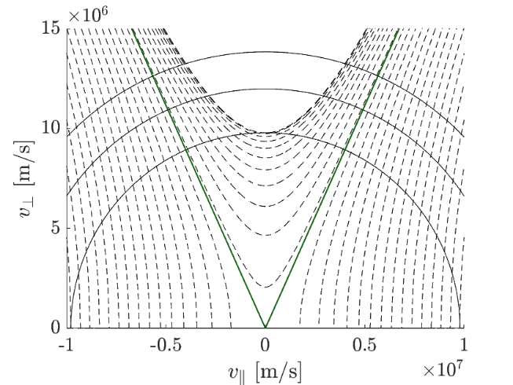



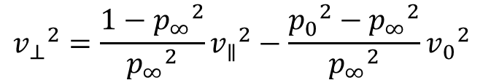

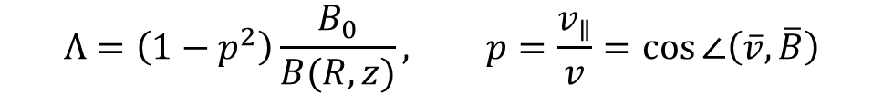

ICRF streamlines
$$Λ=\left(1−p^{2}\right)\frac{B_{0}}{B(R,z)}, p=\frac{v_{∥}}{v}=\cos{∠\left(\overline{v},\overline{B}\right)}$$
Streamlines in velocity space:
$${v_{⊥}}^{2}=\frac{1−{p_{∞}}^{2}}{{p_{∞}}^{2}}{v_{∥}}^{2}−\frac{{p_{0}}^{2}−{p_{∞}}^{2}}{{p_{∞}}^{2}}{v_{0}}^{2}$$
$$Δv_{⊥}=\frac{1−{p_{∞}}^{2}}{{p_{∞}}^{2}}\frac{v_{∥}}{v_{⊥}}Δv_{∥}$$
$$R=R_{0}$$
$R=6.65$ m
$R=7.20$ m
$R=7.50$ m
On-axis resonance heating
Kazakov et al 2021 Phys. Plasmas
Rud et al 2025 “Fast-ion phase-space tomography with wave-particle interactions in the ion cyclotron frequency range as prior” submitted

Slide 14
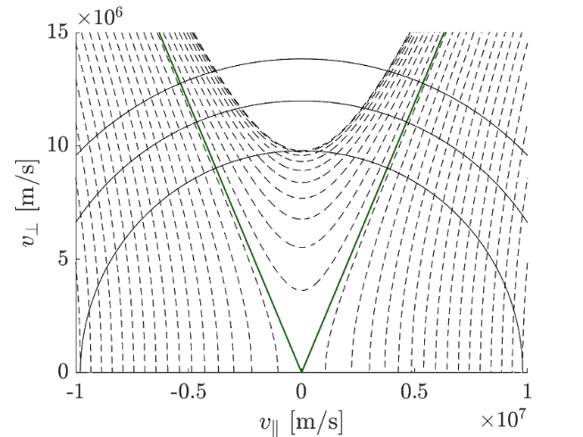
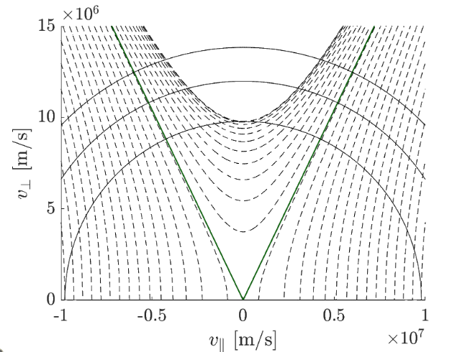
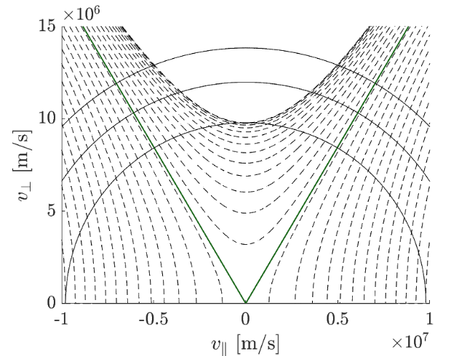
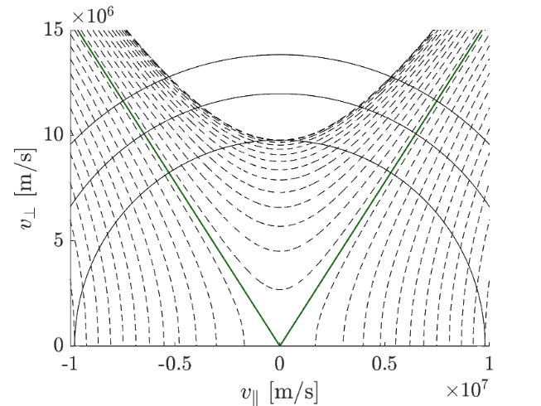
ICRF streamlines
$$Λ=\left(1−p^{2}\right)\frac{B_{0}}{B(R,z)}, p=\frac{v_{∥}}{v}=\cos{∠\left(\overline{v},\overline{B}\right)}$$
Streamlines in velocity space:
$${v_{⊥}}^{2}=\frac{1−{p_{∞}}^{2}}{{p_{∞}}^{2}}{v_{∥}}^{2}−\frac{{p_{0}}^{2}−{p_{∞}}^{2}}{{p_{∞}}^{2}}{v_{0}}^{2}$$
$$Δv_{⊥}=\frac{1−{p_{∞}}^{2}}{{p_{∞}}^{2}}\frac{v_{∥}}{v_{⊥}}Δv_{∥}$$
$$R=R_{0}$$
$R=6.65$ m
$R=7.20$ m
$R=7.50$ m
Off-axis resonance heating
Kazakov et al 2021 Phys. Plasmas
Rud et al 2025 “Fast-ion phase-space tomography with wave-particle interactions in the ion cyclotron frequency range as prior” submitted

Slide 15





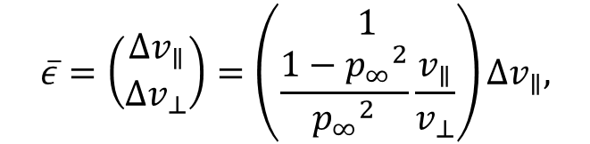
ICRF regularisation matrix
$$\overline{ε}=\left(\begin{matrix}Δv_{∥} \\ Δv_{⊥}\end{matrix}\right)=\left(\begin{matrix}1 \\ \frac{1−{p_{∞}}^{2}}{{p_{∞}}^{2}}\frac{v_{∥}}{v_{⊥}}\end{matrix}\right)Δv_{∥},$$
$$L^{IC}=\left(\begin{matrix}1 & D_{v_{∥}v_{⊥}} \\ D_{v_{⊥}v_{∥}} & D_{v_{⊥}v_{⊥}}\end{matrix}\right)L_{1}$$
$$∇→\overline{ε}{\overline{ε}}^{T}∇,$$
$$R=R_{0}$$
$R=6.65$ m
$R=7.20$ m
$R=7.50$ m
Off-axis resonance heating
Kazakov et al 2021 Phys. Plasmas
Rud et al 2025 “Fast-ion phase-space tomography with wave-particle interactions in the ion cyclotron frequency range as prior” submitted

Slide 16
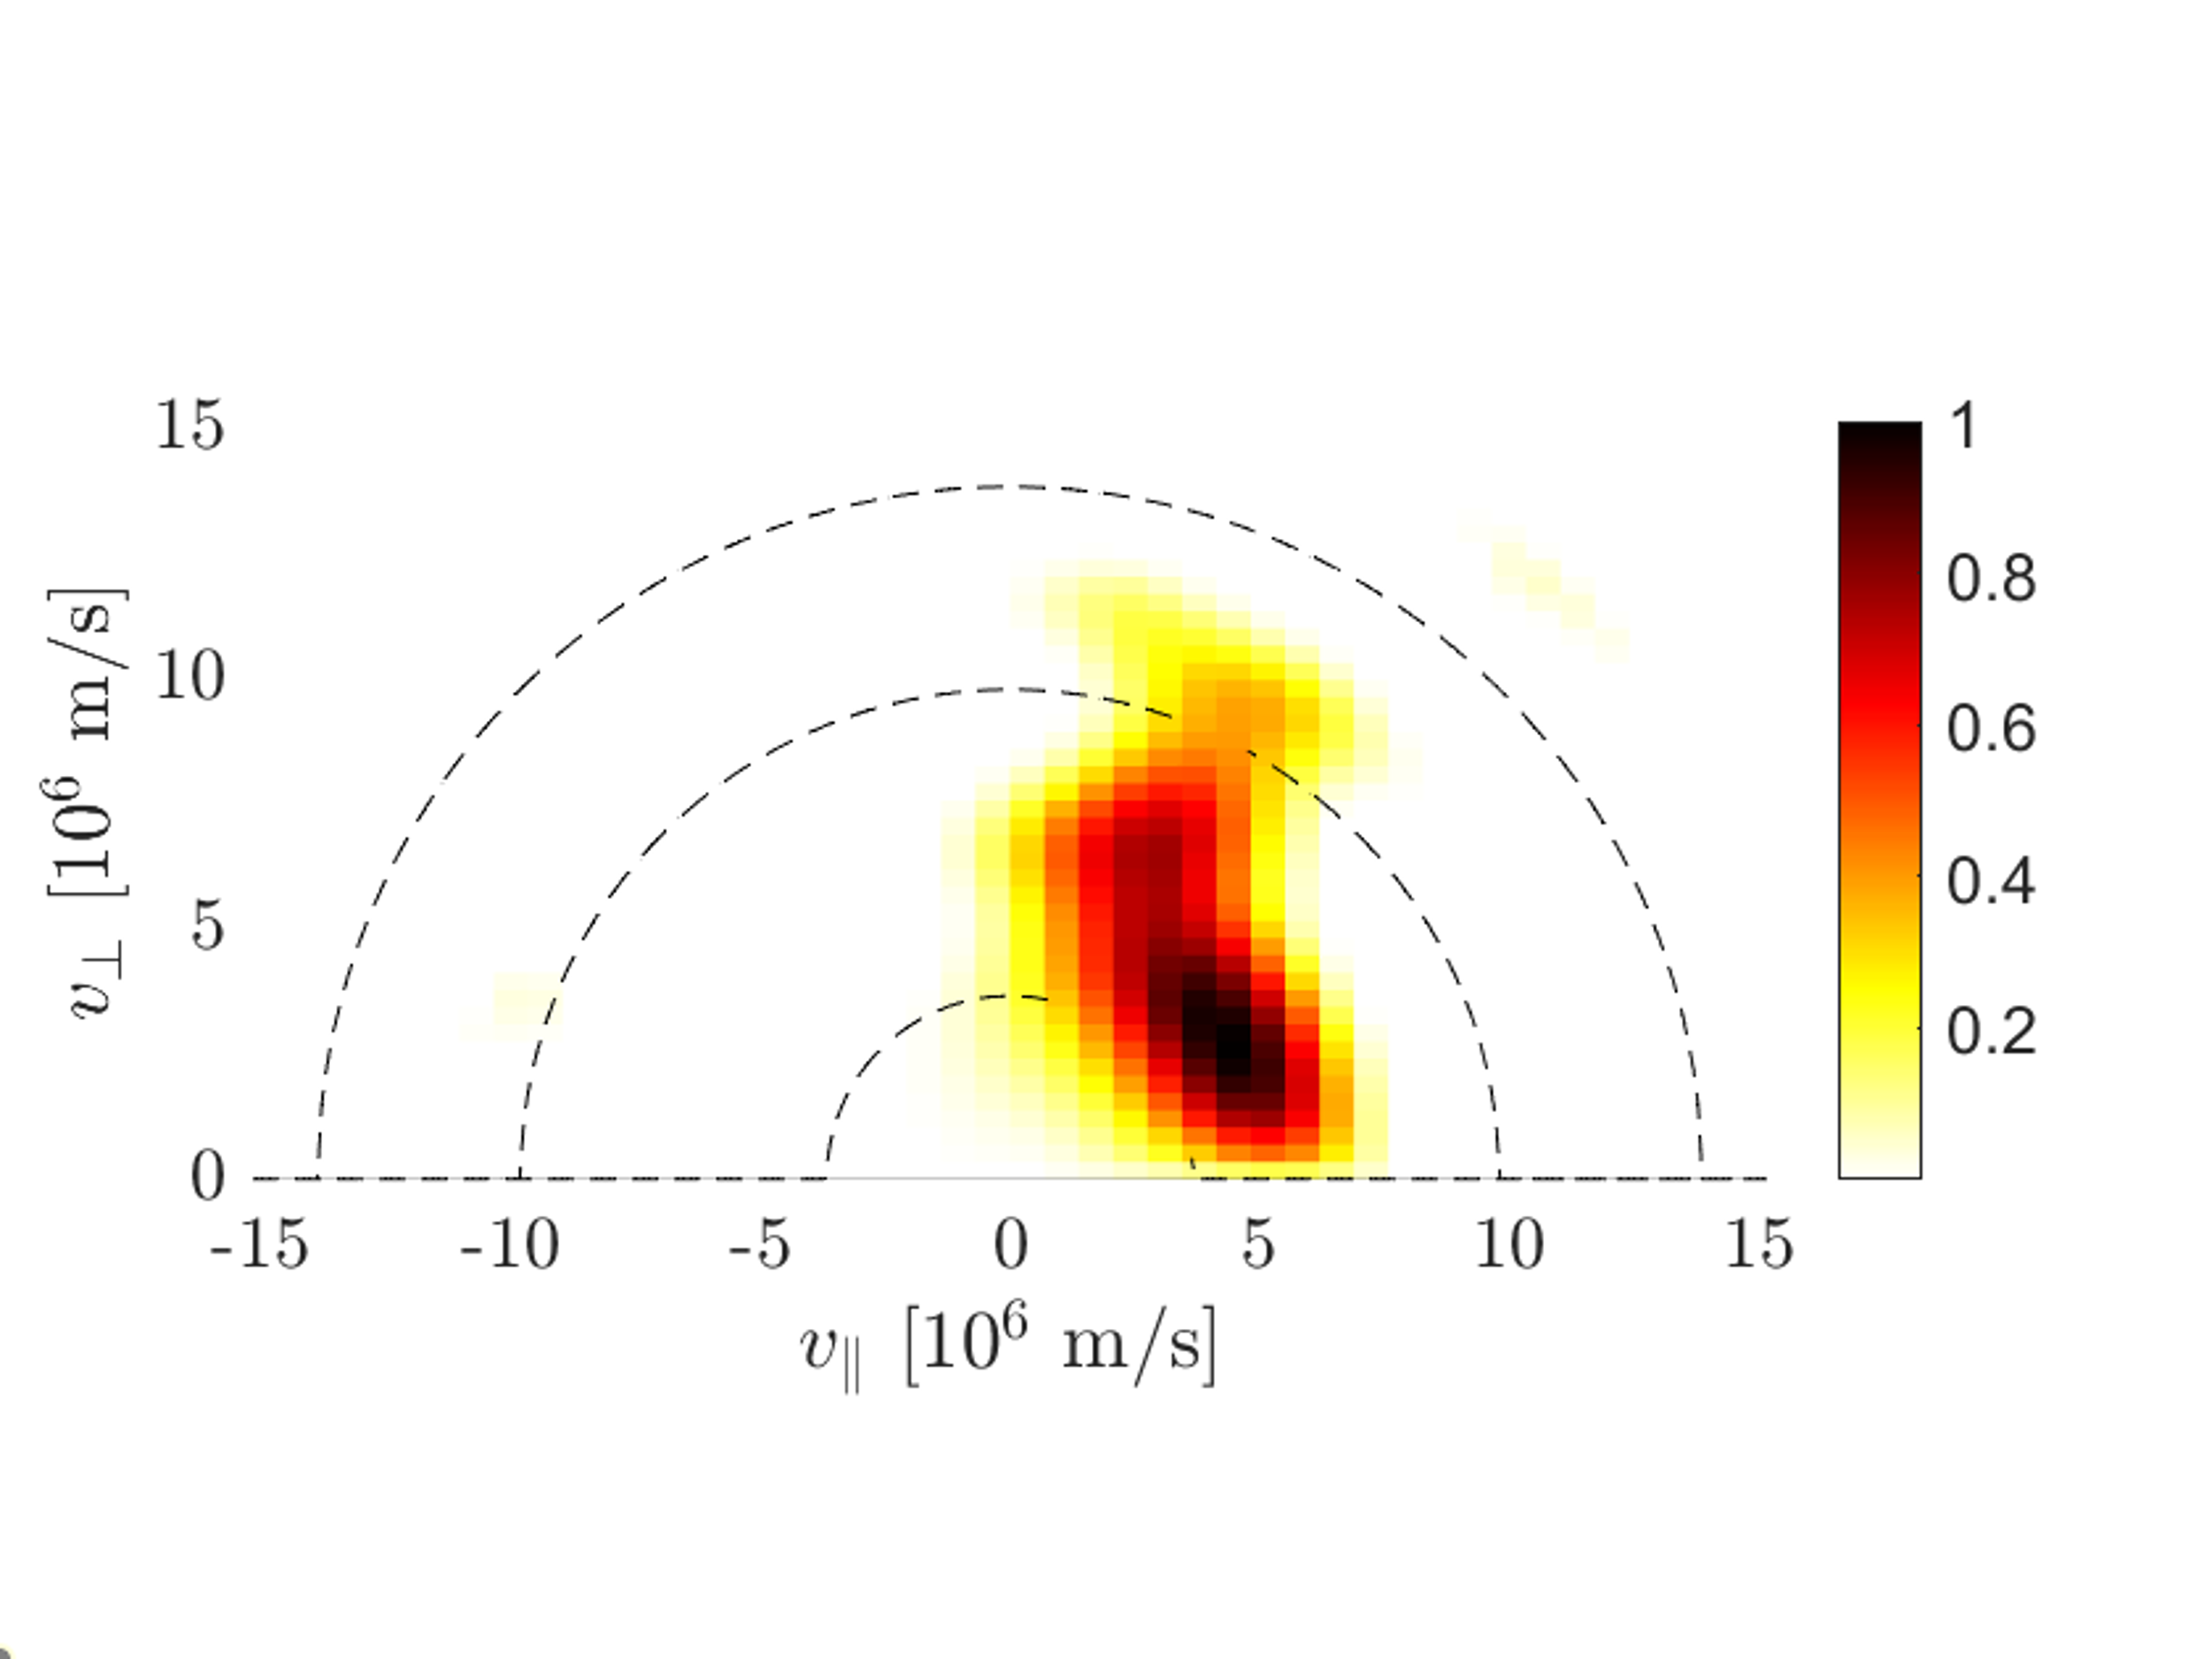
Experimental setup and reconstructions

Slide 17
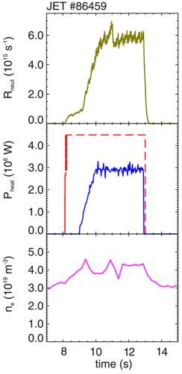
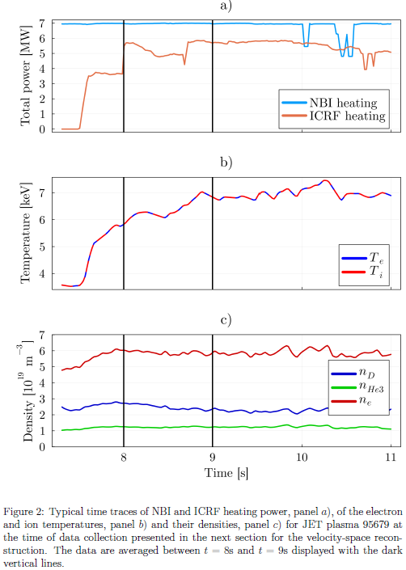
JET discharge #86459, third-harmonic ICRF
JET discharge #95679, 3-ion scheme
B-field on axis:
2.25 T
ICRF wave frequency:
51 MHz (on-axis resonance)
Data collection interval:
[10.5, 12.1] s
Reman et al, submitted
Salewski et al 2017 Nucl. Fusion, Eriksson et al 2015 Nucl. Fusion

Slide 18
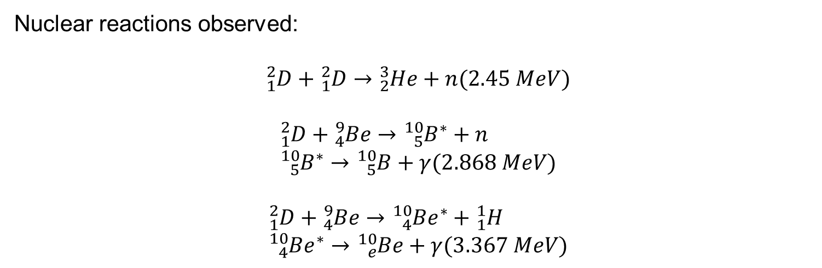
Nuclear reactions observed: $${}_{1}^{2}D+{}_{1}^{2}D→{}_{2}^{3}{He}+n(2.45 MeV)$$ $${}_{1}^{2}D+{}_{4}^{9}{Be}→{}_{5}^{10}{B^{∗}}+n \\ {}_{5}^{10}{B^{∗}}→{}_{5}^{10}B+γ(2.868 MeV)$$ $${}_{1}^{2}D+{}_{4}^{9}{Be}→{}_{4}^{10}{{Be}^{∗}}+{}_{1}^{1}H \\ {}_{4}^{10}{{Be}^{∗}}→{}_{e}^{10}{Be}+γ(3.367 MeV)$$

Slide 19
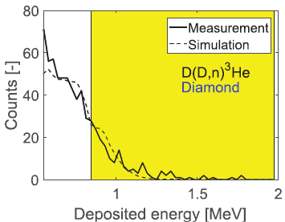
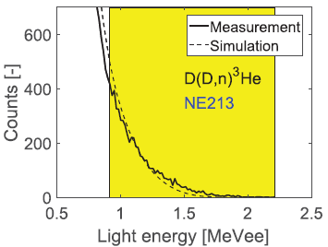
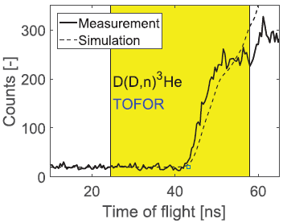
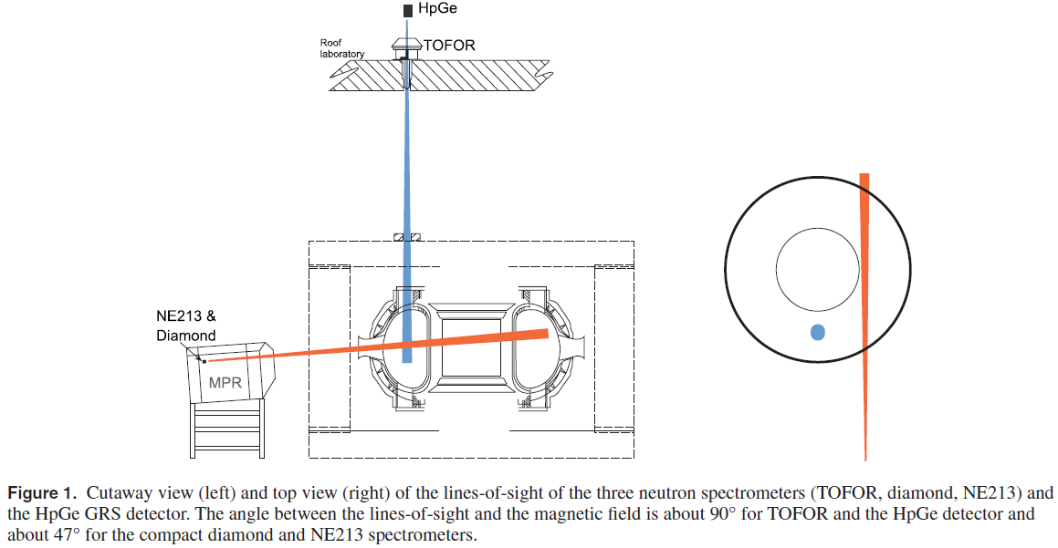
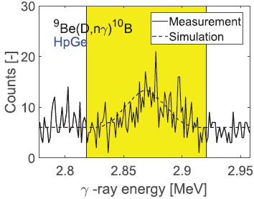
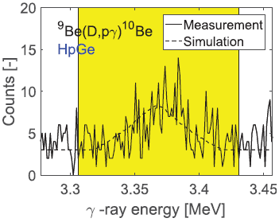

On-axis resonance experiment
$$\overline{s}=W\overline{f}$$
$$W∈ℝ^{434×1089}$$
Salewski et al 2017 Nucl. Fusion

Slide 20
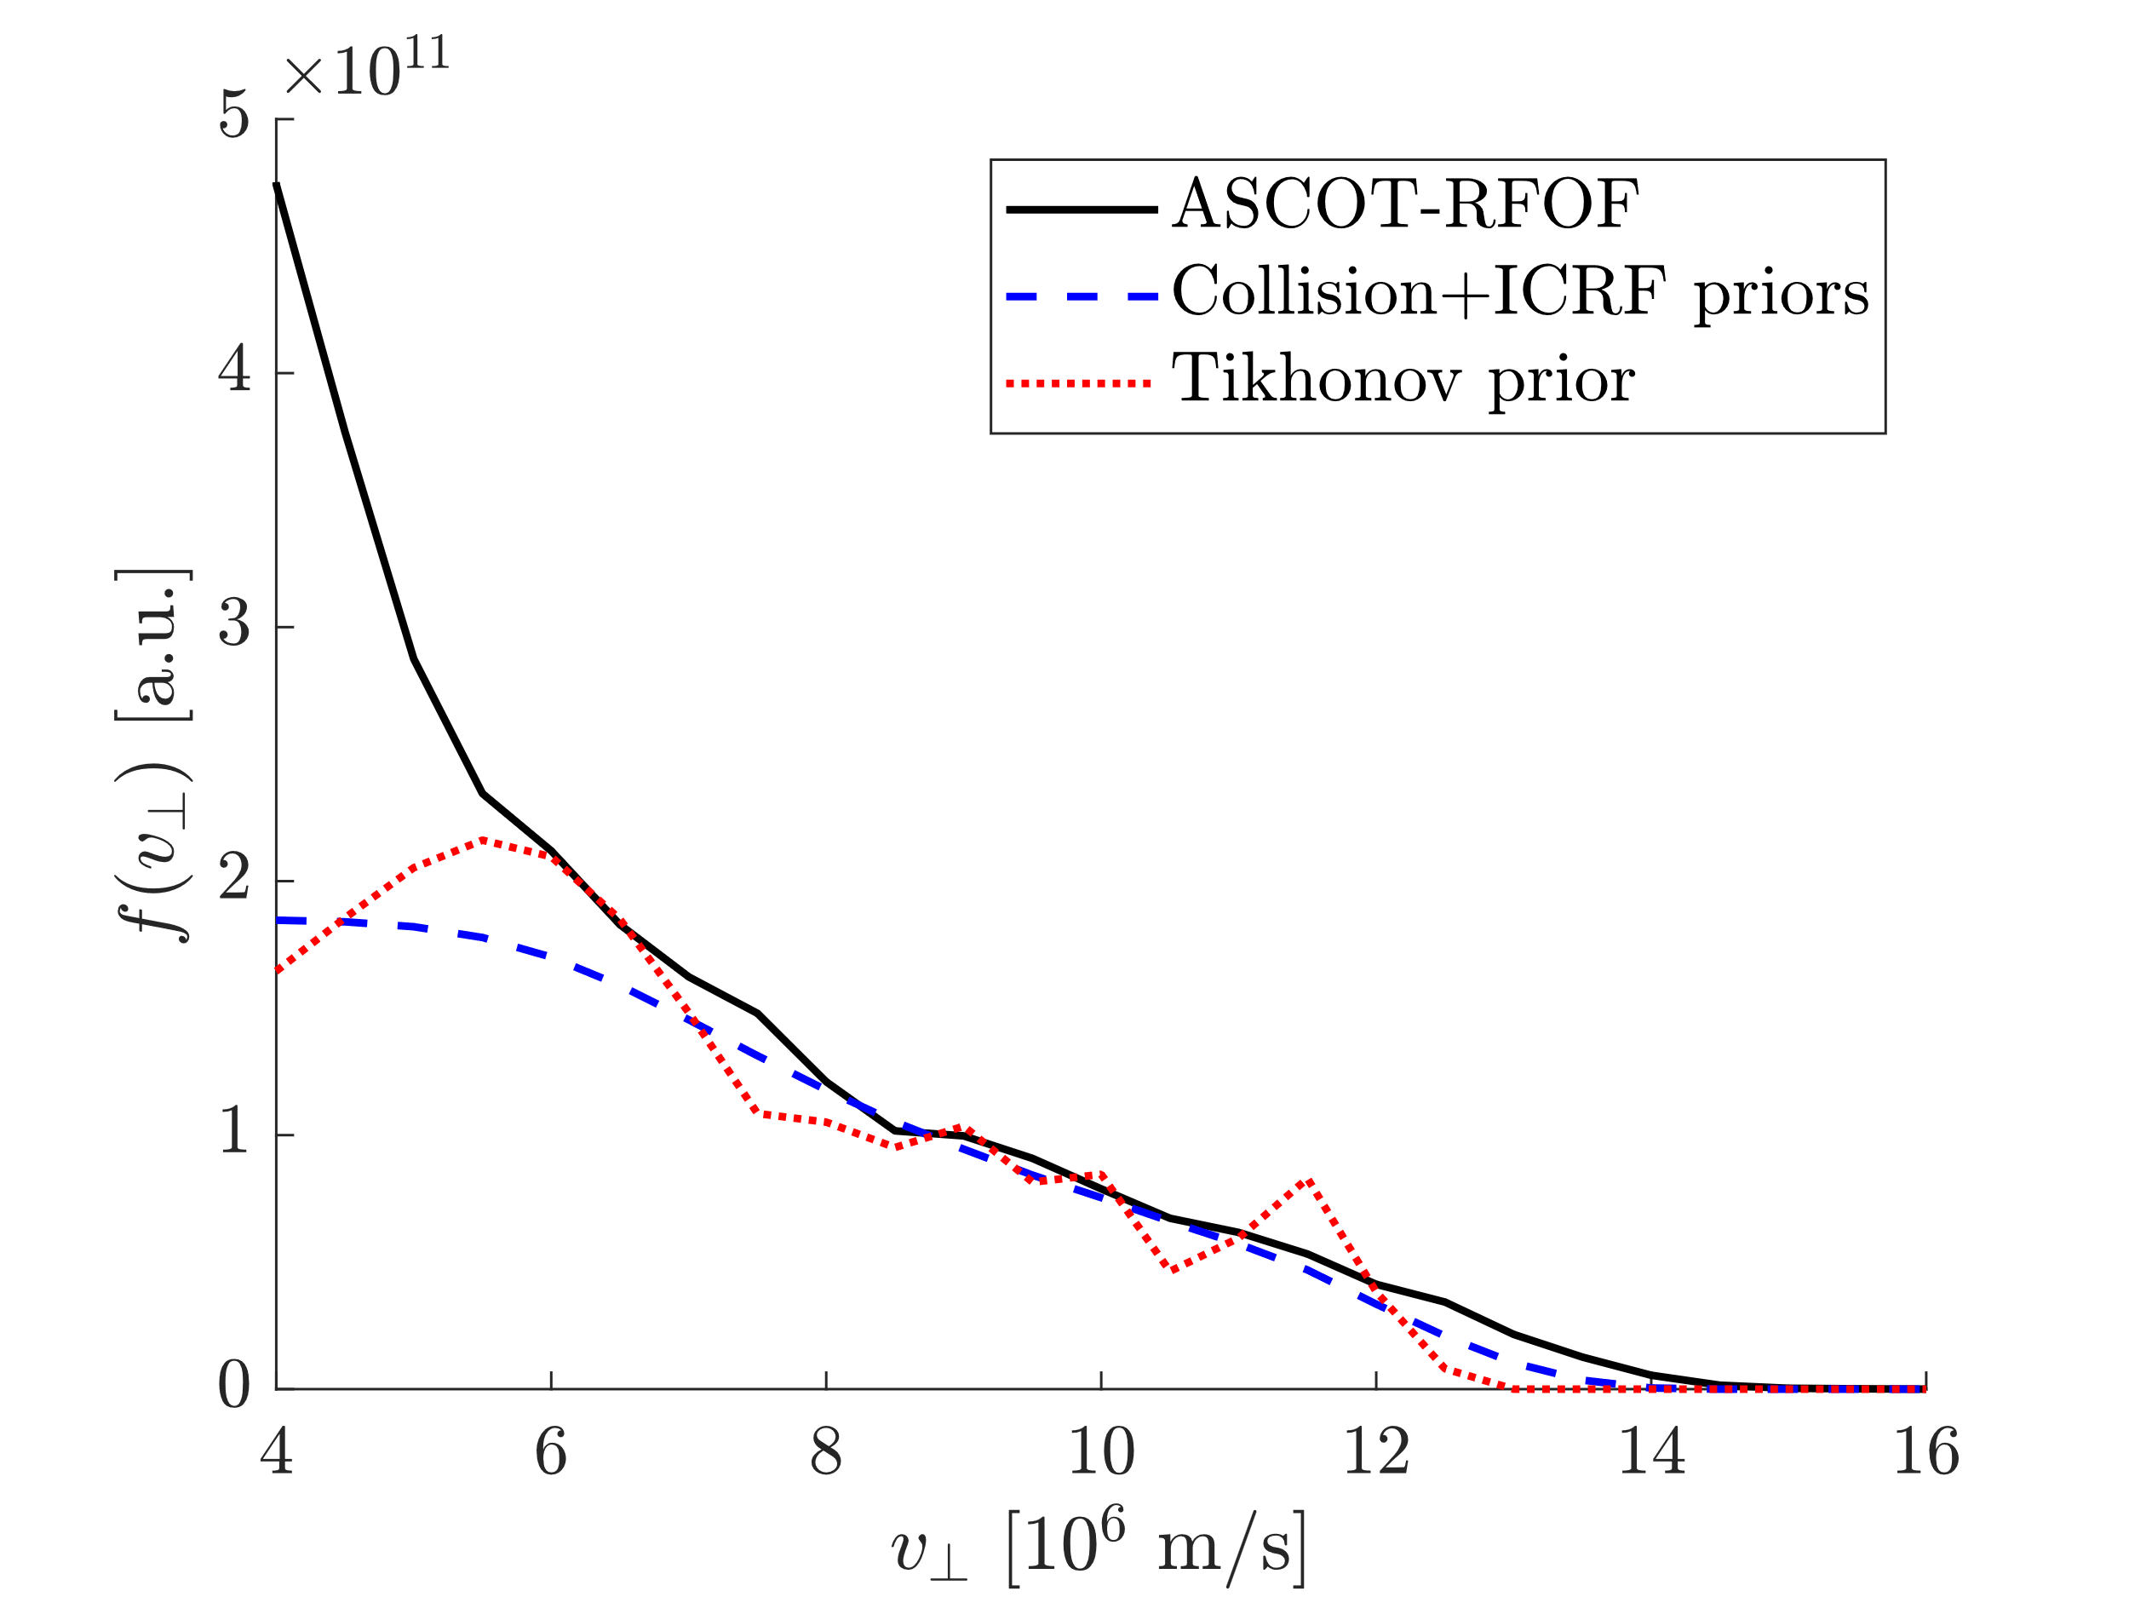
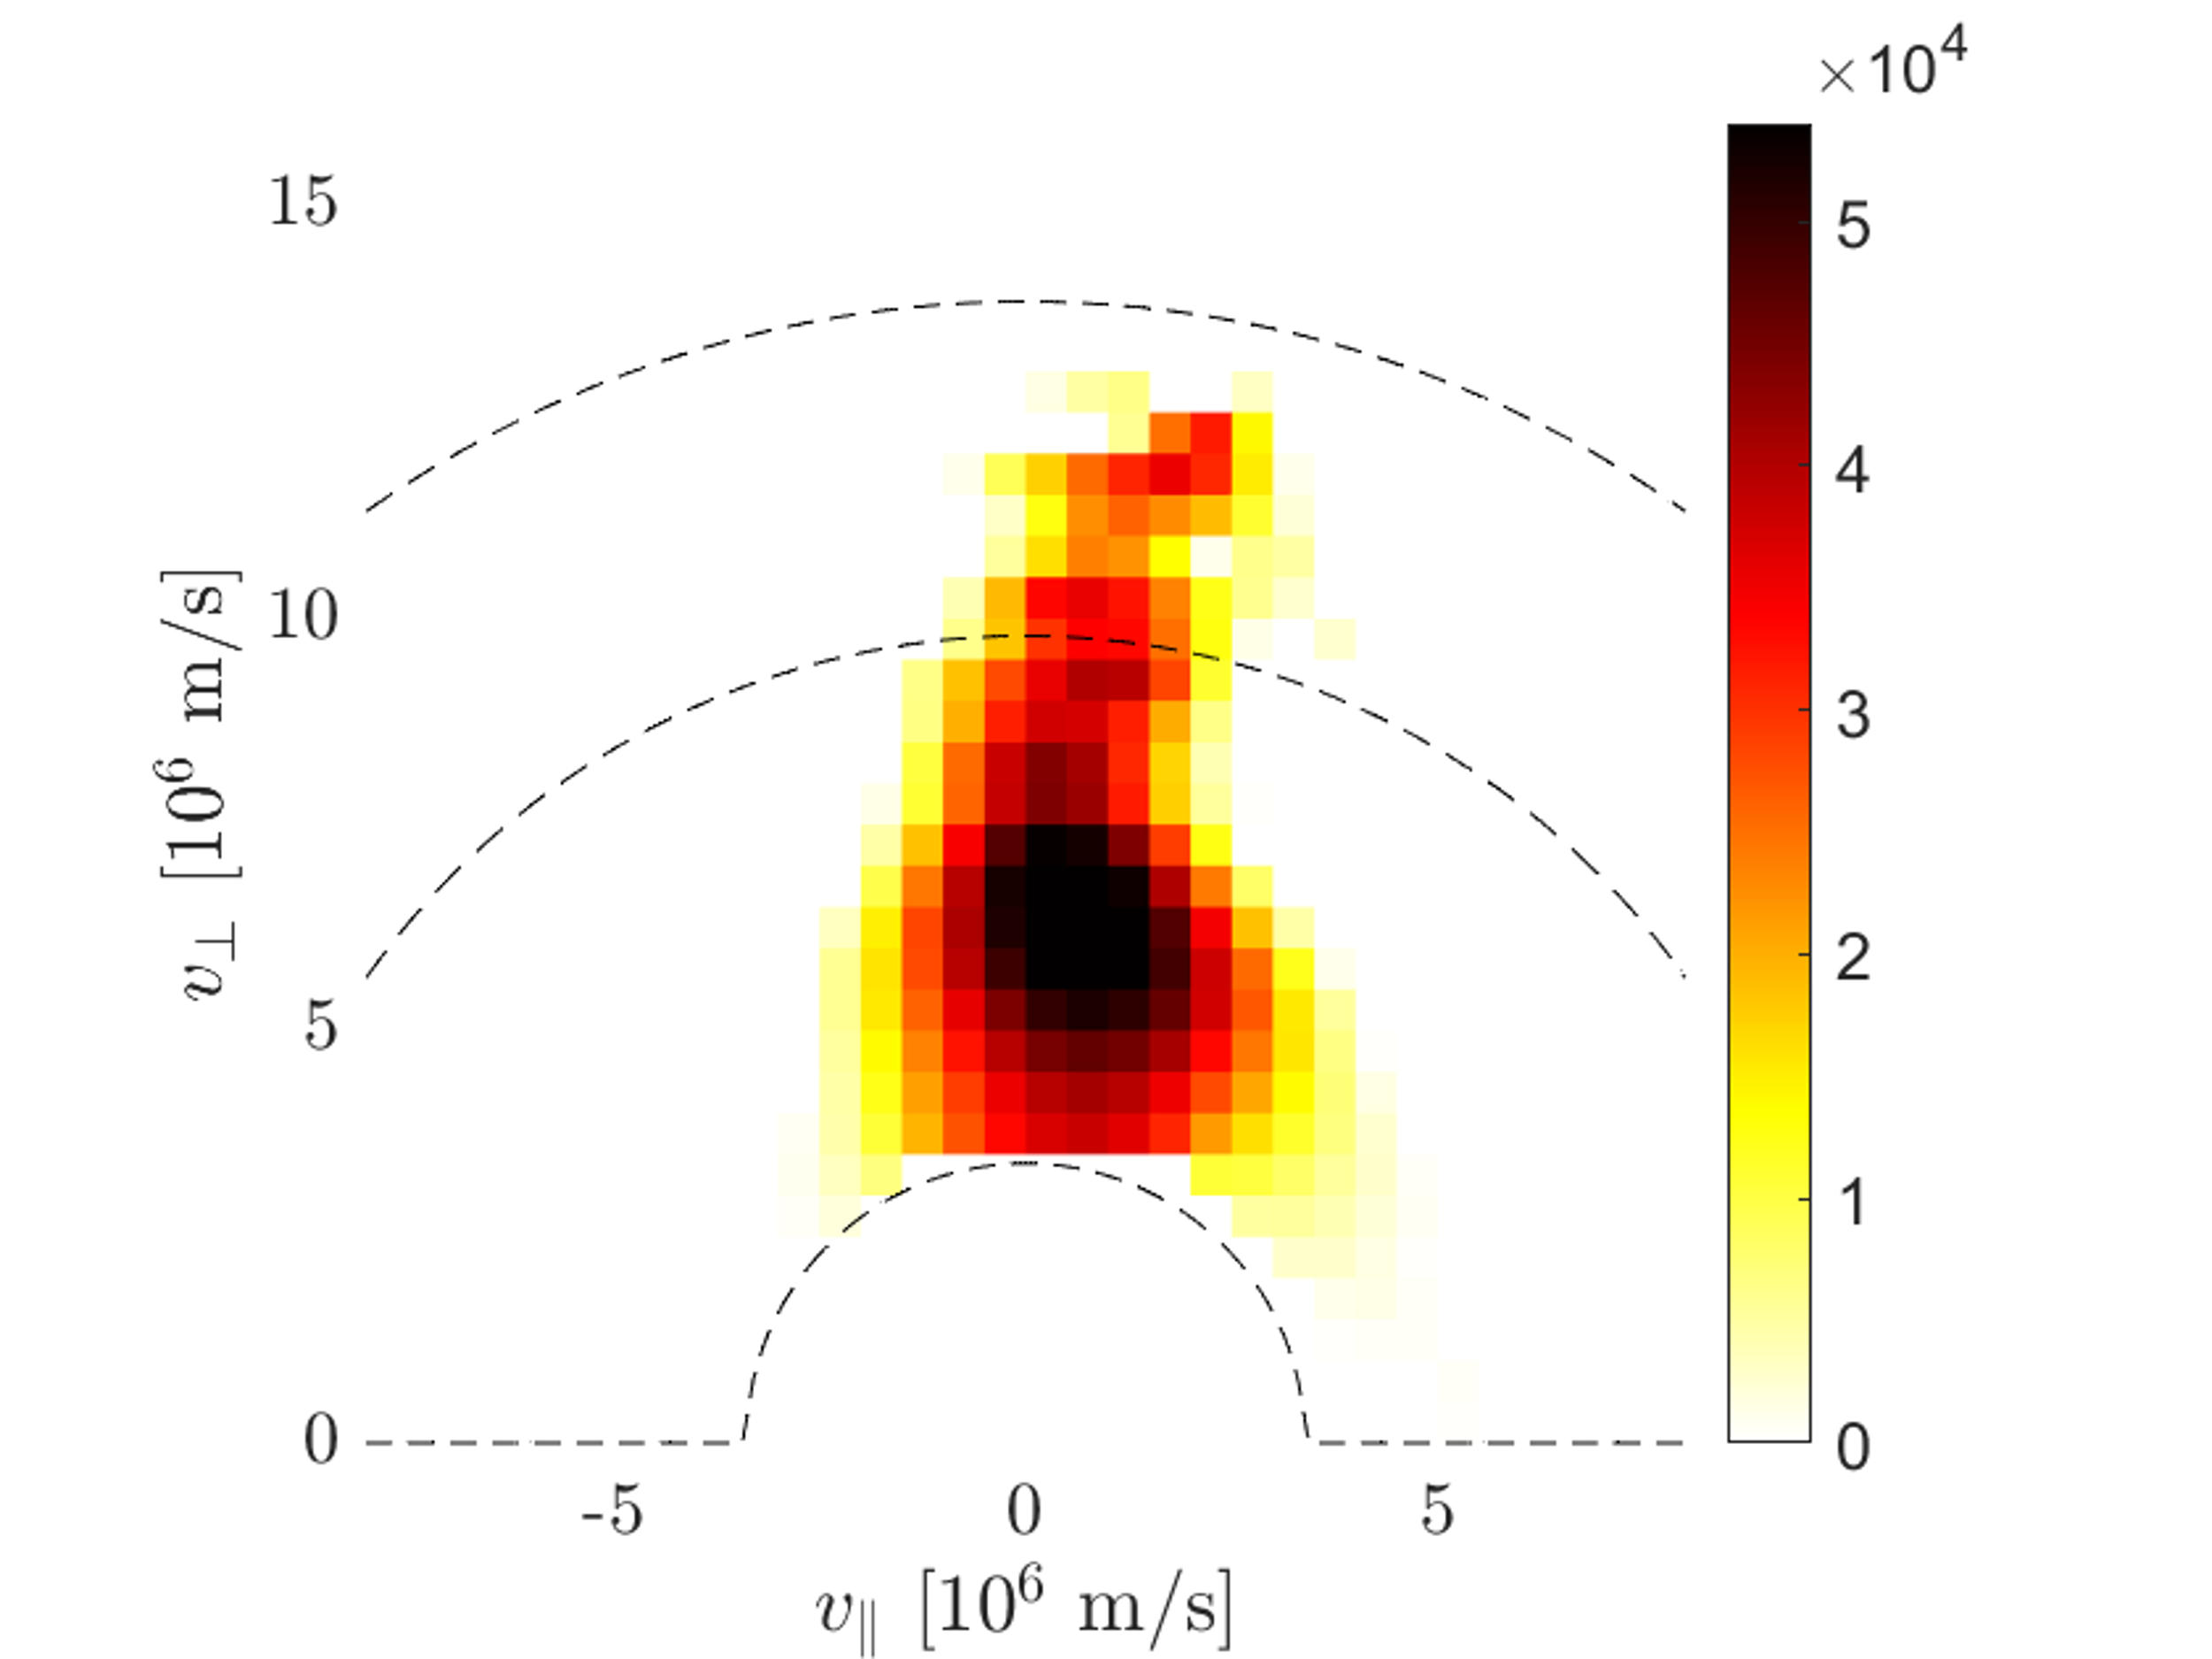
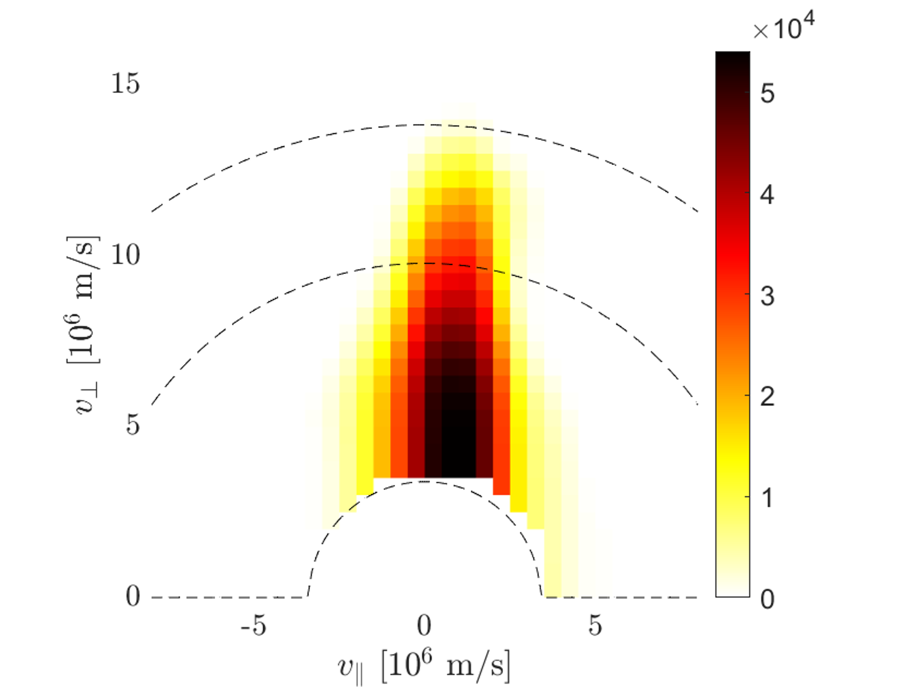
Reconstructions
${\overline{c}}_{λ}={\min_{\overline{c}}\left\|\overline{s}−WX\overline{c}\right\|}_{2}^{2}+{λ_{col}}^{2}{\left\|\overline{c}\right\|}_{2}^{2}+λ^{2}{\left\|L^{IC}X\overline{c}\right\|}_{2}^{2}, s.t. X\overline{c}≥\overline{0}$
1D distributions
ASCOT-RFOF
1st Tikhonov
Collisions+ICRF

Slide 21
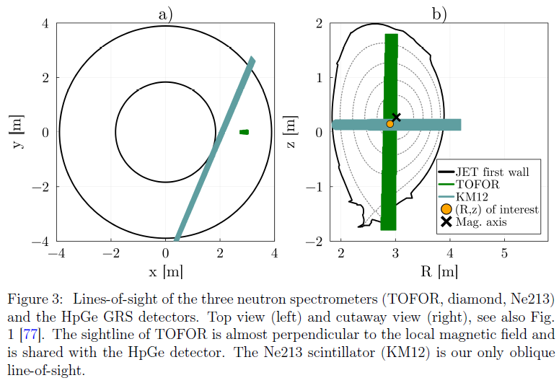
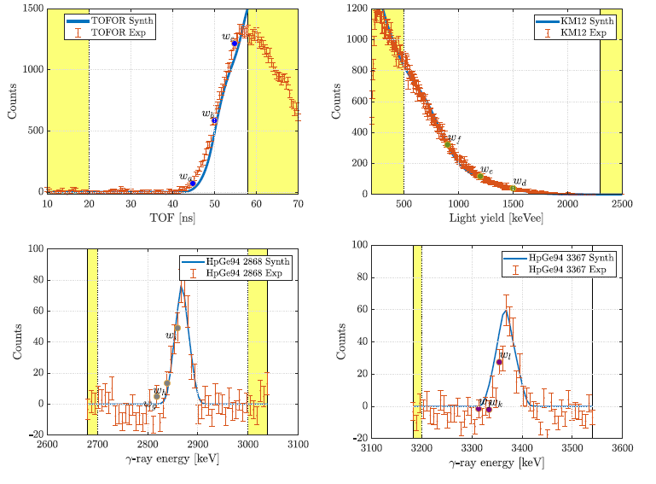

Off-axis resonance experiment
$$\overline{s}=W\overline{f}$$
$$W∈ℝ^{407×2025}$$
Reman et al “Velocity-space tomography of an MeV fast-ion tail generated by three-ion scheme ICRF heating at JET” submitted

Slide 22
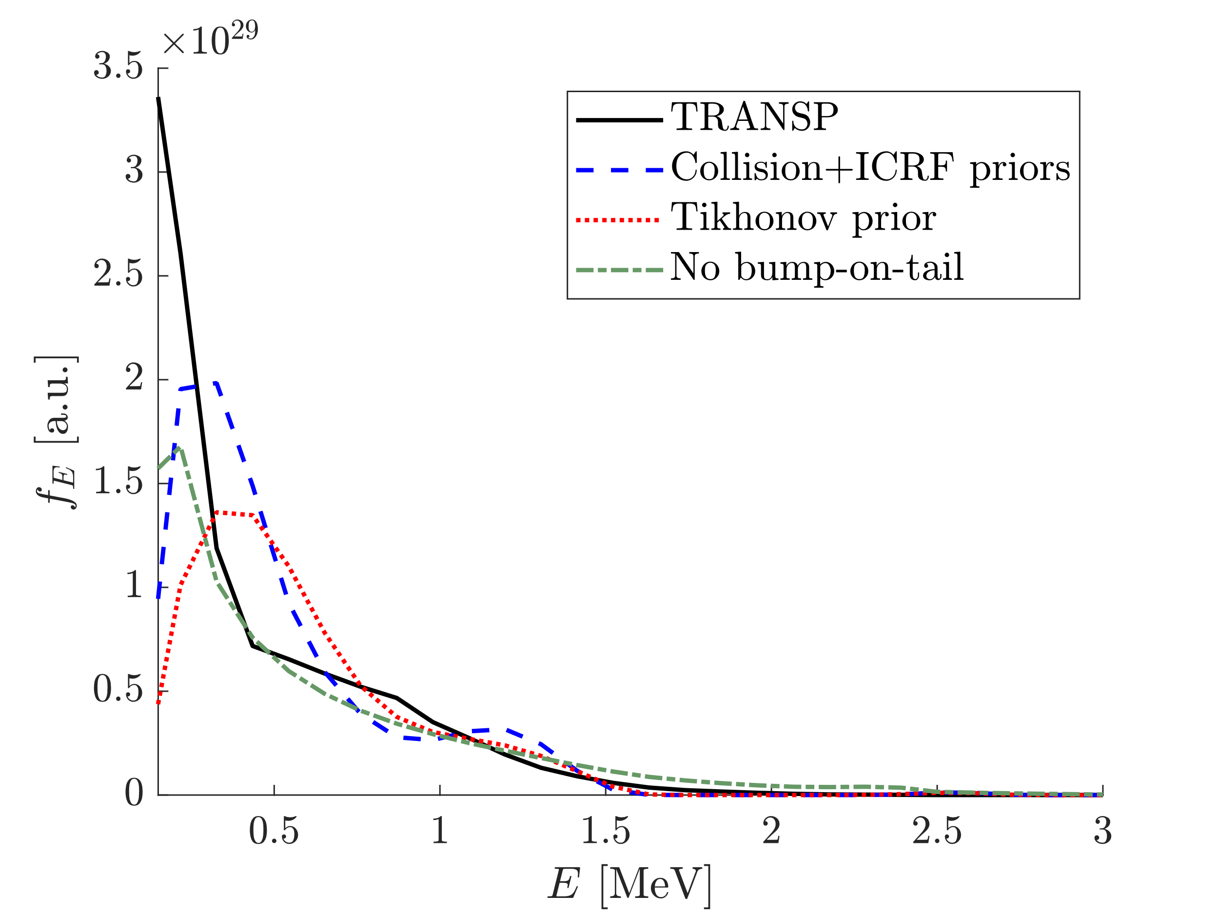
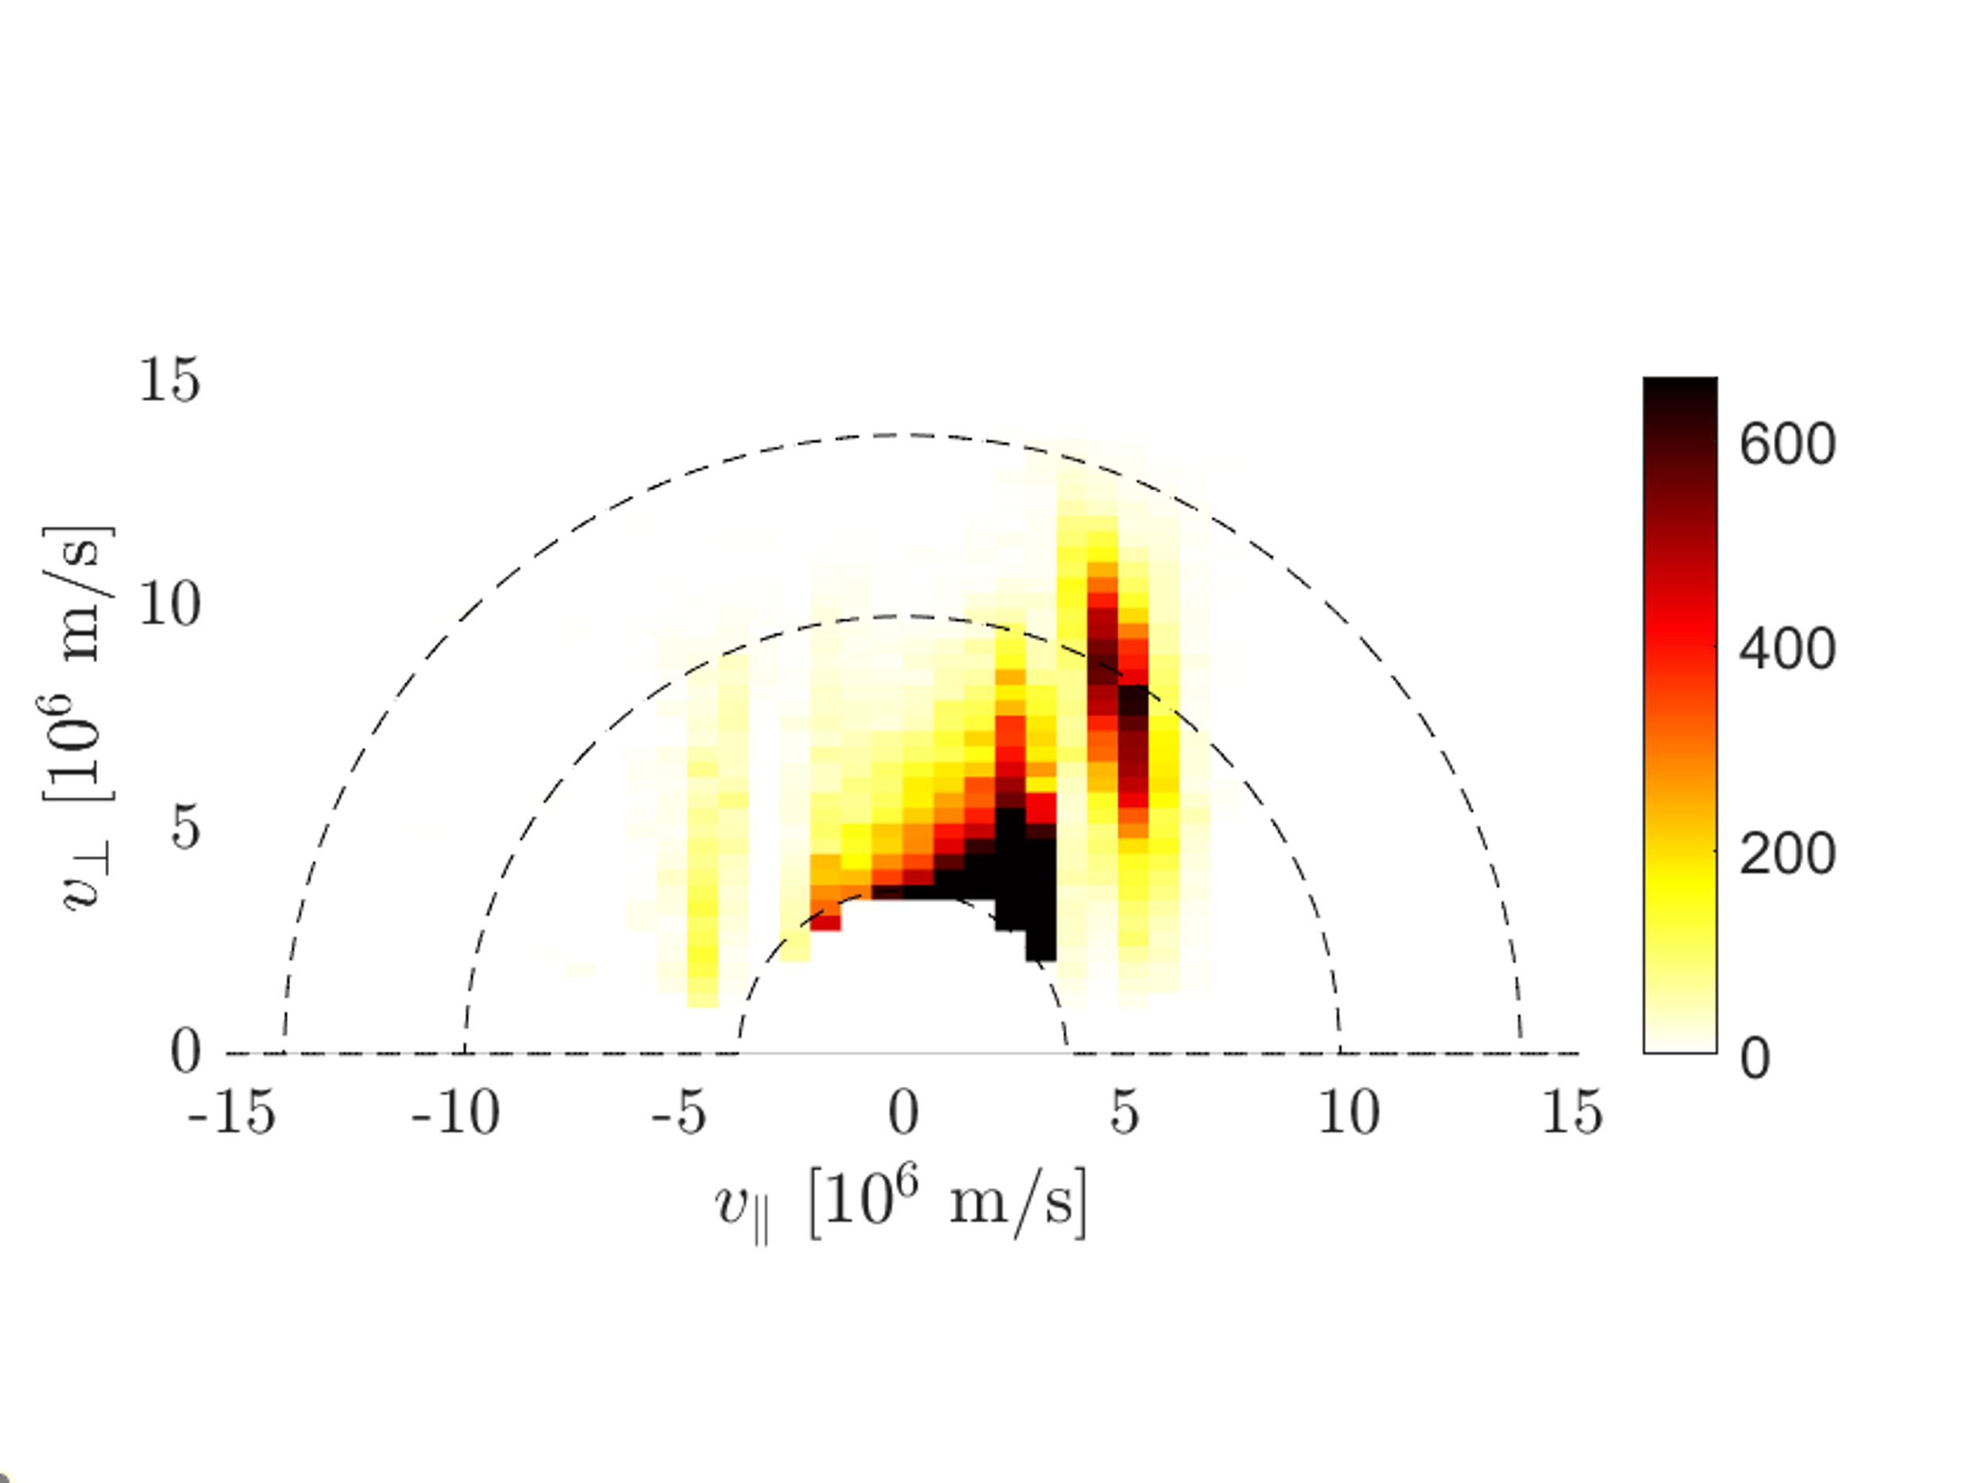
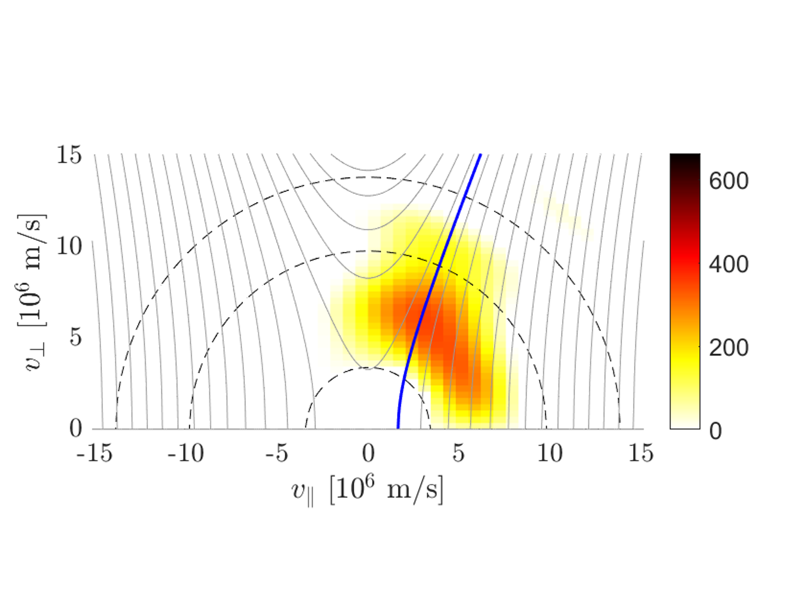
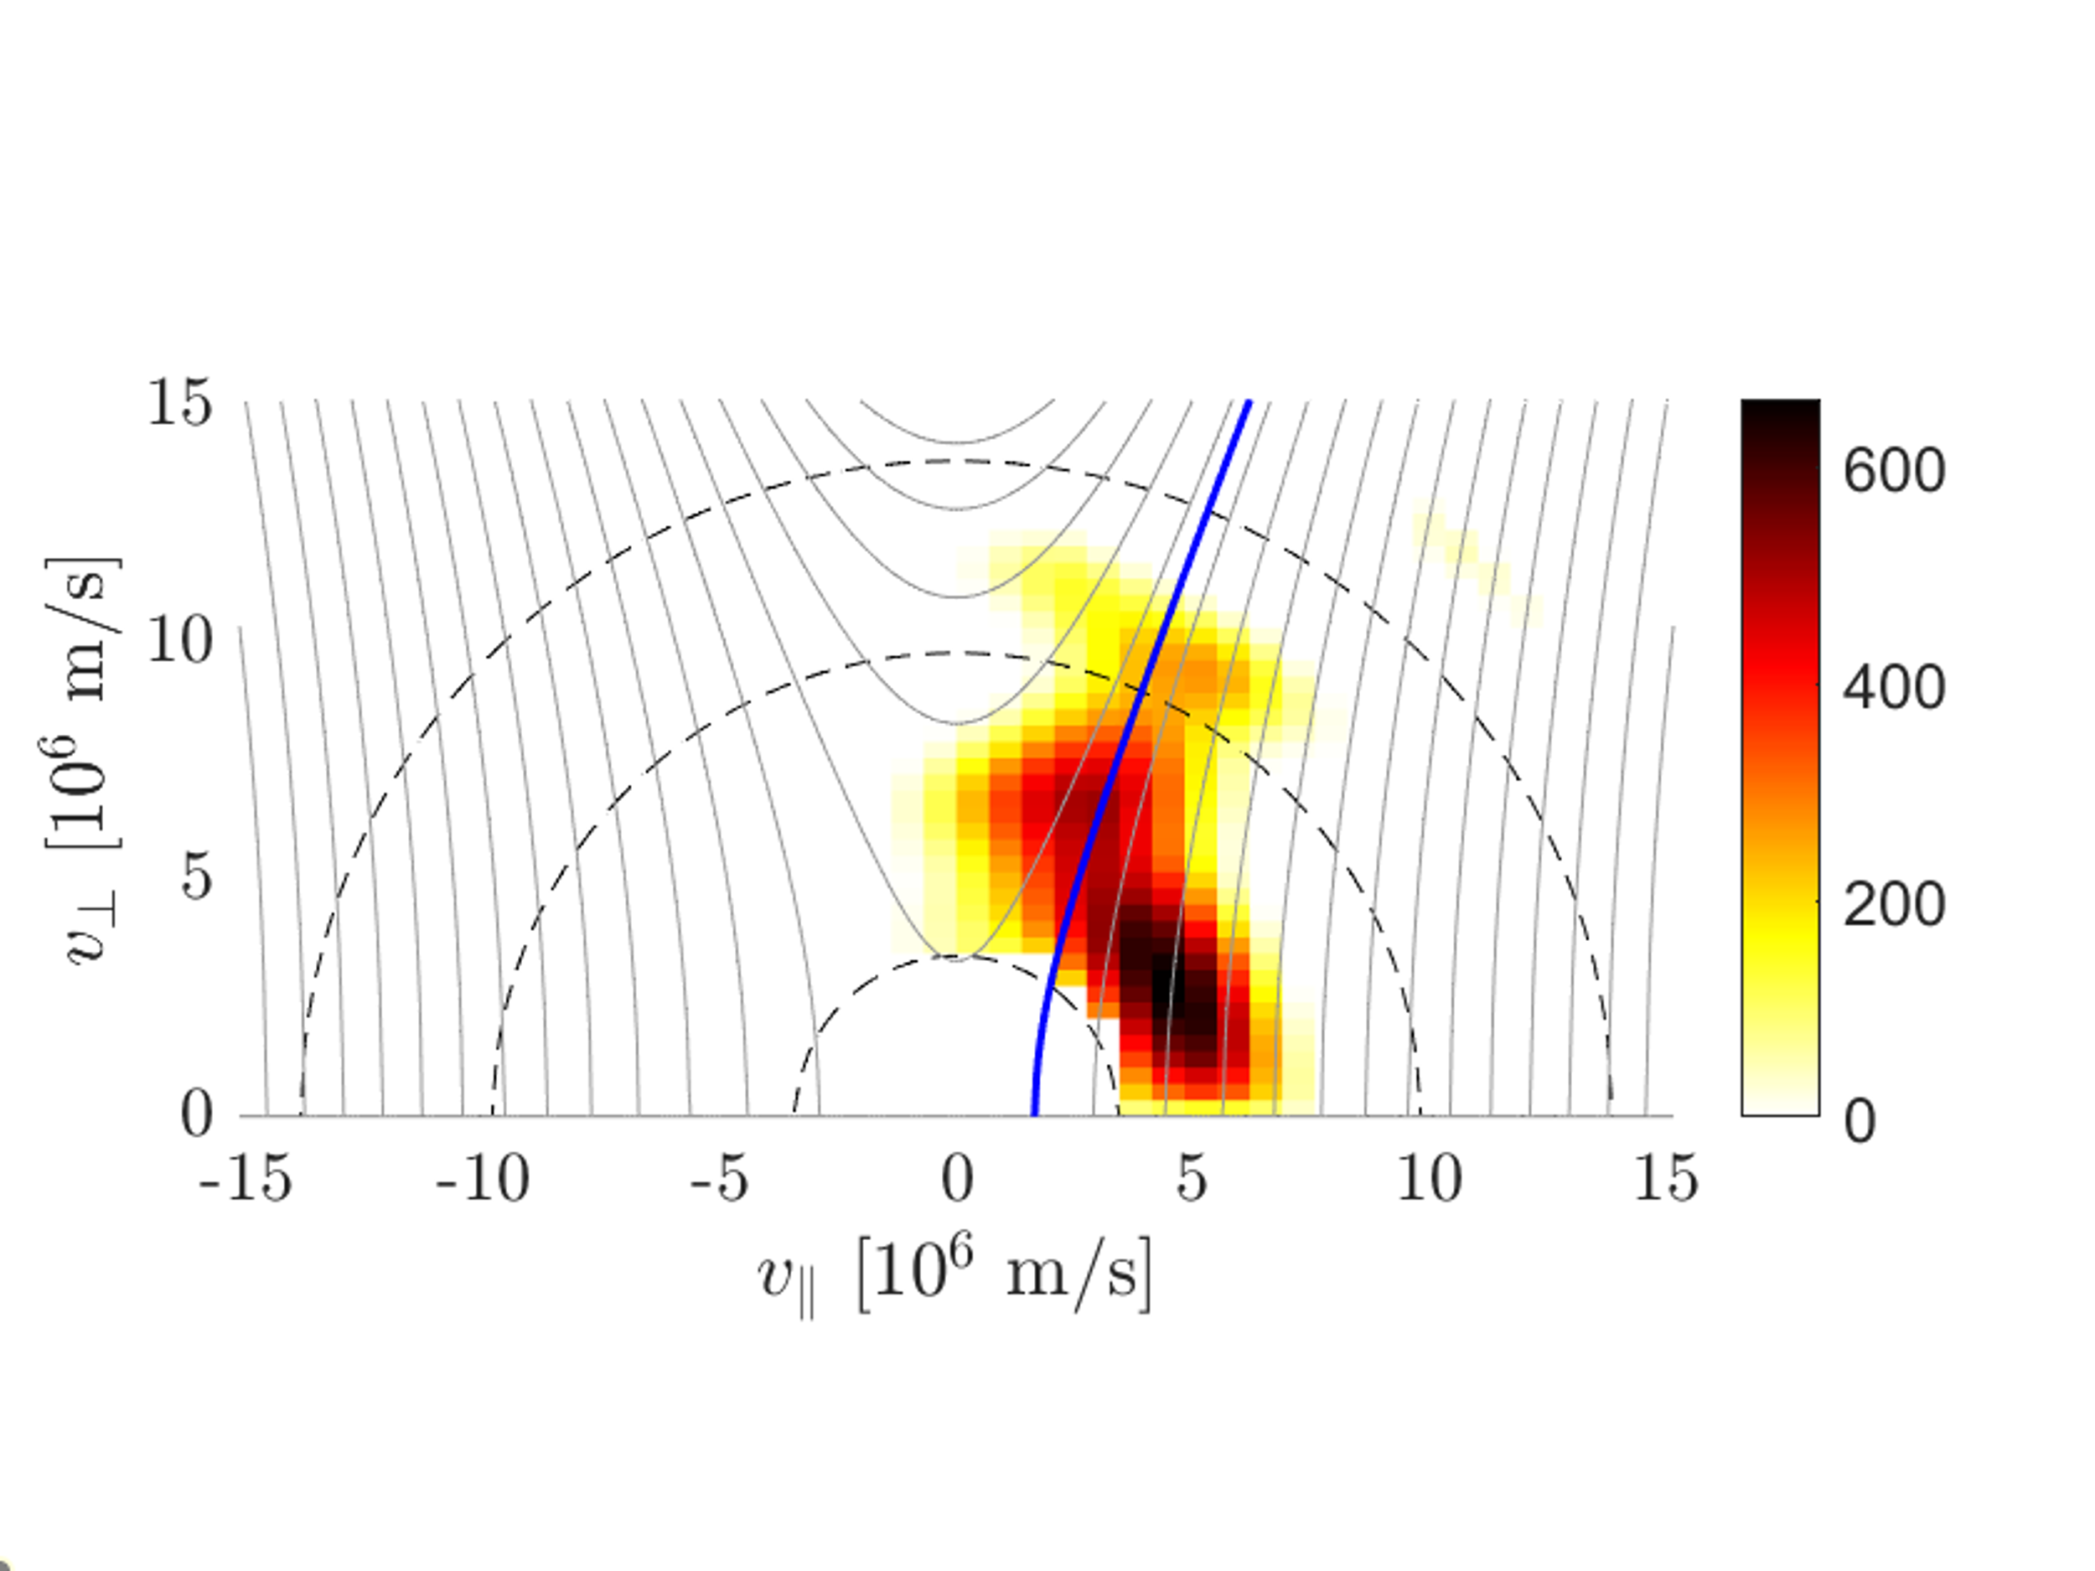
Reconstructions with collision and ICRF physics
1D distributions
TRANSP
1st Tikhonov
Collisions+ICRF

Slide 23
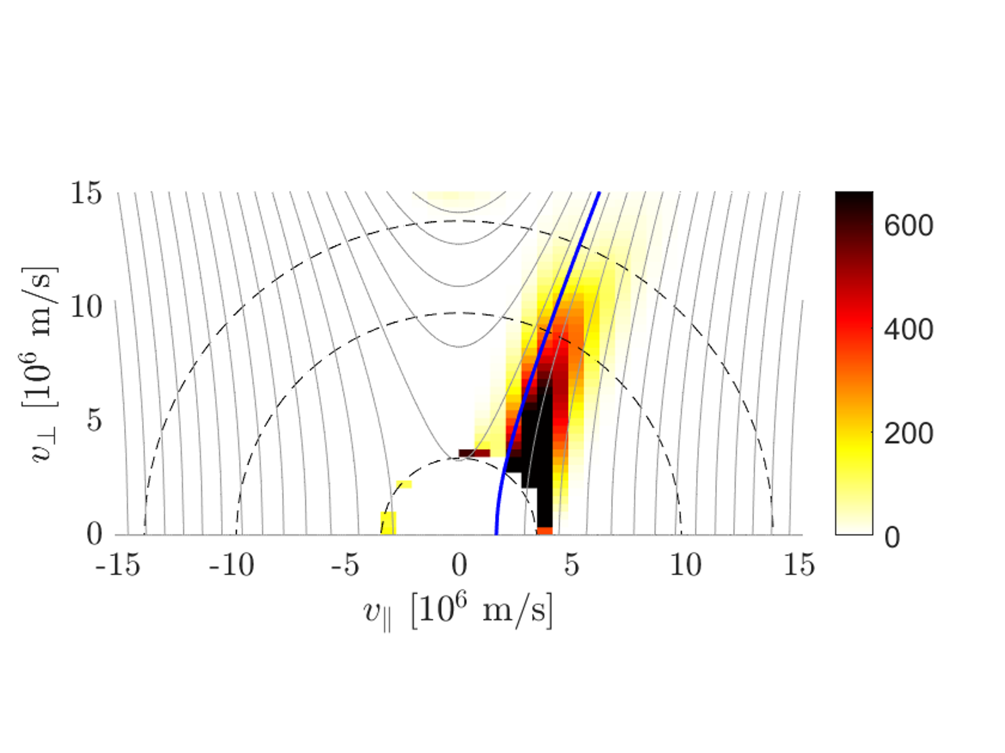
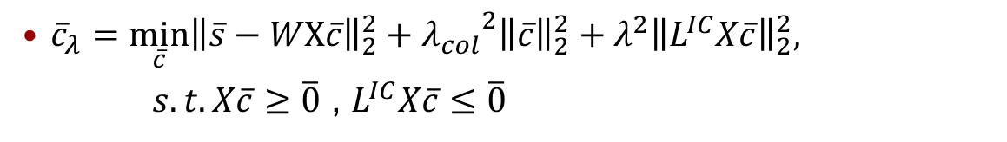
Reconstructions with collision and ICRF physics
More prior information: Monotonicity constraint along streamlines
${\overline{c}}_{λ}={\min_{\overline{c}}\left\|\overline{s}−WX\overline{c}\right\|}_{2}^{2}+{λ_{col}}^{2}{\left\|\overline{c}\right\|}_{2}^{2}+λ^{2}{\left\|L^{IC}X\overline{c}\right\|}_{2}^{2},$
$s.t. X\overline{c}≥\overline{0}$ , $L^{IC}X\overline{c}≤\overline{0}$

Slide 24
Conclusions
Collision physics and ICRF physics priors appear to be superior to Tikhonov regularisation
All regularisations show similar physical properties (such as the tilting tail towards co-passing ions)

Slide 25
Extra slides

Slide 26
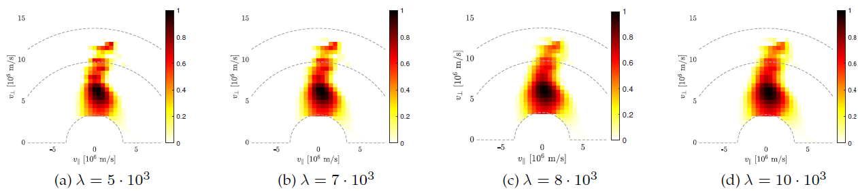
Regularisation parameter scan #86459, 1st order Tikhonov

Slide 27
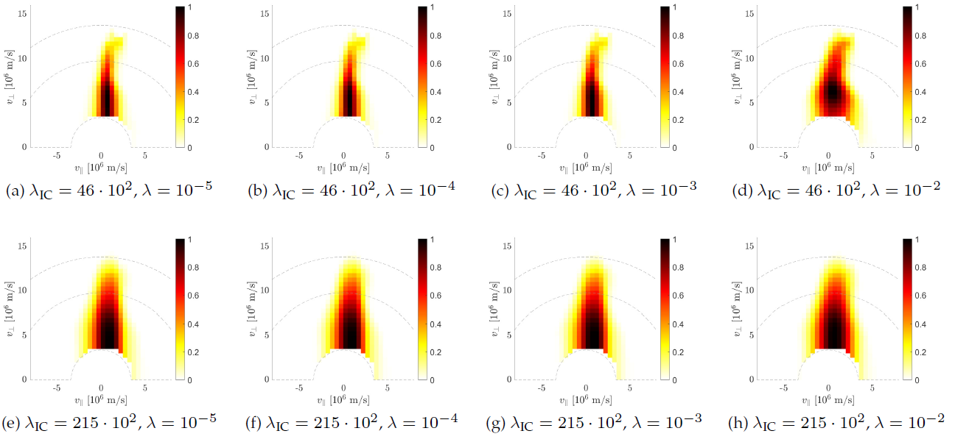
Regularisation parameter scan #86459, Collision- and ICRF-physics priors

Slide 28
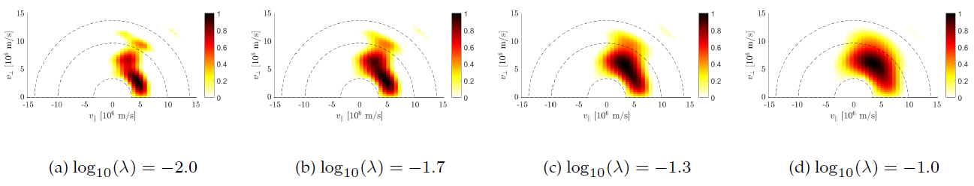
Regularisation parameter scan #95679, 1st order Tikhonov

Slide 29
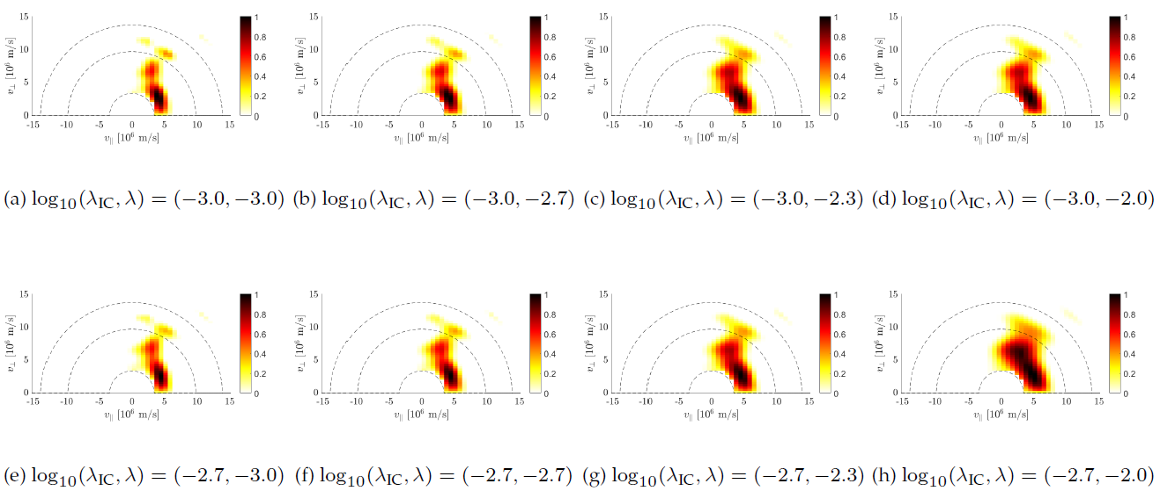
Regularisation parameter scan #95679, Collision- and ICRF-physics priors

Slide 30

Evolution of fast-ion distribution function
Collisions and wave-particle interactions
$$\frac{df}{dt}=\left\langle C\left(f\right)\right\rangle +\left\langle Q\left(f\right)\right\rangle$$
$C(f)$ is the collision operator
$Q(f)$ is the wave-particle interaction operator
$\left\langle −\right\rangle$ average over entire orbit

Slide 31
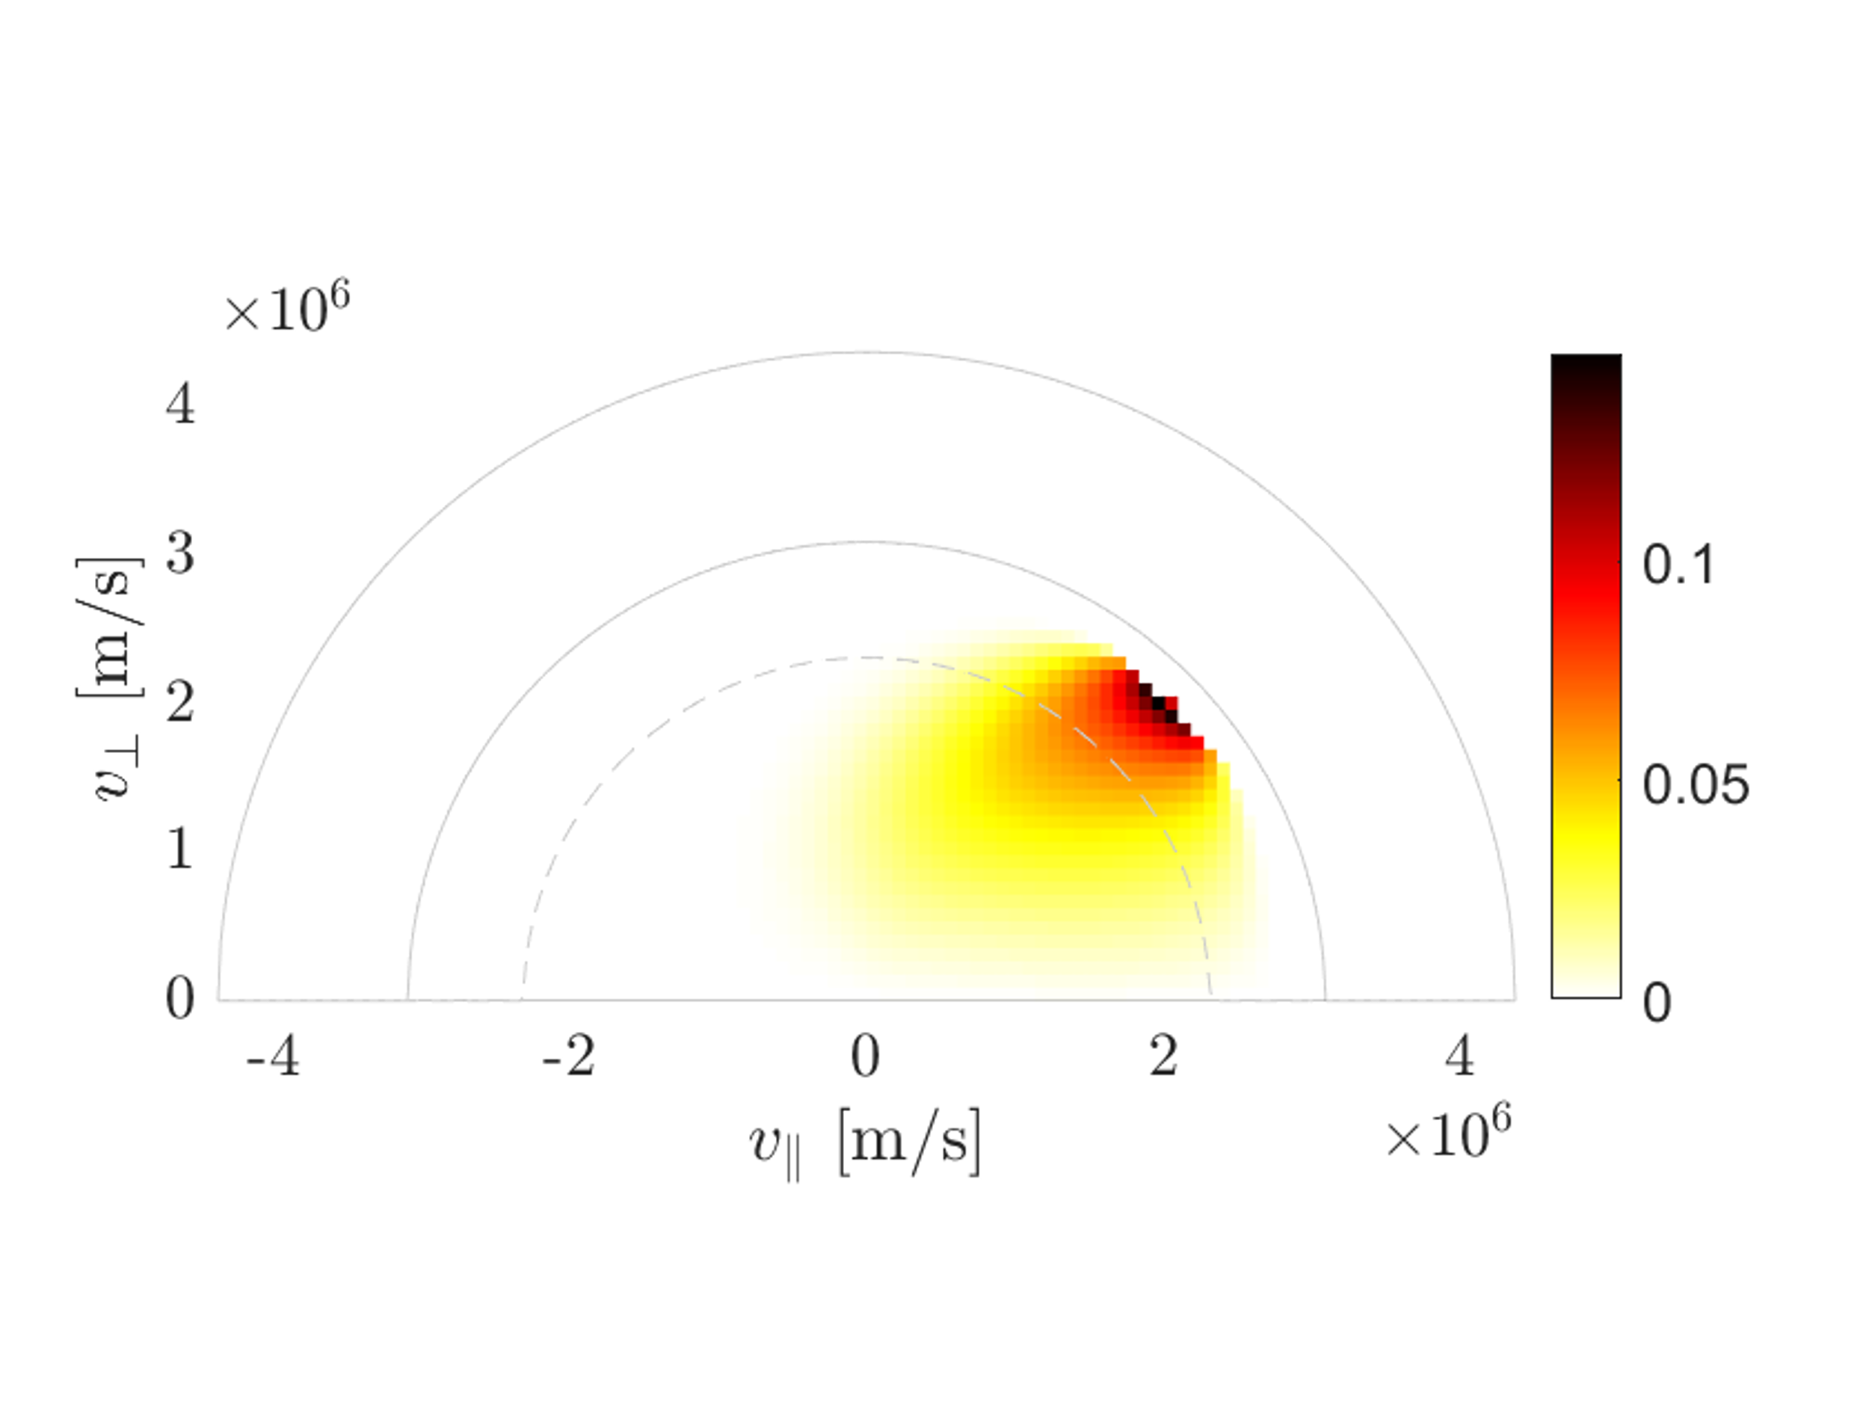
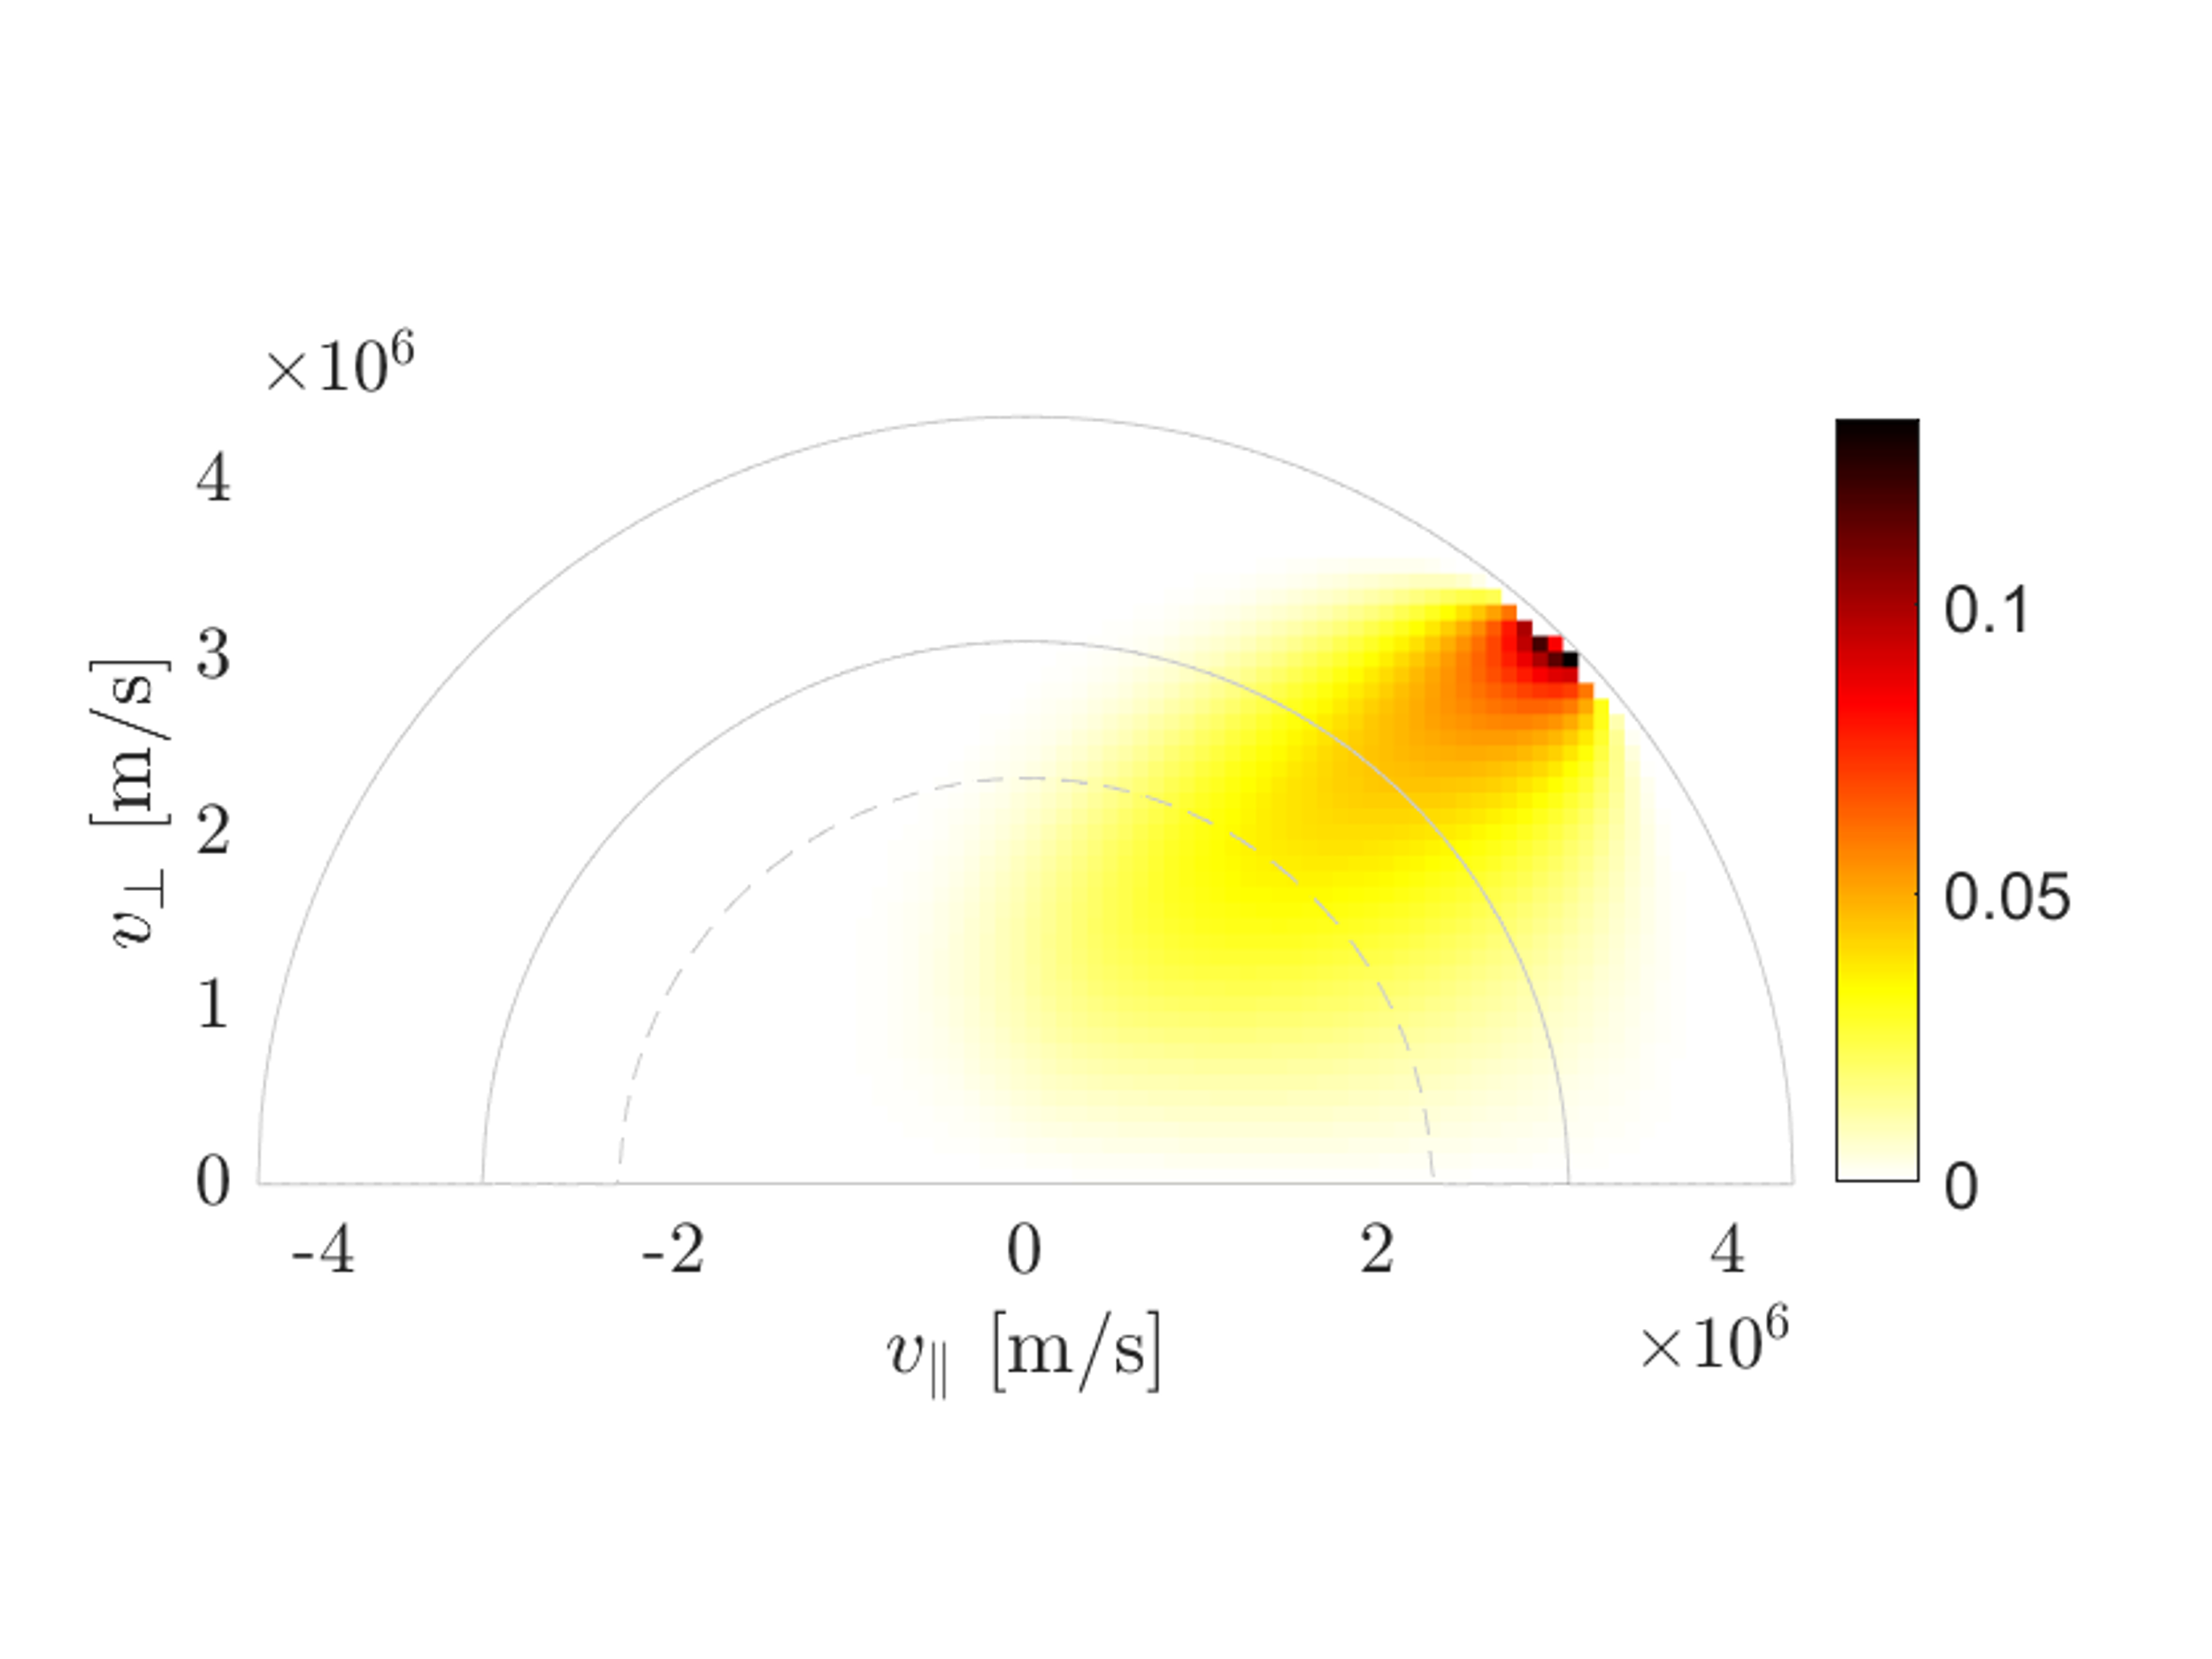
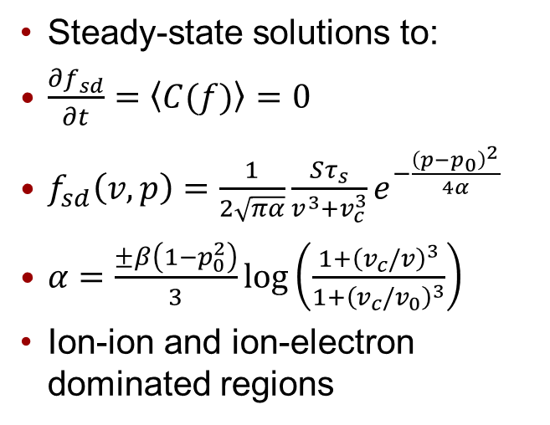
Collision-physics regularisation
Slowing-down distribution functions:
Steady-state solutions to:
$\frac{∂f_{sd}}{∂t}=\left\langle C(f)\right\rangle =0$
$f_{sd}\left(v,p\right)=\frac{1}{2\sqrt{πα}}\frac{Sτ_{s}}{v^{3}+v_{c}^{3}}e^{−\frac{{\left(p−p_{0}\right)}^{2}}{4α}}$
$α=\frac{±β\left(1−p_{0}^{2}\right)}{3}\log\left(\frac{1+{\left(v_{c}/v\right)}^{3}}{1+{\left(v_{c}/v_{0}\right)}^{3}}\right)$
Ion-ion and ion-electron dominated regions
Gaffey, J. Plasma Physics, 1976
Core, Nuclear Fusion, 1993

Slide 32
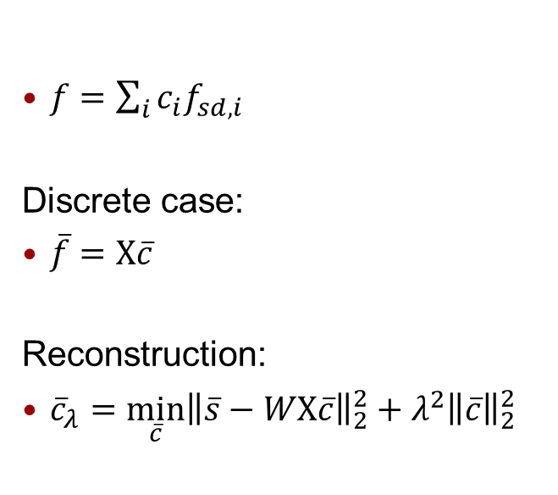
Collision-physics regularisation
Slowing-down expansion functions:
$f=\sum_{i}{c_{i}f_{sd,i}}$
Discrete case:
$\overline{f}=X\overline{c}$
Reconstruction:
${\overline{c}}_{λ}={\min_{\overline{c}}\left\|\overline{s}−WX\overline{c}\right\|}_{2}^{2}+λ^{2}{\left\|\overline{c}\right\|}_{2}^{2}$
Gaffey, J. Plasma Physics, 1976
Core, Nuclear Fusion, 1993
Madsen, Plasma Physics and Controlled Fusion, 2020
Schmidt, Nuclear Fusion, 2023
Järleblad, Nuclear Fusion, 2025,
Reman et al “Velocity-space tomography of an MeV fast-ion tail generated by three-ion scheme ICRF heating at JET”, submitted

