Slide 1
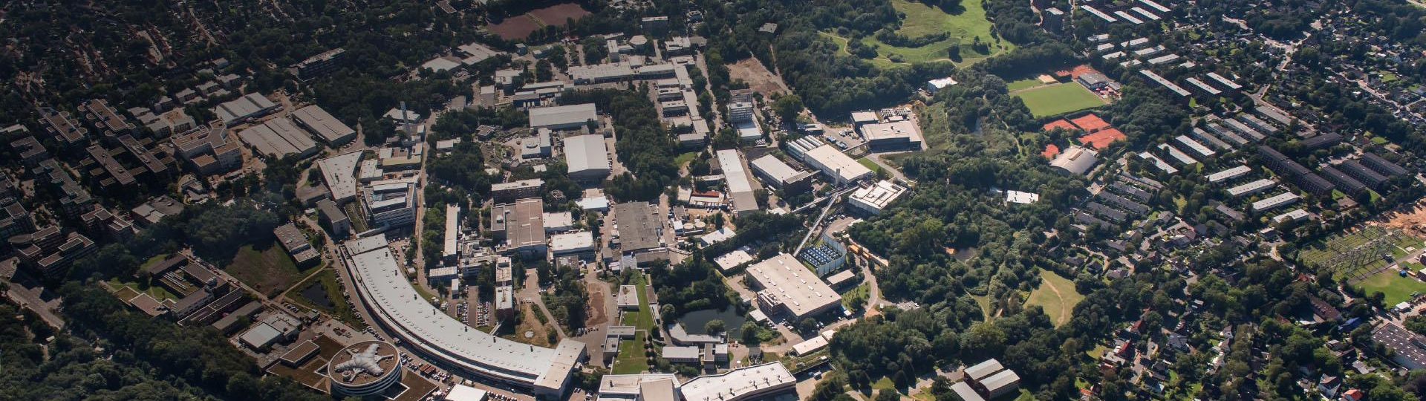
Enhanced Quench Detection at the EuXFEL
Through a Machine Learning-Powered Approach
Lynda Boukela (DESY)
AI AND LARGE DATA VISUALIZATION WORKSHOP
Princeton University, 13th June 2024

Slide 2
Agenda
01 The EuXFEL
In general
Operational overview
The SRFCs
02 Quench detection
Current solution
Model-based fault detection
ML-based quench identification
03 Deployment and evaluation
Data acquisition, postmortem analysis
Evaluation, station-wise and pulse-wise
Reports
Data labeling
04 Outlook

Slide 3
The EuXFEL

Slide 4
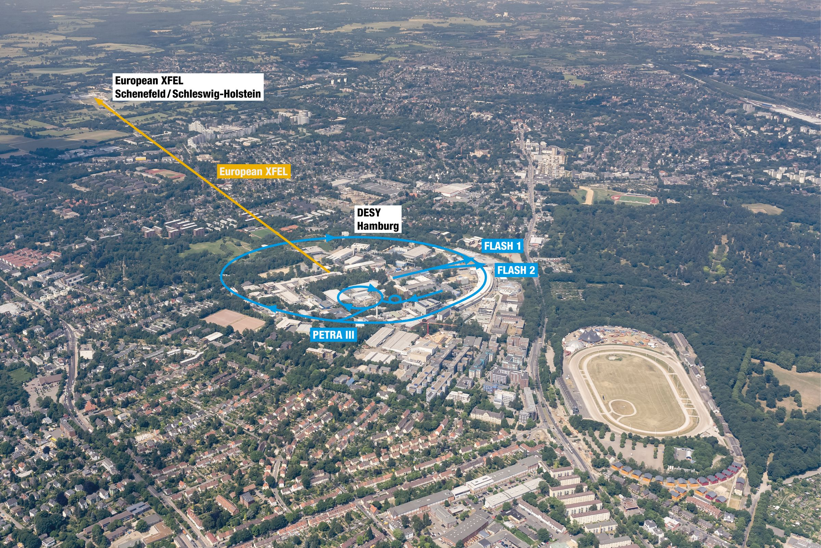
The EuXFEL
In general
Light to probe matter
The European X-Ray Free Electron Laser (EuXFEL), largest particle accelerator for X-ray laser generation worldwide
Up to 17 GeV, 27000 extremely intense laser ﬂashes per second
Located in Hamburg, Germany
Total length of 3.4 kilometers
Several hundred users every year, the availability of the facility is crucial
  © DESY / R. Schaaf und D. Schröder
The course of the European XFEL

Slide 5
The EuXFEL
Operational overview

Slide 6
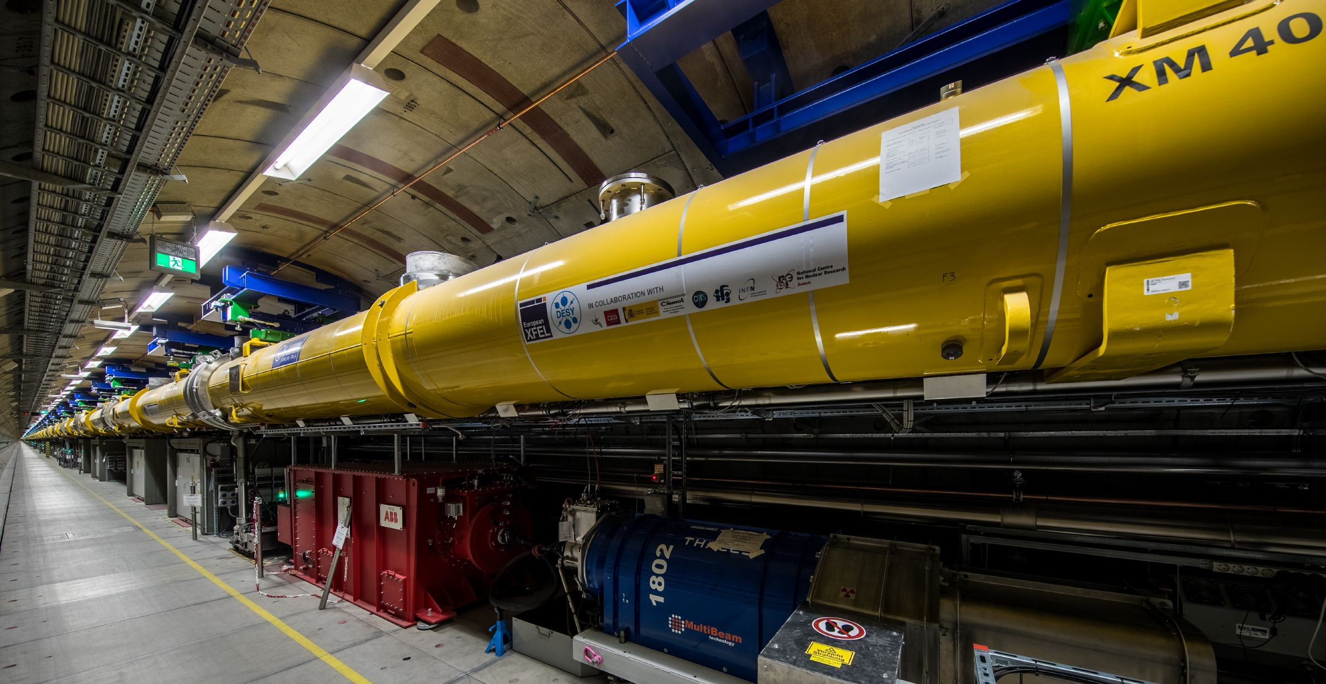
The EuXFEL
Operational overview
  © DESY 2017
25 stations

Slide 7
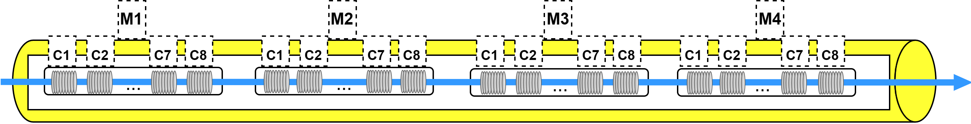
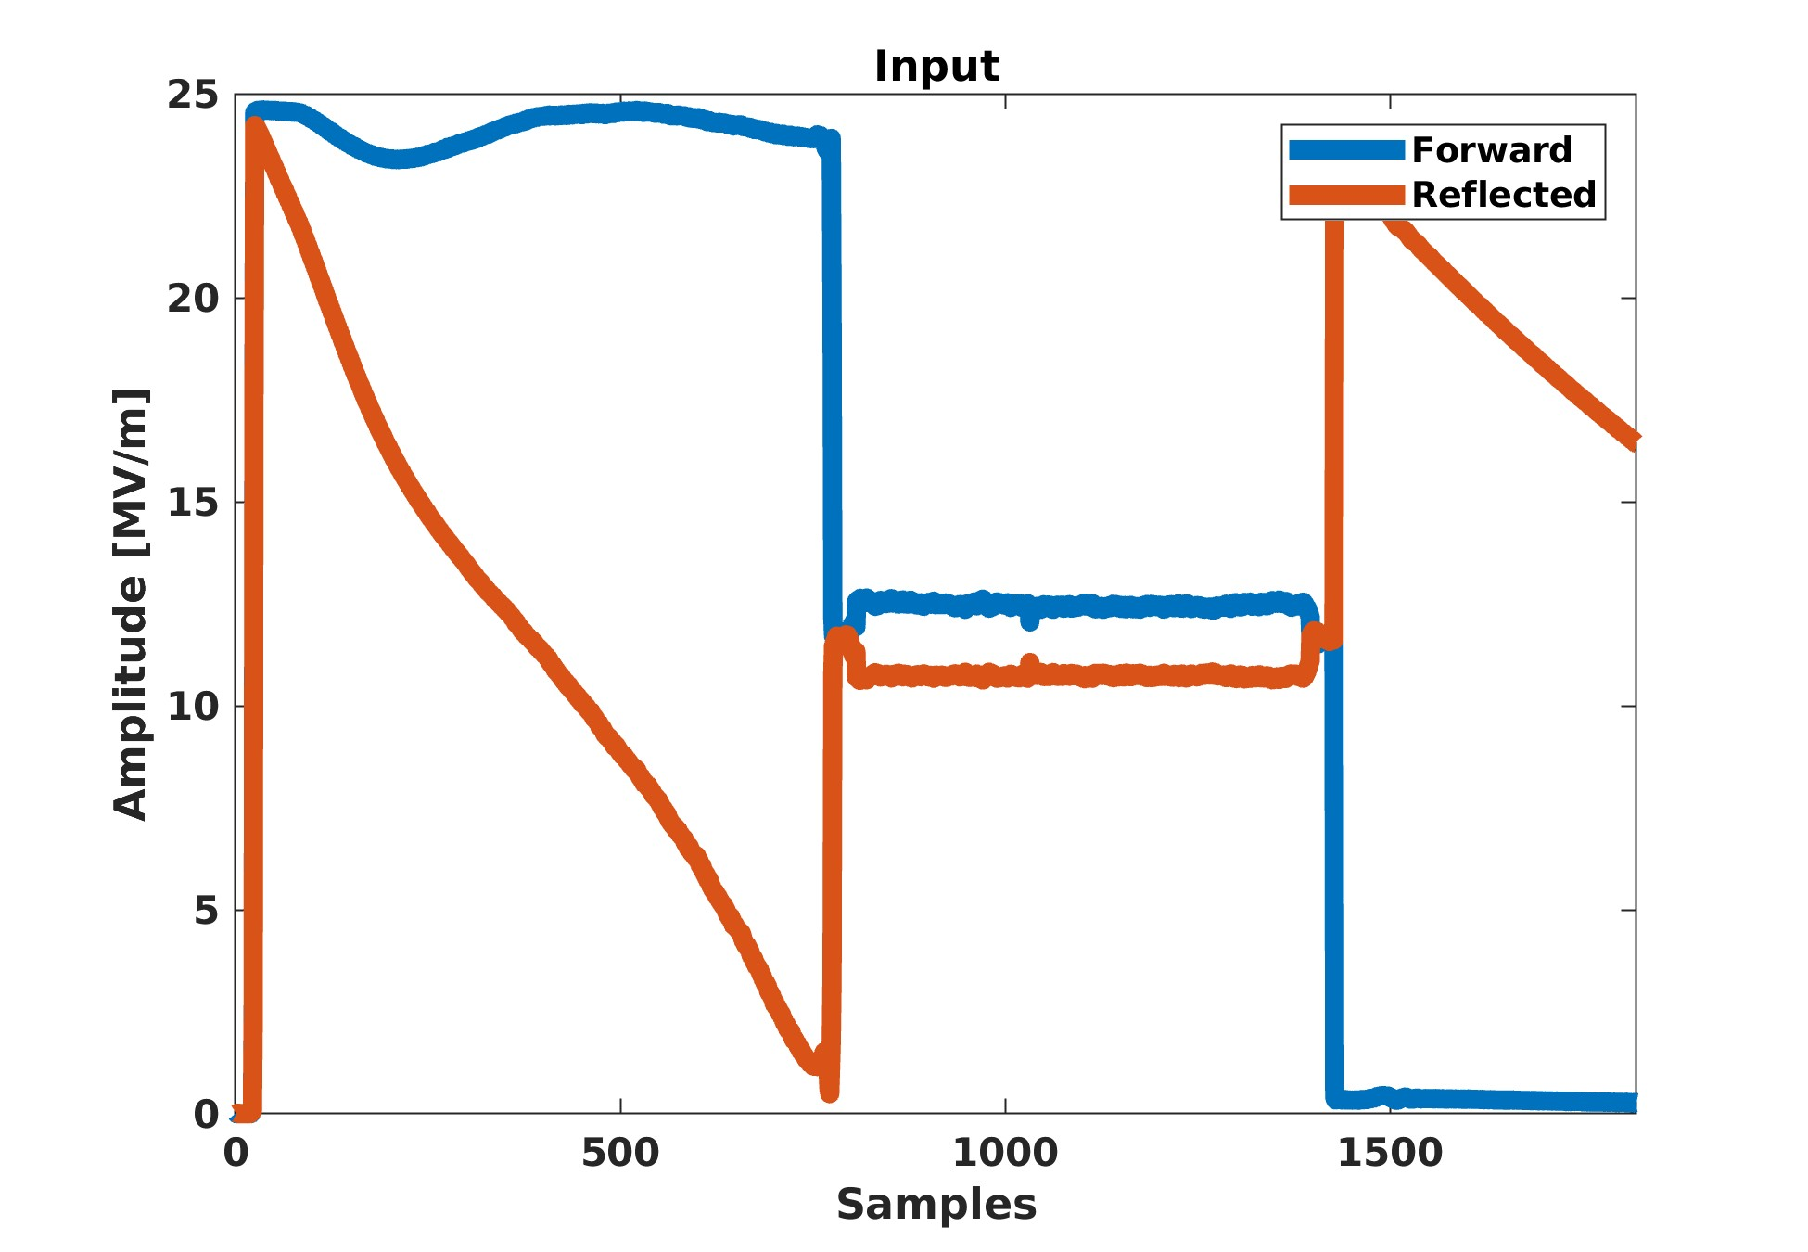
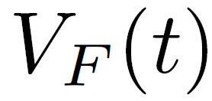
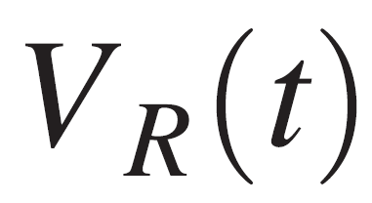
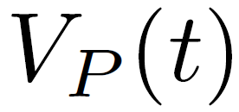
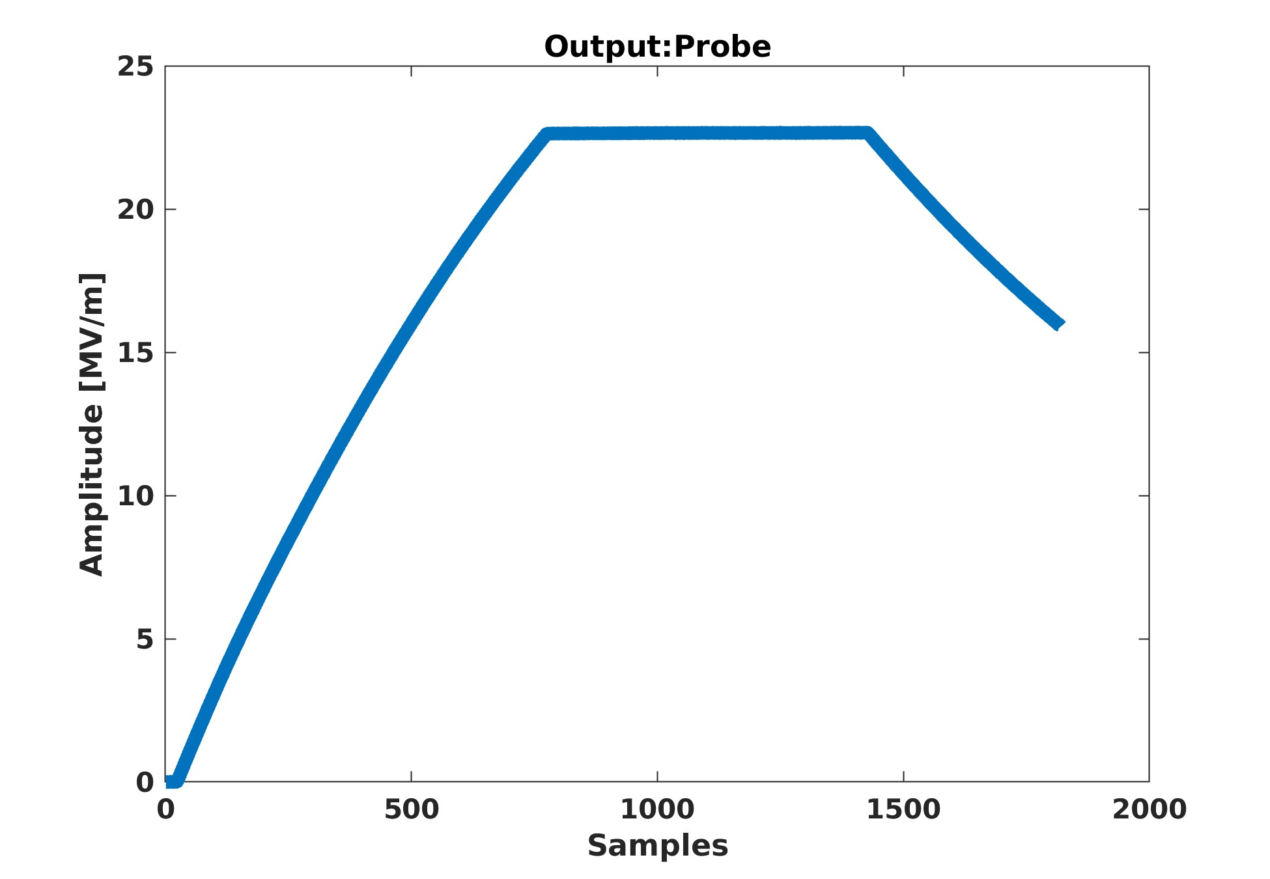
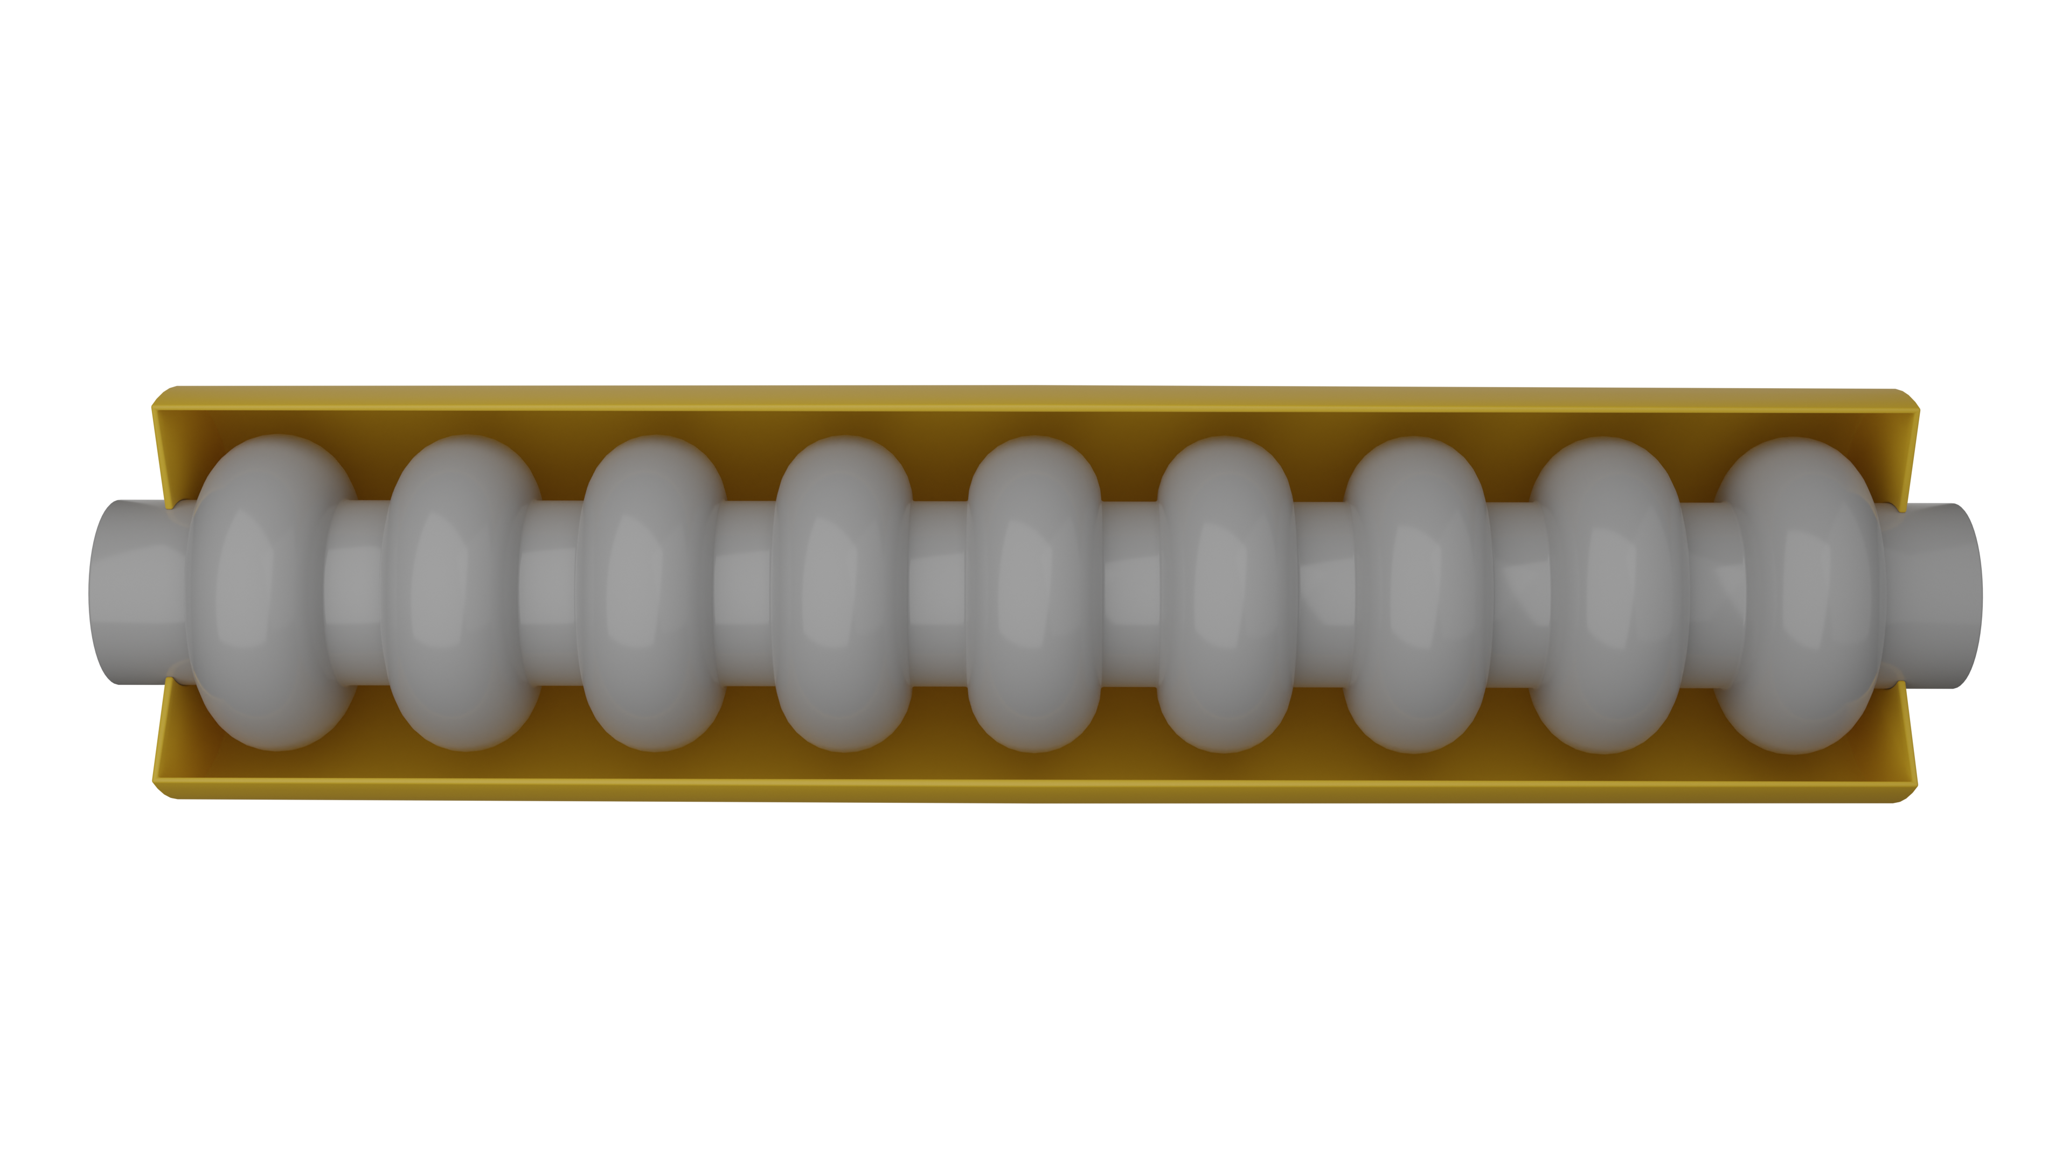
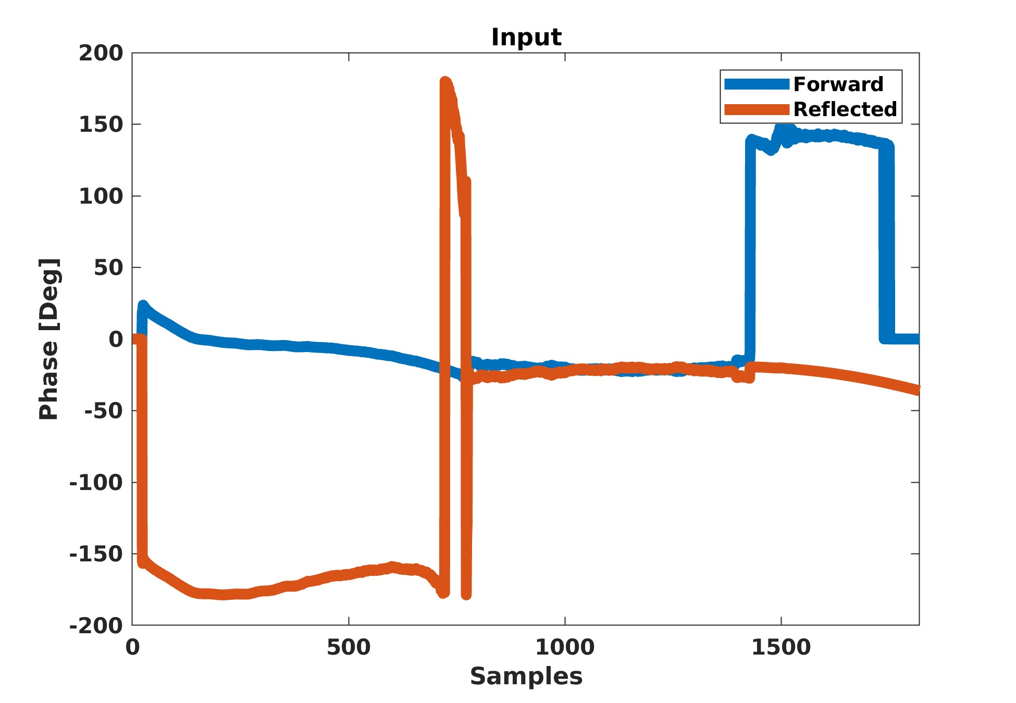
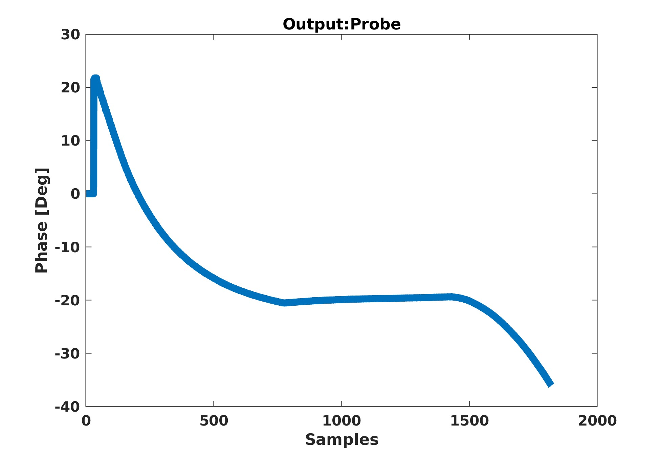
The EuXFEL
The SRFCs
  Resonators (1.3GHz)
  Controlled and monitored with the LLRF system
  Average accelerating field of 23.6 MV/m
  Operated in a pulsed mode, repetition rate of 10 Hz, duration 1.8 ms
  © DESY 2017
25 stations
32 SRFCs
,

Slide 8
Quench detection

Slide 9
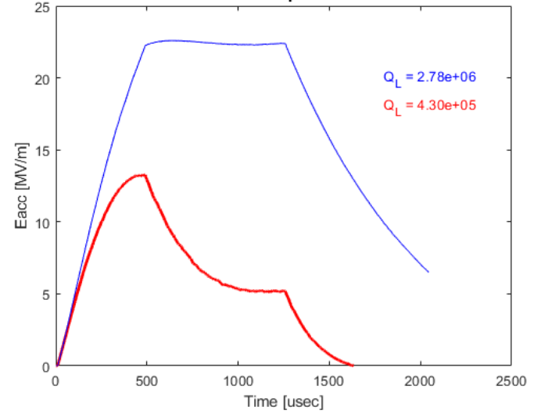
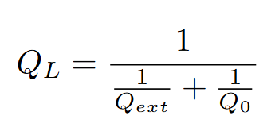


Quench detection
Current solution
Detection through the Q_{L}-based quench QDS
Running average from previous 100 pulses
The QDS triggers an alarm if the Q_{L} computed for a single pulse drops below the running average by more than a user-defined threshold (typically 10% of the nominal Q_{L} value)
This approach, however, suffers from robustness issues
Loaded
  © DESY 2017
External
Unloaded
  - External: power dissipation induced by the coupling process
  - Unloaded: power dissipation through the cavity walls
  © DESY / R. Schaaf und D. Schröder
Branlard J. et. al. Superconducting cavity quench detection and prevention for the European XFEL. ICALEPCS (2013)
Notes:
Ql=wW/Pdiss >> Energy/Power
The unloaded quality factor lies at Q0 ~ 2x 10^10, while the
external quality factor is in a range of 10^6 < Qext < 10^8.

Slide 10
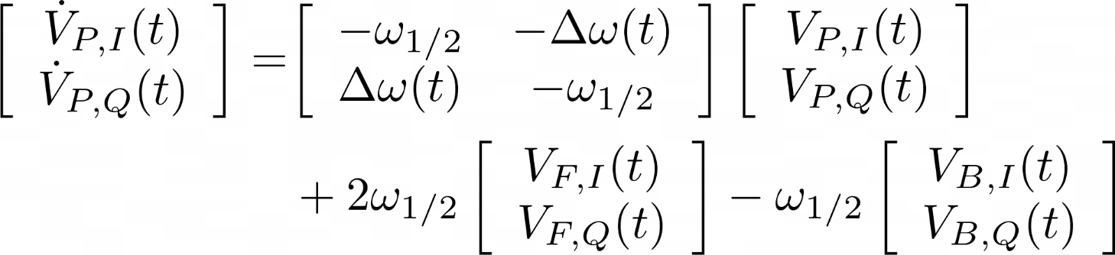
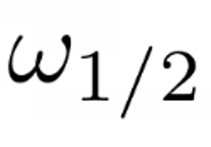
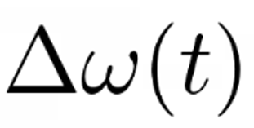
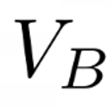
Quench detection
Model-based fault detection
,
Electromagnetic dynamics
: Half bandwidth
: Detuning
: Beam field
  © DESY / R. Schaaf und D. Schröder
Schilcher, T. Vector sum control of pulsed accelerating fields in Lorentz force detuned superconducting cavities. Ph.D. thesis, University of Hamburg. (1998)

Slide 11
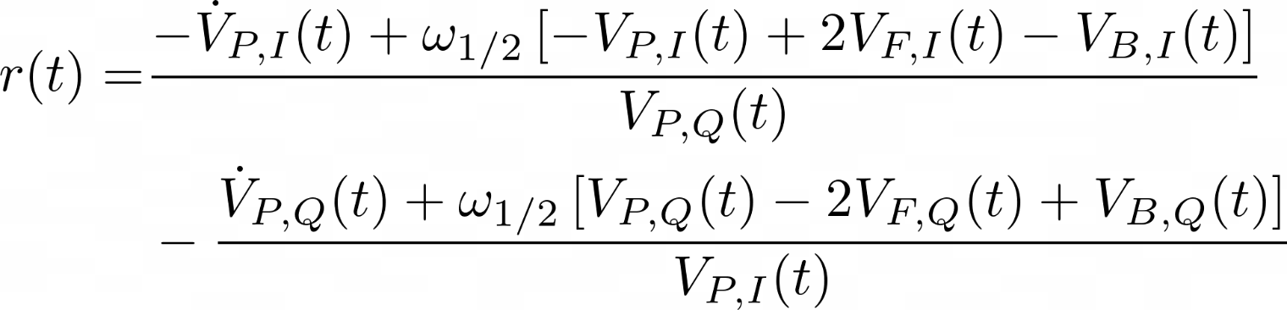
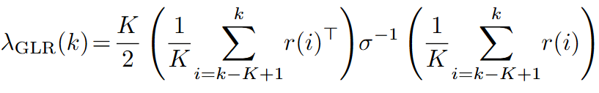
Quench detection
Model-based fault detection
,
Residuals (parity space)
Statistical test (GLR)
  © DESY / R. Schaaf und D. Schröder
Eichler A. et. al. Anomaly detection at the European X-ray free electron laser using
a parity-space-based method. Phys. Rev. Accel. Beams (2023)

Slide 12
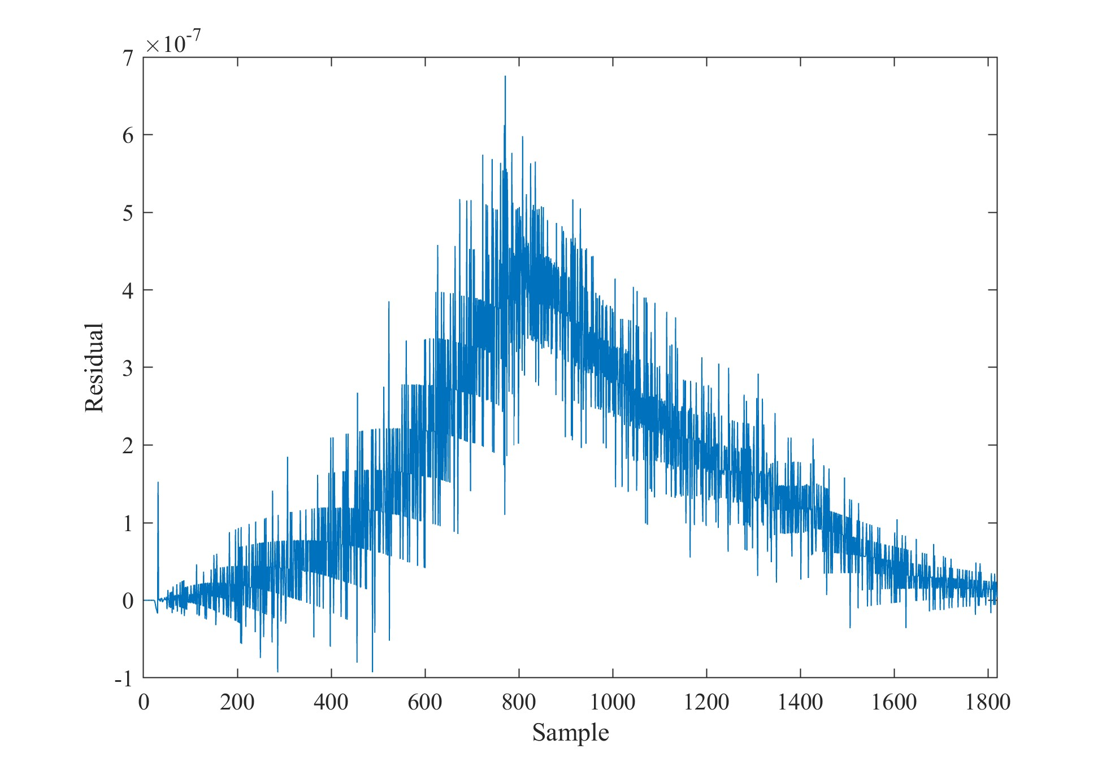
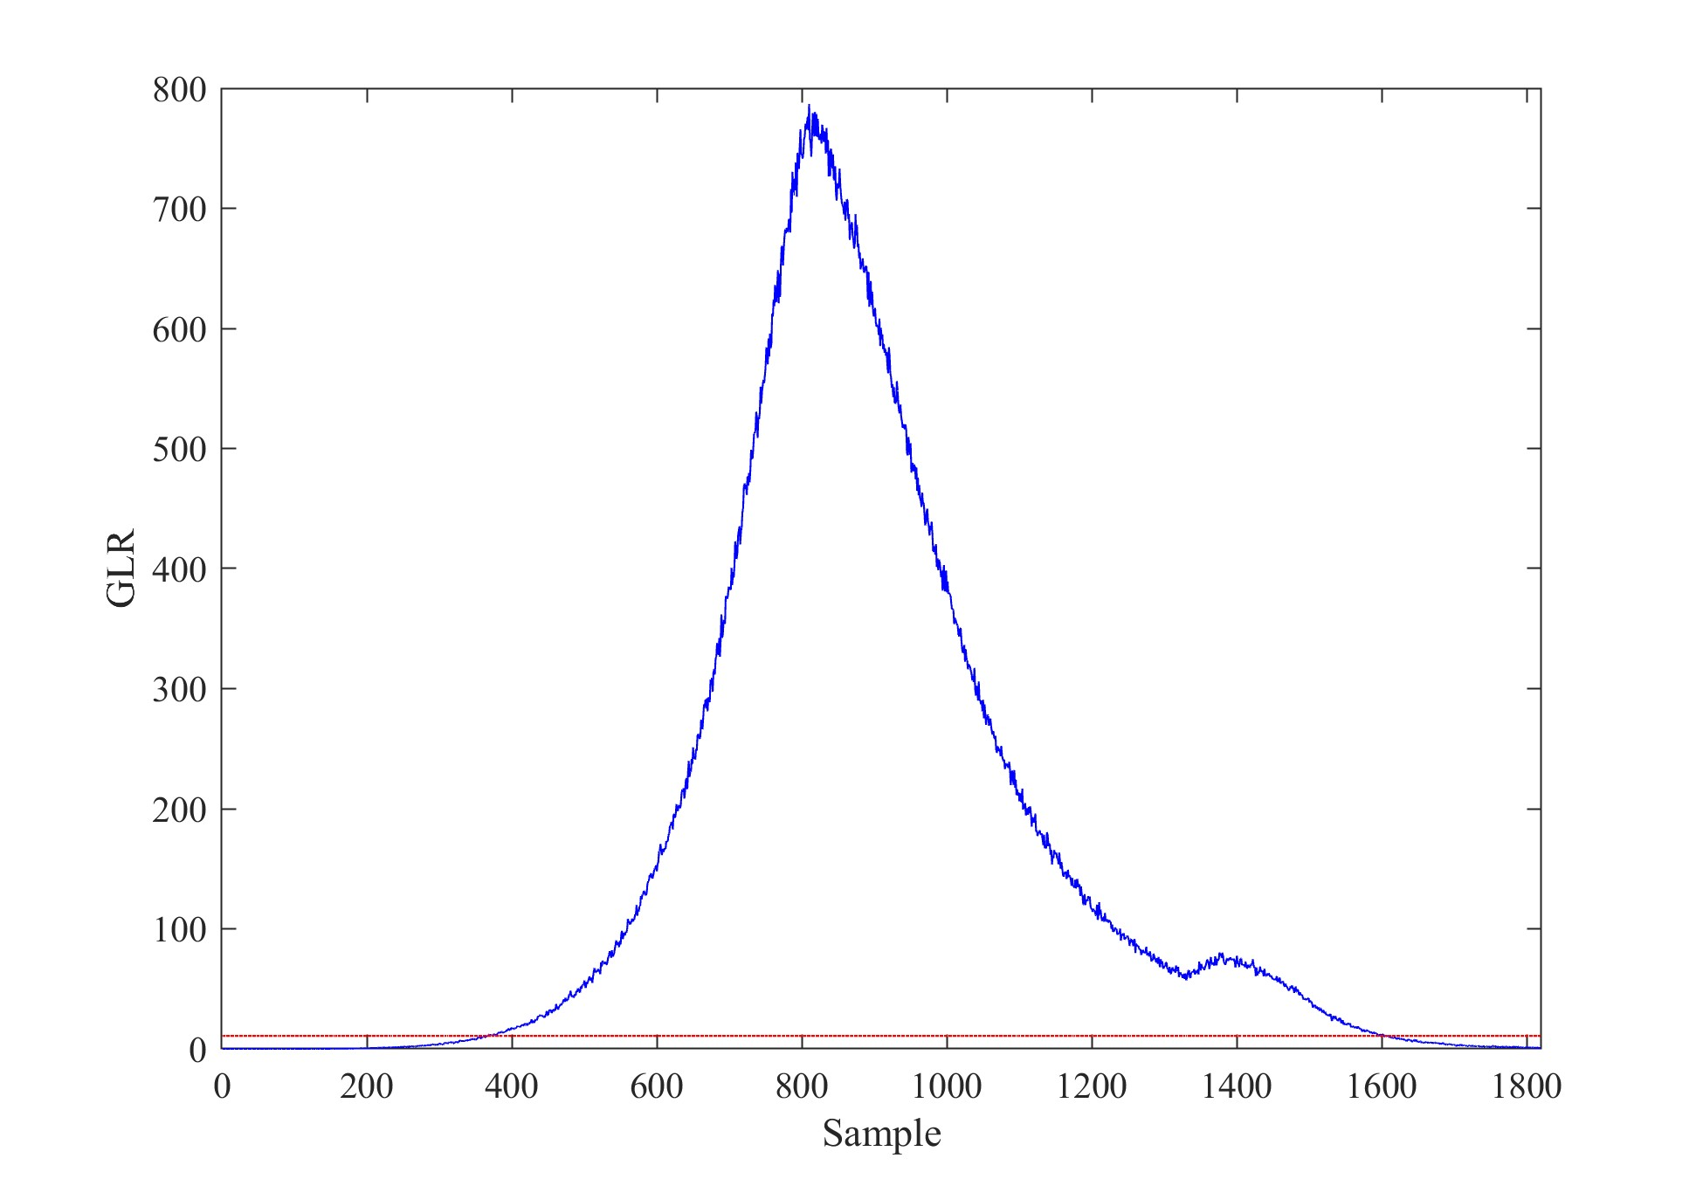
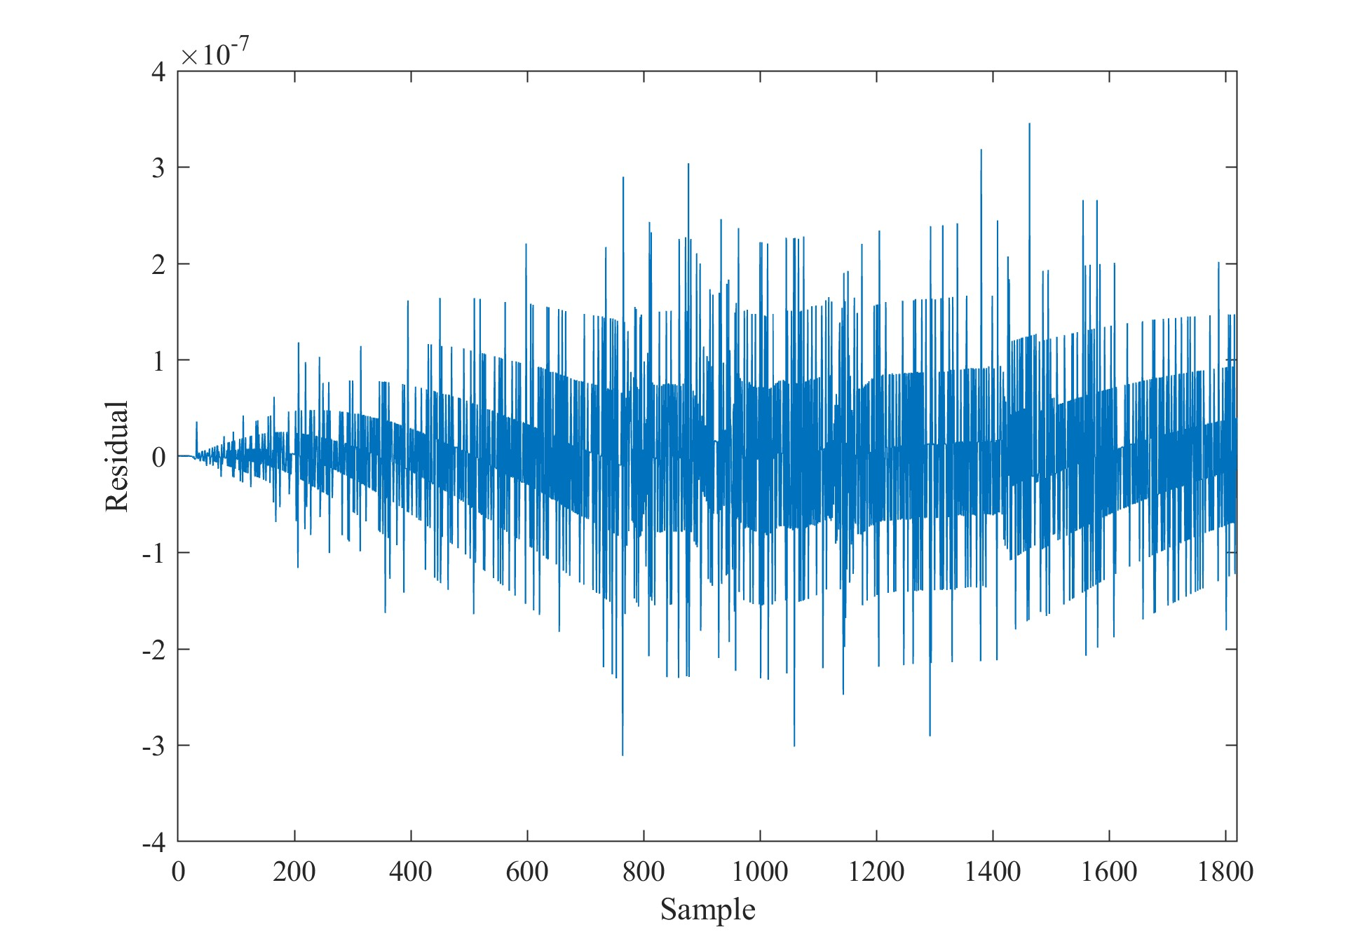
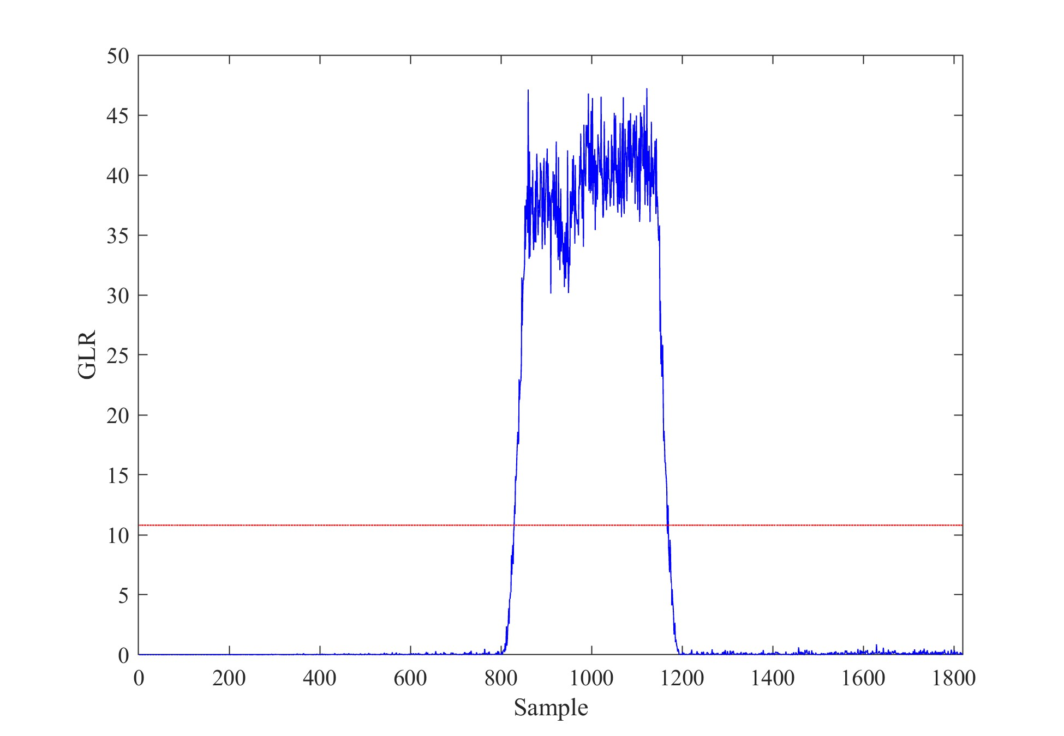
Quench detection
Model-based fault detection
Quench
Other faulty behavior
  © DESY / R. Schaaf und D. Schröder

Slide 13
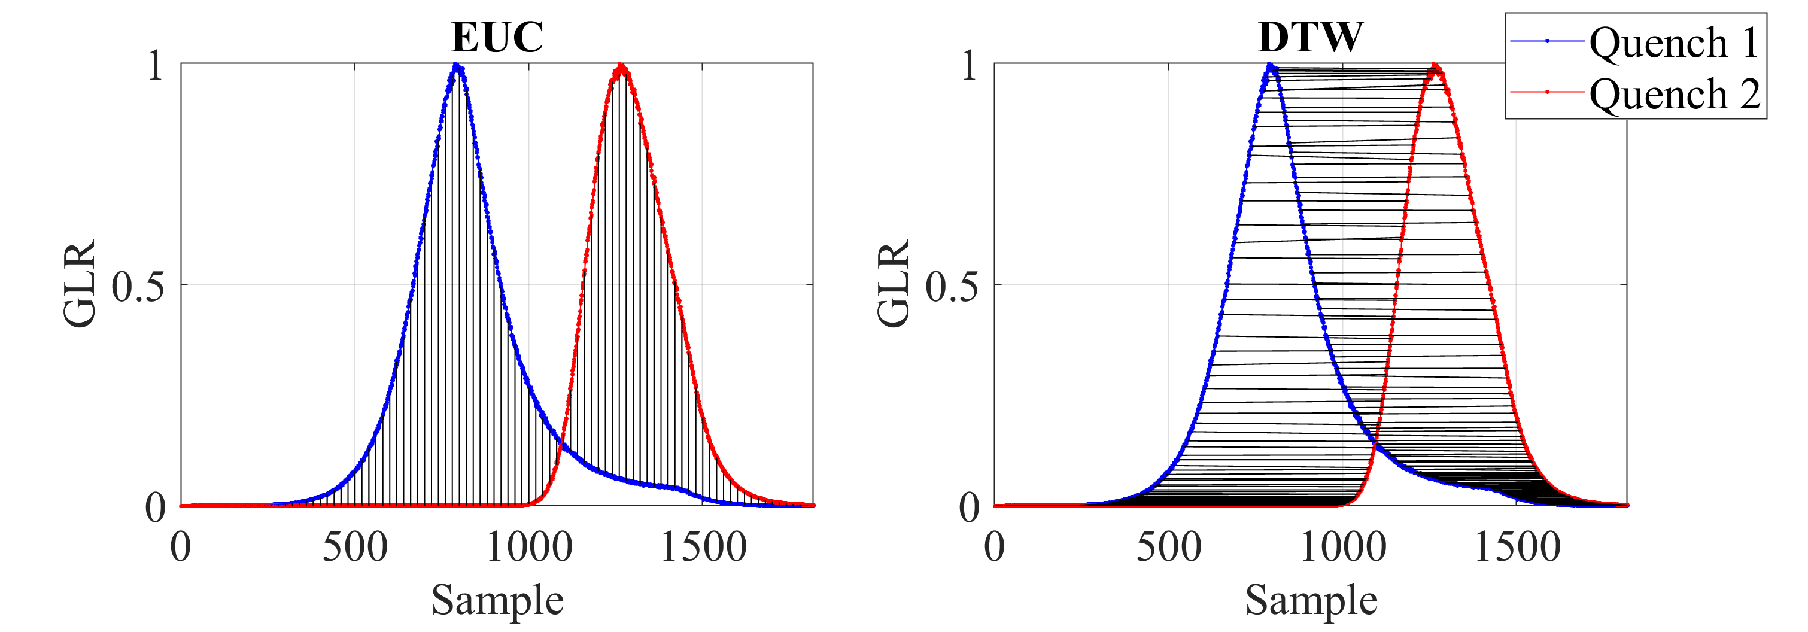
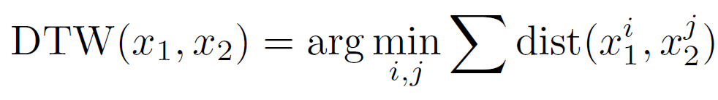
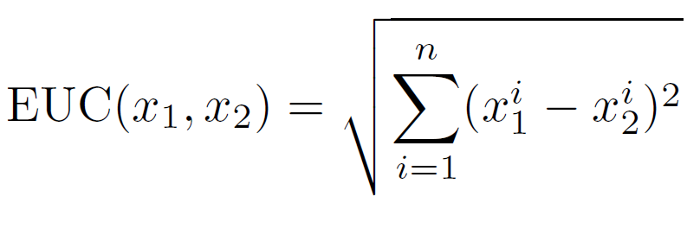
Quench detection
ML-based quench identification
K-medoids to build a profile of the quenches
Two models based on two similarity measures (EUC and DTW)
The traces are normalized and / or reduced
In the example, DTW=2.8 and EUC=18.6
  © DESY 2017
  © DESY 2017
  © DESY 2017

Slide 14
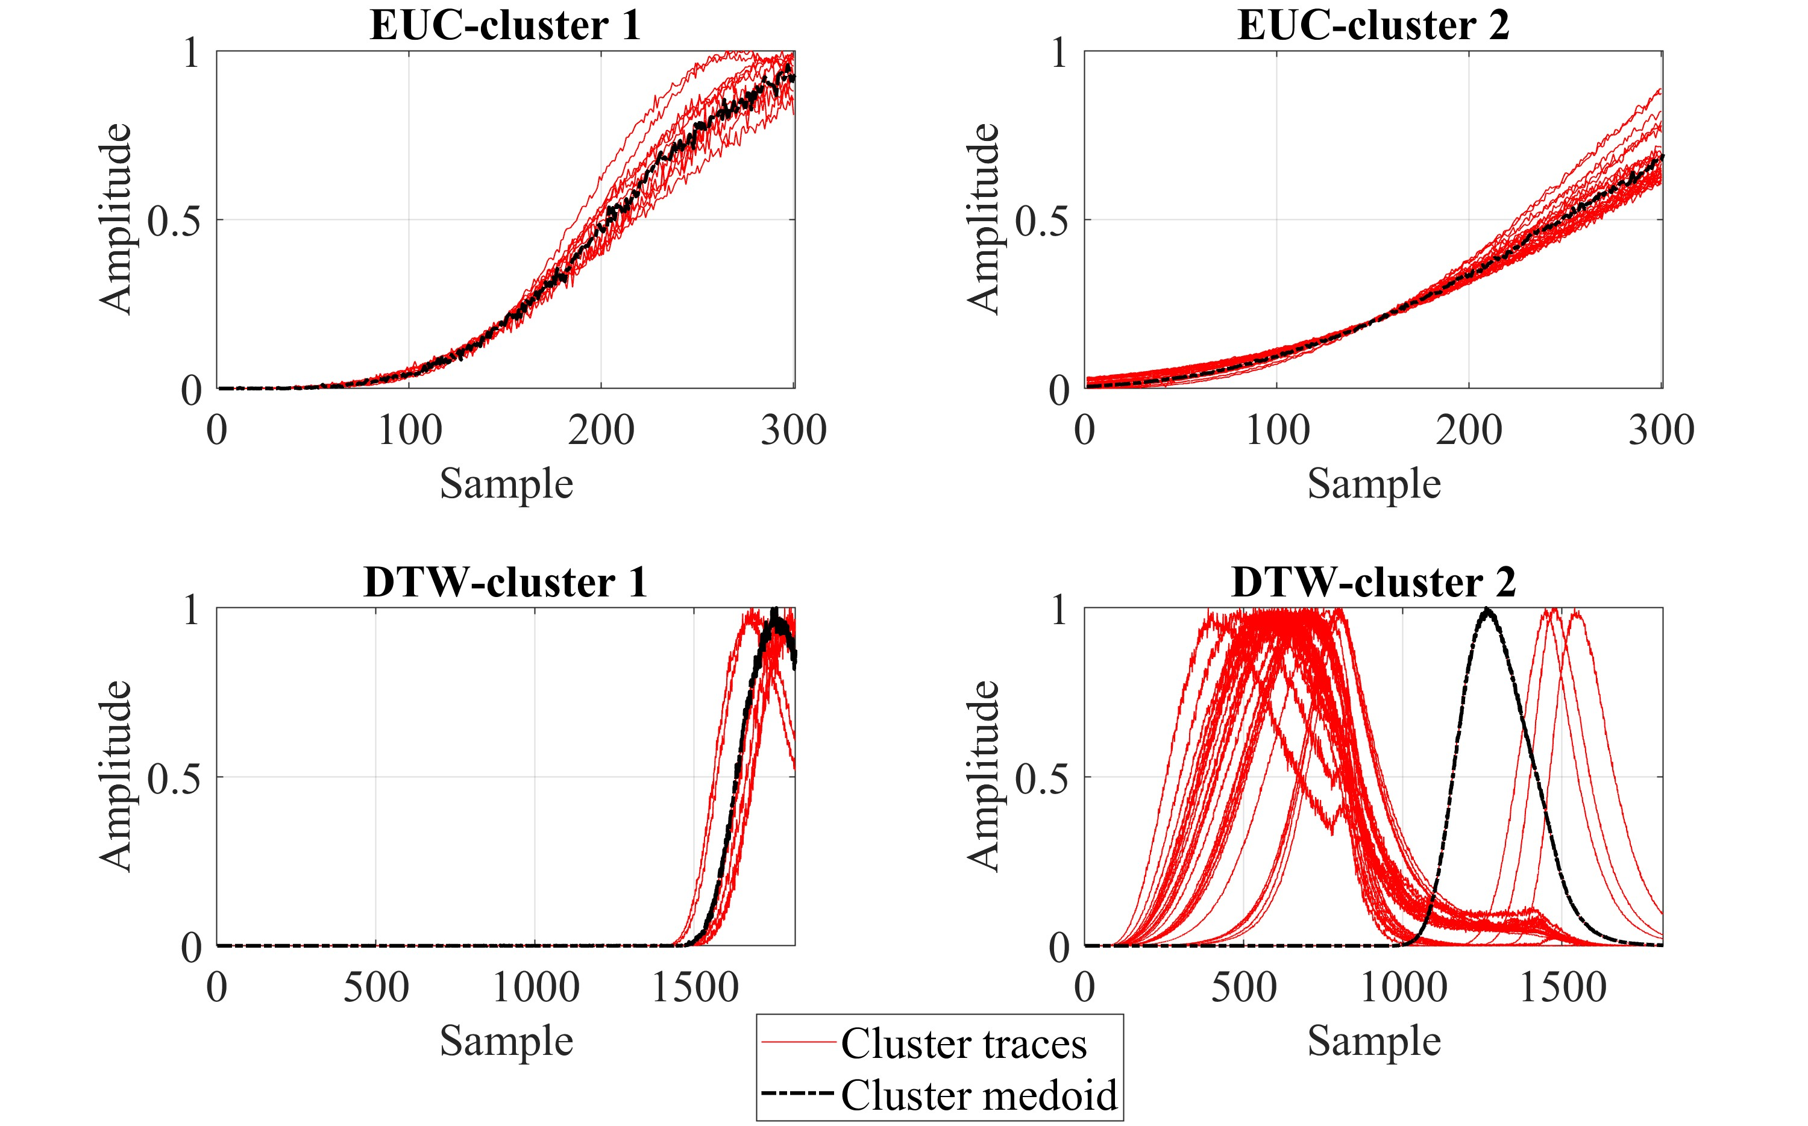
Quench detection
ML-based quench identification
With both models, two clusters and medoids are obtained
Data from 2021 are used, 76 quenching traces
Assignment mainly with respect to time of occurrence of the quenches
  © DESY 2017
  © DESY 2017
  © DESY 2017
  © DESY / R. Schaaf und D. Schröder

Slide 15
Quench detection
ML-based quench identification
Inference in distance space
Fitting different based on the similarity measure
Thresholds & decision boundaries
  © DESY 2017
  © DESY 2017
  © DESY 2017
  © DESY / R. Schaaf und D. Schröder

Slide 16
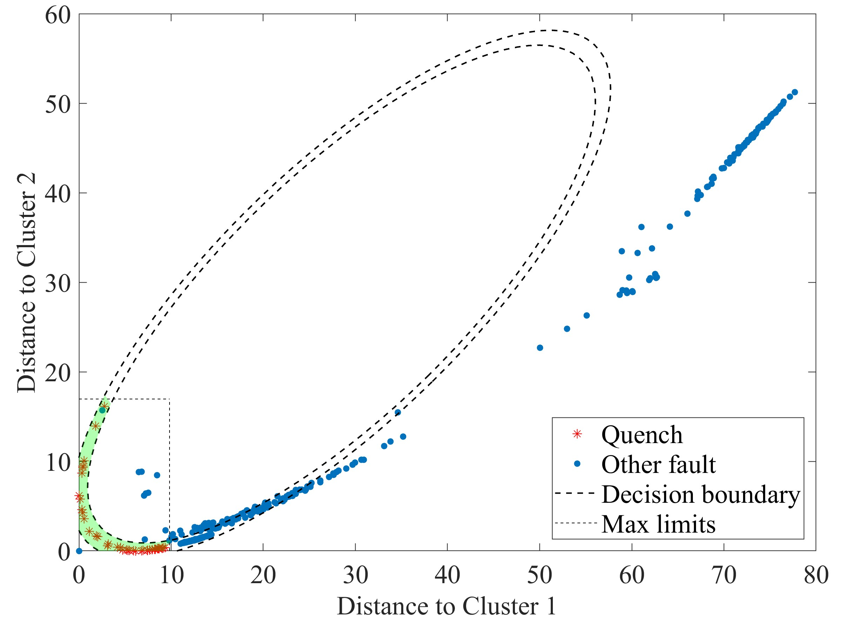
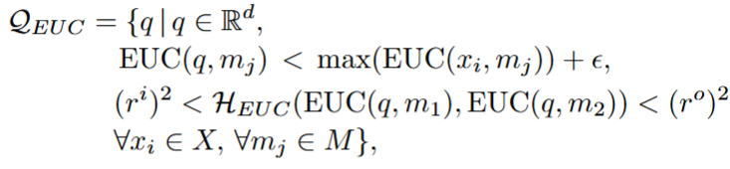

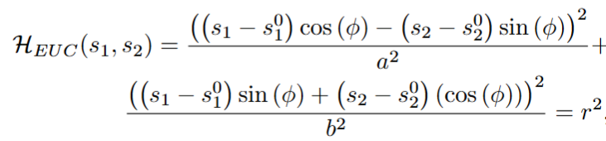
Quench detection
ML-based quench identification
Inference in distance space
Fitting different based on the similarity measure
Thresholds & decision boundaries
EUC
  © DESY 2017
  © DESY 2017
  © DESY 2017
  © DESY / R. Schaaf und D. Schröder

Slide 17
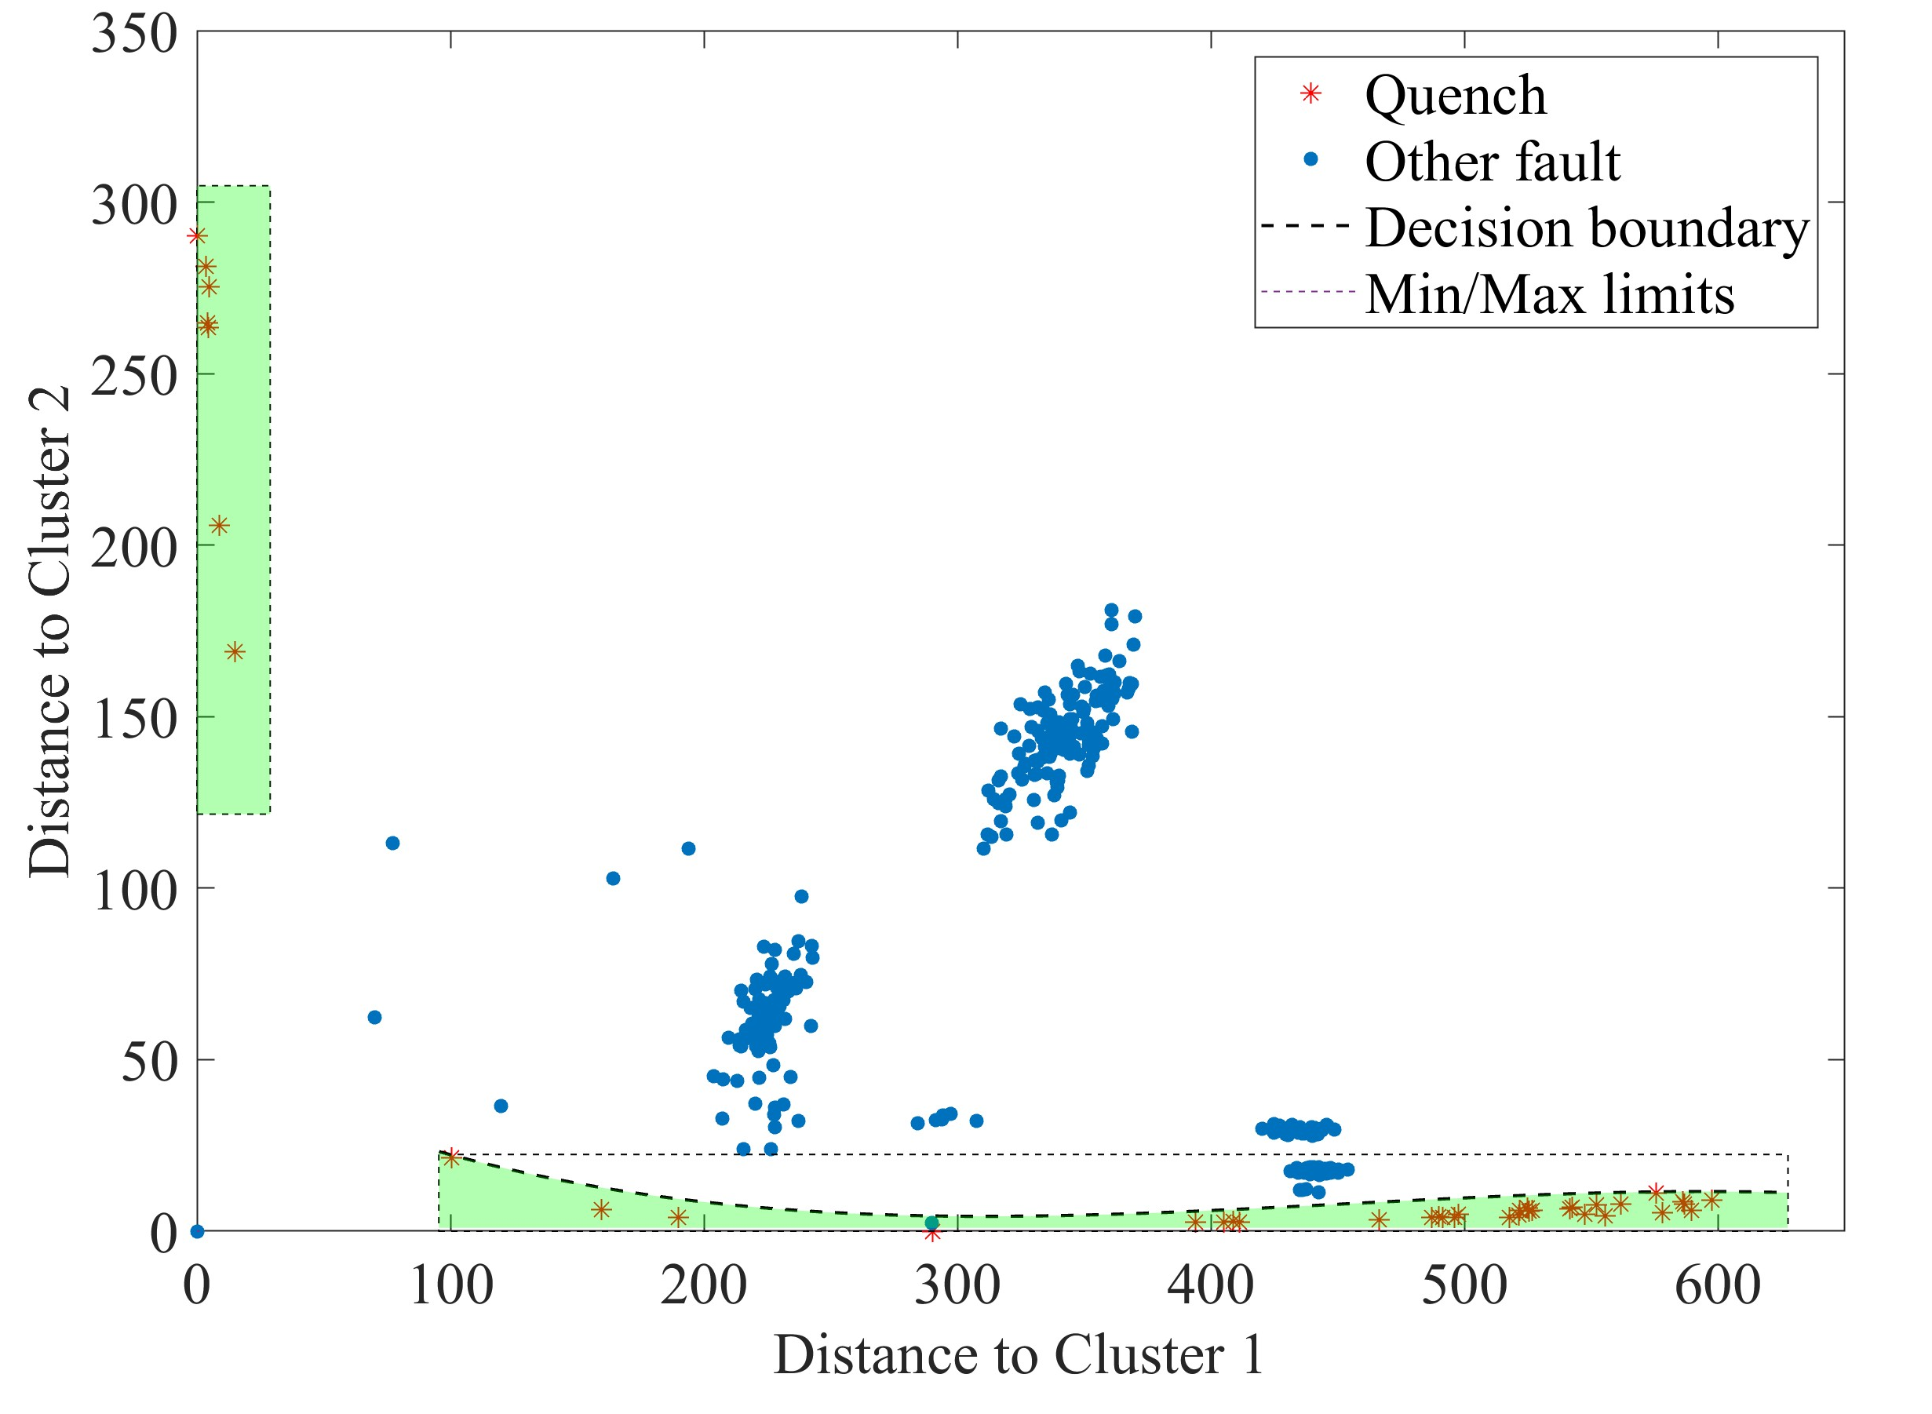
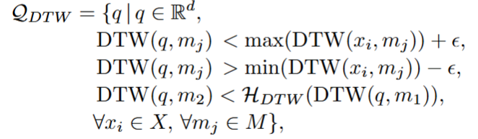


Quench detection
ML-based quench identification
Inference in distance space
Fitting different based on the similarity measure
Thresholds & decision boundaries
DTW
  © DESY 2017
  © DESY 2017
  © DESY 2017
  © DESY / R. Schaaf und D. Schröder

Slide 18
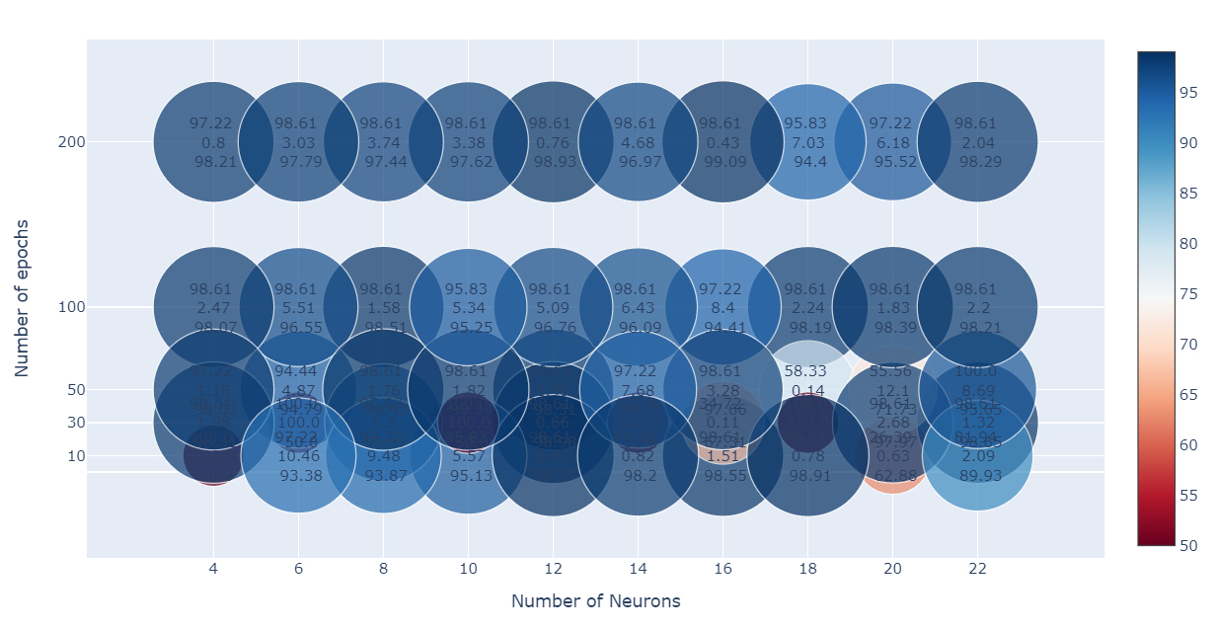
Quench detection
ML-based quench identification
Inference in distance space
MLP
Three hidden layers
Imbalanced data
Based on EUC
1st value: TPR
2nd value: FPR
3rd value: ROC-AUC
  © DESY 2017
  © DESY / R. Schaaf und D. Schröder

Slide 19
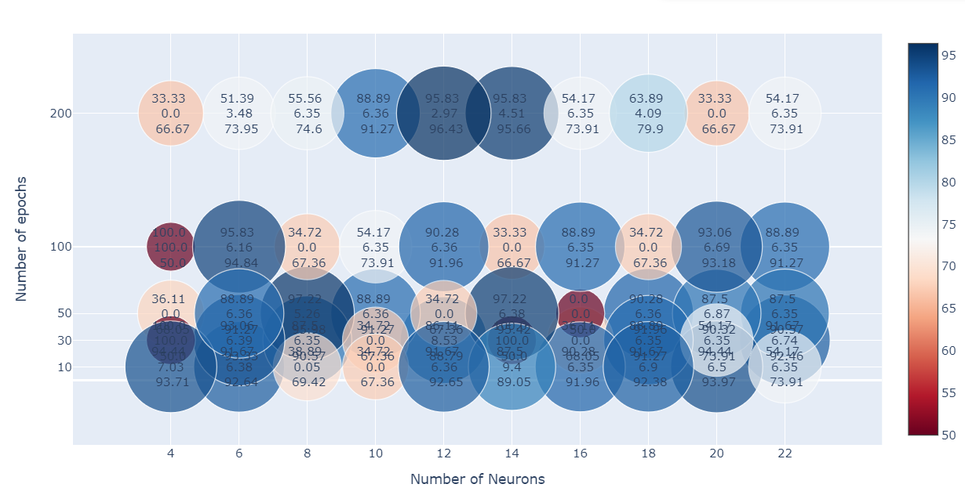
Quench detection
ML-based quench identification
Inference in distance space
MLP
Three hidden layers
Imbalanced data
Based on DTW
1st value: TPR
2nd value: FPR
3rd value: ROC-AUC
  © DESY 2017
  © DESY 2017
  © DESY 2017
  © DESY / R. Schaaf und D. Schröder

Slide 20
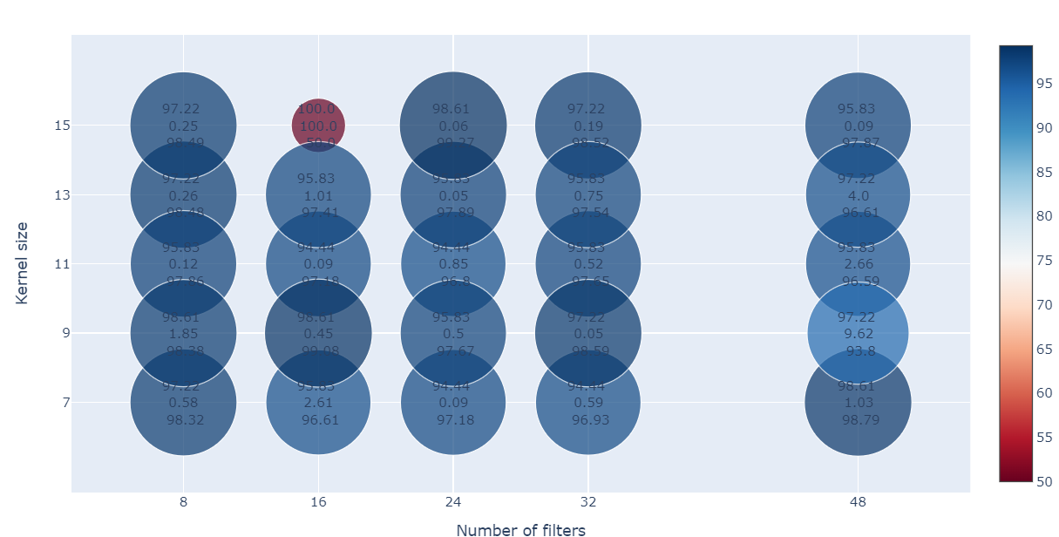
Quench detection
ML-based quench identification
Inference based on the GLR
CNN
Three hidden layers
Max normalization
Imbalanced data
1st value: TPR
2nd value: FPR
3rd value: ROC-AUC
  © DESY 2017
  © DESY / R. Schaaf und D. Schröder

Slide 21
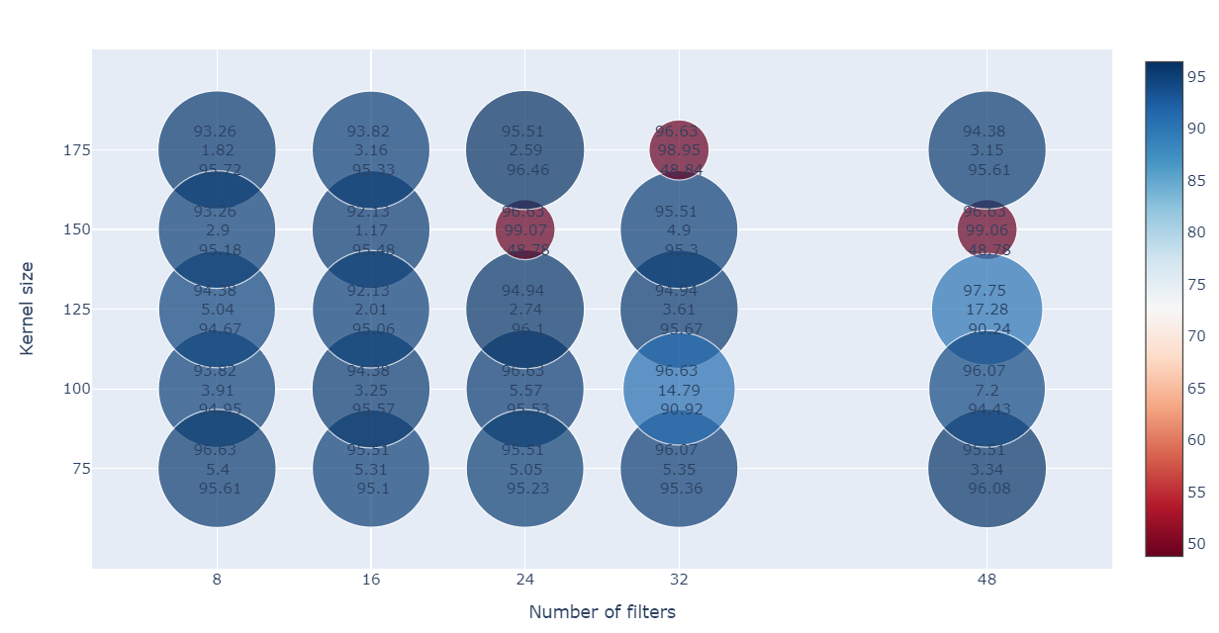
Quench detection
ML-based quench identification
Inference based on the GLR
AE-based quench profile
Two layers in each part
Max normalization
Mean absolute error or mean squared error for the reconstruction
1st value: TPR
2nd value: FPR
3rd value: ROC-AUC
  © DESY 2017
MAE
  © DESY 2017
  © DESY 2017
  © DESY / R. Schaaf und D. Schröder

Slide 22
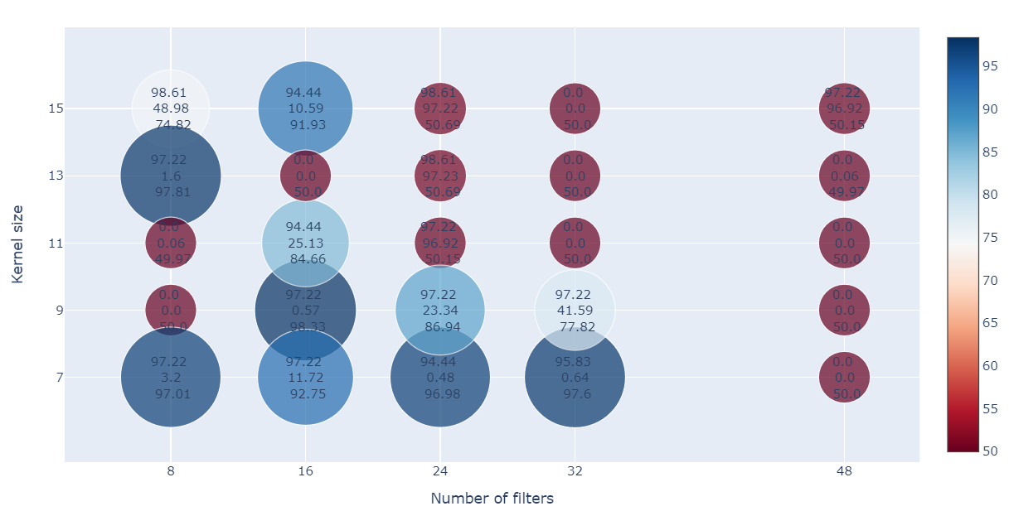
Quench detection
ML-based quench identification
Inference based on the RF
CNN
Three hidden layers
Based on the three signals
Imbalanced data
1st value: TPR
2nd value: FPR
3rd value: ROC-AUC
  © DESY 2017
MAE
  © DESY 2017
  © DESY 2017
  © DESY / R. Schaaf und D. Schröder

Slide 23
Deployment & Evaluation

Slide 24
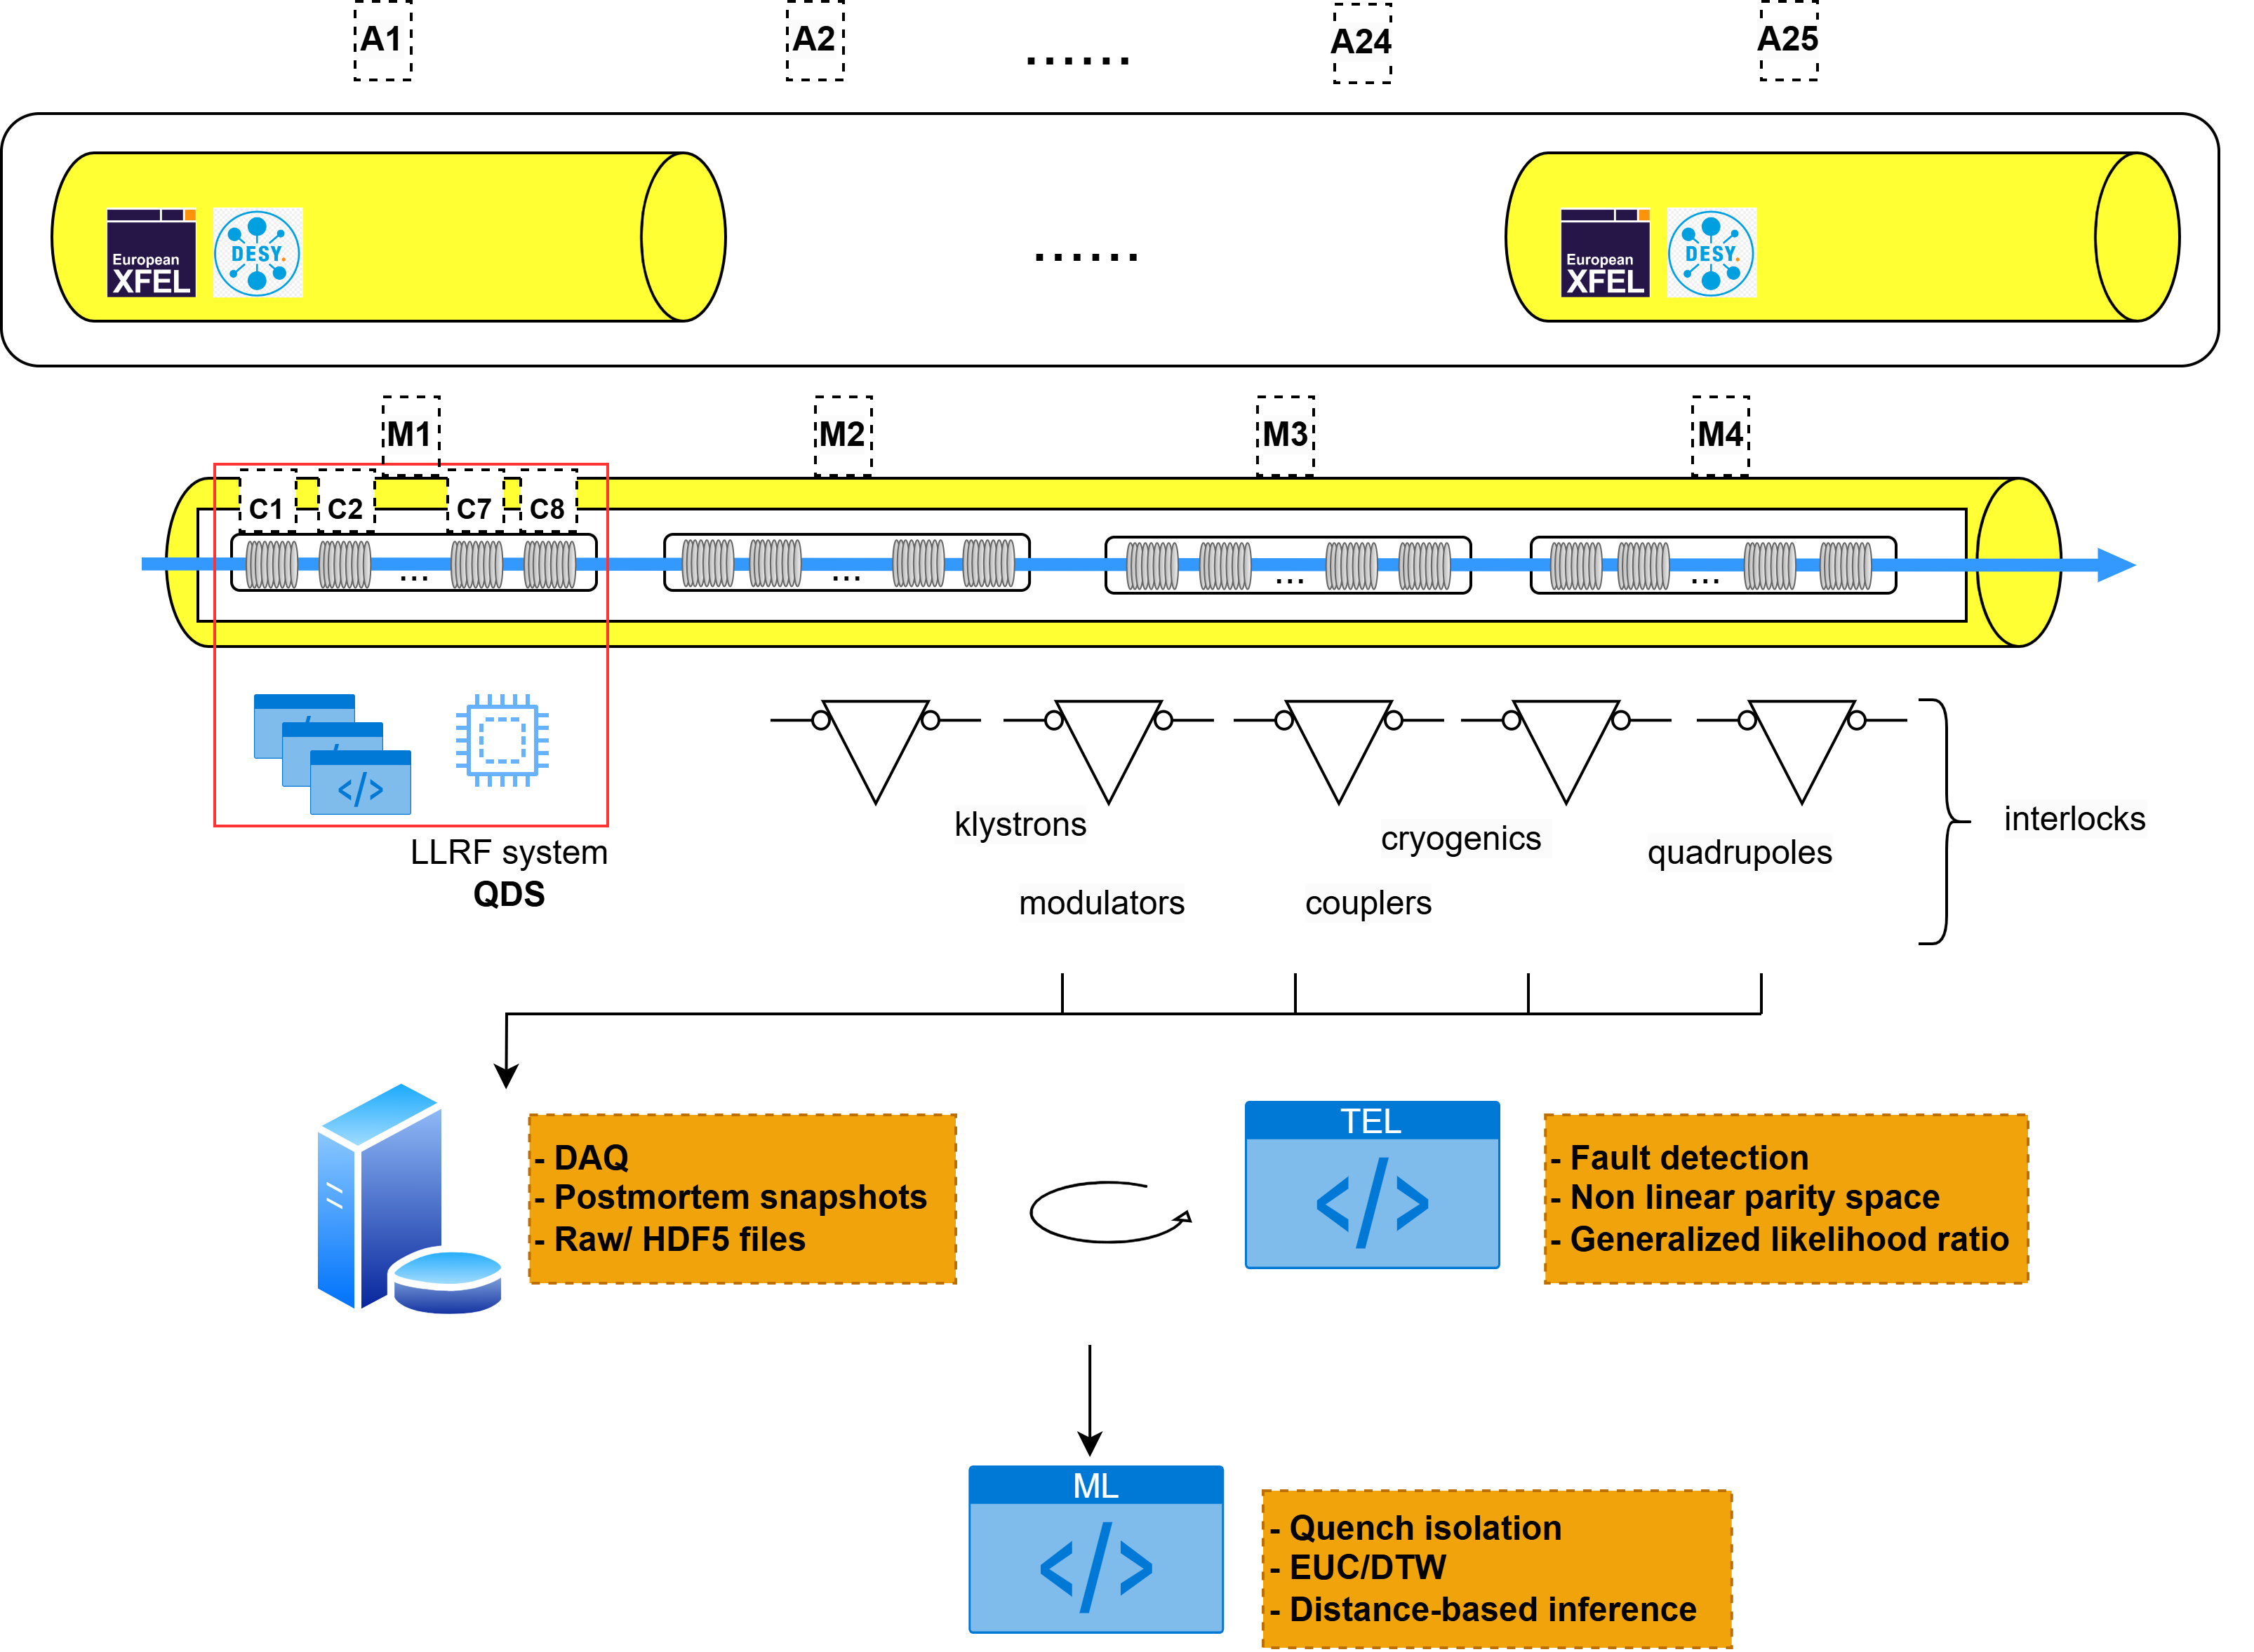
Deployment & Evaluation
Data acquisition, postmortem analysis
Notes:
1.5 GB/s data from RF field measurements

Slide 25
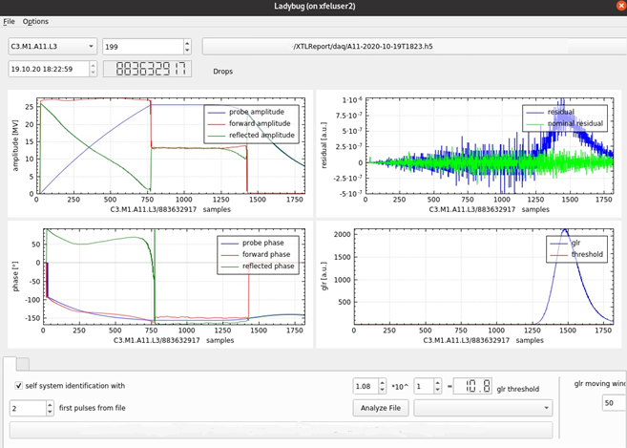
Deployment & Evaluation
Data acquisition, postmortem analysis
  250 pulses (50 first nominal)
  RF signals sampled at 1 Mhz (1820 samples)
  Saved into files, corresponding to station events
Timm, J., et al. The trip event logger for online fault diagnosis at the European XFEL.IPAC, (2021)

Slide 26
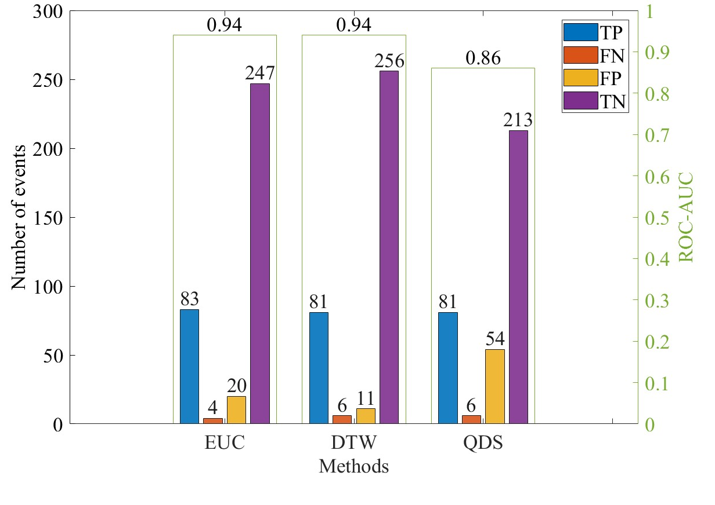
Deployment & Evaluation
Evaluation, station-wise
Data collected from January to December 2022
  671 events, 354 were detected as faults within the SRFCs, 87 corresponding to quenches
Evaluation and comparison based on the station events, using the TPR, the FPR and the ROC-AUC
A clear improvement of the quench identification compared to the QDS
  QDS : TPR = 0.93 and FPR = 0.20
  EUC : TPR = 0.95 and FPR = 0.07
  DTW : TPR = 0.93 and FPR = 0.04
  © DESY 2017
  © DESY 2017
  © DESY 2017
  © DESY / R. Schaaf und D. Schröder
TP : the method accurately identified a quench
TN : the method accurately recognized a fault was not a quench
FP : the method identified a quench that’s in reality not a quench
FN : the algorithm failed to identify a real quench

Slide 27
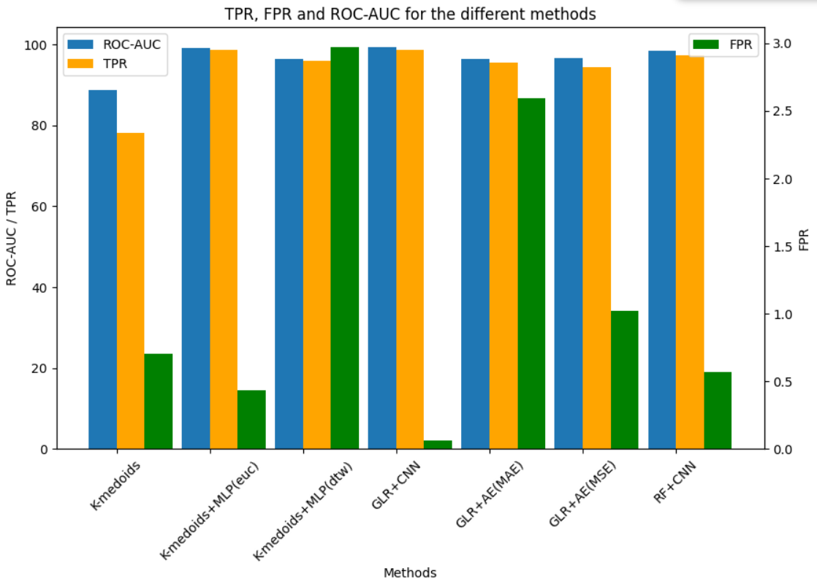
Deployment & Evaluation
Evaluation, pulse-wise
  © DESY 2017
  © DESY 2017
  © DESY 2017
  © DESY / R. Schaaf und D. Schröder
(euc)
ROC-AUC=99.3
FPR=0.06
TPR=98.6

Slide 28
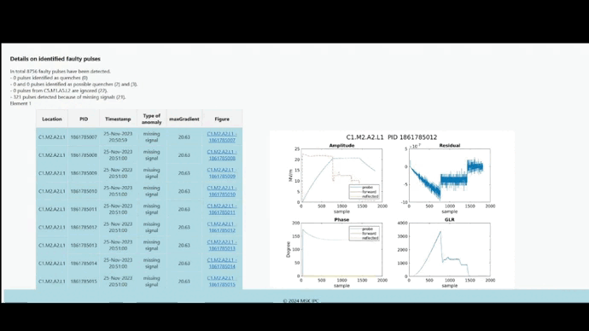
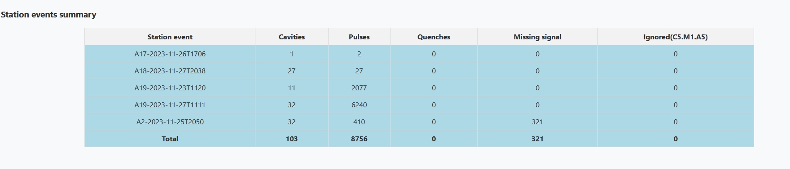
Deployment & Evaluation
Reports
Reports are generated to gain insights
Emails, Web interface
  © DESY 2017
  © DESY 2017
  © DESY 2017
  © DESY / R. Schaaf und D. Schröder
Number of affected cavities
Number of faulty pulses
Number of quenching pulses
Number of missing signals
Affected stations
Ignored cavity
Daily reports

Slide 29
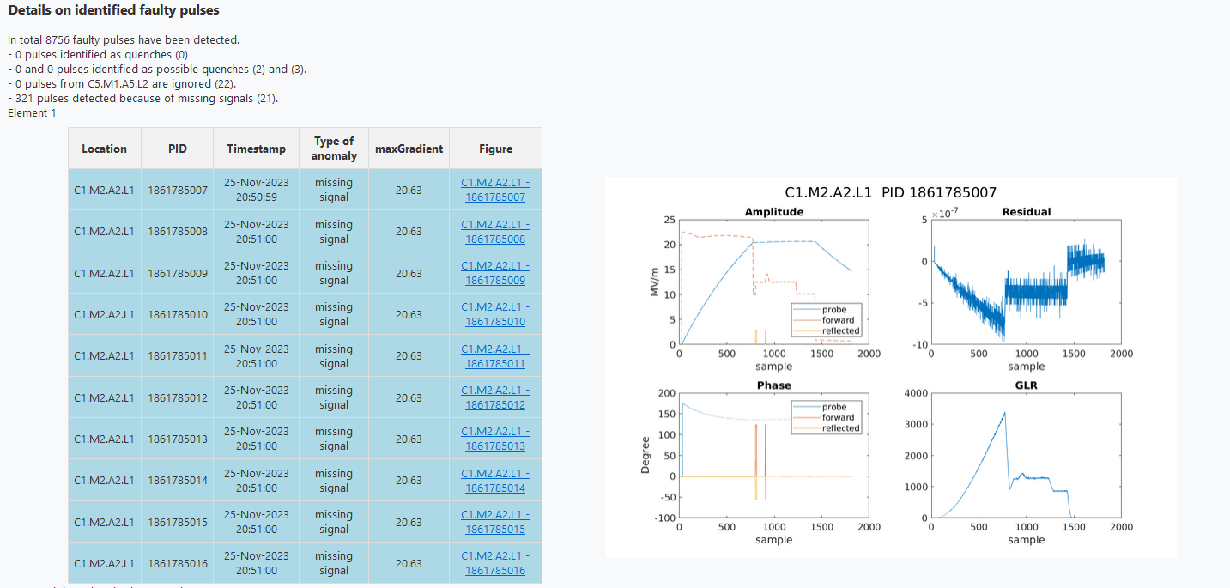
Deployment & Evaluation
Reports
Reports are generated to gain insights
Emails, Web interface
  © DESY 2017
  © DESY 2017
  © DESY 2017
Details on the known faulty pulses
  © DESY / R. Schaaf und D. Schröder
RF signals, residuals and GLR of the known faulty pulses
Daily reports

Slide 30
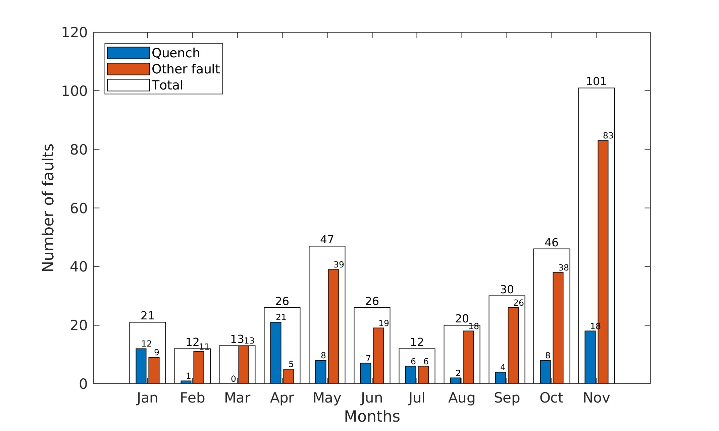
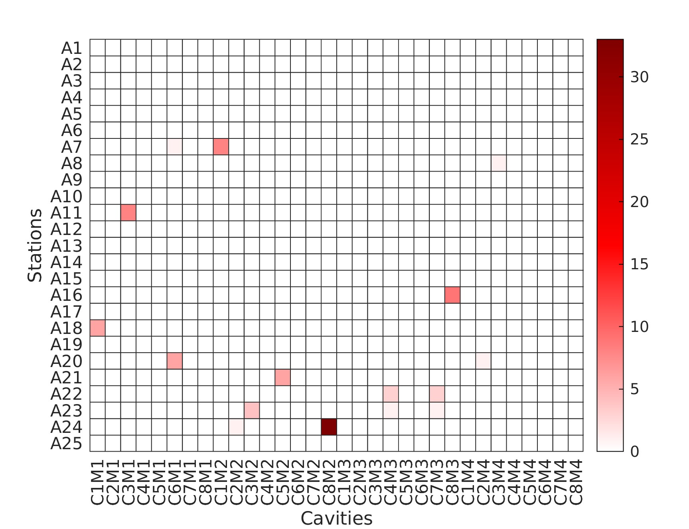
Deployment & Evaluation
Reports
Reports are generated to gain insights
Emails, Web interface
  © DESY / R. Schaaf und D. Schröder
Distribution of the faults and quenches over the year 2022
Distribution of the quenches over the stations and the cavities in 2022
Yearly / half-yearly reports

Slide 31
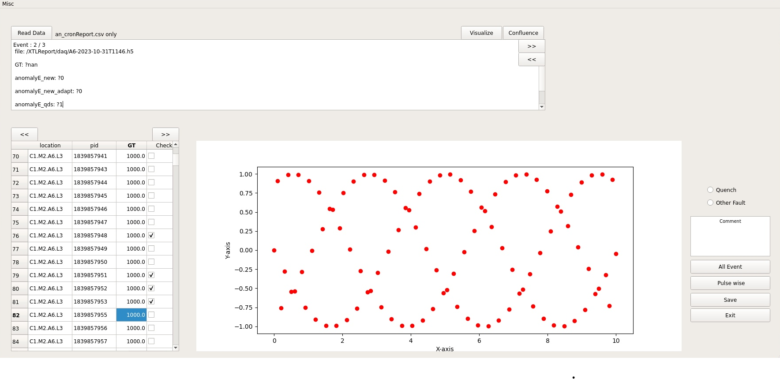
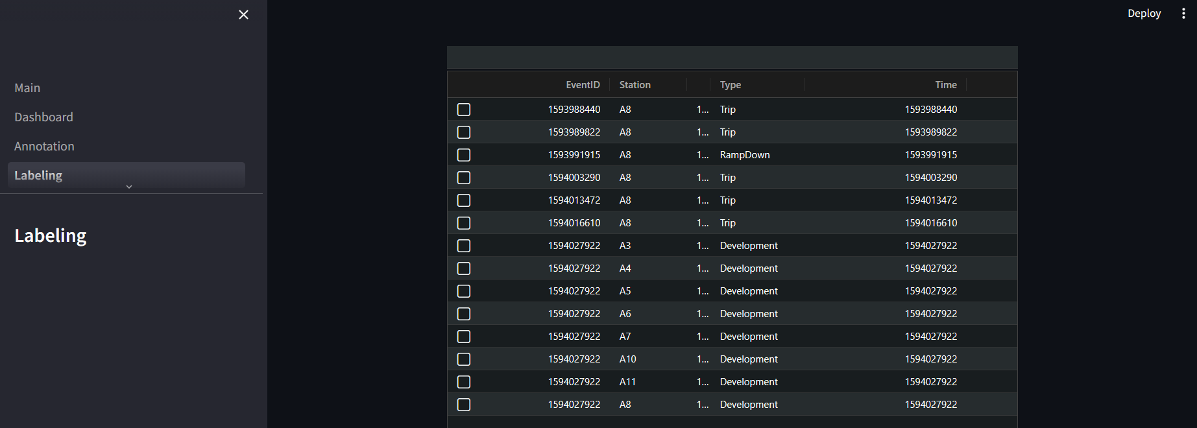
Deployment & Evaluation
Data labeling
Help from the LLRF experts with the data labeling
Difficult and time-consuming task, thousands of traces
A GUI and a web application are being developed
Help in the process through the QDS findings with the station events, and the ML predictions with the pulses
  © DESY / R. Schaaf und D. Schröder

Slide 32
Outlook

Slide 33
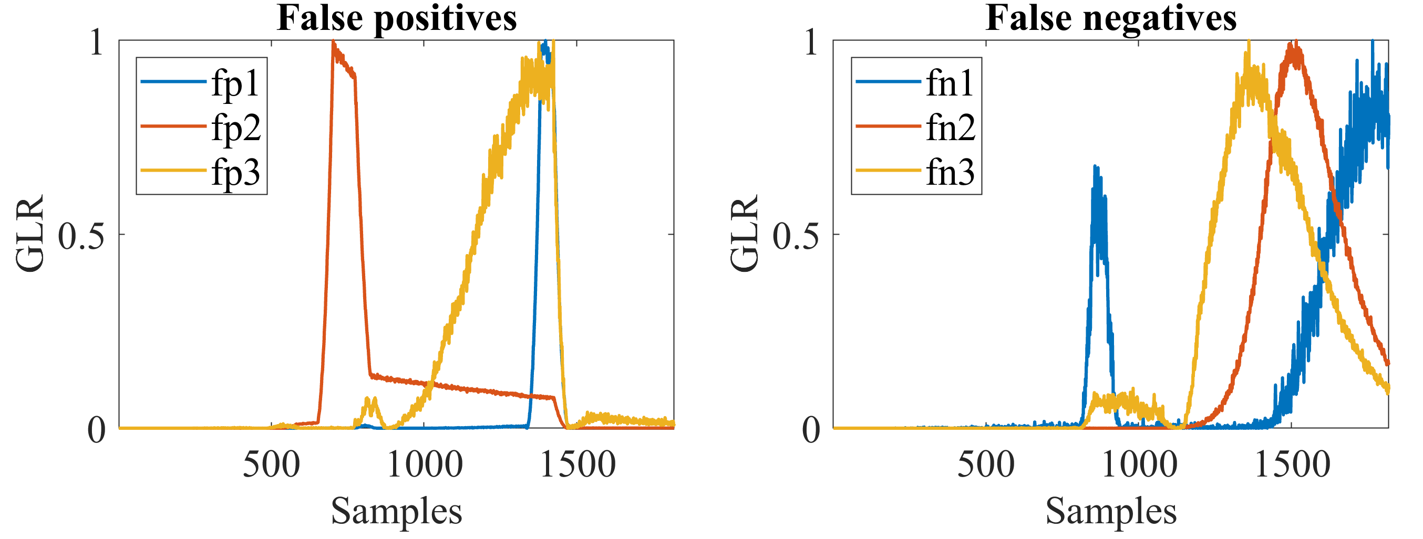
Outlook
Results validation, more data, but smarter labeling ( with an expert-in-the-loop strategy)
Explore other neural network architectures for the quench detection
Go online, firmware implementation has already been initiated
Explore the possibility of early detection
Incremental learning to scale up and detect more anomalies

Slide 34

Lynda Boukela
MSK
lynda.boukela@desy.de

