Slide 1
LHD physical Data management
Masahiko Emoto
National Institute for Fusion Science
AI and Visualizing large dataset workshop
13, Jun. 2024

Slide 2
Table of contents
LHD Experiment
Physical Data
Data Viewer
Open Data Server
Conclusion

Slide 3
LHD experiment

Slide 4
Lhd Experiment sequence
Typical LHD experiment is short pulse repetitive plasma discharges of 3-minute cycle.
Sequence signal of discharges triggers data collection.
When the collected data become available, they are converted into physical data and registered into the physical data server.
In order to operate experiment efficiently, it is required to supply the last results of the ongoing experiment as soon as possible.

Slide 5
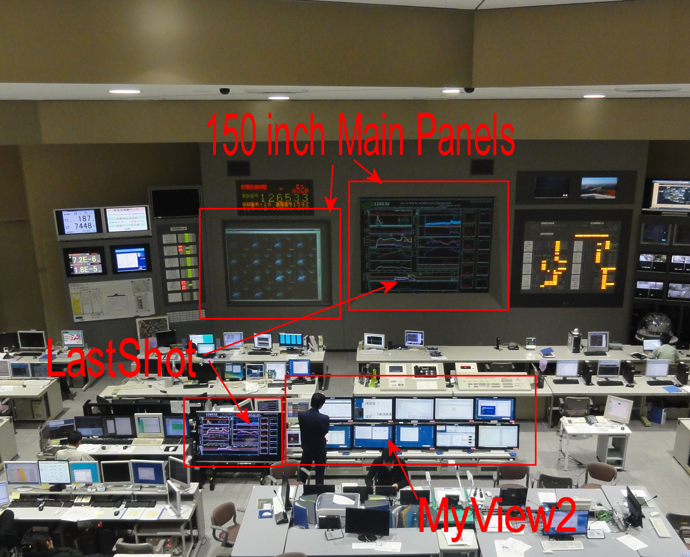
LHD Control Room
In LHD control room, the latest data is displayed using main screens, and personal computers in front of coordinator desk.
The coordinator modify the parameters of ongoing experiment by refereeing the results.
The principal data, such as NBI injection, plasma current, and electron temperature are displayed in the main panel.
Other data specific for experiment are displayed by multiple PC.
Notes:
T

Slide 6
physical data

Slide 7
lhd experiment data
Two kinds of data systems are working for the LHD experiment, LABCOM System for raw signal data, and Kaiseki Server System for physical data including analysis data.
The raw signal data is binary data which is memory image of digitizers or video cameras.
Physical data is a text file data which describes physical quantities, such as, time series of NBI power injection or time series of electron temperatures distributions. Some of physical data are calculated using raw signal data, and others are calculated using several other physical data and raw data.

Slide 8
Physical Data Format
# [Parameters]
# Name = 'SXR'
# ShotNo = 6115
# Date = '1/29 15:14'
#
# DimNo = 2
# DimName = 'R', 'TIME'
# Dimsize = 80, 100
# DimUnit = 'm','s'
#
# ValNo = 4
# Val= 'dt', 'dR', 'SXR', 'dSXR'
# ValUnit = 's', 'm', 'V', 'V'
#
# [comments]
# PHI=3.5
# PHIunit='portNO'
# comments = 'Be thickness = 7.5 micro m'
# [data]
3.26640, 0.302, 0.01, 0.02, -0.0000518, 0.0000002
3.27489, 0.302, 0.01, 0.02, -0.0000076, 0.0000001
3.28338, 0.302 ,0.01, 0.021, -0.0000820, 0.0000003
3.29186, 0.302, 0.01, 0.021, 0.0000149, 0.0000003
...................................
All the physical data is stored as comma separated text file, and files are compressed in the Kaiseki Server.
Soon after the LHD project began, data acquit ion is done by each researcher. This format is adopted because it was easy to handle by researchers who were not familiar with programming.

Slide 9
automatic physical data calculation
In order to achieve quick data registration, there are two kinds of automatic registration systems are working.
Raw2Ana
Raw2ana is an automatic calculation system to run programs that convert raw signal data into physical data. The executable program is started as soon as the collected data becomes available.
AutoAna
AutoAna is an automatic calculation system to run programs to calculate physical data using other physical data. The programs are started as soon as the required physical data are prepared.

Slide 10
Dependency of physical data
There are dependencies among physical data. For example, physical data, TSMAP, is calculated using 5 other physical data.
AutoAna system calculates and registers or updates the dependent data. For example, when “Thomson” is updated, related diagnostics drawn by red are recalculated by AutoAna.

Slide 11
Name | No | Role
UPDATER | 1 | Receives data notification packets from the Analyzed Server, and requets SERVER to create physical data that requires the registered data as input
SERVER | 1 | Maintain the job requests.
EXECUTER | 160 ~ | Get a job request from SERVER to executer an analysis programs.
Notes:
For the LHD experiment, the AutoAna system is working to execute analysis program automatically.
When a new data is registered into the DATABASE SERVER, the AutoAna runs analysis program that requires the new registered data as input.
This figure shows the overview of the AutoAna
Blue arrow shows the data flow, and the green arrow shows the job flow.
The system consists of three components, SERVER, UPDATER, and EXECUTER.
The numbers of UPDATER and SERVER are one, but there are multiple EXECUTERS,
currently we prepare 400 EXECUTERS running on 11 PCs.

Slide 12
data viewer

Slide 13
LHD Control Room
There are two kinds of data viewer are working in the LHD control room, LastShot.py and myView2.
Notes:
T

Slide 14
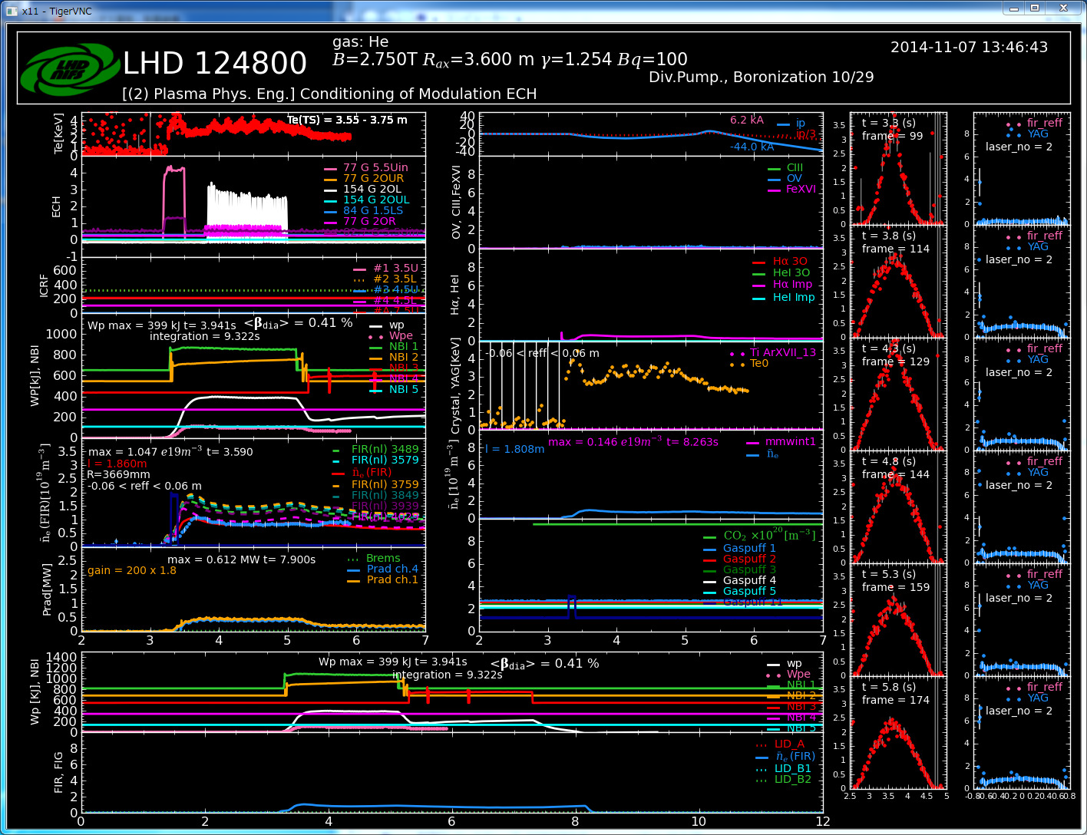
Lastshot.py (Main Screen)
LastShot.py is a python-based application and shows the last principal data.
The data is drawn as first-come-first-served basis. The registration of the data is broadcasted using IP-multicast, LastShot.py displays data when it received the notification.
This screen is shared using VNC reflector. Also, the graph is converted into PDF, and available from the web servers.

Slide 15
Data flow
This figure shows the data and information flow during experiment.
LastShot.py begins to draw new graph when it receives experiment sequence, and updates graph line when it receives the notification packet from the Kaiseki Server.

Slide 16
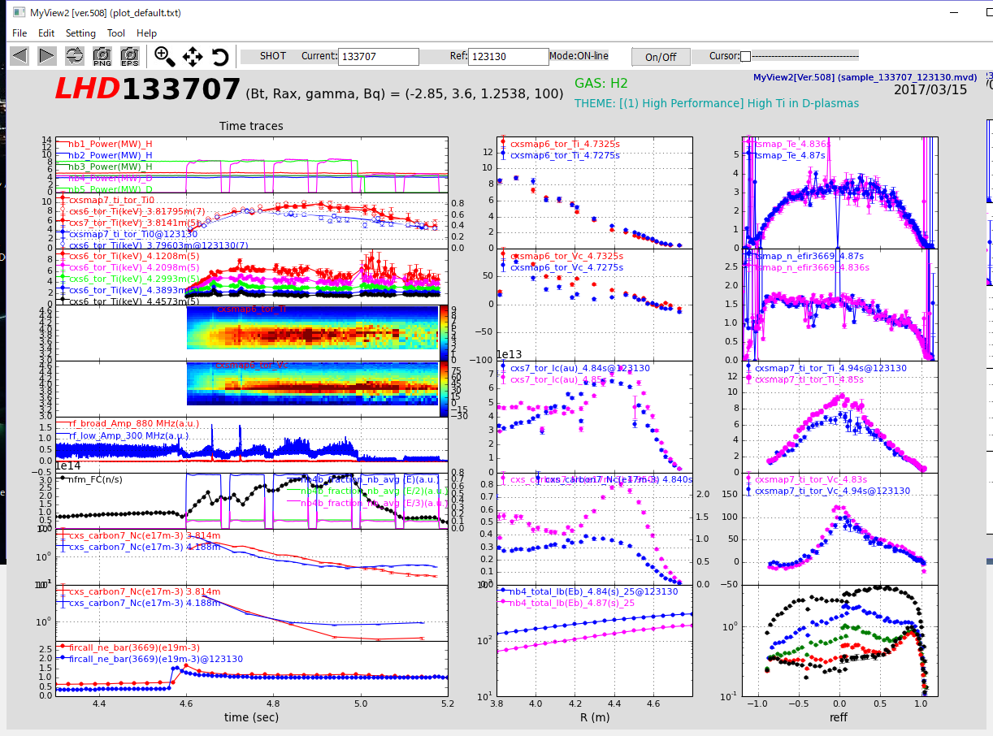
MyView2
(front pc)
Data specific to the experiment are displayed by myView2 on the PC in the front row.
MyView2 is written in python 3, and runs in Windows, MacOS, and Linux

Slide 17
MyView2, python based data viewer
MyView2 is developed for visitors, who is co-researchers participating from outside. Using myView2, they can display the data they need as soon as they arrive at NIFS.
Because myView2 is written in Python3, and support Windows, MacOS, and Linux. So, they can run myView2 in their own computers.
Graph layout is customizable and predefined layout files are provided so that the visitors can display data soon.
It is developed for LHD experiment, but modular structure enables to view various kinds of data.

Slide 18
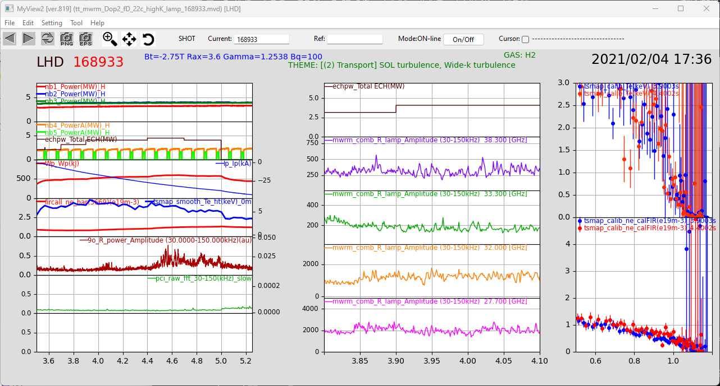
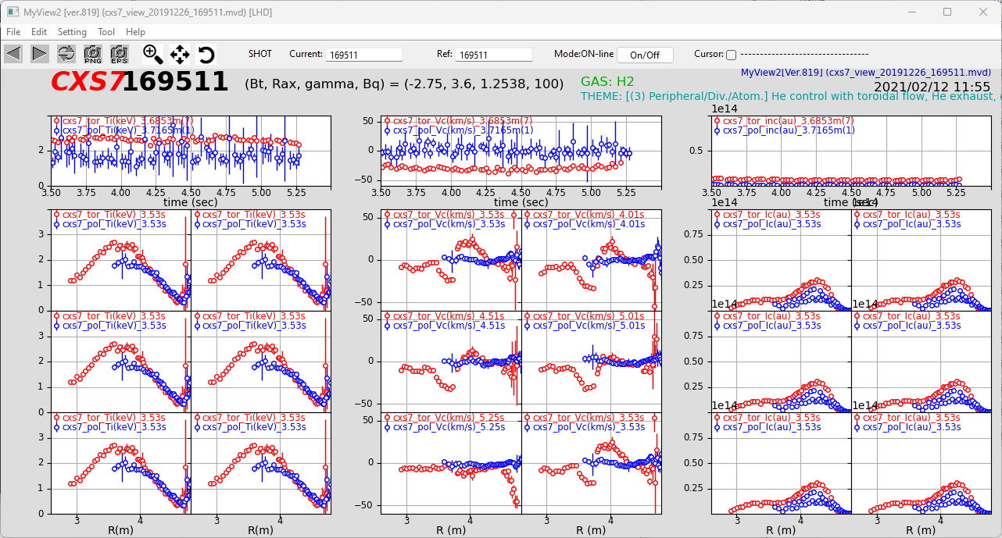
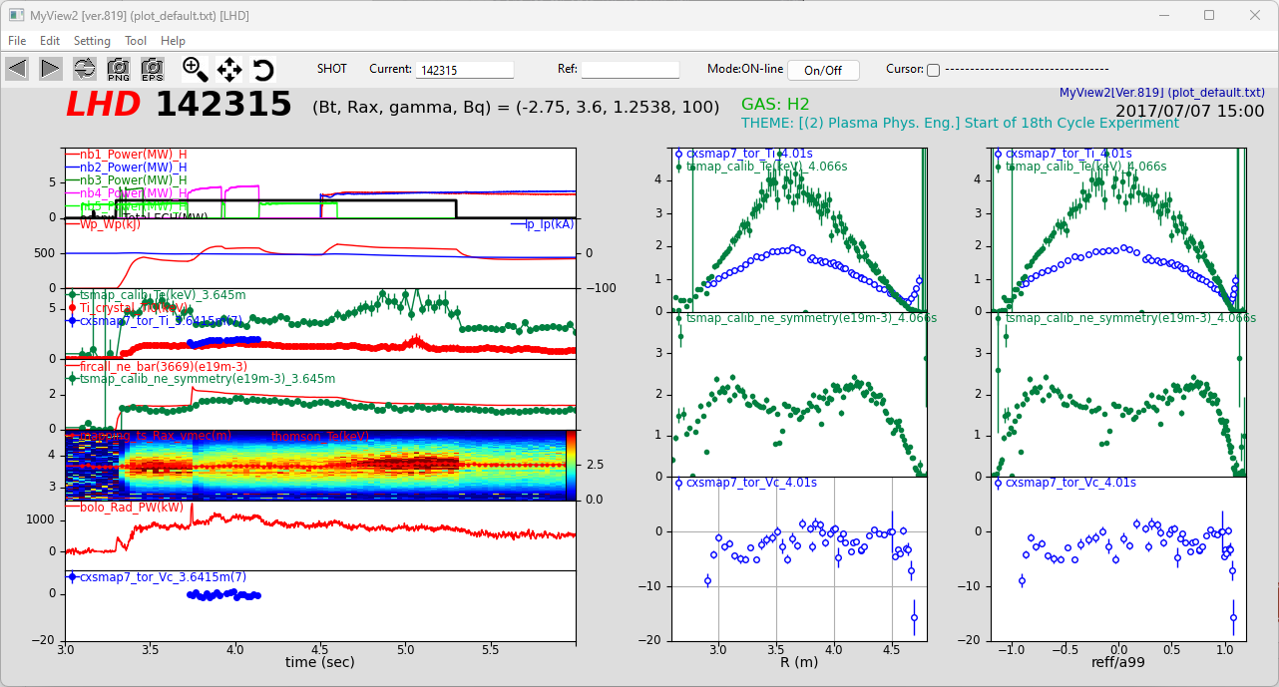
Providing predefined profiles,
visitors can display the data
suitable for their interests soon.

Slide 19
Data loader
myView2 loads data using DataLoader modules. In order to load new data type, it is required to prepare its data loader.
Originally, myView2 was designed to use for LHD experiment, but it can now support data of other experiments.

Slide 20
open data server

Slide 21
Open data server
NIFS has been fully opening LHD measurement and analysis data to the public (open data) since the 2022 fiscal year
The open data includes raw data, physical data, analysis program codes, instrument overviews, shot summaries, visualization tools and other related utilities (developed in-house), etc.
Data are opened immediately after collection and analysis are completed, with no embargo period.
Data are available from the LHD Experimental Data Repository without limitation.
Total number of data
  about 40 million measurements and analysis data,
  about 2 PB.

Slide 22
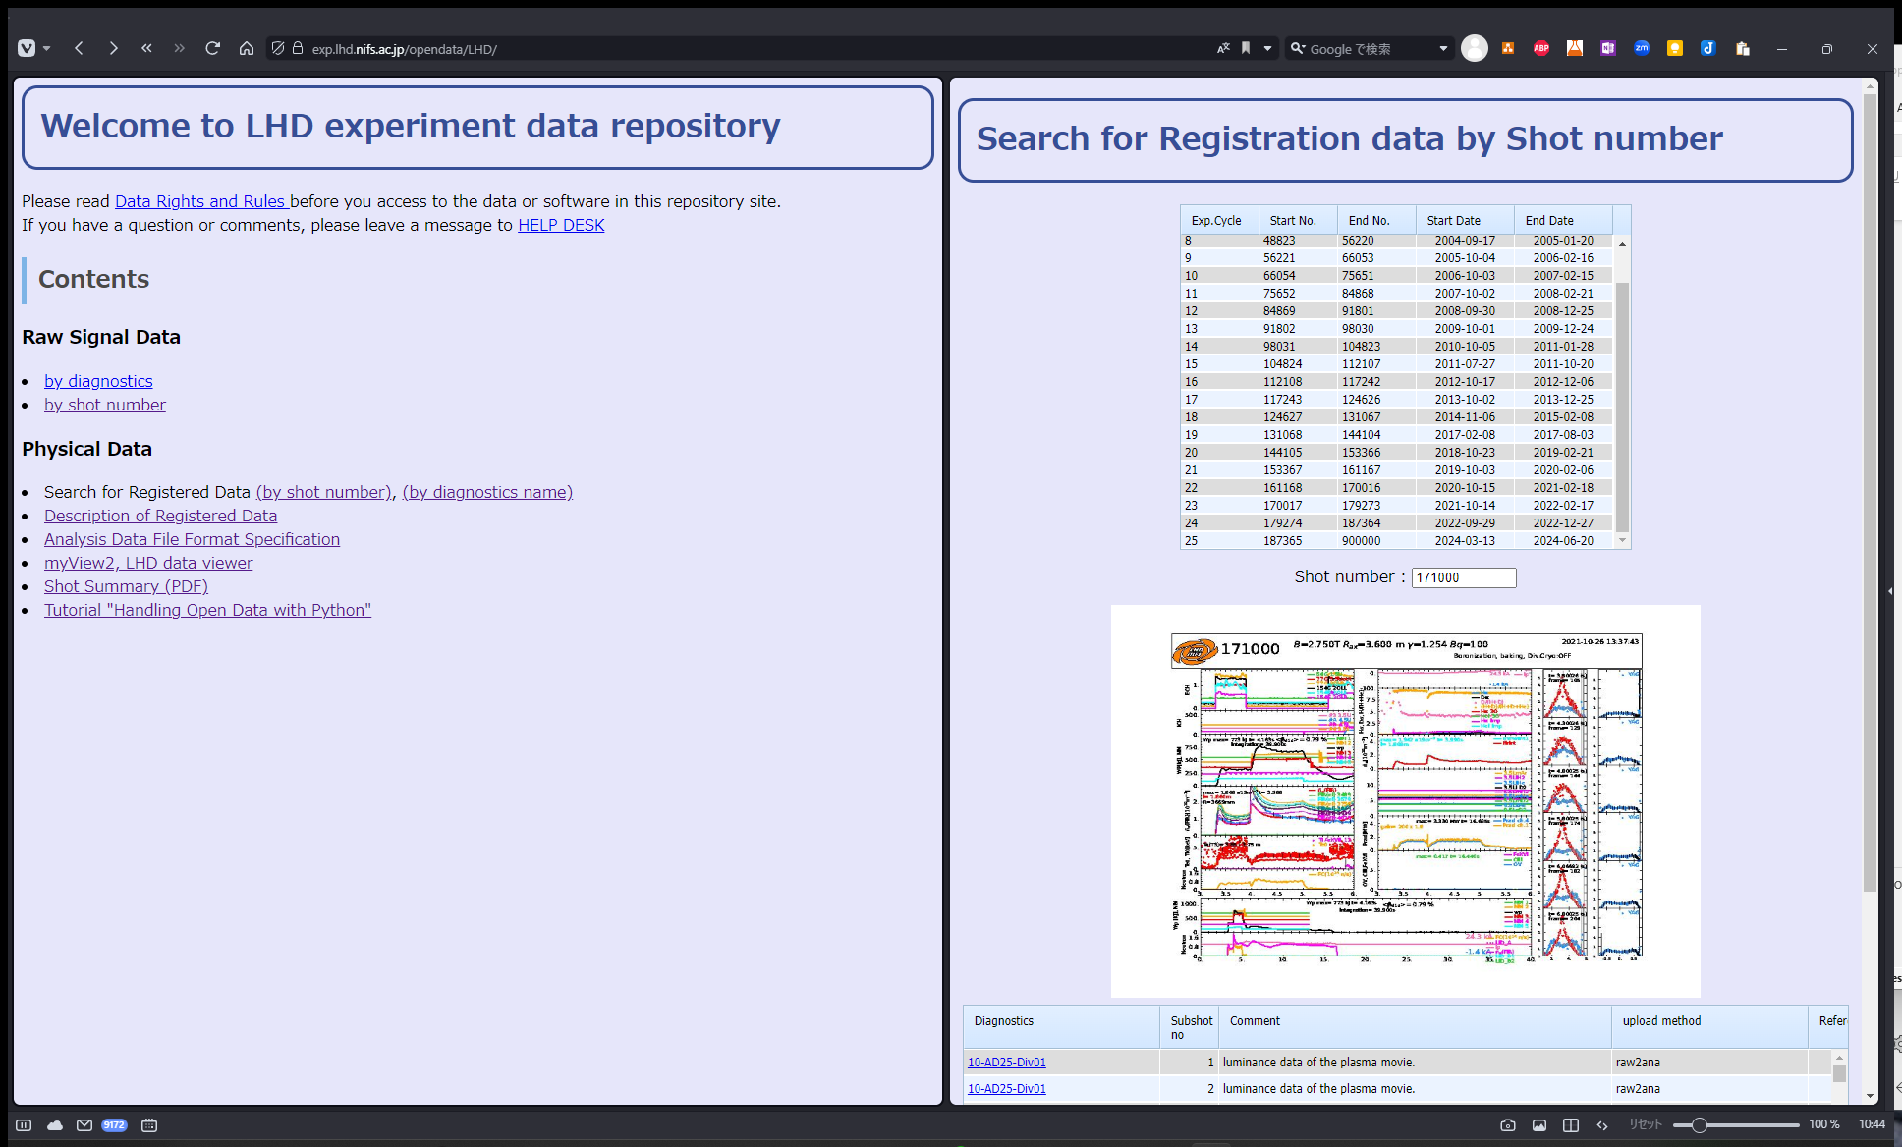
Physical Data:
Open data server
All the data acquired by LHD experiment is opened, and free to use.
The user can download data using standard Web browser and myView2.
Open data Server for LHD Data
https://exp.lhd.nifs.ac.jp/opendatga/LHD

Slide 23
Data synchronization
Open data server is located in DMZ, which is accessible from the Internet by HTTP/HTTPS.
Data placed in the DMZ is periodically synchronized with data placed on the experimental LAN.
Currently, in order to avoid interfere with ongoing experiment, synchronization is stopped during the daytime.

Slide 24
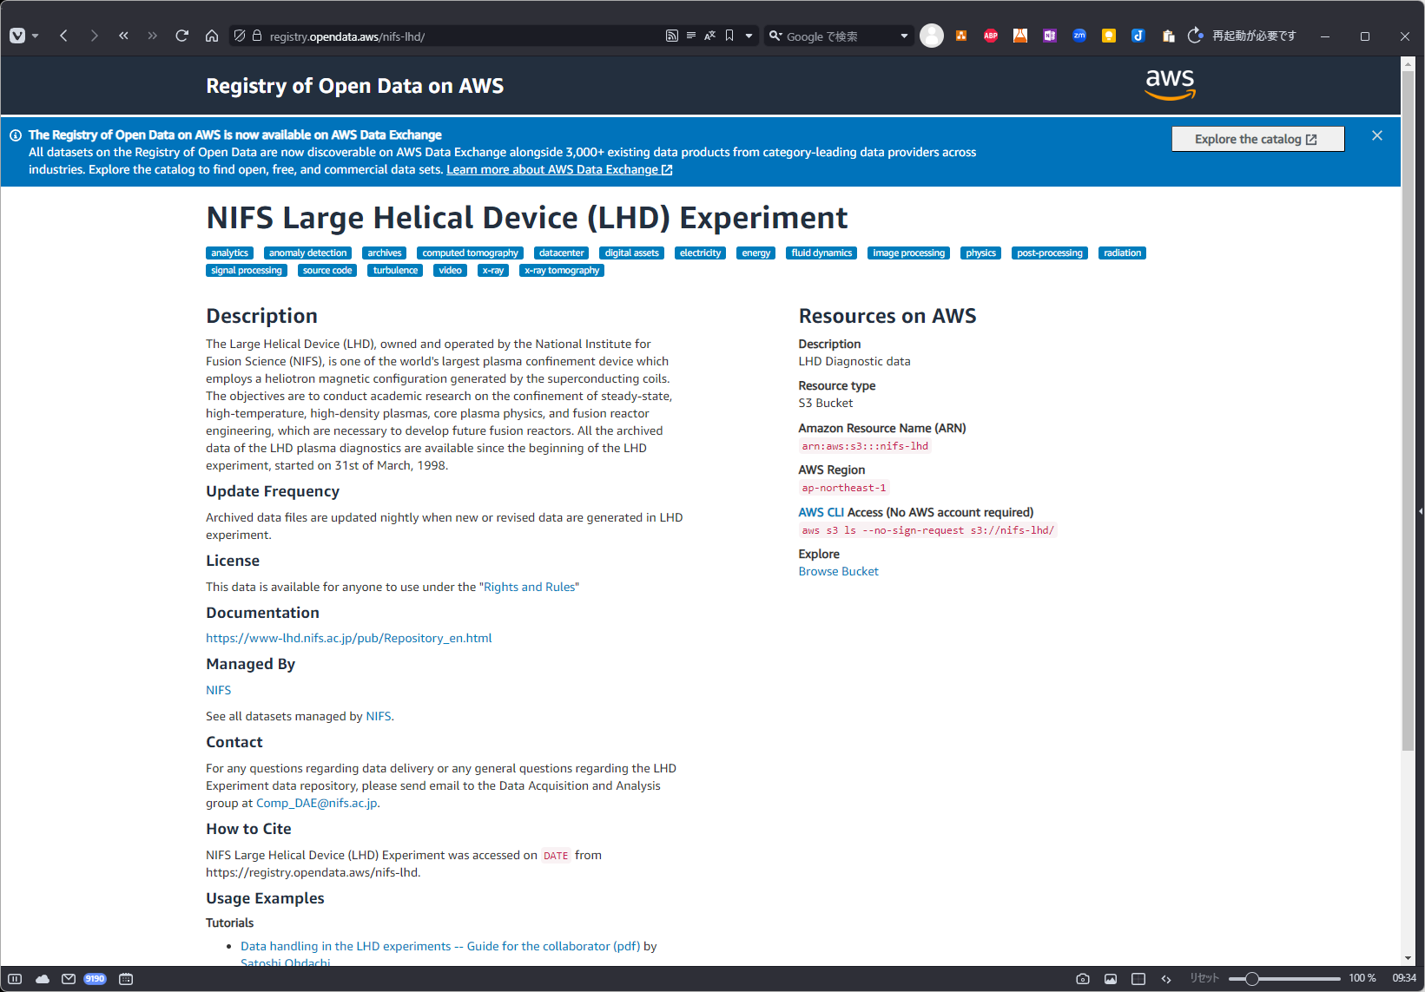
RAW Data:
Data publication by AWS
Raw data is now available from Registry of Open Data on AWS.
The program was adopted by the Open Data Sponsorship Program, a social contribution program of Amazon (AWS), and approximately 2 PB of LHD experimental data was stored and released free of charge on AWS S3 storage
AWS ODP's LHD Registry Page
https://registry.opendata.aws/nifs-lhd/

Slide 25
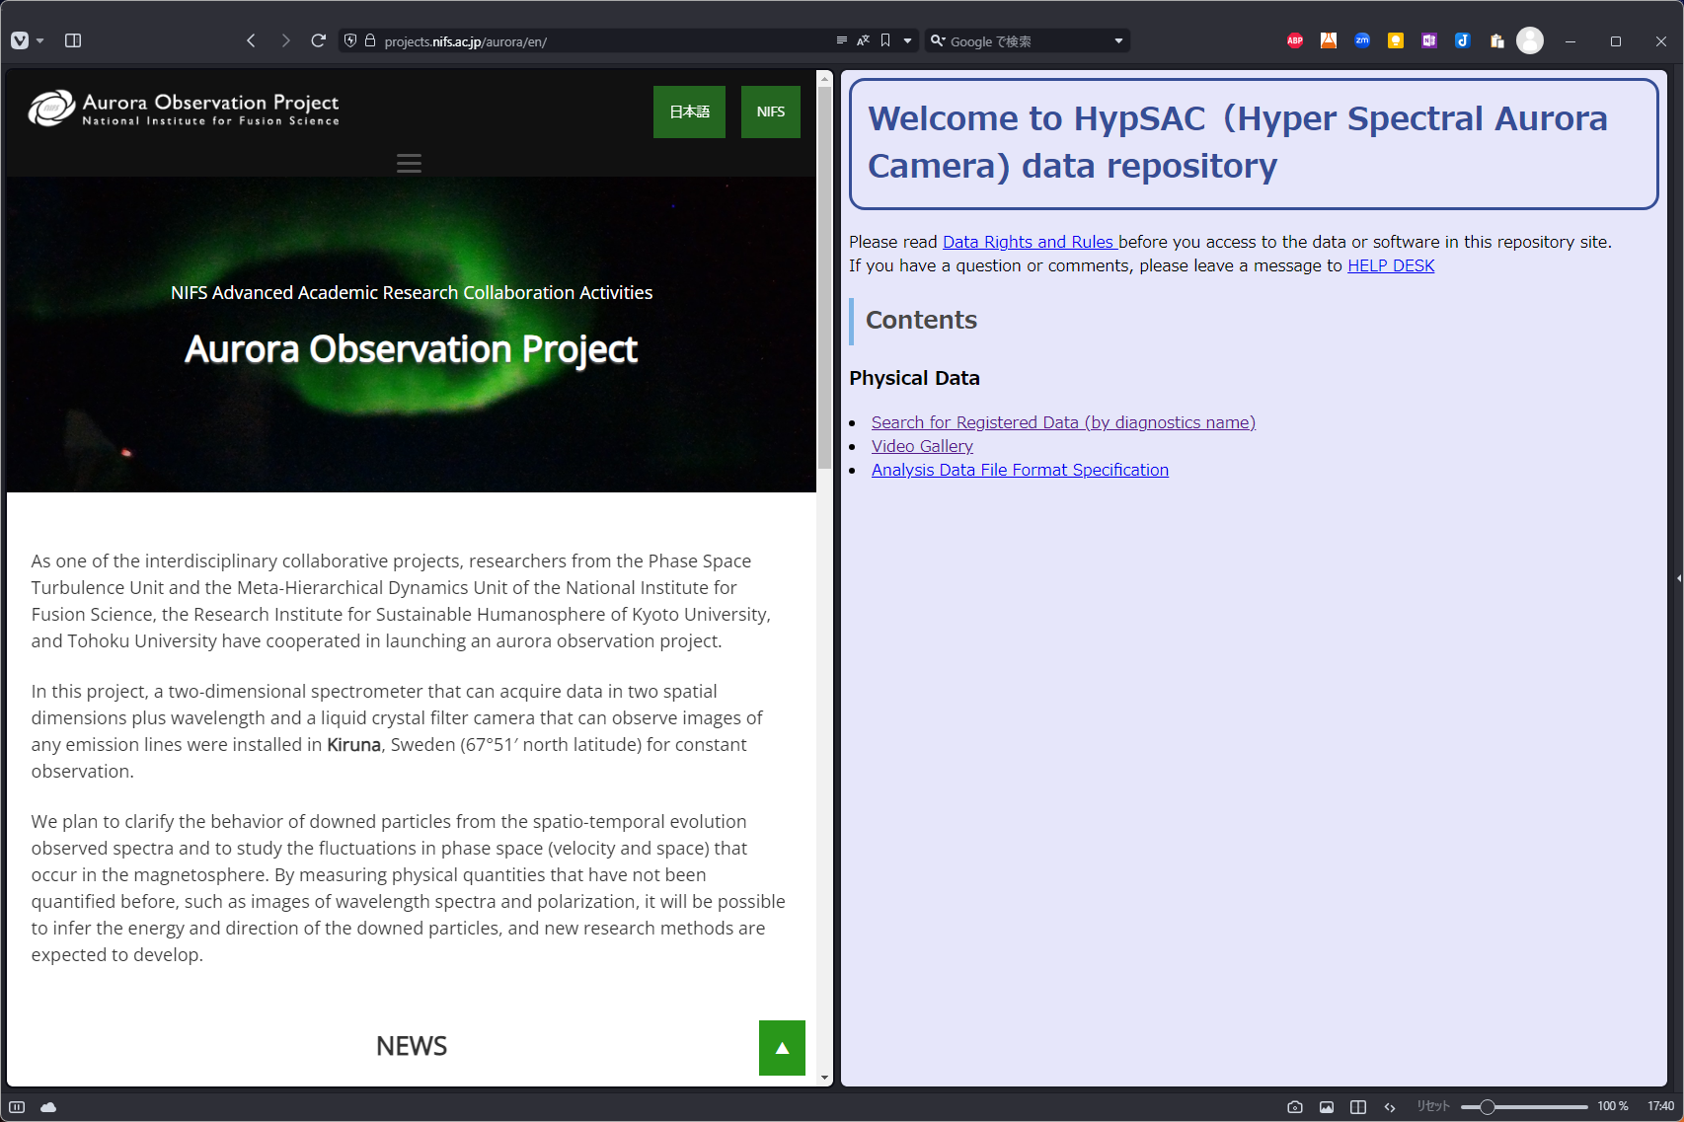
Aurora observation project
Now, Open data Server provides the experimental data obtained by “Aurora Observation Project”. It is a collaborative project among Kyoto University, Tohoku University and NIFS.
Project Home Page https://projects.nifs.ac.jp/aurora/en/
Open Data Server https://exp.lhd.nifs.ac.jp/opendata/HypSAC

Slide 26
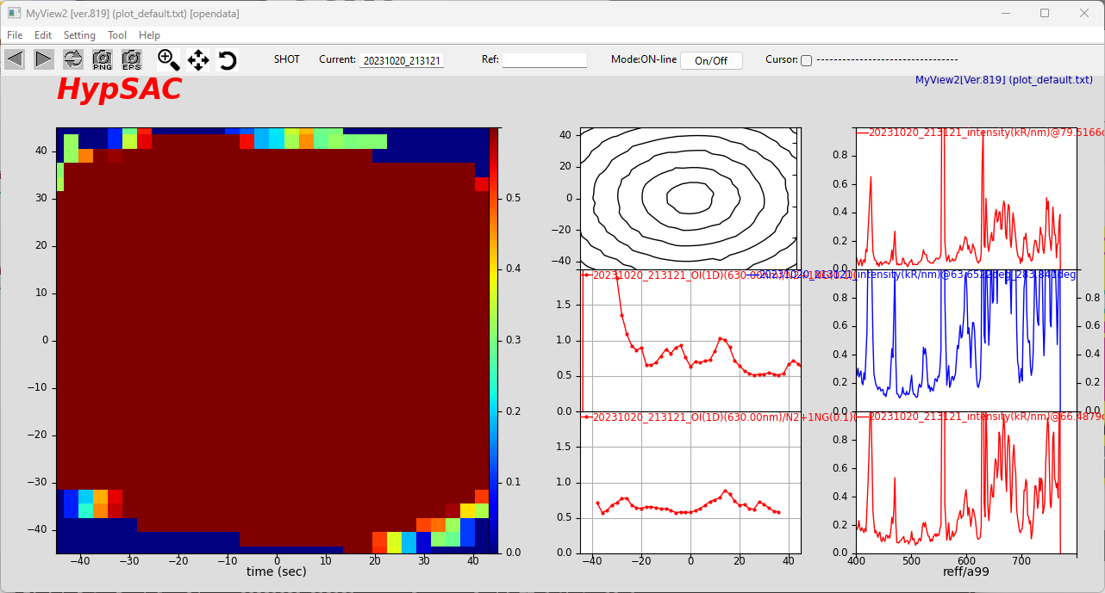
Myview2 for aurora data
MyView2 can display Aurora Project data same as LHD data.

Slide 27
Modification for aurora data
In order to handle Aurora Project Data by the Kaiseki Server, a physical data server for LHD, modifications were required.
LHD Experiment data is identified by shot (pulse) number and sub shot number. Sub shot number is used to identify a part of long pulse. On the other hand, aurora data is identified by the observation start time.
The Kaiseki Server must be modified to interpret shot number and sub shot number as date and time.
Shot number describes the date of ‘YYYYMMDD’ format, and it needs to convert from 32bit integer to 64bit integer.
Sub shot number describes the time of ‘HHMMDD’ format.

Slide 28
displaying aurora data
Another problem is that it takes long time to display aurora data. ( ~ 10 min)
The size of aurora data is larger than that of typical LHD data.
  Thomson Data : ~ MB
  Aurora Data : 2GB
Most of the time is spent for converting text into numerical array rather than downloading the data from the Internet.
myView2 converts text file into python internal object format (.PKL file), and stores them in the local cache, then reuses them if they are referred again.

Slide 29
Performance improvement
Data is store into local cache
Check if the timestamp of the remote file with local cache, and load from the local cache if the remote file is not updated.
The cache data is stored as binary data.
Save the array data as pkl format to eliminate text-to-binary conversion time.
Serialize data loading of the same target.
myView2 loaded the data parallel for each graph line to enhance drawing speed. If there are multiple lines referencing the same file, the text-to-binary conversion process will be duplicated, which in turn will slow down the process.

Slide 30
conclusion

Slide 31
summary
The physical data is managed the Kaiseki Server, a physical data server, and stored as text file.
Raw2Ana and AutoAna systems are working to register physical data between short pulse discharges.
In order to visualize LHD physical data, myView2 is available.
Data of the LHD experiment is now available freely from Open Data Server and Open Data Repository by AWS.
Open Data Server now provides Aurora Project Data as well as LHD data, and ready for other data.

Slide 32
future plan
Support for more generic data other than plasma experiment
  ➔ Each data can be identified by tags rather than shot number.
Improve data access to Open Data Server
  ➔ Support standards: gRPC, HDF5, IMAS, etc.
  ➔ Efficient data access : Retrieve META information, or slice of data without downloading whole data

Slide 33
Thank you for your attention

