Slide 1
DATA VIS TOOLS @ITER L. Abadie, Abreu Paulo, D. Dequidt, D. Iglesias, S. D. Pinches, S. Simrock ITER Organization, Saint-Paul Lez Durance, France Pablo Martin Villares, Jhon Cabanilla, Yury Makushok INDRA, Madrid, Spain Rodrigo Castro CIEMAT, Spain

Slide 2
Challenges/Requirement
Different stakeholders, different needs
Plant Engineers : system investigation, research, quick search
Science : pulse analysis, research, quick search
Operation team : pulse analysis, quick search
Large volumes and Heterogeneous data to be visualized
Time and profiles traces
Spectrum
Fluxes
Images, videos
Architecture shall be flexible to cope with technology changes
-> 2 families : web-based tools and desktop tools

Slide 3
Lessons Learnt
Most of the visualization tools were written in IDL
Discussion with different stakeholders
Importance to have a clear architecture
Modular with an abstraction of the graphical library so that we can change it if needed (3-D is out of scope)
Develop a Python plotting library (but not up to OpenGL level) so that scientists can develop their own tools/applications
Use this library to develop the different tool in the control rooms
Use of tabular view for plot configuration
Results of analyzing existing tools ReviewPlus, JETDSP, CView
Detached/fully integrated panels
Industrial systems like Cooling, Cryo will prefer integrated panels
But not the others…Most tools used in tokamaks consist of detached panel to freely move them around, resized
Community approach, if possible open source
Science, operation, heating, diagnostics

Slide 4
Different tools instead of one big tool
Modular architecture
Can be started individually and assembled via plugin approach
MINT - Trends
View time-series data, by time range or by pulse, include oscilloscope view
Profiles : Plots as function of space at selected time(s)
Can subscribe to the live stream if needed
Image viewer
Mainly for camera data (infra, vis) – requires machine description data
More specialized function related to image processing
Can be mixed with 1-D data for correlation
Magnetic flux surfaces
Requires geometry information (coil position for instance)
2-D plot in (R,Z ) at a selected time(s)

Slide 5
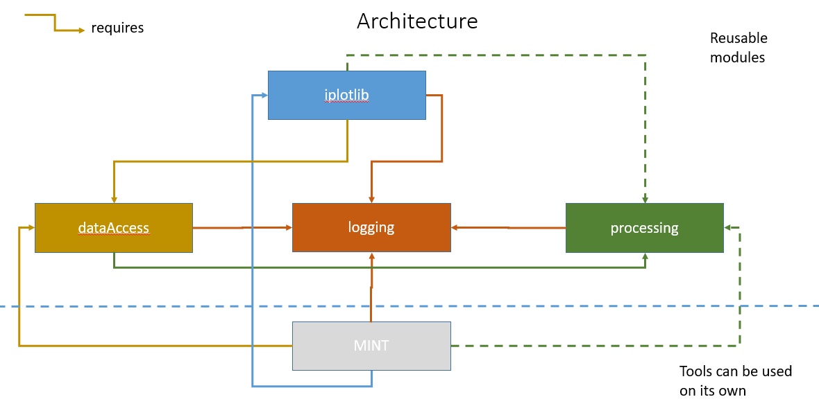
Architecture (1/2)

Slide 6
Architecture (2/2)
Easier to add a new data source for data access :
CODAC UDA
IMAS (local)
IMAS (uda), coming soon
Easier to switch to a new plotting library:
clear abstraction via iplotlib
Select 2 libraries Matplotlib and VTK to validate the library
None of the tools make an import of the underlying plotting library
Can be called with users’ own data
Processing layer can be used in conjunction with data access or not

Slide 7
Technologies
Main tests done on RHEL8
Development with Python 3.8, PySide6
Assumption is that the graphical library needs to support Qt backend (which is rather common)
Qt offers a wide range of widgets and allow building complex UI, support various platforms and good support for screen resolution via env. Variables.
Python is appreciated by scientists and offers a wide range of modules
Use of GIT to store the code
Implement unit tests whenever possible
Zoom/Pan are interactive
Means if the data to be retrieved is too big, only a few points are retrieved (link to screen resolution)
Whenever a zoom/pan is triggered , a new request is triggered if (not all data have been retrieved)
Memory footprint and CPU of MINT are monitored.

Slide 8
MINT – Features supported
Features
View one or several 1-D trends (X axis is the time)
Support for pulse-based and time range data access (all the plots show the same time range/pulse) + relative time (e.g. last 10 mn)
Support for time range or pulse specialization at row level (allow comparing two plots side by side)
Support for pulse overlay
Support for interactive zoom
Support for crosshair (over multiple plots), with option to enable/disable labels
Support for envelope display
Support for interactive pan
Support for preferences update {color of a signal,draw-style {interpolated,stair}, display points with markers, + others}
Add a plot/canvas title
Support for automatic X-axis scale (if I zoom or pan on one plot, all the plots will be rescaled to the same time window).
Import/Export list of variables
Save/load configuration a canvas
Support for streaming
Support for full-screen mode for a plot
Support for signals processing
Support for Y and X-axis label edition
Generate a screenshot given a preference file in an headless environment (to allow report automation)
Variable table : support for copy/paste like in Excel, find/replace support
Support for plot where X is not the time (i.e. plotting a variable versus another variable)

Slide 9
MINT – Features supported
Features
Support for extremity retrieval, in case of PON it is always useful to retrieve the last point of the interval…
Indicate the status and number of points retrieved in the status column
Display the memory consumption – shall be monitored..
Support for 4kscreen
Support for aliasing a signal name
Provide a window to search for variable per data source
Dump the variable content when clicking on draw
Support for various data sources
Support export of samples per canvas
Support for external python modules, which can then be used in data processing
Support for append csv in the variable content

Slide 10
Layout of the tool
Time range {absolute, relative by pulse}
Plotting area
Allow to create your canvas

Slide 11
Pulse data
Courtesy from Lee Woongryol (IO)

Slide 12
100 signals, 1 week of data ~2mn (no optimization,

Slide 13
Plotting library abstraction
API -Backward compatibility will need to be carefully managed!

Slide 14
Iplotlib for imas data

Slide 15
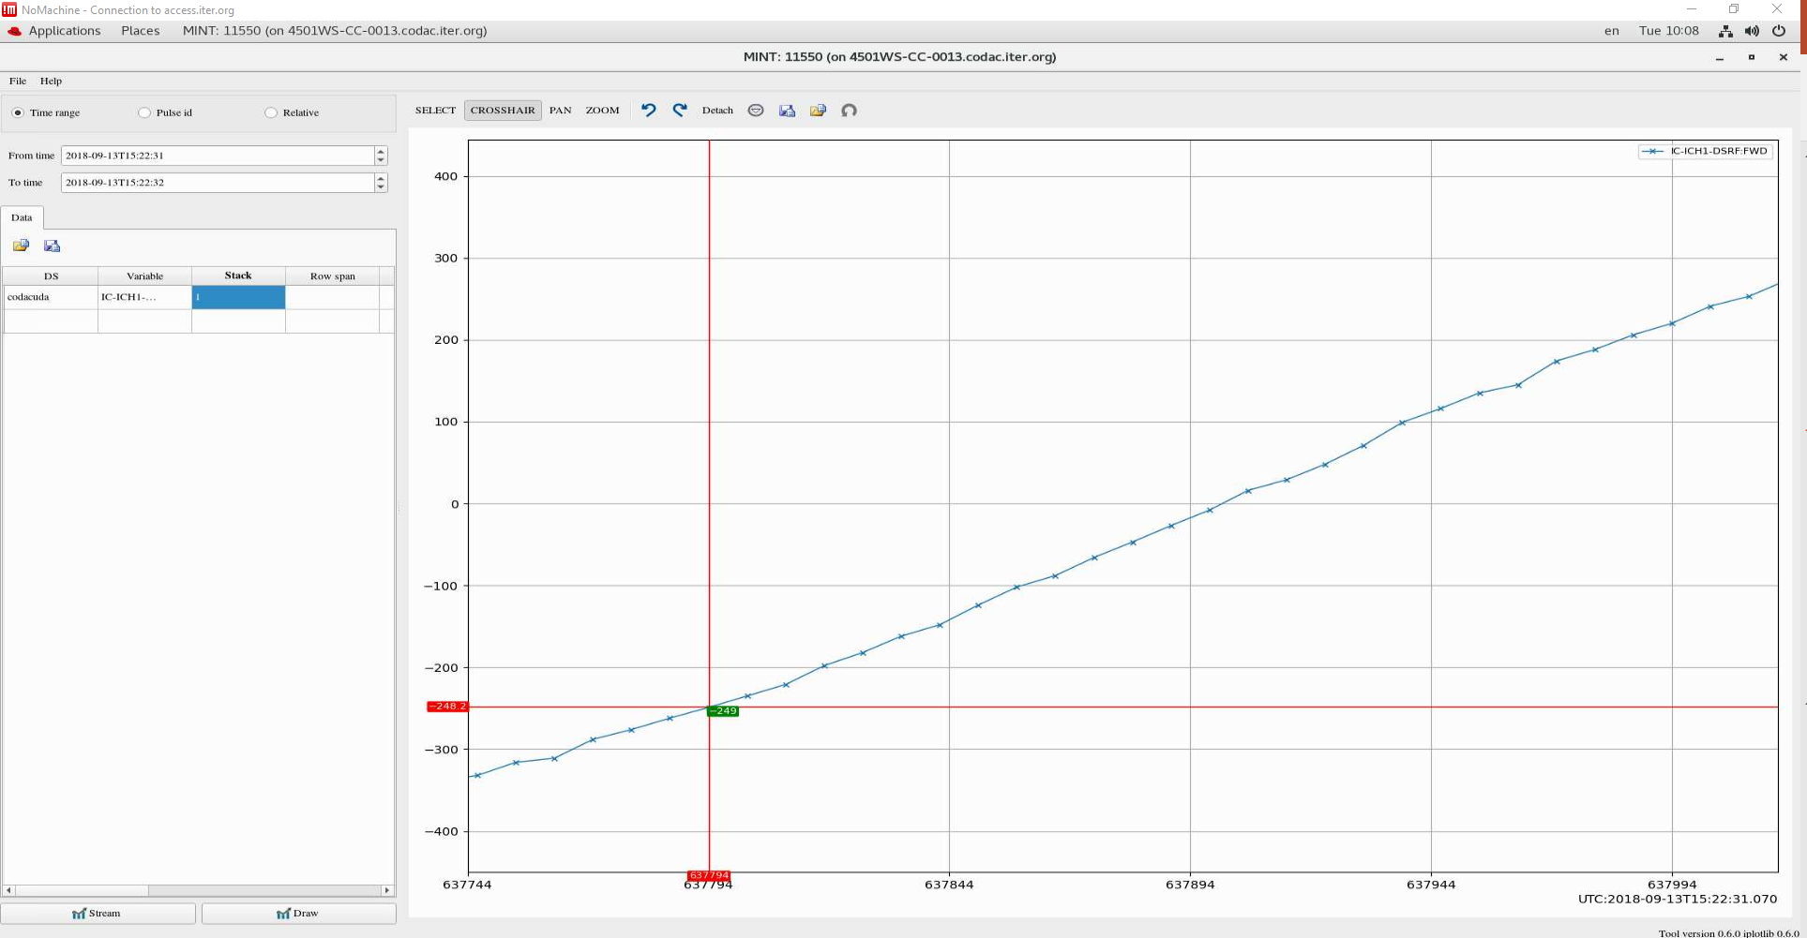
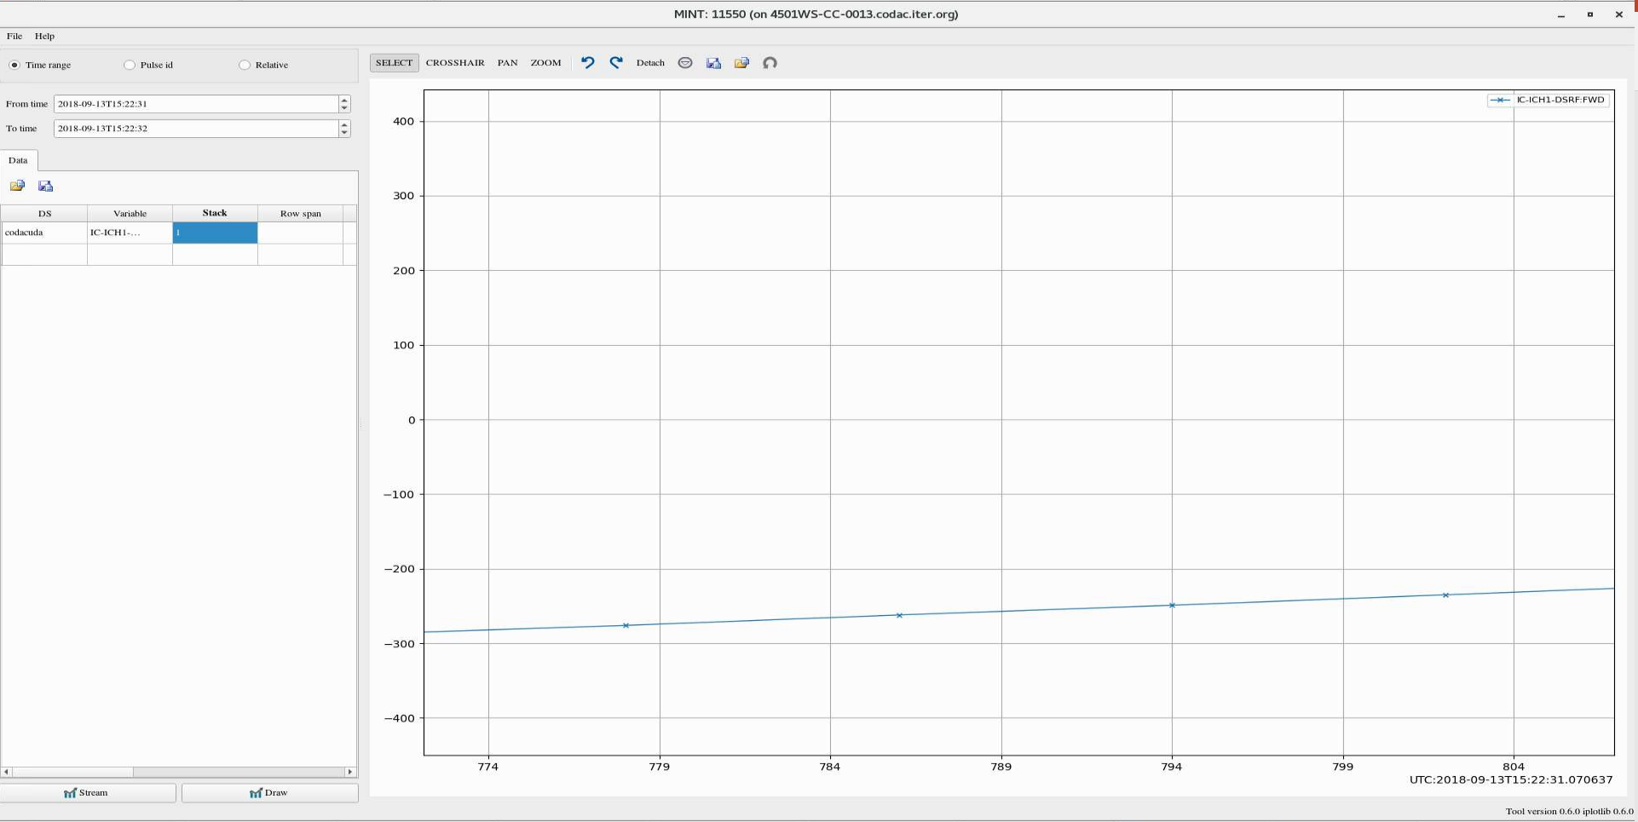
Handling nanoseconds precision
Signal acquired at 125MHz, 2bytes/sample

Slide 16
Trends tool : Next steps/Issues
Improve the performance of the tool
Some features are a little bit “slow”, code refactoring is needed
Carefully assess if a feature is plot-dependent
E.g. compute the distance between 2 points has limited sense for image or contour plot
We start to have some issues with the large volume of the data
We decimate the data (either envelope or simple downsample method).
Issue is with processing: some of them require the full data and it is better to do it on the server side
Issue when we plot a vector against another. As we don’t have the full data, if one zooms or pans we don’t know what to as inversing a function is not always possible and if it is, it is time consuming…
Feedback Mechanisms and User Input:
Insights into how user feedback is collected, analyzed, and incorporated into the development and improvement of the visualization tools. Engaging users in the design process can lead to tools that better meet their needs and preferences.
Virtual assistant?

Slide 17
Iplot modules
We developed a set of python modules to allow scientists to develop new tools
We started with matplotlib and VTK to demonstrate the abstraction of the library
It has 2 modes :
either data-driven you create your canvas via a json file
Or programmatically via APIs
Main issues
Matplotlib is slow but very nice features that is difficult to find in other libraries
Python VTK is very difficult to use and it misses some features, we are considering fastplotlib as a replacement
Handle cases where a feature exists in one library but not in the other one.
Thinking of using PyQtGraph for the streaming part if fastplotlib does not improve things

Slide 18
Next developments (1/3)
Start to add new plot types such as
Contour plots : Science will use iplotlib to develop the magnetic fluxes tool. In MINT, we will provide basic support for contour plot with Slider
Image plots : in MINT, we will provide basic support for image with Slider
Surface plots : : in MINT, we will provide basic support for image with Slider
Timeliner plot : like a calendar with indication of data’s presence.
Statistics plots: with AI, these new plot types will be needed such as histogram, pie chart…
what to do? Feedback is appreciated.
Do we need to mix them with time-base plot, or it is completely new tools

Slide 19
Next developments (2/3)
New tool : image viewing and analysis tool
On the plan if thermavip from CEA could be a good candidate for our image viewing system. It is open source and one of the most advanced tool in that area
To think how Thermavip could be integrated with our current iplotlib
We can see that C++ is more suitable for image viewing and analysis than Python? Any feedback?
Magnetics flux viewer
Will be implemented by Science using iplotlib
They want to add the possibility of “quasi real-time viewing” :
Checking if matplotlib could be the limited factor, if yes need to find another one like PyQtGraph

Slide 20
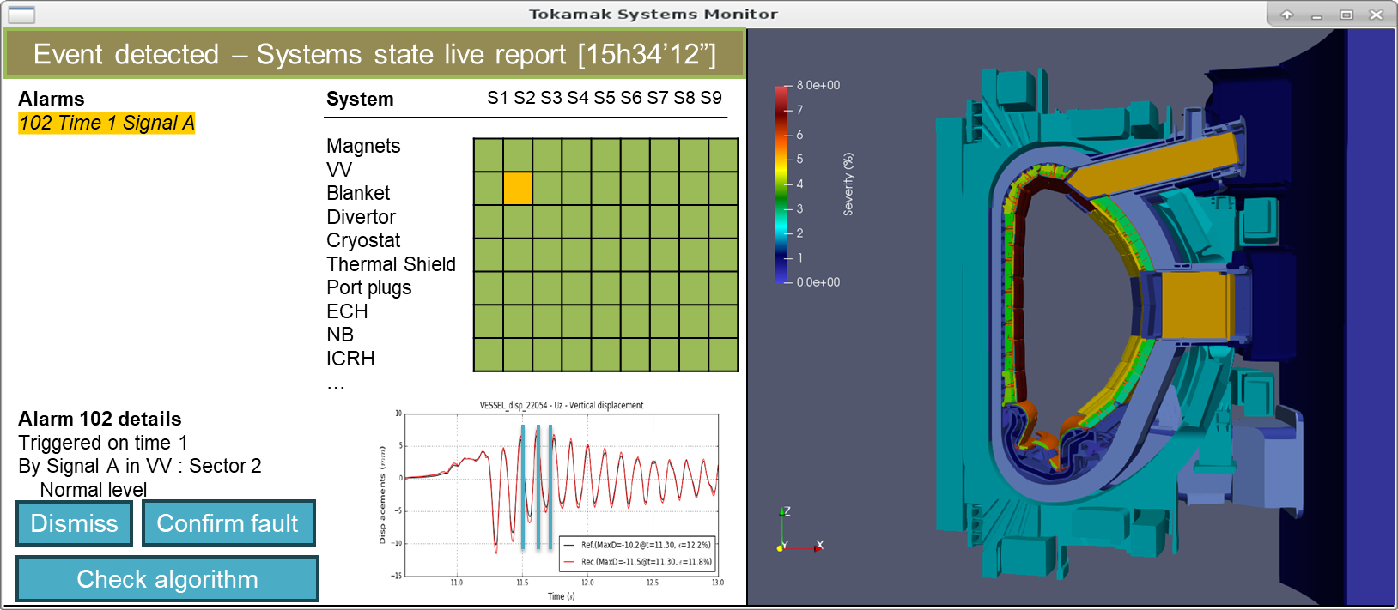
Next developments (3/3)
Tokamak Systems Monitor
Diagnostic tool for evaluating anomalies, loading effects, faults and lifetime of the tokamak structures
Currently uses Qt for windows and widgets, and VTK for system representation. Plan to use iplotlib for the signals plotting
Considering using the Thermavip framework, which would need extension to handle structural and thermal monitoring functions

Slide 21
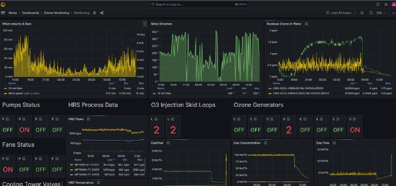
Web technologies
ITER dashboard which allows to monitor continuous data and retrieve data from archive.
Use of node.js and
React to build the GUI (very reactive)
CODAC UDA and Live stream plugin to Grafana
Very powerful user interface, allow to mix various data sources

Slide 22
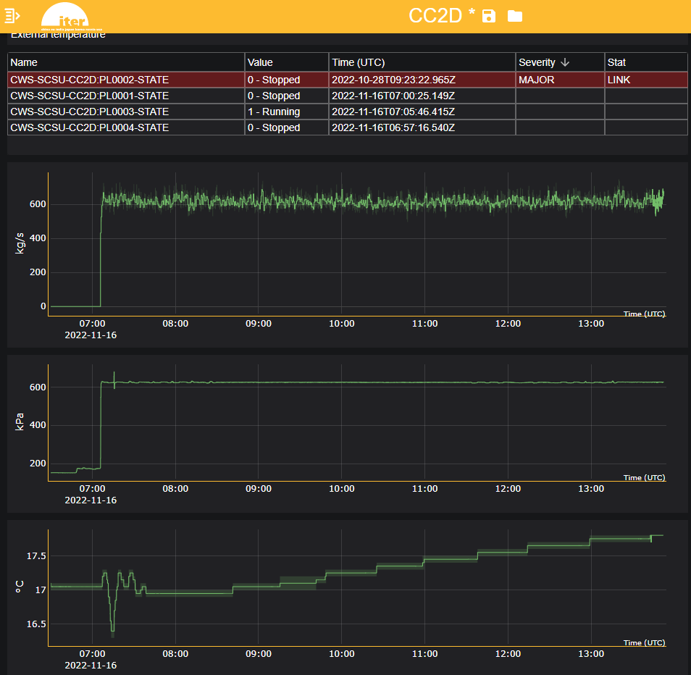
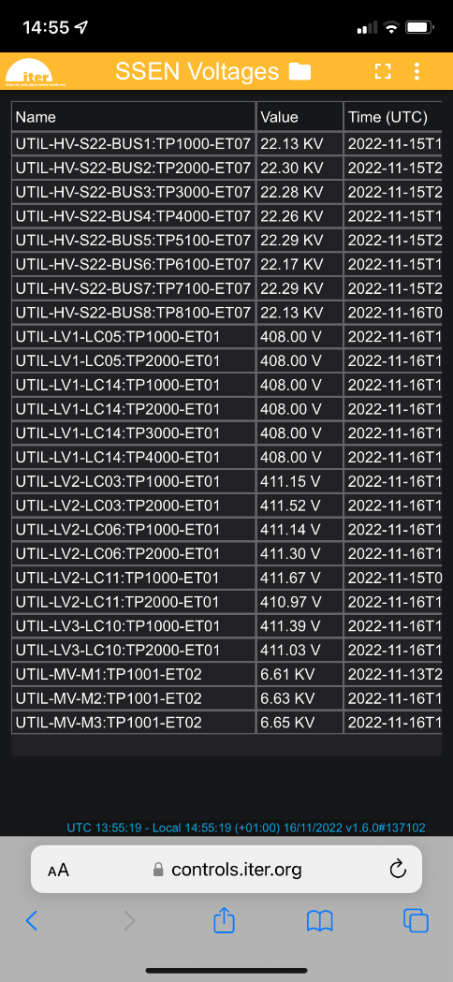
Works well on tablet and mobile phone

Slide 23
Conclusions
Good progress on the data visualization tool mainly one trend (the most urgent one)
Implement the remaining features
Next one will be the image viewer and analyzer
Then flux surfaces viewer
Also work with Science to make sure that the plotting interface matches their expectation
Design and implementation managed according to priorities and users’ need
Improve the performance and scalability of the ecosystem to give the best experience to the users
Always making sure that the UI is user-friendly
Offering user training and support
Details on the training and support provided to users for effectively utilizing the data visualization tools. User training programs and ongoing support mechanisms are crucial for maximizing the tools' utility and ensuring user satisfaction.
Support users to build their own expert tool based on iplotlib
Plan with Science to make it open source like for IMAS
Facilitate collaboration and Knowledge Sharing: workspace sharing is the first step
Information on how the visualization tools facilitate collaboration among different teams and enable knowledge sharing within the ITER community. Collaboration features and knowledge management capabilities can enhance teamwork and innovation.

