Slide 1
From Simulation to Reality: Real-Time Control of CAFe II
Using Reinforcement Learning
Authors: Xiaolong Chen, Chunguang Su, Zhijun Wang, Yuan He
Speaker: Xiaolong Chen

Slide 2
Outline
Motivation and Background
Real Time Control of CAFe II Using Reinforcement learning
Preliminary Exploration: Application in MEBT Section
Further Application: Application in Superconducting Section
Summary
1

Slide 3
Outline
Motivation and Background
Real Time Control of CAFe II Using Reinforcement learning
Preliminary Exploration: Application in MEBT Section
Further Application: Application in Superconducting Section
Summary
2

Slide 4
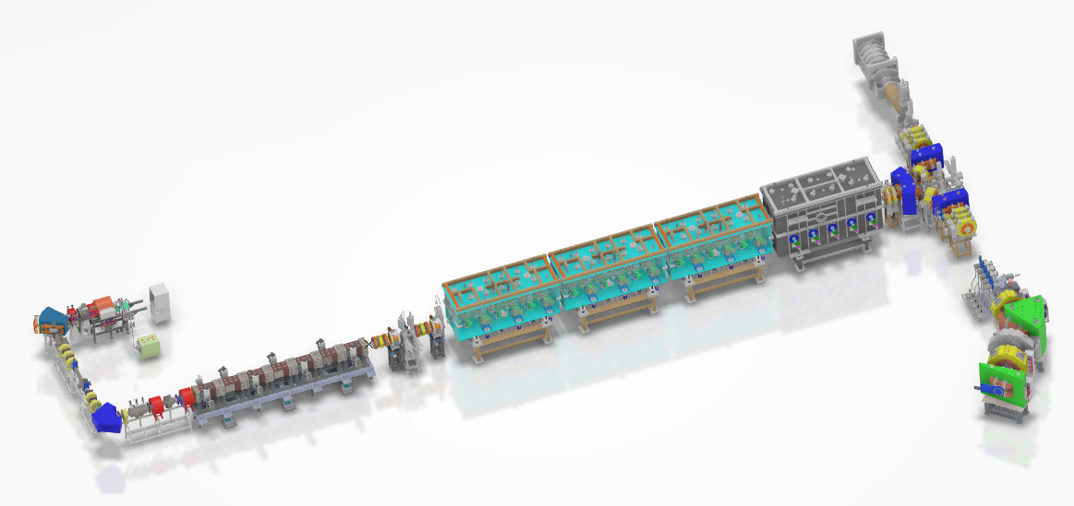
Motivation
CAFe II —— An ion particle accelerator
China Accelerator Facility for superheavy Elements
Features：
Highly non-linear beam dynamics
Hard to tuning and time consuming
Complex beam requirements
CAFe II : significant potential to compress accelerator beam commissioning time.
Goal: Design a automatic and robustness controller for beam tuning to save precious beam time for other fundamental physic experiments.
3

Slide 5
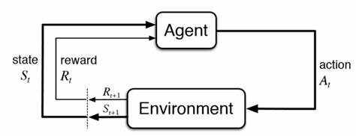
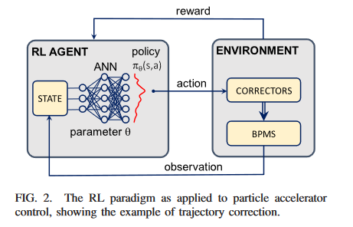
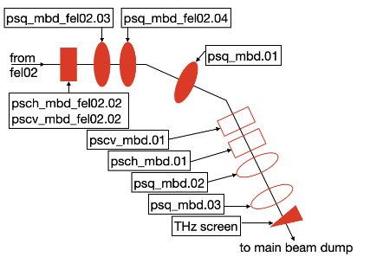
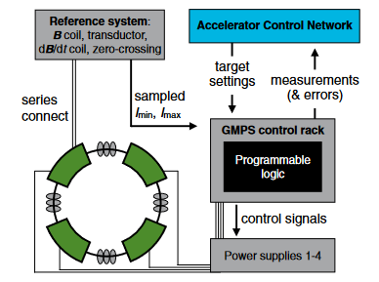
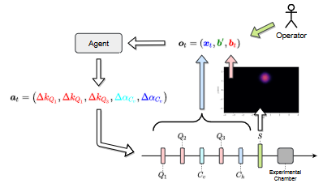
RL for accelerator beam commissioning
Reinforcement Learning (RL): A powerful tool for realizing an effective controller.
Goal of RL: Maximize the expected reward after an episode.
Urgent Issues Needing Resolution:
Challenges persist in overcoming online training limitations: Precious beam time
Accelerator system beam information incompleteness hinders the training efficiency of the agent.
The well trained agents struggle in generalization performance with changes in accelerator or beam state.
CERN:Orbit Correction/PRAB 2020
Fermi :Optimization of FEL/PRAB 2020
DESY：optimization of FEL/ICML 2022
Fermi: Magnet control, PRAB 2021
RL: a promising method for beam tuning
4

Slide 6
Outline
Motivation and Background
Real Time Control of CAFe II Using Reinforcement learning
Preliminary Exploration: Application in MEBT Section
Further Application : Application in Superconducting Section
Summary
5

Slide 7
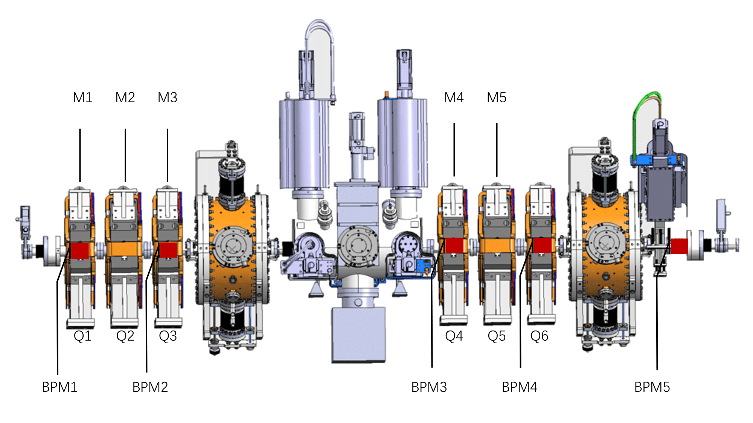
Preliminary Exploration: Application in MEBT Section
Beam Tuning Task: Correct the orbit to the center of the accelerator (make the BPM readings as close to 0 as possible).
Goal: Verify the feasibility of our transfer scheme.
Characteristics: Simple linear optimization problem.
Control Parameters: 5 groups of steers (total of 10 dimensions).
Observations: 4 groups of BPMs (total of 8 dimensions).
Challenge: Overcoming the differences between the simulation and the real accelerator.
The structure of MEBT within CAFe II
6

Slide 8
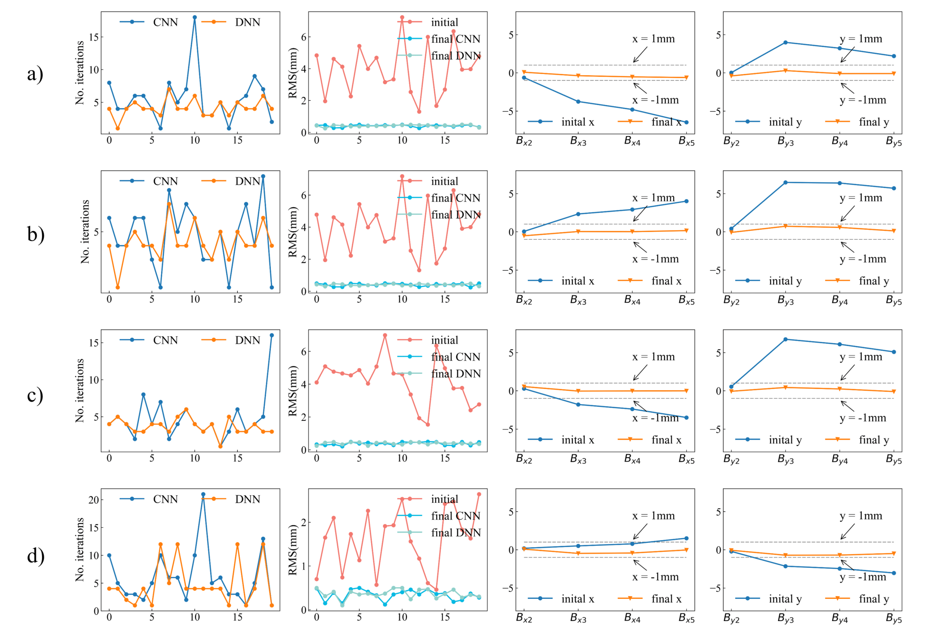
Preliminary Exploration: Application in MEBT Section
Trend incorporation: Time sequence data.
Domain randomization: installation errors to the quadrupoles in both horizontal and vertical directions.
Algorithm: TD3 (Twin Delayed Deep Deterministic Policy Gradients)
Main Reward: - rms(BPMs) + trend reward
Simulation results of different error setup
Ca - Ca
Ca – Ca
$±30\%$ error for quadrupoles
Ca - Mn
Ca - H+
7

Slide 9
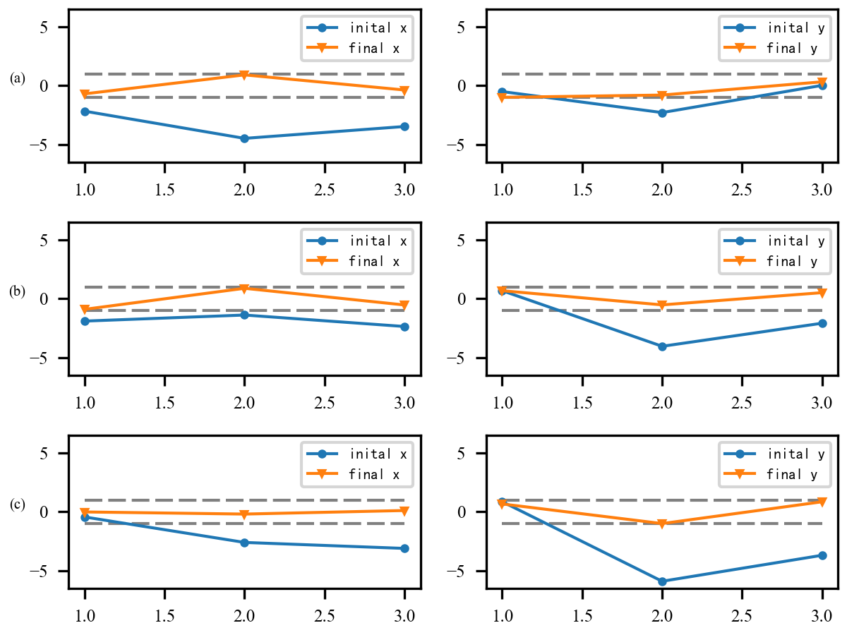
Preliminary Exploration: Application in MEBT Section
Online experiments result of CAFe II
Results：
Seamless transfer from simulation to reality
Completed within 30 seconds and the rms of BPM readings less than 1mm
Not sensitive with the different lattice of the accelerator.
Effective for different particle beams.
Disadvantages：TD3 is sensitive to the hyper-parameters and the noise from accelerator control system.
Ca - Ca
Mn - Ca
Mn - H+
Chen, X., Jia, Y., Qi, X., Wang, Z., & He, Y. (2023). Orbit correction based on improved reinforcement learning algorithm. Physical Review Accelerators and Beams, 26(4), 044601. doi: 10.1103/PhysRevAccelBeams.26.044601.
8

Slide 10
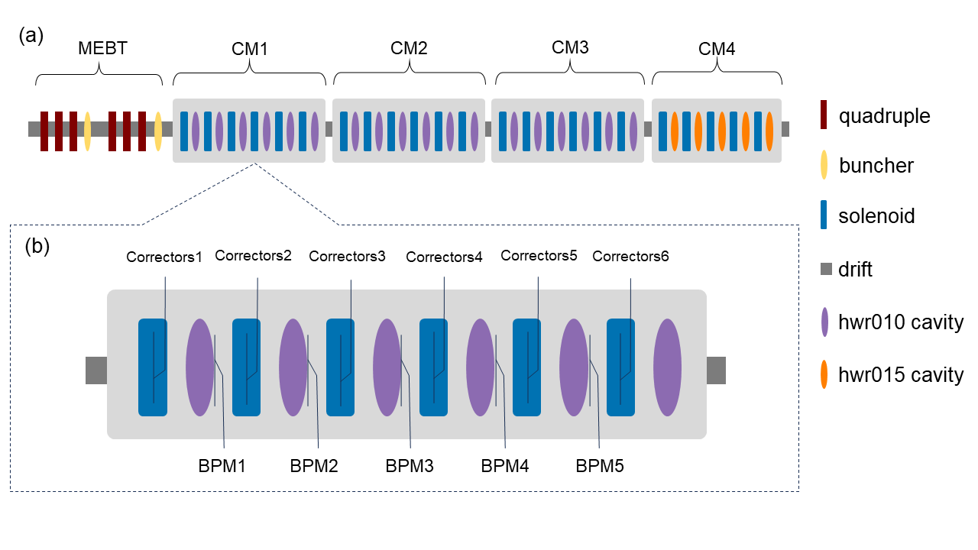
Further Application : Application in Superconducting Section
CAFe II Control System: Matching complex beam requirements, configuration readjustments at least once a week.
Orbit correction task of SC
Human tuning:
Typically 30 mins-180mins.
Reason: Non-linear effects from solenoids.
Example: Horizontal corrections affect both horizontal and vertical BPM readings.
Observations:
5 groups of BPMs (10 dimensions)
Control Variables:
First 5 groups of correctors (10 dimensions)
Goal: Achieve BPM readings as close to 0 as possible.
Structure of the superconducting section in CAFe II
9

Slide 11
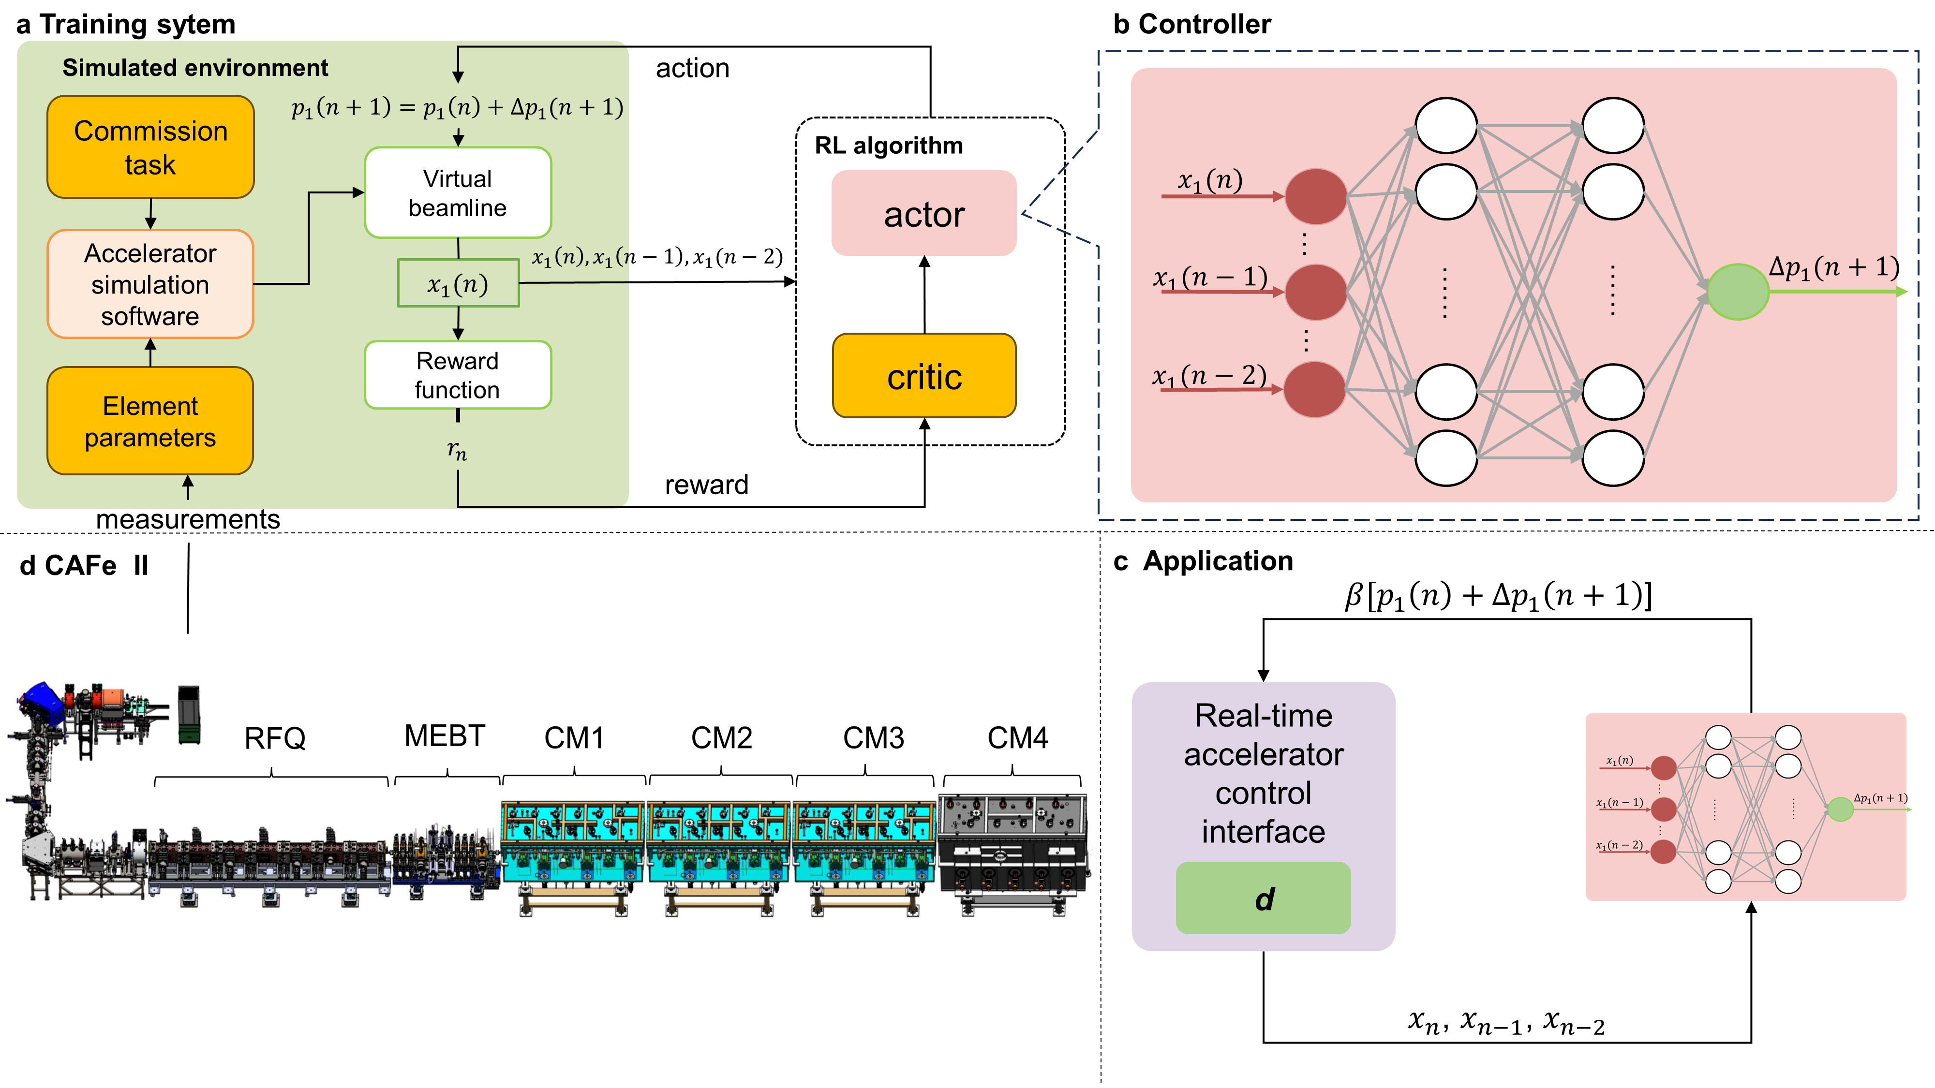
Our scheme
The scheme of our RL-based controller
Four key points to implement an RL-based beam controller:
Parameters alignment.
Domain randomization.
Trend incorporation.
Magnetic field-current alignment ($β$).
Advantage of the scheme:
Seamless sim2real transfer
Suitable for particles with different mass-to-charge ratio
10
5

Slide 12
Further Application: Application in Superconducting Section
Feature of the accelerator during beam commissioning:
Noise in data collected from the beam diagnostic device.
Accelerator system：Partial observable system .
Traditional RL: Maximize the expected cumulative rewards.
SAC: A reinforcement learning algorithm with max entropy.
Entropy boost improves agent's exploration in complex environments.
Better cope with the uncertainties present in the accelerators with significant noise data.
What’s trend?
The time sequence data of the beam diagnostic device.
In RL training process:
Time sequence data instead of the current accessed data
Advantages:
Enhanced information completeness.
Well-suited for accelerator dynamic systems.
Improved generalization ability
Verification: Typical control task-orbit correction
11

Slide 13
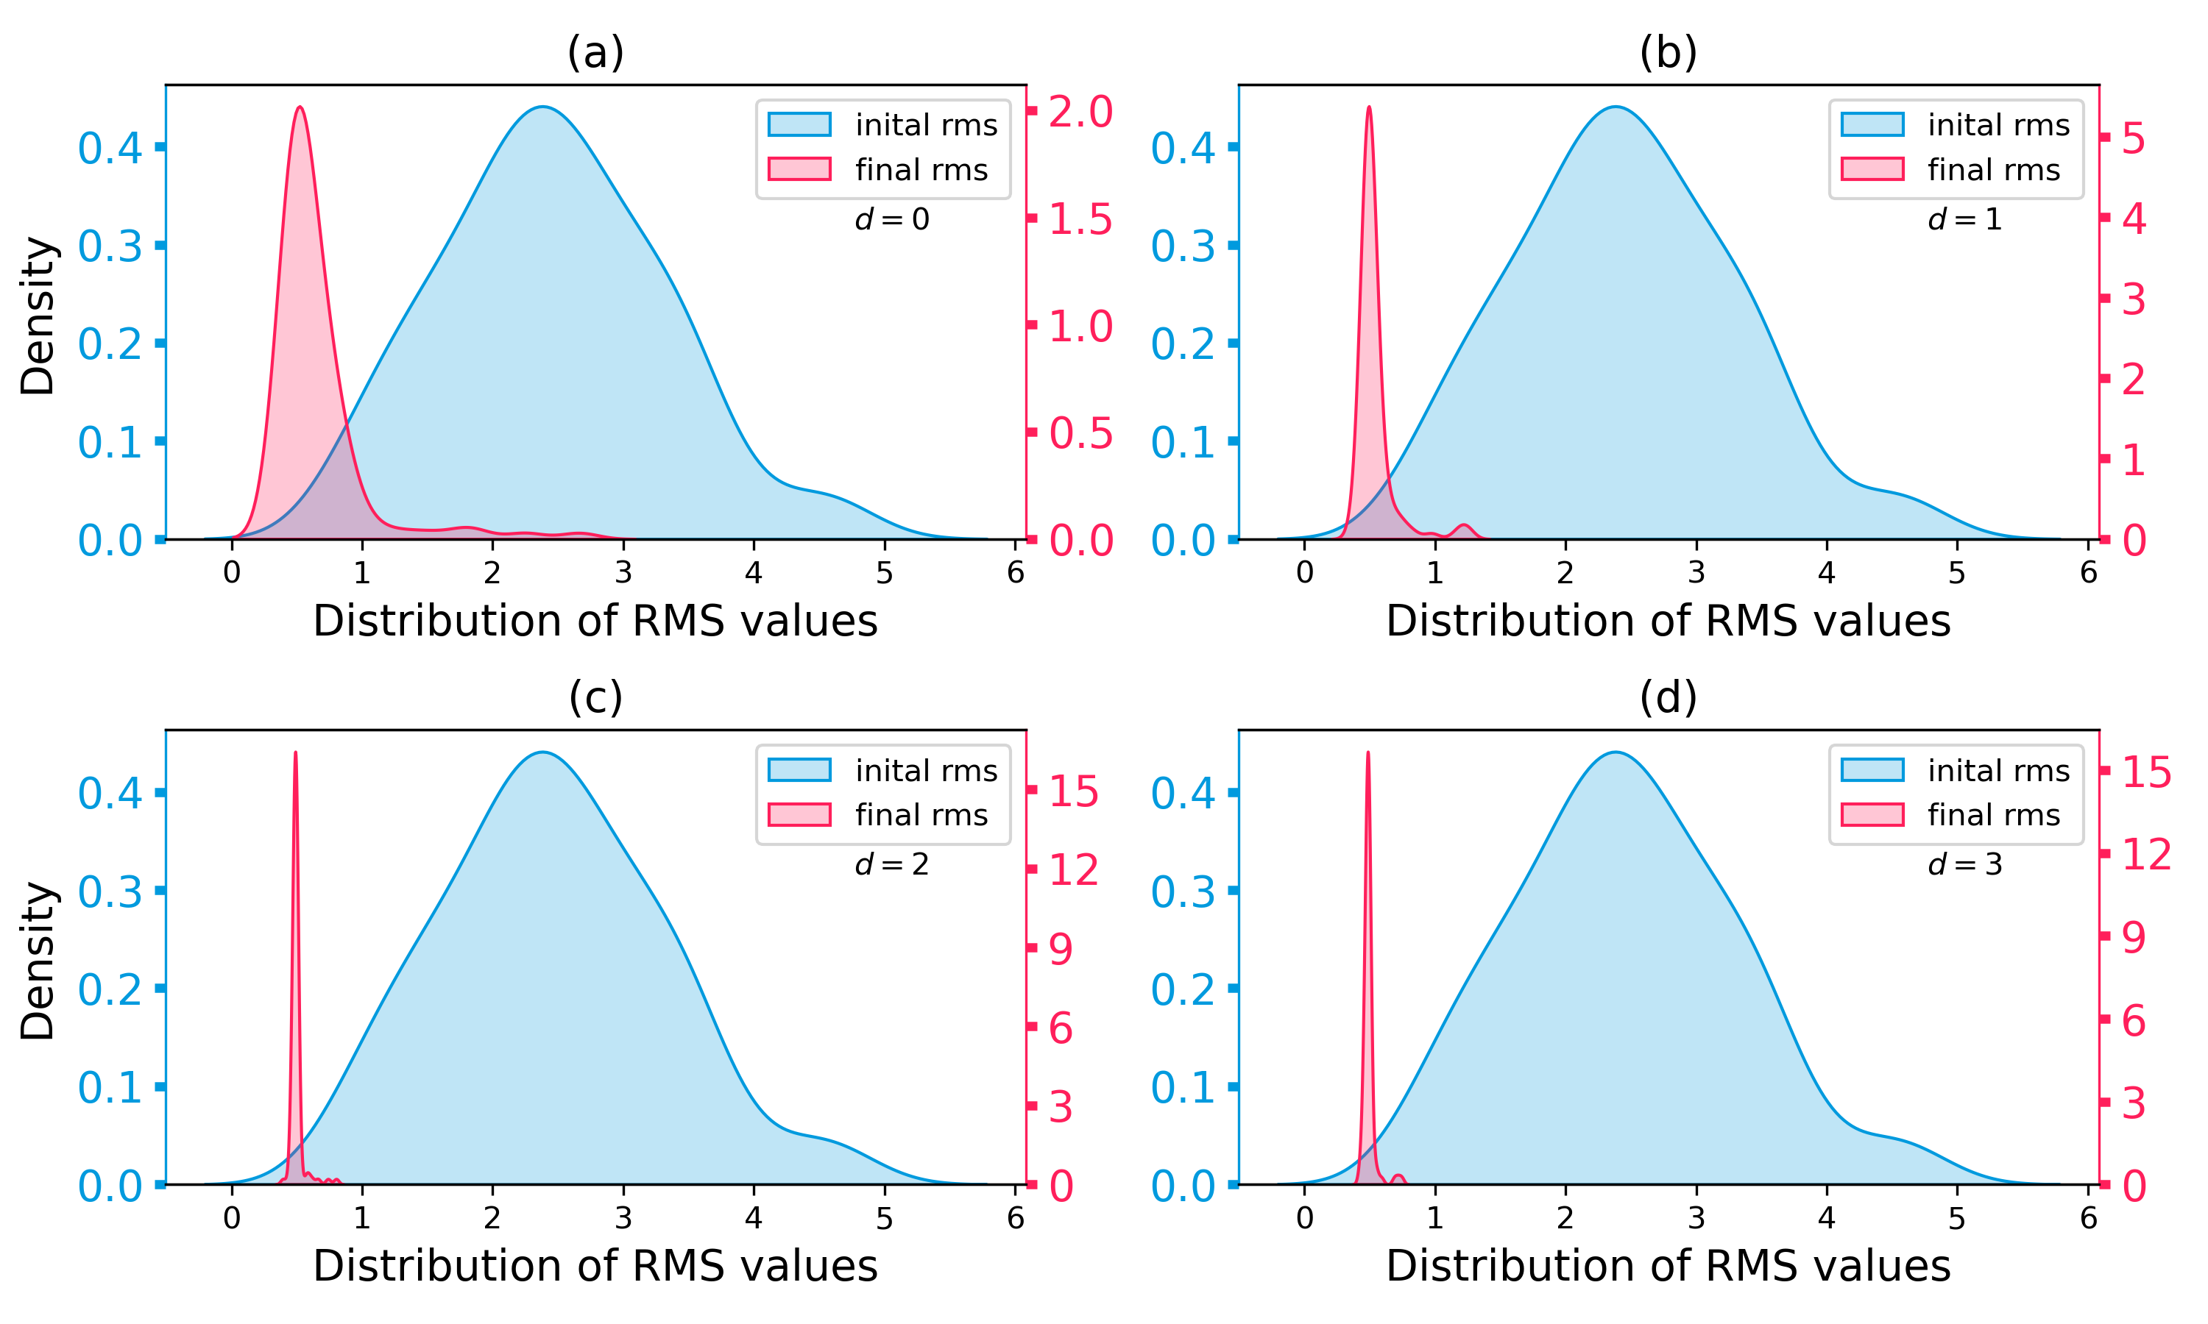
Further Application: Application in Superconducting Section
Simulation Results of 100 comparative experiments：The agent is trained based on the Tracewin-based environment with the particle $40{Ar}^{12+}，$in CM1.
Time sequence length $d=0$
Time sequence length d = 1
Training process:
Total training steps: 20,000
Time spends： 5 hours on a single RTX 3090
Blue indicate the initial RMS distribution of the 100 experiments.
Red indicate the corrected RMS distribution of the 100 experiments.
The performance of the agent increased significantly with the increase of the time sequence length.
Next Sim2Real experiments:
Time series length of $d=2$.
Time sequence length d = 2
Time sequence length d = 3
12

Slide 14
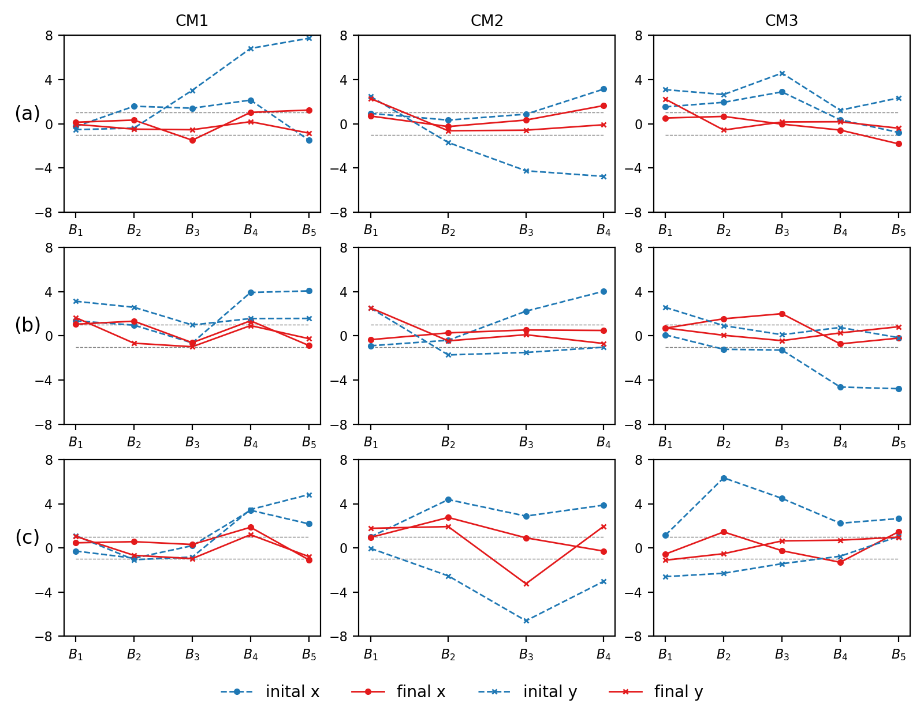
Further Application: Application in Superconducting Section
Sim to Real experiments: Under ${40Ar}^{12+}$, $H^{+}$, and ${48Ca}^{14+}$ on CM1, CM2, CM3.
Agent Features:
Achieves an RMS of the corrected orbit below 1mm (Comparable to or surpassing human tuning).
Rapid correction within 1 minute per module (At least tenfold faster than human).
Enable seamless sim-to-real transfer.
By adjusting parameter 𝛽 ，method suitable to tune multiple types of particle beams.
${40Ar}^{12+}$- ${40Ar}^{12+}$
${40Ar}^{12+}$- $H^{+}$
Worth to mention：
Effectively operates even with some malfunctioning BPMs, reducing RMS from 3.2mm to 1.74mm.
Even better results：
By masking the readings to a fixed value.
e.g., 1mm, the RMS can be further reduced to 1mm.
${40Ar}^{12+}$- ${48Ca}^{14+}$
13

Slide 15
Outline
Motivation and Background
Real Time Control of CAFe II Using Reinforcement learning
Preliminary Exploration: Application in MEBT Section
Further Application: Application in Superconducting Section
Summary
14

Slide 16
Summary
RL-based controller are now used regularly in CAFe II, significantly saving time.
Incorporating time sequence data enhances the algorithm's robustness.
Parameters alignment and domain randomization facilitate sim2real transfer.
A conversion coefficient between magnetic field and current is beneficial for diverse beams and lattices.
Sim2real is advantageous!
Future:
Try higher dimensional tasks.
More complex optimization problems.
15

Slide 17
Thank you
Email: chenxiaolong@impcas.ac.cn
10

