Slide 1
Digital twins for science

Slide 2
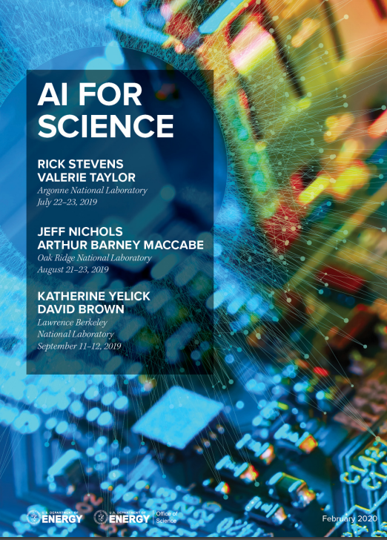
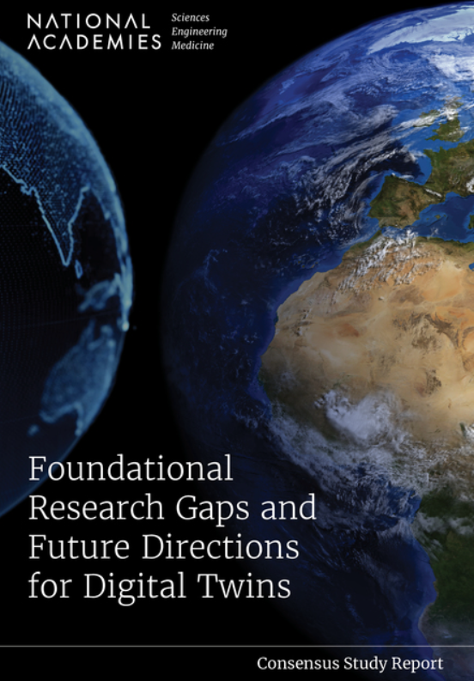
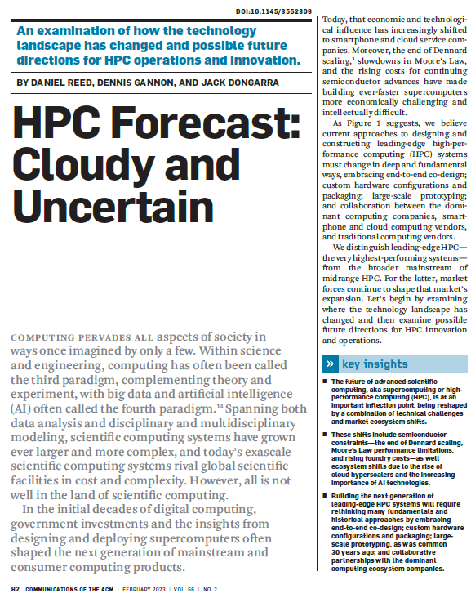
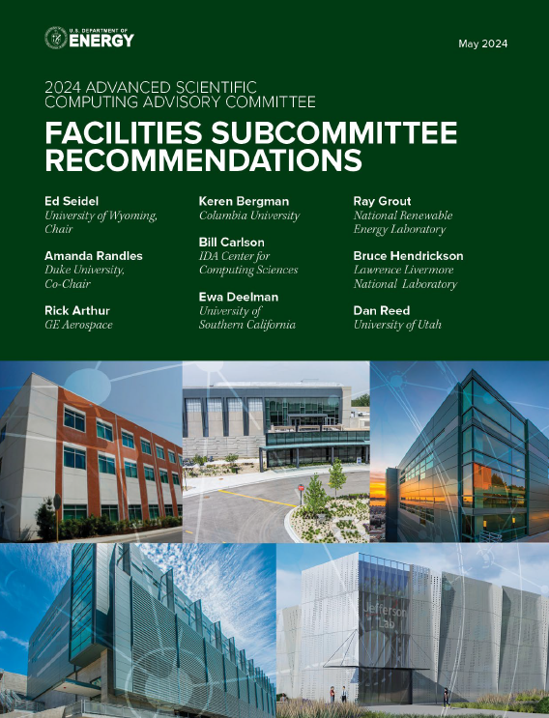
Scientific Computing is evolving
Thought Leaders Map Out the Opportunity and Constraints Given Current Technology and Market Reality
Business-as-usual will not be adequate
Notes:
Reed and Dongarra
Semiconductor Constraints limit the potential increase in scale for legacy algorithms
New Algorithms offer potential for dramatic increase in model scale and reduction in latency that is possible within the constraints
Cloud Economics have changed the supply chain ecosystem
Charting a New Path
OVERARCHING FINDING: The combination of increasing demands for computing with the technology and market challenges in HPC requires an intentional and thorough reevaluation of …. algorithms, software development, system design, computing platform acquisition, and workforce development.
Business-as-usual will not be adequate
AI for Science
The community’s experience with machine learning (ML), HPC simulation, data analysis methods,
and the consideration of long-term science objectives revealed a growing collection of unique and
novel opportunities for breakthrough science, unforeseeable discoveries, and more powerful
methods that will accelerate science and its application to benefit the nation and, ultimately,
the world.
New AI techniques will be indispensable to supporting the continued growth and expansion of
DOE science infrastructure from ESnet to new light sources to exascale systems, where system
scale and complexity demand AI-assisted design, operation, and optimization. Toward this end,
novel AI approaches to experiment design, in-situ analysis of intermediate results, experiment
steering, and instrument control systems will be required

Slide 3
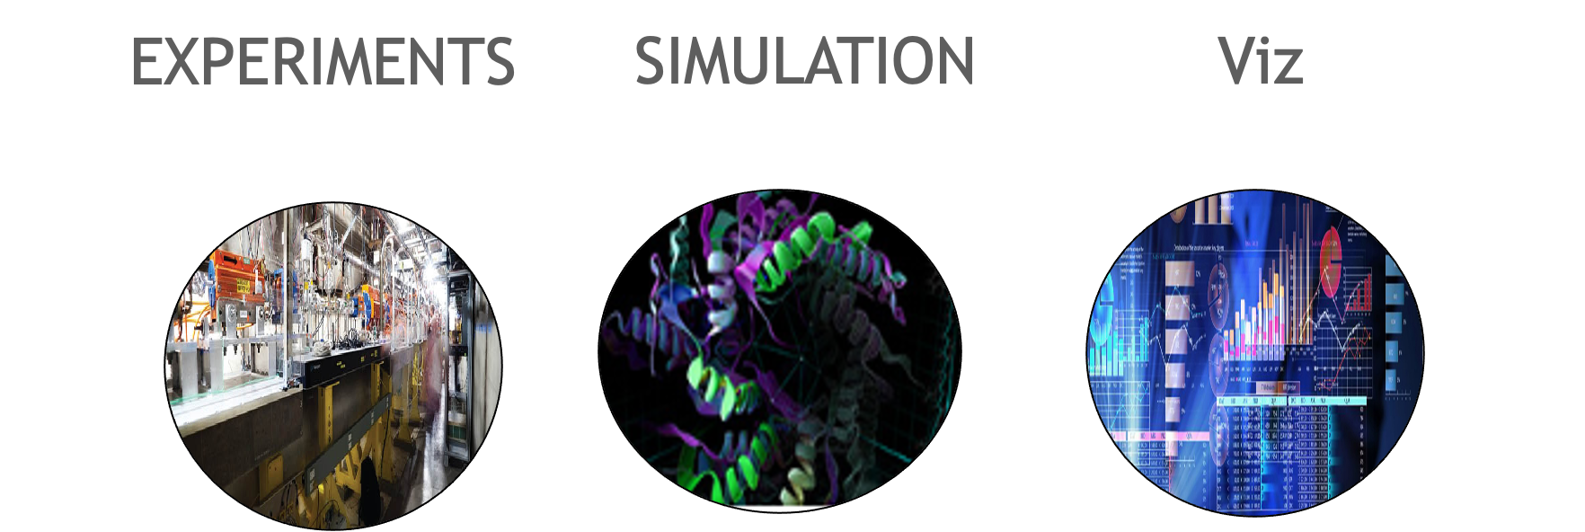
TRANSITION TO POST EXASCALE ERA
FEATURE | TERA THROUGH EXASCALE | POST EXASCALE
USAGE | BATCH & MOSTLY LOCAL TO A SITE | INTERACTIVE & DISTRIBUTED WITH MULTIPLE SITES
WORKLOAD | SINGLE SIMULATION/ENSEMBLE | WORKFLOW COMPRISED OF SIMULATION ENSEMBLES, AI TRAINING AND INFERENCE, LIVE DATA ANALYTICS
EXPERIMENTS | OFFLINE DATA ANALYSIS FOR EXPERIMENTS | MIX OF REAL-TIME ANALYSIS TIGHTLY COUPLED WITH OFFLINE
DIGITAL TWINS | IN-SITU VISUALIZATION OFFLNE | INTERACTIVE VISUAL MODEL COUPLED WITH PHYSICAL ASSET
QUANTUM COMPUTING | SIMULATION | SIMULATION PREPARING FOR A HYBRID MODEL
PROGRAMMING MODELS | FORTRAN, C++, MPI, OPENMP | STANDARD PARALLELISM SUPPORT IN FORTRAN, C++, MPI, OPENMP, OPENACC, PYTHON, JULIA, PYTORCH, TENSORFLOW
SYSTEM CONFIGURATION | MONOLITHIC | MODULAR
CLOUD | GRID | BURST CAPABILITIES, FASTER REFRESH CYCLE, ACCESS TO LATEST TECHNOLOGY AT SCALE

Slide 4
Digital twin for science
A Relatively New Modeling Concept That is Being Adopted by the HPC Community in the Post Moore Era
The concept was first publicly introduced in 2002 by Michael Grieves, at a Society of Manufacturing Engineers conference as the conceptual model underlying Product Life Cycle Management
A digital twin is a set of virtual information constructs that mimics the structure, context, and behavior of a natural, engineered, or social system (or system-of-systems), is dynamically updated with data from its physical twin, has a predictive capability, and informs decisions that realize value.
The bidirectional interaction between the virtual and the physical is central to the digital twin.

Slide 5
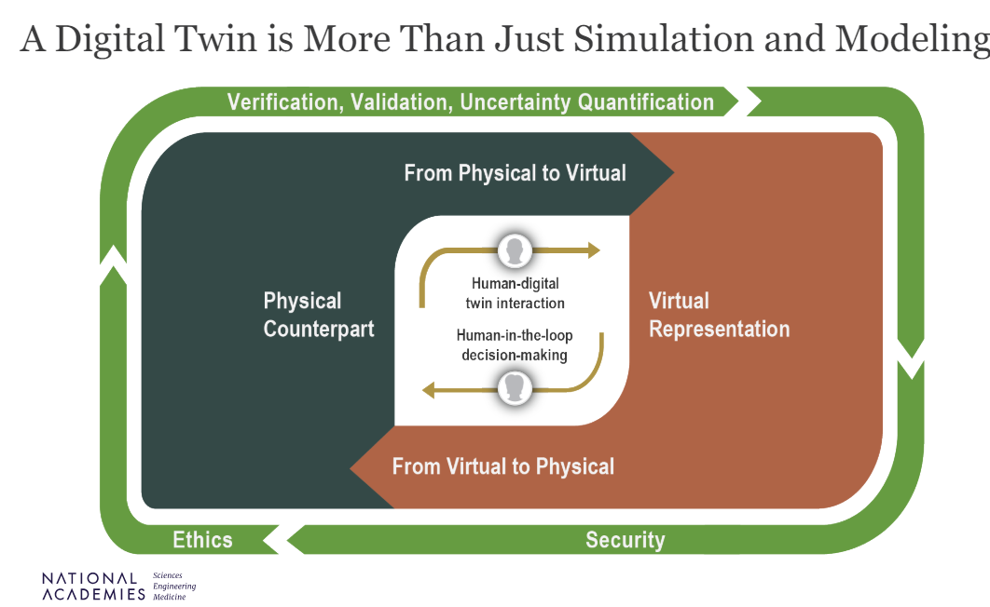

Slide 6
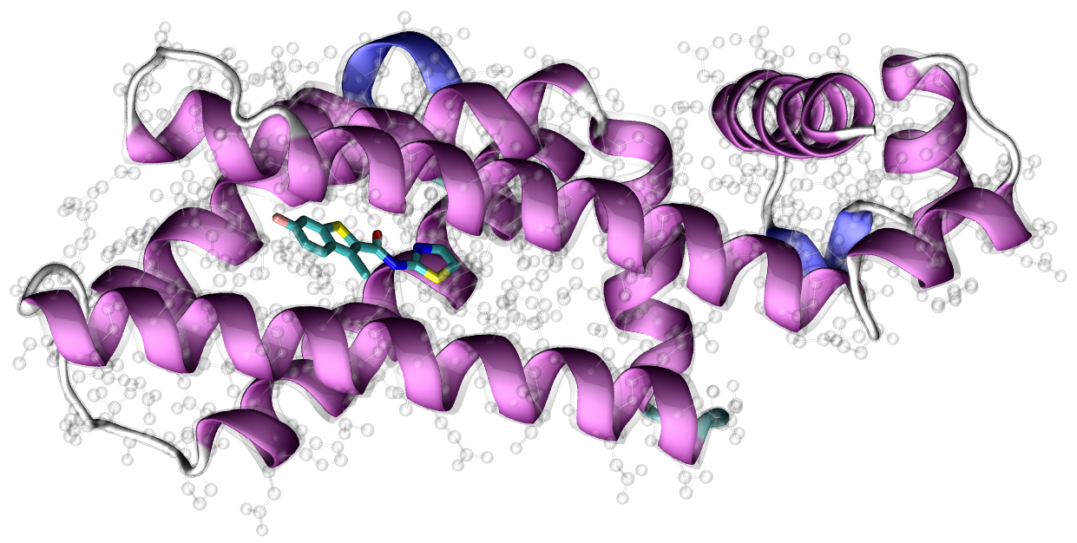
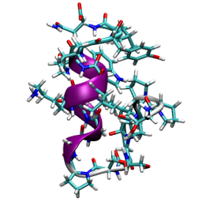
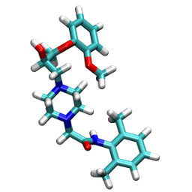
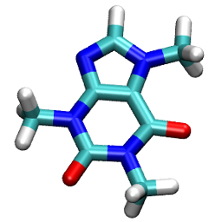
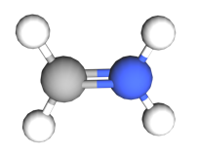
machine learning enables Digital Twins for Science
Quantum Accuracy at Cost for Physical Scale Models
Classical
$$𝒪(n)$$
Error
Tight-binding
$$𝒪(n^{2})$$
DFT
Machine learning!
$$𝒪(n)−𝒪(n^{3})$$
CCSD(T)
Exact solution
$$𝒪(n^{7})$$
$$∼exp(n)$$
…
Log computational cost
Notes:
ML Introduce new capabilities and new use cases with new workflows. Some new workflows have latency requirements that go well beyond traditional batch processing that may include real time response
Accessible system size increase leads to low accuracy and generality

Slide 7
AI introduces new use cases for science and engineering
Accuracy with Unprecedented Scale AND Bridge the Gap Between Simulation and Real-Time
Instrument
Classical
$$𝒪(n)$$
Error
Tight-binding
$$𝒪(n^{2})$$
Machine learning!
DFT
$$𝒪(n)−𝒪(n^{3})$$
CCSD(T)
Exact solution
$$𝒪(n^{7})$$
$$∼exp(n)$$
…
Log computational cost
Notes:
ML Introduce new capabilities and new use cases with new workflows. Some new workflows have latency requirements that go well beyond traditional batch processing that may include real time response
Accessible system size increase leads to low accuracy and generality

Slide 8
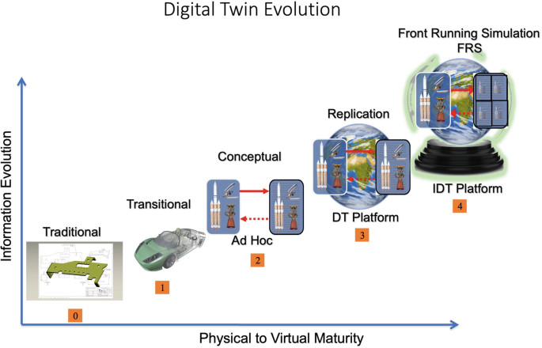
Digital Twin Past, present and future
Michael Grieves
Executive Director Chief Scientist Digital Twin Institute
https://www.brighttalk.com/webcast/18347/456987

Slide 9
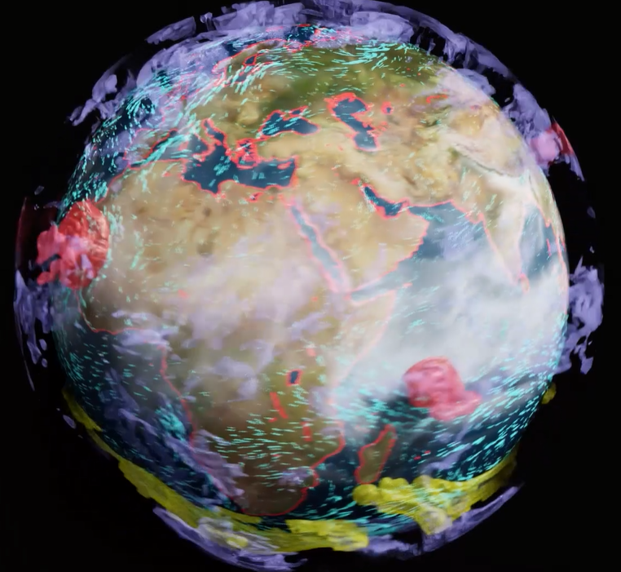
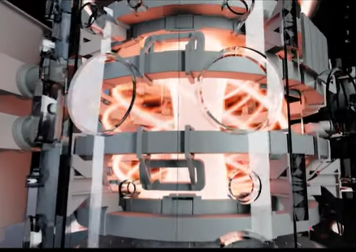
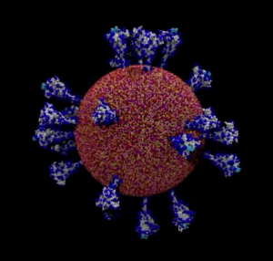
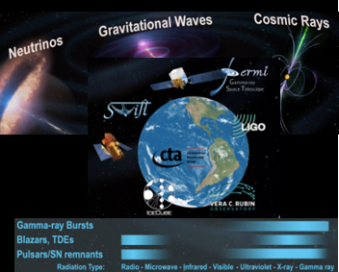
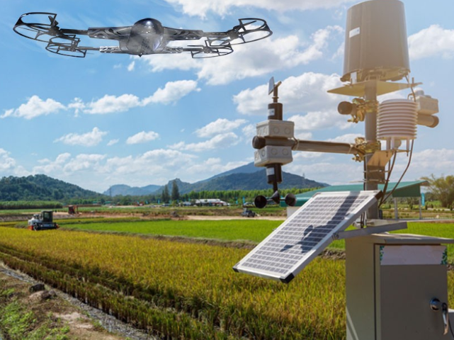
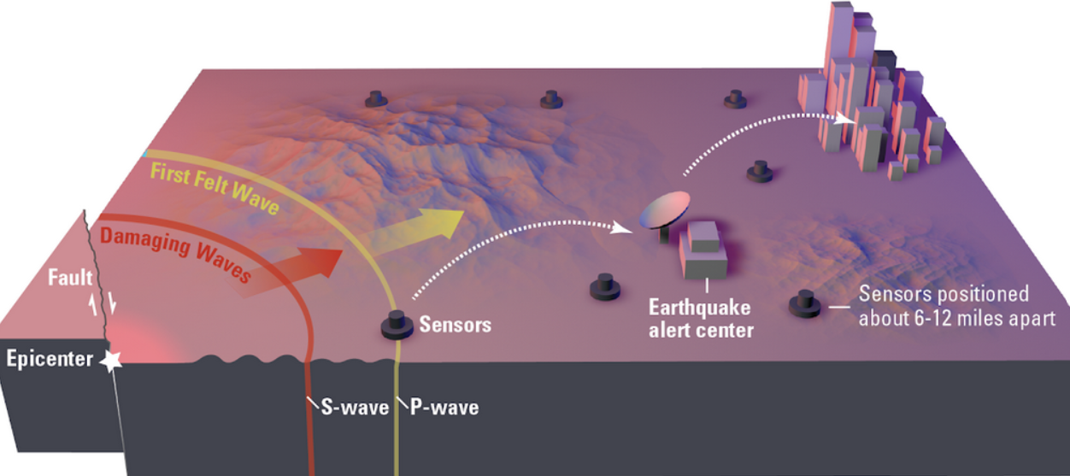
Examples of digital twins for science
Collaborate with the Global Research Community to Pursue Science Discovery that Benefits Mankind
Genome Scale LLMs for Covid
Covid is Airborne
Earth 2
Destination Earth
Towards Real time Fusion Reactor Design
Generative AI to Predict Disruption
Kubota For Earth For Life
Real Time Multi-Messenger Astrophysics
Earthquake Model with Machine Learning
Multi-Messenger Neutrino Detection
Earthquake Early Warning SCEC

Slide 10
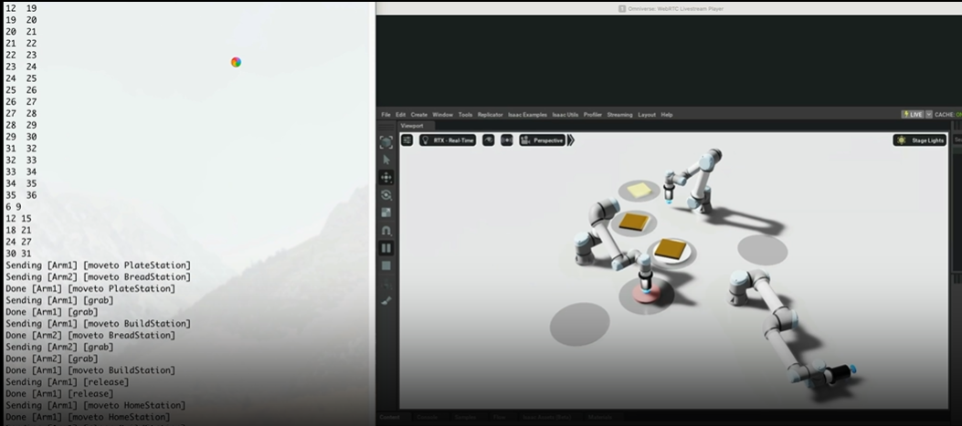
Use chatGPT and IssacSim with Omniverse to Program Robots in the Lab
https://people.cs.uchicago.edu/~rorymb/videos/sandwich3.mp4

Slide 11
NVIDIA Platform evolving to meet the challenge
SIMULATION
GEANT4
QCD
VASP
LAMMPS
MICROSCOPES
HPC SDK
JAX
HPC*AI
Megatron
PINN
LIGHT SOURCES
Rivermax
SuperPOD
Base Command
EXPERIMENTS/SENSORS
NeMo
Holoscan
HGX
GPU
CPU DPU
NVLINK
DGX
Modulus
BERT
TELESCOPES
OVX
EGX
RAPIDS
JETSON
AGX
PARTICLE
ACCELERATORS
GNN
Magnum I/O
QODA
LLM
Omniverse
CuQuantum
QUANTUM
SIMULATION
DIGITAL TWINS
QUANTUM COMPUTING
VIRTUAL DESIGN
AND CONTROL

Slide 12
backup

