Slide 1
Triple-Beampath-scenario for O2-heating at Wendelstein 7-X: experience of OP1.2 and final improvements for OP2
T. Stange, K.-J. Brunner, U. Höfel, H. P. Laqua, C. Lechte, S. Marsen, D. Moseev, B. Plaum, T. Bräuer, C. P. Dhard, M. Endler, E. Grigore, N. Marushchenko, D. Naujoks, Y. Turkin, F. Warner, R. Wolf and the W7-X team

Slide 2
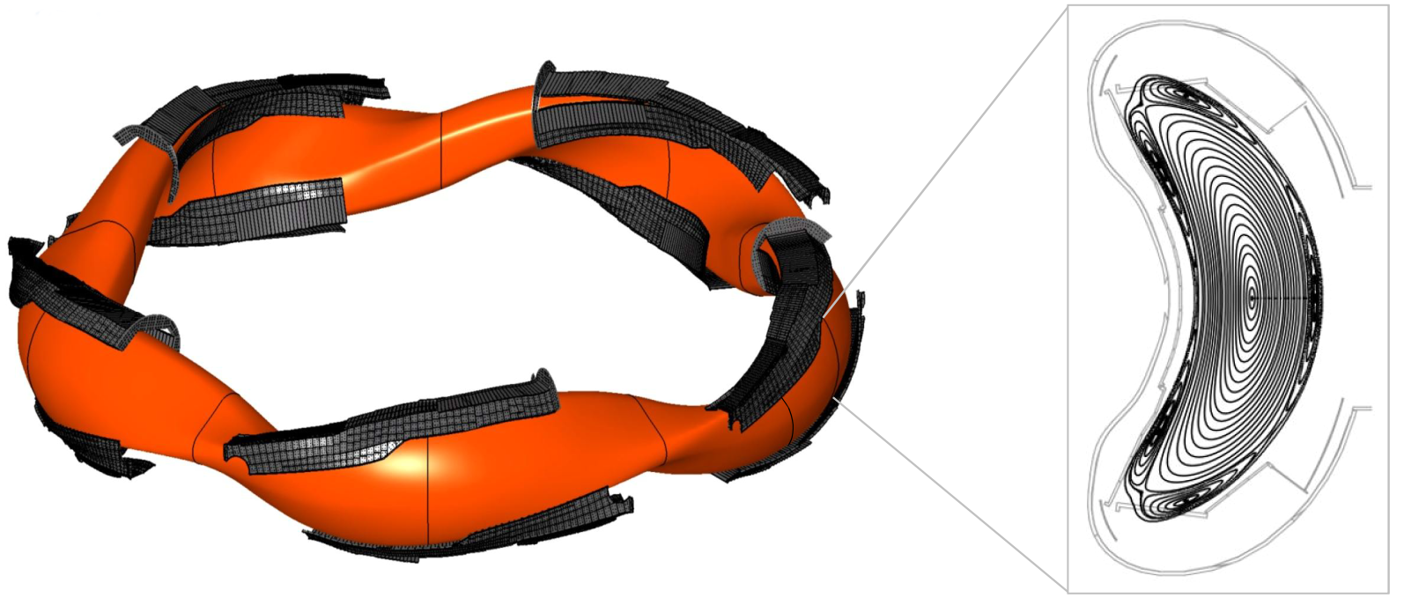
Motivation and Outline
Motivation
The stellarator Wendelstein 7-X (W7-X) operating @ 2.5 T has the final goal to demonstrate 30 min operation at reactor relevant parameters (T_{e,i} > 3 keV @ n_{e} > 10²⁰ m⁻³)
only ECRH steady state capable (2nd harmonic heating @ 140 GHz)
steady state O2-heating scenario necessary to allow n_{e} > n_{X2-cutoff} = 1.2 ∙ 10²⁰ m⁻³
Outline
Reminder: Setup of the ECRH system
Design of O2-scenario
Experimental results of OP1.2
Optimization of O2-scenario for OP2
Summary + Outlook
Island divertor

Slide 3
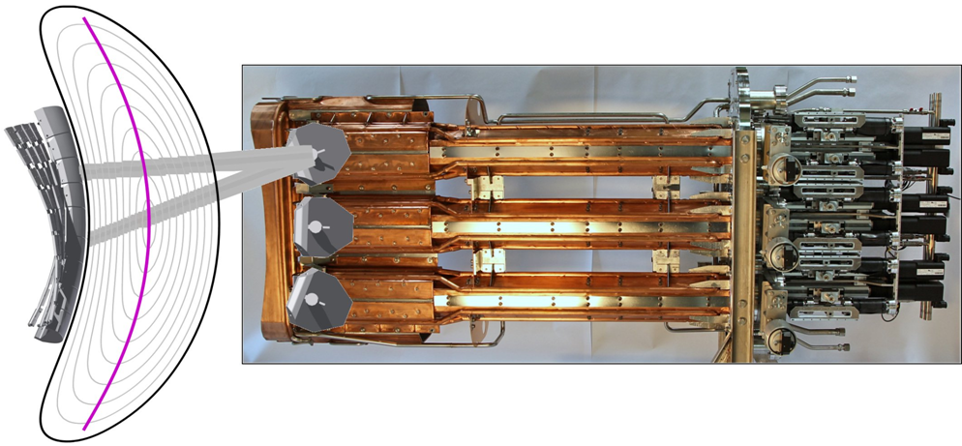
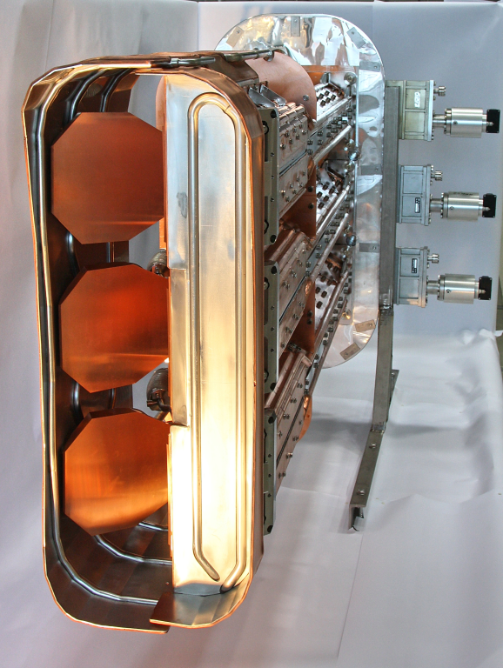
1. Reminder: Setup of the ECRH system – top view
Coupling to plasma by 4 equatorial front steering launchers
biggest ECRH facility in the world (10 MW-class gyrotrons @ 140GHz)
Injected power: 7.5 MW (up to now)
2D-front
steering mirrors
Vacuum valve with diamond window
with 3 Front steering mirrors each
Fully quasioptical transmission line in air (first of its kind!)
A1
B1
C1
D1
E1
2
1
3
5
4
Gyrotrons in two rows for module 1 and 5
A5
B5
C5
D5
E5
F5
=> See talk by H. P. Laqua: ECRH-Power Upgrade at W7-X (Tuesday 17:00)

Slide 4
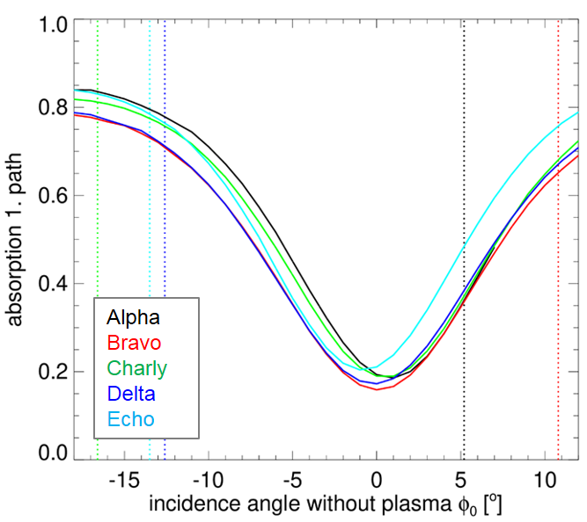
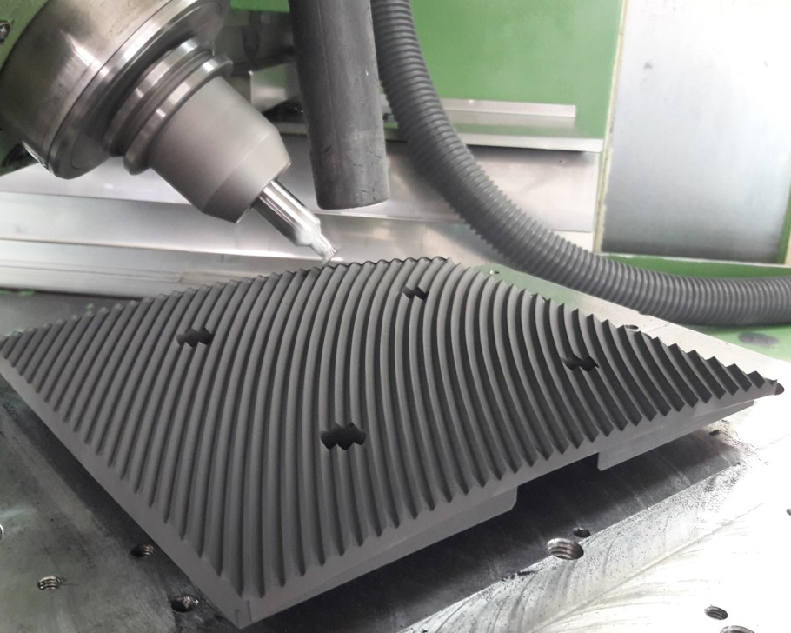
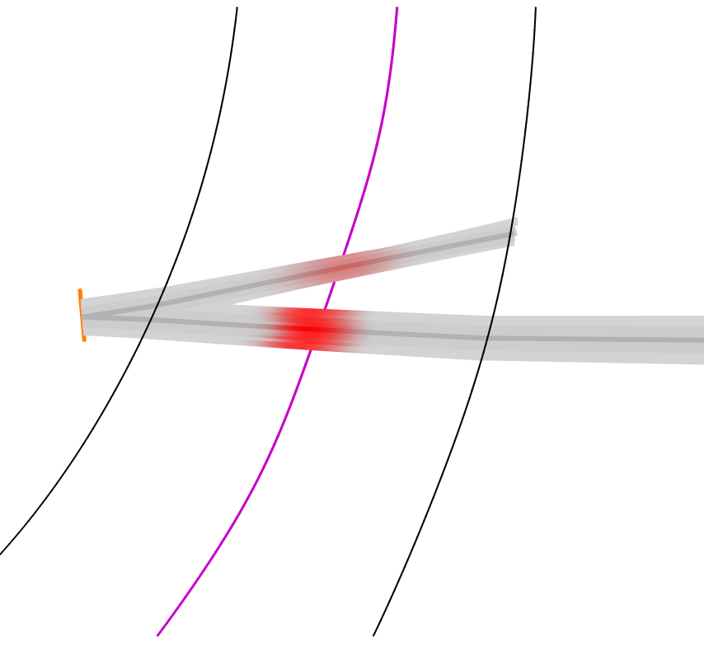
2. Design of O2-scenario: Holographic gratings @ ASDEX Upgrade
Example W7-X @ central values: T_{e}=3keV, n_{e}=10²⁰ m⁻³
single pass absorption < 80 % even with central T_{e} ≥ 3 keV
Incidence angle > 11°
Use of reflector tiles at high field side wall to allow directed 2nd pass
Development of holographic gratings for ASDEX upgrade by IGVP Stuttgart:
holographic grating to allow diﬀering angles of incidence and reflection (3D for refocusing)
Reflected beam close to incident beam
Optimization for no phase shift between TE and TM (reflector acts as plane reflector with regard to polarization)
double-path-absorption: up to 90 %
Optimized reflection
Natural reflection of first wall
Axis
B
Incident beam with incomplete absorption
Graphite tile for AUG produced @ IGVP workshop
[IGVP]
Top view

Slide 5
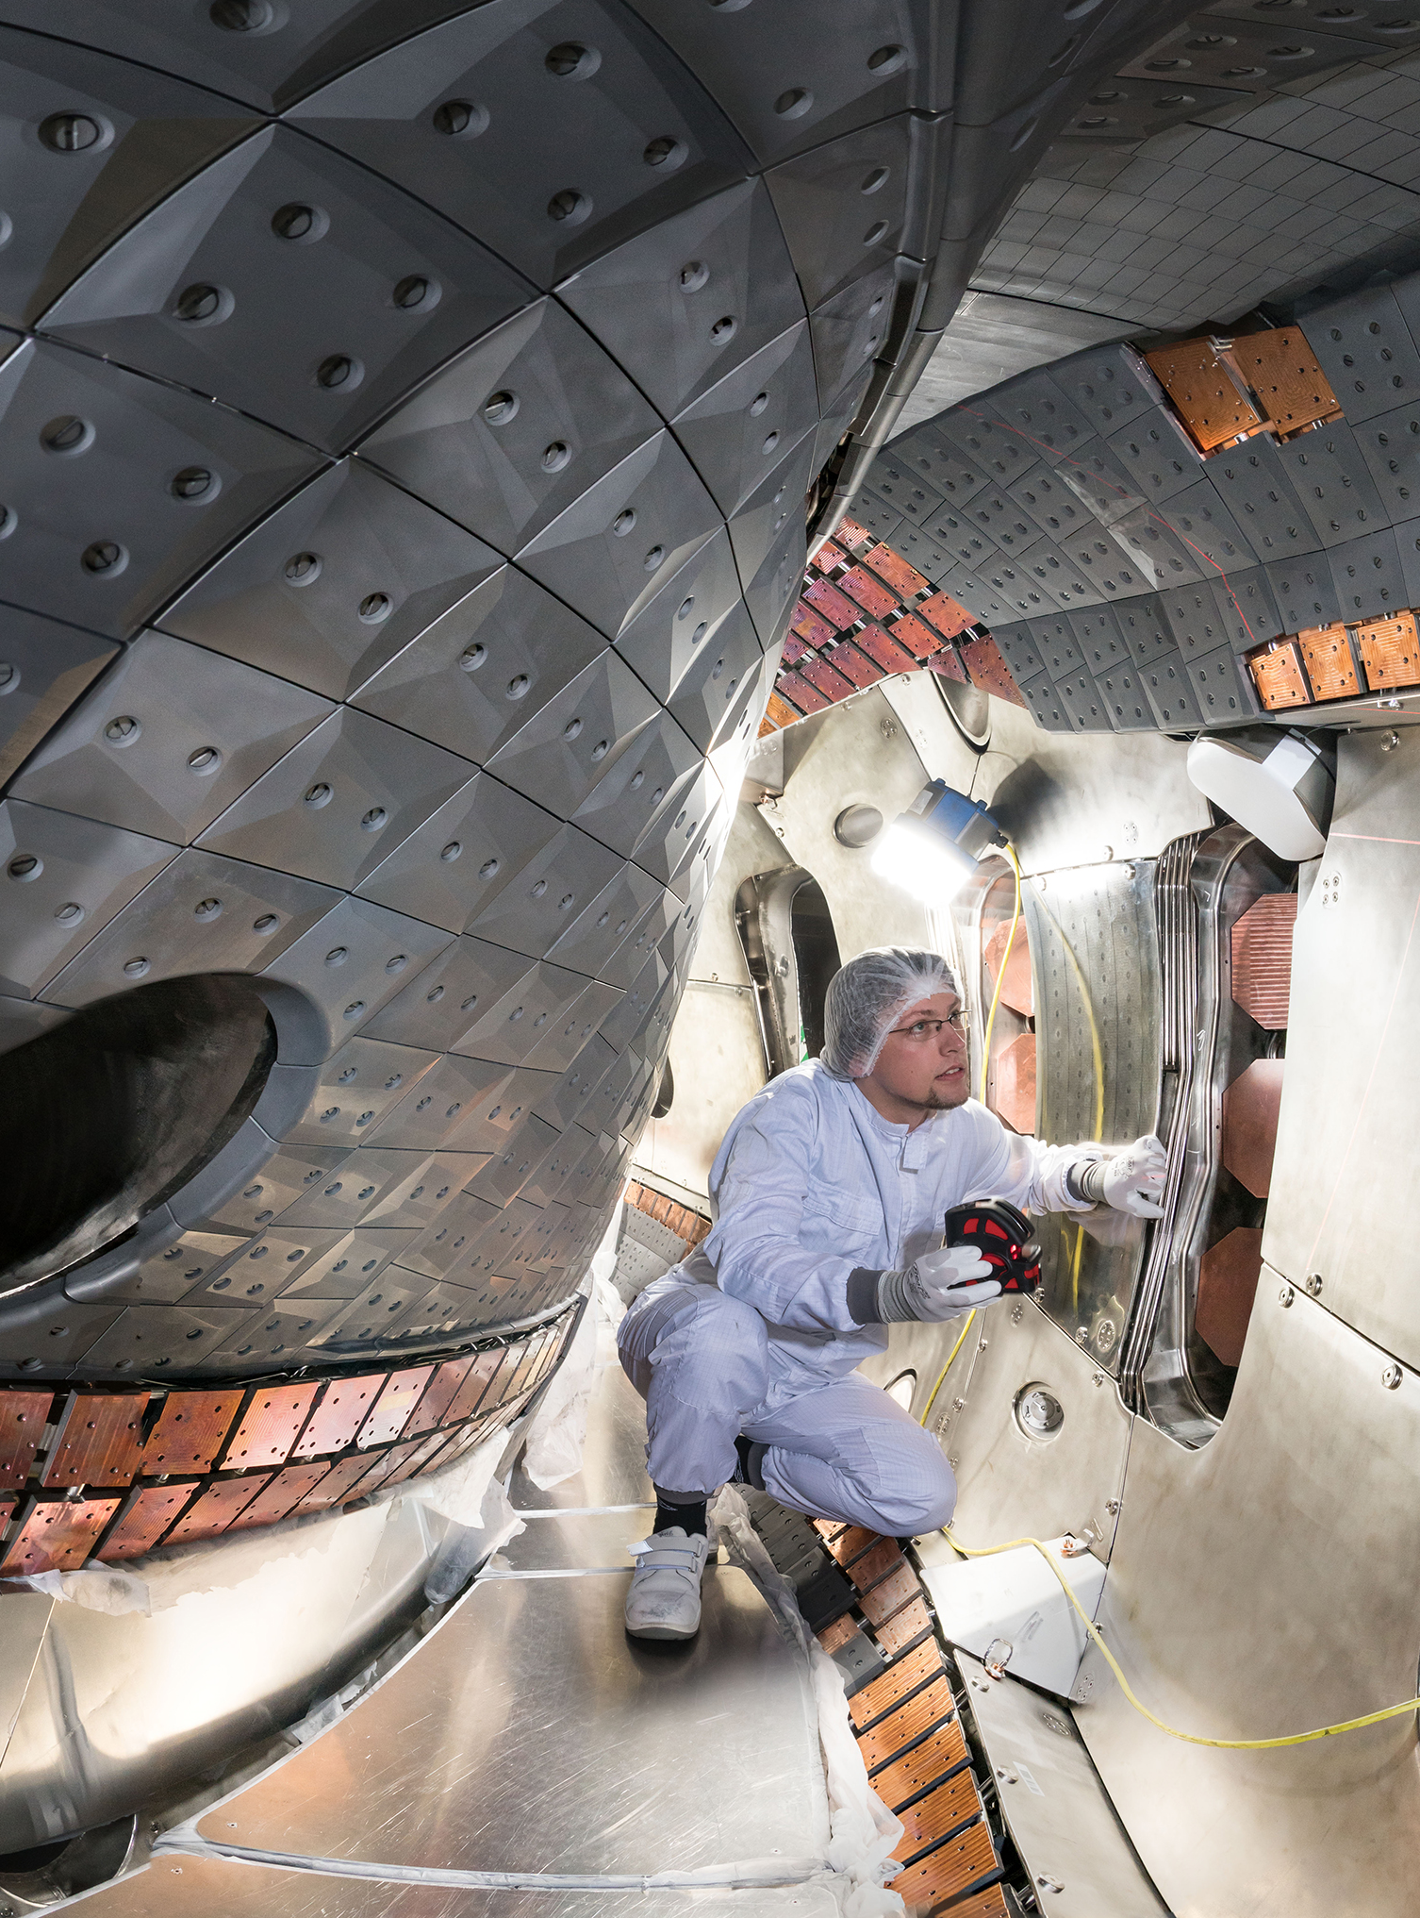
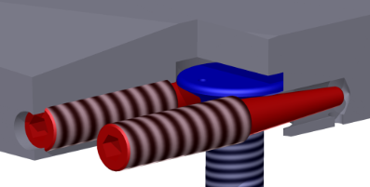
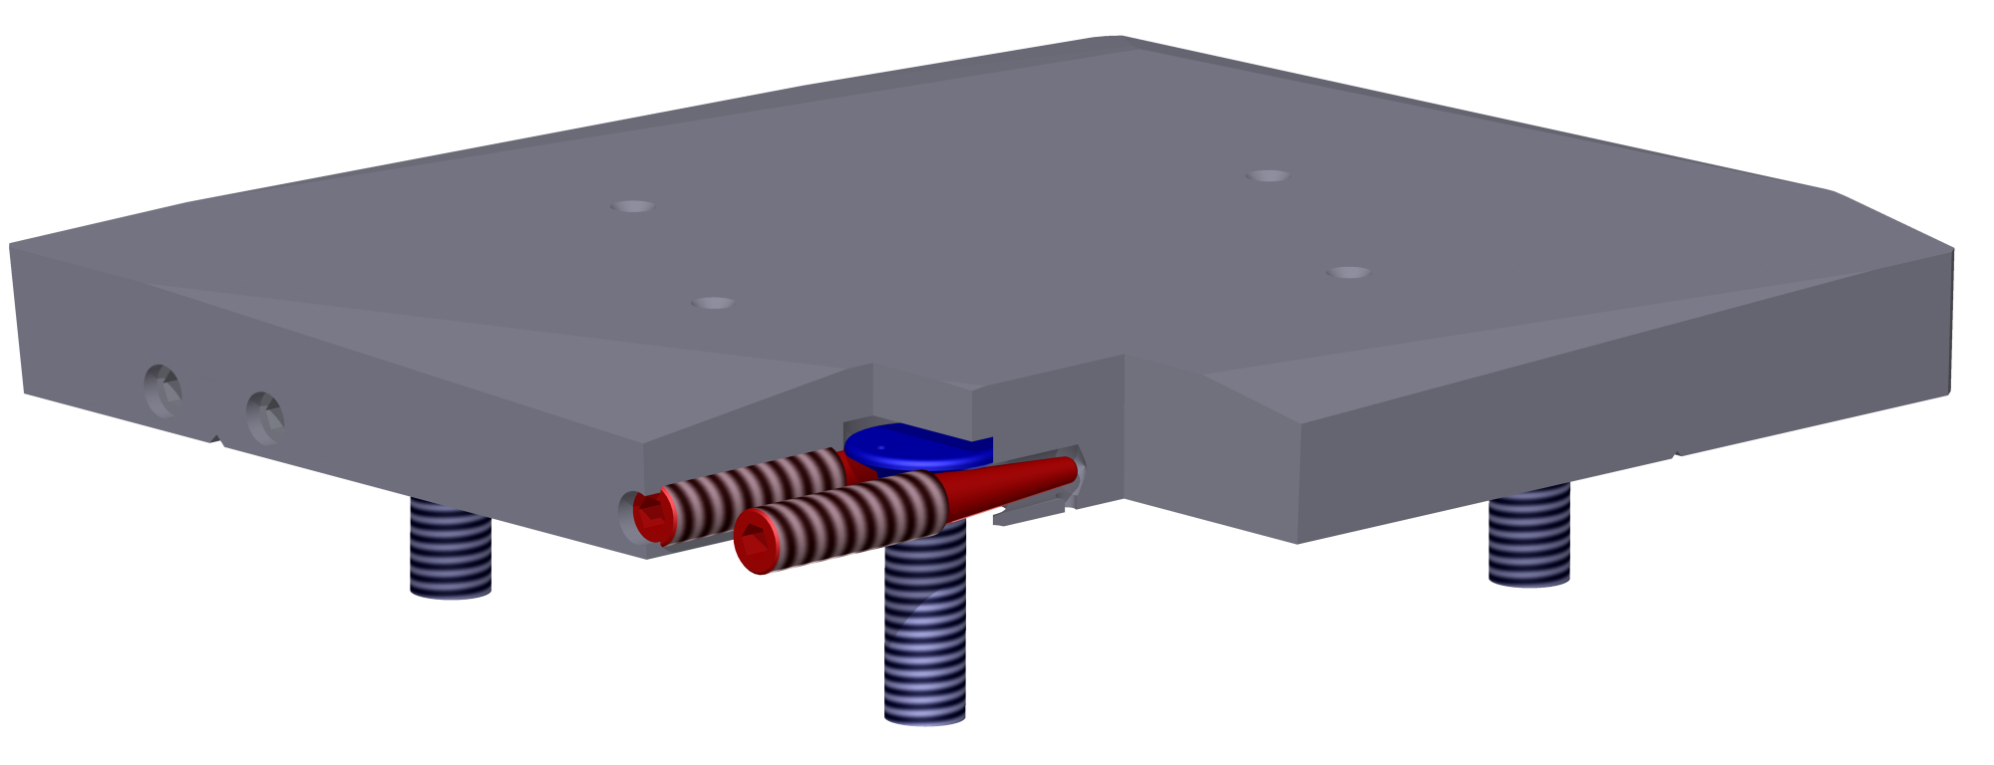
2. Design of O2-scenario: Conditions for O2 @ W7-X
Different situation of first wall in W7-X
Usual size of graphite tiles < 3w
graphite tiles with up to 5% absorption would heat up to > 1000°C (400°C limit for CuCrZr)
replacement by molebdenum alloy (TZM) - good electrical + thermal conductivity - easy to manufacture
heat load < 1 kW with 0.3% absorption
possibility to use advanced mounting to allow undisturbed reflector surface
[IPP, Foto: Volker Steger]
Graphite tiles opposite to ECRH launchers
CuCrZ-heatsinks brazed on stainless steel cooling pipes
ECRH launchers
stainless steel panels at low field side

Slide 6
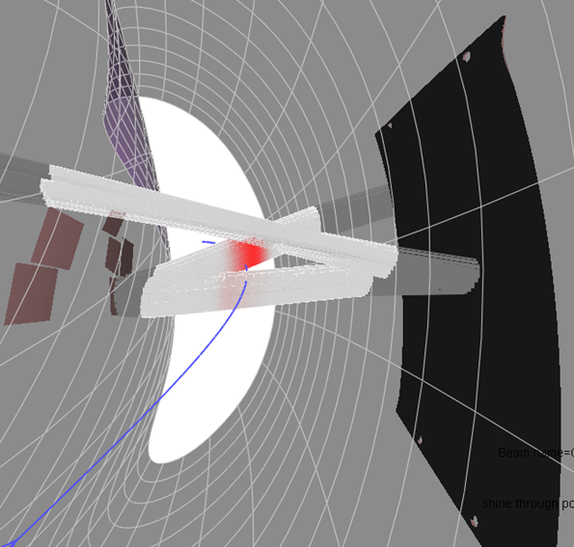
2. Design of O2-scenario: Triple-beampath @ W7-X in OP1.2
Further improvement at W7-X: third beampath by reflection at wide polished steel panel
Refocussing + decreasing of stray radiation by factor 2
Design conditions for OP1.2
1st + 2nd pass through plasma axis
Maximize central T_{e} + absorption
moderate incidence angles < 15°
2nd pass safely hit steel panel & 3rd pass close to plasma axis
Do not care that much about polarization losses
[IPP, Foto: Volker Steger]
Graphite tiles opposite to ECRH launchers
Polished stainless steel panel

Slide 7
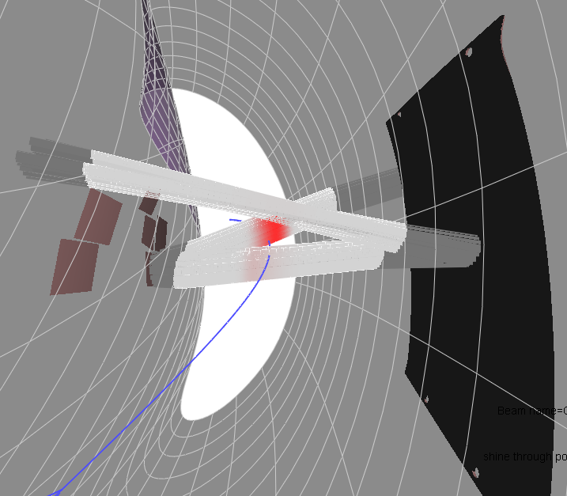
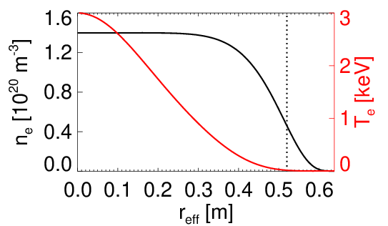
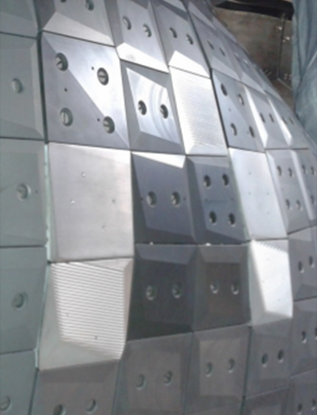
2. Design of O2-scenario: Expected efficiency in OP1.2
OP1.2: Holographic grating (by IGVP Stuttgart) to allow on axis in 1st + 2nd pass
Example: Charly 1-beamline
Comparative TRAVIS-calculations:
flat n_{e}- and peaked T_{e}-profile T_{e} = 3 keV n_{e} = 1.2 ∙10²⁰ m⁻³
2 of 5 tiles with flat surface only
Polished stainless
steel panel
Beam- line | Pstray after 3 passes OP1.2
A1 | 21 %
B1 | 14 %
C1 | 11 %
D1 | 14 %
E1 | 12 %
Average | 14 %
E1
holographic grating + plane surfaces w/o polarization matching → 40% of shinethrough converted into X-mode
p_{1st} _{pass} = 73 % p_{2nd} _{pass} = 50 % p_{3rd} _{pass} = 48 % p_{shine} = 1 %
p_{stray} = 11..13 %
B1
D1
C1
A1

Slide 8
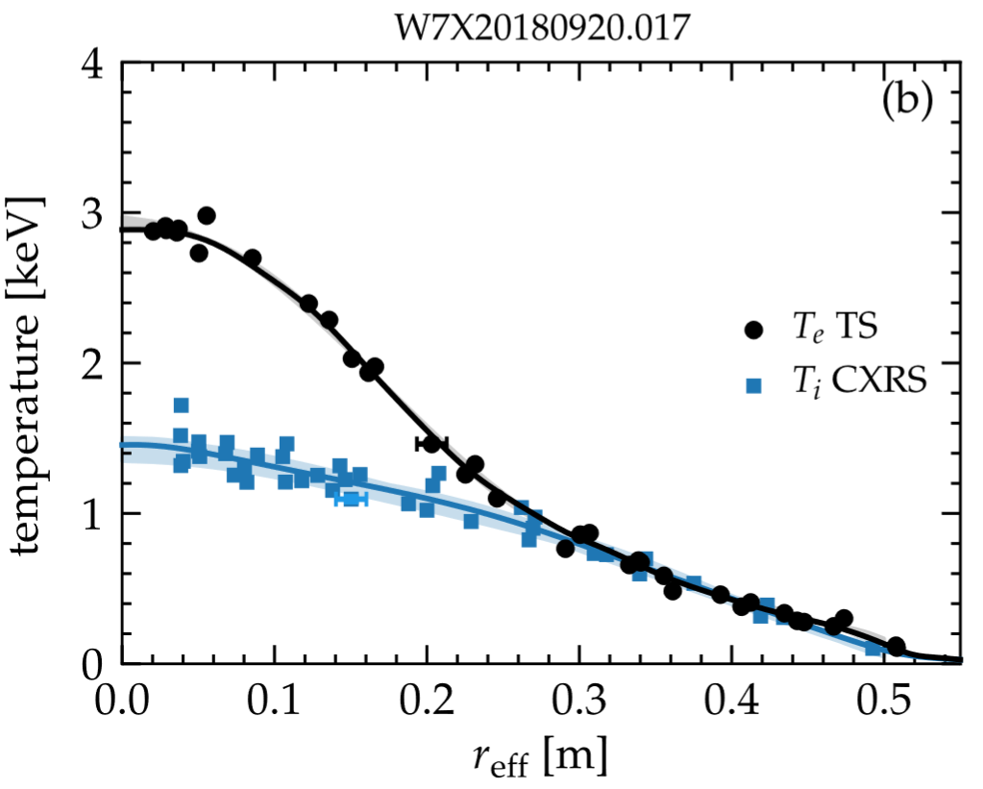
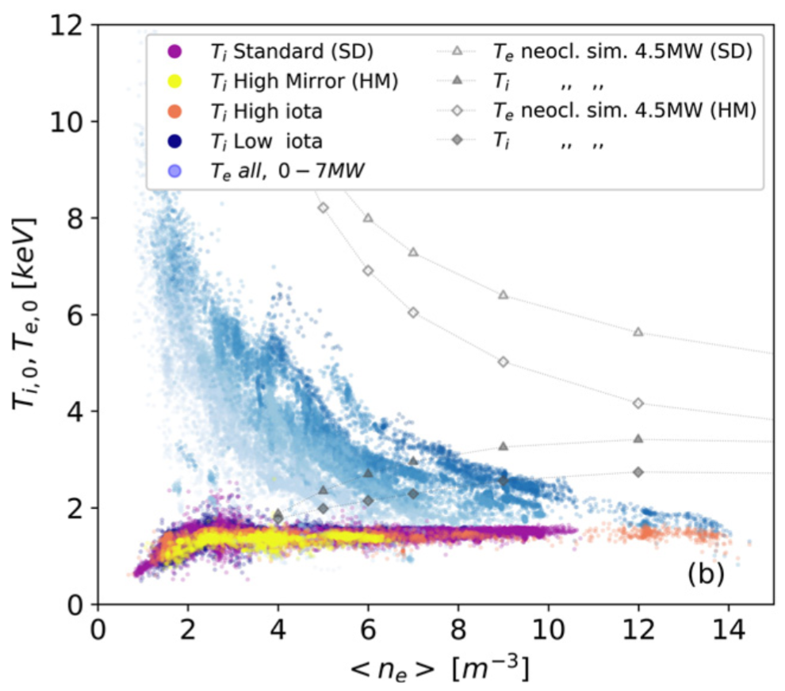
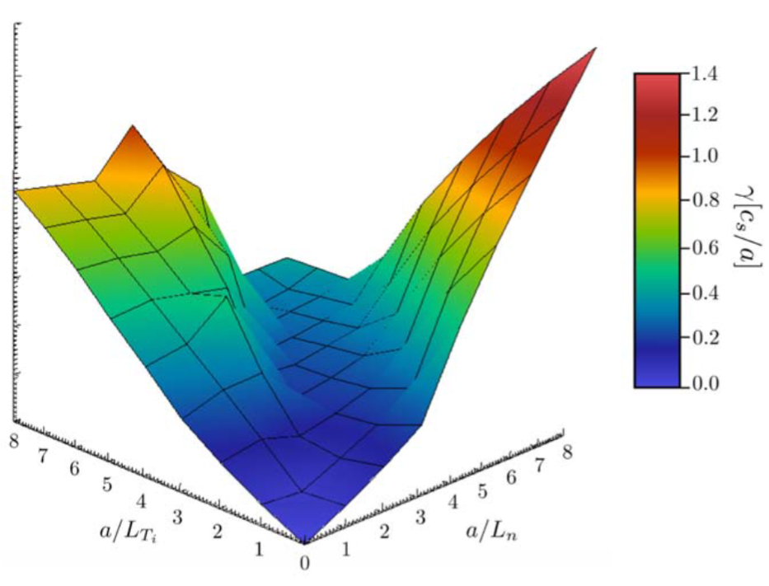
3. OP1.2 results: X2-operation
X2-operation with absorption ≈ 100 % & quite high T_{e} up to 10 keV, but flat density profiles in gas fueled discharges with T_{i} < 1.5 keV
Clamping of T_{i} by enhanced core turbulence (TEM/ITG)
Peaked T_{i}-profiles only demonstrated with peaked n_{e}-profiles
[S.A. Bozhenkov et al 2020 Nucl. Fusion 60 066011]
[M.N.A. Beurskens et al 2021 Nucl. Fusion 61 116072]
Envisaged density range
stability valley
[J A Alcusón et al 2020 Plasma Phys. Control. Fusion 62 035005]

Slide 9
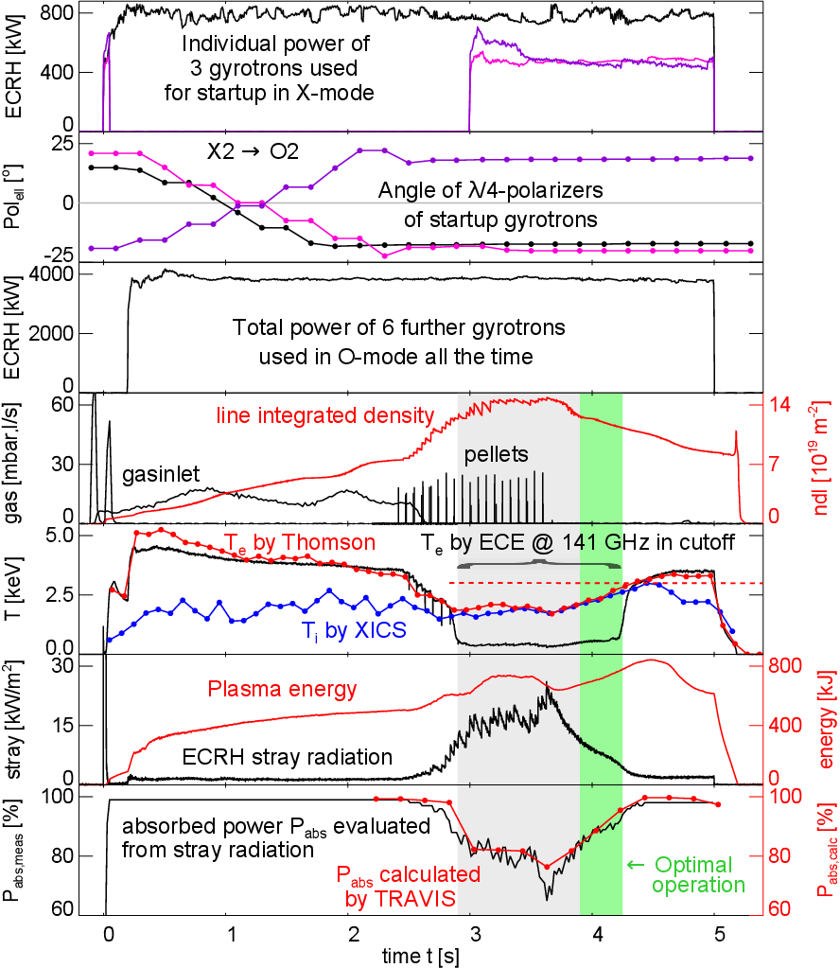
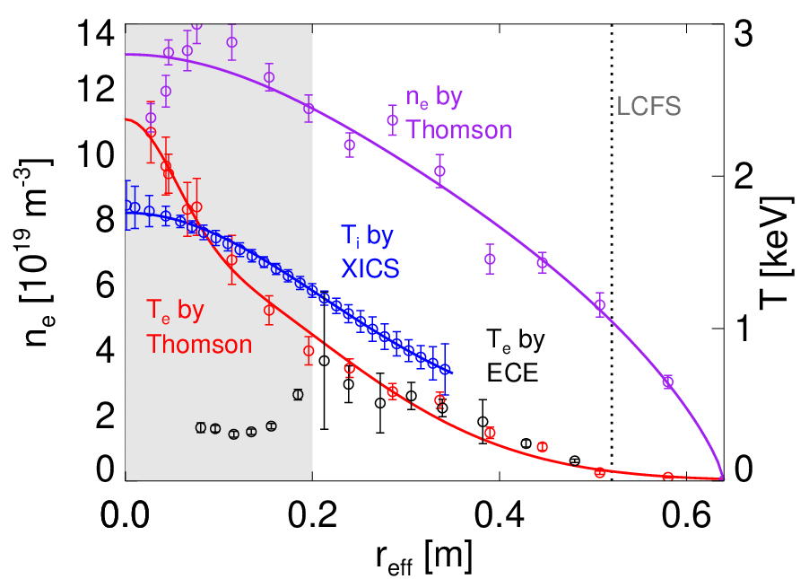
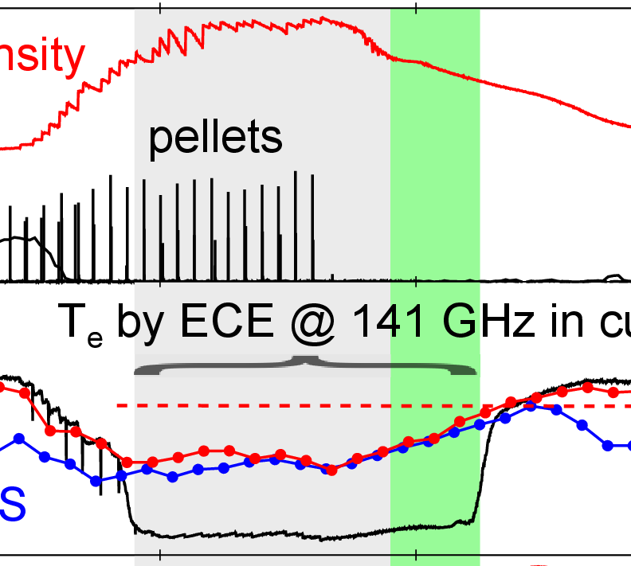
3. OP1.2 results: O2 beyond X2-cutoff with pellets
X2-startup + dynamic change to O2 in the first 2s
Pellets to steepen density profile & overcome X2-cutoff
Low stray radiation demonstrated @ envisaged optimal T_{e} = 3 keV (after restart of startup gyrotrons)
Demonstration of efficient power transfer of T_{e} to T_{i} in an electron heated high density scenario
TRAVIS results in very good agreement with measurements
20171115.039

Slide 10
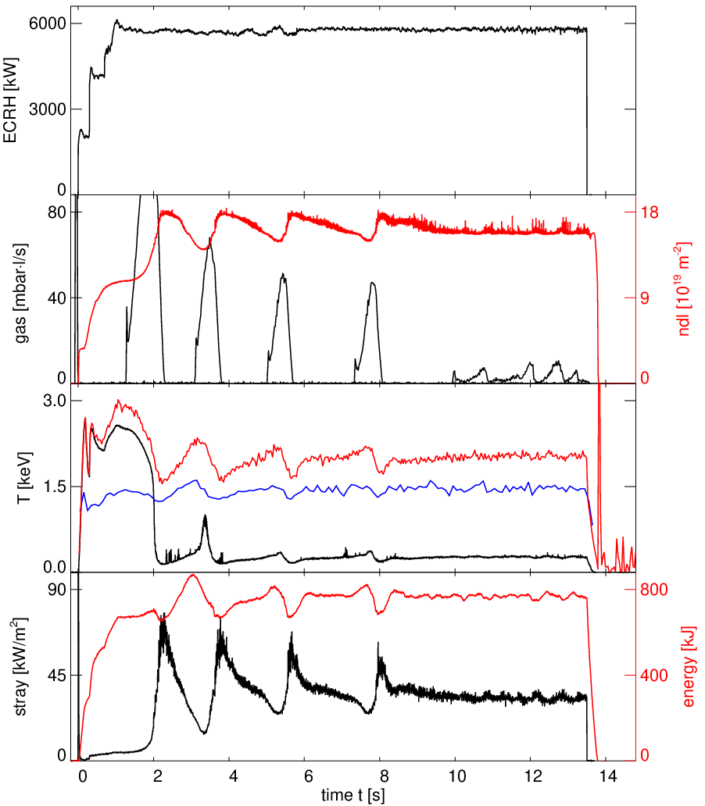
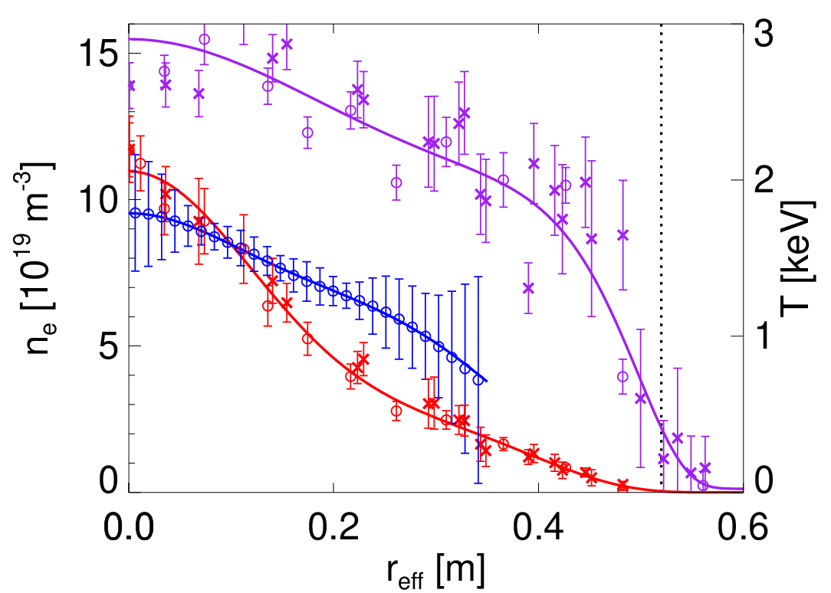
3. OP1.2 results: O2 beyond X2-cutoff with gaspuff
repeat operation beyond X2-cutoff by gas puffing only
steady state beyond X2-cutoff + intrinsically achieving or almost close to detachment (no power load on divertors)
slightly peaked n_{e}-profile!
eventually promising scenario to overcome clamping limit, but low T_{e} did not allow to prove high performance
Power upgrade + optimization of O2-scenario
Total power of 9 gyrotrons (dynamic change from X2-startup to O2-polarization within first 2s)
20180904.015
Line integrated density
gas flux [mbar∙l/s]
Feedback
LCFS
T_{e} by Thomson
n_{e}
2.5 keV to 1.5 keV lead to factor 4 in stray radiation!
T_{i} by XICS
T_{i}
T_{e} by ECE @141GHz in cutoff
Plasma energy
T_{e}
[H. P. Laqua, … T. Stange, … et al 2021 Nucl. Fusion 61 106005]
ECRH stray radiation
0 2 4 6 8 10 12 14
0

Slide 11
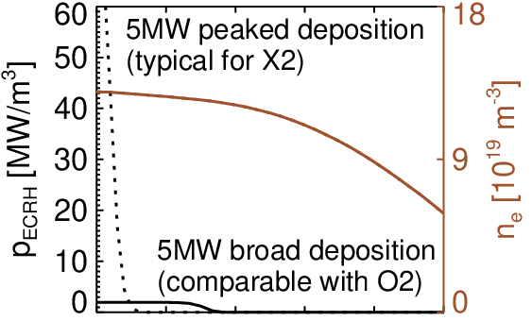
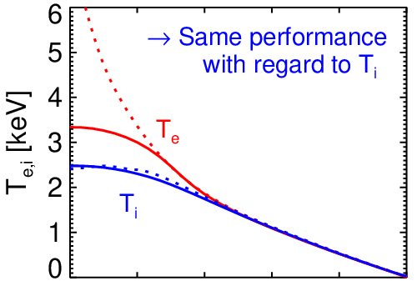
4. Optimization of O2-scenario: Deposition profile
Separation of T_{i} and T_{e} supported by to high power deposition density
Neoclassical transport simulations (NTSS): no change of performance with regard to T_{i} for deposition r_{eff}/a < 0.3
Design conditions for OP2
Allow slight off axis beampaths to use natural shape of inner wall
in this sense favor use of polarization over holographic gratings (which have in general polarization loss + lower efficiency)
in case of holographic gratings allow only 2nd pass close to 1st pass
Use already polished panel as reflector for 3rd pass
favor scenarios with higher 1st pass absorption
allow incidence angles < 20°
NTSS-calculation including 1/n turbulent transport with χ = 0.5 m²/s @ r_{eﬀ} = a

Slide 12
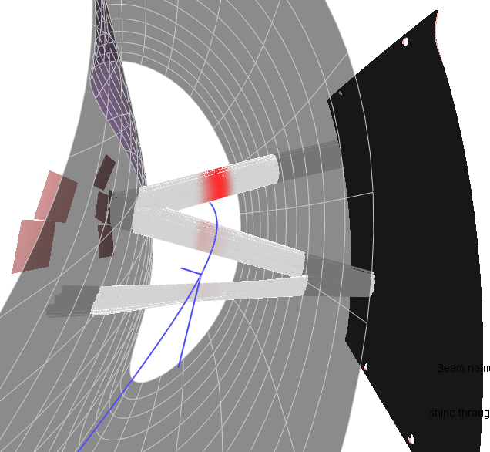
4. Optimization of O2-scenario: triple-beampath OP1.2 vs OP2
OP1.2: Holographic grating (by IGVP Stuttgart) to allow on axis in 1st + 2nd pass
Example: Charly 1-beamline
full polarization matching
OP2: Slightly off-axis + polarization grating to allow pure O-mode in 2nd pass
TZM-tile with holographic grating but without polarization matching → 40% of shinethrough converted into X-mode
Polished stainless
steel panel
Residual stray radiation mostly
in shinethrough after 3rd pass
p_{1st} _{pass} = 73 % p_{2nd pass} = 50 % p_{3rd pass} = 48 % p_{shine} = 1 %
p_{stray} = 11..13 %
p_{1st} _{pass} = 68 % p_{2nd} _{pass} = 63 %
p_{3rd} _{pass} = 46 % p_{shine} = 5 %
p_{stray} = 6..8 %
Further absorption in 4th pass BUT: tungsten coating of
graphite tiles necessary
to do not overheat!!!
reduction of stray radiation by factor 2
High mode purity & beam focusing allows redirection into 4th path

Slide 13
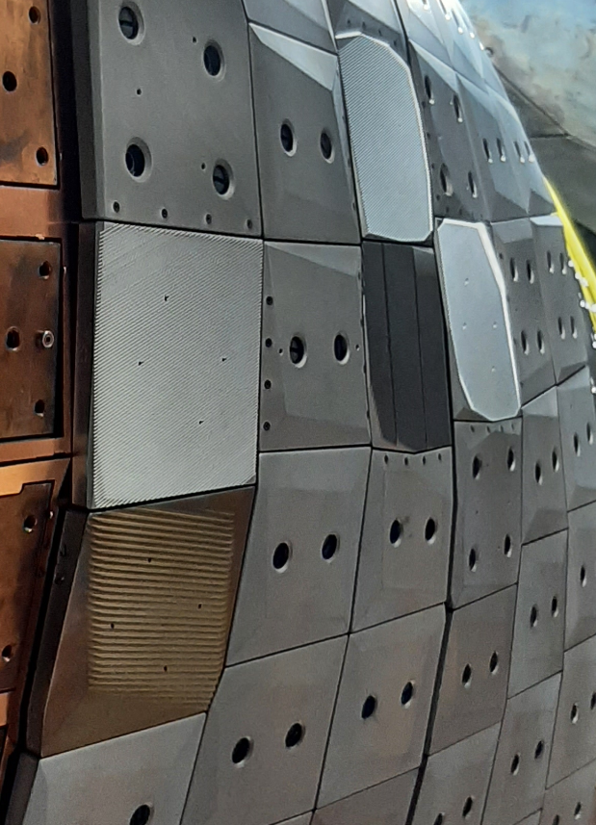
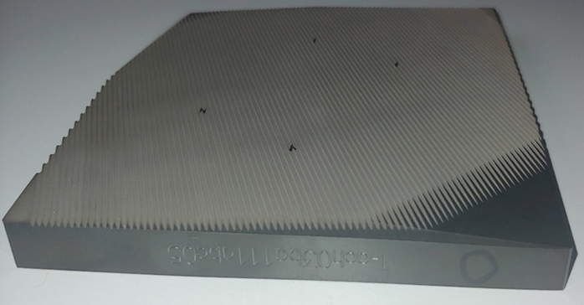
4. Optimization of O2-scenario: polarization gratings
Flat reflectors with polarization gratings for 4 of 5 former beams of OP1.2
tile surface increased as much as possible + field line shadow by surrounding tiles
Sinusoidal gratings produced by wire erosion (< 0.5 k€/tile)
OP2
D1
OP1.2
C1
E1
B1
E1
B1
D1
C1
A1

Slide 14
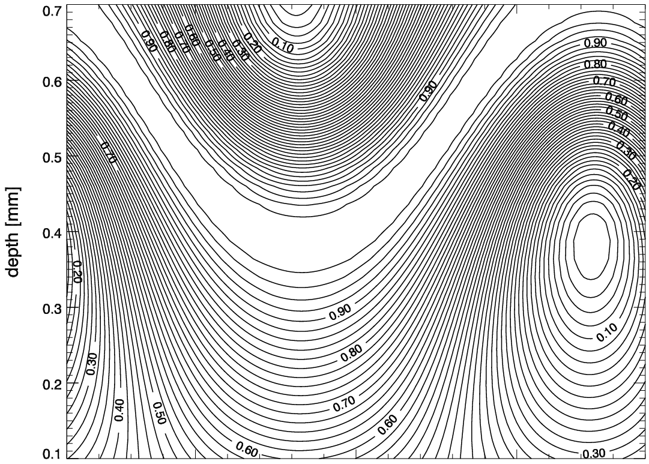
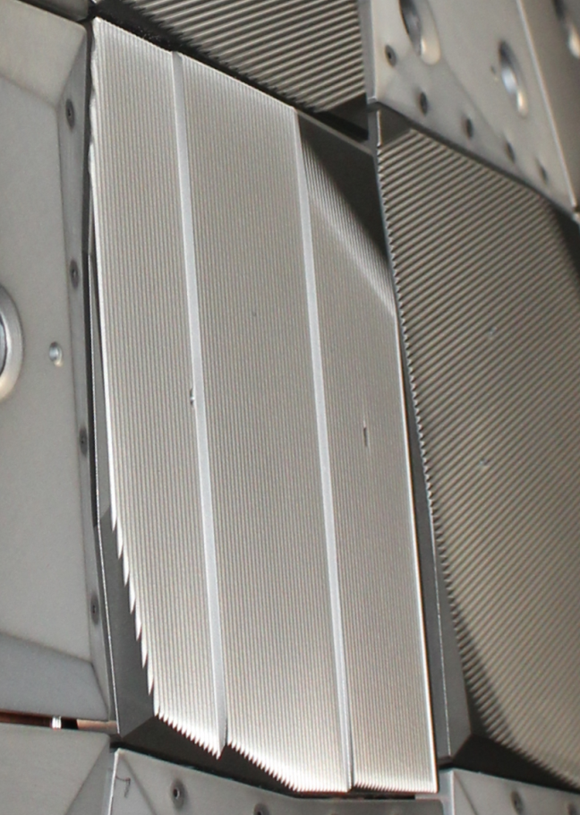
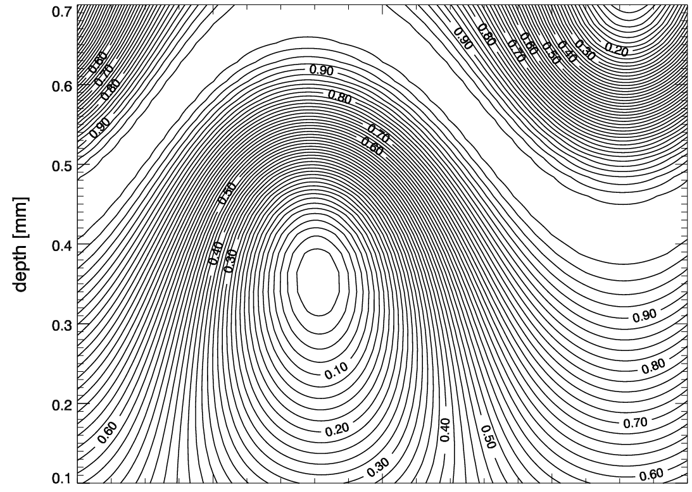
4. Optimization of O2-scenario: polarization gratings
grating orientation (mostly) parallel to field lines at inner wall
no leading edge + low O-mode loss (but maximum X-mode loss)
polarization correction works for both B-field directions+both modes
OP2
D1
Optimum with regard to depth & acceptance angle but works only for B+
Reflected O-mode part for B+
C1
B1
E1
Flexible solution
Final params: d_{eff} = 0.565mm d_{real} = 0.84mm
Except E1 + E5 with roof-edge surface
Reflected O-mode part for B-

Slide 15
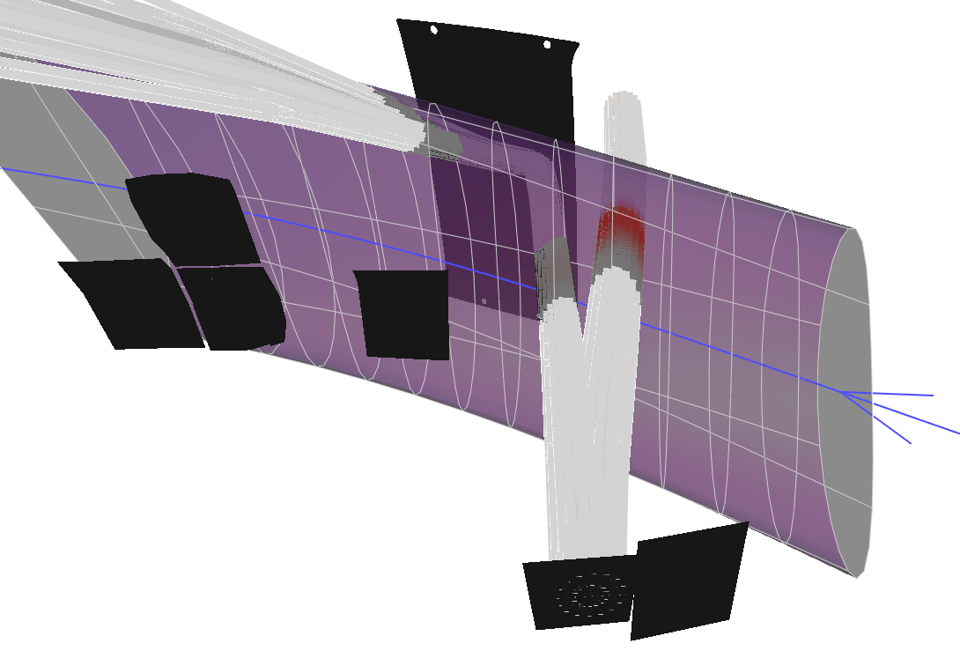
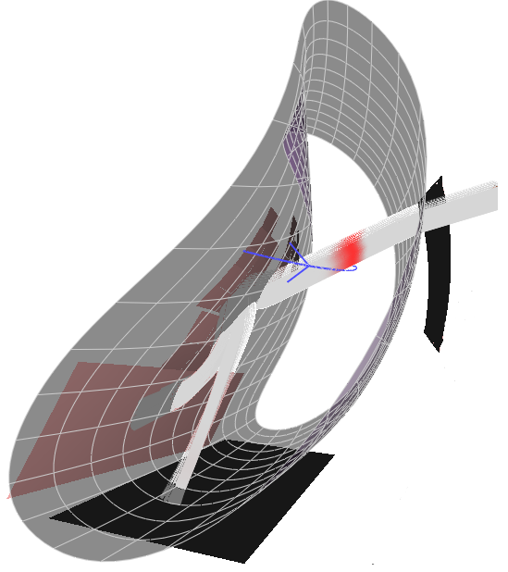
4. Optimization of O2-scenario: holographic reflectors for A+F
Old holographic A1-tile not used anymore because steering range of A1 (& F1) to the right is too small
tiles in opposite direction are used with holographic grating to reflect the beam back to the stainless panel
Beam broadening in vertical direction
use of 3 tiles
OP2
D1
D1
C1
B1
E1
C1
E1
B1
Backside view on reflector tile with polarization gratings
Old A1 tile
„Virtual“ reflector tiles of F-beamline
New A1

Slide 16
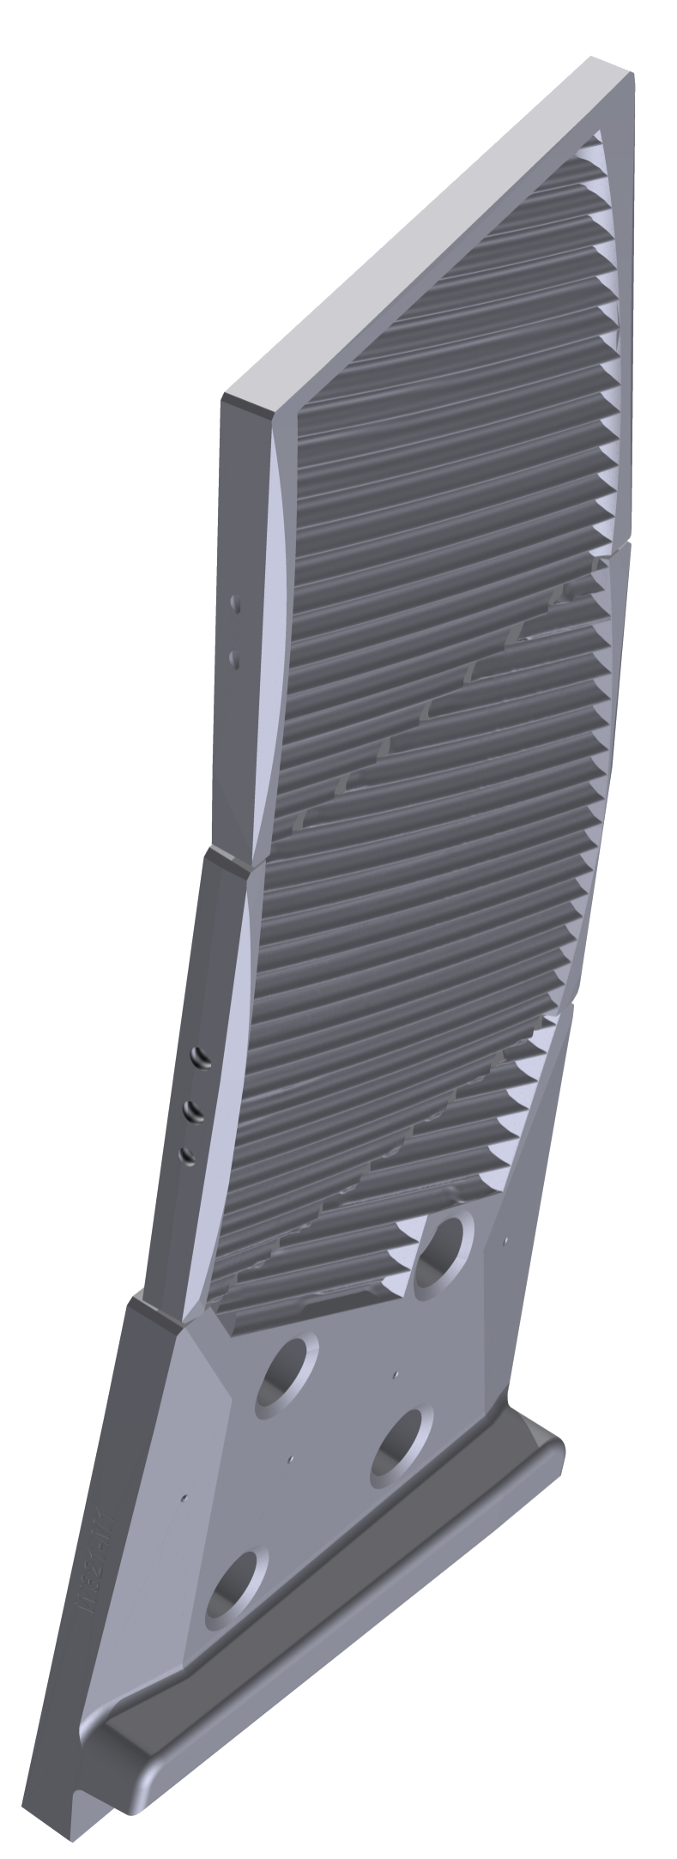
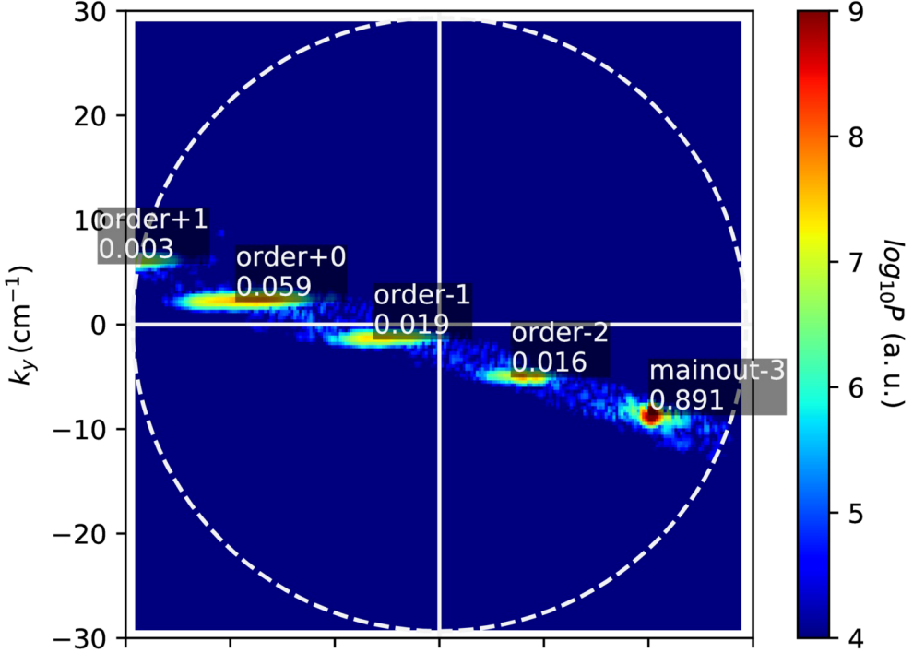
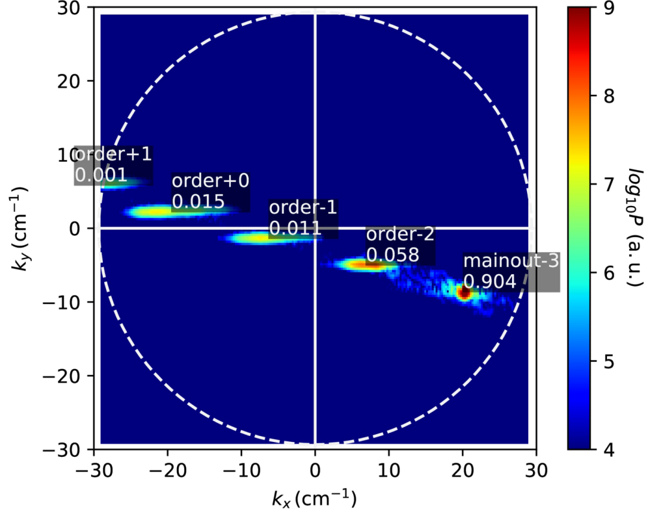
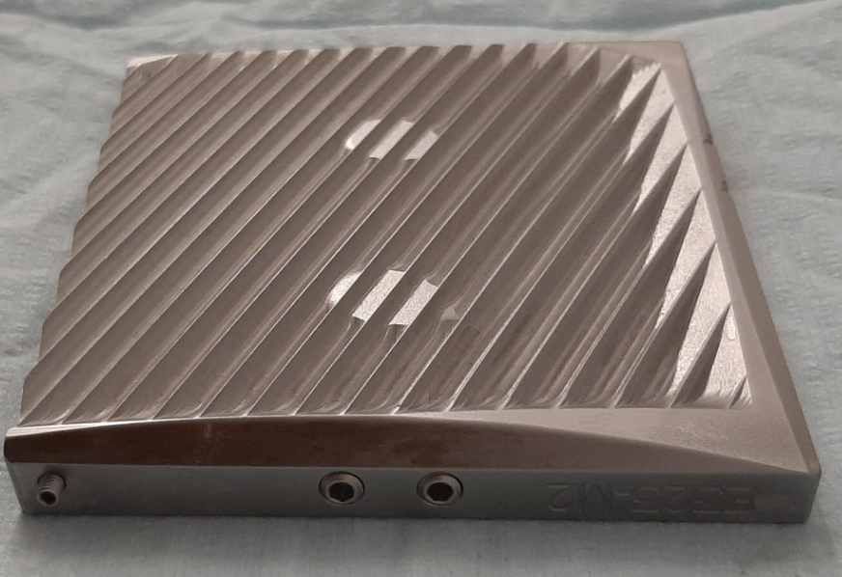
4. Optimization of O2-scenario: segmented holographic reflectors
Holographic grating distributed @ up to 3 tiles
redesign of first wall tiles with as-built- geometry of CuCrZr-structure to achieve necessary accuracy of combined reflectors
3D-holographic gratings calculated for each individual surface
final efficiency by full wave simulations
TE and TM of ideal grating with almost equal efficiency of up to 90%
gratings separately milled into TZM-tiles by special technique at workshop of IGVP Stuttgart
TZM
TE
Graphite
[B. Plaum, IGVP Stuttgart]
[C. Lechte, IGVP Stuttgart]
TM

Slide 17
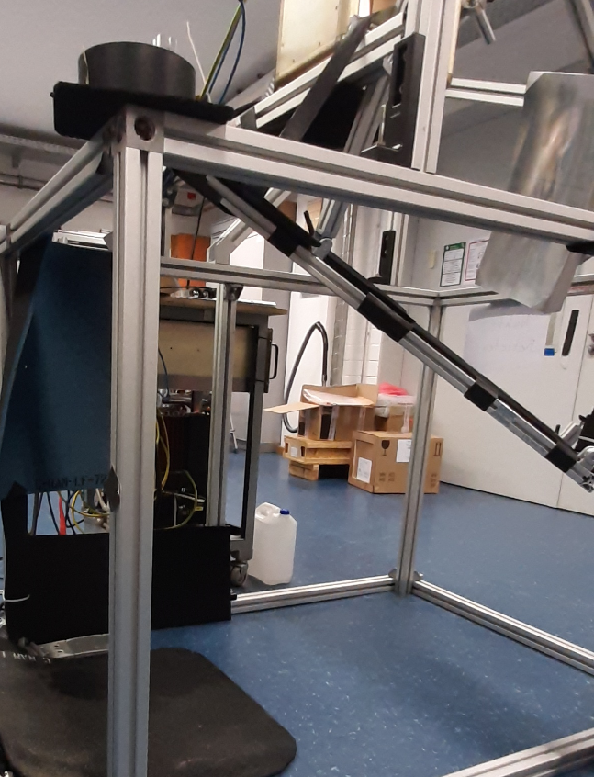
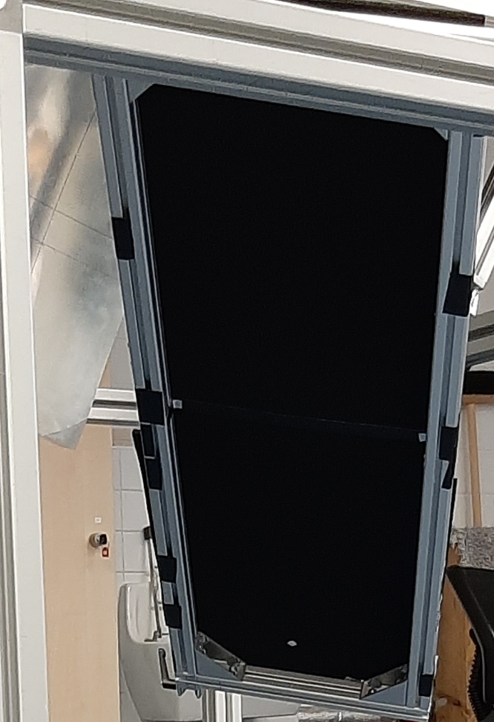
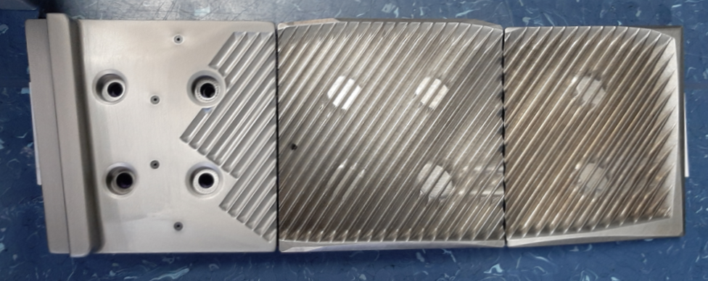
4. Optimization of O2-scenario: proof of beam accuracy
Simulate expected beam shape during plasma operation
Good agreement with Expected position and beam shape
Variations on the grating without obvious problems
Horn antenna with up to 10W
Matching mirror
Tiles with combined grating
Expected position
Ecosorb screen
Envisaged position of incident beam

Slide 18
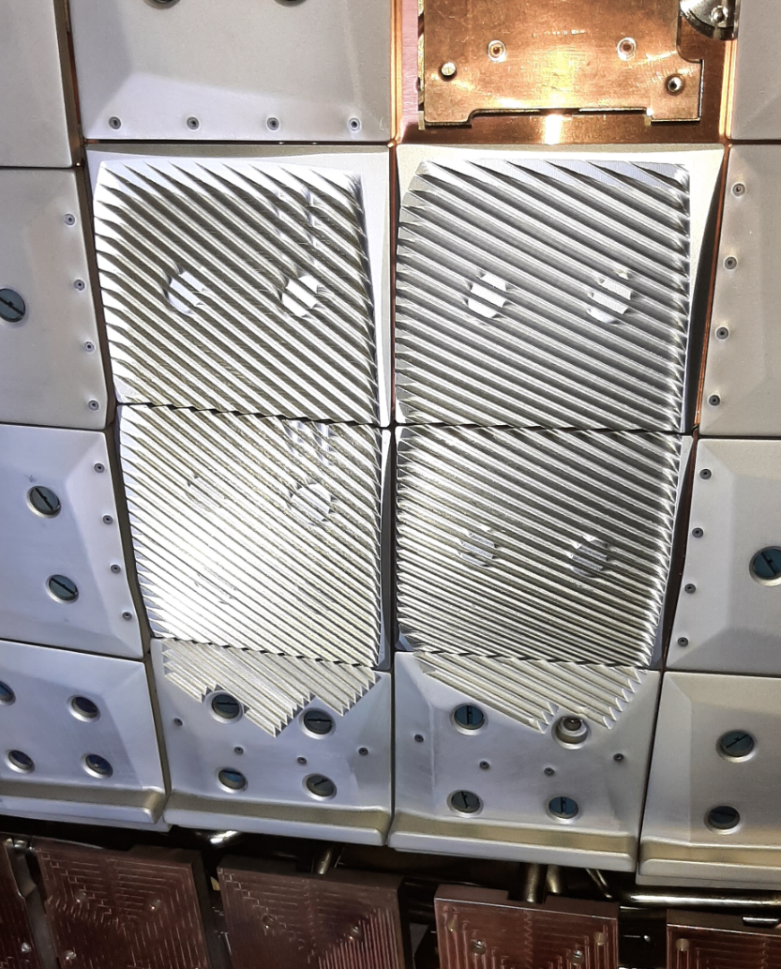
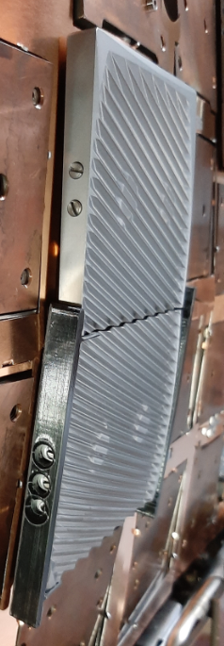
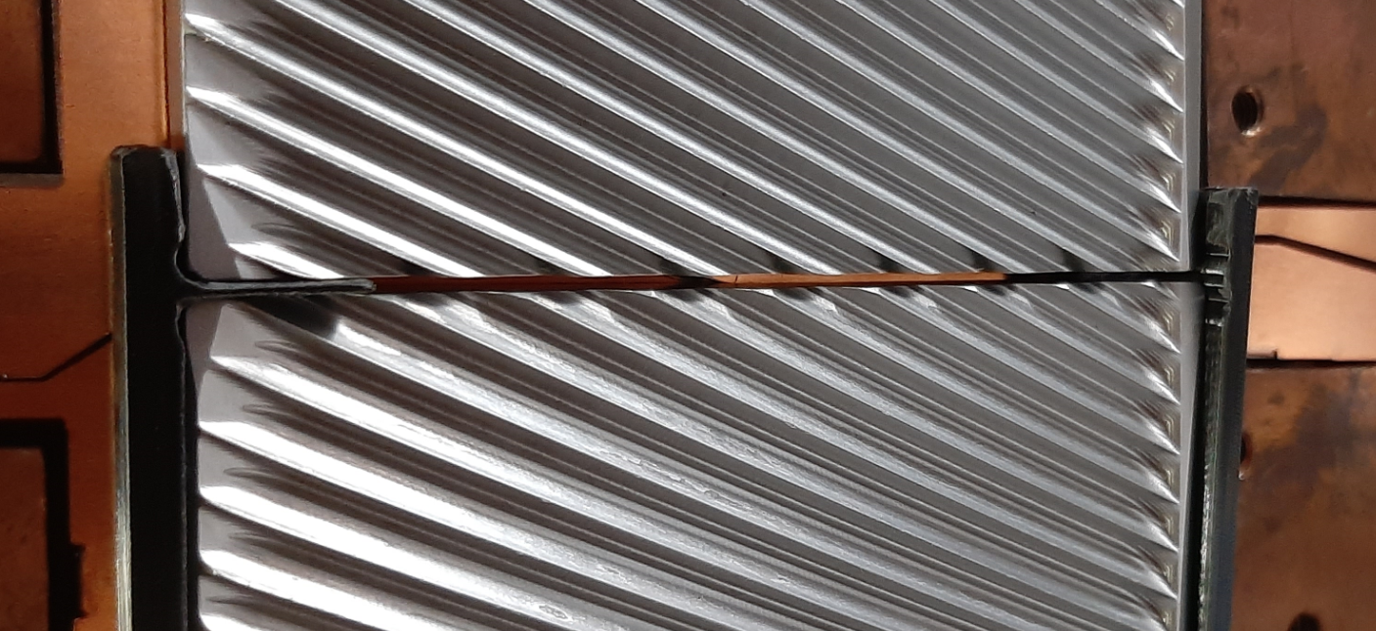
4. Optimization of O2-scenario: practical issues
Mounting of holographic reflectors:
accurate positioning to each other & in relation to CuCrZr-structure by 3D-printed support structure of plastic
Safety issues:
W-coating of surrounding graphite tiles
dots (Ø 4mm) around reflector tiles without W-coating for IR-observation
Identification if beam leaves the tile

Slide 19
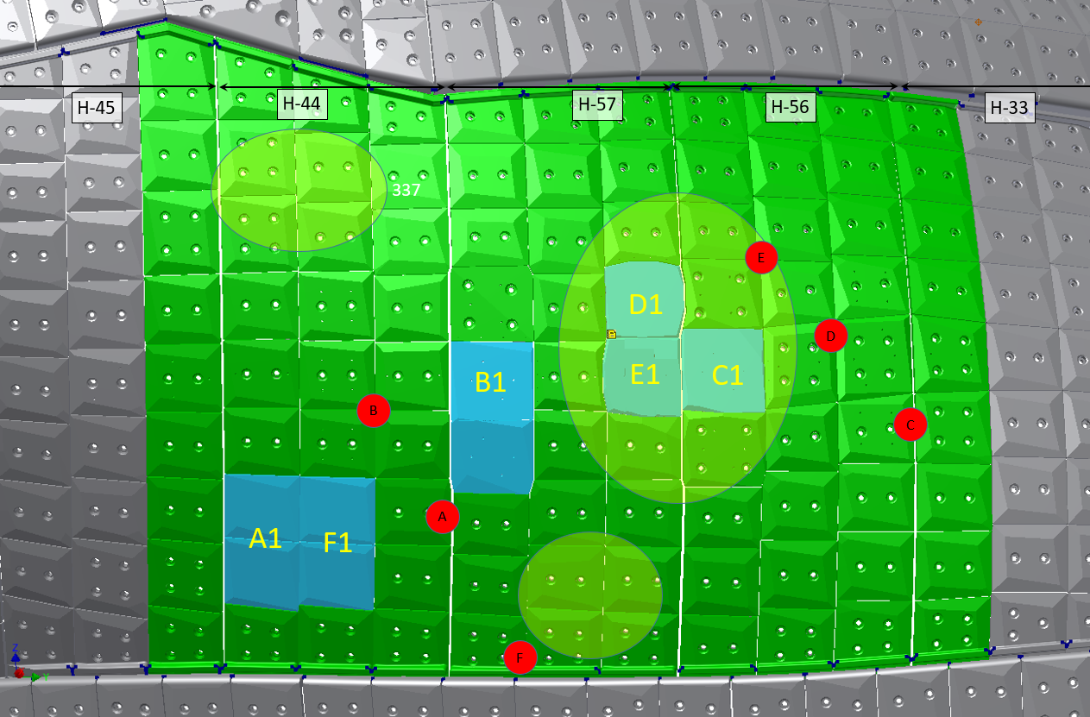
4. Optimization of O2-scenario: Hardening of heatshield
Tungsten coating of almost whole ECRH-heatshield in module 1 and 5
Heatshield module 1
Area affected by stray radiation after 3rd pass
Tungsten coated TZM tiles for O2
Tungsten coated graphite tiles
X2-positions

Slide 20
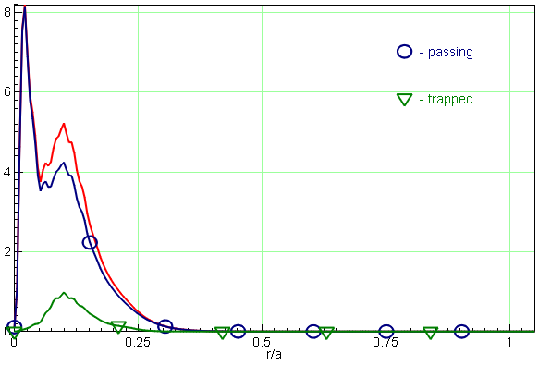
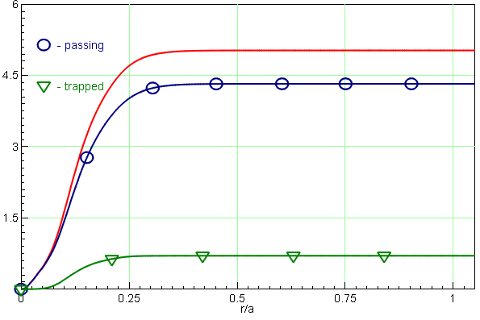
4. Optimization of O2-scenario: Expected efficiency OP1.2 vs OP2
Power deposition of Modul 1 beams
Overview of improvement of stray radiation after 3 beam passes
For information: Shinethrough after 2nd and 3rd pass for OP2-config
Beamline | P_{stray} after 3 passes OP1.2 | P_{stray} after 3 passes OP2 | P_{shine} after 2nd pass OP2 | P_{shine} after 3rd pass OP2
A1 | 21 % | 10 % | 9 % | 2 %
B1 | 14 % | 7 % | 14 % | 5 %
C1 | 11 % | 6 % | 12 % | 5 %
D1 | 14 % | 6 % | 10 % | 3 %
E1 | 12 % | 5 % | 8 % | 2 %
F1 | - | 8 % | 6 % | 2 %
Average | 14 % | 7 % | 10 % | 3 %
O2-heating B‘_{axis,0°} = 2.57T n_{e,0} = 12 ∙10¹⁹ m⁻³
reduction of stray radiation by factor 2
High mode purity & beam focusing allows redirection into 4th pass

Slide 21
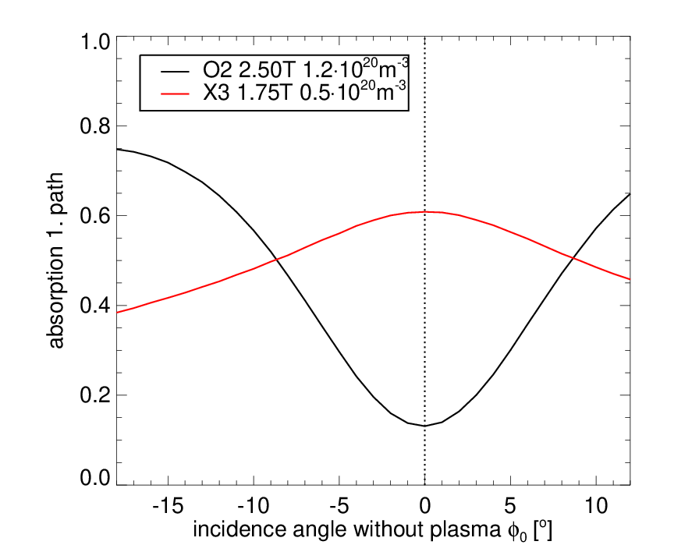
Summary and Outlook
Main results of OP1.2
successful implementation of a triple-beampath scenario for O2-operation
first demonstration of reactor relevant plasmas sustained by O2-ECRH only
measured absorption in very good agreement with theory
Improvements for OP2:
polarization matching of 2nd pass for all beams which mainly determines overall efficiency
Reduction of stray radiation by factor 2 due to advanced use of holographic + polarization gratings
tungsten coating of complete inner heatshield to allow 4th pass
Outlook
further flat reflectors with polarization gratings for high density X3-operation
broad polarization gratings on stainless steel panel to allow matched 3rd pass
eventually further O2-tiles to allow finite current drive in O2-scenarios
T_{e} = 3 keV

Slide 22
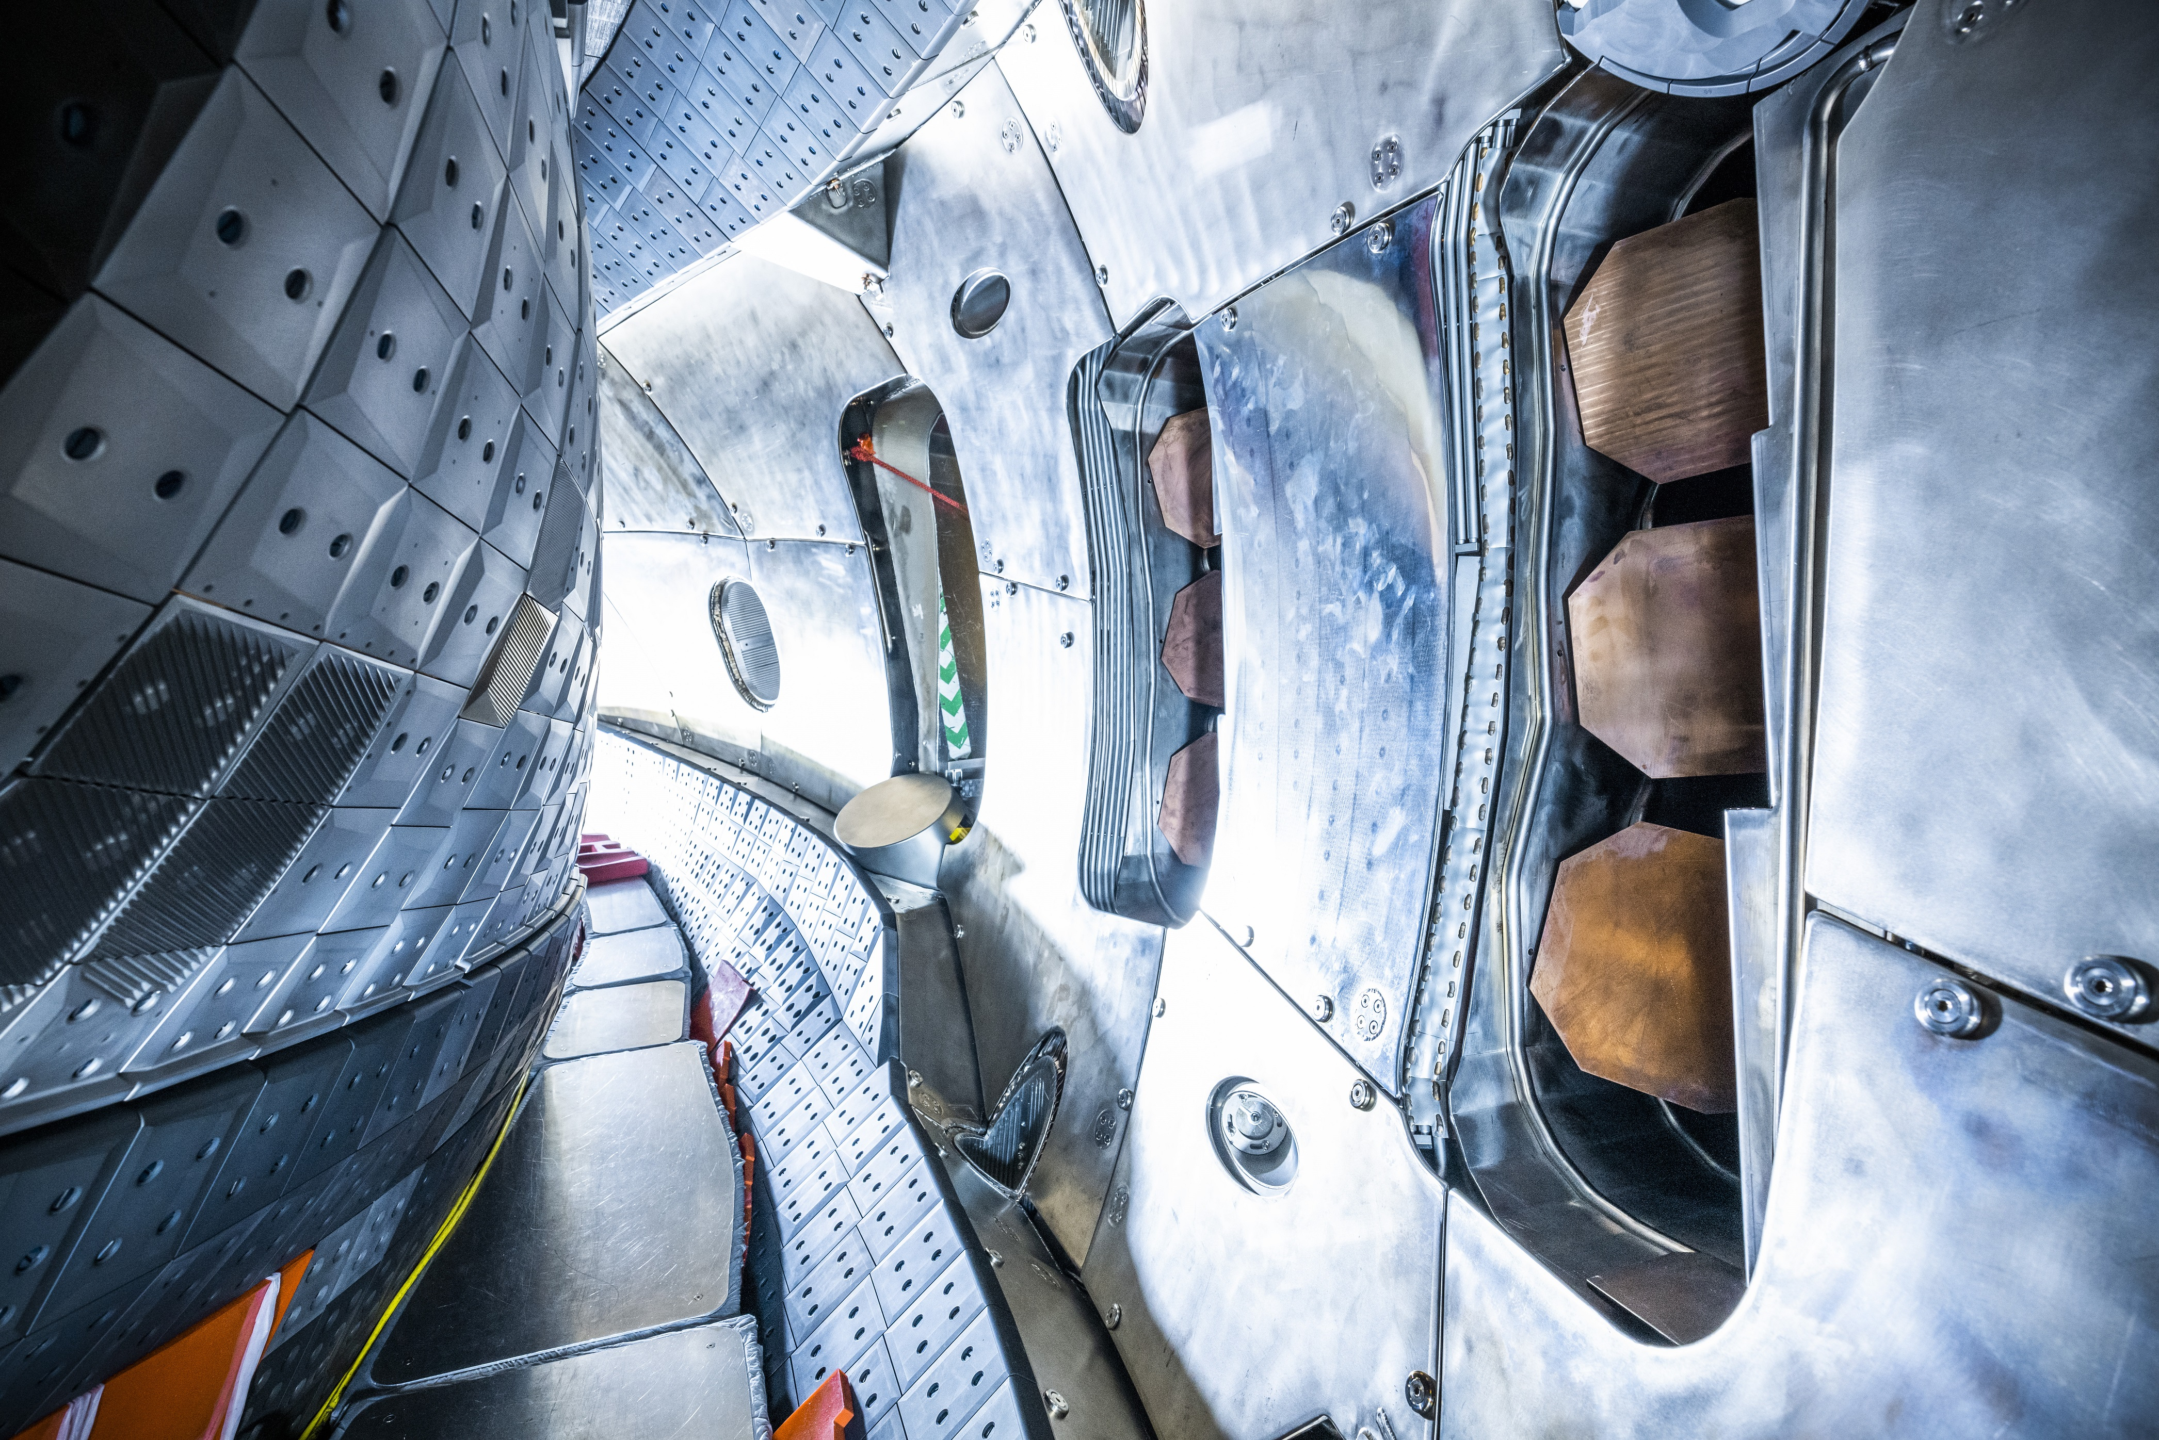
Thank you for attention
[IPP, Foto: Jan Hosan]

