Slide 1
ECRH experiments on Tokamaks SST-1 & Aditya-U and ECRH upgradation plan for SST-1
Dr. Braj Kishore Shukla
(Division Head, High Power ECRH Systems)
Institute for Plasma Research
Bhat, Gandhinagar (Gujarat), India
Braj Shukla, EC-21, June 20-24, 2022, ITER-IO

Slide 2
Plan of Talk
Talk is mainly an overview of ECRH experiments on SST-1 and Aditya-U
Introduction (42GHz ECRH system and old experiments)
Need of two ECRH pulses
Upgradation of Power supply system for two pulse operation
ECRH Two Pulse operation in SST-1
ECRH experiments on Aditya-U
Upgradation plan of old 82.6GHz ECRH system for SST-1
Summary
Braj Shukla, EC-21, June 20-24, 2022, ITER-IO

Slide 3
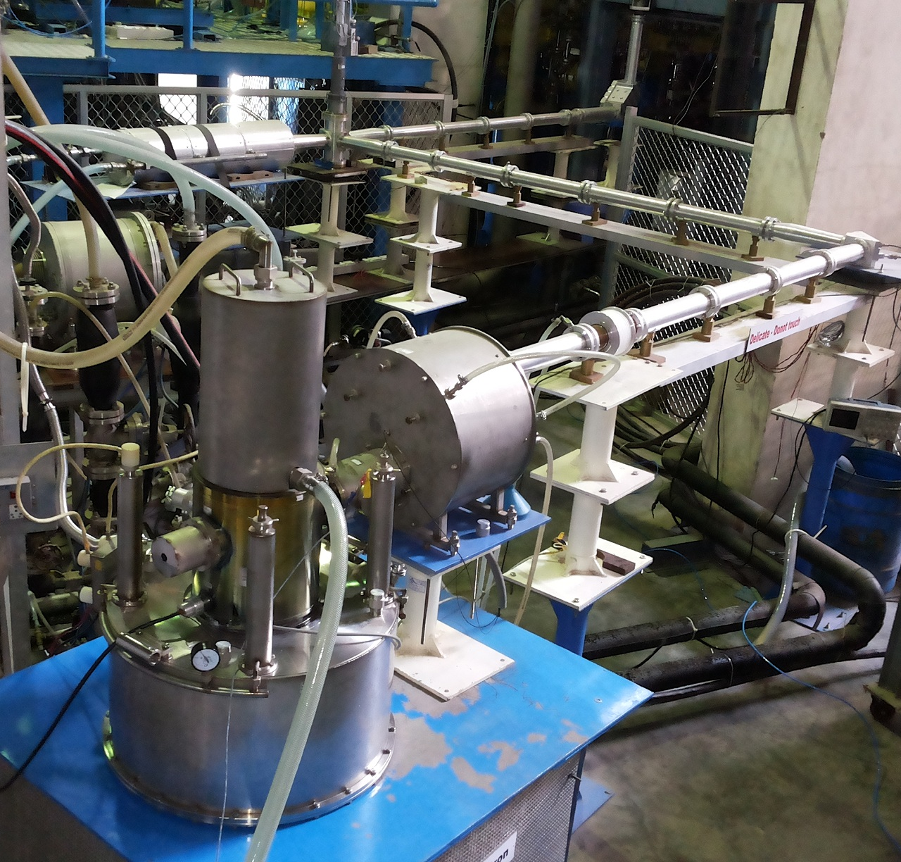
42GHz ECRH system in SST-1
Microwave Source (Gyrotron):
Frequency : 42GHz
Power : 500 kW
Pulse duration : 500ms
Magnet of gyrotron : cryo-cooled
Operating parameters:
- 50kV-20A and + 20kV
Transmission Line:
Corrugated transmission line
Launcher
Two mirrors (Focusing and plane mirror combination)
Braj Shukla, EC-21, June 20-24, 2022, ITER-IO

Slide 4
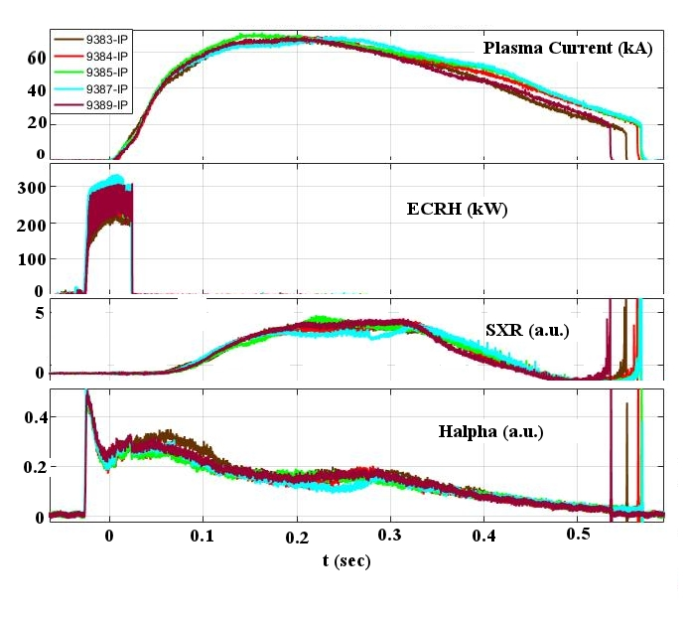
Fundamental harmonic ECRH assisted
plasma start-up in SST-1
Braj Shukla, EC-21, June 20-24, 2022, ITER-IO

Slide 5
ECRH need – single long pulse or two pulses
Braj Shukla, EC-21, June 20-24, 2022, ITER-IO

Slide 6
ECRH need – single long pulse or two pulses
Braj Shukla, EC-21, June 20-24, 2022, ITER-IO

Slide 7
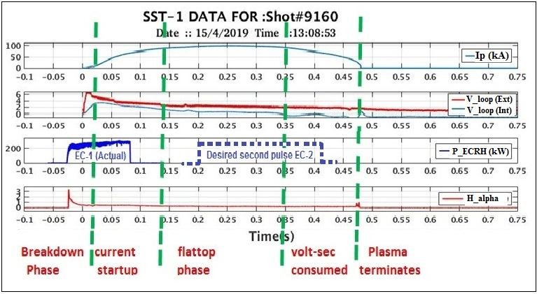
ECRH two pulses desirable (breakdown and heating simultaneously)
Braj Shukla, EC-21, June 20-24, 2022, ITER-IO

Slide 8
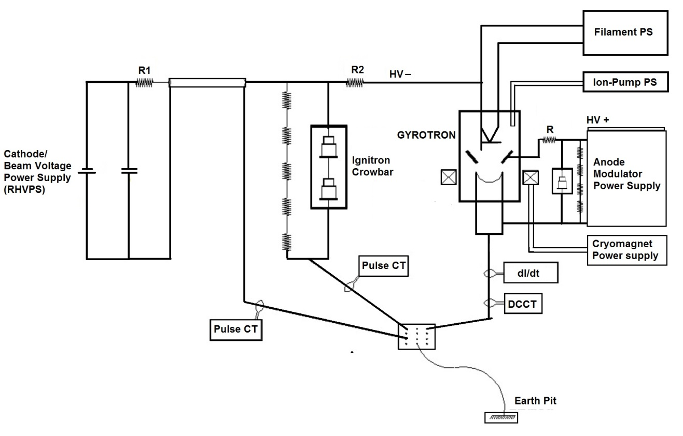
Upgradation plan of power supply system
Gyrotron with associated power supplies
Braj Shukla, EC-21, June 20-24, 2022, ITER-IO

Slide 9
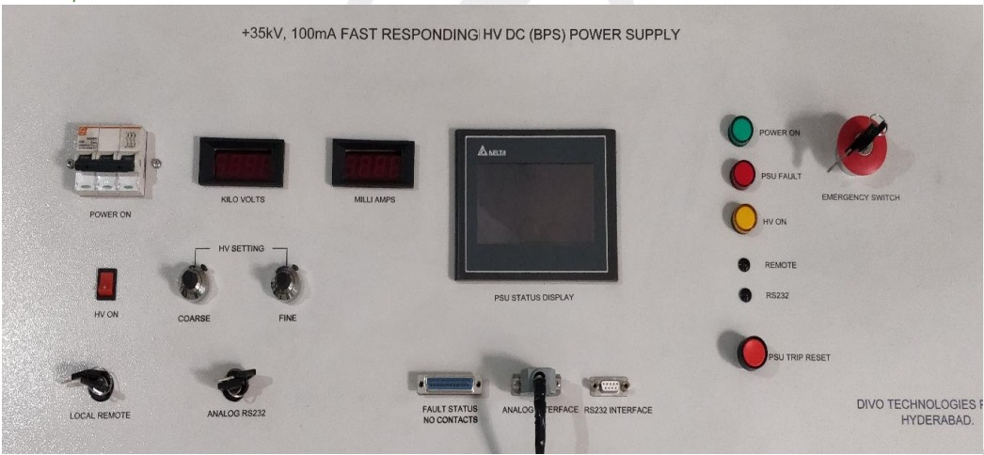
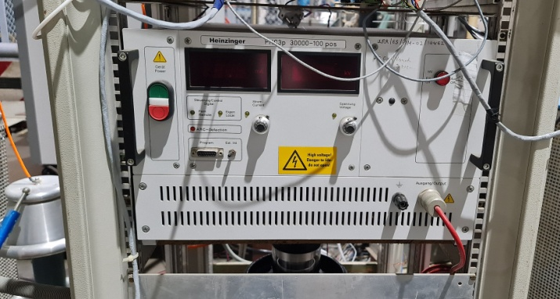
Integration of new AMPS
Power supply with fast Rise and fall time
(voltage rise and fall time for old and new AMPS)
Parameters | Value (Old Power Supply) | New Anode Power Supply
Voltage | 30kV (max) | 30kV (max)
Current | 100mA | 100mA
Voltage rise time | 25ms | 0.5ms
Voltage fall time | 100ms | 1.0ms
Braj Shukla, EC-21, June 20-24, 2022, ITER-IO

Slide 10
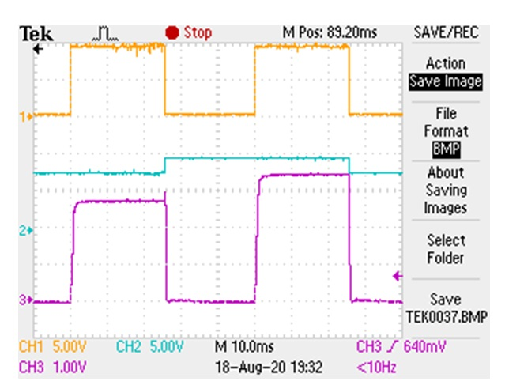
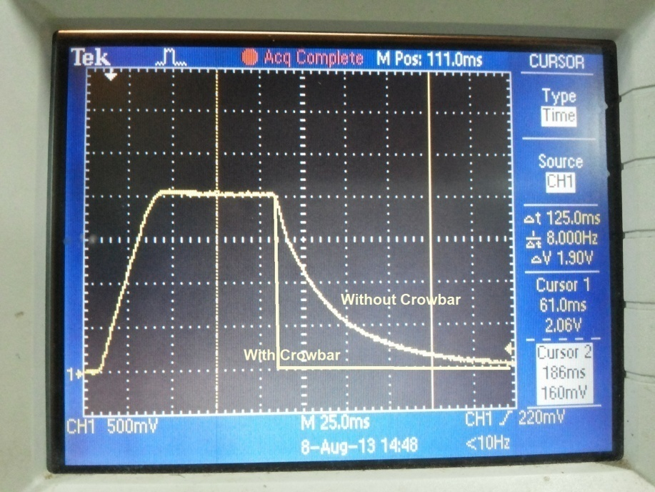
Integration of new AMPS
New AMPS is IGBT based power supply has 3 Phase AC input voltage, which is rectified and filtered to obtain un-regulated DC Voltage, which is fed to a PWM Controlled Inverter. The power supply is designed suitably to meet the critical requirement of pulsing with 1ms rise and 1ms fall time at full voltage 30kV
Braj Shukla, EC-21, June 20-24, 2022, ITER-IO

Slide 11
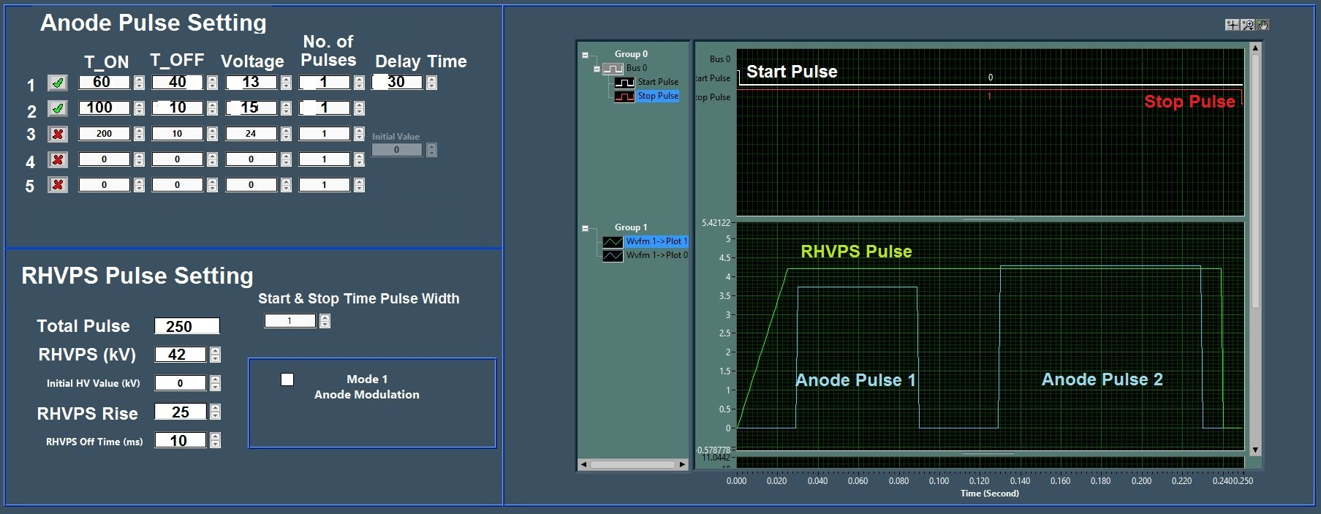
Integration of new AMPS – DAC software upgradation
Power supply is interfaced with ECRH DAC and Software is modified accordingly
Variable input to the power supply: Time and voltage variation among the power supply to launch desired power in different pulses
Software has option of 5 pulses in one shot, not any modulation at this moment
Braj Shukla, EC-21, June 20-24, 2022, ITER-IO

Slide 12
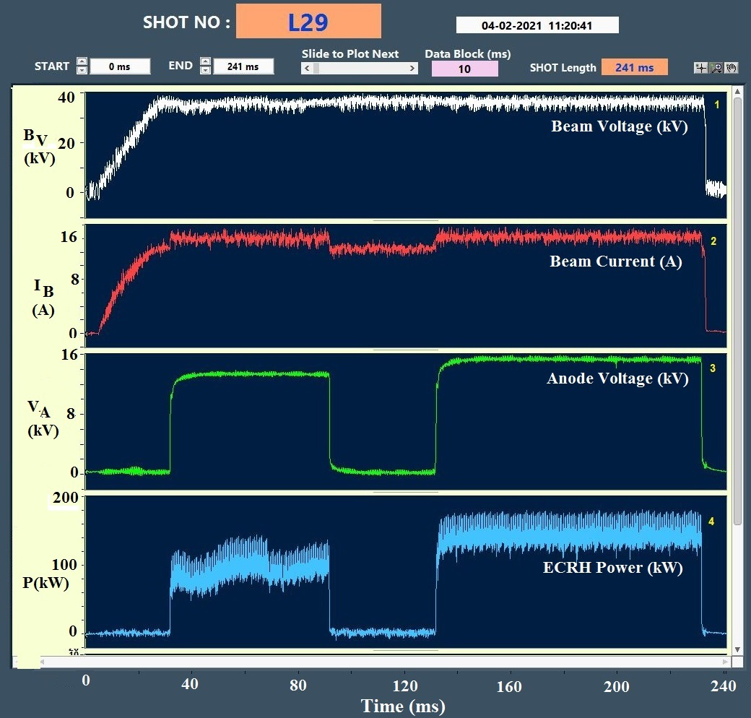
Multi-pulse operation of 42GHz Gyrotron
The power supply system of 42GHz Gyrotron is upgraded with a new advance anode power supply.
The rise and fall time of this power supply is ~1ms.
The main cathode high voltage power supply remains ON throughout the pulse and anode is pulsed to get the ECRH power for more than one pulse.
The pulse duration and ECRH power can be varied as per the requirement.
1st pulse 13kV and 2nd pulse 14kV
The power in first pulse is ~100kW and duration is 60ms. After a gap of 30ms second pulse is launched which has power ~150kW and duration is 100ms.
Thus ECRH power can be launched in the tokamak as per the experimental demand
Braj Shukla, EC-21, June 20-24, 2022, ITER-IO

Slide 13
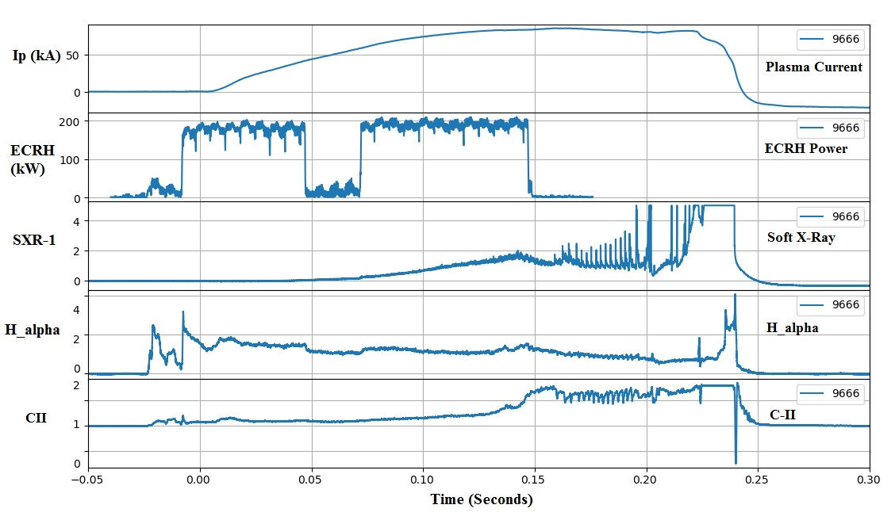
ECRH two pulse experiments in SST-1
In the recent ECRH results in SST-1, two ECRH pulses launched for plasma breakdown and heating simultaneously. The first pulse of 150kW power for 50ms duration and after a gap of 25ms another pulse is launched for 75ms. The breakdown is achieved successfully with first pulse as H_alpha appears with ECRH. The appearance of Hα with ECRH confirms the breakdown but variation of Hα throughout the plasma shot indicates that burn-through is not complete, could be due to presence of impurity in the plasma as carbon increases during the plasma shot. Although there is increase in soft X-ray signal with ECRH 2nd pulse but at this moment, it is not conclusive for plasma heating
Braj Shukla, EC-21, June 20-24, 2022, ITER-IO

Slide 14
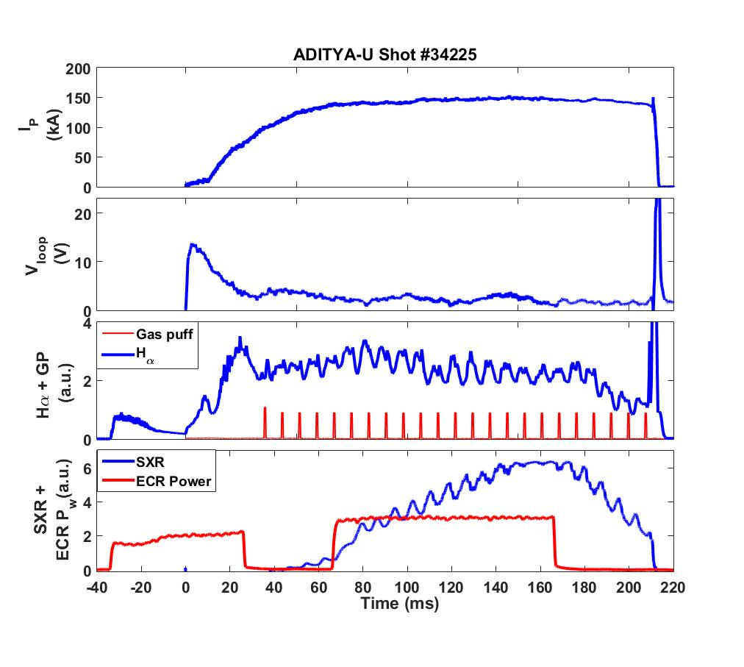
ECRH two pulse experiments in Aditya-U
In Aditya-U tokamak, two ECRH pulses launched in Aditya-U plasma, first pulse of ECRH is launched before the loop voltage and after a gap of 30ms another pulse is launched for plasma heating. The power in first pulse is 100kW while in second pulse 150kW power launched. In Aditya-U tokamak, the operating toroidal magnetic field is 1.35T, so ECR layer lies inboard side the plasma. The loop voltage is around 13V and successful discharge of more than 200ms is achieved with plasma current close to 150kA.
Braj Shukla, EC-21, June 20-24, 2022, ITER-IO

Slide 15
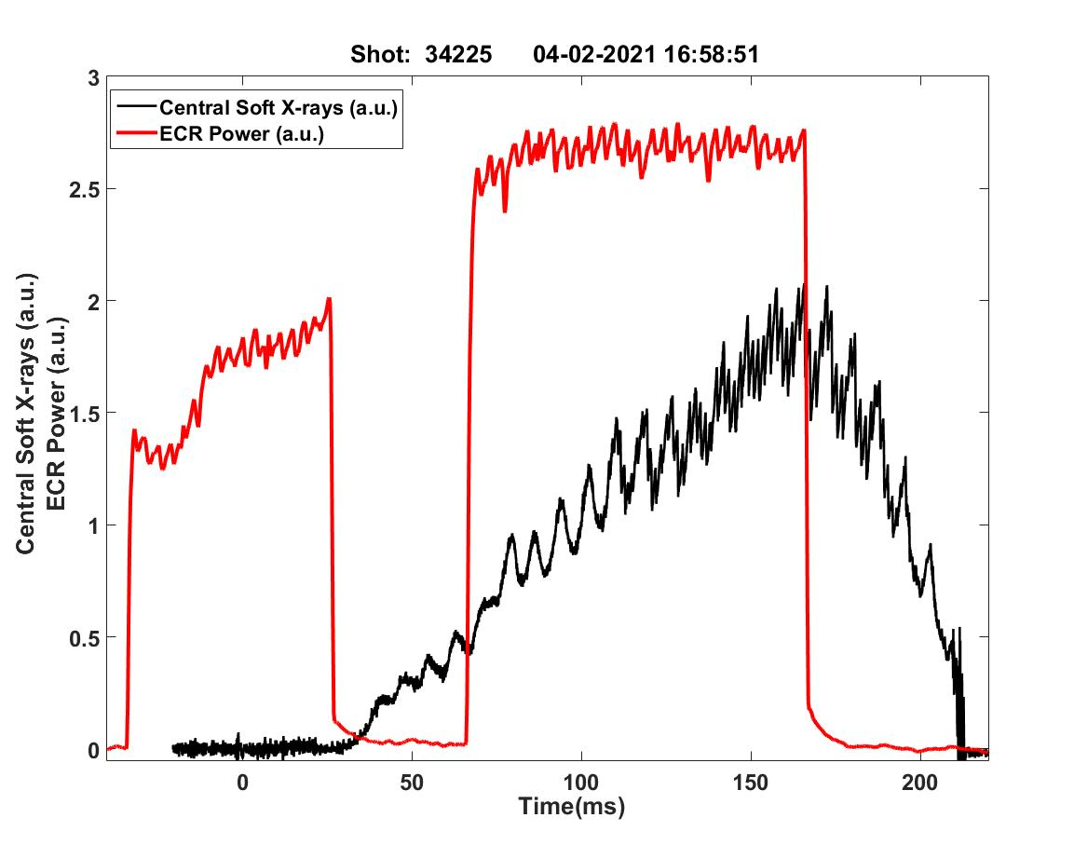
ECRH two pulse experiments in Aditya-U
In Aditya-U, the effect of plasma heating is observed as soft X-ray (SXR) exactly follows the ECH power . The soft x-ray (SXR) radiation depends on both electron density n_{e} and temperature T_{e}: P_{brem} ~ Z_{eff} n_{e}²√Te. So the increase in flux at the detector due to ECRH power could be either due to increase in density or due to increase in electron temperature. Considering the Aditya-U plasma is fully ionized, the increase in soft X-ray could be due to increase in electron temperature. This need to be further confirmed with supporting diagnostics and it is planned in next campaigns.
Braj Shukla, EC-21, June 20-24, 2022, ITER-IO

Slide 16
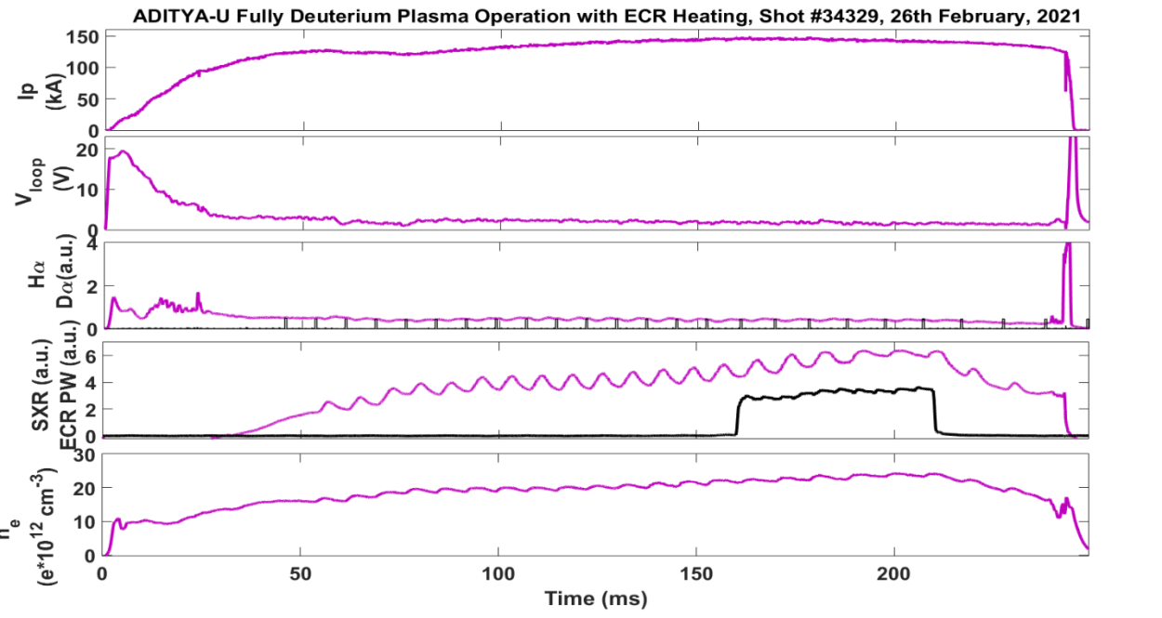
ECR Heating in Deuterium Plasma in Aditya-U
In Aditya-U, deuterium plasma experiments were carried and ECR heating used during this campaign. Around 200kW ECRH power for 50 ms duration is launched in deuterium plasma from 160ms to 210ms. The total plasma discharge length in this shot is around 245ms and plasma current close to 150kA . The effect of heating with ECRH power in D2-Plasma is also seen with the increasing trend of soft X-ray with ECRH power.
Braj Shukla, EC-21, June 20-24, 2022, ITER-IO

Slide 17
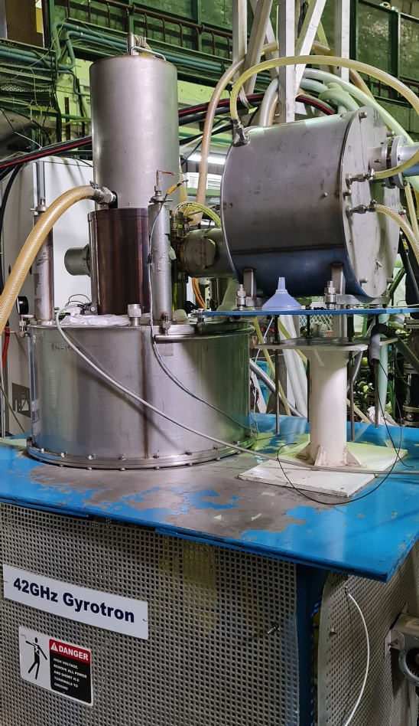
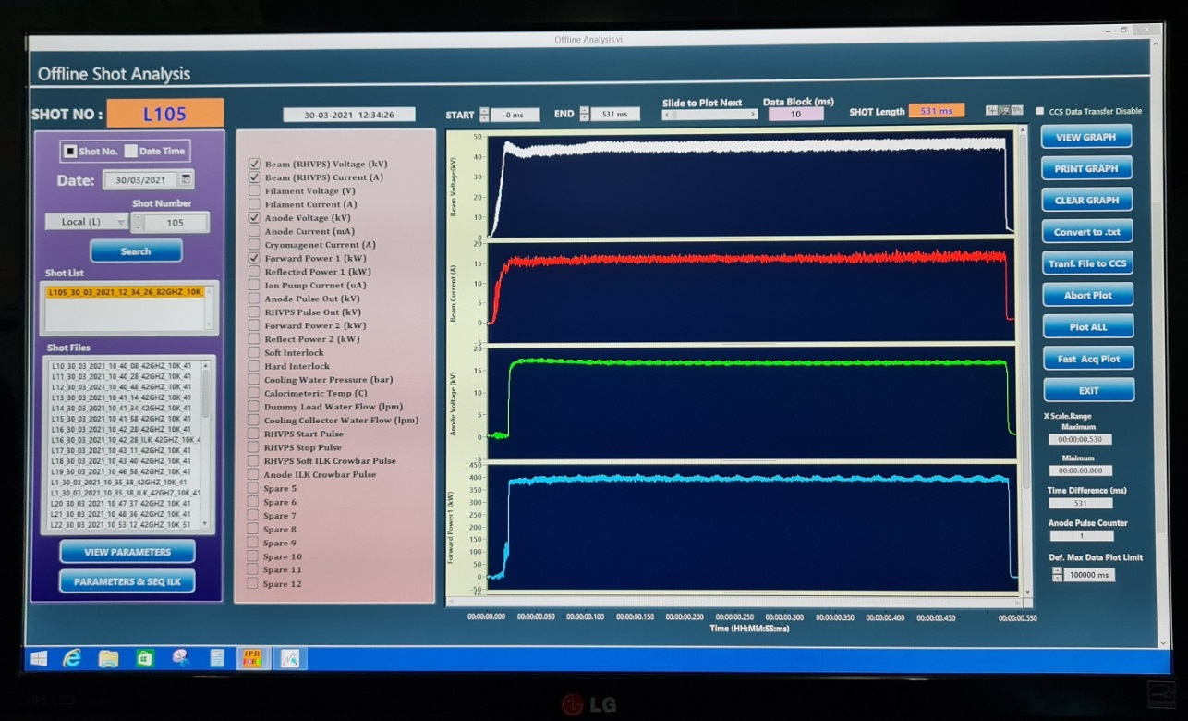
Replacement of 42GHz Gyrotron
In the SST-1, 42GHz-500kW ECRH system commissioned in 2013
Filament Hours of Gyrotron almost consumed
The system is renewed by replacing the existing Gyrotron with new Gyrotron in 2021
New Gyrotron commissioned for full parameters 500kW-500ms
Braj Shukla, EC-21, June 20-24, 2022, ITER-IO

Slide 18
ECRH upgradation Plan for SST-1
In the SST-1, 42GHz-500kW ECRH system is used to carry out breakdown and heating at fundamental harmonic (1.5T operating toroidal magnetic field).
The ECRH will upgraded by adding one more ECRH system in SST-1.
In 2010, 82.6GHz-200kW ECRH system commissioned on SST-1 to carry out breakdown and heating at 3.0T operation (fundamental harmonic) and 1.5T operation (second harmonic). This 200kW ECRH power was not sufficient for plasma start-up at second harmonic (1.5T) and ECR heating also demands higher power.
In order to carry out plasma experiments at higher ECRH power, the 82.6GHz is being upgraded in terms of power. The system is planned to achieve double power (400kW) at 82.6GHz frequency. This 82.6GHz ECRH system is already connected with SST-1 tokamak.
The Gyrotron will be upgraded in terms of power. With this upgradation, the entire ECRH system will be upgraded for SST-1 and total ECRH power in SST-1 will be increased to 900kW and it will facilitate to carry out several experiments related to plasma start-up at fundamental harmonic and heating at both the harmonics.
Braj Shukla, EC-21, June 20-24, 2022, ITER-IO

Slide 19
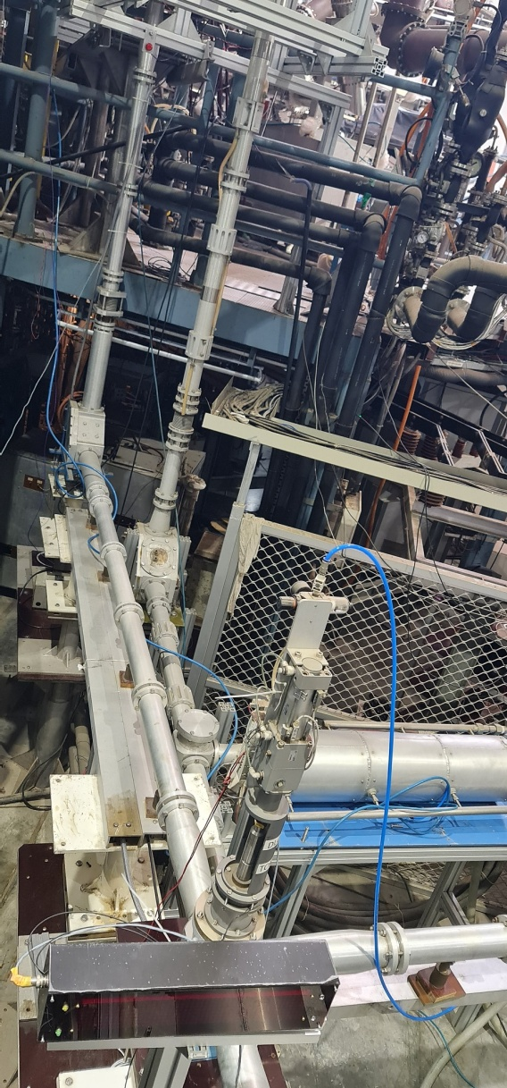
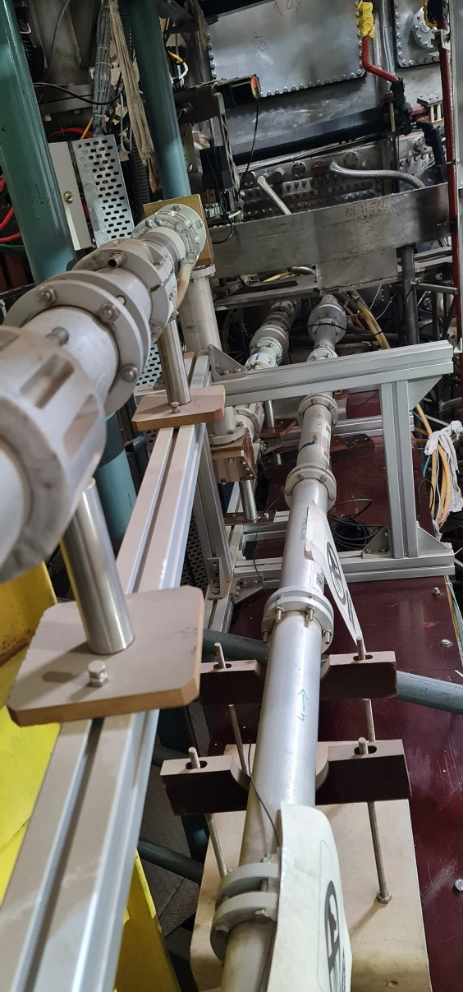
Current status of 82.6GHz ECRH system
The 82.6GHz ECH system is connected already, old Gyrotron is in process to upgrade from 200kW to 400kW
Power supplies are under commissioning stage
Dedicated DAC is under procurement
Braj Shukla, EC-21, June 20-24, 2022, ITER-IO

Slide 20
Summary
Last few years several ECRH experiments were carried out on tokamaks SST-1 and Aditya-U
The Power supply system is upgraded to launch two ECRH pulses from single Gyrotron and two ECRH pulse experiments are carried out in both the tokamaks successfully.
ECR Heating effect is observed in both the tokamaks but not very conclusive as we need more data from the diagnostics.
The 82.6GHz ECRH system will be upgraded for 400kW system, the Gyrotron upgradation is under process and expecting this system would be operational in a year.
ECRH experiments are scheduled in forthcoming campaigns, for SST-1 ECRH is mandatory system for start-up and for Aditya-U, there is flexibility to carry out dedicated experiments.
Braj Shukla, EC-21, June 20-24, 2022, ITER-IO

Slide 21
Thanks You
Braj Shukla, EC-21, June 20-24, 2022, ITER-IO

