Slide 1
ITER ECH&CD Control System: architecture, interfaces and status of development.
Giuseppe Carannante¹ , M. Cavinato², K. Cindric², P. De Vries¹, F. Felici³, M. Ferrari¹, G. Ferrò¹, M. Henderson⁴, A. Neto², M. Preynas¹, M. Reich⁵, F. Sartori² and L. Zabeo¹.
¹ ITER Organization, Saint-Paul Lez Durance, France
² Fusion for Energy, Josep Pla 2, Barcelona, 08019, Spain
³ Swiss Plasma Center - EPFL, Lausanne, Switzerland
⁴ UKAEA, Culham Science Centre, Abingdon, OX14 3DB, United Kingdom
⁵ Max-Planck-Institut für Plasmaphysik, Garching, Germany

Slide 2
Outline of the presentation
EC system layout
Functional analysis
Safety and protection functions
Control functions and interface with Plasma Control System
Operation principles
Test facility FALCON

Slide 3
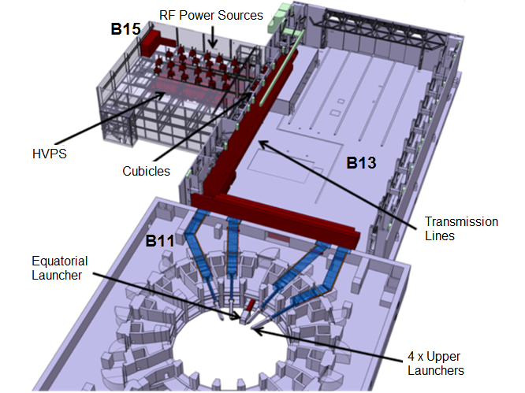
EC System layout and procurement strategy

Slide 4
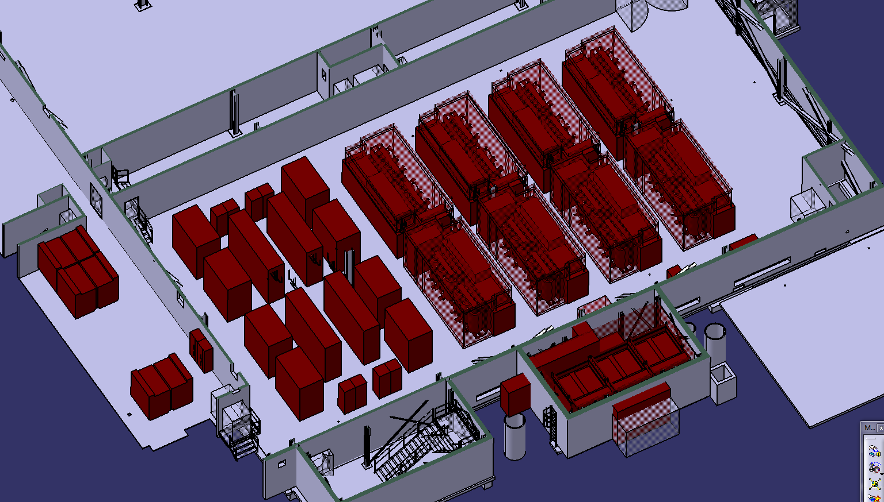
RF Building LEVEL 1
15-L1-01
7: 52HV04.CU.7001
8: 52HV04.CU.7002
5: 52HV03.CU.7001 6: 52HV03.CU.7002
8
6
7
5
DB
9
9: 52HVDL.CU.0001
DB
15-L1-03
4
2
3
1
3: 52HV02.CU.7001 4: 52HV02.CU.7002
1: 52HV01.CU.7001
2: 52HV01.CU.7002

Slide 5
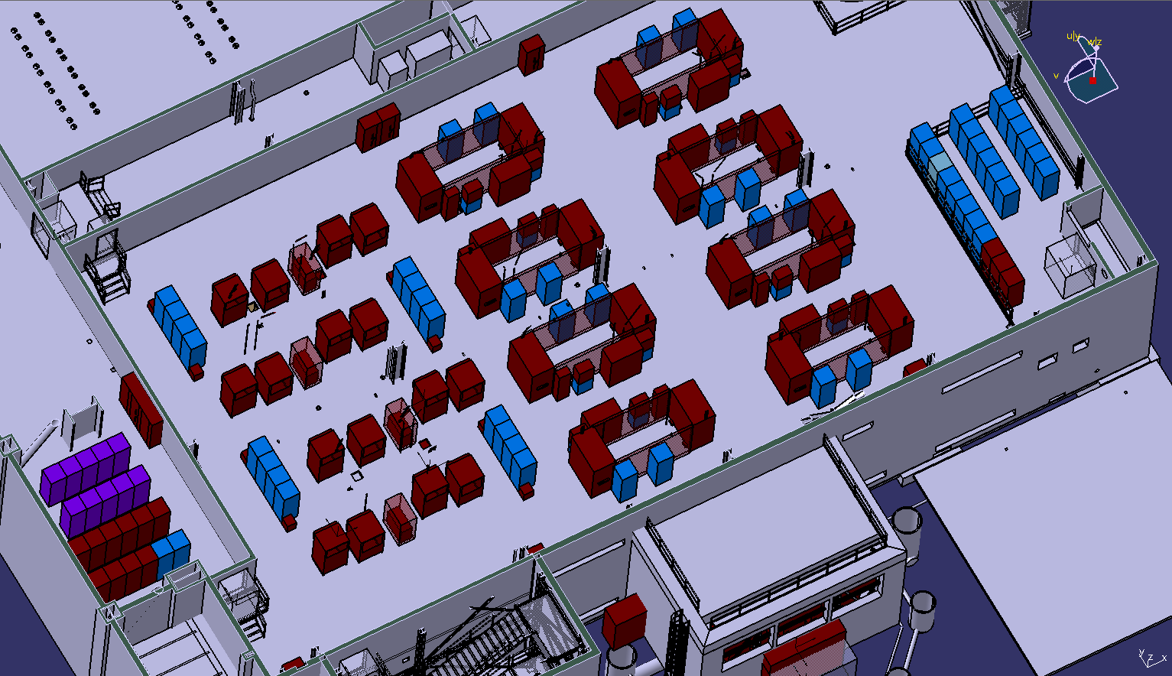
RF Building LEVEL 2
52CSTL (13 Cu)
52CSGY (56 Cu)
52CS00 (10 Cu)
26
27
DB
15-L2-01
26: 52RF23.CU.4300
27: 52RF24.CU.4300
Vacuum Cubicle (PBS31)
14
DB
35
8
15
DB
34
1
9
16
2
10
17
24: 52RF21.CU.4300
25: 52RF22.CU.4300
11
18
34: 52RF15.CU.4301 35: 52RF16.CU.4301
3
12
19
24
25
4
13
23
5
22
6
1: 52RF19-CU-4400
2: 52RF19-CU-4410
3: 52RF19-CU-4420
4: 52RF17-CU-4201
5: 52RF17-CU-4101
6: 52RF17-CU-4401
7: 52RF18-CU-4401
8: 52RF20-CU-4400
9: 52RF20-CU-4000
10: 52RF21-CU-4400
11: 52RF21-CU-4410
12: 52RF21-CU-4420
13: 52RF22-CU-4400
14: 52RF24-CU-4000
15: 52RF24-CU-4400
16: 52RF23-CU-4420
17: 52RF23-CU-4410
18: 52RF23-CU-4400
19: 52RF22-CU-4000
40: 52RF07.CU.4510
41: 52RF07.CU.4610
42: 52RF08.CU.4510
43: 52RF08.CU.4610
7
32: 52RF13.CU.4301 33: 52RF14.CU.4301
22: 52RF19.CU.4300
23: 52RF20.CU.4300
11
15-L2-03
44
33
12
44: 52RF06.CU.4610
45: 52RF06.CU.4510
46: 52RF05.CU.4610
47: 52RF05.CU.4510
45
32
13
43
46
31
42
47
30
1: 52CS00.CU.5001
2: 52CS00.CU.5002
3: 52CS00.CU.5003
4: 52CS00.CU.5004
5: 52CS00.CU.5005
6: 52CS00.CU.5006
7: 52CS00.CU.5007
8: 52CS00.CU.5008
9: 52CS00.CU.5009
10: 52CS00.CU.5010
41
11: 52CSTL.CU.5011
12: 52CSTL.CU.5012
13: 52CSTL.CU.5013
40
30: 52RF11.CU.4301
31: 52RF12.CU.4301
20
21
DB
DB
48
20: 52RF17.CU.4301 21: 52RF18.CU.4301
5
49
4
39
50
29
3
38
51
1
2
10
37
48: 52RF02.CU.4610
49: 52RF02.CU.4510
50: 52RF01.CU.4510
51: 52RF01.CU.4610
28
9
8
36
6
7
5
6
28: 52RF09.CU.4301
29: 52RF10.CU.4301
2
3
4
1
53
36: 52RF03.CU.4510
37: 52RF03.CU.4610
38: 52RF04.CU.4510
39: 52RF04.CU.4610
52
DB
10
9
1: 52CSTL.CU.5001
2: 52CSTL.CU.5002
3: 52CSTL.CU.5003
4: 52CSTL.CU.5004
5: 52CSTL.CU.5005
6: 52CSTL.CU.5006
7: 52CSTL.CU.5007
8: 52CSTL.CU.5008
9: 52CSTL.CU.5009
10: 52CSTL.CU.5010
8
7
52: 52RF09-CU-4501 53: 52RF13-CU-4501
DB

Slide 6
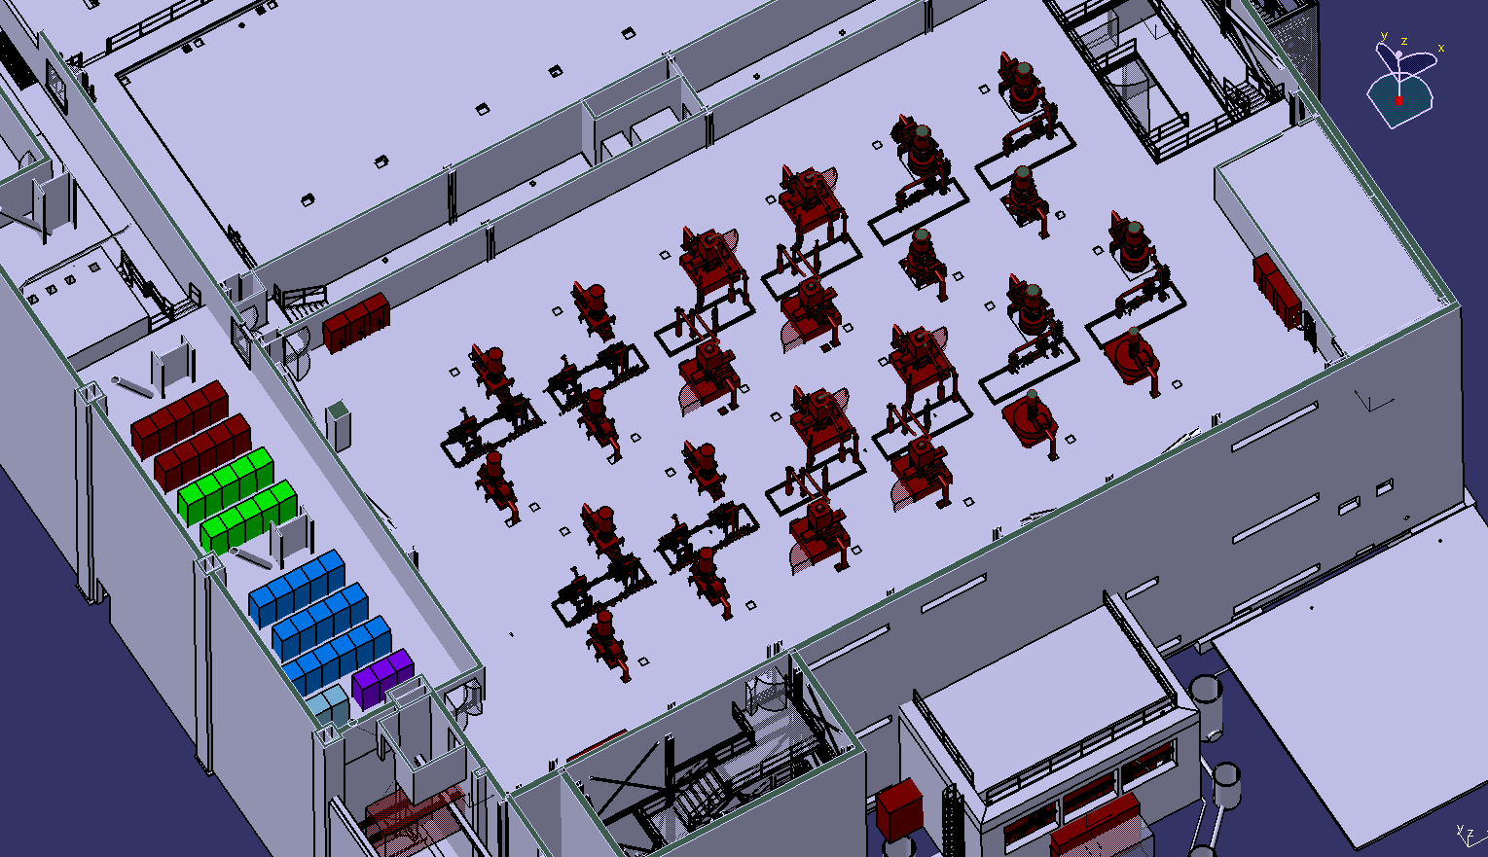
RF Building LEVEL 3
52CSTL (10 Cu)
52CSGY (16 Cu)
52CS00 (3 Cu)
52CSPC (10 Cu)
Control room
DB
1: 52CSTL.CU.6001
2: 52CSTL.CU.6002
3: 52CSTL.CU.6003
4: 52CSTL.CU.6004
5: 52CSTL.CU.6005
6: 52CSTL.CU.6006
7: 52CSTL.CU.6007
8: 52CSTL.CU.6008
9: 52CSTL.CU.6009
10: 52CSTL.CU.6010
DB
15-L3-03
1: 52RF15.CU.4101
2: 52RF11.CU.4201
3: 52RF11.CU.4101
4: 52RF11.CU.4401
5: 52RF12.CU.4401
6: 52RF15.CU.4201
7: 52RF09.CU.4201
8: 52RF09.CU.4101
9: 52RF09.CU.4401
10: 52RF10.CU.4401
11: 52RF13.CU.4201
12: 52RF13.CU.4101
13: 52RF13.CU.4401
14: 52RF14.CU.4401
15: 52RF15.CU.4401
16: 52RF16.CU.4401
15-L3-01
5
4
3
2
10
1
9
8
7
6
5
4
3
2
10
1
9
8
7
1: 52CSPC.CU.6001
2: 52CSPC.CU.6002
3: 52CSPC.CU.6003
4: 52CSPC.CU.6004
5: 52CSPC.CU.6005
6: 52CSPC.CU.6006
7: 52CSPC.CU.6007
8: 52CSPC.CU.6008
9: 52CSPC.CU.6009
10: 52CSPC.CU.6010
6
5
4
3
2
10
1
9
8
7
16
6
15
14
13
3
12
2
11
1
1: 52CS00.CU.6001
2: 52CS00.CU.6002
3: 52CS00.CU.6003
DB
2x Vacuum Cubicles (PBS31)

Slide 7

EC Transmission Lines layout
Up to 3 switches per line allow the power to be distributed to different launching points. The overall switching takes up to 3 seconds to be executed.

Slide 8
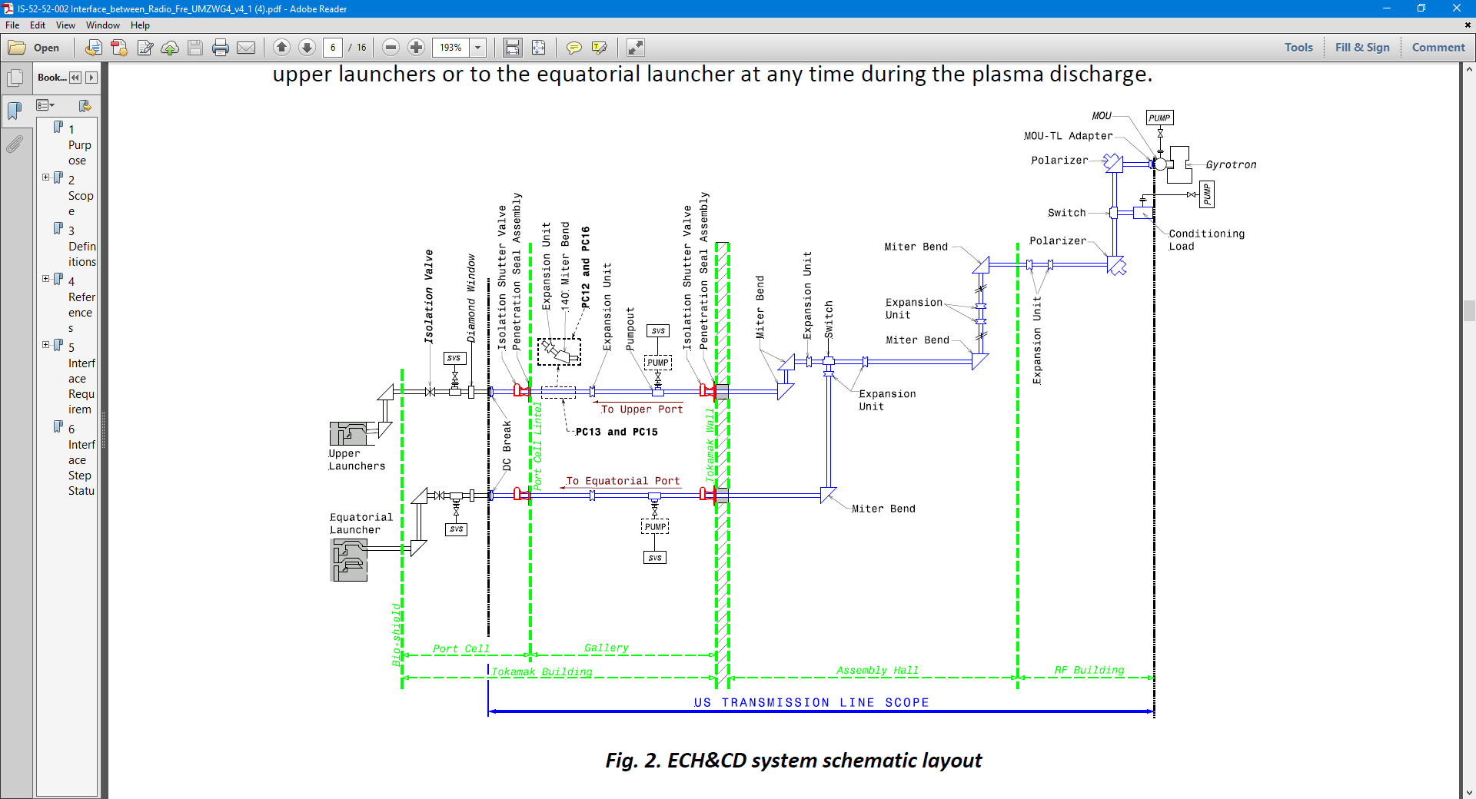
EC Transmission Line detail
Picture courtesy of USIPO.

Slide 9
Safety functions
Safety function | Actuating system | Safety class | Action | Triggering signals
PRIMARY CONFINEMENT
Isolation of ex-vessel waveguides (before diamond window) | Vacuum System | SIC-1 | Valve Closure | - fire, earthquake, increase radiation in port cell, overpressure in the VV - arc detection in diamond window - leak detection at diamond window
Isolation of gas supply to steering mirror | EC System / Central Safety System | SIC-1 | Valve Closure | - fire, earthquake, increase radiation in port cell, increase of pressure in the VV - loss of pressure in Steering Mechanism circuit

Slide 10
Safety functions
Safety function | Actuating system | Safety class | Action | Triggering signals
SECONDARY CONFINEMENT
Isolation of shutter valves for building confinement | EC System / Central Safety System | SIC-2 | Valve Closure | - fire, earthquake, increase radiation in port cell or gallery, overpressure in port cell or gallery, - loss of cooling in EW cooling and ISV cooling - arc detection in diamond window
Isolation of valves on cooling water lines crossing PC lintel (transmission line cooling) | EC System / Central Safety System | SIC-2 | Valve Closure | - fire, earthquake, increase radiation in port cell or gallery, overpressure in port cell or gallery

Slide 11
Protection functions
Protection function | Detecting SCU
Arc inside the gyrotron tube | HVPS
Arc on gyrotron output window and MOU | Gyrotron
Mode jump in gyrotron | Gyrotron
Cooling fault at gyrotron | Gyrotron
Arc in the RF dummy load | TL
Cooling fault at dummy load and TL | TL
Polarizers control malfunctioning | TL
Arc on diamond window (vessel side) | EW
Cooling fault at EW | EW
Cooling fault at diamond window | EW
Arc inside launcher | Launcher
Cooling fault at launcher | Launcher
Steering mirror control malfunctioning | Launcher
Poor vacuum in MOU, TL, RF dummy load | Vacuum system
To execute stop requests from PCS | ECPC
To execute stop requests from CIS | ECPC
To execute stop requests from CSS | ECPC
All the subsystems implement their local protection functions.
Plant-level protection functions are the ones where the EC Plant Controller has to intervene, because the detection and the actuation are not performed by the same subsystems.
The action is always to switch off the HVPS connected to the faulty subsystem, other actions could also be required.

Slide 12
Gyrotron protection functions

Slide 13
Gyrotron protection functions

Slide 14
Control functional analysis
The EC system is used for many plasma control functions:
Assist breakdown
Plasma heating
Current profile control
Impurity control
MHD control
Current drive
Wall conditioning

Slide 15
Functional analysis

Slide 16
Interface with Plasma Control System
PCS
ECPC
The knowledge of the current EC plant status is translated into relevant plasma parameters.

Slide 17
Interface with Plasma Control System
PCS
ECPC
The EC system availability is computed for the current time and for the near future (3 s).

Slide 18
Interface with Plasma Control System
PCS
ECPC
The PCS computes required references as direct power requests but also as preparation for future actions (allocate power to a certain location without firing).

Slide 19
Interface with Plasma Control System
The implementation of NTMs is an open issue both in terms of requirements and implementation.
Power modulation is likely to be required up to 5 kHz. Different solutions are possible:
PCS implements the complete function and sends frequency and phase references to ECPC. ECPC implements a phase locked loop at higher frequency.
  The PCS-ECPC communication rate is up to 1 kHz.
  The assumption is that the phase variation on the magnetic islands is slower than the communication rate.

Slide 20
Interface with Plasma Control System
ECPC (or a separate controller) implements the NTM control function with a direct link to a dedicated diagnostic:
  100 kHz link with the Magnetics measurements. Not included in the baseline and under investigation for feasibility.
  Direct link with an inline ECE diagnostic, to be installed in an EC unused line. Not included in the baseline.

Slide 21
EC Control System hierarchy
EC Plant
Controller
Subsystems
Control
Units (SCU)

Slide 22
EC Operation
Plant Controller can be:
Synchronous with the ITER pulse
  Plant Controller state machine is synchronized to the ITER state machine
Asynchronous with the ITER pulse
  Plant Controller state machine is NOT synchronized to the ITER state machine but is managed by the EC operator
Each Subsystem Control Unit can be:
Synchronous with its supervisor (Plant controller or Gyrotron SCU)
  SCU state machine is synchronized with its supervisor’s state machine
Asynchronous with respect to its supervisor
  SCU state machine is managed by an operator

Slide 23
EC Operation
Plant Controller is in SYNCHRONOUS operation
N SCUs are in synchronous operation
M SCUs are in asynchronous operation
P SCUs are OFF

Slide 24
EC Operation
Plant Controller is in ASYNCHRONOUS operation
N SCUs are in synchronous operation
M SCUs are in asynchronous operation
P SCUs are OFF

Slide 25
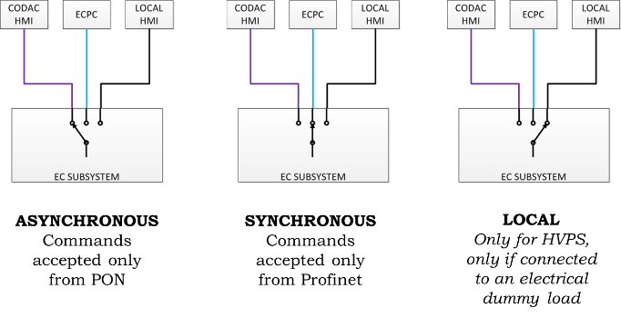
EC Operation

Slide 26
EC Control System architecture

Slide 27
EC Control System architecture
Real-time control function

Slide 28
EC Control System architecture
Fast protection function

Slide 29
EC Control System architecture
Slow protection function

Slide 30
Test facility FALCON
An EC test facility has been built by F4E and the Swiss Plasma Center in Lausanne in 2015, to test the Upper Launcher components.
Two gyrotrons are present in the facility:
An ITER like gyrotron from Gycom
A prototype of the EU gyrotron manufactured by Thales.
Control system

Slide 31
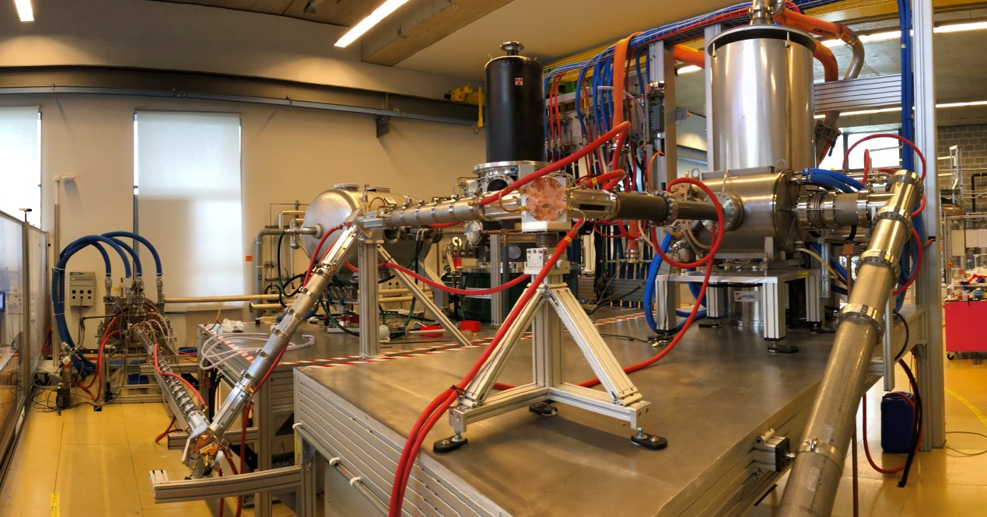
Test facility FALCON

Slide 32
Test facility FALCON
Since a new control system had to be built, we decided to take the opportunity to build a prototype of the ITER ECPC and Gyrotron SCU.
The same technology in terms of hardware and software has been used and also the same control system architecture.
All the operation concepts (operation modes, state machines) were also implemented and tested there.
The details of the control system implementation were presented in the poster “Status of the ITER ECRH&CD control system development” on Thursday.

Slide 33
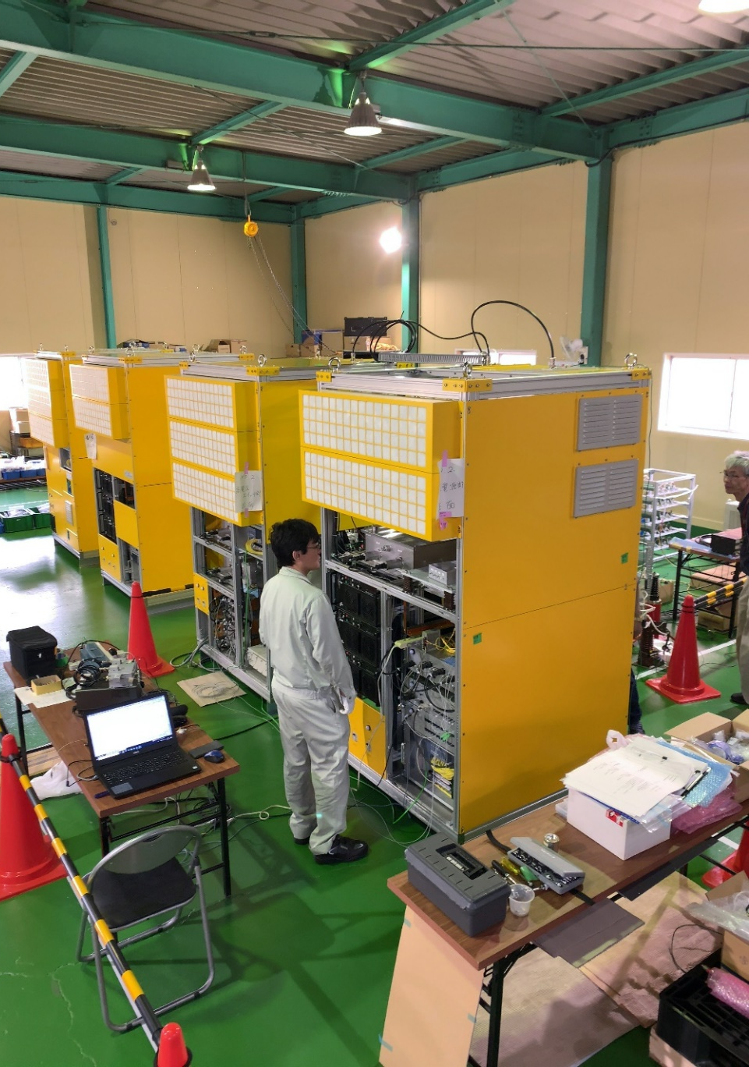
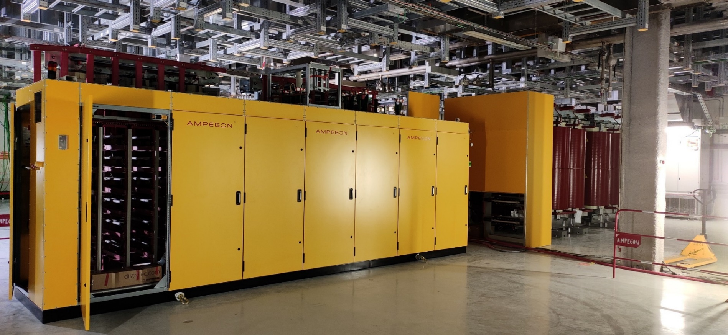
EC Power supplies at ITER
MHVPS procured by F4E are being installed and they will be commissioned starting at the end of the year.
APS/BPS procured by JADA will be tested next year.
Factory tests of AP/BPS at JADA
Two sets of HVPS from EUDA are under installation in B15

Slide 34
Conclusion & future work
The installation of HVPS and gyrotron started in 2022 in B15. HVPS commissioning will start in October.
ECPC is delivered in stages:
The first stage is to test HVPS, gyrotrons and TL
The second stage is for the first integrated commissioning and First Plasma
The third stage is for the entire EC system integrated commissioning and PFPO-1 campaign
The fourth stage is for the advanced plasma protection functions

Slide 35
Conclusion & future work
While making sure we can safely commission all the subsystems, we are working toward the final system requirements:
Clarify the interface to PCS for the implementation of advanced functions
Investigate the diagnostics needs for NTM control
Investigate the control needs for the gyrotron operation (automatic conditioning and beam stabilization).
All these activities involve 5 different DAs and it is the results of a big distributed effort of all the parties including the Iter Organisation, the DAs and fusion laboratories around the world.

Slide 36
Thank you!
Questions?

Slide 37
Backup slides

Slide 38
HVPS Operation

Slide 39
HVPS Operation
Local HMI
CODAC HMI

