Slide 1
Experiments with reduced single pass absorption at ASDEX Upgrade - instrumentation and applications
Martin Schubert, J. Stober, A. Herrmann, E. Grigore ¹, W. Kasparek ², C. Lechte ²,
F. Monaco, B. Petzold, B. Plaum ², E. Poli, C. Ruset ¹, S. Vorbrugg, D. Wagner, ASDEX Upgrade Team ³
Max-Planck-Institut für Plasmaphysik, Garching
¹ Institute for Laser, Plasma and Radiation Physics, Magurele, Romania
² Institut für Grenzflächenverfahrenstechnik und Plasmatechnologie, Stuttgart
³ See author list of U. Stroth et al. 2022 Nucl. Fusion 62 042006

Slide 2
Contents
Two-pass scheme ASDEX Upgrade
Thermocouple measurement within the reflecting gratings
Data evaluation
Exemplary results
Summary

Slide 3
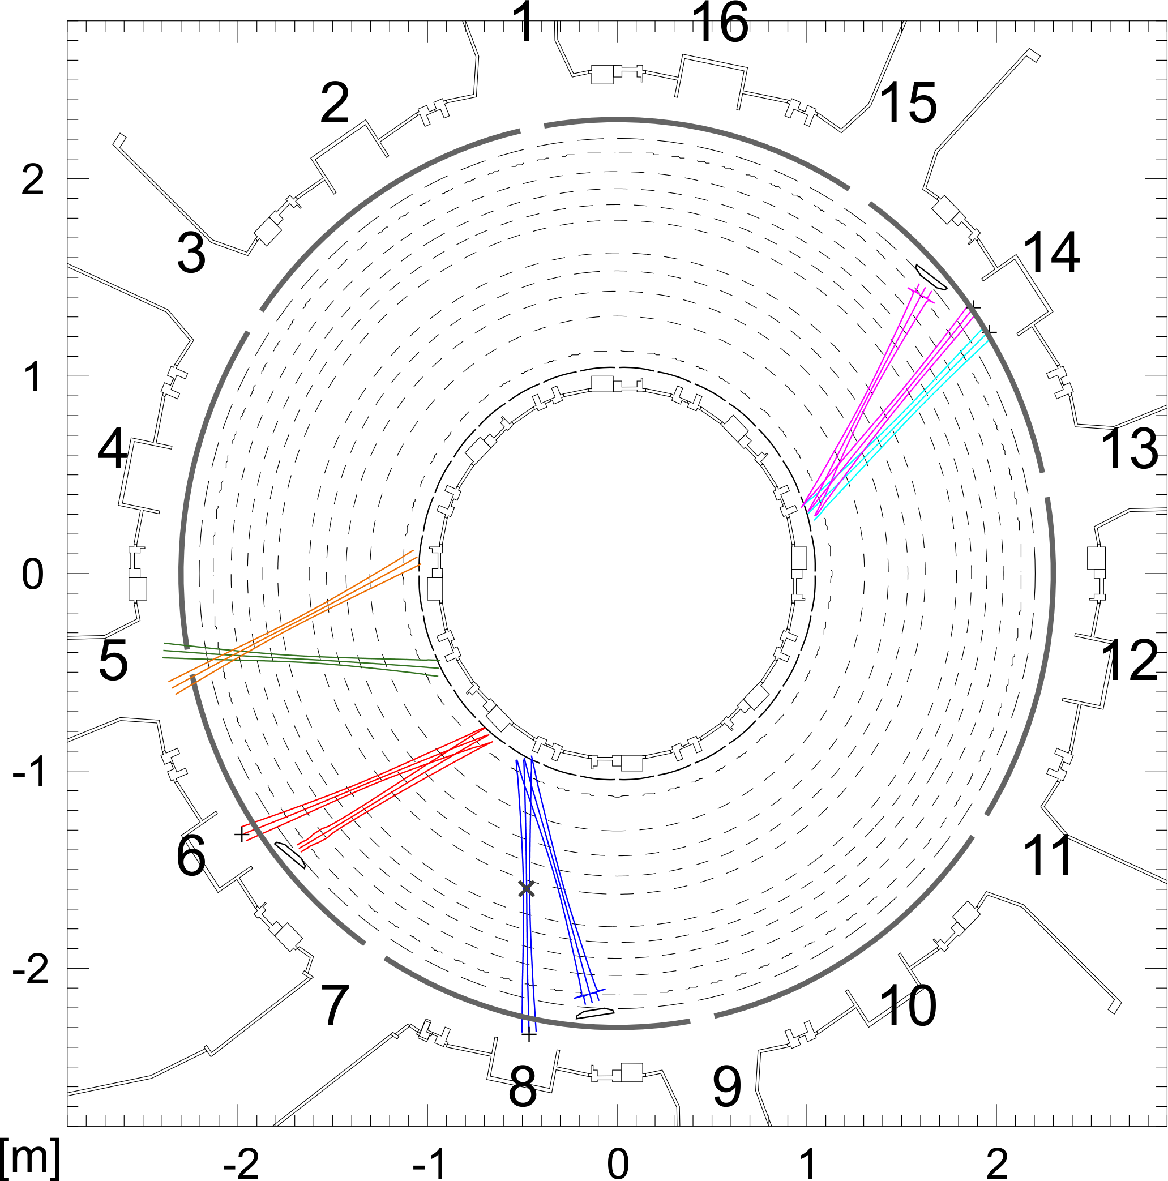
Two-pass scheme ASDEX Upgrade
Top view ASDEX Upgrade (AUG) with segment numbers
Eight ECRH launchers in Segments:
5 (x4), 6, 8, 14 (x2)
Launchers Seg 5 stacked vertically
Reflected beams Seg 5 on top of incoming
Heat Shield: position on the inner column of AUG, where reflecting gratings are mounted
Design of oblique geometry in order to maximize O-2 absorption

Slide 4
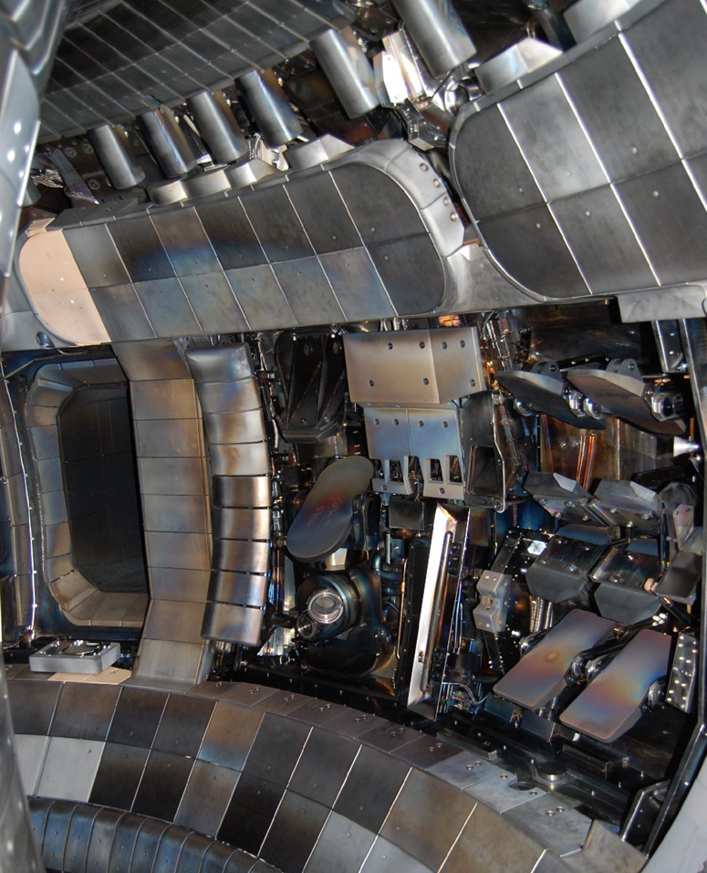
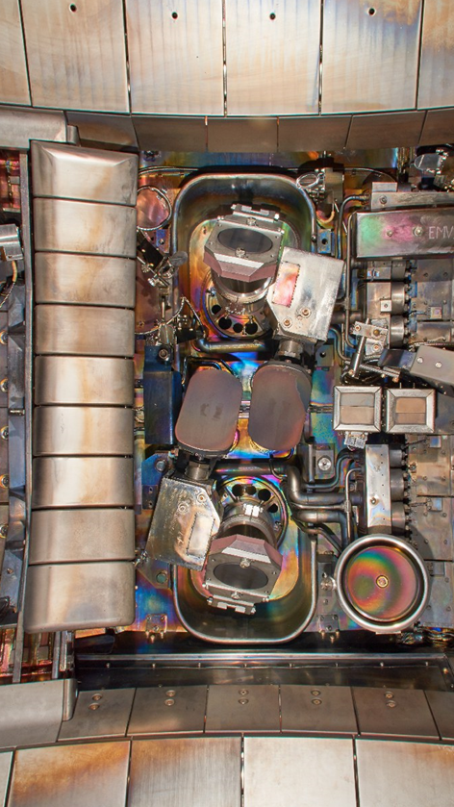
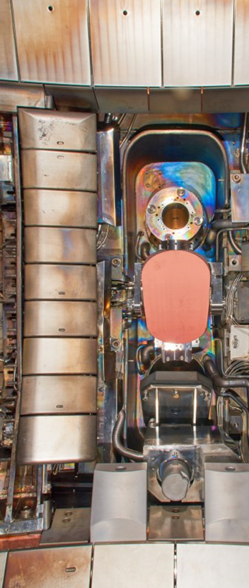
Inside the AUG vacuum vessel:
ECRH Launchers
Robust surfaces and auxiliary limiters were used as designed end point after 2nd pass
This launcher #6 will be used later

Slide 5
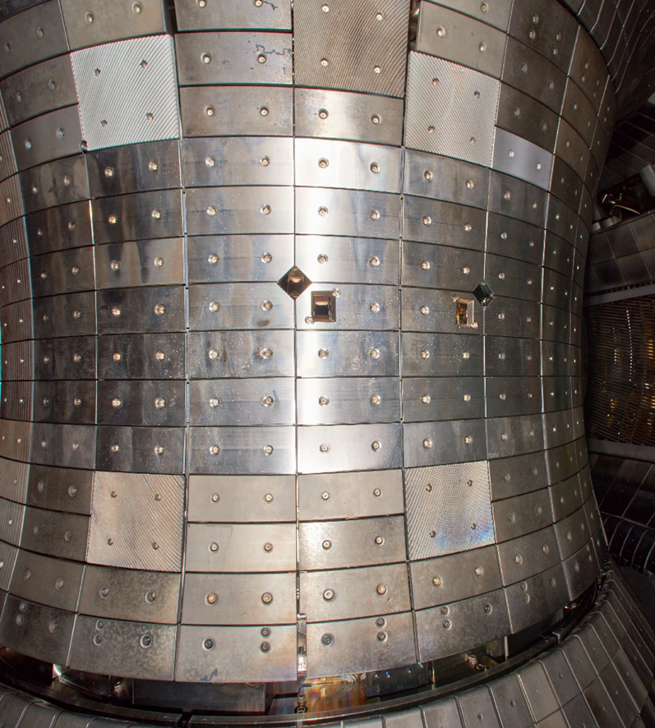
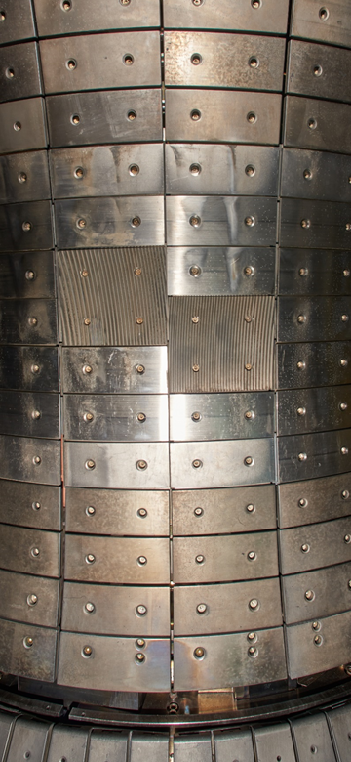
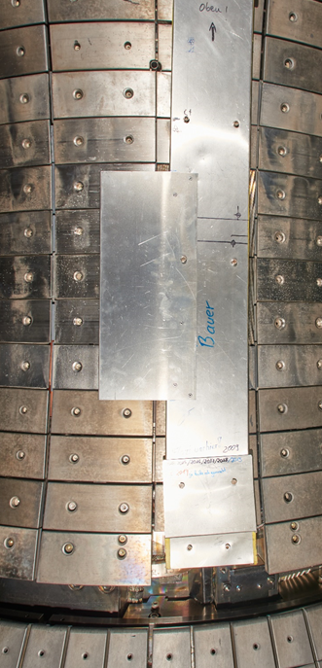
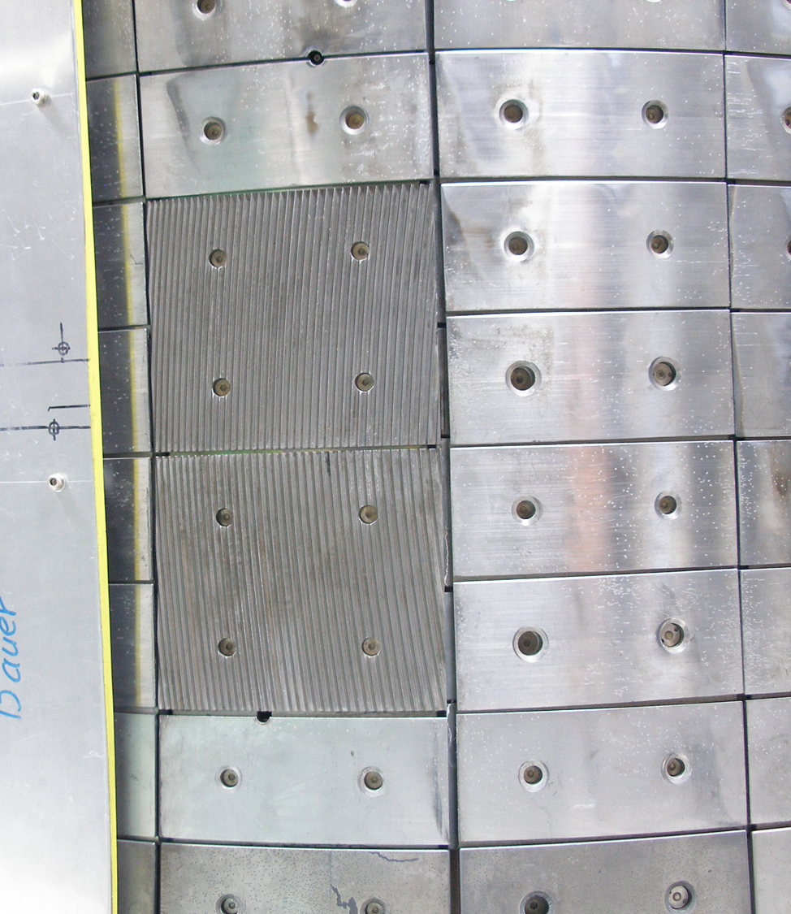
Inside AUG vac vessel: Heat Shield, reflecting gratings
Seg 13
Seg 7
Seg 13
Seg 6
Seg 4
Seg 5

Slide 6

Tungsten coating of W1.4901 steel
Gratings in Seg7 and Seg13 manufactured out of W1.4901 steel
Coating necessary to increase reflectivity
Thin tungsten coating ~ 10 µm using Mo interlayer
Technique newly developed by INFLPR, Magurele, Romania

Slide 7
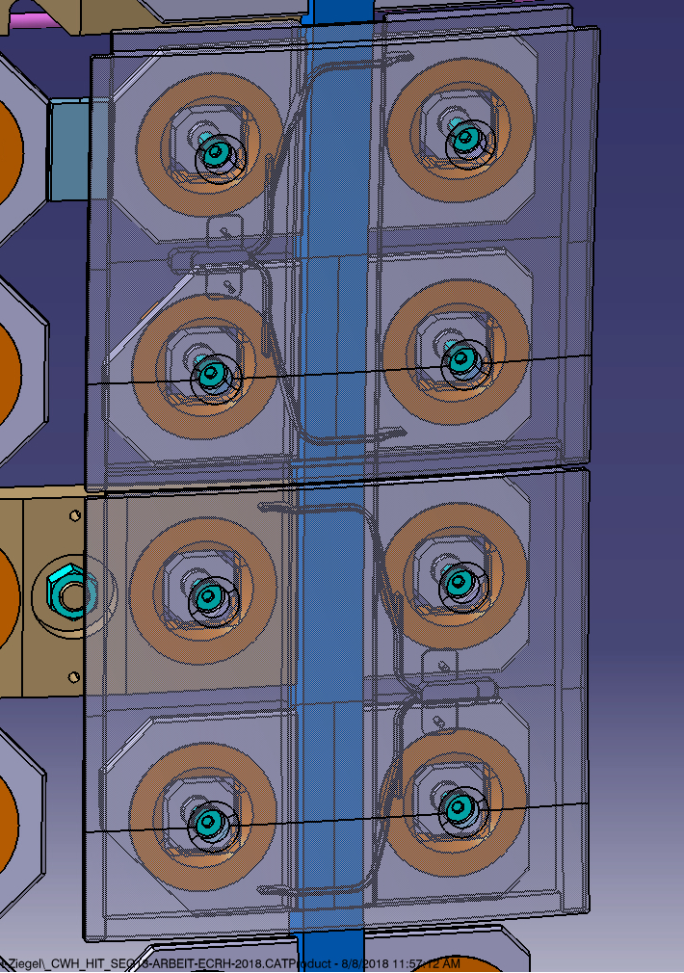
Thermocouple measurement, reflecting gratings
Idea: flush-mounted thermocouple
Borehole diameter 0.5 mm
Thermocouple, outer diameter 250 µm
Type K, NiCr-Ni, T_{max} 1300 ºC
sensitivity 40.96 µV / K
Side view of the tile
Plasma facing side
Incoming
mm-wave power
cable
Roessel Messtechnik GmbH,
PI 071 Mantel-Thermoelemente

Slide 8
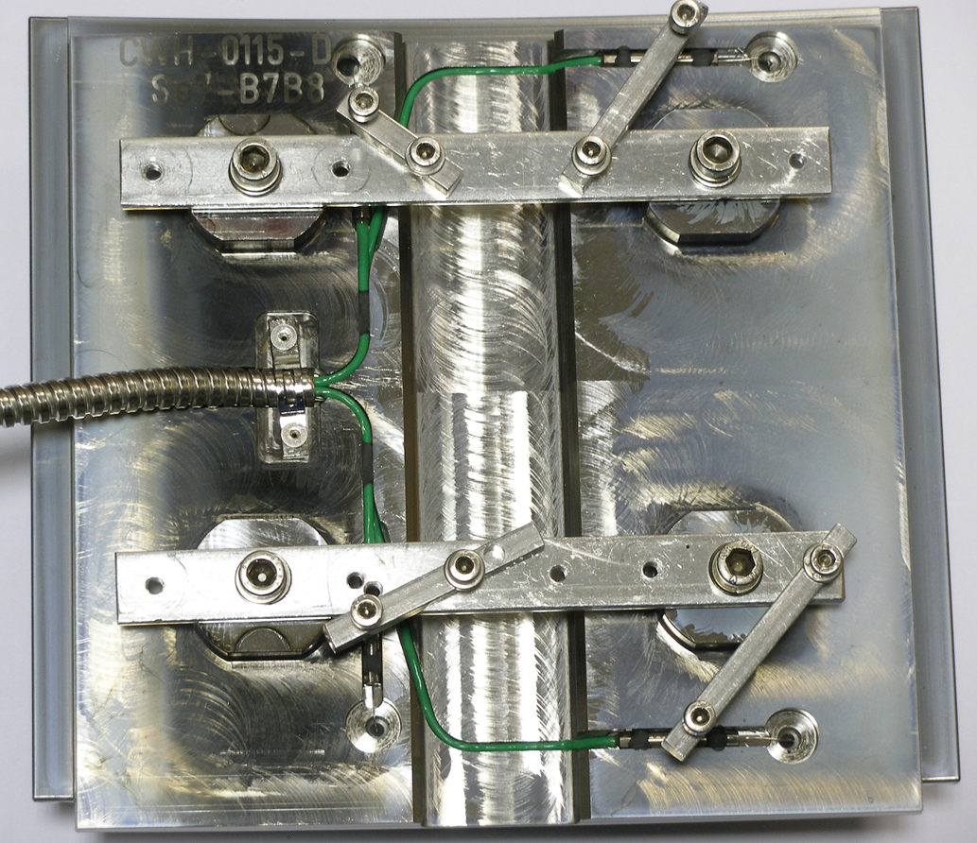
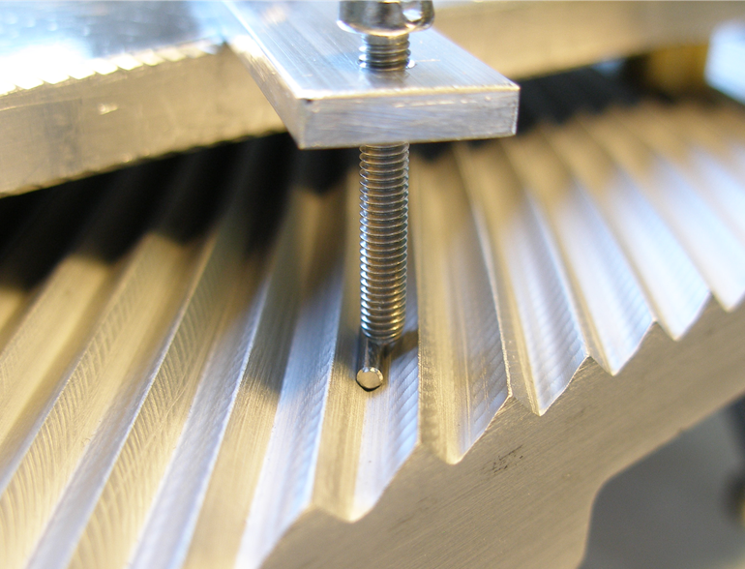
Thermocouple mount - assembly
Ensure flush-mount
Optimized design: cable channels built-in into the tile
Additional cable shielding by flexible metal tube
Acknowledgement: H. Schütz for careful mechanical work

Slide 9
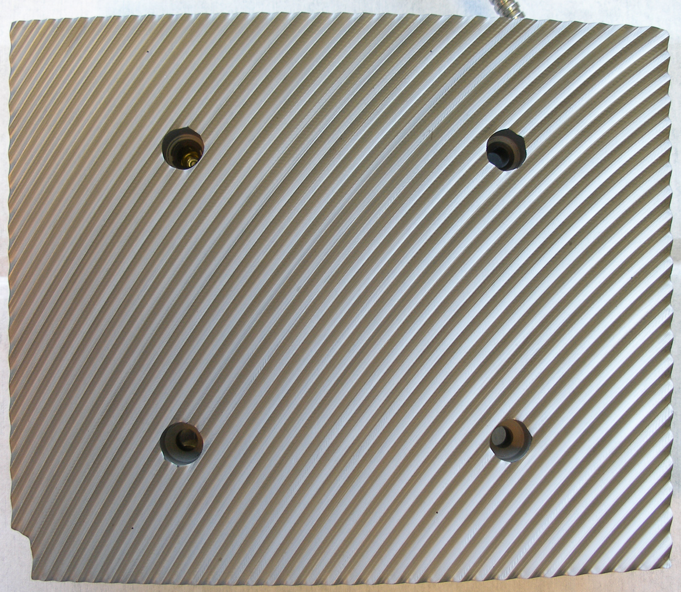
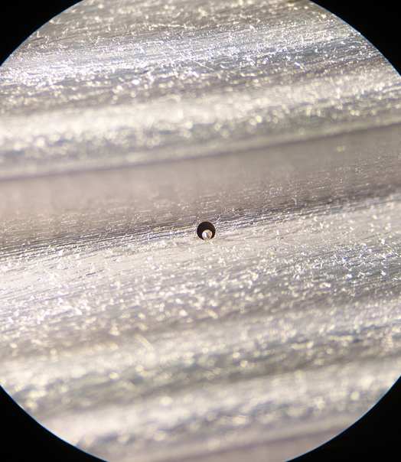
Thermocouple mount - finish
Microscope photo

Slide 10
Data evaluation
What is the consequence of the flush mount?
Power
Large bulk, temperature sensor
inside the bulk
ΔT
Timing of pulse train comparable
to characteristic time of the sensor
t
ΔT
t

Slide 11
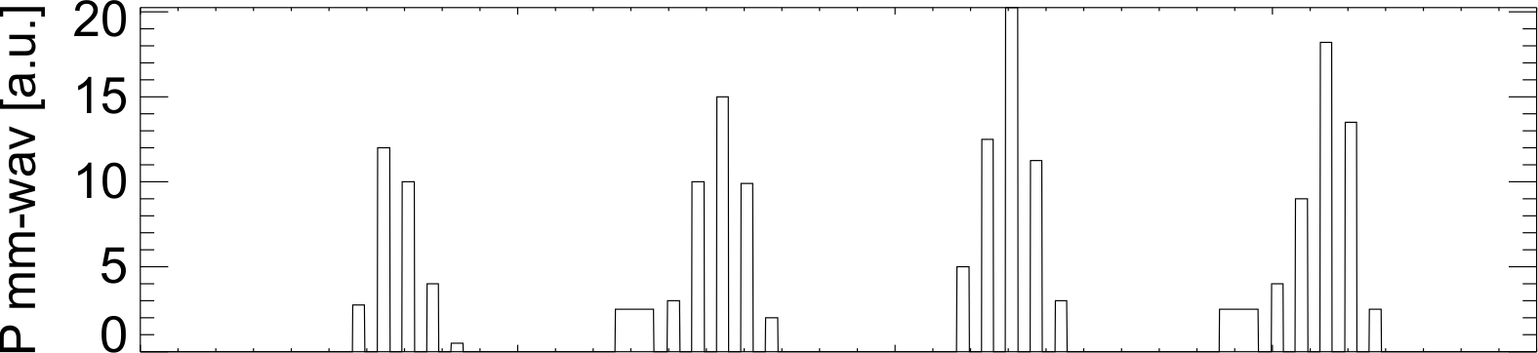
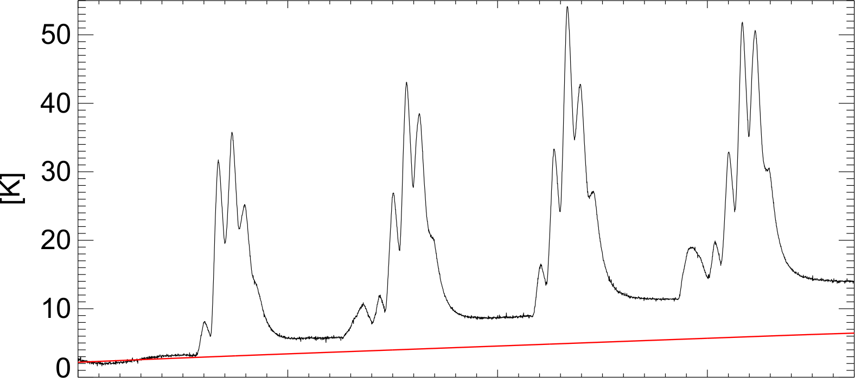
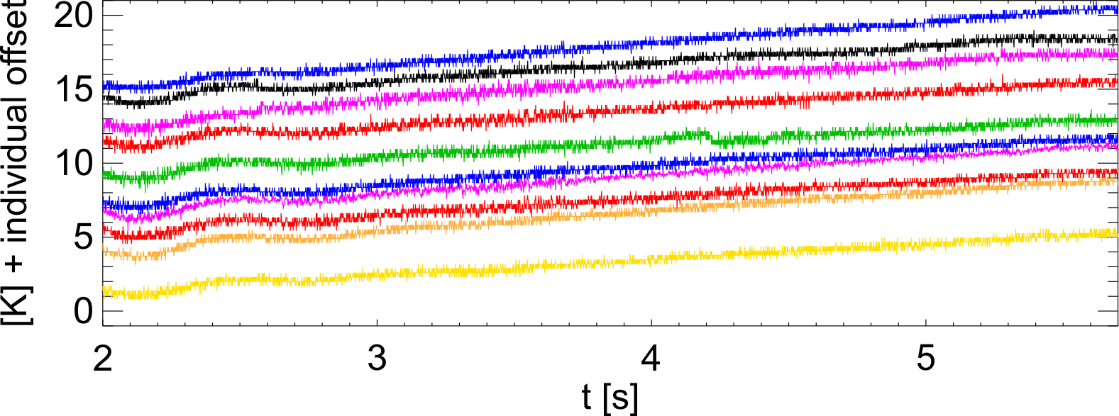
Signal and background – AUG #39747, Gyrotron #6
Timing of Gyrotron 6, model amplitude
Thermocouple signal compared to averaged background (red)
Last row: distant thermocouples, not hit by mm-wave beam, artificial offset for better visibility
  No trace of mm-wave pulse train on distant thermocouples
  Background (plasma load) can be assumed homogeneous across tile
ΔT
ΔT
~ 10 ms
Signal temperature after one pulse train does not return to the background level
Characteristic time delay ο(10 ms)
of the temperature signal

Slide 12

Evaluation model
C_{M}
·
C_{SM}
C_{SM} T_{SM} = A_{SM} (p_{bg} + p_{A}) – k_{SM} (T_{SM} – T_{M})
C_{M} T_{M} = k_{SM} (T_{SM} – T_{M}) – k_{MN} (T_{M} – T_{NB})
f_{NB} C_{B} T_{NB} = f_{NB} A_{tl} (p_{bg} + p_{A}) + k_{MN} (T_{M} – T_{NB}) – k_{NB} (T_{NB} – T_{IB})
f_{IB} C_{B} T_{IB} = f_{IB} A_{tl} (p_{bg} + r_{IB} · p_{A})
A_{SM}
·
k_{SM}
k_{MN}
T_{NB}
“Near Bulk”
p_{A} absorbed mm-wave intensity
p_{bg} (homogeneous) background intensity
T_{M} measured quantity
·
C_{B} (entire tile)
For simplicity: set next temperature zone T_{IB}
as boundary condition, no energy flow from T_{NB}
A_{SM}
A_{tl}
·
A_{NB} = f_{NB} A_{tl}
f_{IB} A_{tl}
Apply fraction r_{IB} of Gyrotron power,
important for the baseline in the measurement signal
“intermediate bulk”

Slide 13
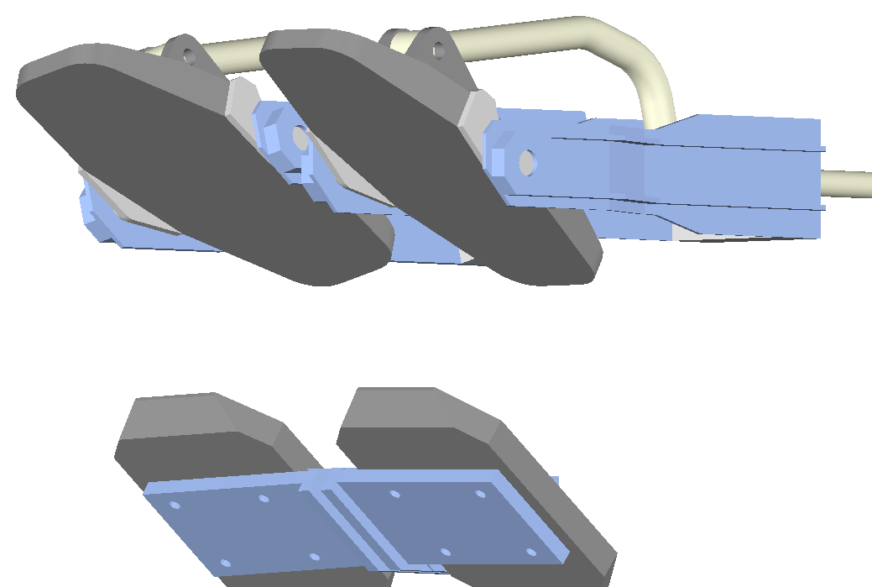
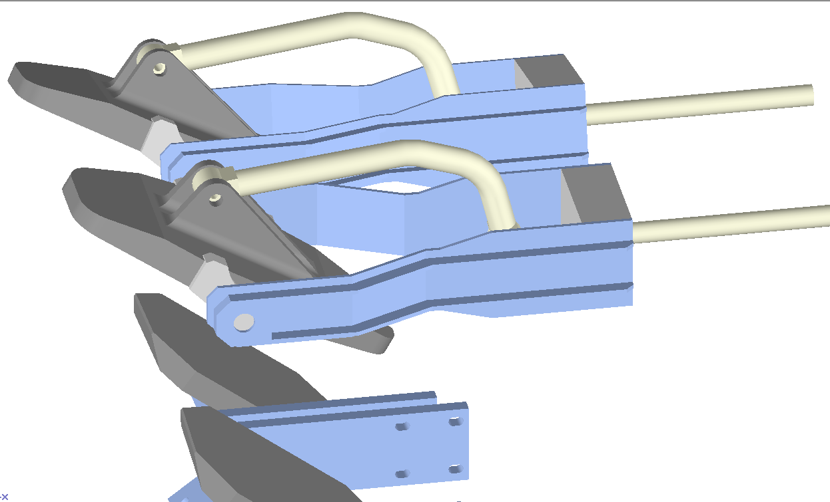
Exemplary results – setup 1/3
Push-rod position
Fast steerable launchers

Slide 14
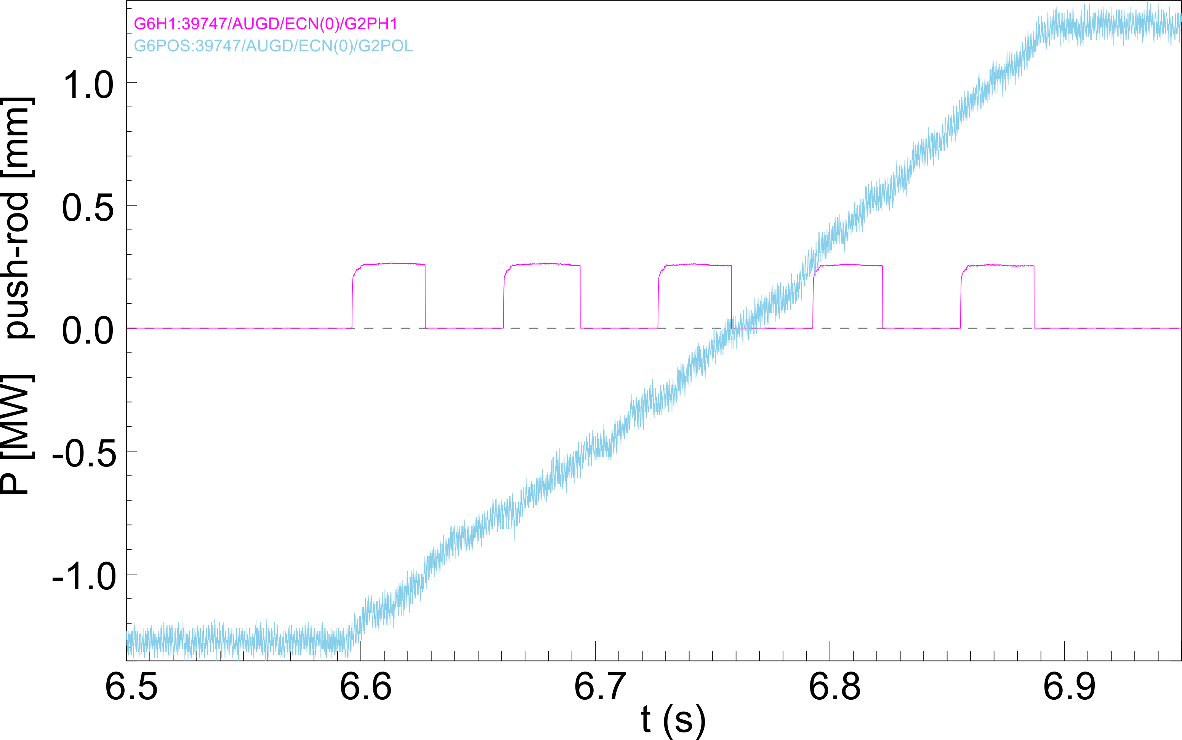
Exemplary results – setup 2/3
Timing of Gyrotron pulses and push-rod position

Slide 15
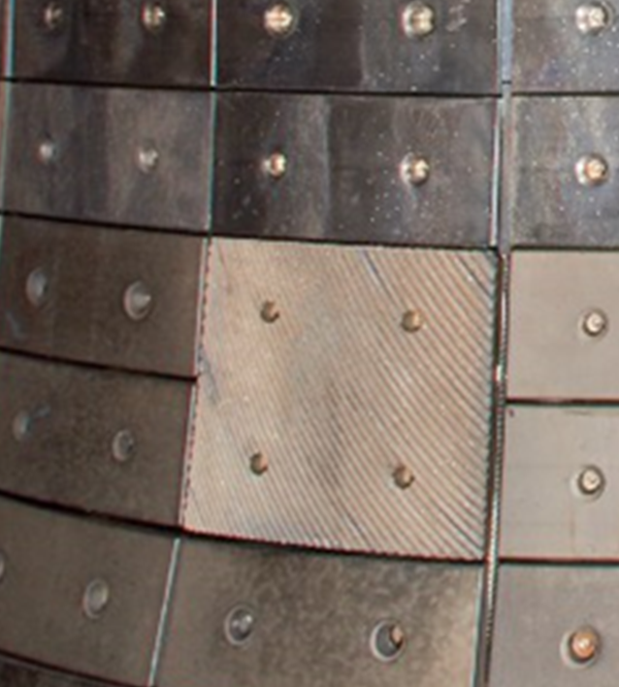
Exemplary results – setup 3/3
126 mm
44 mm
Beam position on the Heat Shield for the five pulses in the pulse train, function of the push-rod position
Heat shield, reflecting grating (double tile)

Slide 16
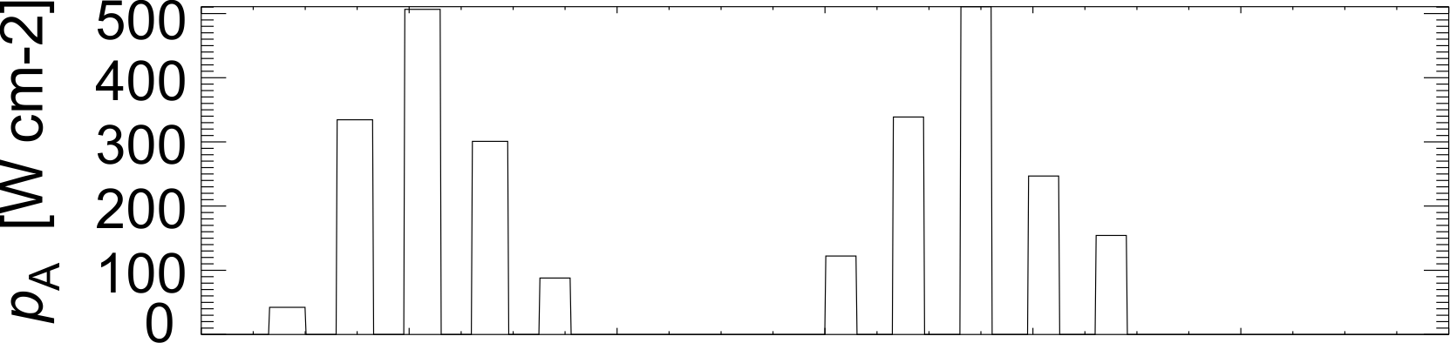
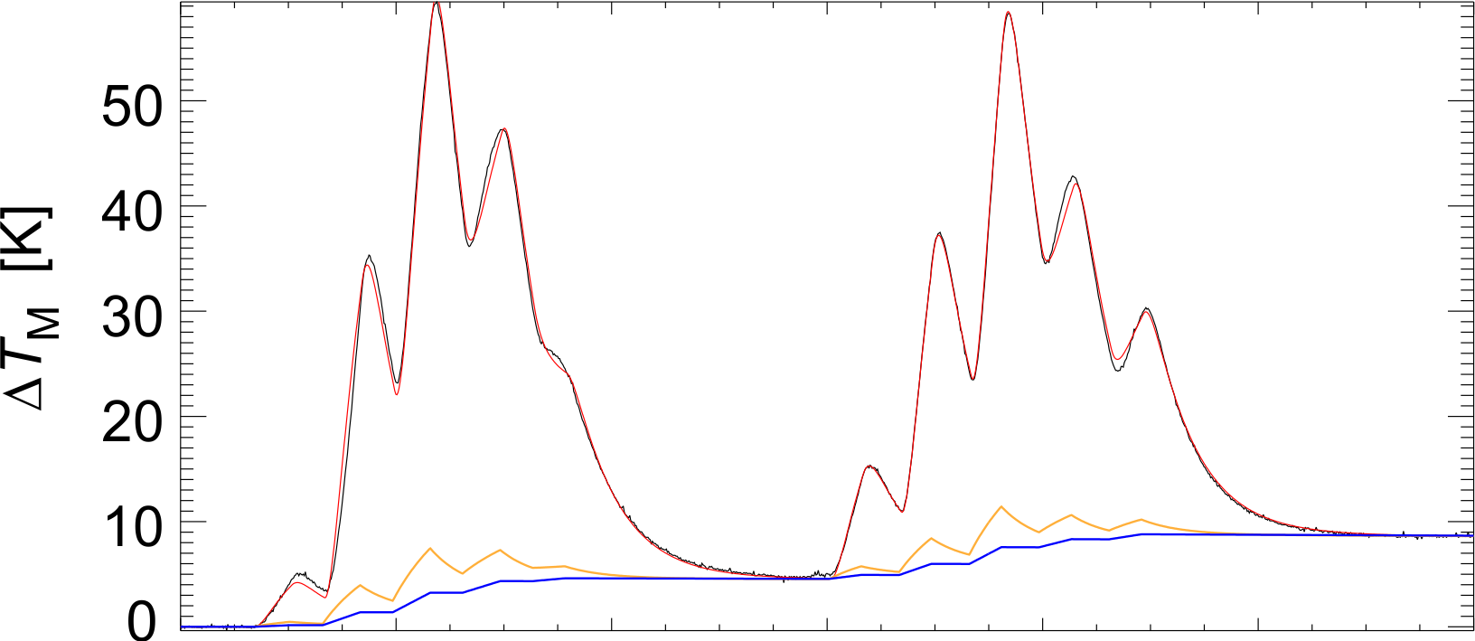
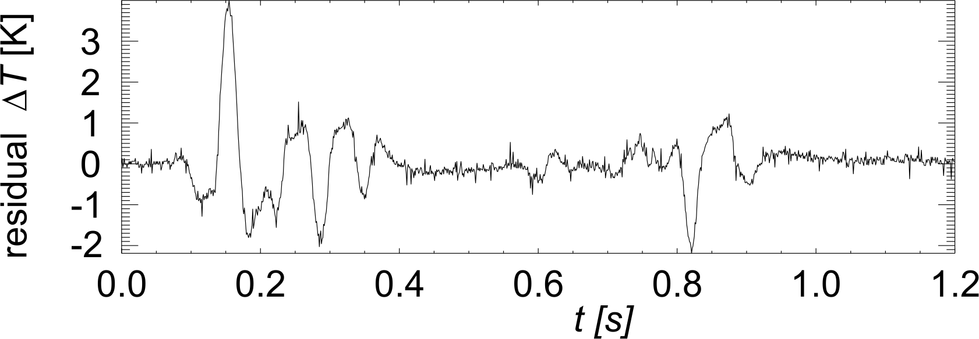
Calibration in empty vessel – AUG #39744
Fit converges, all parameters seem well defined, e.g. C_{SM}/k_{SM} = 30 ms
k_{SM}/A_{SM} = 15000 W / (K m²) = λ/d
λ specific heat conductivity
λ ~ 1 W /(K m), d ~ 10⁻⁴ m
Additional signal delay with respect to the Gyrotron power signal improves the fit (approx. 1 ms)
Fit parameter values seem to be reasonably consistent with Thermocouple specifications and material properties
Residual can be explained by change of real p_{A} during pulse
(launcher/beam movement)
Measurement
Model
T_{NB}
T_{IB}

Slide 17
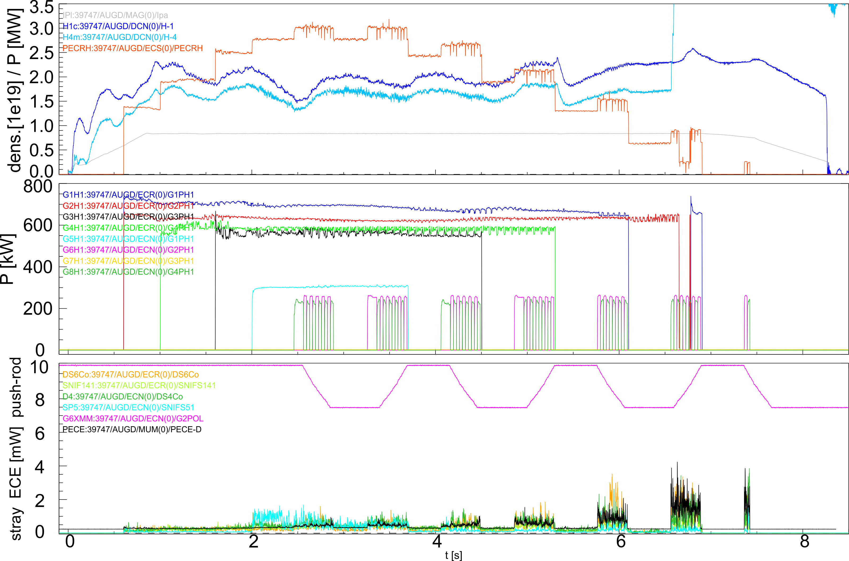
Experiment on X-3 absorption AUG #39747 - overview

Slide 18
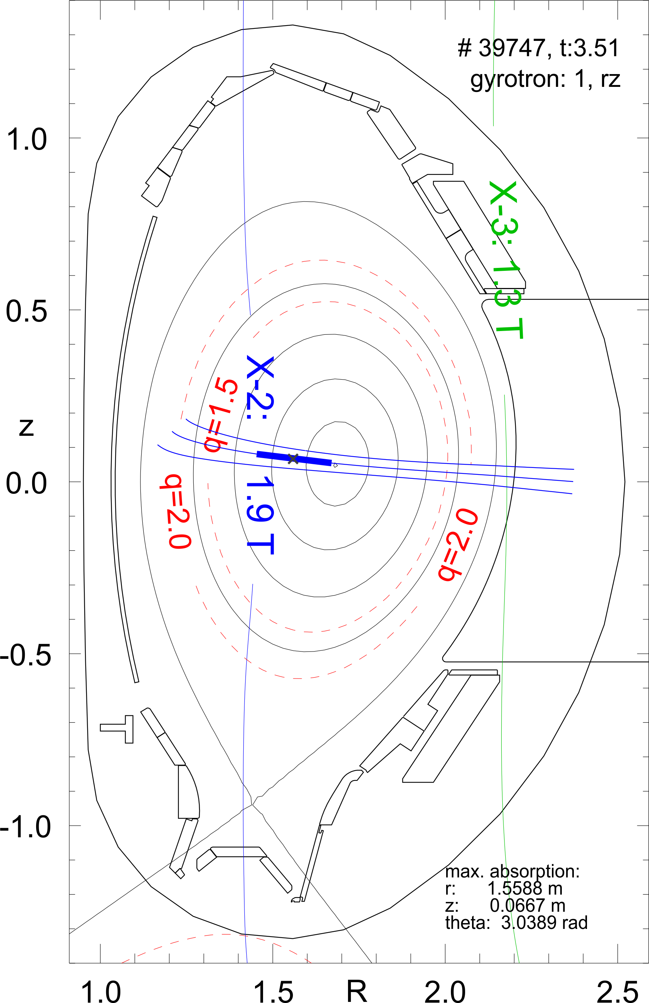
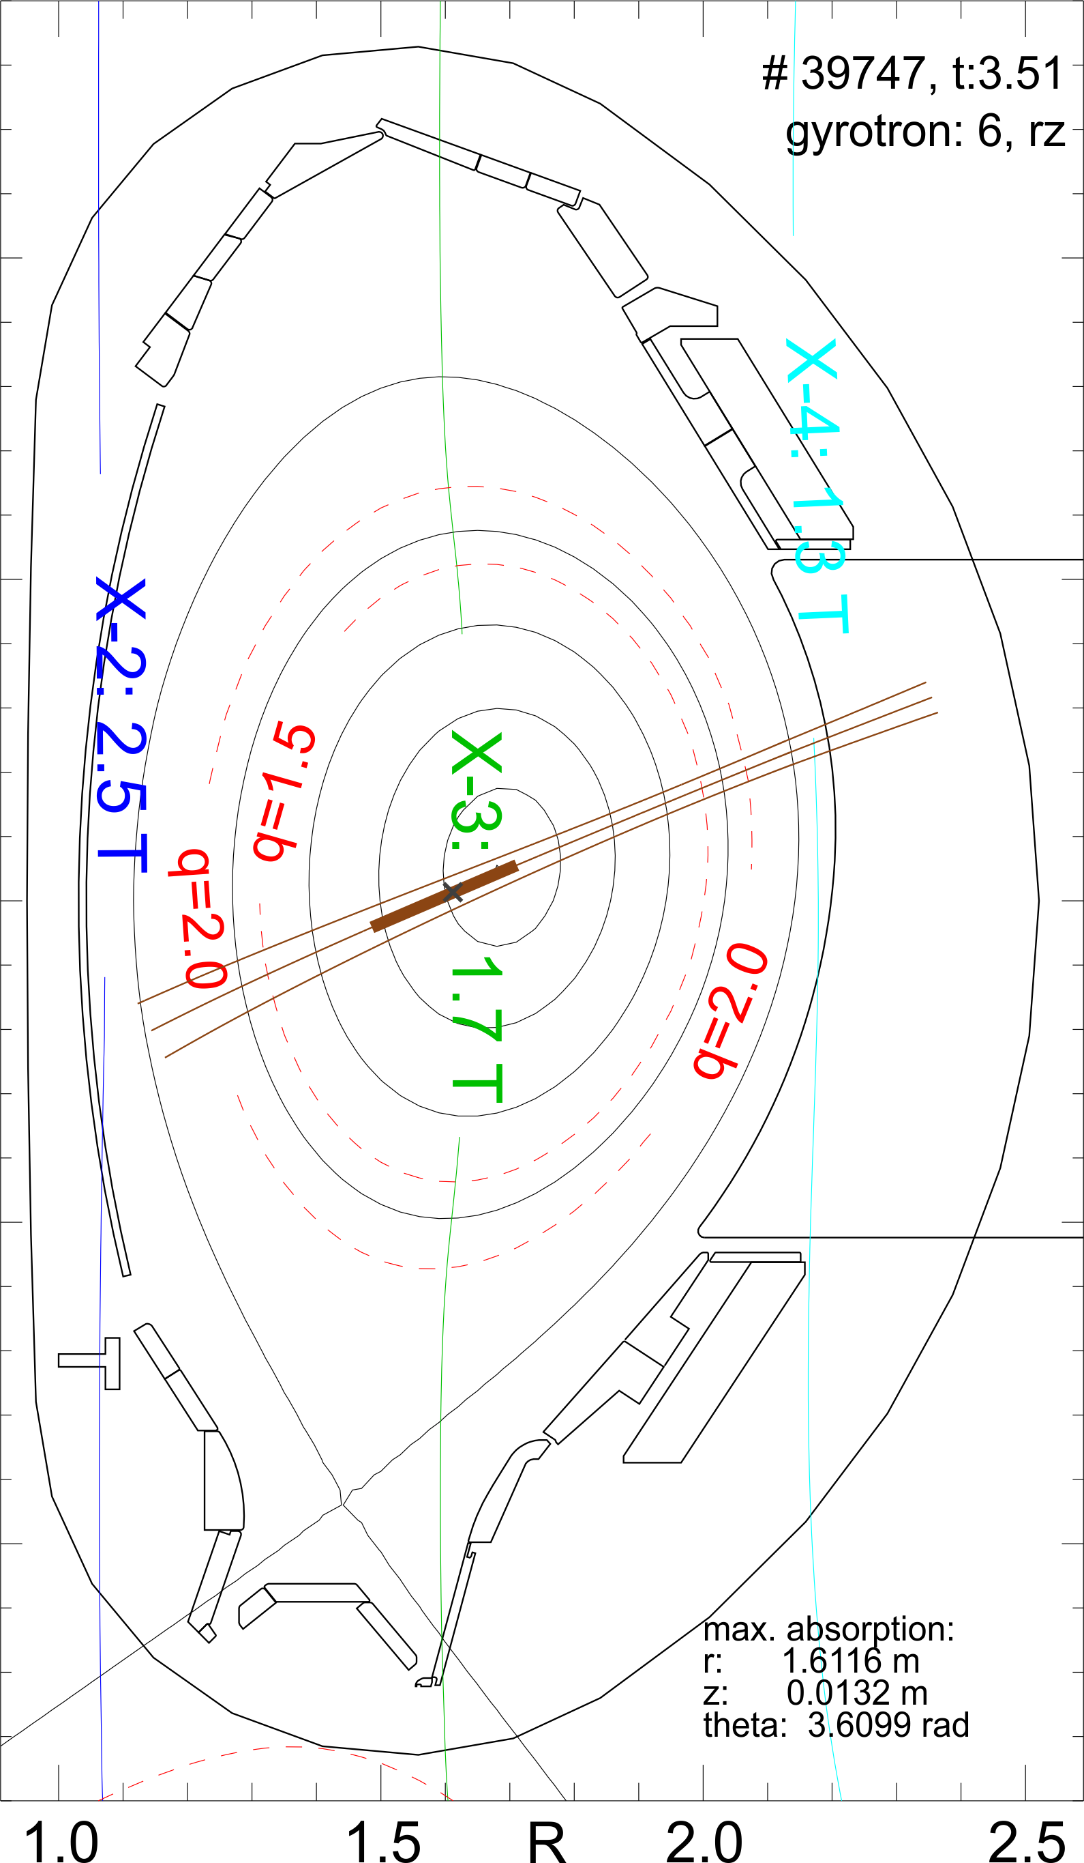
Experiment on X-3 absorption AUG #39747 – geometry
Heating
105 GHz
Probing
140 GHz
See also:
talk by
J. Stober

Slide 19
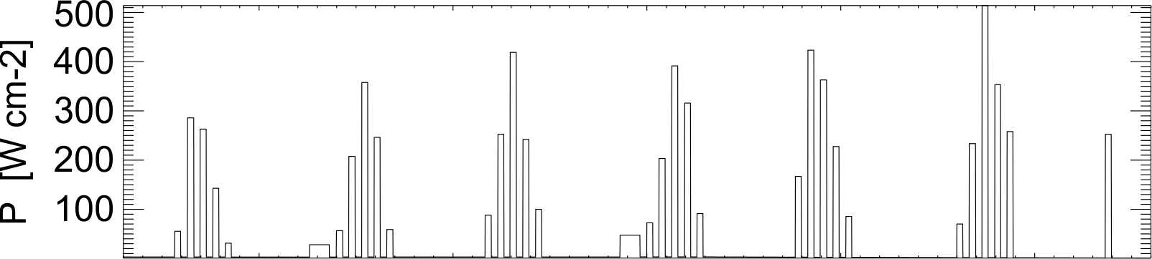
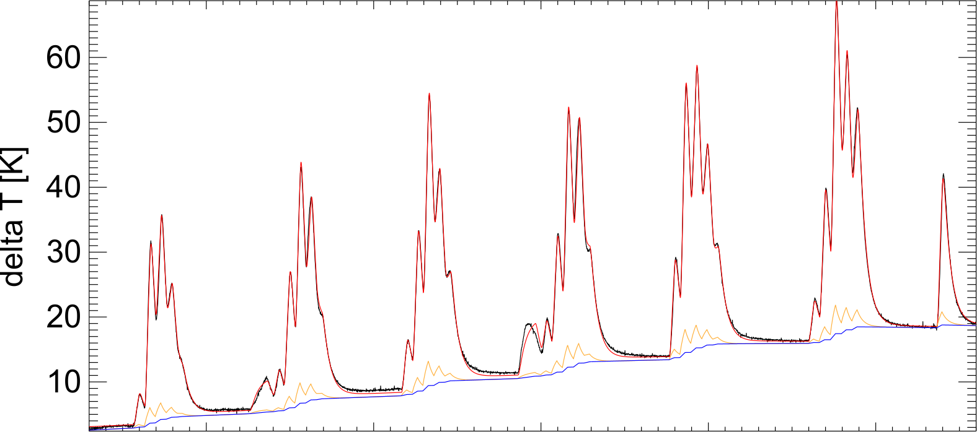
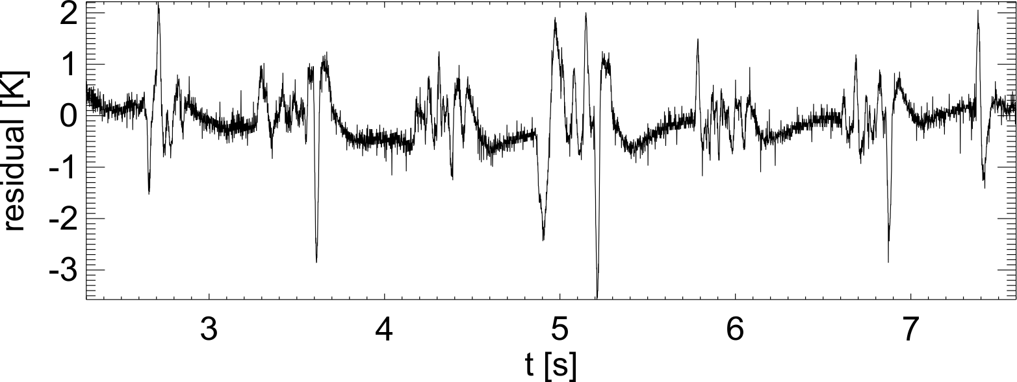
Experiment on X-3 absorption AUG #39747 – model result
Using fitted material constants from the vacuum measurement
Fit parameter r_{IB} must be free
(baseline)
Main result (pulse train amplitudes) seems robust.
r_{IB} seems to vary:
Dynamic misalignment?
Change of beam width?
Fitted power data used for the results in the talk by
J. Stober
Measurement
Model
T_{NB}
T_{IB}

Slide 20
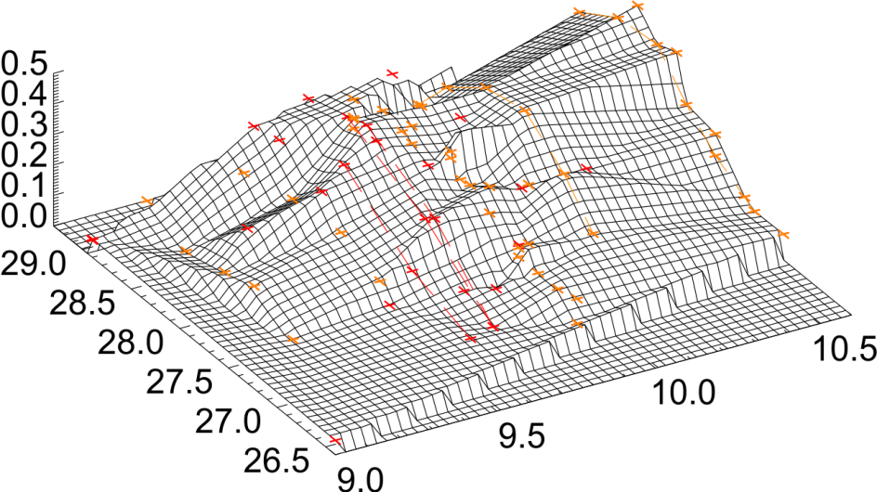
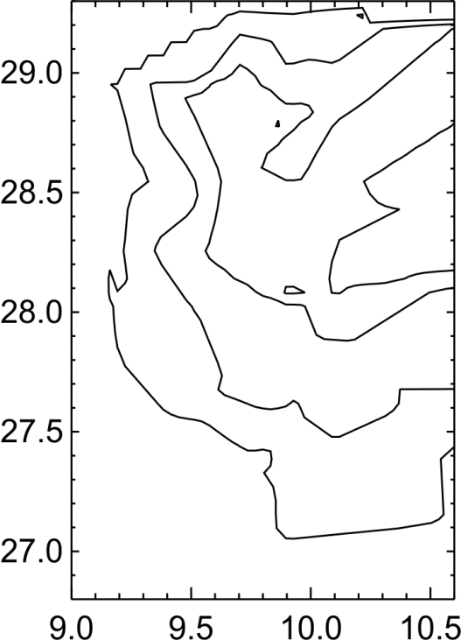
Monitoring O-2 shine-through
Pulse response of one Thermocouple (R8) on shine through power
2D function of launcher setting
approx. 5 cm on Heat Shield
a [mm]
ß [deg]
a [mm]
push-rod pos.
toroidal rot.
Beam of Elisey 3M, O-2 polarisation, 20-40 ms pulses
data points taken 2017 and 2019 in „Std H mode“
type plasma experiments
ß [deg]

Slide 21
Summary
Development of measuring tools to study mm-wave deposited power on the heat shield of AUG with high time resolution
Modelling tools may help to understand details of the heat flow, can be used for planning and preparation
Possible application may also be monitoring of beam geometry and size, systematic comparison with beam tracing prediction seems possible

