Slide 1
Evaluation of the O-X mode conversion rate of the finite width wave in two dimensional systems
21st JOINT WORKSHOP ON ELECTRON CYCLOTRON EMISSION (ECE) AND ELECTRON CYCLOTRON RESONANCE HEATING (ECRH), 20 - 24 June 2022, ITER Organization
H. Igami^{A}, A. Fukuyama ^{B}, K. Nagasaki ^{C}
^{A}NIFS, ^{B}GSE, Kyoto Univ., ^{C}IAE, Kyoto Univ.
P1

Slide 2
Contents
Background and Motivation
Configuration of the 2D wave optical calculation with using TASK/WF2D
Calculation results
Summary
P2

Slide 3
Background and Motivation Mode conversions across the evanescent region
UHR
For ECRH in the “over-dense” plasma, the electrostatic EBW should be excited via the mode conversion process from the SX wave at the UHR
Waves launched from the low magnetic field side transmit the evanescent region to couple with the SX-mode
The ray-tracing cannot treat the propagation across the evanescent region
Wave optical full wave analysis is required
X Evane-scent
O Evane-scent
X Evane-scent
SX-B mode conversion
EBW
SX
O-SX mode conversion
?
O
∇n_{e}
P3

Slide 4
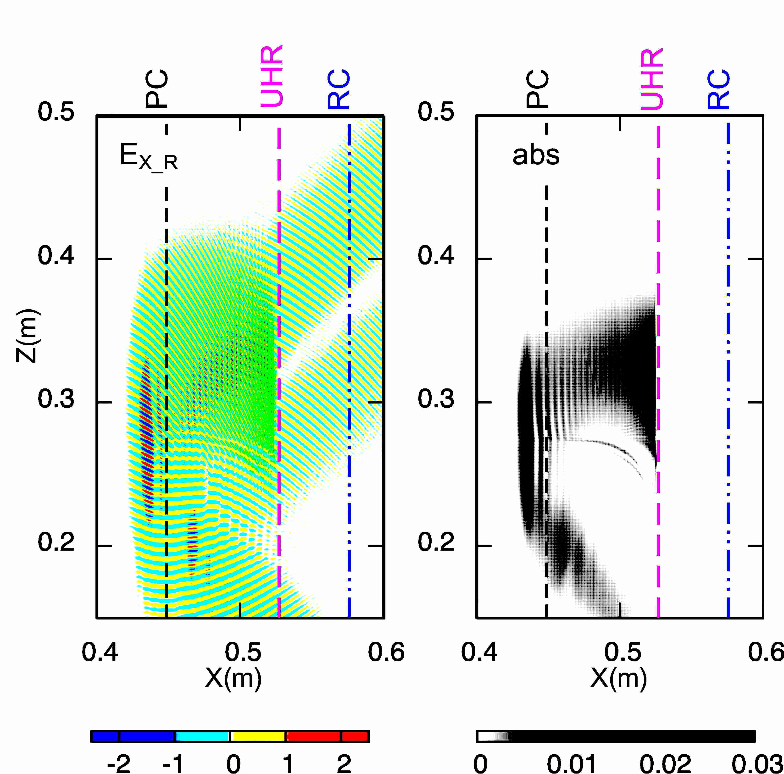
Broadening of the launched finite width beam affects the O-X mode conversion process
In 2D configuration, a finite width electromagnetic wave launched from the waveguide at θ_{inj} = θ_{opt} = arccos(N_{//opt}) is not fully mode converted to the SX mode
At the edge of the launched beam, θ_{inj} = θ_{opt} ± 1.5 °in this case
In this study, we’ve performed 2D wave optical full wave analyses to provide a guideline for designing the launching beam condition for ECRH by EBW
H. Igami. et al.
Plasma and Fusion Research, Volume 11, 2403098(2016)
P4

Slide 5
Configuration of the 2D calculation
Solving Maxwell equation by finite element method with TASK/WF2D code^{*)}
∇×∇×E – (ω²/c²)ε∙ E=iωμ₀ j_{ext}
y_{d_max}
^{*)}A. Fukuyama, et. al 41st European Physical Society Conference on Plasma Physics (EPS 2014) P4.014 (2014)
r_{b}
(x_{bnd}, y)
$\overset{⃑}{k}$_{in}
Gaussian like beam is defined along the y axis at x=x_{ant}
θ
$$E\left(x_{bnd}, y\right)=E(x_{bnd}, y_{cnt})\frac{w_{0}}{w_{z}}exp\left\{ {−\left(\frac{r_{b}}{w_{z}}\right)}^{2}−i{|k}_{in}|\left(z_{p}+\frac{r_{b}^{2}}{2R_{c}}\right)+iζ\right\}$$
z_{g}
(x_{bnd}, y_{cnt})
y
$$w_{z}=w_{0}\sqrt{1+{\left({z_{g}}/{z_{r}}\right)}^{2}}$$
y_{d_min}
$$r_{b}=\left|y−y_{cnt}\right|\sin{θ}$$
$$z_{p}=\left(y−y_{cnt}\right)\cos{θ}$$
$$z_{r}=\left(\frac{ω}{2c}\right){w_{0}}^{2}$$
z
x
$ζ$ =$\tan^{−1}\left({z_{g}}/{z_{r}}\right)$
$$z_{g}=z0+z_{p}$$
$$R_{c}=z_{g}\left(1+{\left(\frac{z_{r}}{z_{g}}\right)}^{2}\right)$$
w_{d} : Absorber
P5

Slide 6
Calculation of the electric field at (x_{ant}, y_{ant})
1. Coordinate transformation $\left(x,y,z\right)⟹\left(x_{d},y_{d},z_{d}\right)$
k_{in}
$$\left(N_{x},N_{y},N_{z}\right)⟹\left(N_{xd},N_{yd},N_{zd}\right)$$
e_{zd} // B
${\overset{⃑}{e}}_{zd}$ $∥\overset{⃑}{B}$
$${\overset{⃑}{e}}_{xd}={{\overset{⃑}{e}}_{zd}× \overset{⃑}{e}}_{yd}$$
e_{yd}
e_{xd}
$${\overset{⃑}{e}}_{yd}={\overset{⃑}{N}{× \overset{⃑}{e}}_{zd}}/{\left|\overset{⃑}{N}{× \overset{⃑}{e}}_{zd}\right|}$$
2. Solving the Maxwell equations
$\overset{⃡}{ε}= \left(\begin{matrix}S & −iD & 0 \\ iD & S & 0 \\ 0 & 0 & P\end{matrix}\right)$ : Cold dielectric tensor
$${\overset{⃑}{N}}_{d}×\left({\overset{⃑}{N}}_{d}× {\overset{⃑}{E}}_{d}\right)+\overset{⃡}{ε}∙{\overset{⃑}{E}}_{d} =0$$
$\left(\begin{matrix}S−\left(N_{yd}^{2}+N_{zd}^{2}\right) & −iD+N_{xd}N_{yd} & N_{zd}N_{xd} \\ iD+N_{xd}N_{yd} & S−\left(N_{zd}^{2}+N_{xd}^{2}\right) & 0 \\ N_{zd}N_{xd} & N_{yd}N_{xz} & P−\left(N_{xd}^{2}+N_{yd}^{2}\right)\end{matrix}\right)\left(\begin{aligned}E_{xd} \\ E_{yd} \\ E_{zd}\end{aligned}\right)$ = 0
3. Coordinate transformation $\left(E_{xd},E_{yd},E_{zd}\right)⟹\left(E_{x},E_{y},E_{z}\right)$
P6

Slide 7
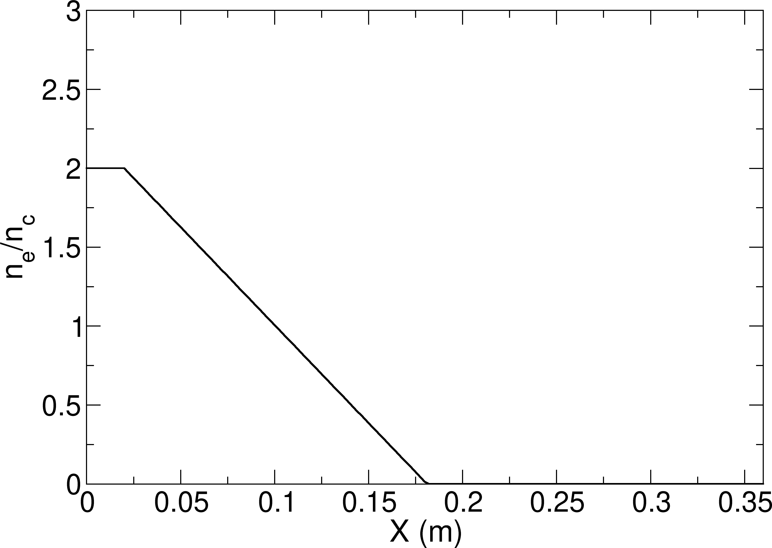
Calculation Parameters
Frequency : f= ω/2π = 28GHz
Waist size : $w_{0}$ = 0.0373m (=3.48λ₀ )
Mesh size = 0.25mm (~ λ₀ /40)
thickness of the absorber : w_{d} = 0.025m
Permittivity in the absorber : ε_{damp} = ε x 2
Normalized collision frequency : ν_{e}/ω = 0.001, ν_{p}/ω = 0.001, ν_{abs}/ω = 0.2
n_{e}/n_{c} = 0.001
Density scale-length at the plasma cutoff,
L_{n}=7.5* λ₀ (λ₀: vacuum wavelength)
Constant magnetic field : |B| = 0.4T, $(\vec{B} ∥ \hat{z}$ ) ω_{ce}/ω = 0.4
Intel Xeon Silver 4216 CPU @ 2.10GHz, 16C/32T x 2
Memory: 768GB
Number of element : 12096000 (typical)
CPU time : 3196.55 sec (for FEM calculation, typical)
P7

Slide 8
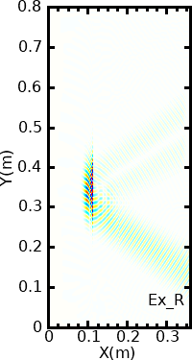
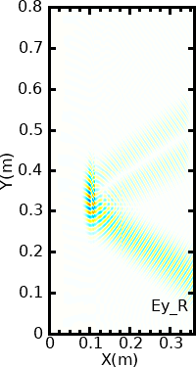
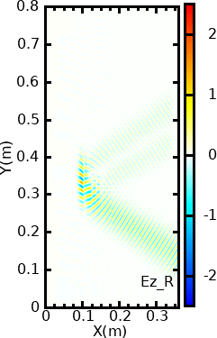
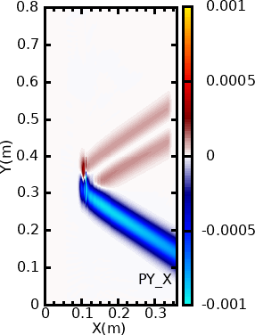
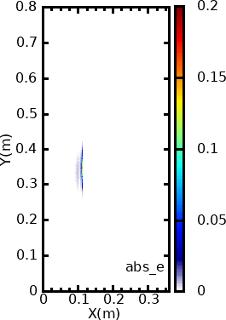
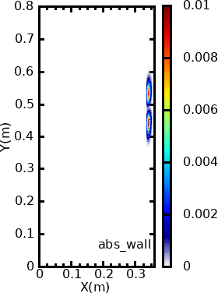
An example of the calculation Launching of the Gaussian like beam with N// = N_{// opt} (θ_{// opt} =57.7deg.)
Real electric field components
Poynting flux
Collisional absorption
electron
wall
O-mode
Cold dielectric tensor with weak collisional damping for UH resonant absorption
The artificial dielectric tensor is adopted in FEM calculation inside the artificial “absorption wall ” to make the wave number gradually diverge to cause the resonant absorption like in the UHR
The “absorption wall” has an aperture around the launched wave
P8

Slide 9
Based on the cold plasma resonant absorption model $T_{OX}$ can be calculated from the outputs of TASK/WF2D
From the collisionally absorbed power
$T_{OX}$: O-X mode conversion rate
$$P_{abs}= {\vec{j}}^{∗}∙\vec{E}={\left(σ ∙\vec{E}\right)}^{∗}∙\vec{E}$$
$$T_{OX}=\frac{\sum_{X=0}^{X=Xant}{P_{abs_e}}}{\sum_{X=0}^{X=Xant}{\left(P_{abs_e}+P_{abs_i}+P_{abs_wall}\right)}}$$
From Poynting fluxes
$$T_{OX}=1−\sum_{Y=0}^{Y=Ymax}{\left|{\vec{P}}_{X_ref}\right|/\left|{\vec{P}}_{X_in}\right|}$$
$\vec{P}=Re\left(\vec{E}e^{−iωt}\right)×Re\left(\vec{B}e^{−iωt}\right)/u_{0}$
$=$ $Re\left(\vec{E}e^{−iωt}\right)×Re\left(\frac{\left(∇×\vec{E}e^{−iωt}\right)}{iωu_{0}}\right)$
$=$ $\frac{1}{4ωu_{0}}$ $\left[\begin{matrix} \left\{E_{y}^{∗}\left(∂_{x}E_{y}−∂_{y}E_{x}\right)−E_{z}^{∗}\left({−∂}_{x}E_{z}\right)\right\}−c.c. \\ \left\{E_{z}^{∗}\left(∂_{y}E_{z}\right)−E_{x}^{∗}\left(∂_{x}E_{y}−∂_{y}E_{x}\right)\right\}−c.c. \\ \left\{E_{x}^{∗}\left({−∂}_{x}E_{z}\right)−E_{y}^{∗}\left(∂_{y}E_{z}\right)\right\}−c.c.\end{matrix}\right]$
time average
$$\left\langle E_{i}∂E_{j}\right\rangle =\left\langle E_{i}^{∗}∂E_{j}^{∗}\right\rangle =0$$
P9

Slide 10
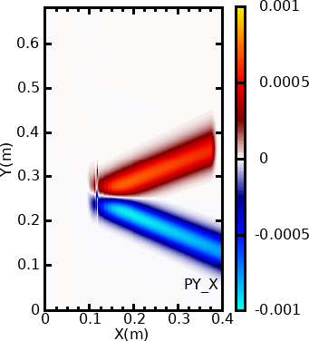
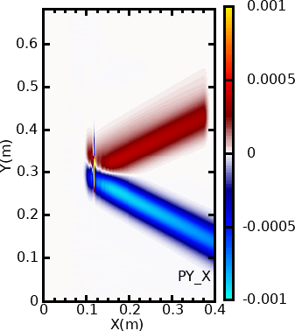
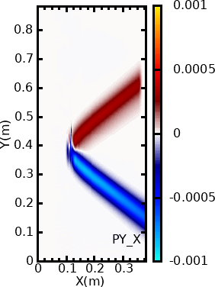
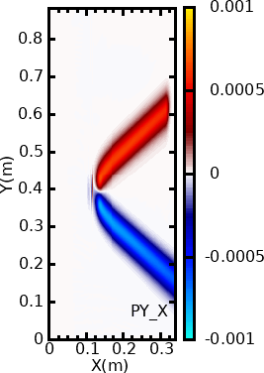
Poynting fluxes of various launching angle cases
θ = θ_{// opt} +10deg.
θ = θ_{// opt} +5deg.
θ = θ_{// opt}
θ = θ_{// opt} -5deg.
θ = θ_{// opt} -10deg.
$T_{OX}$=0.15
$T_{OX}$=0.46
$T_{OX}$=0.81
$T_{OX}$=0.46
$T_{OX}$=0.13
The incident Gaussian like beam is focused on the plasma cutoff for each case
$$w_{z}=w_{0}\sqrt{1+{\left(z/{z_{r}}\right)}^{2}}$$
$$E\left(x_{bnd} y\right)=E(x_{bnd}, y_{cnt})\frac{w_{0}}{w_{z}}exp\left\{ {−\left(\frac{r_{b}}{w_{z}}\right)}^{2}−i{|k}_{in}|\left(z_{p}+\frac{r_{b}^{2}}{2R_{c}}\right)+iζ\right\}$$
$$z_{r}=\left(\frac{ω}{2c}\right){w_{0}}^{2}$$
$$z_{p}=\left(y−y_{cnt}\right)\cos{θ}$$
P10

Slide 11
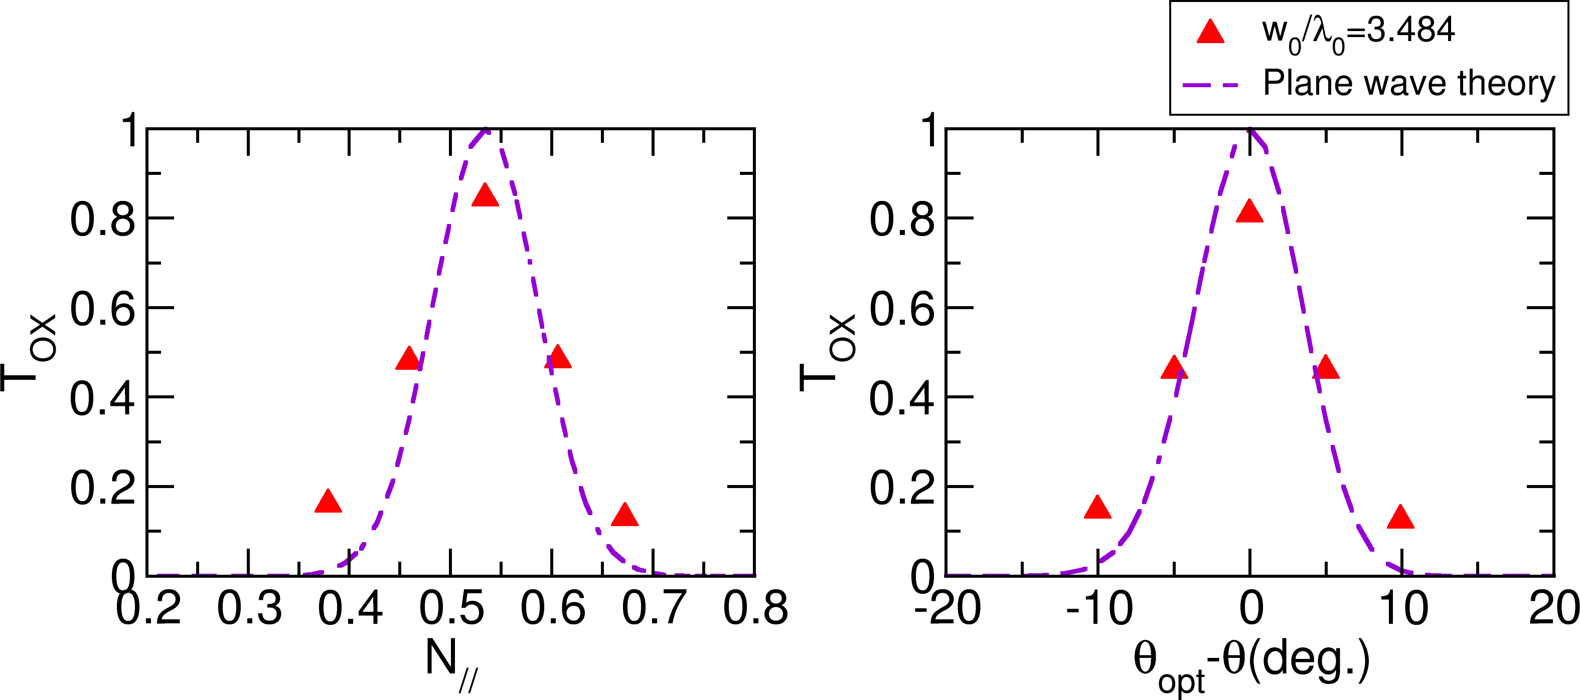
Calculation results T_{ox} estimated for various propagation angles
T_{ox} is less than plane wave theory at θ = θ_{// opt} , greater than θ ≠ θ_{// opt}
plane wave theory :
T_{OX} = exp{-πk₀L_{n}(Y/2)^{1/2}[2(1+Y)(N//-N_{//opt})² +N_{y}²]},
Y = (Ω_{ce}/ω), N_{zc} ={Y/(1+Y)}^{-1/2} Mjolhus (1984)
P11

Slide 12
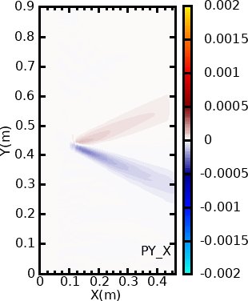
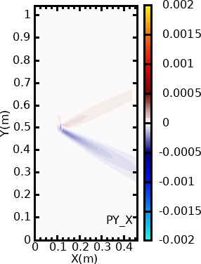
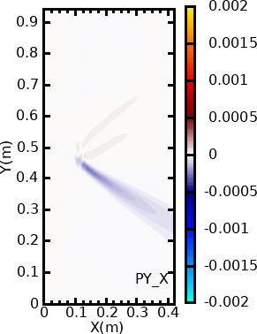
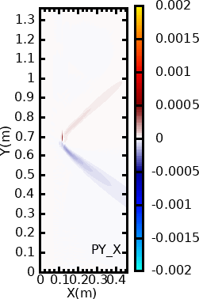
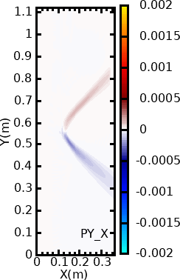
Propagation of waves of a smaller waist size $w_{0}$ = 0.017m (=1.59λ₀ )
θ = θ_{// opt} +10deg.
θ = θ_{// opt} +5deg.
θ = θ_{// opt}
θ = θ_{// opt} -5deg.
θ = θ_{// opt} -10deg.
$T_{OX}$=0.226
$T_{OX}$=0.454
$T_{OX}$=0.576
$T_{OX}$=0.471
$T_{OX}$=0.267
θ = θ_{// opt} : $T_{OX}$ decreases
θ = θ_{// opt} ±10 deg. : $T_{OX}$ increases
P12

Slide 13
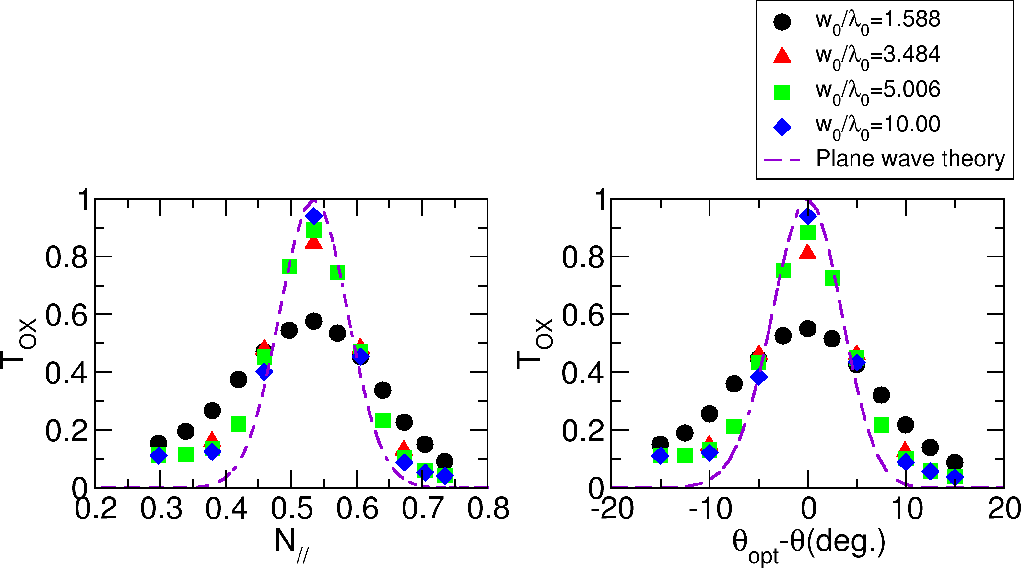
T_{ox} estimated for various beam waist sizes for various propagation angles
With increase of the beam waist size w₀, numerically calculated T_{ox} with taking N//=N_{//opt}, approaches 1
P13

Slide 14
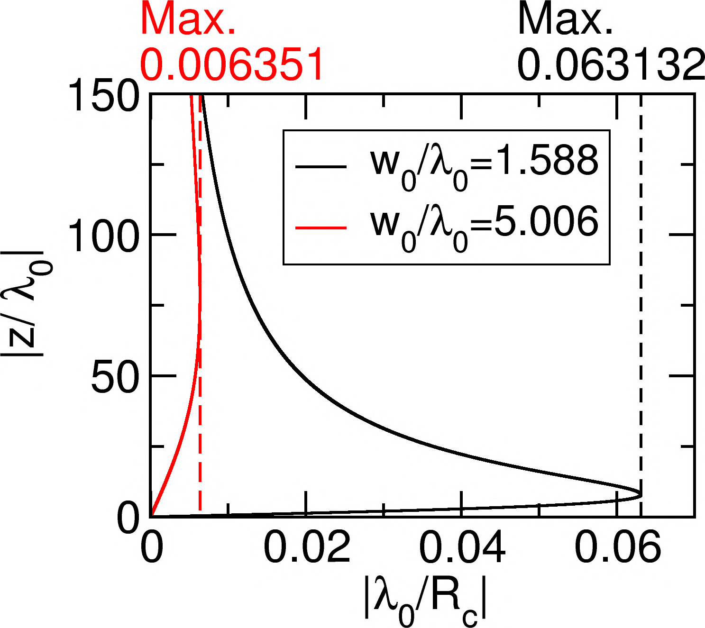
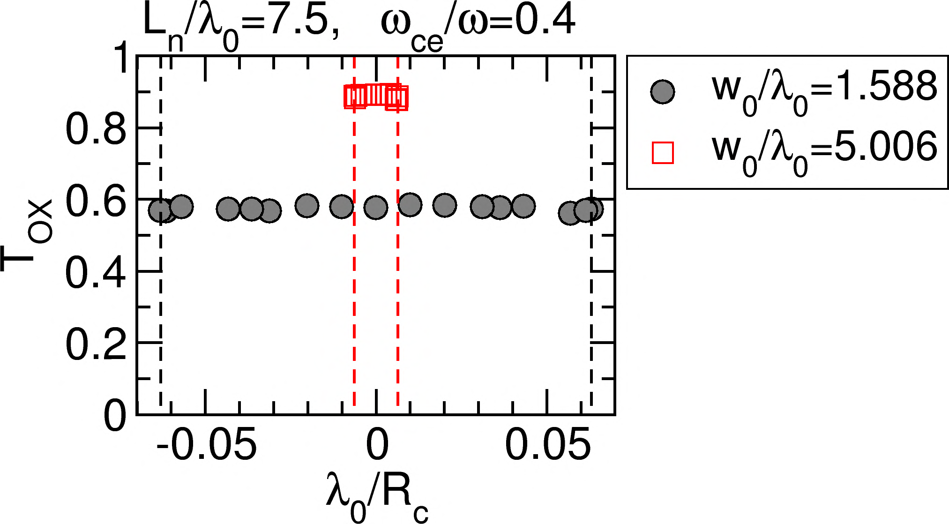
The effect of the beam curvature radius R_{c} on the T_{ox} is investigated with changing the beam focal point
$$R_{c}=z\left(1+{\left(\frac{z_{r}}{z}\right)}^{2}\right)$$
$$z_{r}=\left(\frac{ω}{2c}\right){w_{0}}^{2}$$
, x=x_PC
T_{OX} remains to be constant for the same beam waist size w₀ since the N// Fourier spectrum is conserved in the slab plasma in the uniform magnetic field.
With introducing the magnetic shear, T_{OX} can change because the N// spectrum can change during the wave propagation
P14

Slide 15
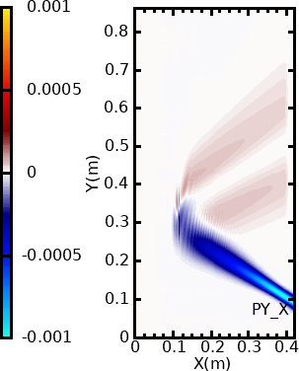
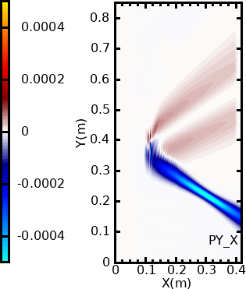
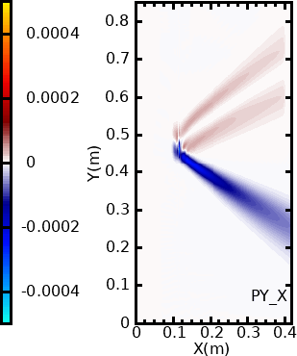
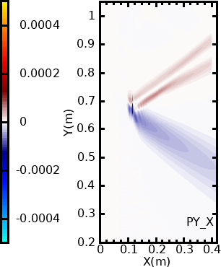
L_{n}=7.5* λ₀ , w₀ /λ₀ =1.59
z_{PC} : Distance between the beam focal point ant the plasma cutoff
z_{PC}/λ₀ =-30
z_{PC}/λ₀ =-20
z_{PC}/λ₀ =0
z_{PC}/λ₀ =20
z_{PC}/λ₀ =30
The phase and amplitude along the y-axis vary with the propagation
On the other hand, the N// Fourier spectrum is conserved
P15

Slide 16
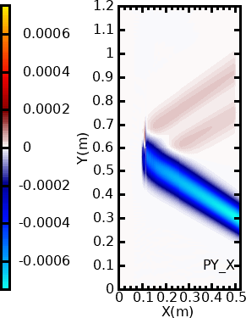
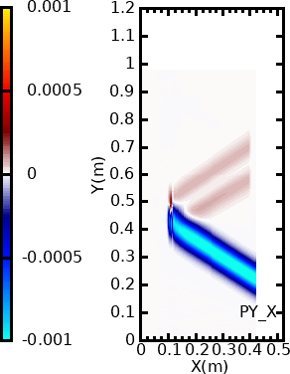
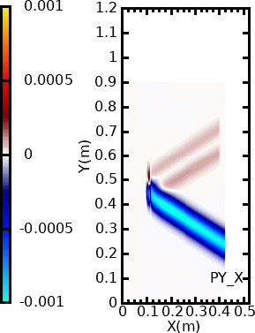
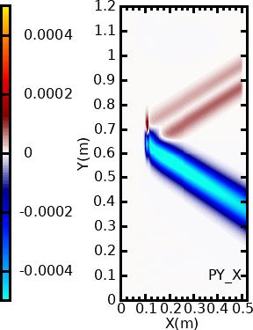
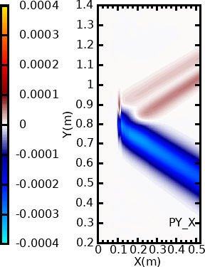
L_{n}=7.5* λ₀ , w₀ /λ₀ =5.006
z_{PC}/λ₀ =-100.0
z_{PC}/λ₀ =-30.0
z_{PC}/λ₀ =0
z_{PC}/λ₀ =50.0
z_{PC}/λ₀ = 100.0
With adopting a larger beam waist size w₀, the spreading of the N// Fourier spectrum can be reduced to obtain higher T_{OX}
P16

Slide 17
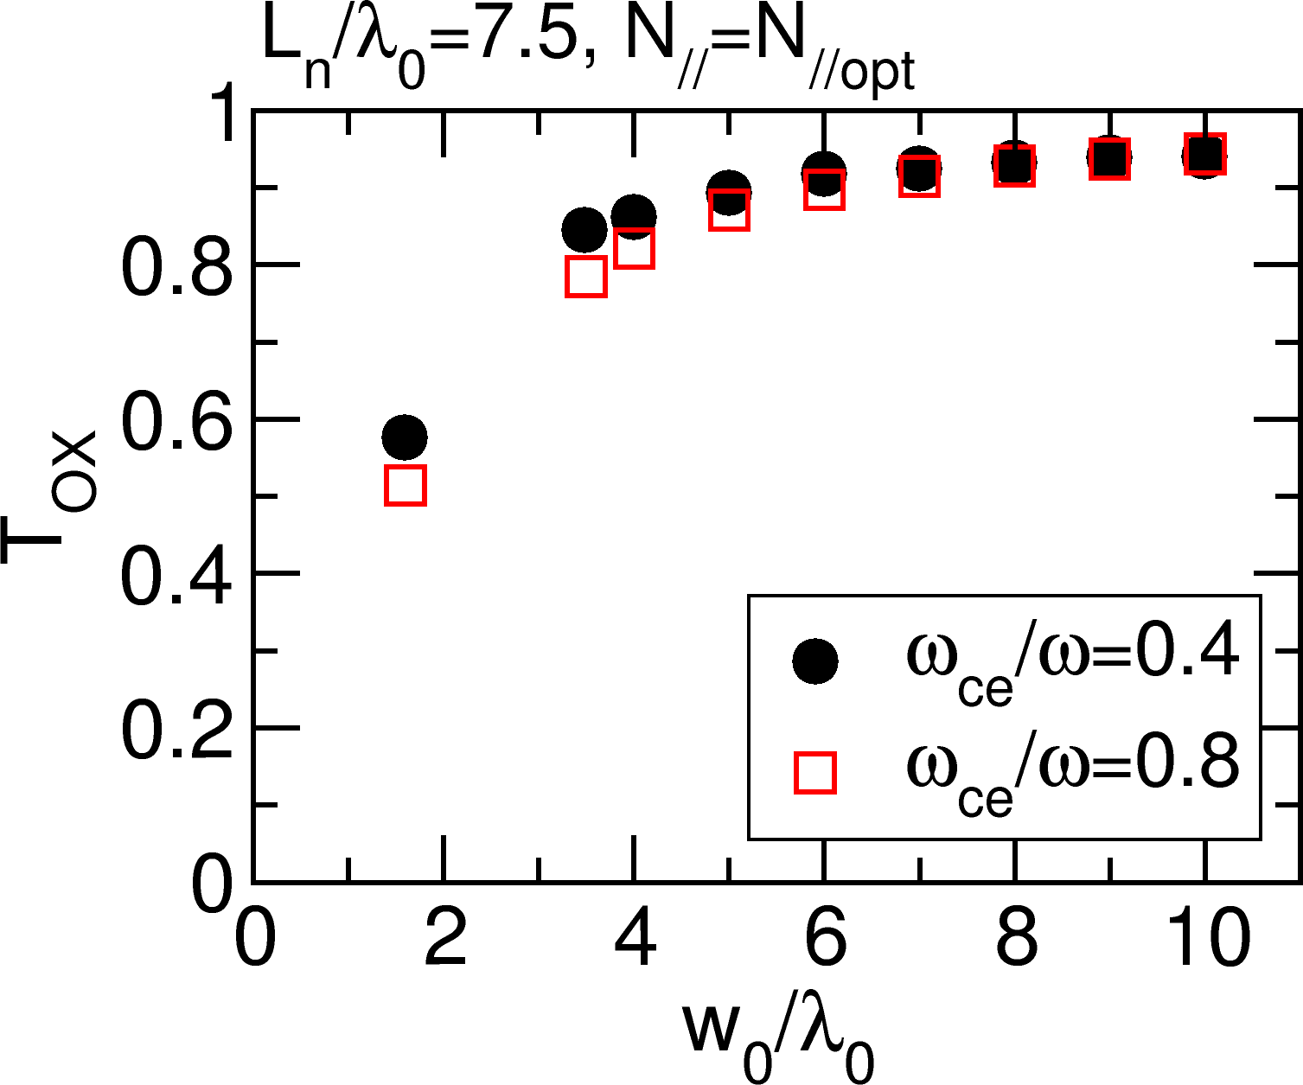
T_{ox} with change of the beam waist size w₀ for the case of ω_{ce}/ω = 0.4 and 0.8
w₀/λ₀ > 6 is required for T_{ox} > 90 % with L_{n}/λ₀ =7.5
Higher T_{ox} can be obtained with lower ω_{ce}/ω for the small waist size beam
P17

Slide 18
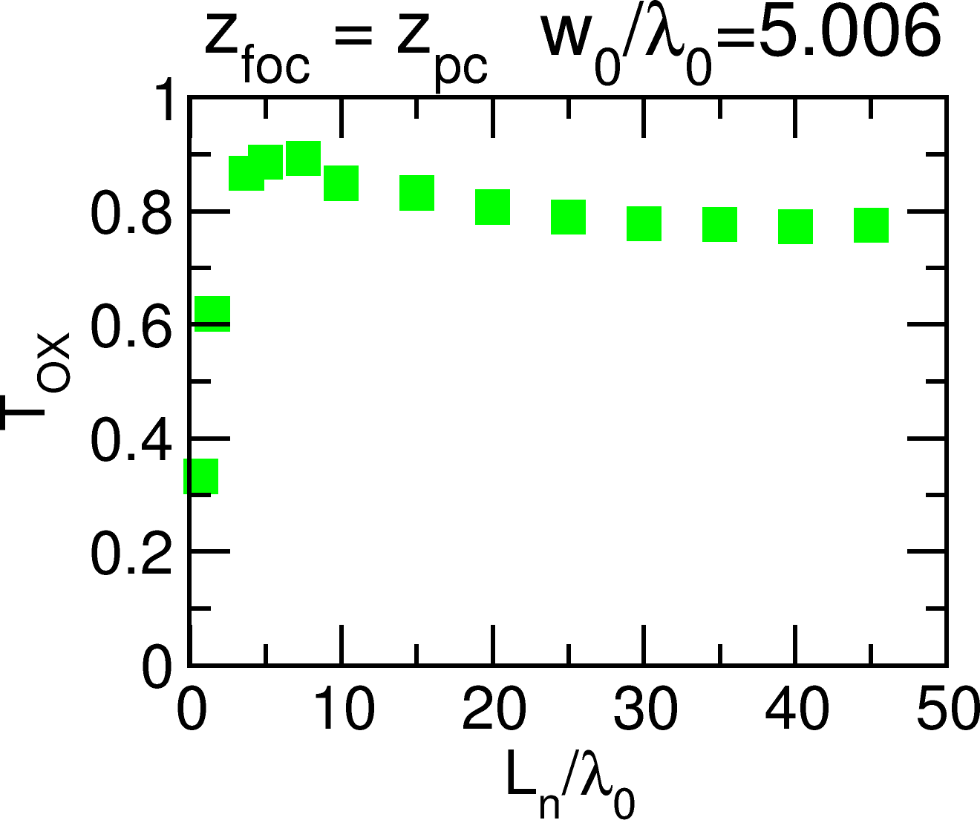
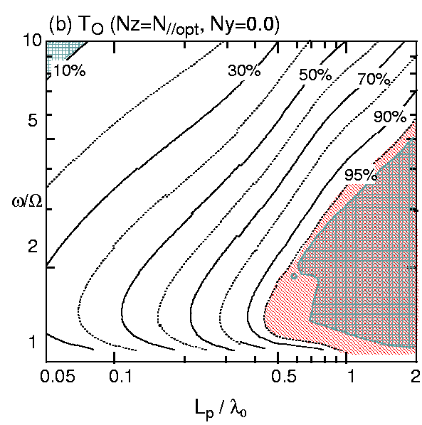
Estimation of T_{ox} with change of the density gradient
T_{ox} decreases as increase of L_{n}, however, it converges with 80% for L_{n}/λ₀ > 30
Decrement of Tox in low L_{n}/λ₀ region might cause by transmission of the X-mode toward the lower density side after the O-X mode conversion as the 1D calculation suggested
P18
H. Igami et al., Plasma Phys. Control. Fusion 48 (2006) 573–598

Slide 19
Summary : purpose and method
To provide a guideline for designing the launching beam for ECRH by EBW, wave optical analyses were performed for various normalized density scale lengths and beam parameters with using of TASK/WF2D code
T_{OX} is estimated based on the cold plasma UH resonant absorption model in slab plasmas in the uniform magnetic field
P19

Slide 20
Summary : results and future works
The beam waist size w₀ affects T_{ox}
With adopting sufficiently large w₀/λ₀, higher T_{OX} can be obtained so that the spreading of the N// Fourier spectrum can be reduced
consistent with the previous 2D numerical analysis (Y. Oka, et al., COMSOL Conference 2020, K. Nagasaki et al., EPS 2020)
Though T_{ox} decreases as increase of L_{n}, it converges with 80 % for L_{n}/λ₀ > 30 with adopting sufficiently large w₀/λ₀ (≳ 5 )
Future works
Effect of the magnetic shear on for finite width waves
Propagation characteristics during the X-B mode with introducing integral from of dielectric tensor
P20

