Slide 1
Parametric Dependence of Microwave Beam Broadening Through Turbulent Plasma
L. A. Holland¹ (lucy.holland@york.ac.uk), A. Köhn², R. G. L. Vann¹
(1) University of York
(2) University of Stuttgart
One of the contributors (LAH) was funded by the EPSRC Centre for Doctoral Training in Science and Technology of Fusion Energy grant EP/L01663X.
This work used the ARCHER UK National Supercomputing Service, allocated through the Plasma HEC (EP/R029148/1), the ARCHER2 UK National Supercomputing Service, allocated through TDoTP (EP/R034737/1), the Cirrus UK National Tier-2 HPC Service at EPCC funded by the University of Edinburgh and EPSRC (EP/P020267/1), and the MARCONI Tier-0 system, allocated through EUROfusion.
Notes:
I’ll be talking about developing an empirical formula to predict how microwave beams used in fusion plasmas are broadened by plasma turbulence. First off I just want to thank my collaborators as well as UKRI for the funding and the various computational facilities we used to complete the simulations. And thank you to the programme committee for the opportunity to share this research.

Slide 2
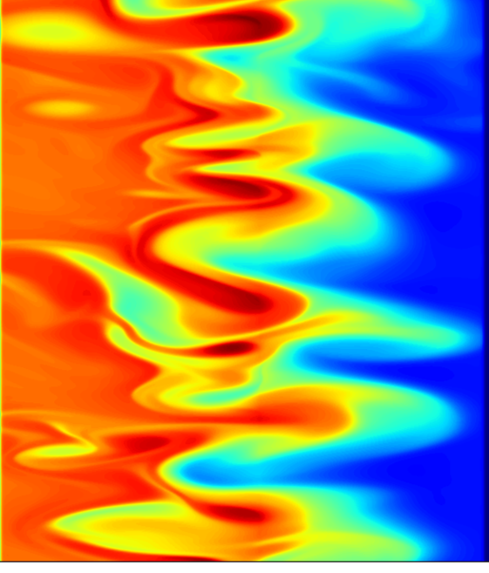
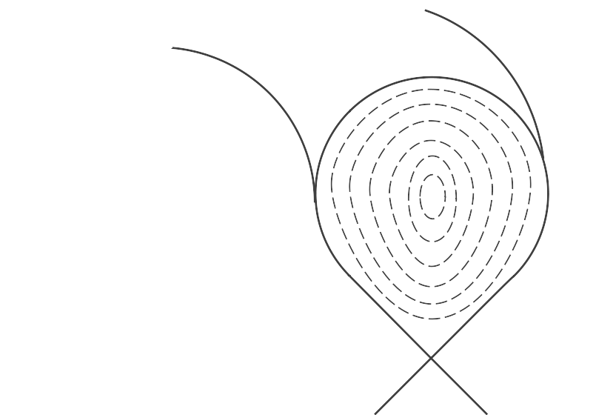
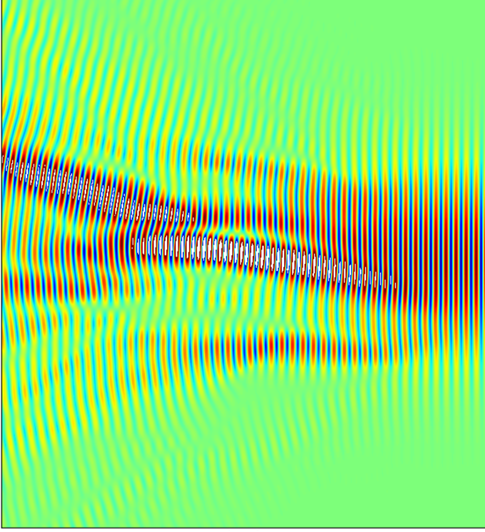
Motivation: Turbulence Scattering
Layer of turbulence at plasma edge
Density fluctuations on same length scale as microwave wavelength cause scattering
Turbulent density profile
Beams substantially broadened by edge turbulence
Microwave Beam
Notes:
Large temperature and density gradients at the plasma edge drive a number of instabilities, resulting in turbulent plasma where the amplitude of the density fluctuations can reach 100% of the background density. These density fluctuations can often be of comparable length scale to microwave wavelengths and can result in significant scattering of incident microwaves. In the case of microwave beams, this results in an overall broadening of the beam compared to if there were no turbulence present.

Slide 3
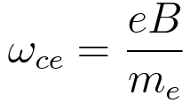
Motivation: Power Injection
Microwave beams used to heat plasma and drive current
Turbulent density profile
Broadening by turbulence can result in power being wasted, affecting efficiency of machine
Other applications in diagnostics using microwaves, but I’ve been focussing on beams used for power injection
Microwave Beam
Notes:
My main motivation for investigating this is with respect to microwave beams used for power injection. Electron cyclotron heating and current drive allow for targeted power deposition, as they’re absorbed at the cyclotron frequency or a harmonic of it (often the 2nd harmonic). As the cyclotron frequency depends on magnetic field strength, and the field strength varies across a cross section of the plasma, this allows for targeted, localised power deposition.
Turbulence in the plasma edge can result in significant additional broadening, meaning we’re depositing power over a different area to that which we intended. This can significantly impact the efficiency of out machine. The prediction of this effect, and its inclusion in efficiency calculations is therefore important.

Slide 4
Motivation: Predictive Capability
Power deposition profile affects efficiency of current drive and heating
To optimise current drive efficiency in new devices it is important to consider this effect
Carrying out full-wave simulations for every scenario as part of an optimisation would be too computationally expensive
Developing an empirical formula to predict broadening could allow it to be part of an integrated model
Notes:
Given a specific set of plasma and beam parameters, I can simulate the beam propagation through turbulence, and predict how much it will be broadened by. However, in cases where a wide variety of scenarios are being considered, such as optimisation of new power injection systems, conducting these simulations for each different scenario is unfeasible. It is therefore desirable to come up with some kind of formula which predicts how much the beam will be broadened based on various parameters. This could them be included in an integrated model of current drive efficiency, for example. This is why I’m carrying out parameter scans.

Slide 5
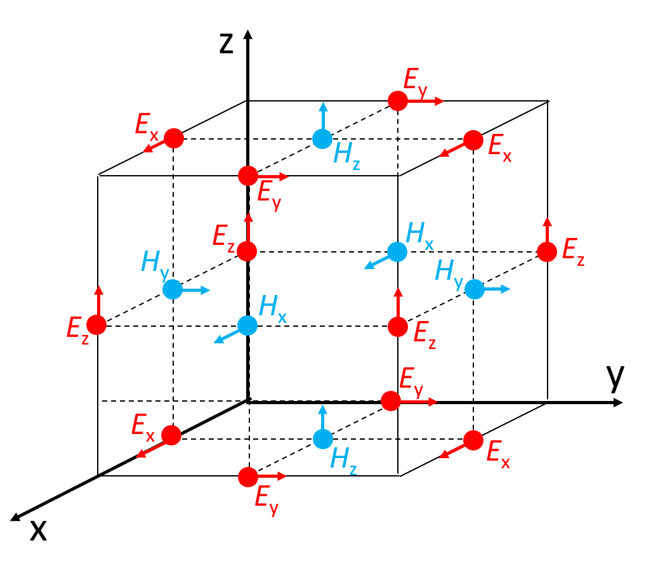
Method: EMIT-2D
Full-wave cold plasma code developed at University of York
Solves Maxwell’s equations with a cold plasma response on Yee lattice using 2nd order leap-frog algorithm
The Yee cell showing displaced E & H grids.
Notes:
In order to do these simulations I’m using a code I wrote based on a 3D code written by previous PhD students, called EMIT2D. This is a full wave code, meaning it solves Maxwell’s equations in the plasma. In order to solve the equations we need an equation for current density, and it is here that we make some assumptions to make the equations solvable. We neglect temperature affects, meaning we assume all electrons are travelling at the same speeds (hence cold plasma), neglect collisions, and also neglect the contributions of ions. We also linearise the equation (and neglect the J0 x B0 term as this is only relevant when magnetic shear scale length is comparable to wavelength).
I then solve these equations on the displaced grids shown here, where E and J are solved on integer grid points and H is solved on half integer grid points, making the calculation of a centred difference spatial derivative easier. H and J are then solved on integer timesteps and E on half integer timesteps, hence leap-frog.

Slide 6
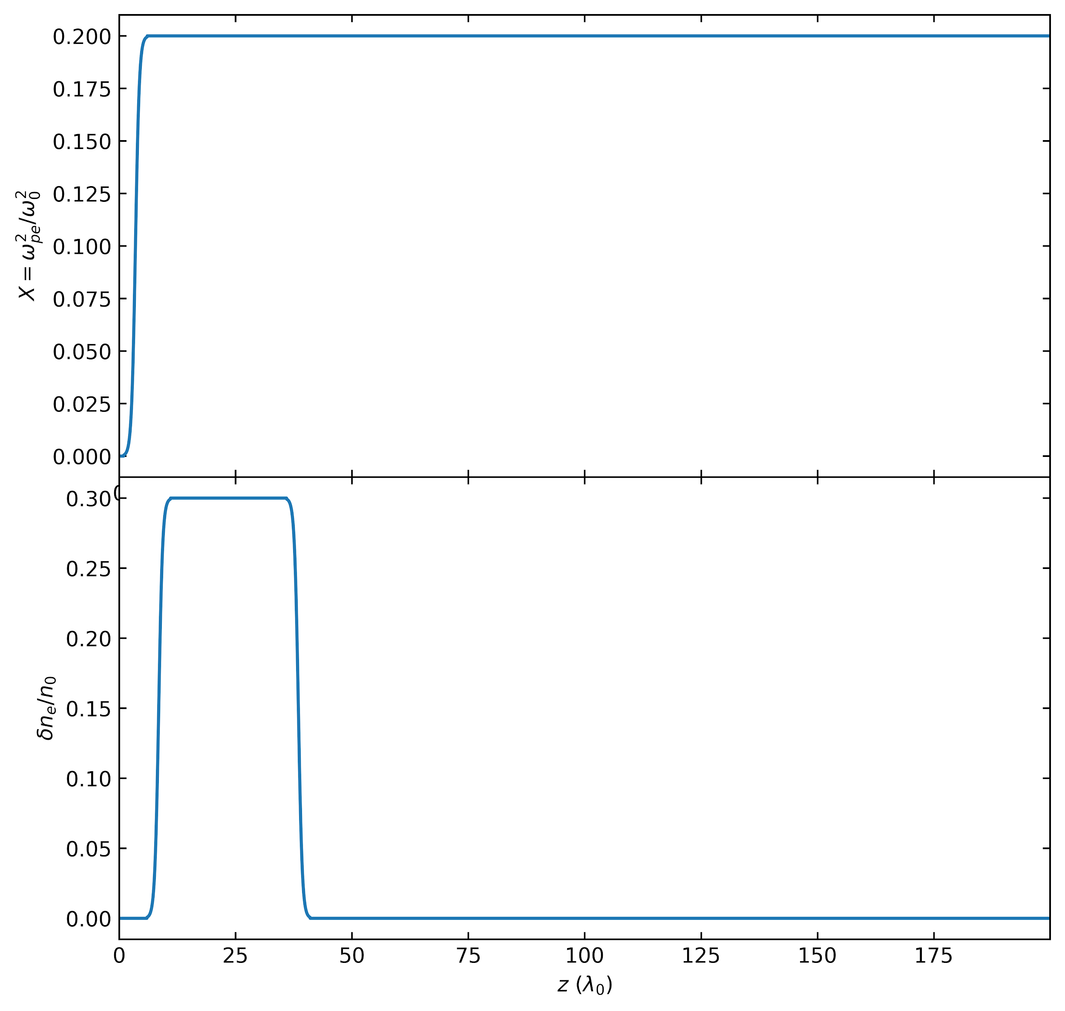
Method: Turbulence Generation
Generate ensembles of turbulent density profiles using synthetic turbulence
Use background density profile shown above
Use envelope of density fluctuation level shown below
Turbulence is electrostatic
Notes:
In order to solve these equations within a plasma, we first need to generate a plasma density profile. As I’m conducting parameter scans which entail thousands of simulations I have opted to use a synthetic turbulence generator rather than a fluid model or gyrokinetic approach which would be too computationally expensive. This recreates the macroscopic properties of the turbulence such as power spectra, turbulence scale lengths, fluctuation level while allowing fast generation of thousands of profiles.
Shown here is an example background density profile and turbulence amplitude envelope which result in the profile shown here (next slide.

Slide 7
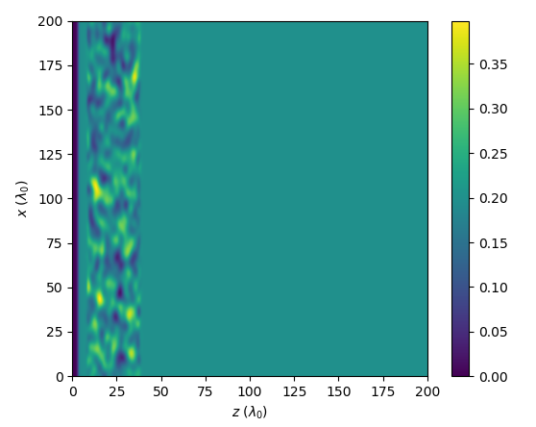
Method: Turbulence Generation
Generate ensembles of turbulent density profiles using synthetic turbulence
Use background density profile shown above
Use envelope of density fluctuation level shown below
Turbulence is electrostatic
Notes:
Here is an image of a resultant profile.

Slide 8
Method: Parameter Scans
Parameters of interest:
Background density
Fluctuation level
Width of turbulence layer
Perpendicular correlation length
Binormal correlation length
Microwave beam waist
To determine if the dependence of each parameter is separable, conduct 2D parameter scans in pairwise combinations ⇾ 15 2D scans
Background density
Fluctuation level
Width of turbulence layer
Notes:
The parameter I then vary are listed here. Varying background density consists of varying the height of this line, and fluctuation leven this one. Varying the width of the turbulence layer increases of decreases this width here. The correlation lengths are the scale length of the density fluctuations perpendicular to the magnetic field, and binormal to the magnetic field and direction of microwave beam propagation. The microwave beam waist is the waist radius of the injected microwave beam.
Previous work on this problem has conducted 1D parameter scans, however we began to wonder if the dependence on each parameter was entirely separable. In order to check I’m conducting 2D parameter scans in each pairwise combination of these parameters, making sure to include ranges relevant to fusion plasmas.
So, for each combination of these parameters that I do, I generate a turbulent density profile…

Slide 9
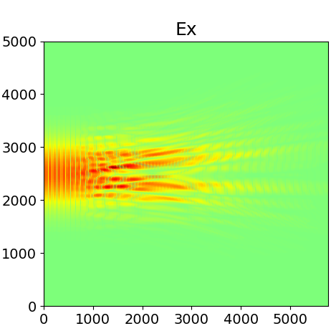
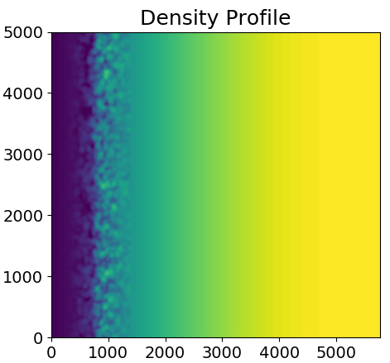
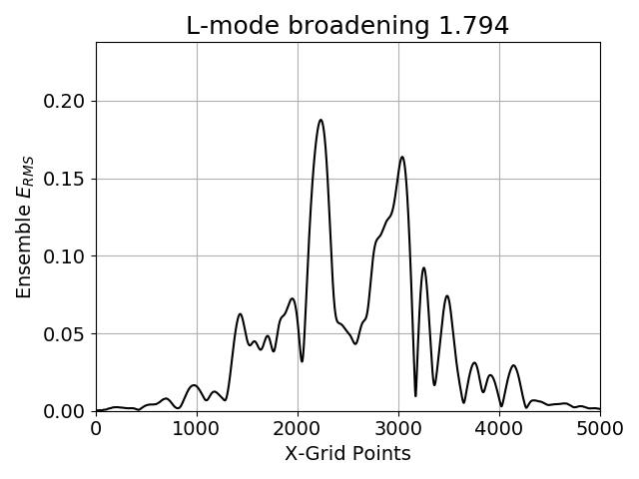
Method: Calculate Broadening
Turbulence evolves slowly compared to microwave propagation
Treat turbulence as “frozen” and average over a series of snapshots
Notes:
…and then I can simulate the beam propagating through it
In order to then find the beam broadening, I have to simulate the microwave beam propagating through an ensemble of these turbulent density profiles, and average across all of them. This takes advantage of the fact that the microwave propagates at a speed significantly faster than the turbulence moves, allowing me to average over a series of snapshots, rather than simulate the beam propagating through a moving plasma. In my scans, I’m averaging over 20 snapshots for each combination of parameters.
So through each snapshot I simulate the beam propagating through, then measure the RMS field at the backplane of the simulation domain.

Slide 10
Method: Calculate Broadening
Turbulence evolves slowly compared to microwave propagation
Treat turbulence as “frozen” and average over a series of snapshots
E_{RMS} at back plane averaged over:
1 turbulence snapshot
Notes:
So here is the result if I only consider 1 turbulent snapshot. This is the RMS field at the location the beam would be absorbed.

Slide 11
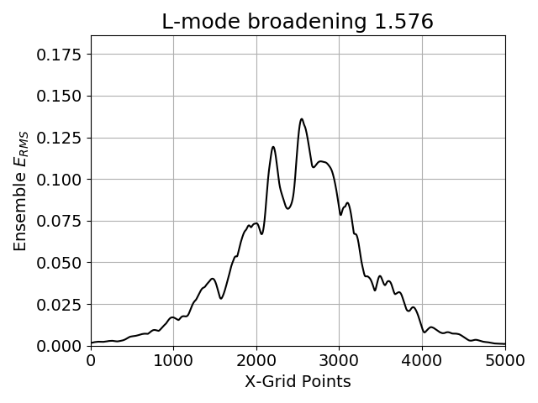
Method: Calculate Broadening
Turbulence evolves slowly compared to microwave propagation
Treat turbulence as “frozen” and average over a series of snapshots
E_{RMS} at back plane averaged over:
10 turbulence snapshots
Notes:
As I increase the number you can see the result begins to smooth out

Slide 12
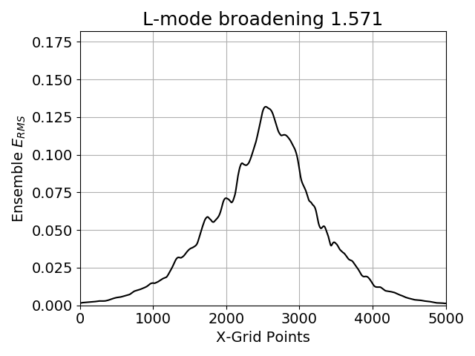
Method: Calculate Broadening
Turbulence evolves slowly compared to microwave propagation
Treat turbulence as “frozen” and average over a series of snapshots
E_{RMS} at back plane averaged over:
50 turbulence snapshots
Notes:
And continues...

Slide 13
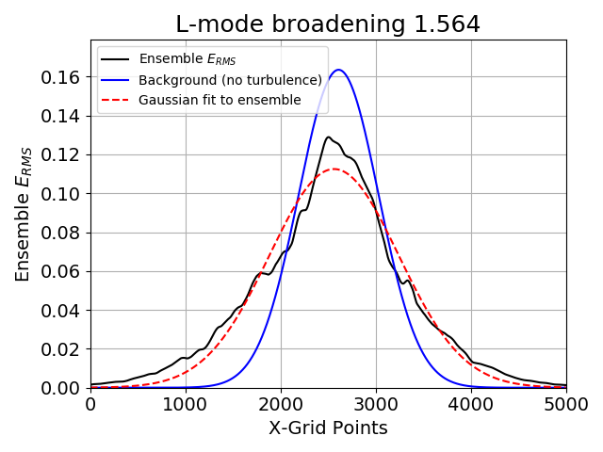
Method: Calculate Broadening
Turbulence evolves slowly compared to microwave propagation
Treat turbulence as “frozen” and average over a series of snapshots
E_{RMS} at back plane averaged over:
100 turbulence snapshots
Notes:
Finally, when I have completed the ensemble, I also complete a simulation with no turbulence present, and compare the results. I fit a gaussian to the turbulence result and compare with the FWHM of the background gaussian beam to see how much the turbulence has broadened the beam by.

Slide 14
Method: Fitting
Conduct pointwise fit to each 2D parameter scan
For a 2D parameter scan where dependence on each parameter is separable:
Г_{i,j} = A f ( x_{i} ) g ( y_{j} ) + 1
To determine separability, allow for a rotation of coordinate axis in parameter space such that
Г_{i,j} = A f ( x_{i} cos θ - y_{j} sin θ) g ( y_{j} cos θ + x_{i} sin θ) + 1
If we find from the fit that: θ = 0, then the dependence is separable
Notes:
Once I’ve done this for each combination or parameters in one of my 2D parameter scans, I then perform a fit to the data to test if the parametric dependence is separable. If it were, we’d expect something of this form, where the broadening depends on two separate functions, one of each parameter, multiplied together in someway. In order to test for separability, I allow a rotation, allowing for the functions to be dependent on a linear combination of the two parameters. Theta is a fitting parameter, which then indicated the separability.

Slide 15
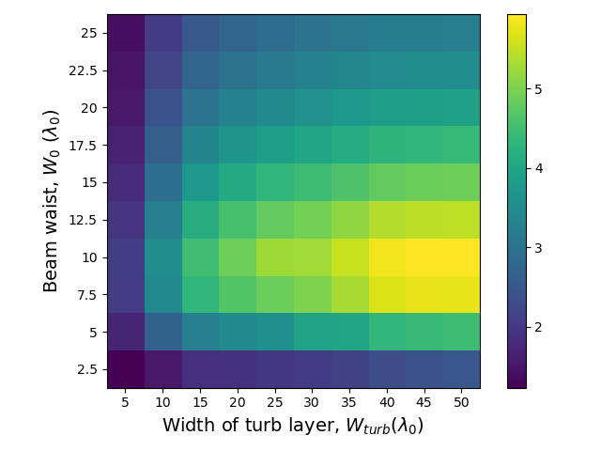
Results: Example 2D Scan
Colour map of broadening as a function of beam waist and the width of the turbulence layer
Dependence is separable
Notes:
So here are some example results. This is a 2D scan of how broadening depends on the beam waist and the width of the turbulence layer. Each of these squares corresponds to an ensemble of 20 simulations, sot his figure represents results from 2000 full wave simulations.
The colour indicates the degree by which the beam was broadened by the turbulence in each case. So a broadening factor of five, for example, means that the FWHM of the ensemble beam when turbulence was present was five times larger than when no turbulence was present. In this case, the two parameter are separable.

Slide 16
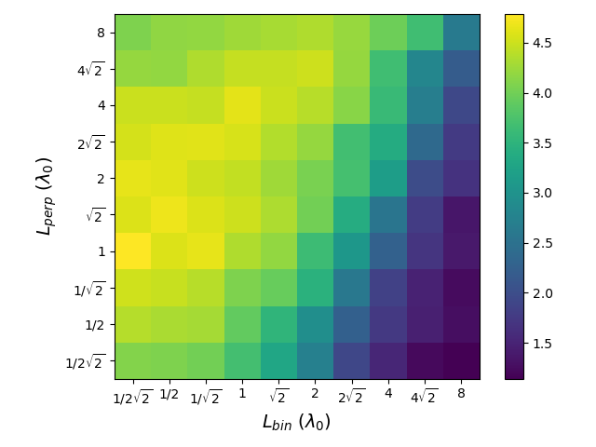
Results: Example 2D Scan
Colour map of broadening as a function of turbulence correlation length
Dependence is not separable
θ = 67° ± 2°
Noting log scale:
cos θ log L_{perp} - sin θ log L_{bin}
= log(L_{perp}^{0.4}/ L_{bin}^{0.9}) for θ = 67°
ratio/product of correlation
lengths important
Notes:
And here you see a result of two parameter which were not separable. This is the scan of both correlation lengths and the angle in the fit comes out to be 67 degrees. Noting the log dependence, rather than suggesting a linear combination of the two parameters, this means the dependence on the ratio of the two parameters and the product of the two parameters is important.

Slide 17
Results: 2D Scans
It was found that:
Dependence for L_{perp} and L_{bin} is not separable
Dependence for dn/n₀ and n₀/n_{crit} is not separable
All other dependences are separable
The resulting empirical equation for beam broadening is of the form:
Notes:
So, we carried out a series of these 2D parameter scans, each of which involved a large number of full-wave simulations. From these 2D scans, we determined which dependencies were separable from the others and which were not.
We found that the dependences of the two correlation lengths weren’t separable from each other. This is an important result, as in previous work it has been common to have both correlation lengths equal each other in simulations of beam broadening by turbulence. This is often not the case in fusion plasmas, so will affect the result.
We also found that the dependence on black ground density and fluctuation level weren’t separable from each other.
And we found that all the other dependencies were separable.
With this knowledge, and the results of all the parameter scans, we were then able to perform a fit to the data set to find how the broadening of microwave beams depended on these six plasma and beam parameters. The resultant formula would be of the form shown here.

Slide 18
Results: Normalized dependence
Beam waist (W₀/λ₀) and Width of Turbulence layer (W_{turb}/λ₀)
Notes:
The resultant dependence on each parameter is then shown here. On the left is how the broadening depends on the beam waist, and the right is how it depends on the width of the turbulence layer. The point marked in orange is the point which is present in every 2D scan, to which the results are normalised.
The dependence on beam waist matches that seen in previous 1D scans, where it increases to some peak value before decreasing again.
The dependence on the width of turbulence layer is as you might expect. It increases, then levels off when the beam effectively can’t be broadened anymore.

Slide 19
Results: Normalized dependence
Perpendicular (L_{perp}/λ₀) and binormal (L_{bin}/λ₀) correlation length
Notes:
You can see the dependence of the approximate ratio of the two correlation lengths on the left, and the approximate product on the right. You can see that the dependence on the ratio is much stronger than that on the product. It seems maximal when the radial correlation length is longer than the poloidal one. This is beneficial as it is usually the other way round in fusion plasmas.

Slide 20
Results: Normalized dependence
Fluctuation Level (dn/n₀) and Background Density (n₀/n_{crit})
Notes:
This shows the dependence on two linear combinations of the background density and fluctuation level. The dependence on the sum seems stronger than the dependence on the difference.

Slide 21
Summary
Series of 2D Parameter scans carried out to determine separability of the dependence of beam broadening on different plasma and beam parameters
It was found that:
Dependence for L_{perp} and L_{bin} is not separable
Dependence for dn/n₀ and n₀/n_{crit} is not separable
All other dependences are separable
The resulting empirical equation for beam broadening is of the form:
This can then be used to predict microwave beam broadening based on plasma and beam parameters.
Notes:
So, in summary, we carried out a series of 2D parameter scans, each of which involved a large number of full-wave simulations. From these 2D scans, we determined which dependencies were separable from the others and which were not.
We found that the dependences of the two correlation lengths weren’t separable from each other. This is an important result, as in previous work it has been common to have both correlation lengths equal each other in simulations of beam broadening by turbulence. This is often not the case in fusion plasmas, so will affect the result.
We also found that the dependence on black ground density and fluctuation level weren’t separable from each other.
And we found that all the other dependencies were separable.
With this knowledge, and the results of all the parameter scans, we were then able to perform a fit to the data set to find how the broadening of microwave beams depended on these six plasma and beam parameters. The resultant formula would be of the form shown here.

Slide 22
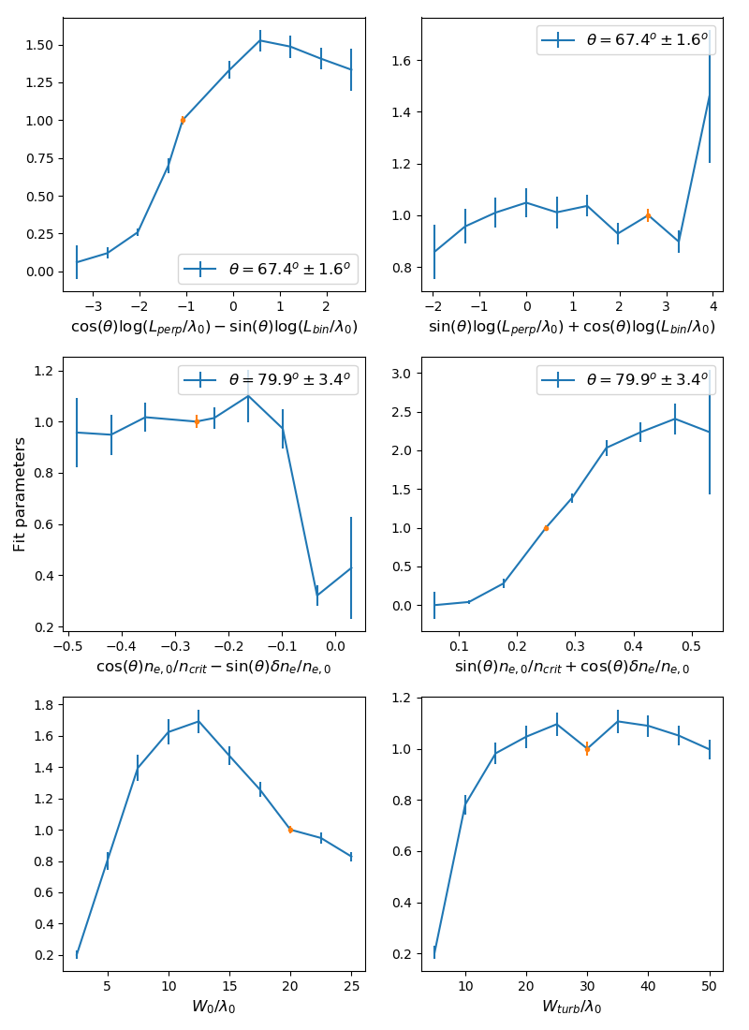
Thanks for your attention

Slide 23
Additional Slides

Slide 24
Method: Turbulence Generation
The density fluctuations are generated using a truncated sum of Fourier-like modes
The random phases are uniformly distributed between 0 and 2π
The amplitudes are related to the structure size by
where
Notes:
The phi terms are the random phases and the A terms are the amplitudes
Ax and az are the box size

Slide 25
Method: Parameter Scans
Parameter | Varied as | Base case | Range from | Range to | Step
Perpendicular correlation length | log₂(L_{perp} / λ₀) | 2 | -1.5 | 3 | 0.5
Binormal correlation length | log₂(L_{bin} / λ₀) | 2 | -2.5 | 2 | 0.5
Beam waist radius | w₀ / λ₀ | 20 | 2.5 | 25 | 2.5
Fluctuation level | 𝛿n_{e} / n_{e,0} | 0.3 | 0.05 | 0.5 | 0.05
Background density | X = n_{e} / n_{crit} | 0.2 | 0.05 | 0.45 | 0.05
Width of turbulence layer | W_{turb} / λ₀ | 30 | 5 | 50 | 5
Notes:
And for anyone interested, here are the parameter ranges, and the ‘base case’ that is used when varying other parameters. Important things to note here is that everything is normalised so are all dimensionless quantities. Also, the turbulence correlation lengths are varied logarithmically. I won’t go through them now but if your interested they’re here.

