Slide 1

Electron temperature fluctuation measurements with Correlation Electron Cyclotron Emission in L-mode and I-mode plasmas at ASDEX Upgrade
R. Bielajew¹, G. D. Conway², T. Happel², K. Höfler^{3,2}, P.A. Molina Cabrera², U. Plank², P. Rodriguez-Fernandez¹, D. Silvagni², C. Yoo¹, A.E. White¹, the ASDEX Upgrade Team
¹MIT Plasma Science and Fusion Center
²Max Planck Institute for Plasma Physics
³Physics Department E28, Technical University of Munich
21st Joint Workshop on ECE and ECRH
ITER June 20-24, 2022
MIT
This work is supported by the US DOE under Grants DE-SC0006419, DE-FC02-99ER54512- CMOD, and DE- SC0017381. This work has been carried out within the framework of the EUROfusion Consortium and has received funding under grant agreement No 633053. The views and opinions expressed herein do not necessarily reflect those of the European Commission.

Slide 2
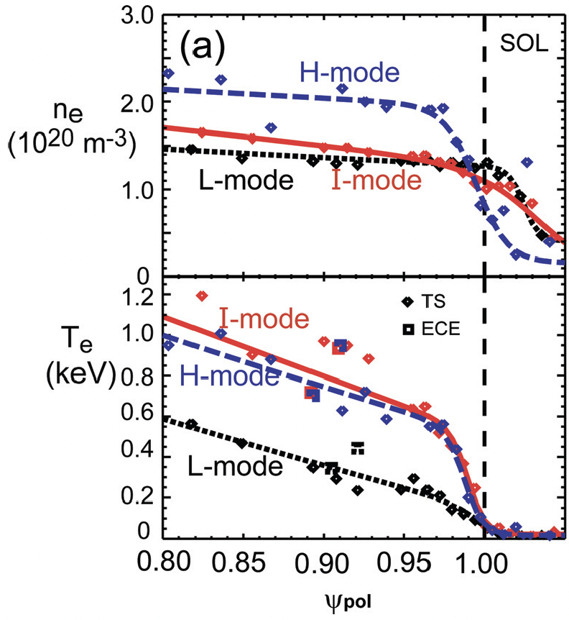
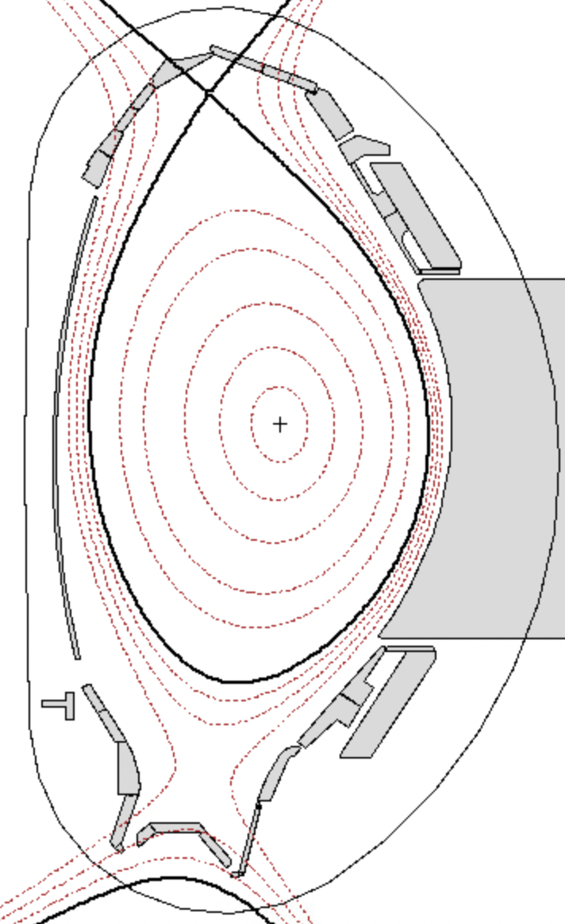
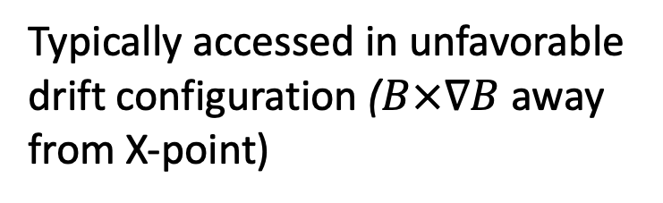

The I-mode improved confinement regime
[Hubbard et al, PoP 2011]
Unique I-mode edge features:
Heat transport barrier without particle transport barrier
  Low impurity confinement time
  No ELMs
Separation of transport channels is still under investigation
$∇B$ drift
Typically accessed in unfavorable drift configuration ($B×∇B$ away from X-point)

Slide 3
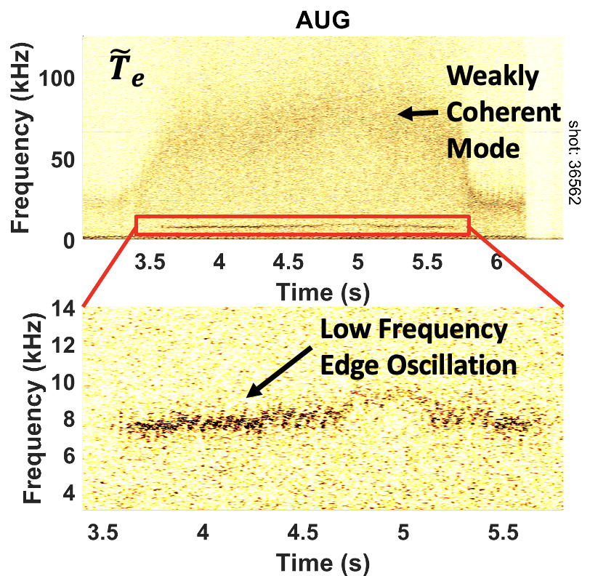
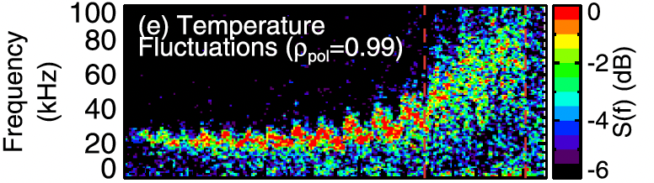
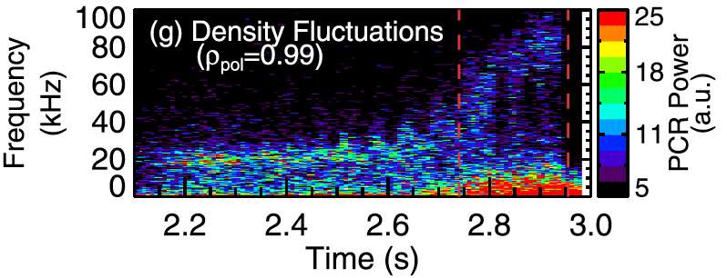


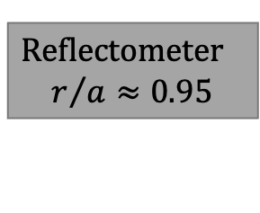
Characteristics of pedestal fluctuations across L to I transition on C-Mod and AUG
“Weakly Coherent Mode” (WCM) appears in I-mode and some preceding L-modes
“Low Frequency Edge Oscillation” (LFEO) appears in some I-modes
AUG
L-mode
I-mode
Reflectometer
$$r/{a≈0.95}$$
WCM
C-Mod
CECE
$$r/{a≈0.95}$$
L-mode
I-mode
Reflectometer
[Hubbard et al, PoP 2011]
[Happel et al, Nucl. Mater. Energy 2018]
[W. McCarthy, PhD Thesis 2022]
Open question:
How do changes in fluctuations track changes in transport across the L to I transition?

Slide 4
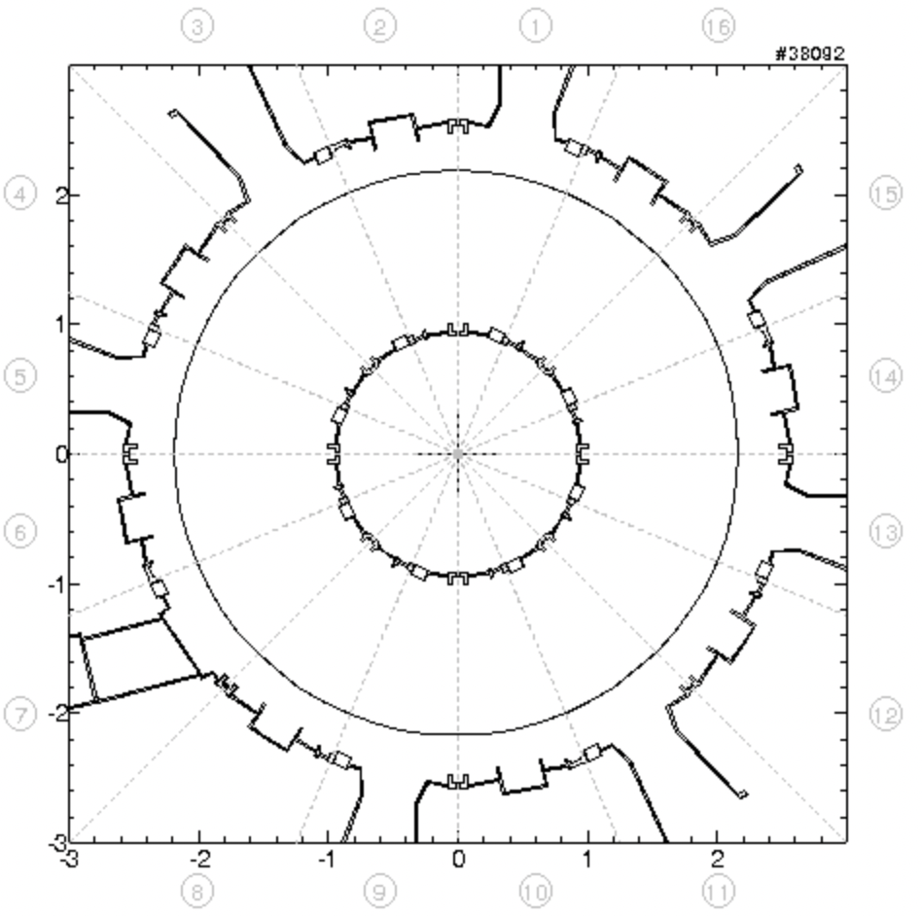
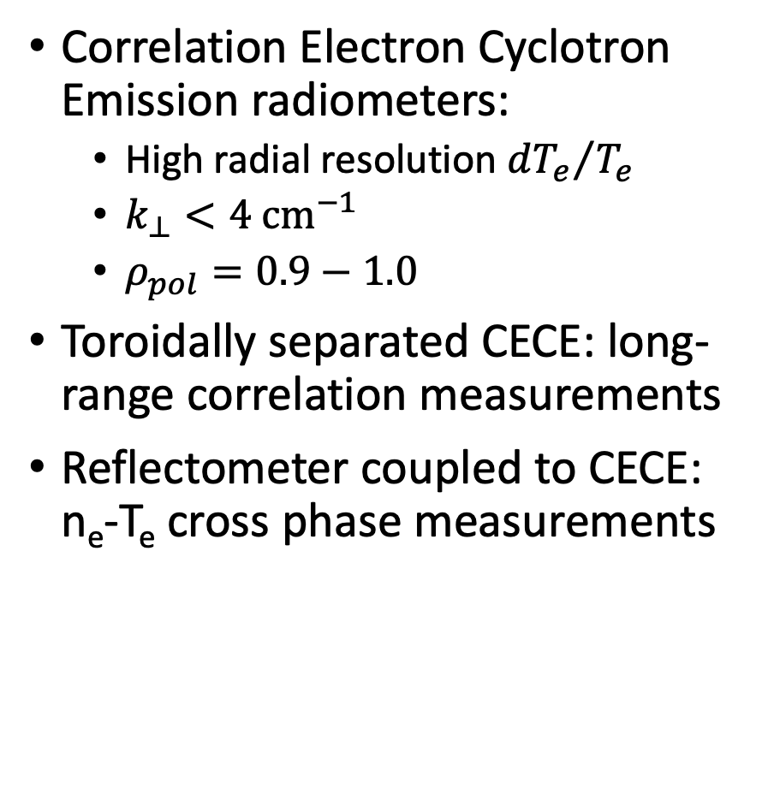
Several diagnostics at AUG measure edge turbulence
Correlation Electron Cyclotron Emission radiometers:
  High radial resolution ${dT_{e}}/{T_{e}}$
  $k_{⊥}<4 {cm}^{−1}$
  $ρ_{pol}=0.9−1.0$
Toroidally separated CECE: long-range correlation measurements
Reflectometer coupled to CECE: n_{e}-T_{e} cross phase measurements
AUG Top View of Port and Diagnostic Access
Experimental design:
Discharges with steady-state L-modes and I-modes
Reflectometer
CECE
CECE

Slide 5
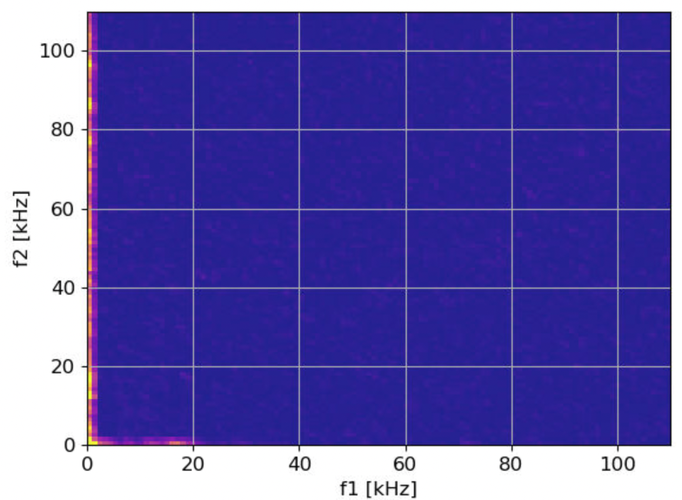
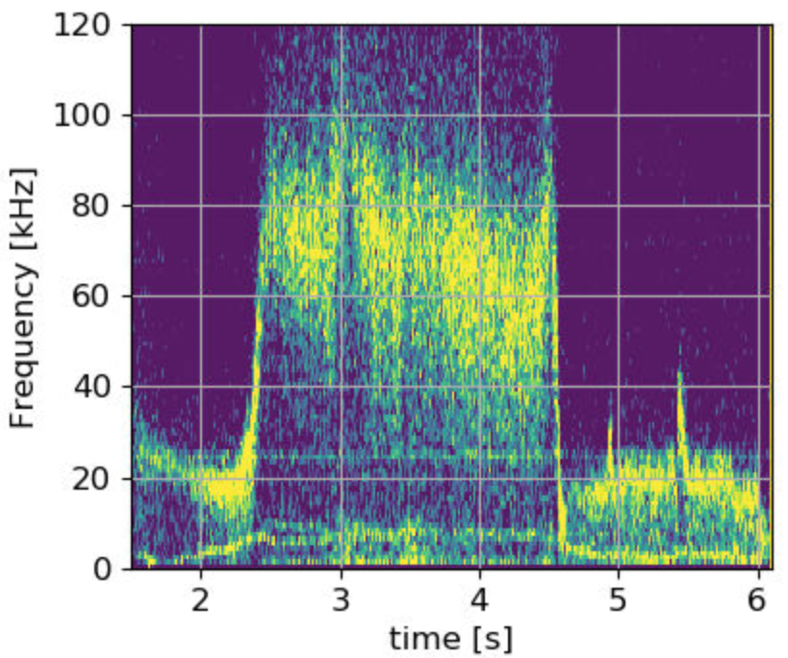
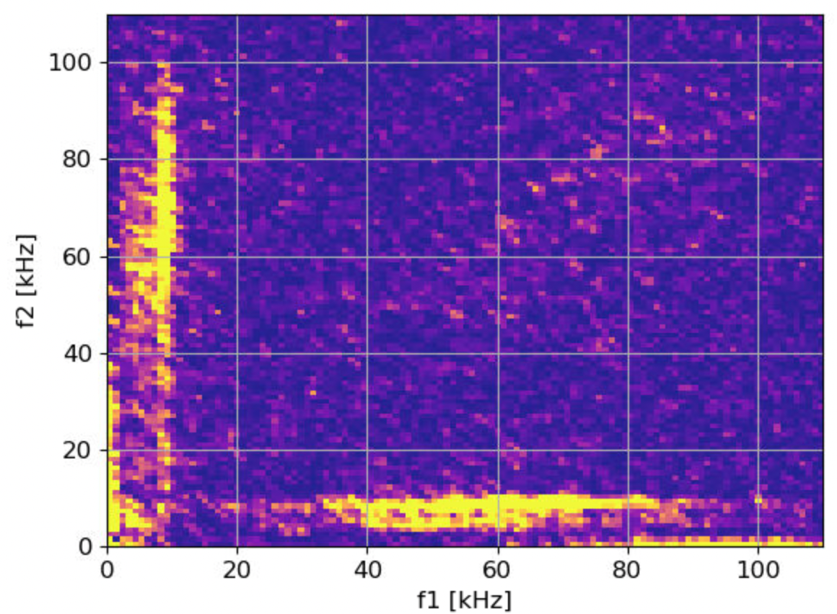



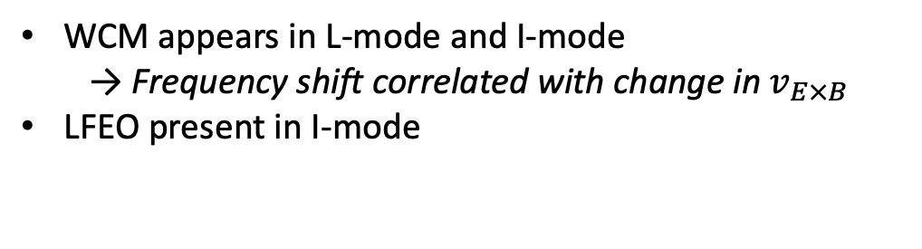
CECE measures presence and coupling of WCM and LFEO in L-mode and I-mode
Spectrogram from single CECE channel
Cross-bicoherence between neighboring channels
L-mode
#39561
5.10-5.70s
$$ρ_{pol}=0.99$$
$$ρ_{pol}=0.99$$
AUG CECE
#39561
I-mode
No coupling
L-mode
L-mode
WCM
I-mode
#39561
3.00-3.95s
$$ρ_{pol}=0.99$$
LFEO
WCM-LFEO coupling
WCM appears in L-mode and I-mode
  Frequency shift correlated with change in $v_{E×B}$
LFEO present in I-mode
LFEO and WCM are coupled in I-mode

Slide 6
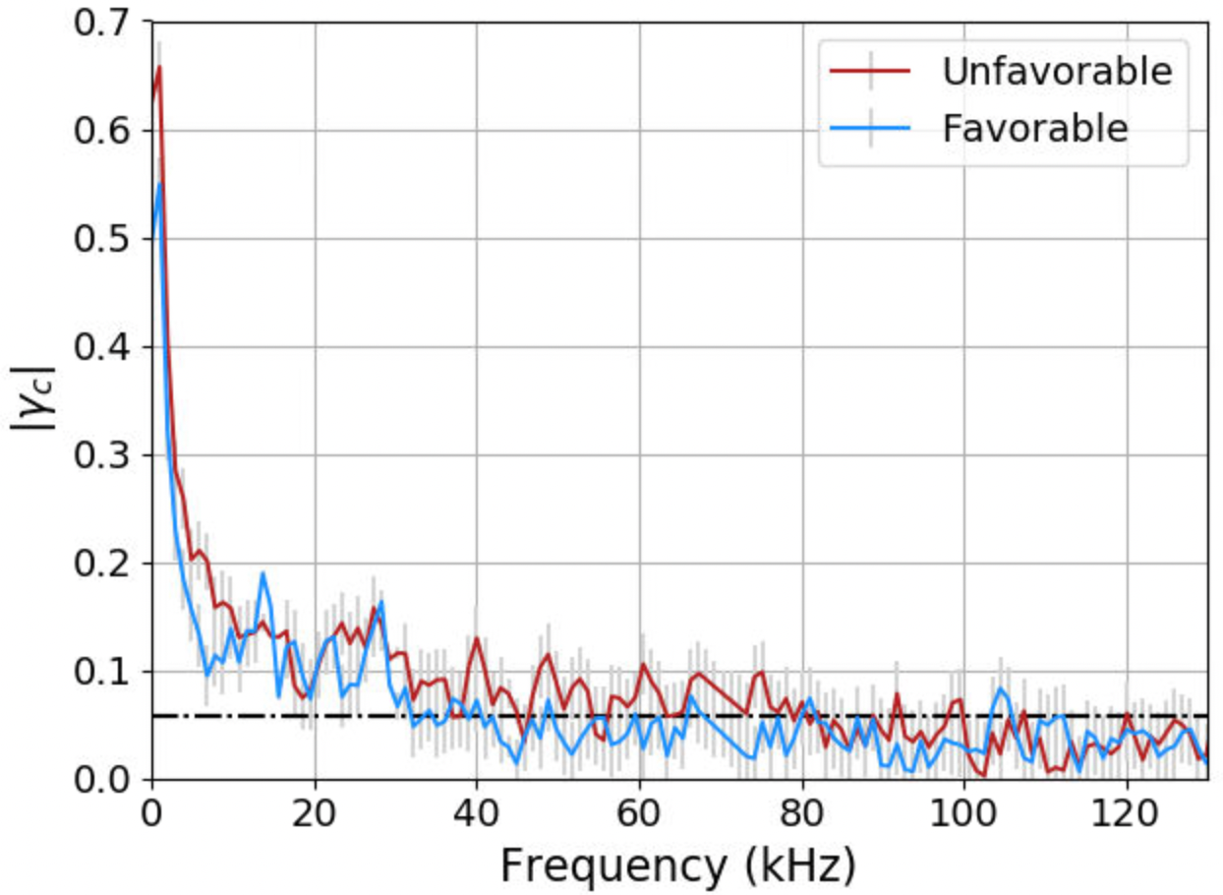
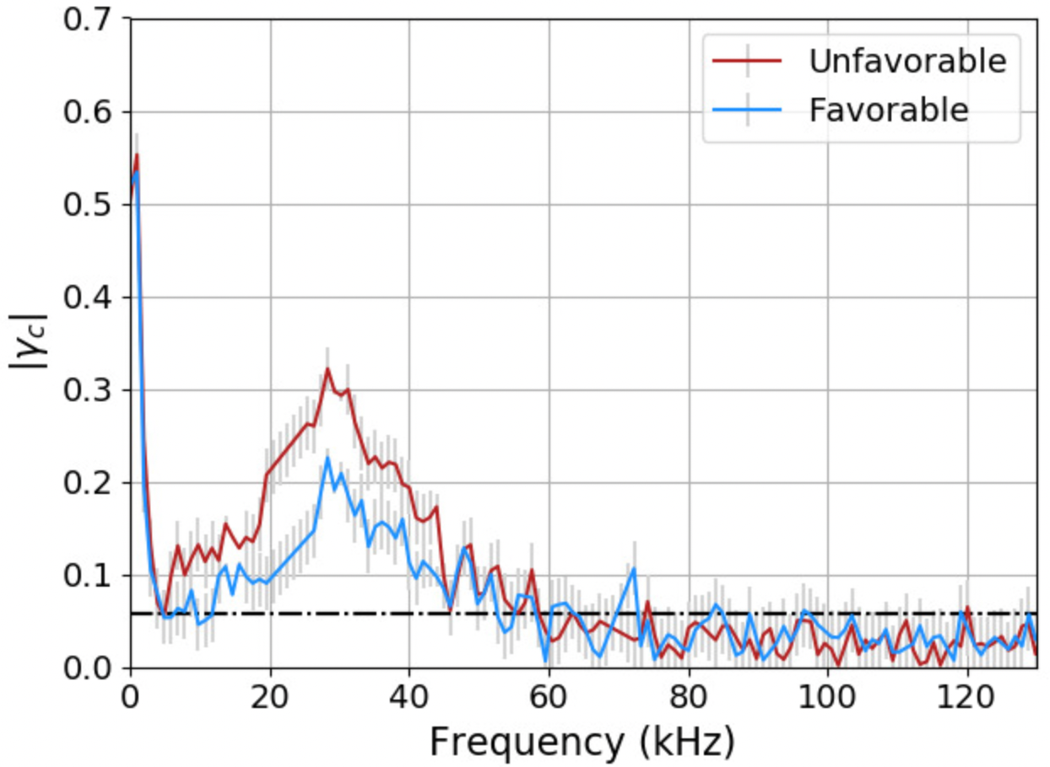
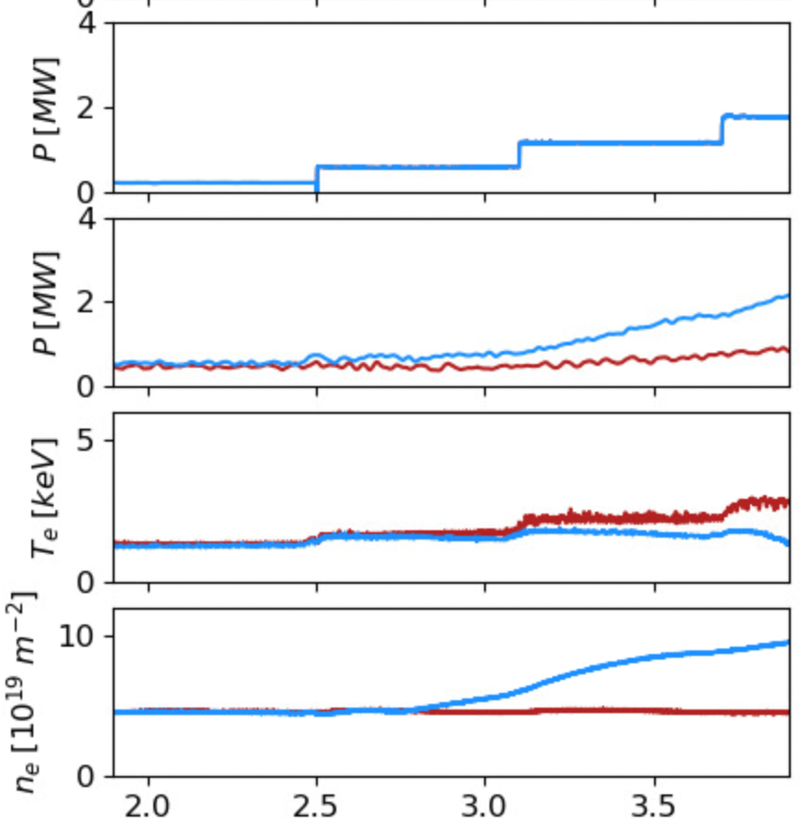
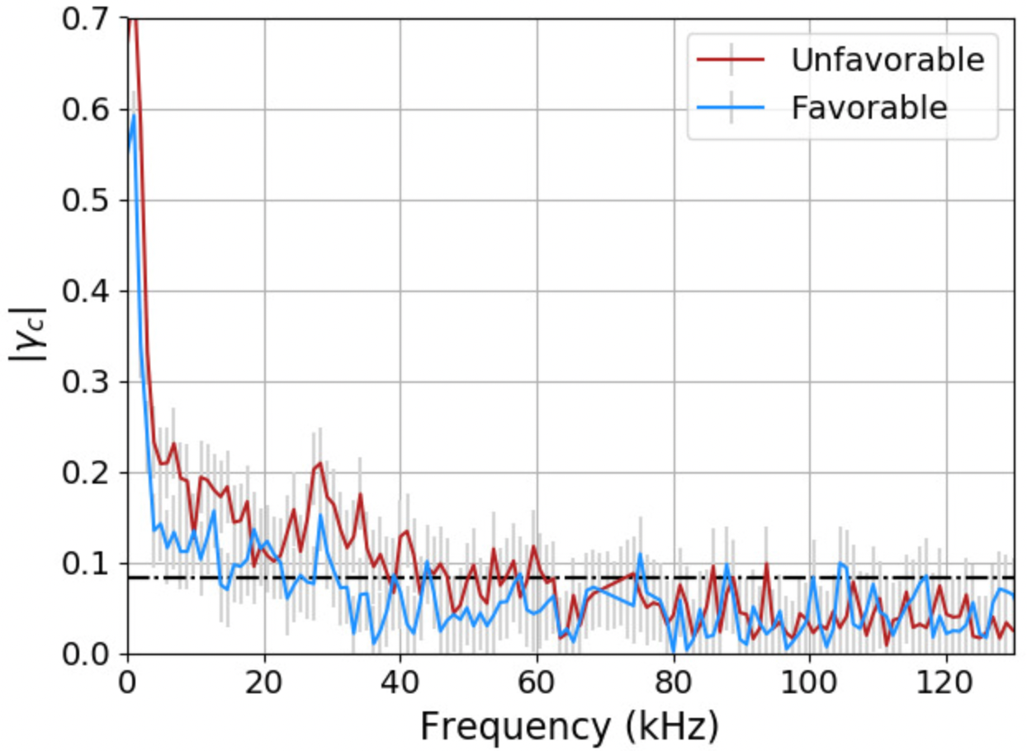
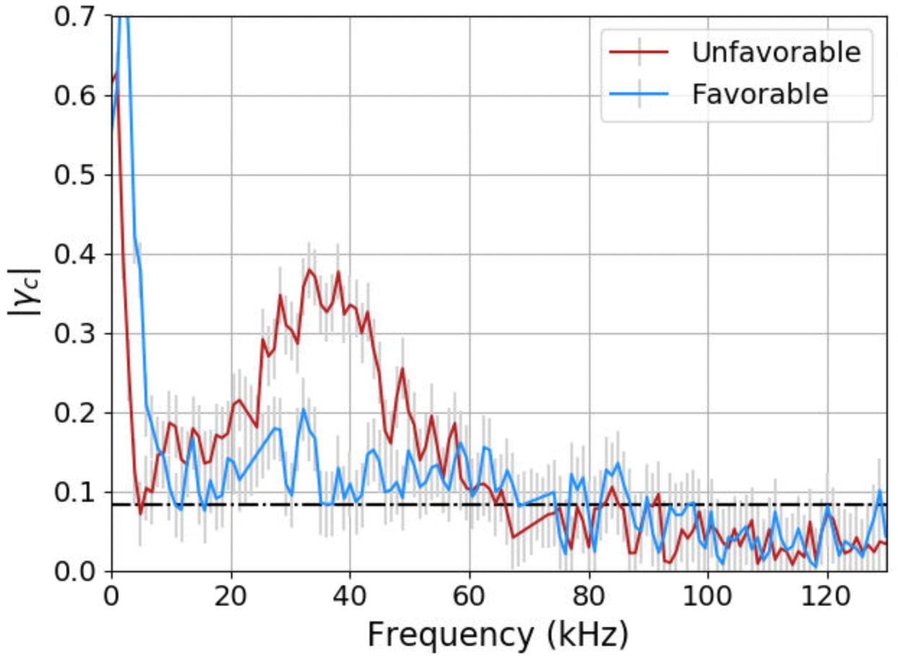
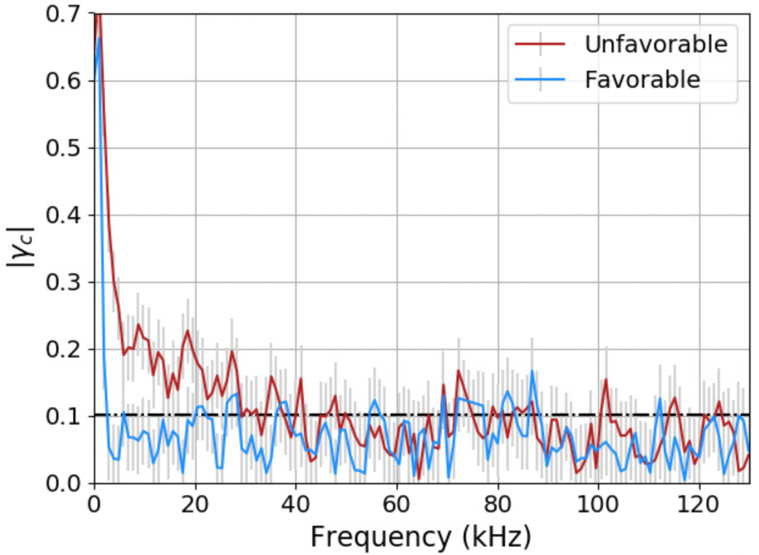
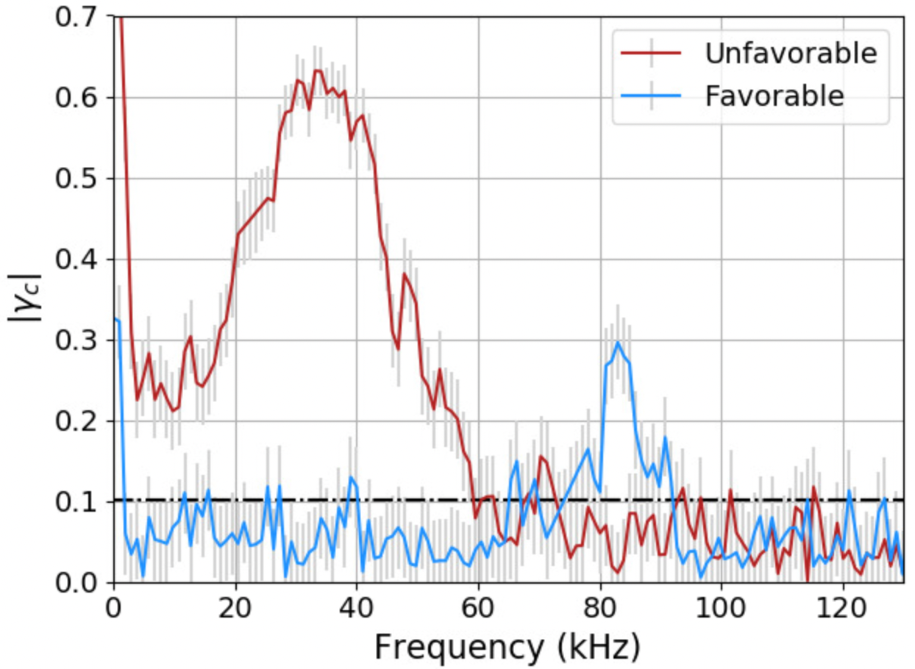



L-mode WCM development in different drift configuration
Pedestal top ($ρ_{pol}=0.96$)
WCM location ($ρ_{pol}=0.99$)
Matched power discharges in favorable and unfavorable drift configurations
L-mode
0.2 MW ECRH
(1.9-2.5s)
0.2 MW ECRH
(1.9-2.5s)
#40971, 40972
ECRH power (matched)
Radiated power
L-mode
0.6 MW ECRH
(2.6-2.9s)
0.6 MW ECRH
(2.6-2.9s)
Core temperature
Core line integrated density
Unfav.: L-mode
Fav: H-mode
1.8 MW ECRH
(3.7-3.9s)
1.8 MW ECRH
(3.7-3.9s)
Time [s]
ELM-free H-mode transition

Slide 7
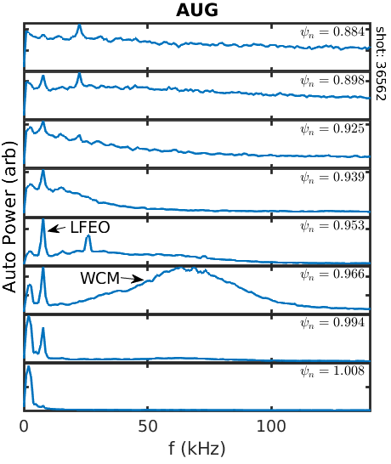
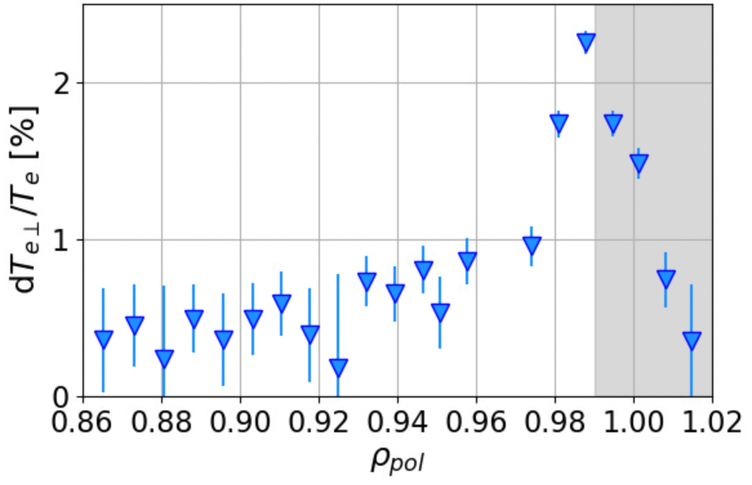
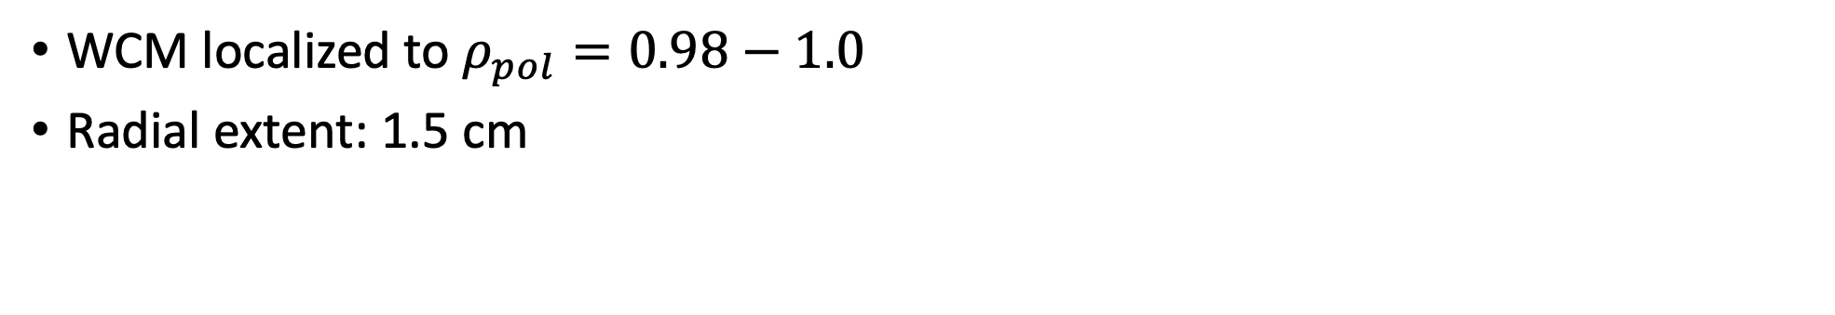

High resolution CECE provides details of mode radial locations
#39561
AUG
I-mode
3.0-4.0s
10-250kHz integration
370-400kHz background
WCM peak
$$τ<2$$
Pedestal Top
WCM
LCFS
WCM localized to $ρ_{pol}=0.98−1.0$
Radial extent: 1.5 cm
[W. McCarthy, PhD thesis 2022]
LFEO across pedestal

Slide 8
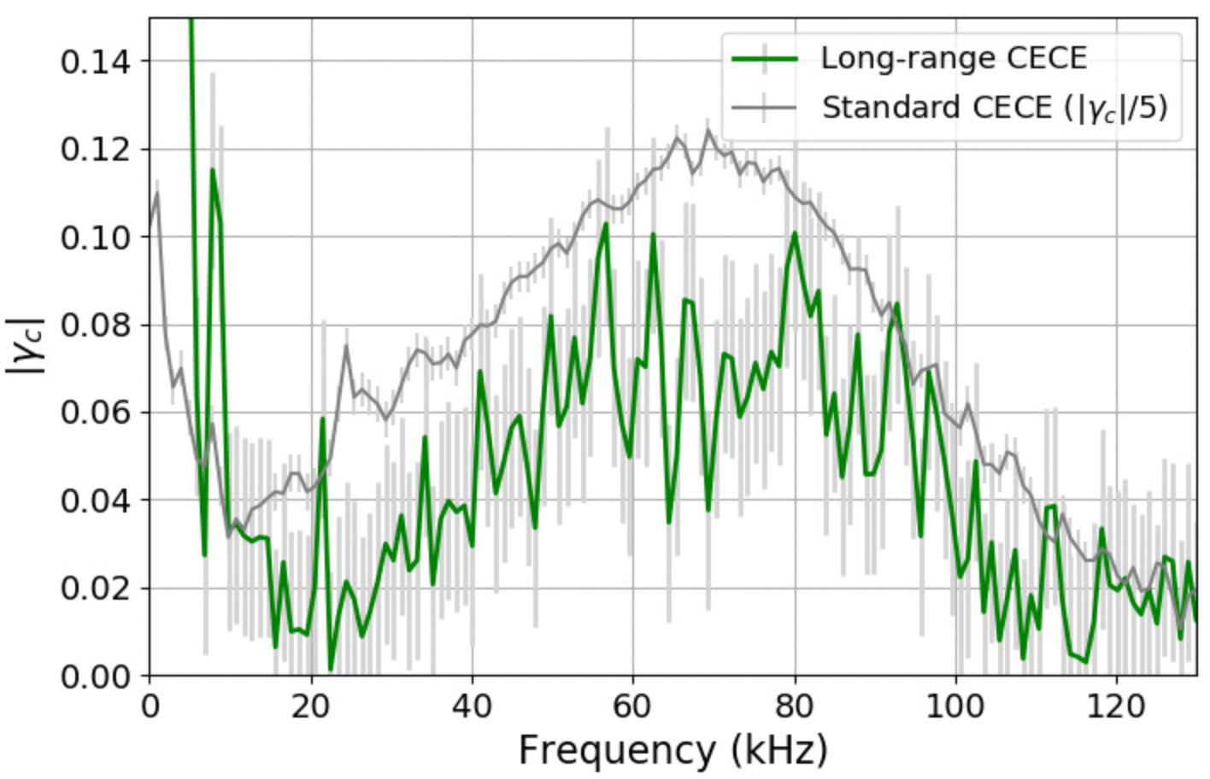
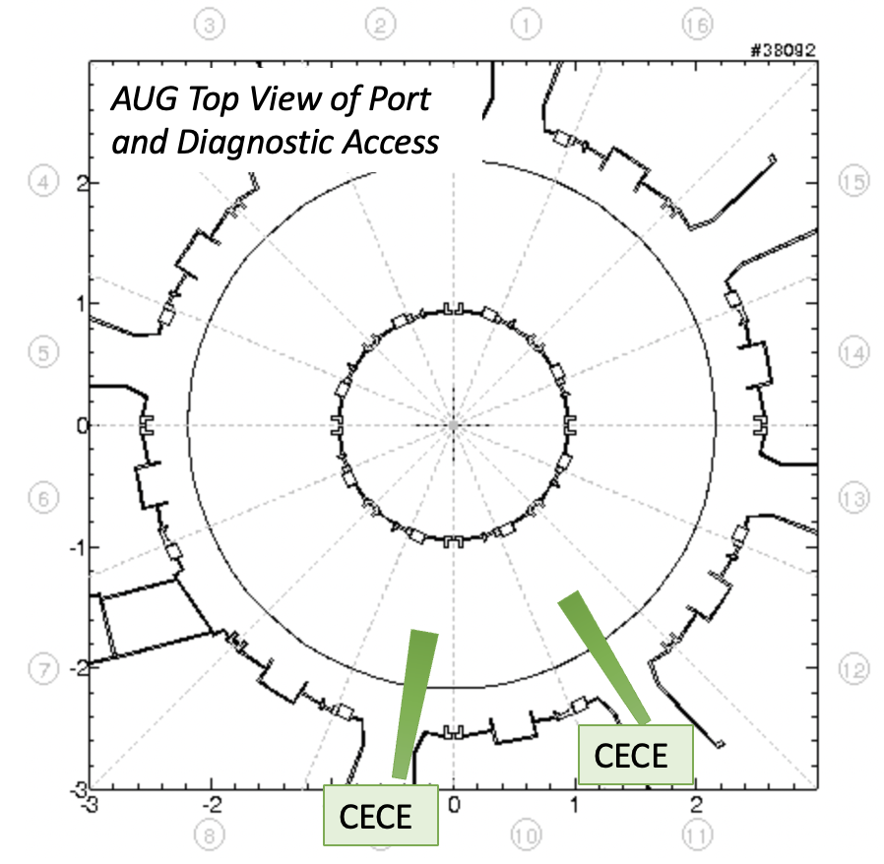

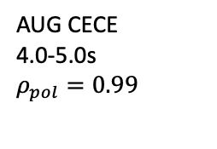
Long range correlations capture WCM and LFEO
Toroidal and poloidal separation allow measurement close to same field line with $q_{99}=5$
AUG CECE
4.0-5.0s
$$ρ_{pol}=0.99$$
LFEO
WCM
→ may indicate WCM and LFEO have low n number

Slide 9
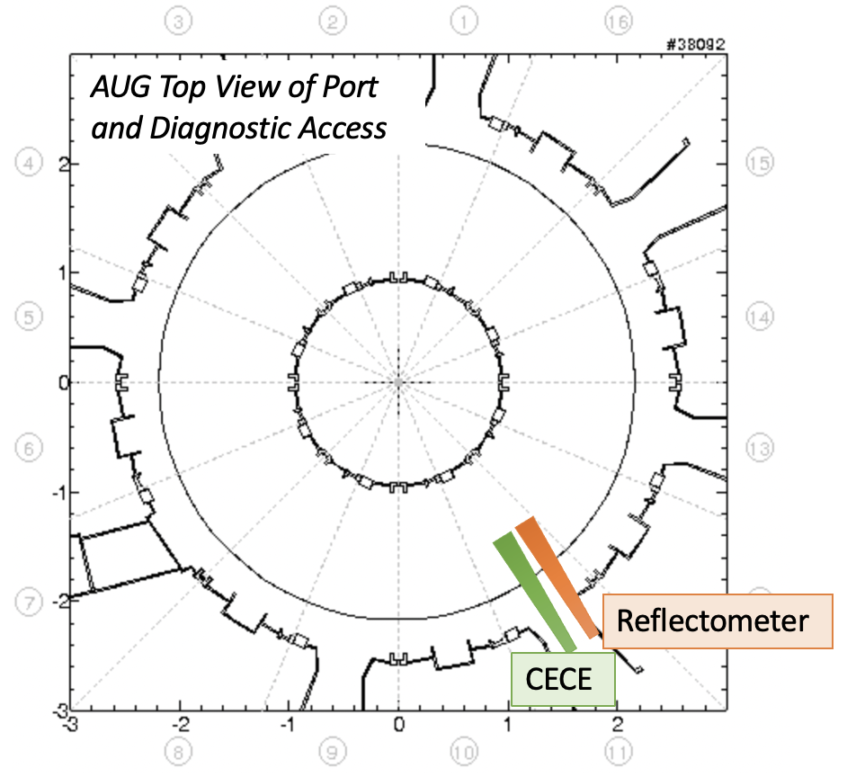
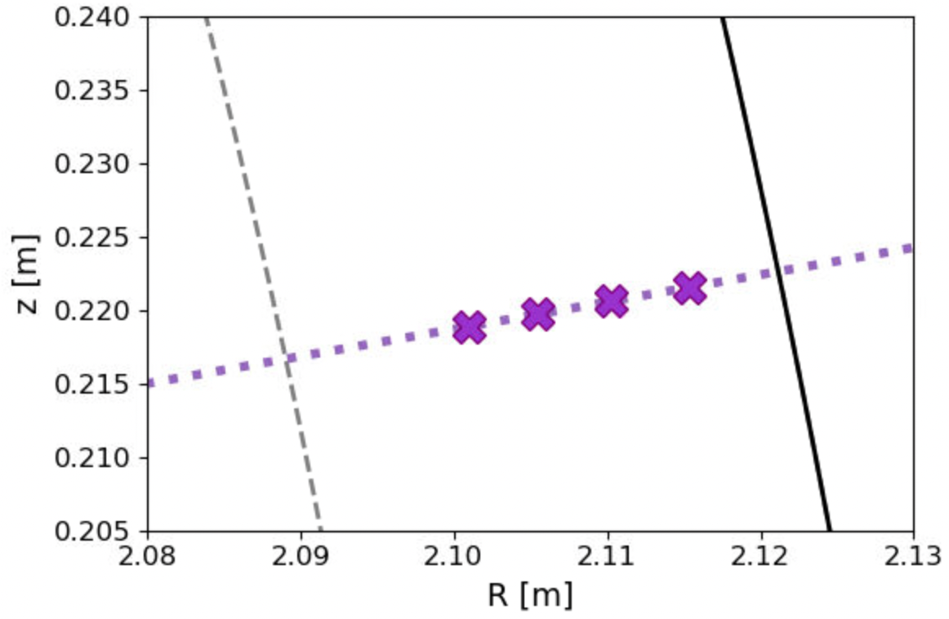


$n_{e}T_{e}$ phase diagnostic principles
CECE comb and reflectometer cutoff
$$ρ_{pol}=0.95$$
LCFS
Reflectometer
(X-mode V-band)
8
7
6
9
CECE channels
CECE line of sight

Slide 10
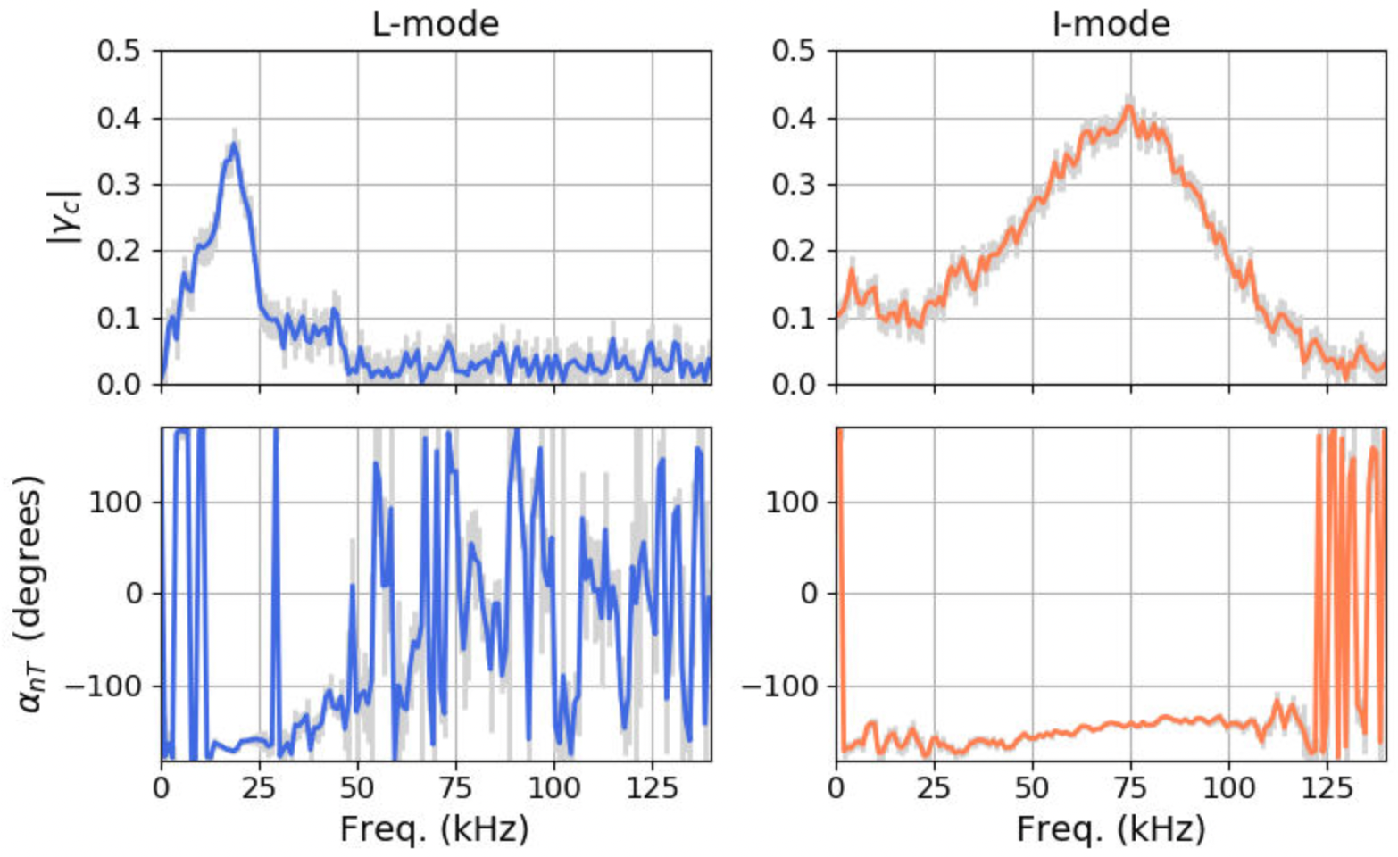
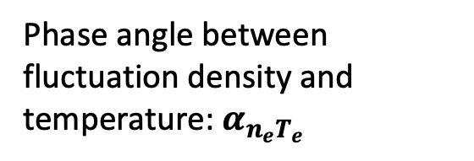



$n_{e}T_{e}$ phase measurements show slight change between L-mode and I-mode
$n_{e}T_{e}$ phase angle measurements from coupled CECE-reflectometer
#39651
CECE-reflectometer
5.1-5.7s
CECE-reflectometer
3.0-4.0s
Coherency between reflectometer and ECE channel at WCM location
$$α_{n_{e}T_{e}}=−171 °$$
$$α_{n_{e}T_{e}}=−143 °$$
Phase angle between fluctuation density and temperature: $α_{n_{e}T_{e}}$

Slide 11
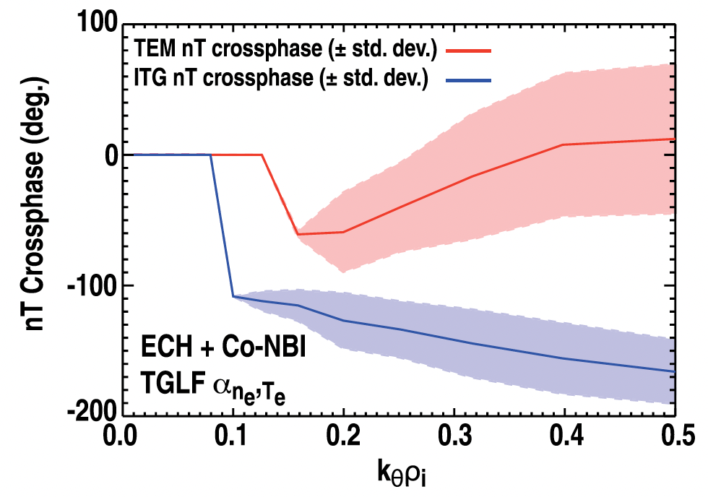

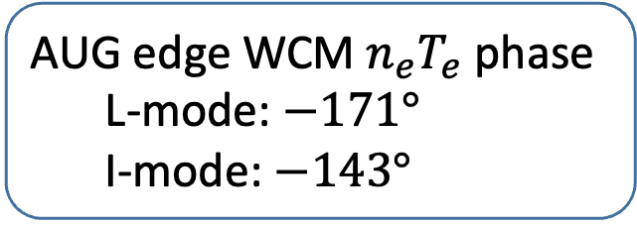

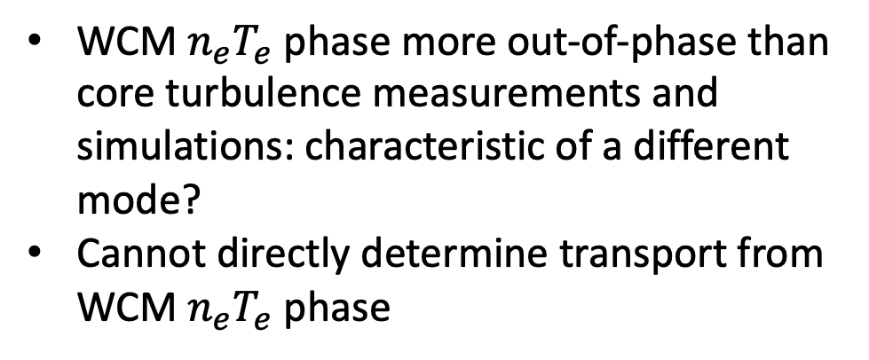
Cross-phase changes with $∇T_{e}$, but WCM cross-phase is more out-of-phase than core broadband turbulence
$α_{nT}$ has been shown to change with $∇T_{e}$
AUG edge WCM $n_{e}T_{e}$ phase
  L-mode: $−171°$
  I-mode: $−143°$
WCM $n_{e}T_{e}$ phase more out-of-phase than core turbulence measurements and simulations: characteristic of a different mode?
Cannot directly determine transport from WCM $n_{e}T_{e}$ phase
[Hillesheim et al PoP 2013]

Slide 12
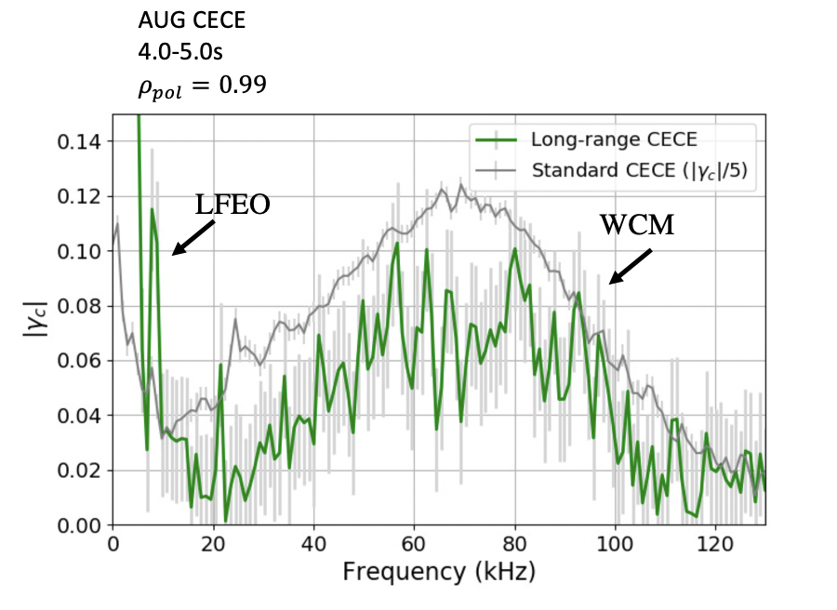
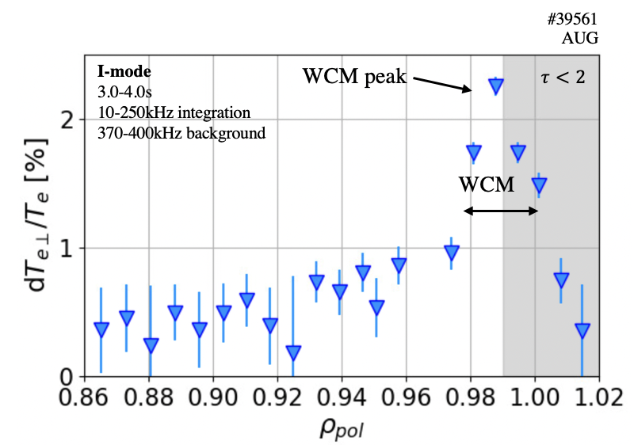
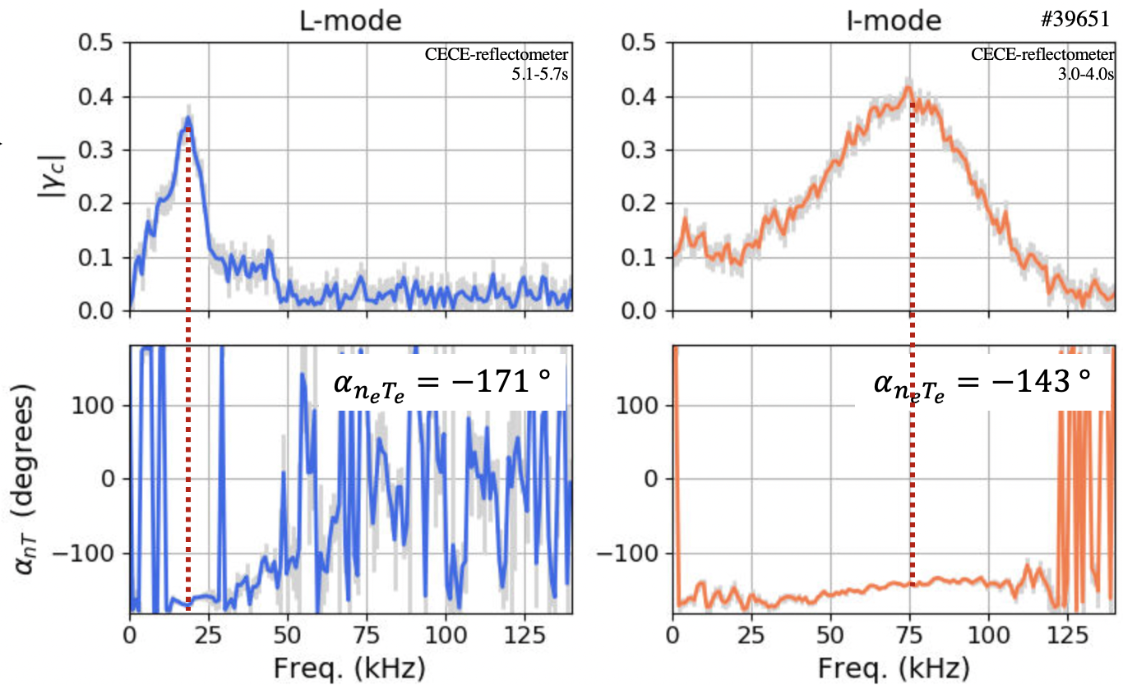
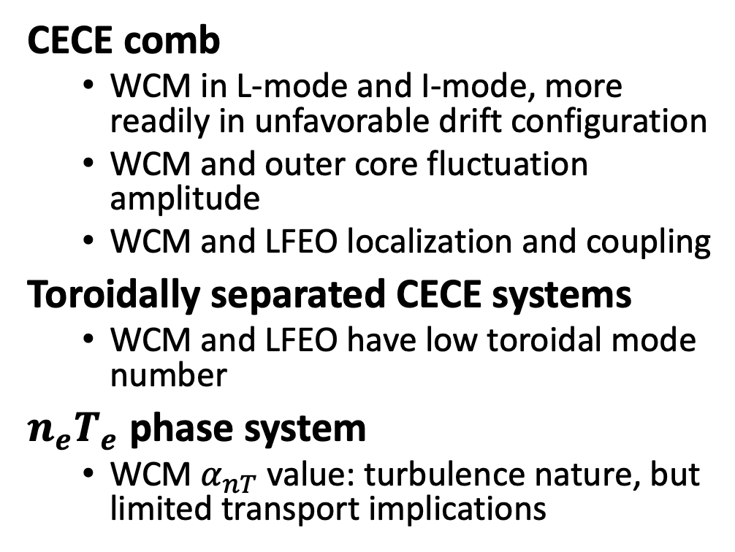
Summary
CECE provides detailed investigation of L-mode and I-mode outer core and pedestal fluctuations
CECE comb
  WCM in L-mode and I-mode, more readily in unfavorable drift configuration
  WCM and outer core fluctuation amplitude
  WCM and LFEO localization and coupling
Toroidally separated CECE systems
  WCM and LFEO have low toroidal mode number
$n_{e}T_{e}$ phase system
  WCM $α_{nT}$ value: turbulence nature, but limited transport implications

Slide 13
Backups

Slide 14
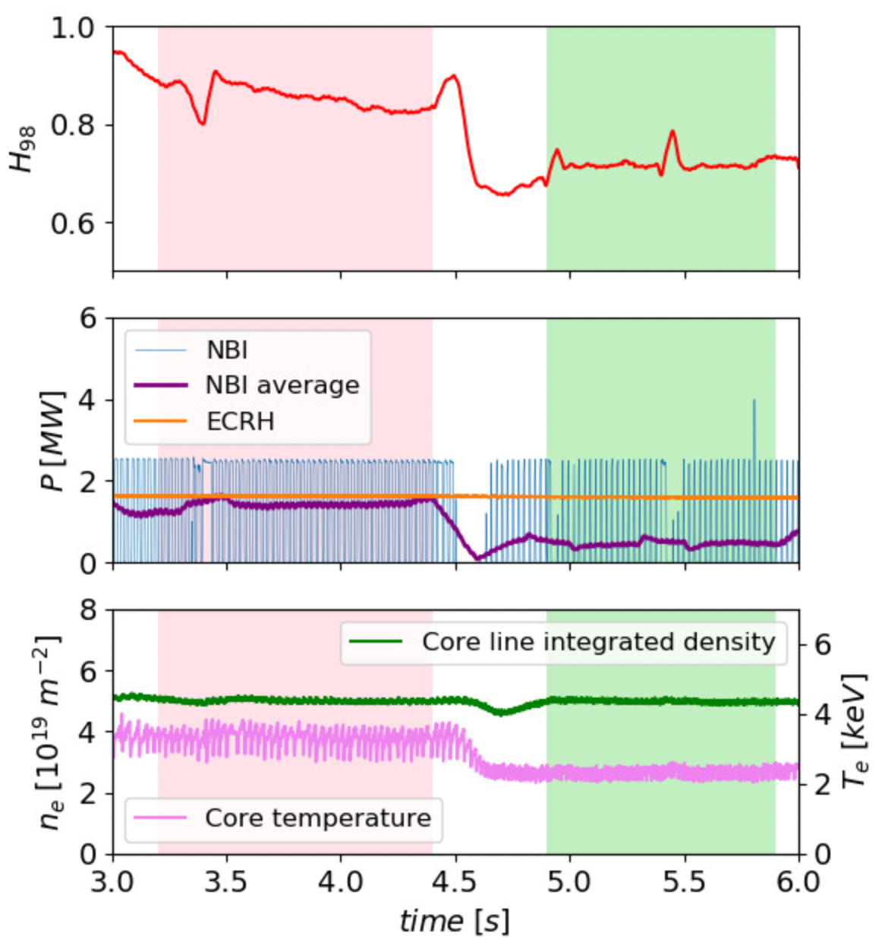
Experimental design: discharges with L-mode and I-mode phases
Time histories of typical L-mode/I-mode
#39561 AUG
I-mode
L-mode
Investigation across parameter space
Density and collisionality: low and high
Heating scheme: NBI and ECRH

Slide 15
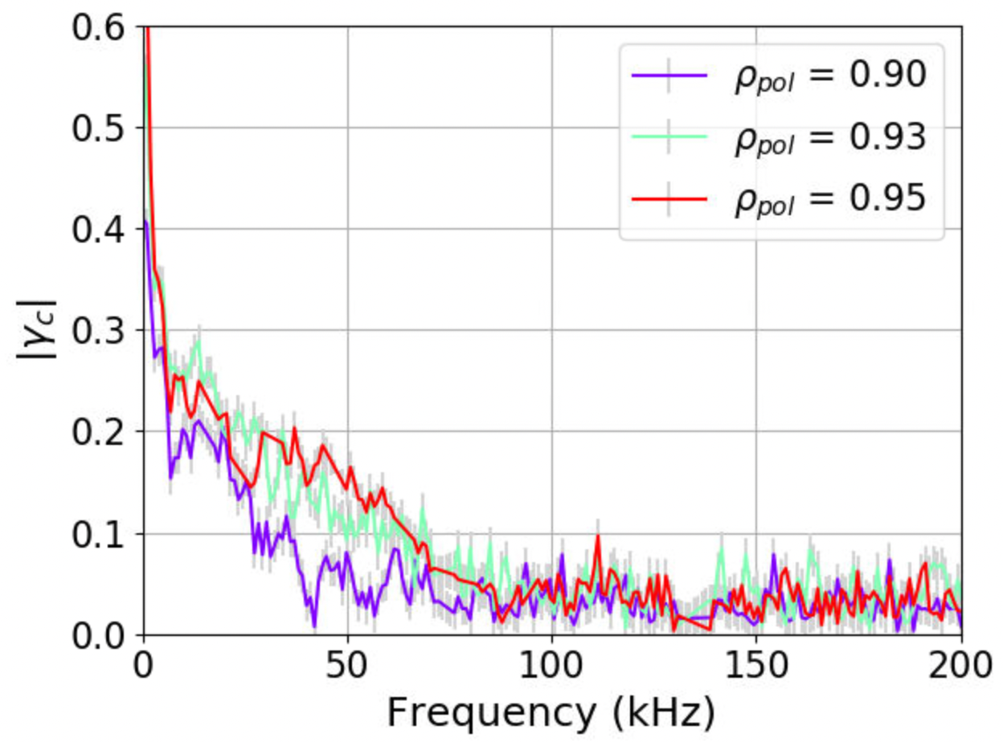
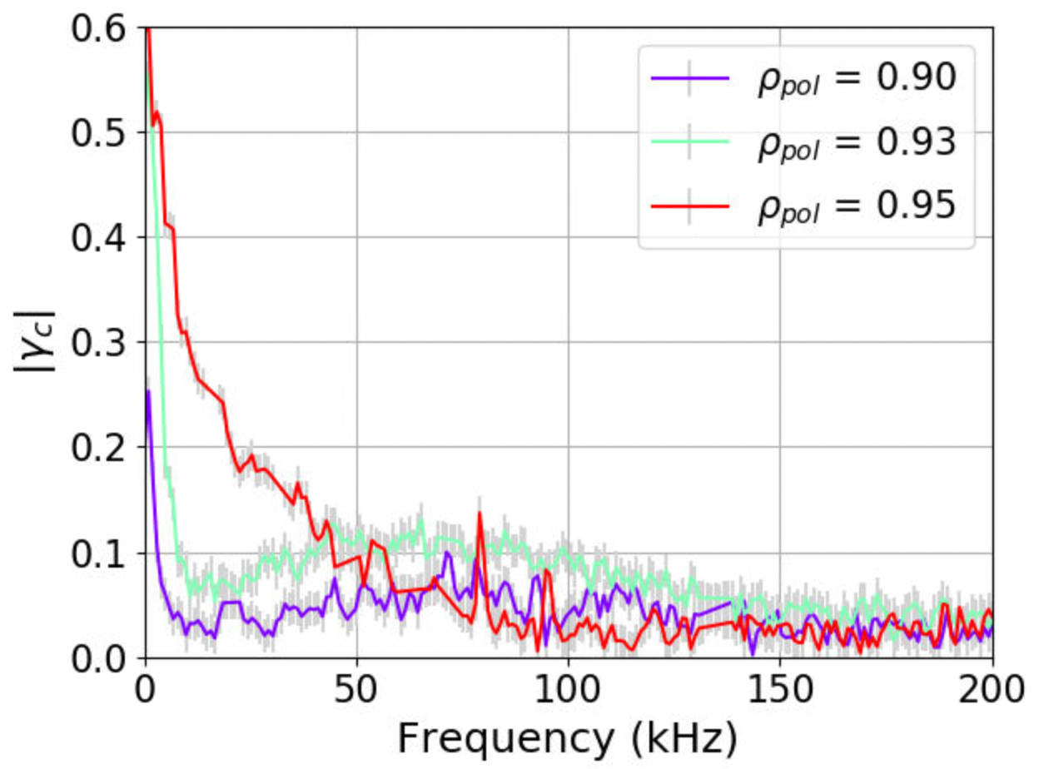
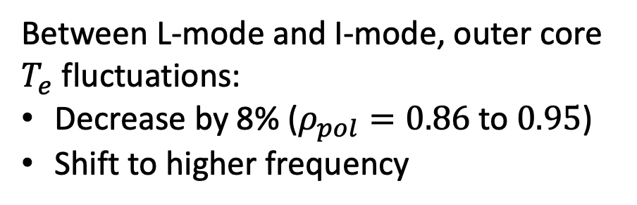
Outer core fluctuations track global confinement
#39561
AUG
I-mode
3.0-4.0s
10-250kHz integration
370-400kHz background
WCM peak
$$τ<2$$
L-mode
I-mode
AUG CECE
5.1-5.7s
AUG CECE
4.0-5.0s
WCM
#38092
#38092
Between L-mode and I-mode, outer core $T_{e}$ fluctuations:
Decrease by 8% ($ρ_{pol}=0.86$ to $0.95$)
Shift to higher frequency

Slide 16
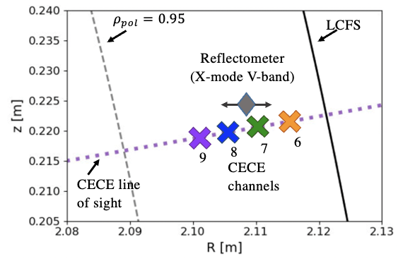
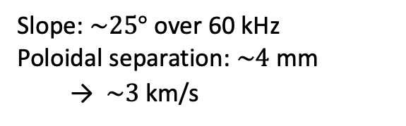

Phase velocity estimation from $α_{nT}$ slop
I-mode
#39651
CECE-reflectometer
3.0-4.0s
Slope: $\sim 25°$ over 60 kHz
Poloidal separation: $\sim 4$ mm
  → $\sim 3$ km/s

Slide 17
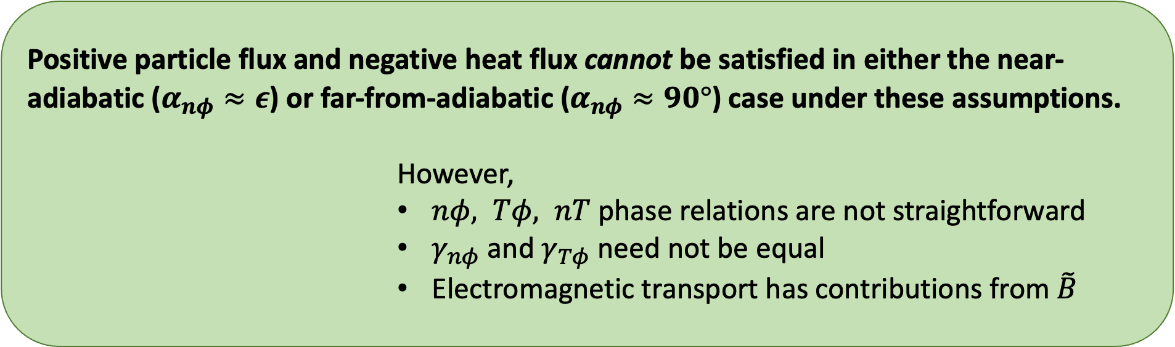

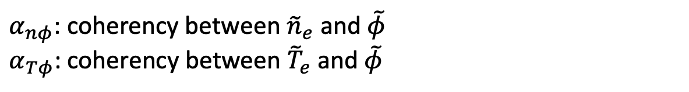

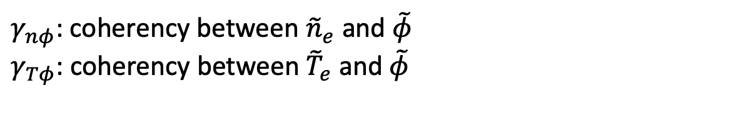

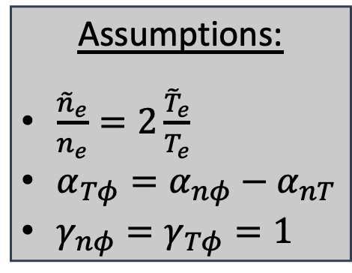
Turbulent electrostatic particle and heat transport
Electrostatic transport equations
Particle:
$Γ_{e}^{turb}=\left\langle {\tilde{n}}_{e}{\tilde{v}}_{r}\right\rangle =\frac{1}{B}\left\langle {\tilde{n}}_{e}{\tilde{E}}_{θ}\right\rangle$
$$\frac{{\tilde{n}}_{e}}{n_{e}}γ_{nφ}sin\left(α_{nφ}\right)>0$$
Heat:
$$Q_{e}^{turb}=\frac{3}{2}\left\langle {\tilde{p}}_{e}{\tilde{v}}_{r}\right\rangle =\frac{3}{2}T_{e}Γ_{e}^{turb}+\frac{3}{2}\frac{n_{e}}{B}\left\langle {\tilde{T}}_{e}{\tilde{E}}_{θ}\right\rangle$$
$$\frac{{\tilde{n}}_{e}}{n_{e}}γ_{nφ}sin\left(α_{nφ}\right)+\frac{{\tilde{T}}_{e}}{T_{e}}γ_{Tφ}sin\left(α_{Tφ}\right)<0$$
Positive particle flux and negative heat flux cannot be satisfied in either the near-adiabatic ($α_{nφ}≈ε$) or far-from-adiabatic ($α_{nφ}≈90°$) case under these assumptions.
                However,
                $nφ, Tφ, nT$ phase relations are not straightforward
                $γ_{nφ}$ and $γ_{Tφ}$ need not be equal
                Electromagnetic transport has contributions from $\tilde{B}$
Can the WCM give positive particle and negative heat flux?
Assumptions:
$\frac{{\tilde{n}}_{e}}{n_{e}}=2\frac{{\tilde{T}}_{e}}{T_{e}}$
$α_{Tφ}=α_{nφ}−α_{nT}$
$γ_{nφ}=γ_{Tφ}=1$
Positive particle flux
Negative heat flux
$γ_{nφ}$: coherency between ${\tilde{n}}_{e}$ and $\tilde{φ}$
$γ_{Tφ}$: coherency between ${\tilde{T}}_{e}$ and $\tilde{φ}$
$α_{nφ}$: coherency between ${\tilde{n}}_{e}$ and $\tilde{φ}$
$α_{Tφ}$: coherency between ${\tilde{T}}_{e}$ and $\tilde{φ}$
$${\tilde{φ}≈−\tilde{E}}_{θ}/k_{θ}$$

Slide 18


Correlation ECE principles
[S. Freethy EC20 2019]
Correlating neighboring channels gives:
  Frequency spectra
  Fluctuation amplitude
  Correlation length

Slide 19



Out-of-phase $α_{nT}$ and optical depth
Assumptions:
Reflectivity $χ=0.85$ (???)
${dT_{e}}/{T_{e}}=3\%$
${dT_{e}}/{T_{e}}=20\%$

