Slide 1
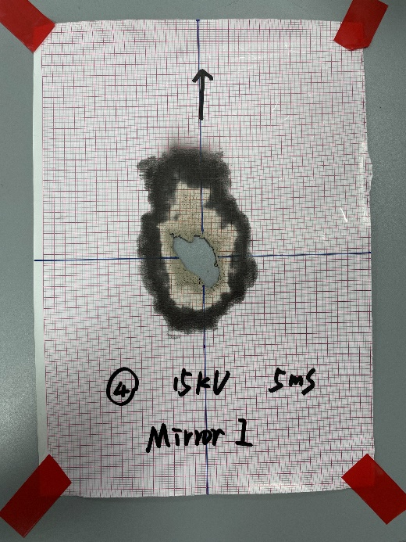
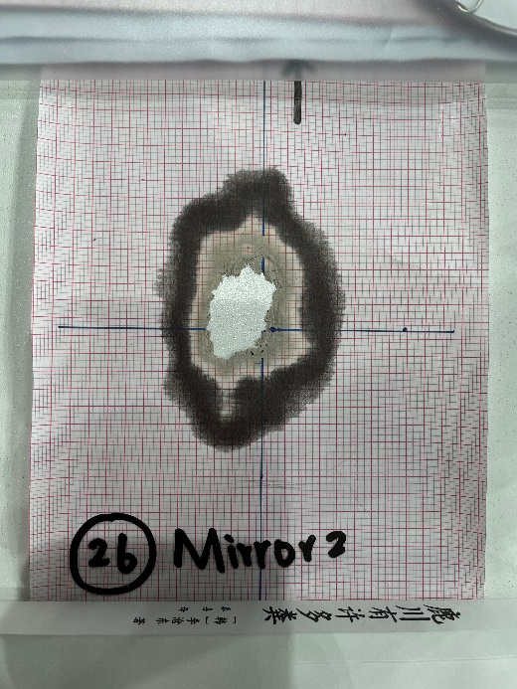
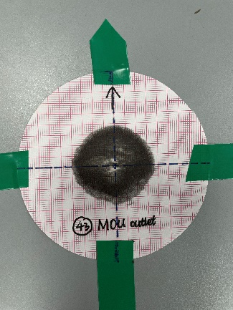
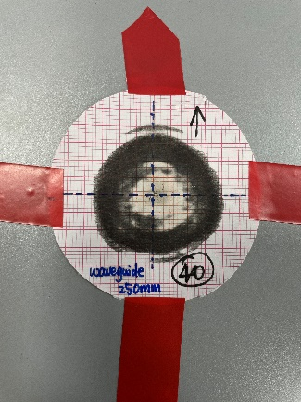
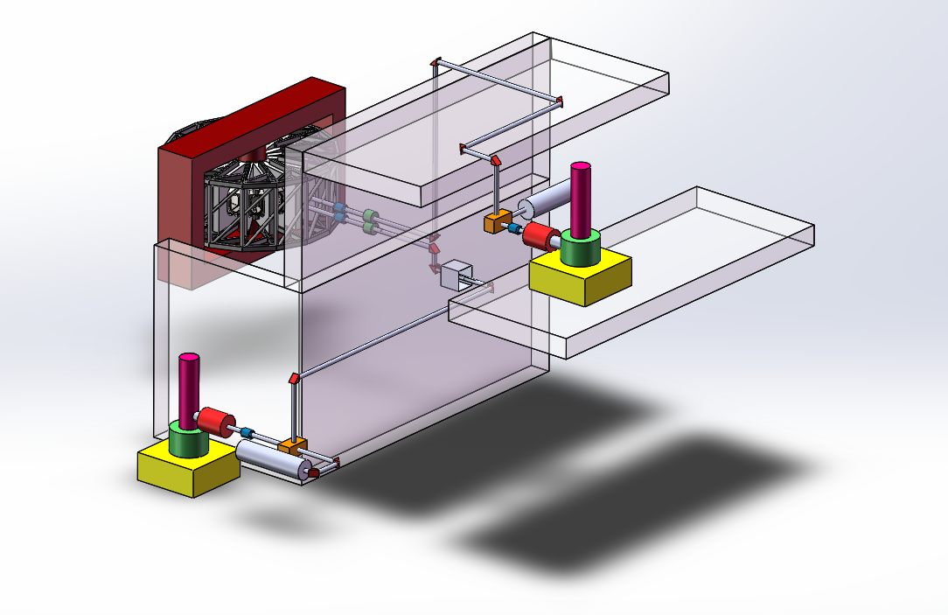
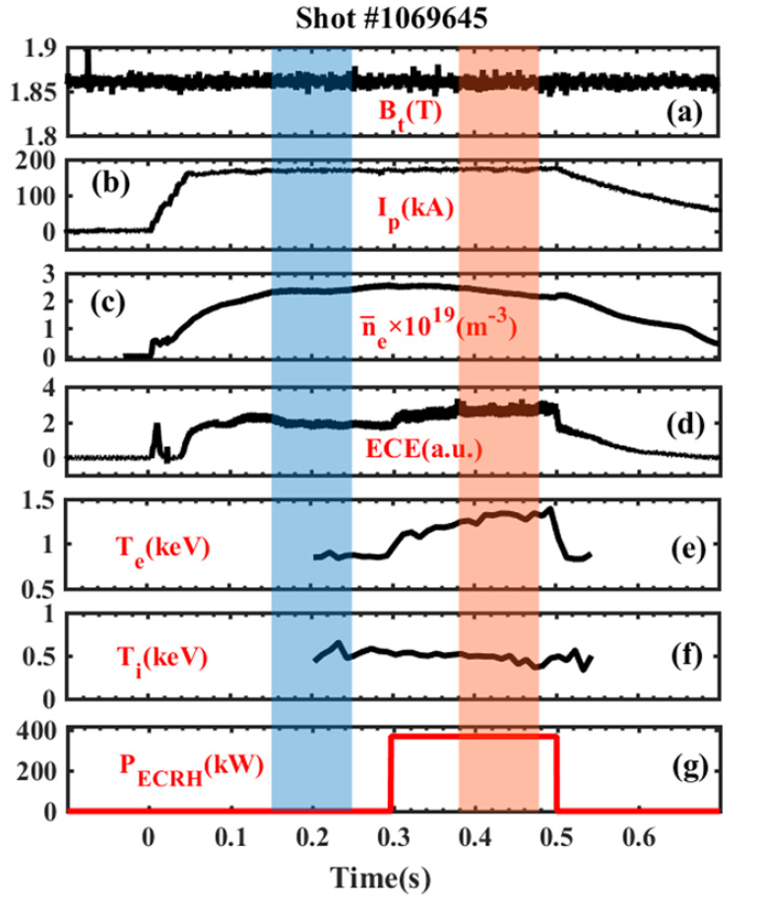
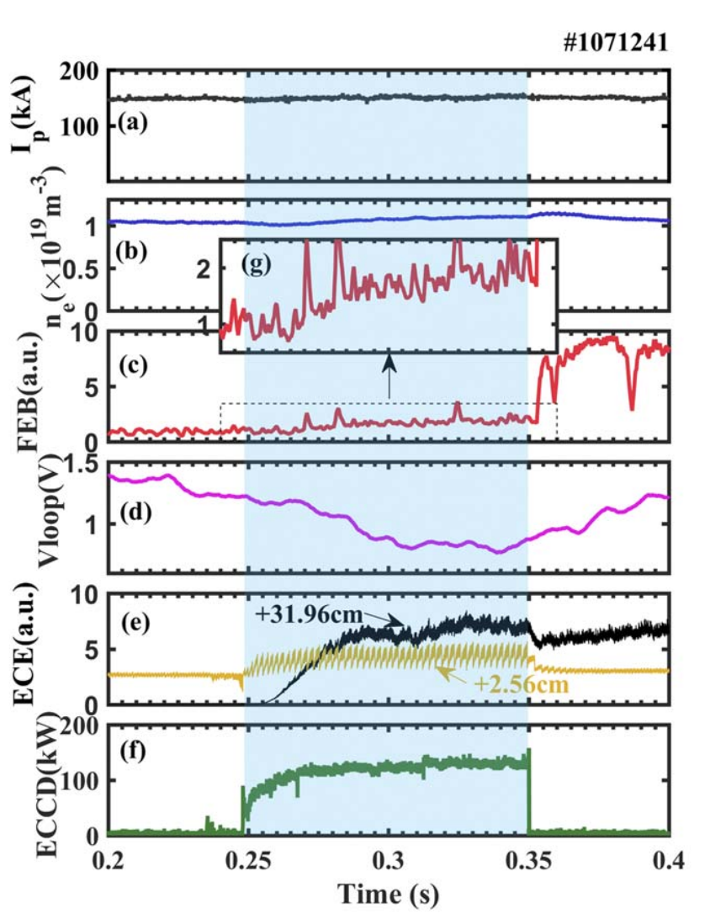
21st joint workshop on electron cyclotron emission (ECE) and electron cyclotron resonance heating (ECRH)
The development of 1 MW ECRH system on J-TEXT
Xixuan Chen*, Donghui Xia, Junli Zhang, Zhijiang Wang, Yuan Pan and the J-TEXT team
International Joint Research Laboratory of Magnetic Confinement Fusion and Plasma Physics,
Huazhong University of Science and Technology
Ⅰ. Introduction
Ⅲ. Commissioning tests of gyrotron
Advantages of Electron Cyclotron Resonance Heating
Alignment of the superconducting magnet and MOU
Gyrotron operation
Highly localized power deposition
High coupling efficiency
Long distance between the launcher and plasma
Power measurement
Joint-Texas Experimental Tokamak
J
-TEXT tokamak is a
conventional iron core
tokamak reconstructed from TEXT-U. In order to improve the plasma parameters and broaden the operation range of J-TEXT tokamak, the development of the ECRH system has been initiated in 2017.
Basic operation parameters of J-TEXT
Parameters | Value
Major radius (R₀) | 1.05 m
Minor radius (a) | 25-29 cm
Toroidal field (B_{t}) | <2.4 T
Plasma current (I_{p}) | <240 kA
Plasma densities (n_{e}­) | (1-7)$×$10¹⁹ m⁻³
Electron temperature (T_{e}) (Under ohmic heating) | ~1 keV
Alignment results of MOU
Measured RF signal during gyrotron operation
Temperature rise curve during gyrotron operation
Ⅳ. The experimental results with ECRH
Ⅱ. J-TEXT ECRH system
Electron thermal transport and temperature fluctuations
Fast electrons with ECCD
To investigate the electron thermal transport and plasma fluctuations before and during ECRH.
The spatial profiles and energy spectrum of the fast electrons have been measured with either on-axis or off-axis ECCD injection.
J-TEXT tokamak
Transmission line
Superconducting magnet
MOU
Transmission line
#2 Gyrotron
(Established in 2022)
#1 Gyrotron
(Established in 2019)
Layout of J-TEXT ECRH system
Main characteristic parameters of the gyrotrons for J-TEXT ECRH system
Parameters | Value (#1 Gyrotron) | Value (#2 Gyrotron)
Frequency | 105 GHz | 105 GHz
Maximum output power | 500 kW | 500 kW
Maximum pulse duration | 1 s | 1 s
Output efficiency | 45% | 45%
TEM₀₀ mode purity (after MOU) | 97% | 98%
A typical discharge with ECRH
Temporal evolution of typical on-axis ECCD
Ⅴ. Summary
A 1 MW ECRH system has been developed on J-TEXT.
Commissioning tests for the two gyrotrons have been finished.
Experiments with ECRH have been carried out, the electron temperature raised significantly with ECRH assisted.
Contact Us：xxchen@hust.edu.cn
Address：School of Electrical and Electronic Engineering, Luoyu Rd. #1037, Huazhong University of Science and Technology, Wuhan 430074, China

