Slide 1
21st joint workshop on electron cyclotron emission (ECE) and electron cyclotron resonance heating (ECRH)
Plasma heating and improvement of lower hybrid current drive efficiency by electron cyclotron waves on EAST
M.H. Li¹, H.D. Xu¹, X.J. Wang¹, M. Wang¹, W.Y. Xu¹, D.J. Wu¹, Y.Y. Tang¹, J. Wang¹, T. Zhang¹, H.L. Wang¹, B.J. Ding¹, Q. Zang¹, H.L Zhao¹, J.P. Qian¹, X.Z. Gong¹, F.K. Liu¹ and X.L. Zou²
1. Institute of Plasma Physics, Chinese Academy of Sciences, Hefei 230031, P. R. China
2. CEA, IRFM, Saint Paul-lez-Durance, France
21 June 2022

Slide 2
Outline
EAST Tokamak overview and features
ECRH/ECCD system
LHCD systems
Experimental results and analysis
Progress in long-pulse operation with high Te
Effects of EC location on plasma heating and current density profile
LHCD efficiency improved by ECRH
Summary and next work

Slide 3
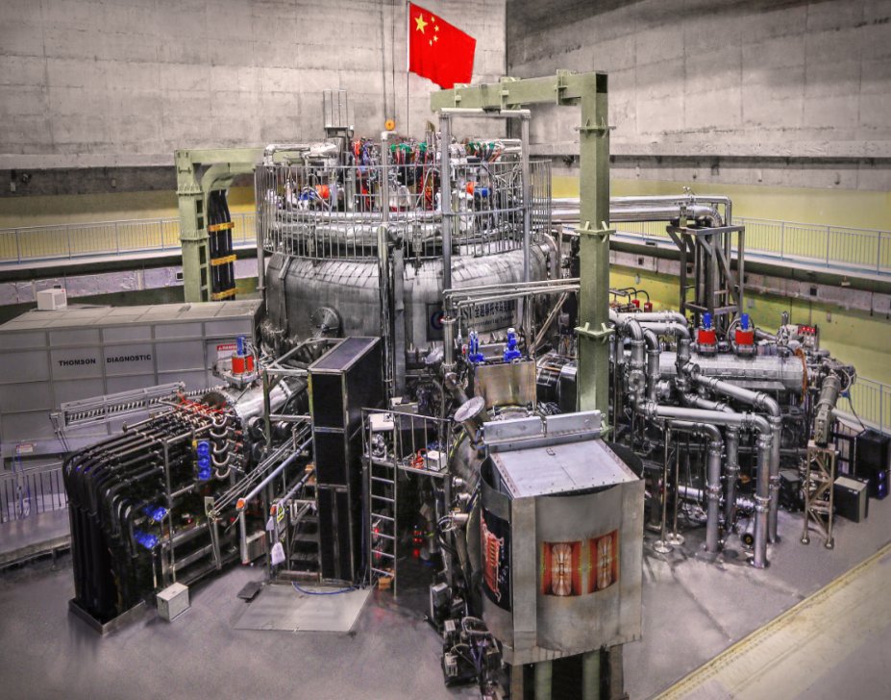
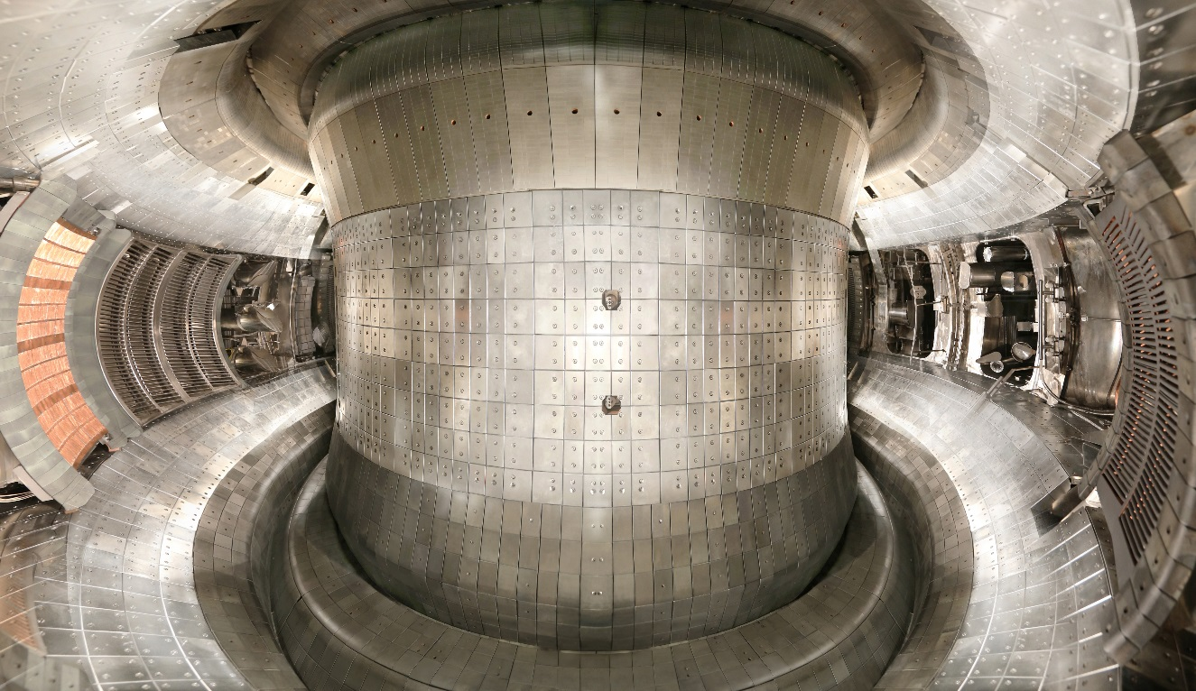
EAST overview
Top view
In-vessel view
Main Parameters:
B_{t} 3.5 T
R₀ 1.89 m
a 0.45 m
k_{max} ~ 1.8
I_{P} 1.0 MA
H&CD NBI 8 MW, ICRF 12 MW,
LHCD 10 MW, ECRH 4 MW
Divertor configurations
ITER-like W/Cu divertor
Feature:
Steady-state long-pulse operation
Mission:
conducting ITER-like steady-state advanced plasma science and technology research

Slide 4
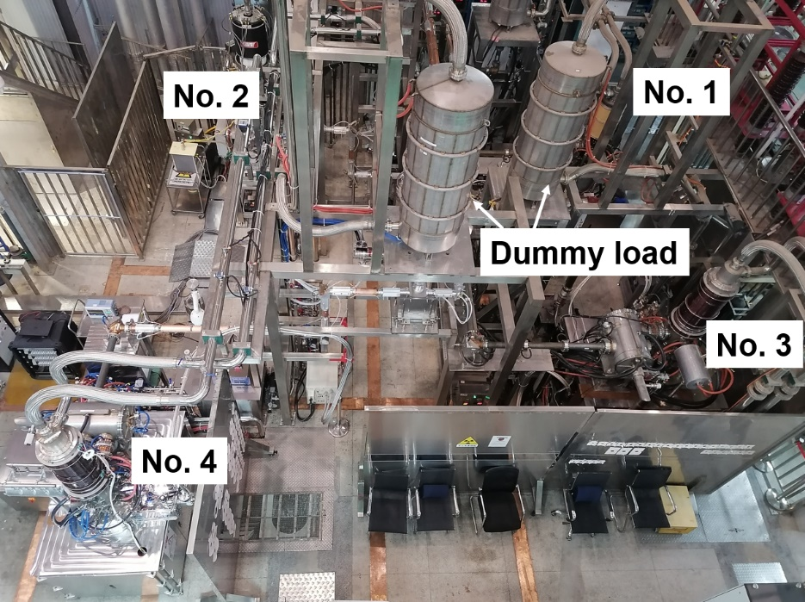
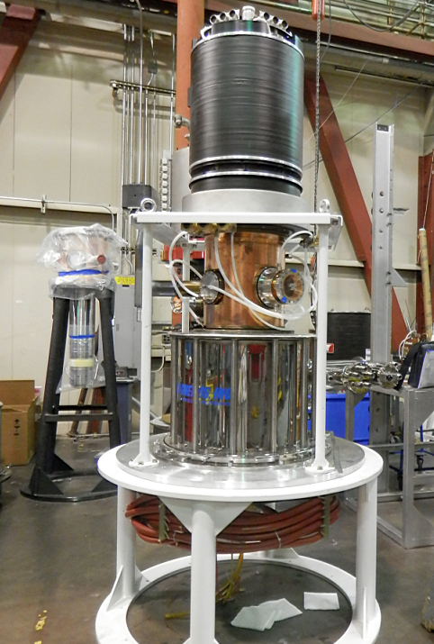
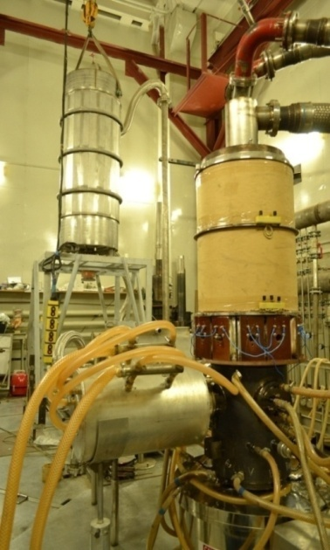
ECRH/ECCD system
Four 140 GHz (2X mode) gyrotrons, 4 MW power installed.
Long-pulse operation (100 – 1000 s) with actively water cooled launchers
No. 1: undergoing repair (air leakage issue).
No. 4 from GYCOM: dual frequency gyrotron (0.6 MW/105 GHz and 1.0 MW/140 GHz)
Additional two gyrotrons systems under development
Layout of ECRH system
Fusion Eng. Des.164 (2021) 112222
Fusion Eng. Des. 96-97 (2015) 181
CPI Gyrotron
GYCOM Gyrotron

Slide 5
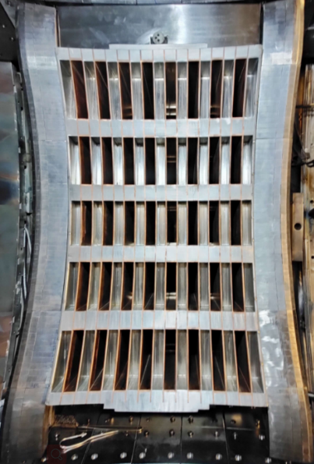
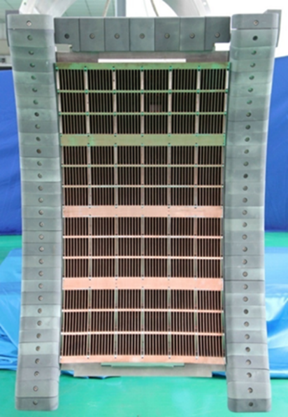
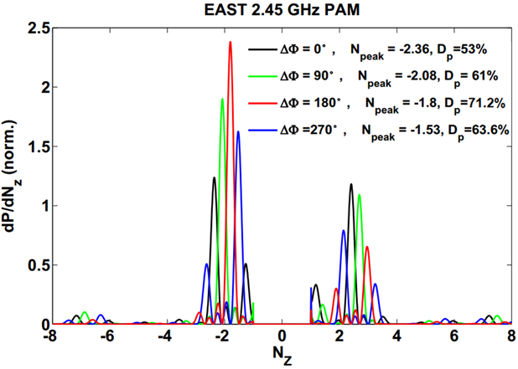
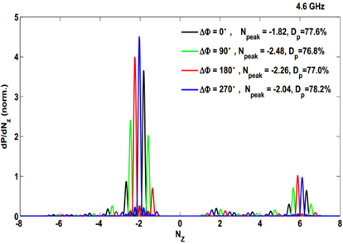
LHCD systems
LH1:
4MW/2.45GHz
LH2:
6MW/4.6GHz
20 klystrons
Long-pulse (>1000s)
PAM launcher from 2021
24 klystrons
Long-pulse (>1000s)
FAM launcher
N//^{peak} = 1.4~2. 4
N//^{peak} = 1.8 ~ 2.48
Fusion Eng. Des. 147 (2019) 111250
Fusion Sci. Technol. 75 (2019) 49

Slide 6
Outline
EAST Tokamak overview and features
ECRH/ECCD system
LHCD systems
Experimental results and analysis
Progress in long-pulse operation with high Te
Effects of EC location on plasma heating and current density profile
LHCD efficiency improved by ECRH
Summary and next work

Slide 7
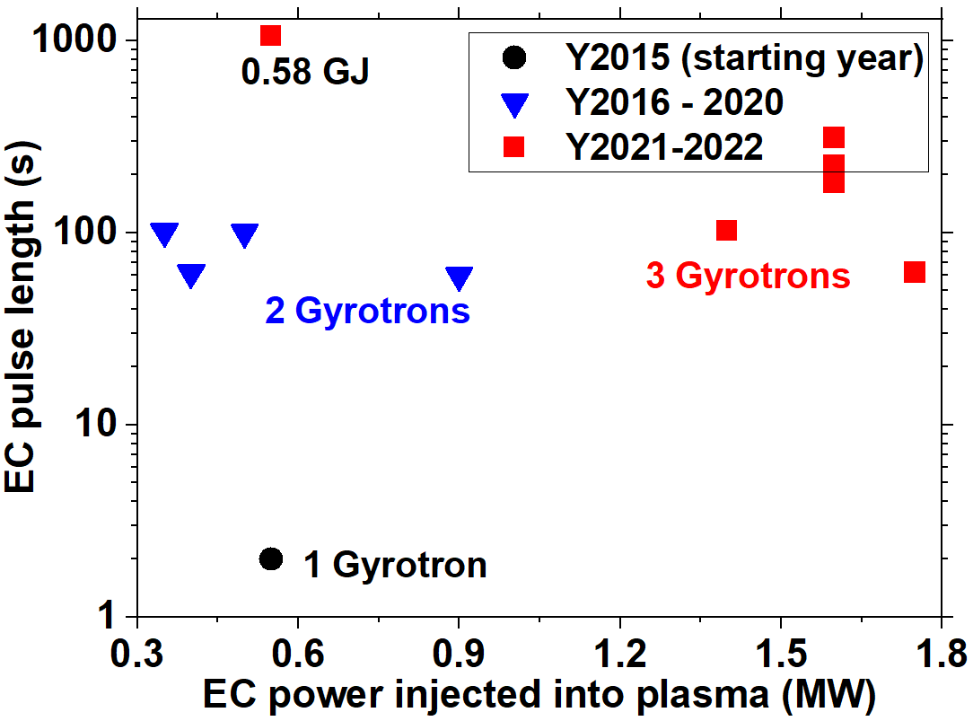
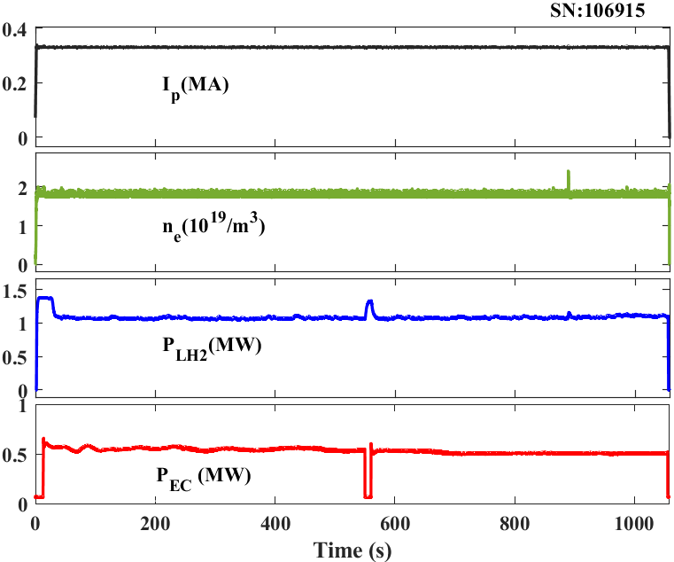
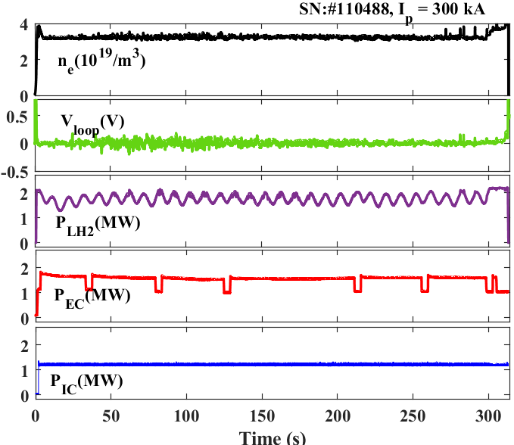
Recent progress in high-power and long-pulse operation
1056 s long - pulse discharge
310 s long - pulse discharge
Pulse duration extended to ~ 1056 s with P_{EC} ~ 0.55 MW. Energy injected into the plasma reached 0.58 GJ.
Pulse duration ~ 310 s with P_{EC} up to 1.6 MW (H-mode plasma).

Slide 8
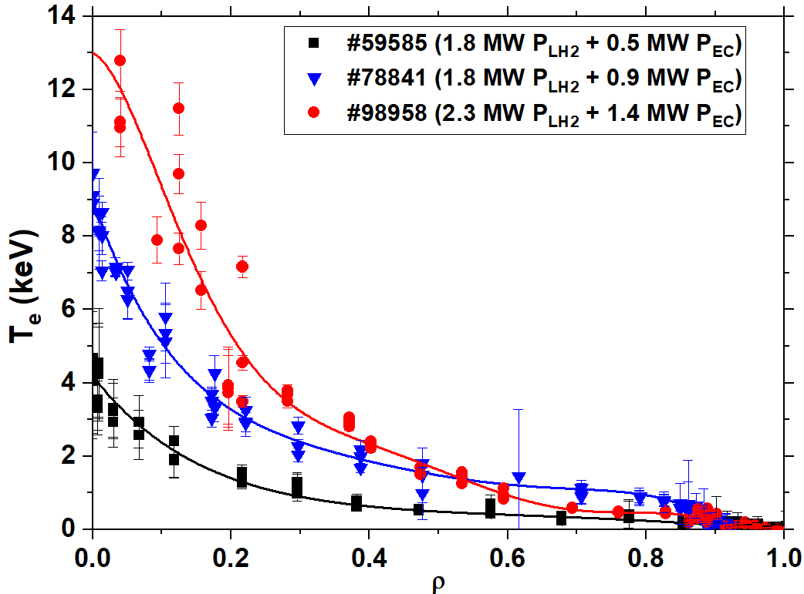
Progress in high Te operation with on-axis ECRH
Shot No. | Ip (MA) | <n_{e}> (10¹⁹/m³) | V_{loop} (mV) | P_{EC} (MW) | P_{LH2} (MW) | T_{e0} (keV) | Gyrotrons
#59585 | 400 | 1.55 | 0 | 0.5 | 1.8 | 4.2 | 1
#78841 | 450 | 1.9 | -20 | 0.9 | 1.8 | 9.0 | 2
#98958 | 500 | 1.7 | -29 | 1.4 | 2.3 | 12.0 | 3
With EC power increasing, the electron temperature increases significantly.
Te0 ~ 12 keV was obtained with the combined heating of 1.4 MW EC and 2.3 MW LH power.

Slide 9
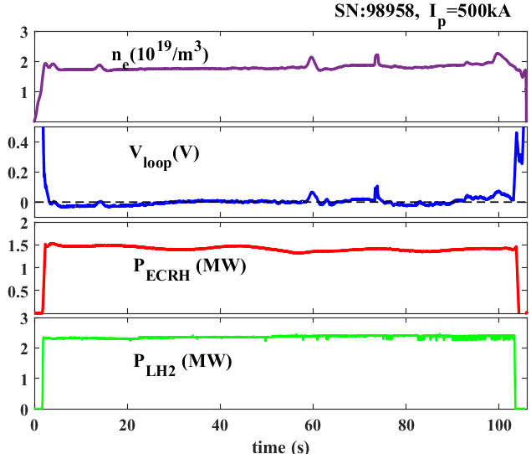
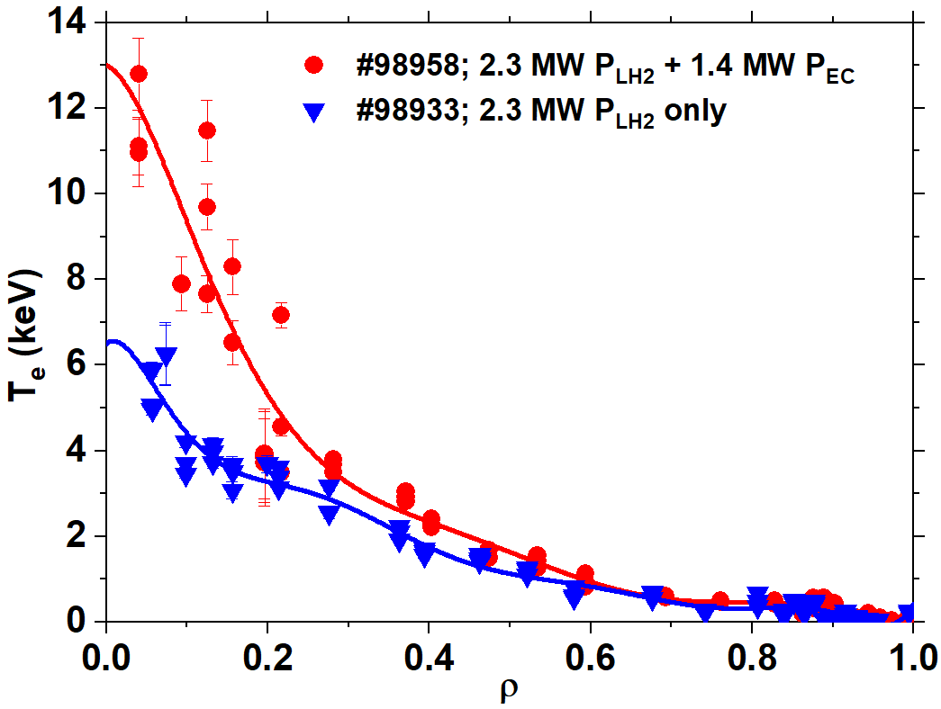
Long-pulse and high Te plasmas
Plasmas with Te0 ~ 12 keV was maintained for 100 s by the combination of 1.4 MW EC and 2.3 MW LH power.
The peak electron temperature was increased from 6.5 keV to 12 keV when 1.4 MW EC adding to the plasmas sustained by 2.3 MW LH power.

Slide 10
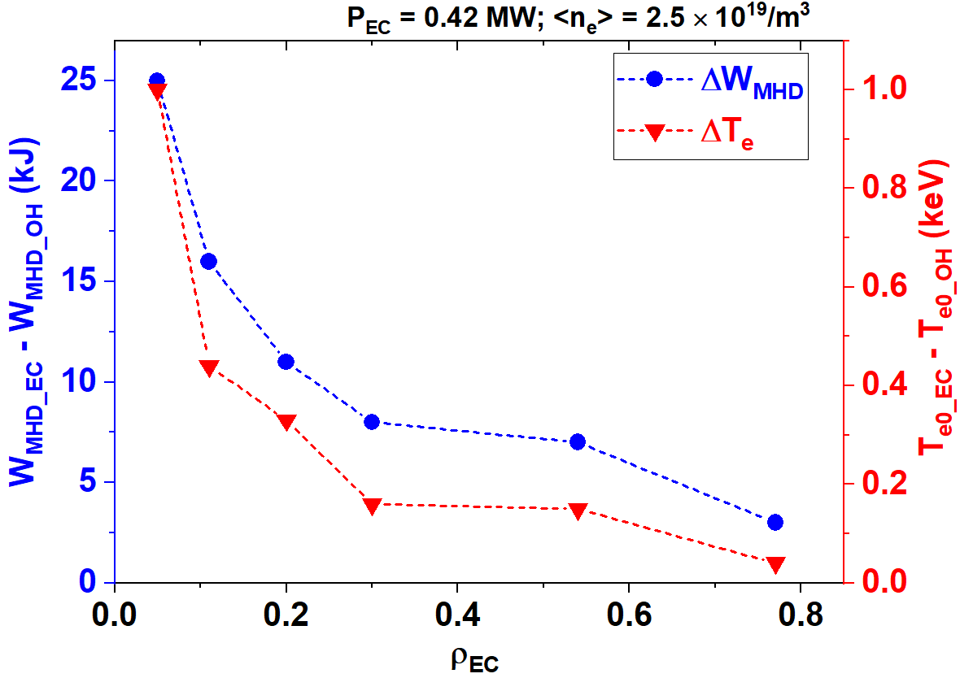
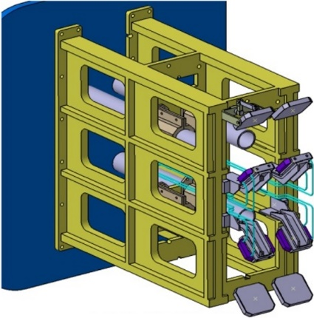
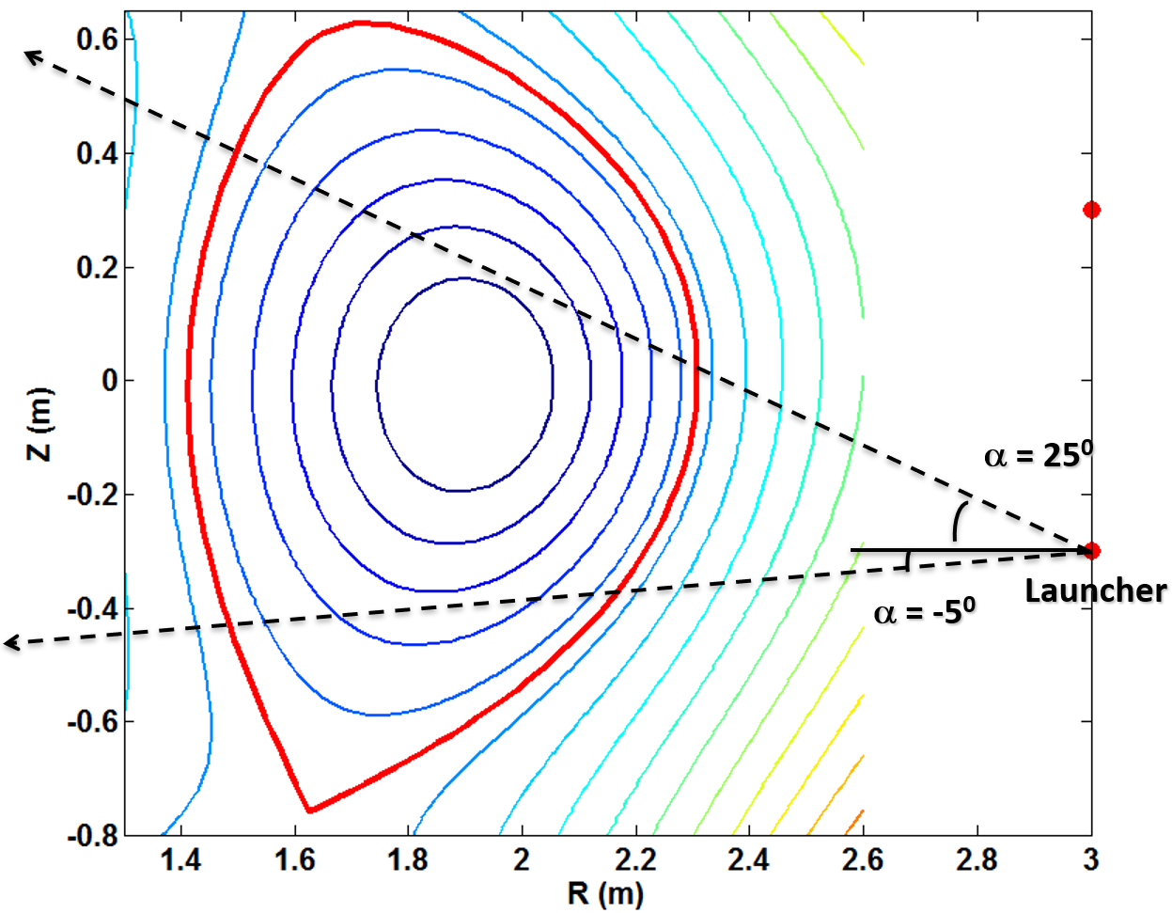
Effects of EC power location on plasma heating
EC antenna
Fixed focusing mirror
Movable plane mirror
Steering range
poloidal：-5º - 25º; toroidal：±25º
Steering range in poloidal direction: -5º - 25º, corresponding to radial region ρ ~ 0 - 0.8.
On – axis power deposition is critical for effective heating.

Slide 11
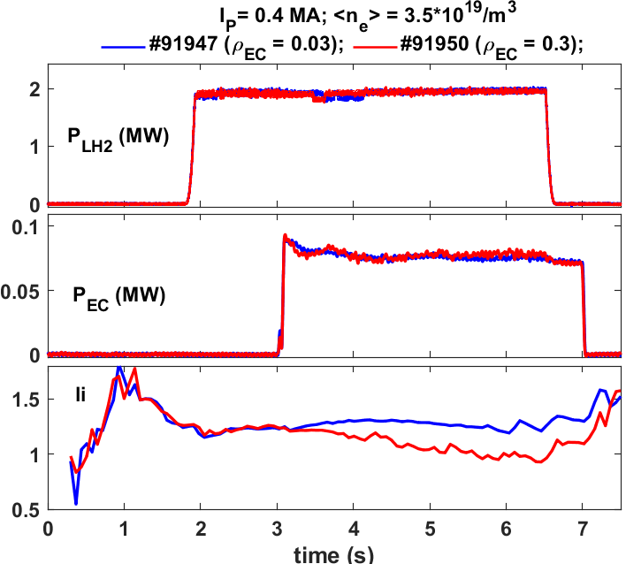
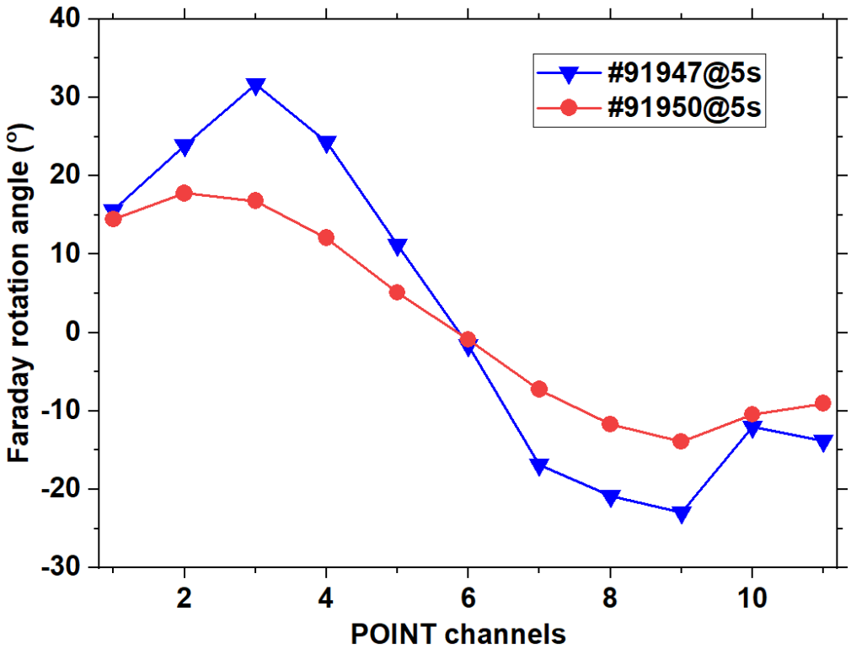
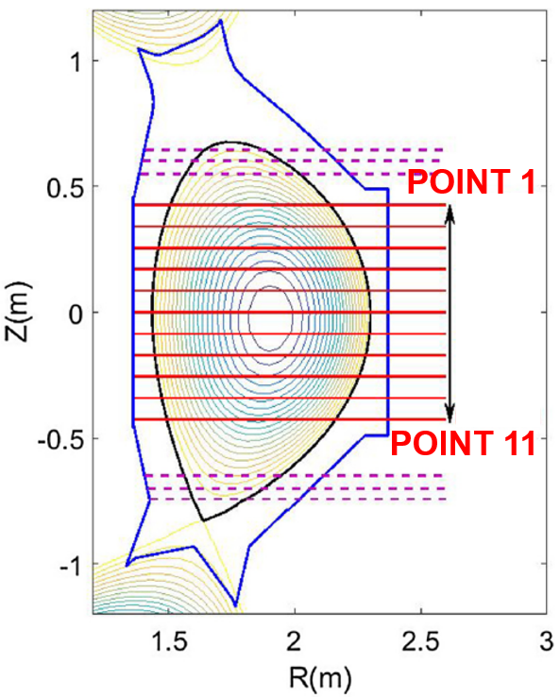
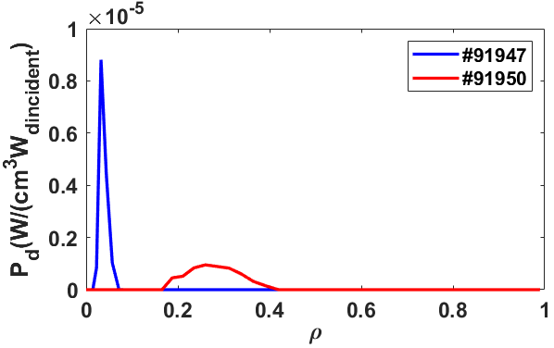
Modification of current density profiles by adjusting the EC deposition in LHCD sustained plasmas
POINT measurements
li = 1.24
li = 0.96
Shaping of the current density profiles by adjusting the EC power deposition is demonstrated.
Off-axis ECRH is helpful to broaden the current profile indicated by the polarimeter /interferometer (POINT) measurement.
TORAY simulations

Slide 12
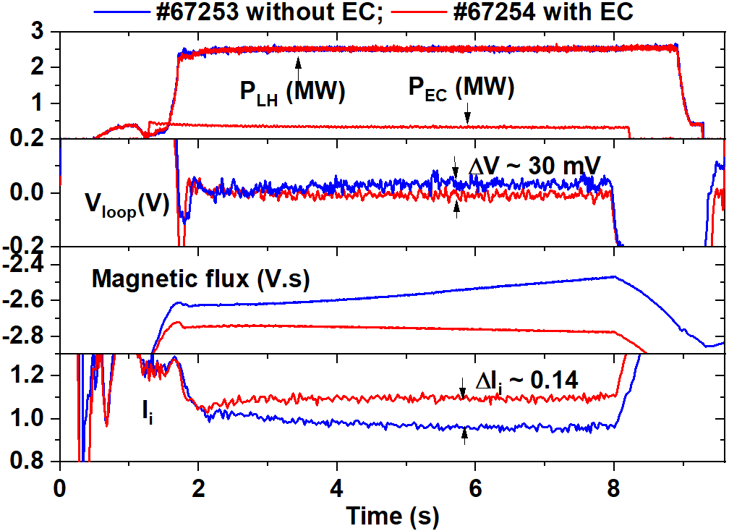
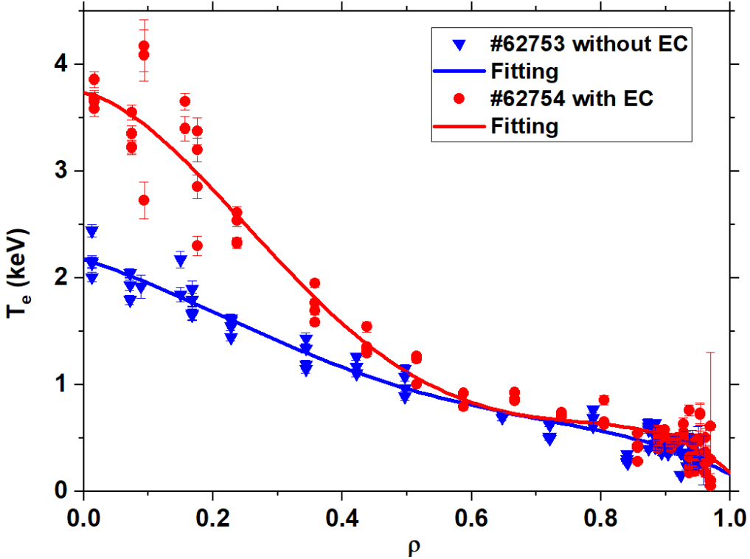
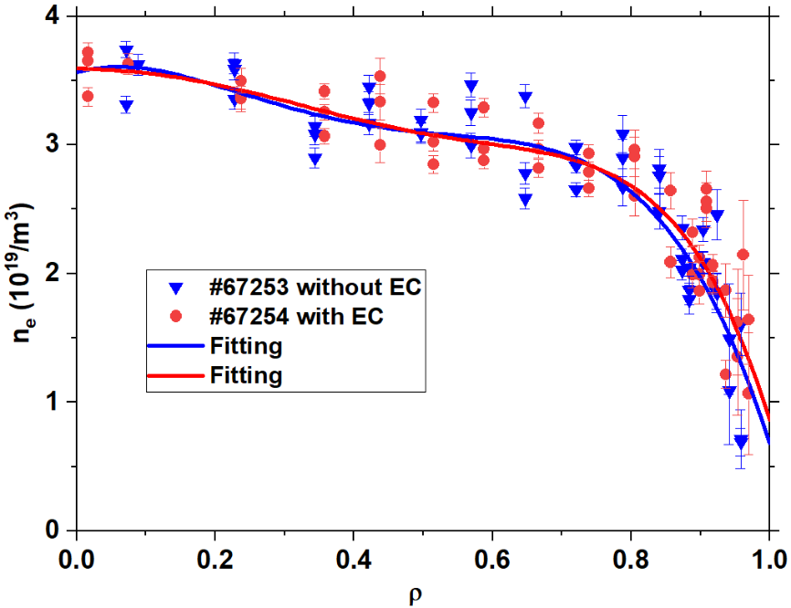
LHCD efficiency improved by ECRH (experimental results)
With ECRH in plasma core, the central electron temperature is increased significantly, leading to a higher CD efficiency indicated by the lower Vloop.
A higher internal inductance (li) indicates that the LH current shifts to the inner region.

Slide 13
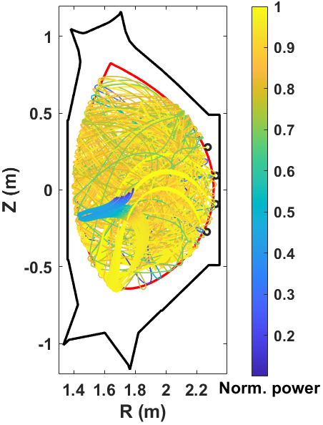
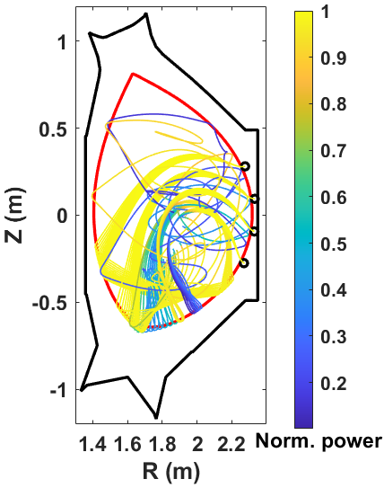
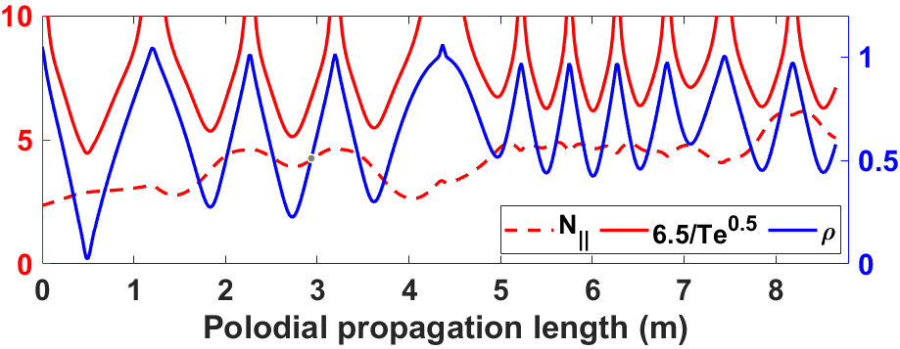
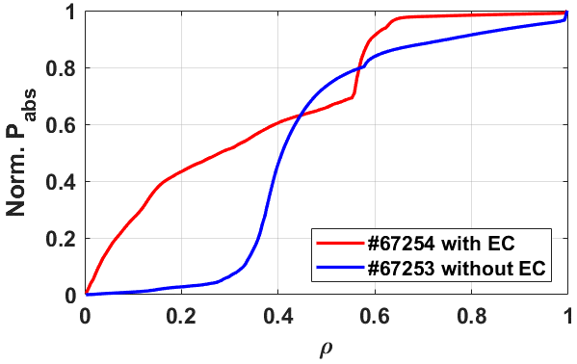
LHCD efficiency improved by ECRH (modeling analysis by GENRAY code)
Without EC
With EC
With EC
Landau damping
Without EC
A ray-tracing modeling shows that the rays undergoes a longer propagation before fully absorbed for that without ECRH.
With ECRH, due to higher Te, most of the LH power is damped even during the first pass.
~ 50% LH power deposited in ρ < 0.3 for the case with ECRH, while it is only 10% for that without ECRH.
ρ < 0.3

Slide 14
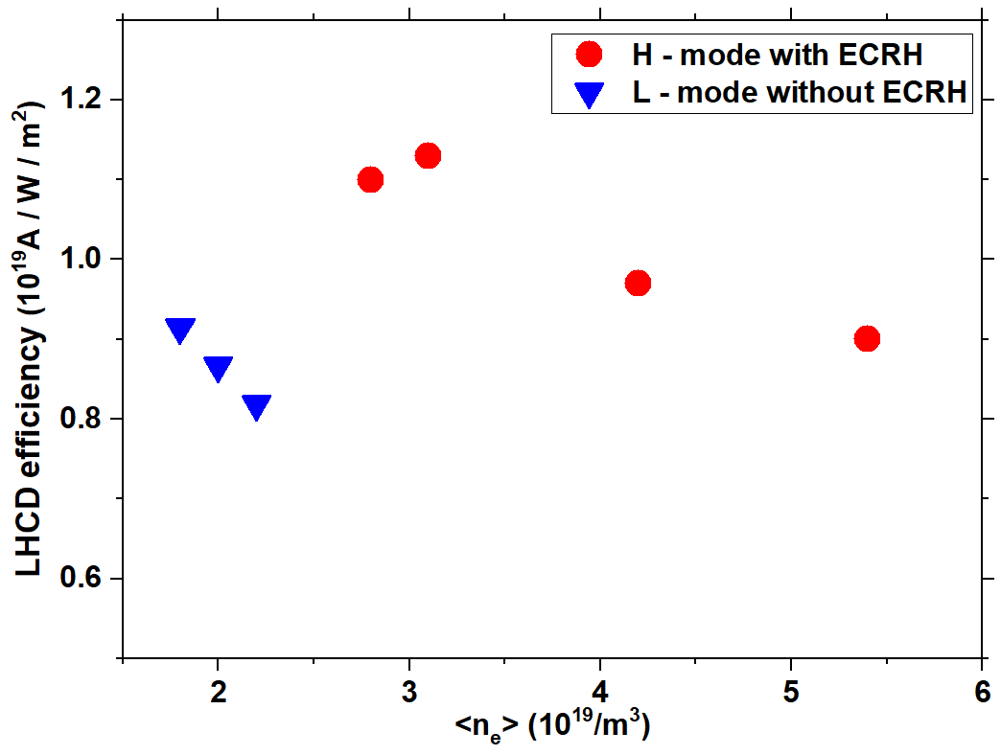
Comparison of LHCD efficiency with and without ECRH
Qusi-steady-state (V_{loop} < 100 mV) discharges are selected and the LH driven current is calculated by I_{LH} = I_{P} – I_{EC} – I_{OH} – I_{BS}.
The LHCD efficiency in plasmas with ECRH is higher by ~ 20% than that without ECRH.
Good CD effect (η ~ 0.9 × 10¹⁹A/W/m²) is obtained with the combined LH and EC power injection even when density increased up to 5.4 × 10¹⁹/m³.

Slide 15
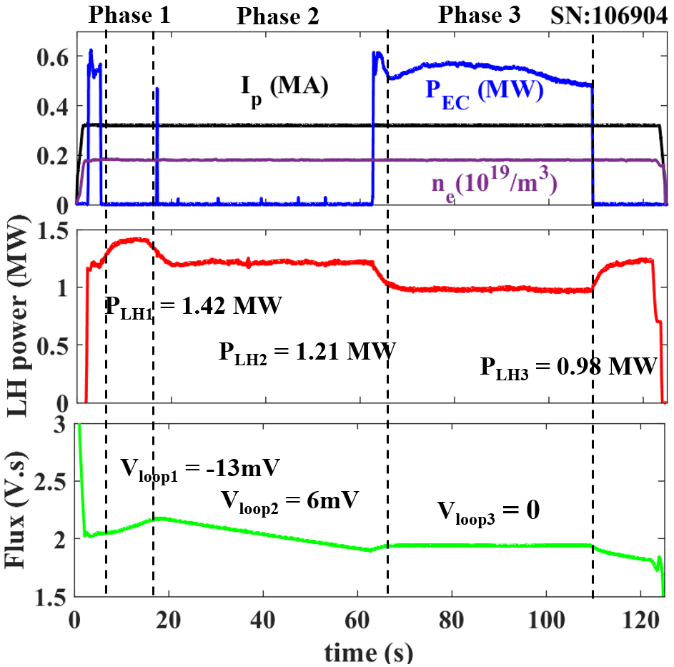
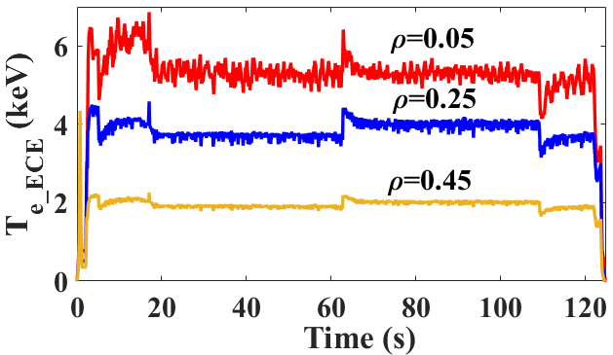
Synergy effect between LHCD and ECCD
LH power was feedback controlled by the magnetic flux consumption.
During the application of 0.55 MW ECCD, the LH power drops by~ 0.3 MW.
The synergy factor defined as F_{syn} = ΔI / I_{EC} with ΔI = I_{LH+EC} – I_{LH}, is estimated to be ~ 2.1 ± 0.1.
The ECE electron temperature is in the same level during ECCD and before ECCD.

Slide 16
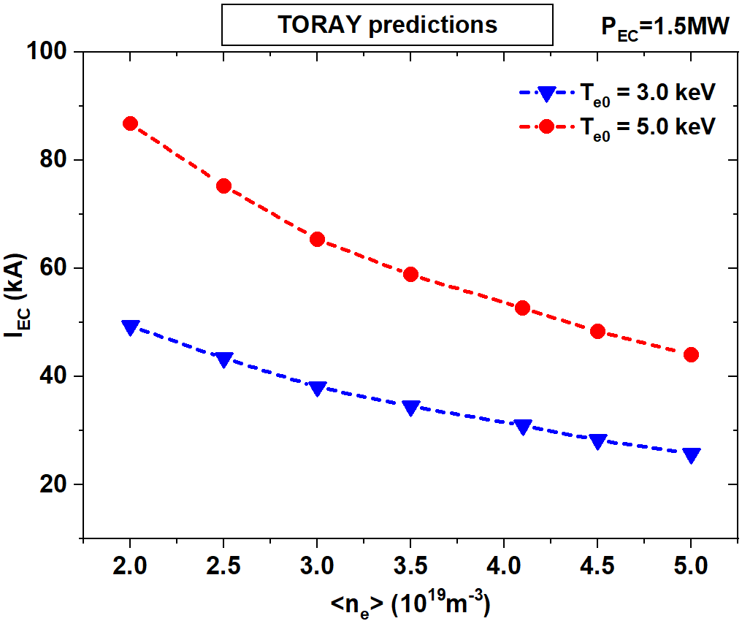
Summary and next work
Significant progress in long-pulse operation has been achieved with EC system, including pulse duration extended to ~ 1056 s with P_{EC} ~ 0.55 MW. And pulse duration ~ 310 s with P_{EC} up to 1.6 MW.
High Te0 ~ 12 keV plasmas was maintained for 100 s by the combination of 1.4 MW EC and 2.3 MW LH power.
Thanks to a higher electron temperature in the plasma core with ECRH, the LH power deposition shifts to the inner region, thus giving a higher LHCD efficiency.
A synergy effect between ECCD and LHCD was observed in steady-state plasmas.
TORAY modeling predicts that the ECCD current can be > 80 kA at low density. Next work will investigate the ECCD efficiency and the synergy effects with different N|| of LH waves.

Slide 17
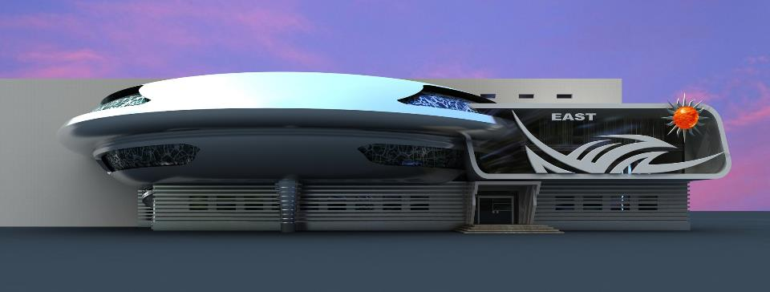
Thanks!

